Slide 1
Chapter 9: South Asia
Diversity and Global Connections

Slide 2
Regional overview
Political Boundaries
Pakistan
India
Nepal
Bhutan
Sri Lanka
Pakistan
The Maldives
Physiographic Regions
Mountainous North
Himalayas
Delta Lowlands
Brahmaputra
Ganges
Indus
Islands
Maldives
Sri Lanka

Slide 3
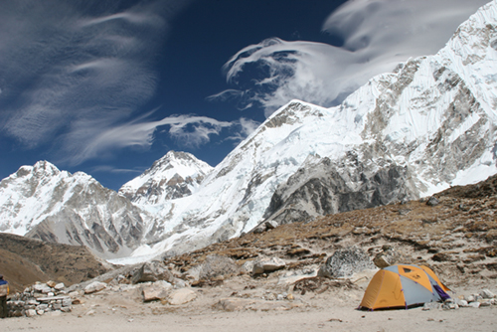
Mt Everest, Nepal, 29,000’

Slide 4
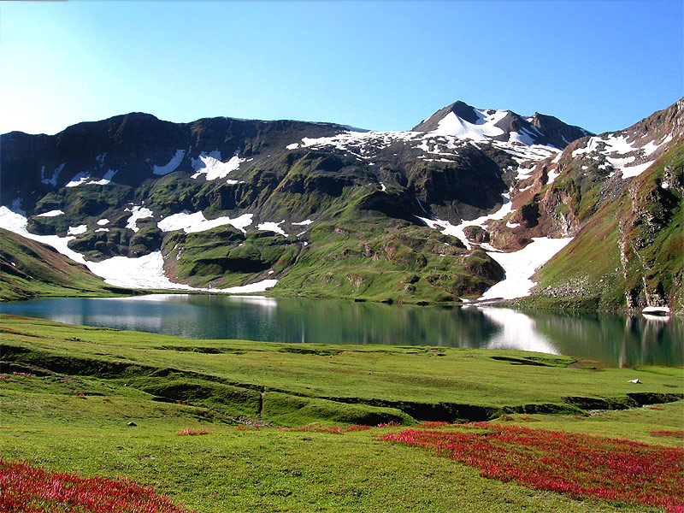
Mountainous Pakistan.

Slide 5
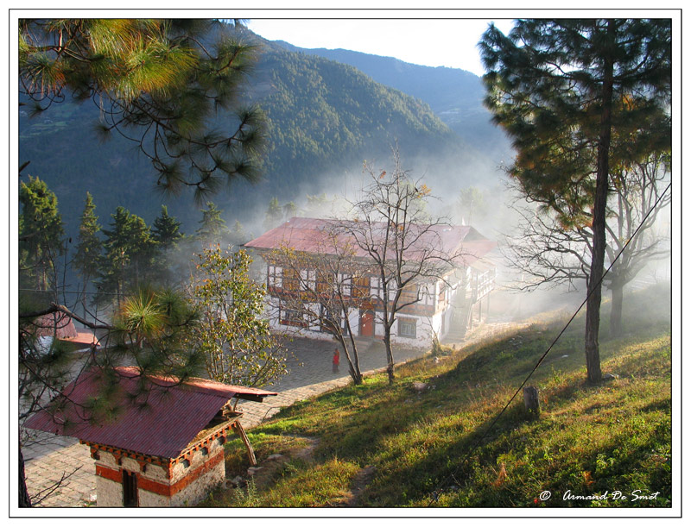
Bhutan.

Slide 6
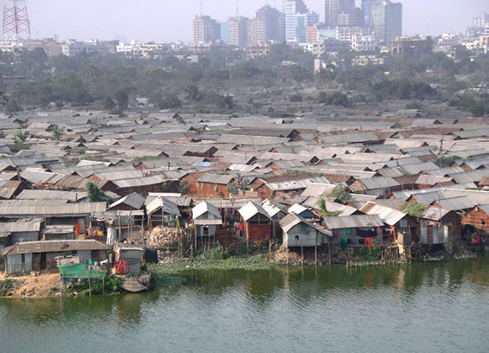
Delta of the Brahmaputra River, Bangladesh.
The world’s largest delta.

Slide 7
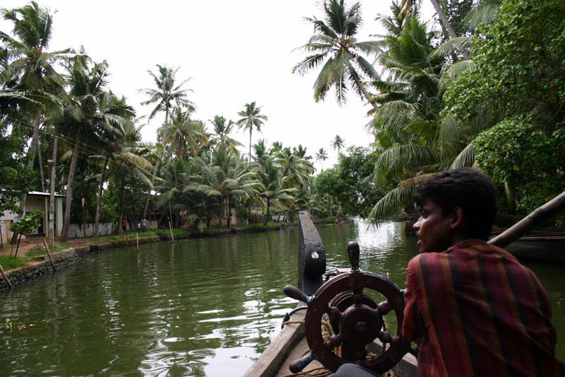
Kerala, India.
Southwest coast of Indian peninsula.

Slide 8
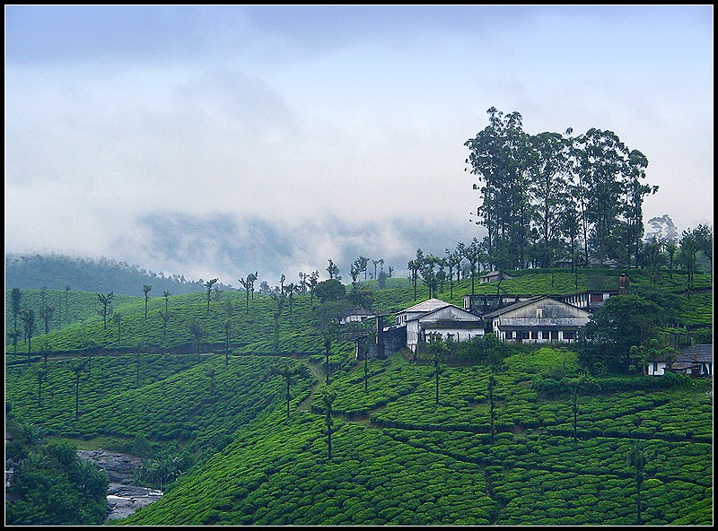
Tamil Nadu, India.
Southernmost state of the Indian peninsula.

Slide 9
The Maldives, the most endangered place on Earth?
1200 islands, highest elevation is only 6’ above sea level.

Slide 10
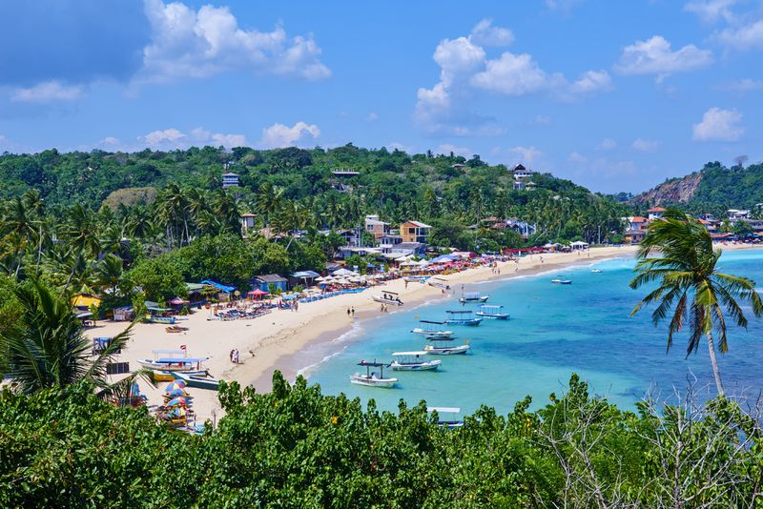
Unawatuna Beach, Sri Lanka, along the southernmost coast of the island.

Slide 11
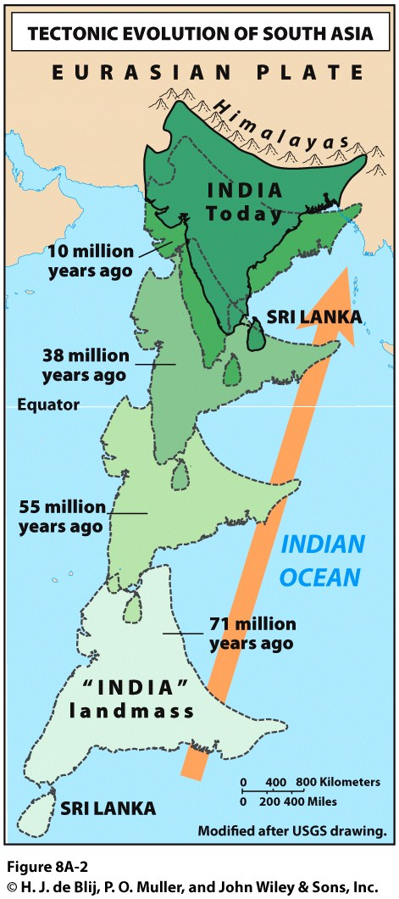
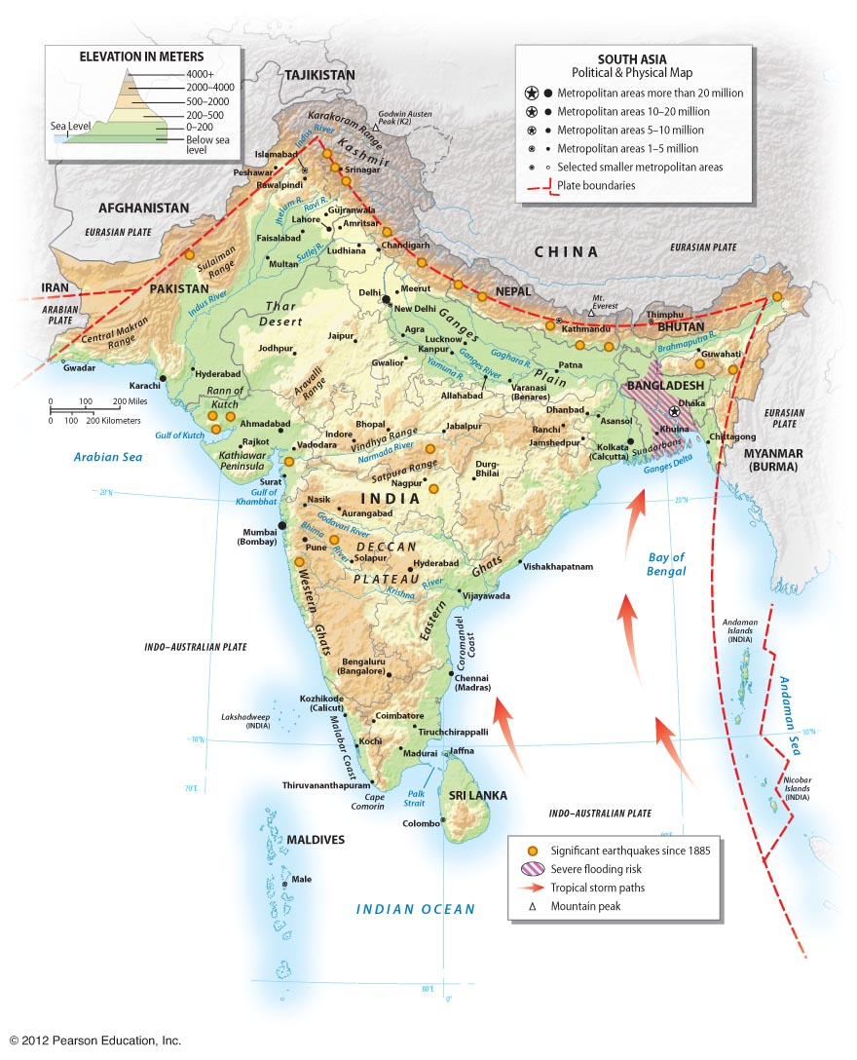
Himalayas grow at 0.2 inches a year.
Home to over 50 million people.
Source of the three largest rivers of the region.

Slide 12
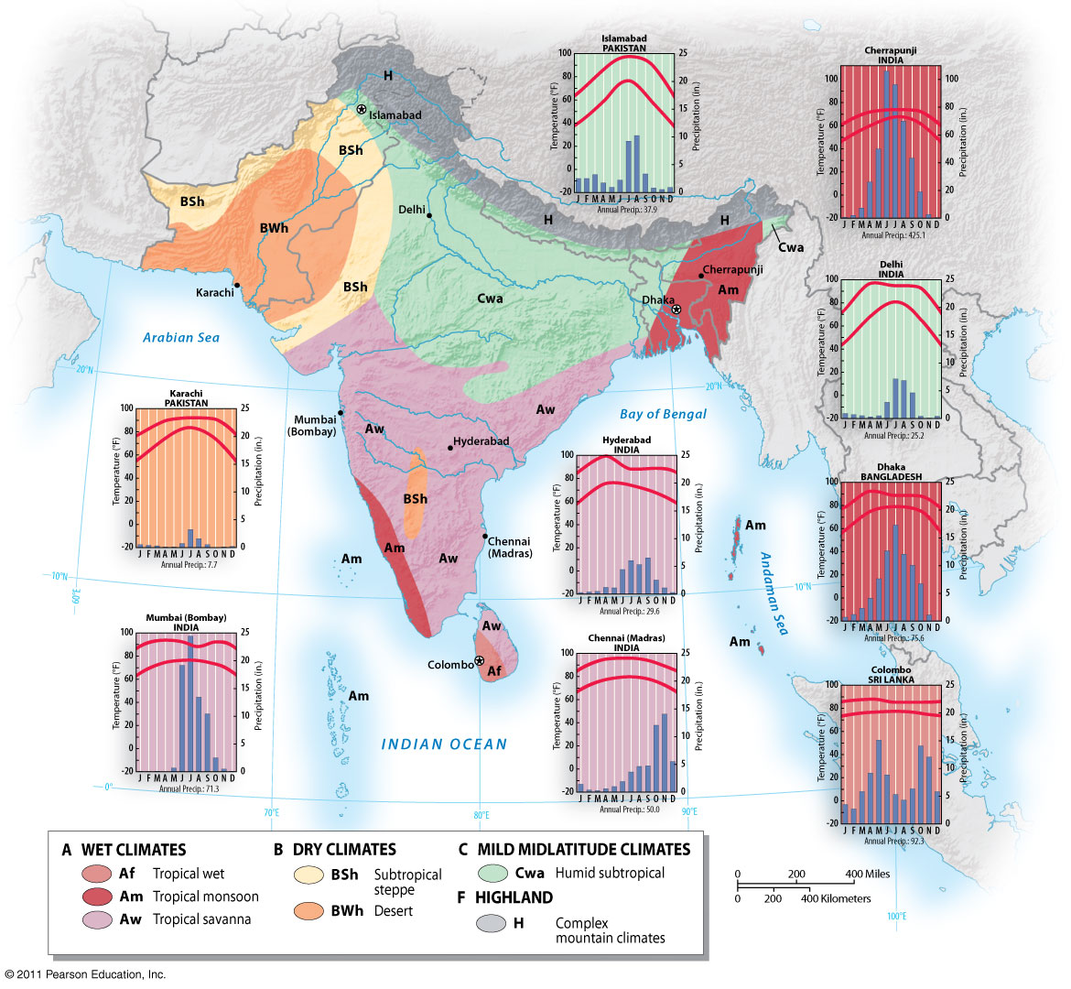
South Asia Climate
Am
Aw
BW
Cw

Slide 13
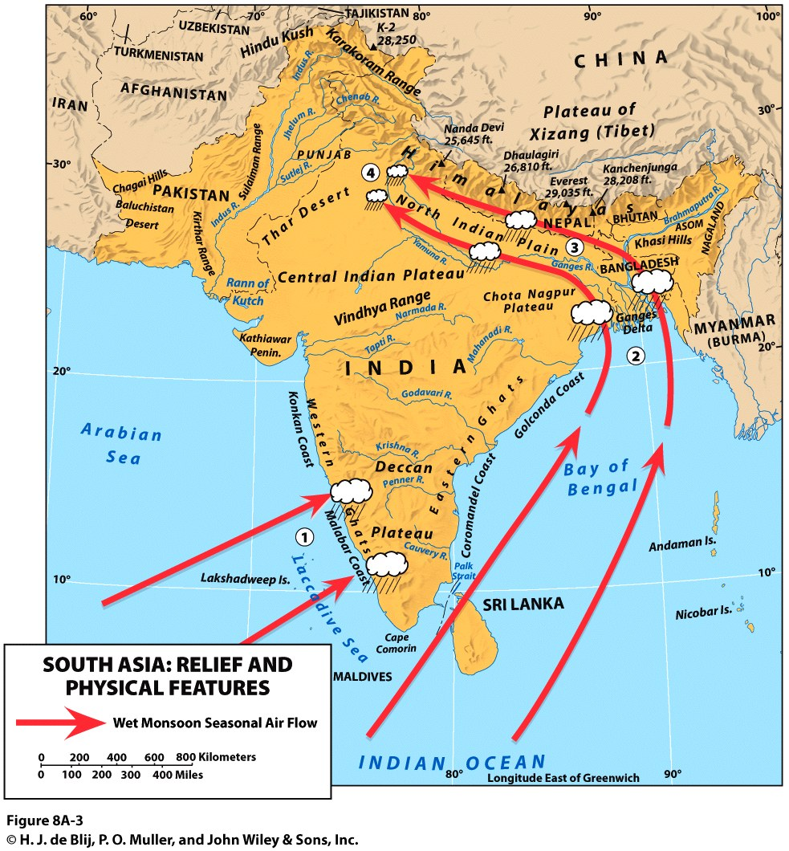
The Wet Monsoons
Heat in the Asian interior creates an area of low atmospheric pressure.
Higher pressure over the ocean creates an on-shore flow of air, bringing warm, moist air masses over the subcontinent.

Slide 14
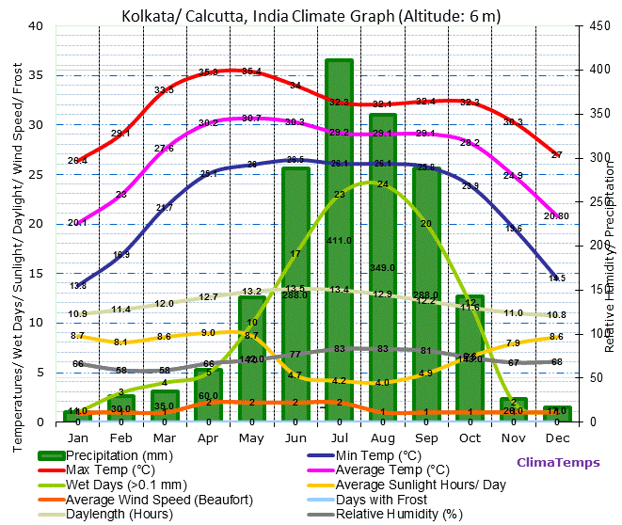

Slide 15
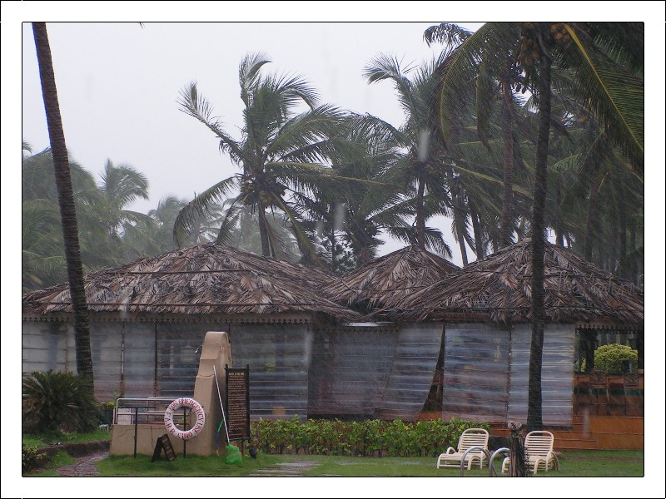
Goa, during heavy monsoon rains. Southwest coast of Indian peninsula.

Slide 16
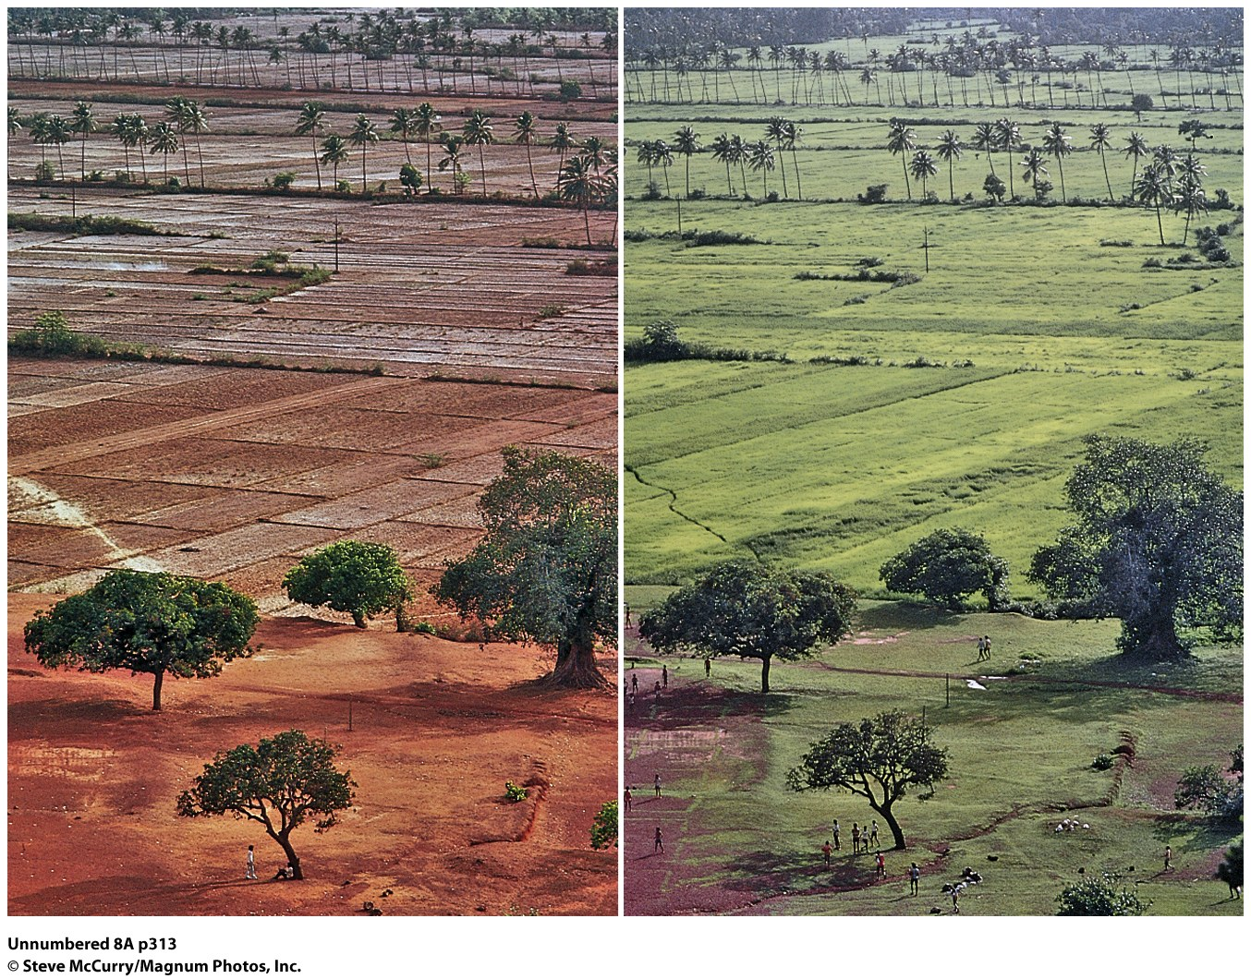
The importance of the Asian monsoons.

Slide 17
Demographics of South Asia
 | Population | Density people/sq mile | TFR | GDP Per Capita (US $) | Poverty Rate $1.90/day | % Literate | IMR Per 1000
India | 1.2b | 1190 | 2.33 | 1,940 | 5.5 | 69 | 38
Pakistan | 187m | 728 | 3.48 | 1,548 | 4 | 57 | 50
Bangladesh | 158m | 2889 | 2.1 | 1,517 | 8 | 73 | 30
Sri Lanka | 22m | 881 | 2.05 | 4,065 | 4 | 96 | 8
Bhutan | 807,000 | 18 | 2.05 | 3,110 | 2 | 65 | 30
Nepal | 28m | 201 | 2.12 | 835 | 15 | 68 | 27
Maldives | 463,000 | 1102 | 2.09 | 10,536 | 7 | 99 | 21
For comparison: US has a density of 93/square mile and a GDP of 59,532. 12.3% of the US population live below the poverty line. IMR=6.

Slide 18
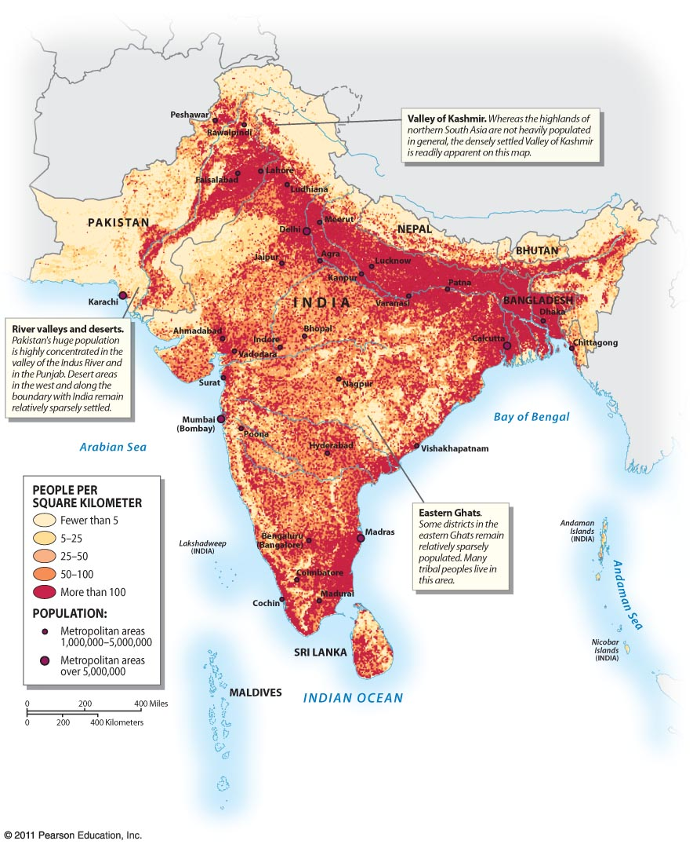

Slide 19
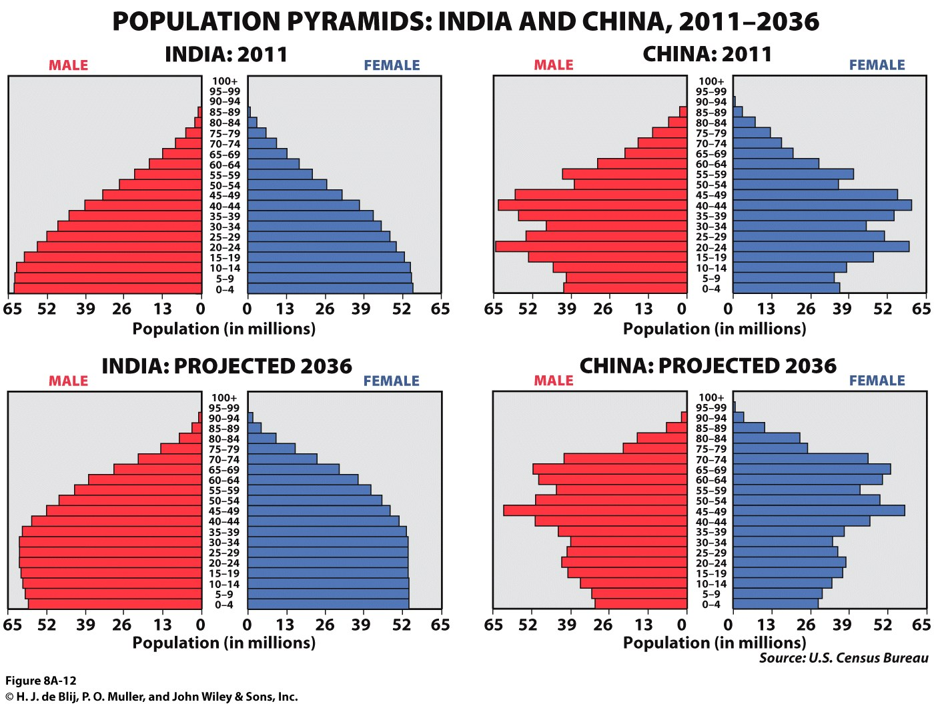

Slide 20
28.6% of India’s population is under the age of 15 years old.
17% of China’s population is under the age of 15.
India’s natural increase rate: 1.14%
China’s natural increase rate: 0.37%
India’s population is expected to exceed China’s by 2024.

Slide 21
Each year India adds approximately 9.1 million people.
To accommodate this, each year India would have to add:
127,000 new village schools
373,000 new teachers (at 50 students per teacher)
2.5 million new homes (with 7 people per home)
4 million new jobs
180 million new bushels of grain and vegetables

Slide 22
Population Policy in South Asia
--Pakistan
*little policy effort
*TFR has been falling
*still very high growth
*very high rates of infant mortality
*issues of gender equality
--Bangladesh
*has seen its TFR fall
*efforts directed towards women’s status
*Grameen Bank
--India
*policies began in 1952
*vasectomy and IUD ‘camps’
*coercion during the ‘Emergency Drive’ of 1970s
*backlash and distrust of government programs
*now focus is on education; abandoned targets on sterilization in 1998
*issues of women’s status

Slide 23
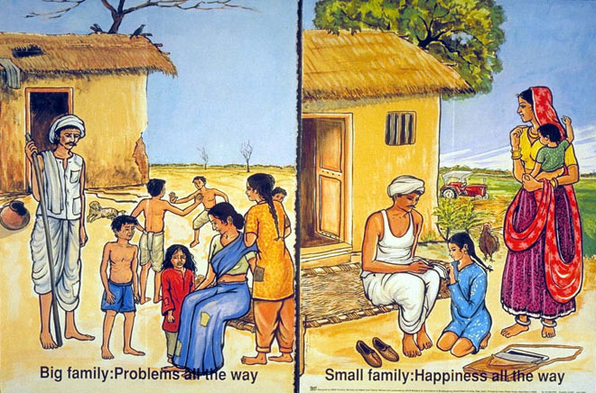
Family planning poster from India

Slide 24
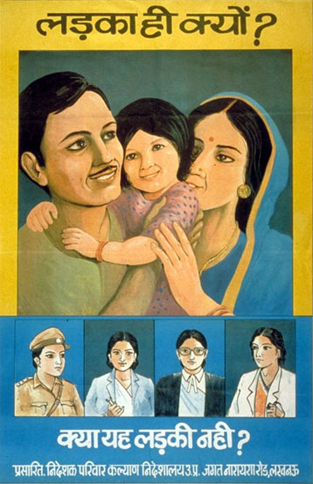
“Why only a boy?”
family planning poster from India

Slide 25
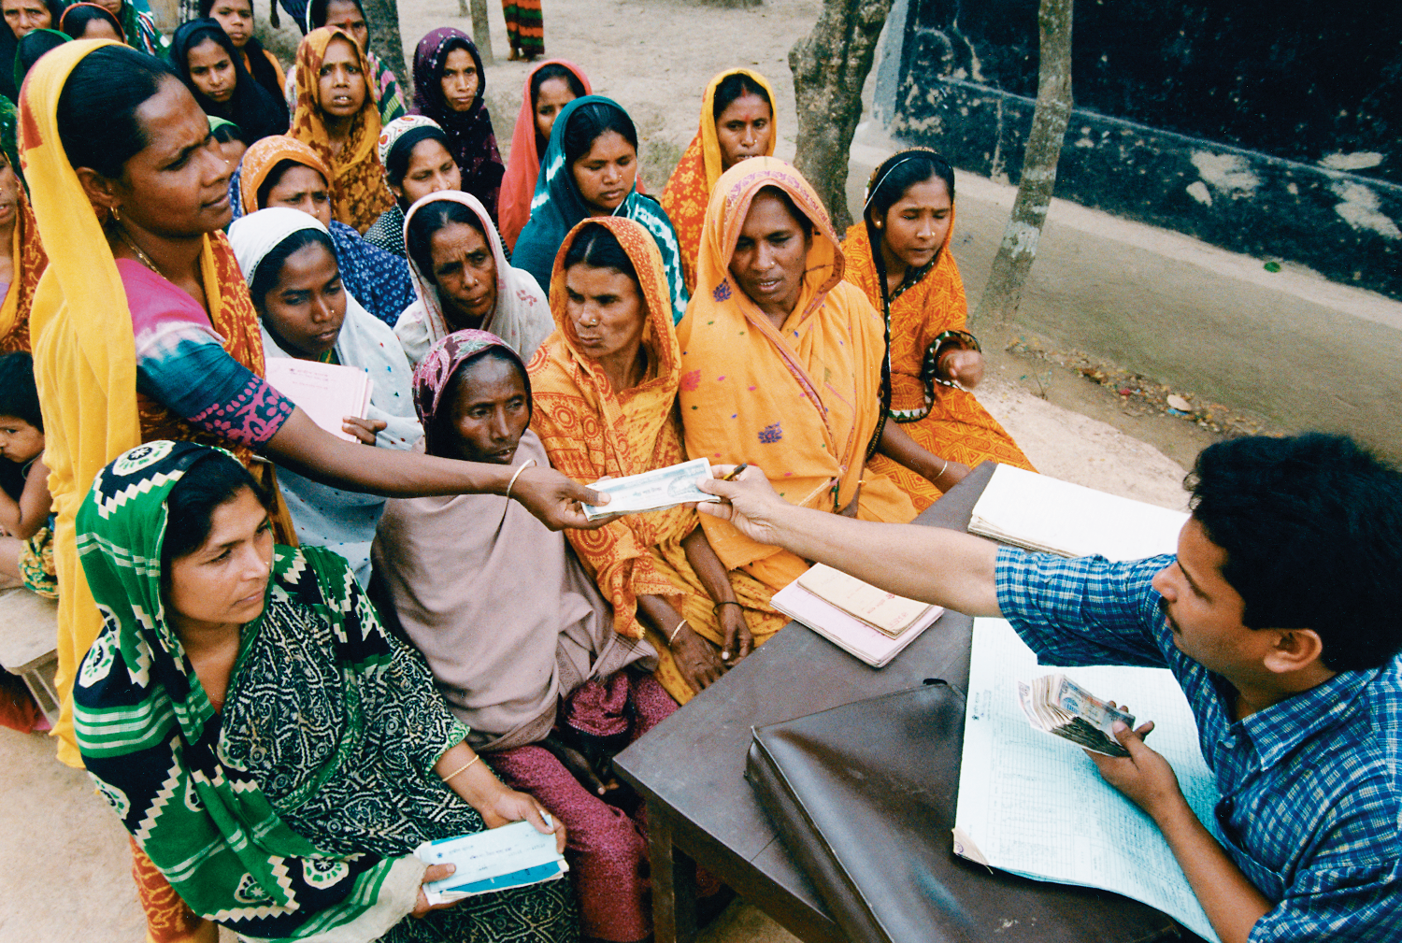

Slide 26
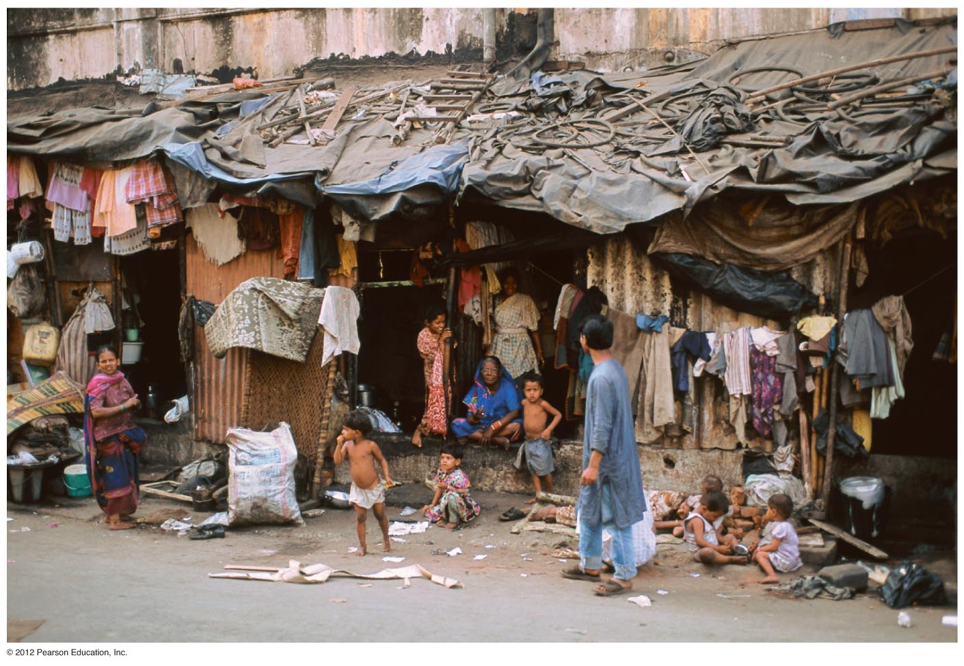
Mumbai (Bombay) Hutments. These makeshift homes are built on former sidewalks. They have no sanitary facilities and house 100,000s of urban dwellers.

Slide 27
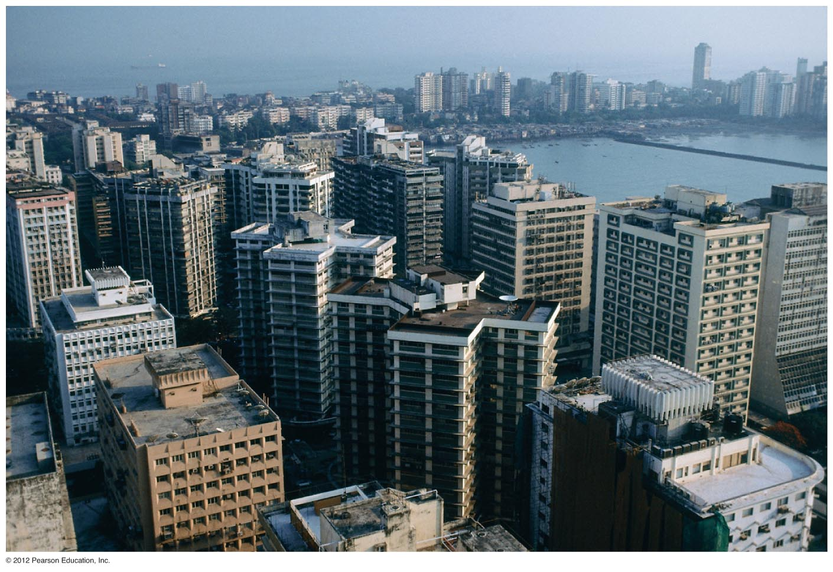
Another view of Mumbai, central city. 16 million urban dwellers. Despite poverty, the city has some of the highest office and apartment rents in the world.

Slide 28
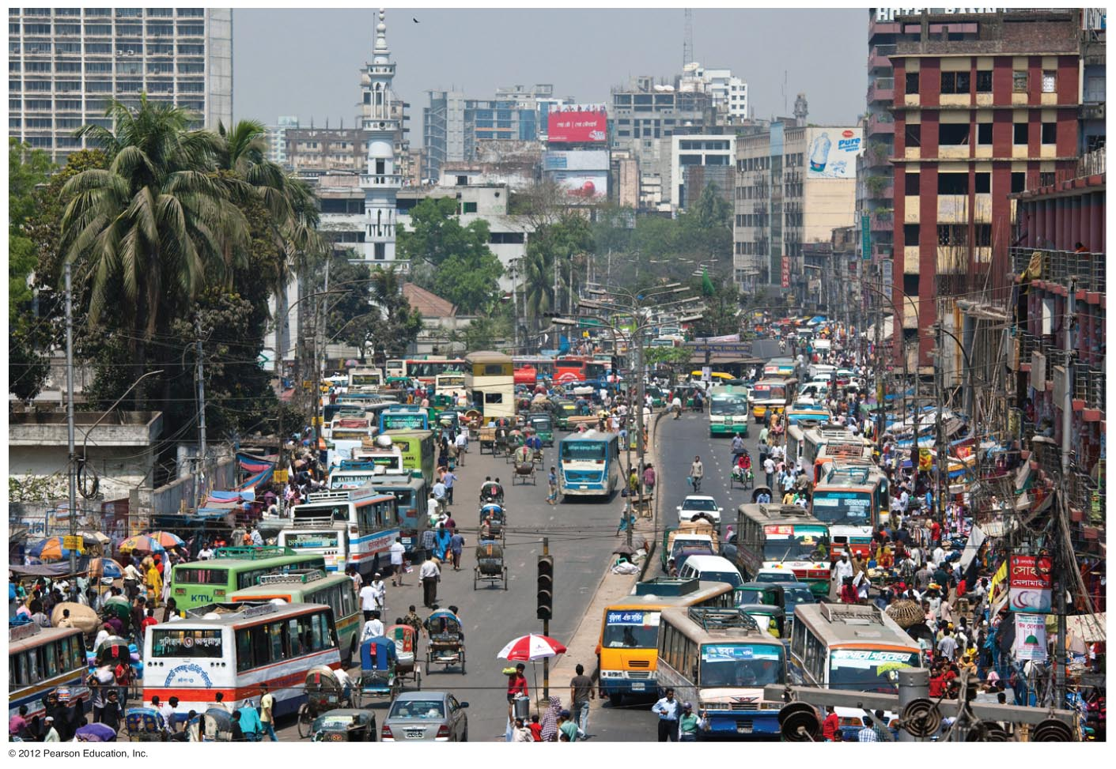
Dhaka, Bangladesh.

Slide 29
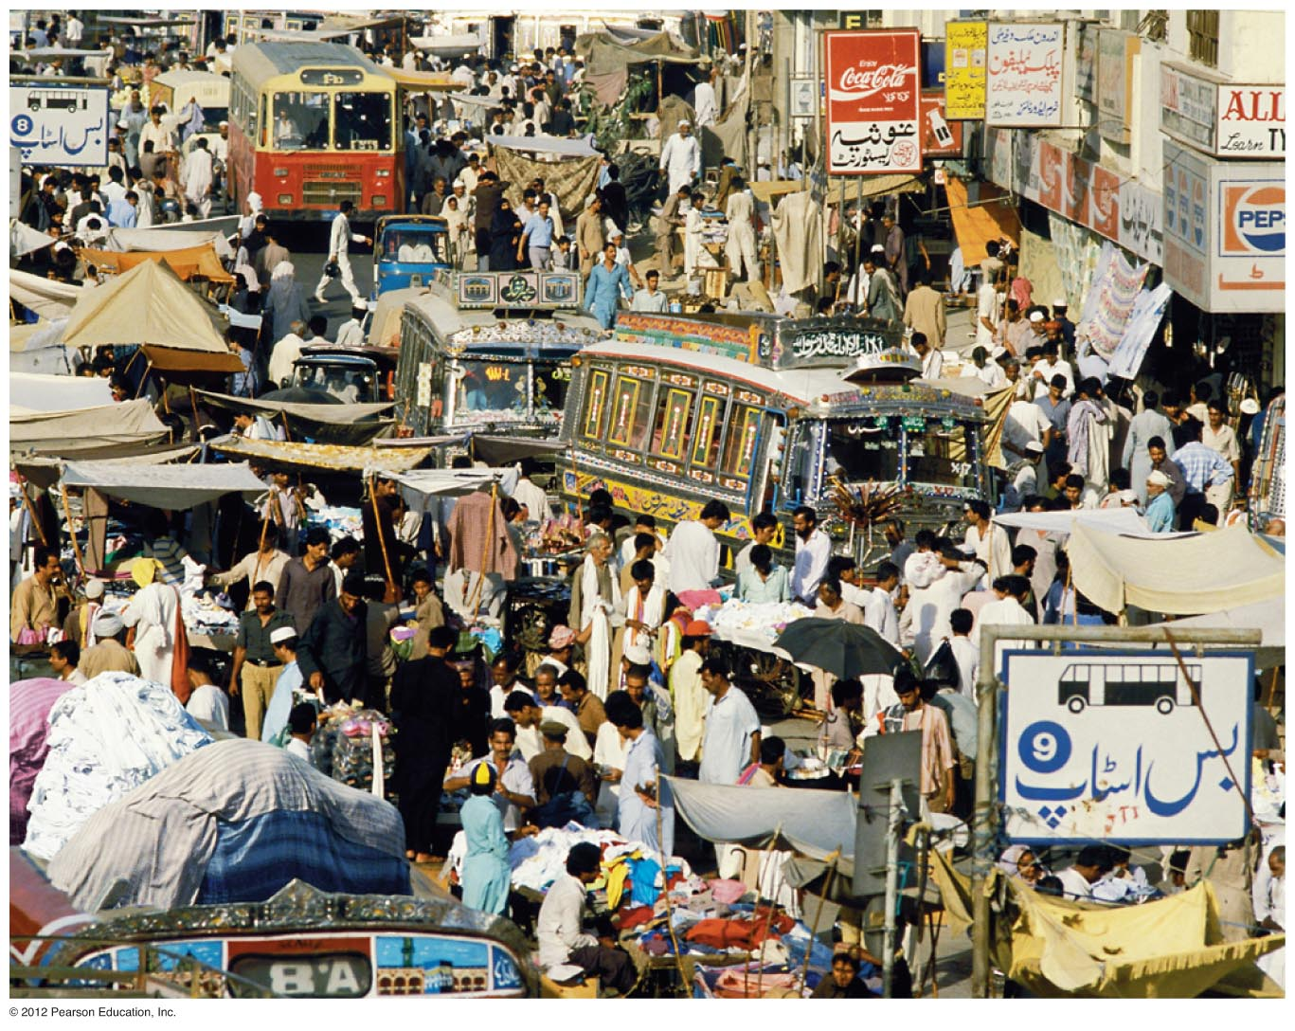
Karachi, Pakistan. 12 – 18 million residents.

Slide 30
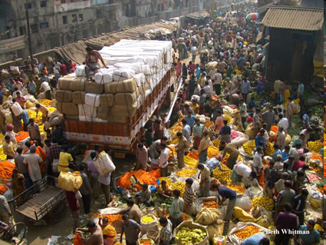
Flower market in Kolkata (Calcutta).

Slide 31
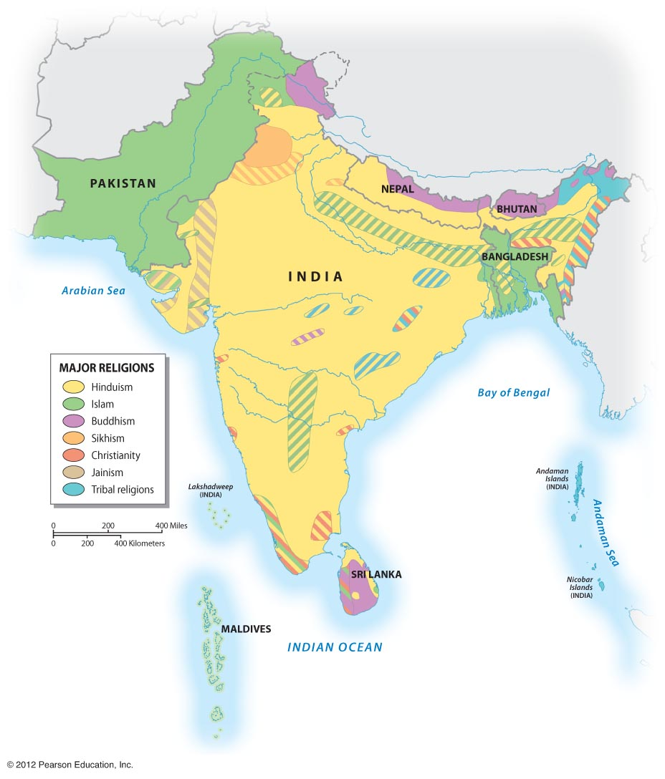
Religion in South Asia
Hinduism
Buddhism
Islam
Christianity
Jainism
Sikhism
Baha’i
Zoroastrianism

Slide 32
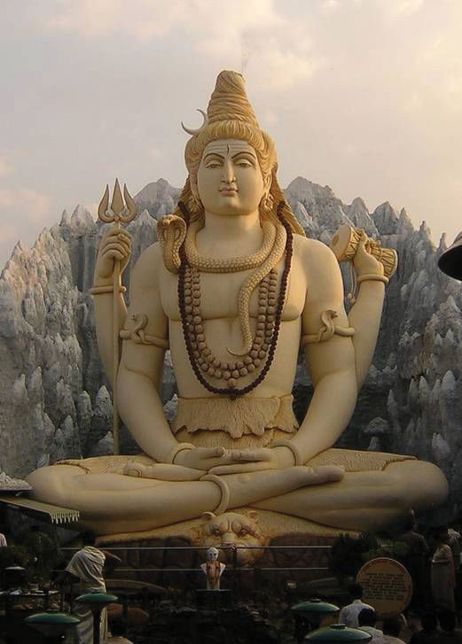
Hinduism
Shiva statue, Bangalore, India.
3000 years old
Indus River Valley
Polytheistic
Vedas, Upanishads, Bhagavad Gita
Atma
Karma
Dharma
Moksha, Samsara
The Caste System
Brahmin/Priest
Kshatriya/Warrior
Vaishya/Merchant
Shudra/Servant
Dalits/Untouchables

Slide 33
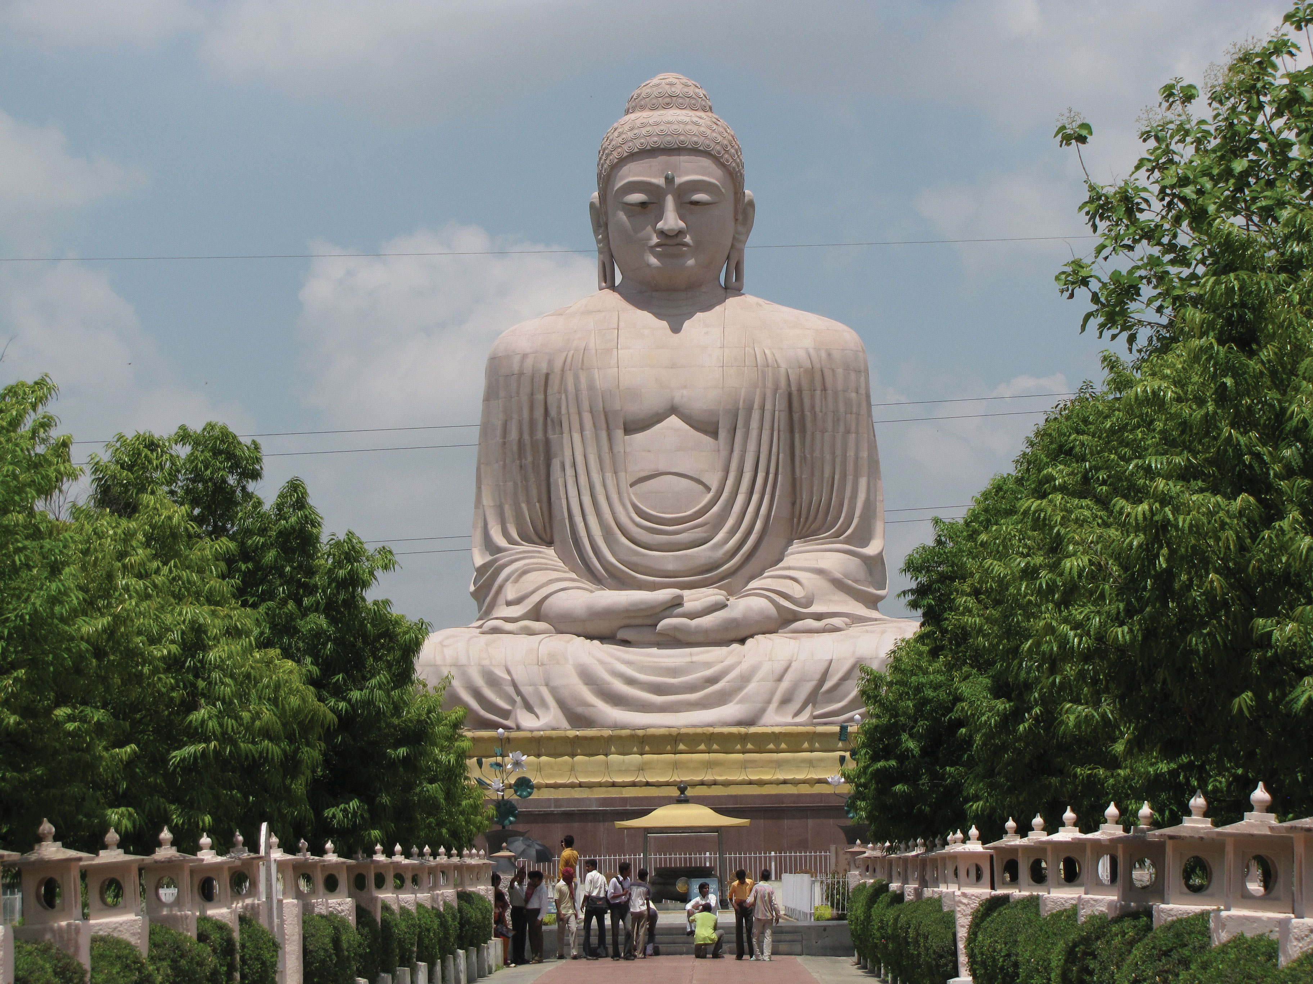
Buddhism
Ganges River Valley
2500 years ago
Siddhartha Gautama
Four Noble Truths
Eightfold Path
Nirvana
Mahayana, Theravada
Statue of Buddha, Bodh Gaya, India.

Slide 34
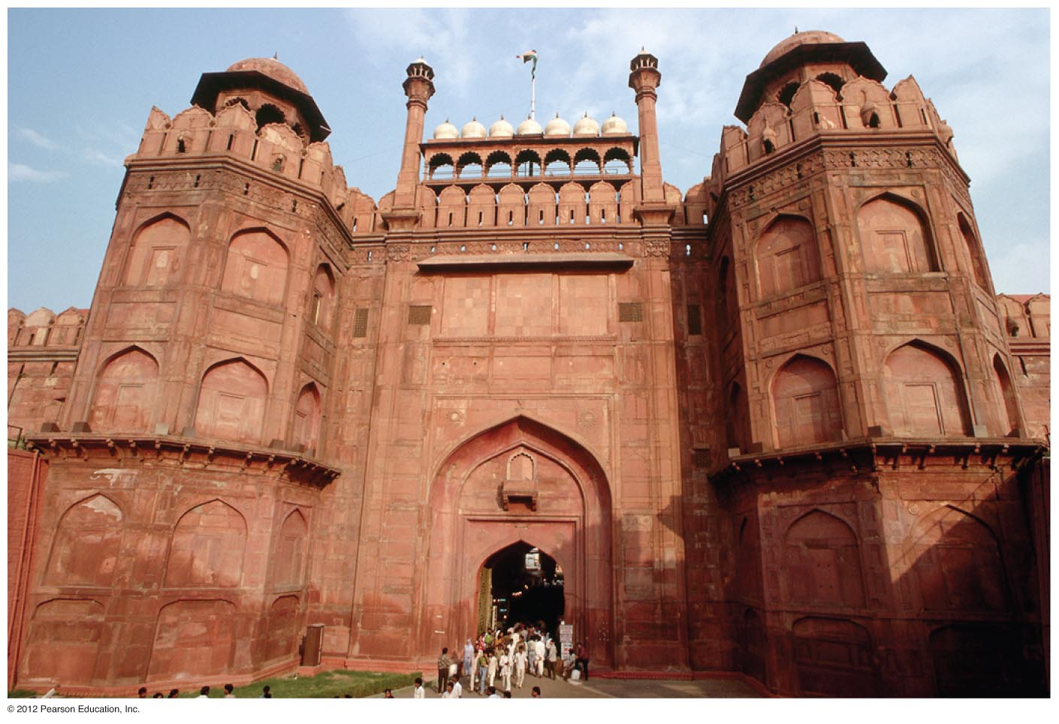
Islam
From Middle East via trade
Muslim control by 1300
Mogul Empire 1500s-1800s
The Red Fort in Delhi, 1648, military center of the Mughal Empire.

Slide 35
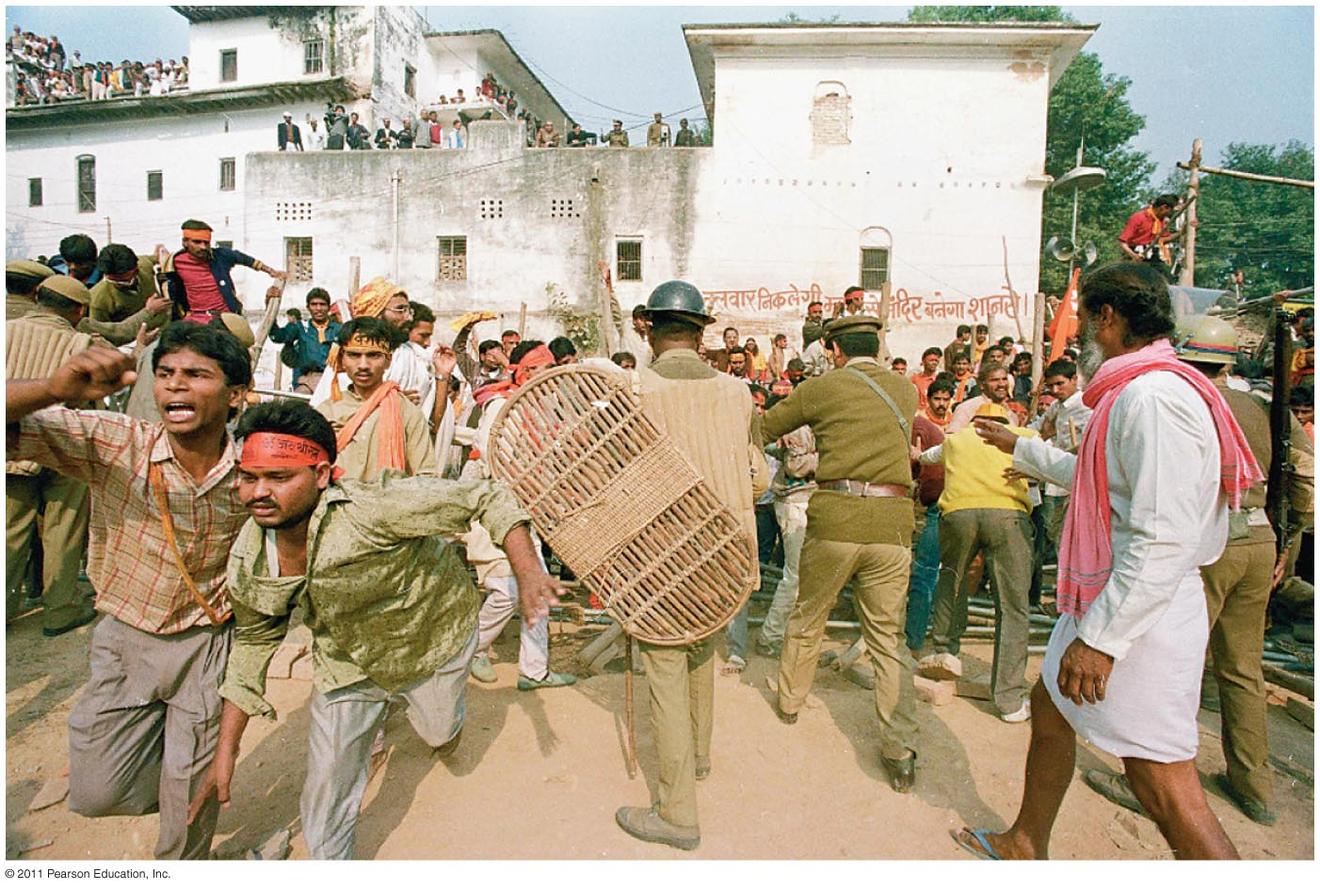
Ayodhya, India. Hindu nationalists at a rally calling for the destruction of a mosque in 2010.
Indian courts awarded 2/3 of the site to two Hindu groups and 1/3 to a Muslim foundation.
In 2019 courts ruled against Muslims and gave land to Hindus.
Prime Minister Narendra Modi—Hindu Nationalism.

Slide 36
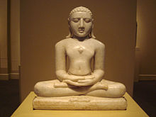
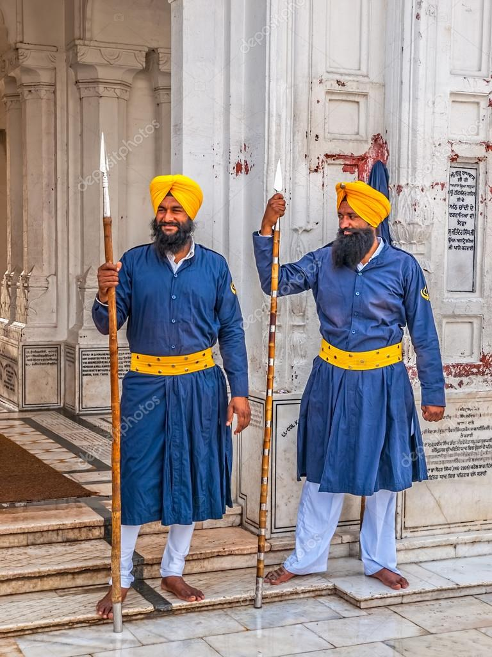
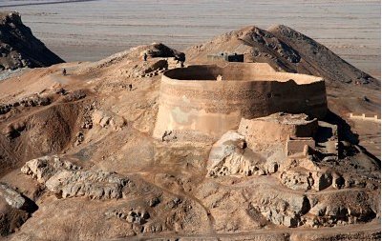
Other South Asian Religions
Jainism
9th Century
Fruititarians
5 million
Zoroastrians
From Iran
200,000
Use of fire as a purifying agent—fire temples
Towers of Silence
Sikhism
Punjab
Monotheistic
Persecuted minority
British guards
Image of Adinatha, founder of Jainism.
Zoroastrian Towers of Silence

Slide 37
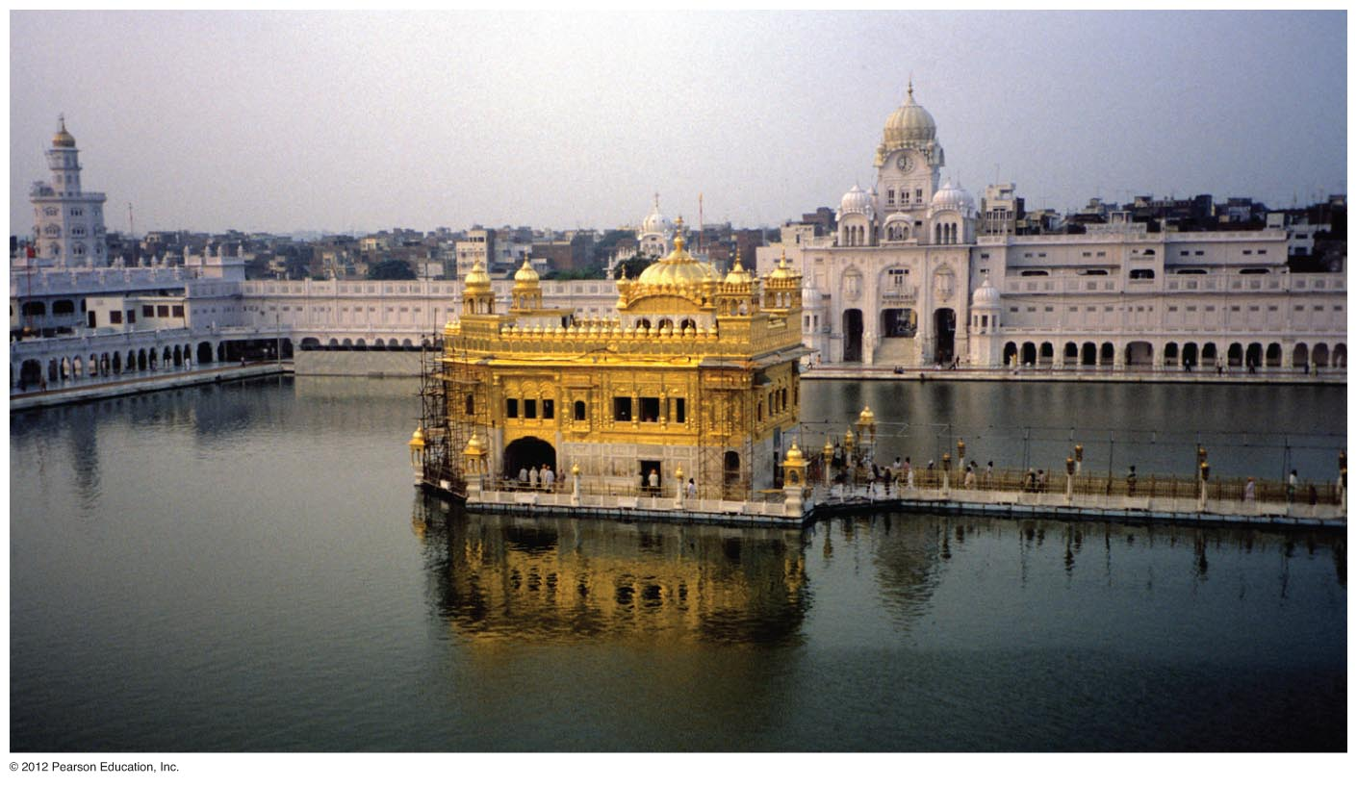
Sikh temple at Amristar. Punjab region. Raided by Indian army in 1984 to root out Sikh militants.

Slide 38
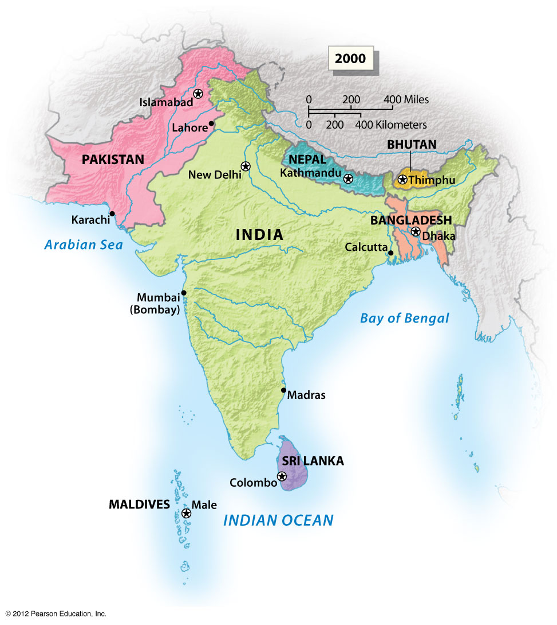
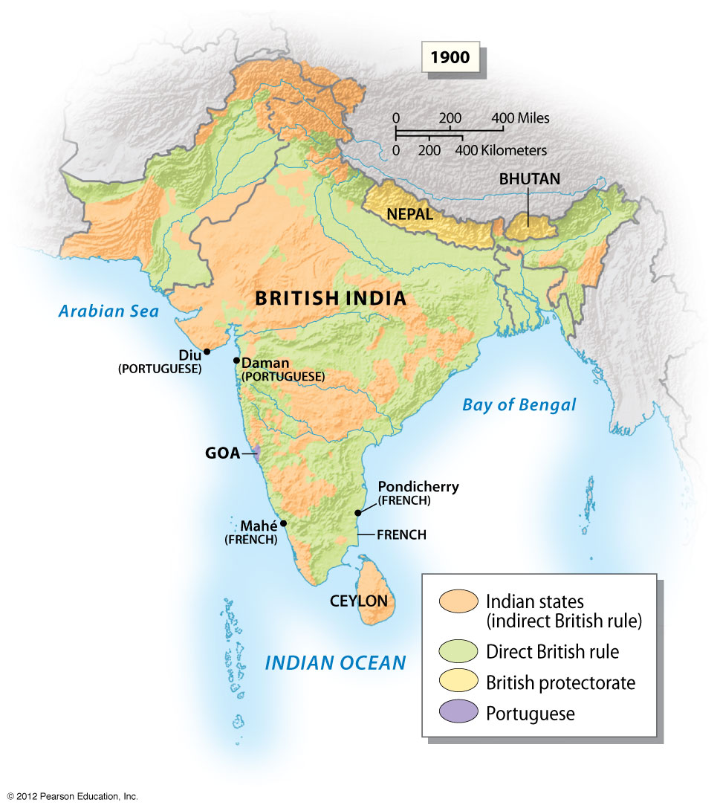
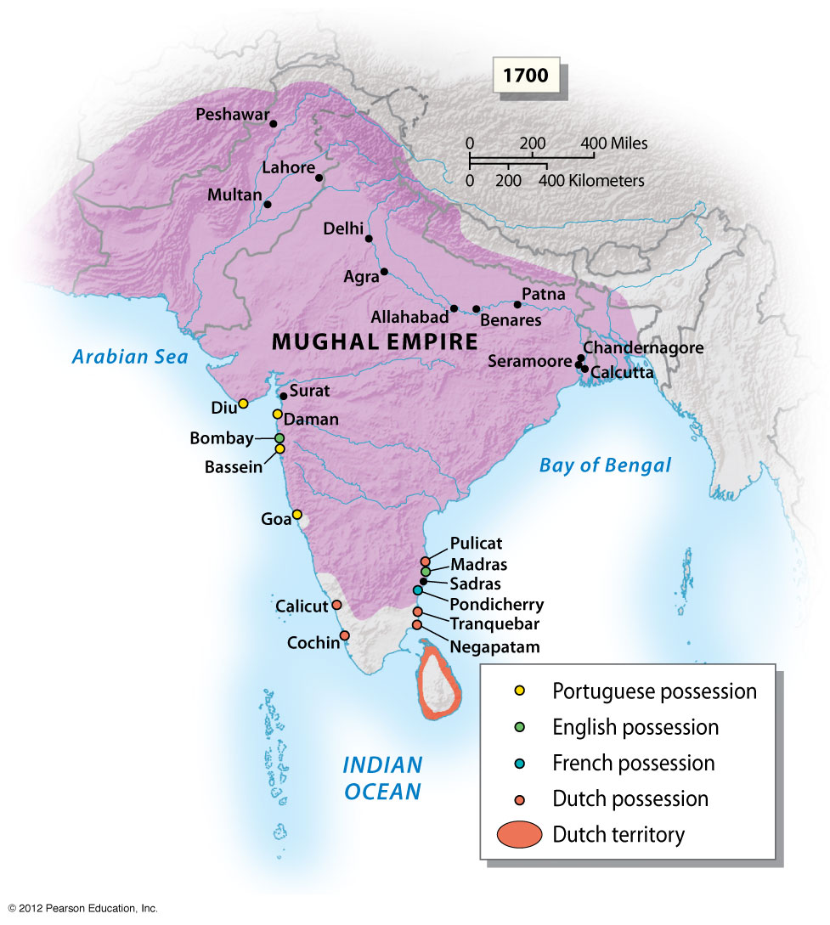
Geopolitical Change
Mogul
British
Full control by 1840s
British East India Co.
Local Elites
Sepoy Mutiny
Independence
Rising nationalism
Ghandi & Muslim leaders
1947 partitioning
14 million displaced
Bangladesh independent 1971
Notes:
Figure 12.29a

Slide 39
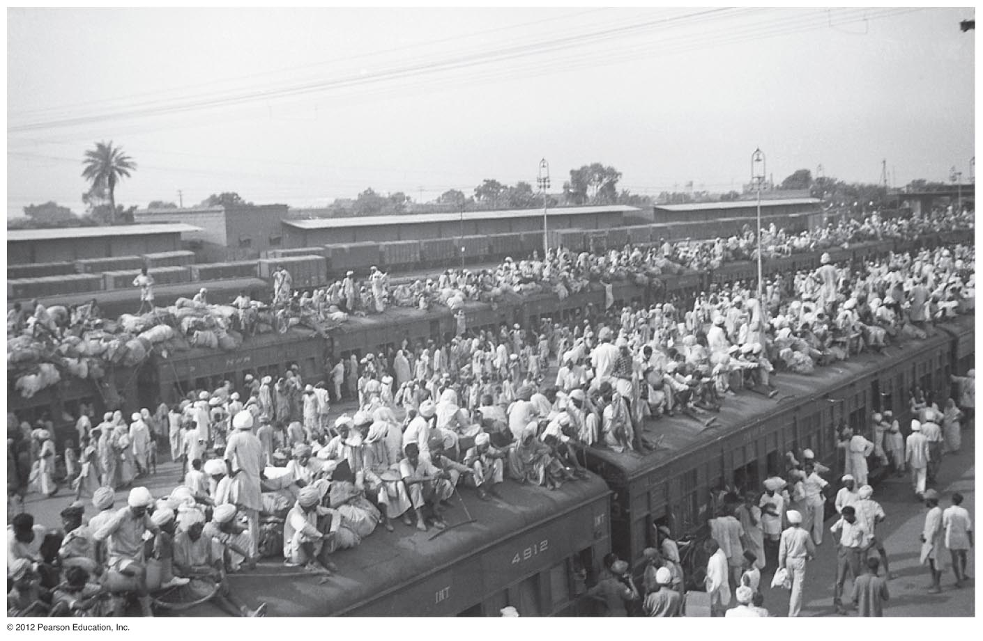
Notes:
Figure 12.30

Slide 40
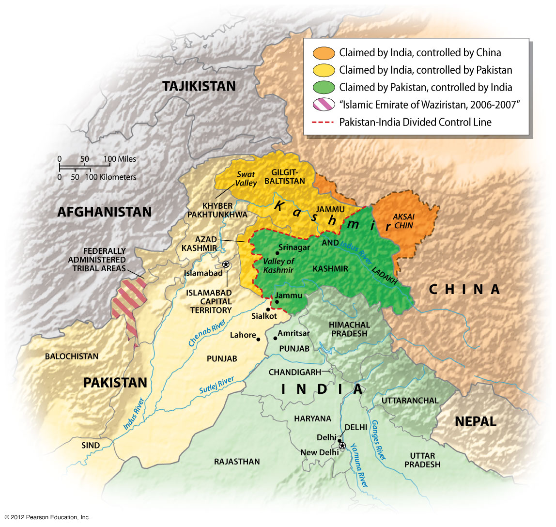

Slide 41
Politically unstable Pakistan & Cold War politics
During the Cold War U.S. aligned itself with Pakistan
India non-aligned, leaned towards USSR
US support for the Taliban in Afghanistan as they were fighting Soviets

Slide 42
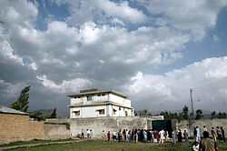
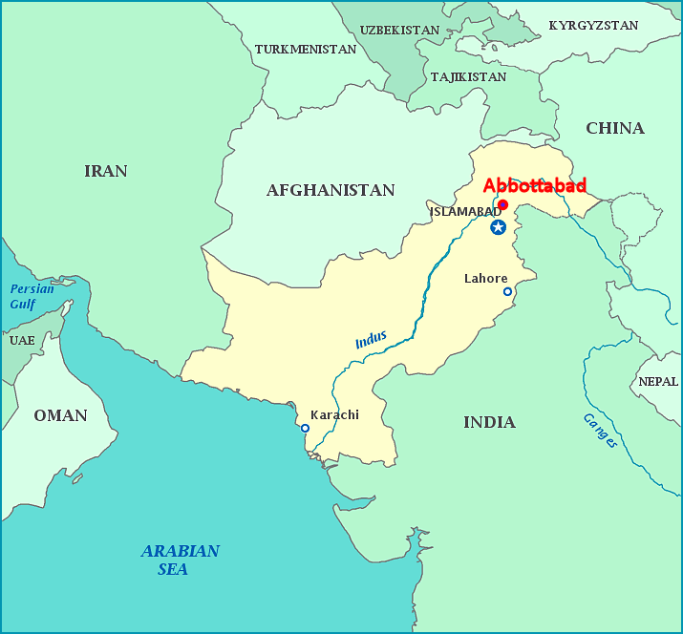
Post 9/11
U.S. gave Pakistan an ultimatum—choose Islamic Fundamentalists or U.S. Aid
Created internal turmoil, anger toward Pakistan’s government
Large geographic areas that are not controlled by Pakistan government
Pakistani militants carry out deadly attacks in Mumbai, India, 2008
Benazir Bhutto assassinated, 2008
Killing of Osama bin Laden, 2011
CIA drones…

