Slide 1
Europe
Chapter 2

Slide 2
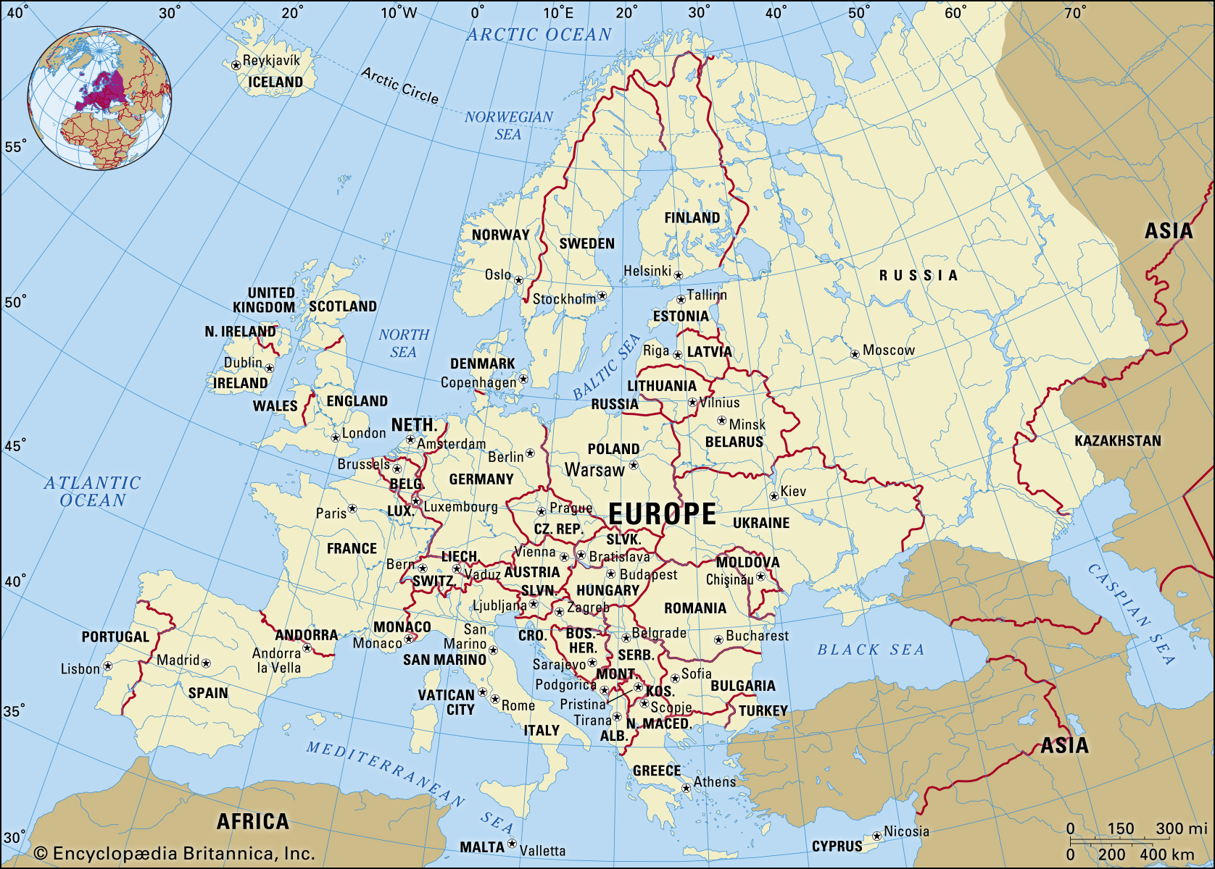

Slide 3
Location & Climate of Europe

Slide 4
Landform regions of Europe
Alpine
Central Uplands
Northern Lowlands (Northern European Lowland)
Western Highlands

Slide 5
Alpine Region
Pyrenees
High Alps
Apennines
Carpathians
Balkans

Slide 6
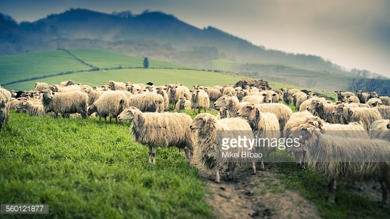
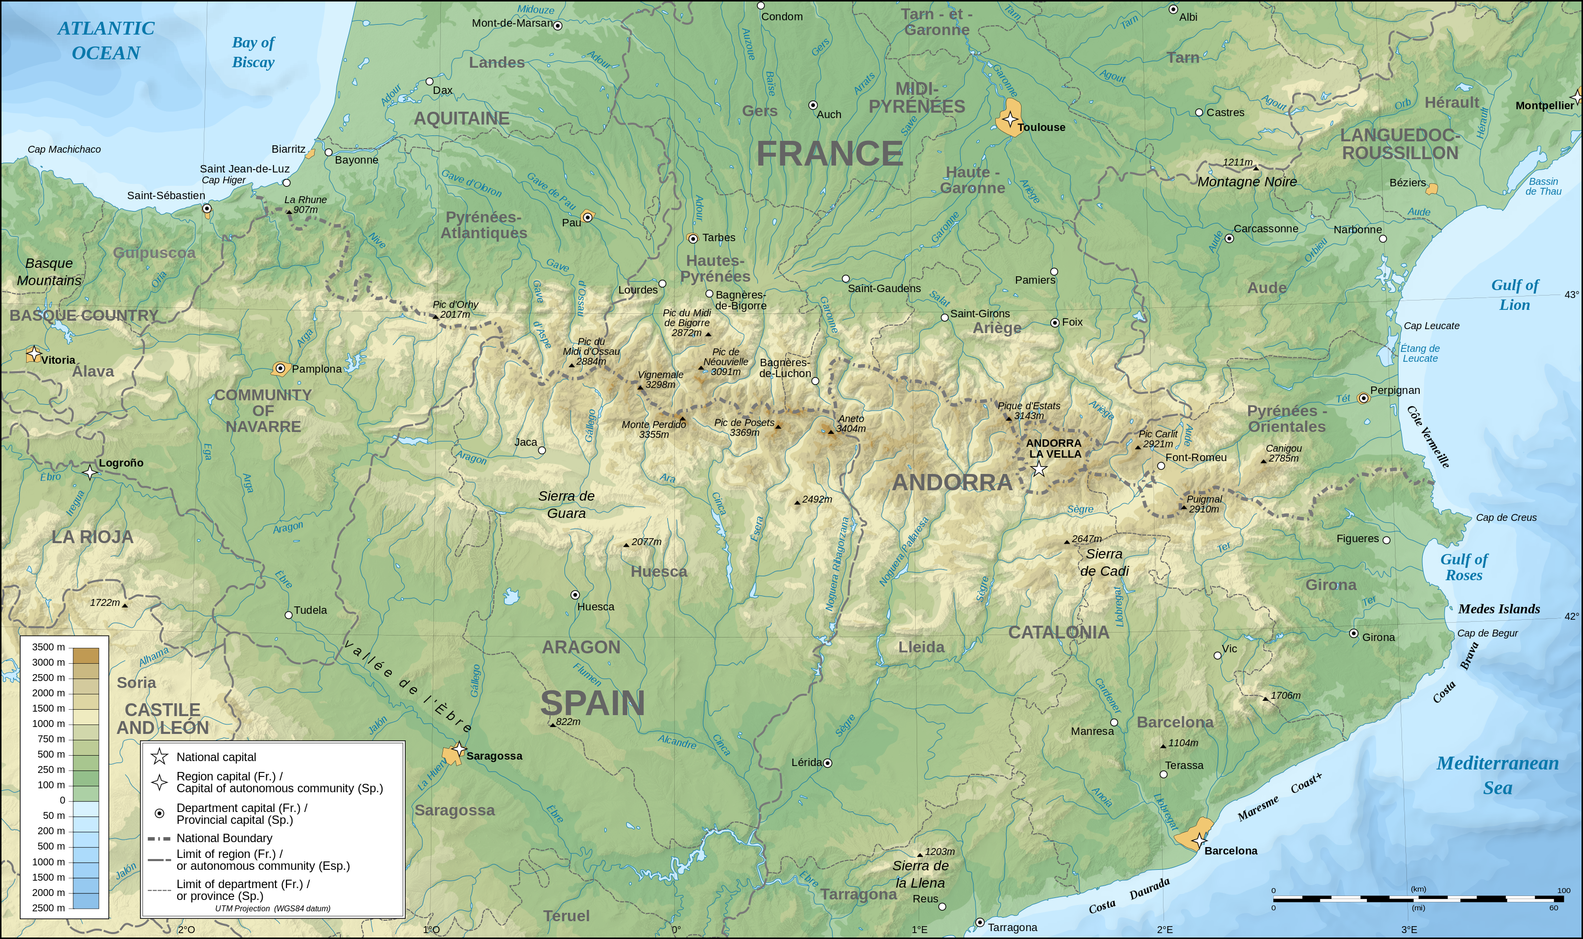
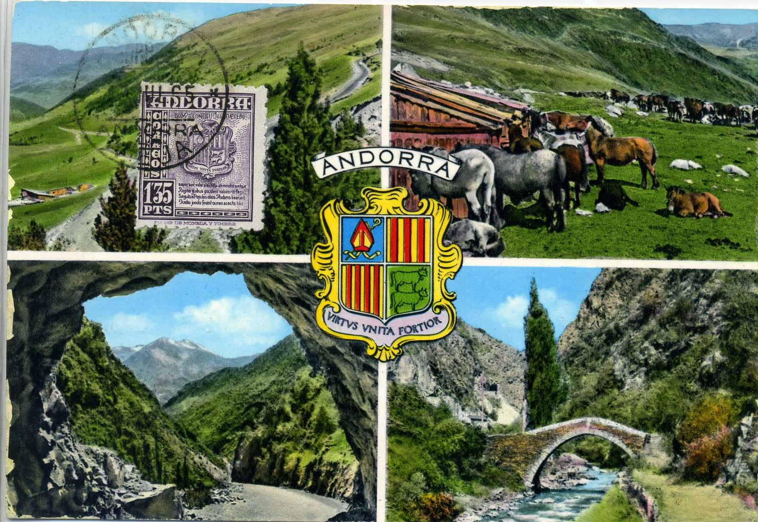
The Pyrenees

Slide 7
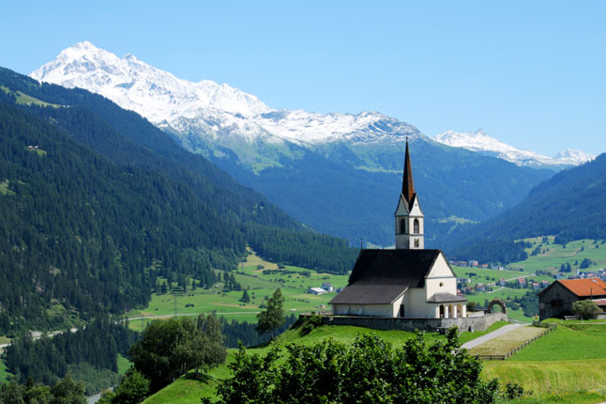
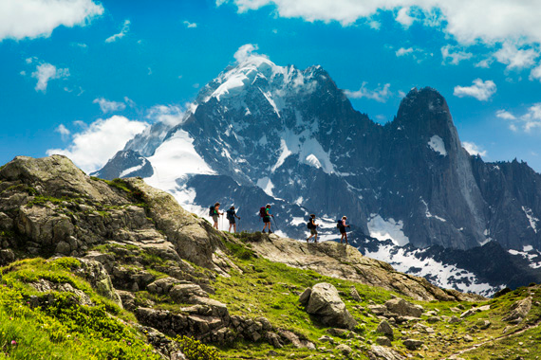
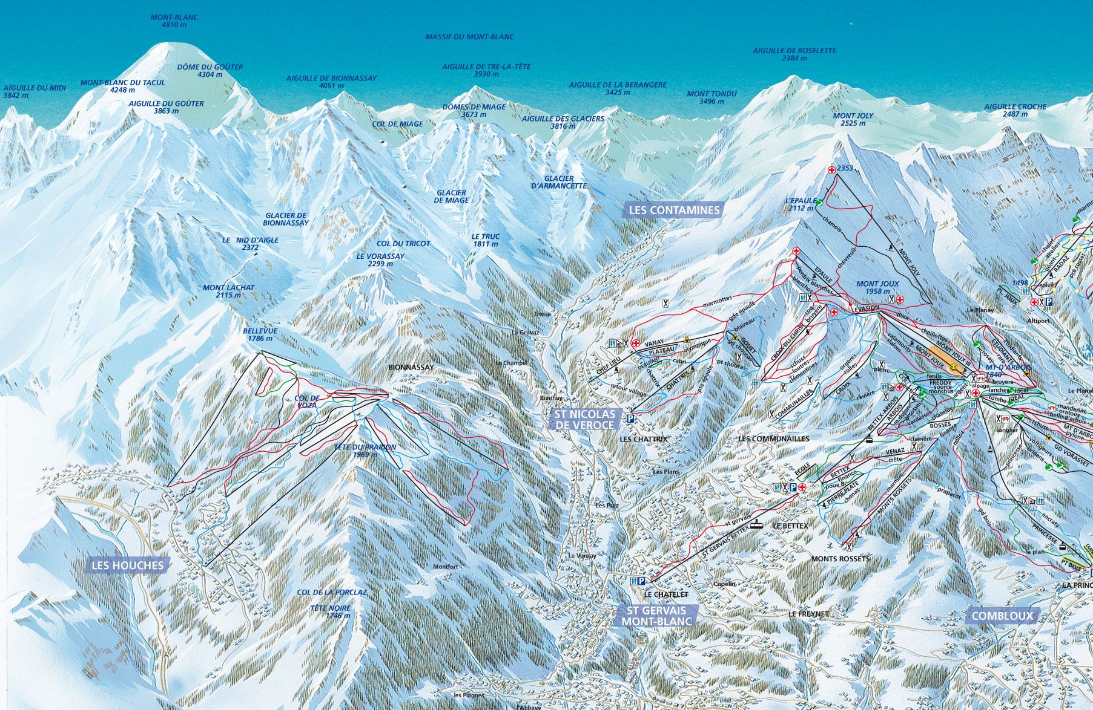
The High alps
The High Alps: Switzerland. 15,000’ in west—Mt Blanc to 10,000’ in Austria.

Slide 8
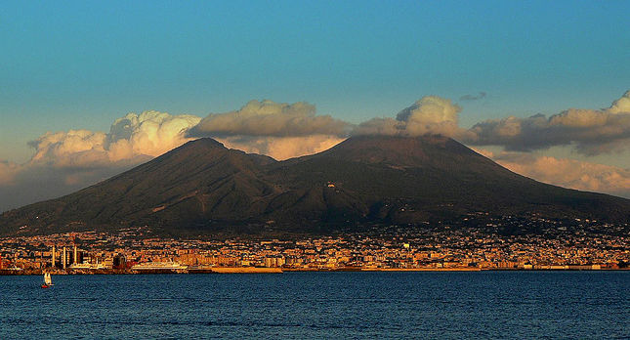
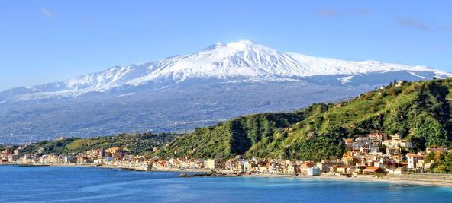
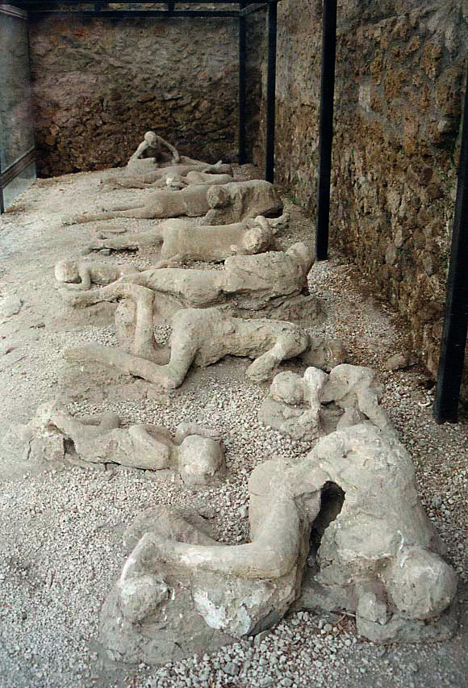
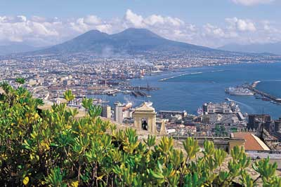
The Apennines
Mt Vesuvius looms over the Italian city of Naples. 4000’
Pompeii
Mt Etna in Sicily.
11,000’

Slide 9
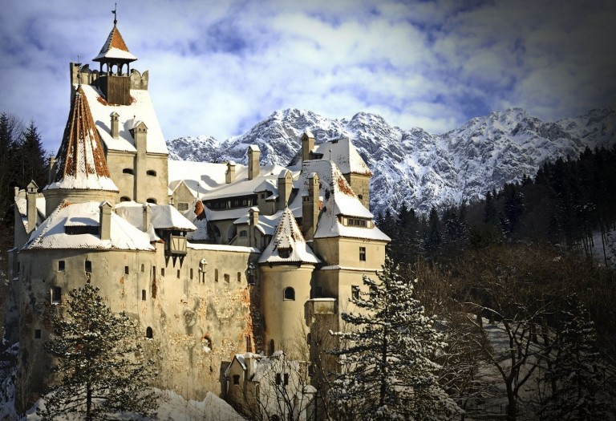
The Carpathians
Also known as the Transylvania Alps. Origin of the legend of Prince Vlad the Impaler (Dracula).

Slide 10
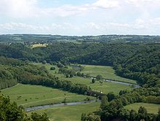
Central uplands
100 mya. 6000’
Raw materials for Europe’s
Industry, iron ore, coal…

Slide 11
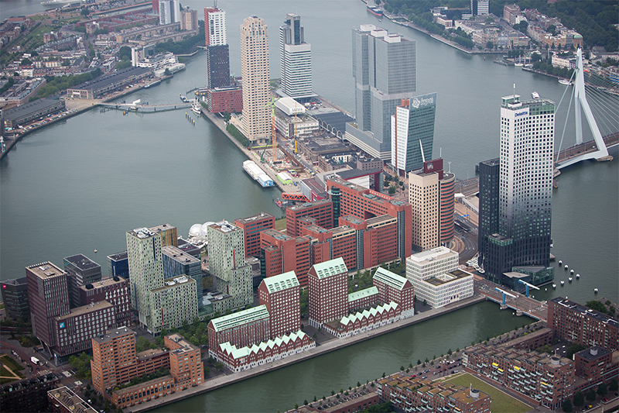
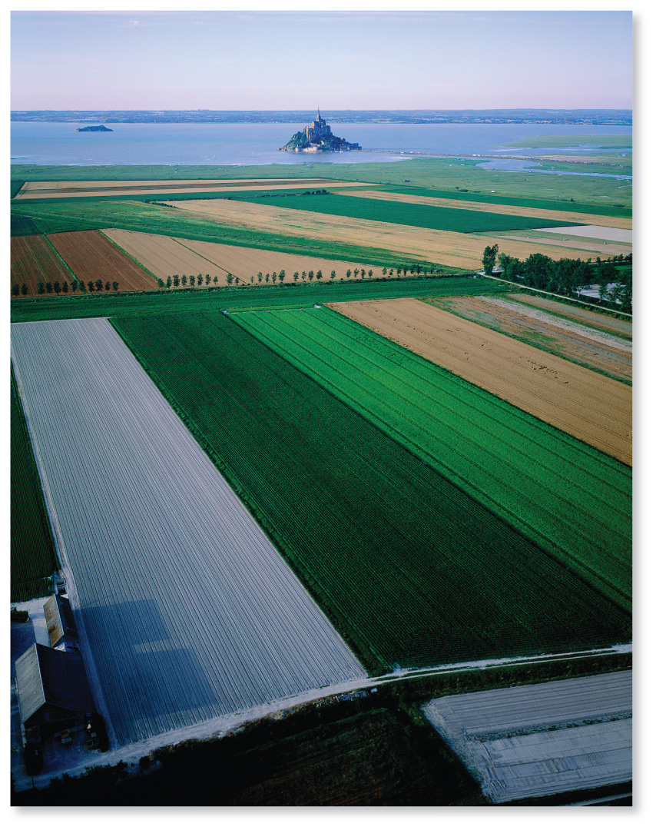
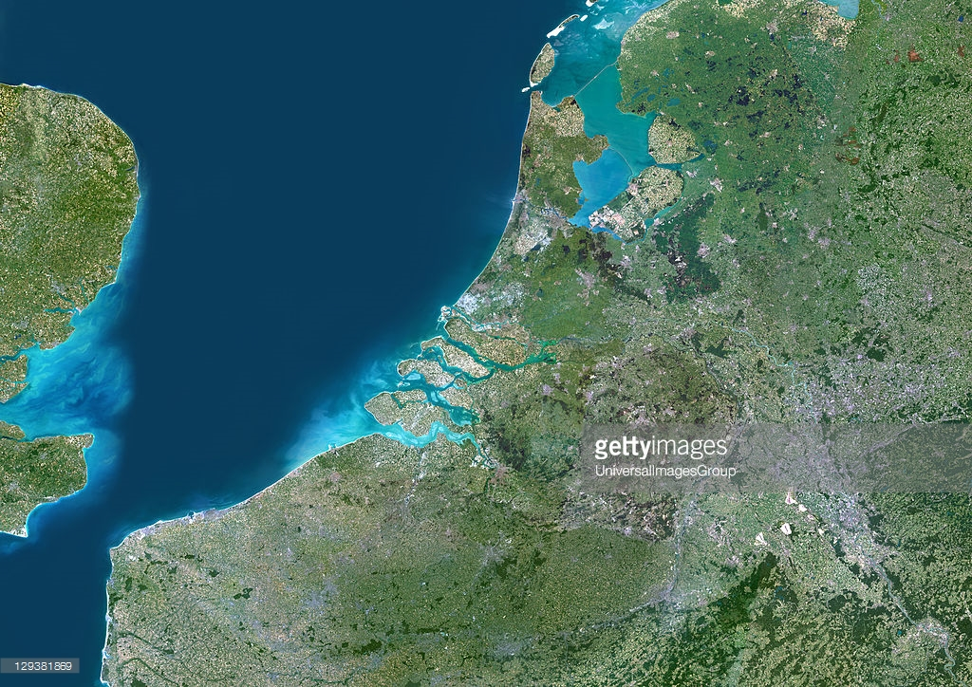
Northern lowlands
Normandy,
Western France
Rotterdam, Netherlands
Europe’s largest port on the Rhine River.

Slide 12
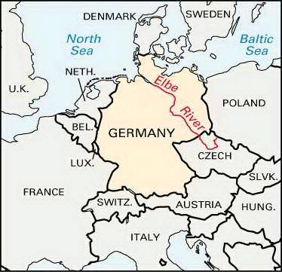
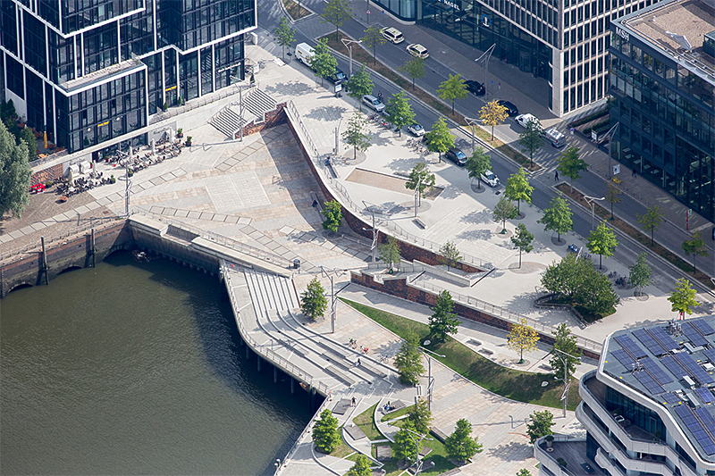
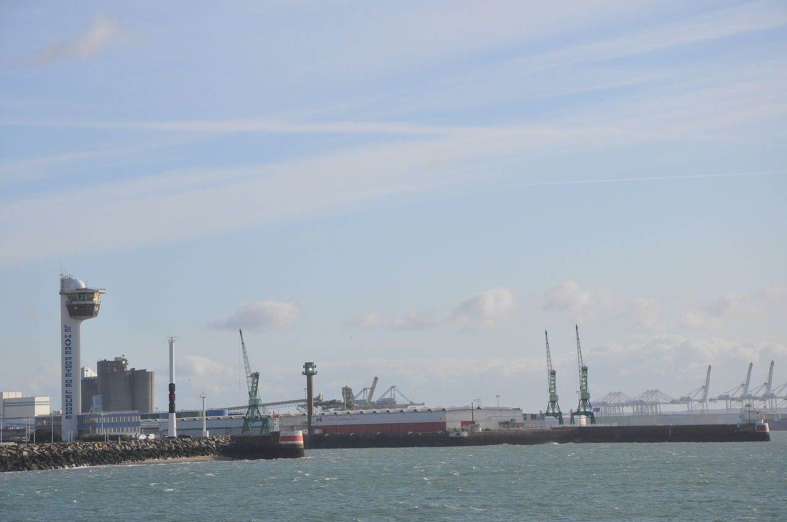
The Elbe River and Hamburg, Germany (Europe’s 3rd largest port).
La Havre, France port of the Seine River

Slide 13
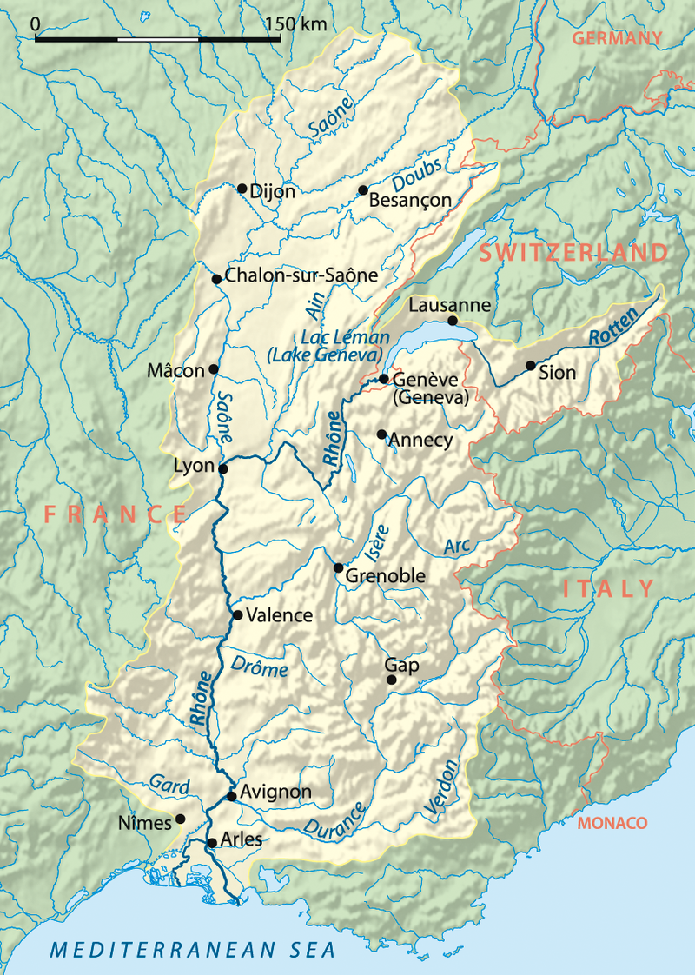
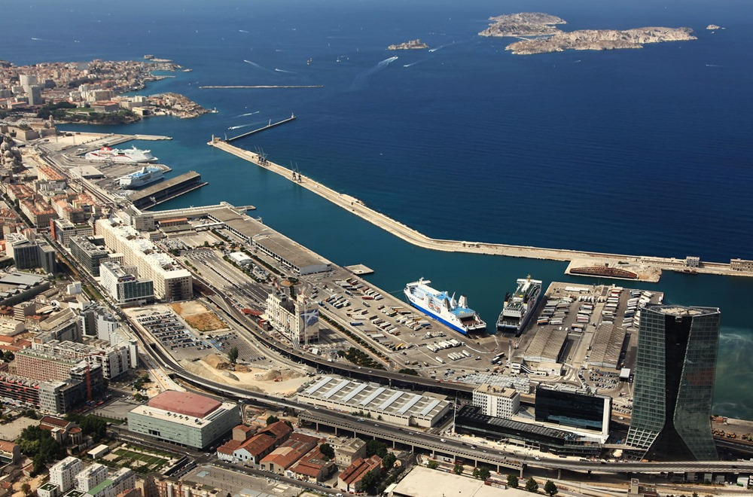
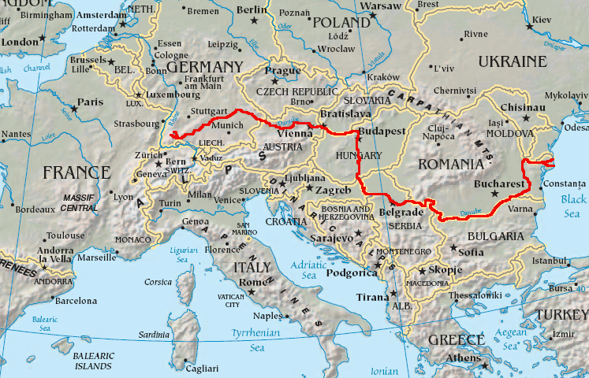
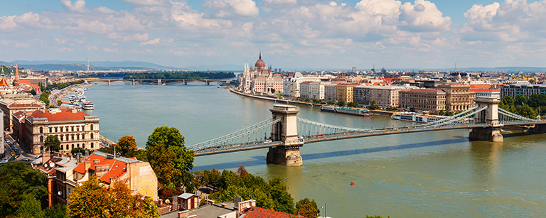
The Rhone River empties into the Mediterranean at Marseille
The Danube, Europe’s longest river. Begins in Southern Germany and
Empties into the Black Sea in Eastern Europe.
Budapest, Hungary along the Danube.

Slide 14
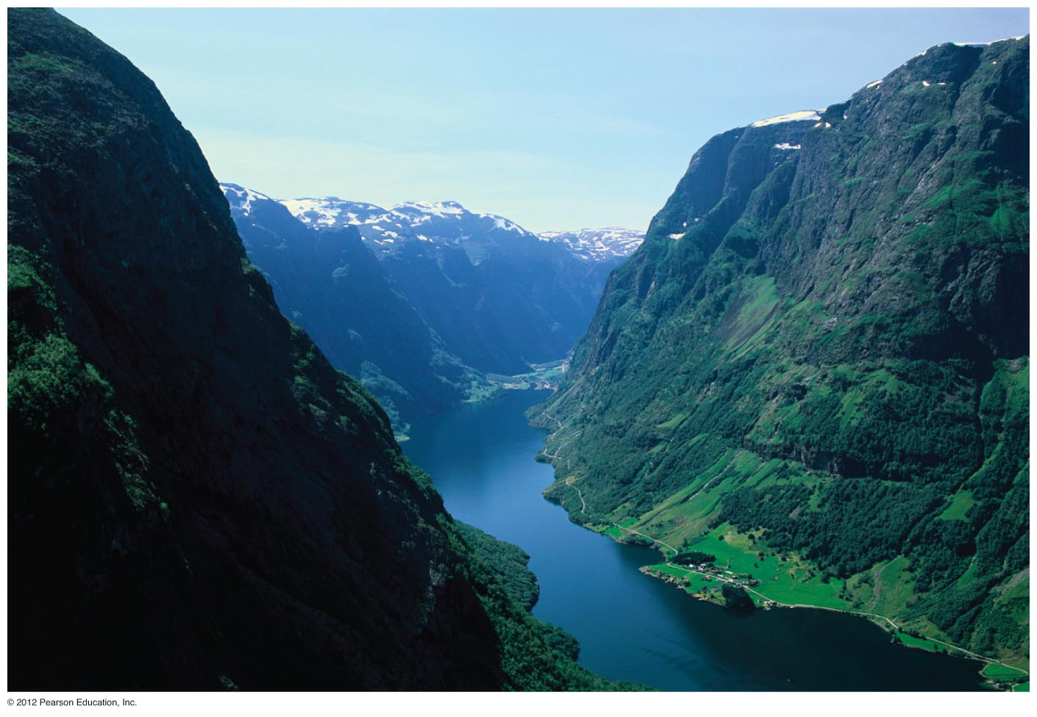
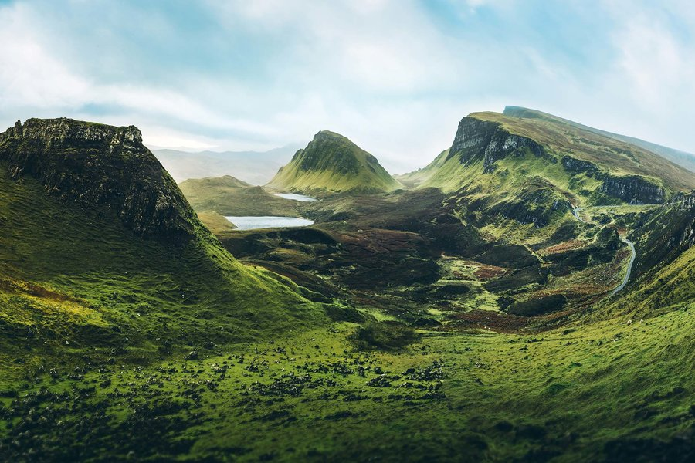
Western highlands
Fjords of Norway.
The Scottish Highlands

Slide 15
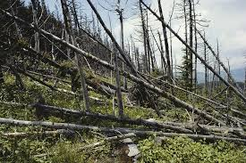
Natural resources & Environmental Concerns
Long history of manufacturing and environmental degradation
Fishing industry—The Common Fisheries Policy (cod)
Forestry (40% of the land area)
Coal & Petroleum—Norway, the UK, Denmark, Netherlands, Germany (about 50% gone)
Alternative Energy and Approaches to Global Warming

Slide 16
Alternative Energy in Europe
Pledged a reduction of 8% below 1990 levels of GHGs, Germany now at 10%
Political support
Two pronged approach
Reduce consumption: Europeans emit 5-9 tons of CO2 per person. US is 18 tons.
New energy sources

Slide 17
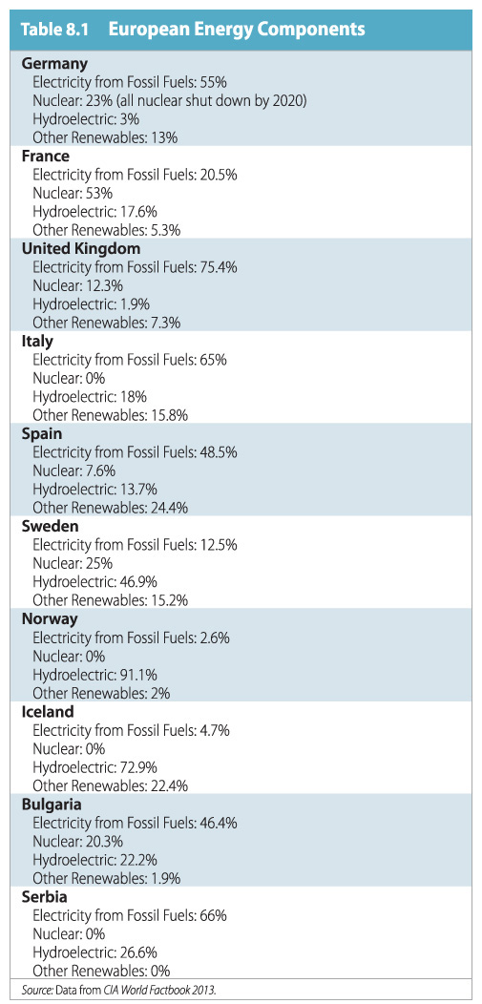
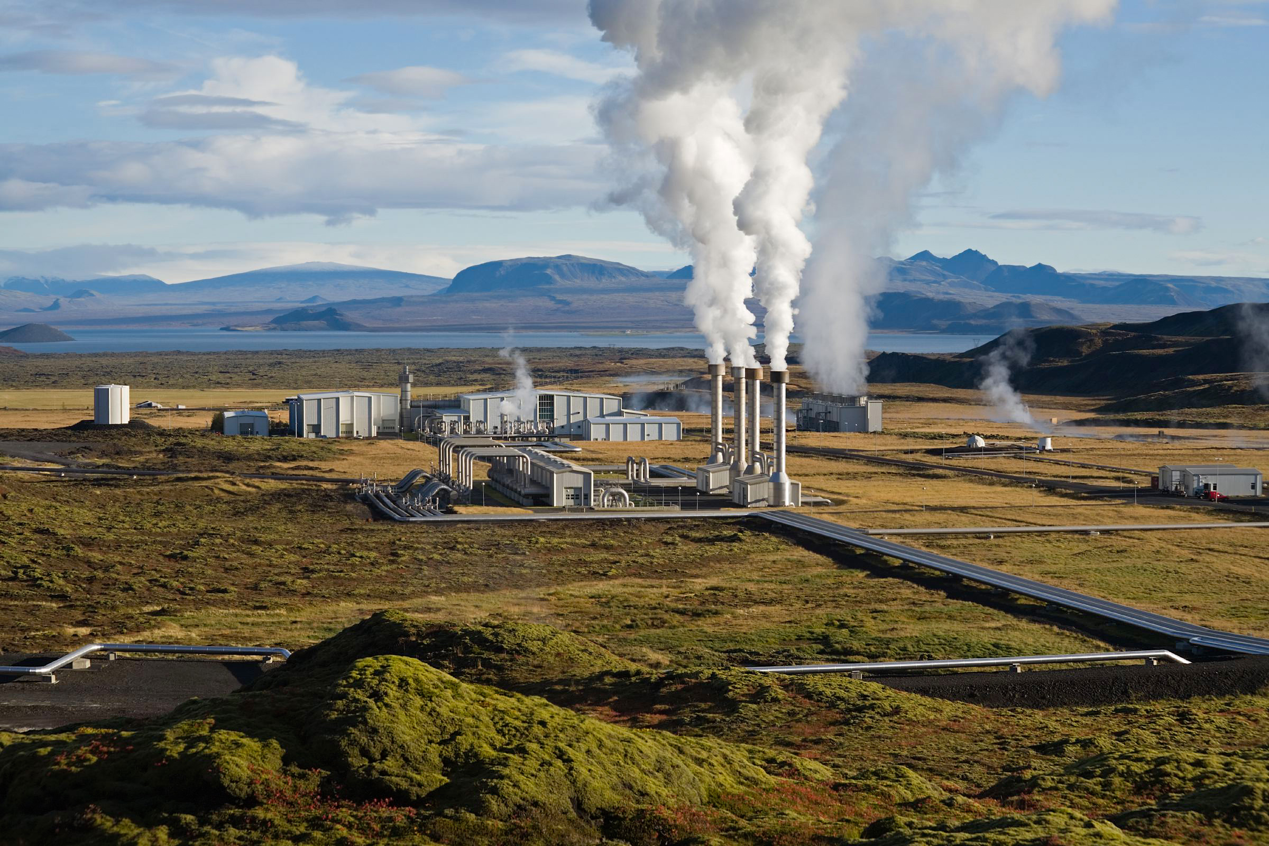
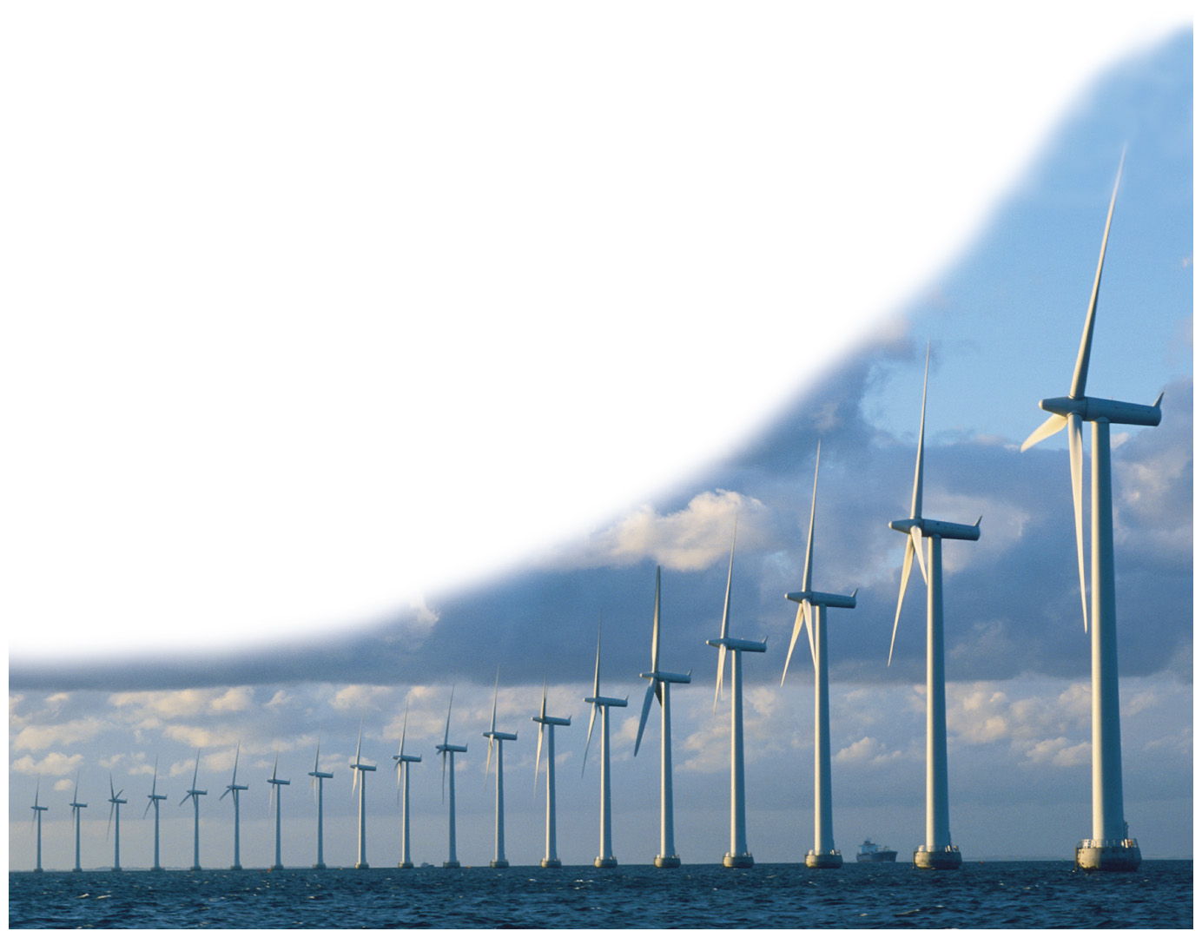
Alternative energy sources
Iceland’s Geothermal approach.
Denmark—has the highest production of wind power in the world; 42% of electricity from wind (2015). Up from 39% the year before.

Slide 18
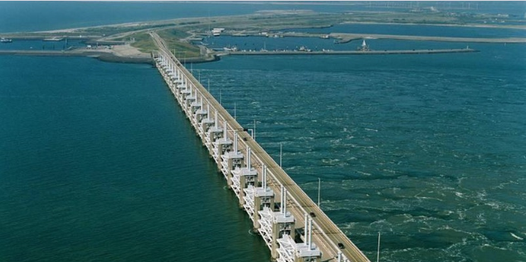
Adapting to sea level rise
The Dutch Delta Works. 50% of the Netherlands lies below sea level
This promenade in the Hafen City district of Hamburg is designed to withstand flooding. An elevated roadway passes behind it.
Other resources on the Dutch approach:
Al Jazeera: Netherlands sets model of flood prevention
PBS News Hour: What the Dutch can teach about warding off water
News First: Going Dutch to conquer rising seas

Slide 19
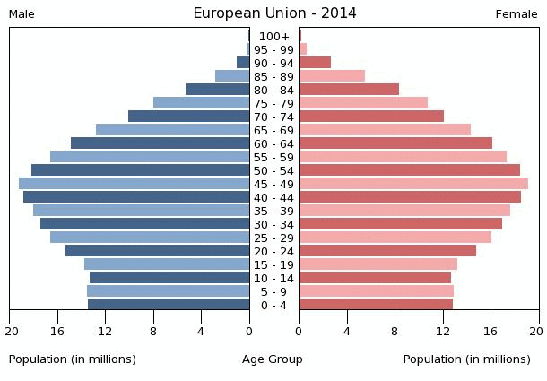
Europe’s changing population
Projections are that Europe
Will need 3 million immigrants a year
To meet labor force demands.
Gastarbeiter:
Italy’s demographic future
Germany’s Turkish Community

Slide 20
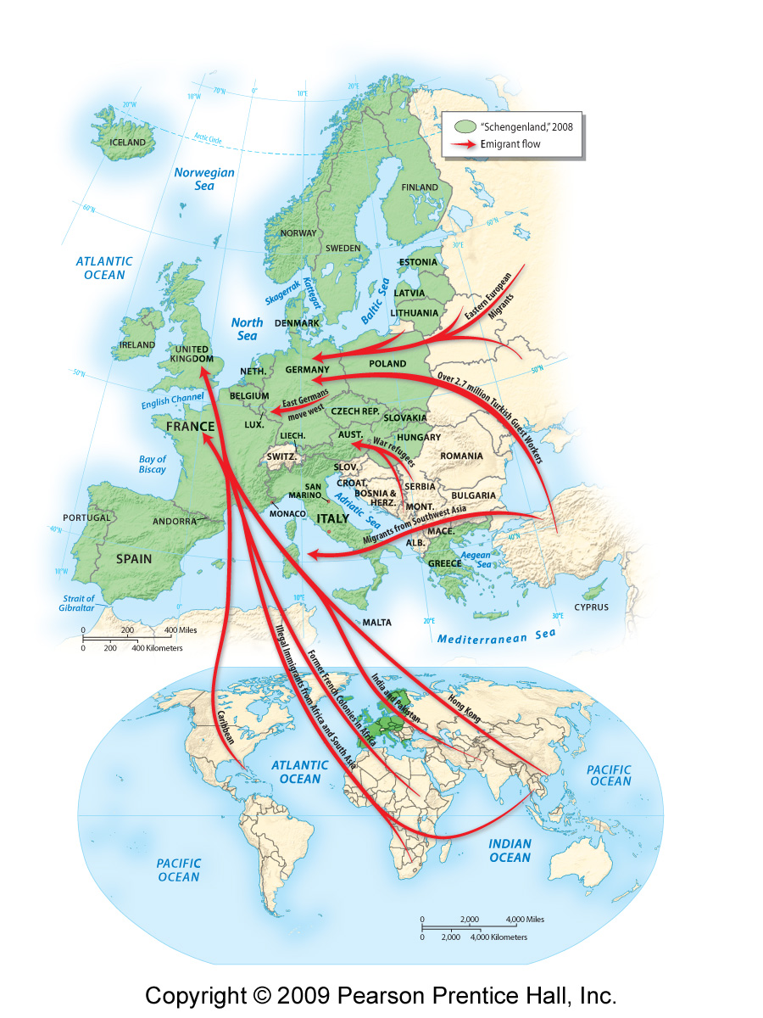
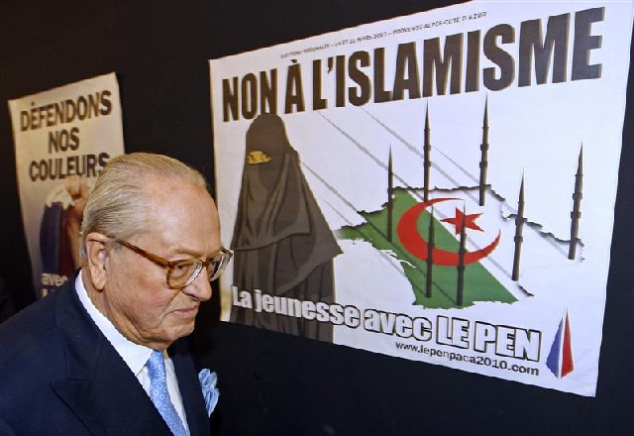
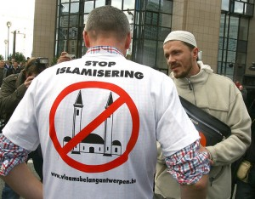
Jean-Marie LePen at a rally on March 7, 2010. The sign reads “No to Islamism.
You’re with LePen”
Vlaams Belang is a Flemish National Political Party advocating the independence of Flanders and strict limits on immigration, requiring immigrants to adopt Flemish culture and language.

Slide 21
Religion in Europe
Christianity
Judaism
Islam

Slide 22
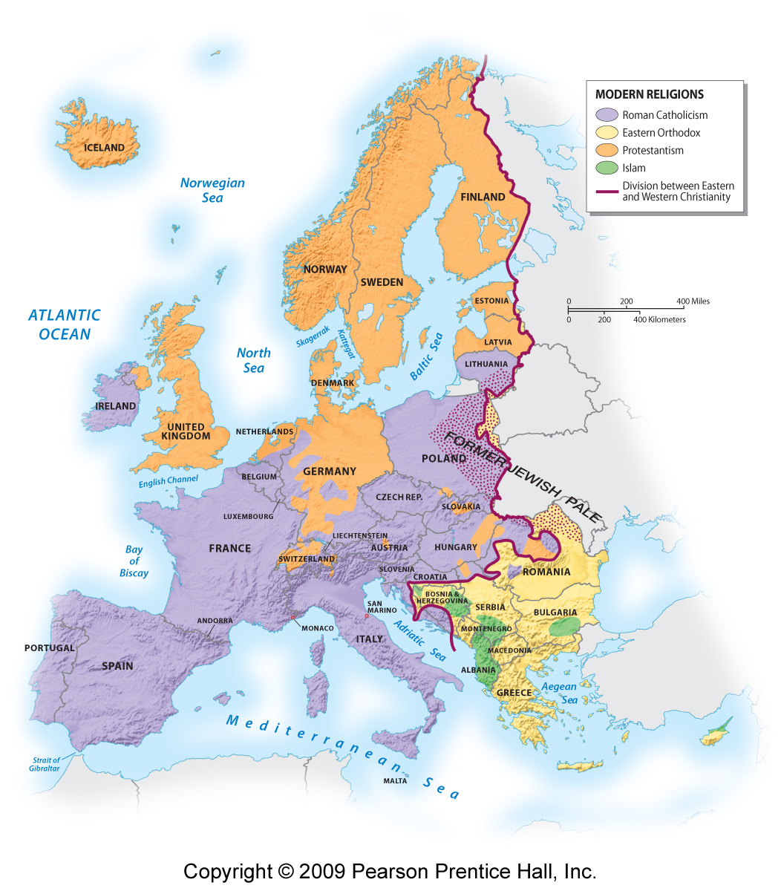
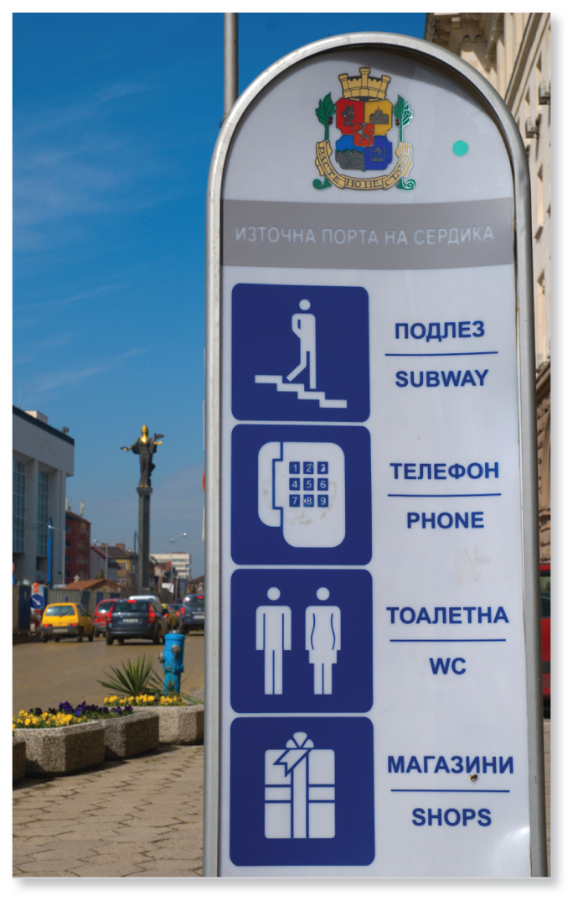
Christianity in Europe
Great Schism 1054
Protestant Reformation 1517
250 million Roman Catholics
Fewer than 100 million Protestants
About 20 million Orthodox

Slide 23
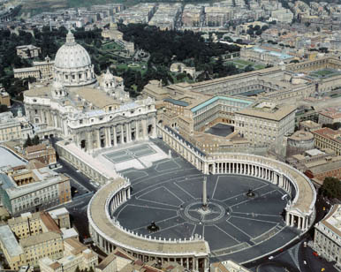
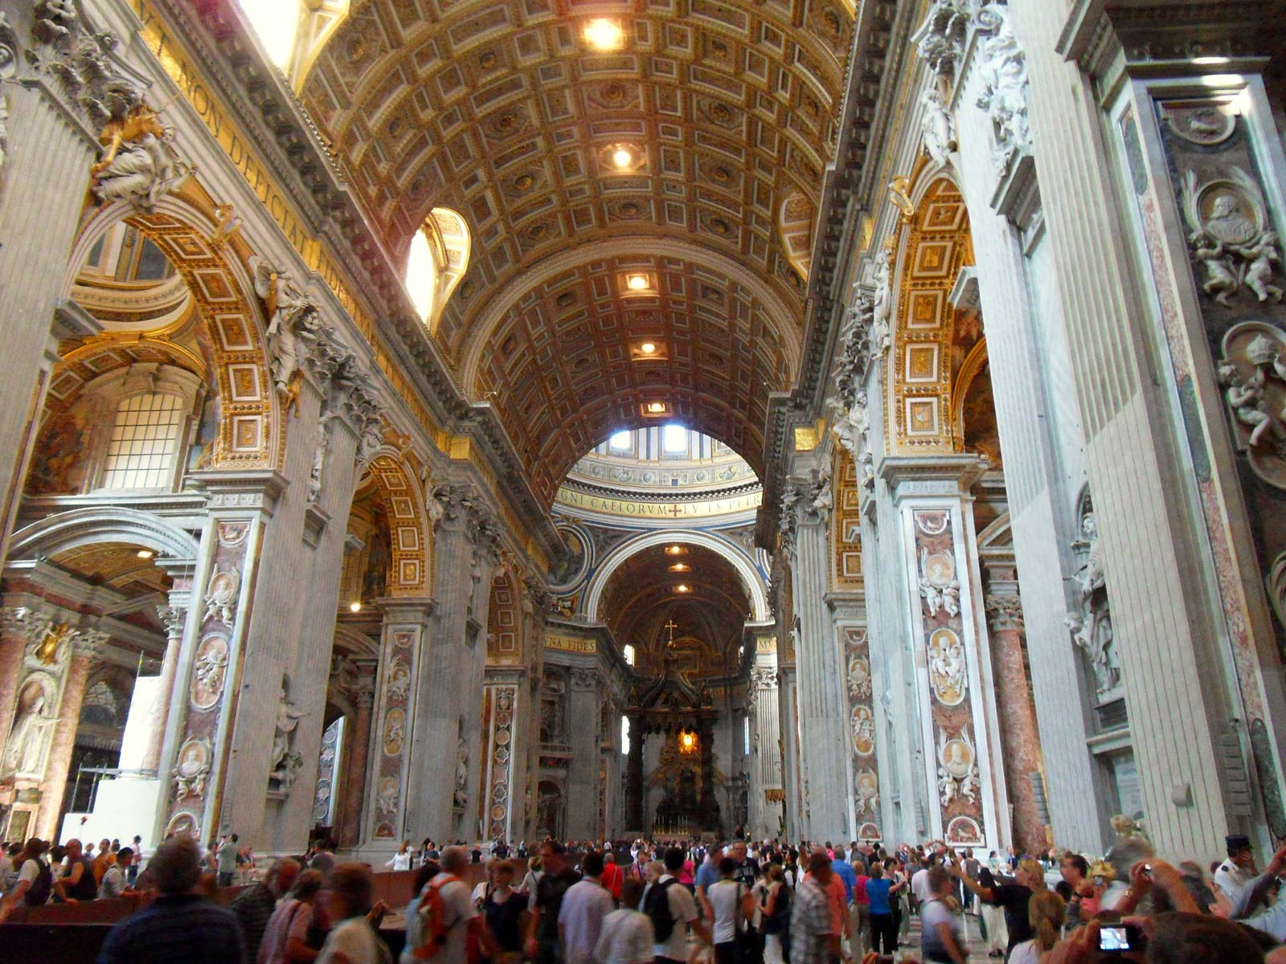
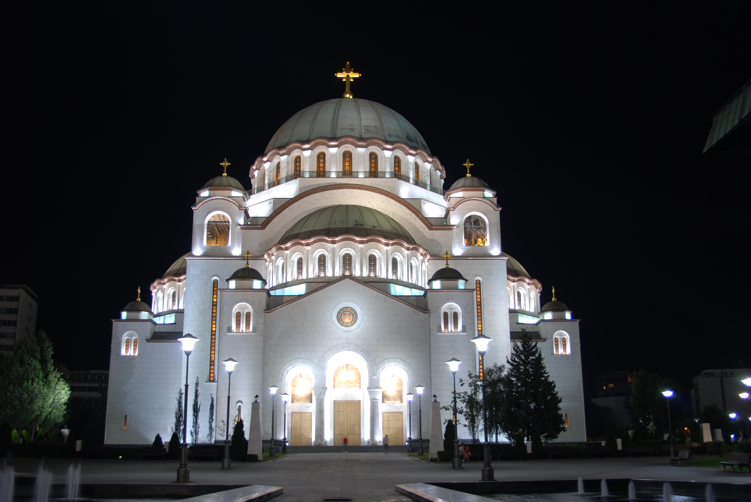
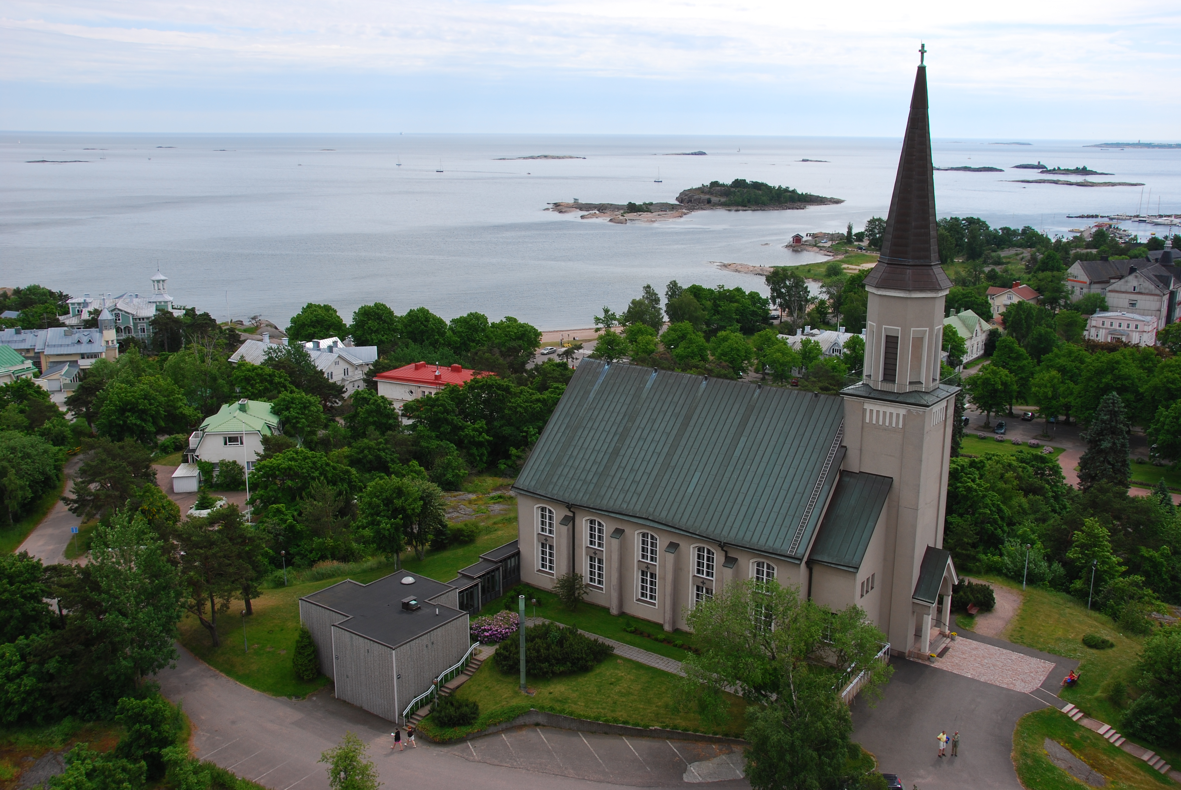
St. Peter’s
Basilica
In Rome.
Sveti Sava
Serbian Orthodox Cathedral
Protestant Church,
Finland

Slide 24
The Troubles
Northern Ireland
1968 Civil Rights March in Londonderry
1972 Bloody Sunday – Battle of Bogside
UVF/UDA (Orange order, Sandy Row, Belfast) vs IRA (Bogside, Derry)
1998 Good Friday Agreement
Brexit?
A political conflict or a religious conflict?
Control of space

Slide 25
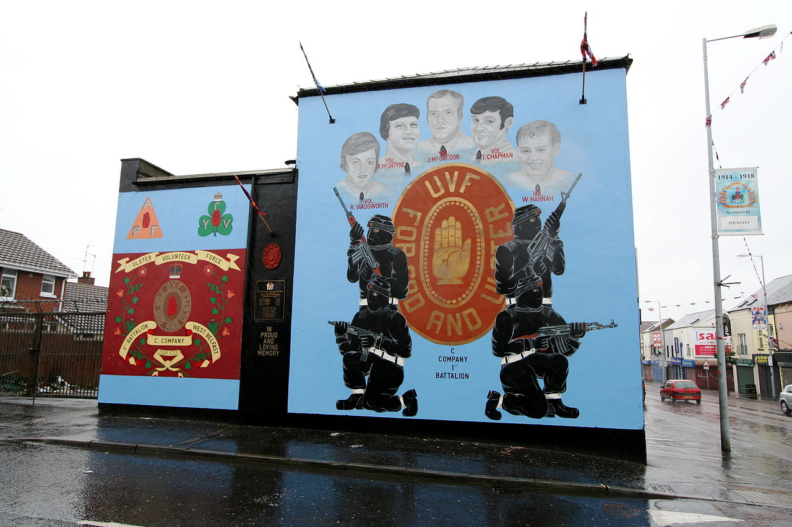
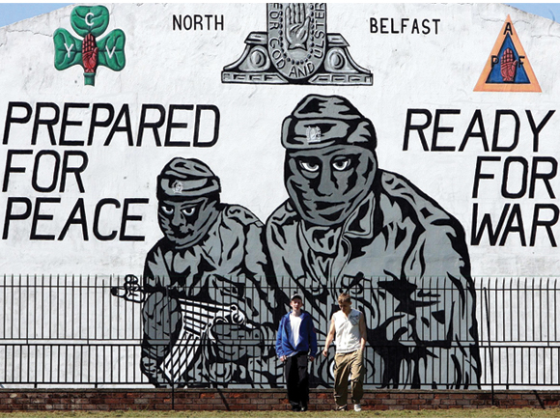
Murals
Murals are used in Northern Ireland to
Assert control over space
Create an historical narrative.

Slide 26
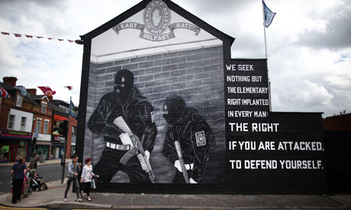

Slide 27
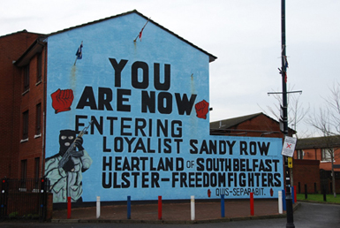
UVF=Ulster Volunteer
Force. Paramilitary group.
Formed in 1966.
Loyalists=Protestants= Ulster Freedom
Fighters.
Murals—advertisement
For civil unrest?

Slide 28
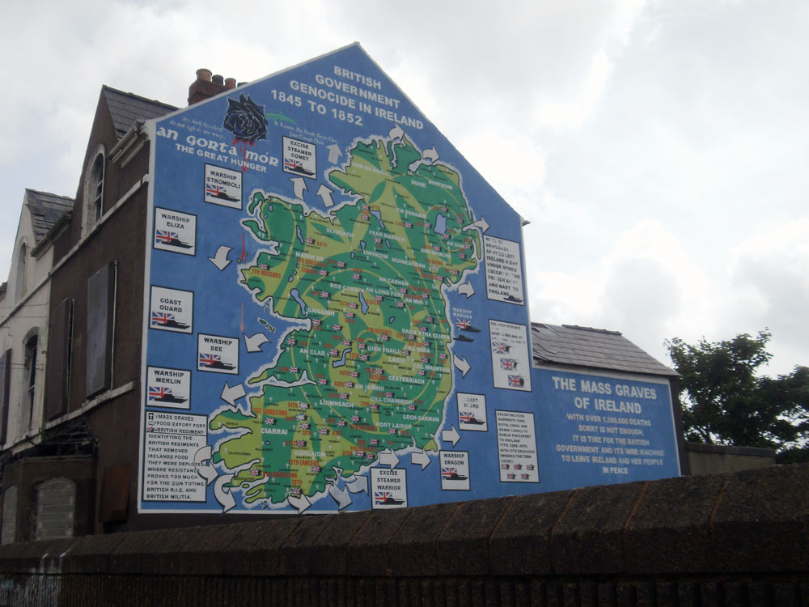
The Catholic,
“Republican”
viewpoint.
A counter-narrative.

Slide 29
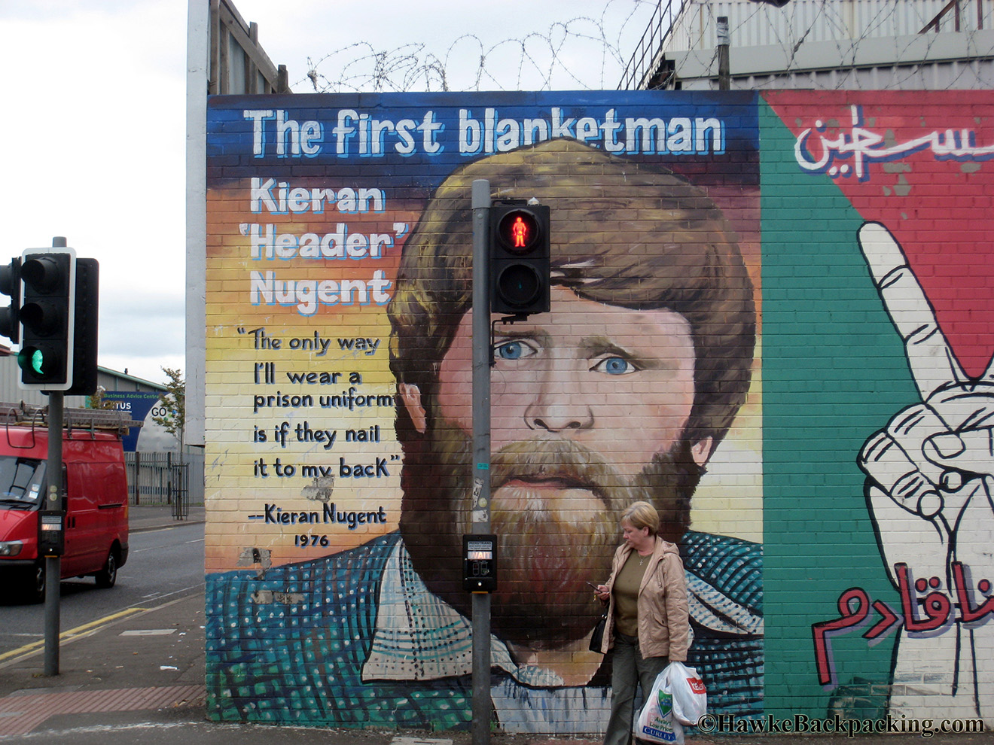

Slide 30
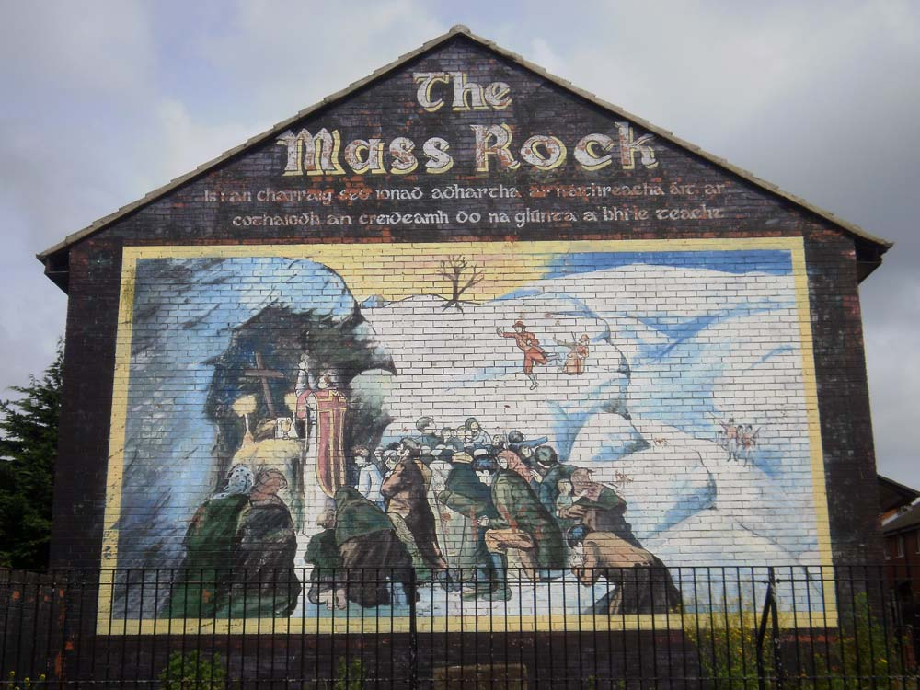
Mural in Irish Republican
neighborhood Ardoyne, Belfast.
One of oldest murals in the area.
Reflects experience of the Irish during British occupation in 18th and 19th Centuries.
The Irish were not allowed to express their Catholic identity by holding mass so they sought out places outside the city to secretively practice their religion.

Slide 31
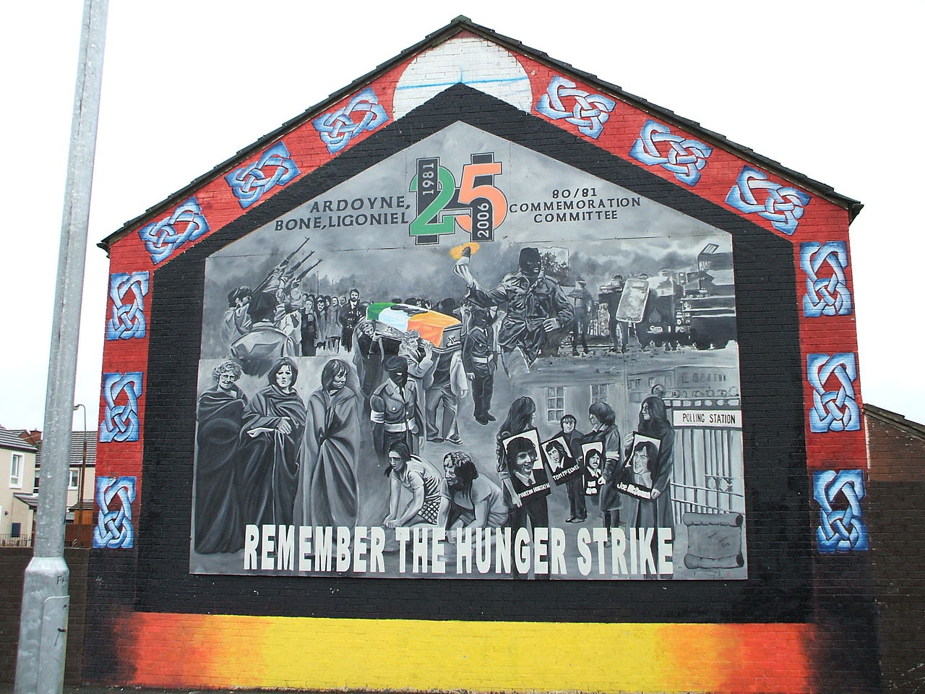
1981 hunger strike. Protest by IRA prisoners in Northern Ireland. 10 prisoners starved themselves to death, including the well known Bobby Sands who was elected to Parliament during the strike.
This was a turning point—radicalized the Irish Nationalists (Republicans).

Slide 32
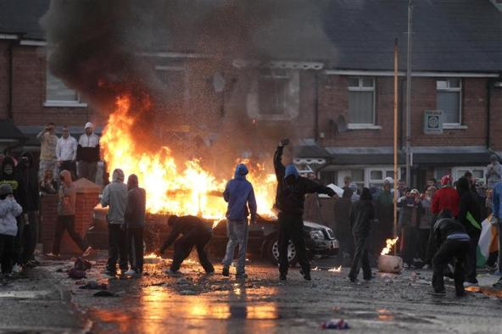
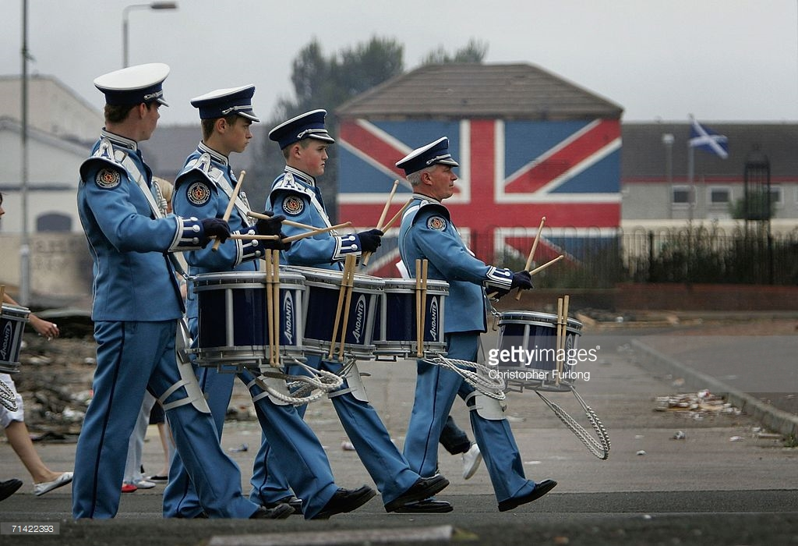
July, 2011, upper left, riots erupt during Parade Season. Police fire plastic bullets and use water canon at Catholic youth.
North Belfast in the 1960s (right)
and current era (above).
July is “Parade Season” for the Unionists.

Slide 33
The “Peace Lines” solution.
Inner Belfast in the 1970s was heavily segregated.
Peace Lines were walls built to keep Protestant neighborhoods separate from Catholic ones.
Some walls are as high as 40’, separate the city house by house. The walls run through parks, housing developments.
Urban “scars” on the landscape.

Slide 34
Judaism in Europe
300 bce, 70 ce
Southern Europe
8th C persecution
The Jewish Pale (18th C-early 20th)
1890: 90% of world’s Jewish population lived in Europe
1939: 60%, 9.5 million
Today: 0.3% of world’s Jewish population live in Europe (2.4 million).

Slide 35
% of Jewish population murdered during the Holocaust (% of pre-war total).

Slide 37
Islam in Europe
Moors: Iberia & Southern Italy 900s-1400s
Ottomans: southeastern Europe 900s – 1900s
Crusades: 1200s-1400s
Post WWII Immigration
Cartoon following the attack at Charlie Hebdo in Jan., 2015.

Slide 39
The European nation-state
1648 Treaty of Westphalia
A fractured political landscape
By early 1800s, more than 39 German states
Post WWI Rise of Nationalism & Fascism
War re-draws the political map again
Cold War
Yet another new map of Europe
Balkan War
New boundaries, new countries

Slide 40
World war I 1914-1919
France, Britain & Russia
Germany, Austro-Hungary, Ottomans
The Black Hand
End of war, boundaries redrawn to reward winners and punish losers
New nation-states created
Czechoslovakia
Yugoslavia
Poland
Estonia
Latvia
Lithuania
Finland
Green indicates new countries, or those who had their borders re-drawn.

Slide 41
World war ii 1939-1945
Motivated by territorial losses in WWI
Irredentism
Greater Germany
Fascism: the nation, the race, natural, organic
Germany invades Poland in 1939
Germany violates nonaggression pact with Soviets in 1941 and invades the Baltics
1945 Soviets reach Berlin

Slide 42
The Cold war 1945-1989
Churchill: “An Iron Curtain”
Nuclear
Divided Europe; buffer zones
Germany reunified in 1990
USSR falls, 1990

Slide 43
Post cold war Europe
Return of nationalism, ethnic cleansing
Balkanization

Slide 44
The Balkan war 1991-1995
100,000 killed
2 million displaced
83% of civilians killed were Muslim

Slide 46
Peace solution: the European union
Reasons for European Unification (EU)
EU in current form began in 1991
15 countries originally, now 28
Desire for rapid economic recovery Post WWII
US desired European markets for their manufactured goods post WWII
US desired strong ally and buffer to USSR
US desired to keep communist influences away in Western Europe
Europe’s desire to keep Germany in check
Europe’s desire to prevent a repeat of the excessive nationalism that fueled WWII
Today desire to maintain a competitive market (that can compete globally with US, Japan, China)
Keeping a stable Europe, esp. along Russian ‘frontier’
Maintaining ‘good’ relations with Russia

