Slide 1
Middle & South America
Chapters 5 & 6

Slide 2
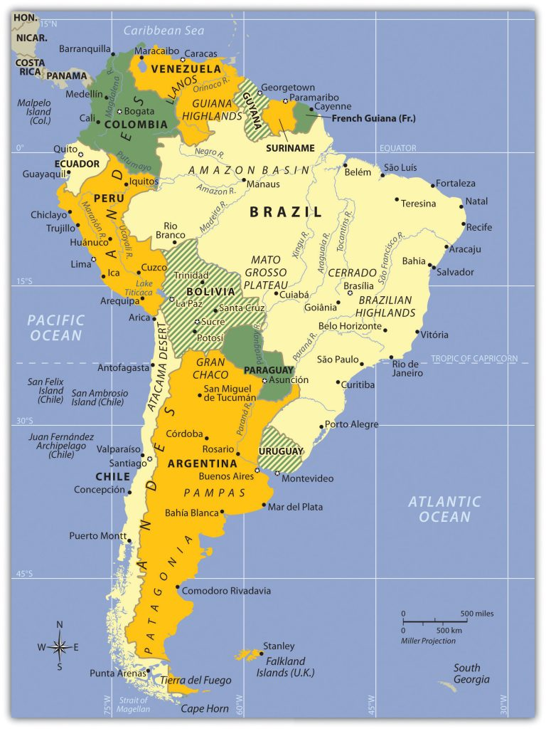
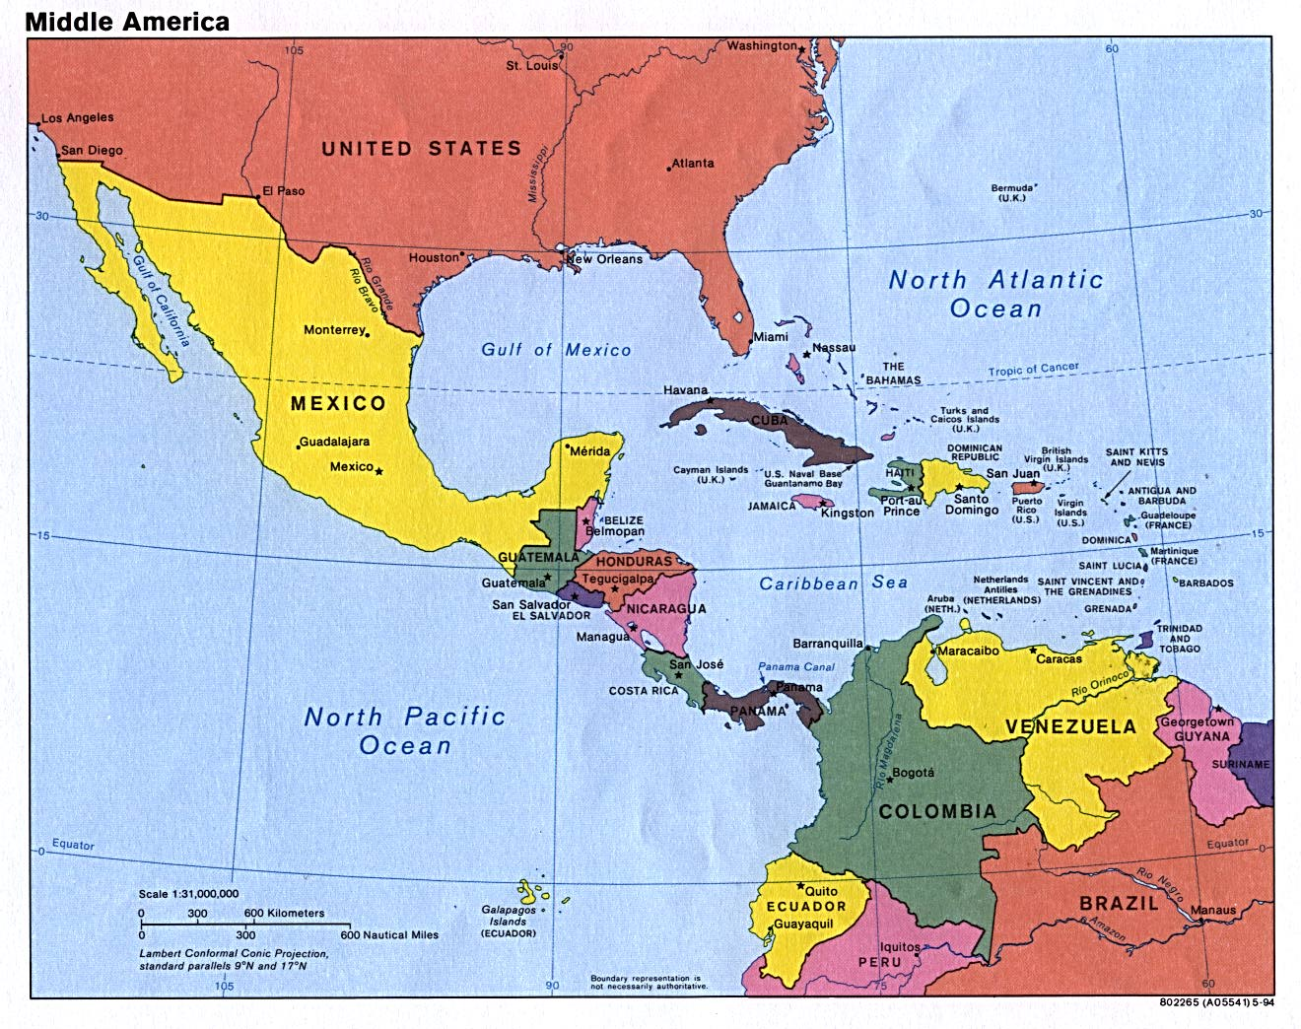

Slide 3
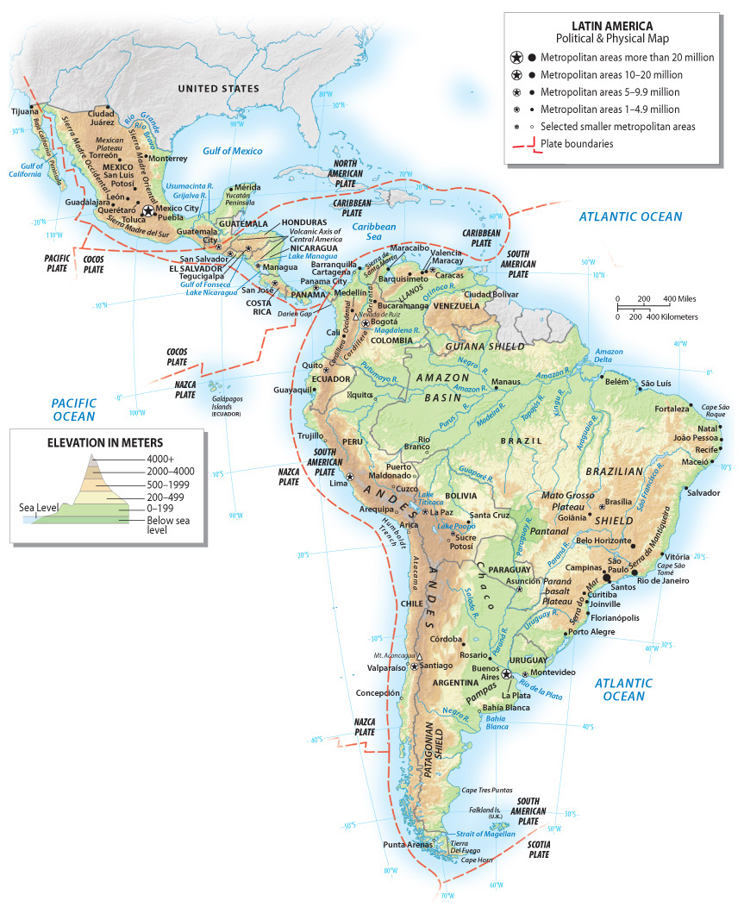
Overview
Fragmented
Physically (Isthmus of Panama)
Historically
Cultural similarities
Language
Religion
Historical similarities
Colonialism
Similar social patterns
Urbanized
Ethnic and “racial” diversity
Biodiversity & Natural Resources
Tropical rainforest
Temperate forests
Altitudinal zonation
Similar economic patterns
Early independence
Wealth and poverty extremes

Slide 4
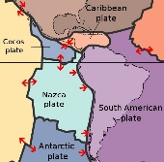
Tectonics & Hazards
Earthquakes, Volcanoes
Haiti, 2010, 7.0 killed 100,000
Hurricanes
El Nino

Slide 5
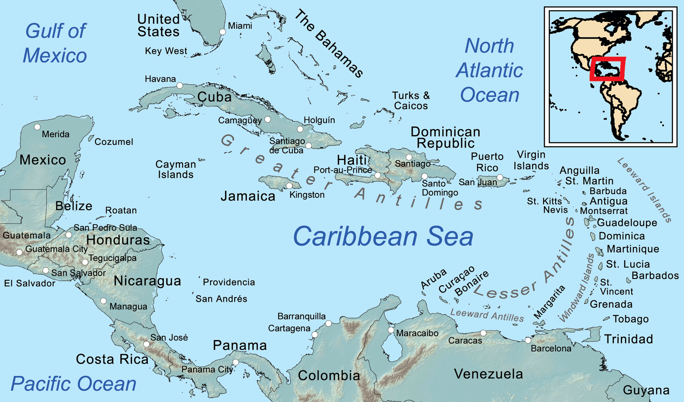
Caribbean Archipelago
VIAs & Coral Reefs
Greater Antilles
Lesser Antilles
Hurricanes
El Nino

Slide 6
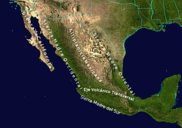
Mountain Ranges
Sierra Madre Occidental
Extension of the Sierra Nevada
Sierra Madre Oriental
Extension of the Rocky Mountains
Cordillera Neovolcanica
East to west
As high as 16,000’
Popocatepetl (“smoking warrior”)
Ixtaccihuatal (“white lady”)

Slide 7
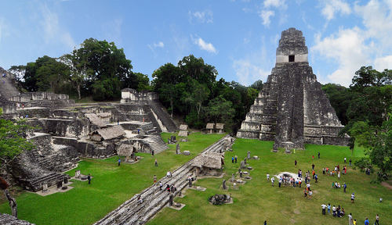
Pre-Columbian Middle America
Mayan 300 – 900 CE (prime years)
Yucantan Peninsula & South-central Mexico—Mesoamerica
Extended to Guatemala, Honduras
City-states; pyramids, Chichen-Itza, over 1 million people
Math, astronomy, engineering, architecture, calendar…
Where did they go? Why did they disappear?

Slide 8
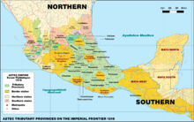
Aztec – dominant by 1300 (14th Century)
Took over and subjugated other groups
City of Tenochtitlan, over 100,000 people
Hernan Cortes, 1519, conquered by 1521
Demographic catastrophe; from 15-25 million to 2.5 million

Slide 9
Middle America: Colonialism
Cultural change
Social change
Biome change
Land use change

Slide 10
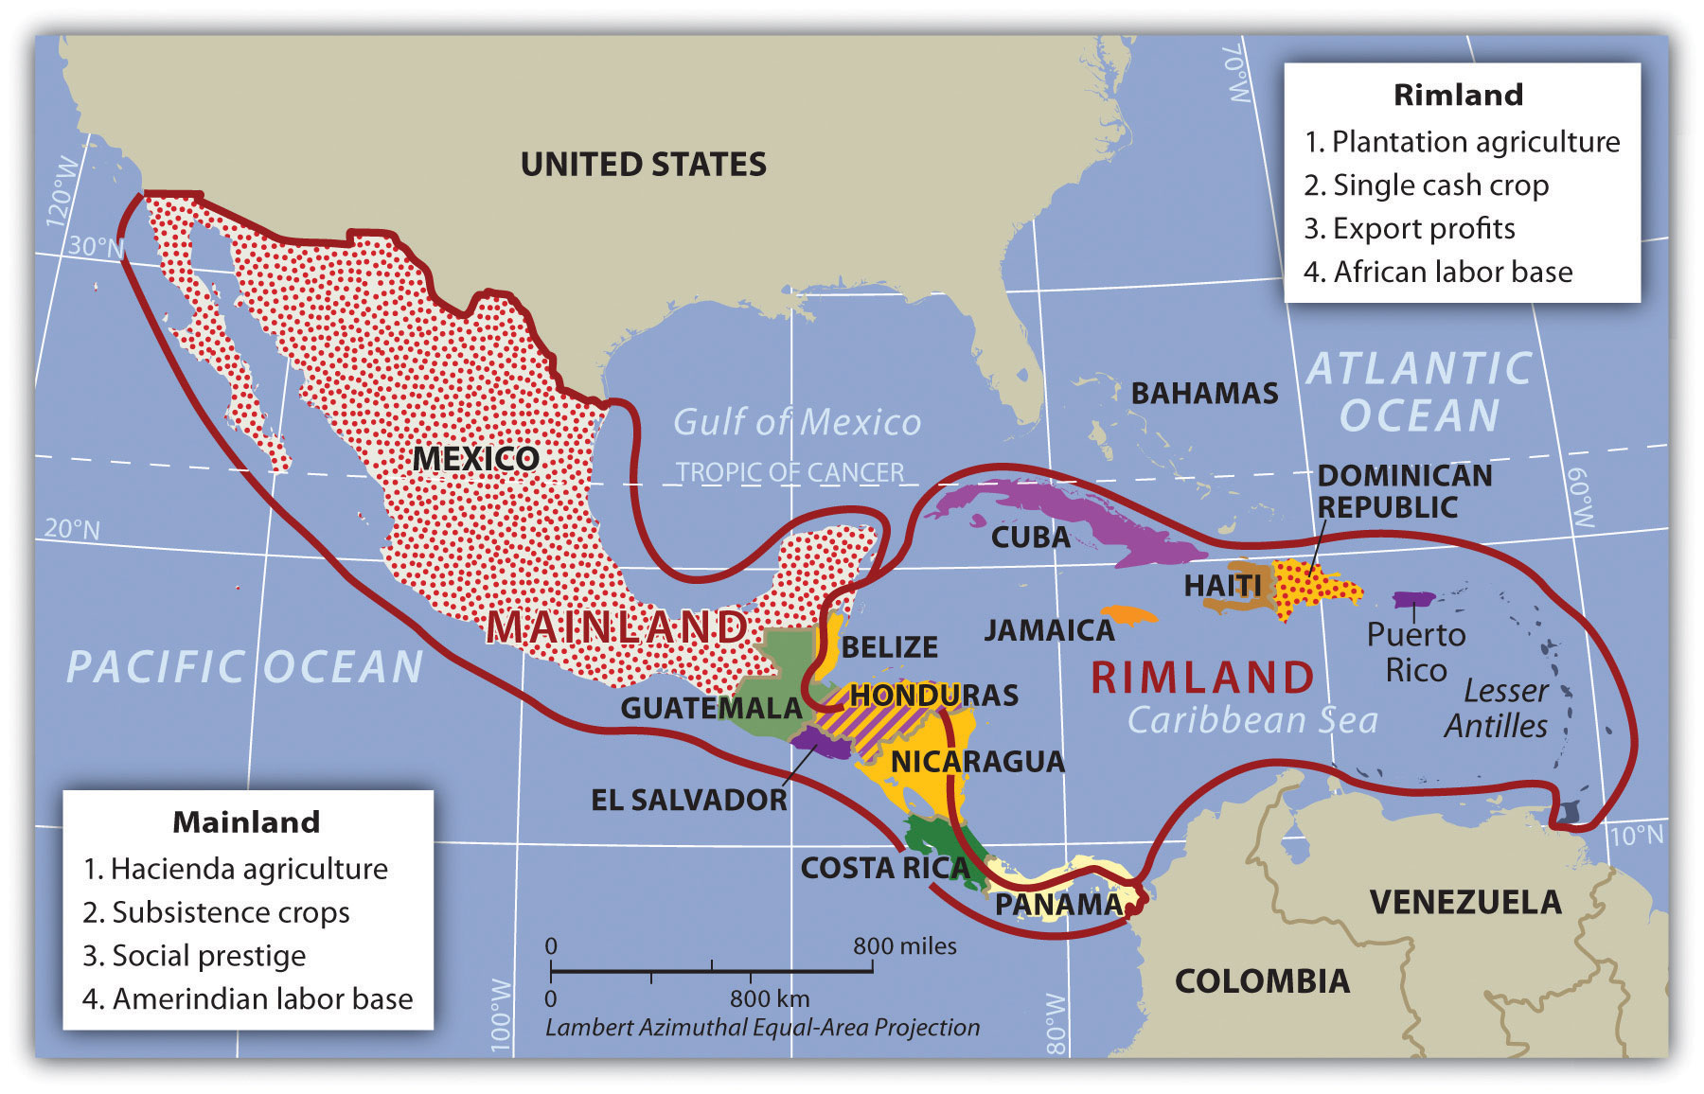
Land-Use Change

Slide 11
Land-use Change in the Rimland
Colonialism thrived here—very accessible
Plantation Agriculture
Locals used as labor
Mono-cropping, non-native crops
Import: humans, technology, raw materials
Export: cash crops
Change in ethnic composition of population
By 1800s population primarily of African descent
Change in food production
Local populations no longer subsistence farming
Farming on marginal lands
Land alienation
Wealthy Europeans owned plantations, may not have even lived there

Slide 12
Land-use Change in the Mainland
Hacienda System
Land taken because seen as prestigious
Allowed a certain lifestyle
Not as driven by desire for export profits
Locals worked for (meager) wages, continued subsistence farming
Large land claims—1,00s even millions of acres
AmerIndians experience land alienation
Land ownership remains major conflict in Latin America
End of slavery, series of revolutions, led to land reform
Ejido system

Slide 13
Social and Cultural Change
Language
Religion
Ethnicity
Caribbean goes from Amerindian to Afro-Caribbean
Mainland experiences more mixing, rise of mestizo

Slide 14
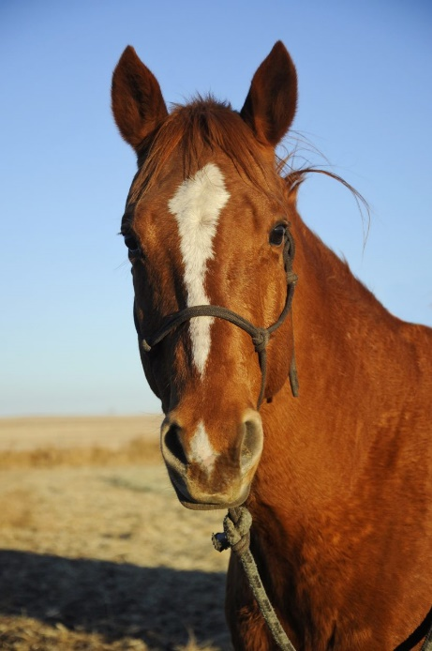
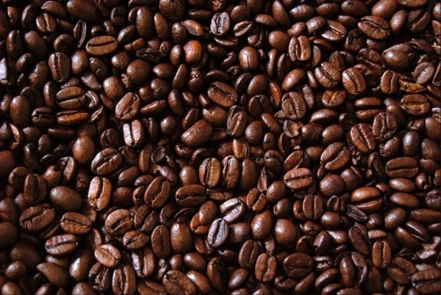
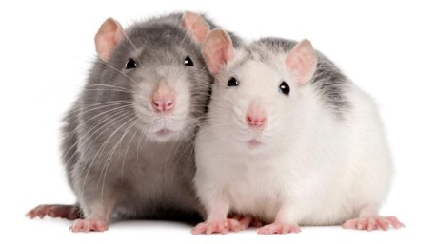
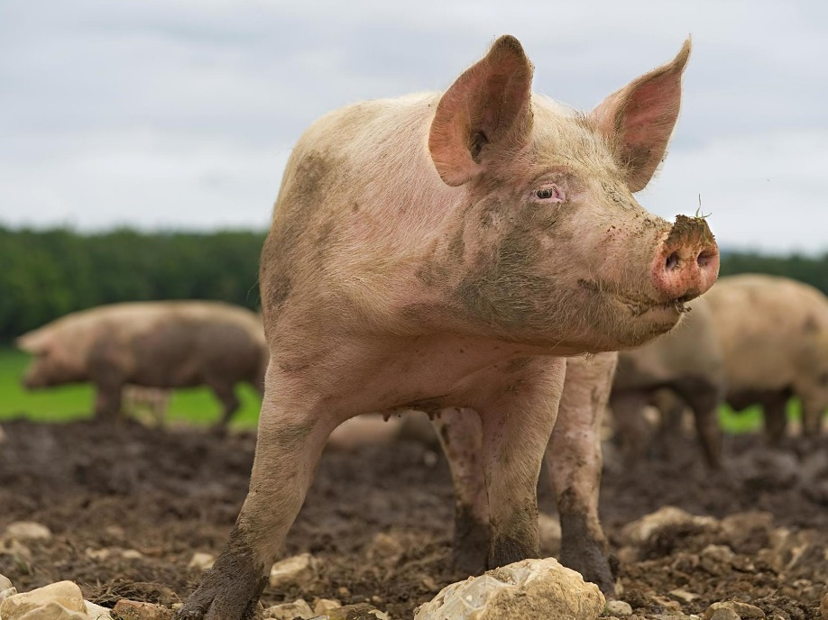
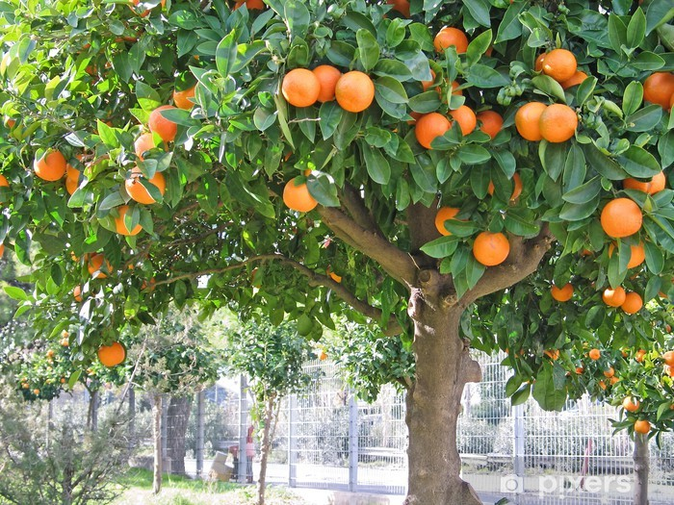
Biome Change
Columbian Exchange—Alfred Crosby
Horses
Donkeys
Sheep
Chickens
Cattle
Coffee
Wheat
Barley
Sugarcane
Rice
Bananas
Citrus
Building methods,
Agricultural practices
Disease…

Slide 15
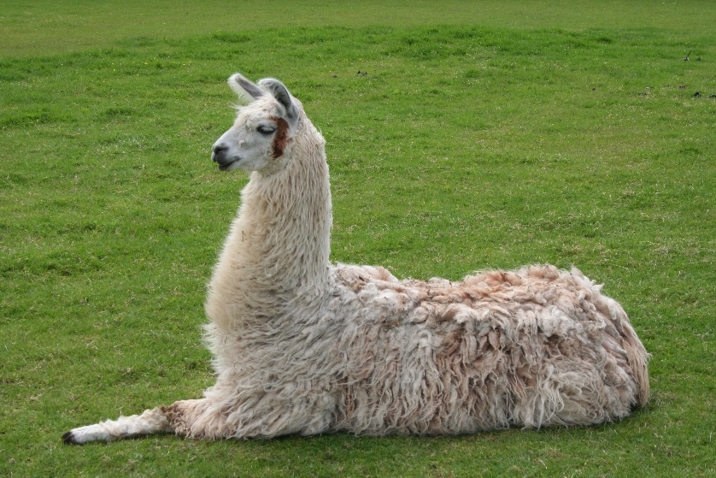
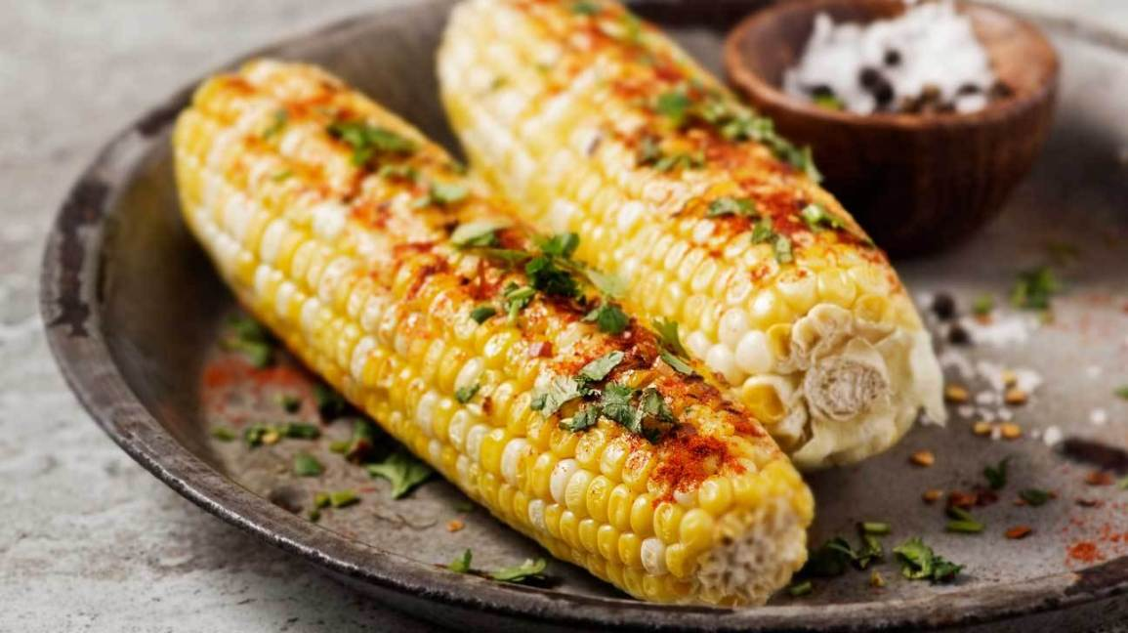
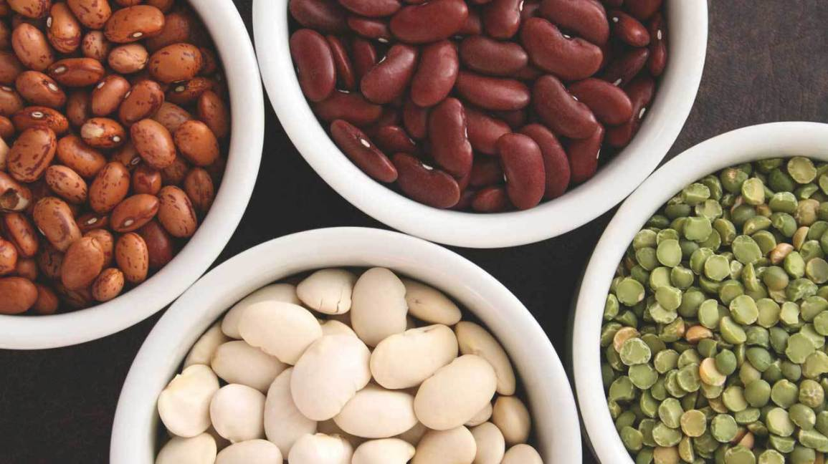
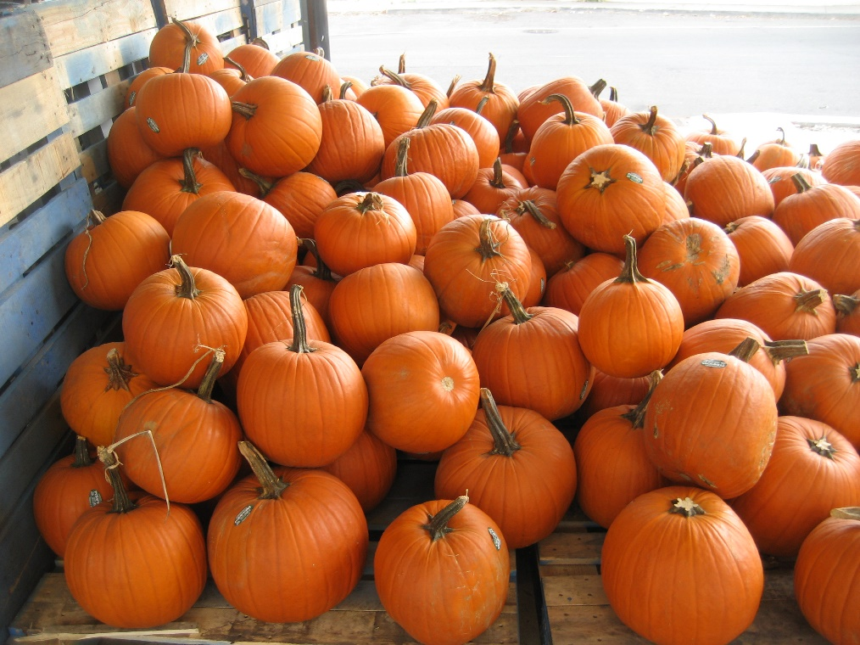
From Americas
Potato
Tobacco
Squash
Beans
Chili peppers
Corn

Slide 16
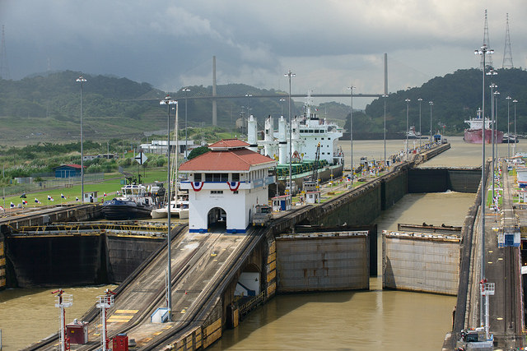
The Panama Canal
France, 1881
US, 1914
Imported workforce from Caribbean
Marvel of engineering, takes 8-10 hours
15,000 ships/year
Politics of the canal
President Carter
President Regan
Manuel Noriega

Slide 17
South America
Amazon River
Andes Mountains
Islands
Resource Rich

Slide 18
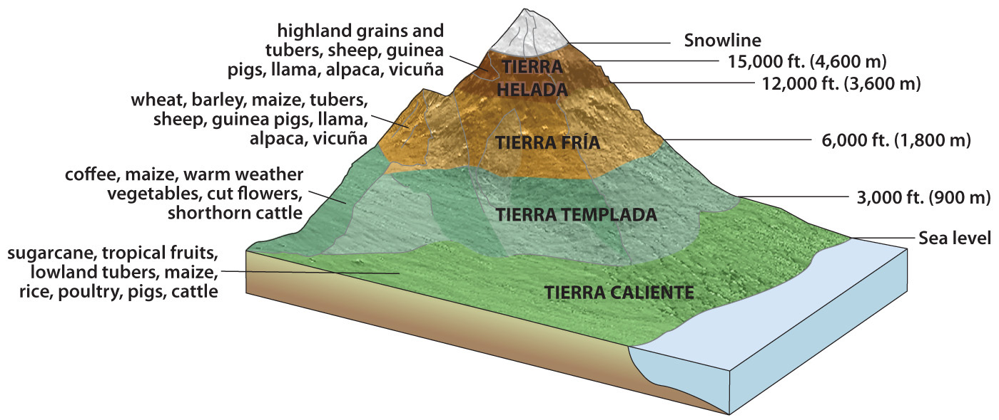
Altitudinal Zonation
Alexander von Humboldt
ELR 3.5 F/ 1000 ft
Diversity in food production
Altiplano, grazing
potatoes, quinoa

Slide 19
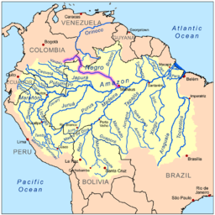
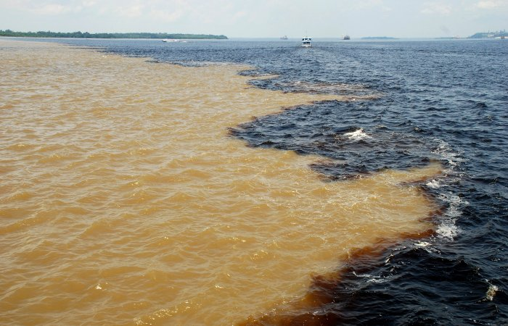
Amazon
Largest by volume
1/5 of all world’s river water
Fed by glacial melt
Drainage basin is 40% of SA
No bridges, 100 miles wide
Rio Negro, Madeiro, Xingu

Slide 20
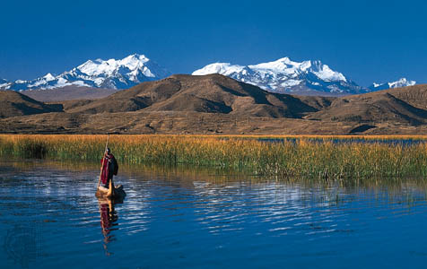
Altiplano & Lake Titicaca
High elevation valleys
Human settlement/agric.
Lake Titicaca, 120 mi long, 50 mi wide
12,000’
1000s of years of human settlement
Some sites date to 1500 bce
Highest elevation navigable lake in world

Slide 21
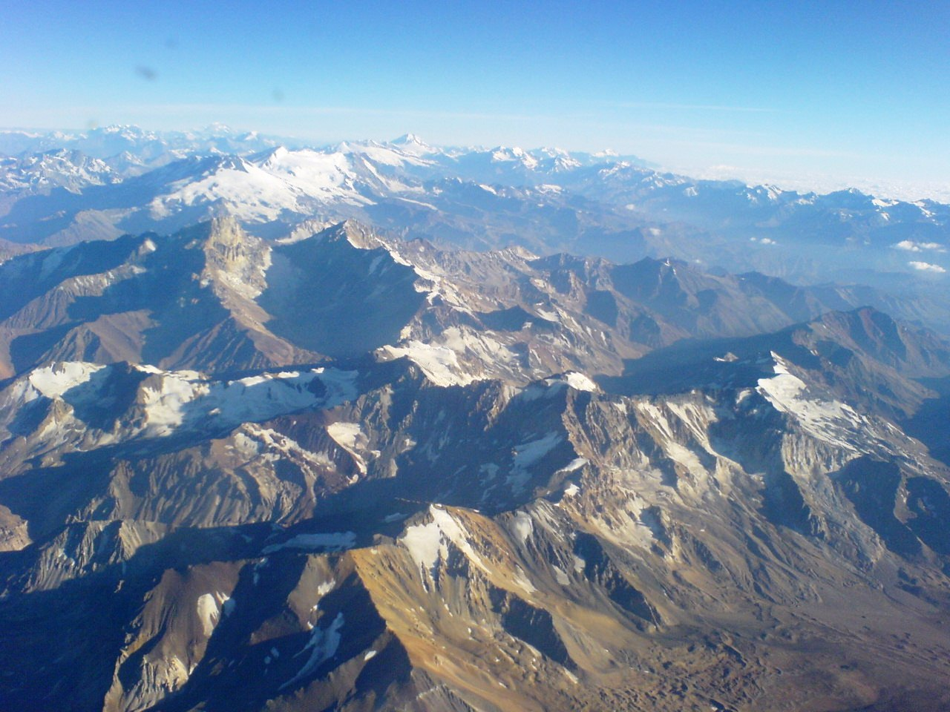
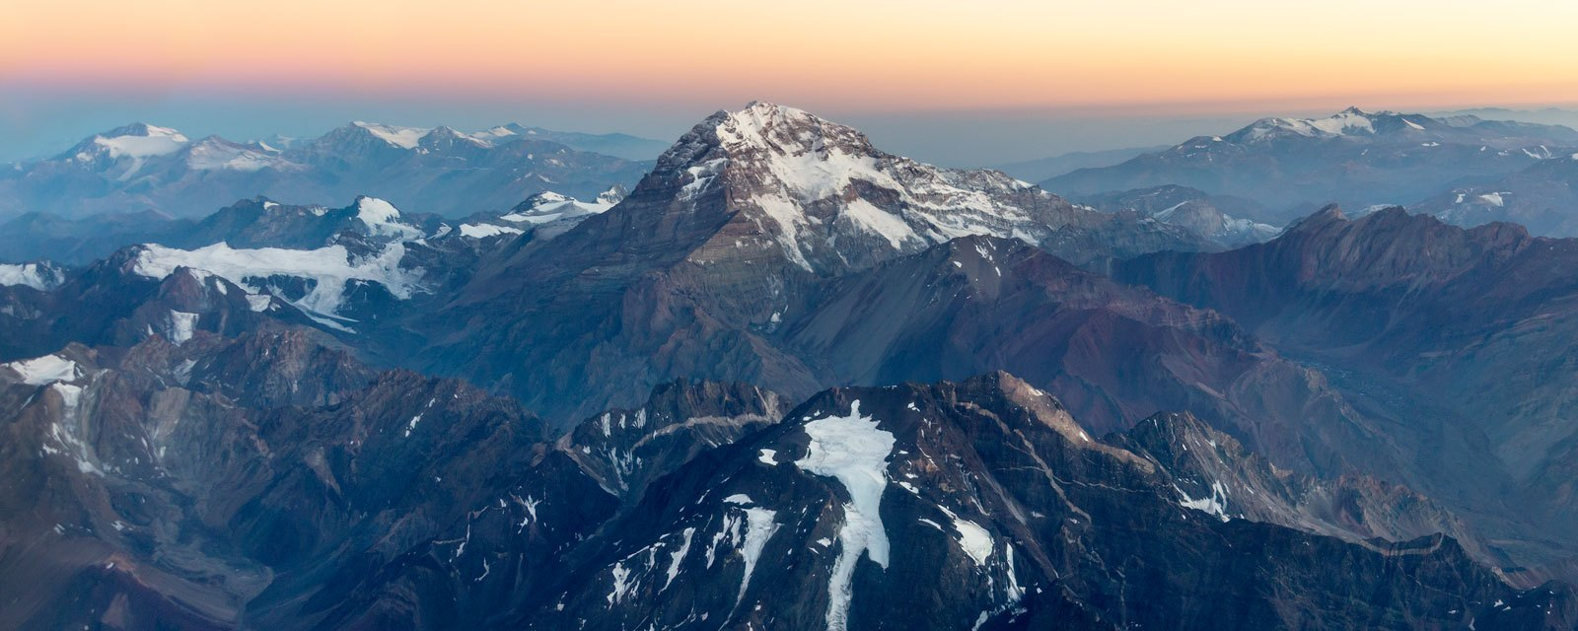
Andes
Protected the Inca Empire
5000 miles long
Longest mountain range in world
Volcanic
30 peaks over 20,000’
Mineral wealth, mining
Mt Aconcagua 22,000+’

Slide 22
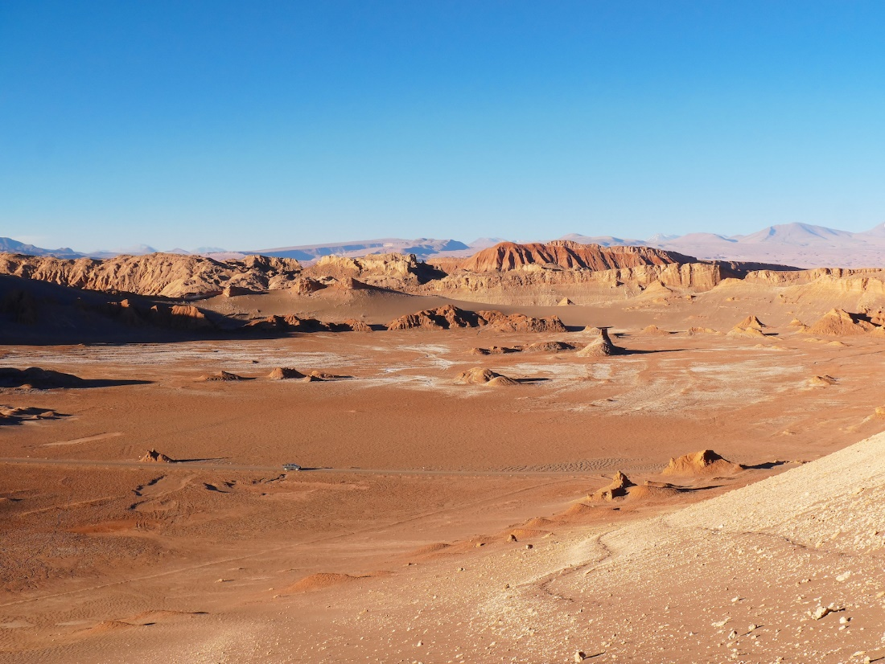
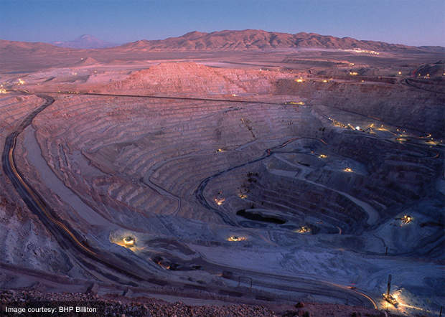
Atacama Desert
Some parts have never received rainfall
In rainshadow of Andes
Copper mining

Slide 23
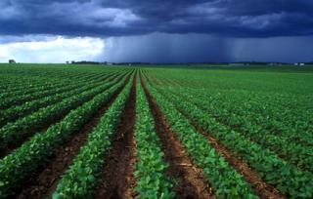
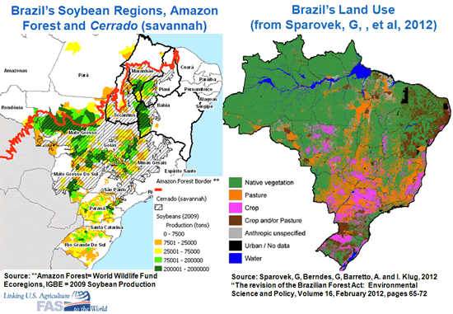
Plateaus of South America
Mato Grosso
Central Brazil
Soybeans
Brazilian Highlands
Coffee
Pampas
Eastern Argentina & Uruguay
Ranching
Patagonia
Grasslands, Arid
Cattle ranching

Slide 24
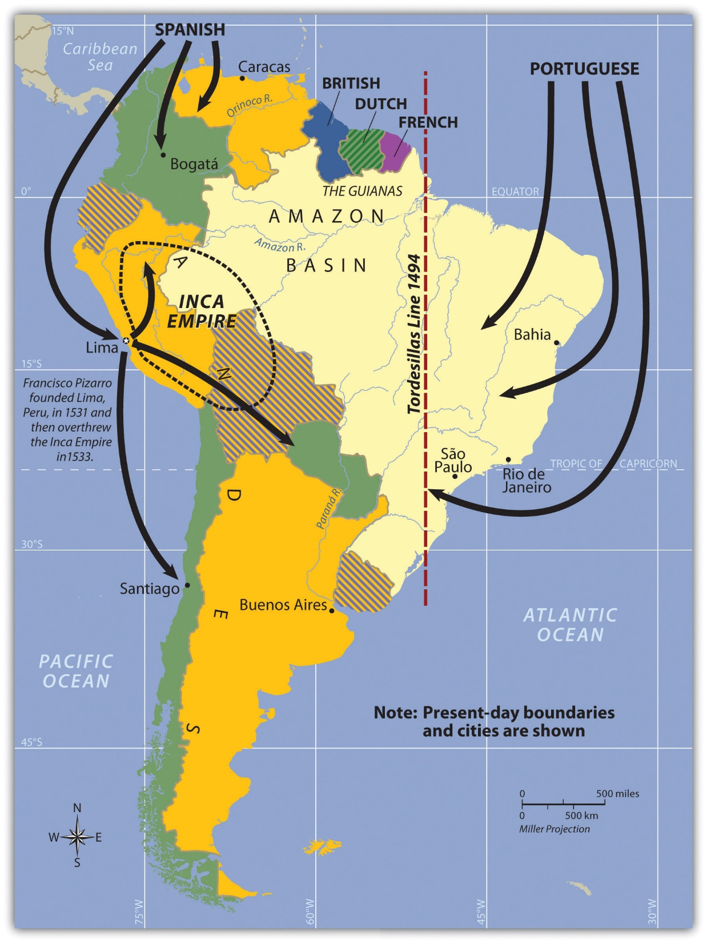
Colonialism in South America
Francisco Pizarro 1531 founded Lima
Defeated Inca Empire (1200-1535)
Mineral and metal wealth—gold, silver
Mixing; Mestizo or European ruling elite
Portugal—east coast
1494 Tordesillas Line
In Brazil—plantation system, African slaves
Independence by 1820s

Slide 25
Dams
Smaller carbon footprint
Less reliance on foreign energy
Local rights vs “Progress”
Whose environment? Whose resources?

Slide 26
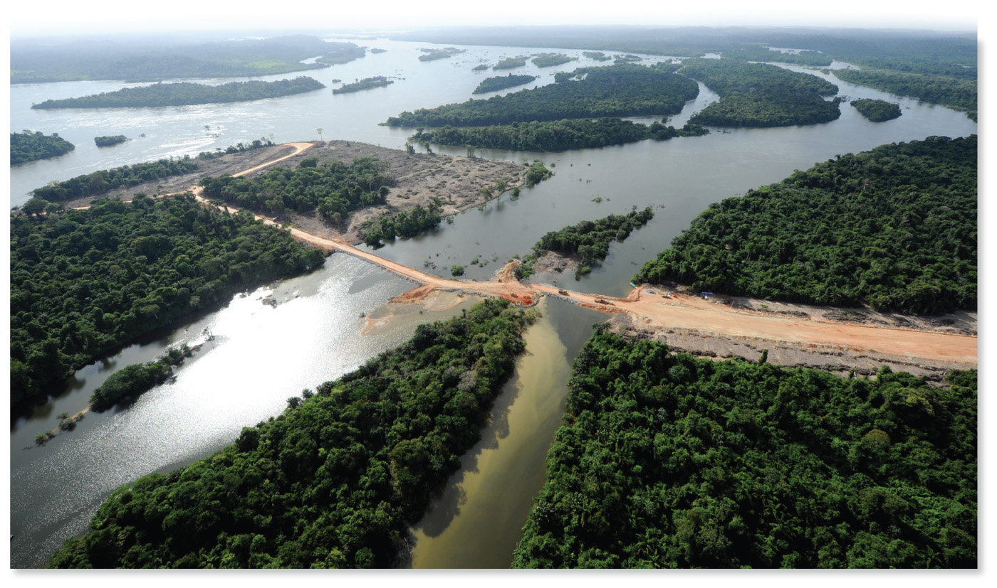
Belo Monte Dam
Xingu River
Will be 4th largest
Proposed in 1975 (military dictatorship)
Shelved until 2010
Led to the first gathering of indigenous peoples in Brazil: The Altamira Gathering in 1989
Kayapo, Out of the Forest
There are more than 400 dams on tributaries of the Amazon.

Slide 27
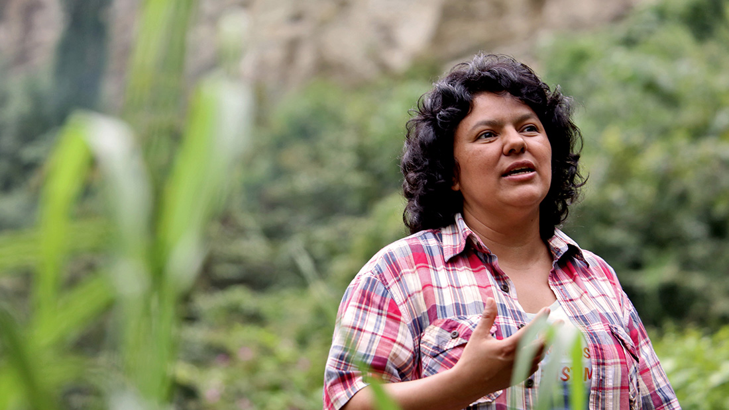
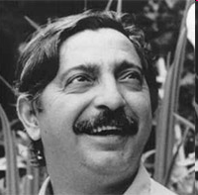
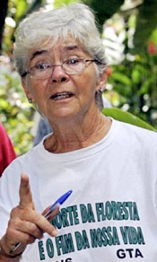
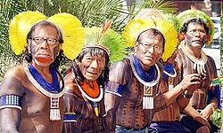
Local Say in Resources
Sister Dorothy Stang, murdered in 2005, Brazil
Berta Caceres, murdered in March
2016, Honduras
Chico Mendes
Murdered in 1988, Brazil.
The Kayapo, Altamira Gathering, 1989

Slide 28
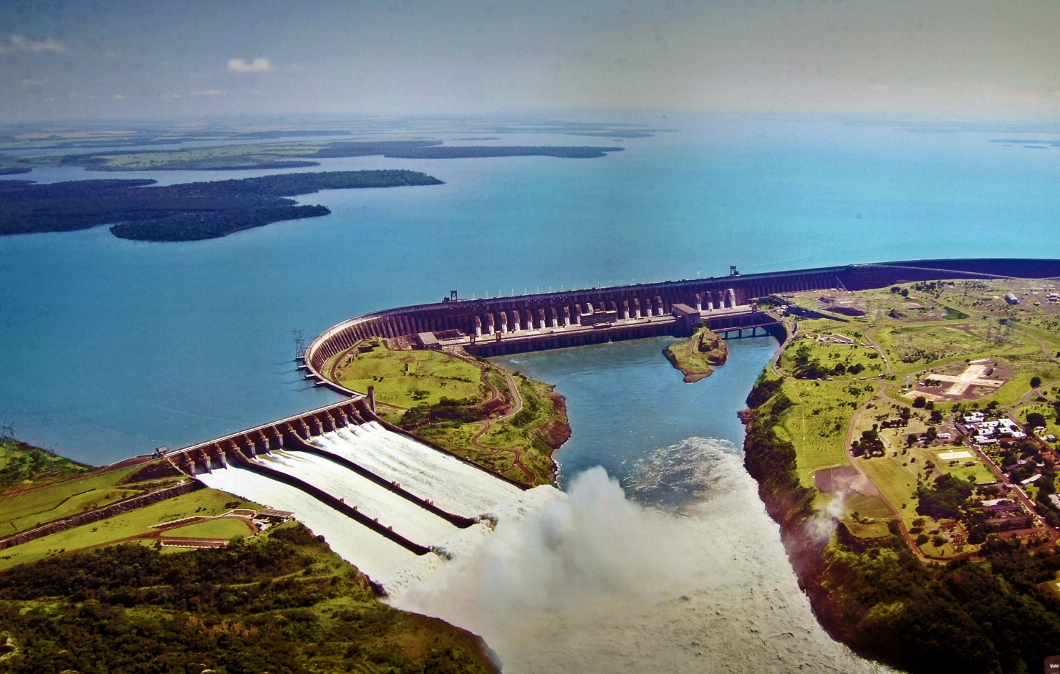
Itaipu Dam
Borders Paraguay
Plata Basin, Parana River
Hydroelectricity
Generates electricity for all of Paraguay and much of southern Brazil
One of the most productive areas of Brazil
Soybeans
Coffee
Oranges

Slide 29
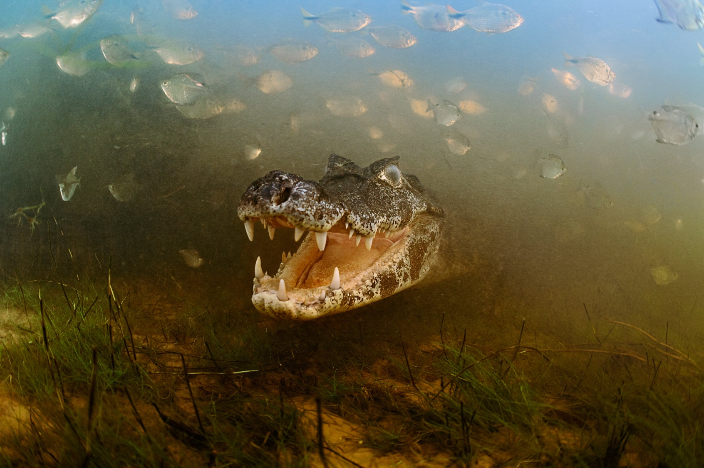
The Pantanal
Vast interior wetland
Biodiverse

Slide 30
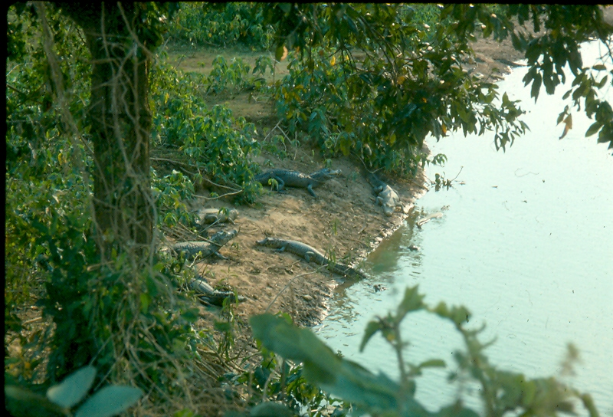

Slide 31
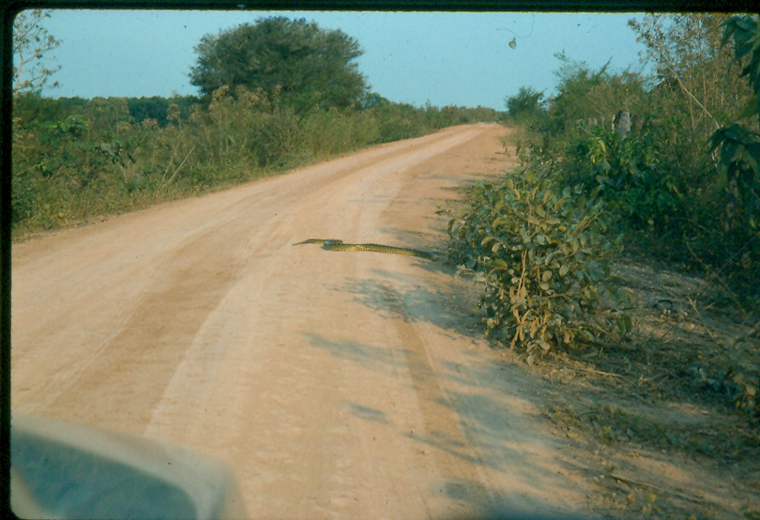

Slide 32
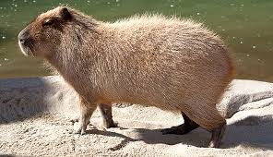
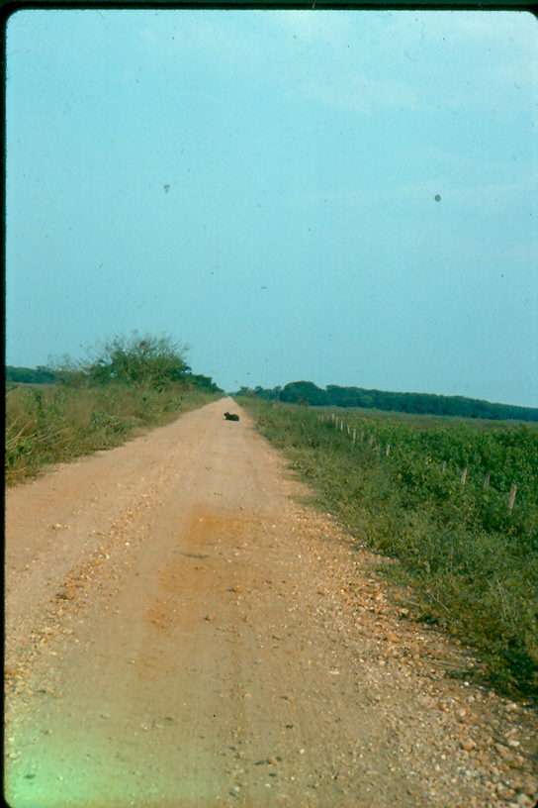
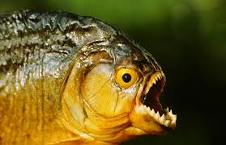

Slide 33
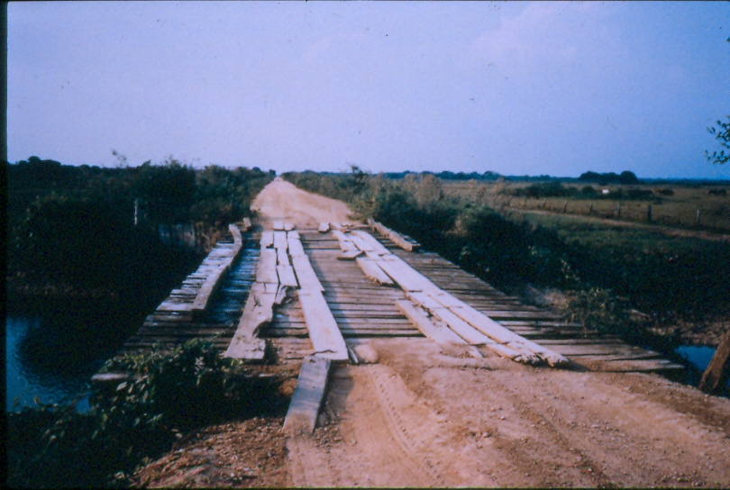

Slide 34
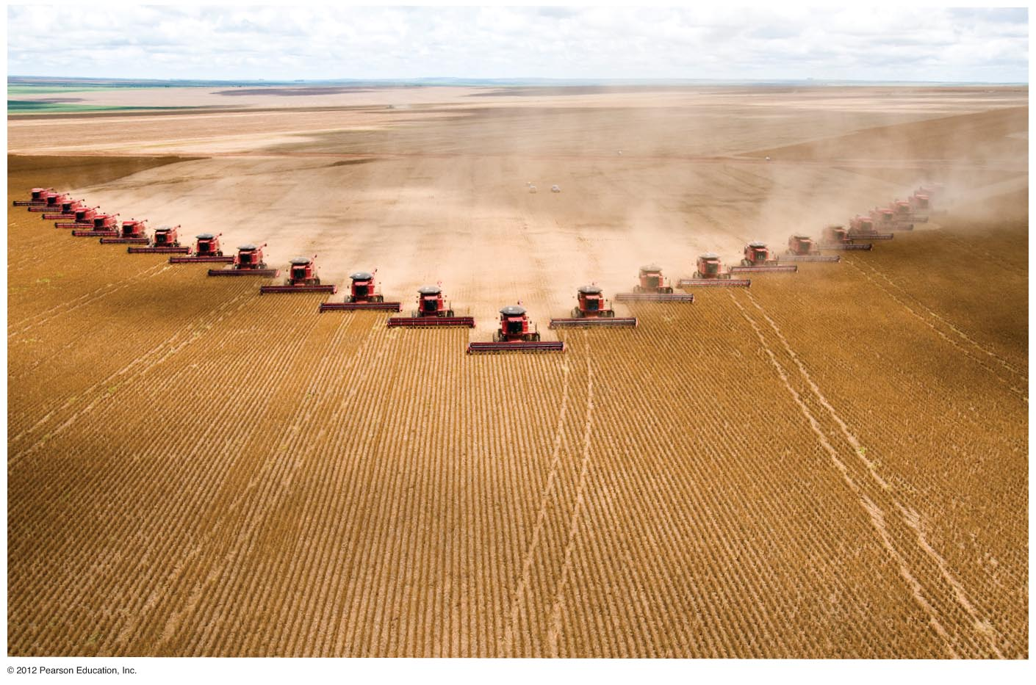
Soy production in Brazil. Fartura Farm in the state of Mato Grosso, Brazil,
embodies the large-scale industrial agriculture that has transformed much
of South America into one of the world’s largest producers and exporters of
soy products.

Slide 35
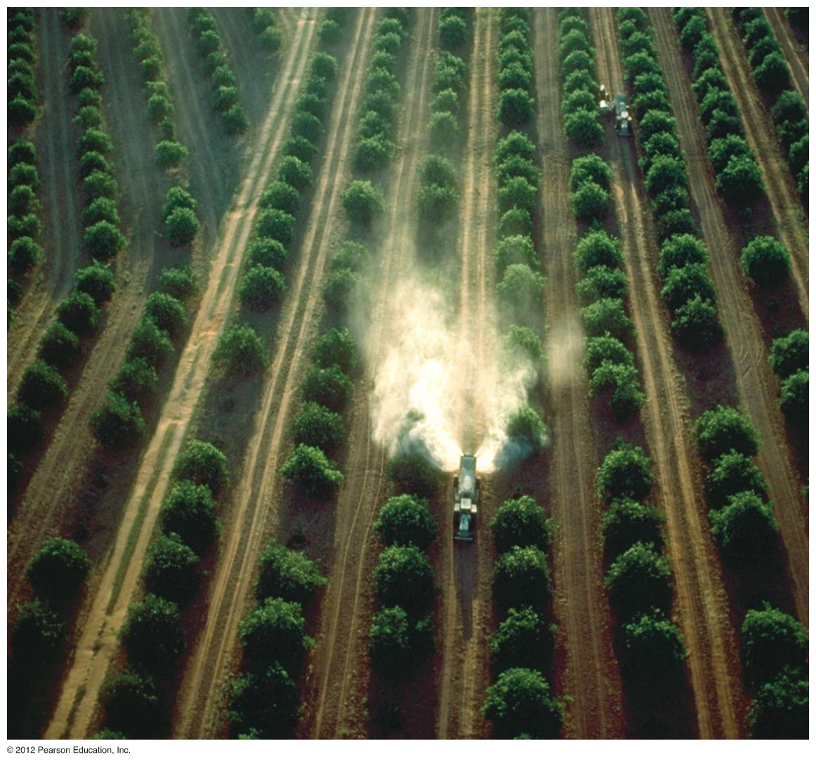
Orange production in Brazil. Most is destined for concentrate and exported.

Slide 36
More resources on dams in the Amazon basin:
YaleEnvironment360: How a Dam Building Boom is Transforming the Amazon
National Geographic: Amazon Dams Keep the Lights On But Could Hurt Fish, Forests
Popular Science: Dams on the Amazon River could have widespread, devastating impacts—and we keep building more of them.

Slide 37
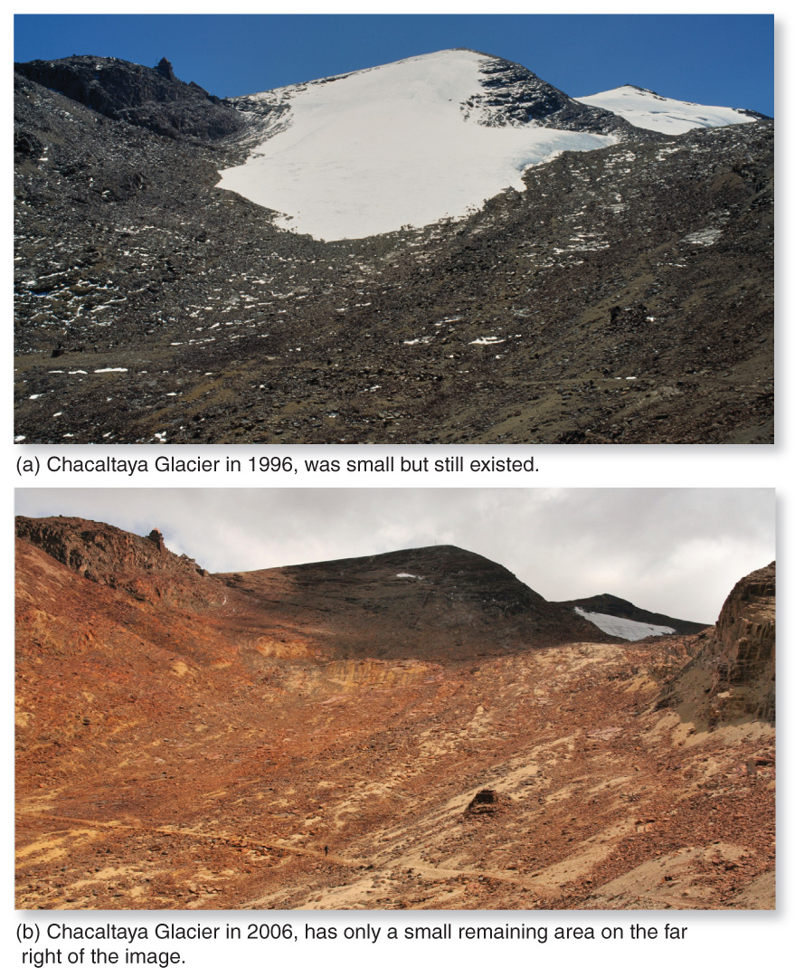
Global Warming Concerns
Relatively low carbon footprint; only 8% of global GHG only 6% of the world’s pop
Impacts --Ag: highland coffee production, --Temps may increase 1-3C in highlands. --expanded zone for tropical diseases --melting glaciers, Chacaltaya Glacier, Bolivia, has lost 80% of its volume in last 20 yrs.

Slide 38
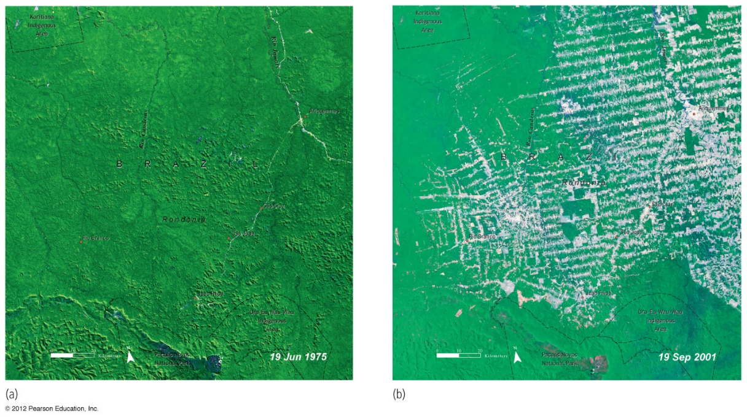
Deforestation
Brazil’s tropical rainforest—a critical resource
Last 40 years, 20% of forest gone with some states losing more than 60%
Since 2000 $40 bill for new roads, infrastructure, part of “Advance Brazil”
Commercial agriculture and ranching
Increased logging—Chinese demand for wood chips
Deforestation in the Amazon Basin. Rondonia, Brazil.
1975, only one major road and most of the area still covered in forest.
2001 roads, pasture and farmland have replaced the forest.

Slide 39
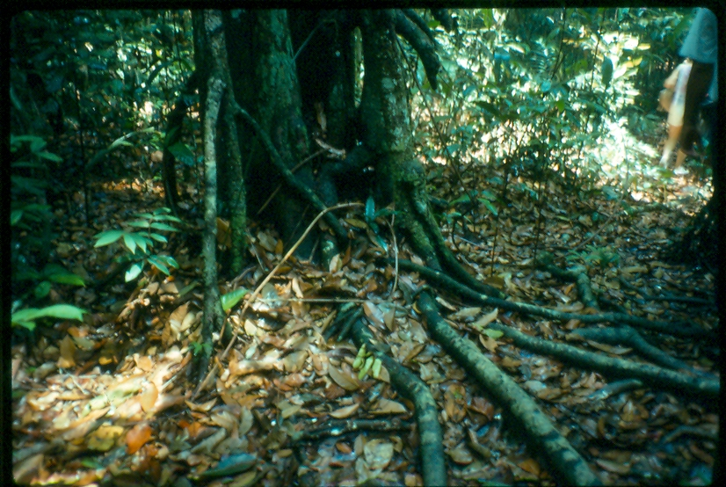
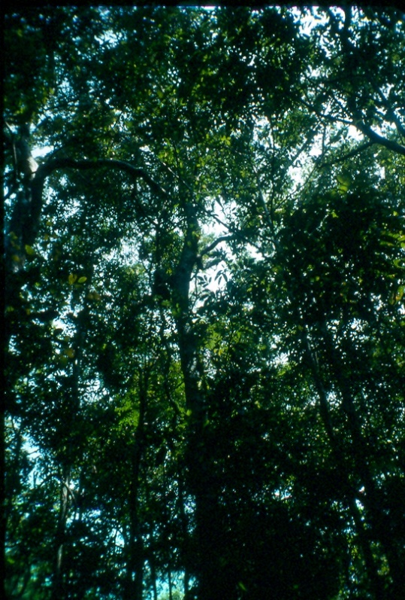
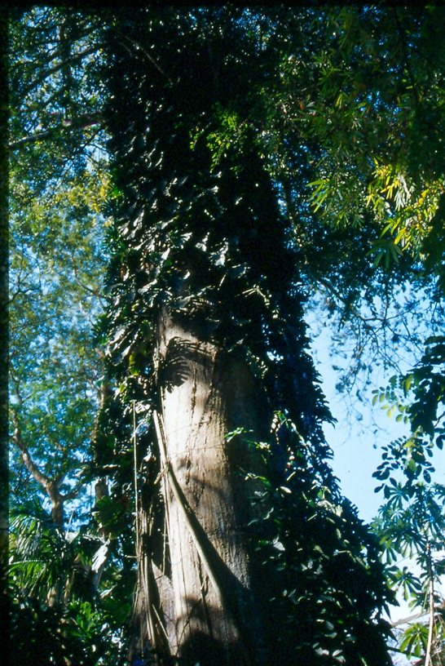

Slide 41
Land without Men for Men without Land
Land give-away, 1960s
Transamazon Highway
350,000 square miles settled and 12,000 square miles cleared
Every 12 square miles
Almost 90% of settlers gone after 5 years
Amazon land became part of the old system of land=status, became tied to politics, corruption & cronyism.
New global demands for beef
Since 2000 an increase in deforestation to 8000 square miles/year
Population growing at a rate of 4%/year

Slide 42
Alternatives?
Ecotourism
Costa Rica

Slide 43
Urban Development
80% of South America lives in cities; 75% of Latin Americans
Primate Cities—left over from colonial era
Megacities
Super megacities
Problems with megacities?
Urban structure and colonial influence

Slide 44
Urban problems: air quality
Santiago, Chile.
7 million residents, prosperous.
Basin setting (1870’) creates thermal
inversions.
Have restricted driving—20% off the road
on any given day.
Mexico City, Mexico
Rapid urban growth—almost 5% from 1950-80
Like Santiago, a basin with inversions. 7382’
1980s—catalytic converters, low-emission bus system
Today—closing streets to vehicles, more bike lanes
No longer one of world’s most polluted cities, as it was designated in 1992. By 2012 about the same as Los Angeles.

Slide 45
Urban problems: water
Mexico City
Valley of Mexico once a large, shallow lake
Subsidence
Underground aquifers overdrawn, contaminated
Pump in water from more than 100 miles away
Many homes don’t have piped water
Mexico City’s Water Problems: PBS Newshour

Slide 46
A Sustainable City?
Curitiba, Brazil
Rio de Janeiro, Brazil: The Four Commandments of Cities

