Slide 1
Geography 8
Lecture 11: Urban Poverty and the Neglected CBD

Slide 2
Keywords
Slum
Spatial/Structural mismatch
Neighborhood effects, culture of poverty
Public housing, Pruitt-Igoe, Cabrini-Green, Section8, HOPE VI
Community development block grants
Empowerment zones, enterprise zones
Blight
Housing Act 1949
Title I, Urban renewal, redevelopment agencies
Downtown Los Angeles—Bunker Hill, Grand Avenue, South Park, L.A. Live
Larry Ford’s “New Downtowns”
Festival marketplaces—Rouseificiation
Adaptive reuse

Slide 3
What explains the concentrated poverty of urban areas?
Economic structural mismatch
De-agrarianization, deindustrialization
Need to retool workers and rebuild economic base
Spatial mismatch
Jobs on the suburban periphery; unemployed poor in the inner city
Gentrify/renew the center? Move the poor to the periphery?
Failure of social institutions and public programs
Laws that have reinforced segregation and discrimination
Banks, schools, etc., both public and private institutions failing the poor
Neighborhood effects, culture of poverty
Stigmatization of neighborhoods and their residents
Self-perpetuating “culture of poverty” (oppositional culture, peer pressure, lack of role models, no or little community surveillance).

Slide 4
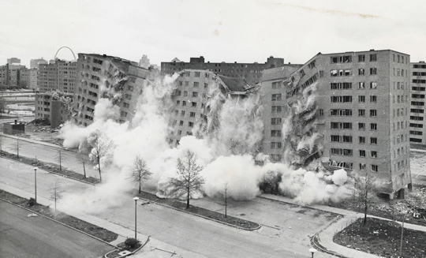
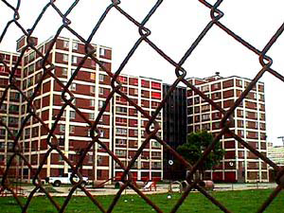
Public Housing in the United States
Goal: transitional alternative
Seen as better than the tent cities of the Great Depression
Reality: failed warehouses for the desperately poor
Accentuated marginalization
St. Louis’s Pruitt-Igoe
1955: 33 identical 11-story dormitories, 2800 units
1969: nine-month rent strike over disrepair of facilities
1970: occupancy rate under 35%
1972: demolished

Slide 5
Why did they fail?
Structural
Already in very poor neighborhoods
Already prone to “spatial mismatch”
Perhaps already steeped in the “culture of poverty”
Urban Renewal to clear “blight”
They were designed less to address the needs of the poor and more to provide a political solution
The “solution” was to clear the “blight” of the slums through renewal
Lack of operational funds
Federal money given to local agencies to build housing, but no money for maintenance or other operational costs
This had to come from local funds
Created a vicious cycle: increased vacancy, dilapidation—as residents move out, the money received from rent declines, so there is less money for maintenance and repair, meant even more would leave….creates an increasingly desperate situation
Bad design for the needs of a poor family
The modernist design (think tower in a park) doesn’t work when tenants can’t afford hefty monthly payments to maintain elevators, keep grounds beautiful, pay for an on-site swimming pool, fitness center, etc.
Poor match for single-parent families on welfare
Peter Hall: “very poor welfare families, with a deep fatalism about their power to influence their environment, could not cope with this kind of building, nor it with them.”

Slide 6
Public Housing and Welfare Reform
1970s—today?
Reform public housing
Reform welfare
Community Development Block Grants from the Fed. Govt.
Thru HUD (new in the 1970s)
Idea was to spur economic development at the local level (jobs, etc.) to reduce welfare payments from feds.
Local govts, non-profts received grants, but had to prove were serving low-income groups
Meant to be participatory (what does the community want).

Slide 7
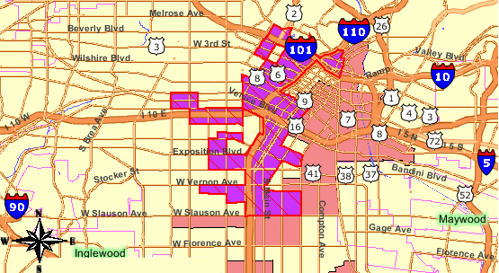
Enterprise Zone/Empowerment Zones
“distressed” neighborhoods
Encourages private investment here thru tax breaks, deregulation, subsidies (businesses in an EZ can deduct environ. cleanup costs)
Offer wage tax credit (Clinton’s “Empowerment Zones”) done to encourage job creation.

Slide 8
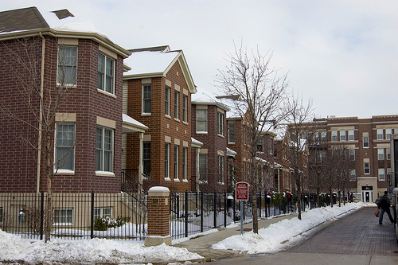
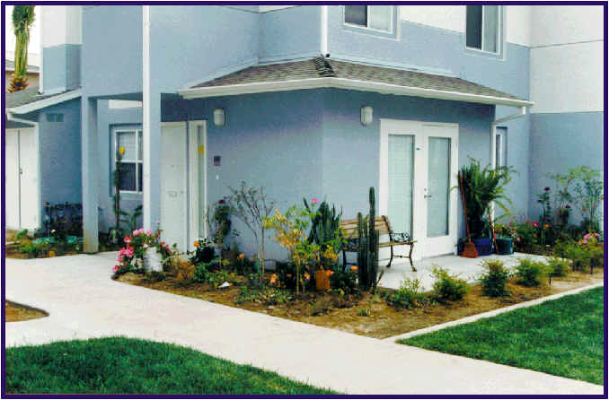
Public Housing Reform
Section 8
Federal subsidies to low-income individuals living in a privately owned rental housing unit.
Alternative to housing owned and operated by the federal govt
HOPE VI
1992
Pool of federal money that local housing agencies could tap into to tear down old tower-in-a-park public housing and replace it with more friendly designs
Criticisms
Actually causes affordable units to be torn down
But overall, supported. Greater variety of housing options, mixed-use, mixed-income neighborhoods.
Chicago’s Hope project housing.
The re-envisioned Pico-Aliso projects in
Boyle Heights.

Slide 9
Poverty vs. Blight
Urban renewal policies
Post WWII focus is largely on the buildings (blight), not the people (poverty)
Cities concerned about decentralization and run-down, abandoned buildings
Polices address the landscape not the people
Housing Act’s Title I, 1949—federal money for urban renewal
Federal money given through local “redevelopment agencies”
Local redevelopment agencies run by political appointees
Very powerful: agencies could claim tax revenue AND condemn land for redevelopment thru eminent domain.
Redevelopment agencies gathered large pieces of property and then sold these to private developers at huge discount (subsidized by feds)—sometimes as much as 2/3 less.
Developers enticed to areas they would have otherwise avoided

Slide 10
Criticisms of Urban Renewal
Gentrification
“blighted” neighborhoods DID have communities or small businesses, working-class residents, etc.
Entire neighborhoods dislocated for new projects whose only interest was to bring office and retail activity downtown
Corporate Welfare
Public money subsidizing private developers
About buildings, not people
“Overriding objective was not to wipe out the slums in order to build decent housing and pleasant neighborhoods for low-income families. …[but was] to induce the well-to-do to move back to the center by turning the slums and blighted areas into attractive residential … to revitalize the CBD and ease the city’s fiscal plight”—Robert Fogelson, historian.

Slide 11
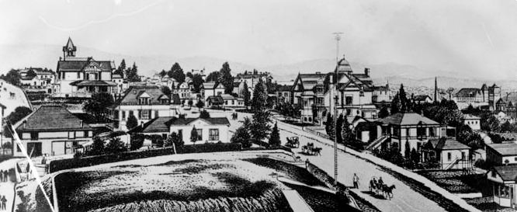
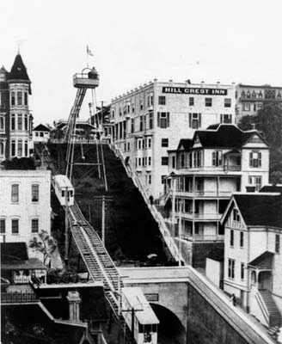
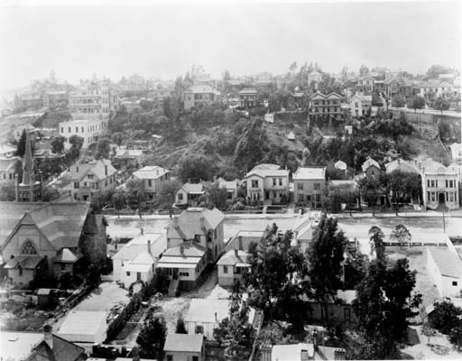
Bunker Hill: Los Angeles Redevelopment Area No. One
Angel’s Flight
Victorian Mansions on Bunker Hill.

Slide 12
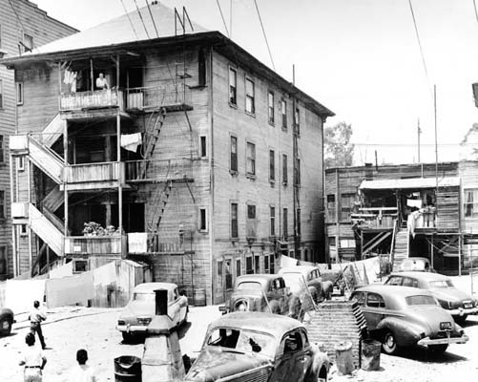
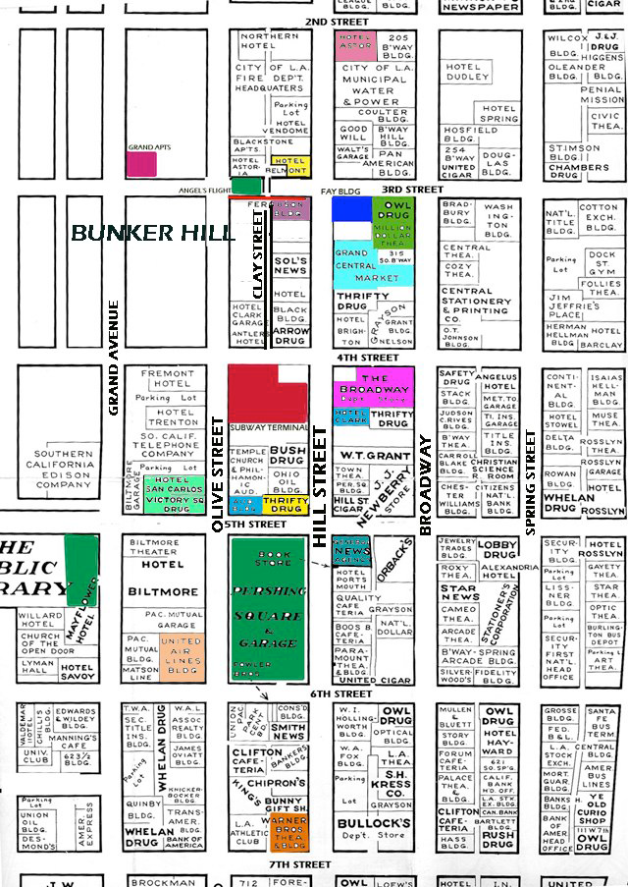
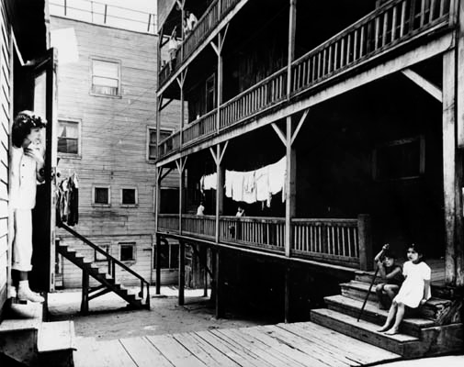
By 1920s, Bunker Hill begins to change; wealthy residents with cars leave for outlying communities like Beverly Hills or Palos Verdes.
Bunker Hill still home to many though—recent immigrants, itinerant workers, poor.
Is it still a neighborhood?
Or is it simply “blight”? Does it need to be “fixed?”
This fire insurance map from the 1950s illustrates the numerous vacant properties on Bunker Hill.

Slide 13
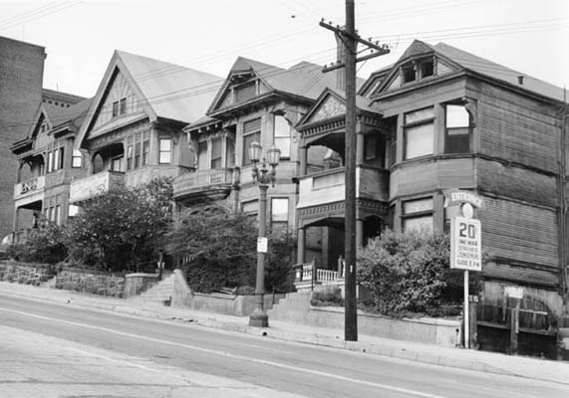
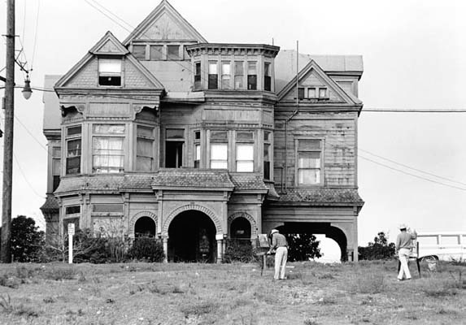
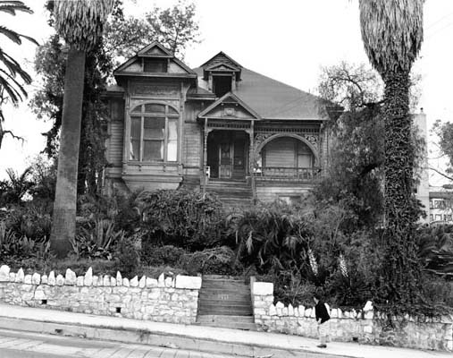
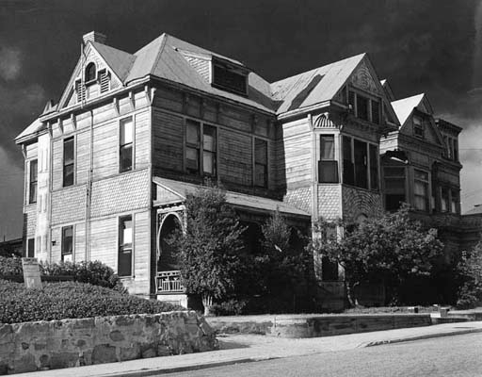

Slide 14
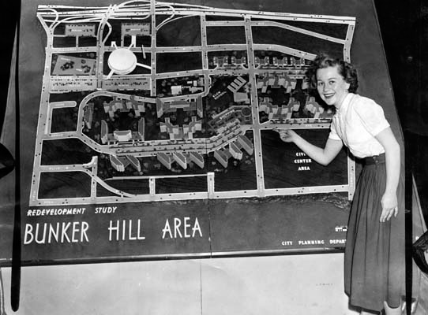
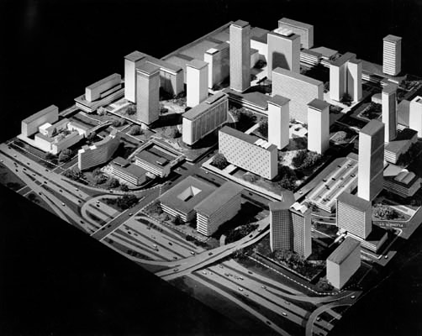
Bunker Hill Transformed
Make way for a new, modern CBD
*1959-60: CRA plan for Bunker Hill: raze the “slums” and remove the “blight.” *About 10,000 made homeless.

Slide 15
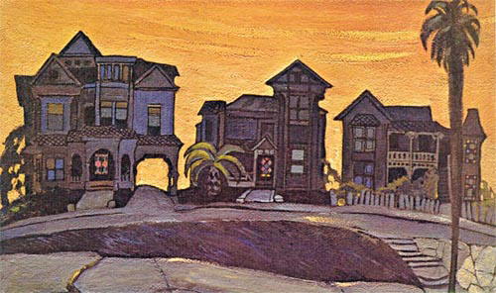
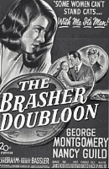
Memories of the “old” Los Angeles
A lost L.A. preserved by Leo
Politi.
Raymond Chandler, noir writer of the early 1900s captured the grittiness of Los Angeles in his novels (some made into movies). His description of Bunker Hill in the 1940s: “Bunker Hill is old town, lost town, shabby town, crook town. Once…it was the choice residential district of the city…jigsaw Gothic mansions with wide porches... They are all rooming houses now, their parquetry floors are scratched and worn …on the wide cool front porches…staring at nothing, sit the old men with faces like lost battles. In and around the old houses there are flyblown restaurants and Italian fruitstands and cheap apartment houses and little candy stores …And there are ratty hotels where nobody except people named Smith and Jones sign the register.

Slide 16
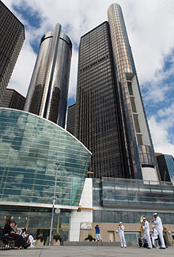
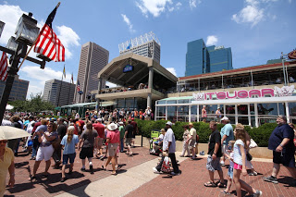
Does Urban Renewal Work?
Concerns of impacts of gentrification
Mike Davis “the infinite game” of urban renewal
Some successes
Others….
Baltimore’s Harborplace
Detroit’s Renaissance Center

Slide 17
Urban Renewal in Los Angeles
1933: new vision for the city proposed
Civic Center around City Hall
New Union Station
Park around the Pueblo celebrating its origins
But freeway is soon built (Hollywood)
Most of plan never built—neoclassical design, forum-like space
1960s: Bunker Hill
High culture
Dorothy Chandler Pavillion
Mark Taper Forum
An “elite” acropolis
1990s: More High Culture
Disney Hall in 2003
MOCA
Broad Museum

Slide 18
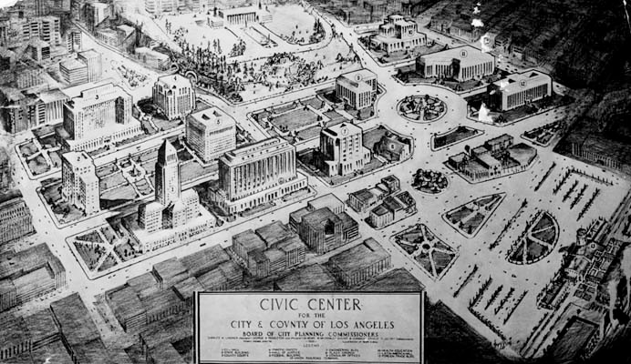
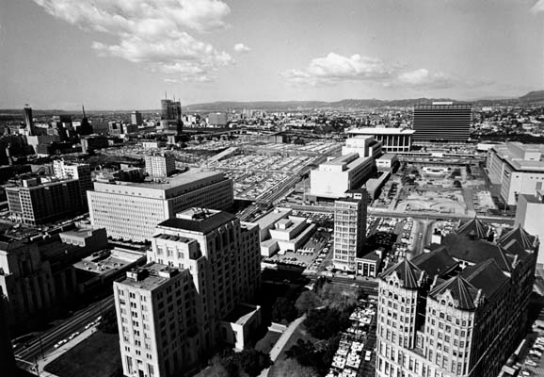
1933
1966

Slide 19
Grand Avenue: The Elite Acropolis Continued
$3 billion (private & public $$)
Grand Avenue project (“The greatest urban street Los Angeles has never quite figured out how to build, William Fulton).
Infill of parking lots
Hotel
Grand Park
Broad Museum
Restaurants…
Pedestrian Only?
Shopping???

Slide 20
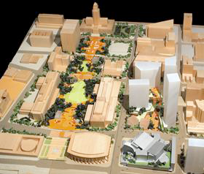
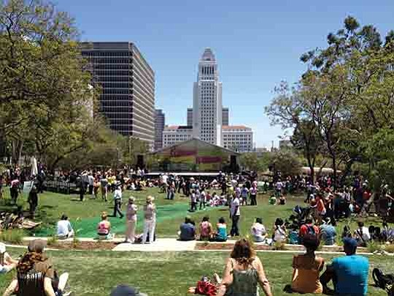
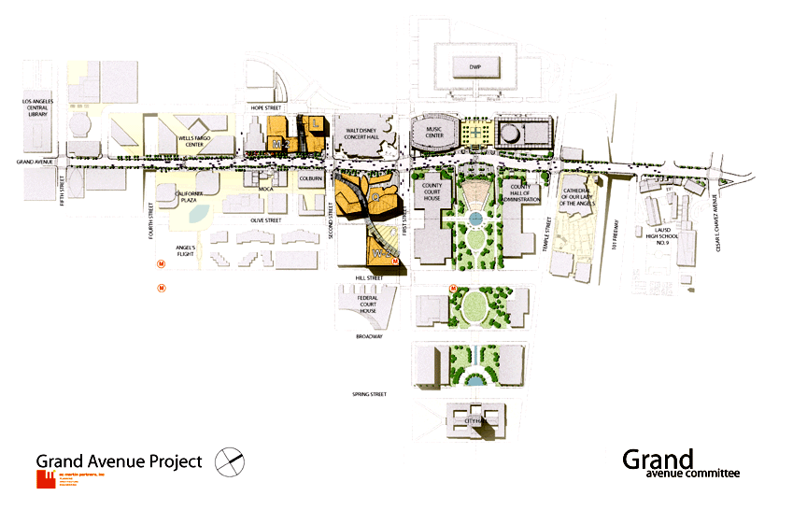
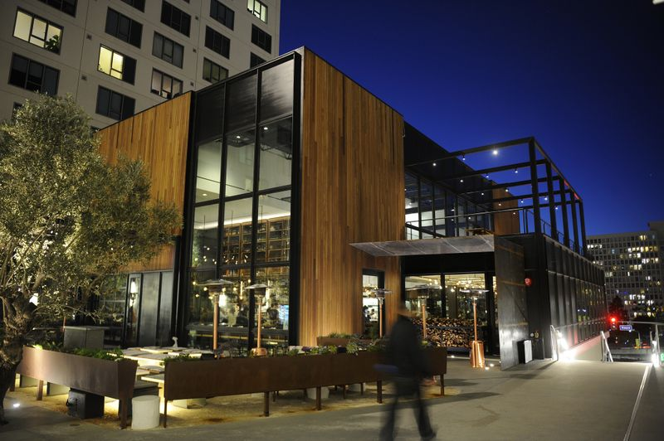
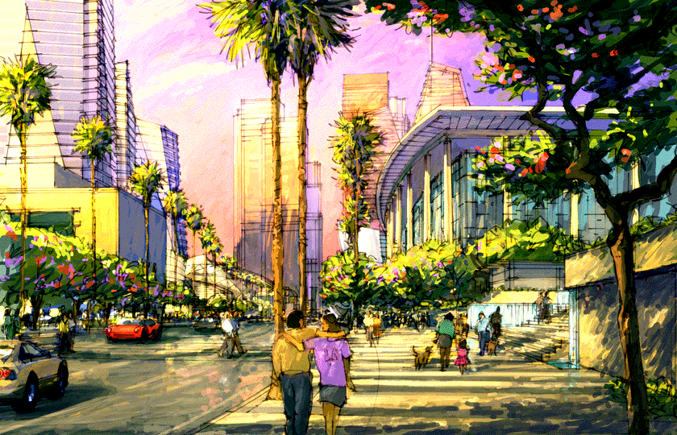

Slide 21
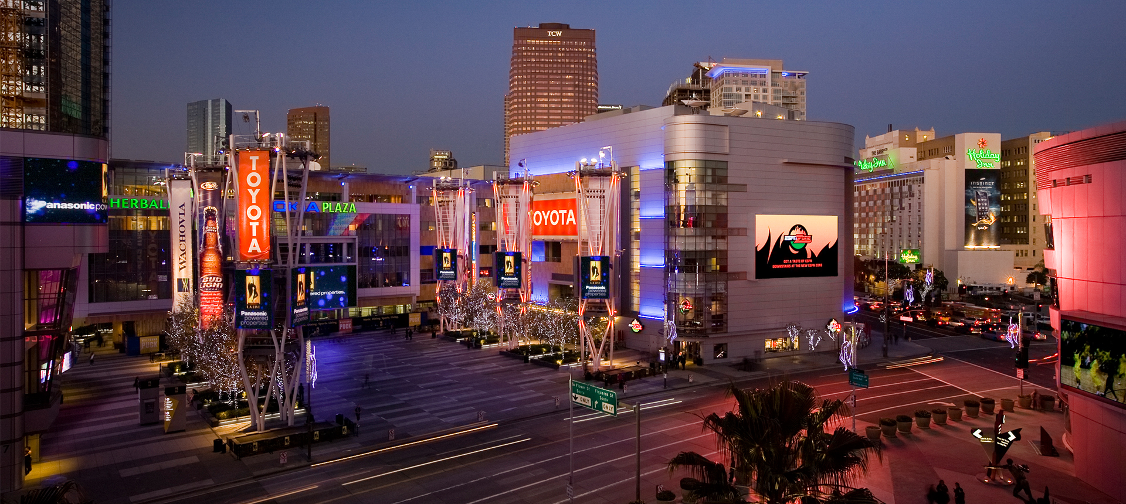
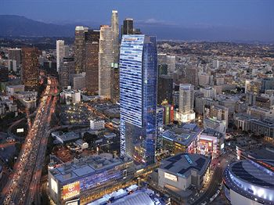
South Park: LA’s Zone of Assimilation
The L.A. Live complex in South Park
LA Live—a “Times Square” for Los Angeles.
Began in 1990s with Staples Center.
2000s largest-ever mixed-use project downtown.
New hotel for Convention Center, 7000 seat Nokia Theater, Grammy Award museum, 3000 car underground parking garage, 800 new housing units in two apartment towers, 5500 new permanent jobs.
A new, more just urban renewal?
New Ritz-Carlton hotel near South Park.

Slide 22
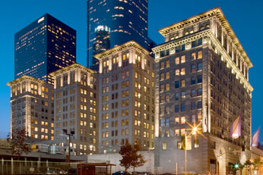
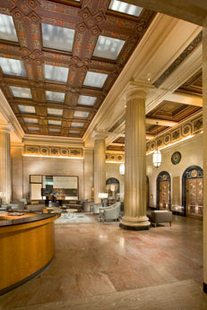
The New Downtown
Ford’s 4 Themes of New Downtown
Visitor-oriented fun zones
Public investment in transportation facilities
Celebrated and renovated historic buildings and districts
New emphasis on housing for the affluent
Los Angeles Adaptive Reuse Ordinance
June, 1999
Goal: remove blight and encourage preservation of old, but economically obsolete, buildings by conversion into residential properties
How? Reduce parking requirements, increase allowable density, expedite project review, grandfather older approved heights.
Los Angeles’s Subway Terminal Building,
417 Main.

