Slide 1
Urban Geography
The Segregated American Dream

Slide 2
Keywords
Racially restrictive covenants
Bruce’s beach
Segregation: evenness, isolation, centralization, clustering, concentration
Hypersegregation
Segregation index (index of dissimilarity)
Steering
Redlining
Hedonic price model
Ghetto
Old, new, third waves of U.S. immigration
The Great Migration of rural Blacks to the urban North
Ethnoburb

Slide 3
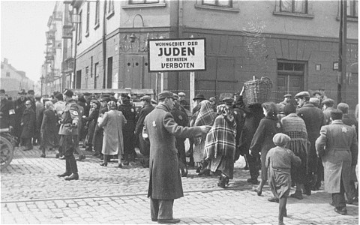
Ghetto
A group of people who are a minority population, but may or may not be poorer than the rest of society.
Has been deliberately marginalized without access to the city’s institutions of power.
Europe: Jews separated into distinct neighborhoods in cities, marginalized culturally, politically.

Slide 4
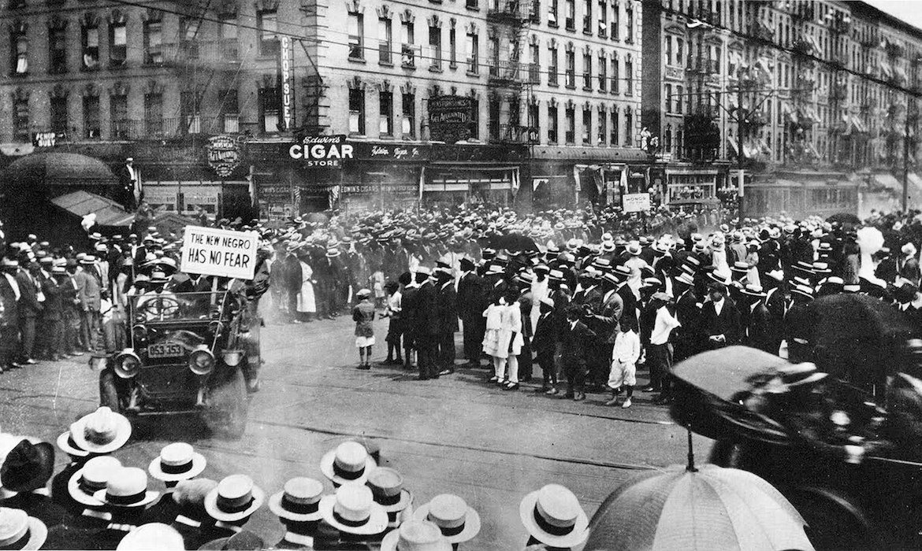
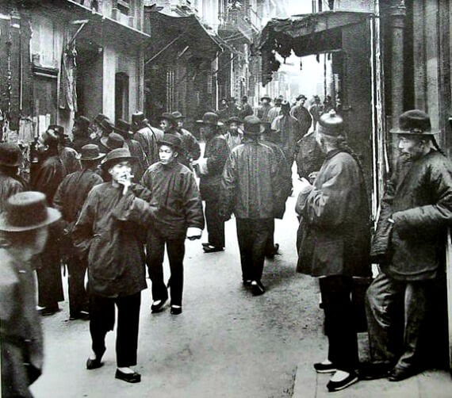
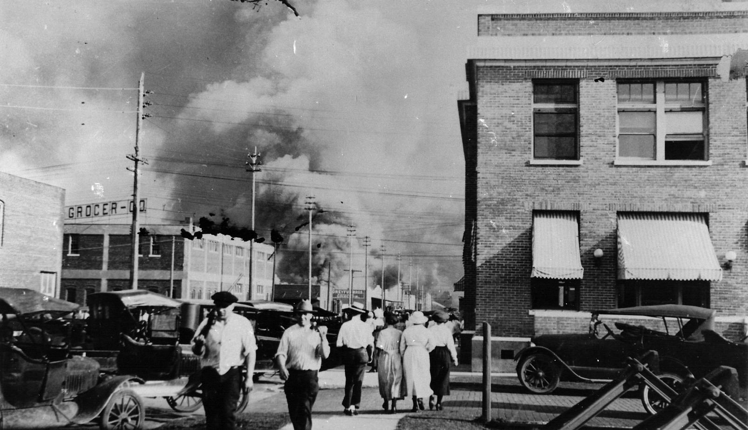
The Ghetto In America
Race massacre, Tulsa, OK.
Destroyed wealthy black neighborhood. 1921.
Some Chinatowns in American cities dating back to 1800s
But “ghetto” has been historically occupied by African Americans
Harlem, 1920s, UNIA Parade
(Universal Negro Improvement
Association)

Slide 5
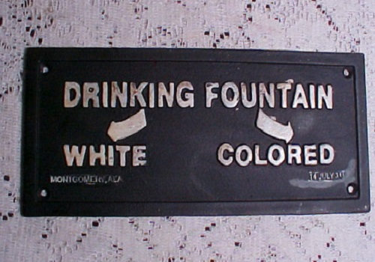
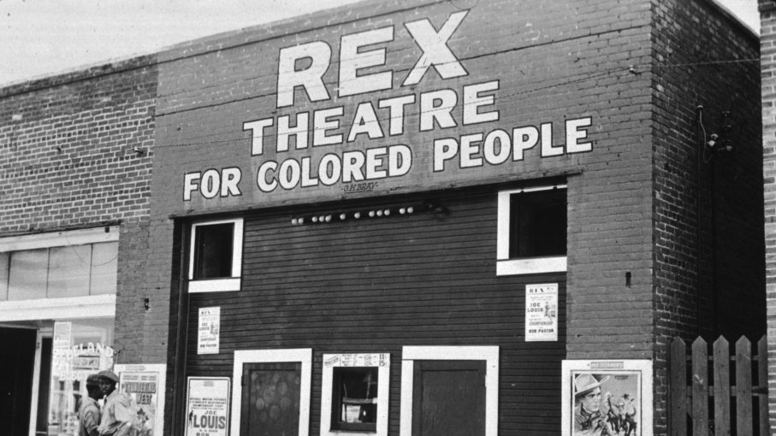
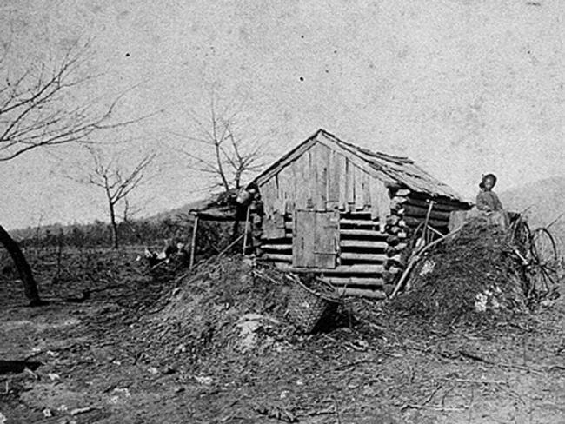
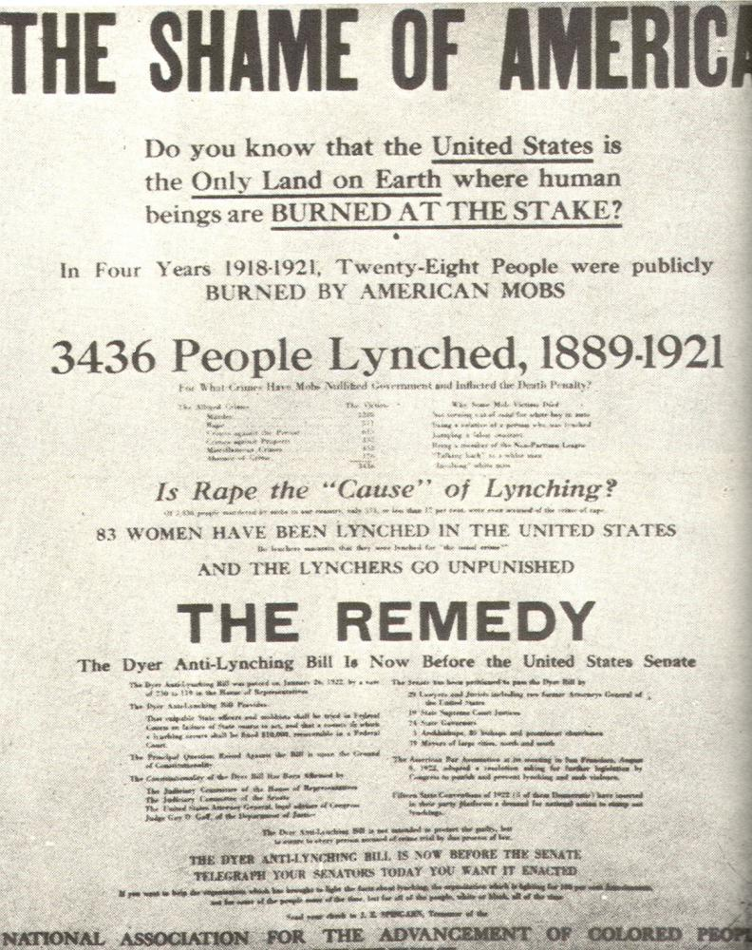
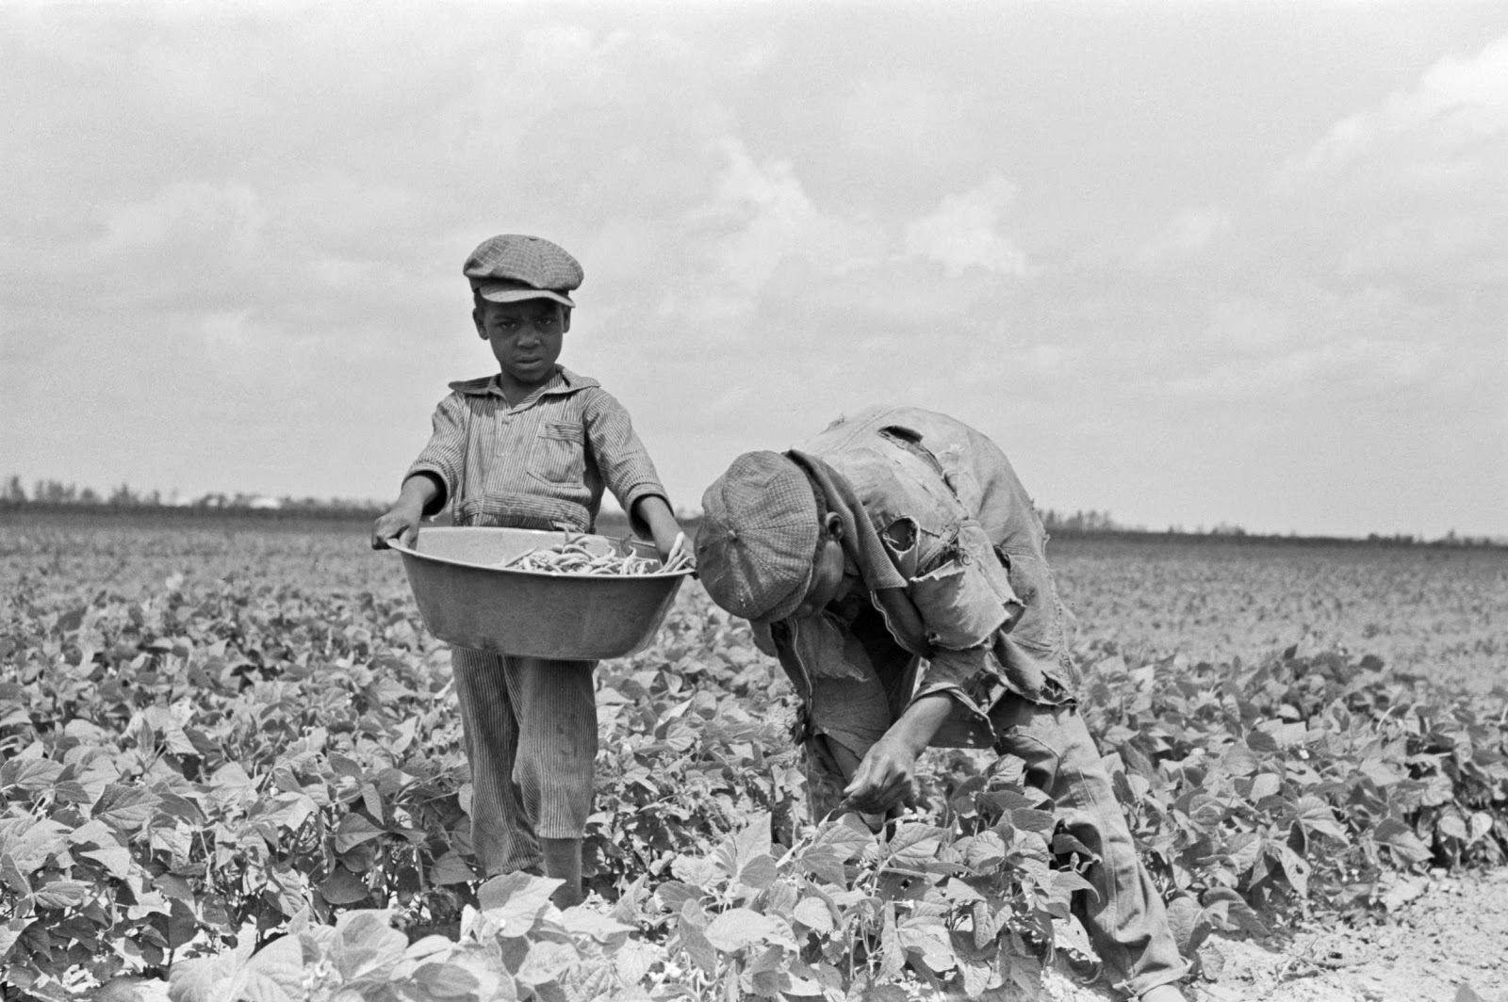
The failure of Reconstruction

Slide 6
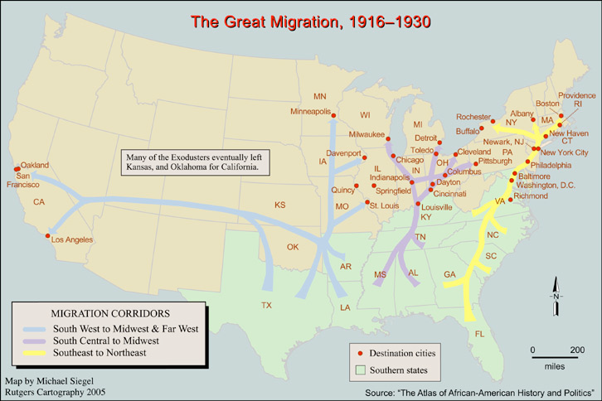

Slide 7
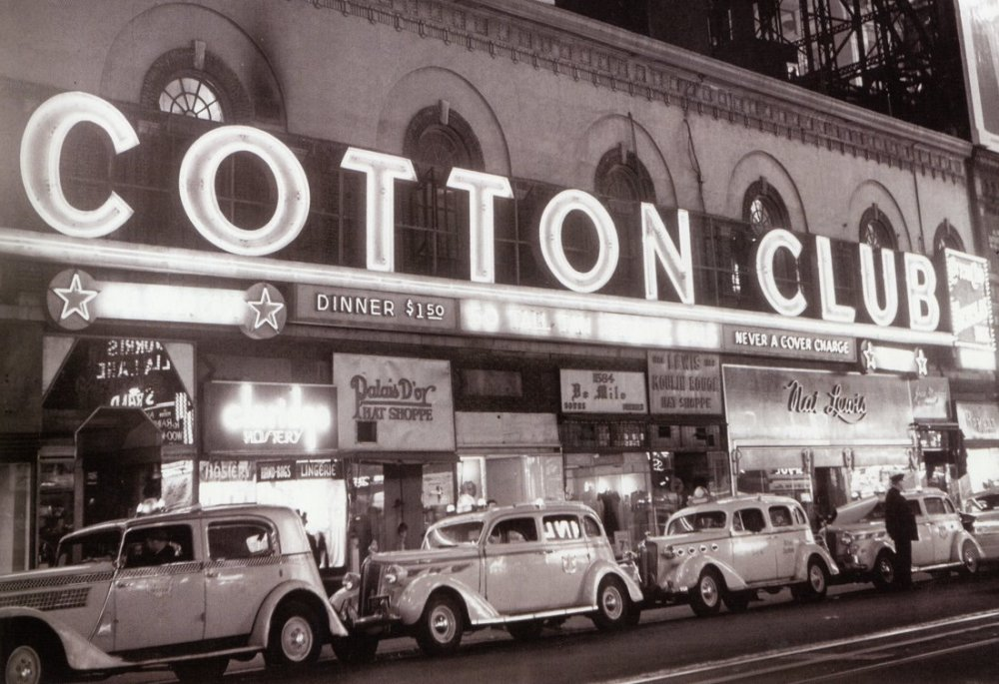
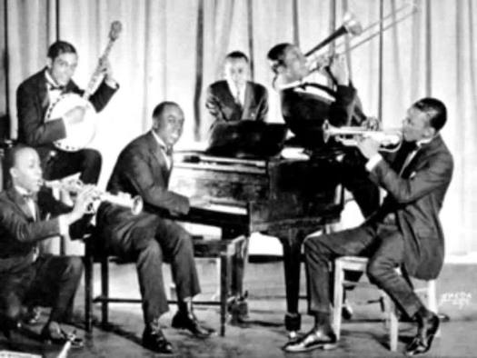
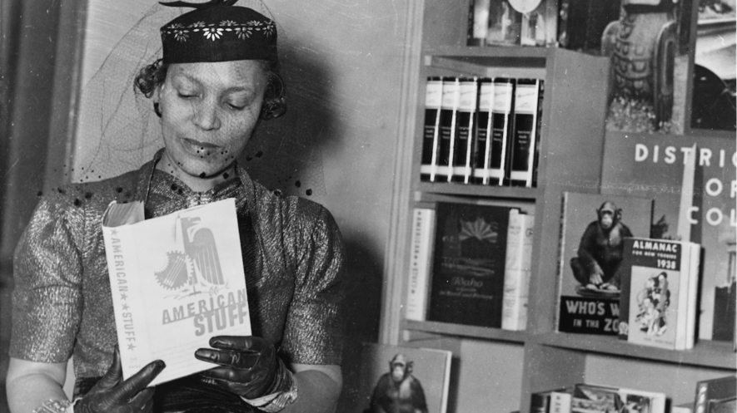
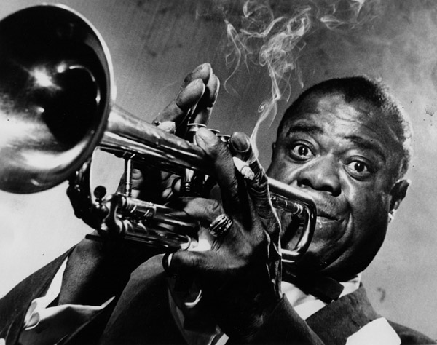

Slide 8
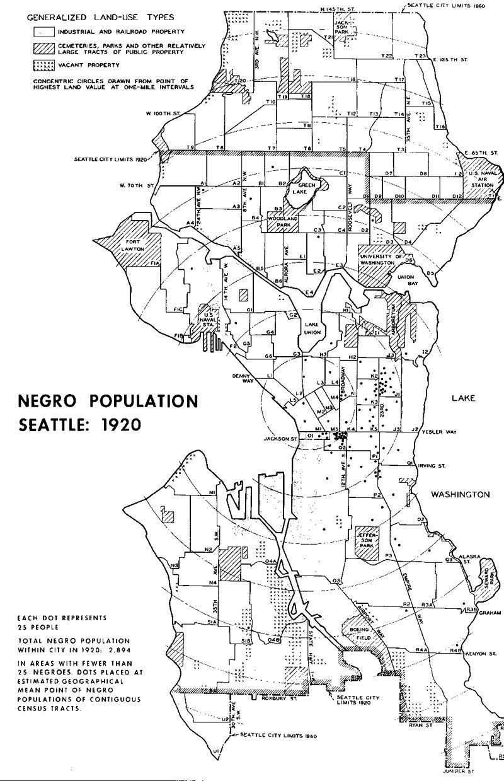
No Respite from Racism
1920 Seattle, African-American population.
Each dot represents 25 people.
Total Black population: 2, 894.
Source: Seattle Civil Rights & Labor History
Project, University of Washington.
https://depts.washington.edu/civilr/segregation_maps.htm

Slide 9
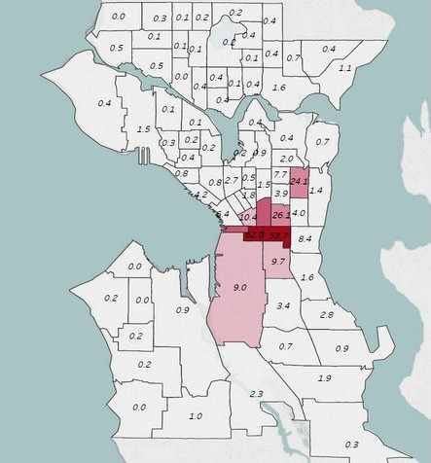
Non-white population (as % of total in Seattle, 1940.
Source: Seattle Civil Rights & Labor History
Project, University of Washington.
https://depts.washington.edu/civilr/segregation_maps.htm

Slide 10
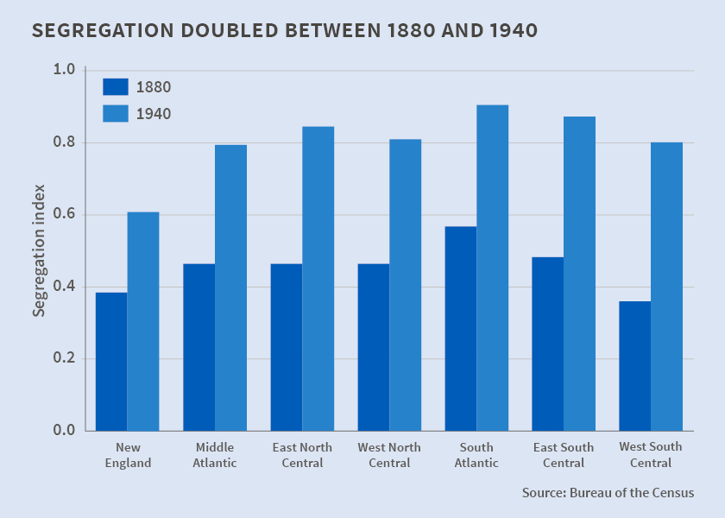
Source: Trevon Logan and John Parman, “The National Rise in Residential Segregation,” National Bureau of Economic Research.

Slide 11
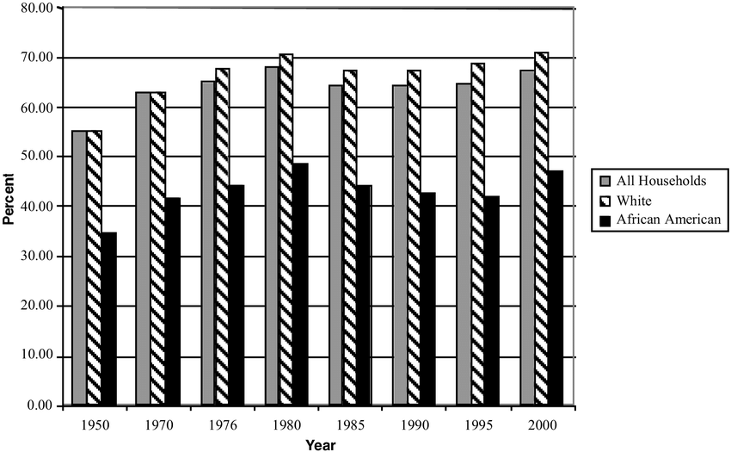
Post WWII: Expansion of Black Middle Class & New South Emerges
Homeownership rate by race. Source: US Census Bureau.

Slide 12
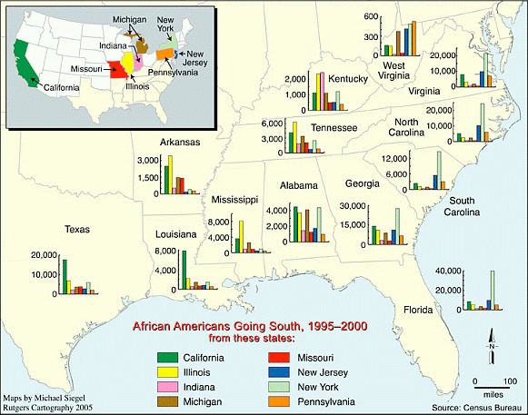
The “New” South

Slide 13
Inequality & Segregation Persists
Deindustrialization
Influx of new immigrations post 1965
Globalization
A tale of two cities
Compton
Manhattan Beach

Slide 14
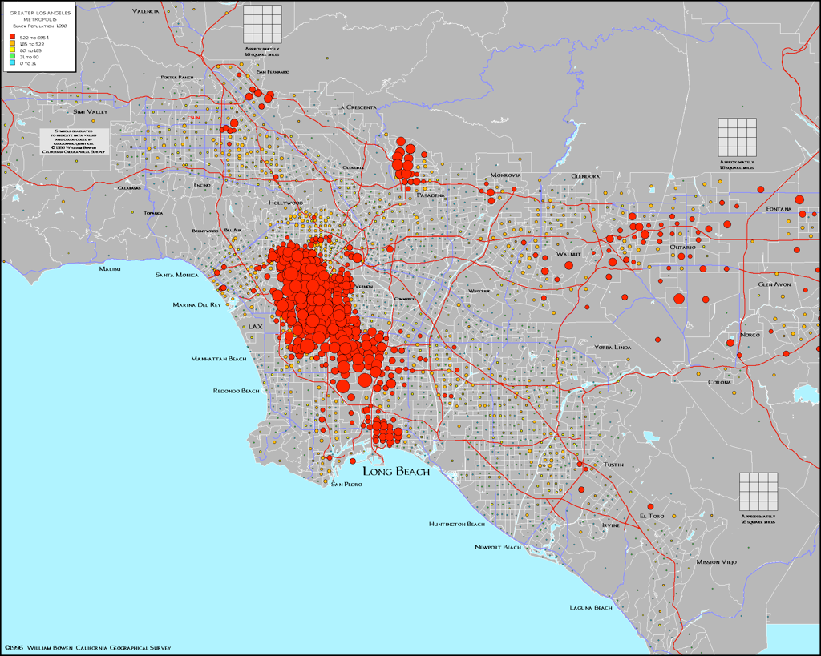
Concentration of African Americans in Los Angeles, 1990.
These patterns are not an accidental side-effect of history.
They are not an outcome of the free-market and bid-rent competition.

Slide 15
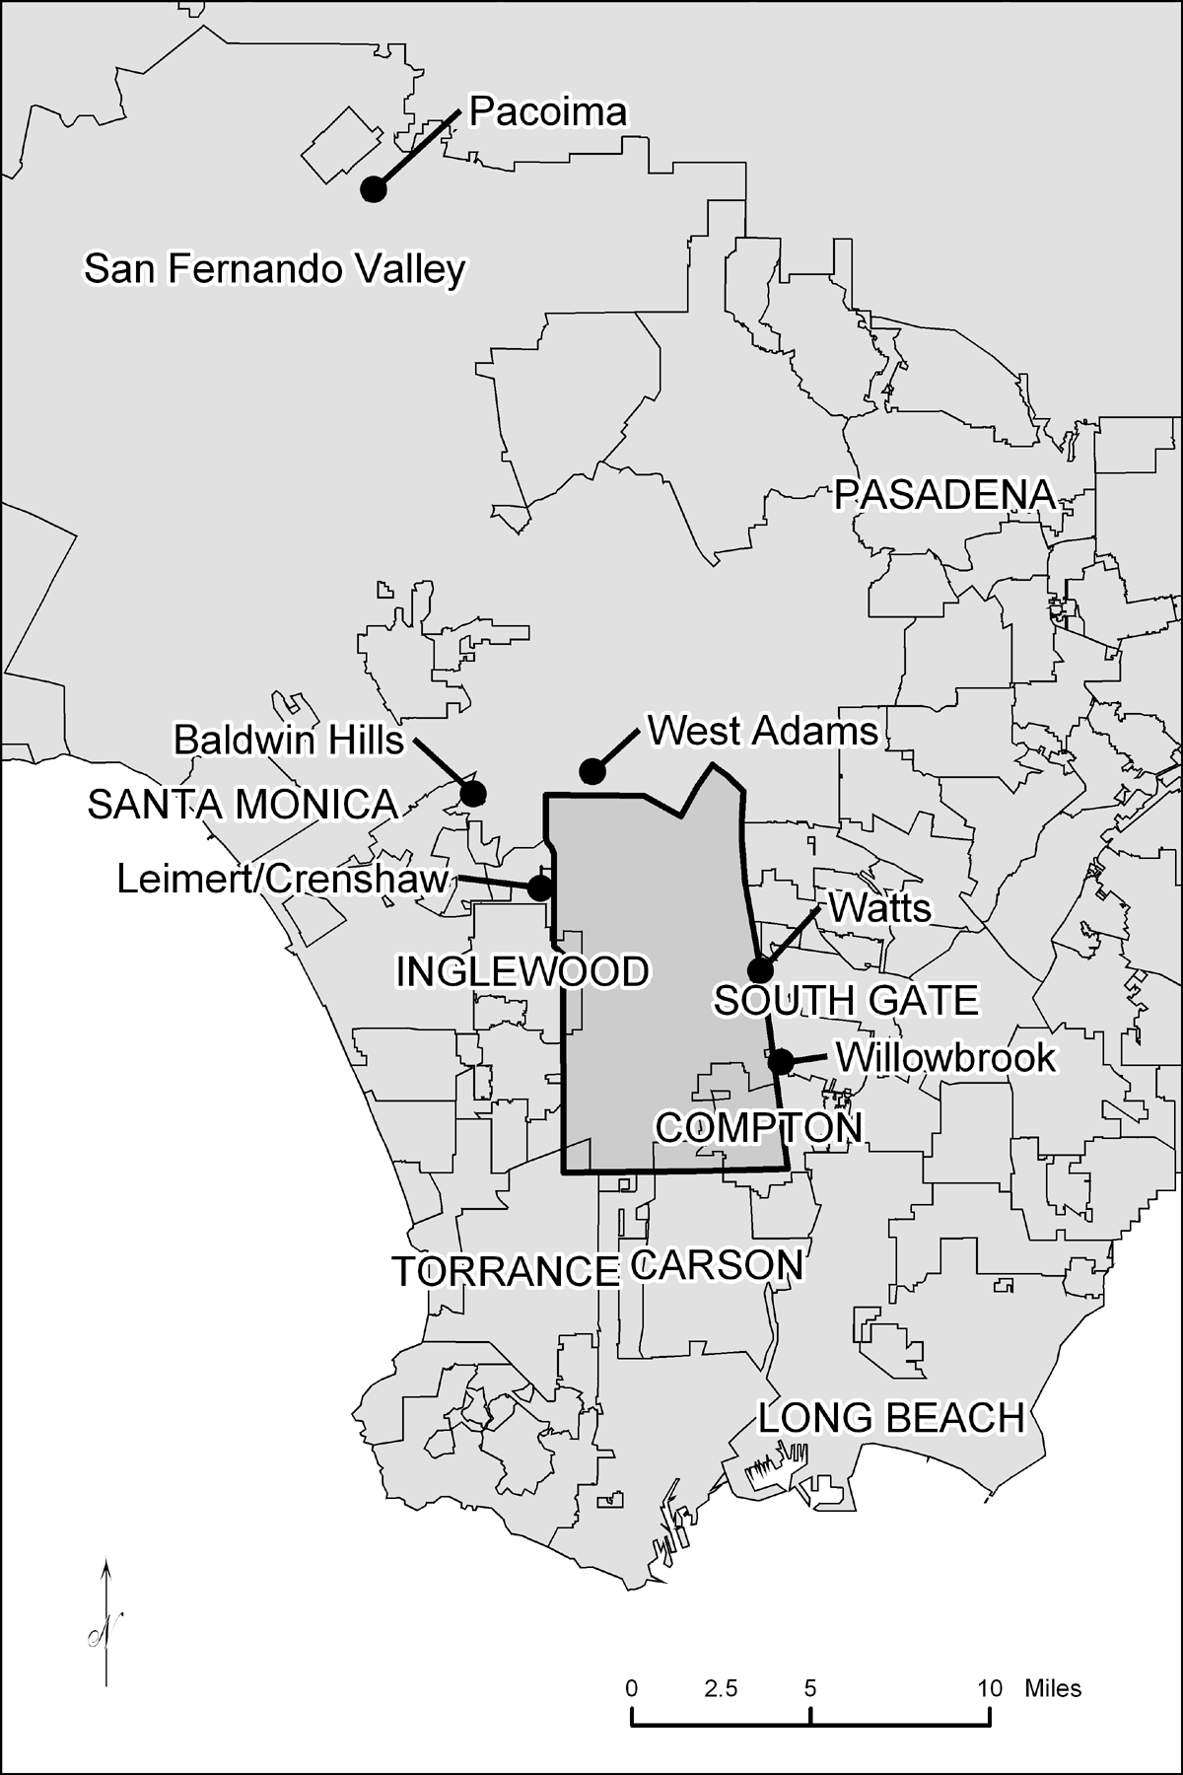
The geography of African-American residential areas of Los Angeles.

Slide 16
1940

Slide 17
1950

Slide 18
1960

Slide 19
1970

Slide 20
1980

Slide 21
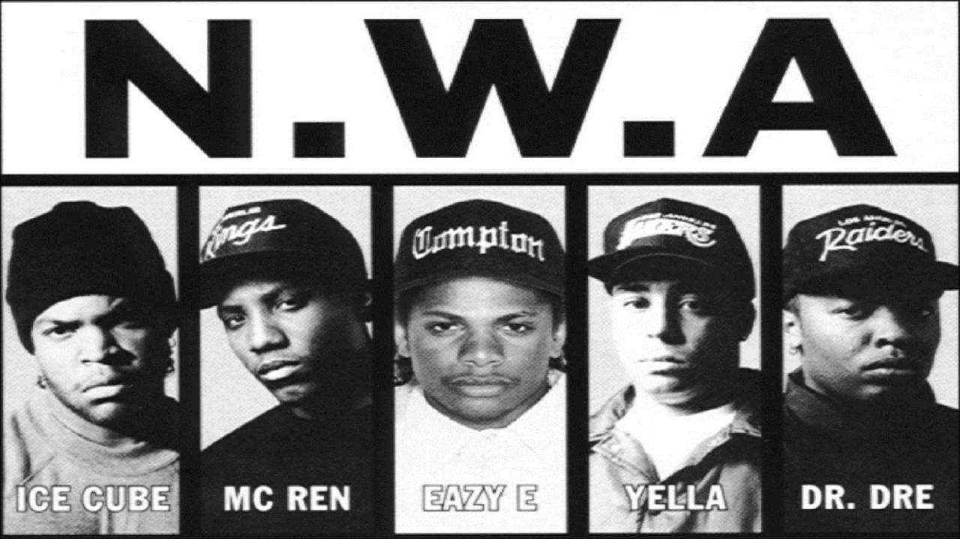
Compton, CA
Compton embodies the post WWII hope that African Americans had
Compton becomes emblematic of all the woes of African American urban communities.

Slide 22
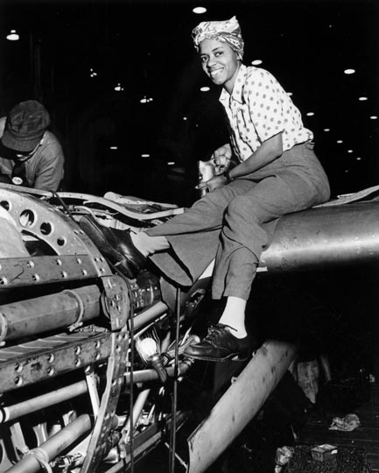
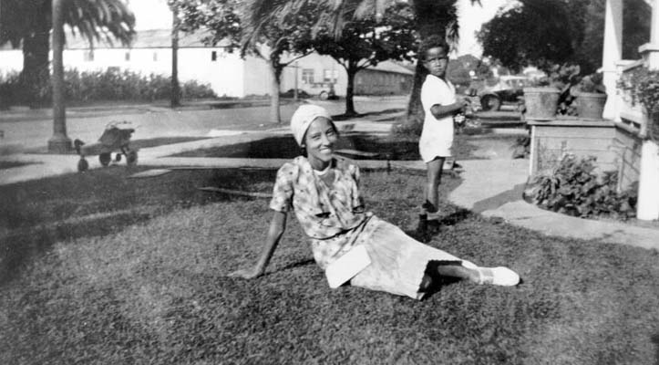
Compton, circa 1950s

Slide 23
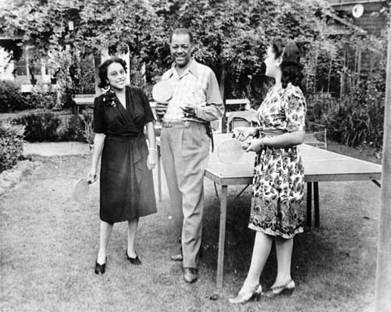
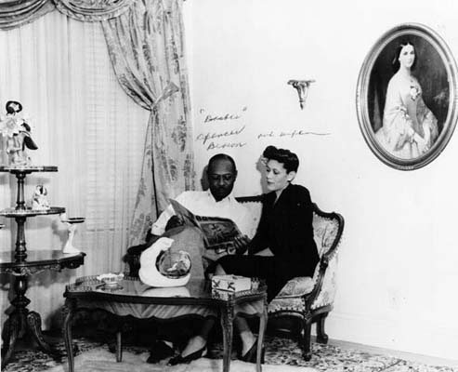

Slide 24
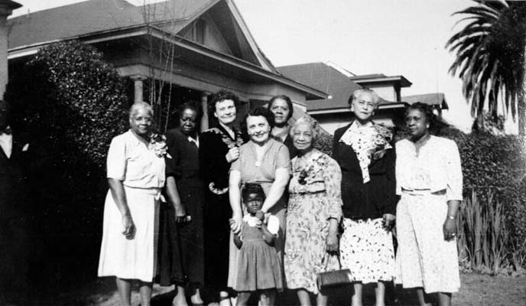

Slide 25
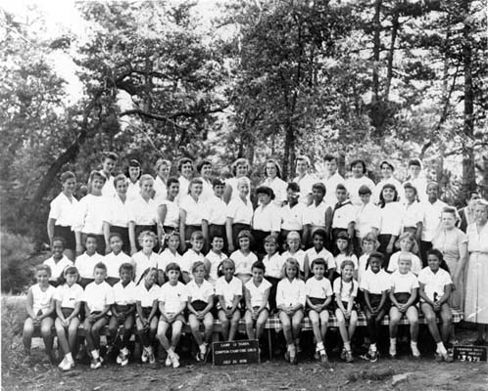
Compton Campfire Girls, 1958

Slide 26
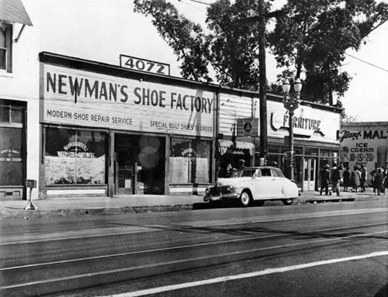
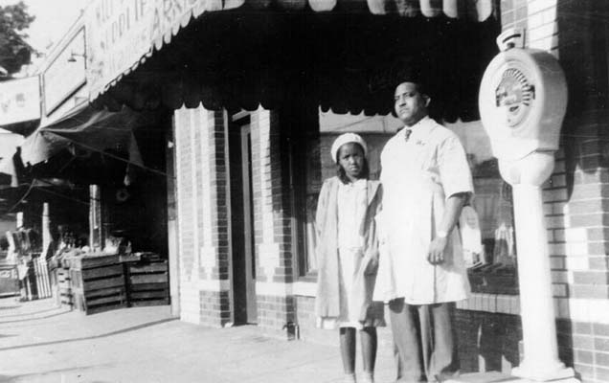
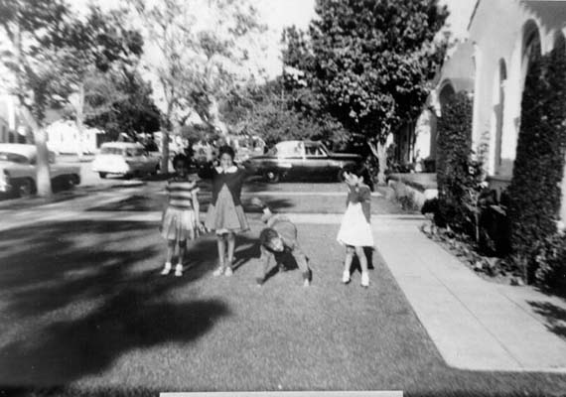
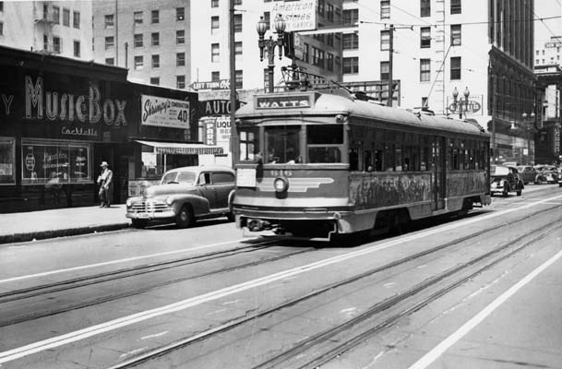

Slide 27
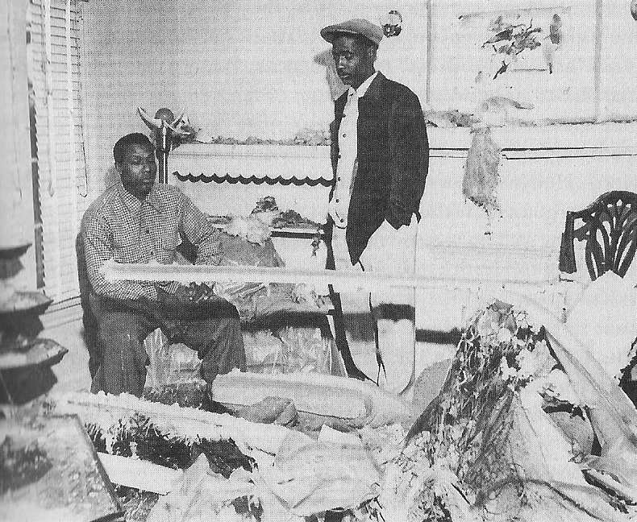
William Bailey surveys the wreckage from a bomb that exploded in his house at 2130 Dunsmuir in 1952

Slide 28
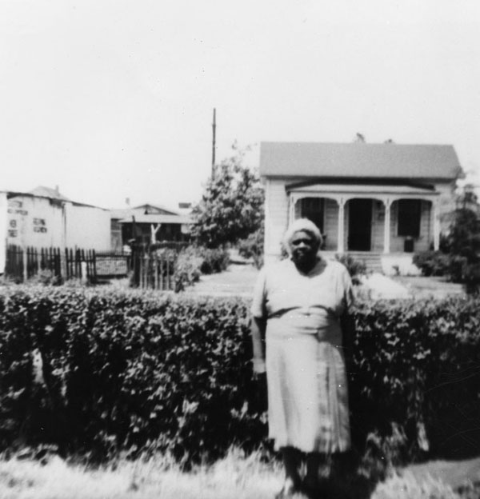
The Un-doing of Compton
Woman stands in front of a home at 48th Place and Compton Avenue. Photo courtesy of the Los Angeles Public Library, Shades of LA collection.

Slide 29
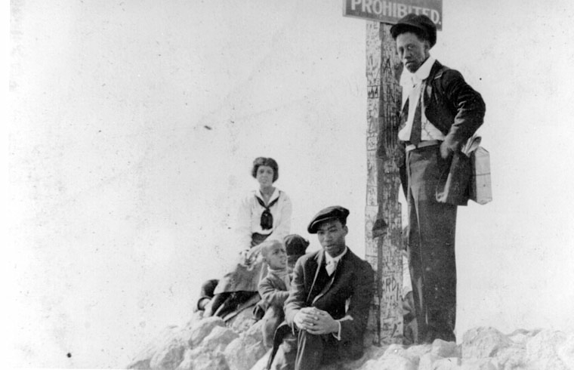
Manhattan Beach and the “Inkwell”
At the limit of the “Inkwell.”
Circa 1920s.

Slide 30
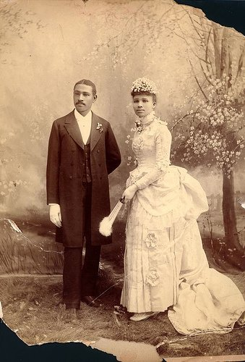
Bruce’s Beach
1912 George Peck reserved two large blocks of land for Black property owners
Charles & Willa Bruce are first to buy
Build a small resort for other African Americans
Fishing pier
Café
Dance hall…

Slide 31
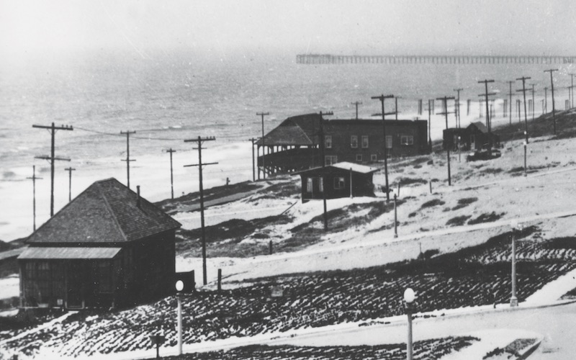
Life wasn’t easy for the Bruces. KKK members harassed them, along with any African Americans who went beyond the ropes marking the beach’s boundaries. There were reports of at least one cross burning, abusive phone calls, and bogus restricted parking signs, but the Bruces held on. Then in 1924, the city condemned the property and began proceedings to claim it through eminent domain. Though the Bruces sued, they ultimately lost the property and moved to South L.A.
Recounting his family’s story in a letter to the California Coastal Commission, their grandson, Bernard Bruce, wrote, “My grandparents moved here from New Mexico. They worked on the railroad. They saved their money…. They lost everything when the city took Bruce’s Beach. How would you feel if your family owned the Waldorf and they took it away from you?” Source: Los Angeles Magazine, June 22, 2017.

Slide 32
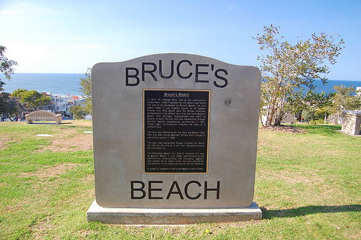
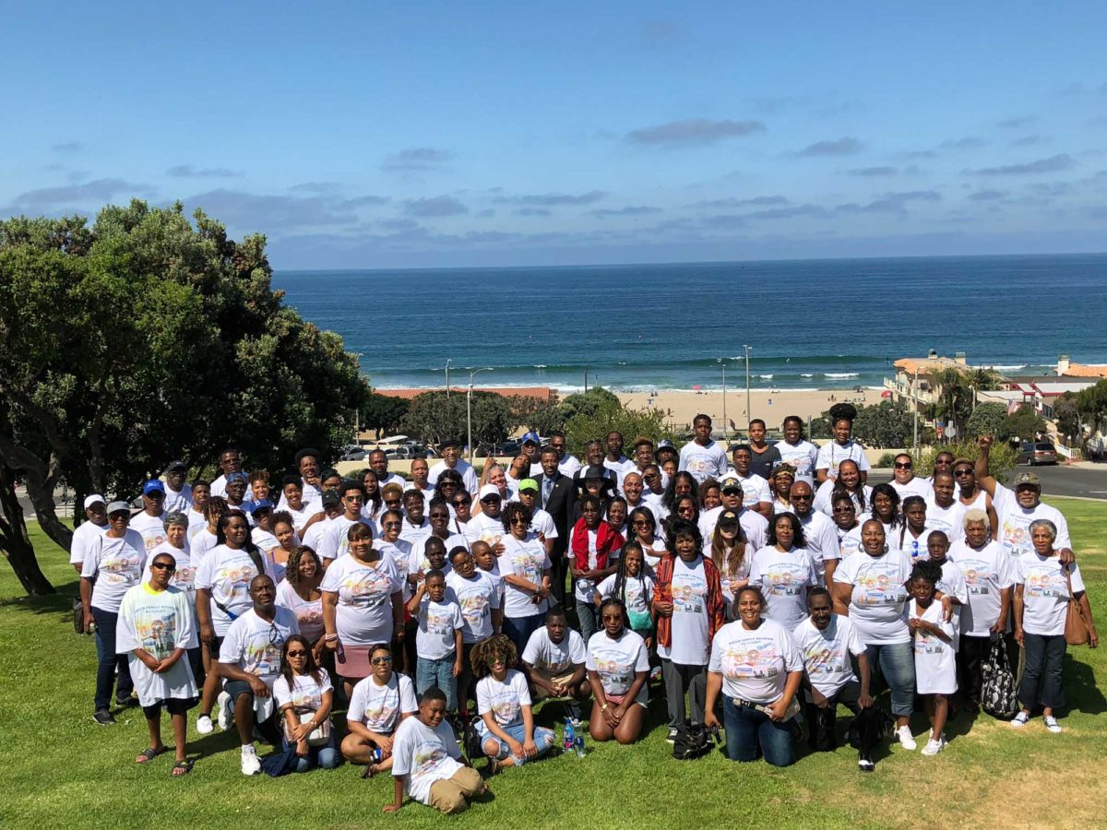
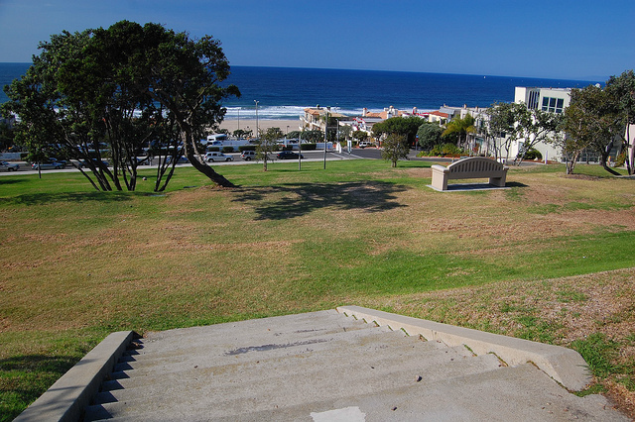
The Bruce Family reunion, 2018.
2006, official re-naming of the park to Bruce’s Beach

Slide 33
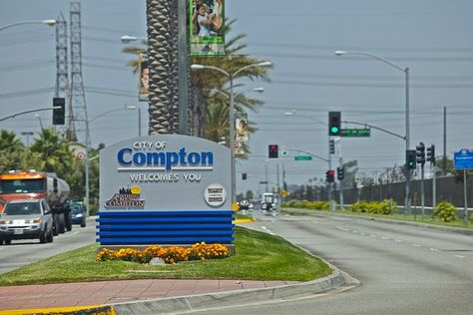
Compton as Microcosm of Urban Decline

Slide 34
How to Measure Segregation?
Isolation
Compares diversity by social group
City A: 75% White, 25% Black
Average Black resident lives in a neighborhood that is 80% black, group is “isolated”
Its members generally live in areas that don’t reflect the broader diversity of the city as a whole
Evenness
Compares diversity by neighborhood
The social mix of each neighborhood is compared to the overall social mix of the city.
The larger the neighborhood-to-entire-city difference on average, the more segregated the city is said to be

Slide 35
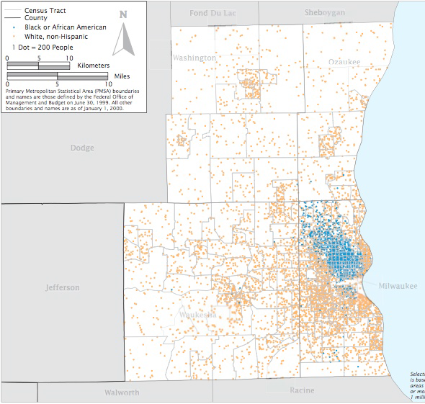
Milwaukee, WI

Slide 36
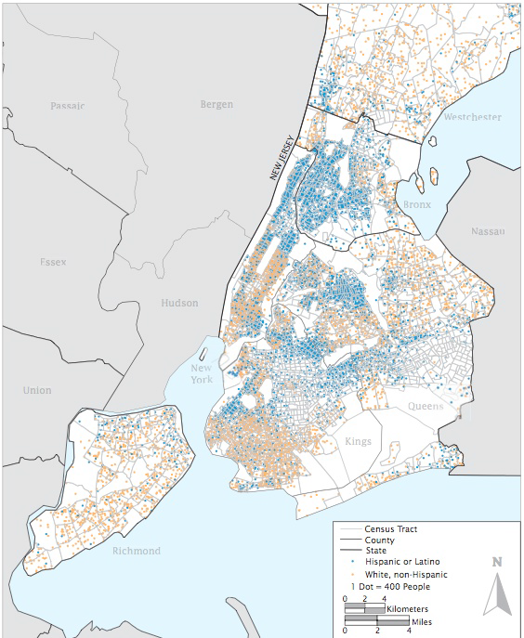
New York, NY

Slide 37
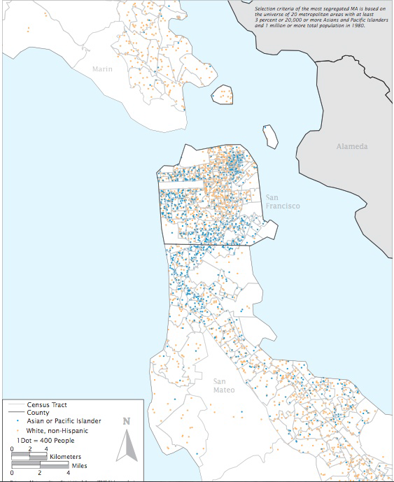
San Francisco Bay Area

Slide 38
Index of Dissimilarity
Santa Monica, CA
ZIP Code | Share of Hispanic Population | Share of non-Hispanic population | Absolute Value of Difference
90401 | 5.6% | 6.1% | 0.5
90402 | 3.7% | 14.8% | 11.1
90403 | 11.8% | 29.7% | 17.9
90404 | 48.8% | 19.2% | 29.5
90405 | 30.2% | 30.2% | 0.0
TOTAL | 100% | 100% | 59.1
Santa Monica’s Hispanic population is not evenly distributed among its five zip codes.
Note: 90404 has almost half of the Hispanic population.
How severely segregated is this? It has an index of dissimilarity of 29.6. 29.6% of Santa Monica’s Hispanic residents would need to move to create evenness. This is seen as low-to-moderate segregation.
For Blacks in Santa Monica it’s 33 and for Asians, it’s 5.
By comparison, Blacks in Milwaukee have an index of 80 (80% of Blacks would have to move to create evenness).

Slide 39
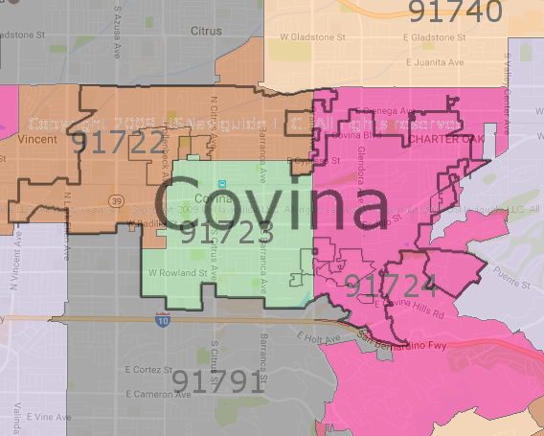
ZIP Code | Share of Hispanic Population | Share of non-Hispanic population | Absolute Value of Difference
91722 | 50% | 37% | 13
91723 | 23% | 24% | 1
91724 | 28% | 40% | 12
TOTAL | 100% | 100% | 26
Covina, CA
Index for Covina = 13; means only 13% of Hispanic population would have to move to achieve perfect evenness.

Slide 40
Segregation of U.S. Metro Areas
African American
Milwaukee: dissimilarity = 82, isolation = .72
Detroit: dissimilarity = 85, isolation - .81
Cleveland: dissimilarity = 77, isolation = .72
Los Angeles: dissimilarity = 66, isolation = .65
Orange County: dissimilarity = 37, isolation = .09
LA County’s African-Americans are moderately-to-highly segregated. On average, they live in census tracts that are 65% African-American and 66% would need to move to achieve evenness. Orange County has an African-American population that is much smaller but also less segregated.

Slide 41
Hispanic
NY: dissimilarity=67, isolation = .71
Providence, RI: dissimilarity = 68, isolation = .43
Phoenix, AZ: dissimilarity = 52, isolation = .51
Los Angeles: dissimilarity = 63, isolation = .77 (on average, LA County Hispanics live in census tracts that are 77% Hispanic, and 63% of its residents would have to move to another ZIP code to achieve evenness.)
Orange County: dissimilarity = 55, isolation = .61
Los Angeles even more segregated in terms of its Hispanic populations—on average they live in census tracts that are 77% Hispanic and in Orange County, 66% Hispanic.
Only New York metro area has a more segregated Hispanic population.

Slide 42
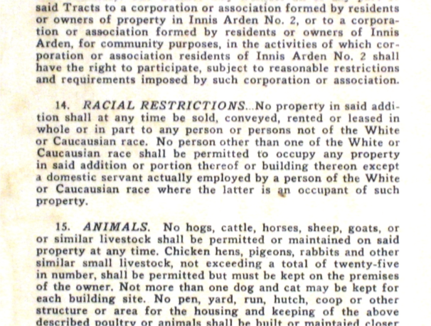
Explaining Segregation
Racially restrictive covenants
Legally binding rule attached to private property
Restricts what owner can do with or on the property (on top of any local, state, federal laws)
Today may be things like what color a house can be painted but in the 1920s-50s required owners and residents to be “of the White race.”

Slide 43
Role of real-estate agents, insurers, banks
“Steer” clients towards certain neighborhoods where they’re perceived to “belong.” RACIAL STEERING
Loans more likely if the home or business owner “fits” in with surroundings
Insurers refuse to do business in a neighborhood they perceive as too “risky”—REDLINING
Realtors convince white owners to sell their homes at low prices by promoting fear of racial minorities. BLOCKBUSTING.

Slide 44
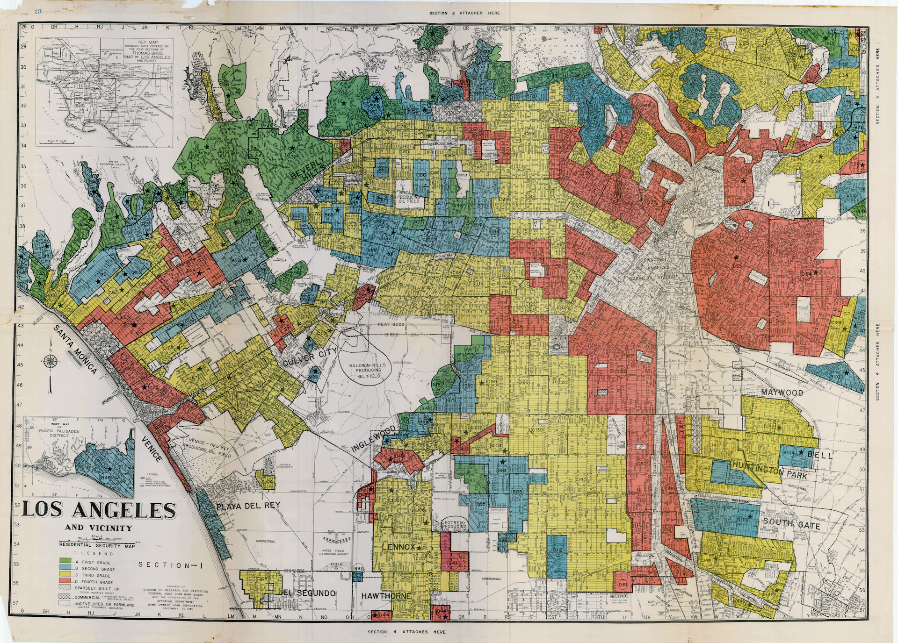
1939 Home Owner Loan Corporation (HOLC) map of Los Angeles.
HOLC created by FDR. Guarantee mortgages to ease lending.
Source: urbanoasis.org

Slide 45
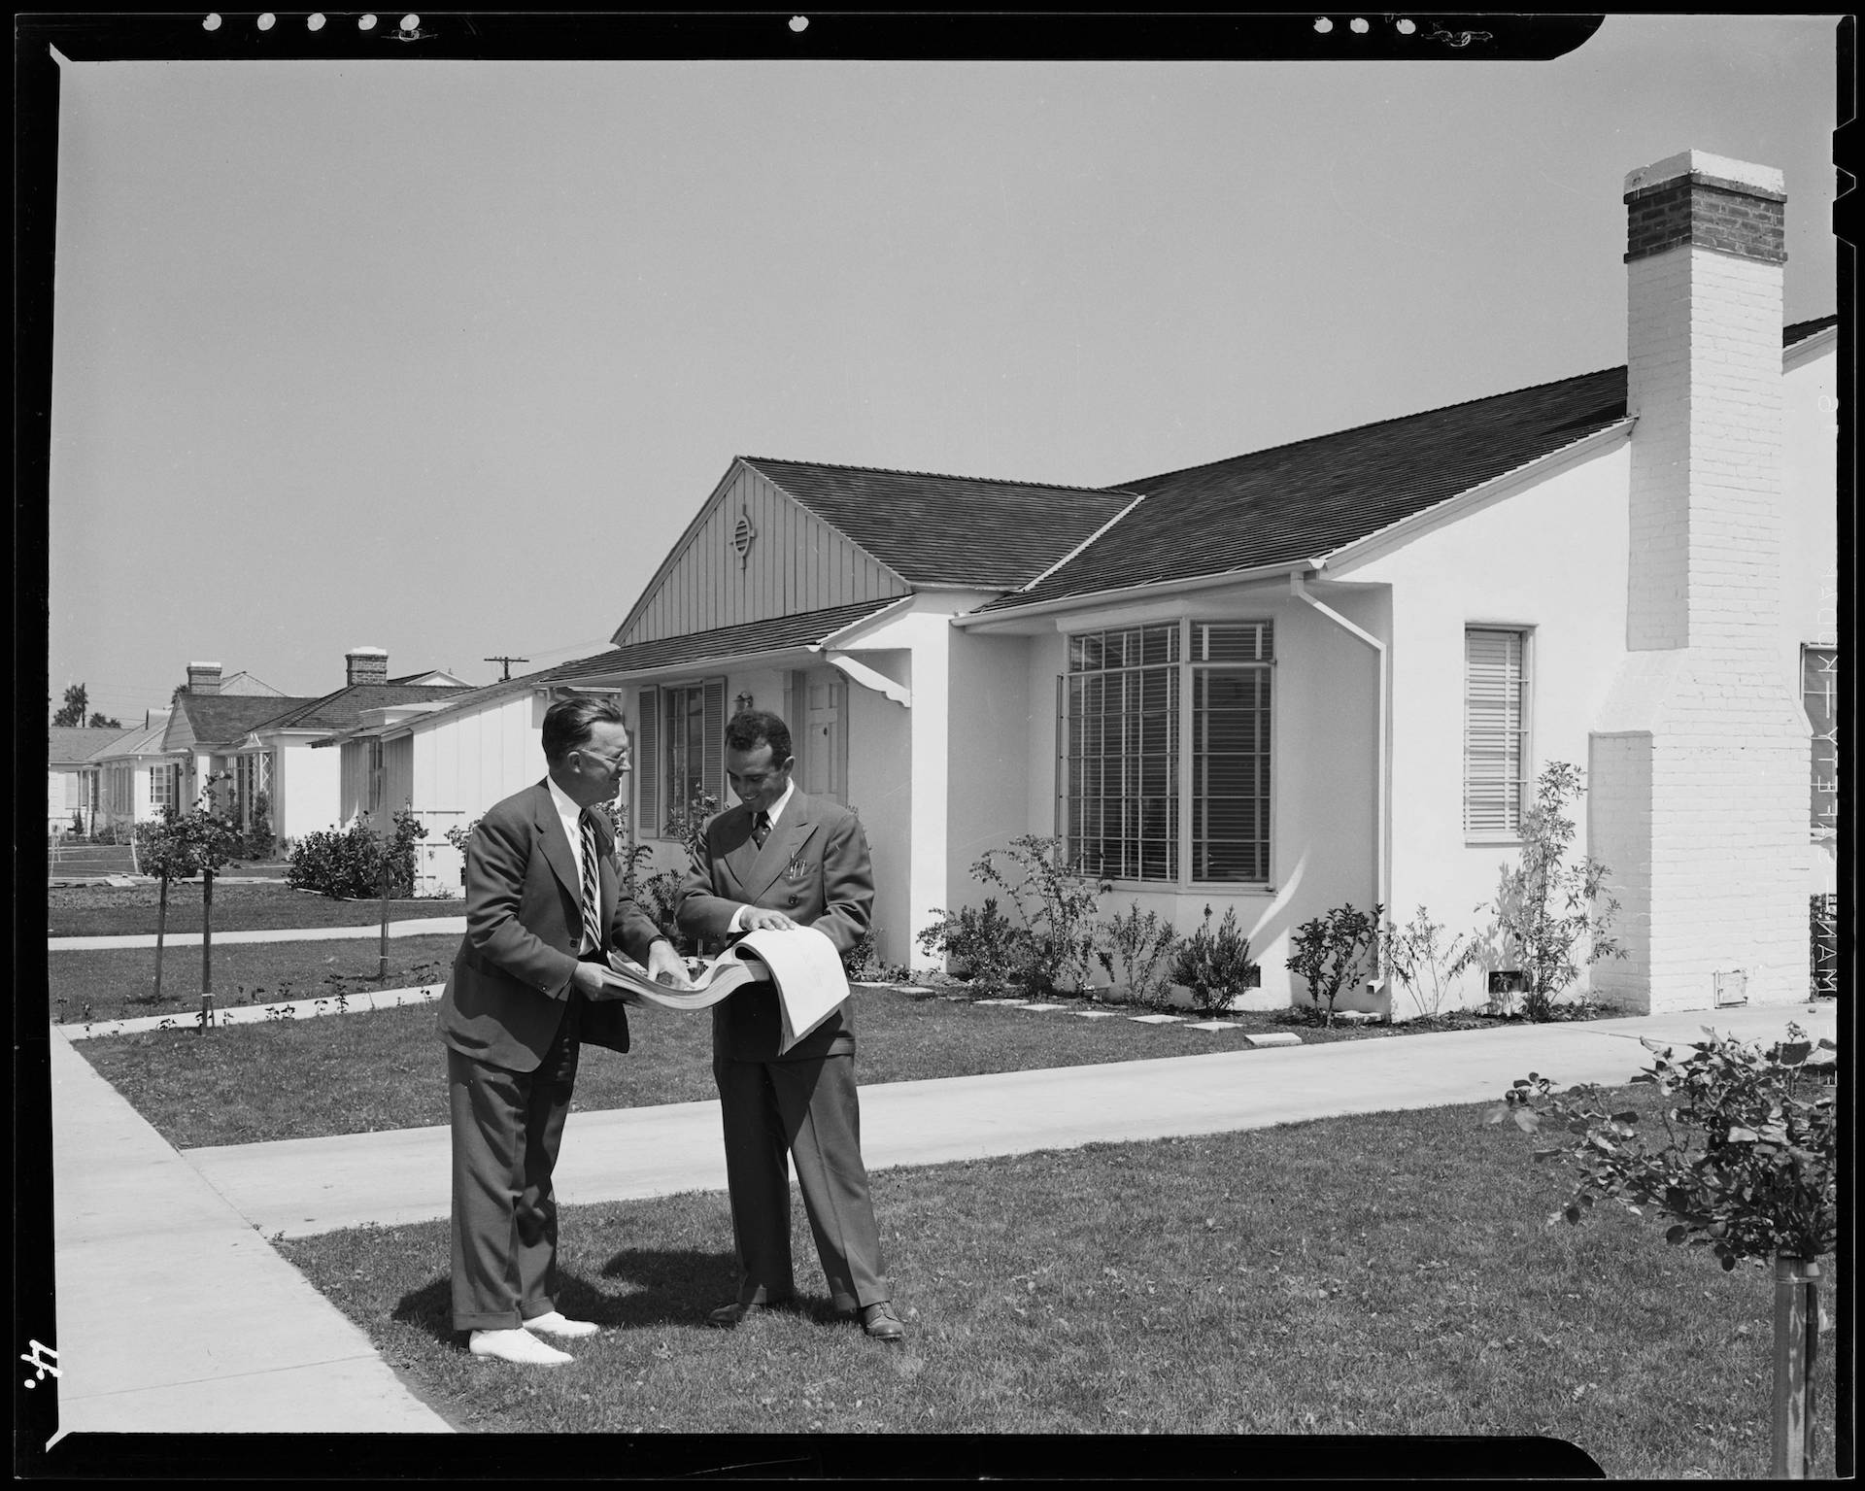
A 1940 publicity shot for the Crenshaw Park housing development, courtesy of the USC Libraries.

Slide 46
HOLC and FHA created a set of national standards for assessing mortgage “risk.”
HOLC ranked neighborhoods from A to D.
A=green, best environments for investments for homeowners and banks
B=blue, still desirable neighborhoods
C=yellow, neighborhoods in decline
D=red, hazardous neighborhoods
How was “risk” assessed?
Valued homogeneity, especially in regard to ethnicity and race
“Red” communities usually contained minority populations—African-Americans, Mexican-Americans, Asian-Americans and sometimes new immigrant groups like Slavs, Jews, Italians.
Drew private investment away from heterogeneous communities like Boyle Heights in Los Angeles, and Watts.
Working class and white ethnic communities fared better but were also penalized with a “C” grade (and sometimes a “D”).

Slide 47
Impacts of Redlining
These communities struggled to get federally backed home loans, making property ownership much more difficult.
Difficult to get loans for improvement—maintenance, upkeep, renovation became very unlikely.
Created a vicious circle of decline: inability to access capital led to disrepair and the physical decline of a community’s housing stock, which reinforced the redline designation.
The groups within the “redline” then became associated with declining home values and a “threat” to neighborhoods—racialized.

Slide 48
From the maps:
if “not for a scattering of Japanese and Filipino residents [Hollywood] would be entitled to a higher grade.”
Central LA dismayed appraisers due to its “highly heterogeneous” population and “sprinkling of subversive racial elements”, its “concentrations of Japanese and Negroes.”
Almost all the neighborhoods abutting downtown were redlined.
West Adams had seen an “infiltration” of blacks and Japanese; one homeowner is quoted, “This home of ours is the one big financial venture of our life, and there must be some way to protect us from this particular Japanese invasion” (1940).
The HOLC chided suburban, working-class South Gate for its lack of deed restrictions, but praised it for its homogeneity, awarding it a low-blue rating.

Slide 49
Created a caste system of race and ethnicity in Los Angeles
FHA & HOLC assessors saw Asians and African-Americans as the most “subversive”
Southern, Eastern Europeans and Mexicans with the right mix of social class, occupation and skin color could “climb the ladder of whiteness.”
Claremont—one neighborhood received a “C” rather than a “D” since it contained “a few better class Mexicans.”
Areas like El Monte were described, however, as populated by “goats, rabbits, and dark skinned babies” for its larger concentration of Mexican-Americans. Referred to as “peon Mexicans” even if they were native born.
Once a community was redlined, its decline was often targeted as “blight” and a candidate for “renewal”
Chavez Ravine—Dodger Stadium.
Other blighted communities became the site for freeways (Boyle Heights) undoing and marginalizing them further.

Slide 50
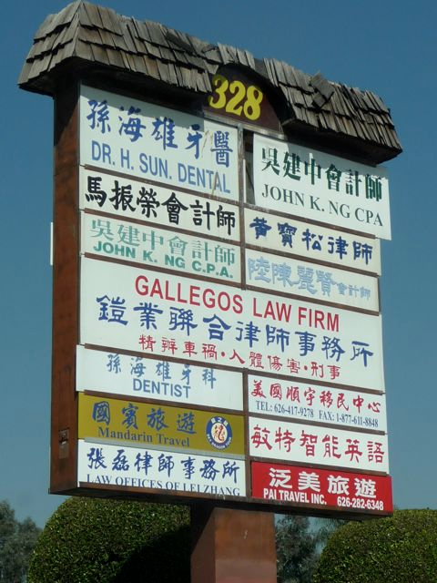
Why does segregation persist?
Market economics (bid-rent competition)
Today, the geography of affluent vs less affluent?
Hedonic price models—location matters, there will be neighborhoods the less affluent cannot afford.
Personal preferences (voluntary self-separation)
Income and wealth only part of the story today.
Esp among 1st and 2nd generation immigrants—may desire an “isolated” neighborhood (foods, languages, churches, etc. are familiar)
Can isolation be supportive rather than marginalizing?
Ethnoburbs—Monterey Park need to be considered as well as the discriminatory ghettos of the past, like Chinatown.

Slide 51
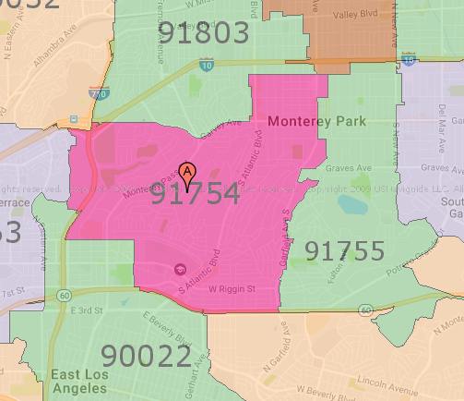
Monterey Park, CA
ZIP Code | Share of non-Asian populations | Share of Asian population | Absolute Value of Difference
91754 | 61% | 51% | 10
91755 | 39% | 49% | 10
TOTAL | 100% | 100% | 20
10% of non-Asian population would have to move to create evenness.

Slide 52
Cities and Immigrants
Old Wave: early, mid 1800s
Entered in New York
Mostly from northwestern Europe
Boston—Irish
Chicago/Cincinnati/Milwaukee—German
San Francisco—Chinese
Less segregation, except Chinatown
New Wave: late 1800s, early 1900s
Southern and eastern Europe—Catholic, Orthodox Christian, Jews
Urban, tenement-heavy slums, segregated ghettos
Most in the industrial Northeast
Third Wave: late 1900s, early 2000s
Post 1965, Latin America, Southern and Eastern Asia
Urban, but Sunbelt
Houston, Miami, Atlanta, Phoenix, LA
High levels of segregation and regionalization
Segregation not always black/white issue.
Waves of new immigrants shaped urban
residential patterns, too.
At early 1900s about 10 mill entered the US
per year.

Slide 53
Third Wave Immigration
Spatially clustered, ethnic/enclave communities—primarily voluntary segregation. Geographic sorting.
Koreatown (Los Angeles), Little Saigon (Westminster), Little Havana (Miami), Pilsen (Chicago).
Often seen as centers of empowerment now rather than exclusion or marginality.

