Slide 1
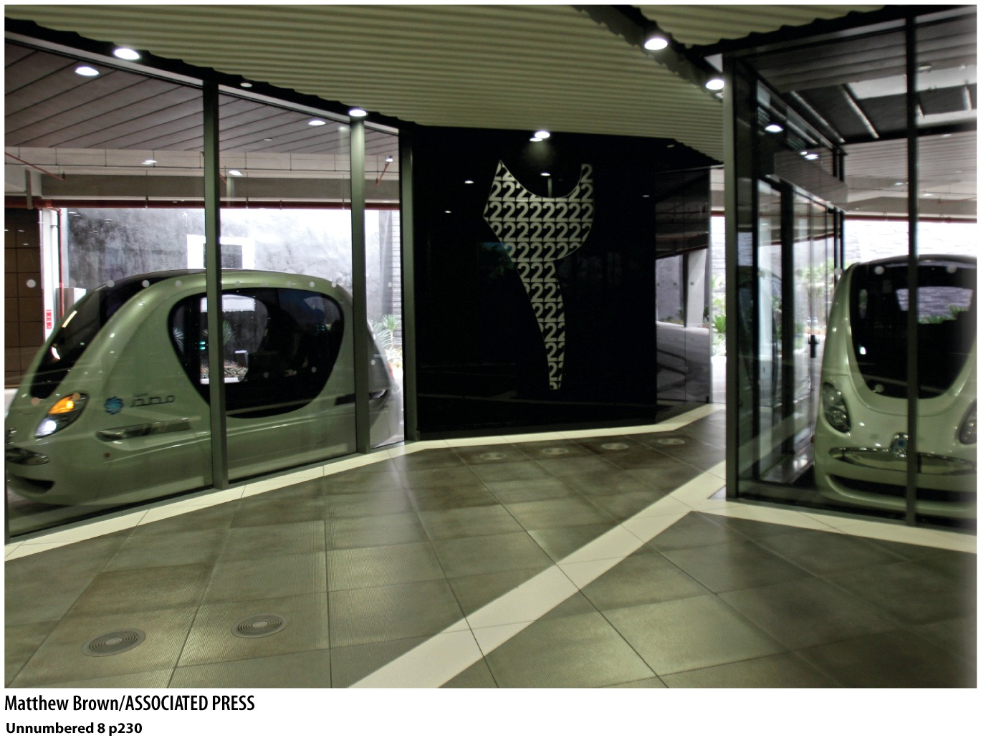
Geography 8: Introduction to Urban Geography
Masdar City, United Arab Emirates. The city of the future?
A zero-waste, zero-carbon desert city.

Slide 2
Keywords—Week 1
Urban | Rural | Density | Urbanized
Sphere of influence | Tributary areas | Metropolitan | Mother City
MSA | CSA | Conurbation | Jean Gottmann
Megalopolis | Bos-Wash | Tokaido | Blue Banana
Chicago School | Inter-metropolitan | Intra-metropolitan | Lewis Mumford
Richard Florida | Agglomeration | Bradley & Katz

Slide 3
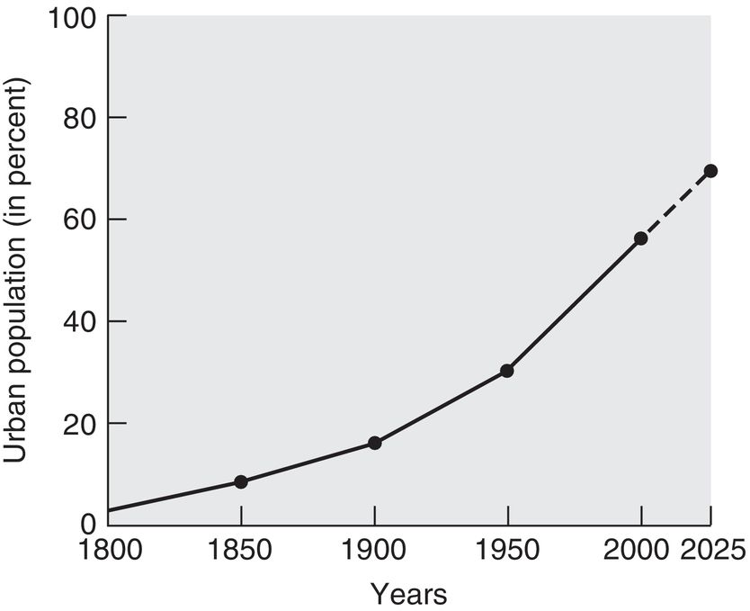
Why do we study cities?
Because humans created them
Because most humans live in them
Mid-1990s: 50%
2010s: almost 4 billion urban dwellers
Today: 1 in 5 humans
2050: 2/3s of humans
This is all pretty new
100 years ago: 14%
200 years ago: 3%
Today: 50%+

Slide 4
What’s different about urbanization today?
Was tied to development
Today urbanization happening fastest in the developing world
Even rural areas are connected to and dependent upon cities.

Slide 5
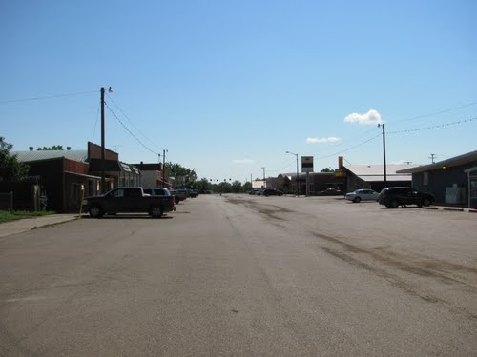
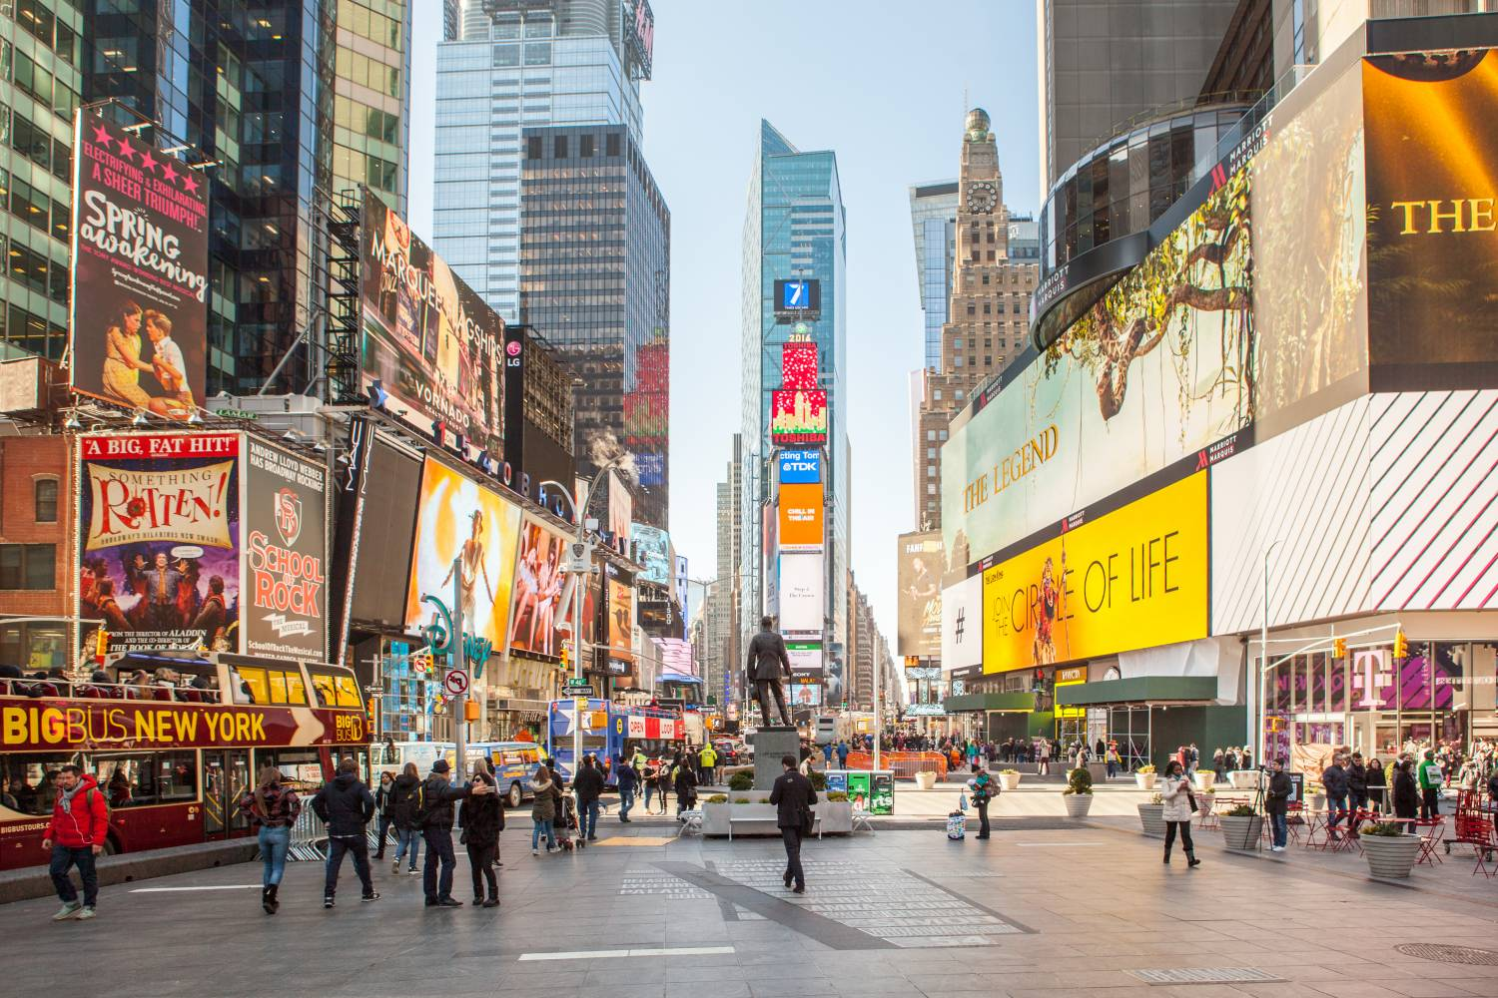
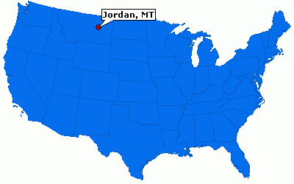
So, what is urban?

Slide 6
Defining urban
Number of people
US Census Bureau=2500
Some countries set the threshold much higher (20,000)
Density
US Census Bureau=1000 persons/square mile
The problem of the suburbs, the exurbs?
What’s going on there
Functional complexity
Mixed land use
Power
Connections to other places
The urban-rural continuum. Neil Brenner, Harvard School of Design and Urban Planning, says no such thing as rural anymore.

Slide 7
Sphere of Influence & Tributary Areas
What “sphere of influence” does a city have?
What areas does a city have connections to
What areas does a city have influence over
Tributary areas
Movement of goods, services
Hospitals, sports team, entertainment, consumption
Movement of labor
Commute patterns

Slide 8
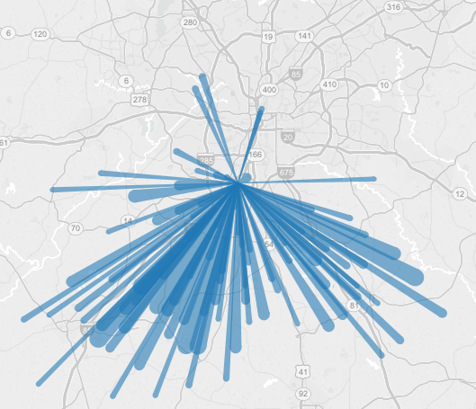
Commute patterns in Atlanta, GA

Slide 9
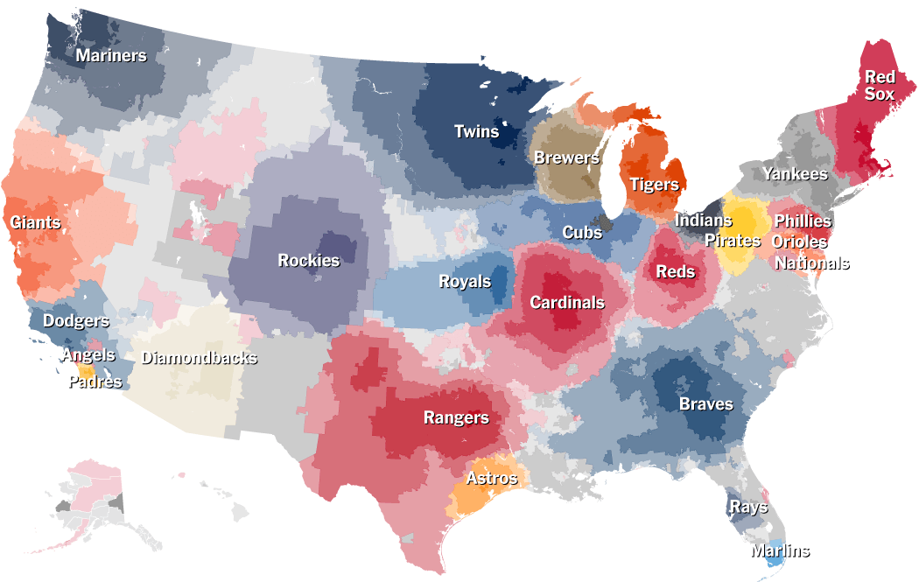
Source: NY Times, April 2014

Slide 10
Metropolitan Area
Metropolitan Statistical Area
A collection of counties
At least 50,000 people
Some of these counties may have rural areas
All are connected to the “Mother City”
Consolidated Statistical Area
MSAs that have grown and merged together

Slide 11
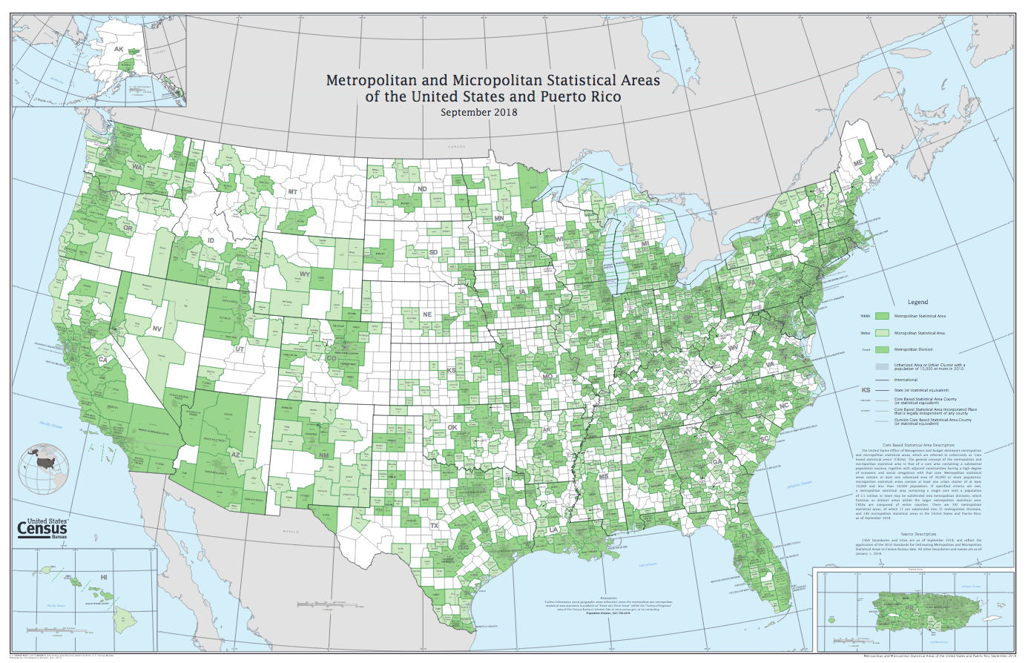
Green areas are counties that are considered metropolitan, non-metropolitan counties are white. Entire counties are included (even though some parts of these counties may have rural areas), and because the cut-off is 50,000 so a large portion of the country falls into an MSA.

Slide 12
Rank | Metropolitan Area | 2010 (millions) | % change, 2000-2010
1 | New York, NY | 19.6 | 3.3
2 | Los Angeles, CA | 12.8 | 3.7
3 | Chicago, IL | 9.5 | 4
4 | Dallas-Fort Worth, TX | 6.4 | 23.5
5 | Philadelphia, PA | 6.0 | 4.9
6 | Houston, TX | 5.9 | 26.1
7 | Washington, DC | 5.6 | 16.5
8 | Miami, FL | 5.6 | 11.1
9 | Atlanta, GA | 5.3 | 24
10 | Boston, MA | 4.6 | 3.7
11 | San Francisco, CA | 4.3 | 5.1
12 | Detroit, MI | 4.3 | -3.5
13 | Riverside, CA | 4.2 | 29.8
14 | Phoenix, AZ | 4.2 | 28.9
15 | Seattle, WA | 3.4 | 13
16 | Minneapolis-St. Paul, MN | 3.3 | 10.5
83% of Americans live in an MSA.
America’s urban population occupies about 25% of the total land.

Slide 13
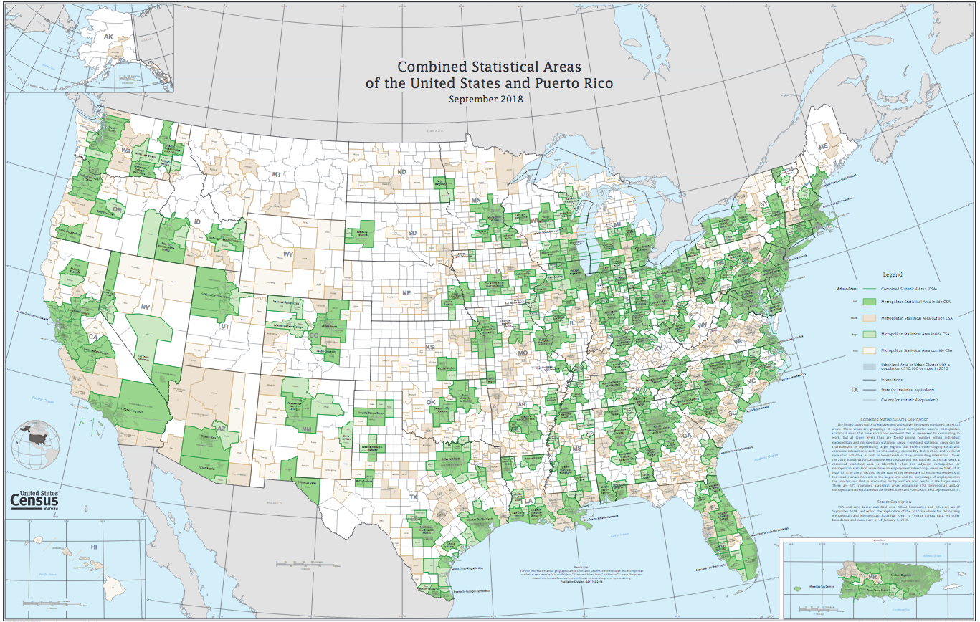
1. NY-Newark-CT-PA. 23.7m 2. LA-Long Beach. 18.7 m. 3. Chicago 9.8m 4.Baltimore-Washington 9.7m
5. SF-San Jose 8.8m 6. Boston 8m Fast growing areas: Las Vegas, Raleigh (42%), Phoenix, and Austin (37%)

Slide 14
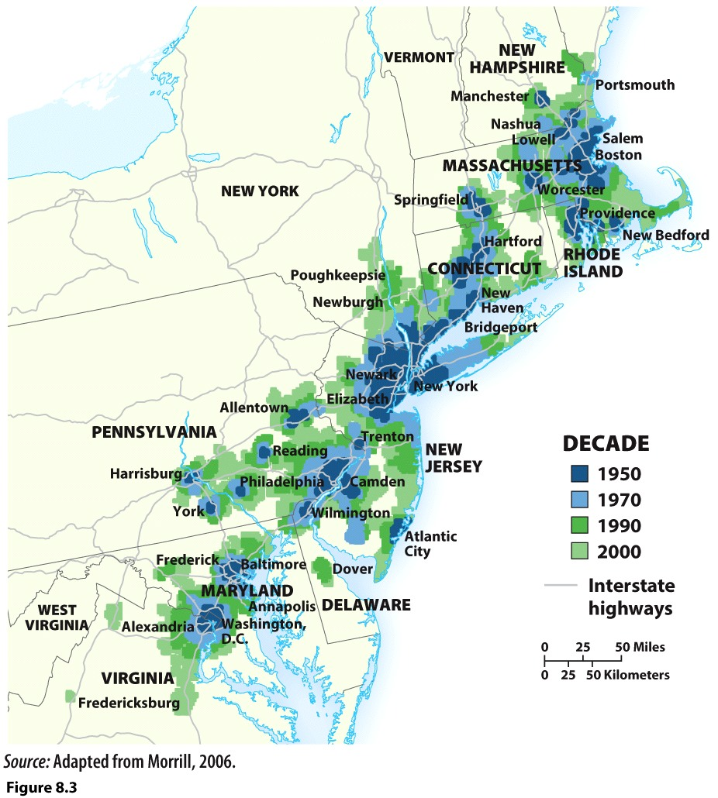
Conurbation
Jean Gottmann
The Bos—Wash Conurbation
Megalopolis: the sprawl of interwoven cities

Slide 15
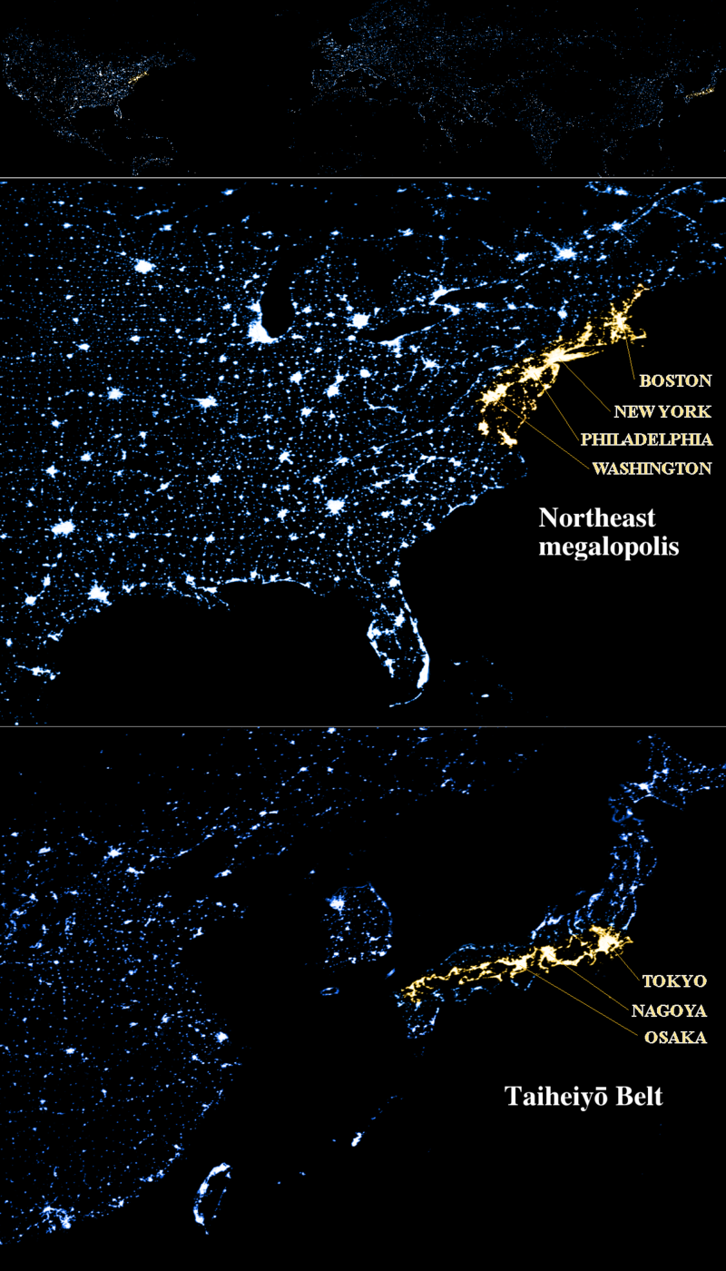
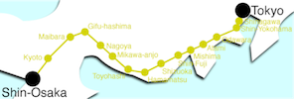
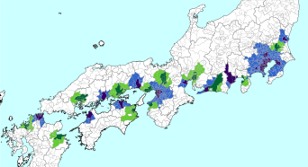
The “I-95” corridor from Boston to Washington, DC
The Tokaido conurbation—along Pacific coast of Honshu island. Tokyo to Osaka/Kobe.

Slide 16
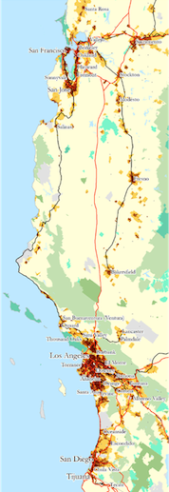
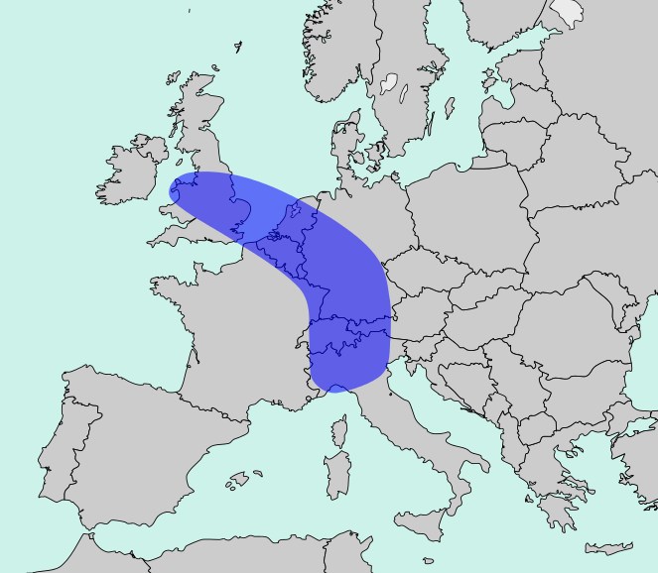
Coastal CA conurbation—clusters around Los Angeles MSA and SF Bay Area.
Europe’s Blue Banana conurbation—London to Netherlands, Belgium, Northern France and Western Germany, through Switzerland and Northern Italy.

Slide 17
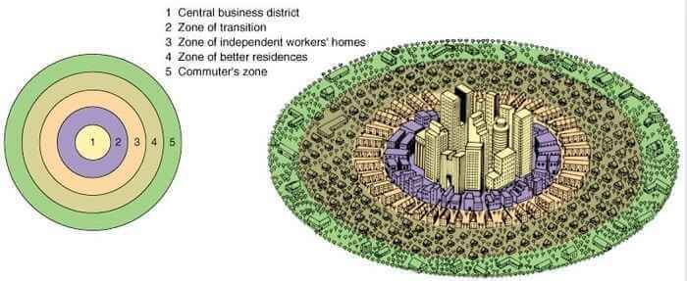
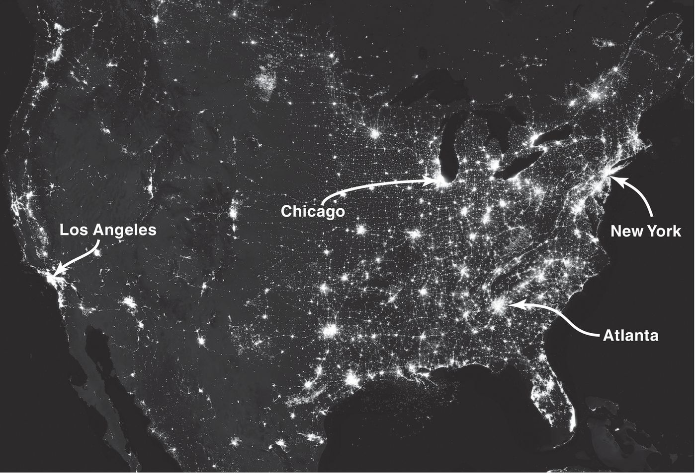
How do geographers study cities?
Sociology
The Chicago School
Human geography
Where people and their activities are found
Urban geography
What types of economic activities?
Where do different economic activities occur?
How do social relationships take spatial form?
How is culture reflected on city landscapes?
Inter-metropolitan
Relationship between a group of cities
Intra-metropolitan
Internal arrangement of humans, activities and institutions within a city

Slide 18
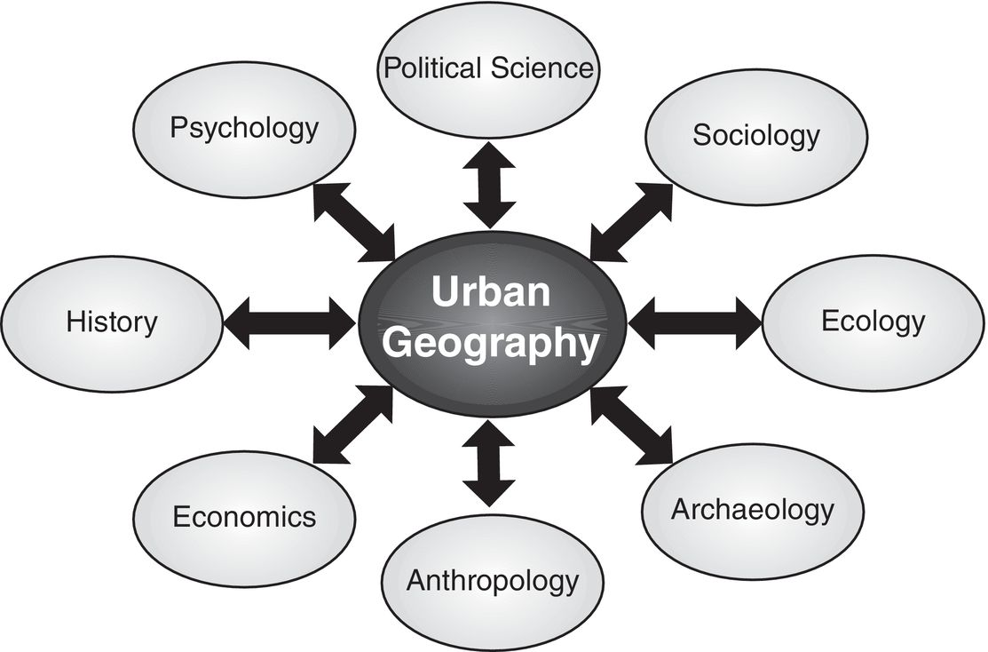
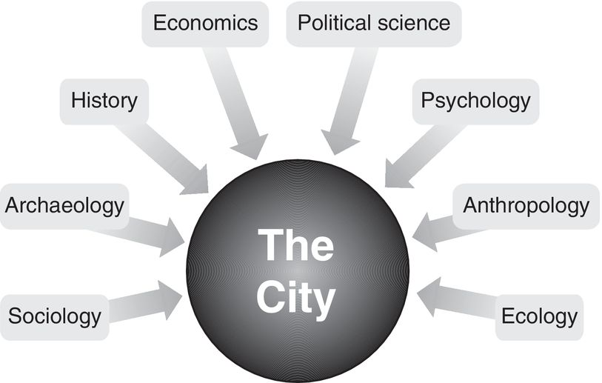
What can I do with urban geography?
Urban planning—both public & private
Urban design—architecture, landscape architecture
Public administration—policy
Real estate and real estate development
Civil engineering
Non-governmental organizations, non-profits, groups that work to improve cities and the lives of residents in cities.

Slide 19
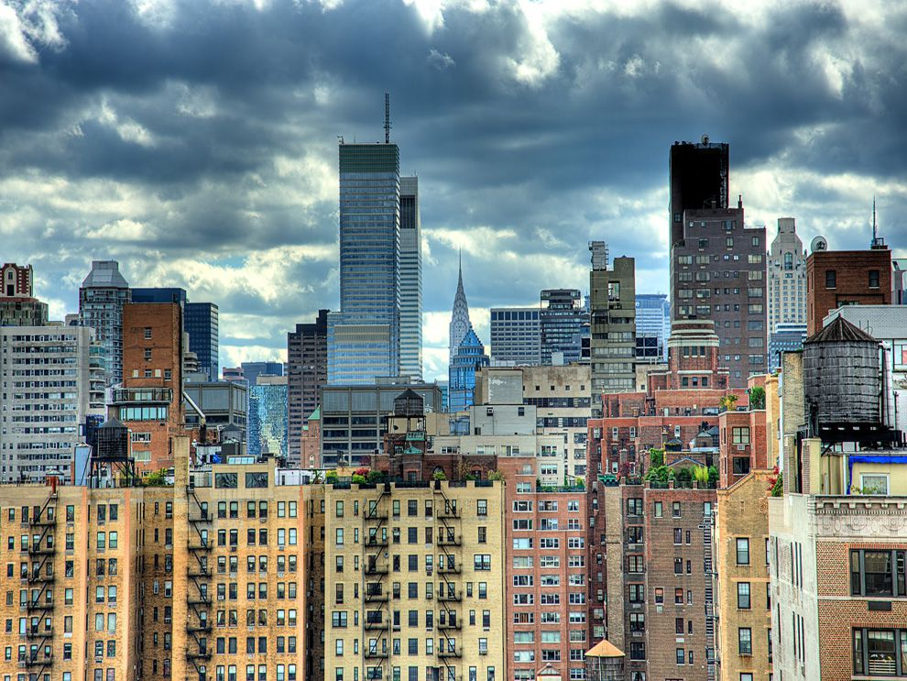
New York City is the largest urban area in the United States with more than 19 million people living in the metro area.
Credit: NatGeo, Alex Flatov.

Slide 20
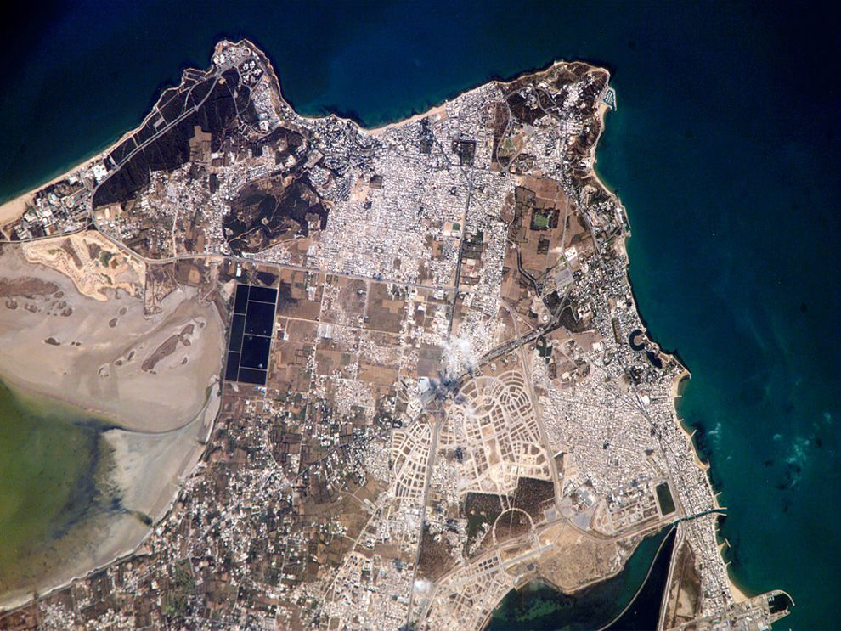
Ancient city—Carthage, Tunisia. There is also a modern Carthage—it has become a suburb of Tunis.
Photo taken by the International Space Station’s Expedition 13 crew.
Modern Carthage is a wealthy suburb of the Tunis metropolitan area.
Credit: NatGeo, NASA

Slide 21
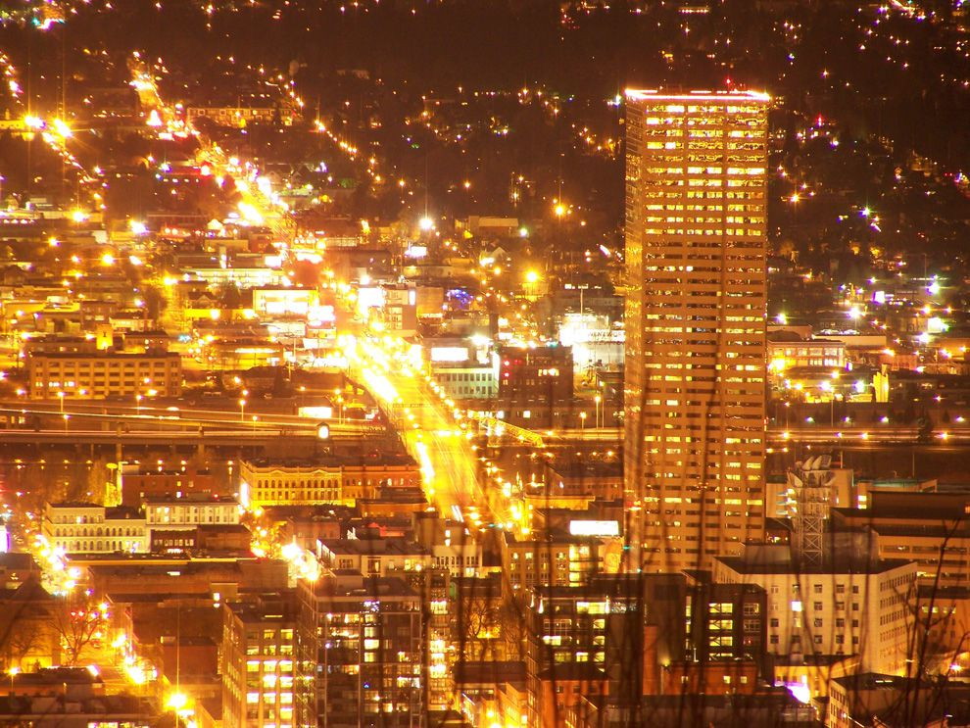
Portland, Oregon. Portland is the 3rd largest urban area in the Pacific Northwest. Only Seattle, WA and Vancouver, BC, Canada are more populous.
Credit: NatGeo, Jared Elder.

Slide 22
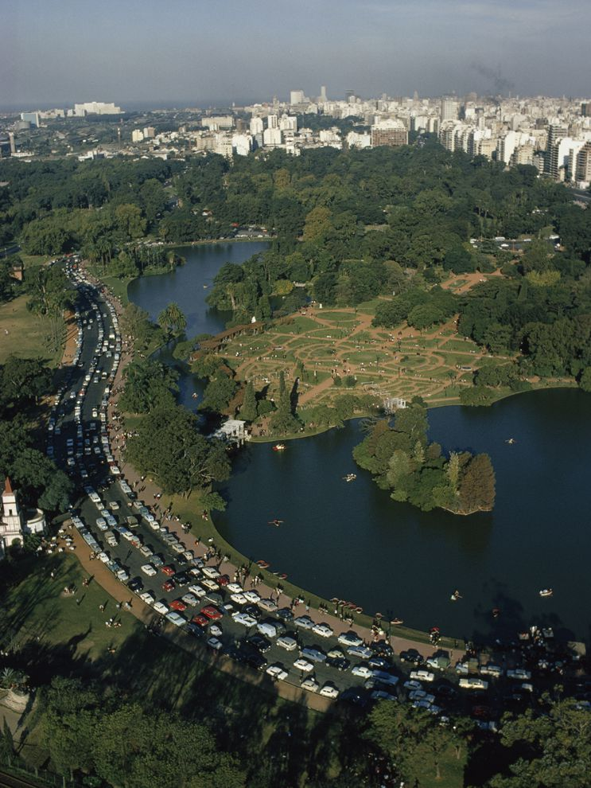
Buenos Aires, Argentina.
Park along the Rio Plata.
The Rio Plata has made the city’s port one of South America’s busiest. People of Buenos Aires are called “portenos.”
Credit: NatGeo, Winfield Parks

Slide 23
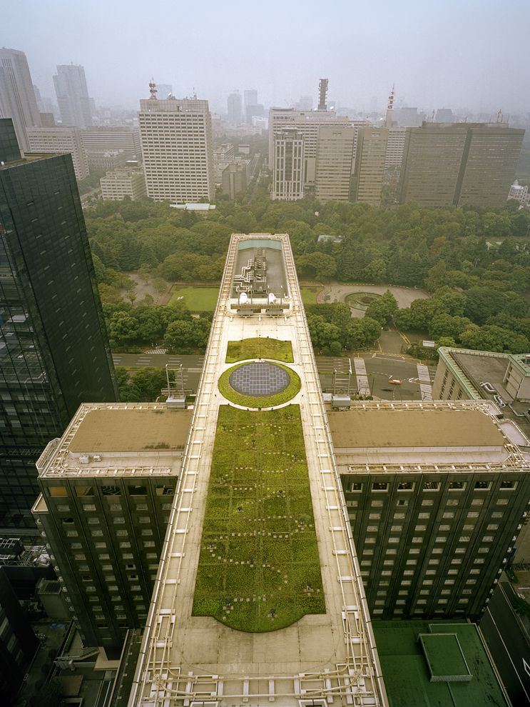
Tokyo, Japan.
Green plants and solar electric panels adorn the rooftop of a hotel.
Tokyo is one of the most crowded urban areas
In the world, and green areas are very valuable.
Credit: NatGeo, Diane Cook, Len Jenshel.

Slide 24
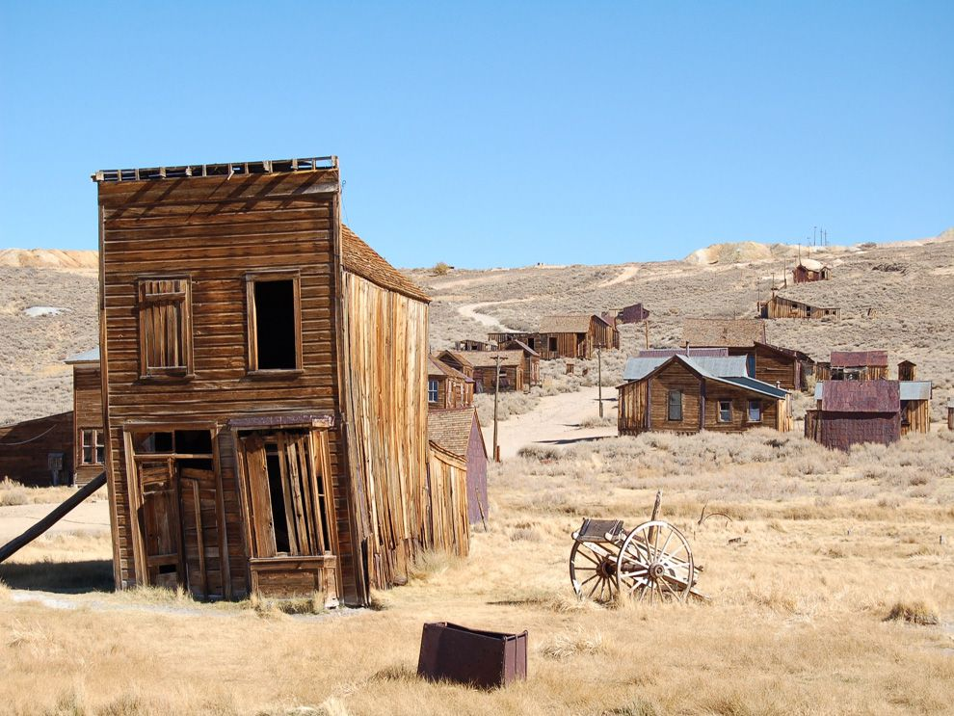
Bodie, CA. Was a bustling urban area during CA’s Gold Rush. Had nearly 200 buildings.
Now a ghost town on the border with Nevada.
Credit: NatGeo, Christine Tuohy.

Slide 25
Why do we care about cities?
Not just because there are a lot of people in them.
Lewis Mumford, “The city as one finds it in history, is the point of maximum concentration for the power and culture of a community.”
Richard Florida, “Cities are our greatest invention. They generate wealth and improve living standards while providing the density, interaction, and networks that make us more creative and productive.”
Bradley & Katz—economists at the Brooking Institute
cities are disproportionately important to the US economy
Top 100 metro areas in the US use only 12% of the land but house 2/3s of the people and contribute ¾ of the total economic output.
There really is no “American Economy;” a national economy made up of a network of metropolitan economies.

Slide 26
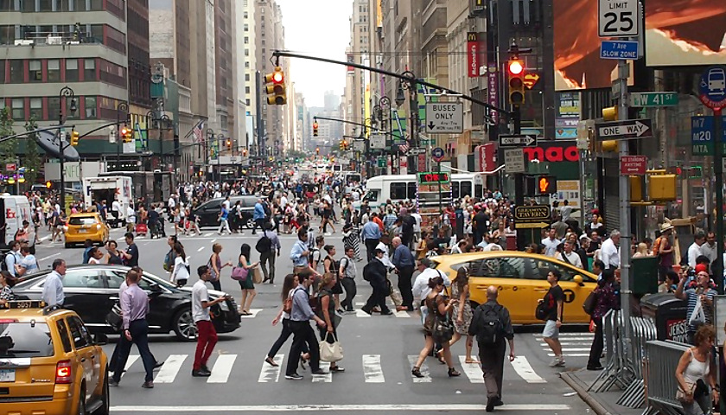
Cities are more important than ever
Cities embody concentration and agglomeration
networks of innovative companies
concentrations of talented workers
risk-taking entrepreneurs
support institutions

Slide 27
Do cities change over time?
Yes!
They are especially impacted by economic change.
But, cities are also the origins of change—social and cultural.
“The only consistent thing about cities is that they are always changing”
Tim Hall
“The mortality of persons contrasts sharply with the immortality of cities”
James Vance

Slide 28
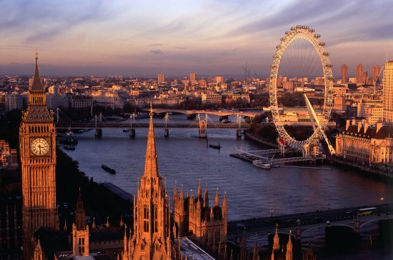
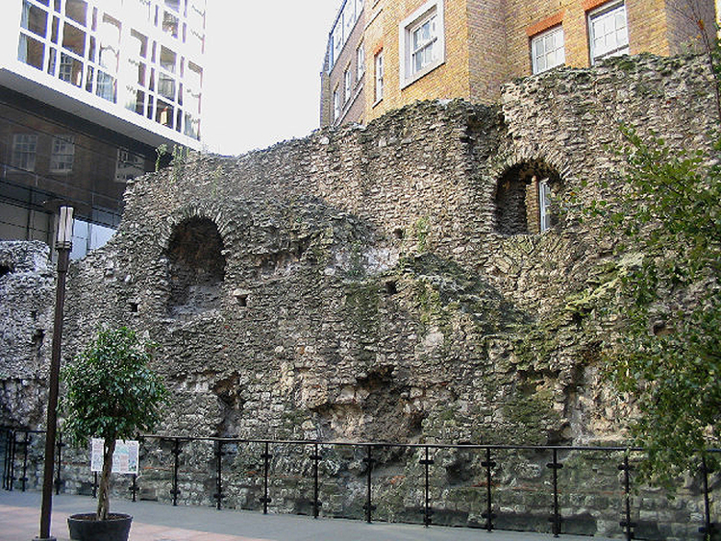
As much as cities change, they are also timeless
Today’s London Wall built around Londinium
by the Romans, 120 CE

Slide 29
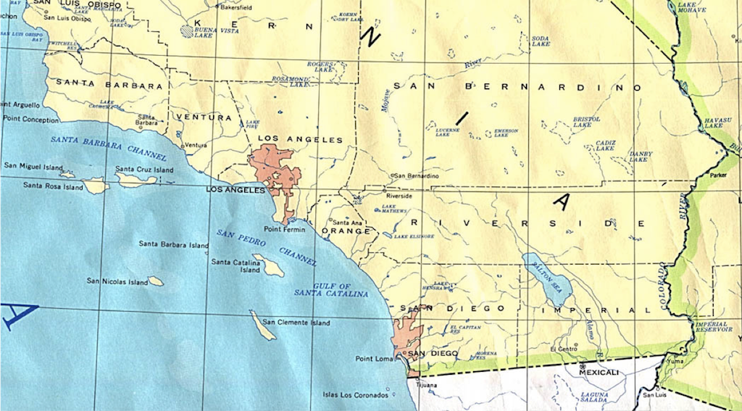
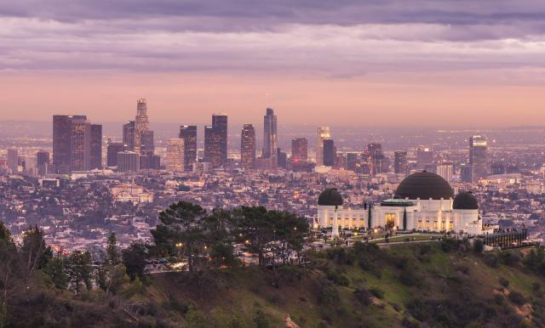
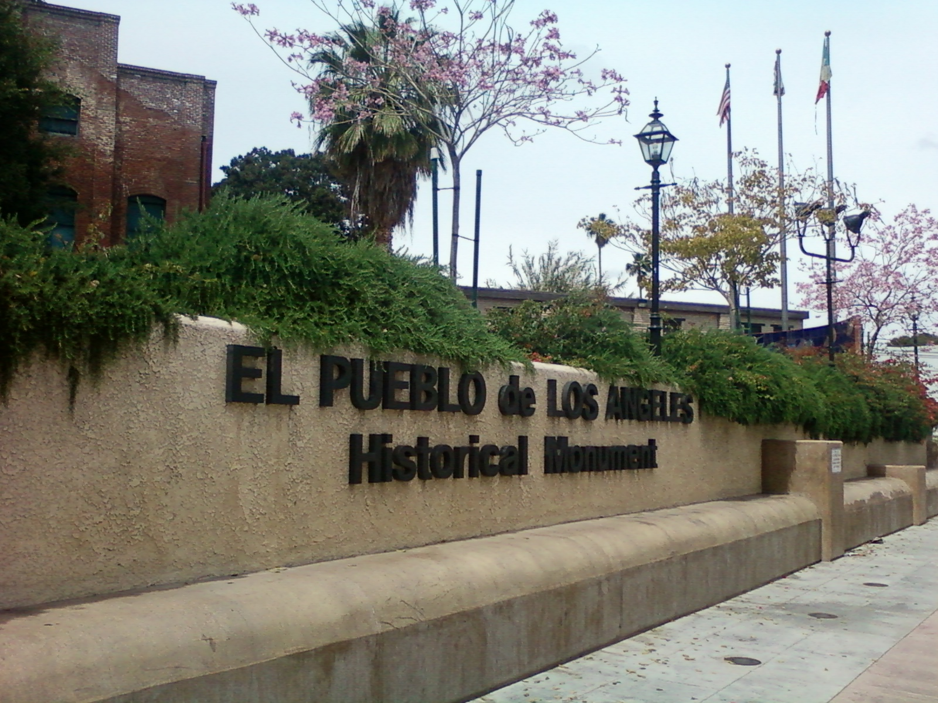
The past is still visible in the present

