Slide 1
Geography 8: Urban Geography
The Social Life of Cities & Urban Morphology

Slide 2
Keywords
Anomie
Bid-rent competition
Chicago school
Communitiy
Deviance
Enclave
Gemeinschaft vs Gesellschaft
Human ecology
Jane Jacobs & sidewalks as public space
Los Angeles School
Postmodern
Shock city
Spatial entrapment
Urban morphology/morphogenesis
Concentric zone model (Burgess)
Ecology of fear (Davis)
Keno capitalism (Dear & Flusty)
Multiple nuclei model (Harris & Ullman)
Sector model (Hoyt)
Urban mosaic (Murdie)
Urban villagers
Urbanism

Slide 3
The Urban Way of Life
Centuries trying to explain, make sense of “urban life”
Know that “urban life” is different than “rural life”
Humans are impacted by the urban spaces they occupy
But humans constantly modifying, altering places to suit their needs
A “Socio-Spatial Dialectic”
Cities and human behavior
History of theories to explain this
New viewpoints, in “critical theory”
Urban morphology
Internal structure and geographies of cities

Slide 4
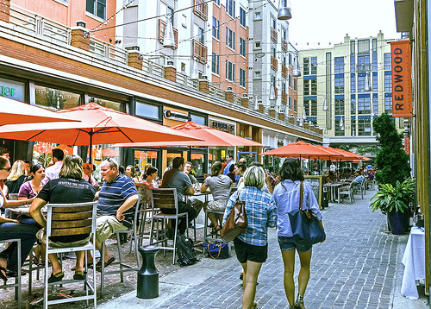
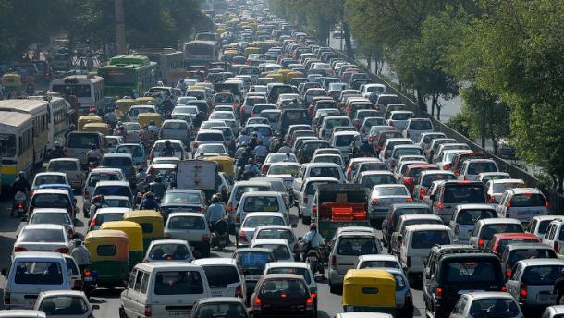
What Does Urban Life Mean?
Fragmented, decadent, lacking in community, alienating
polarizing.
Modern, culturally advanced, cosmopolitan, exciting,
diverse.

Slide 5
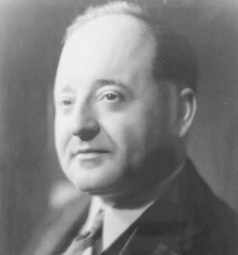
Louis Wirth: Urban Sociologist
German immigrant to Chicago, early 20th C.
Chicago, early 20th C, a “shock city”
University of Chicago, famous Chicago School
“Urbanism as a Way of Life,” 1938
Observed Chicago, with its waves of newly arriving immigrants
Living in densely packed neighborhoods in a large city
Concluded:
Urban life fundamentally changing human behavior
As people are forced to cope with a greater number and more variety of physical & social stimuli, they become withdrawn, emotionally closed off
Interactions with people become “shallow & short”
Social norms are weakened—egocentric, unconventional behavior
People’s personal crisis become social problems
Fragmentation of social life: separation of work, school, friends, family mean that family support/control was weakened
Ultimately, urban dwellers will never develop meaningful community: lead to decline, disorder & anomie.

Slide 6
The German School: Anomie
Emile Durkheim: “anomie”=normlessness
Norms of personal & social behavior are weak/muddled, people become isolated, confused as to how to behave, or likely to challenge conventions
Durkheim, Tonnies, Simmel: Community Lost
Germany undergoing shocking changes
“Old Community” or Gemeinschaft
Pre-industrial, rural, homogenous, everyone did same work, had same interests
Norms of behavior emerge based on this shared experience
Relationships are mutually dependent that creates an informal discipline
“New Community” or Gesellschaft
In cities the old community is lost; lots of people in small areas, organized along economic specialization
Harder to sustain family, friend relationships because your life is fragmented (work & home separated)
Nuclear family replaces the extended family
Now need clear rules and punishments to keep people behaving correctly
Durkheim concluded—a breakdown of society will occur, social disorganization
Wirth agreed

Slide 7
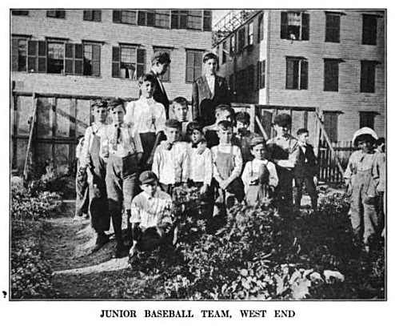
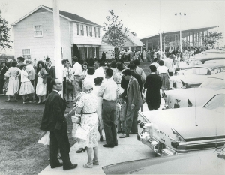
Alternatives to Community Lost
A Counterargument
People living in cities do develop meaningful community
Stress and alienation just as prevalent (if not more so) in small-towns, rural areas
Herbert Gans
Also an immigrant, he looked at how immigrants adapt in a city—Italians in West-end Boston
Found intense cohesion in these neighborhoods—called his book “The Urban Villagers”, 1962.
Low-income, immobility (personal, occupational, residential) creates very strong bonds in neighborhoods.
Immobility means greater residential proximity—kids friends in school, carries over to streets, etc. Little population turn-over, everyone in “same boat”.
The Suburbs? Mumford “ultimate withdrawal from society”
Gans studied Levittown, NJ—the quintessential suburb; for many urbanists the suburbs represented the ultimate in urban alienation—a physical retreat from community
Gans found the bonds were strong! Even in low-density, affluent suburbs—saw themselves as “pioneers” and “in the same boat”. Social networks formed around their kids’ schools, outside activities like sports, dance, music, etc.

Slide 8
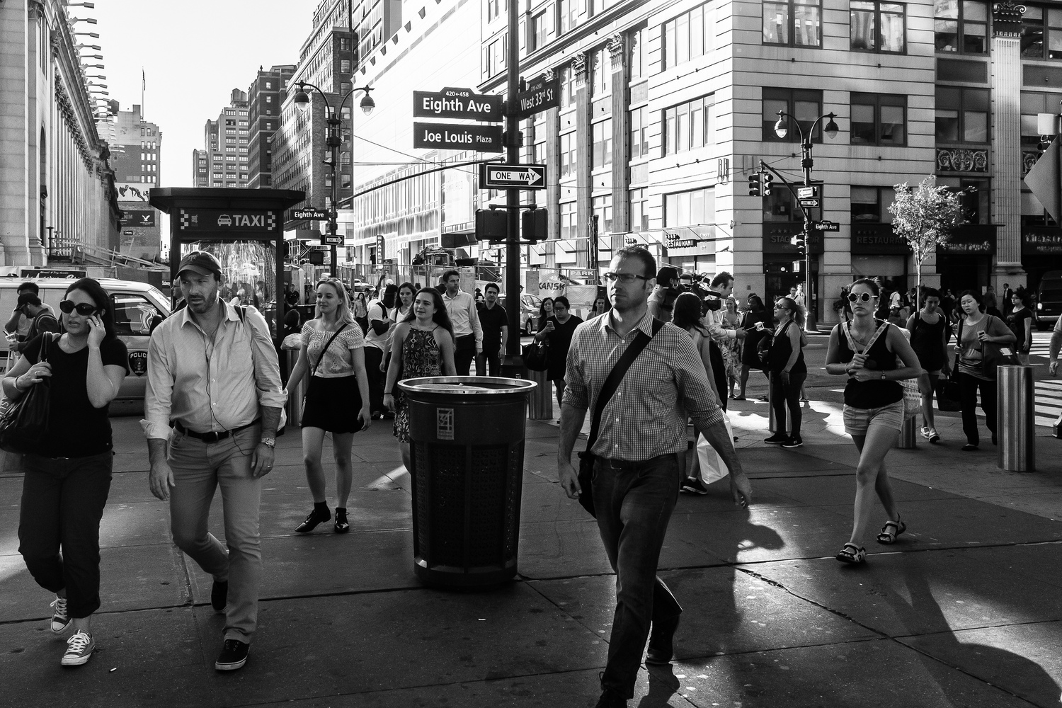
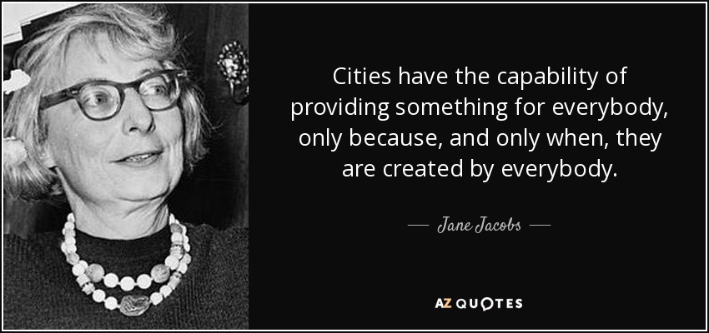
Jane Jacobs
Not an academic, self-taught, a true community member
Lived her whole life in Greenwich Village NYC
Vigorously rejected Wirth’s assessment
“The Death and Life of Great American Cities”, 1961
Urban landscapes were human and humane landscapes
The “Active Sidewalk”: a sign of health, the busy-ness of a city, the interactions among strangers in public was as effective in fighting anomie as traditional communal bonds
City streets are kept safe by everyone’s “casual observation” of each other; creates an every-day sacredness, a feeling of attachment to each other.

Slide 9
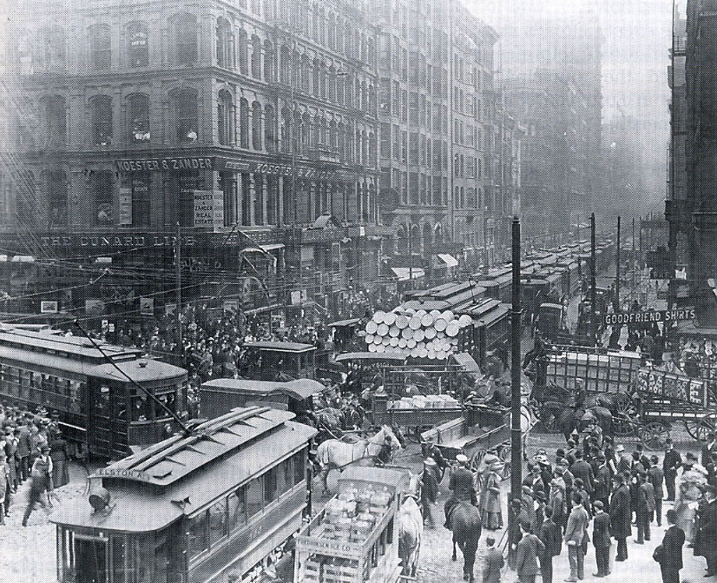
The Chicago School
Community Lost narrative dominates largely due to the Chicago School (1920s)
Observed a rapidly changing Chicago
Chicago had become the U.S.’s #2 city
Chicago embodied the changes the U.S. experienced during industrialization, like Manchester was for the UK 100 years before
Viewed the city as an organism—a living thing with a struggle to survive, borrowing theories from Biology
Examine the city at the neighborhood level through detailed observations

Slide 10
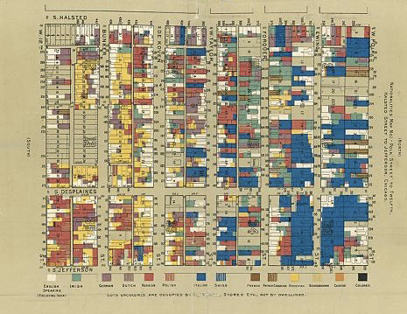
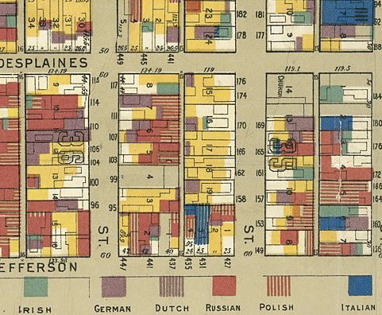
Themes of the Chicago School
Social deviance
Technology transforming geographic connections
Human ecology—humans adapting to new environment; engaged in invasion and succession.
Used empirical methodologies as well as detailed ethnographies (see maps).
Urban morphology—the shape of cities, how groups and activities sort themselves in a city.
Chicago ethnicities. Near Jane Addams’ Hull House, west side.

Slide 11
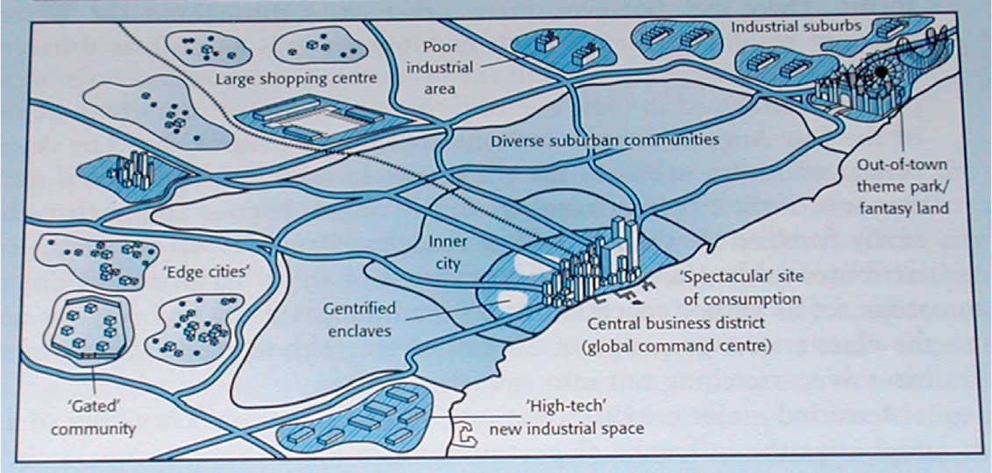
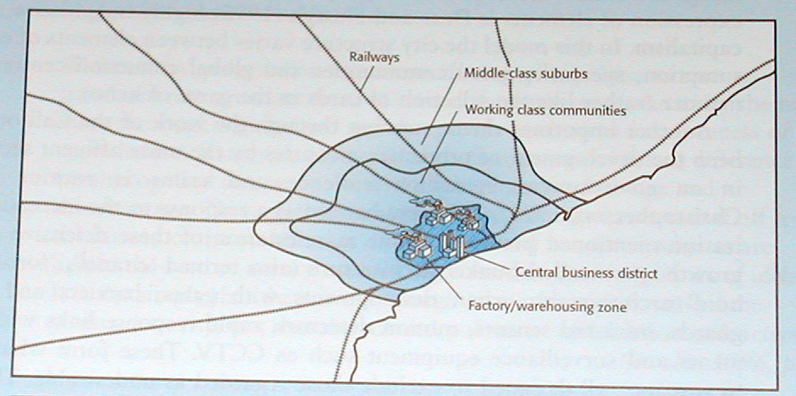
How Do People & Activities Sort Themselves in a City?
Urban morphology
The shape of cities
Processes shaping morphology
Economic, demographic, political
Old Shape
City organized around one center
The CBD—usually near port or end of RR
New Shape
Multiple centers
Freeways link these centers
Economic activity found in pockets scattered throughout city
The older 20th Century model. A single center, organized around a CBD, converging rail lines, possibly a port nearby.
The evolving model of the latter 20th Century. Multi-centered, spider’s web connected by freeways/cars, pockets of specialized activities. Sprawling metropolis.

Slide 12
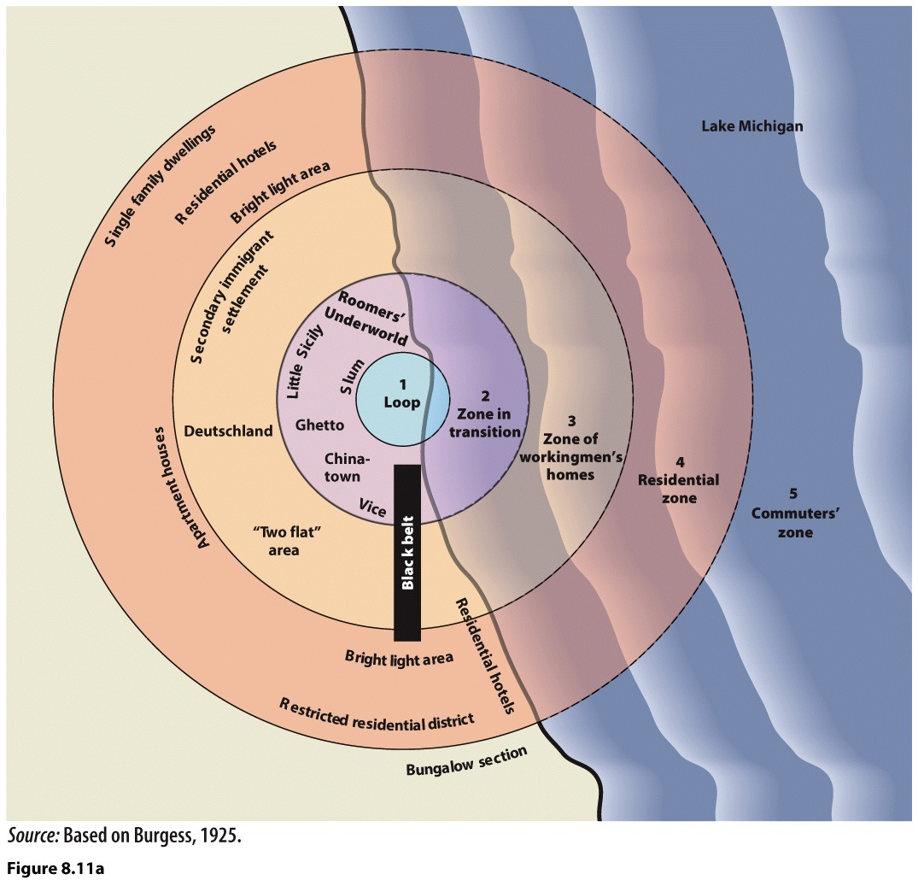
Burgess’ Concentric Zone Model
Used Chicago
Examined how Chicago’s neighborhoods had changed over time
Economic Competition Drives Sorting
Bid-Rent Curve
Activities and people will be sorted by cost; economic competition creates a “natural” sorting
Land most expensive at CBE (less of it)
Those who can afford it, will pay to be near center
Those who can’t, will locate somewhere outside center
Invasion & Succession
Constant movement in & out of zones
Newcomers “invade” and “succeed” groups that were there
New immigrants move in, older immigrants move out, long-standing residents move out.

Slide 13
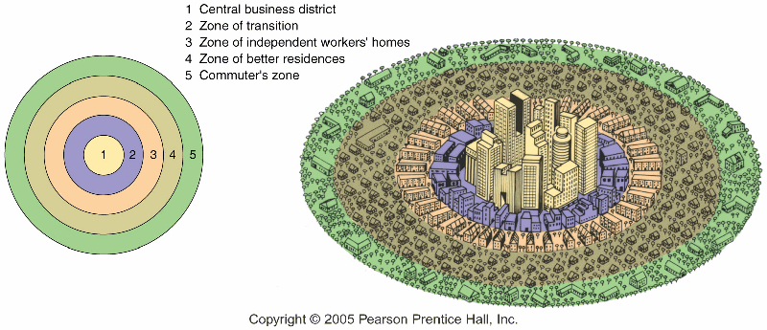
The Zones
Zone 1: CBD
Dense, skyscrapers
Specialized office activities
Zone 2: Transition
Old residential
Invaded by factories, warehouses
Now new immigrants
Zone 3: Independent Workingmen’s Homes
Older, 2nd gen immigrants who’ve “moved up”
Inner suburbs
Zone 4: Better Residences
Lower density housing
Newer, larger homes
For those who’ve “moved up” or born into it
Zone 5: Commuter’s zone
Small towns, villages
Bedroom communities with no industry, employment of their own.

Slide 14
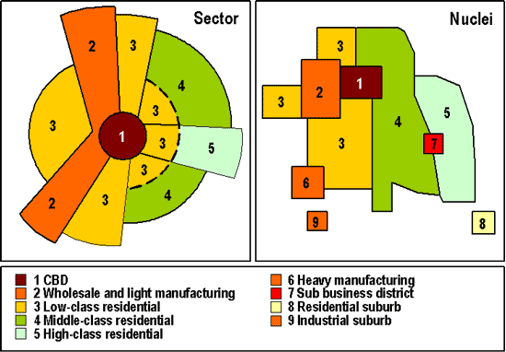
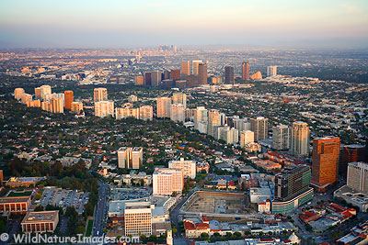
Other Models
Homer Hoyt’s Sector Model, 1930s
Distinct radial corridors that cut across Burgess’s sectors
#2: Industrial zone along railway
#3: Working class housing adjacent to area with lots of jobs
#5: Corridor of wealth:
upper-class housing, usually along a prestigious commercial corridor
Wilshire Blvd’s “Miracle Mile” in LA
5th Ave in NYC
Michigan Ave in Chicago
Harris and Ullman’s Multiple Nuclei Model, 1940s—the rise of the auto city
Car leads to multiple centers, no longer one dominant CBD
Businesses still cluster, based on agglomeration economies, but not on a straight-forward gradient of high intensity at center to low intensity at edge
Each of these multiple centers has its own agglomeration economy with a clustering of activities.
LA is a close approximation of Hoyt’s model. Wilshire Blvd radiates out from downtown toward the ocean. It is lined with affluent homes, museums and shopping.

Slide 15
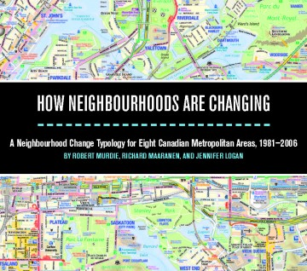
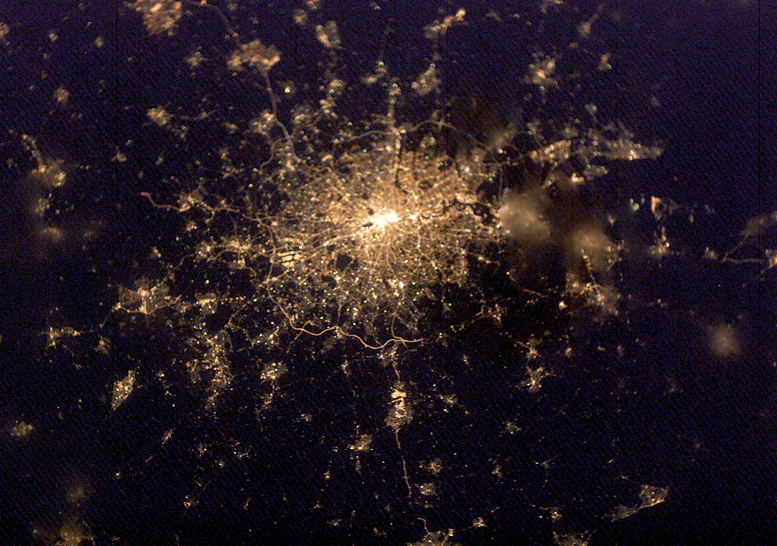
Robert Murdie—the Urban Mosaic model
Argued that cities have multiple shapes/morphologies
Creates a complex mosaic but with underlying patterns:
The geography of economic status sorts along a sector pattern
The geography of family status sorts along a concentric pattern
The geography of ethnic-racial status sorts along clustered patterns.
The Galactic Metropolis
The sprawl of London
Embodies the complex web of cities today.
London almost looks like a galaxy—
a self-contained urban center woven into the metropolitan whole.

Slide 16
Critical Theory
Challenges to dominant narrative of human progress and modernization
Excluded the viewpoint of many groups
Feminist lens, Marxist lens, Post-Colonial lens
Critique of modernization
Not all groups have benefited from modernization
Some have been left out of progress
Postmodernism
There is not a “single narrative”
Multiple narratives/stories

Slide 17
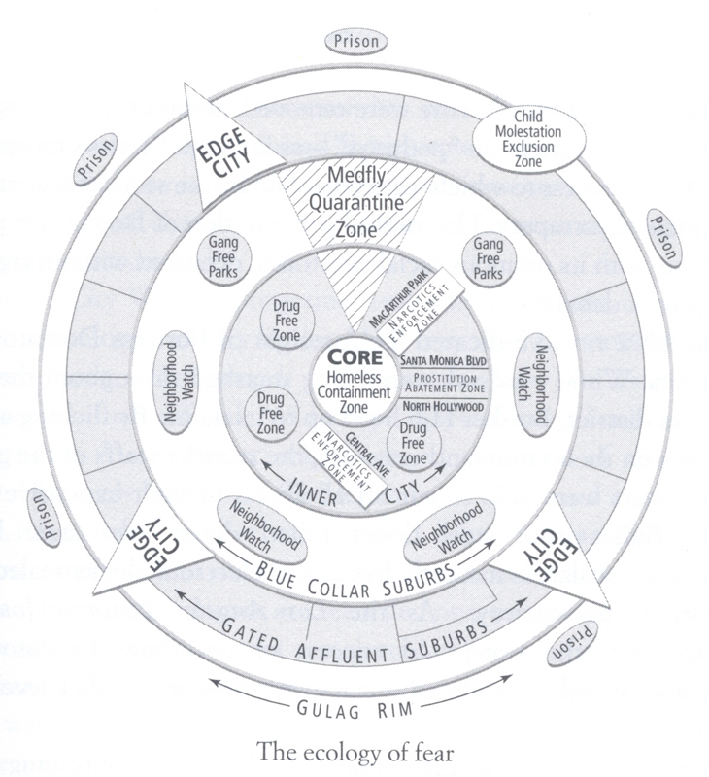
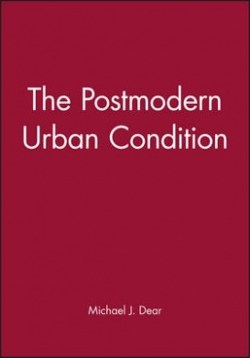
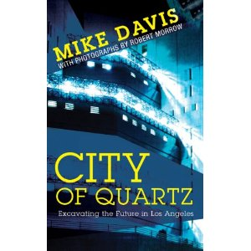
Critical Urban Geographies
Examine power on the landscape
How do power dynamics shape cities and spaces?
Cities of “difference”
Mobility
Spatial entrapment
How does spatial entrapment limit people?
Enclaves of Wealth & Islands of Poverty
Cities have been complex patterns
Citadels
Ethnoburbs
Ghettos
Edge Cities
Mike Davis
City of Quartz
Centers of cities have become “homeless containment zones”
Affluent fled to gated suburbs & citadel-like edge cities
Michael Dear & Stephen Flusty
Keno Capitalism
No longer a center in cities (esp LA)
Cities are random distributions of ethnoburbs, citadels and areas of “street warfare”
Spatial arrangements in cities the outcome of history, not economic sorting

Slide 18
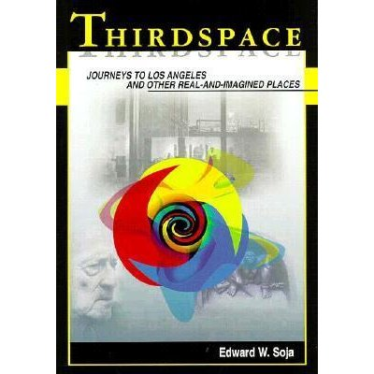
The Los Angeles School
Los Angeles “Shock City”
Shock city of late 20th C
Sprawling, auto dependent, built around car
Center of global migration
Themes of the LA School
New Urban Morphology
Cities now driven by the hinterlands (suburbs)
CBD dominance challenged by new tech industries
Linked to global economy
Enclosure Movements
Obsession with security by wealthy
Culture of fear
Gentrification ousts poor
Loss of public space--privatization
Public Divestment, A New Civic Culture
Slash city and county budgets
Public services get privatized, loss of public space
End of progressive taxation
No way to redistribute wealth, deterioration of public services
New Architecture
Reject modernist architecture
Form no longer follows function
Imagined places

Slide 19
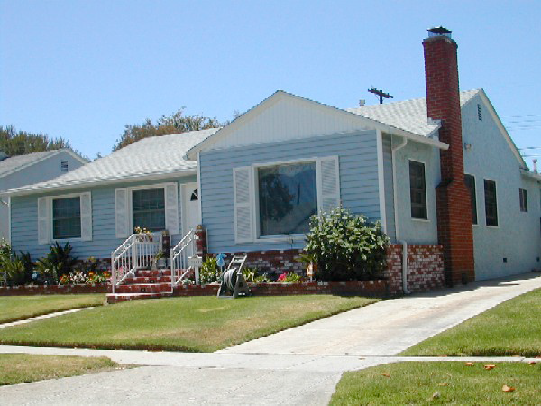
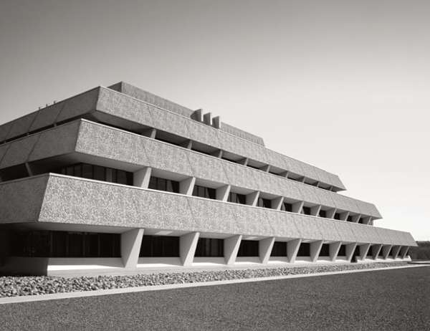
Postmodern Design and Architecture
Revive historic looks
Reaction to modernism’s clean, simple and generic lines
Jane Jacobs, “Modernism is a great blight of dullness.”
Robert Venturi, “Less is bore.”
Edward Relph, placelessness: “they merge both in perception and memory into a confusion of pale tones, sharp angles, and cereal box forms, standing on end downtown and lying flat in the suburbs”
The tract house of the 1950s.
Generic, non-decorative, mass produced.

Slide 20
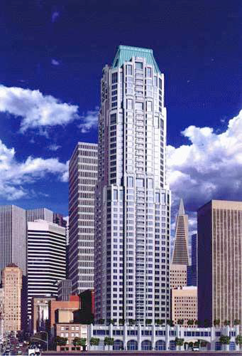
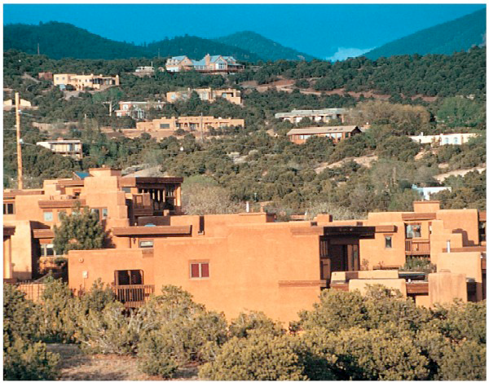
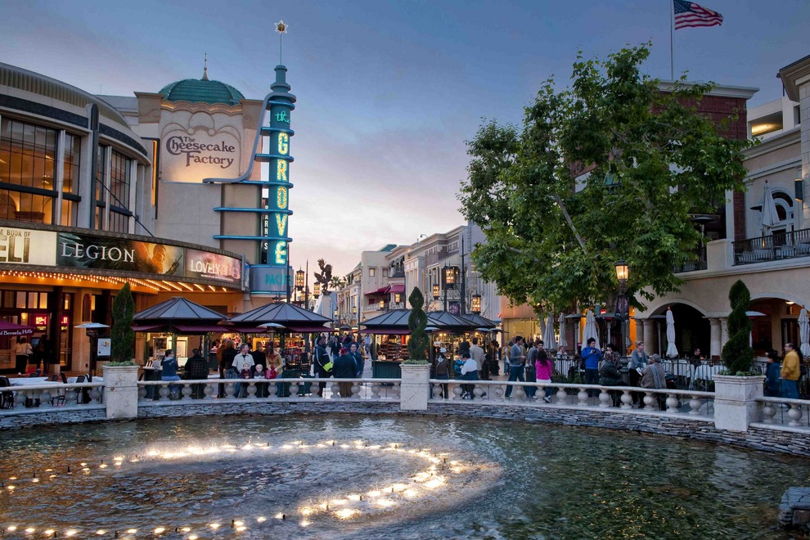
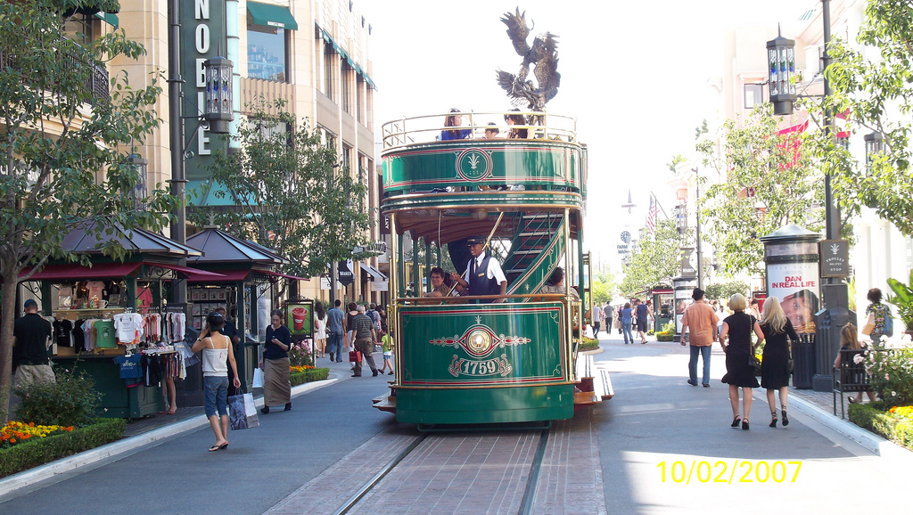
San Francisco skyscraper. Hat on top evokes a historic French look. At base of tower is a columned arcade, looks fashionably European. 1990s.
The tract house of the postmodern era. Neo-traditionalism, an attempt to foster a distinctive sense of place.
But a “real” or “imagined” sense of
place?

Slide 21
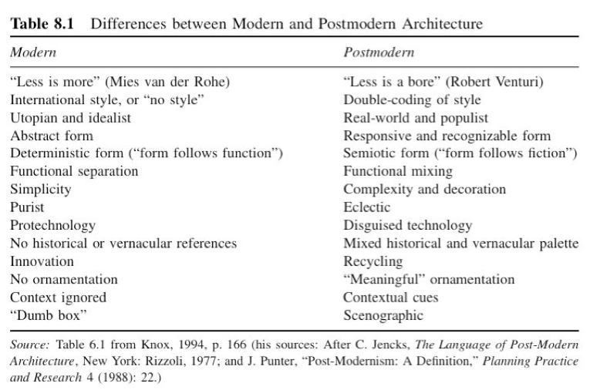

Slide 22
Postmodernism—More Livable Cities?
Is a genuine sense of place being evoked?
Whose past is being evoked. Usually not a local one.
Landscapes that are contrived—symbolic
Dreamscapes, like Las Vegas
Modernism at its core was a mission that sought progressive change and inclusion—does postmodernism?
Although it had its own elitism, modernism used public money and state of the art design to make urban life better for all.
Postmodernism vision is capital driven, consumption oriented, caters to the elite.

