Slide 1
Geography 8
Unit 5: The North American Urban System

Slide 2
Keywords
Urban system
Urban hierarchy
Central place theory
Normative
Quantitative
Threshold
Range
Market Area
Higher-order urban area
Lower-order urban area
Rank-size rule
Urban primacy and the primate city
Trans-Atlantic colonialism
Mercantile colonialism
James Vance—Mercantile Model to explain NA urban hierarchies
Bohert and Wyckoff—transportation technology (water to RR to car to plane)
Frontier Urbanization
New Amsterdam
Law of the Indies
Mercantile Period, the Mercantile City
Erie Canal
Gateway city—entrepot
American manufacturing belt
The “Cheap Oil Epoch”
Sunbelt vs Rustbelt
Principle of initial advantage—Pred’s model of cumulative causation

Slide 3
Overview
Younger cities than previously studied
European outposts, 17th century
Economic and social changes in region
Transformation of the region
Four historical stages
Interurban theories & models

Slide 4
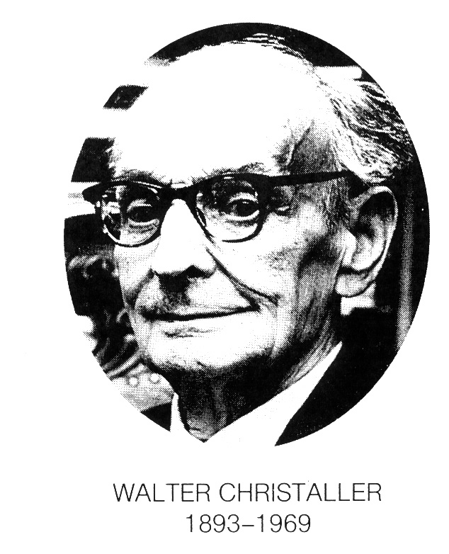
Walter Christaller Central Place Theory
Southern Germany
Quantitative, normative, theoretical social sciences
Nazi, later German Communist Party
Controversial figure
Very influential, esp post 1960
Not describing the “real world”
Isotropic plain
Flat
Featureless
Homogenous spatial density
Cities exist only for trade
Produce at home, sell in city
Distance is the only variable
How does distance influence the geography of economic activities?
Planning purposes
An “optimal” geography to minimize the distance people will have to travel to go to “market”
Used by the Nazis in Poland

Slide 5
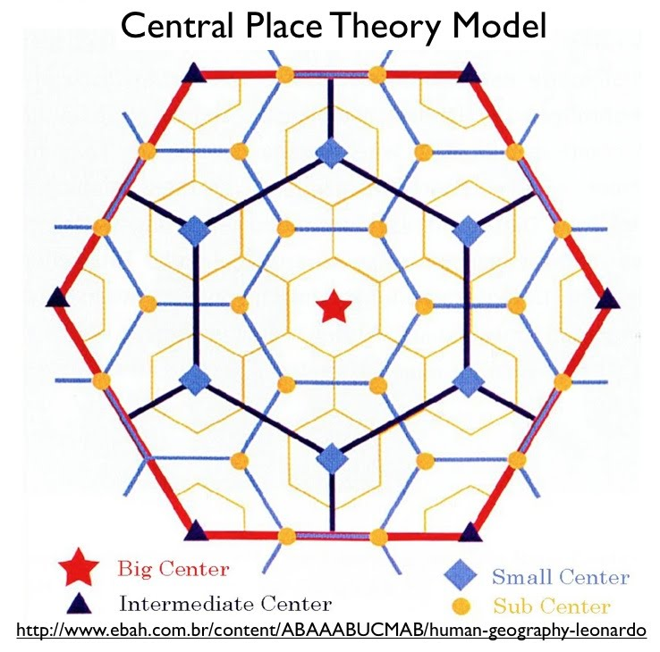
Central Place Theory
Ideal interurban pattern:
Cities vary in size
Interurban hierarchical symmetry
Towns of the same size are evenly spaced
More lower-order towns than higher-order towns
Urban hierarchy mapped in a hexagonal area
Size of cities determined by their economic activities
all economic activities have a RANGE & a THRESHOLD
Range: maximum distance of travel
Higher order goods=larger range
Lower order goods=smaller range
Threshold: minimum market area
Higher order=larger threshold
Lower order=smaller threshold

Slide 6
Criticisms of Central Place Theory
Assumes humans are rational
people will access goods and services at the closest location.
Assumes only market area determines the size and spacing of cities
Doesn’t consider manufacturing or long-distant trade
Chains of production even by mid 1800s
harvesting, mining, processing, packaging, shipping, storing
a product for sale in Buffalo, NY was most likely from all corners of the U.S.
System is Static—Cities Don’t Change Even If…
Changes in population size or density
Changes in transportation technology
Changes in consumption habits.

Slide 7
Rank-Size Rule
Compares a city’s “rank” with its population size
Relationship between a city’s rank and its size can be calculated with a formula
Pi = P1 / Ri
If P1= 1,000,000 (1 million), than the 5th largest city would be 1,000,000/5 (200,000).
If P1=1,000,000 (1 million), than the 100th largest city would be 1,000,000/100 (10,000).
Ranking looks a lot like CPT
Cities may move up or down in rank as their size changes

Slide 8
Rank-Size Rule fits the U.S. urban pattern
Urban Primacy
*breaks with rank-size rule
*the largest city is disproportionately large
Law of the Primate City--Mark Jefferson, 1939
*at least 2x as large as the next largest city
and more than twice as important.
*center of “national capacity & feeling.”
Rank | MSA | Actual | Predicted
1 | New York | 21.2 m
2 | Los Angeles | 16.4 | 10.6
3 | Chicago | 9.2 | 7.1
4 | Washington | 7.6 | 5.3
5 | San Francisco | 7 | 4.2
6 | Philadelphia | 6.2 | 3.5
7 | Boston | 5.8 | 3
8 | Detroit | 5.5 | 2.6
9 | Dallas | 5.2 | 2.4
10 | Houston | 4.7 | 2.1
50 | Richmond | 997 k | 424 k
100 | Canton | 407 | 212
200 | Wheeling | 153 | 107
Country | Largest city | 2nd largest city
United Kingdom | London—7 x larger than | Birmingham
Ireland | Dublin—4x larger than | Cork
France | Paris—3x larger than | Marseille
South Korea | Seoul—3 x larger than | Busan
Mexico | Mexico City—8x larger than | Guadalajara
Iran | Tehran– 3x larger than | Mashhad
Why primacy? Development levels? Population size? Probably many factors.

Slide 9
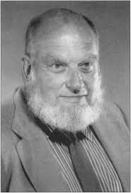
James Vance: Mercantile Model
Prominent urban geographer, UC Berkeley
Developed the “Mercantile Model”
Argued previous models do not explain NA Urban System
CPT can’t explain NA cities
Started as “outpost settlements”
Grew because they were entrepots

Slide 10
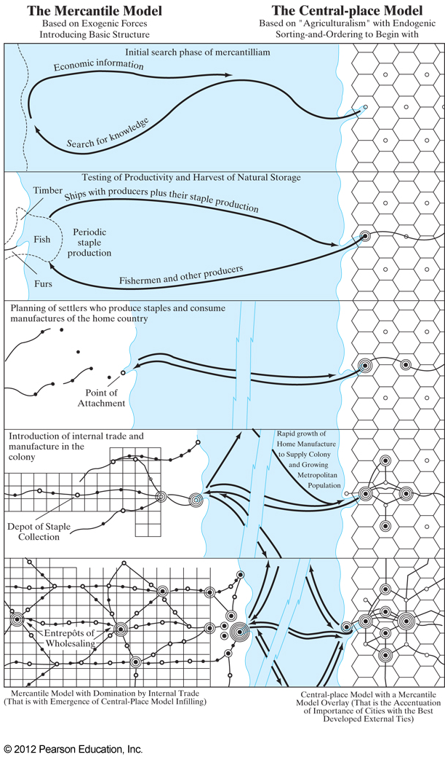
Vance’s model of mercantile settlement as compared to the CPT.
Vance emphasizes the role of long-distance (international) trade in establishing an urban hierarchy in North America.

Slide 11
John Borchert: 5 Epochs
Prominent urban geographer at the University of Minnesota
Identified 5 periods (epochs) of urban change in NA
Helps us understand NA urbanization post 1870
Transportation technology drove change in the urban system of NA
Water to Railroad to Airplane to High-Tech/Communication

Slide 12
5 Historical Stages of Urban Change
Settlement Outposts: the colonial town
The Mercantile City: Water & Rivers
Into the Interior: frontier urbanism
Industrialization: the industrial city
20th Century Urbanism in North America

Slide 13
Settlement Outposts: the colonial town
Extraction Oriented
Codfish in Newfoundland, Beaver Pelts/Timber in New England
Spanish
Florida & Southwestern US
1616: La Villa Real de Santa Fe (New Mexico)
1565, Saint Augustine, FL
Spanish Mission System--1769
Pueblos & Presidios & Missions, started in San Diego
Pueblos: Los Angeles, Santa Cruz, San Jose, San Francisco

Slide 14
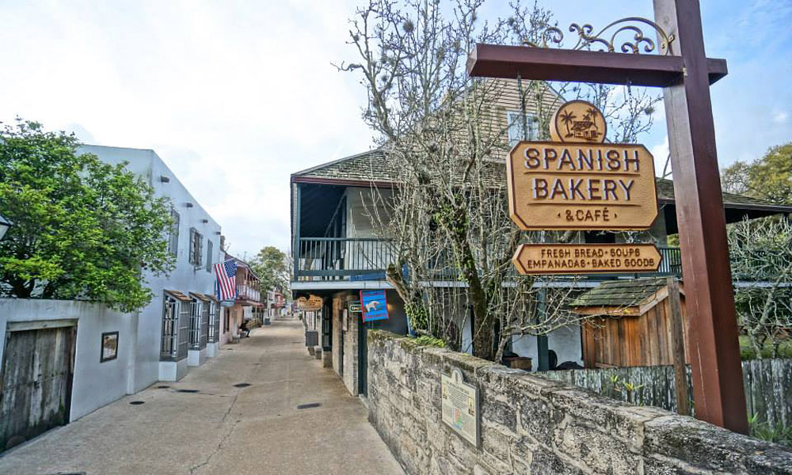
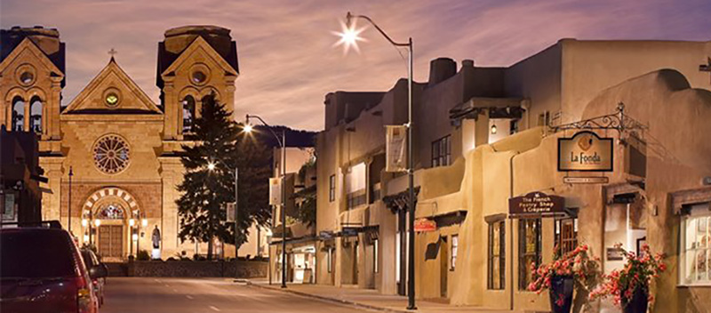
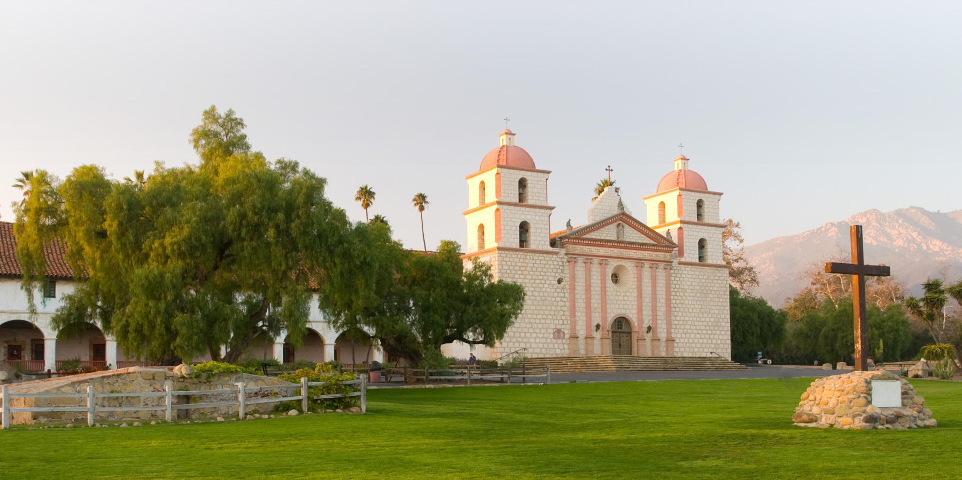
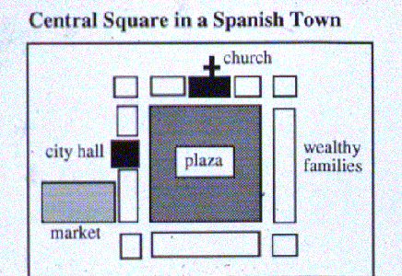
Spanish Towns
Saint Augustine, Florida
1565
La Villa Real de Santa Fe
(New Mexico), 1616
Santa Barbara mission, 1786
Series of missions, pueblos and presidios beginning in 1769.
Los Angeles, Santa Barbara, San Francisco, San Diego…
Law of the Indies, 1592
Specified grid-iron pattern to towns/cities
Plaza at the center, church at one end, civic building at another, market nearby.

Slide 15
Settlement Outposts: the colonial town
Dutch
1625: New Amsterdam, trading post on the Hudson estuary
French
Cities founded on trade; located on water (Mississippi River, Great Lakes)
1608: Quebec
1642: Montreal
1701: Detroit
1764: St. Louis
1718: New Orleans
English
Had the most settlements, backbone for much of urban system
1607: Jamestown colony
1663: Williamsburg became capital of Virginia colony
1630: Boston 1630
1664: take New Amsterdam in 1664 and rename in New York (best natural harbor on Atlantic seaboard)
1680: Charleston
1682: Philadelphia
English towns import slave labor for tobacco cultivation. By the time it’s banned in Britain (1807) about 650,000 African Americans in the U.S.

Slide 16
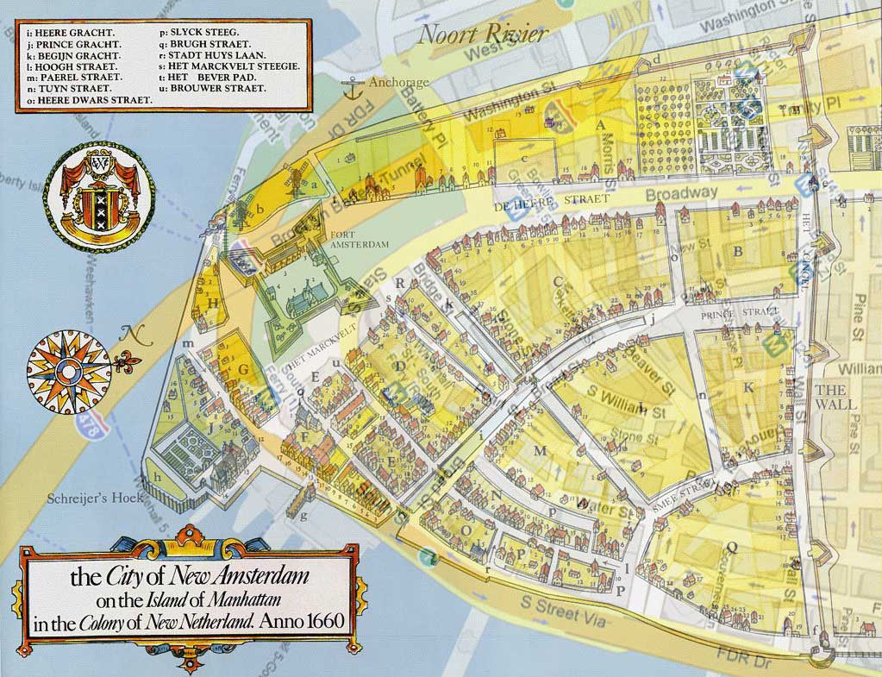
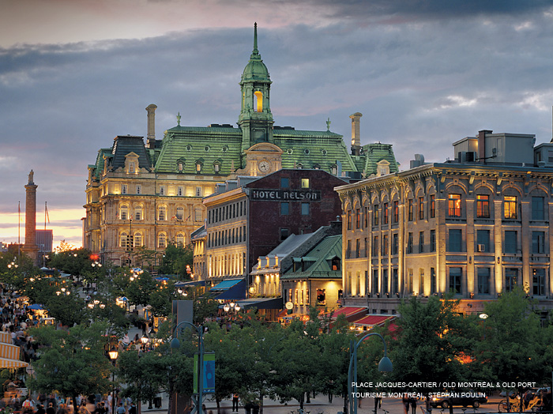
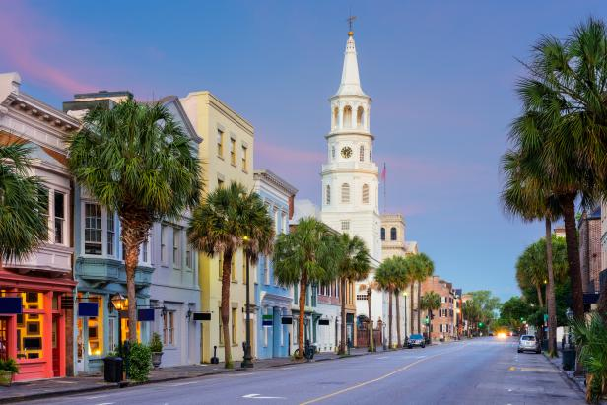
New Amsterdam,
Founded by the Dutch in 1625
Montreal, founded by the French, 1642
Charleston (Charles Town), South Carolina, founded by
The British, 1670

Slide 17
Water & Rivers: the mercantile city
Agriculture grows
Cured meats, indigo, tobacco, cotton
Products coming into cities from farms to be exported
Imports coming in through cities—manufactured, luxury goods
Ports and Waterways Dominate
Montreal, St. Lawrence River
Ports: Boston, Baltimore, Philadelphia, New York
Entrepots
collection point for all things being exported and imported; administrative centers
Mini-Entrepots: Hartford, Albany, Lancaster, Richmond

Slide 18
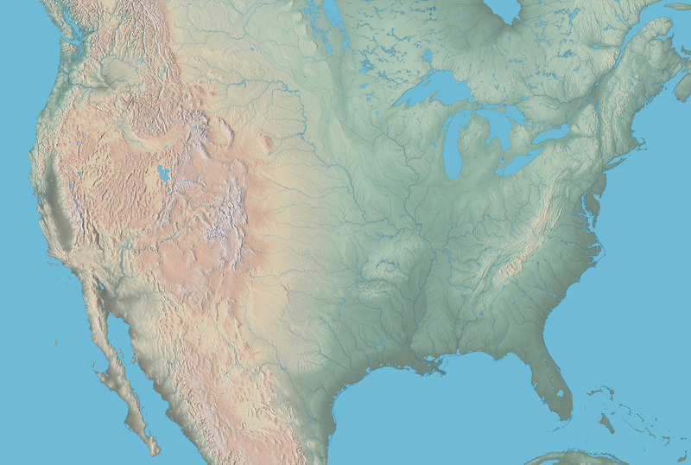
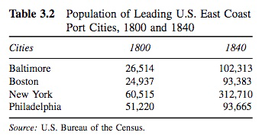
Stage 2: 1790s-1870s Water & Rivers
Montreal
A new urban hierarchy emerges: cities with good access to harbors or rivers dominate
Montreal on the St. Lawrence River
Harbor cities: Boston, Baltimore, Philadelphia, New York
Rise of the “entrepot” city
All things being exported to Europe pass through
All things being imported in from Europe pass through
Major administrative center
Mini entrepot cities
Agricultural production, these receive the goods coming in from farms to be sent to the major port cities
Mini entrepot cities also receive imported goods before they’re disseminated
Hartford, CT, Albany, NY, Lancaster, PA, Richmond, VA
Boston
New York
Philadelphia
Baltimore
New Orleans
New Orleans has also grown to 100,000 by 1840…

Slide 19
The American Mercantile City
Desire to reach interior
Appalachians are a barrier
Cities that can get access gain advantage
New York: Hudson River, Erie Canal via Buffalo to Great Lakes
Baltimore: B&O RR, connects it to Philadelphia & Ohio Valley (Pittsburgh, Cincinnati, Louisville).
These “mini entrepots” focus on doing one thing—maximize efficiency
Cincinnati “porkopolis”

Slide 20
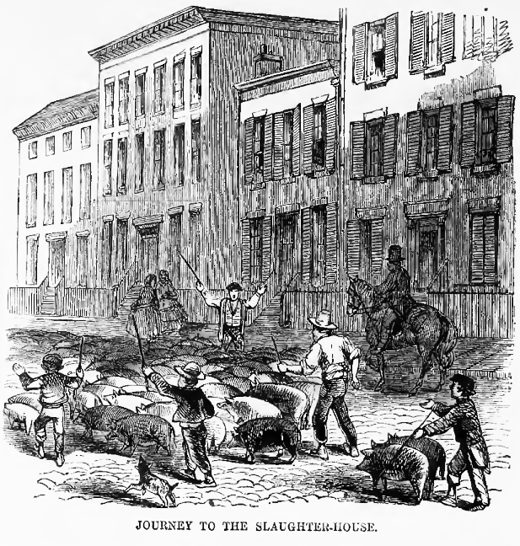
Buffalo
New York
Pittsburgh
Cincinnati
Baltimore

Slide 21
Life in the Mercantile City
Center
Port or waterfront
Walkable, pedestrian city
Everything nearby: merchant offices, workshops, warehouses, churches, retail
Social geography
little separation between work and home (like the Burgher House)
little separation between rich and poor
owners of factories lived next to factory; artisans and storekeepers lived above or behind store/workshop
laborers, other workers lived off alleyways, and in lofts
servants lived on upper floors of masters’ houses
clustering of people and activities eventually (Boston’s North End: Irish then Italian)

Slide 22
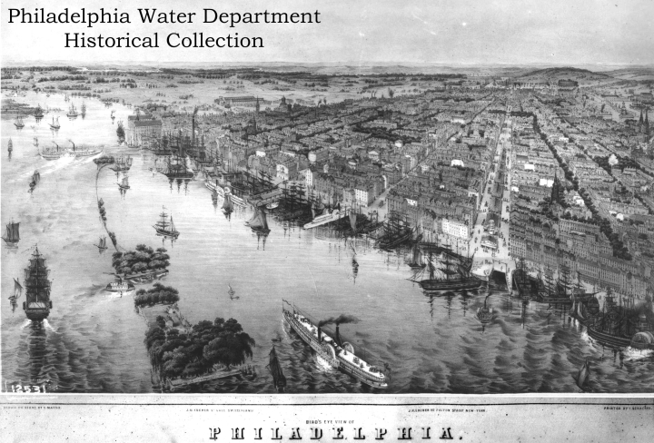

Slide 23
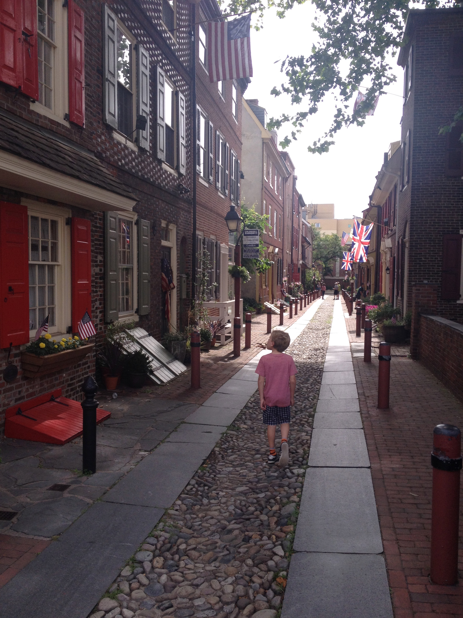
Elfreth’s Alley,
Philadelphia

Slide 24
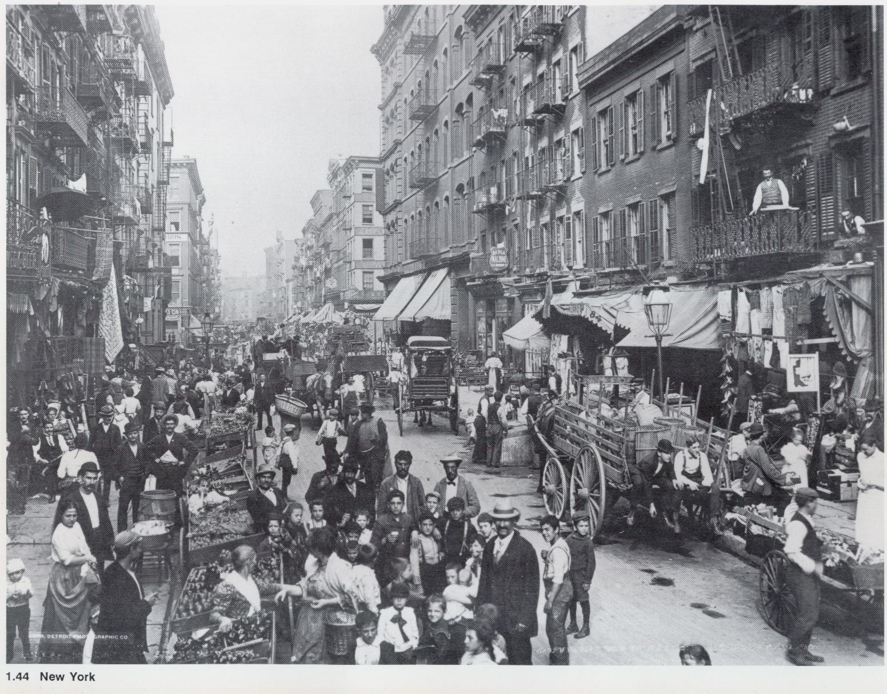
New York City, turn of the century.

Slide 25
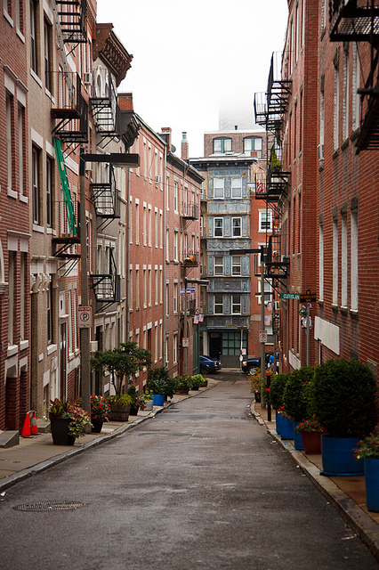
Boston’s North End

Slide 26
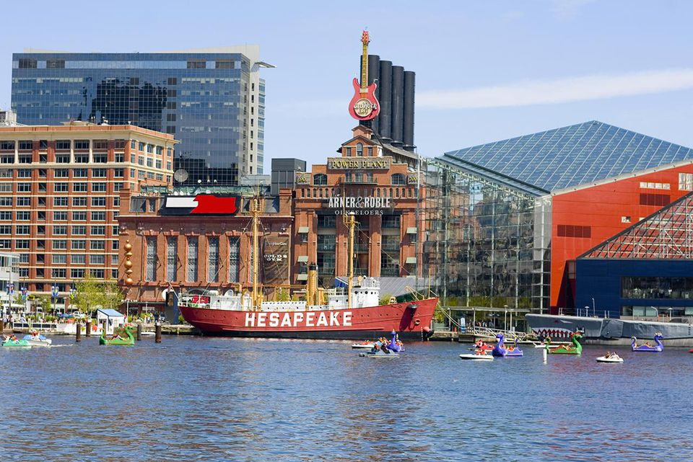
Baltimore harbor.

Slide 27
Frontier Urbanism
Growth of a domestic market
Growing market demands in cities: immigration from outside of US and from countryside
Mechanization of agriculture pushing rural population to cities
Increased yields in agriculture
Railroad
Chicago
Funnel point for all goods moving east and west
Connects the country economically, socially.

Slide 28
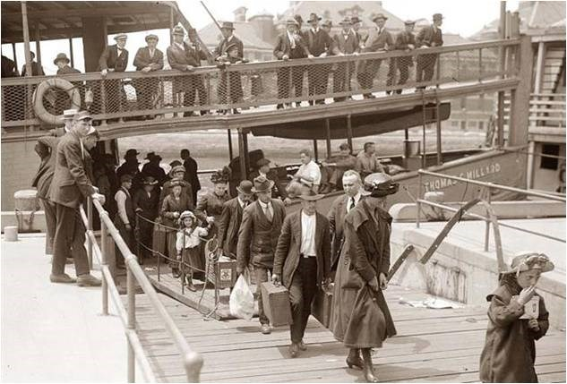
19th Century Immigration to North America
1840—Ireland and British Isles
Irish famine
British consolidate farm land into huge estates
1850—Germany, France, Belgium
Agricultural mechanization, industrialization
1870—Scandinavia
Danish, Norwegians, Swedish
1880/90s—Southern and Eastern Europe
Italians, Jews, Slavs

Slide 29
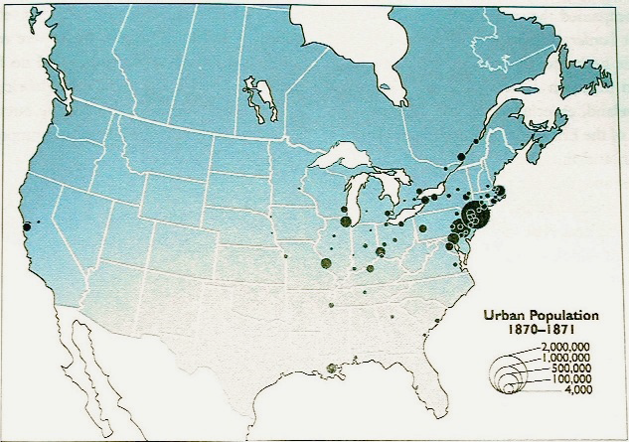
The American Industrial City
AMB
Geographically Concentrated
The American Manufacturing Belt
Great Lakes region
Domestic Markets Expand
Goods can now travel distances
Bottling, shipping in refrigerated trains
Brewers in Milwauke, WI have a national market
Farmers in Salinas, CA can send their produce to the Midwest
Chicago Cements Its Centrality
“Nature’s Metropolis”
Funnel point for the collecting, processing, repackaging of the “bounty” of the American interior
“Empty” Regions Fill
The South
The West

Slide 30
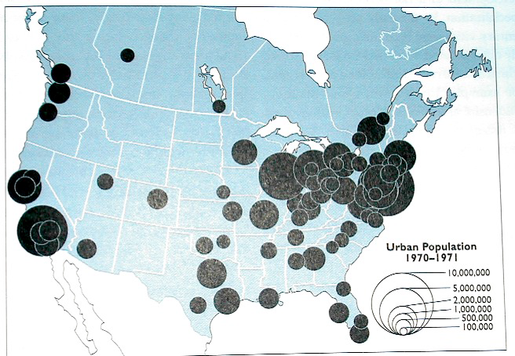
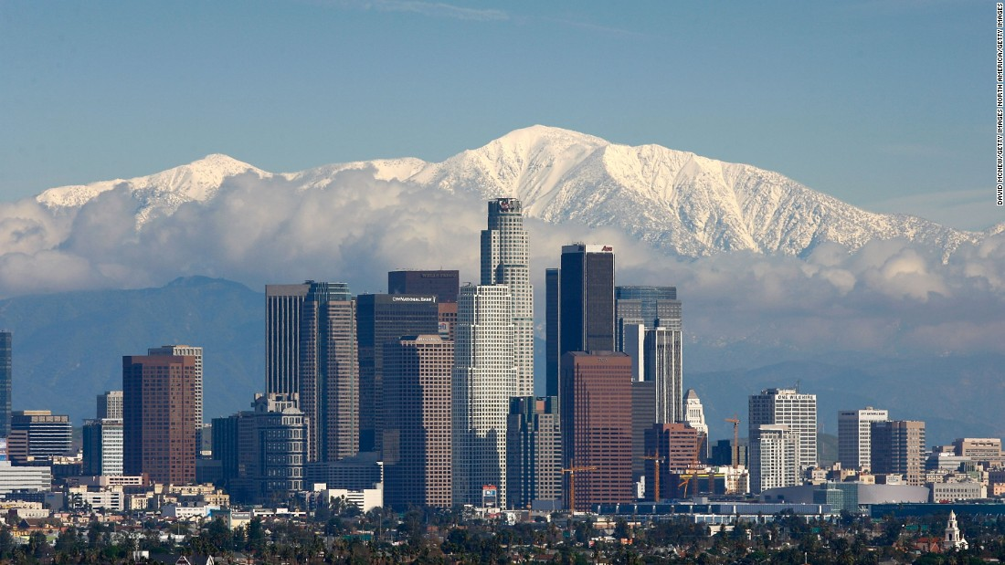
20th Century Urbanism Geographic Shift
AMB Becomes Rust Belt—Growth moves to “SunBelt”
Structural Changes
Fordist production ending
Growth in aerospace--technopoles
Cheap Oil
Sprawl
Internal combustion engine, jet engine
Federal Money
New Deal projects
Bring money and development to West & South
Golden Gate Bridge, Hoover Dam…
National Defense Spending
WWII then Cold War
Rockets, Satellites, Space Shuttles
Cities emerge/grow to support these industries in CA, NV, AZ, TX FL, NM

Slide 31
Why do the First Cities Persist?
NE of the US remains important today, it is the urban geographic core—less because of what is happening now and more because that’s how it’s long been.
Allan Pred’s:
Initial Advantage & Cumulative Causation

