Slide 1
Geography 8
Lecture 7: Urban Planning Part I

Slide 2
Keywords
Urban planning
Settlement houses
Company towns
Grand Manner
Hausmannization
Arcadian Classicism
City Beautiful
Hitler, Germania
Speer
Master Plan
Modernism
Le Corbusier and “Radiant City”
Mikrorayon
Red Square
Tianamen Square
Googie
Height limits
Sacred skyline
New York City zoning ordinances of 1916, 161
FAR, floor area ratio
POPS, publically owned private space
Ebenezer Howard and “Garden Cities”
Growth boundaries

Slide 3
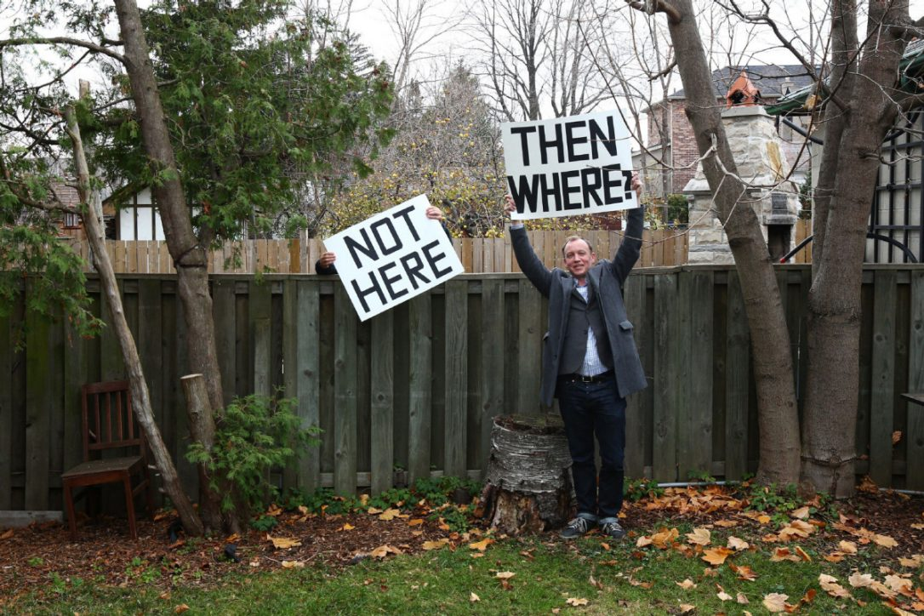
Roots of Urban Planning and Urban Policy
Began as response to the industrial city
Influence has waxed and waned in U.S.
Response to crises
Persistent themes
Urbanization’s central paradox
Property-owning democracy
Regulation vs Over-regulation
“State activities that seek to influence the distribution and operation of investment and consumption processes in cities for the common good.” Michael Pacione, urban geographer Univ. of Glasgow

Slide 4
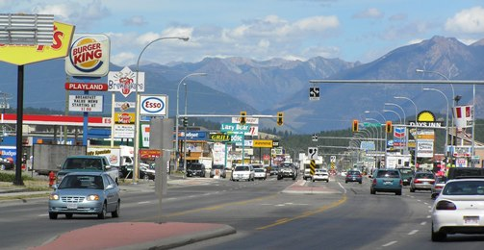
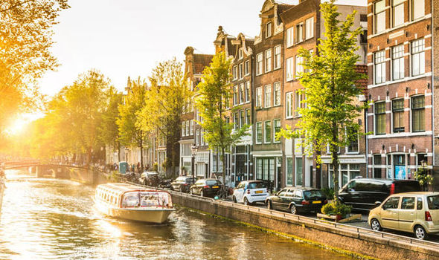
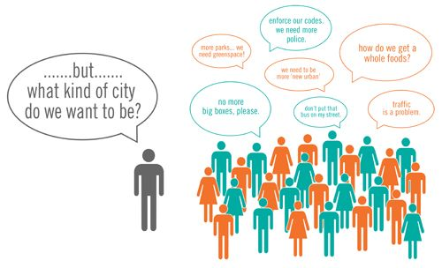
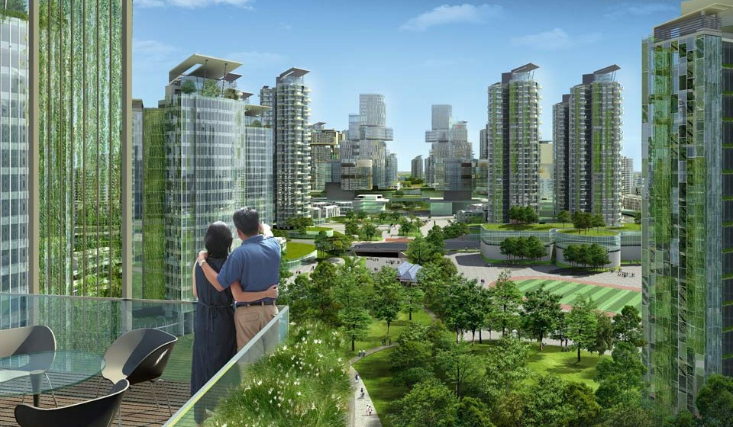
The Common Good and the Perfect City
Different citizen interests and different ideals
Individual freedom or collective good?
Growth, innovation, cosmopolitan or status quo, neighborhood preservation?
What is “safety”?
Property owner or property user?
Romantic sense of place or efficient, modern?

Slide 5
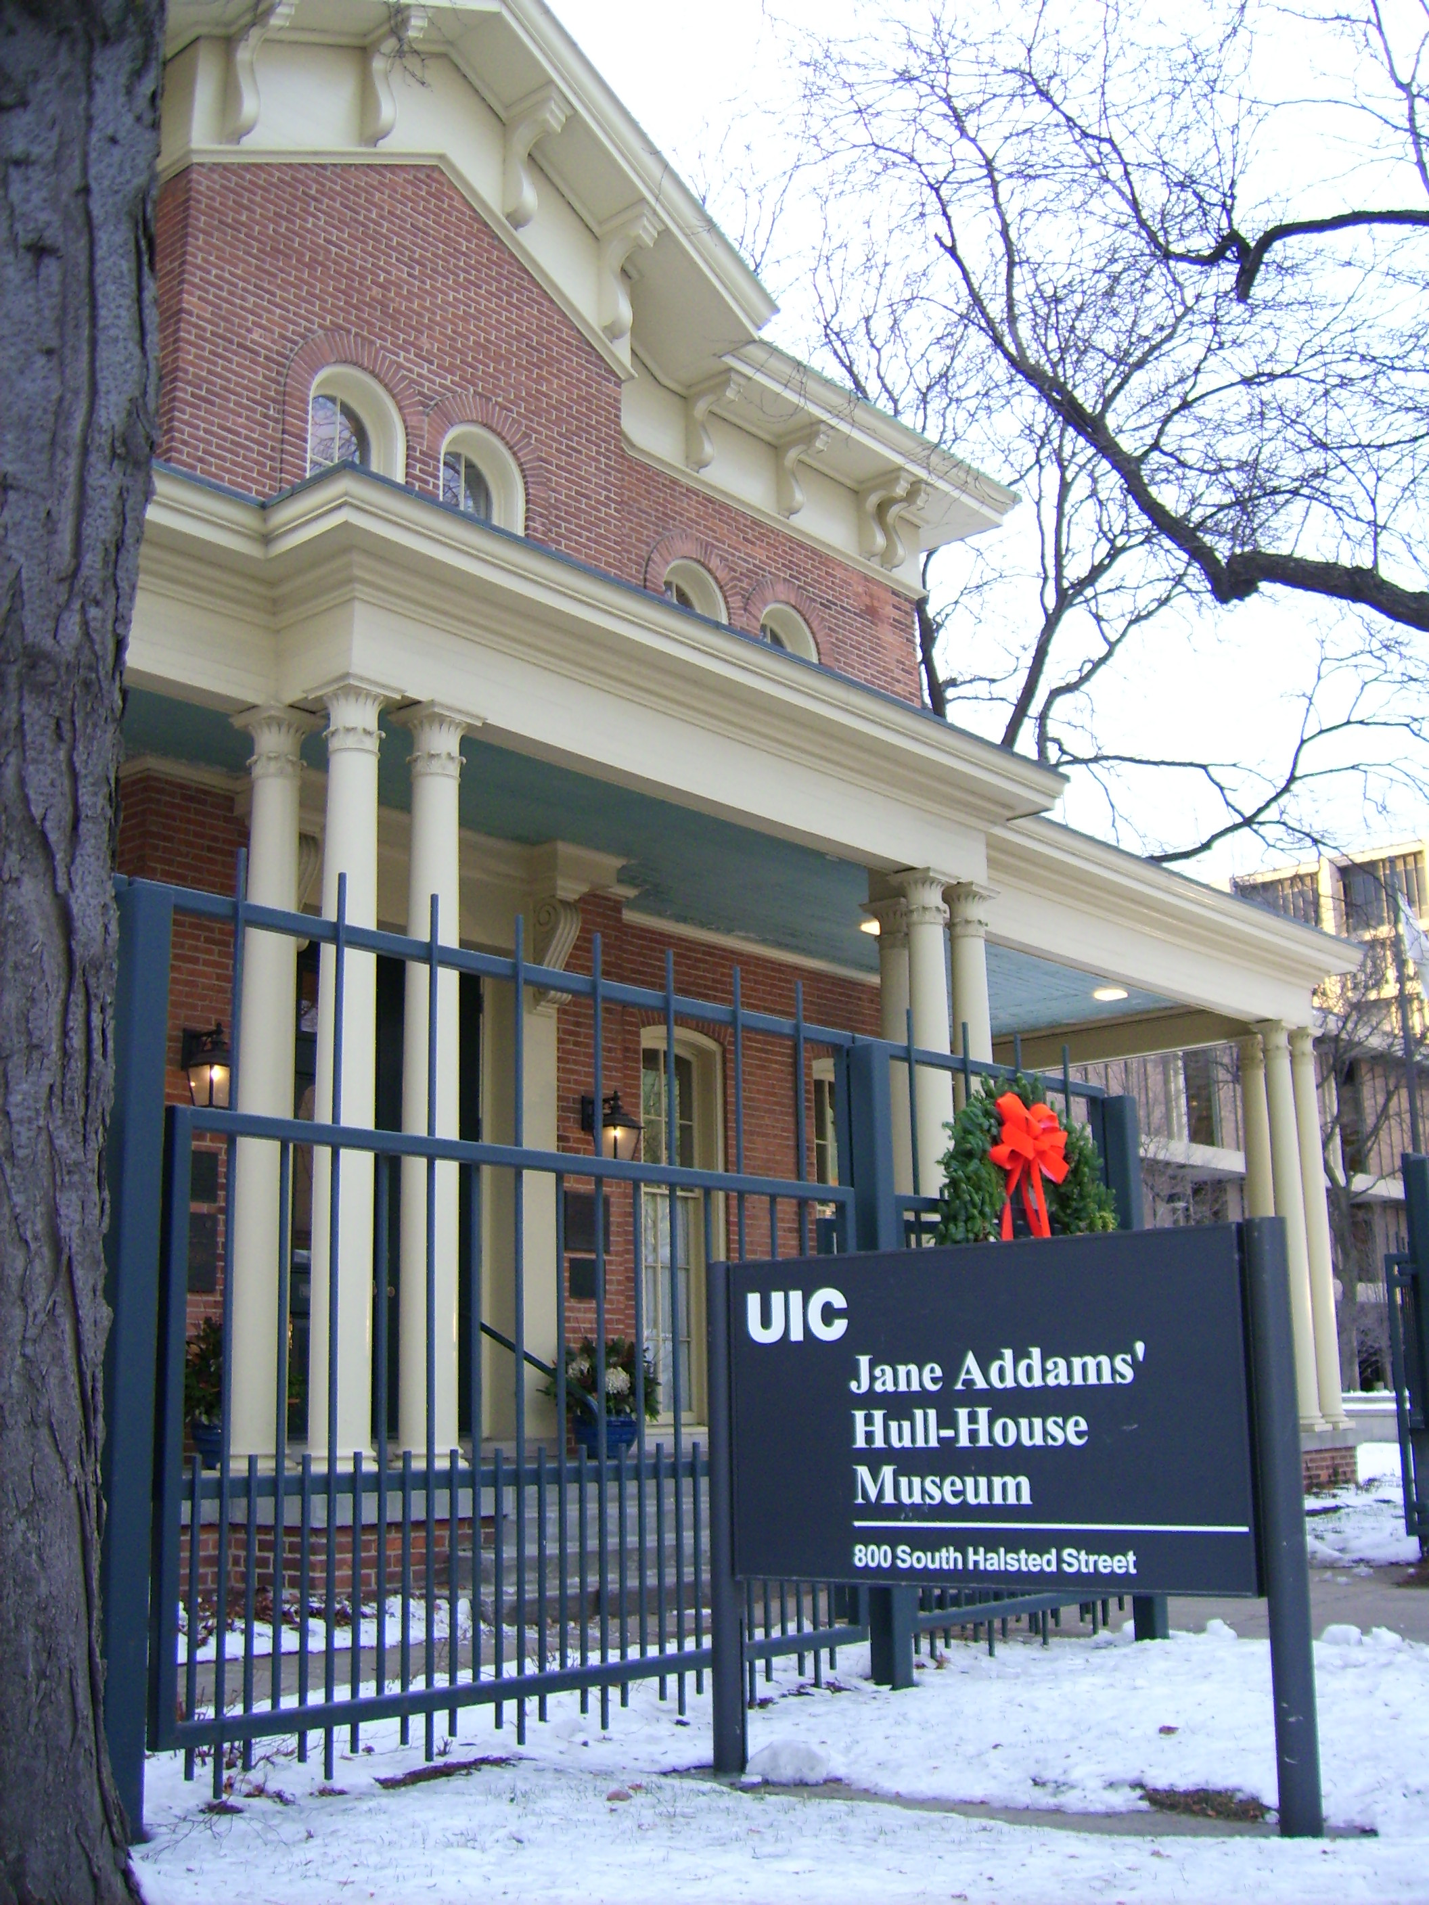
Progressive Era Reformers
Horrors of the industrial city
Jacob Riis, late 1800s
Federal Tenement House Commissions 1894, 1900
Urban reform as charity
Aid to families, but not addressing structural issues
Settlement House Movement
Great Britain model, “Toynbee Hall,” London, 1884
Jane Addams’ Hull House
Programs for “fallen” women, “correct” the deviance of urban life
Deserving vs Undeserving Poor
Conventional thinking of the Chicago School—immigrants prone to social disorganization
Criticisms
Paternalistic, condescending, who “deserves” help/charity
Sinclair Lewis wrote that theses “reformers” were: “upholding a standard of tight-smiling prissiness.” Sinclair Lewis

Slide 6
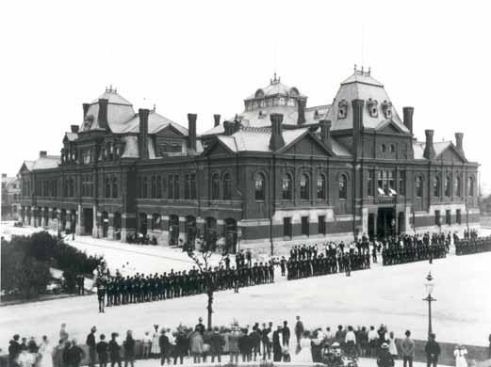
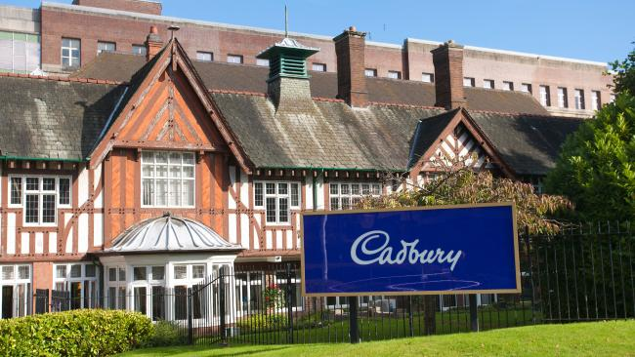
Company Towns
Turn to private sector to “fix” urban ills
Provide all housing to workers (and stores, restaurants, etc)
19th C elite businessmen’s “moral duty”
Chicago: George Pullman
a community of happy, morally upright, productive workers
He “wanted to create a better life for…employees: decent housing, good schools, and a ‘morally uplifting’ society. In return [he] expected hard-working employees who would eschew the evils of drink, and most important, not fall prey to the blandishments of union organizers.” historian Linda Carlson.
Modeled on the “Factory in a Garden” of Bournville, England
Criticisms:
Paternalistic, controlling, monopoly
Led to one of the worst labor strikes in U.S. history in 1894 after Pullman lowered wages

Slide 7
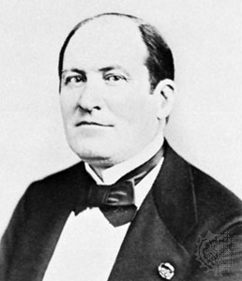
Grand Manner--Haussmannization
Planners & architects set out to “fix” the city
Create a rational and monumental city
Paris under Napoleon III
Fear of the slums, completely re-design Paris
Baron Georges Haussmann, 1853-1870
Grand Manner vision, broad, tree-lined avenues
Criticisms
Elitist, more concerned with monumental sensibilities than the living conditions of the poor
A form of social control
In the US?

Slide 8
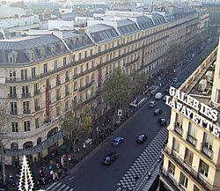
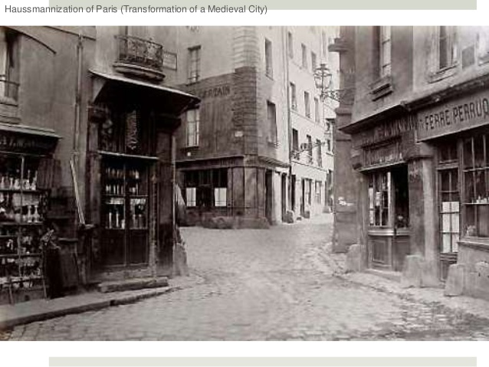
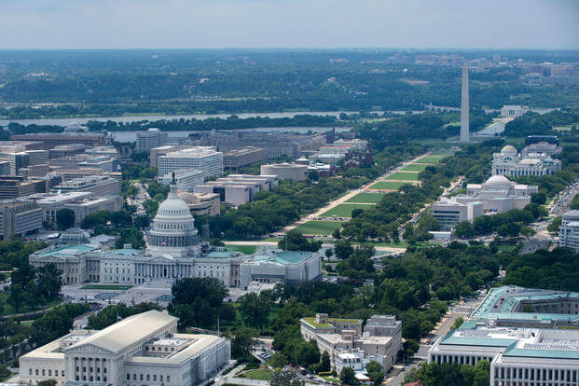
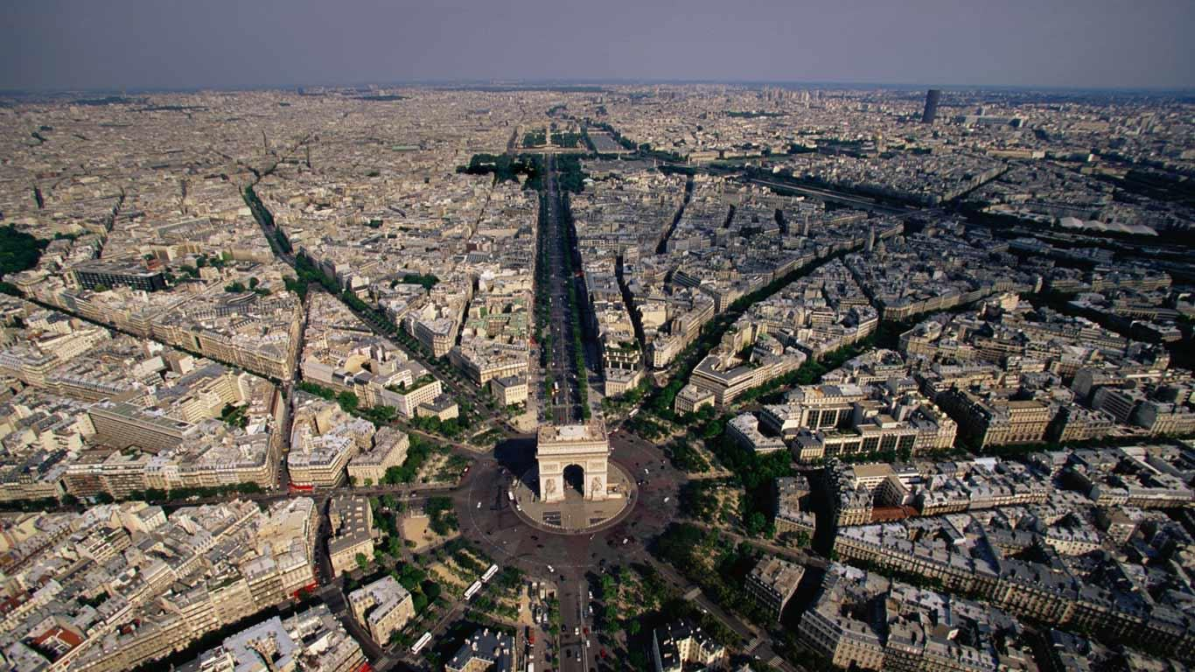

Slide 9
The Park Movement
Thoreau and Emerson, the “pastoral”: Arcadian Classicism, drew from Ancient Greek notion of “Arcadia.”
An antidote to the urban-industrial society
Progressives: bring working class into nature to “tame” them and have them mingle with elites to democratize, create fraternal feelings.
“It was believed that parks would breed a desire for beauty and order, spreading a benign, tranquilizing influence over their surroundings.” Christine Boyer, 1983, Prof. of Arch.
Early vision: Parks as wild nature, restorative
SF’s Golden Gate Park, NY’s Central Park, LA’s…?
NYC had 11 parks of 100 acres or more by early 20th C
Los Angeles’ Olmsted Vision

Slide 10
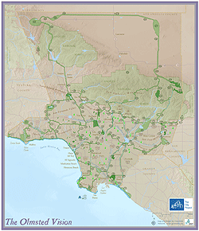
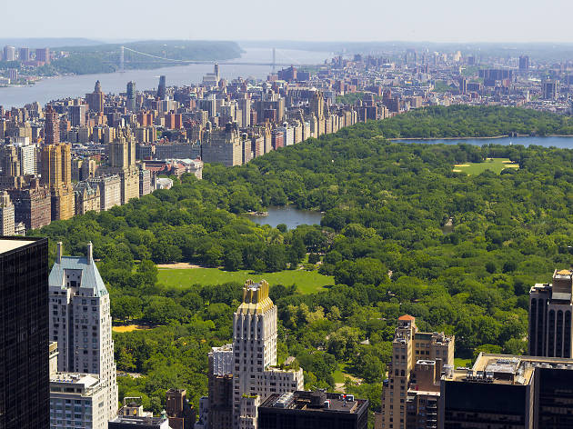
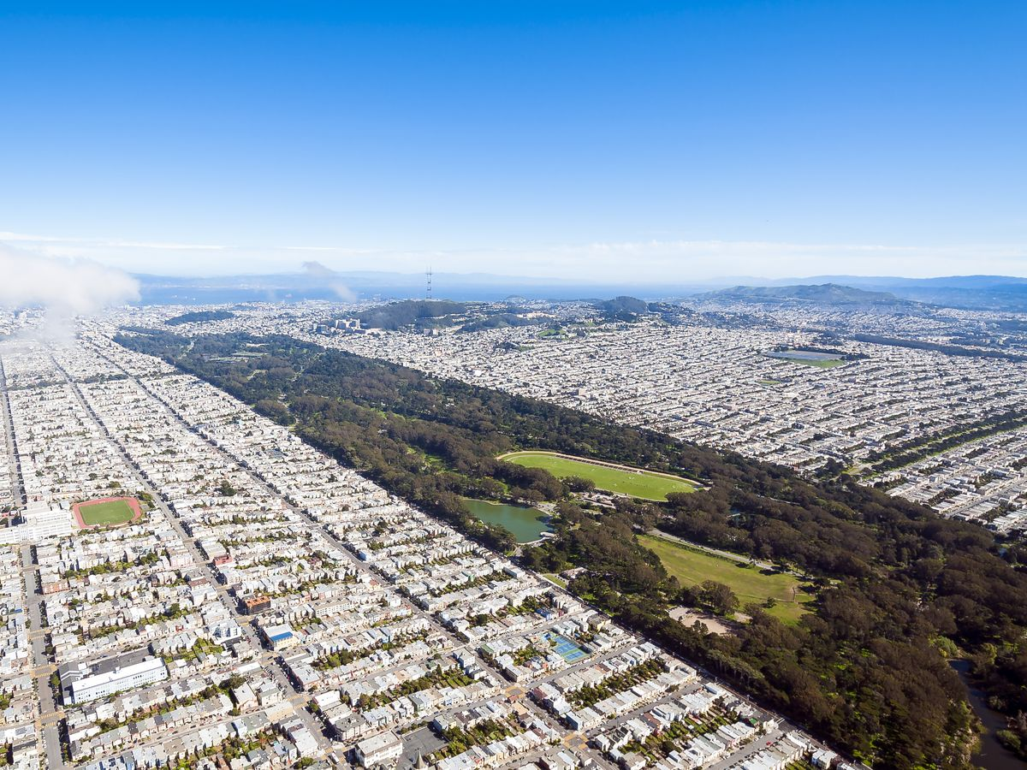
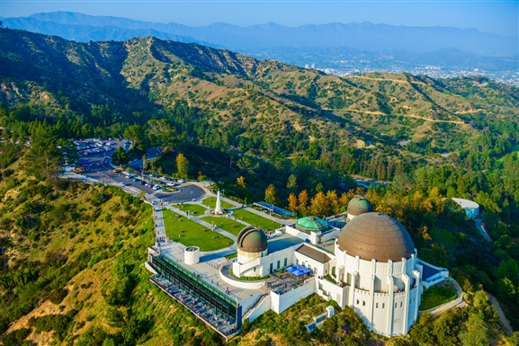
New York’s Central Park
Los Angeles’ Griffith Park
San Francisco’s Golden Gate Park

Slide 11
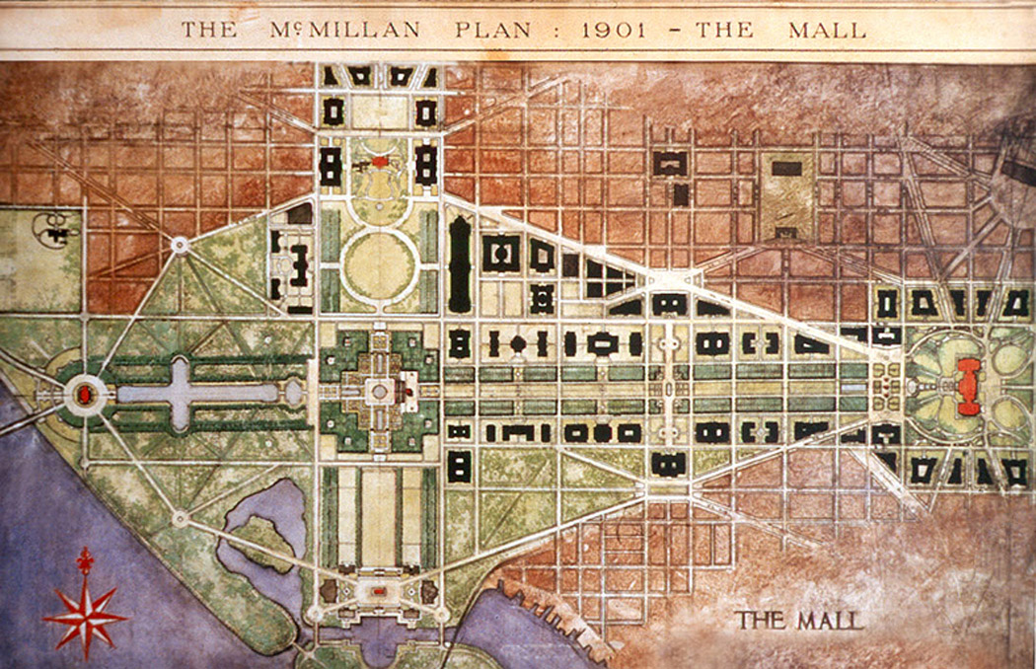
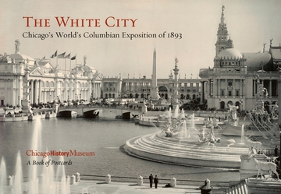
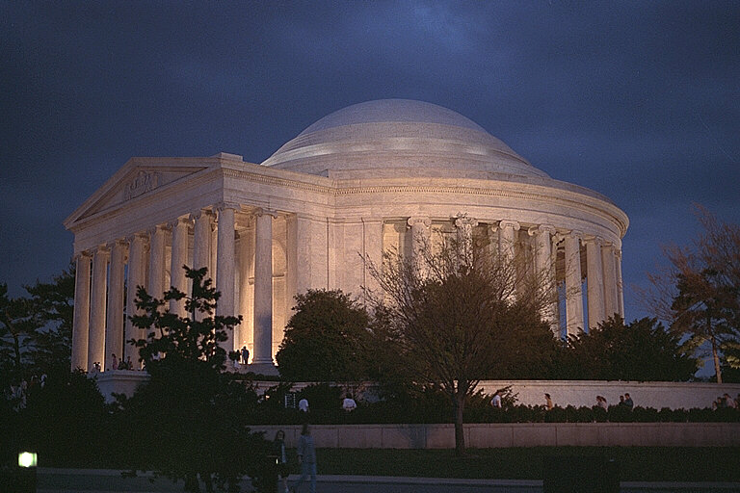
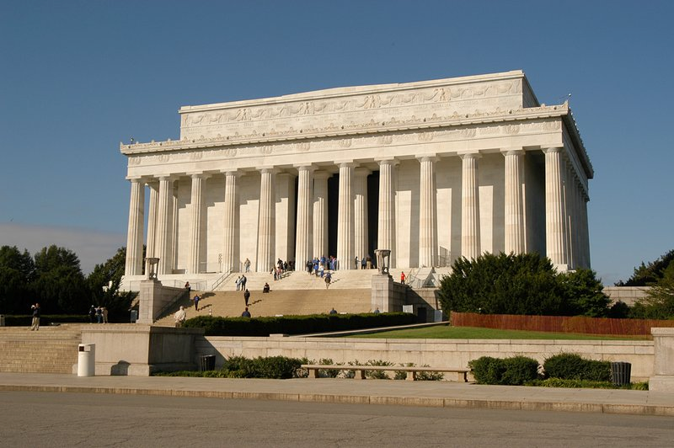
City Beautiful
Also meant to “tame” the masses but through neoclassical design and architecture.
It was also seen as rational, efficient and orderly restructuring of the city.
Burnham’s White City for Chicago World Fair, 1893
Washington DC, McMillan Plan
Public monumentality
Did it fix urban problems?
Did it legitimize “Anglo-Saxon” rule at time of mass immigration?
Often driven by “egotistical” architects
Daniel Burnham, “Make no little plan.”

Slide 12
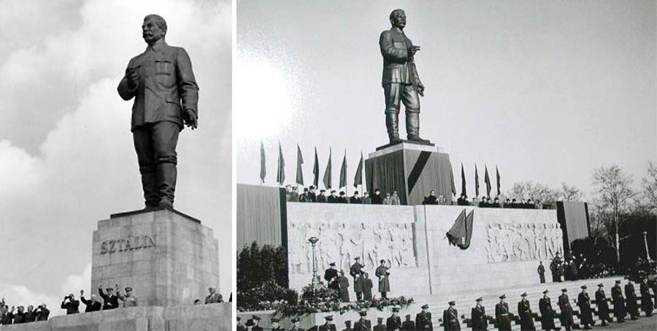
Authoritarian Urban Planning
Russia: 1917 Communist Revolution
New Capital: Moscow (St. Petersburg becomes Leningrad)
Lenin, then Stalin: centrally planned bureaucracy
Goal: rapid transformation of society, from peasant and rural to urban and industrial power.
Achieved
But at what cost— “oppressive urbanism”

Slide 13
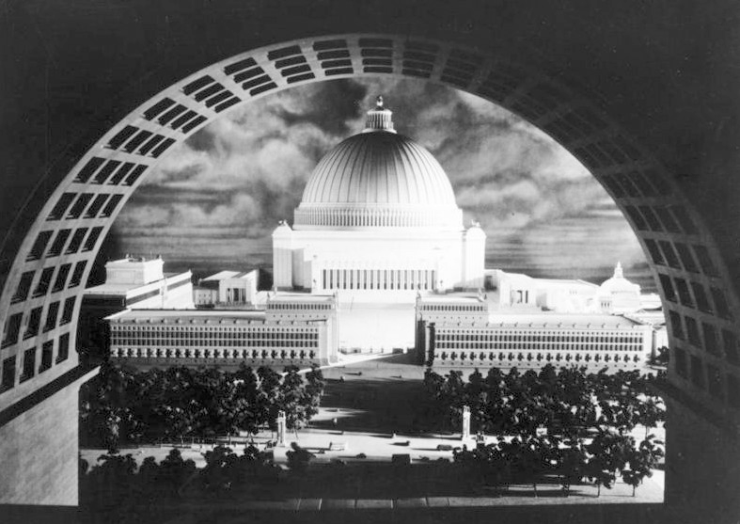
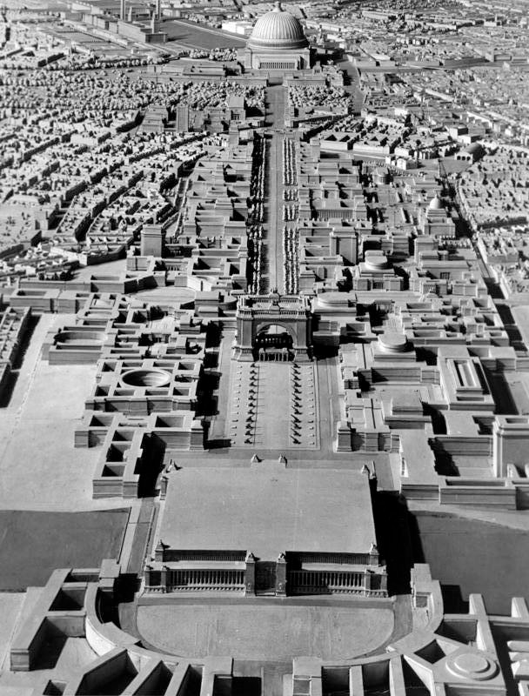
Nazi Germany
Germany already industrialized
Fascists come to power 1930
Make Germany Great Again!
Berlin: center of the Greatest Empire
Berlin, imperial city, center of European Empire
Albert Speer, chief planner, architect
A New Berlin
Boulevard of Splendor, a monumental axis
Traffic free, parade ground
Pass thru giant arch end at massive domed temple: Temple to the Fuhrer, “Volkshalle”
900’ high, 820’ diameter dome
World’s largest enclosed space
Made of granite & marble “ruin value”
As a world capital, Berlin will only be comparable with Ancient Egypt, Babylon and Rome! What is London, what is Paris compared to that!”—Adolf Hitler, 1942

Slide 14
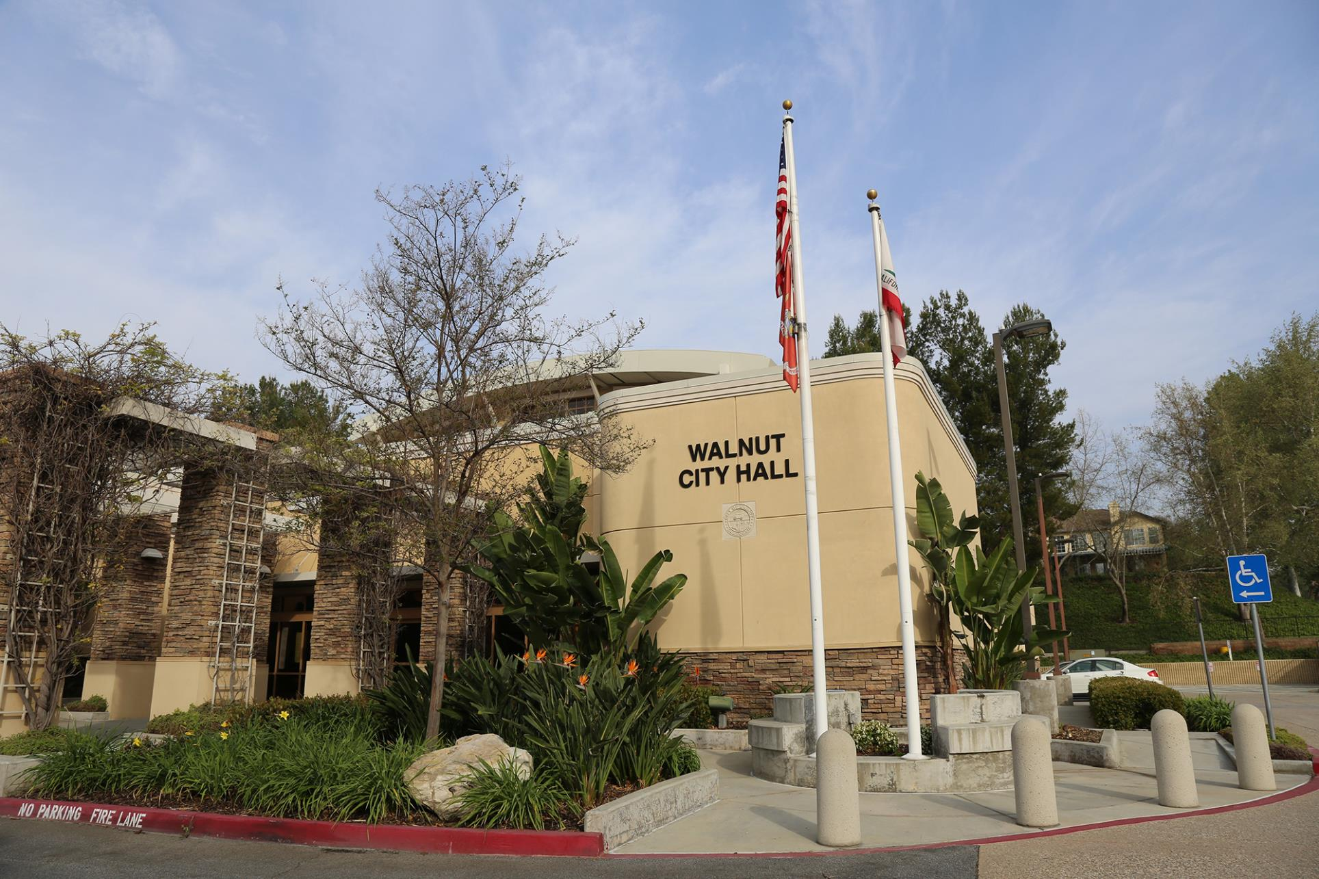
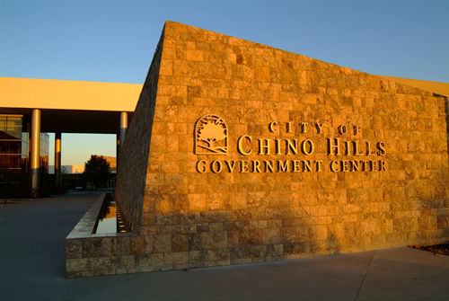
Contemporary Urban Planning
Becomes standardized in mid-century
Less about aesthetics, more a function of politics, bureaucracy.
More inclusive
The Master Plan
Land use
Transportation
Utilities
Public safety
Housing

Slide 15
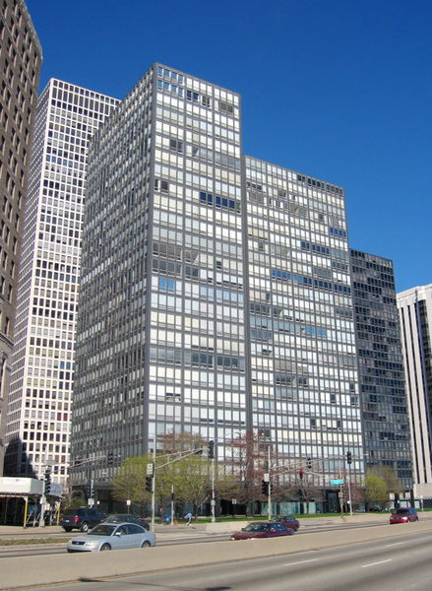
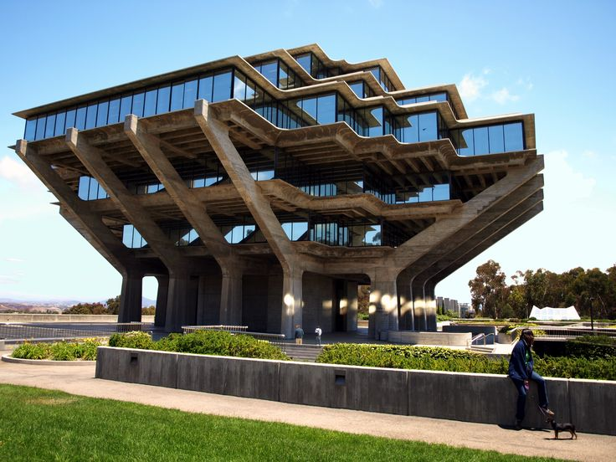
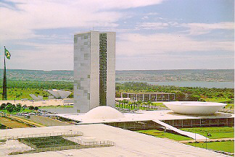
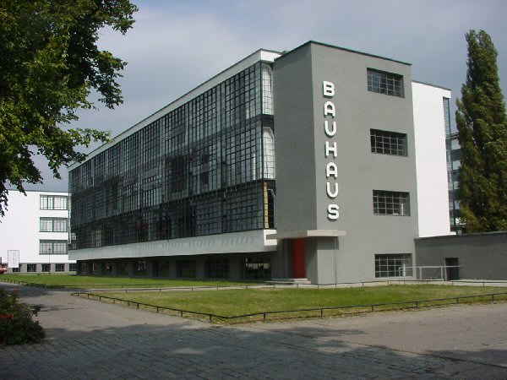
Modernist Design
Brasilia, Brazil
Response to the technical, bureaucratic planning
Core principles
Simple structures
Time-less and place-less
Efficient
Most modern materials
Less is more, Form follows function
Bauhaus school of design, 1920s. Walter Gropius, Ludwig Mies vna der Rhoe.

Slide 16
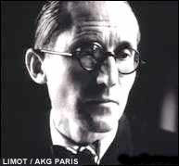
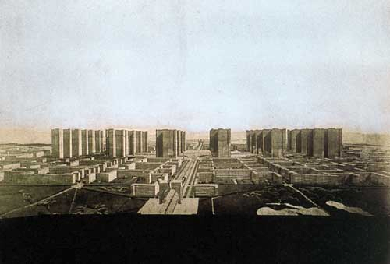
Le Corbusier “Corbu”
Radical plan for Paris
Tower in a Park
High rises
Space between
Functional zones
The Radiant City
Zones and residences dispersed but connected by transportation system
Unveiled at 1933 meeting of Modern Architecture in Athens.
Embraced by authoritarian regimes (Soviets, China)
Many criticisms.
“Modern town planning comes to birth with a new architecture. By this immense step in evolution, so brutal and so overwhelming, we burn our bridges and break with the past.”

Slide 17
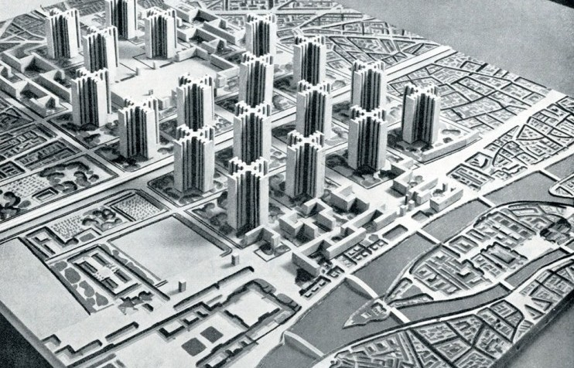
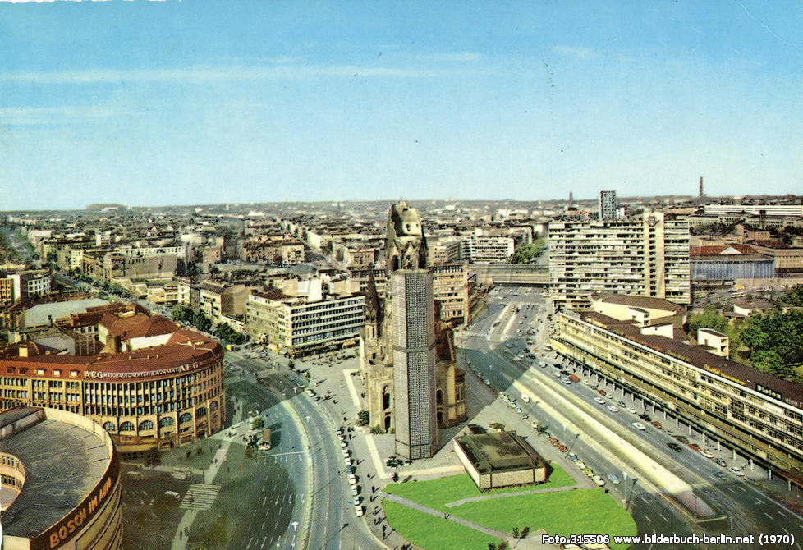
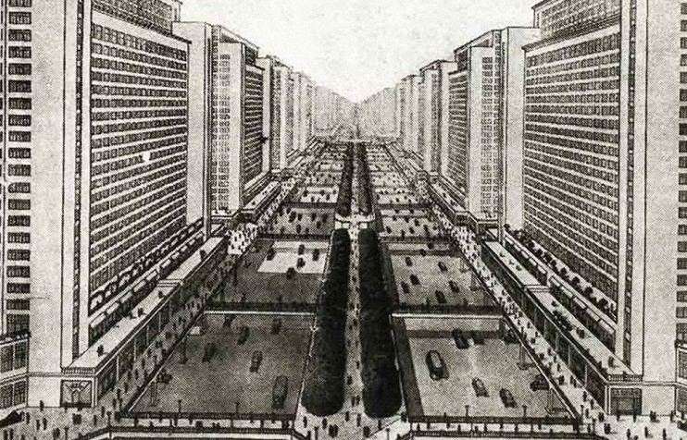
Authoritarian Modernism
Communist urbanism, eastern Germany to USSR to China
Tower-block housing
Industrial nodes away from housing
The Soviet “mikrorayon” a completely planned community.
Would “lift” them into the modern era without any of the ills of the crowded slum/tenement.

Slide 18
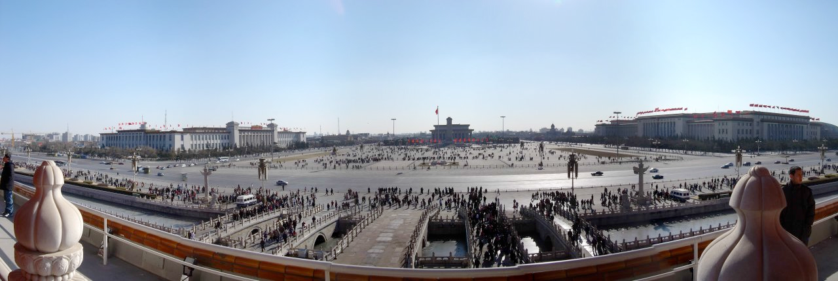
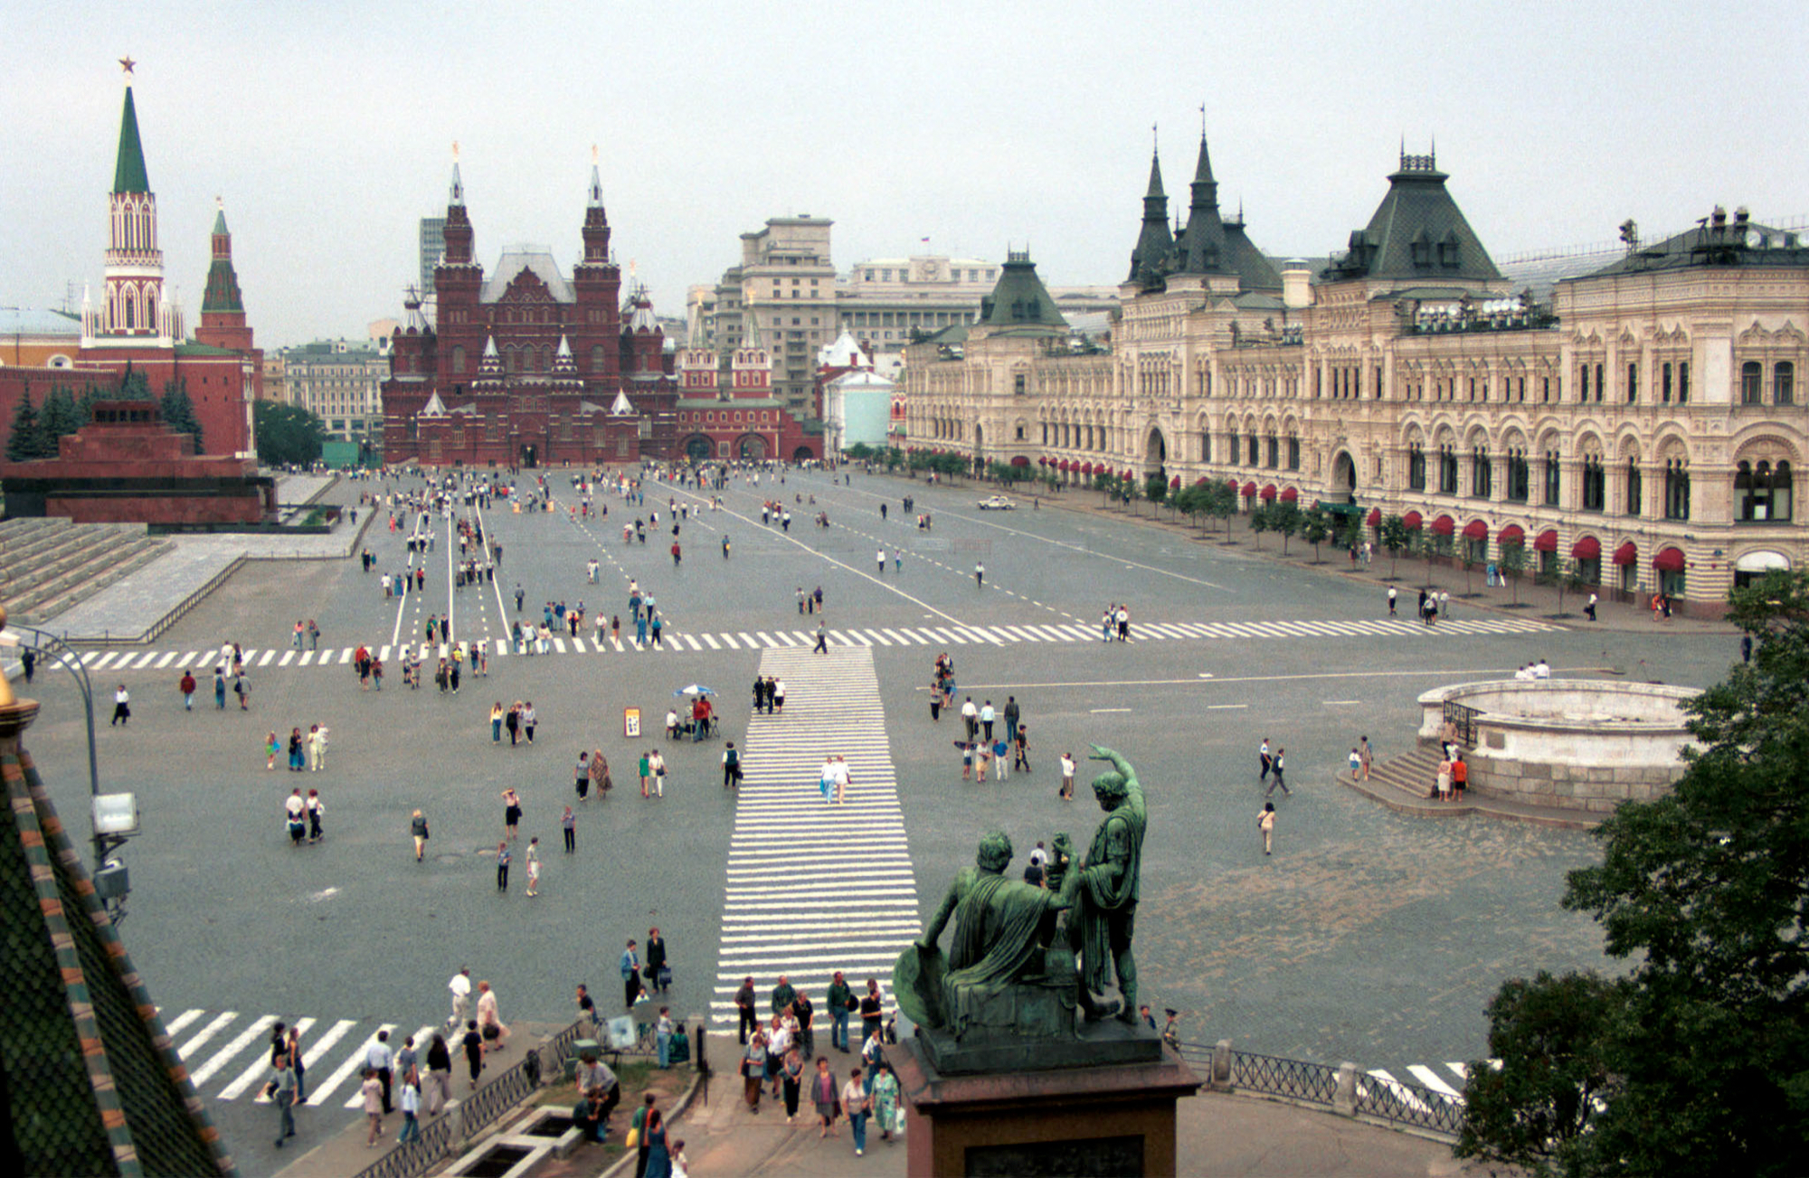
Only diversion in 20th C communist cities were the enlarged squares and parade grounds
Monumental symbols to celebrate the city’s historical past
Red Square in Moscow—celebrated modern Soviet Union but also sense of historic greatness in the Kremlin fortress (had been the center for Russian Tsars).
Tiananmen Square in Beijing (located in front of the Emperor’s Forbidden City).

Slide 19
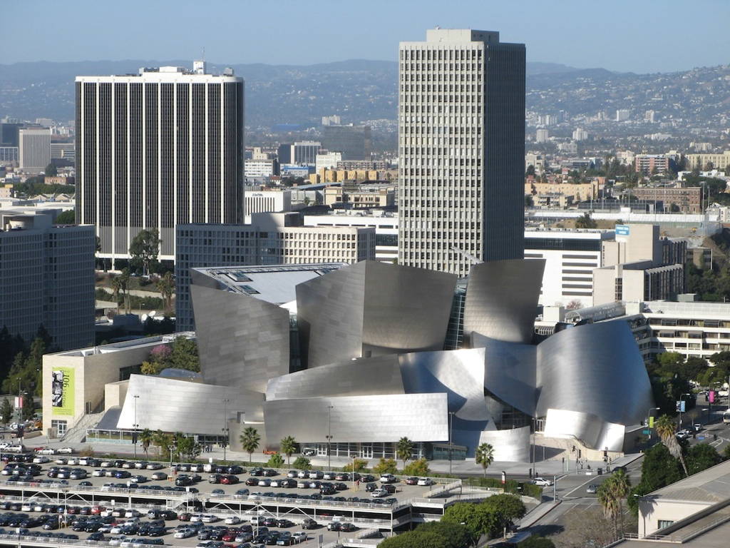
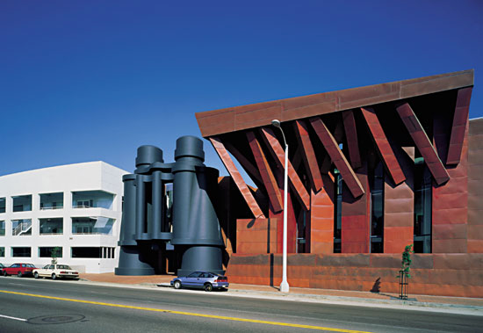
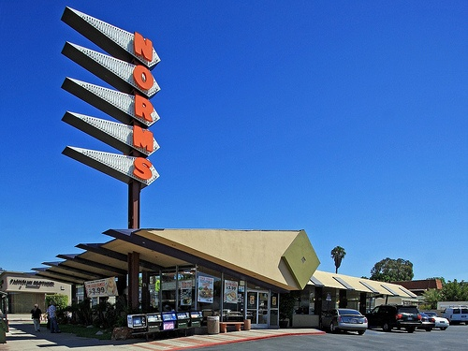
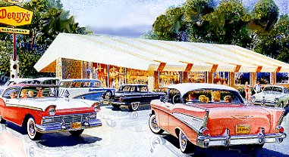
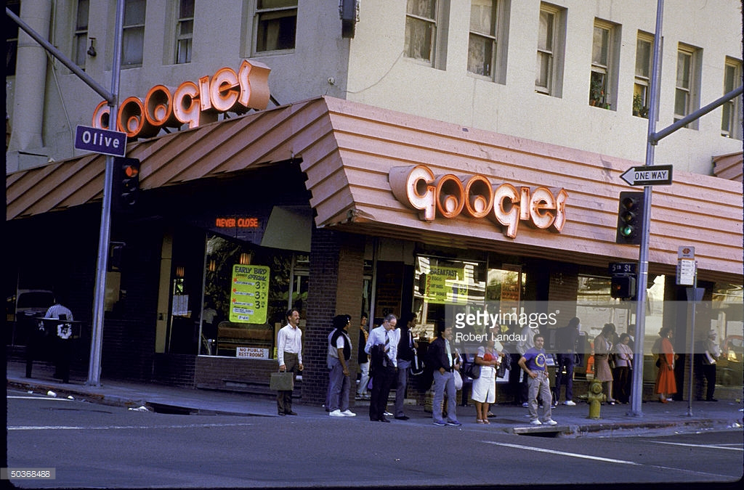
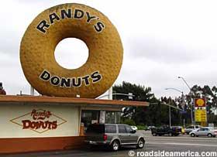
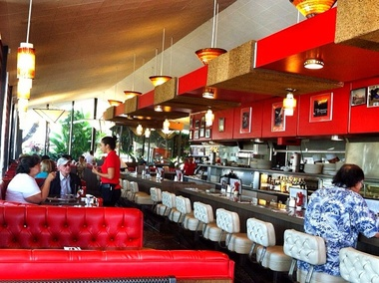
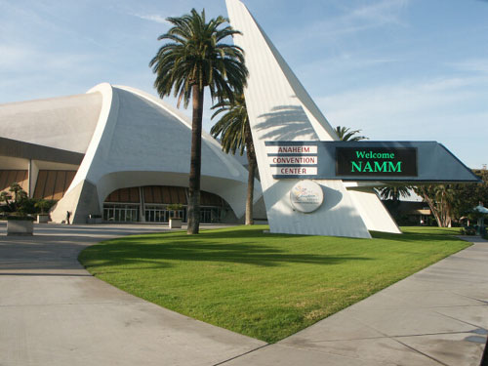
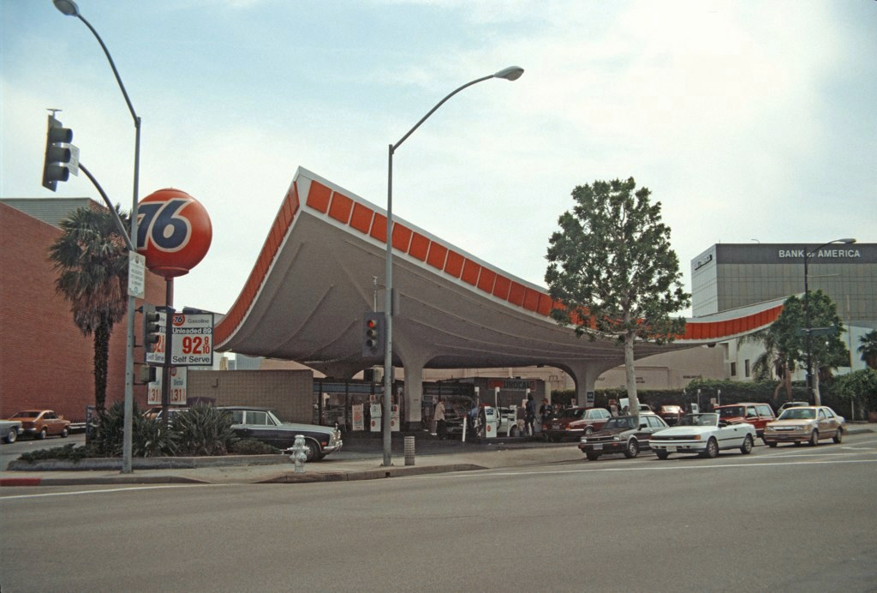
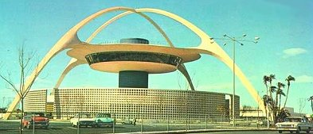
Other Modernist Design
Disney Hall
Frank Gehry “Star-chictect”
Anaheim Convention Center
Not all was “brutal” or bleak.
Star-chitects like Frank Gehry
Playful architecture to catch motorists’ eye
Gravity-defying rooflines, animated neon signs, enormous windows.
“Googie” design. Only Pann’s exists.
Los Angeles Airport

Slide 20
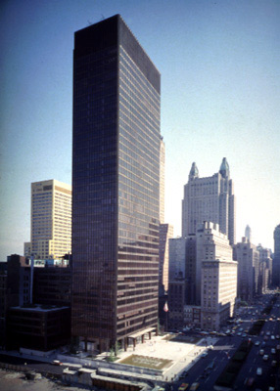
The push for height limits
Limits on skyscraper construction
Most severe in Europe—absolute ceilings of maximum height to preserve the visual prominence of the city’s historic “sacred skyline”
In the U.S., height limits in Boston (125’) and L.A. (150’). Remained well through the 1900s.
NY’s 1916 Zoning Resolution—height limits that were flexible
Zoned for areas of differing heights.
Height tied to the width of the street and how far back the upper floors of the building were set back. So in the city’s most generous height district of 1916, a building’s “streetwall” could be as tall as 2.5 times street width (up to 250’ on the widest streets) and each 10’ of setback allowed an additional 50’ in height.
NY’s 1961 Zoning Reform
Allowed for more tall buildings
Established an FAR—floor area ratio
Total internal area/area of the lot
1500 sq ft home/6000 sq ft lot=FAR 0.25, 500,000 sq ft office building /100,000 sq ft lot has an FAR of 5.0
FAR bonuses included if developers included street-level open space at the foot of the building—the bigger the open space, the bigger the bonus
Also must make the open space accessible to the public “at all times”—creates ambiguous Privately Owned Public Space (POPS)
POPS have proliferated in the U.S., more than 500 in NY alone—Occupy Wall St’s Zuccotti Park
Concerns with the skyscraper
Ambivalence towards modernism captured in ambivalence towards the skyscraper
Symbol of progress or modern problems?
Threat to environmental quality and public safety?
Threat to economic stability—new construction might depress the value and rental income generated by neighboring buildings

Slide 21
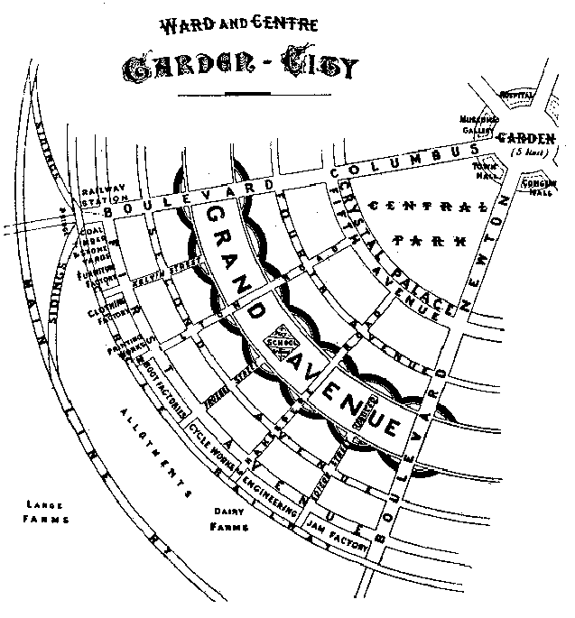
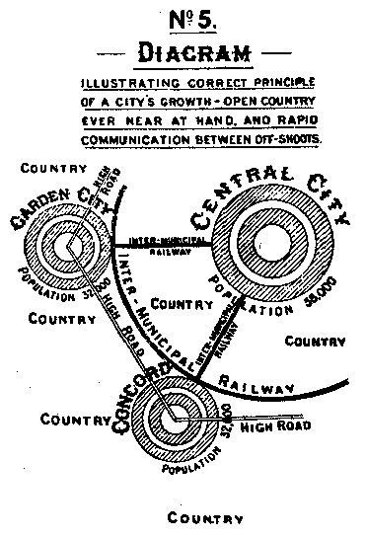
Another Response: Ebenezer Howard’s Garden City
Ebenezer Howard (UK, 1898)—saw density and alienation from the countryside as the chief problem of industrial cities
Too much crowding, excessive density
His vision: regionally planned decentralization
Rather than bulldoze slums for a City Beautiful or Corbusian high rises, create “new towns” from scratch in the countryside
Help reconnect with nature; “town-country magnet”
Sounds a lot like sprawl (think Orange County)
But popular today, even among critics of sprawl
They were compact, walkable, mixed use clusters connected by rail (about 32,000)
Housing would be affordable, sustainable
Circular central park for libraries, museums, public space
Inspired early planned “new towns” in Britain like
Letchworth (1903) and Welwyn (1920)

