Slide 1
Lecture 8
Decentralization, Suburbanization and the Galactic Metropolis

Slide 2
Keywords
Suburbanization
Fogelson and Ford
PLVI
Agglomeration
Decentralization
White flight
Erickson and Hartshorn model
Edge cities
Bedroom communities
Commercial strip
Triple dream of suburbia
Street car suburbs
Light frame construction
FHA
VA
Fannie Mae, FNMA
Minimum house
Mansions/Bulkification
Measuring sprawl

Slide 3
Decentralization
People, businesses, buildings leave the historic city center
Transforms the city
National Scale
Local Scale

Slide 4
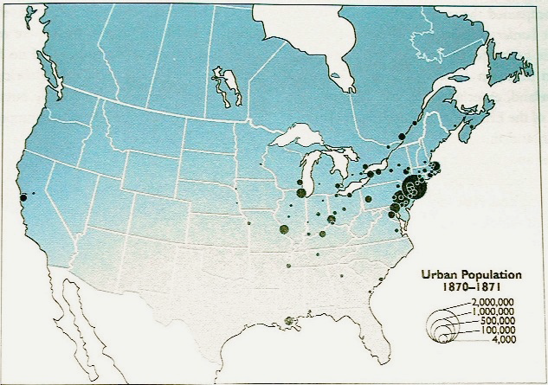
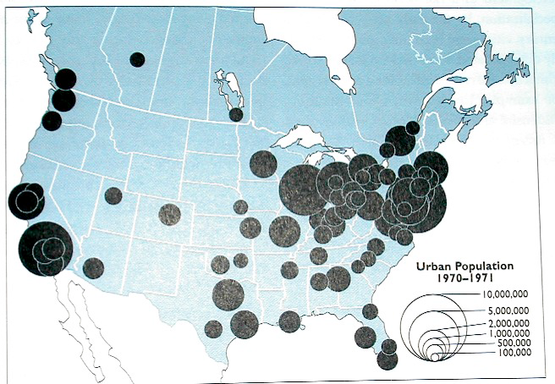
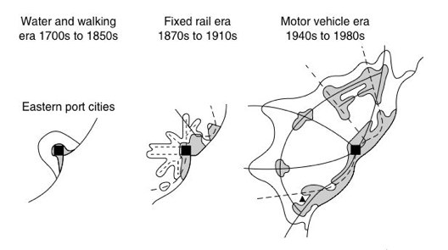
Changes in the geographic extent of the city.

Slide 5
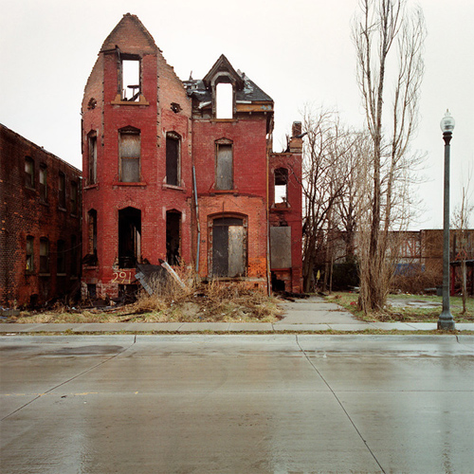
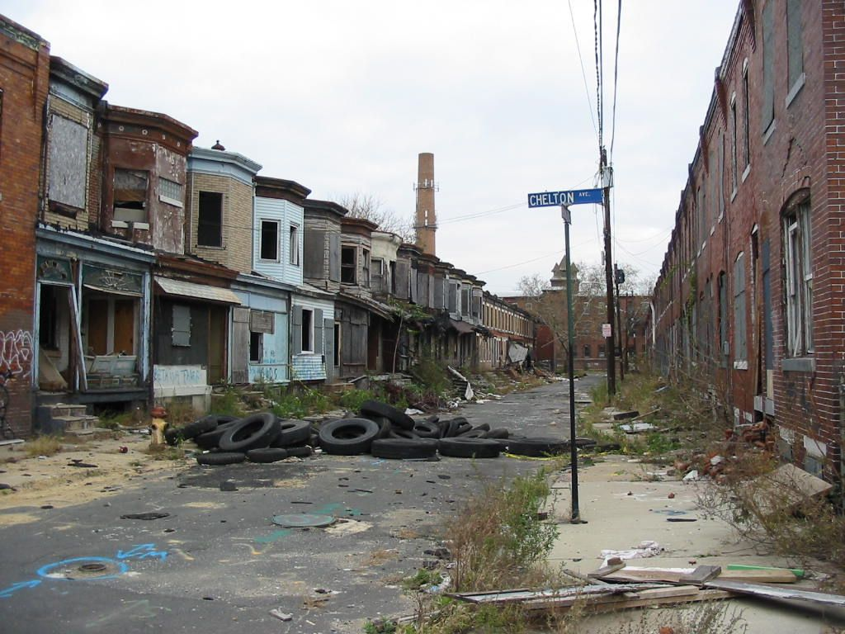
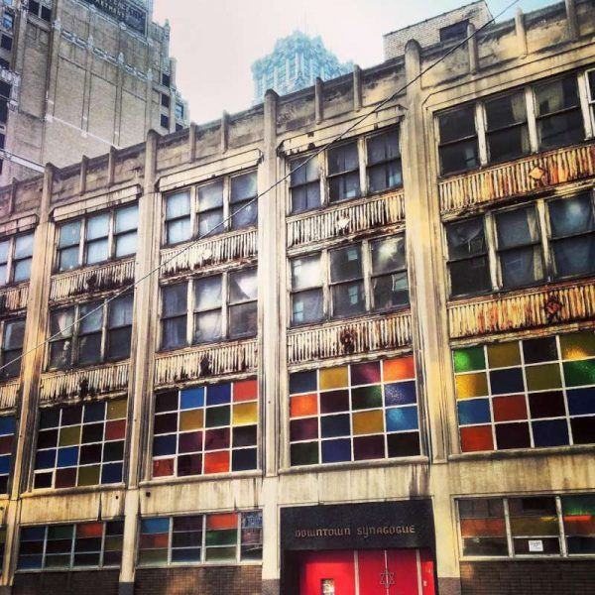
Abandoned synagogue, downtown Detroit
Abandoned housing, Detroit.
Camden, New Jersey

Slide 6
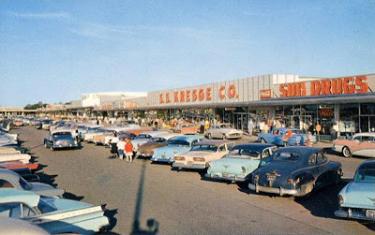
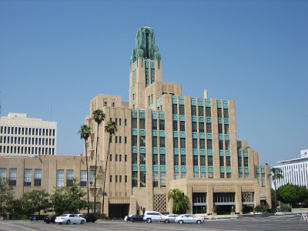
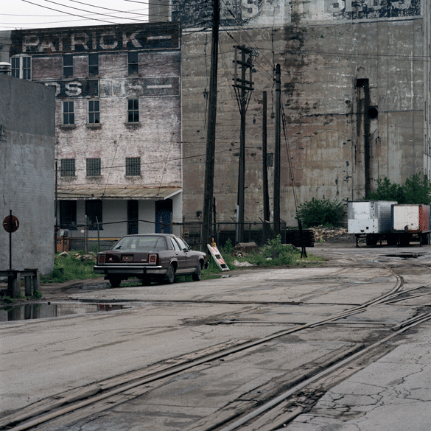
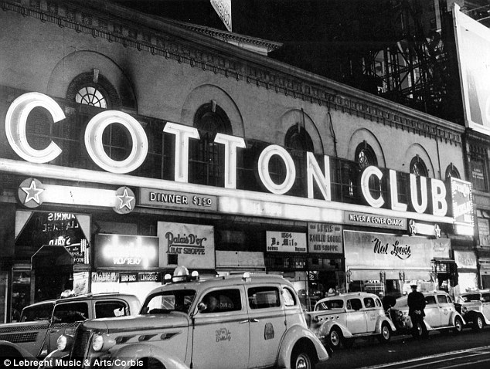
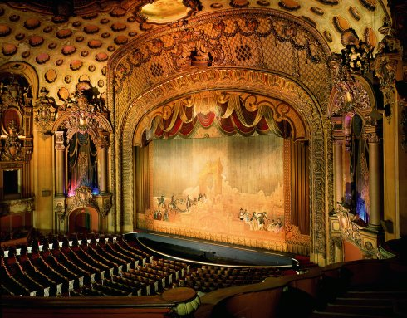
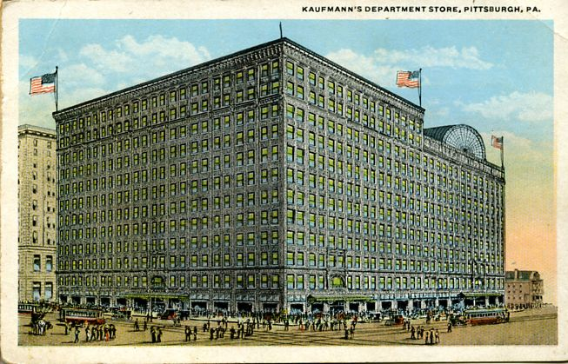
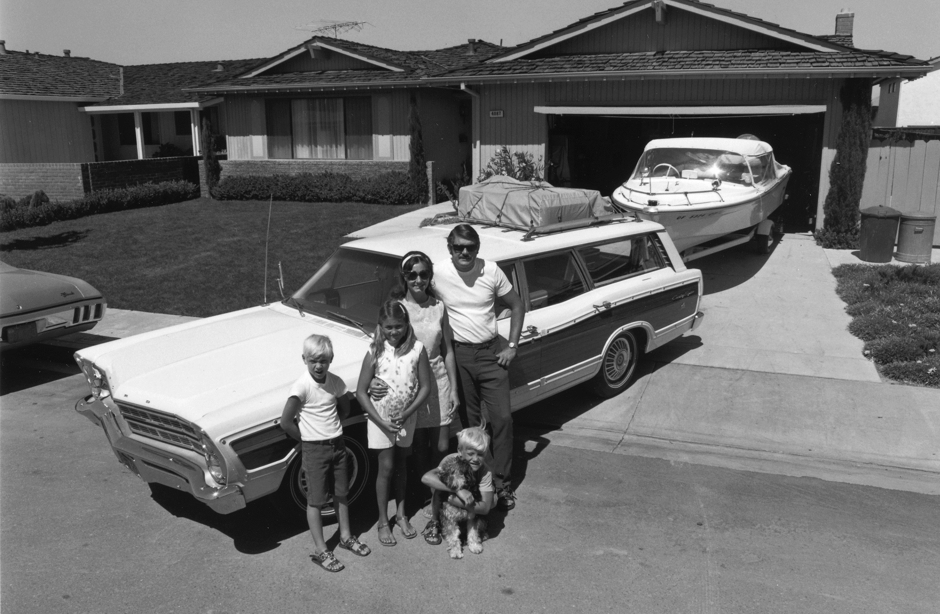
The Rise & Fall of Downtown
1800s
1920s
1930s
Post WWII
1960s
Now?

Slide 7
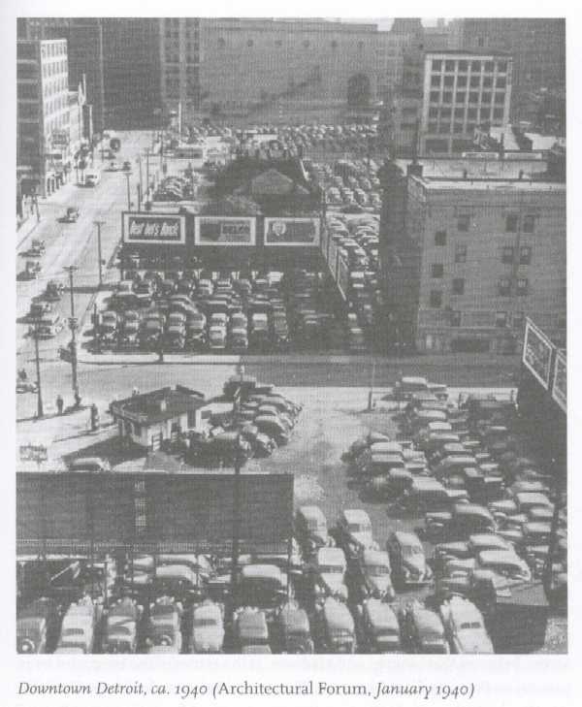
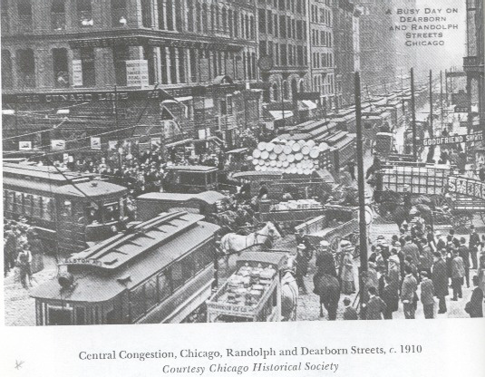
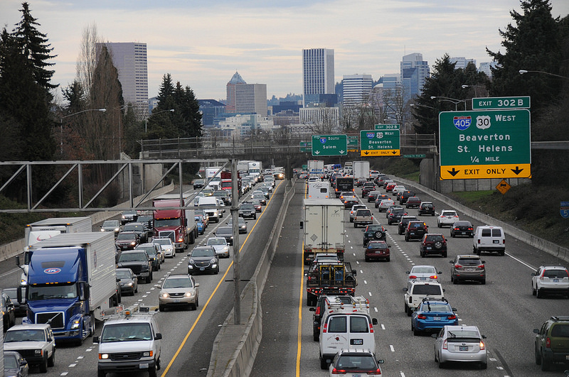
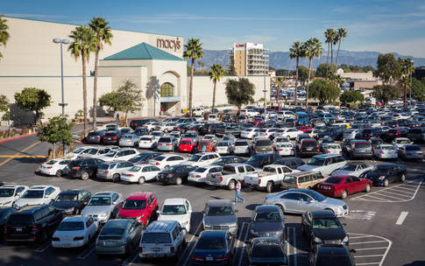
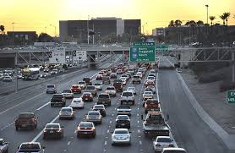
Why Decentralization?
White Flight
No immigration
The Great Migration
Automobile
Changes the center
Congestion, parking
Suburban Advantages
Car friendly
Agglomeration over centrality
Downtown Tries To Accommodates the Car
Elevated highways
Fly-over on/off ramps
Parking, parking, parking
Downtown as we knew it begins to be eroded away
Historic downtown is hollowed out, looks less and less appealing

Slide 8
Inside-Out Cities
Contradiction of decentralization
PLVI is downtown
But downtown becomes area of poor, not wealthy
Location rent
Consider factors beyond rent: maintenance, transportation
Density: lowers rent
Wealthy in periphery
Low value land in suburbs means more $$ for expensive construction
Poor in core
Live in high-value CBD but more affordable because of density, lower maintenance, lower transportation costs

Slide 9
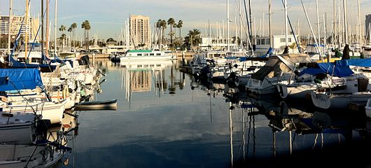
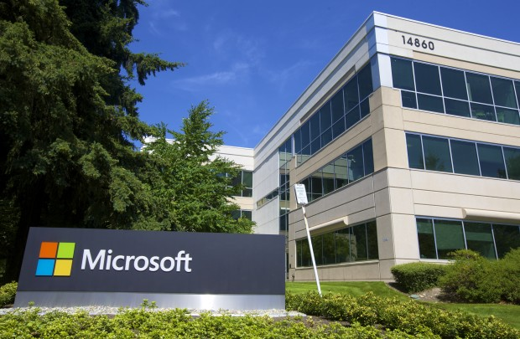
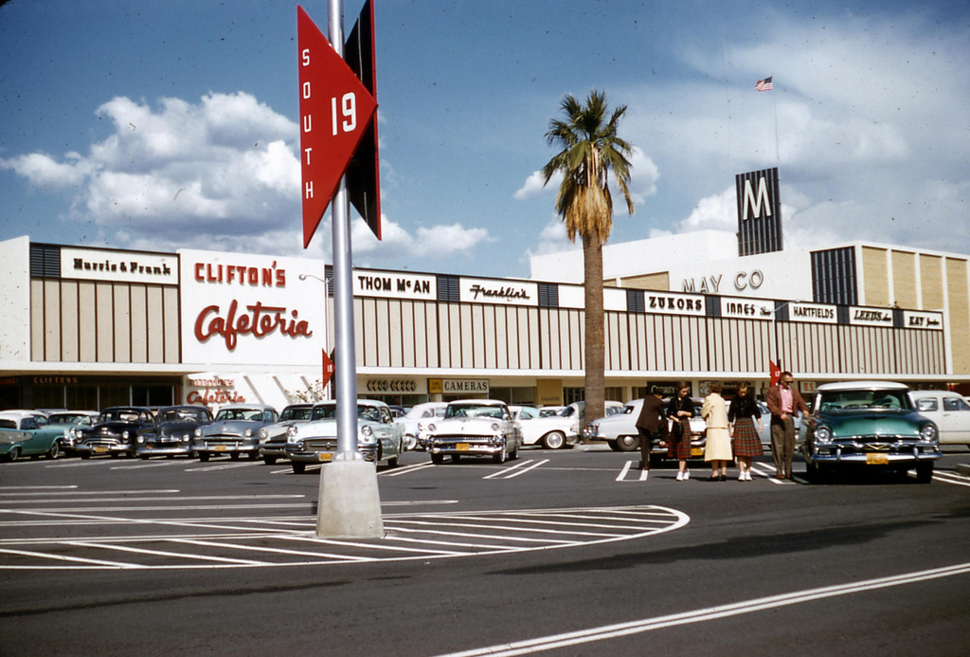
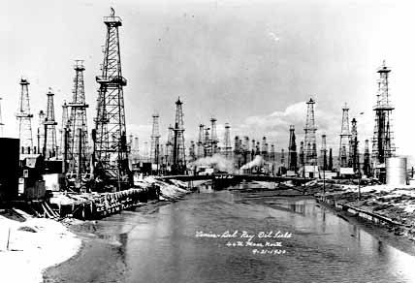
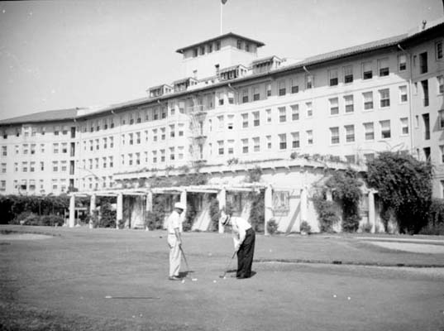
The Five Stages of Suburbanization
1930s
Spillover along rail lines, auto corridors
1950s
Car dominant, more sprawl
Bedroom communities
1970s
infill
1980s
Tech sector
New CBDs in suburbs (some even have skyscrapers)
2000s
More infill, densification
Mixed-use

Slide 10
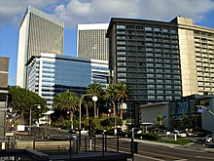
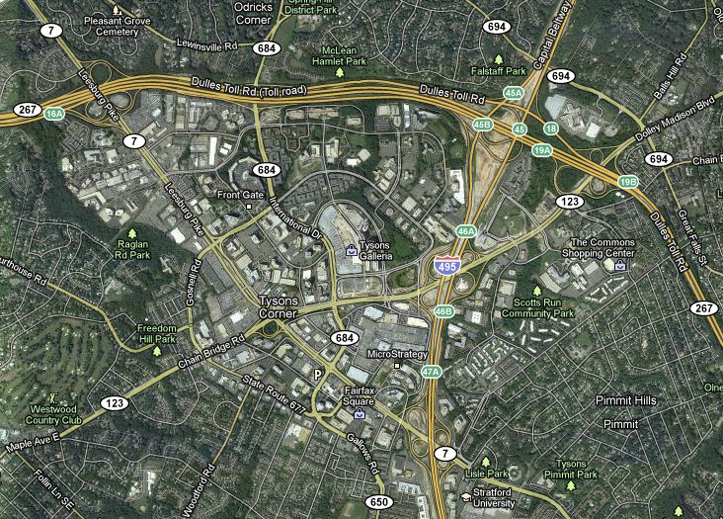
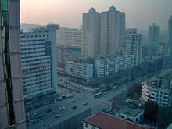
Edge Cities
Joel Garreau
Office parks (clusters), stores, housing
30 years ago were rural places
Accessible by freeway, interstate or airport (on edge)
No longer arrive by train in the city center, now arrive at the edge
What used to cluster at the PVLI now at the edge: hotels, convention centers, retail, entertainment…
Tyson’s Corner, VA
Century City, CA
Wuhan, China

