Slide 1
Heating the Atmosphere

Slide 2
Weather vs. Climate
Both deal with atmospheric phenomena
Weather denotes the state of the atmosphere over short time scales - hours or days
Climate denotes these phenomena over long time scales -many years or centuries
Seasons denote an intermediate time scale of months.

Slide 3
What Do We Measure?
“ELEMENTS” of weather are different from “elements” of the Periodic Table:
Air Temperature (measured in the shade)
Humidity
Type/Amount of Cloudiness
Type/Amount of Precipitation
Air Pressure
Wind Speed and Direction.

Slide 4
Atmospheric Pressure “The Weight of the Overlying Molecules”
Measured with a Barometer
“baro-” = pressure, “-meter” = measuring device
Pressure of One Atmosphere = 1 bar
Variations in pressure at the surface of the Earth are measured in thousandths of a bar = millibars
Avg pressure @ sea level = 1.013 bars = 1013 mb
Variations result from:
Changes in altitude
Changes in the direction of net movement of air.

Slide 5
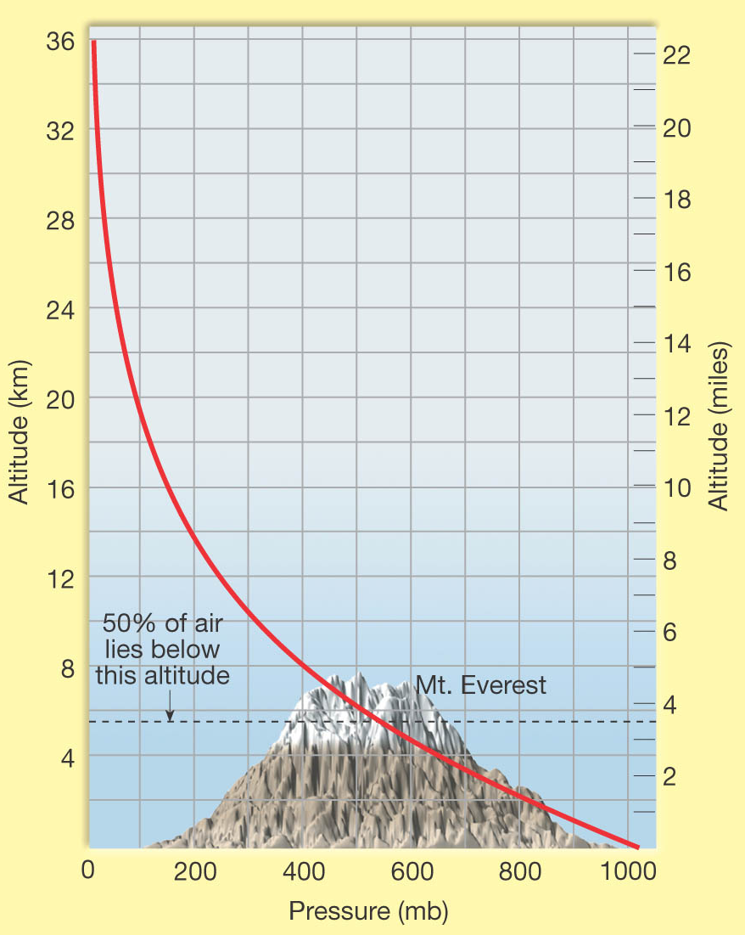
Pressure Changes: Altitude
Gravity holds air molecules close to Earth
Air is “concentrated” nearest the Earth
Fewer air molecules at higher altitudes
Only light or energetic molecules can bounce to higher altitudes
Pressure can be a measure of the “proportion of air:”
At 500 mb, half the air is above, half below
500 mb occurs at about 5.6 km elevation.

Slide 6
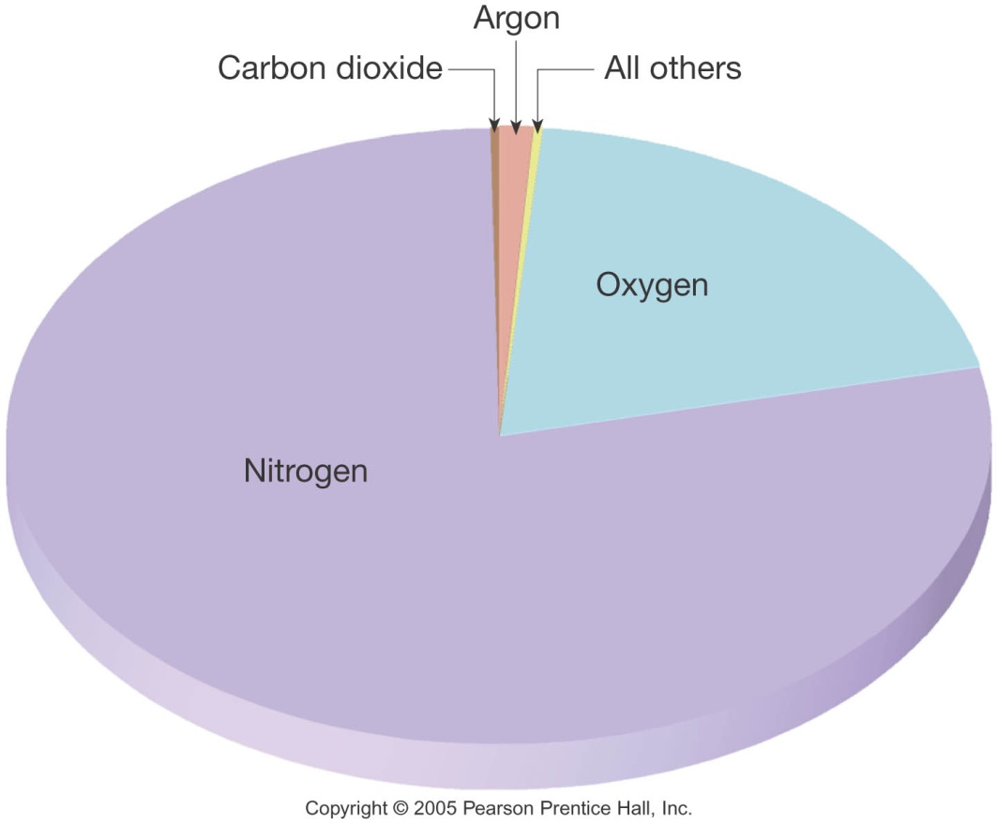
Composition of Dry Air
Air is composed of molecules in gaseous form
DRY air (excluding H2O) contains:
71% Nitrogen (mostly N₂)
21% Oxygen (O₂, some O₃)
0.93% Argon gas (Noble Gas!)
~0.035% CO₂
~0.035% other components
Some of these constituents have important properties...
Notes:
Last = Pie Chart

Slide 7
Variable Components: DUST
Dust is made of (for example):
Silicate materials
Salt crystals
Dust plays some very important roles:
Reflects sunlight back into space
There was a ½° DROP in average global temperature after the eruption of Mt. Pinatubo in 1992!
Absorbs sunlight
Helps to warm the atmosphere
Important nucleus for condensation
Every raindrop initially forms around a particle.

Slide 8
Variable Components: Ozone
Ozone (O₃) can act as a POLLUTANT...
Smell of “burnt air” after a lightning strike
Not good for us to breathe
...but also acts as a PROTECTANT
Ozone is a strong absorber of ultraviolet (UV) radiation that can kill living organisms
More on this later...

Slide 9
The Ozone Hole Problem
The “ozone hole” is a well-defined, large-scale destruction of the ozone layer over Antarctica that occurs each Antarctic spring.
The word "hole" is a misnomer; the hole is really a significant reduction in ozone concentrations which results in the destruction of up to 70% of the ozone normally found over Antarctica
Ozone is very reactive, easily losing its third oxygen atom in the presence of other highly reactive compounds called radicals, which contain chlorine, hydrogen, nitrogen, or bromine. Minute quantities of these radicals can cause large decreases in ozone because they are not consumed in the reaction. This is called a catalytic cycle.

Slide 10
Ozone Hole and CFCs
Humans have introduced Chlorofluorocarbons (CFCs) that interact with ozone
CFCs are INERT at the Earth’s surface
Make great aerosol propellants
Drift up into the stratosphere
CFCs are broken down by UV rays (like ozone)
Products re-unite with that free oxygen atom...
...so Ozone cannot reform
CFCs continue to deplete the supply of ozone...

Slide 11
Ozone Hole is Seasonal
In Antarctica, it grows in the Spring (October) and shrinks in the Fall (March).

Slide 12
Variable Components: CO₂ + H₂O
Gases are TRANSPARENT to Visible Light
They allow sunlight to pass through the atmosphere
How do we know this? Hmm...
CO₂ & H₂O ABSORB IR Radiation from Earth
They help keep atmosphere warm
Any increase in their abundance means warmer temperatures
These are two important Greenhouse Gases.

Slide 13
Temperature A Specific Definition
Temperature is often a relative measure:
“This porridge is too hot!”
“This porridge is too cold!”
“Temperature is a measure of the average kinetic energy (thermal energy of motion) of the particles of a substance.”
We will use a more objective measure:
Thermometer measures T in °C
Freezing pt of Water = 32°F = 0°C
Boiling pt of water = 212°F = 100°C

Slide 14
Heating = Transfer of Thermal Energy
Some Physics:
Hot objects have molecules with lots of thermal energy
They try to give that energy to objects that are “less fortunate” (cold objects) – or to empty space
Hot objects heat cool objects
We don’t say that a cold object is cooling a hot object
“Hot coffee warms the ice” in your Iced Mocha

Slide 15
More Physics…
Newton’s Law of Cooling
“The rate of change of the temperature of an object is proportional to the difference between its own temperature and the ambient temperature (i.e. the temperature of its surroundings).” $∆Q=mCP∆T$
Q = heat (in cal), m = mass (g), C_{P} = heat capacity (cal/g°C), $∆$ = “difference,” T = temperature (˚C)
Simply put, the larger the difference in temperature, the faster the heating!

Slide 16
Heat Transfer: Conduction
Conduction works in Solids
Molecules that make a solid heat their neighbors
Energy spreads through matter that does not move
Ex: Iron Bar and Blowtorch.

Slide 17
Heat Transfer: Convection
Convection works in Fluids
Heated molecules move away (up)
Energy spreads when matter moves, carrying the energy
Ex: hot air rises.

Slide 18
Heat Transfer: Radiation
Works in Vacuum (between gas molecules)
”Photons” radiate through empty space from hot object
Energy spreads to matter that can absorb photons
Ex: Sun, Campfire
The closer you are to the heat source, the more photons you absorb.

Slide 19
The Nature of Light
Light is one STRANGE phenomenon!
Electric and magnetic forces are really two aspects of the same phenomenon, which we now call electromagnetism
Light exhibits BOTH wave-like (wavelength) AND particle-like (photon) natures

Slide 20
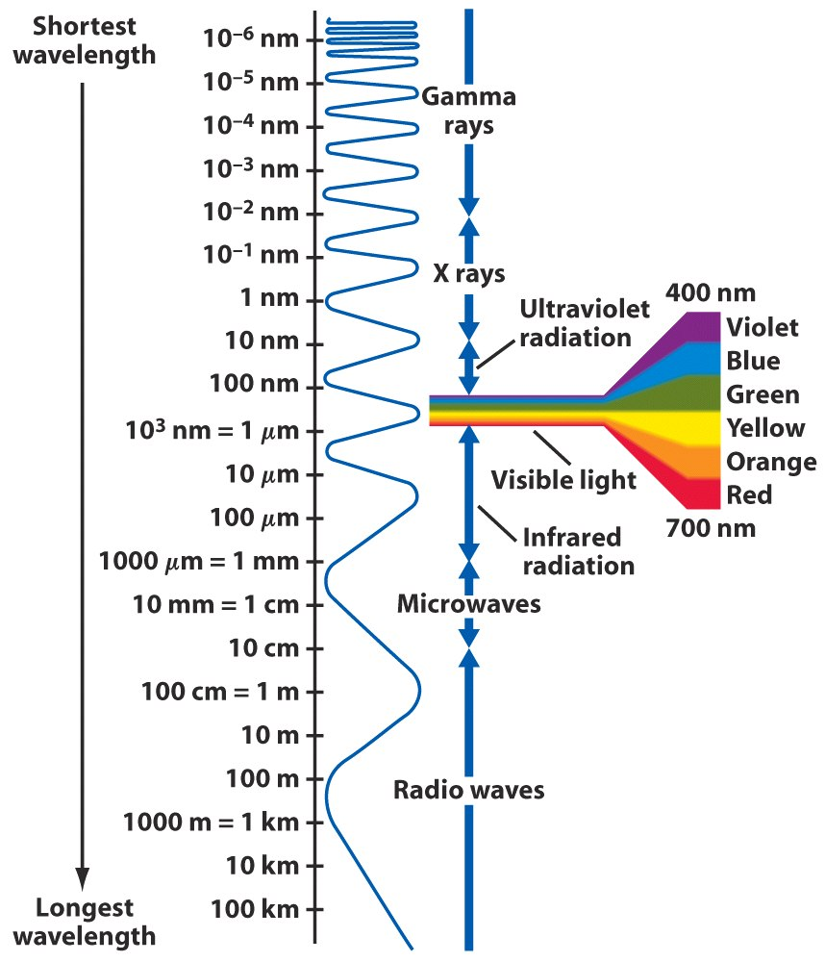
The Electromagnetic Spectrum
All objects emit radiation
$E=\frac{hc}{λ}$
E = energy of a photon
h = Planck’s Constant
6.6 x 10⁻³⁴
c = speed of light
3 x 10⁸
λ =wavelength

Slide 21
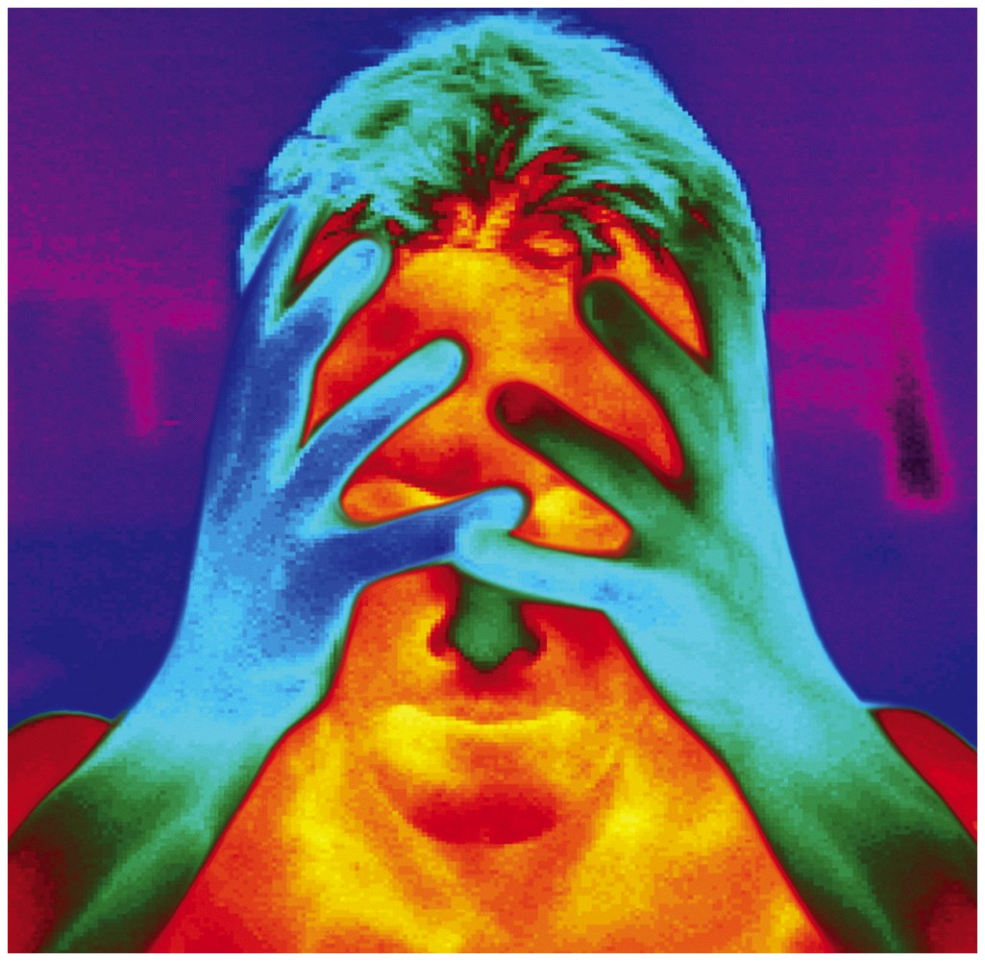
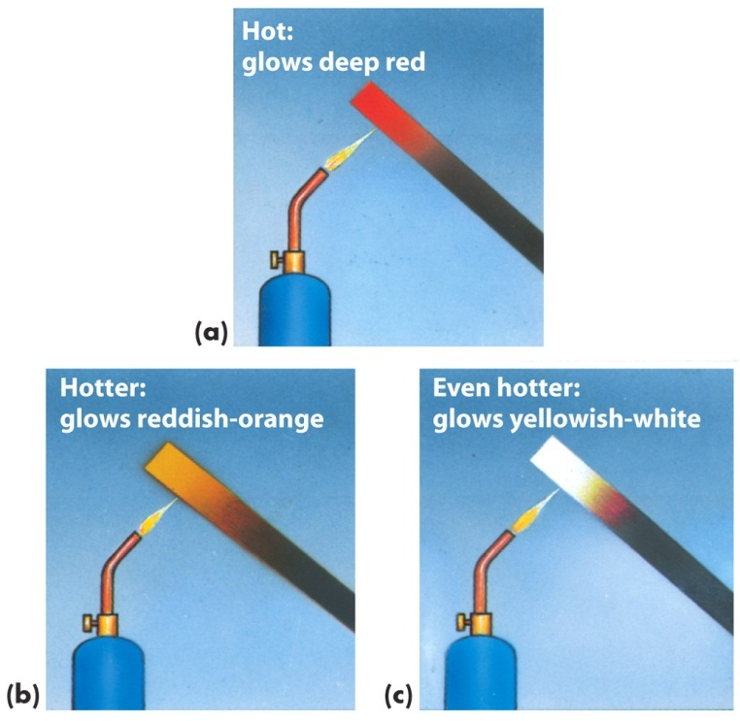
Principles of Radiation II
All objects emit radiation
Our eyes can only detect Visible Light
Hotter objects emit more energy per unit surface area than colder objects
Ex: Charcoal - how do they do that?
Hotter objects emit higher energy (shorter wavelength) photons than colder objects.

Slide 22
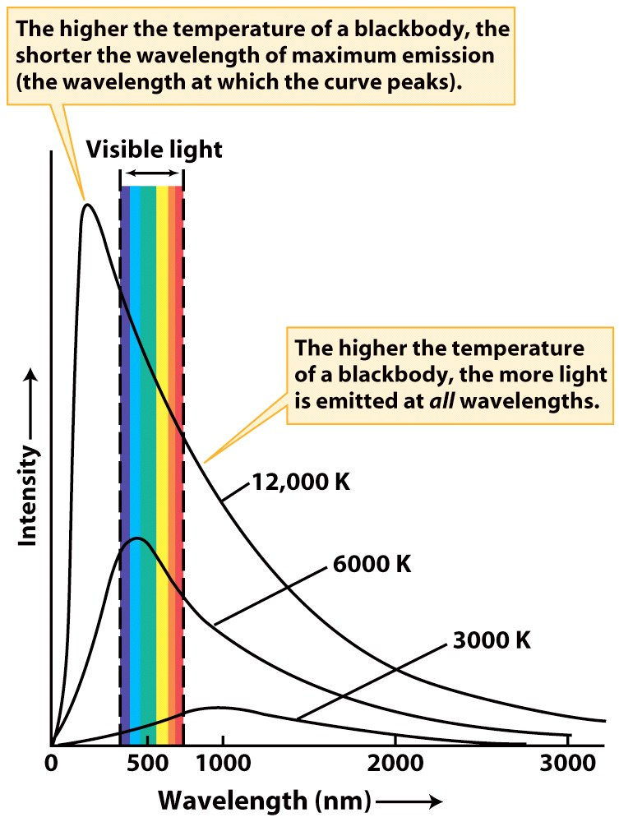
Blackbody Radiation and the Solar Spectrum

Slide 23
Principles of Radiation III
Good Absorbers Make Good Emitters
If this weren’t true, what would happen?
Some materials absorb everything;
Some materials are selective absorbers
Gases of H₂O and CO₂ are examples:
They DON’T absorb Visible light
They DO absorb IR radiation.

Slide 24
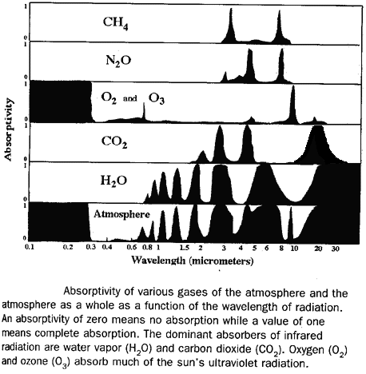
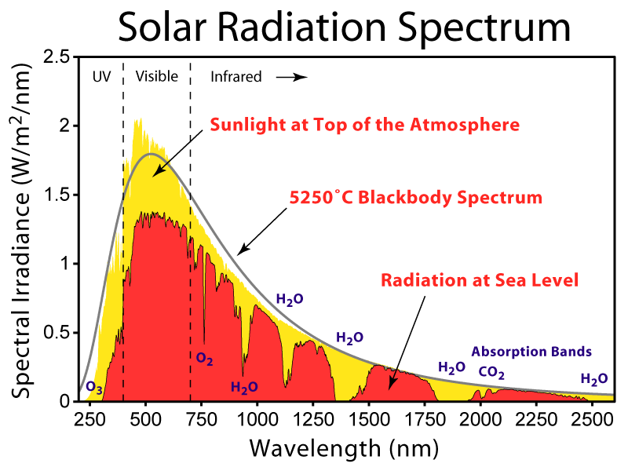
Absorption Spectra

Slide 25
Simple Question:
If Hot Air rises, why is there snow in the mountains?

Slide 27
Temperature Variations I
If we send a balloon up through the atmosphere to measure the temperature:
Temperature DROPS through the Troposphere
Temperature RISES through the Stratosphere
Temperature DROPS through the Mesosphere
Temperature RISES through the Thermosphere

Slide 28
Temperature Variations II
Remember that simple question?
If Hot Air rises, why is there snow in the mountains?
Answer is not so simple!
How is each layer heated? It needs:
Heat Source, which emits some…
Type of Radiation
Material to absorb photons.

Slide 29
The Troposphere
This is also known as the “Weather Sphere”
Temperature drops with increasing altitude
Rate of decrease with altitude is known as the Environmental Lapse Rate (ELR)
Average (or Normal) ELR is 6.5°C/km (3.5°F/1000 ft), but varies widely with place, season, etc.
Earth is the source of heat for the Troposphere
Discussed further in a moment
Top is defined where the temperature stops dropping - called the Tropopause.

Slide 30
The Stratosphere
Temperature rises with increasing altitude
The SUN must be the heat source!
OZONE absorbs UV rays and becomes warmer
“Heat Rises”, but...
...what this really means is that “Air that is warmer than its surroundings will rise”
Air doesn’t rise much in Stratosphere - lack of vertical motion results in layering
Top of Stratosphere is called the Stratopause.

Slide 31
The Mesosphere
Temperature drops with increasing altitude
“Heat source” is hot material (atoms) escaping from the Stratosphere
Ozone doesn’t exist in this thin air
Sun’s rays are extremely energetic, but there is nothing there to absorb the energy!
Top of Mesosphere is the Mesopause.

Slide 32
The Thermosphere
Temperature rises with increasing altitude
Energetic rays of the Sun are absorbed by ions of O and N
Highest temperature of any layer is reached - more than 1000°C!!
Pressure is VERY low - very few atoms or molecules around
Thermosphere grades out into the vacuum of space.

Slide 33
Heating the Thermosphere
Source:
Photons:
Absorbed by:

Slide 34
Heating the Mesosphere
Source:
Photons:
Absorbed by:

Slide 35
Heating the Stratosphere
Source:
Photons:
Absorbed by:

Slide 36
Heating the Troposphere
This is much more complicated!
Heated from Above or from Below?
Albedo: Reflectivity of surface
Fresh snow:
Asphalt:
Green Forest:
Think of GHGs as baseball mitts… :

Slide 37
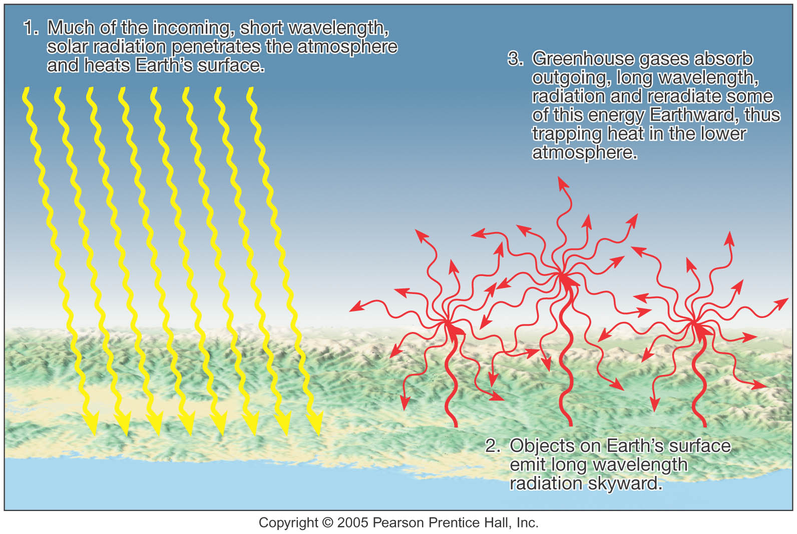
Greenhouse Effect

Slide 38
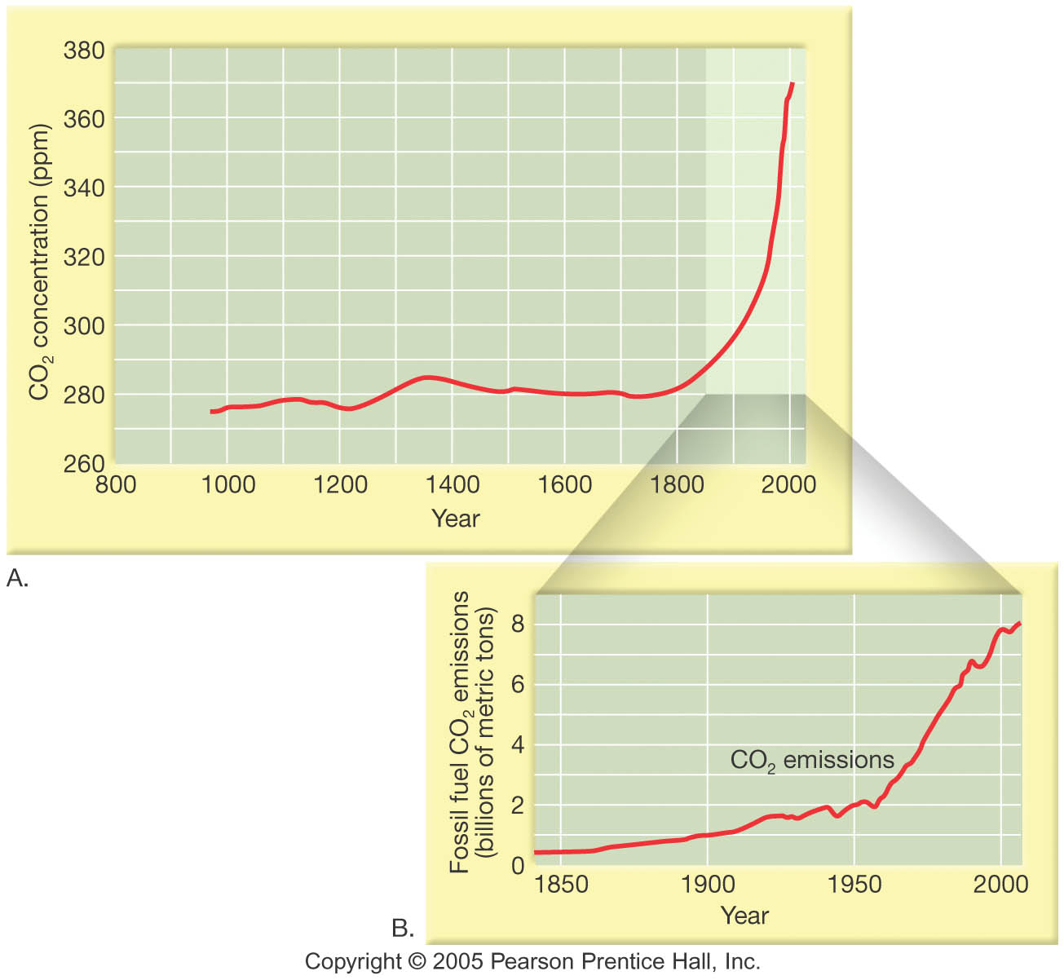
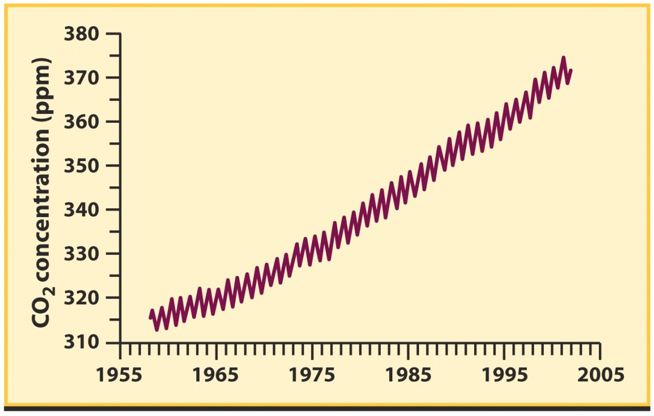
Adding Mitts?

Slide 39
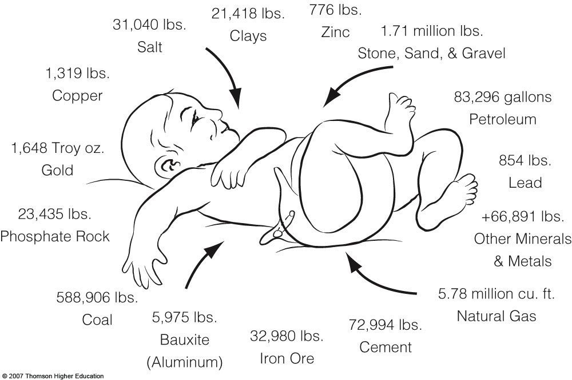
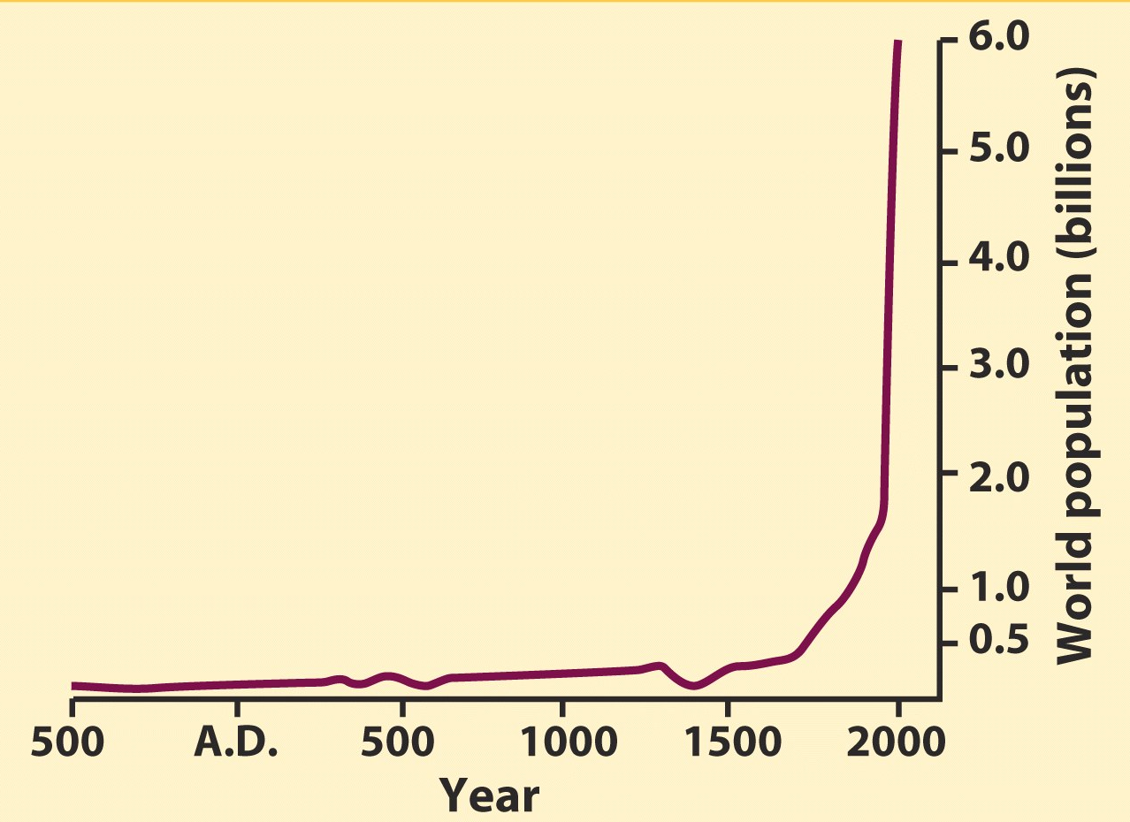
Adding Mitts?
Popclock: http://opr.princeton.edu/popclock/

Slide 40
Global Warming
Increase in CO₂
Increase the Temperature
Increase the Temperature
Increase the H₂O
Increase the H₂O
Increase the Temperature
Repeat…

Slide 41
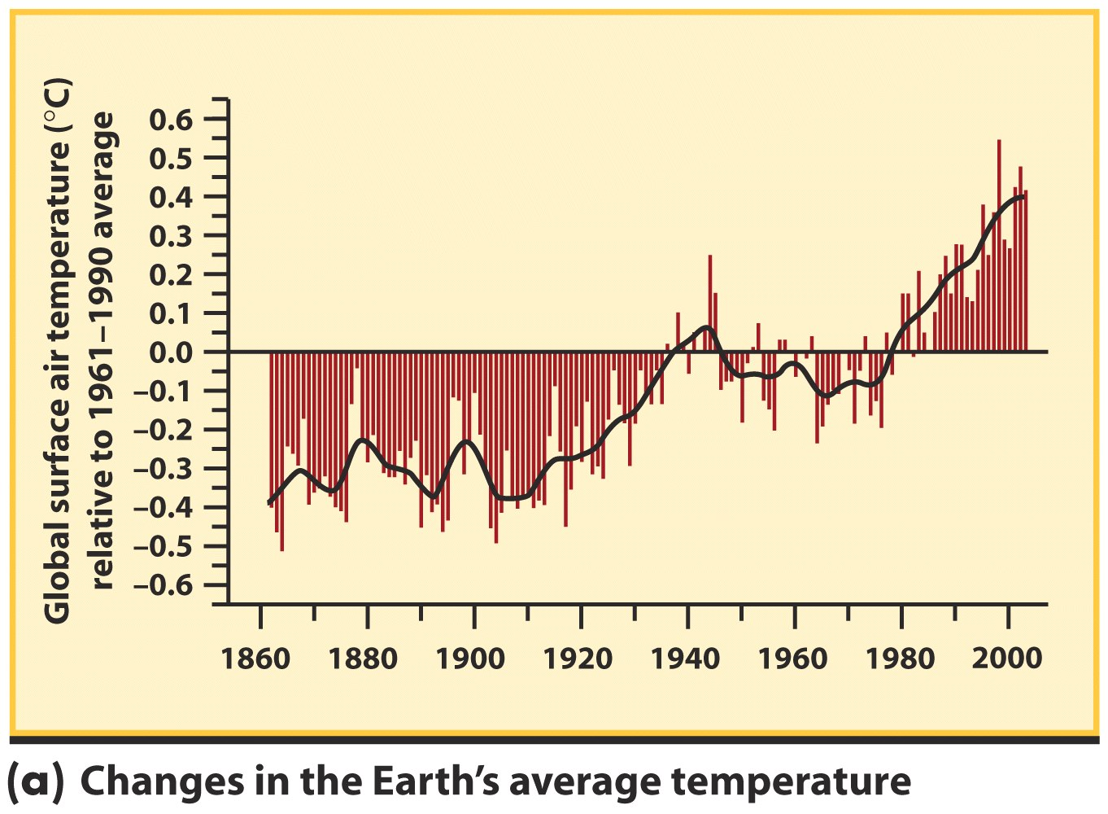

Slide 42
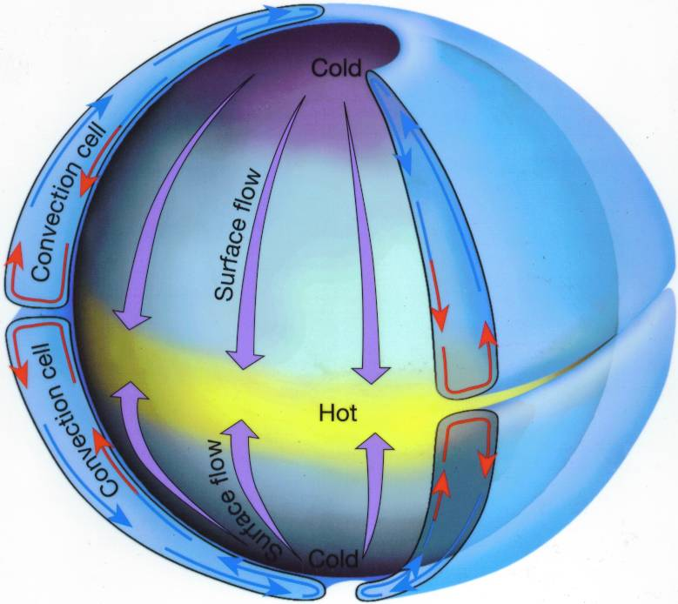
Non-Rotating Atmosphere

Slide 43
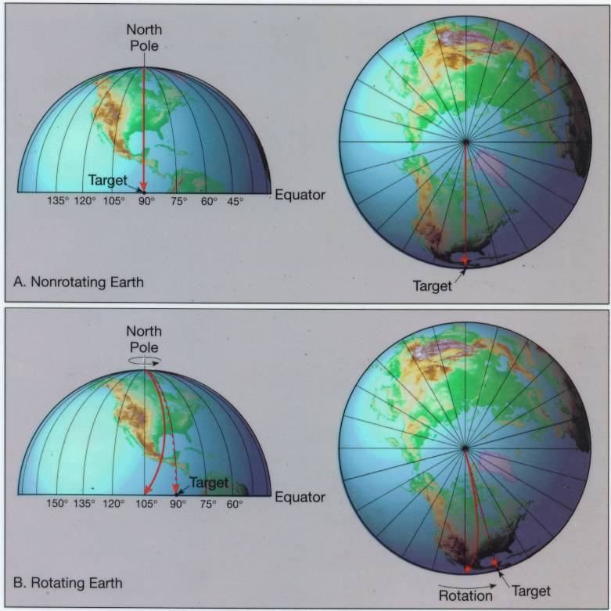
Spinning and Coriolis Effect
http://www.youtube.com/watch?v=mcPs_OdQOYU

Slide 44
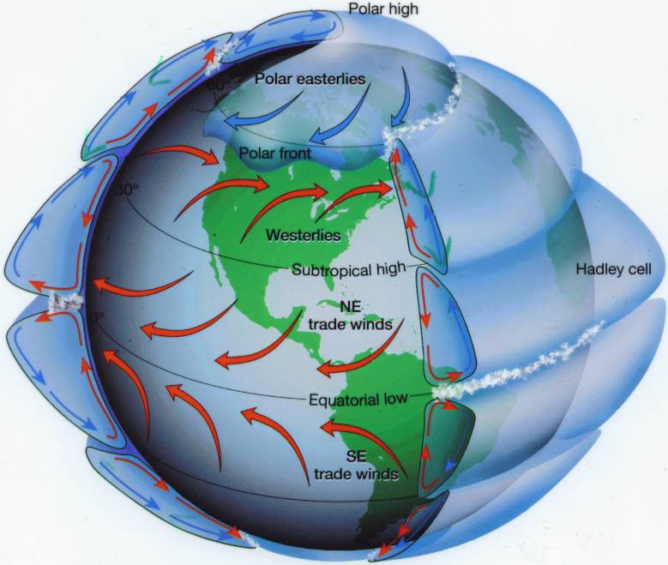
Result: 3 Belts
Because of Earth’s rapid rotation, the circulation in its atmosphere is complex, with three circulation cells in each hemisphere

Slide 45
Planet Earth – the Blue Planet

Slide 46
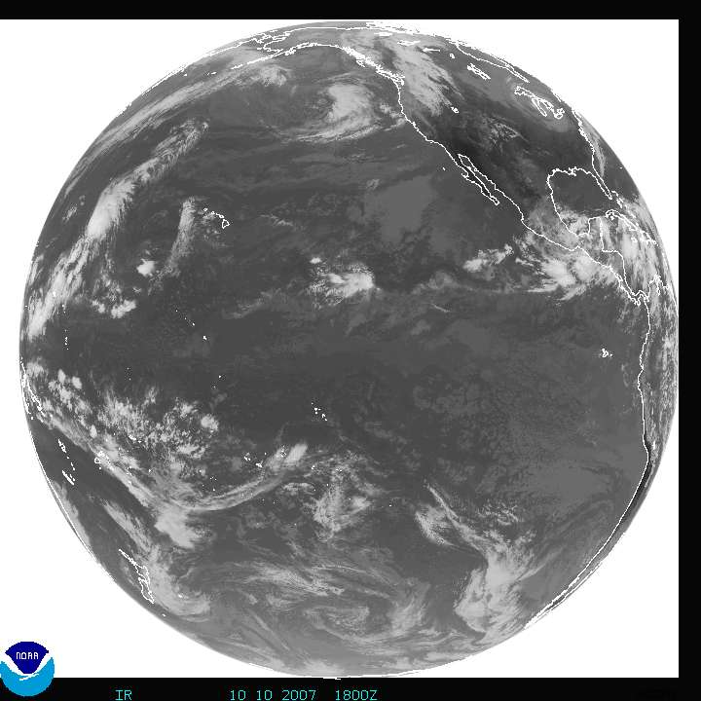
http://www.goes.noaa.gov/goesfull.html

