Slide 1
Io The Volcanic moon of Jupiter

Slide 2
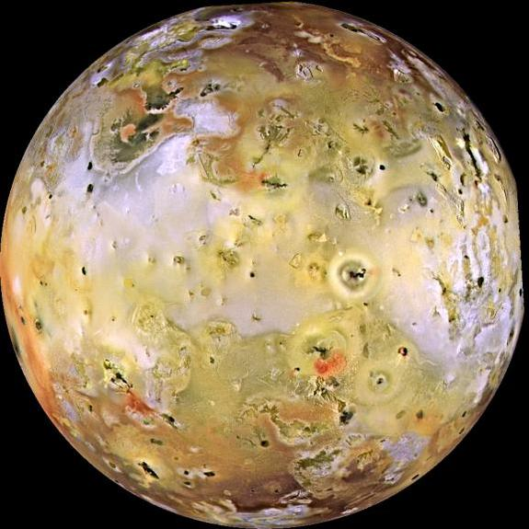

Slide 3
What's the difference
Compared to earth, Io has 150 to 300 volcanic hot spots and 400 active volcanos, Earth has 1,500 of which 600 are active.
Usually earths volcanos erupts and stays somewhat contained by atmospheric forces, on Io with its extremely thin atmosphere it erupts into a large plume; The largest reaching around 620 miles.

Slide 4
What's so great about Io
It is the most geologically active object in our solar system.
The Lava can be many colors from red to yellow or green etc. due to different types of sulfur.
All of this activity is caused by tidal heating (extreme stresses by gravitational pull of jupiter and its fellow moons.)

Slide 5
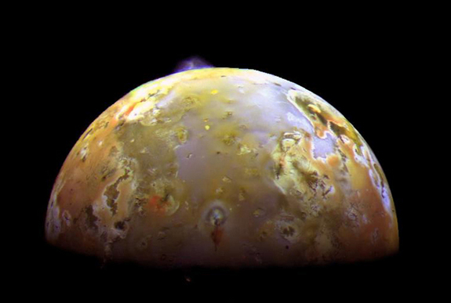
The Lava of Io
In 1997, a major eruption on io produced more than 1,400 square miles of Lava.
Io’s Lava is mostly composed of consisting mostly of basalt silicate lavas with either mafic or ultramafic (magnesium-rich) compositions.
The large plumes that are produced consist of sulfur, sulfur dioxide gas and silicate pyroclastic material (like ash).

Slide 6
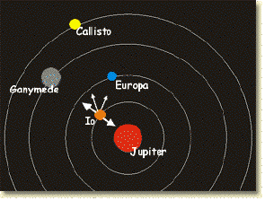
Tidal Heating
Io’s has over 400 volcanos on its surface, but what is causing this planet to be the most geologically active object in our solar system?
Tidal Heating- The heating of the interior of one planetary body caused by stresses from the gravitational pull of another

Slide 7
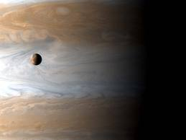
The Gravitational Effects
Io is the closest moon to Jupiter and if it were the only moon of Jupiter it would not suffer tidal heating, however since it is in-between Jupiter and its 3 other moons they have a gravitational tug of war with Io.
Jupiter could fit 1,300 earths inside its volume or 318 times its mass.

Slide 8
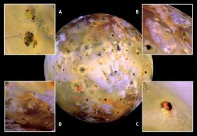
Tides created From Tidal Heating
This pull creates a tide on Io, this can cause its surface to rise and fall as much as 300 ft. (Tides on earth go about 60 ft.)
This is an enormous strain on Io and causes heating inside Io’s core, and creates the intense volcanos we see on its surface.

Slide 9
Io’s Atmosphere
thin atmosphere
average surface temperature ~100K
released gas condenses back onto the surface as frost
made up primarily of sulfur dioxide gas

Slide 10
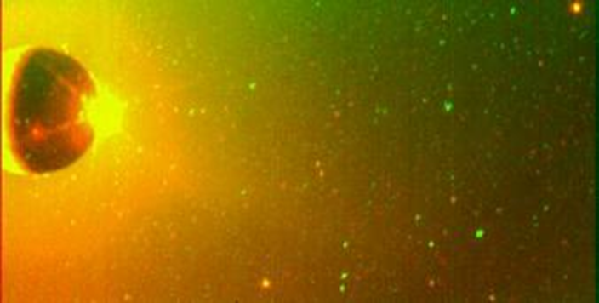
Composition
surrounded by a cloud of sodium, potassium, and oxygen atoms
????? Sodium????????? (」゜ロ゜)」
chlorine recently discovered
sodium chloride (table salt)

Slide 11
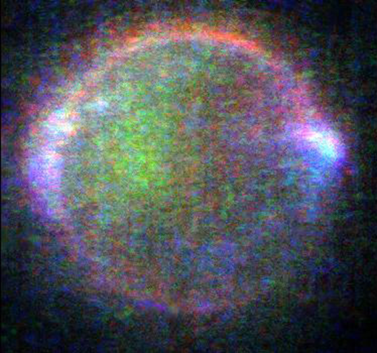
Io Plasma Torus
Io's volcanoes spew out huge amounts of particles into space
Swept up by Jupiter's magnetic field
ionized in the magnetic field
creates a track around Io's orbit

Slide 12
Electrical Current Between Io & Jupiter
2 trillion watts of power is generated
creates lightning in the upper atmosphere

Slide 13
Works Cited
"Io's Color." Io's Color. N.p., n.d. Web. 30 Jan. 2014. http://www.mmedia.is/~bjj/3dtest/io
"Solar System Exploration: Planets: Jupiter: Moons: Io: Overview." Solar System Exploration: Planets: Jupiter: Moons: Io: Overview. N.p., n.d. Web. 30 Jan. 2014.
"Io." Jupiter Moon. N.p., n.d. Web. 30 Jan. 2014.
http://hyperphysics.phy-astr.gsu.edu/hbase/solar/io.html

