Slide 1
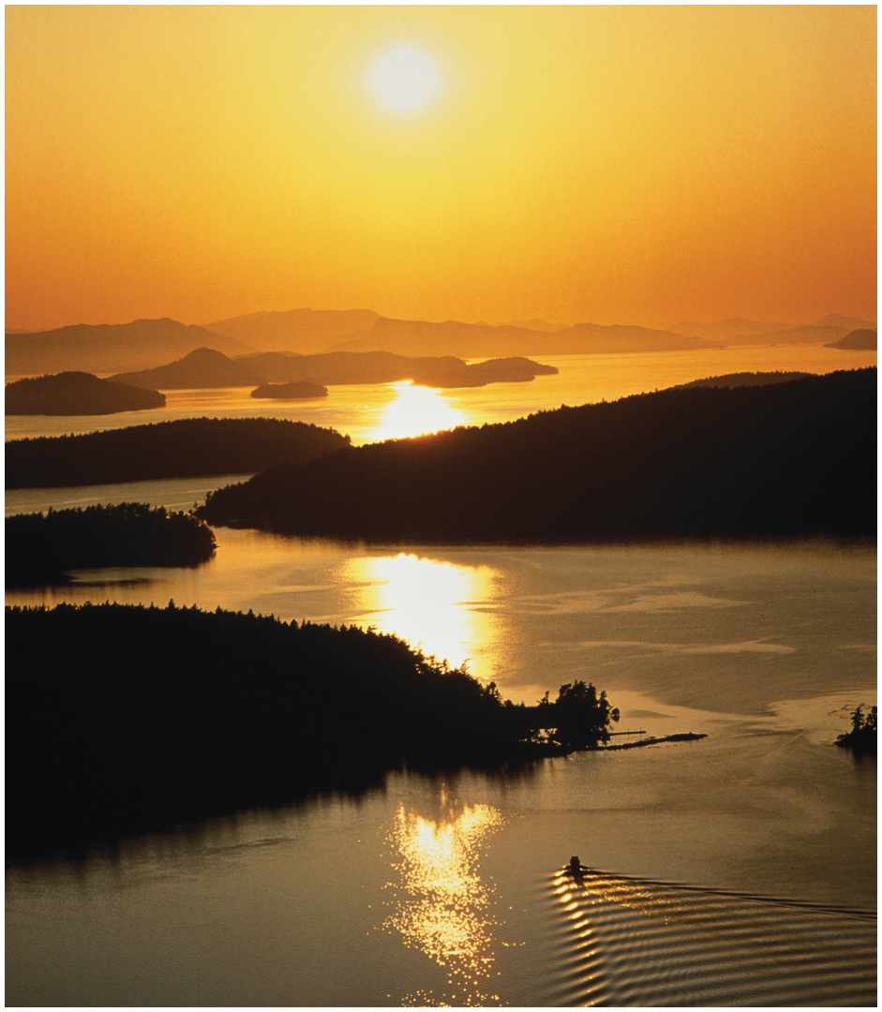
Chapter 2: Earth’s Global Energy Balance

Slide 2
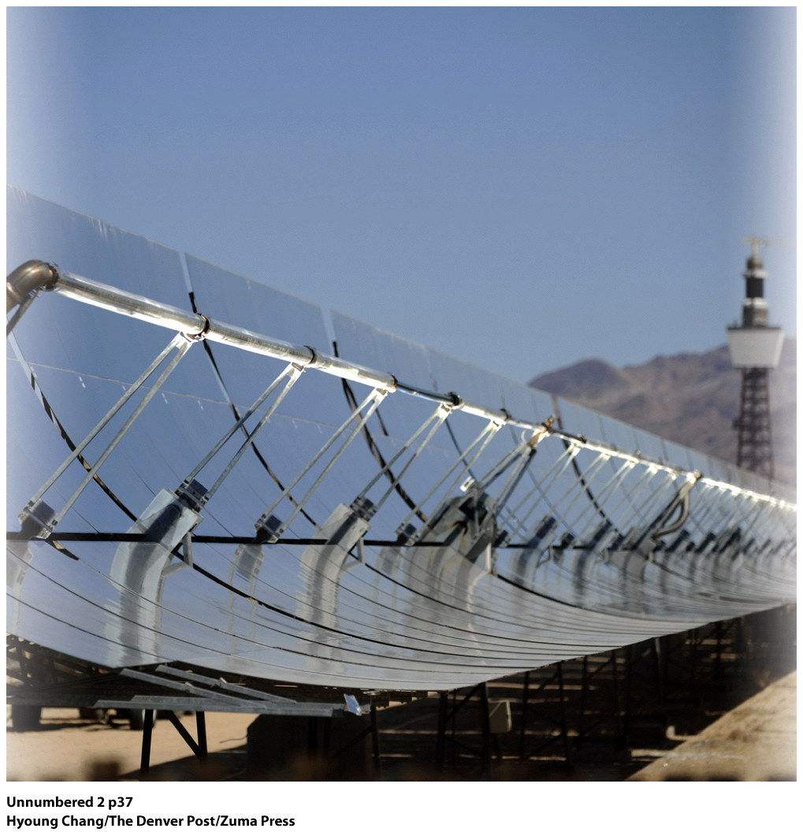
Solar Energy
1 second=10 days
1 minute=2 years
Wavelengths
Distance separating one wave crest from the next
Solar One thermal plant in Nevada generates 64 megawatts of solar thermal energy. Is solar the answer?!

Slide 3
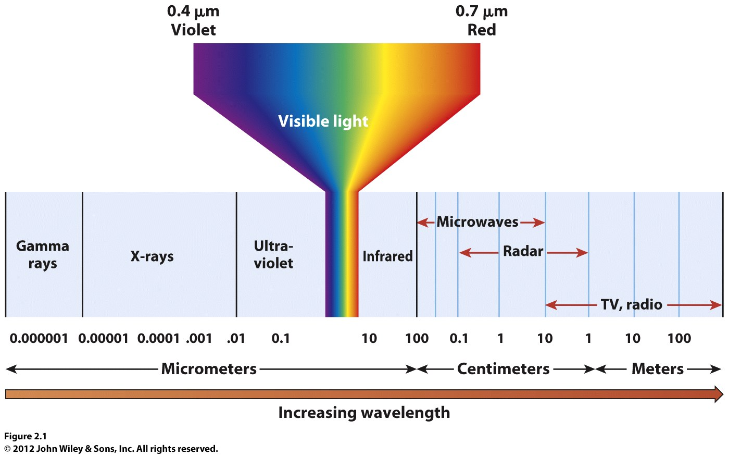
Gamma rays, X-rays: shortest
Shortwave: visible, middle, light bulb, the sun
Long-wave: microwaves, radar, Earth

Slide 4
Which object emits more energy?
Which emits shorter wavelengths?

Slide 5
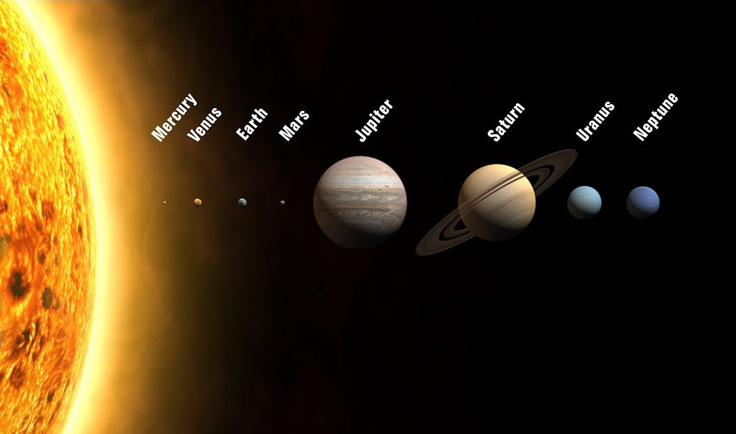
Solar radiation fueled by nuclear reactions.
Earth is the ideal distance from the sun.

Slide 6
The June Solstice, as seen from Stonehenge, England.
Do all locations on Earth receive the same amount of insolation?
What two factors determine the amount of insolation a location receives?

Slide 7
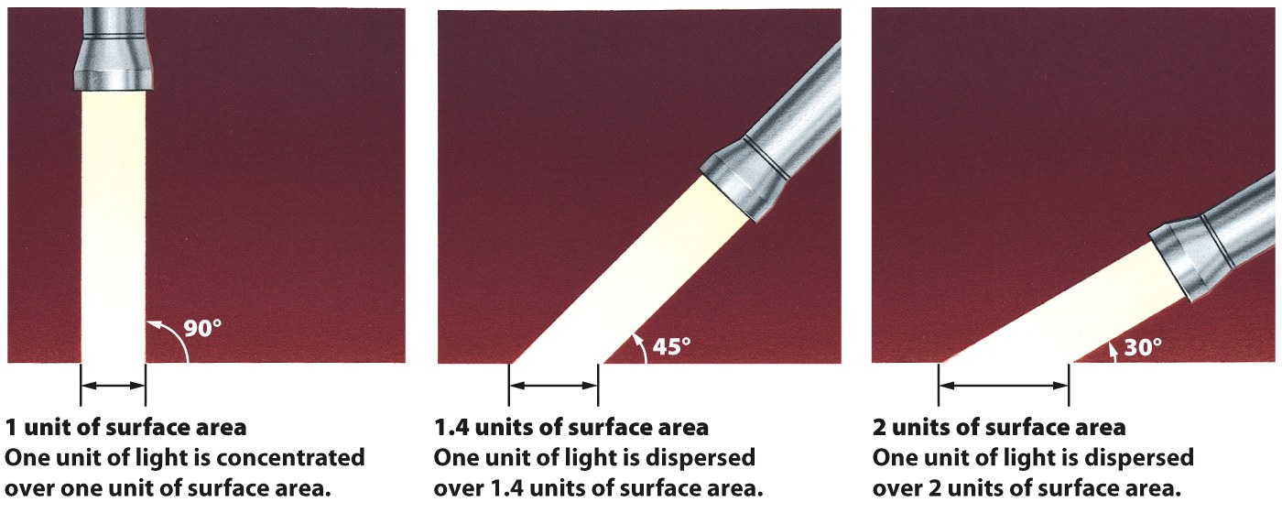
Angle of sunlight
Zenith, when sun is at its highest
Only directly overhead in one location, sub-solar point
Declination Latitude
© John Wiley & Sons, Inc.

Slide 8
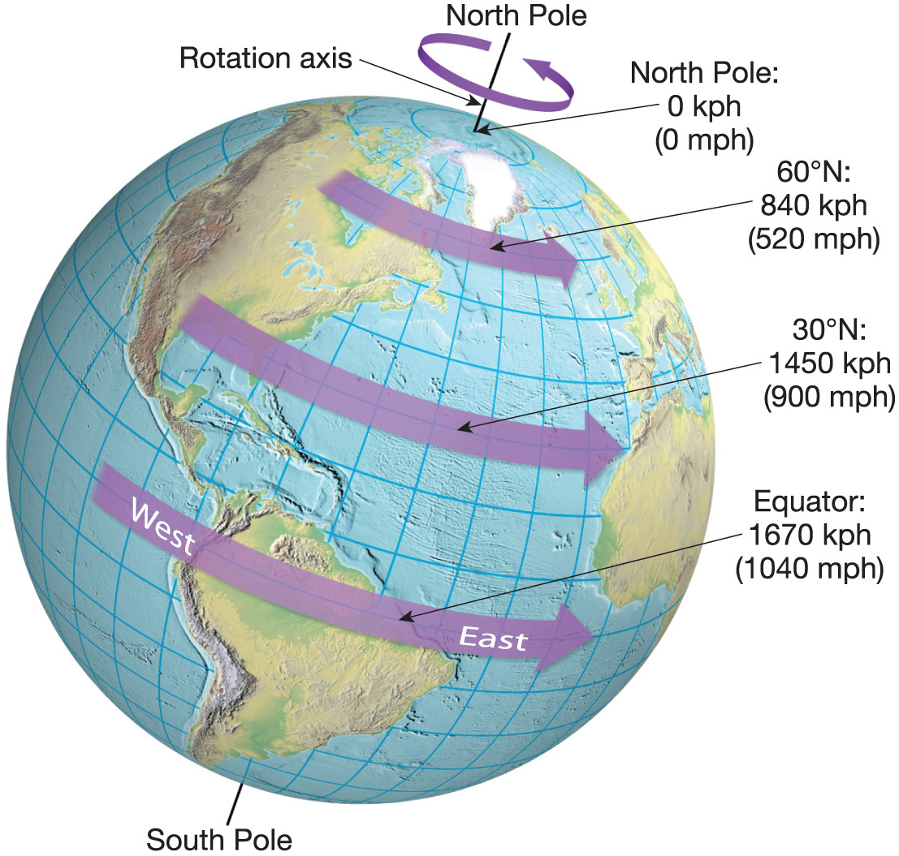
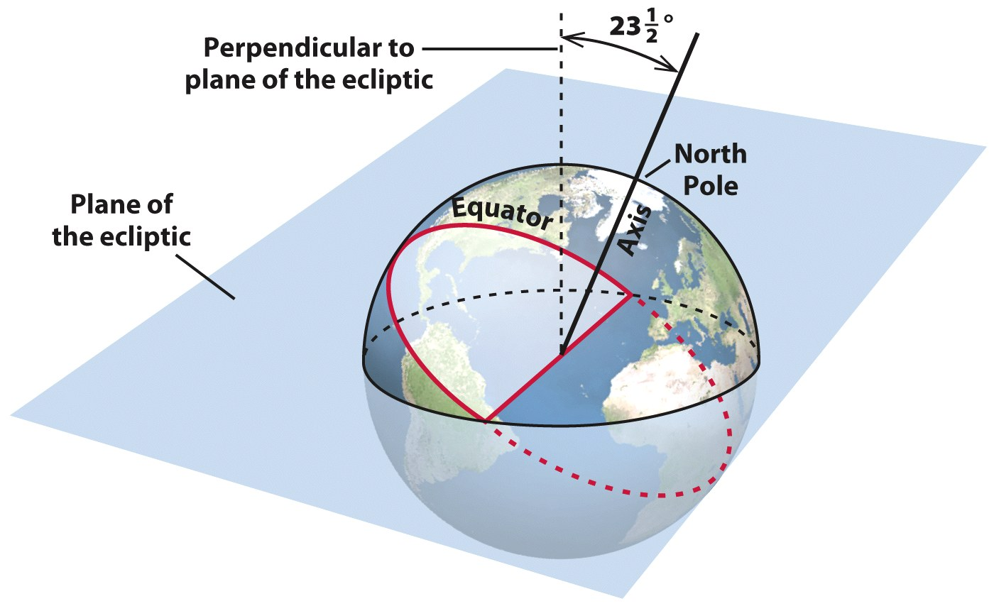
Day length variation across the globe is due to the tilt of the Earth on its axis, at an angle of 23 ½ degrees.
The movement of the Earth, on its axis, and around the sun means that this angle produces an uneven distribution of solar energy across the globe.
© John Wiley & Sons, Inc.
What does this mean, then, for day length at the equator? For day length at the poles? For latitudes in between?

Slide 9
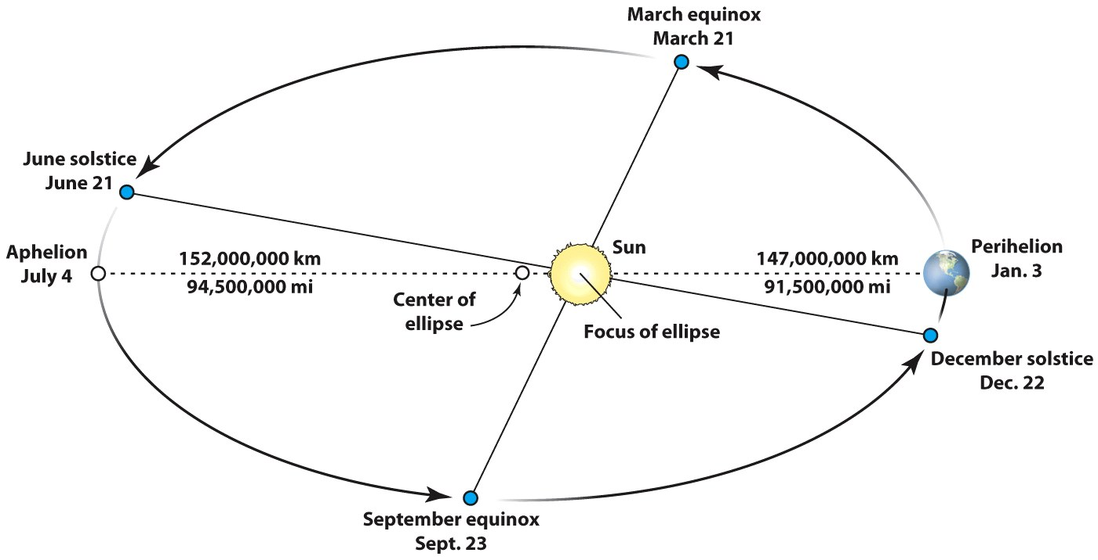
© John Wiley & Sons, Inc.
Revolution and tilt produce seasons—seasons reflect changes in insolation receipt.
It takes 365.242 days to complete a revolution.
Orbit is counterclockwise, and an ellipse
Perihelion: point in orbit when Earth is closest to sun (January)
Aphelion: point in orbit when Earth is farthest from sun (July)

Slide 10
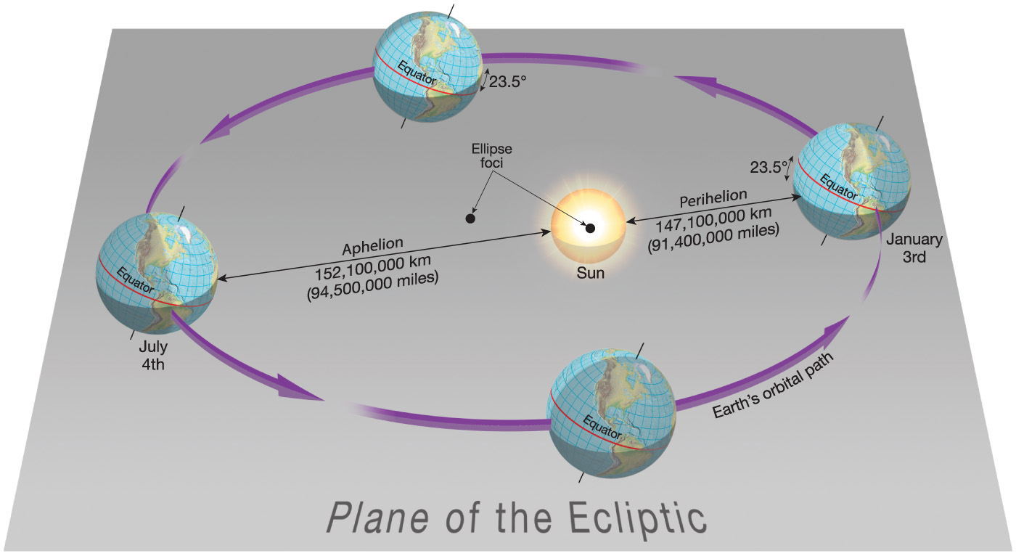

Slide 11
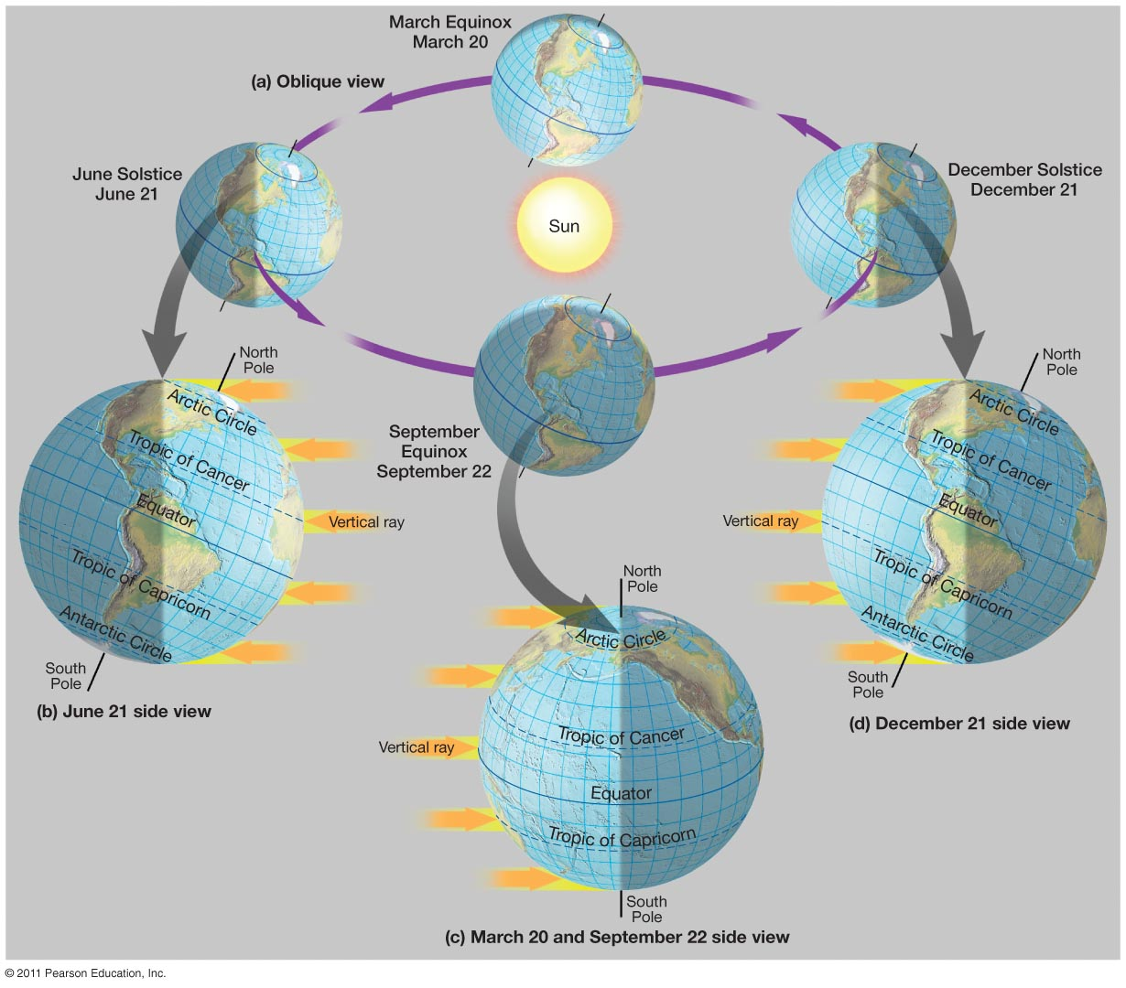
Annual march of the seasons
Notes:
Figure 1-22

Slide 12
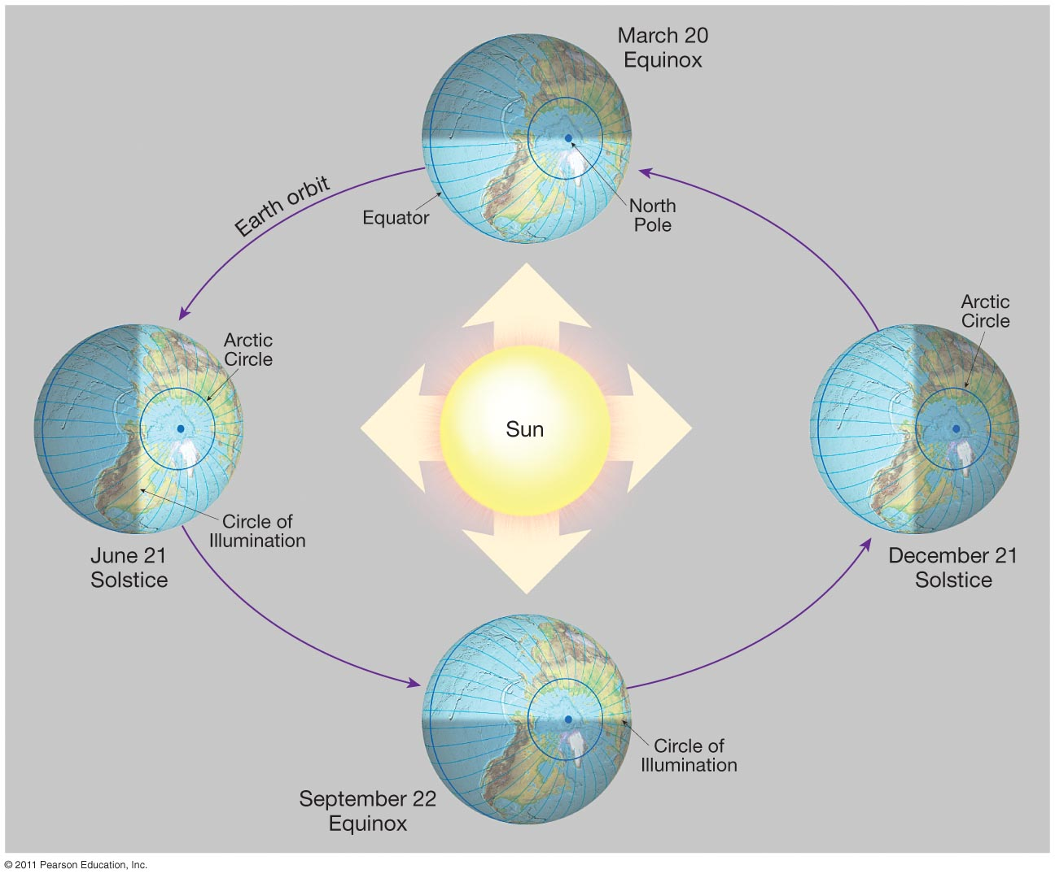
Notes:
Figure 1-21

Slide 13
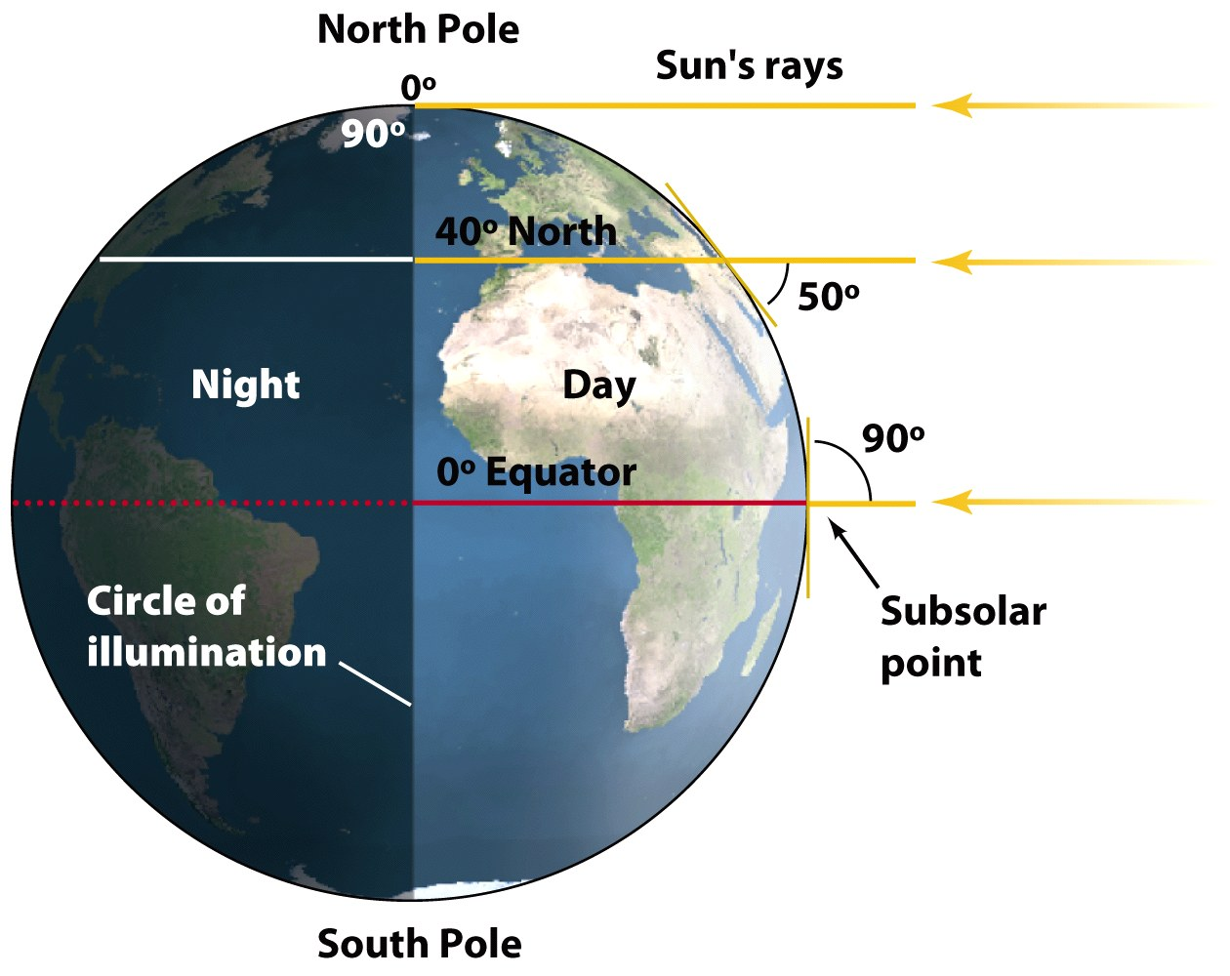
March (Vernal) and September (Autumnal) Equinox
Declination Latitude = 0 degrees (subsolar point)
Solar altitude is 90 degrees at 0 degrees
Circle of illumination equally bisects the poles
12 hours of daylight/darkness everywhere on globe

Slide 14
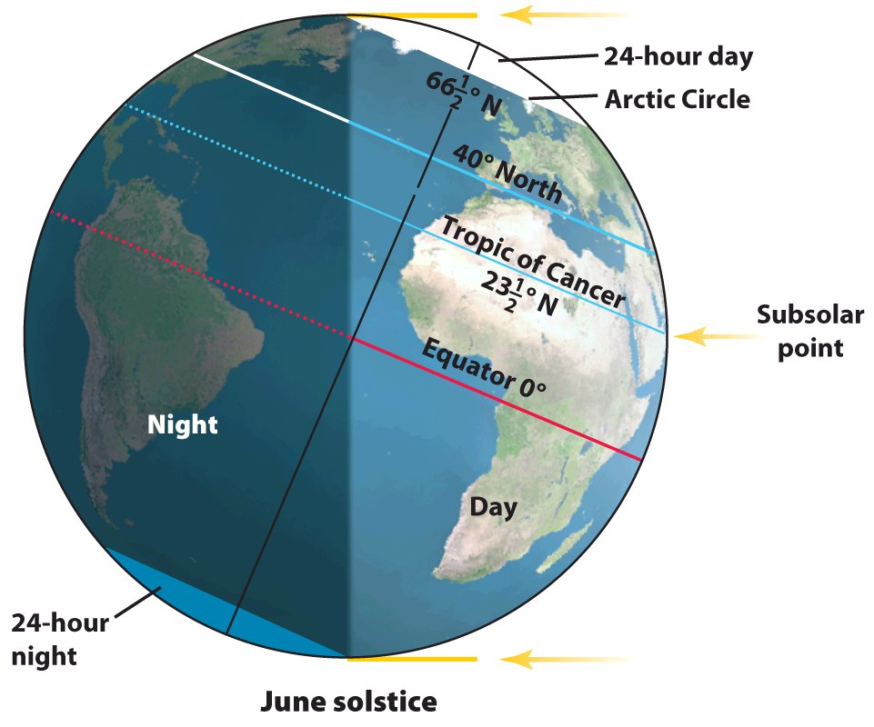
June Solstice
Declination Latitude = 23 ½ N (subsolar point)
Sun’s angle (solar altitude) is 90 degrees at D.L.
Circle of illumination never enters points south of the Antarctic Circle
Circle of illumination never leaves points north of the Arctic Circle
© John Wiley & Sons, Inc.

Slide 15
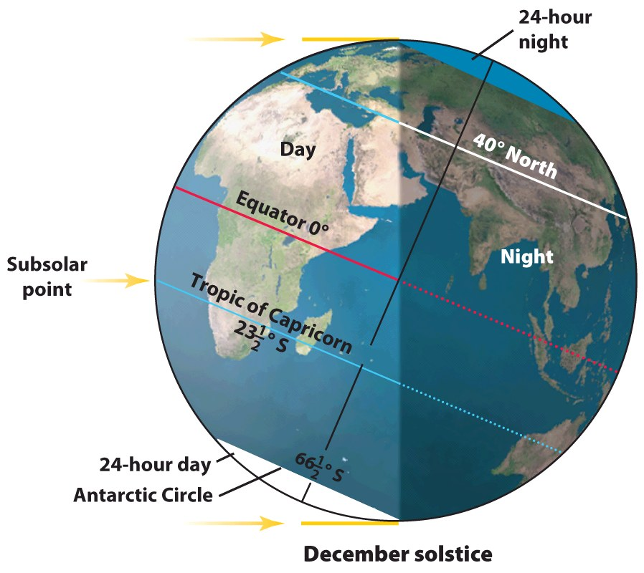
December Solstice
Declination Latitude = ?
Solar altitude is 90 degrees at ?
Circle of illumination never enters points south of the ?
Circle of illumination never leaves points north of the ?
Animation on seasonal variation in
day length and intensity of insolation.

Slide 16
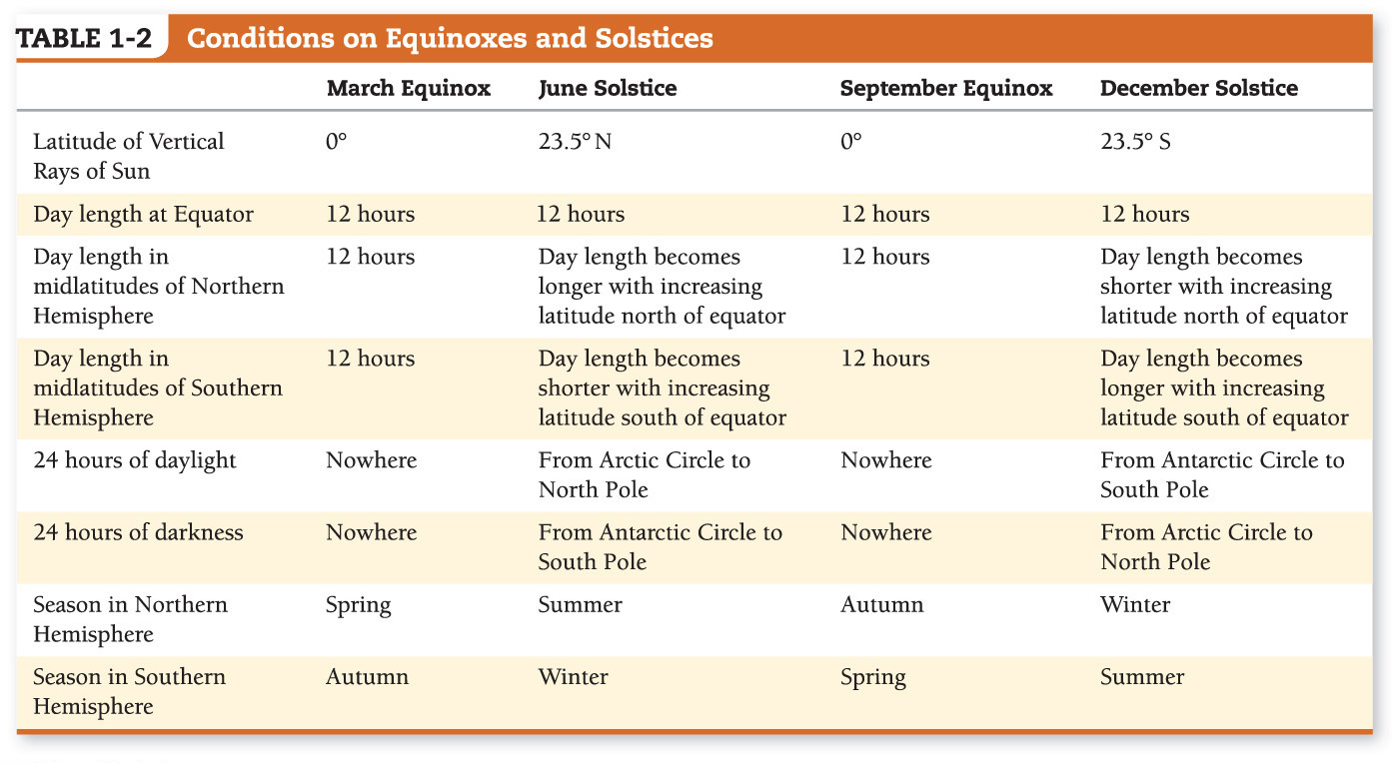
Notes:
Chapter 1, Table 1.2 Labeled

Slide 17
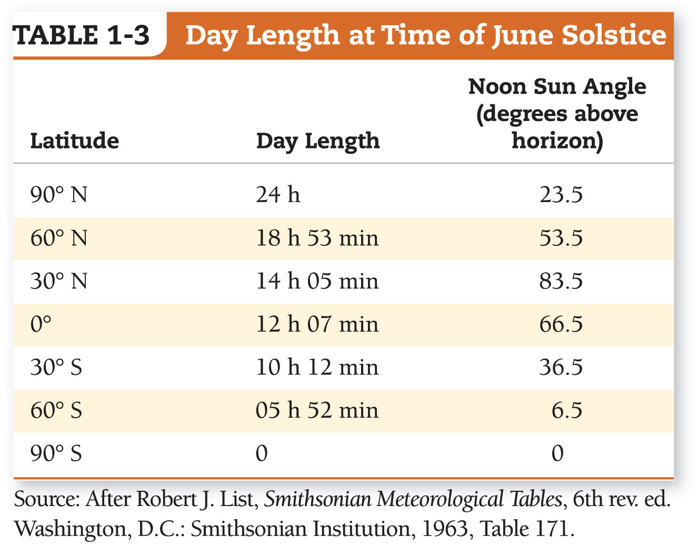
What is the connection between latitude and length of day on an annual basis?

Slide 18
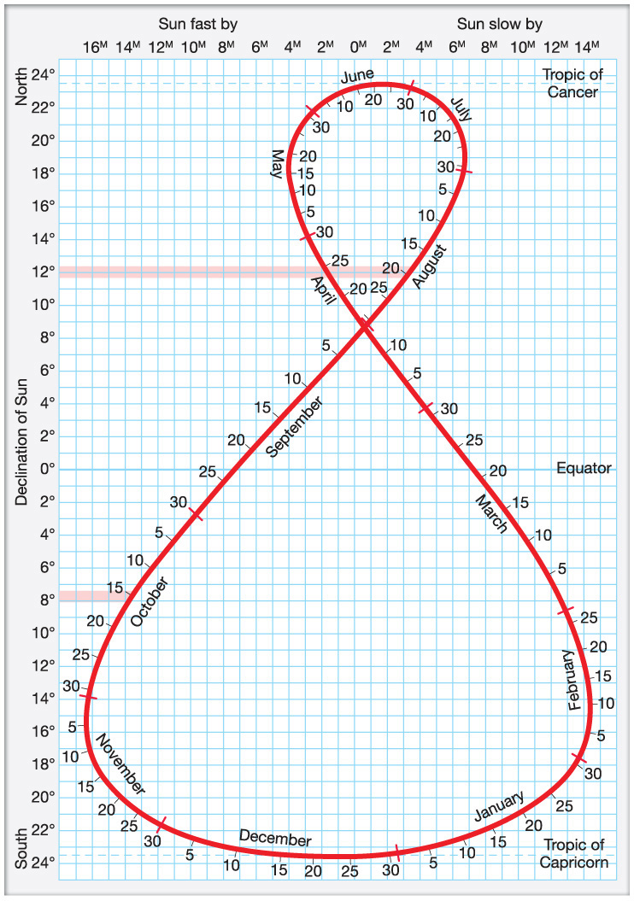
The migration of the vertical rays of the sun.
What is the declination latitude on August 20th?
What is the declination latitude on October 15?
Notes:
Chapter 1, Figure 1.29 Labeled

Slide 19
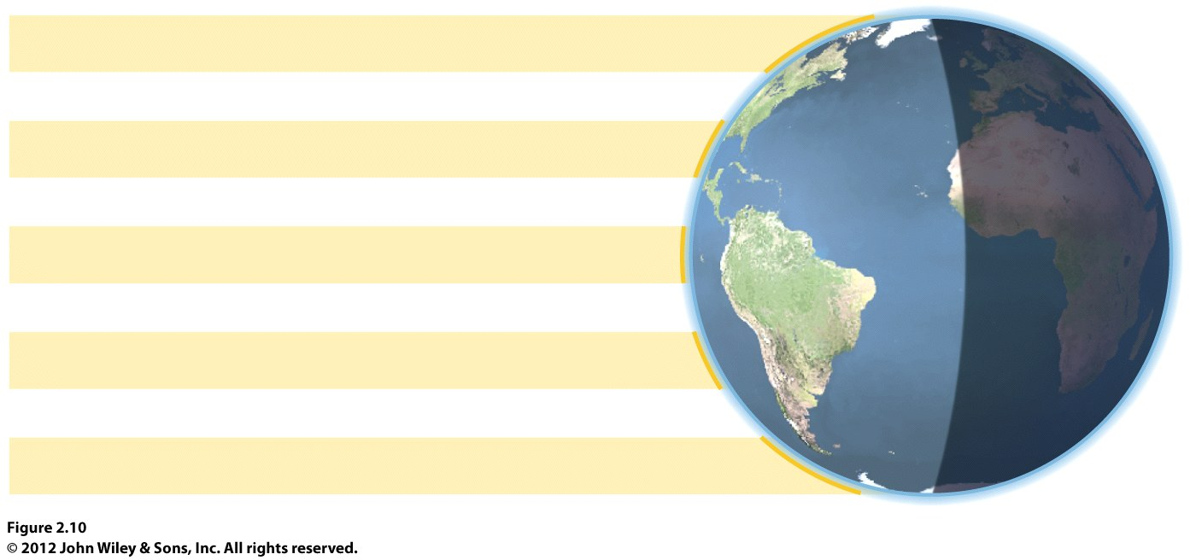
Latitude determines the intensity of the solar energy a location receives AND the amount of solar energy a location receives.
There will be little change through the year in intensity and amount at the equator.
What area has the greatest variation?
This is key to understanding climate and landscapes!

Slide 20
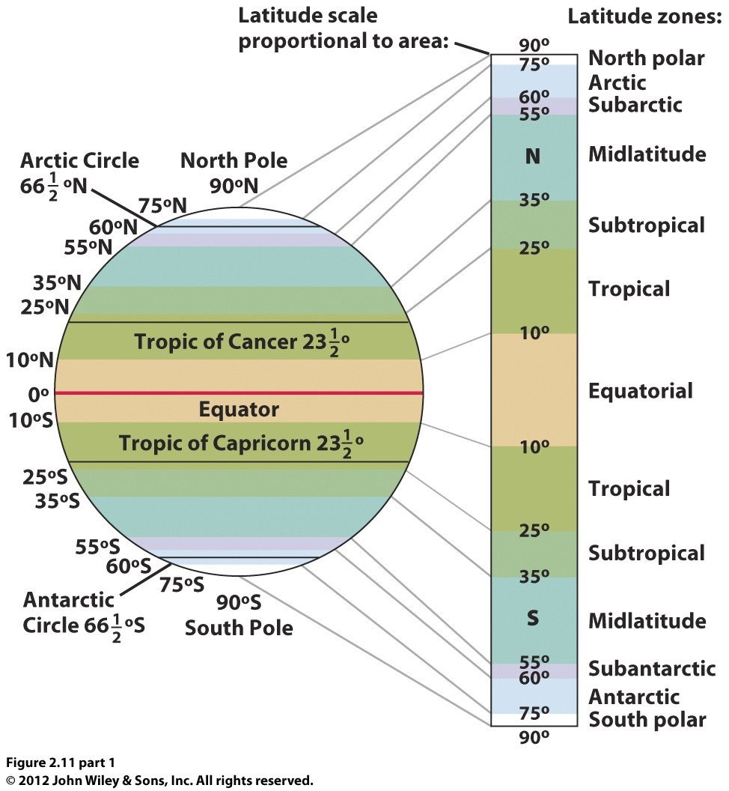
General climate zones based on latitude.
Tropics will receive the maximum solar energy over the year.
The poles will receive the smallest amount and the greatest change.
The mid latitudes will have variability—the subtropics more than the midlatitudes!

Slide 21
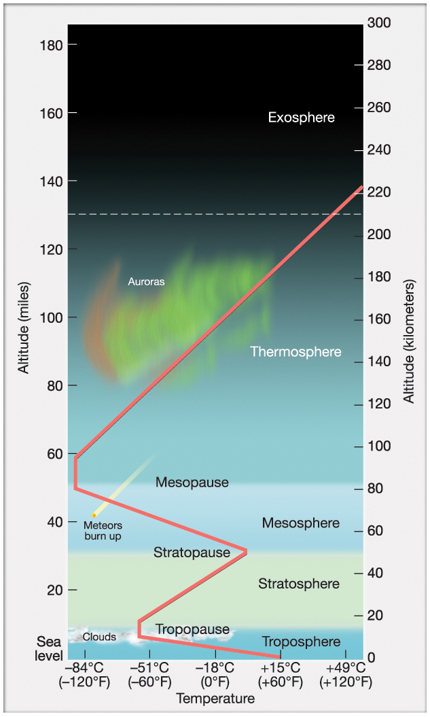
The Earth’s Atmosphere
*interacts with incoming solar energy
*scatters, absorbs, reflects it
Troposphere
at earth’s surface
varies in depth 4-10 miles
temp decreases with altitude
Stratosphere
up to 30 miles
ozone layer
temp increases with altitude due
to presence of Ozone
Upper Layers
mesosphere (30-50 miles)
temp decreases, coldest at top
thermosphere (50 miles to?)
temp increases, hottest layer
Notes:
Chapter 3, Figure 3.5 Labeled

Slide 22
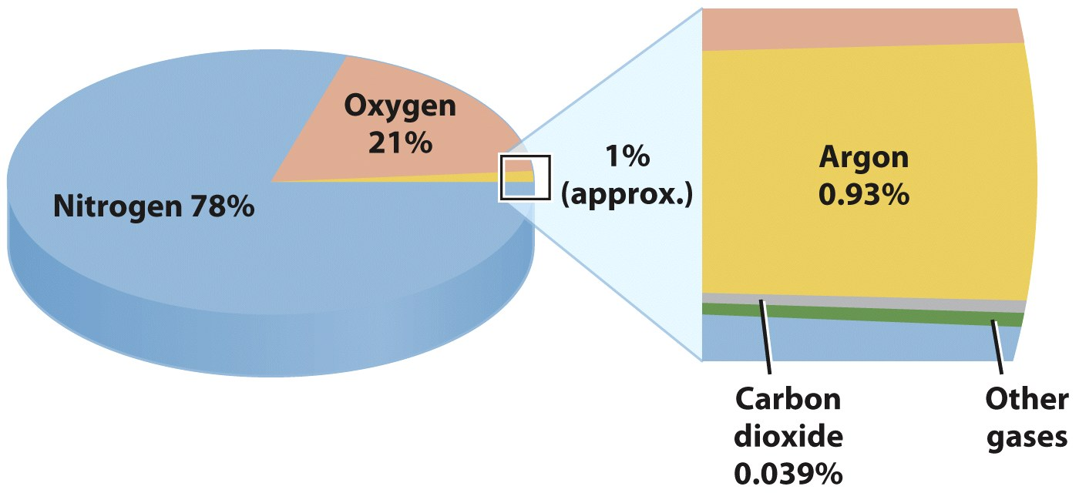
Composition of the Atmosphere
Permanent gases
78% nitrogen
21% oxygen
Variable gases
Carbon dioxide (CO₂): needed by green plants, absorbs long-wave radiation and heats the lower layers of the atmosphere.
Water vapor varies up to 2%, absorbs heat
Ozone (O₃): ozone layer in the stratosphere
Aerosols: particulates (wind carries from deserts, lakebeds, volcanic eruptions, fires). Important because they can provide surface for condensation, and can reduce the amount of incoming radiation.

Slide 23
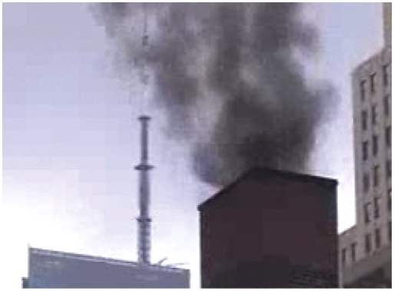
In what ways has the reduction in pollution caused a negative feedback?
Notes:
Figure 3-4

Slide 24
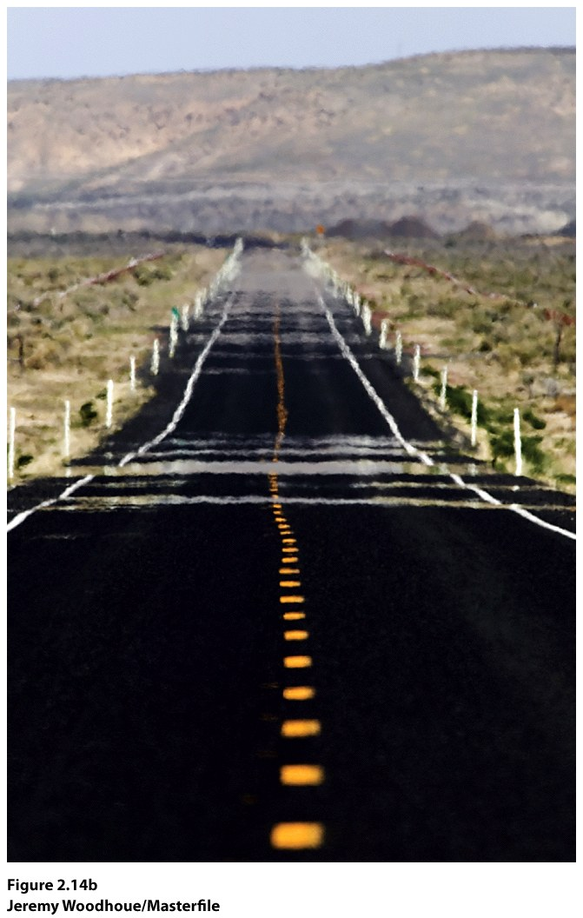
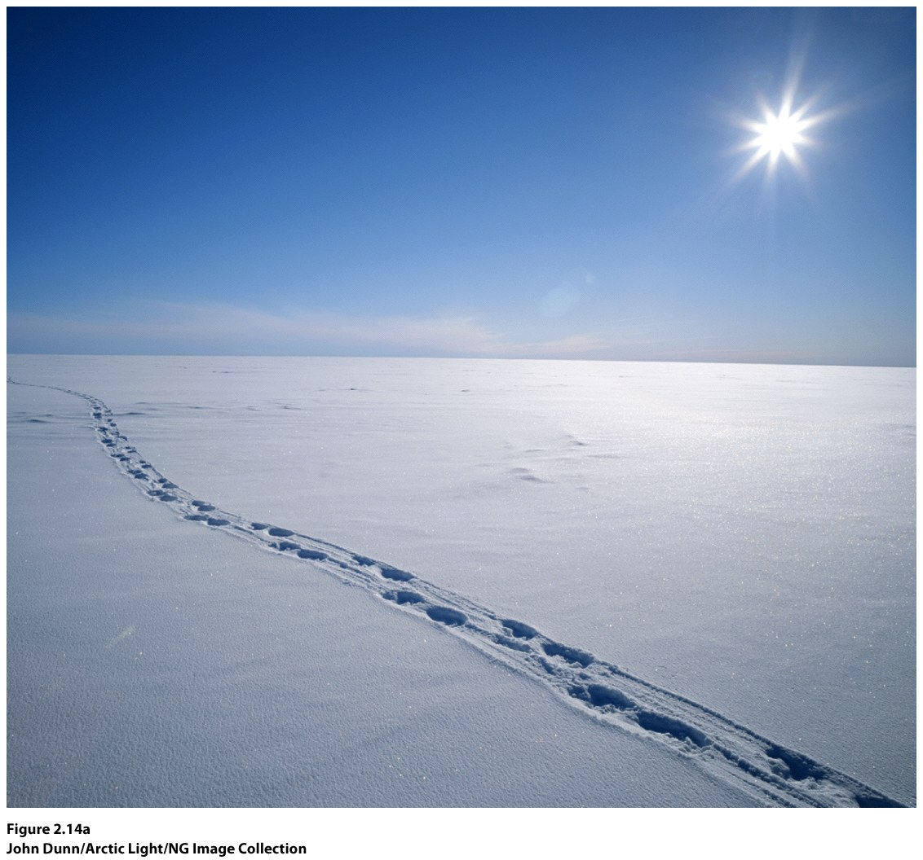
Incoming Radiation
Absorption (CO2, Water Vapor, clouds)
Scattering (aerosols, diffuse radiation)
Reflection (albedo)

Slide 25
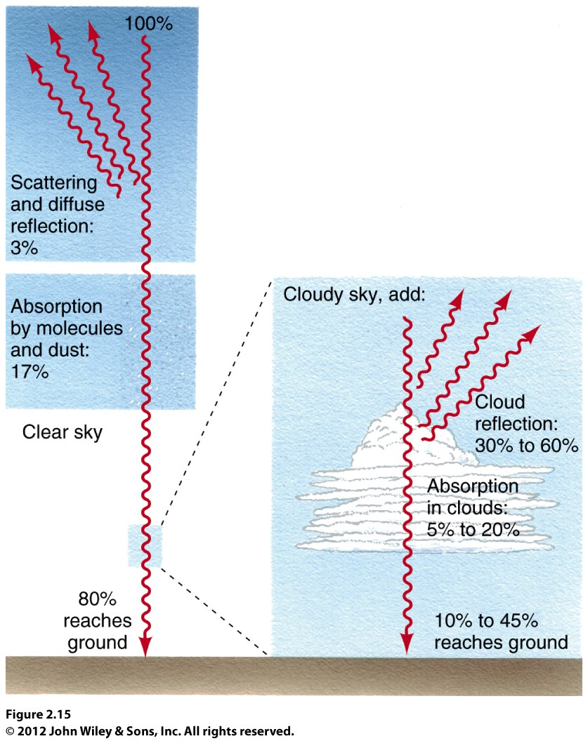
Far less incoming radiation reaches the Earth’s surface when there is cloud cover.

Slide 26
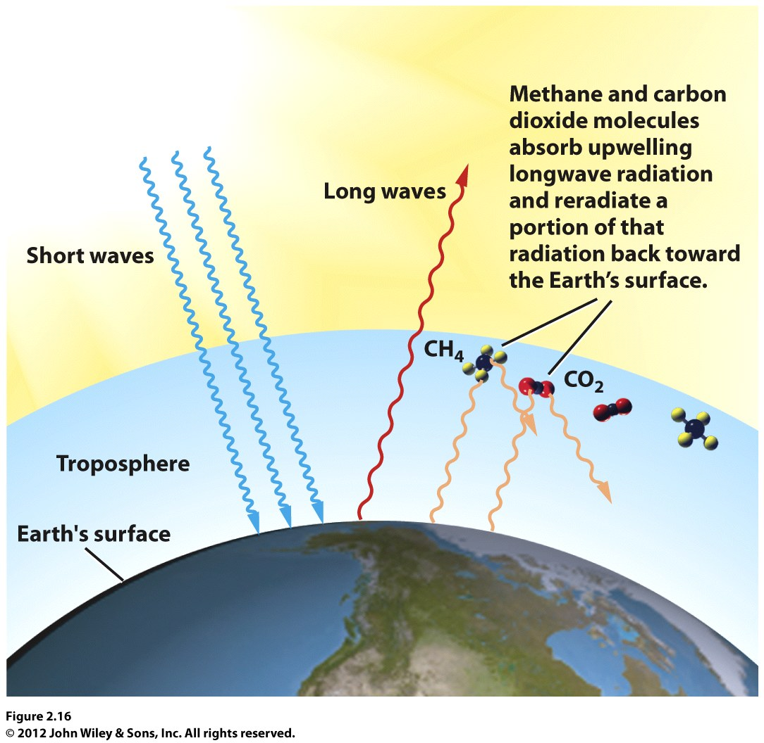
Earth’s Energy Output
Longwave radiation
The greenhouse effect
Why might the greenhouse effect be stronger in humid regions, such as the Amazon Basin, than in dry regions?

Slide 27
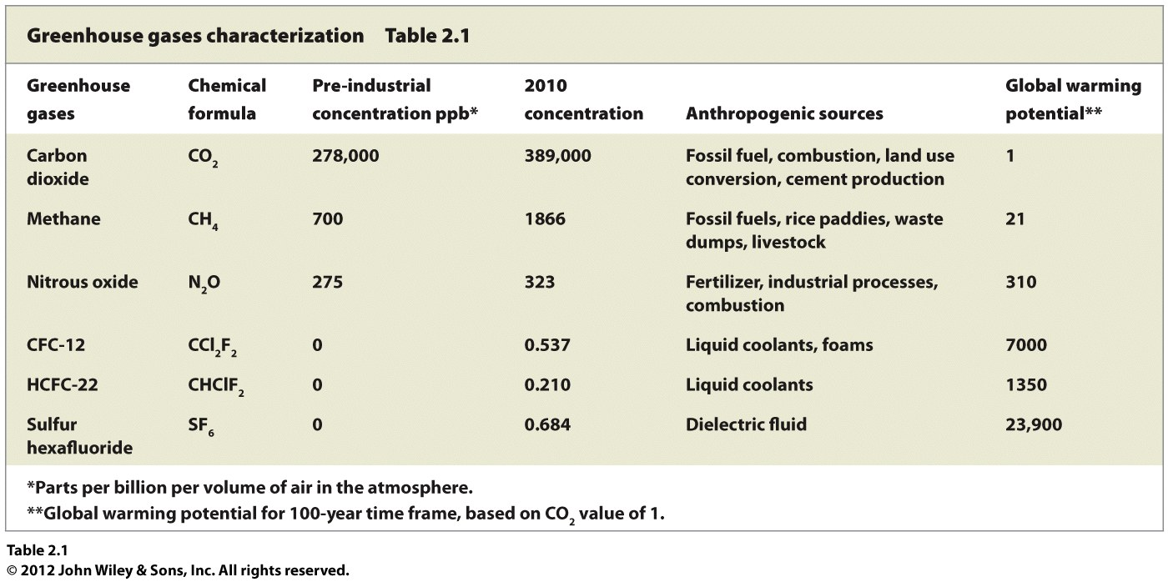
Greenhouse gases. Even though some of the gases may occur in very small amounts, their potential for impact on warming may be greater.

Slide 28
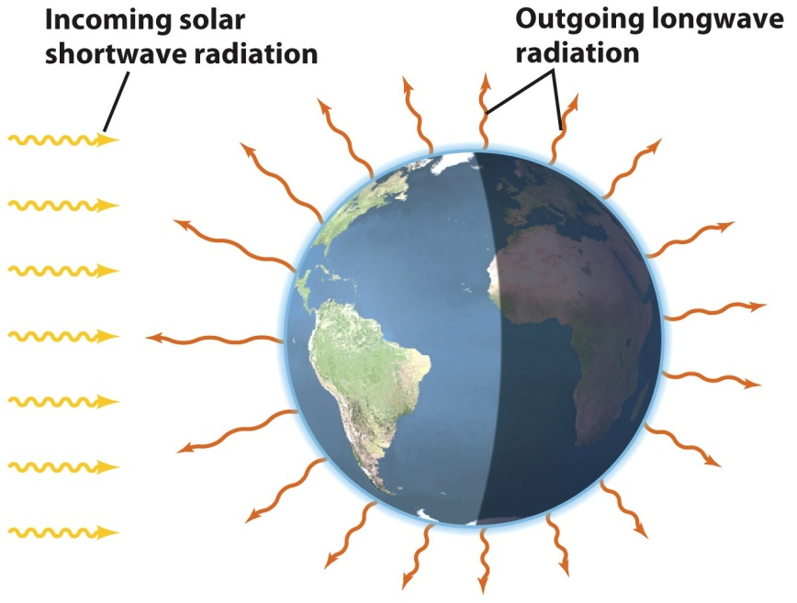
Net Radiation and the Global Energy Budget
Net radiation is the difference between incoming and outgoing radiation.
Outgoing energy:
Reflected SW
LW radiation emitted
from earth
Incoming energy:
SW from the sun
LW energy from greenhouse gases
Net radiation increase has resulted in temperature
increase of about 1º C in the past century
© John Wiley & Sons, Inc.

Slide 29
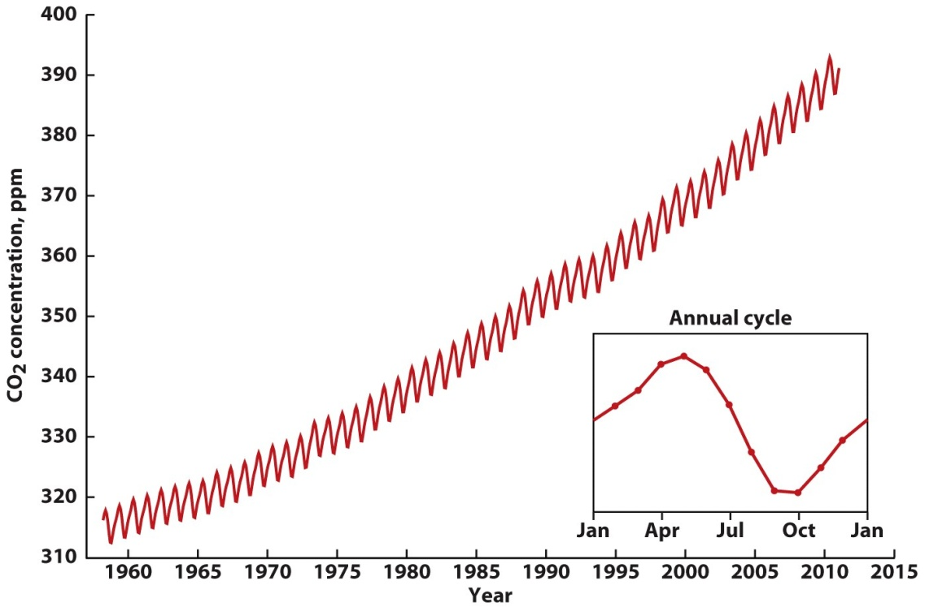
Human Impacts on the Global Energy Balance
1. Rising Concentrations of Greenhouse Gases
Carbon dioxide (CO₂):
Trend since 1958
Trend since 1860s
Methane (CH₄)
Wetlands, decay
Rice production
Farm animal waste
Sewage, landfills
Nitrous oxides (N₂O)
Bacteria
Makes smog yello
The Keeling Curve. Reveals annual shifts in CO2 amounts. In northern hemisphere spring (more land mass) there is a decrease in CO2 as growing plants absorb it. CO2 increases in the northern hemisphere’s winter as plants go dormant.

Slide 30
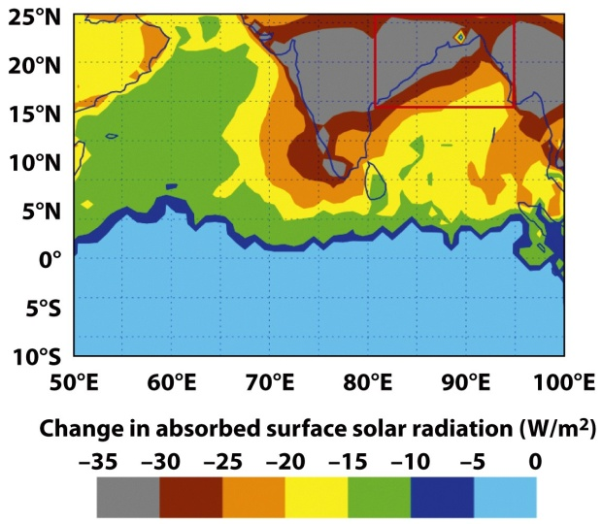
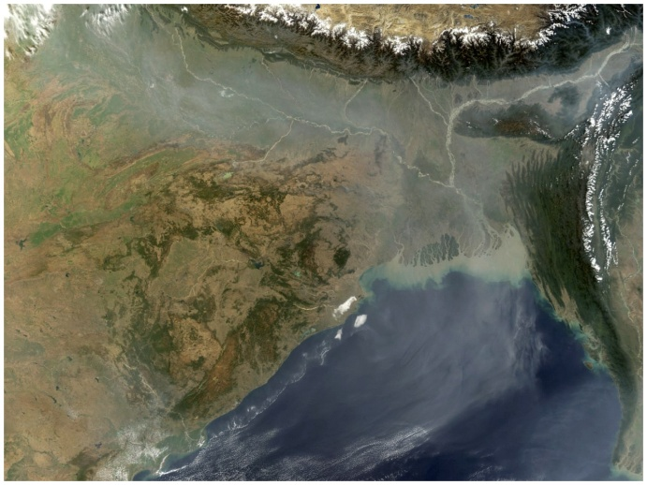
Human Impacts on the Global Energy Balance
Changes to Surface Albedo
Clearing forests
Urban/suburban areas
Heat islands
Increased longwave radiation and counterradiation
3. Air Pollution
Can increase cloud cover/haze
Can mean less incoming radiation
More particulates may also reduce incoming radiation
Asian Brown Cloud (Nov-April), 10% reduction in crop yields
Dark soot particles lower the albedo of snow pack in the region—faster melting of glaciers.
© UNEP Assessment Report
Courtesy NASA

Slide 31
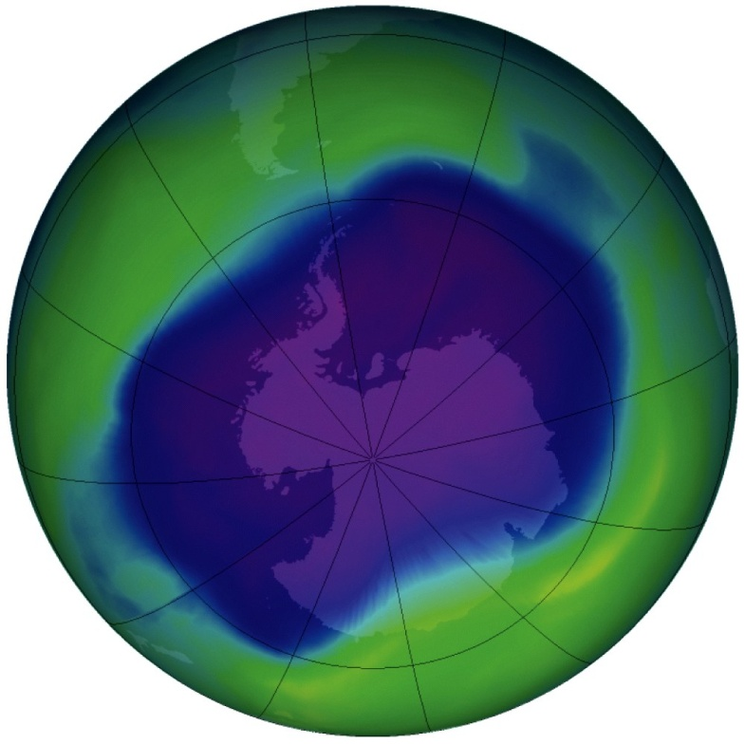
Human Impacts on the Global Energy Balance
4. Thinning of Ozone Layer in the Stratosphere
Ultraviolet radiation is damaging to life, so, absorption of UV radiation by ozone layer protects life on Earth’s surface
Montreal Protocol treaty
23 nations signed in 1987.
By 1999, scientists confirmed that concentrations
had topped out in 1997 and were beginning to
fall.
Courtesy NASA

