Slide 1
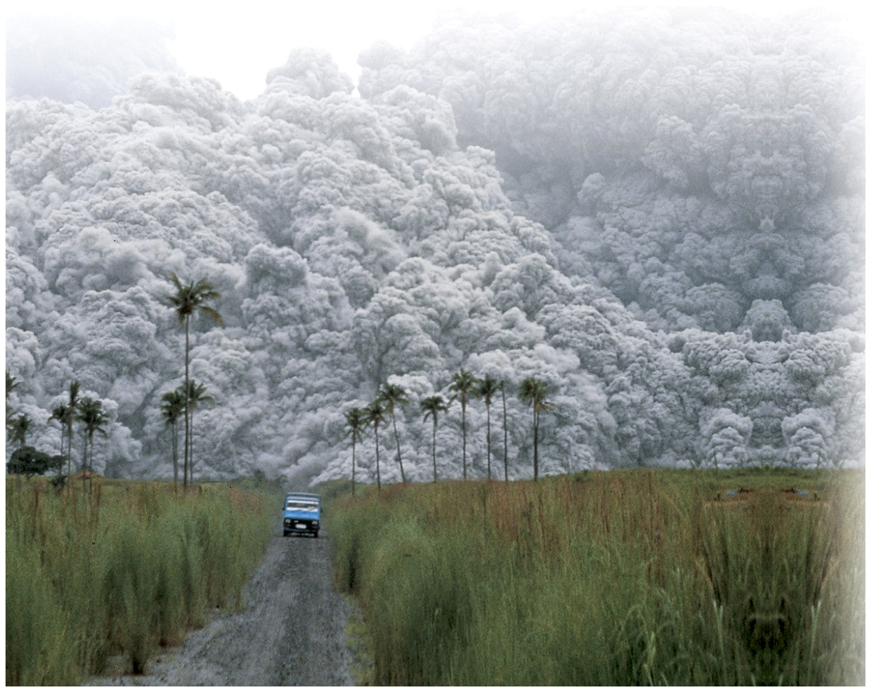
Chapter 3: Air Temperature
Guess whether the eruption of Mt. Pinatubo had a cooling or warming effect?
© Alberto Garcia/©Corbis

Slide 2
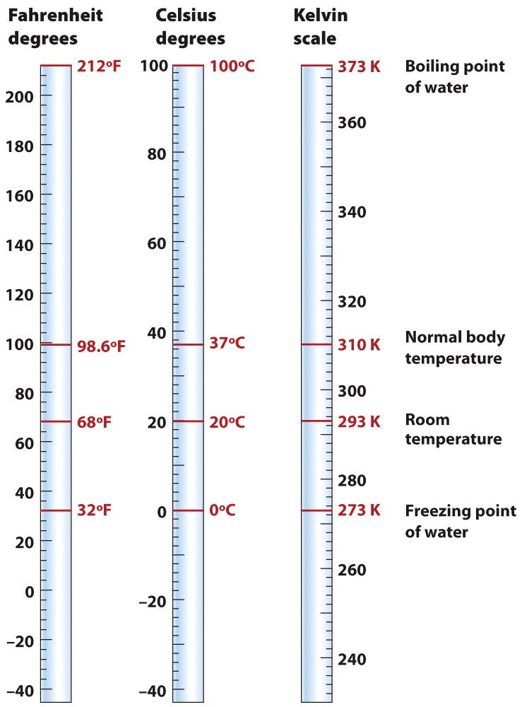
Temperature and Heat Flow Process
Measuring Temperature
Temperature = level of internal motion of atoms and molecules that make up the matter
Temperature scales
Fahrenheit
Celsius
Kelvin
What is the freezing and boiling point of water in ºF and ºC?
© John Wiley & Sons, Inc.

Slide 3
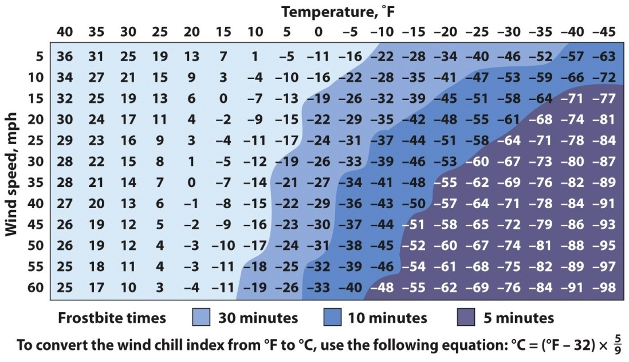
Temperature and Heat Flow Process
Surface Temperature
Air temperature is measured at 1.2 m (4 feet).
Daytime ground temperatures are usually warmer than 1.2 m.
Night ground temperatures tend to be cooler than at 1.2 m.
Ground temperatures are often more extreme than air temperatures.
Wind Chill & Heat Index
If the air temperature is 0º F and the wind speed is 30 mph, what is the wind chill?
© Courtesy NOAA

Slide 4
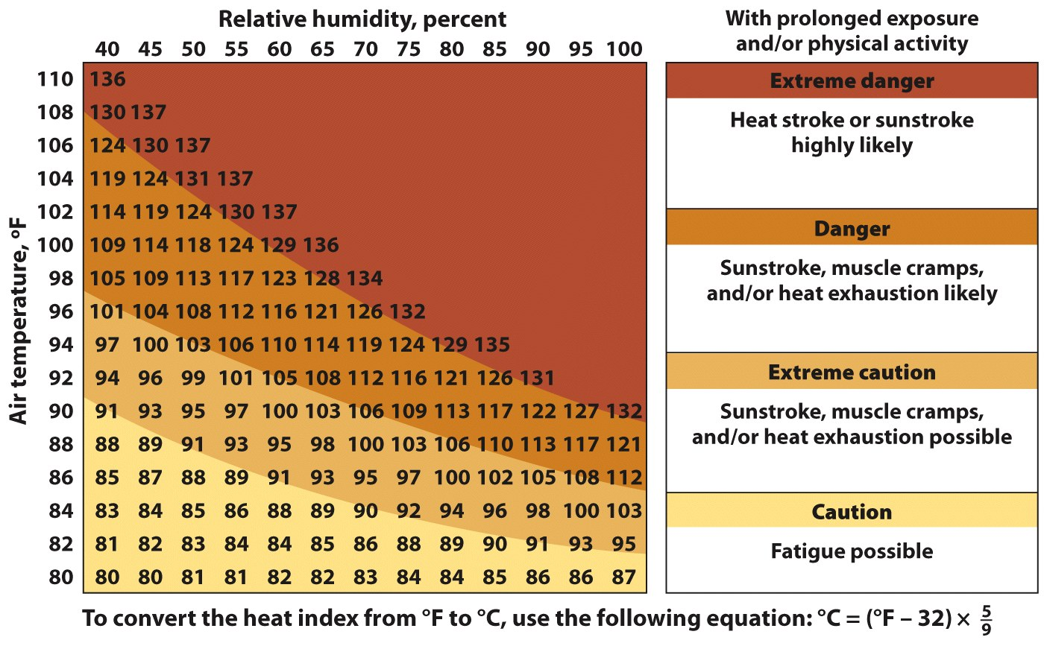
Temperature and Heat Flow Process
Heat Index
Higher levels of humidity raise our perception of heat.
Humid conditions reduce the amount of evaporative cooling when we sweat.
If the relative humidity is 85%, at what temperature should someone exercising outdoors use “extreme caution”?
© Courtesy NOAA

Slide 5
Temperature and Heat Flow Process
Energy Transfer
Heat = internal energy transferred from one substance to another as a result of their temp differences.
Heat flows by:
Radiation = all objects emit heat (e.g., SW and LW).
Conduction = transfer by particles (atoms or molecules).
Convection = in gases or liquids (e.g., warm air rises).
Advection = a mass of air moves to a new location, bringing along its properties (temperature and moisture).

Slide 6
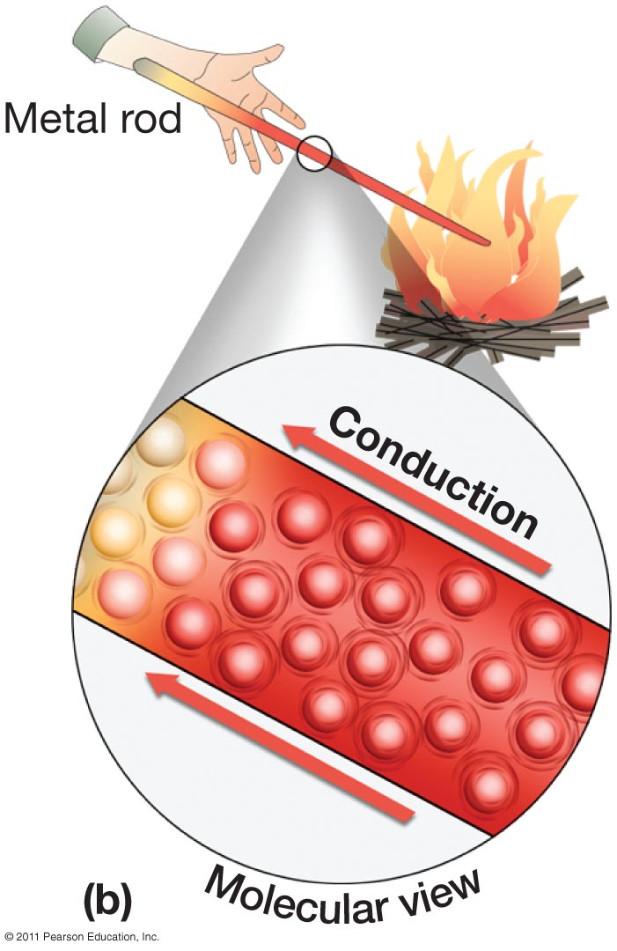
Conduction: movement of energy from one stationary body to another.
Energy passes when these objects touch.
Energy always passes from the warmer to the cooler object.
Some objects are better at conducting energy than others. Metal is a good conductor, air isn’t.
Earth not a good conductor.
Notes:
Figure 4-13b

Slide 7
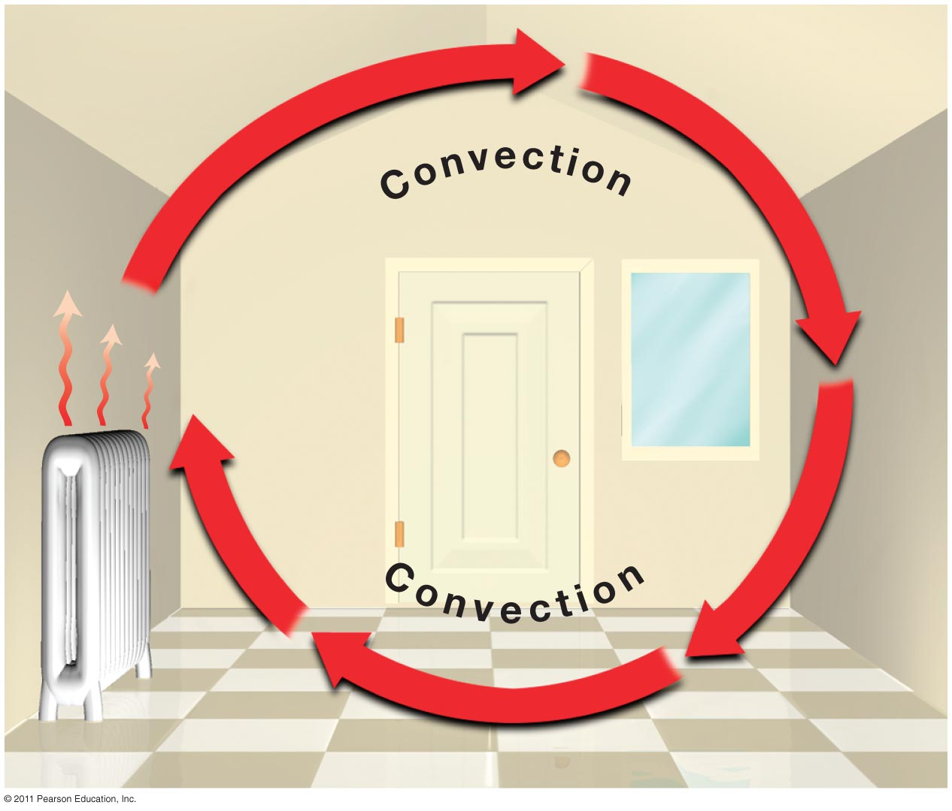
Convection: Energy is moved from one point to another. Warm air expands and rises and cooler air moves in to replace the rising warmer air. Creates a cell of moving air. A convection cell.
Notes:
Figure 4-14

Slide 8
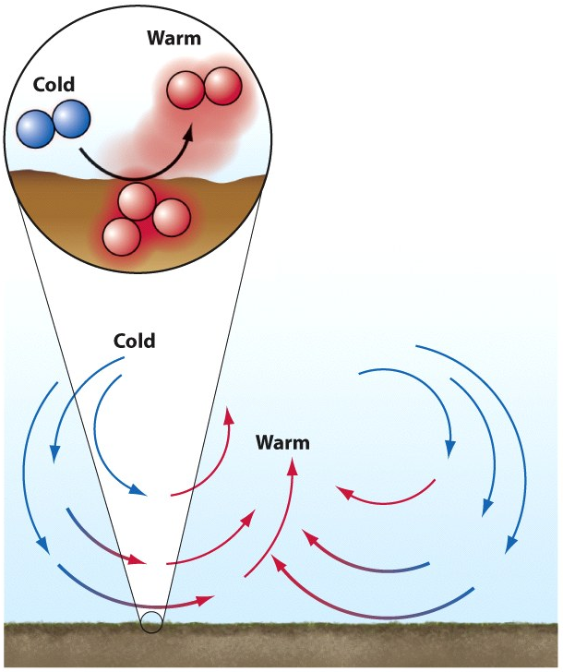
Temperature and Heat Flow Process
Energy Transfer
Example:
Sunlight hits earth via SW radiation.
SW is absorbed by ground, raising its temperature.
The surface layer radiates (LW) energy to the air, and heats the soil below it through conduction.
© John Wiley & Sons, Inc.
Where is convection occurring in this image?

Slide 9
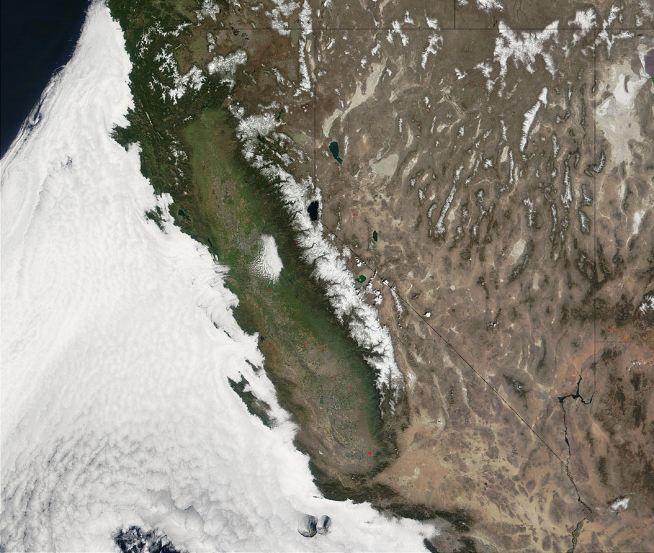
Advection—horizontal movement of energy. Usually through wind. Wind can transfer warm or cool air horizontally.
What is happening in this picture?

Slide 10
Latent Heat
“storage” of heat in the form of potential energy to be released
Occurs when water changes its form from a solid to a liquid to a vapor or vice versa
Evaporation: Energy Added
Liquid converted to a gas is a cooling process
1 kg water at 25C to water vapor requires 2441 kJ of energy
Solid water to liquid requires 334 kJ
Condensation: Energy Lost
Water vapor to a liquid is a warming process
Water vapor to 1kg of liquid water at 25C releases 2441kJ of energy
Water to sold releases 334 kJ

Slide 11
Latent Heat
Important energy transfer in the atmosphere/ocean:
Water evaporating into water vapor is a cooling process as heat is absorbed into the water vapor.
The latent heat stored in water vapor is released in the condensation process.
Hurricanes are fueled by warm water and this process.

Slide 12
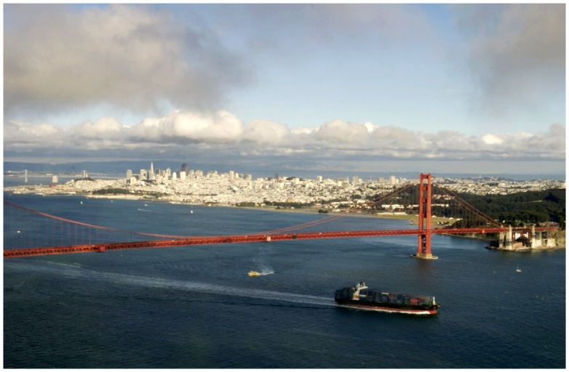
Daily and Annual Cycles of Air Temperature
Four important controls of air temperature:
Time of day
Season
Surface type (continental or maritime)
Latitude
Other local factors involved in determining temperature (see the next section) include:
Elevation
Land use and urbanization
Ocean currents

Slide 13
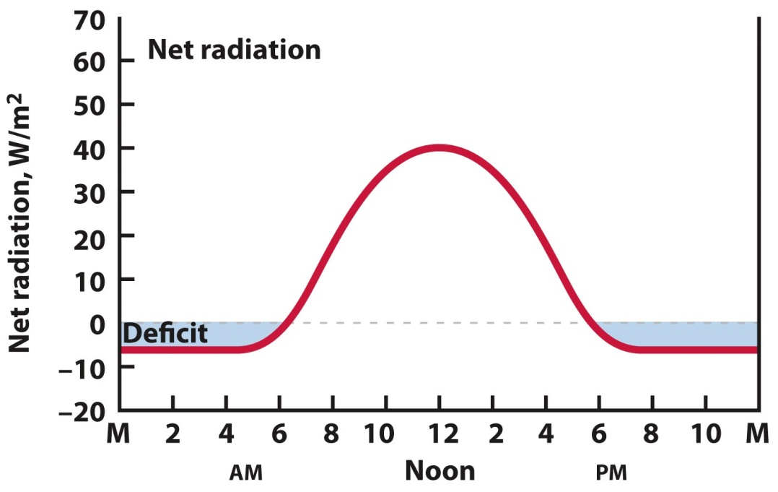
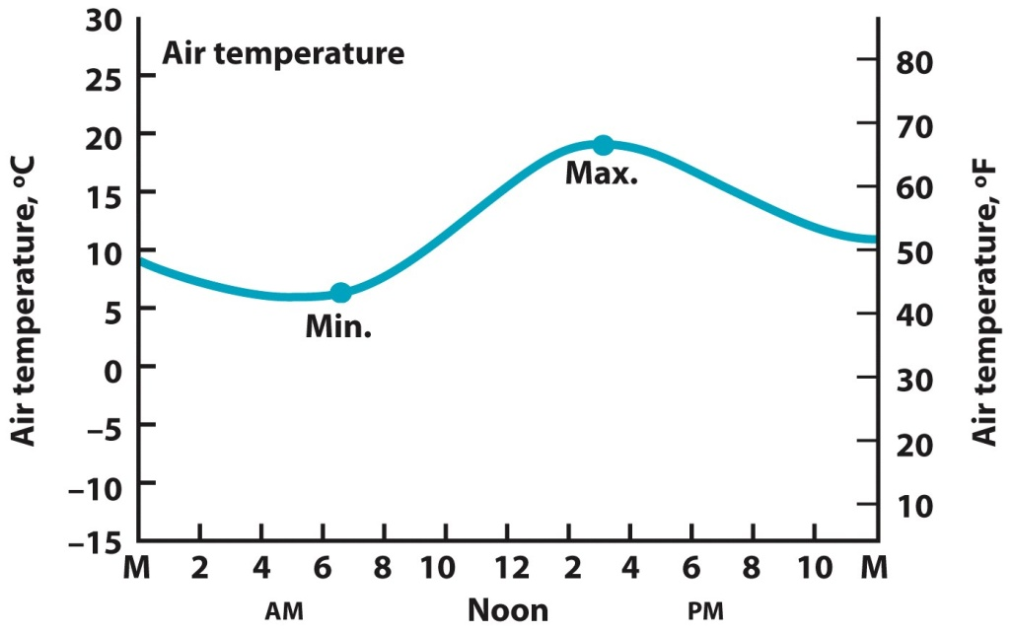
The Daily Cycle of Air Temperature
Net radiation varies daily:
Positive after sunrise
Decreases to negative by sunset
Air temperature varies daily:
Minimum is just after sunrise.
Rises to a peak in mid-afternoon.
Even after noon, incoming radiation is still greater than outgoing radiation (positive net radiation); thus, the temperature continues to increase.
Temperatures begin to decrease once net radiation is negative.
© John Wiley & Sons, Inc.
© John Wiley & Sons, Inc.
What time of day would you expect the high temperature?

Slide 14
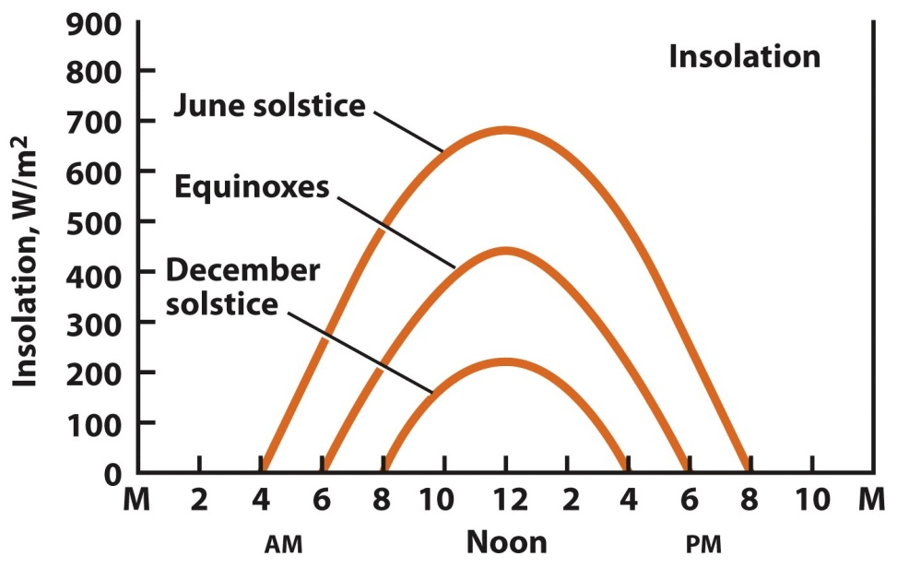
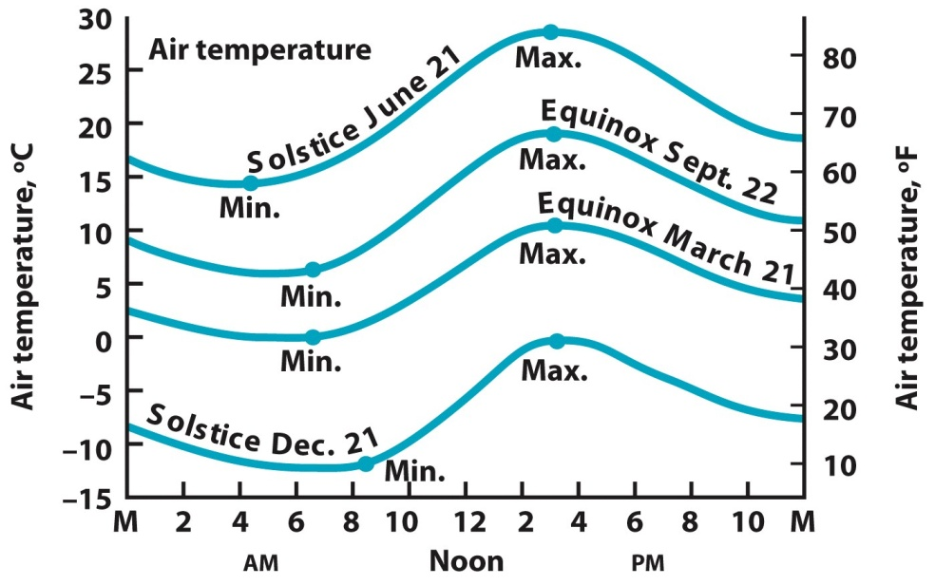
Annual Cycles of Insolation and Air Temperature
Insolation varies by season:
Day length longest at summer solstice = warmer temp.
Day length shortest at winter solstice = colder temp.
Air temperature
The height of the temperature curves varies with the seasons. In the summer, temperatures are warm, and the daily curve is high. In winter, the temperatures are colder. The September equinox is considerably warmer than the March equinox.
Insolation
At the equinox (middle curve), insolation begins at about sunrise (6am), peaks at noon, and falls to zero at sunset (6pm). The June solstice peak is much greater than at equinox, and there is much more TOTAL insolation. The daily total insolation is greatly reduced in December.

Slide 15
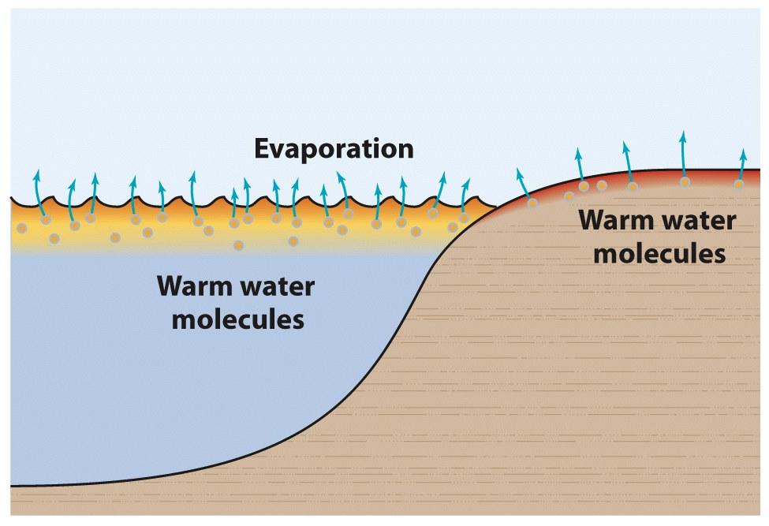
Land and Water Contrasts
Specific heat = amount of heat required to raise the temperature of a unit mass of a substance by 1ºC.
Rock and soil (inland areas) have low specific heat, which means less energy is needed to raise the temperature.
© John Wiley & Sons, Inc.
Water has a much higher specific heat capacity. An extensive, deep body of water heats more slowly and cools more slowly than inland areas.

Slide 16
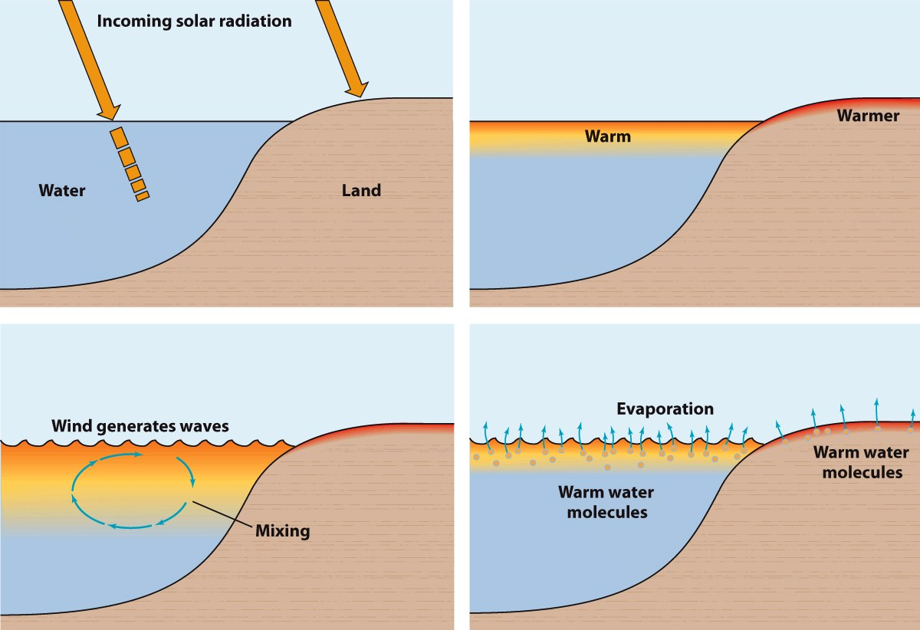
1
2
3
4
Inland climates have more temperature extremes than coastal climates:
1. Transmission of light: solar rays heat land surface, but are distributed deeper in water.
2. Specific heat: water has higher heat capacity than rock and soil.
3. Mixing: water mixes.
4. Evaporation: water evaporates, removing latent heat.

Slide 17
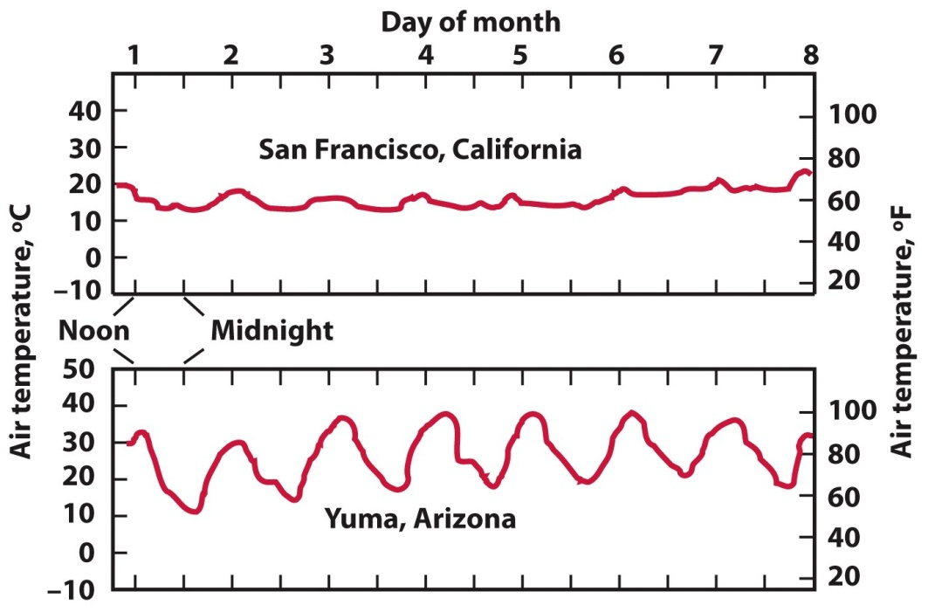
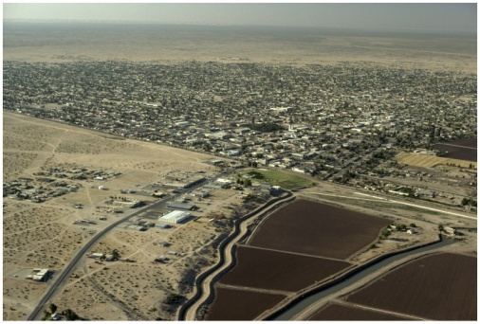
Land and Water Contrasts
Maritime = Coastal regions have smaller daily and annual temperature ranges.
Continental = Inland regions have greater daily and annual temperature ranges.
© NG Image Collection
© John Wiley and Sons Publishers Inc.
© NG Image Collection

Slide 18
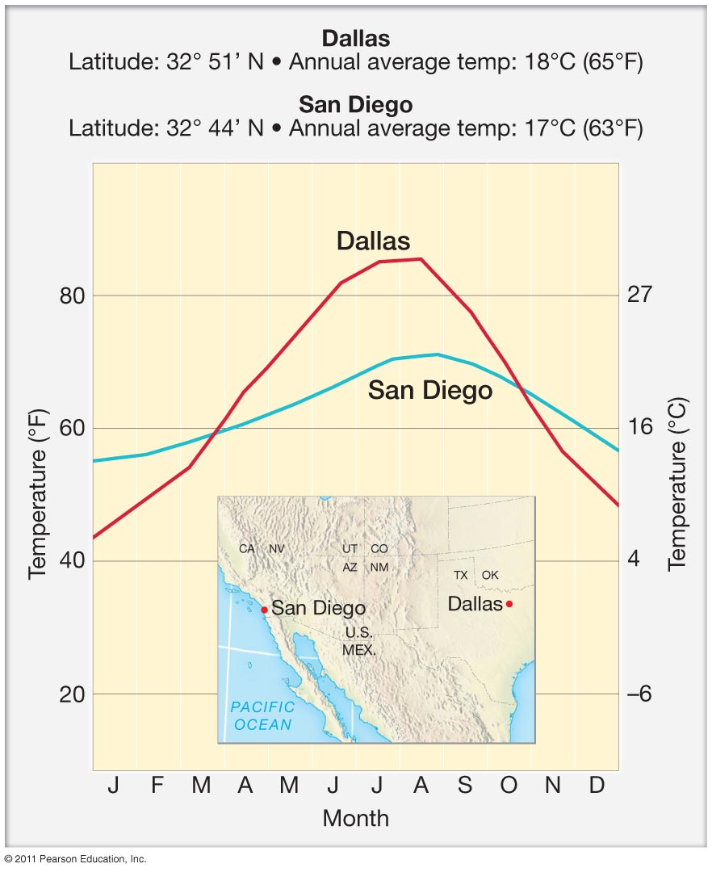

Slide 19
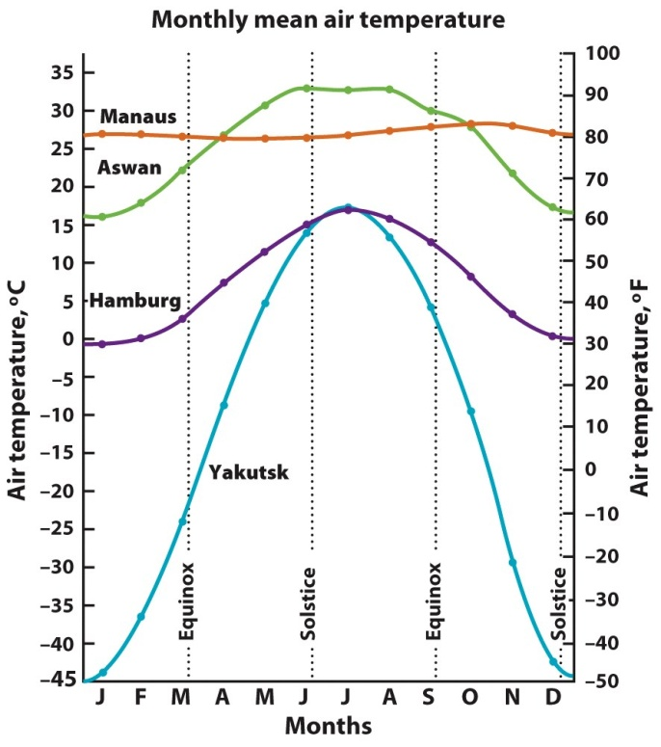
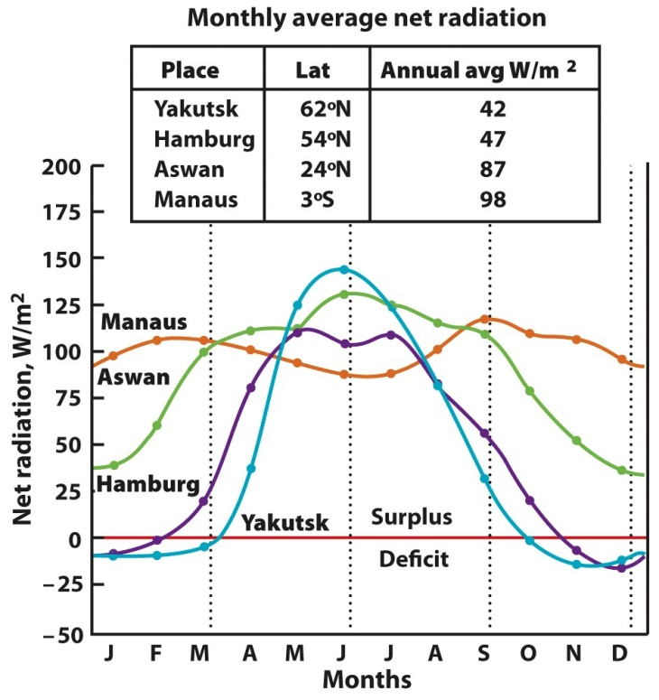
Temperature by Latitude
Annual cycle of insolation affects→ net radiation, which affects→ monthly mean air temperature.
Higher latitudes experience large annual temperature range.
Equatorial regions experience small annual temp ranges.
The monthly mean net radiation and air temperature at latitudes near the equator are higher and steadier throughout
the year. Moving closer to the poles, the annual average net radiation is lower, and the seasonal variations are more extreme.

Slide 20
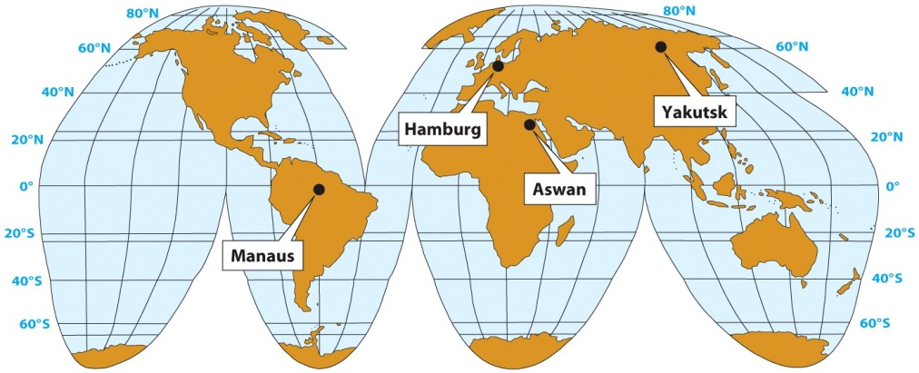
Four cities to compare:
Manaus, Brazil
Hamburg, Germany
Aswan, Egypt
Yakutsk, Russia

Slide 21
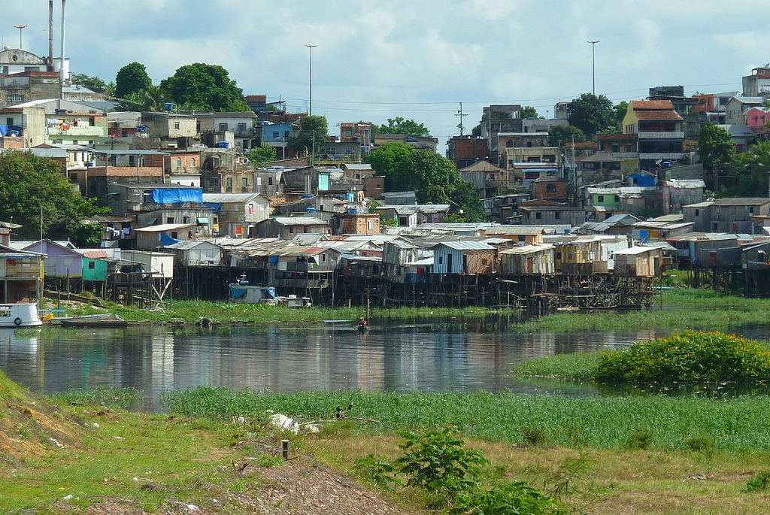
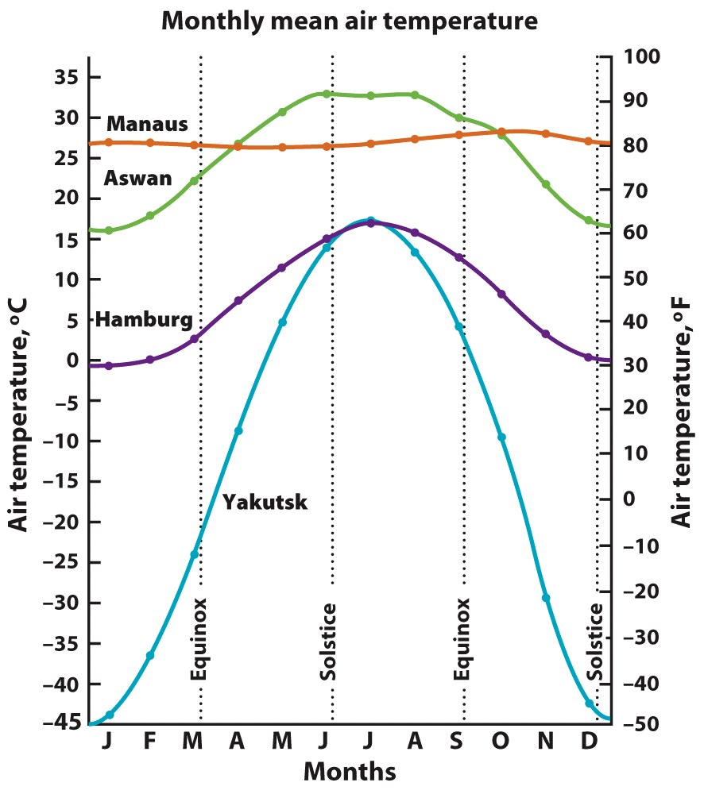
Manaus, Brazil.
© NG Image Collection
Courtesy David H. Miller

Slide 22
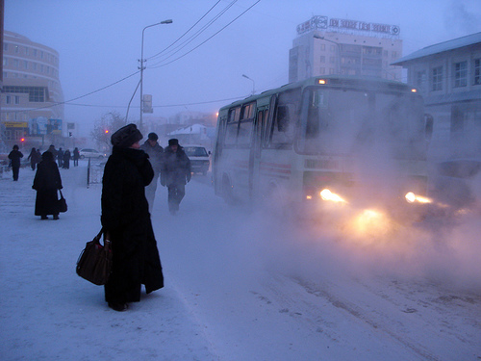
Yakutsk, Russia

Slide 23
Hamburg, Germany

Slide 24
Although Yakutsk is only 9.5° further north than Hamburg, the annual temp cycles of these two cities are quite different. While summer temp are similar, winter temp at Yakutsk average –45°C compared to just about freezing at Hamburg.
Which is the best explanation for this observation?
a. The elevation is much higher in Yakutsk.
b. The elevation is much higher in Hamburg.
c. Winds bring air from the Arctic Ocean to Yakutsk.
d. Winds bring air from the Atlantic Ocean to Hamburg.

Slide 25
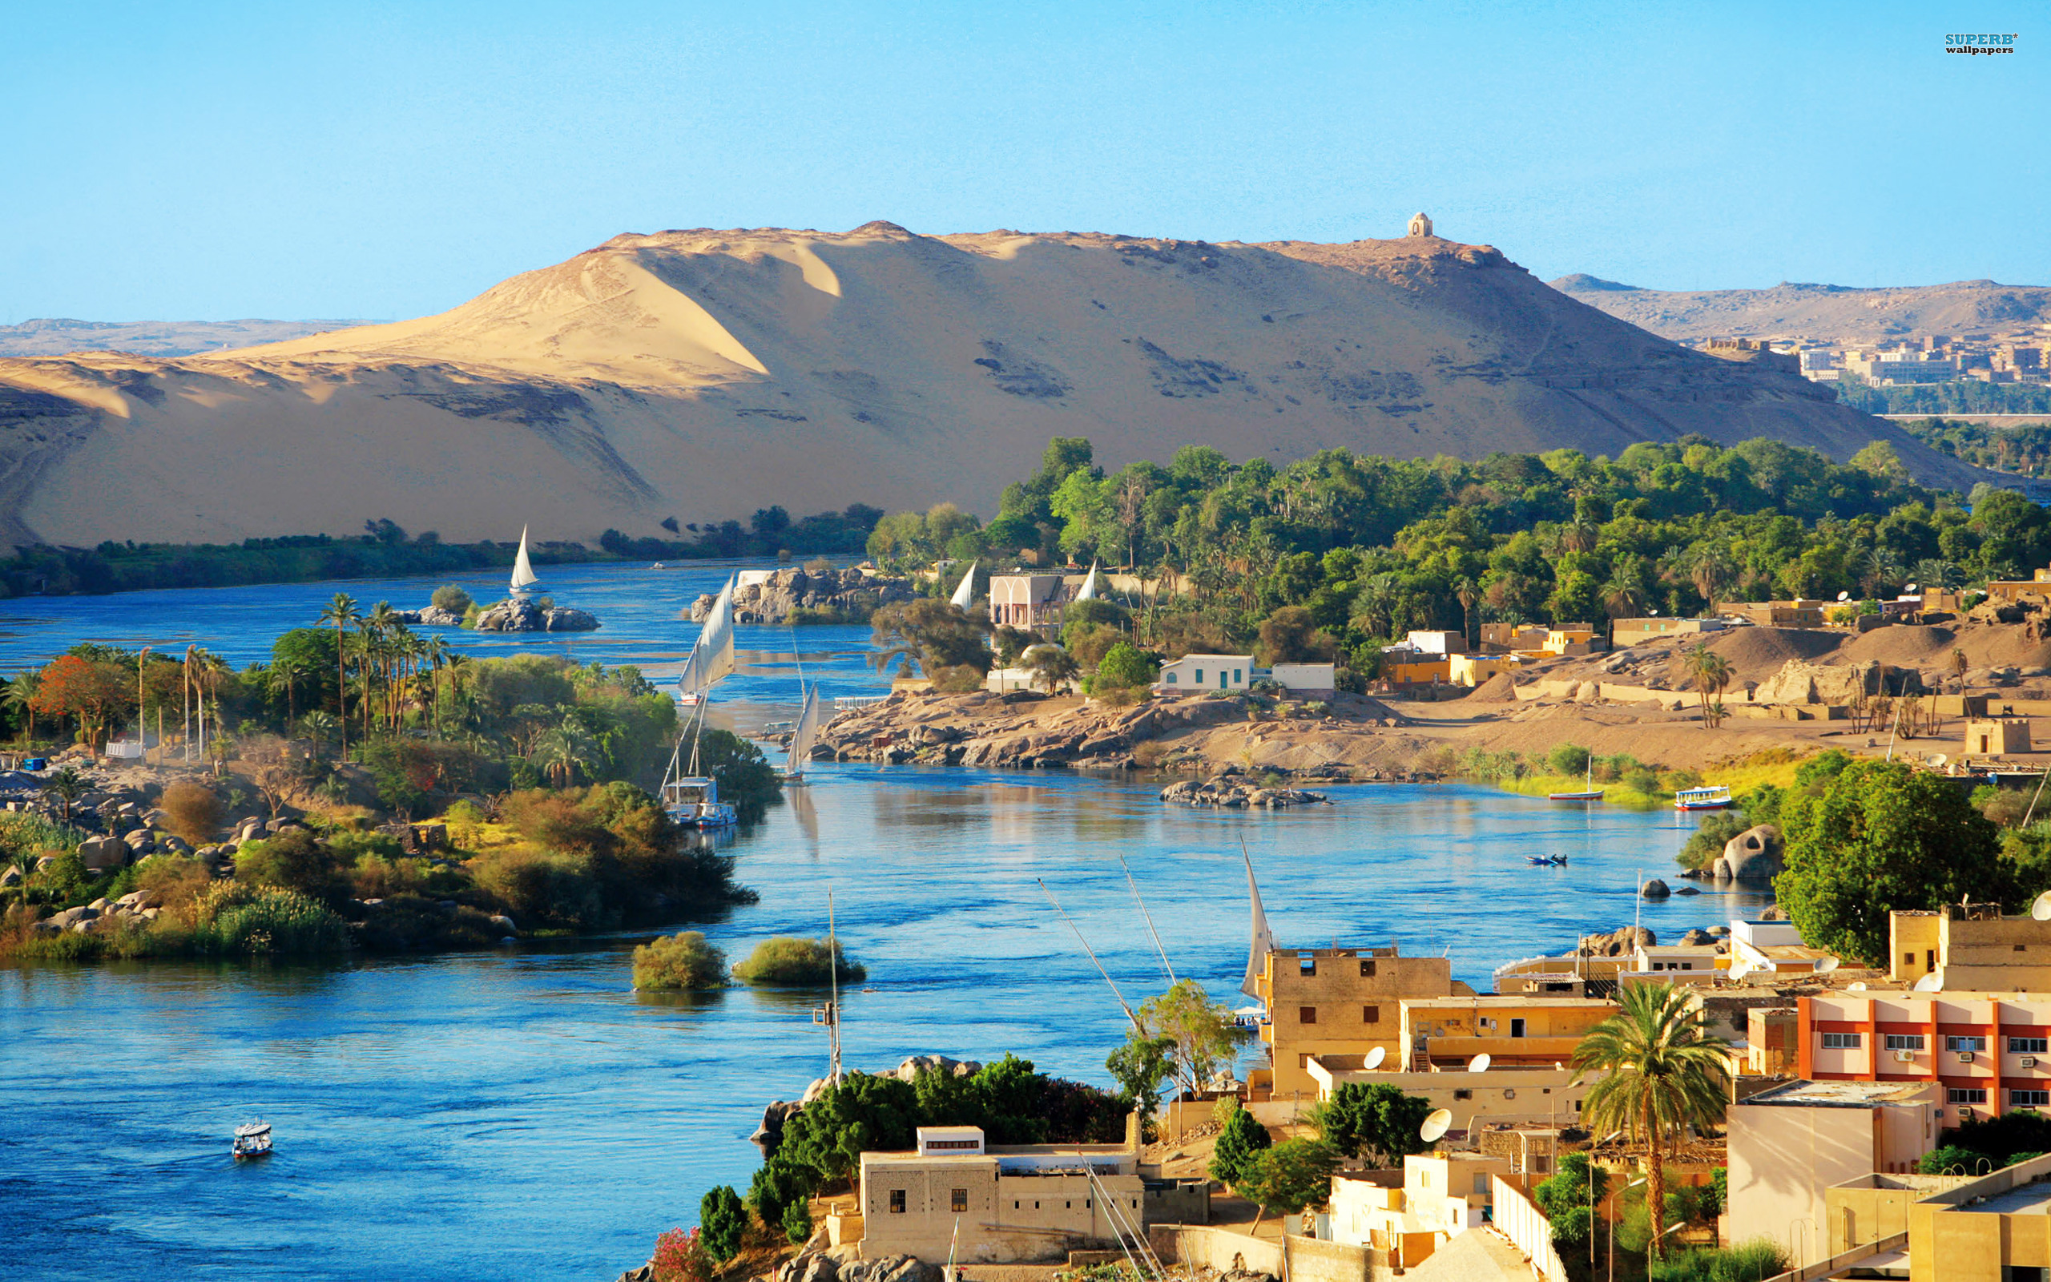
Aswan, Egypt

Slide 26
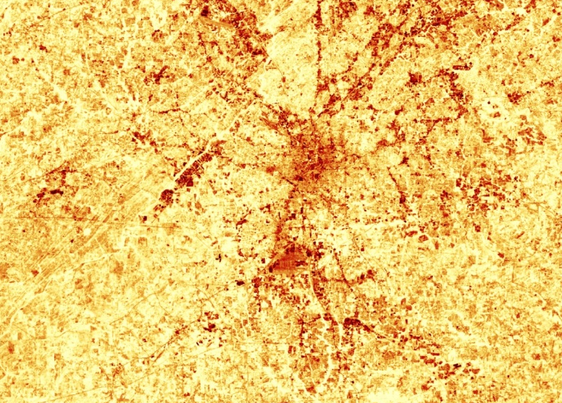
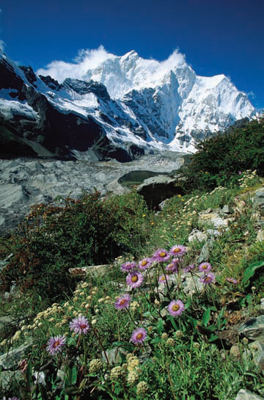
Local factors involved in determining temperature:
Elevation
Land use and urbanization
Ocean currents
Microclimates = Local atmospheric zones where the climate differs from surrounding areas
© Courtesy NASA
© NG Image Collection

Slide 27
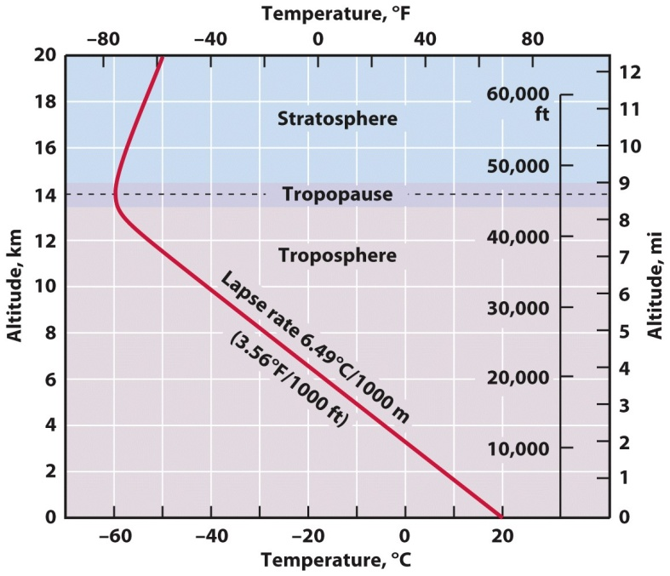
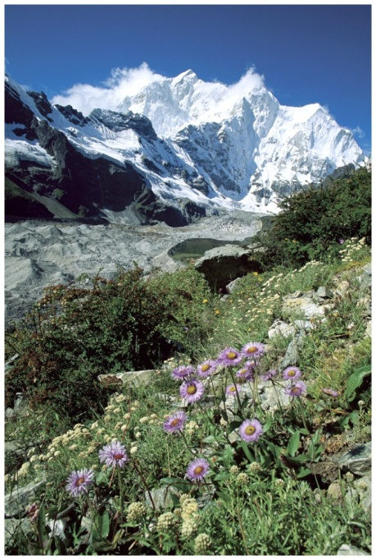
Effects of Elevation on Temperature
Temperature decreases with altitude in the troposphere, then increases above the troposphere.
Environmental temperature lapse rate = rate at which air temperature drops with increasing altitude due to pressure drop and subsequently less carbon dioxide and water vapor to absorb longwave radiation (the greenhouse effect is reduced).
Average temperatures will decrease with increased elevation (altitude), and daily range between highs and lows will also increase
© NG Image Collection
© NG Image Collection

Slide 28
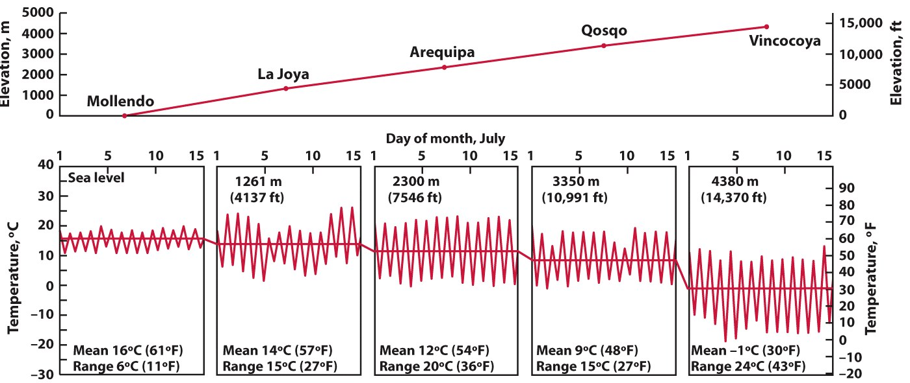
Five weather stations at different altitudes in the Andes Mountains.
© John Wiley & Sons, Inc.

Slide 29
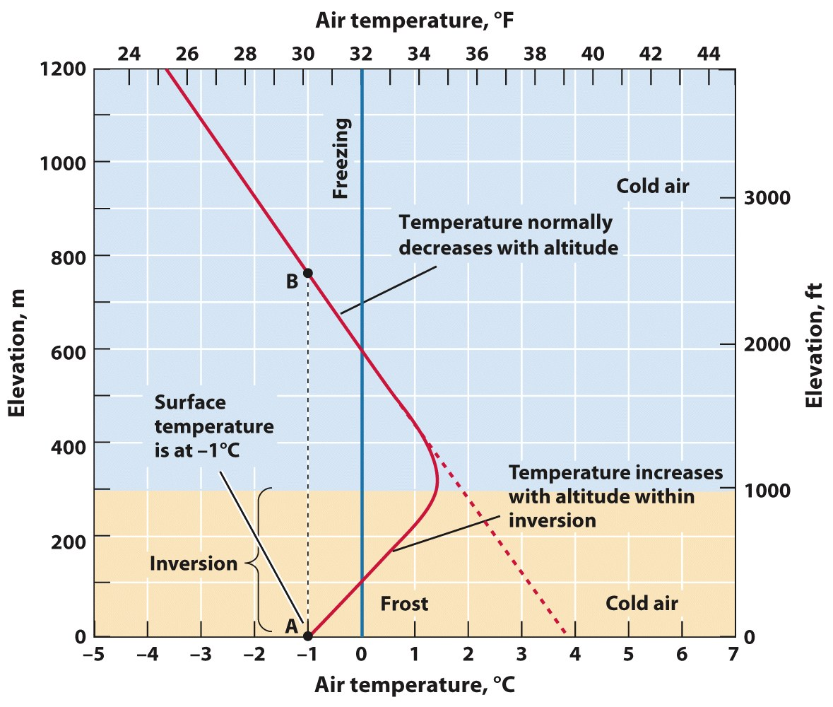
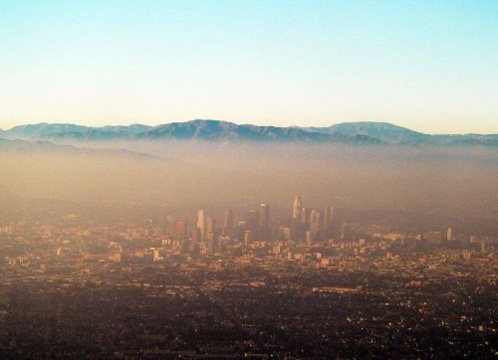
Temperature Inversions
© John Wiley & Sons, Inc.
If you were to plant a frost-sensitive plant/tree, is it best to plant it on the valley floor or on a hill side?

Slide 30
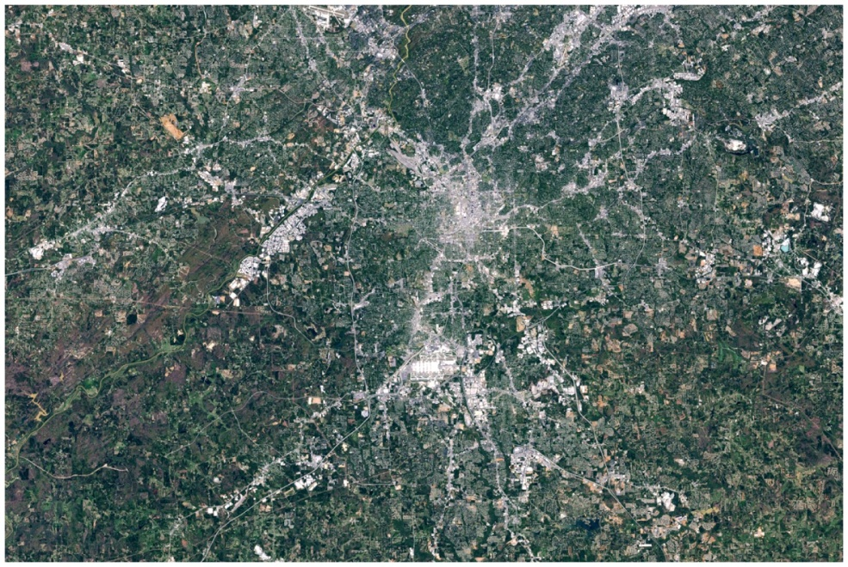
Urban and Rural Environments
Urban heat island = an area at the center of a city that has a higher temperature than surrounding regions
Problems?
Solutions?
© Courtesy NASA
The figure on the left is an aerial view of Atlanta, GA. The image on the right is a thermal infrared image that shows surface temperature, highest temps are red. Highest temps are concentrated in the city center, while lower temps are in the suburbs, and lowest temps are in outlying rural areas.
Why are there strips of red radiating out from the city center?
© Courtesy NASA

Slide 31
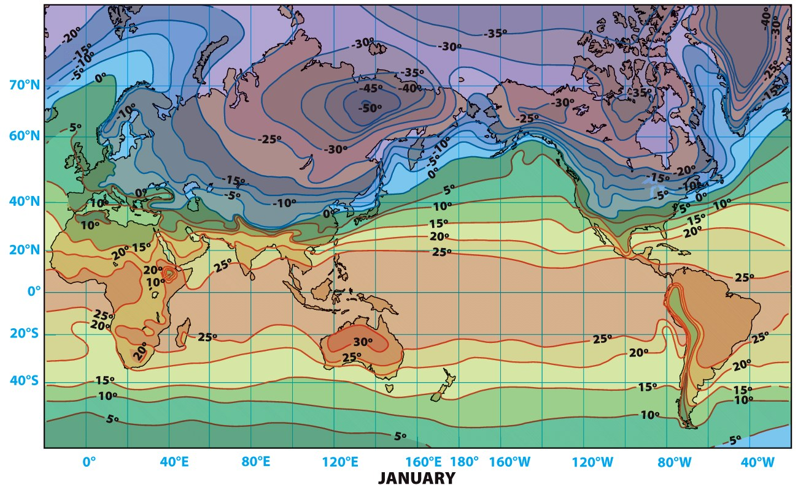
Data from John E. Oliver
Air temperature maps use isotherms (lines connecting points of equal temperature.
Usually they are separated by 5 or 10 degrees.
Will show areas of high and low temperatures
Also illustrate the rate at which temperature changes with distance, the temperature gradient

Slide 32
Air Temperature Patterns around the Globe
Four main factors explaining world isotherm patterns:
1. Latitude
2. Land/Water
3. Ocean Currents
4. Elevation
Data from John E. Oliver

Slide 33
Air Temperature Patterns around the Globe
Temperature Extremes
Hottest = 58ºC (136ºF) at El Azizia, Libya (~28ºN).
Coldest = –89°C (–128°F) at Vostok Station, Antarctica (high elevation near 85ºS).
Within North America, temperatures range from 57°C (134°F) in Death Valley, California, to –63°C (–81°F) in Snag, Yukon, Canada.
Find these locations on physical map. Use at least two temperature controls to explain the temperature extremes in Libya and Antarctica.

Slide 34
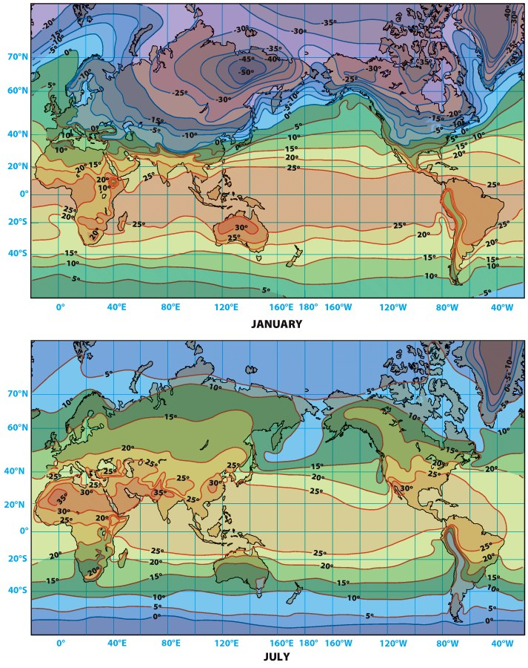
Temp Change in Midlatitudes & Equator
Where is change greatest
in the mid-latitudes from
January to July?
What is happening near
the equator in those two months?

Slide 35
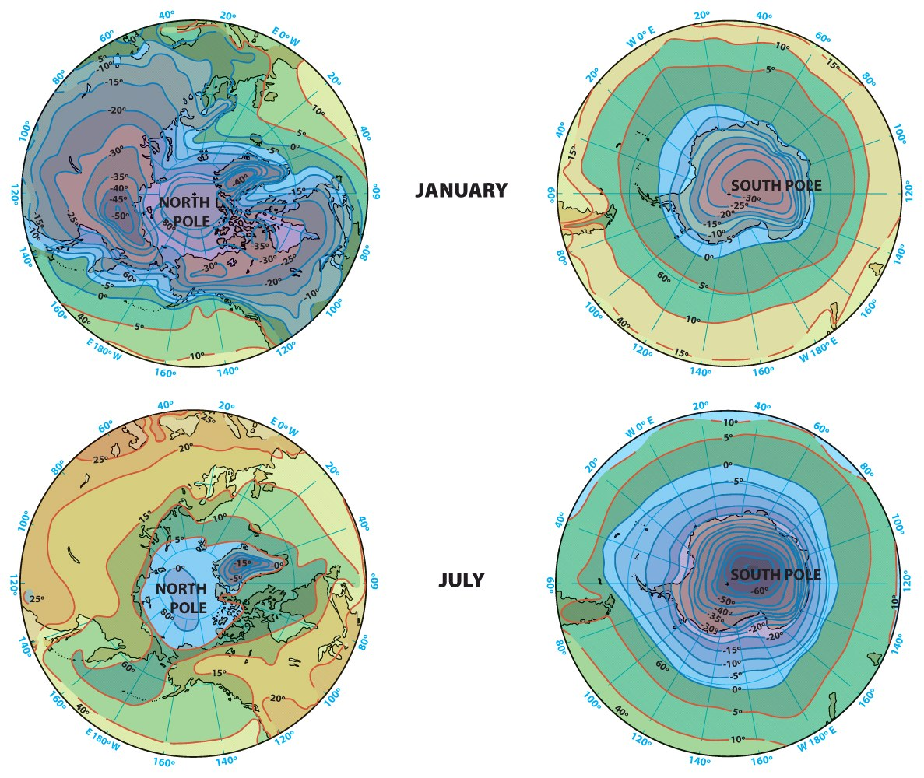
Temp Change at Poles
Intensely cold because insolation decreases poleward.
Ice sheets—Greenland & Antarctica.
High elevations and high albedo and in a continental position.

Slide 36
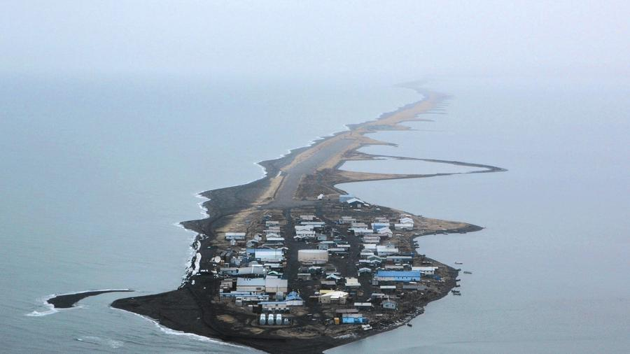
Global Warming
How do scientists develop a temperature record?
Why might there be wide swings in mean annual temperatures?
What is the IPCC? What have they said?
Does latitude matter in people’s perspectives toward climate change?
Kivalina, Alaska in 2007. The barrier reef Kivalina calls home gets smaller and smaller with every storm. LA Times 8/30/2015

Slide 37
Impacts?
Arctic thawing/polar sea ice melting
Native people’s way of life disrupted
Coast communities eroded
Melting permafrost and infrastructure
High $$$ cost
Polar bears?
Positive feedback loop
Sea-level rise
11-17” rise by 2100
Who/what will adapt?
Annual flooding risks—92 million people
More frequent & intense storms
Ecosystem change (pine beetles, coral bleachign)
Spread of insect born diseases (malaria)
Where will there be more rain? Less?

Slide 38
International Efforts
Kyoto Protocol
Earth Summits

