Slide 1
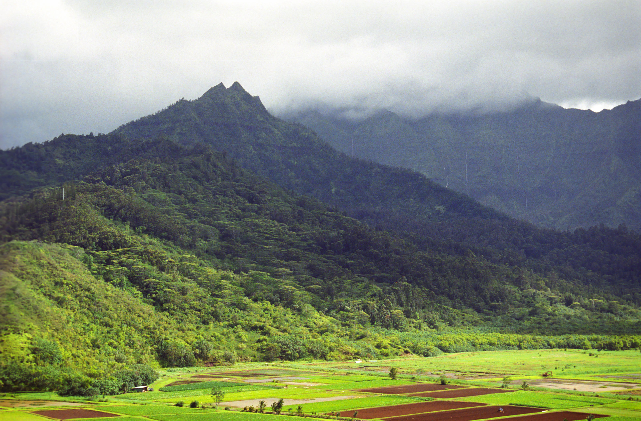
Chapter 4: Atmospheric Moisture & Precipitation
Mt. Waialeale, Kauai. Said to be wettest spot on Earth with 460” of rainfall annually.

Slide 2
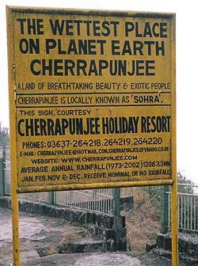
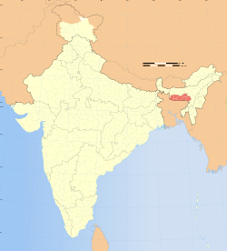
Or is it Cherrapunji, India?
Water is the lifeblood of the planet. The Sun’s energy fuels its transformation to all three forms: water, solid, vapor. Gravity moves water across the lithosphere, shaping landforms.

Slide 3
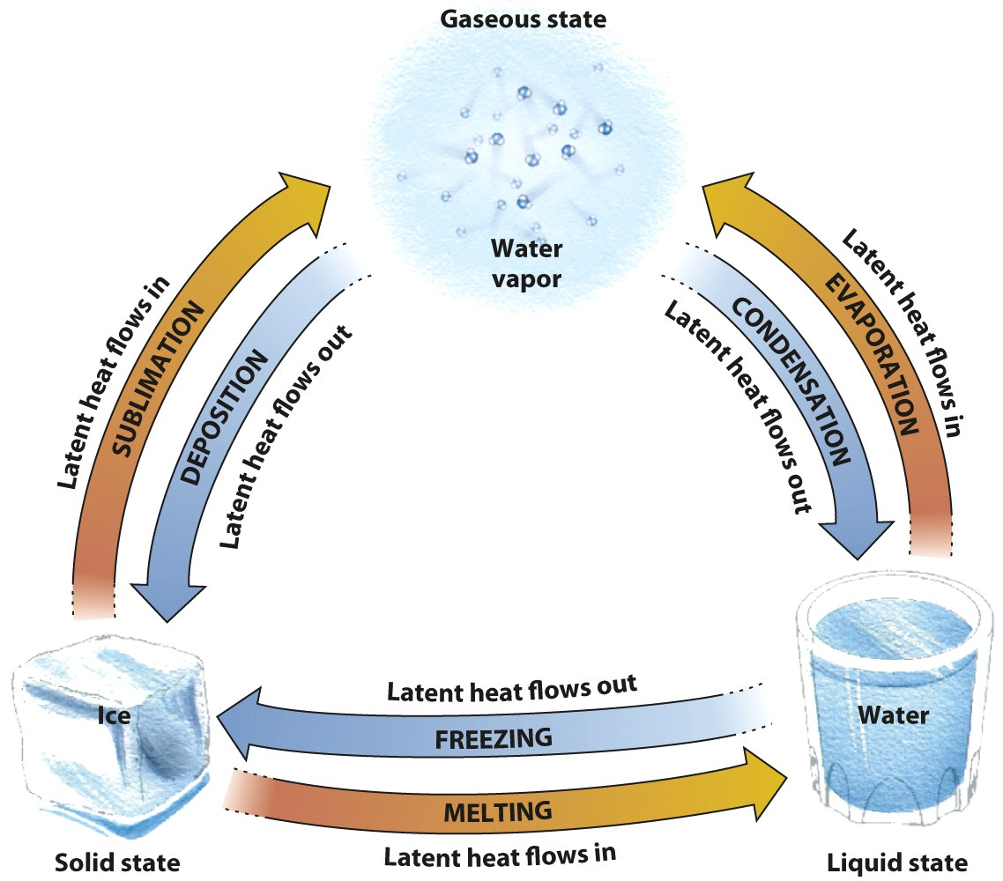
The Three States of Water
Solid (ice)
Liquid (water)
Gas (water vapor)
Latent heat is transferred when water changes states
Release of energy occurs when...
Absorption of energy occurs when…
Which are ‘warming’ processes where energy is released?
Which are ‘cooling processes’ where energy is added?
On a cold, dry day, snow covering a sidewalk slowly disappears, and there is no visible melting. Which process is at work?
a. Sublimation b. deposition c. condensation d. evaporation?

Slide 4
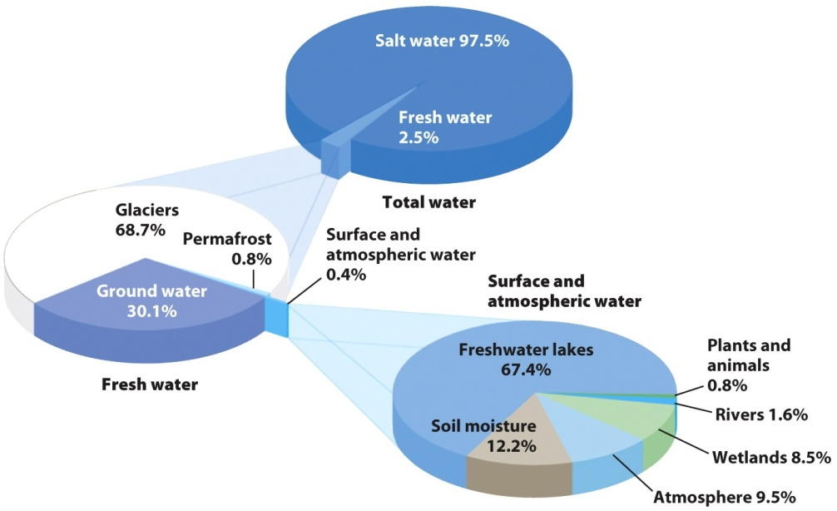
The Hydrosphere
The total water realm of the Earth’s surface, including the oceans (97.5%) and freshwater (2.5%).
Most fresh water is stored in ice sheets and glaciers (68.7%, ground water (30%) and permafrost (.8%), rivers/streams/lakes only make up about .4%.

Slide 5
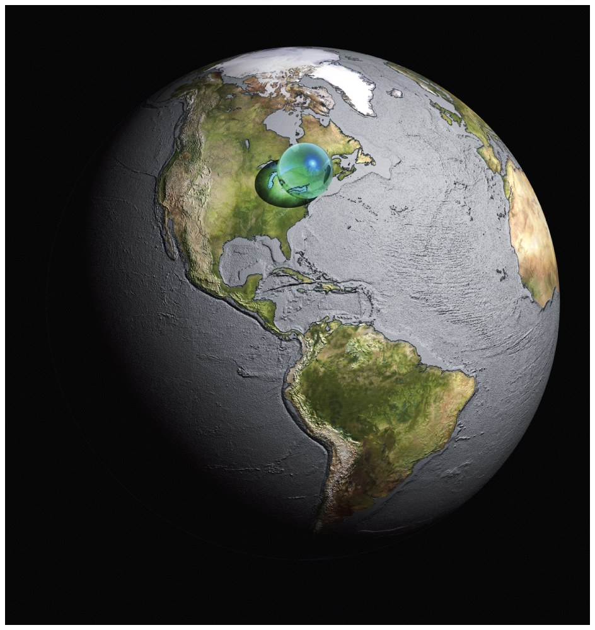
The small blue sphere represents the planet’s total water volume in proportion to the Earth’s size, demonstrating the limits on this critical resource
© SPL/Photo Researchers
¾ of the Earth is covered with water, but it is a very thin layer. It is a finite resource and it is in constant motion, shifting from ocean to land to living systems.

Slide 6
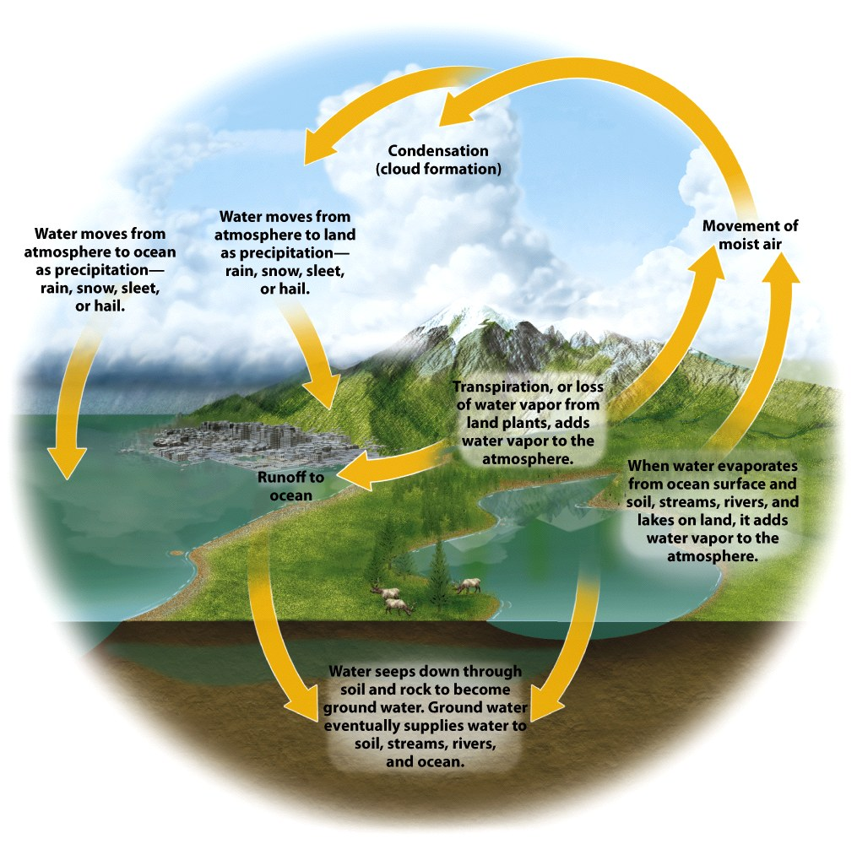
Where is evaporation rate the highest?
Does evaporation occur over land…what are transpiration & evapotranspiration?
The Cycle: Evaporation, Precipitation, Transpiration, Runoff, Sinks into Soil, Groundwater
Precipitation over land has 3 fates, what are they?

Slide 7
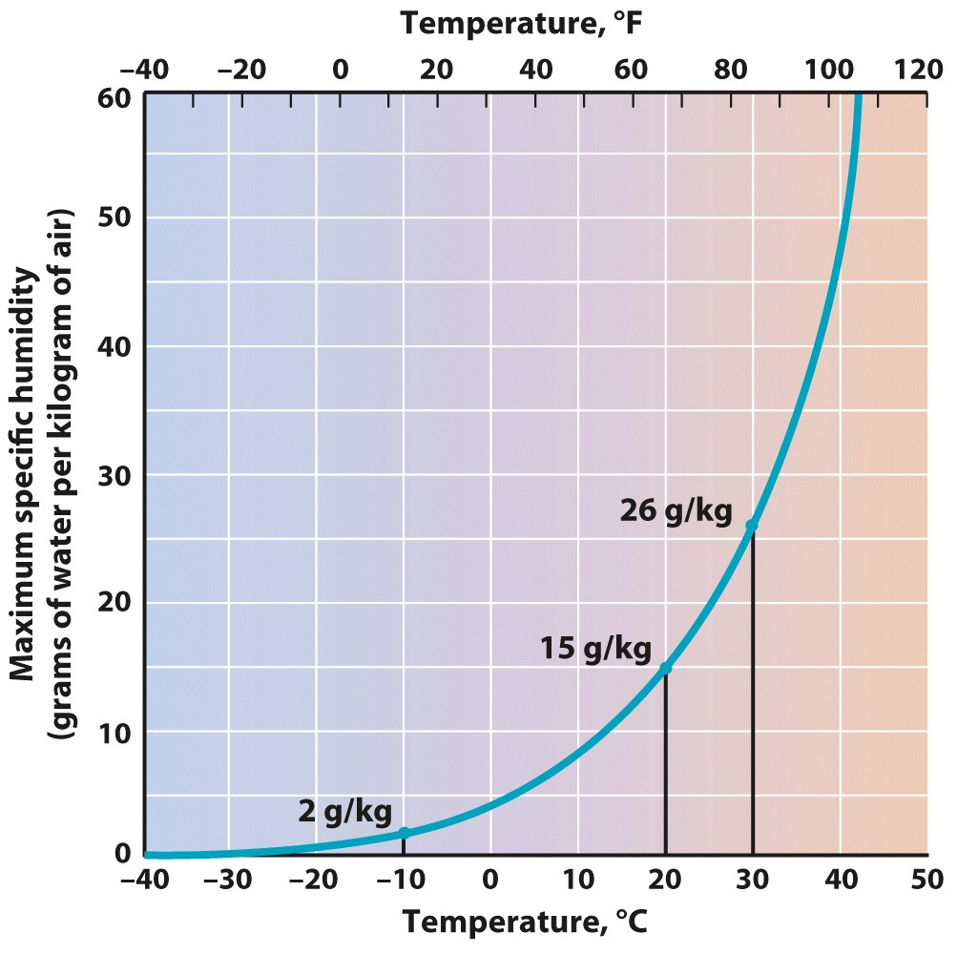
Humidity
The amount of water vapor in the air
Varies widely over the globe
The maximum volume of water vapor, or humidity, of a mass of air increases sharply with rising temperature
Air at room temperature (20°C [68°F]) can hold about three times as much water vapor as freezing air (0°C [32°F])
© John Wiley & Sons, Inc.

Slide 8
Relative Humidity (RH)
Compares the amount of water vapor present to the maximum amount that the air can hold at that temperature
Expressed as a percentage
Air holding ½ its capacity has a RH of 50%
Can change in two ways:
Gain or lose moisture
Change in temperature

Slide 9
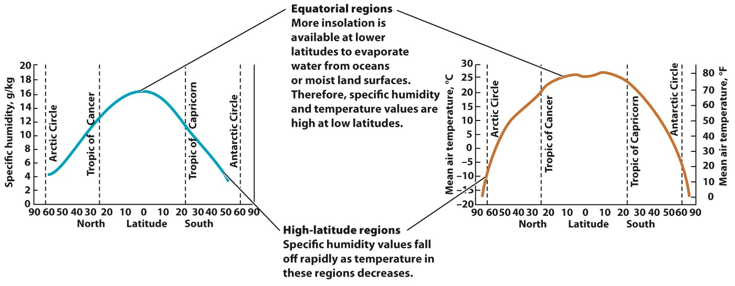
Specific Humidity
The actual amount of water vapor held by a parcel of air (g/kg)
When air cools, capacity is reduced
When air warms, capacity increases
Specific humidity and temperature values are high at low latitudes
Specific humidity values fall as temperature in high latitude regions
© John Wiley & Sons, Inc

Slide 10
Dew Point
The temperature at which air with a given humidity will reach saturation when cooled without changing its pressure
Dew
Frost
What happens as air is cooled below the dew-point temperature at temperatures above freezing?

Slide 11
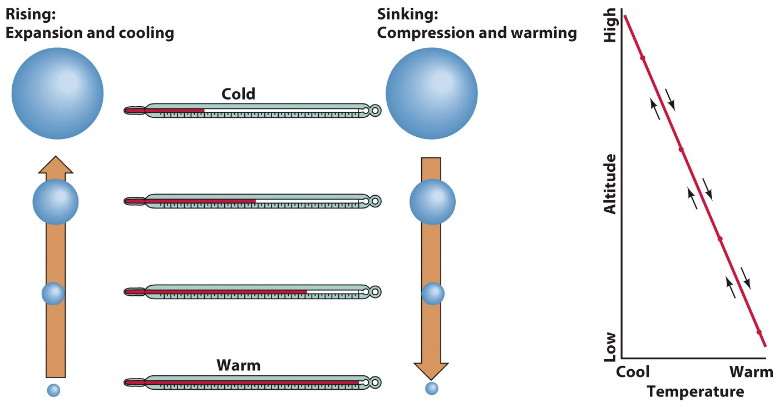
Adiabatic Processes
As a parcel of air is lifted, atmospheric pressure becomes lower, and the parcel expands and cools
As air cools to the dew point, clouds form
As air descends, air is compressed and warms
Adiabatic processes = process in which the temperature of a parcel of air changes in responses to a change in atmospheric pressure

Slide 12
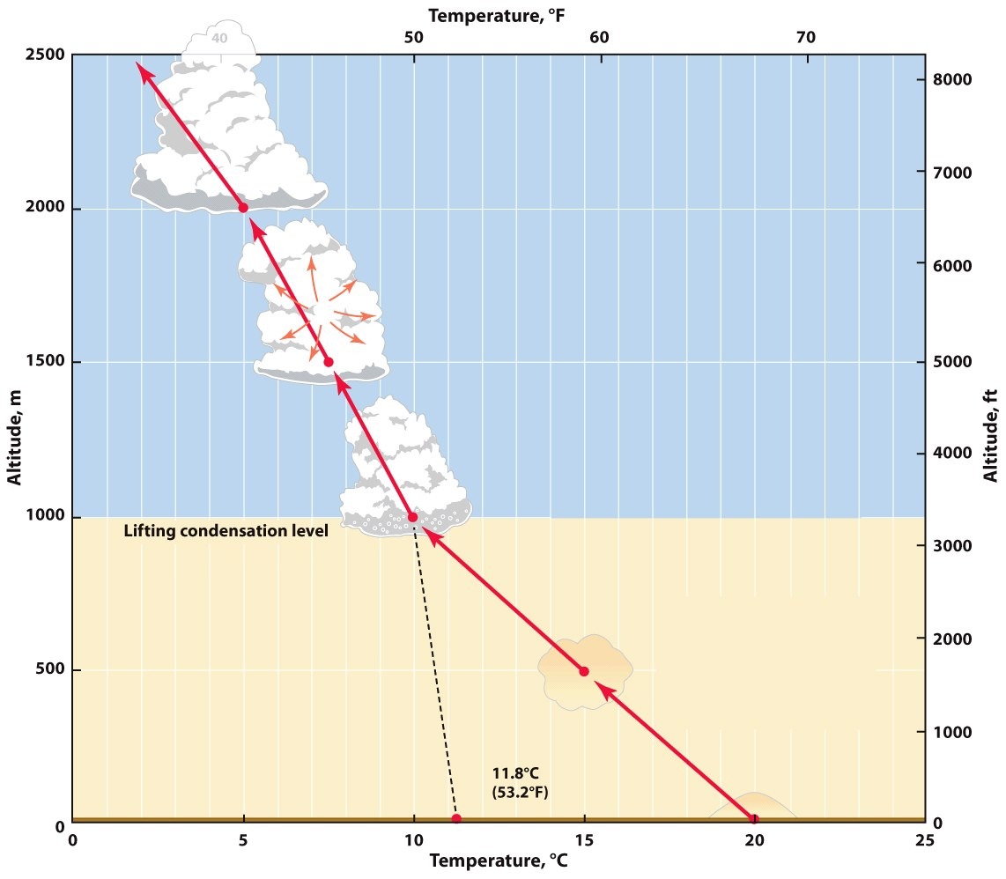
The Dry Adiabatic Lapse Rate
The rate at which rising air cools or descending air warms when no condensation is occurring
10°C per 1000 m
5.5°F per 1000 ft
© A. N. Strahler

Slide 13
The Moist Adiabatic Lapse Rate
The rate at which rising air is cooled by expansion when condensation is occurring; ranges from:
5°C per 1000 m
2.7°F per 1000 ft
© A. N. Strahler

Slide 14
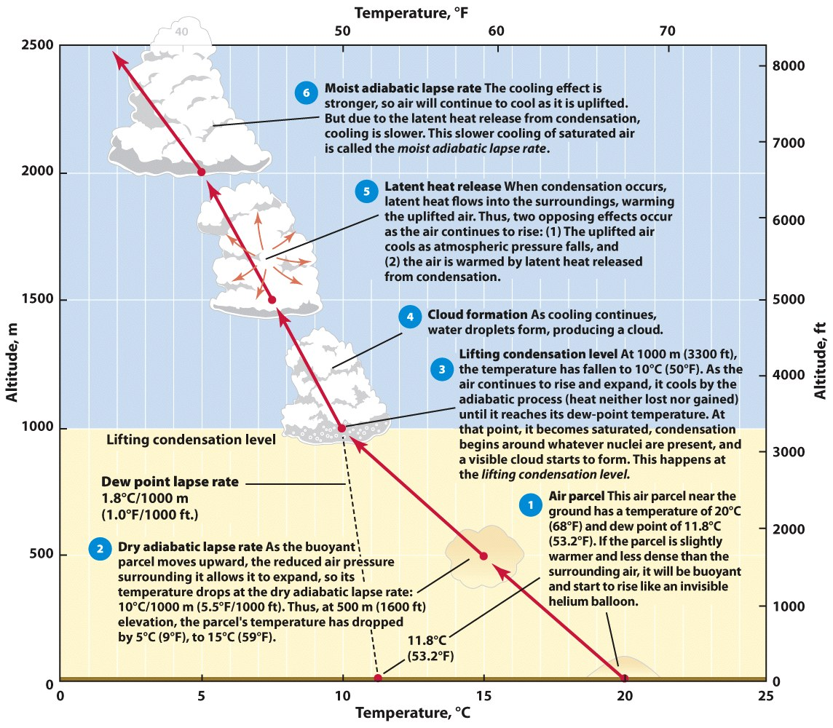
© A. N. Strahler
Suppose the air parcel shown in the diagram contained more water vapor. How would that affect the lifting condensation level? What would be the effect if there were less water vapor in the air parcel?

Slide 15
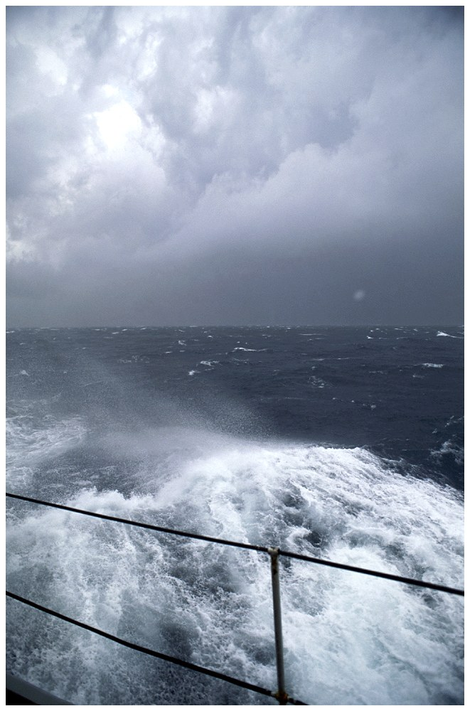
Clouds and Fog
Clouds consist of water droplets, ice crystals, or both
Condensation nucleus = a tiny bit of solid matter (aerosol) in the atmosphere, on which water vapor condenses to form a tiny water droplet
© NG Image Collection

Slide 16
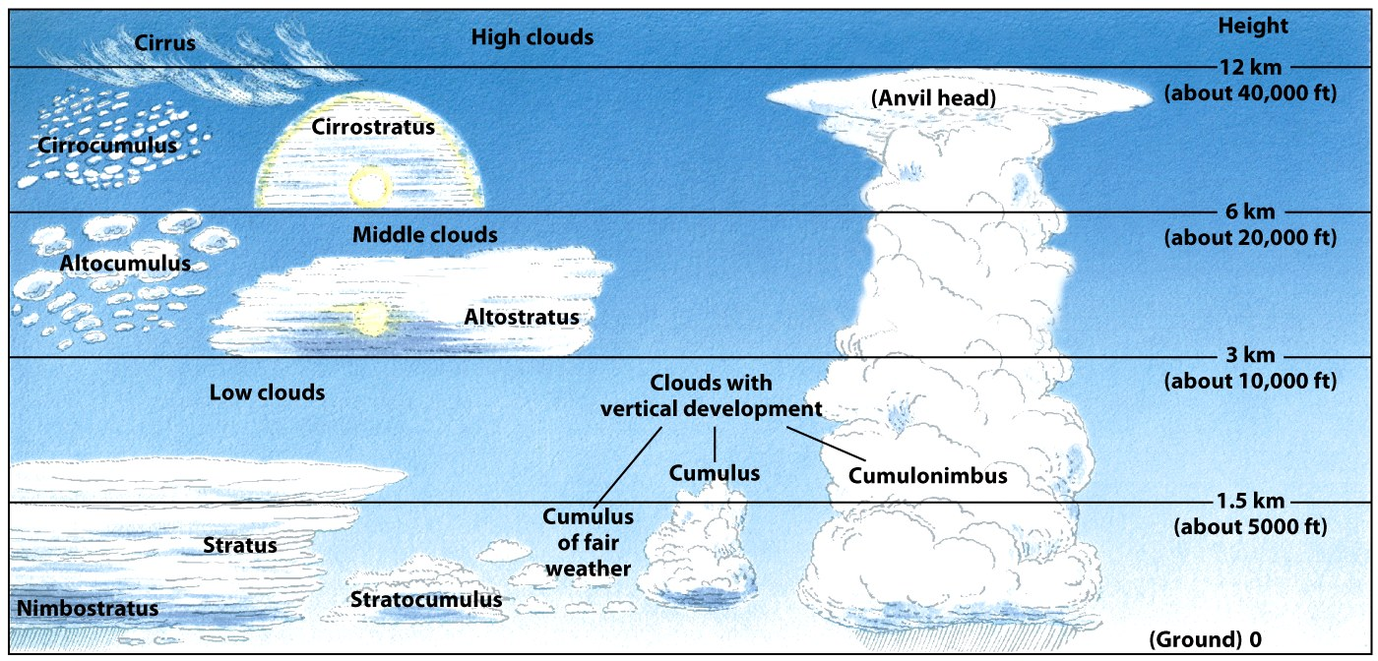
© A. N. Strahler
Clouds Classification by Height
Cloud Families: High clouds, middle clouds, low clouds, clouds of vertical development

Slide 17
Cirrus Clouds
© NG Image Collection
Cirroform clouds = at the top of the troposphere, these clouds are high, thin, wispy clouds drawn out into streaks. They are composed of ice crystals and form when moisture is present high in the air

Slide 18
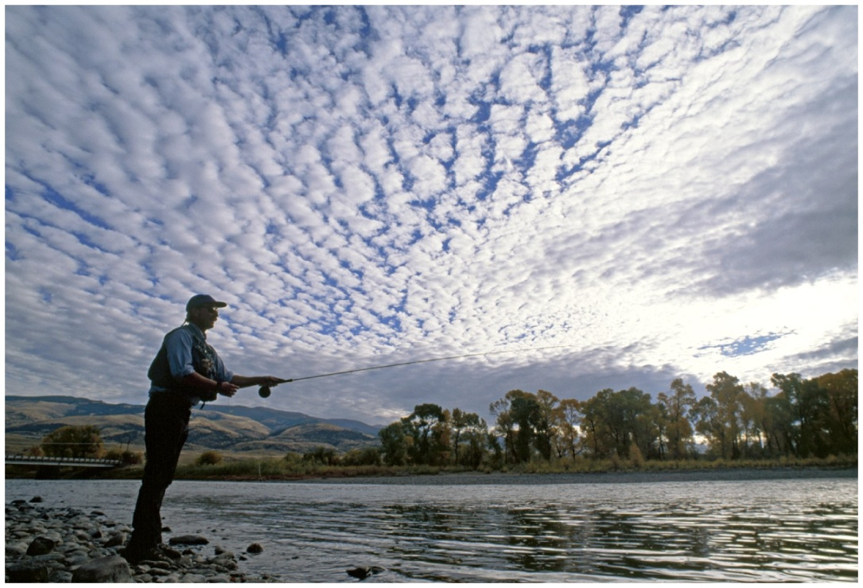
Stratiform Clouds
© NG Image Collection
Stratiform clouds = are blanket-like layers that cover large areas. A common type is stratus clouds, which often cover the entire sky. In this photo, high cumulus clouds (left) grade into a high stratus layer (right).

Slide 19
Cumulus Clouds
© NG Image Collection
Cumuliform clouds = globular masses of cloud that are
associated with small to large parcels of moist rising air. In this
photo, puffy, fair-weather cumulus clouds drift over a lake.

Slide 20
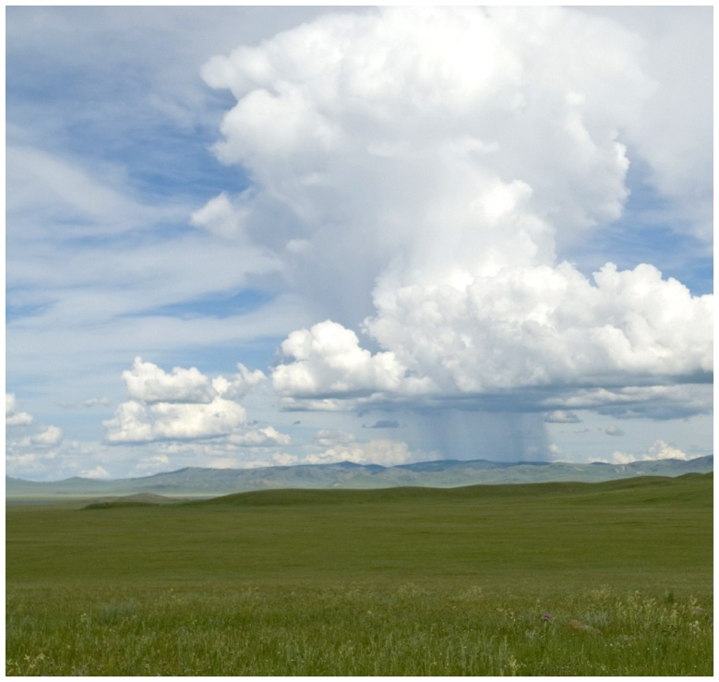
Cumulonimbus Clouds
© NG Image Collection
Nimbus clouds = are clouds of any of type that produce
precipitation. An isolated cumulonimbus cell discharges
its water volume as precipitation in this photo.

Slide 21
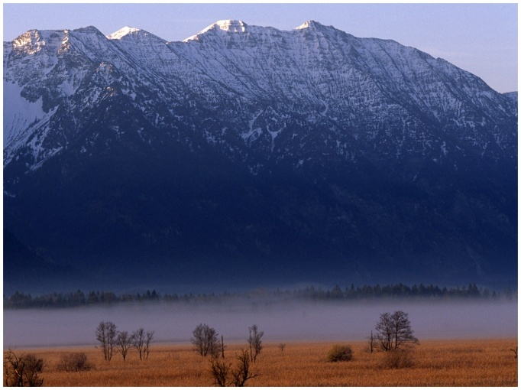
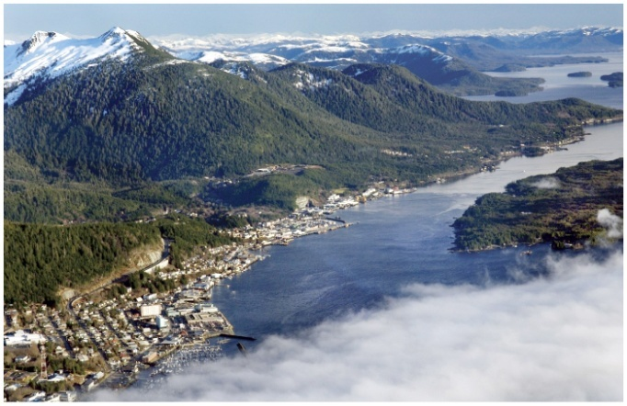
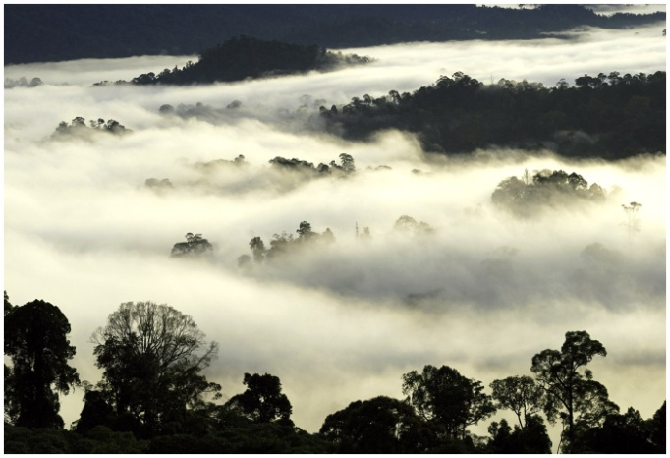
Fog
Radiation fog: formed when temperature of the air at ground level falls below dew point
Central Valley of CA
Advection fog: forms when warm moist air moves over a cold surface
Common over oceans (“sea fog”)
West Coast of US and Canada
The wet Murnauer Moor in Germany, loses heat at night, leading to condensation that produces a layer of fog (radiation fog).
Ketchikan, Alaska. Coastal area, frequently experiences advection fog as moist maritime air moves over colder water currents.
Borneo, Malaysia. Mountains supply gravity-fed cool air that moves down drainage paths, creating valley fog (advection fog).

Slide 22
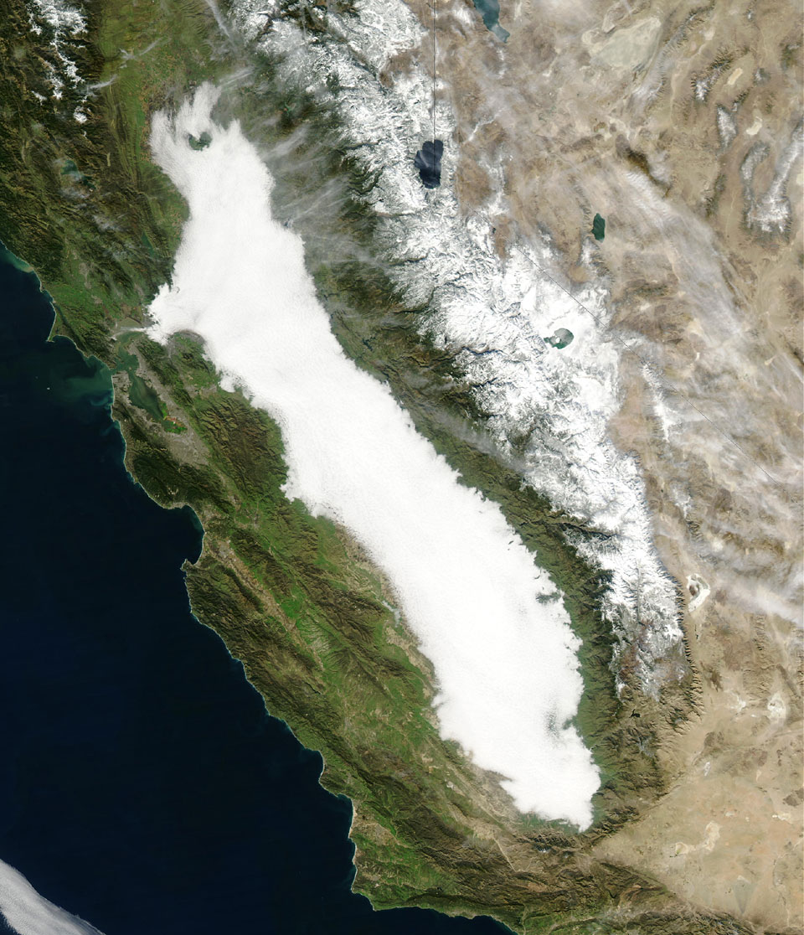
What is happening in this satellite image?

Slide 23
Precipitation
Formation of Precipitation
Warm Clouds
Condensation, collision and coalescence of water droplets
Cold Clouds
Ice crystals
Supercooled water droplets

Slide 24
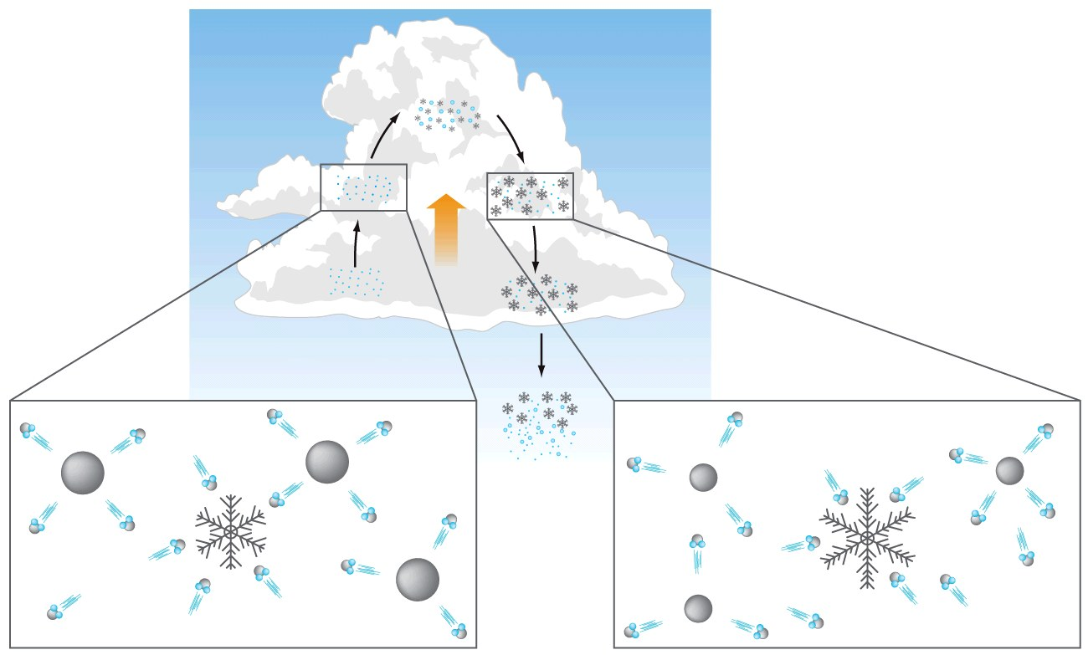
Cold Cloud = Ice crystal process
Precipitation forms as water vapor evaporates from super cooled liquid cloud drops. The water vapor is then deposited on ice crystals, forming snowflakes
© John Wiley & Sons, Inc

Slide 25
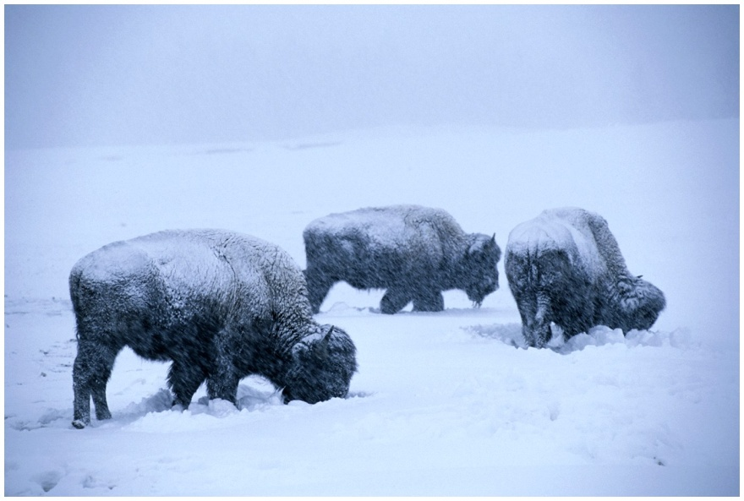
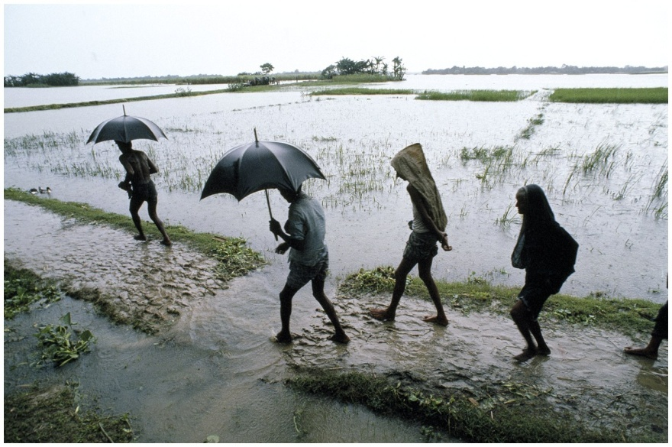
Types of Precipitation
Rain
Snow
Freezing rain
Hail
© NG Image Collection
© NG Image Collection

Slide 26
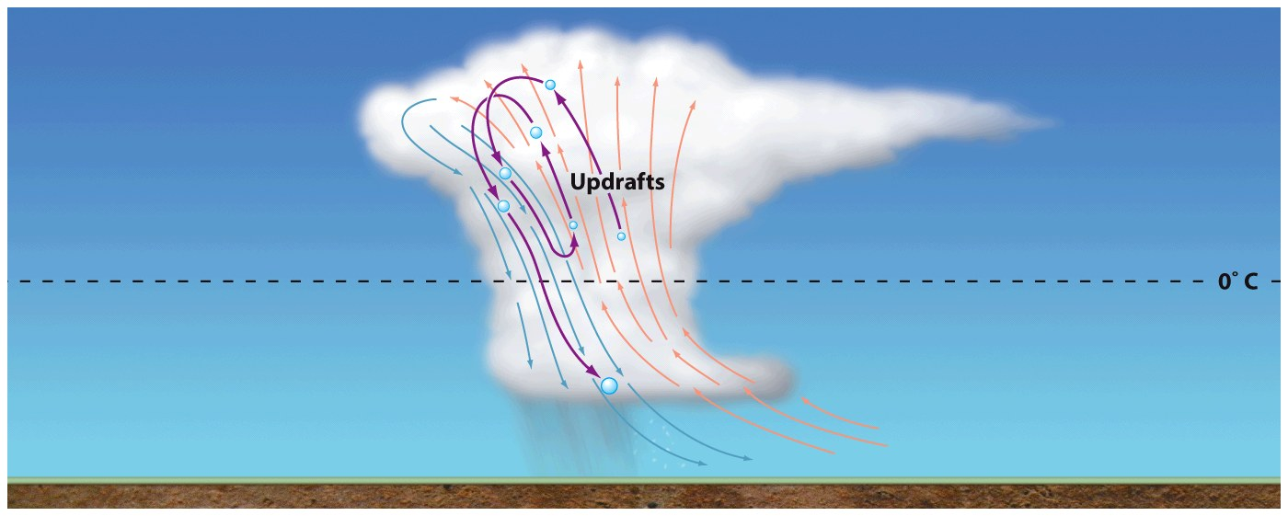
Types of Precipitation
Hail can form during thunderstorms when there are strong updrafts
© John Wiley & Sons, Inc

Slide 27
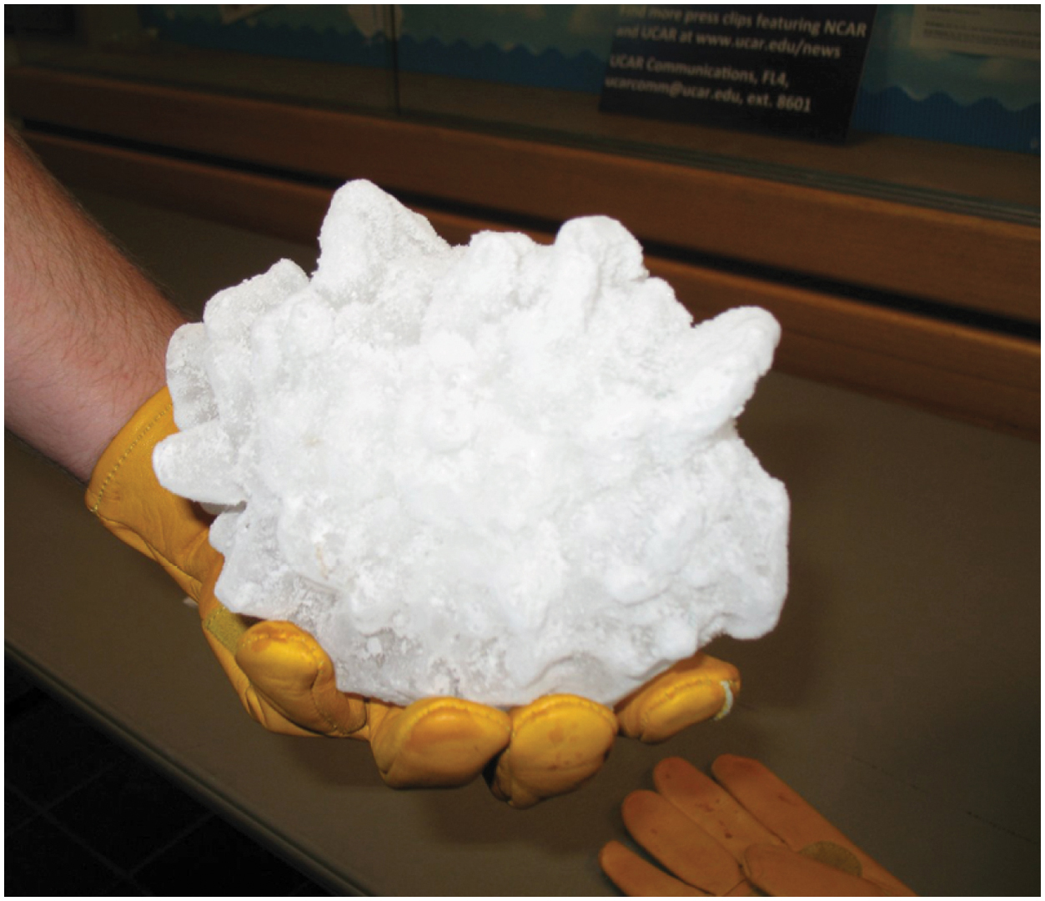

Slide 28
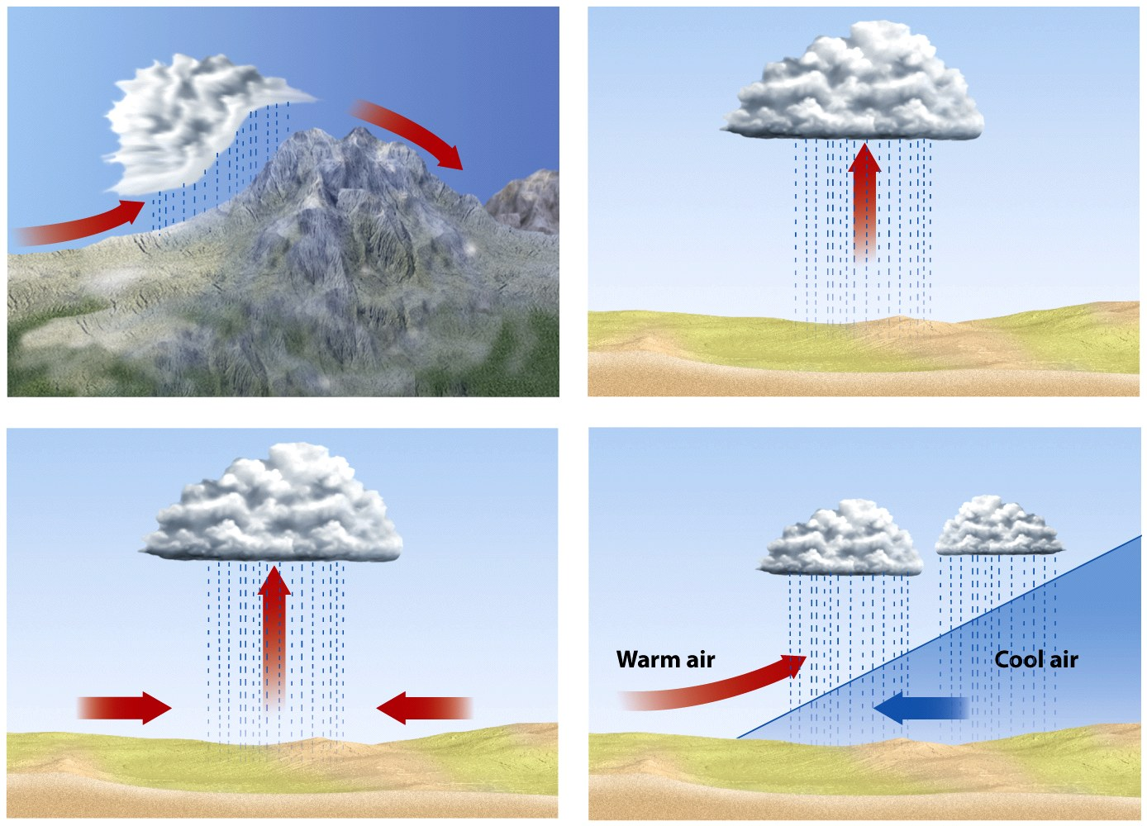
Atmospheric Lifting
Air can move upward in four ways: through orographic, convective, frontal, or convergent lifting
© John Wiley & Sons, Inc

Slide 29
Atmospheric Lifting
Orographic precipitation = Precipitation that is induced when moist air is forced vertically over a mountain barrier
Convective precipitation = Precipitation that is induced when warm, moist air is heated at the ground surface, rises, cools, and condenses to form water droplets, raindrops, and eventually rainfall
© John Wiley & Sons, Inc

Slide 30
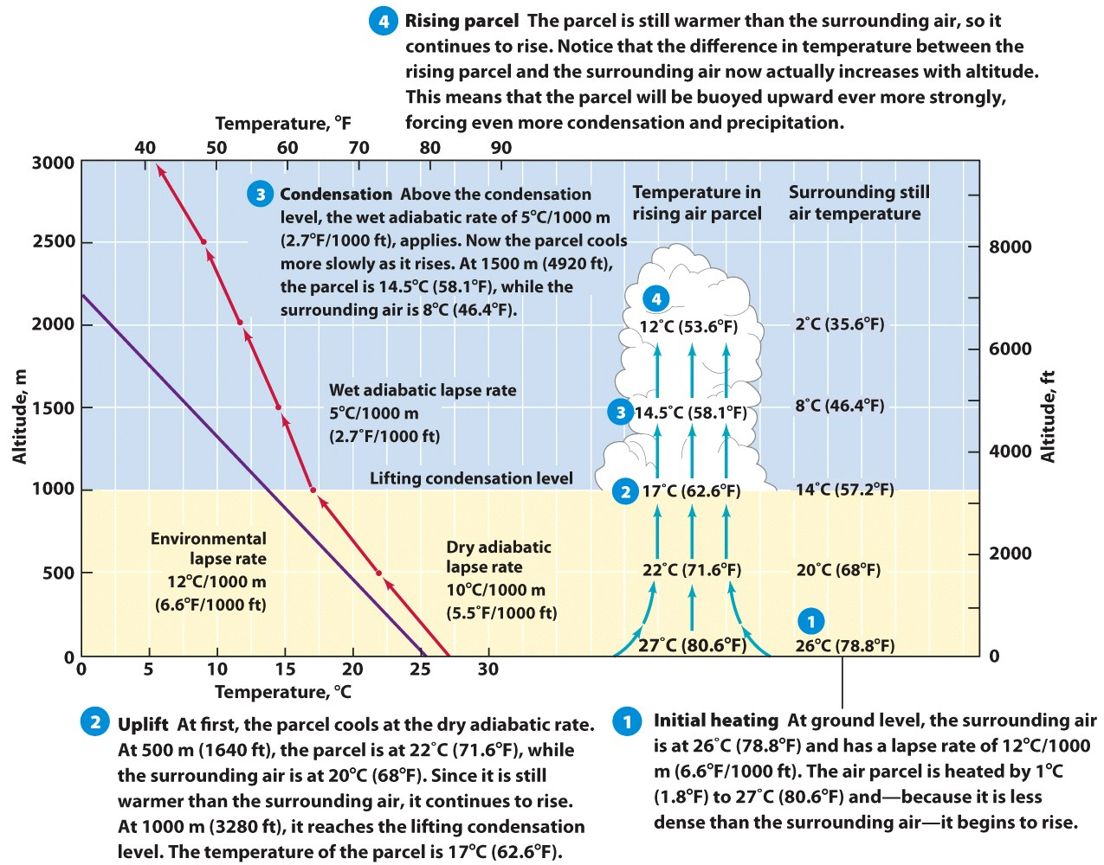
Convective Lifting: stability & instability
© John Wiley & Sons, Inc

Slide 31
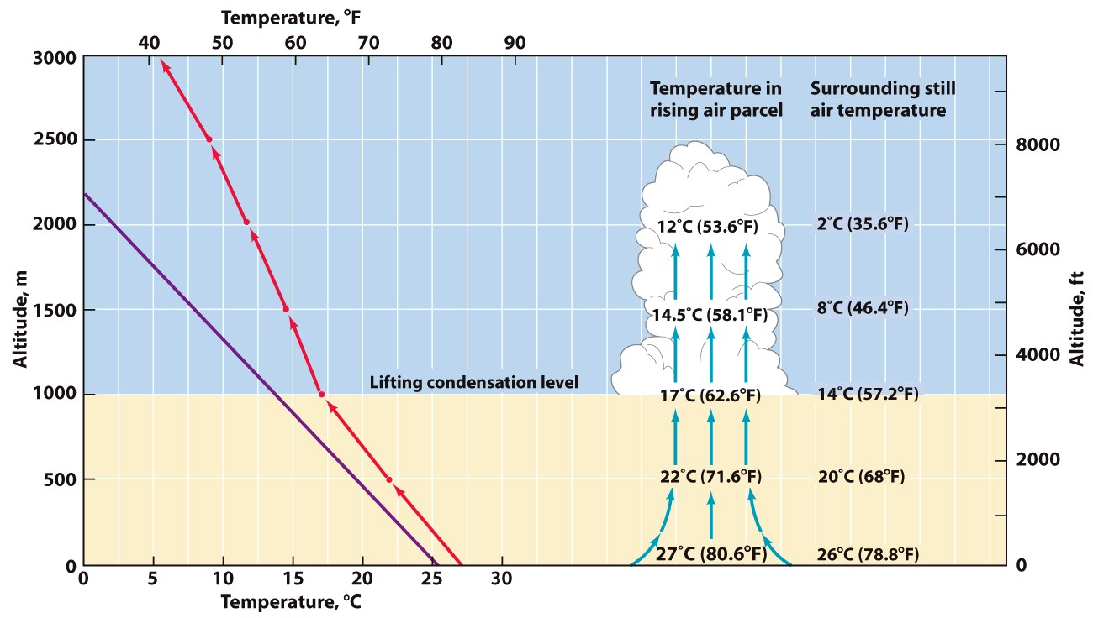
Convective Lifting
© John Wiley & Sons, Inc
If the environmental lapse rate increased (that is, if it were cooler at higher altitudes), how would the lifting condensation level change?
a. It would be higher.
b. It would be lower.
c. It would stay the same.
d. It is impossible to determine.

Slide 32
Convergent Lifting
© John Wiley & Sons, Inc

Slide 33
Frontal Lifting
© John Wiley & Sons, Inc

Slide 34
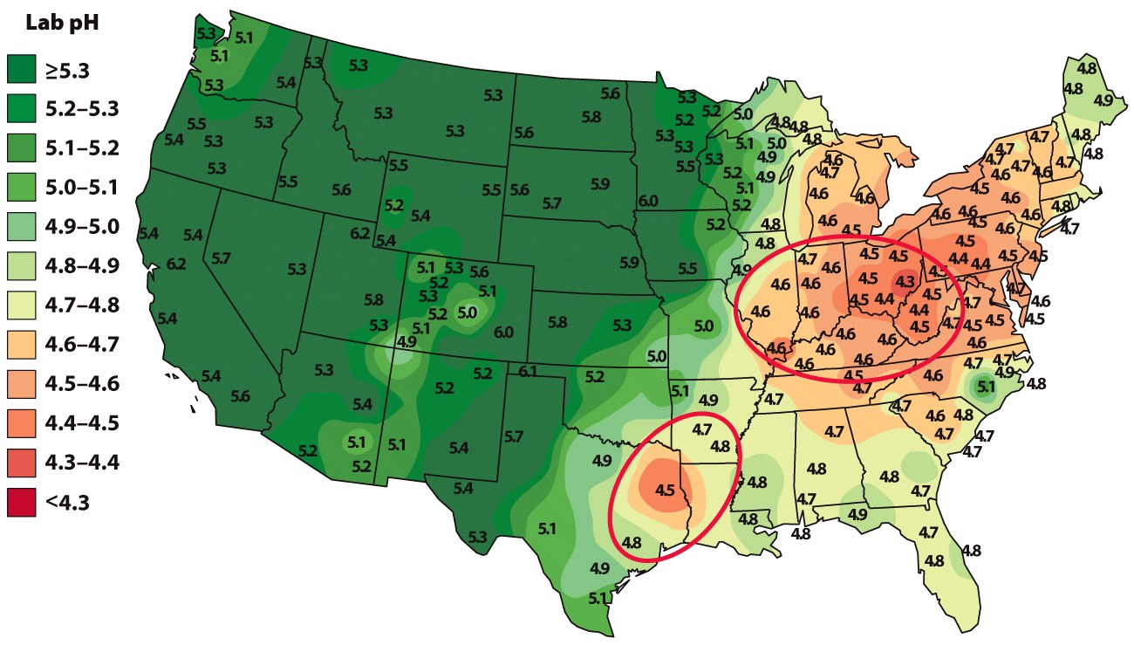
Human Impacts on Clouds and Precipitation
Acid Rain
Also called acid deposition
made up of raindrops that have been chemically acidified by industrial air pollutants such as sulfur dioxide (SO₂) and nitric oxide (NO₂)
Acids have a low pH value, less than that of distilled water (pH = 7)
The lower the pH value, the more acidic the liquid.
© Illinois State Water Survey
Acidity of rainwater in U.S., 2005

Slide 35
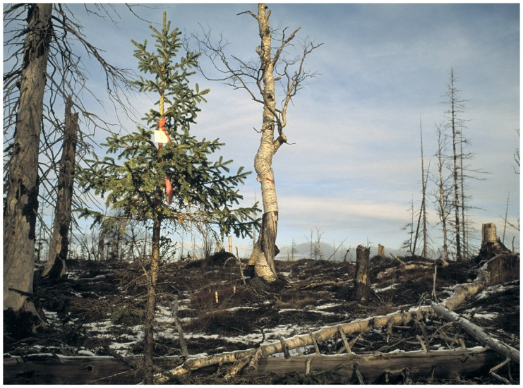
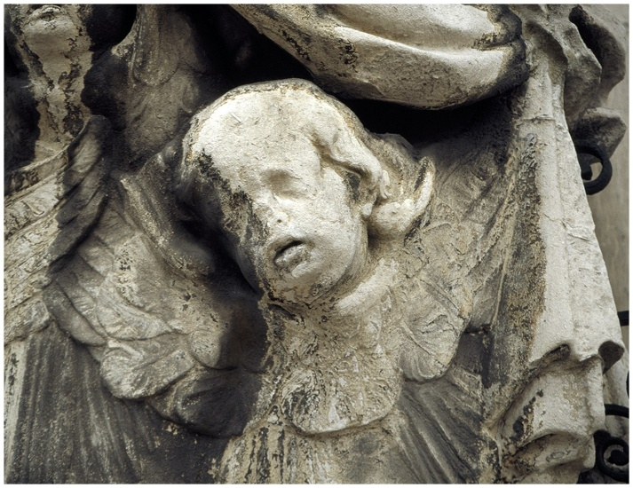
Effects of Acid Rain
Acid streams and lakes affect aquatic life
Damage to forests
Damage to soils
Damage to buildings
© Gerd Ludwig/INSTITUTE
© NG Image Collection
Consider the pattern of acid rain deposition in the northeastern United States. What is the implication for international relations?

Slide 36
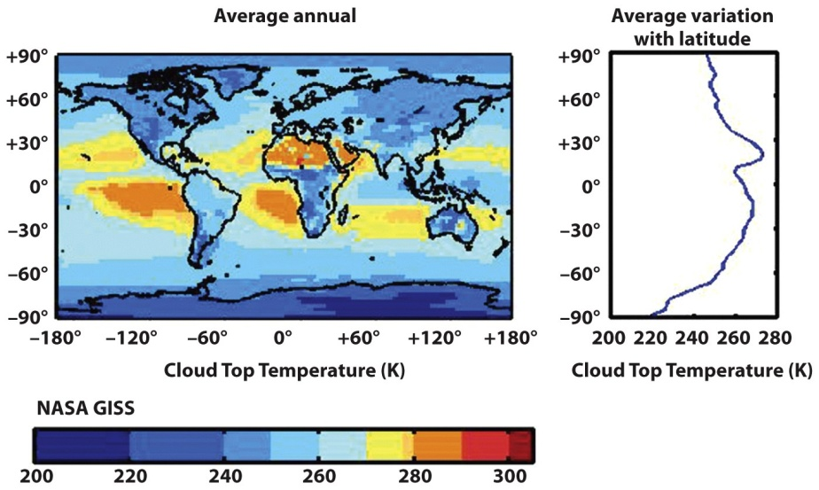
Cloud Cover, Precipitation, and Global Warming
Clouds: Longwave warming or shortwave cooling?
Increased Precipitation?
Any rise in sea-surface temperature will increase the rate of evaporation, and an increase in evaporation will raise the average atmospheric content of water vapor. What effect will this have on climate?
© NASA Images

