Slide 1
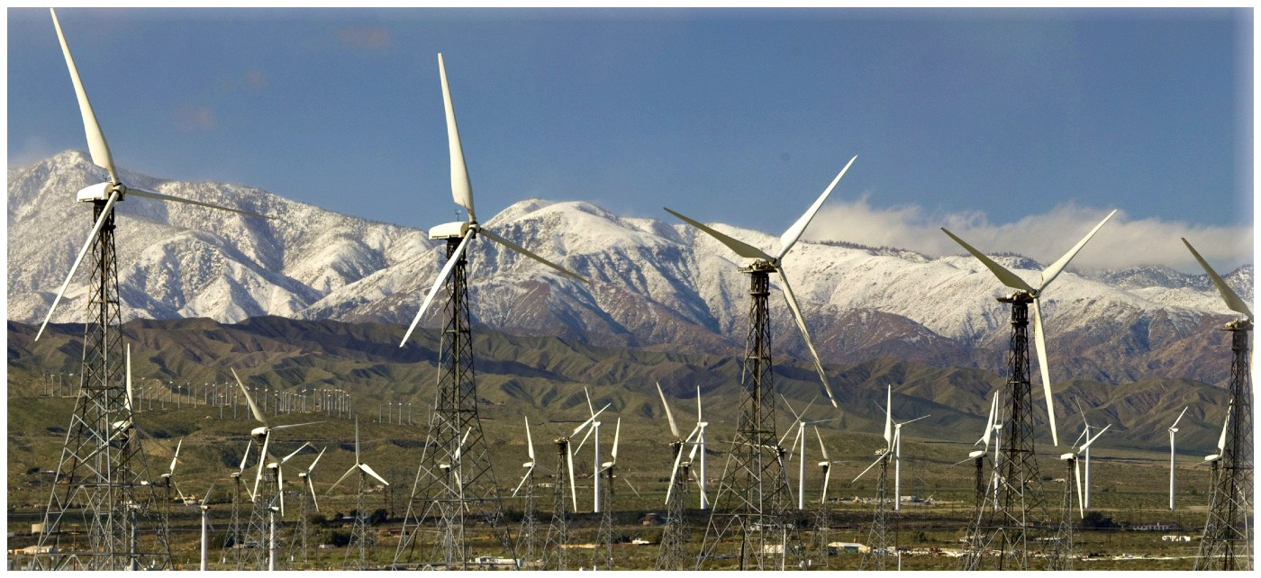
Chapter 5: Global Atmospheric & Oceanic Circulation
© NG Image Collection
Wind farm in the San Gorgonio Pass near Palm Springs.

Slide 2
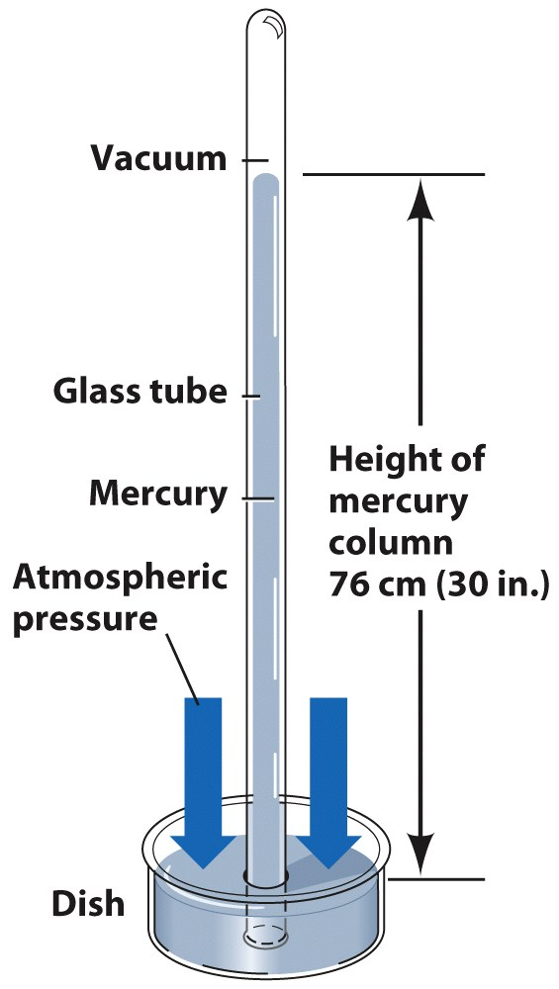
Atmospheric Pressure
Atmospheric pressure is pressure exerted by the atmosphere because of the force of gravity acting on the overlying column of air.
15lbs per square inch
Measuring Atmospheric Pressure
Units = inches of mercury (in. Hg) or millibars (mb).
Standard sea level pressure = 1013.2 mb.
Barometer is an instrument that measures atmospheric pressure.
Height of mercury: 76cm Hg standard
© John Wiley & Sons ,Inc

Slide 3
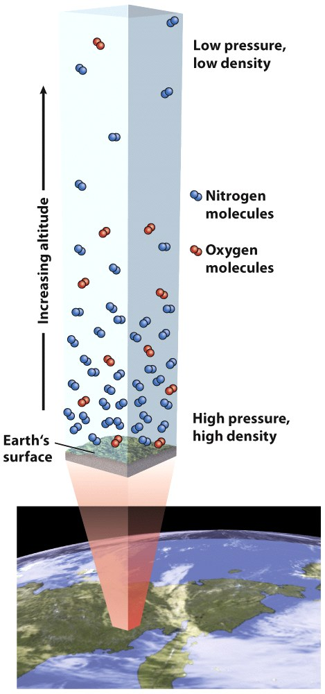
Atmospheric Pressure and Altitude
Ever felt your ears pop?
Pressure is determined by the mass of air molecules above that elevation
The more mass, the higher the pressure
Air density also depends on pressure and temperature.
Atmospheric pressure decreases with altitude. Density decreases with altitude.
© John Wiley & Sons, Inc.

Slide 4
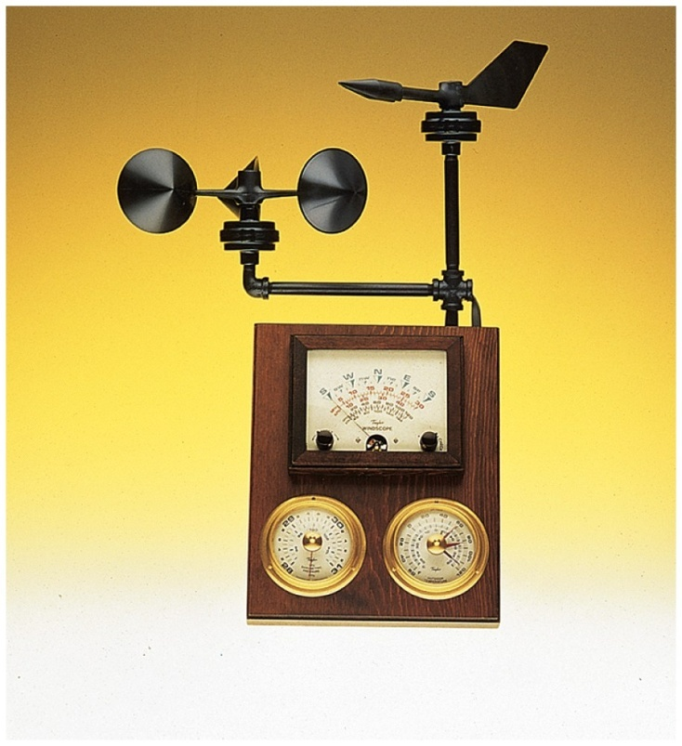
Atmospheric Pressure & Wind
Wind:
Horizontal movement of air
Renewable resource
Measured with an anemometer
Wind direction:
Identified by the direction from which the wind comes
West wind blows from west to east
Wind speed and direction:
determined by three factors:
pressure gradient, Coriolis effect, and friction.
Combination cup anemometer and wind vane. Wind speed and direction are displayed on the meter.

Slide 5
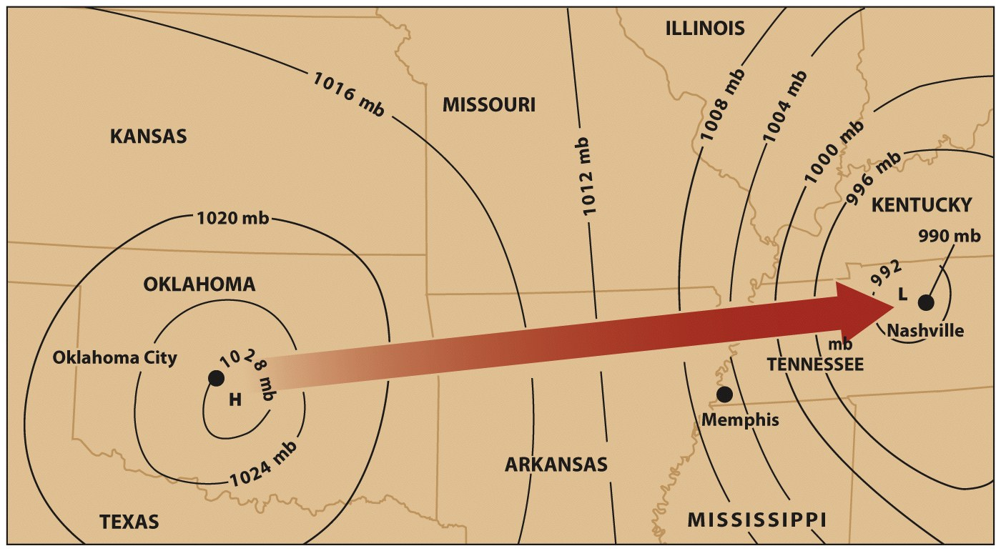
Pressure Gradients
Pressure Gradients
Caused by differences in pressure from region to region
Air is pushed down the gradient (from higher to lower pressure)
Causes of pressure gradients?
Uneven heating of the atmosphere—why?
© John Wiley & Sons, Inc.

Slide 6
Pressure Gradients
Isobar = line on a map drawn through all points having the same atmospheric pressure
Widely spaced isobars → weak gradient and weaker winds.
Closely spaced isobars → strong PG and stronger winds.
Where would you find the greatest pressure gradient on this map?
a. Oklahoma City
b. Southwestern Missouri
c. Memphis
d. Nashville
© John Wiley & Sons, Inc.

Slide 7
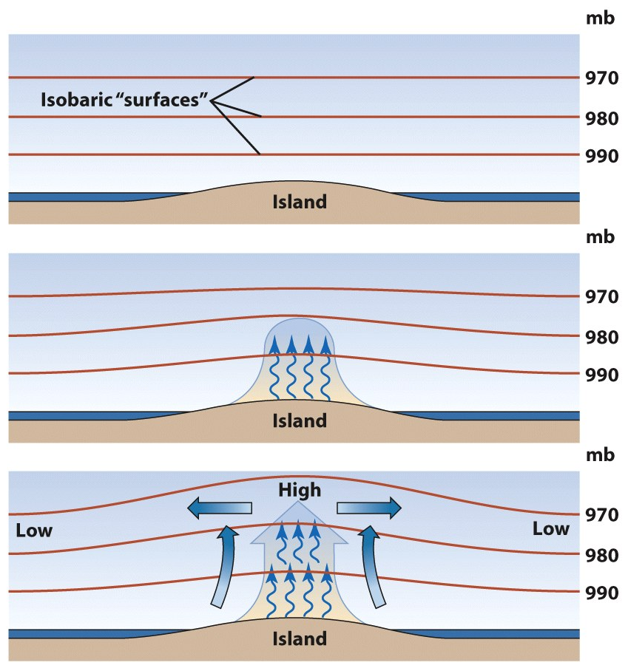
Pressure Gradients
Unequal heating of the Earth’s surface leads to a pressure gradient and causes wind.
Latitude, terrain differences, and land cover can cause uneven heating, pressure gradients and wind.
1
2
If the island were in the Arctic and covered by glacial ice, would the pressure gradient be the same or different?
3
© John Wiley & Sons, Inc.

Slide 8
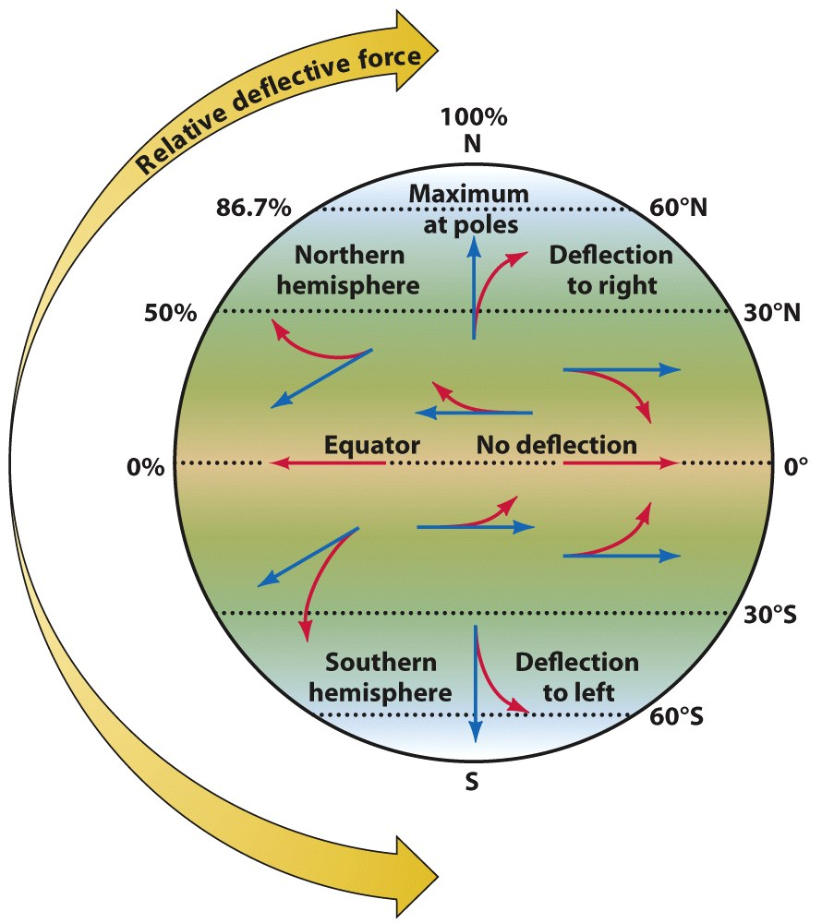
Coriolis Effect
The Coriolis Effect (CE)
An effect of the Earth’s rotation that acts like a force to deflect a moving object on the Earth’s surface to the:
Right in the northern hemisphere
Left in the southern hemisphere
Coriolis Effect Animation

Slide 9
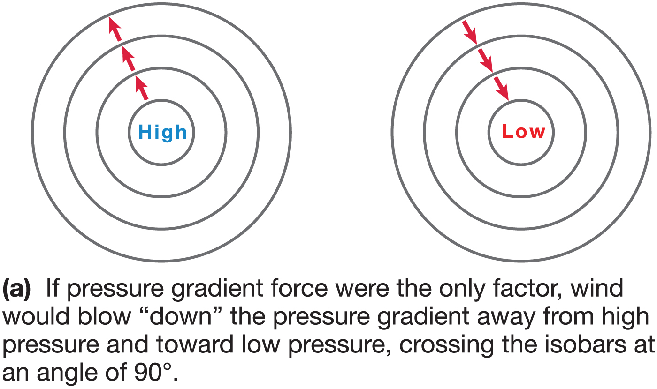
Notes:
Chapter 5, Figure 5.6A Labeled

Slide 10
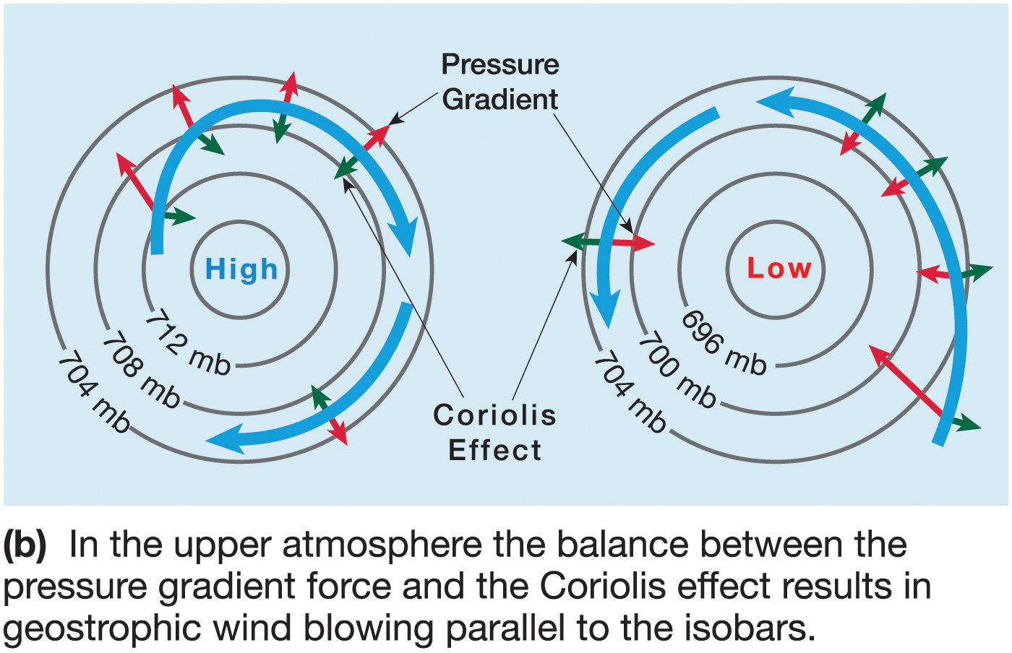
Notes:
Chapter 5, Figure 5.6B Labeled

Slide 11
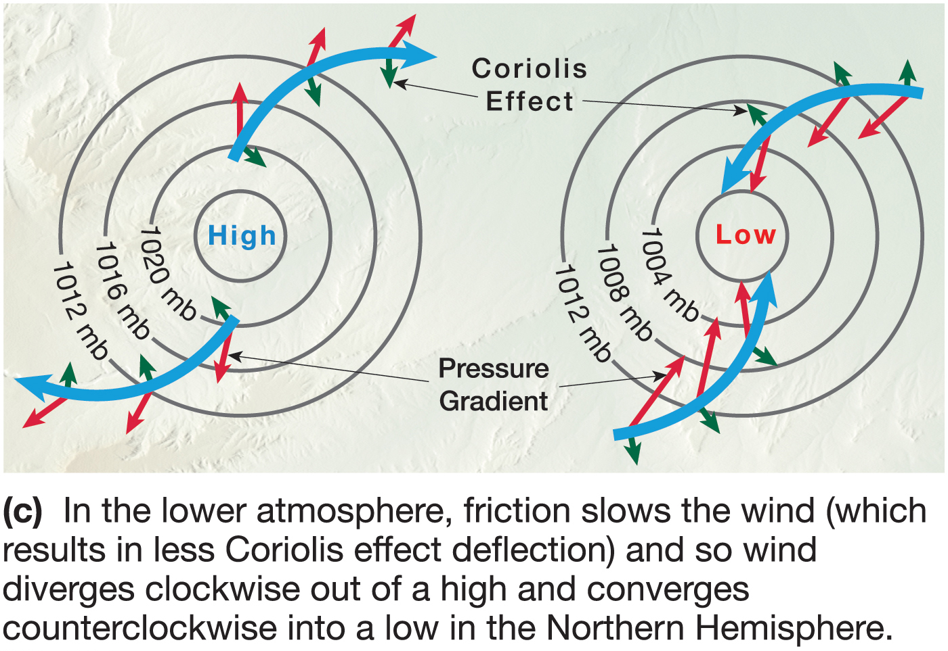
Notes:
Chapter 5, Figure 5.6C Labeled

Slide 12
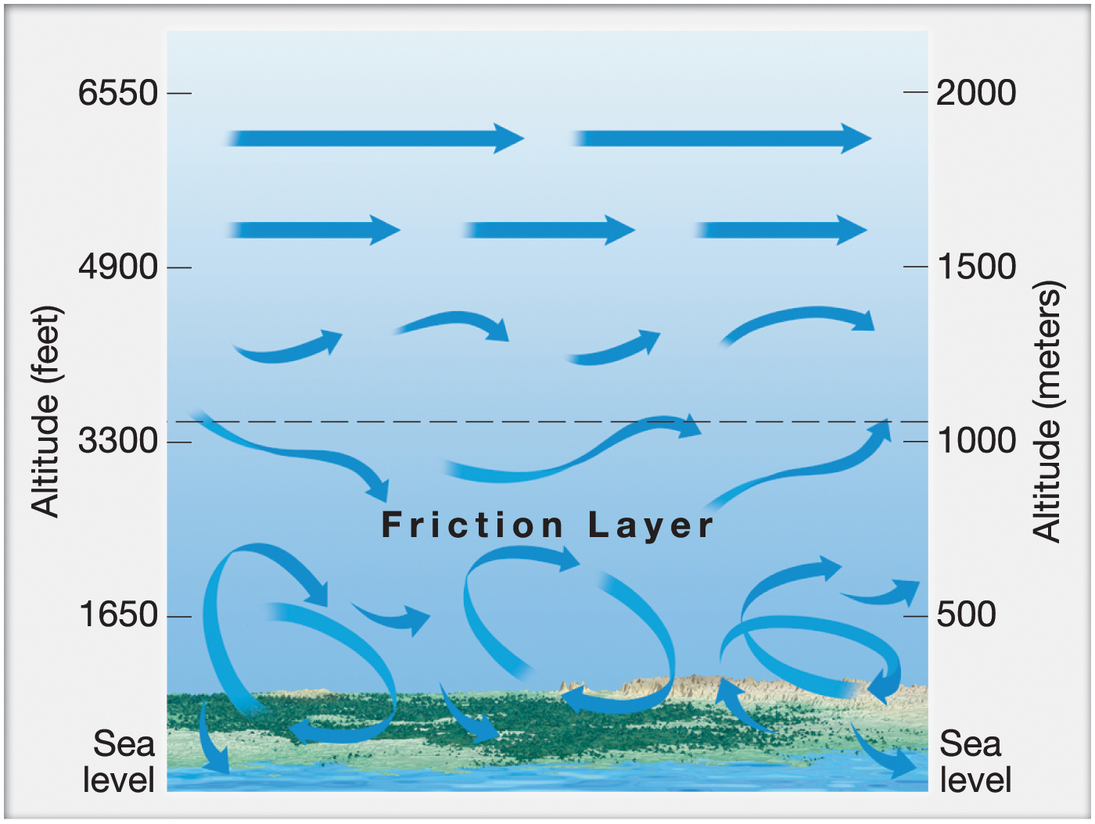
Notes:
Chapter 5, Figure 5.7 Labeled

Slide 13
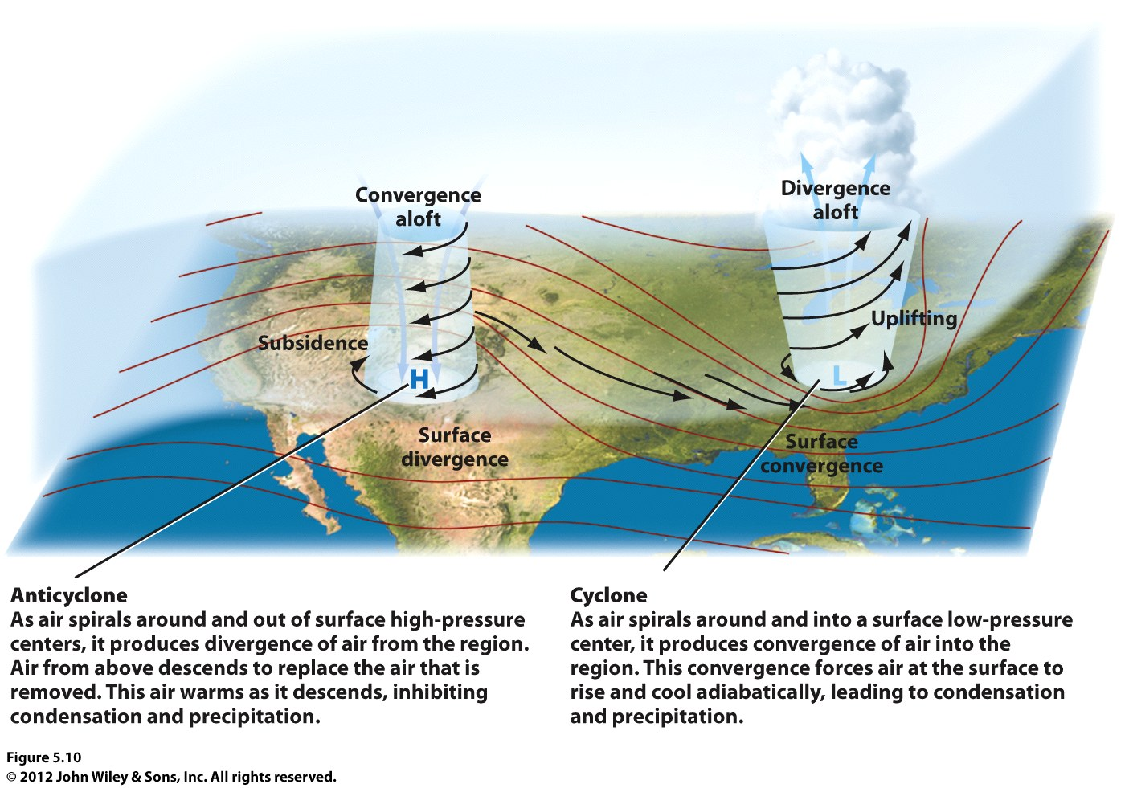

Slide 14
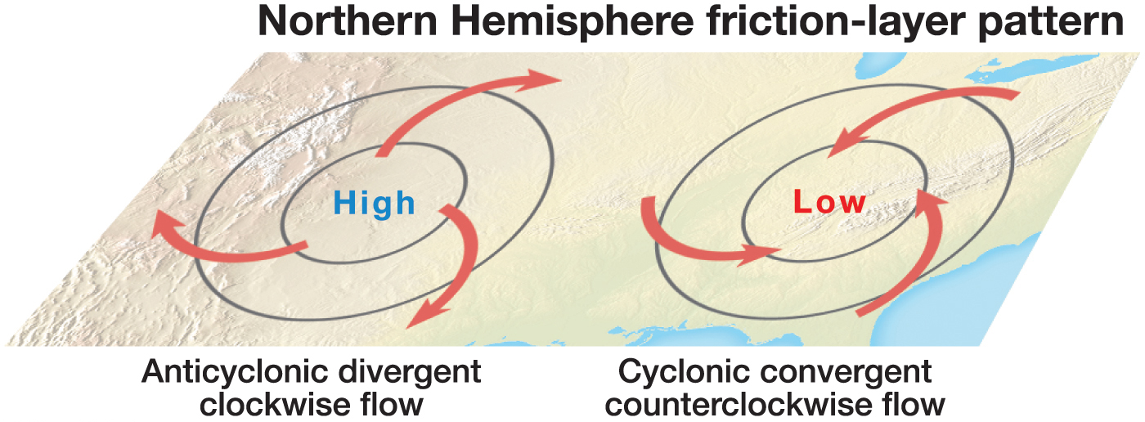
Notes:
Chapter 5, Figure 5.10B Labeled

Slide 15
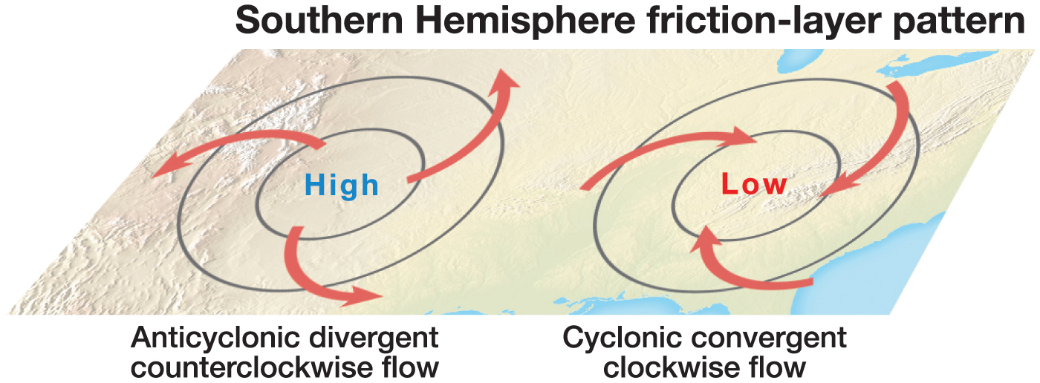
Notes:
Chapter 5, Figure 5.10D Labeled

Slide 16
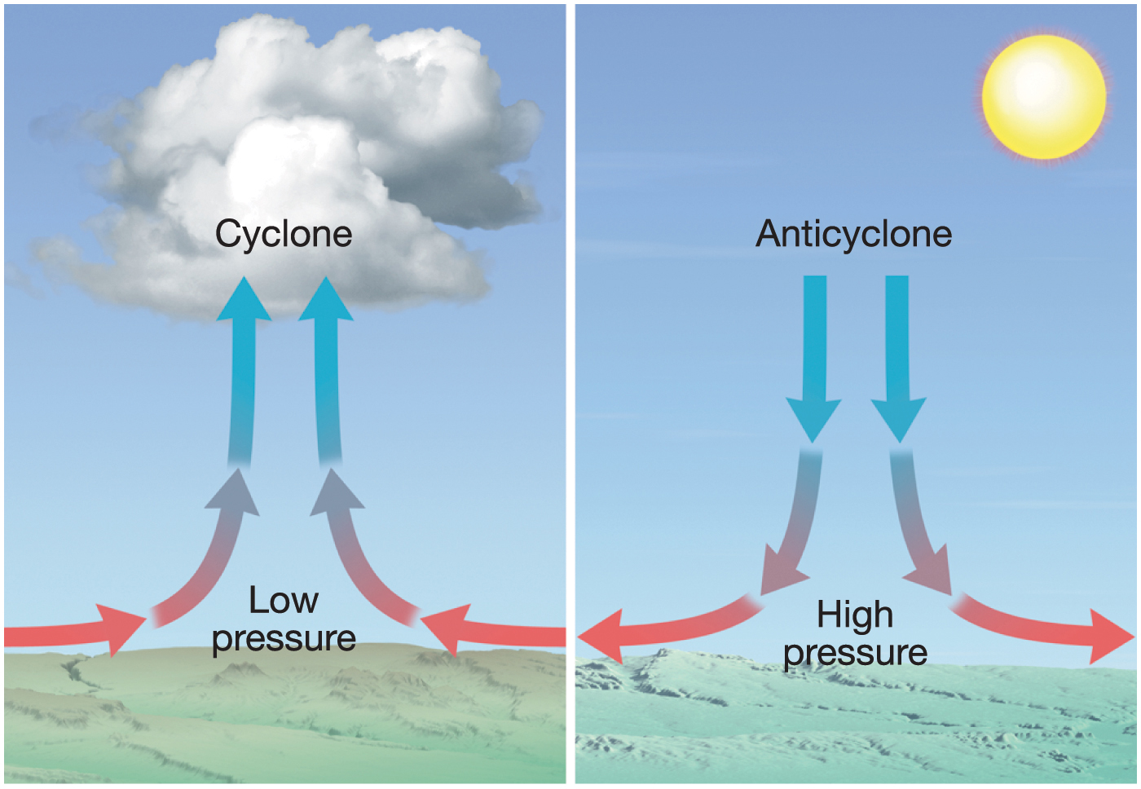
Notes:
Chapter 5, Figure 5.11 Labeled

Slide 17
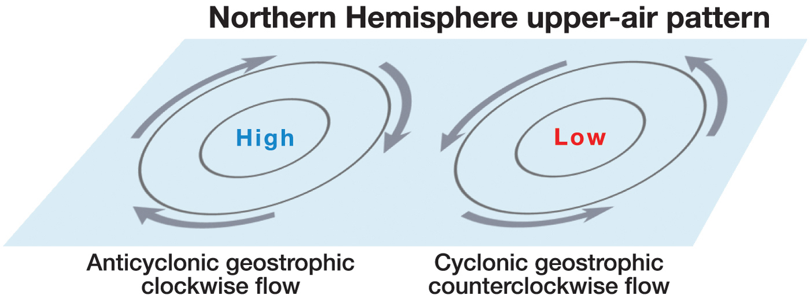
Notes:
Chapter 5, Figure 5.10A Labeled

Slide 18
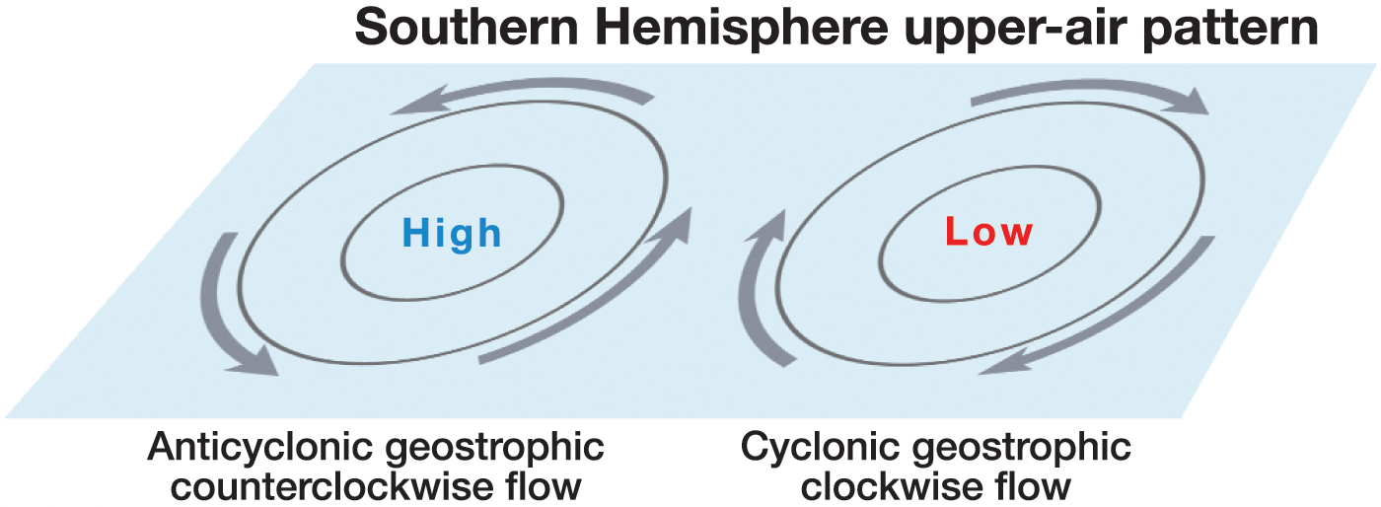
Notes:
Chapter 5, Figure 5.10C Labeled

Slide 19
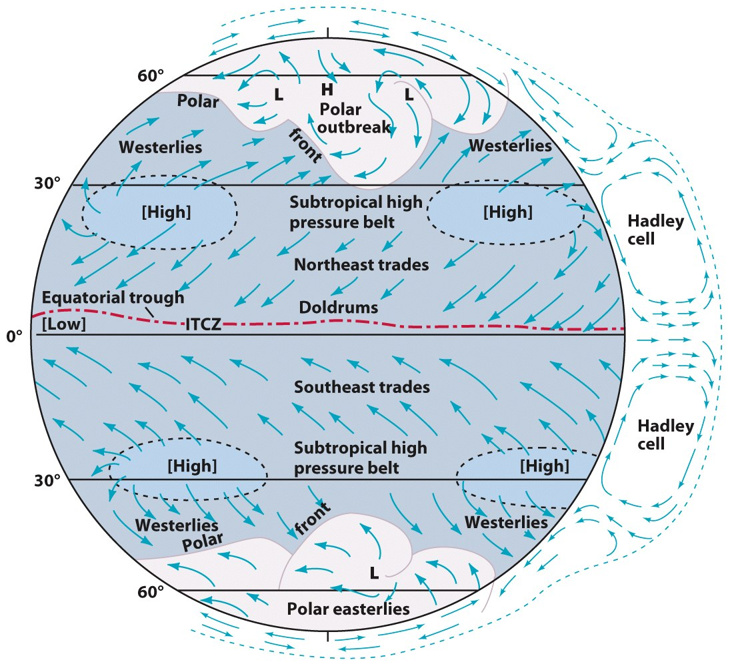
Global Winds & Pressure Patterns
In an ideal model, warm air at the equator rises, expands and creates a belt of low pressure.
Colder air at the poles, is denser, moves along the pressure gradient toward the equator.
Disrupted by variability in insolation due to:
seasons
land/water contrasts
© John Wiley & Sons, Inc.

Slide 20
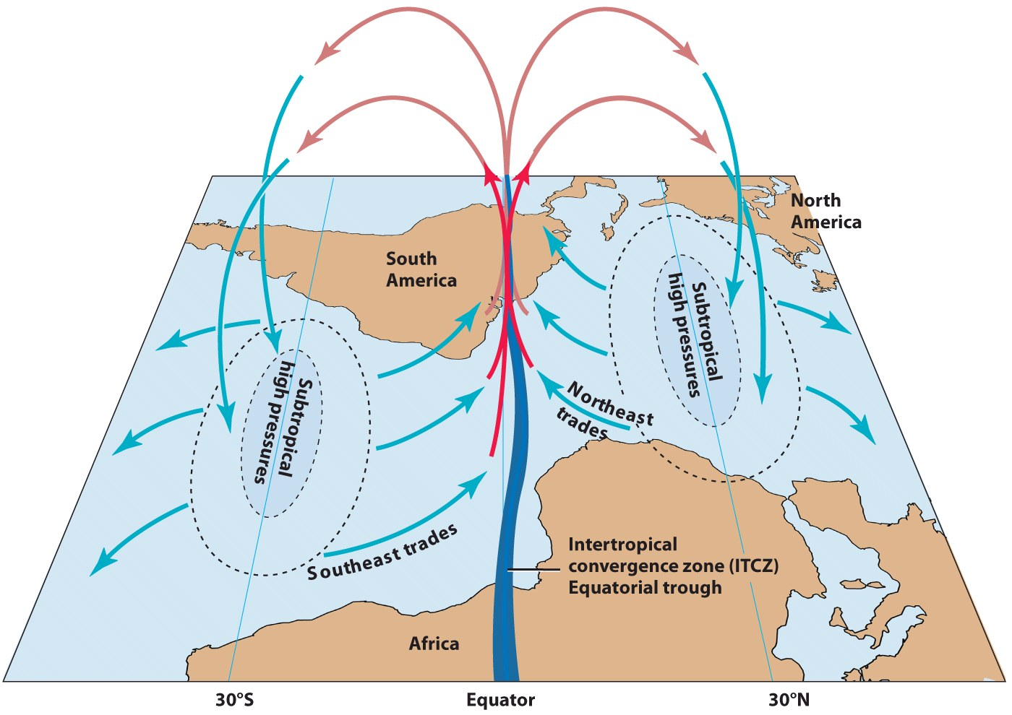
Pressure and Winds in the Tropics
Warm air rises along the equator, but never makes it to the poles to sink.
The Coriolis Effect pulls it eastward and causes it to sink at about 30 degrees. Hadley Cell.
The ITCZ is the low pressure along the equator, very light winds.
The ITCZ migrates seasonally. When is it farthest north? South?
What happens to the ITCZ near Asia?
© John Wiley & Sons, Inc.

Slide 21
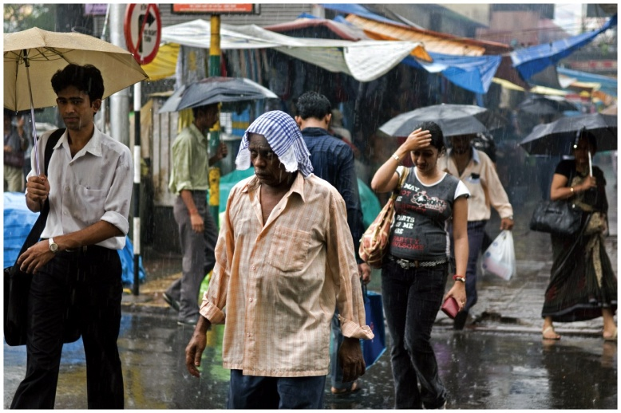
ITCZ’s migration is intensified over Asia.
Huge land/water temperature contrasts.
Wet monsoons….dry monsoons?
© NG Image Collection
© John Wiley & Sons, Inc.

Slide 22
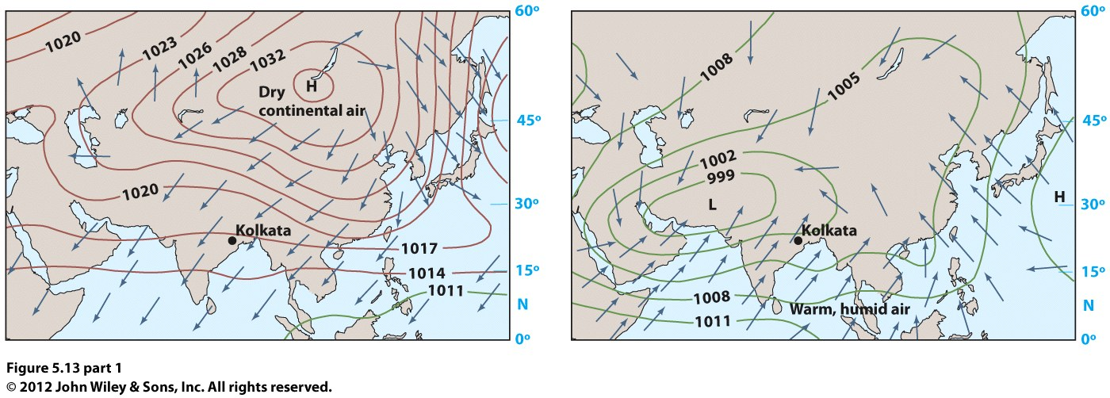

Slide 23
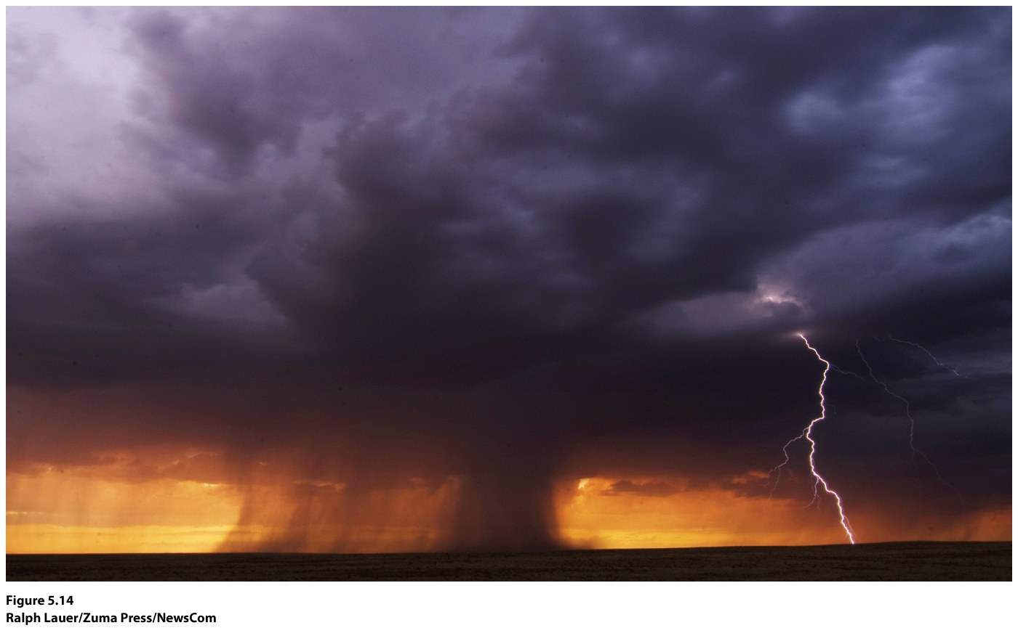
North American monsoons? Warm air from Gulf of Mexico tends to move northward and westward into the Southwestern states (Arizona, Nevada, New Mexico). In winter, air flow has reversed bringing dry continental air from Canada south and eastward.

Slide 24
Pressure and Winds in the Subtropics
Very large and stable anticyclones
Dry conditions
Migrate seasonally
Hawaiian high and Azores high
Strongest in our summer months
Weaken and move south in winter
Different influences for each

Slide 25
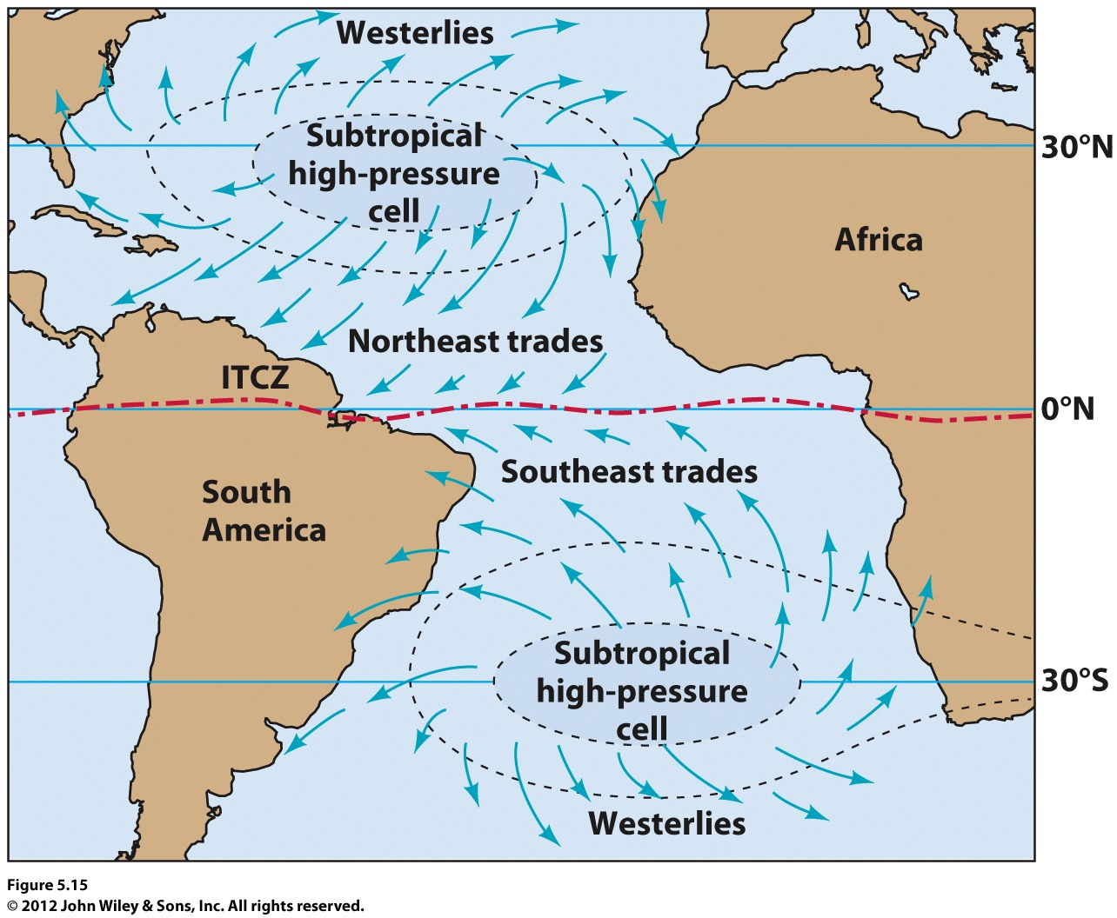

Slide 26
Midlatitude Winds and Pressure Patterns
Westerlies: prevailing winds, from the subtropical high anticyclone
Polar front—boundary between cold and warm air masses, air is being lifted (frontal lifting), creating low pressure
Jet stream—upper air westerlies

Slide 27
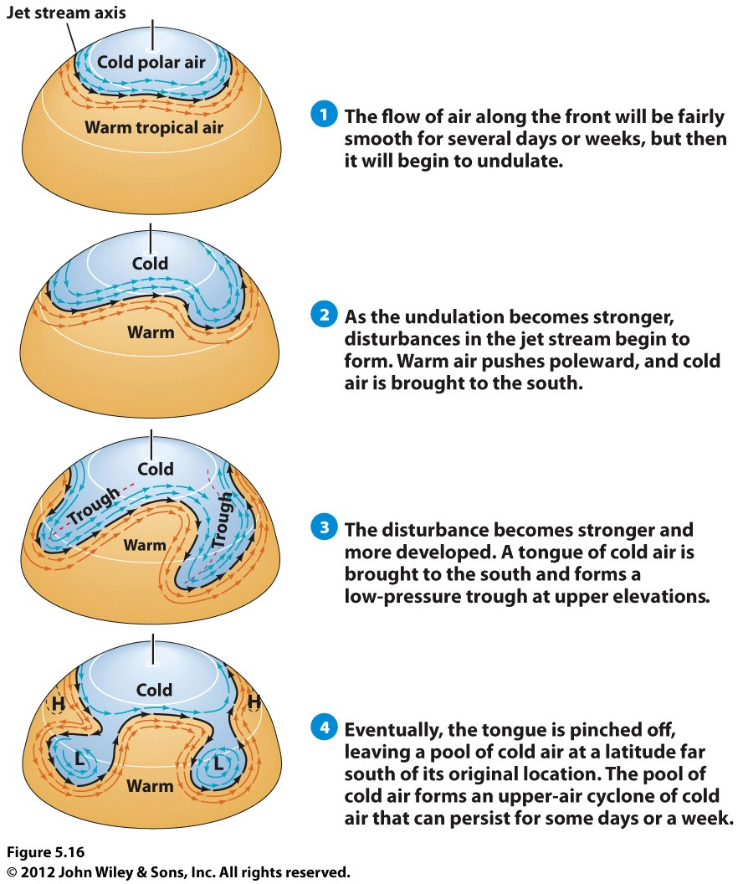
Jet stream disturbances
Rossby waves
Zonal flow (west to east)

Slide 28
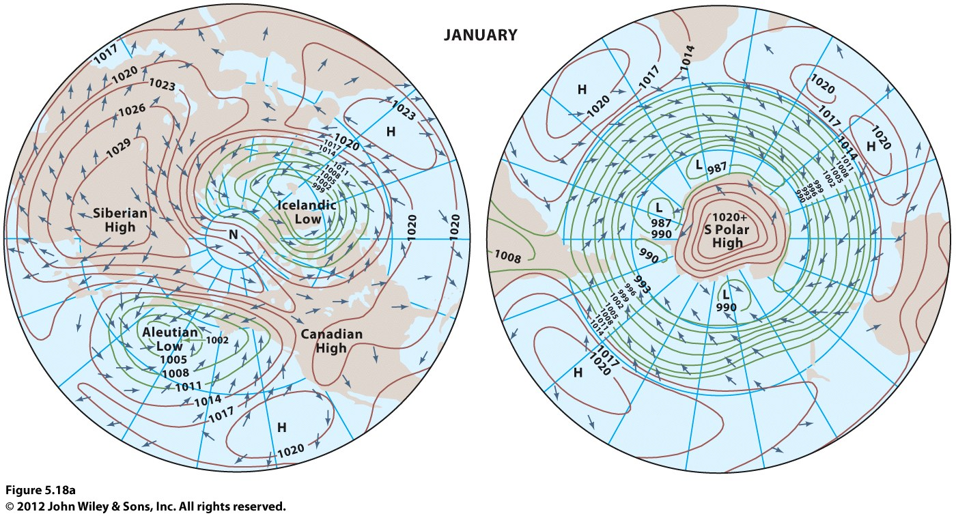
In northern hemisphere winter, air spirals outward from the strong Siberian high and its weaker cousin, the Canadian high. The Icelandic low and Aleutian low spawn winter storm systems that move southward and eastward on to the continents. In the southern hemisphere summer, air converges toward a narrow low pressure belt around the south polar high.

Slide 29
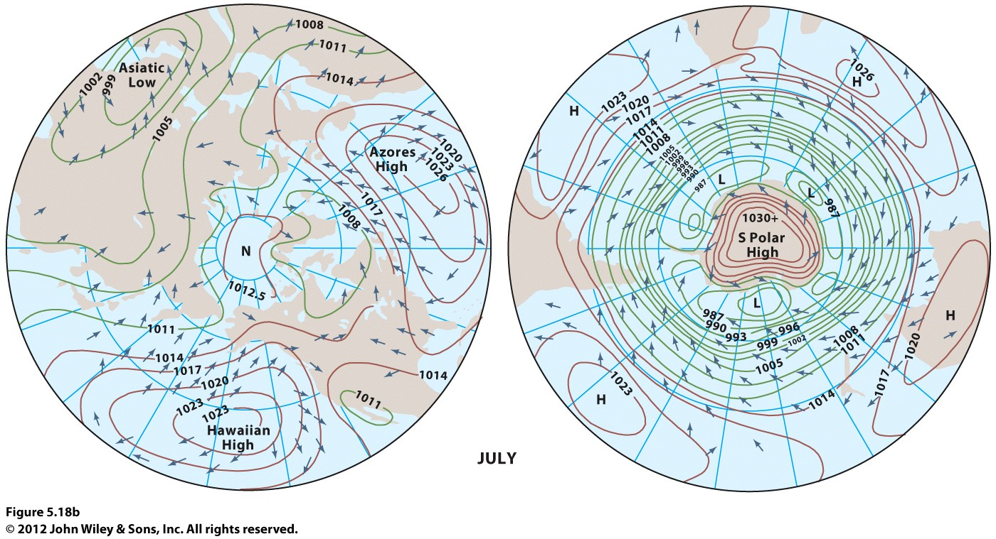
In northern hemisphere summer, the continents show generally low-surface pressure, and high pressure builds over the oceans. The strong Asiatic low brings warm, moist Indian Ocean air over India and Southeast Asia. A weaker low forms over the deserts of the southwestern U.S. and northwestern Mexico. Outspiraling winds from the Hawaiian high and Azores high keep the west coasts of North America and Asia warm and dry, and the east coasts of North America and Asia warm and moist. In the southern hemisphere summer, the pattern is little different from winter, although pressure gradients are stronger.

Slide 30
Local Winds
Daily Cycle of Winds
Sea breeze: during the day when land begins to warm more than ocean waters, creates low pressure over land, pulling in air from the sea
Land breeze: during evening, reversal of above
Valley breeze: during day air over mountain slopes becomes warmer than air at the valley floor, creating low pressure, pulling air up mountain slopes from the valley
Mountain breeze: during evening, reversal of above

Slide 31
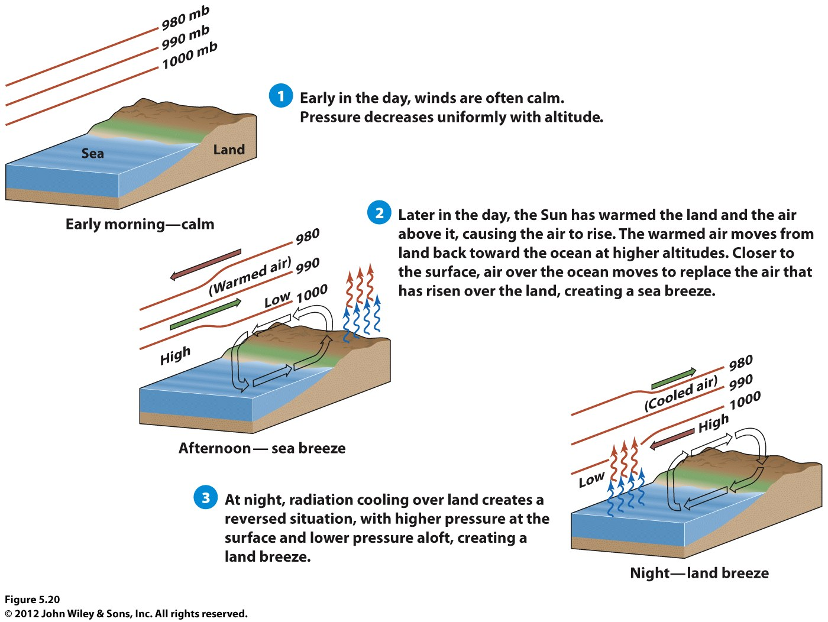

Slide 32
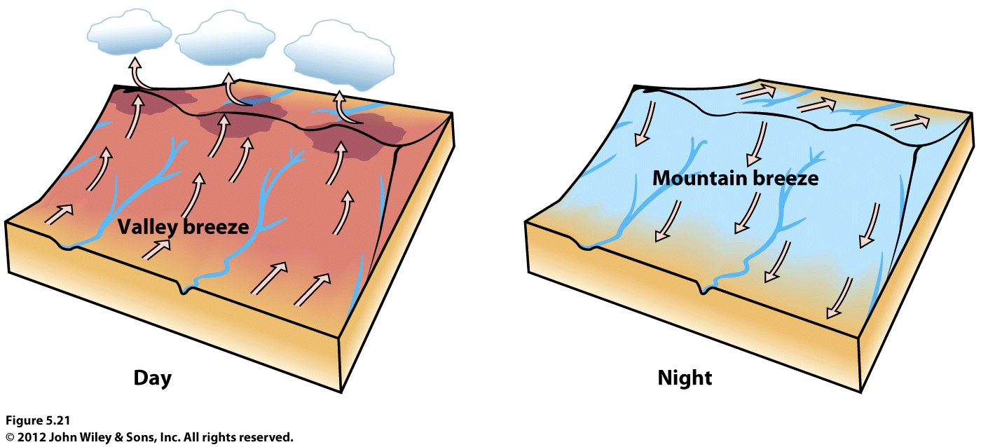

Slide 33
Topographic Winds
Santa Anas: air drains from high-pressure in the Great Basin (between Rockies and Sierras), dry air flows downhill toward coast, warms adiabatically, rapidly dries-out the landscape

Slide 34
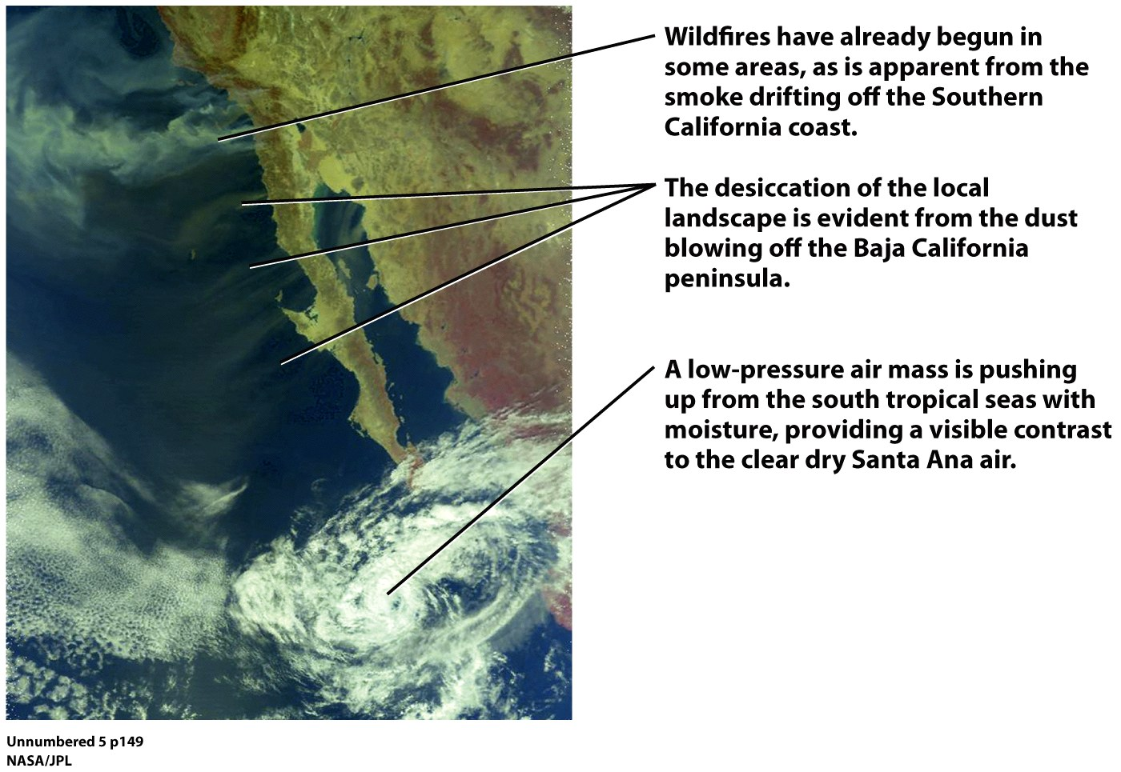

Slide 35
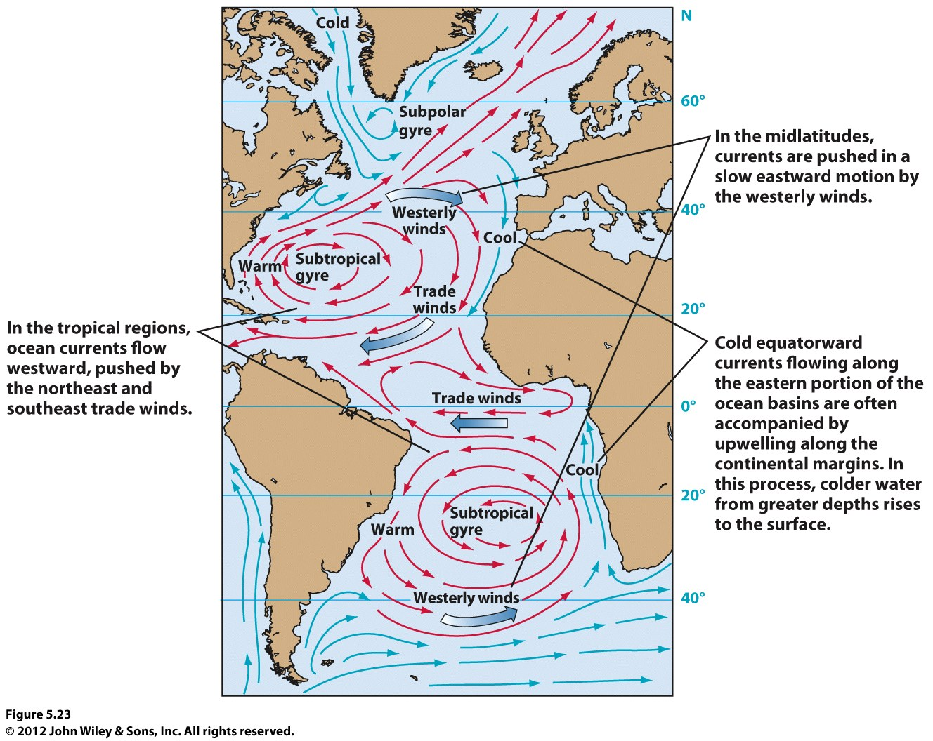
Ocean Currents

Slide 36
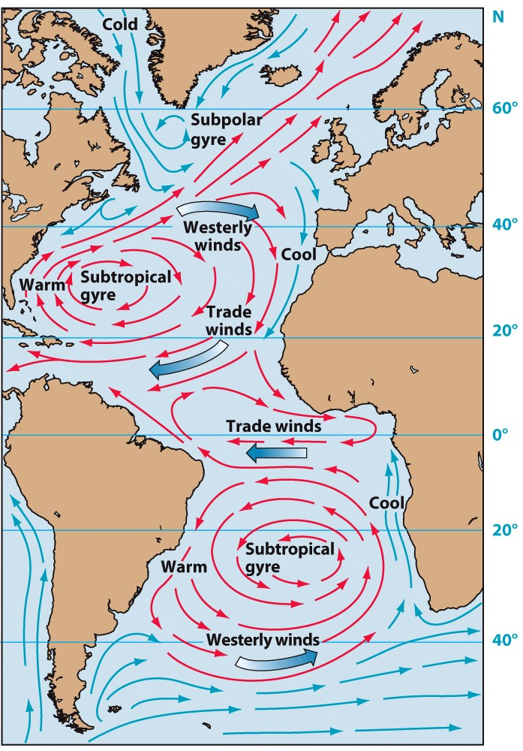
Oceanic Circulation
Ocean Currents
A persistent, dominantly horizontal flow of water controlled by wind patterns
Gyres: large circular ocean movements
© John Wiley & Sons, Inc
What relationship do you notice with the northern hemisphere ocean current and the pressure type typically located at 30º N?

Slide 37
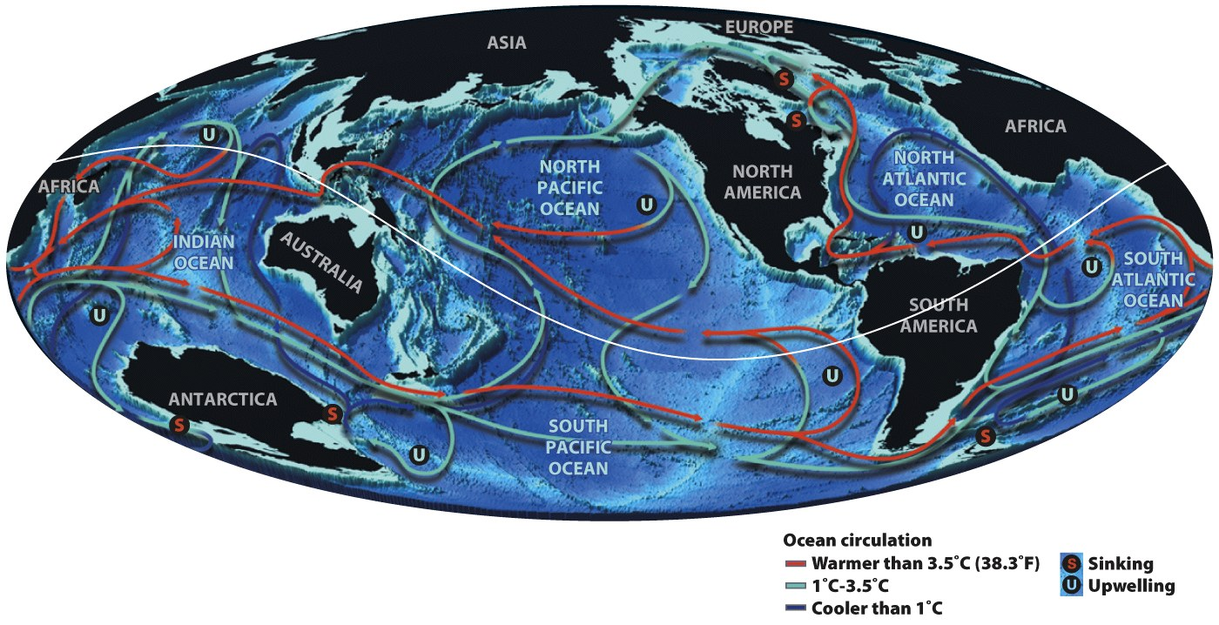
Oceanic Circulation
Ocean Currents
Ocean circulation and energy transport:
Warm surface waters in the tropics move poleward.
Thermohaline circulation: Cold and dense waters in the N. Atlantic sink, flow equatorward, and eventually upwell to the surface at far distant locations to cool surrounding regions and complete the circuit.
© NG Maps

Slide 38
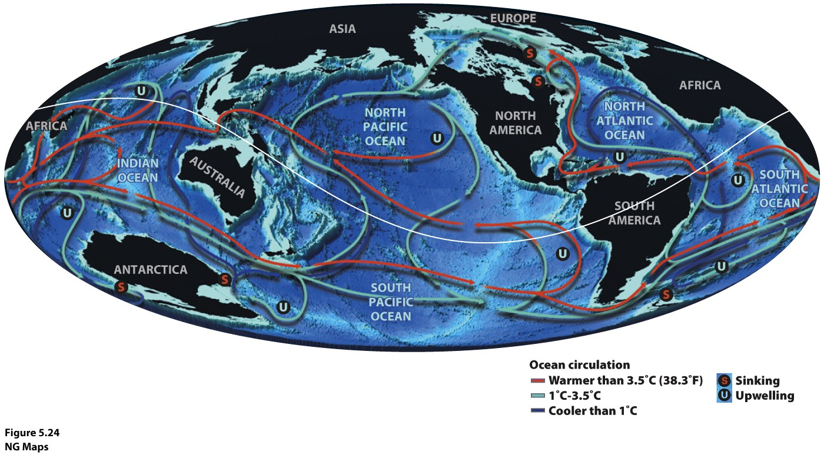

Slide 39
