Slide 1
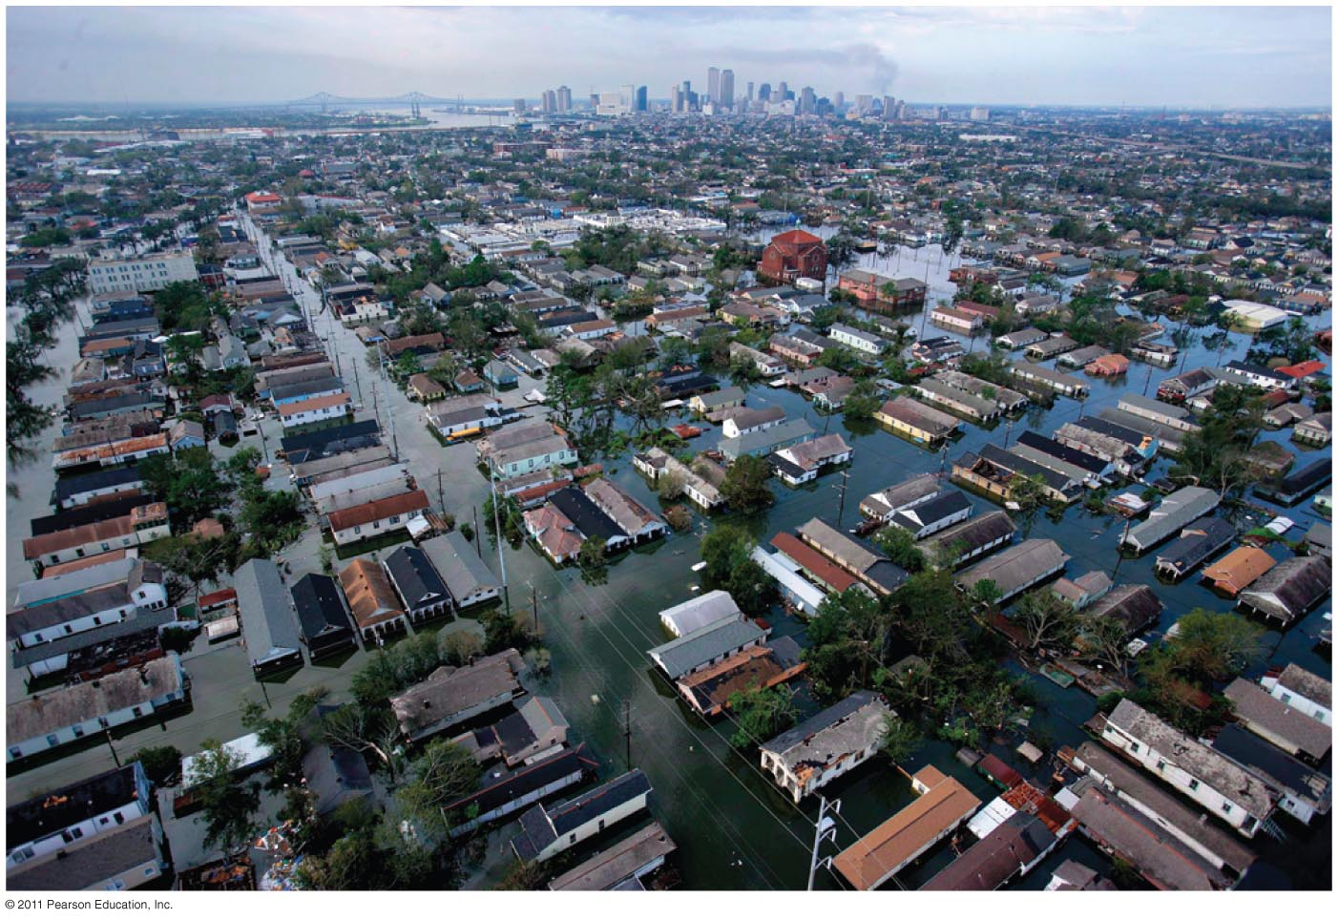
Chapter 6: Weather Systems
80% of the city New Orleans was under 20’ of water after Hurricane Katrina, in August, 2005

Slide 2
What is Weather?
State of the atmosphere in one location at one point in time
Determined by temperature, moisture (RH!), precipitation and winds
How does this differ from Climate?

Slide 3
What are Weather Systems?
Patterns of atmospheric circulation that lead to distinctive weather events
Associated with the movement of air masses
Air Masses are large areas of air with uniform characteristics (temp, moisture)
Can be HUGE! 1000s of miles long and as high as the top of the troposphere!

Slide 4
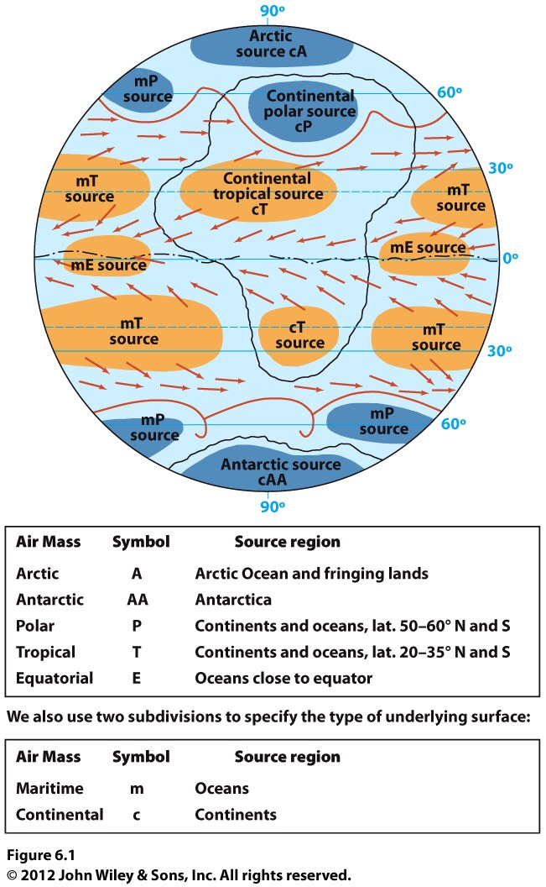
Air masses are defined by the temperature and moisture
These characteristics are determined by their source area (arctic, tropical, ocean, land)

Slide 5
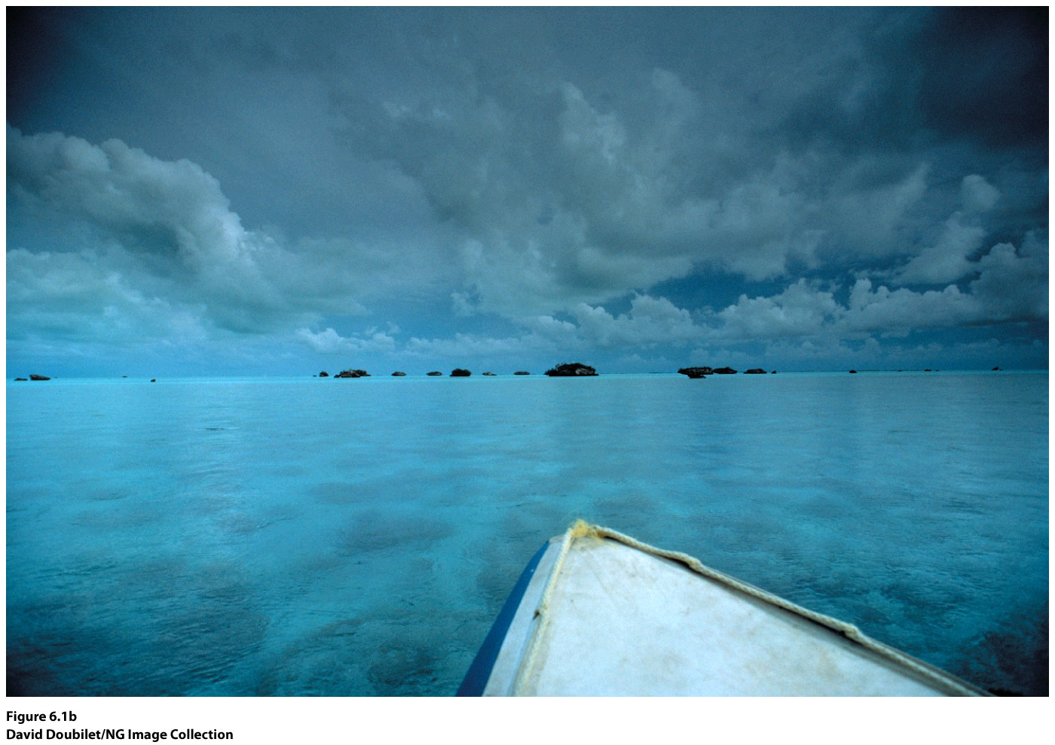
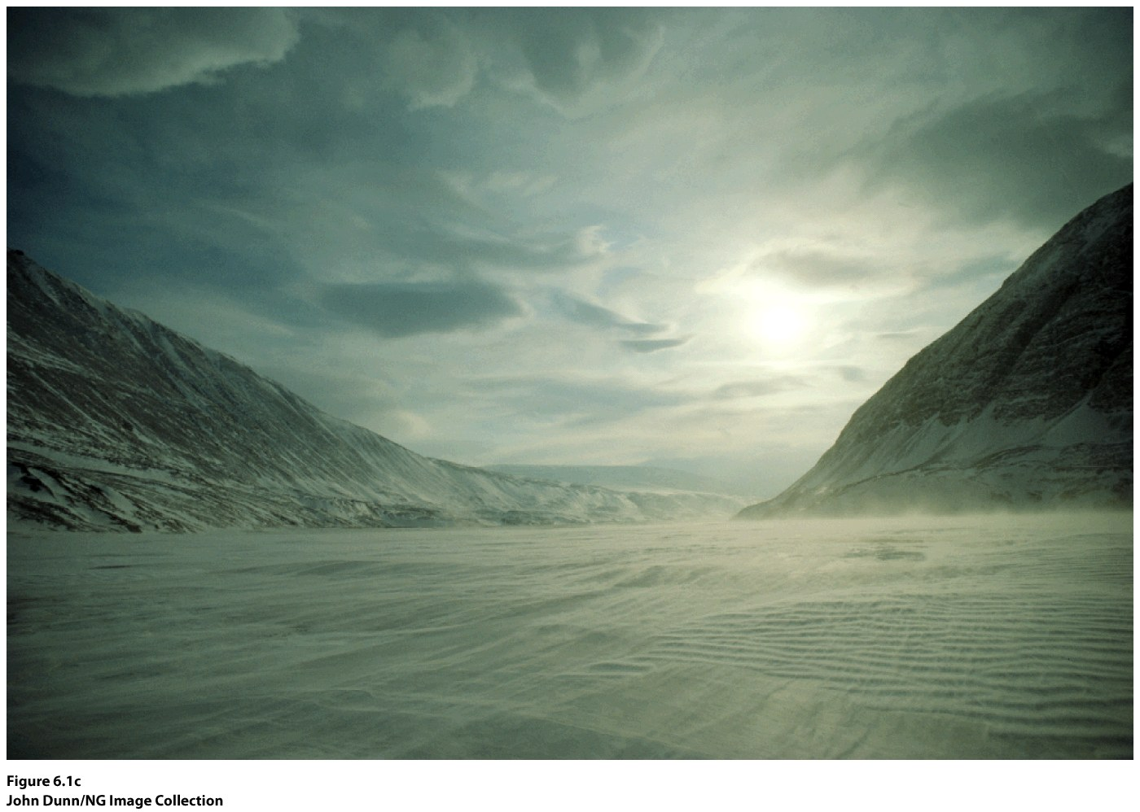
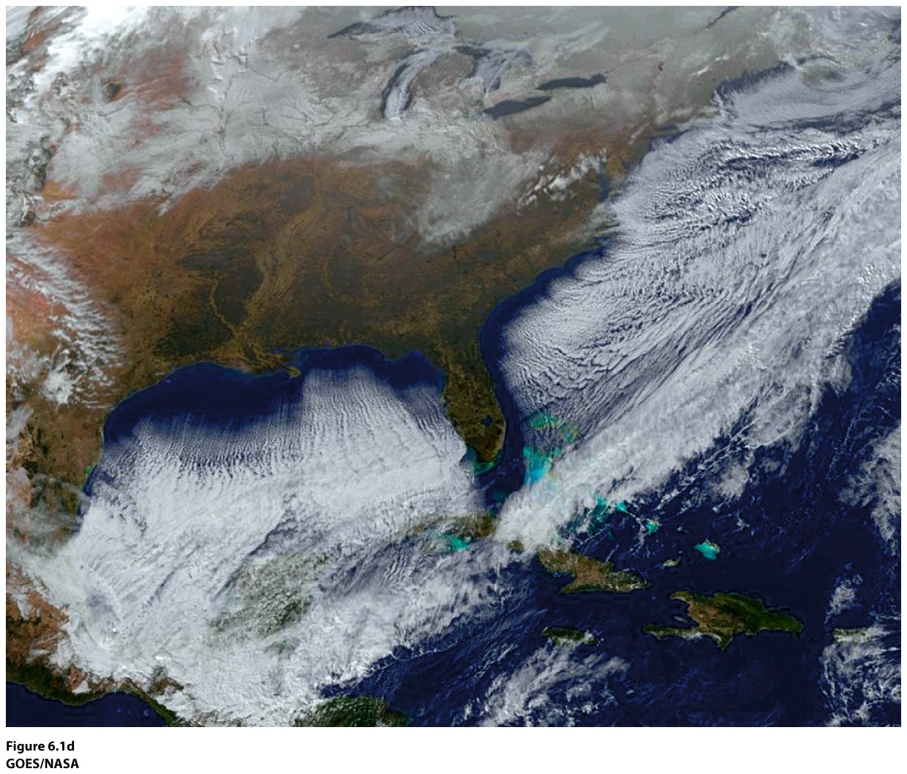

Slide 6
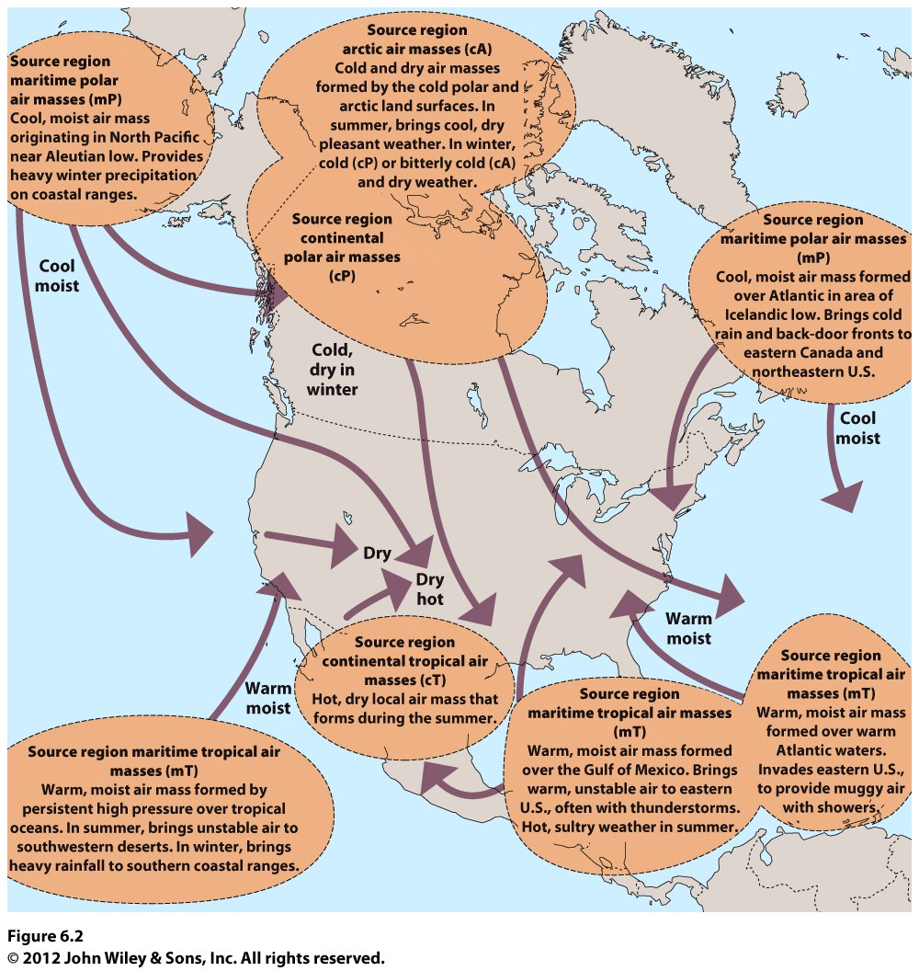
Air masses often leave their source areas.
When it moves to a new area two things happen:
--its properties change
--it influences the new area

Slide 7
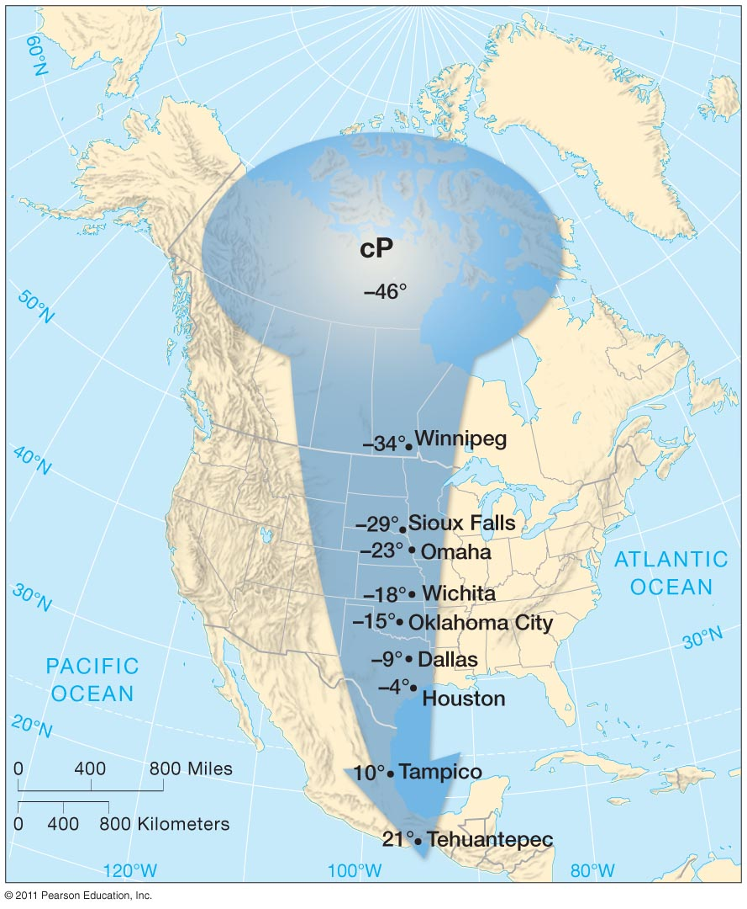
A cP air mass leaves northern central Canada very cold. It warms as it moves south, but also brings very cold temperatures to the northern plains—some of the coldest temperatures these areas will see all year.
Based on today’s weather, where do you think the air mass came from?

Slide 8
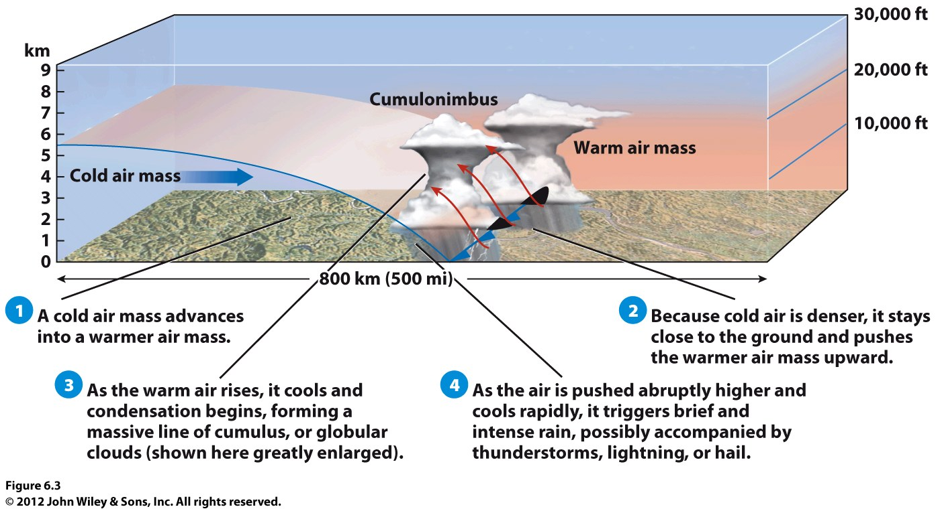
Fronts: the boundary between two different air masses
Cold Front

Slide 9
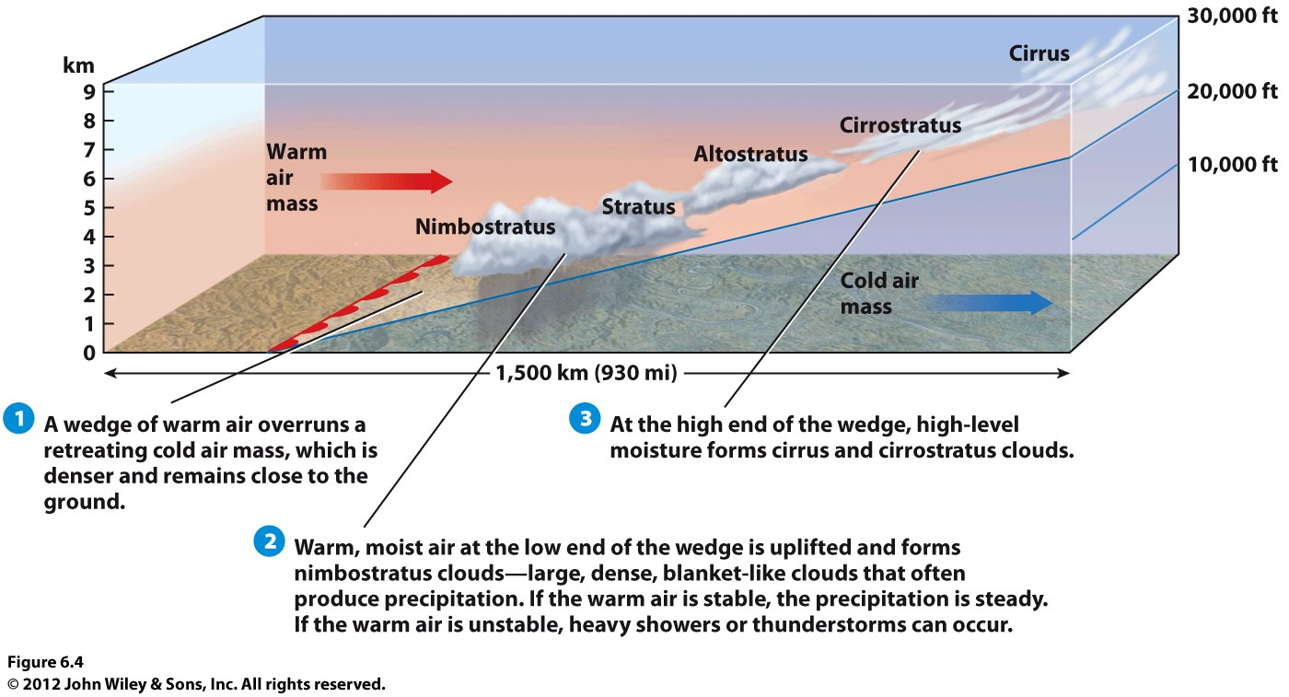
Warm Front
Which type of clouds first indicates an approaching warm front?
a. nimbostratus
b. stratus
c. Altostratus d. cirrus

Slide 10
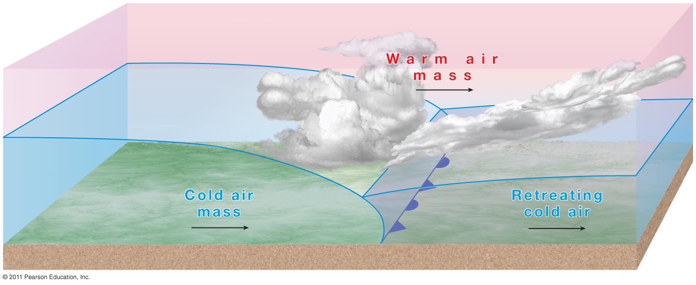
Occluded Fronts
Cold front overtaking a warm front—all the warm air is pushed aloft
© John Wiley & Sons, Inc.

Slide 11
Stationary Front: neither air mass is displaced. Might be enough lifting to create precipitation and can last for awhile.
Occluded Front: cold front overtakes the slower moving warm front; all warm air has been lifted, leaving cold air at the surface.
Notes:
Chapter 7, Figure 7.5 Labeled

Slide 12
Midlatitude Cyclones & Anticyclones
Cyclone: low pressure, air rising, converging, adiabatic cooling, condensation, precipitation, counter clockwise rotation (nor. hem.)
Anticyclone: high pressure, air diverging, sinking, adiabatic warming, no condensation, clockwise (nor. hem.)

Slide 13
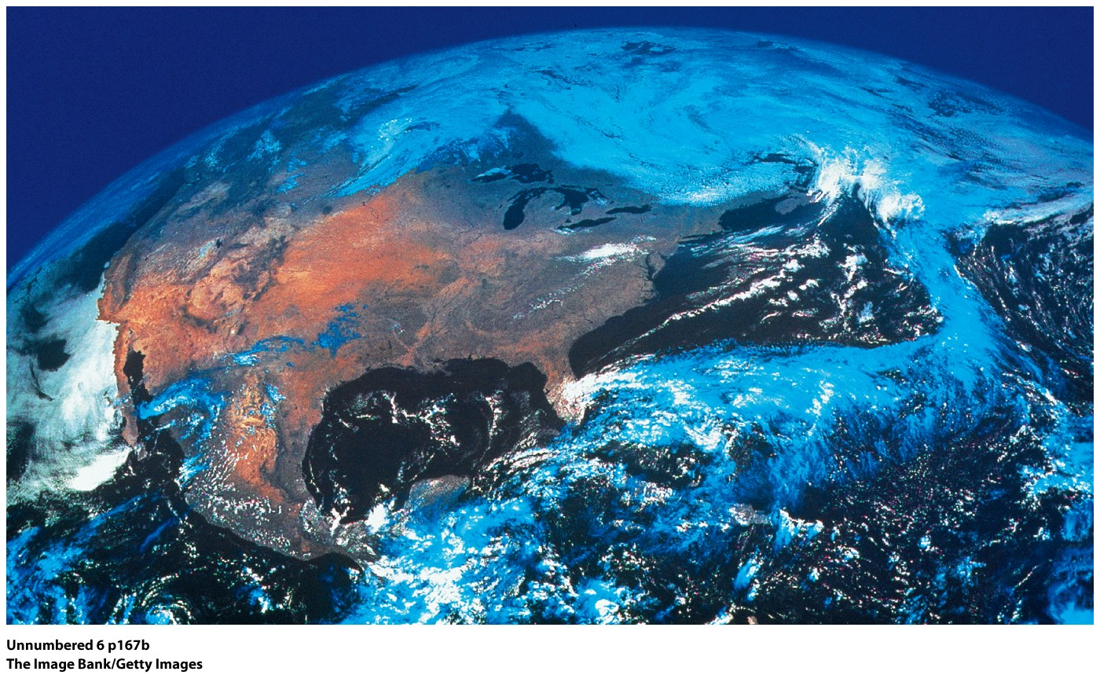
C
A
B

Slide 14
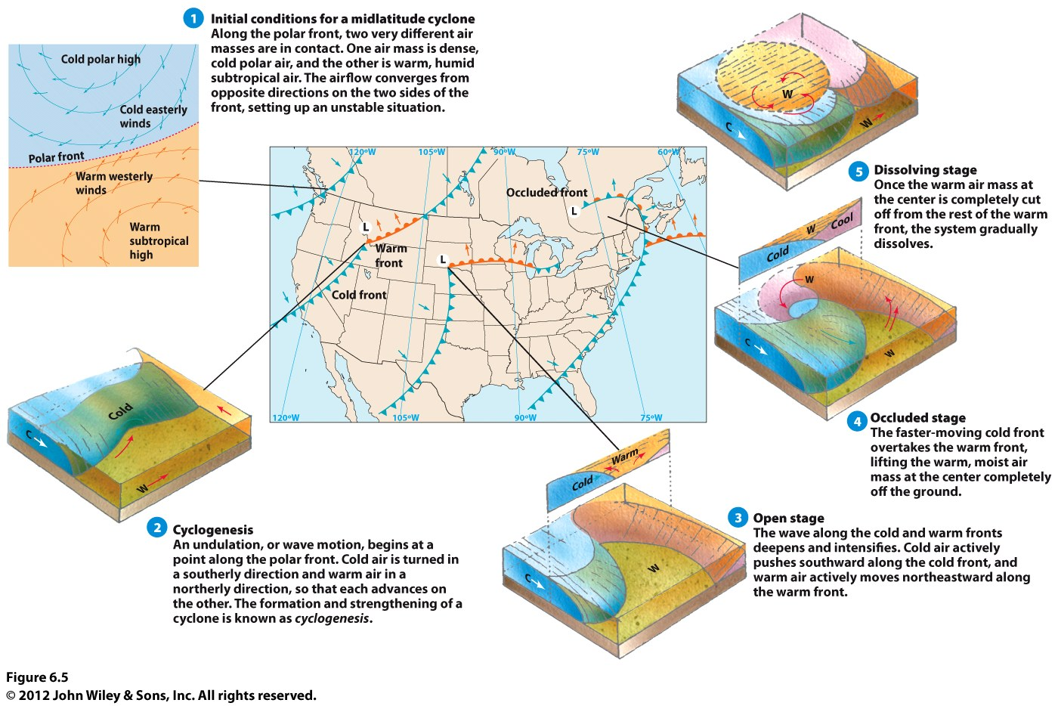
Animation of Cyclogenesis

Slide 15
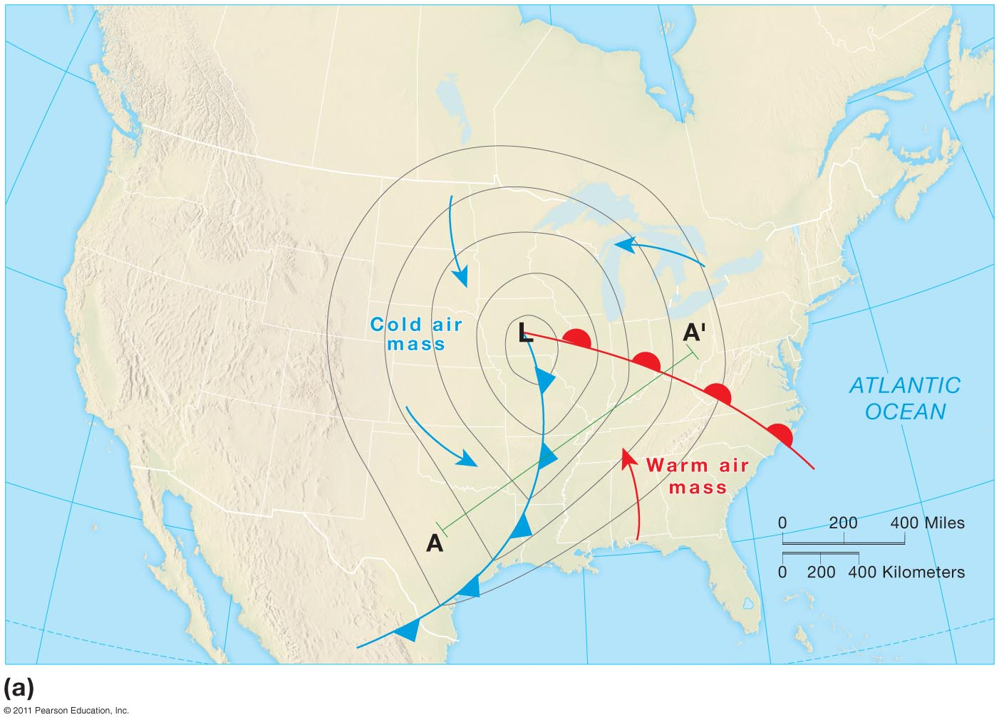
Midlatitude cyclones, while rotating counter clockwise, are being moved by global wind patterns, so are moving eastward.
Also, each front is advancing (moving forward) and the cold front will move faster than the warm front.
So there are four movements going on: 2 frontal advances, counter-clockwise low, eastward with global winds
Notes:
Figure 7-6a

Slide 16
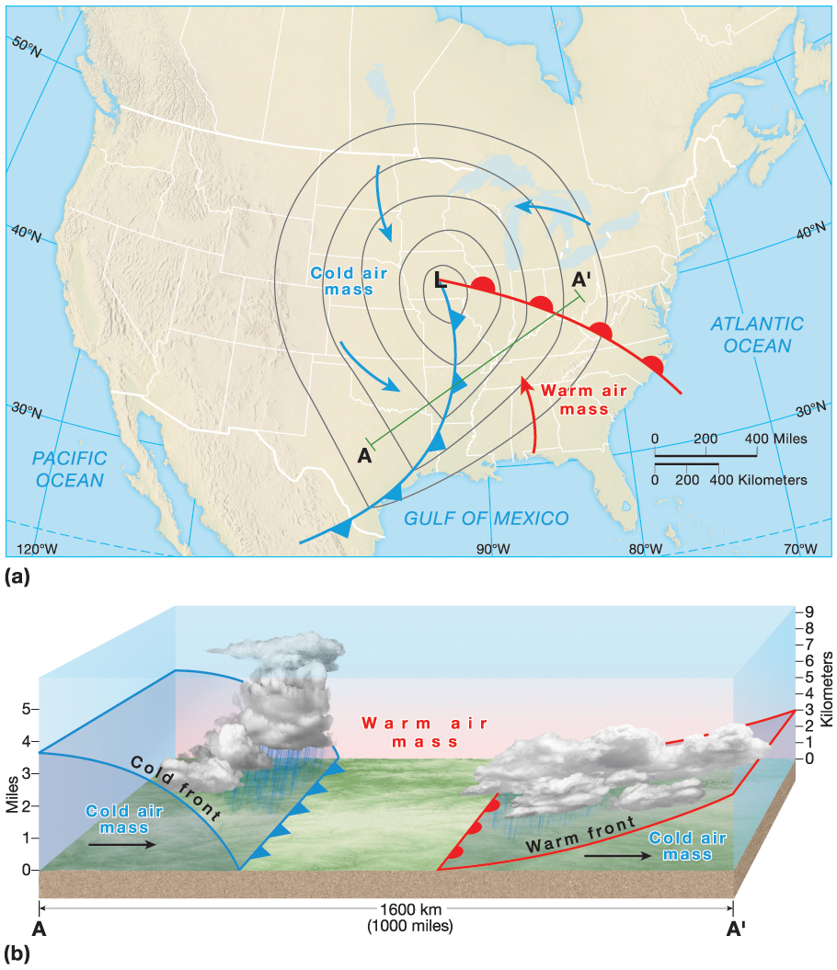
Animation of a mid-latitude cyclone
Notes:
Chapter 7, Figure 7.6 Labeled

Slide 17
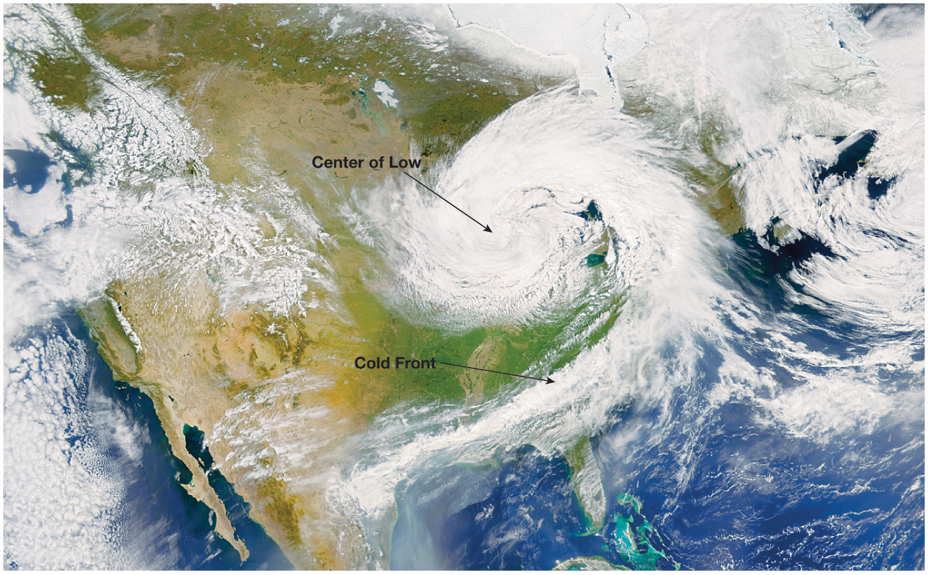
Notes:
Chapter 7, Figure 7.7 Labeled

Slide 18
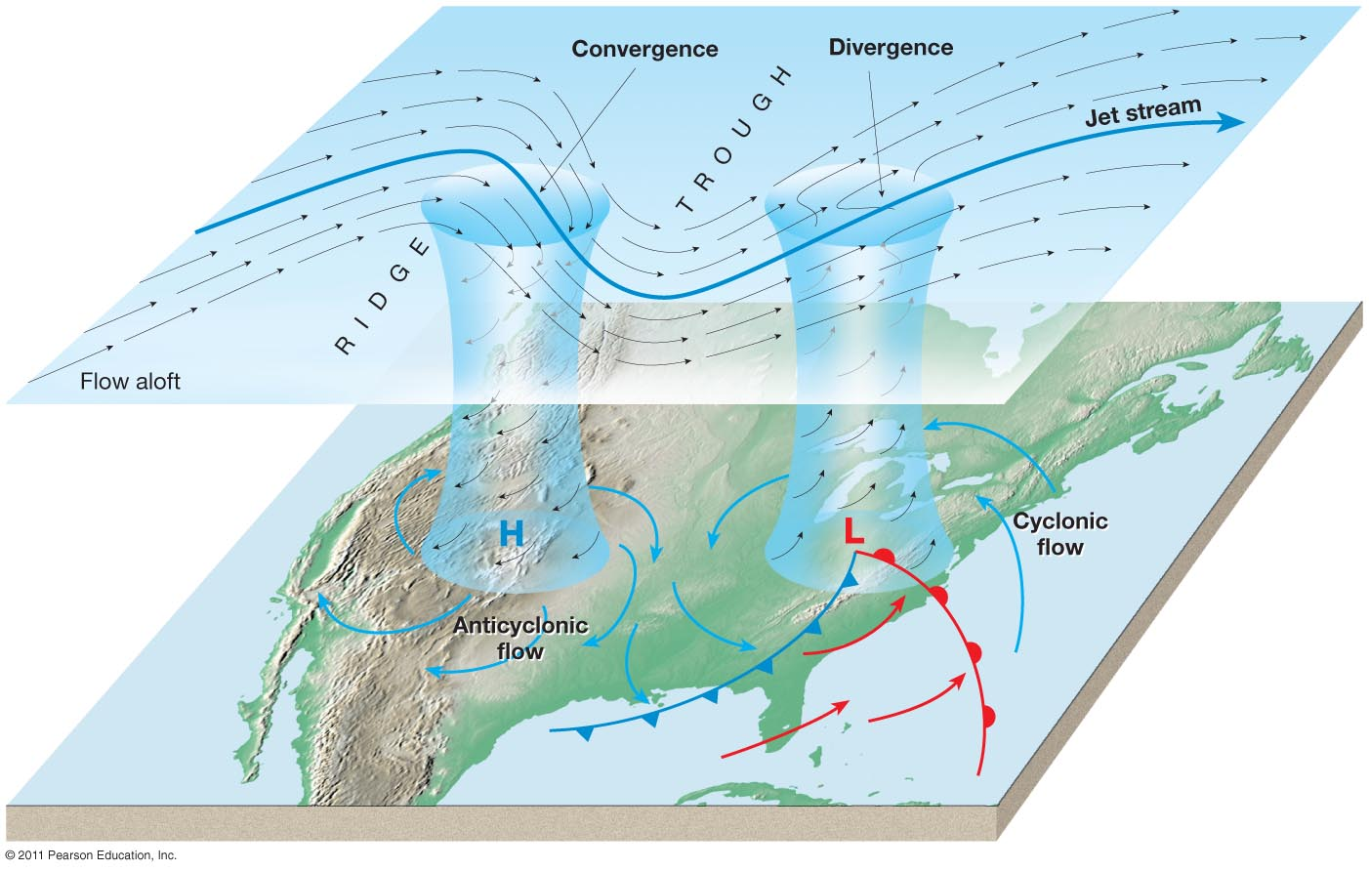
The formation of midlatitude cyclones is impacted by upper atmosphere winds: the polar jet stream. If the jet stream is moving from ridge to trough, this causes divergence at the surface, so storm formation unlikely.
If the jet stream is moving from trough to ridge, this causes convergence at the surface, so storm formation accelerated.
Notes:
Figure 7-10

Slide 19
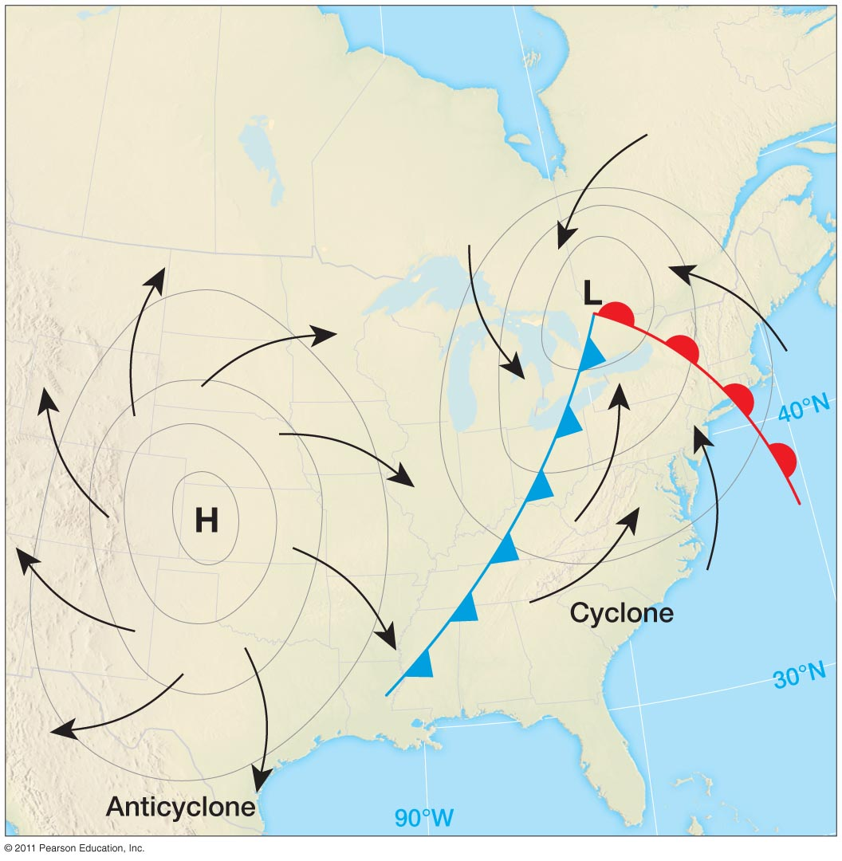
With every midlatitude cyclone, there is also an area of high pressure—mid latitude anticyclones which are usually larger in area. They bring calm conditions. In the winter can mean very cold temperatures and air stagnation which can make smog worse in areas.
Notes:
Figure 7-14

Slide 20
Tropical Cyclones
Air mass movement is different in the tropics
Slower, less movement
But full of moisture
Doesn’t take much lifting to produce precipitation and powerful storms—hurricanes (typhoons in the western Pacific)!

Slide 21
Hurricanes
Unlike midlatitude cyclones, these form in tropical waters along the ITCZ, usually 8-15degrees N/S.
Areas of low pressure (950mb), with a steep pressure gradient, so winds spiral inward (converge) at very high speeds (65-135 mph).
Convergence, uplift and condensation are intense with very heavy rainfall.
Latent heat released by condensation warms the air more, fueling more uplift and condensation.
Unlike midlatitude cyclones, their trajectory is not eastward, but westward as they are influenced by the trade winds.
Eye---clear skies, calm winds in the vortex. In the eye, air descends from high altitudes and is warmed adiabatically

Slide 22
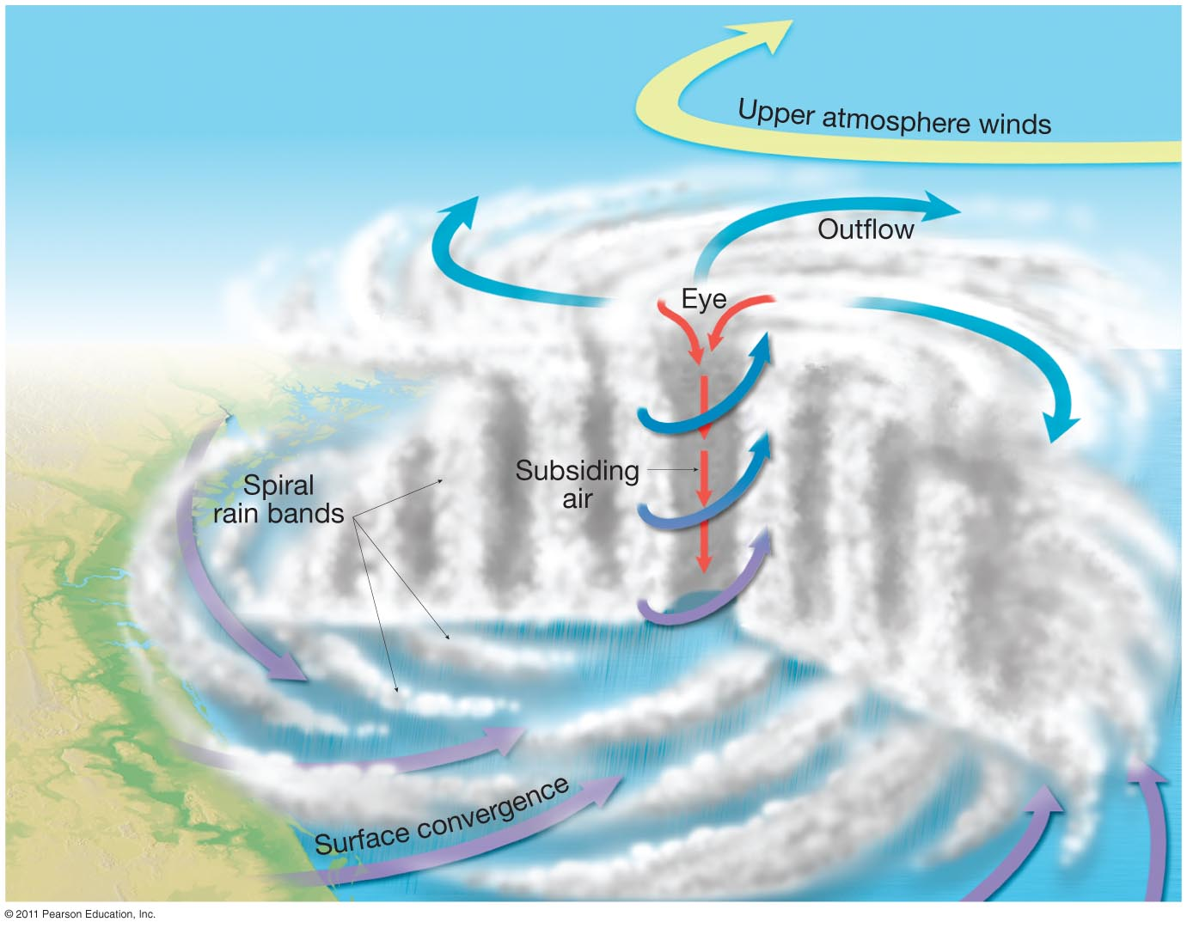
Animation of hurricane formation
Notes:
Figure 7-18

Slide 23
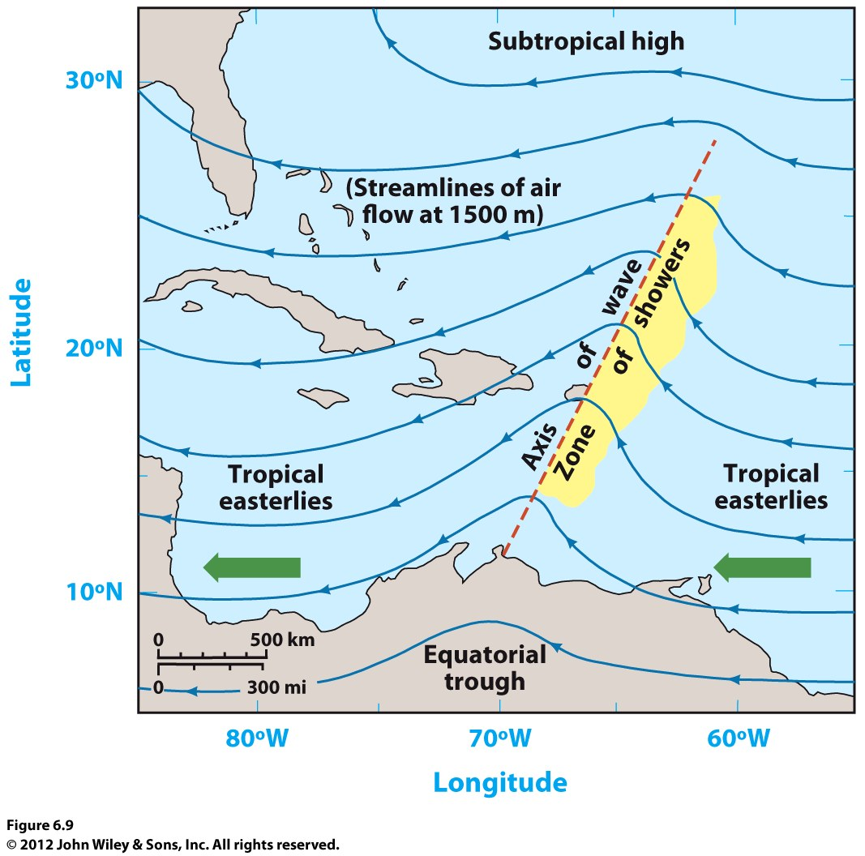
Formation and Movement of Hurricanes
Four Conditions: low pressure, high humidity, high temps, weak Coriolis force
Low pressure, moving slowly, intensifies into an easterly wave.
Occurs within the belt of the tropical easterlies, or trade winds, usually 5-30degrees N or S.
A weakened Coriolis force causes the winds around the low pressure to be faster.

Slide 24
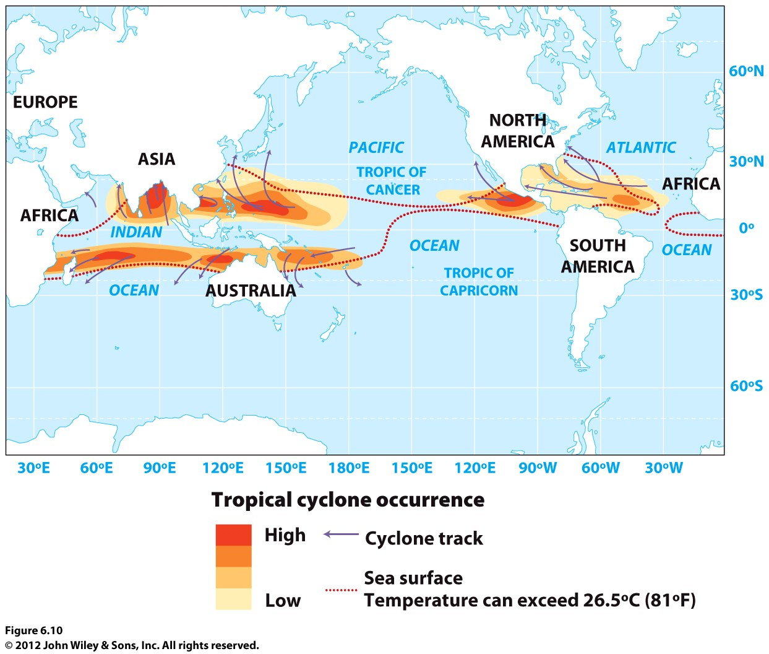
Hurricanes always form over oceans. But not in the southeast Pacific.
High sea-surface temps are also required (81F), so there is a seasonal pattern to their formation. North Atlantic: May – Nov. Opposite pattern in the southern hemisphere.

Slide 25
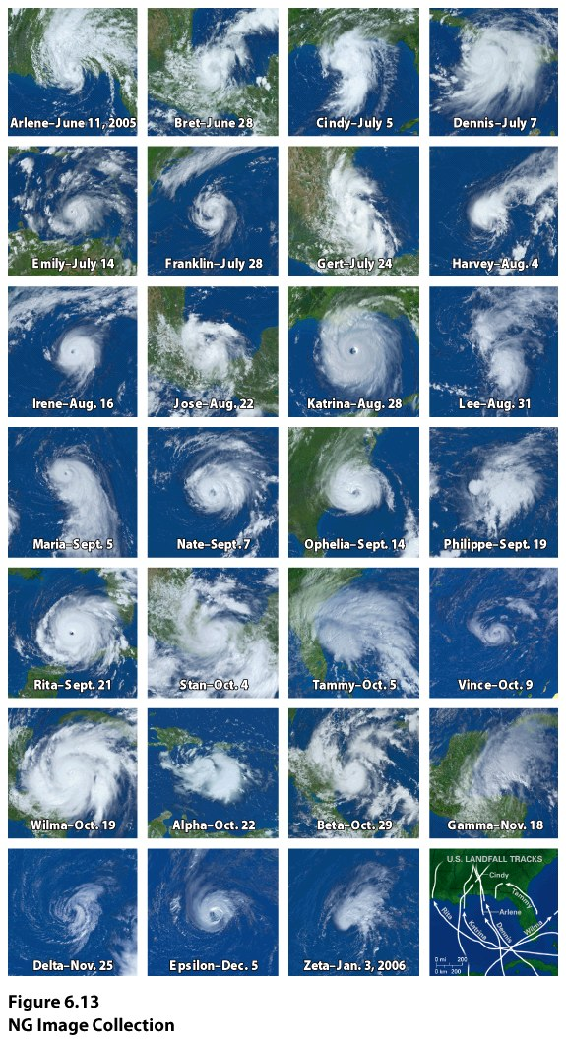
Number of cyclones has been increasing each season. By 2005, the average number of named storms had increased to 13 per year, compared to 8.6 from 1970-1994.
In 2010 19 storms were named with a total of 12 hurricanes.

Slide 26
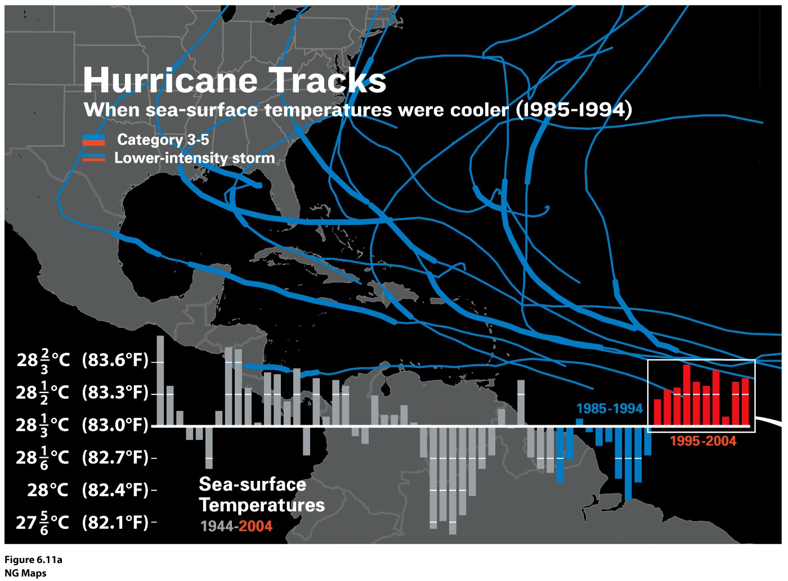

Slide 27
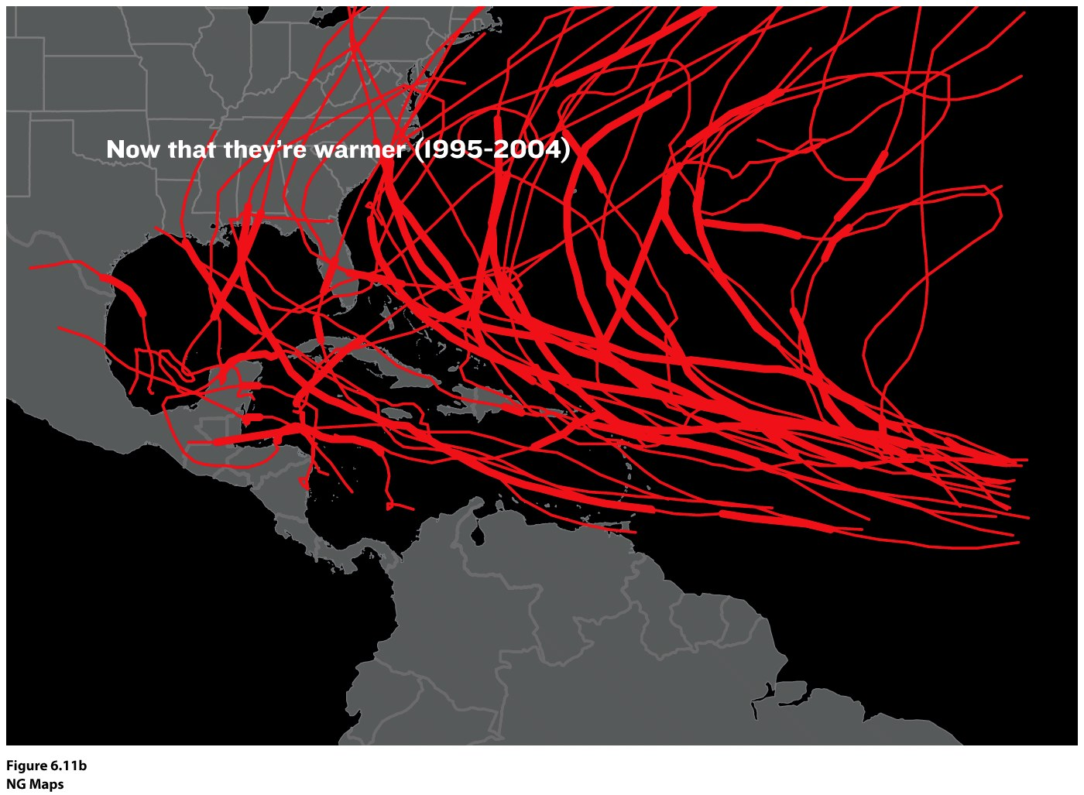

Slide 28
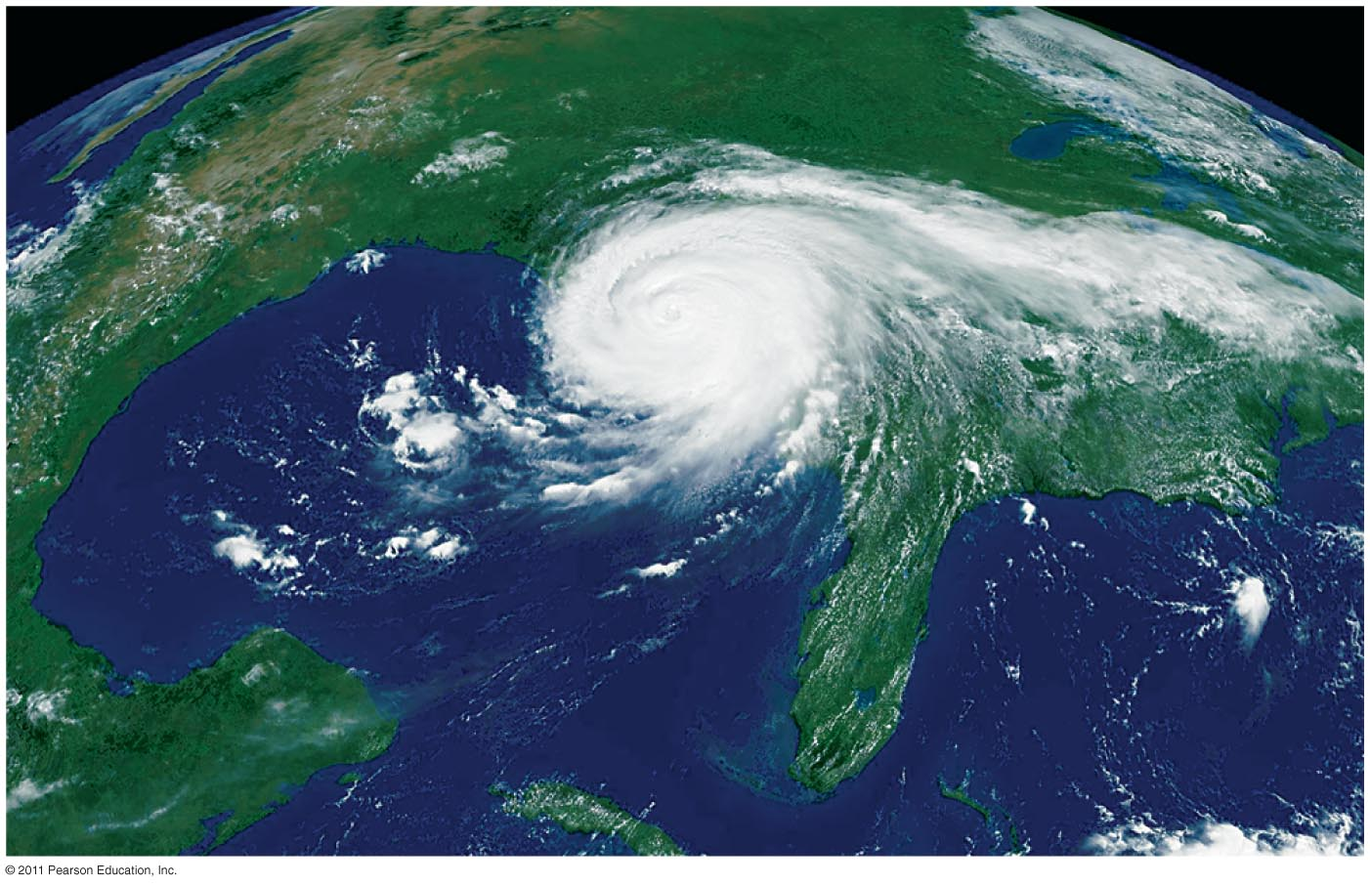
Hurricane Katrina, 9am, 8/29/2005
Once the cyclone has formed, it moves westward along the trade winds (tropical easterlies). It can then curve northwest, north and northeast influenced by upper level winds.
Florida can be attacked from both the east and west!
Notes:
Figure 7-A

Slide 29
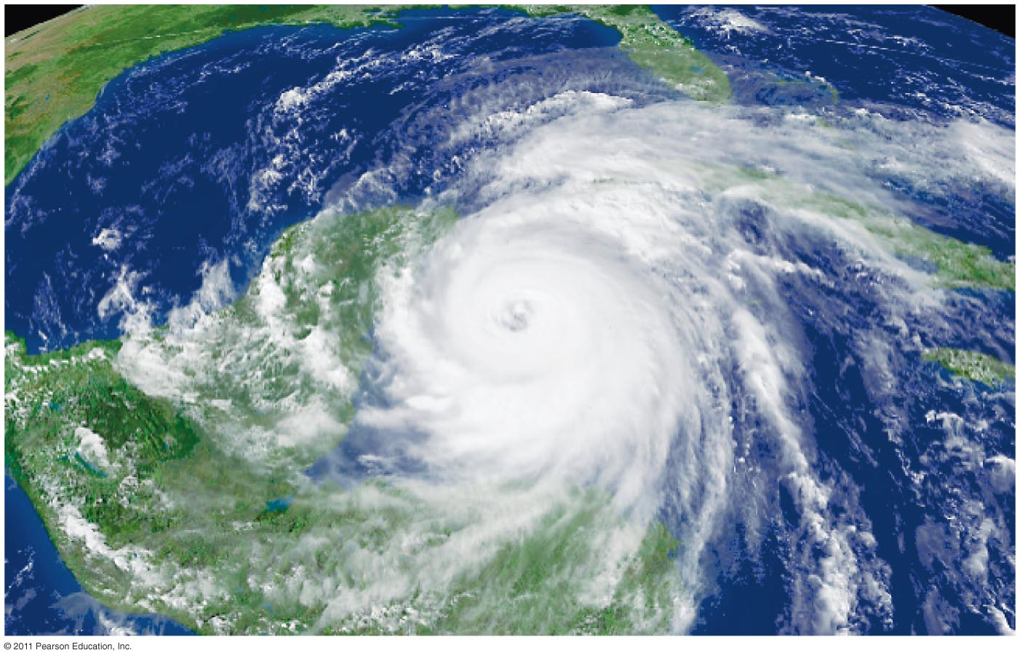
Hurricane Wilma, strongest North Atlantic hurricane ever recorded, approaching Yucatan, Mexico, 10/20/2005
Notes:
Figure 7-C

Slide 30
Hurricane Sandy, October, 2012
The 2005 Hurricane Season in the Atlantic

Slide 31
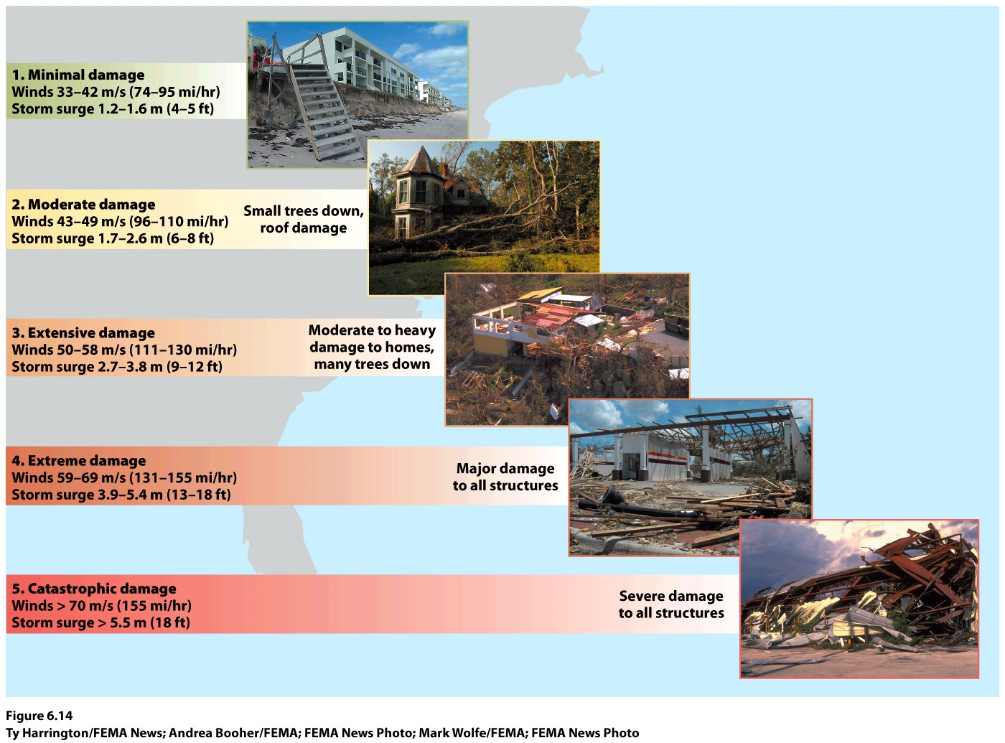
Intensity and Damage
Use the Saffir-Simpson Scale
Remember that hurricanes can gain or lose intensity depending on the surfaces they are traveling over (Hurricane Katrina).

Slide 32
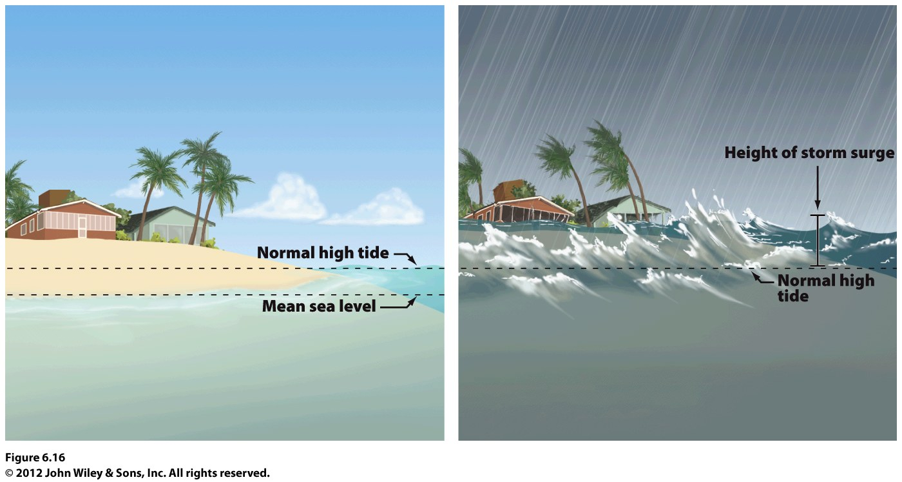
Storm surges
The very low pressure at the center of the hurricane pushes sea level up, toward center of the storm
High winds can then push that water on shore, carrying the surf far inland

Slide 33
