Slide 1
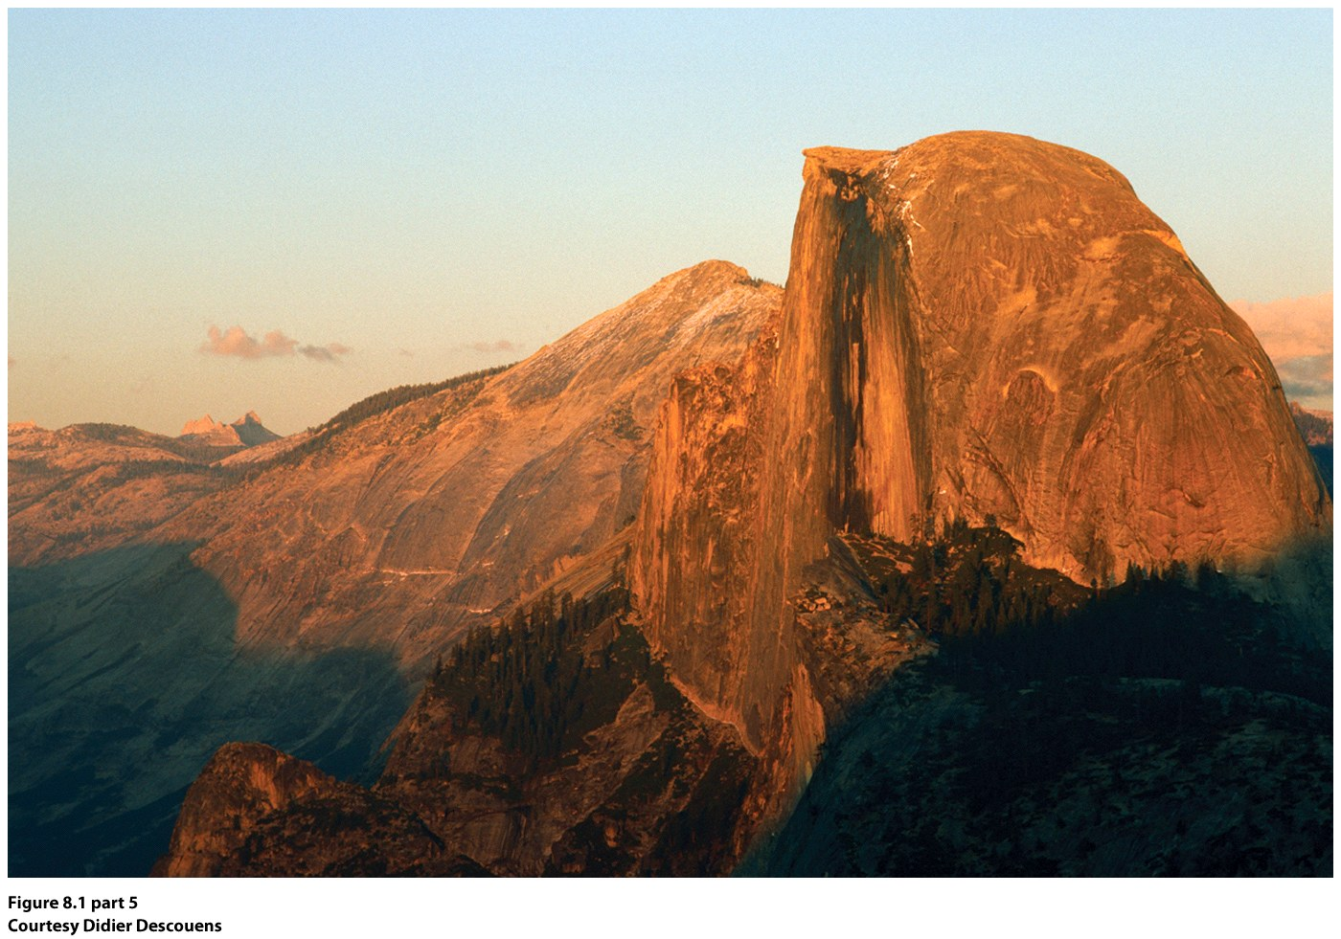
Chapter 8: Earth From the Inside Out
Yosemite’s Half Dome, part of the Sierra Nevada mountain chain.

Slide 2
Geomorphology: study of the shape of the Earth’s features and how they change over time
Uniformitarianism: James Hutton, 1795: the same geologic processes observable today have operated since the beginning of Earth’s history, the present is the key to the past
Catastrophism—previous theory that argued change came through sudden upheavals

Slide 3
The geologic timescale: 4.5 billion years
Priscoan Eon (Hadean)—earliest known rocks on Earth, 4.3 billion years old, Northwest Territories, Canada.
Proterozoic Eon—oxygen added to atmosphere, 2.8-2.4 billion years ago, through photosynthetic bacteria.
Ordovician Period (Paleozoic Era, Phanerozoic Eon)—480 mya Appalachians form, Pangea
Triassic Period (Mesozoic Era, Phanerozoic Eon)—Sierra Nevadas form
Quaternary Period (Mesozoic Era, Phanerozoic Eon)—glaciers, 2.5mya – 10,000 years ago. Ice Age climate variability meant proliferation of plants and animals and rise of Homo sapiens.

Slide 4
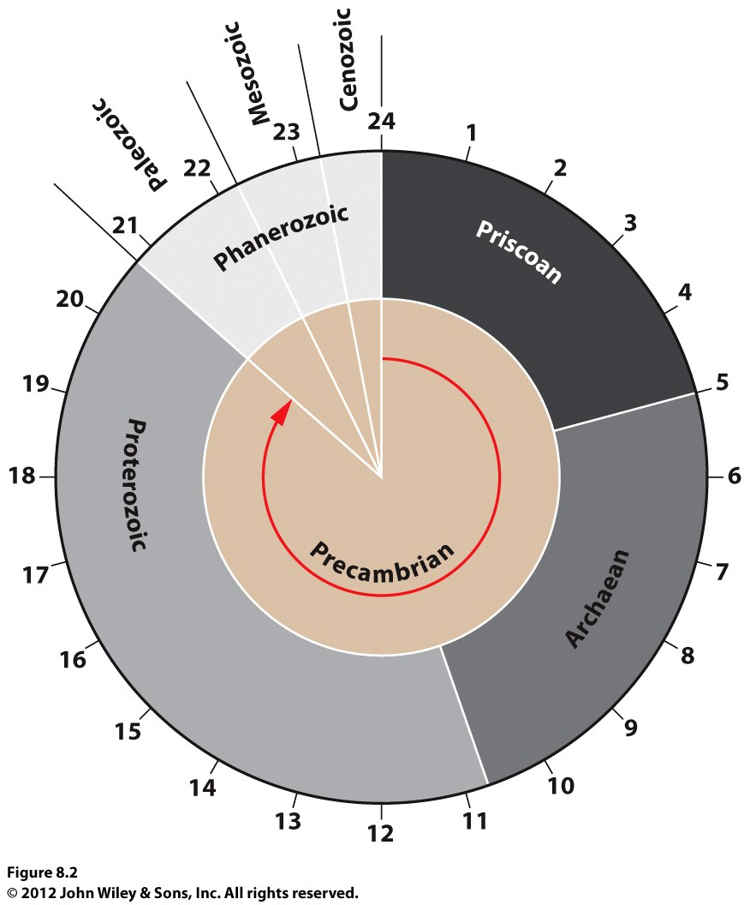
The Earth’s history in a 24 hour day or a 12 month year
The Earth in 1 Year:
1 cell by May-Nov
Multi-cell in Nov.
Nov.21—fish, vertebrates
Nov. 27—plants
Dec. 7—reptiles
Dec. 14—mammals, birds
Dec. 21—flowers
Dec. 24—grass, primates
Dec. 31—upright walking
12am, Jan.1—Homo Sapiens
Modern humans appear about 200,000 years ago…in Earth’s 4.6 billion year history.
Life emerges in the last 2 hours & 50 minutes.

Slide 5
Forces of Geologic Change
Endogenic processes (internal); processes working from within the Earth to change the Earth’s surface. Volcanic & tectonic activity.
Exogenic processes (external); processes at work at Earth’s surface. Weathering by wind, water.
Landforms—specific shapes of Earth’s surface
Freshly created landforms: initial landforms
Older landforms shaped by weathering/erosion: sequential landforms.

Slide 6
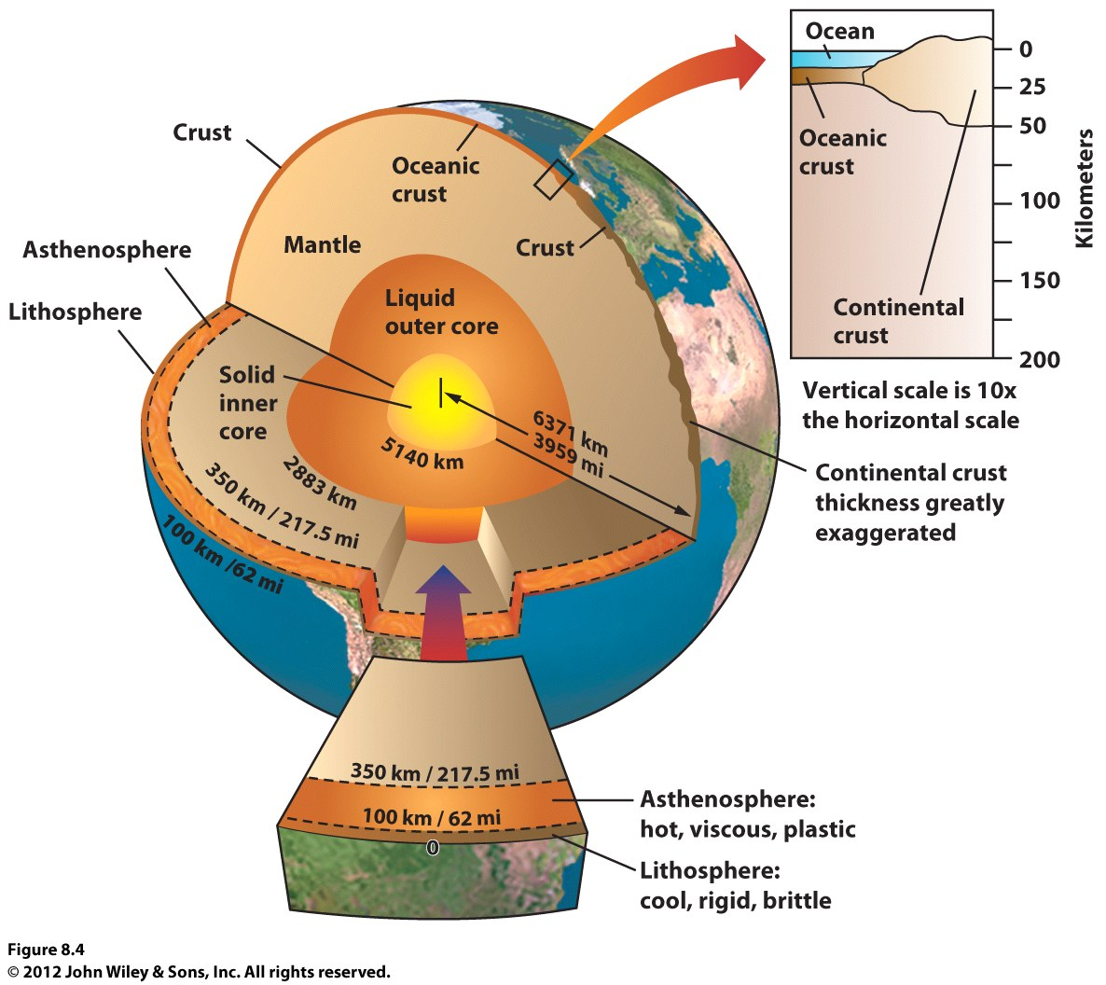
The Structure of the Earth
Core: Is about 2200 miles in radius, and is very hot, 5400-9000F;
Has 2 distinct layers an outer liquid zone and an inner solid zone .
Known through measurements of waves of earthquakes.
Inner core is solid—iron, and some nickel.
Despite heat, inner core is solid because of the tremendous pressure exerted on it.
Notes:
Insert Figure 8.4 (no captions)

Slide 7
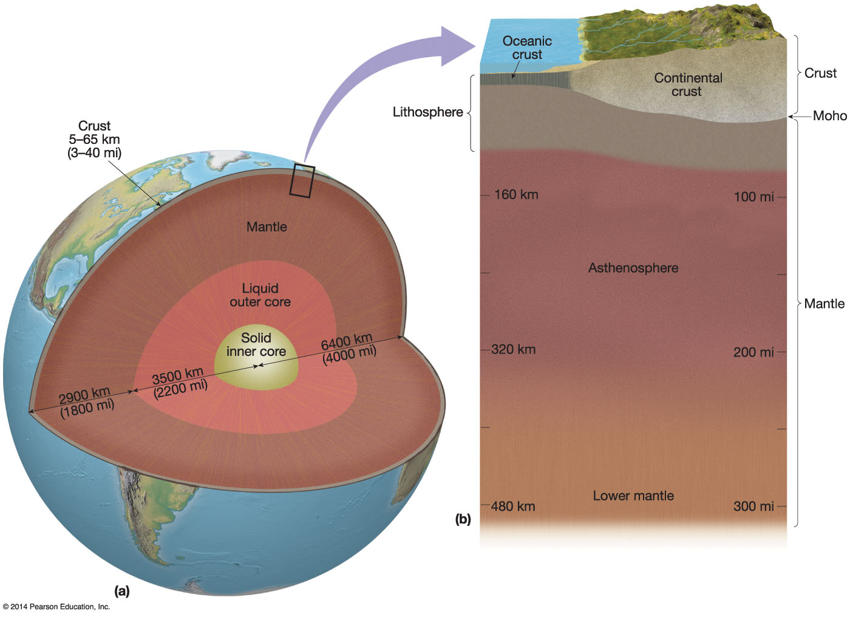
Mantle—surrounds the core. About 1800 miles thick.
Made of mafic—magnesium & iron minerals
5100-3300F
80% of Earth’s total volume
Lower mantle is hotter, but largely rigid
Upper mantle temp is lower and so is pressure, so less rigid: asthenosphere
This is the molten layer of the mantle—hot spots from radioactive decay
This energy drives earthquake and volcanic activity at the surface

Slide 8
Crust --outermost solid layer of the Earth
Separated from the mantle by the Moho, where density changes
Crust is 4-25 miles thick
Contains continents and ocean basins
Oceanic crust is almost entirely made up of mafic rocks (magnesium & iron)
Continental crust has two zones, the lower one is more dense and is largely mafic and the upper one that is lighter, felsic (aluminum, sodium, potassium, calcium)
Crust beneath continents much thicker than beneath oceans
Notes:
Insert Figure 8.4 (no captions)

Slide 9
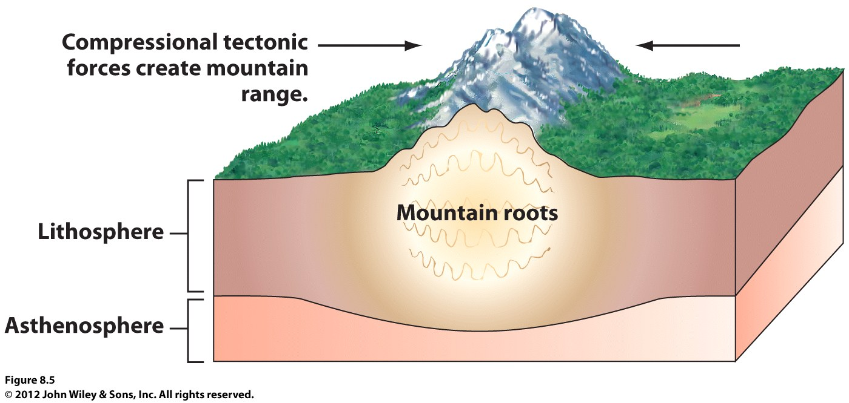
Lithosphere
includes the outer crust and the upper mantle. 40-95 miles thick.
Hard, brittle shell on top of soft, plastic underlayer (lithosphere on top of the asthensophere)
Lithosphere moves over asthenosphere
Notes:
Insert Figure 8.5 (no captions)

Slide 10
Isostasy—lithosphere floats on asthenosphere much like an iceberg floats in water, in an equilibrium state (isostasy)
Isostatic adjustment—response of the lithosphere to addition or subtraction of material
Isostasy Animation
As the mountain erodes and weighs less, it rises, gaining back elevation until the erosion process again reduces its mass. This is called isostatic adjustment
If a large series of glaciers formed in this mountain range, the elevation of the surface underneath the glacier would ______.
a. increase c. stay the same
b. decrease d. stay the same but shift laterally

Slide 11
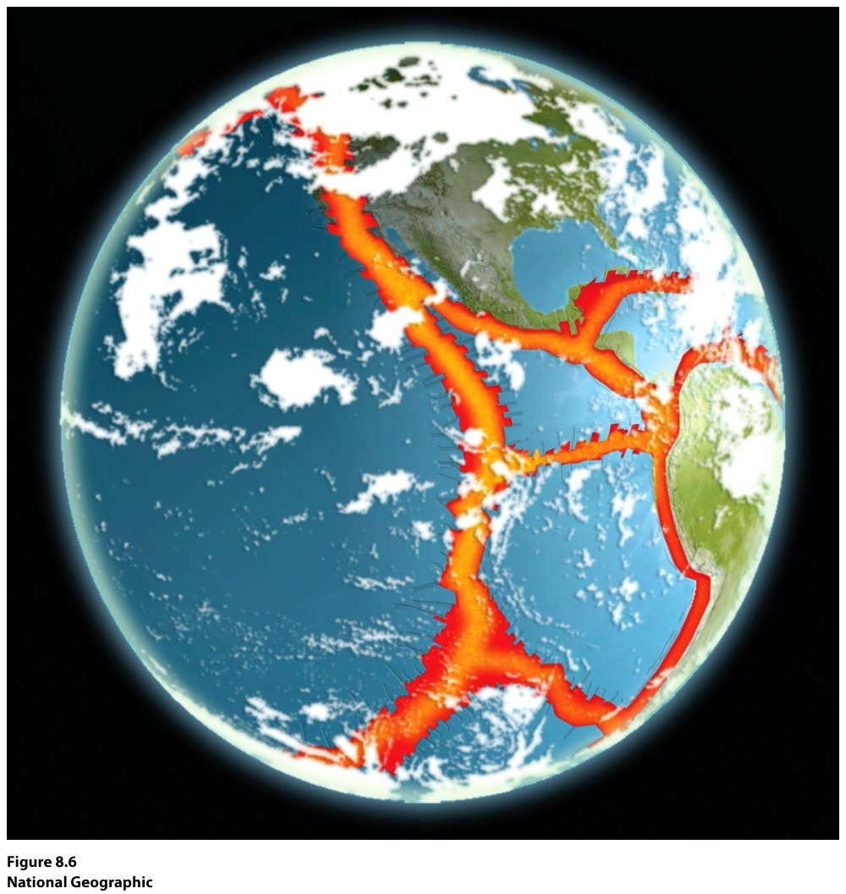
Lithosphere is divided into plates
Move independently.
Can separate from each other.
Can collide with each other.
Major relief of Earth created by such movements.

Slide 12
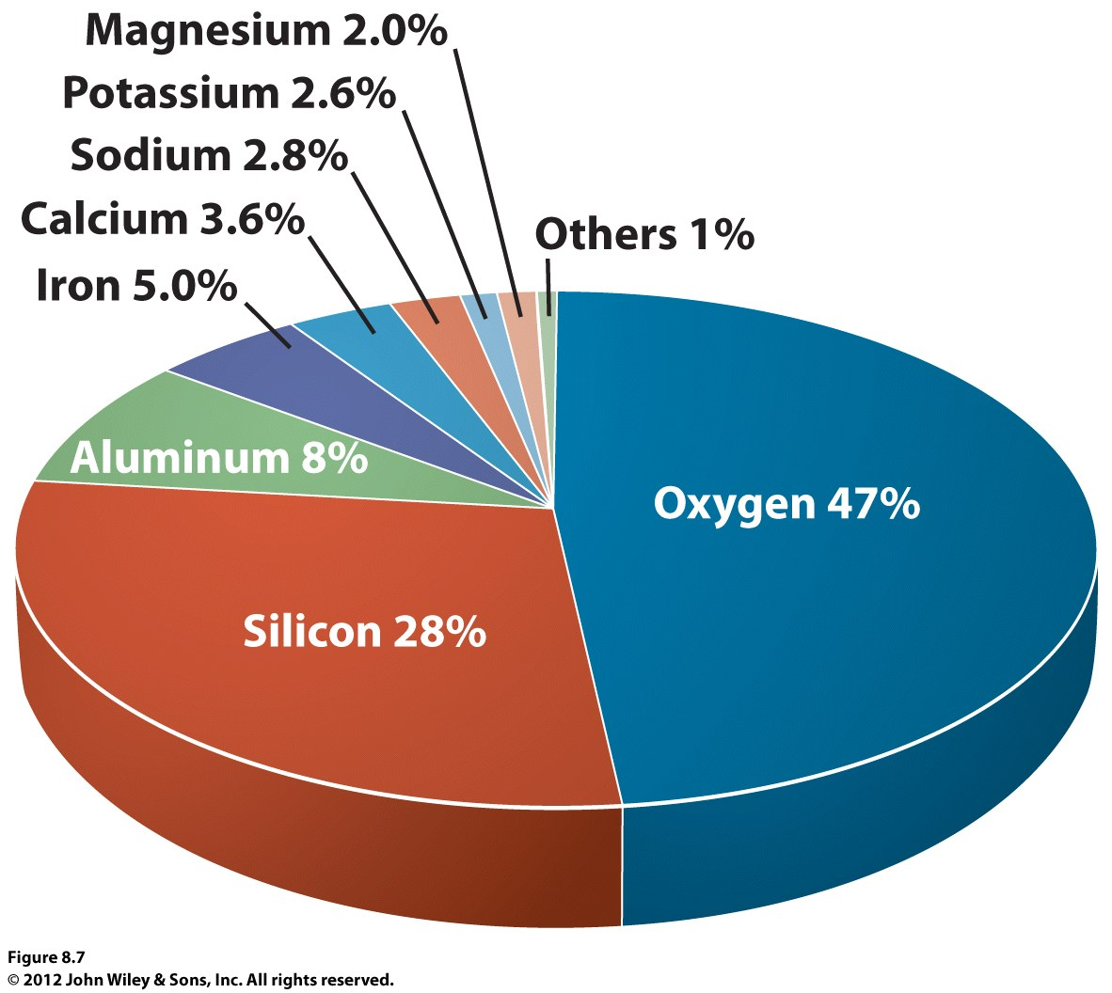
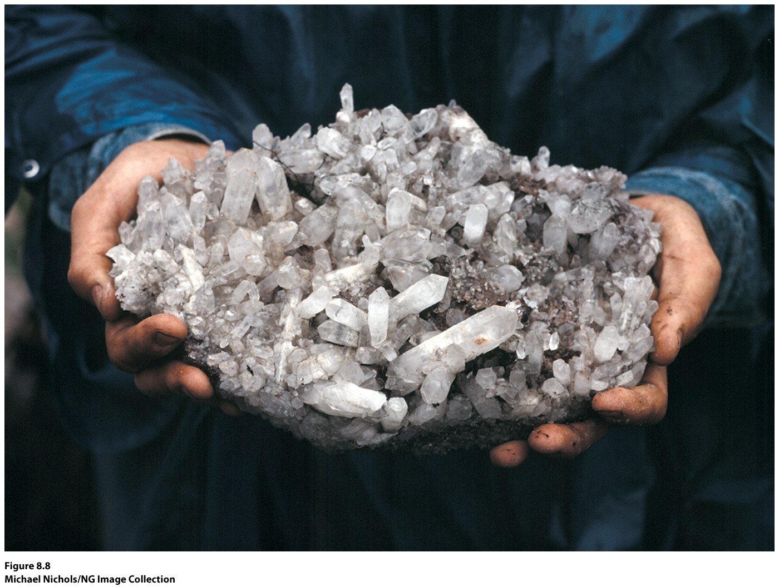
Earth Materials & the Rock Cycle
Most abundant elements in crust:
Oxygen, silicon, aluminum, iron, calcium, sodium, potassium, magnesium
Exist in a variety of rock combinations
Elements can form chemical compounds---minerals
Minerals: naturally formed; inorganic; solid; has a characteristic (recognizable) crystal structure and chemical composition.
Quartz, silicon dioxide. Very common. Clear, light-colored. Often found in sediment like sand or gravel. These are unusual because of their six-sided crystal shape. From Venezuela.

Slide 13
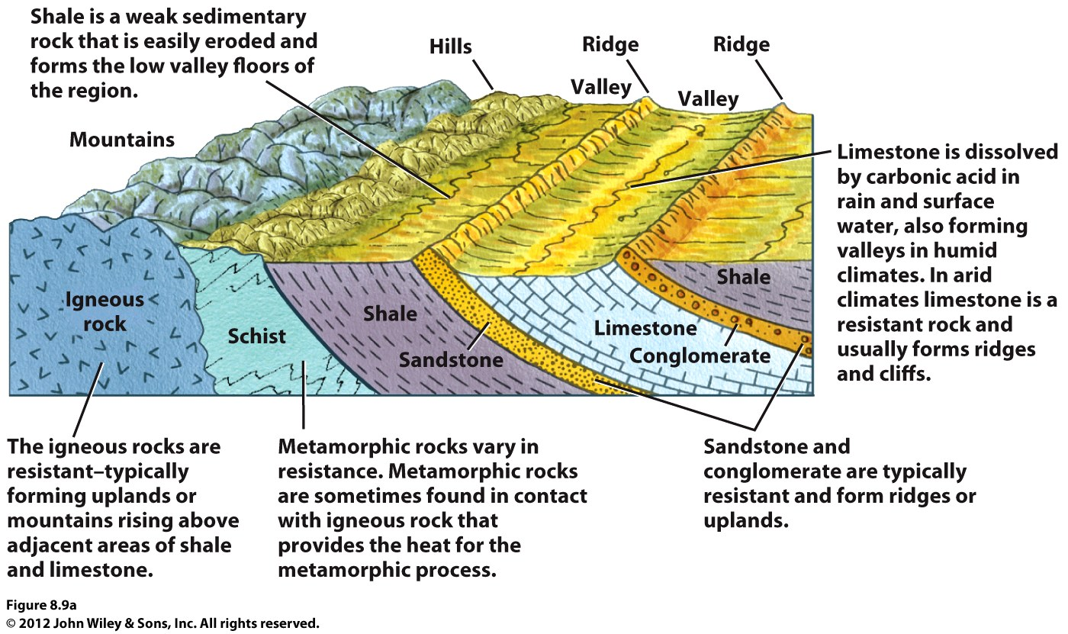
Rocks: usually two or more minerals
Most rock in Earth’s crust is very old (millions), but rock is always being formed, too.
Rock Classes:
Igneous
Sedimentary
Metamorphic
Each class of rock
has unique properties, which determine how fast/slow they are eroded.

Slide 14
Igneous
Rock that cools and hardens from molten material (magma or lava)
Often very resistant to erosion
Typically form uplands or mountains
Two types: intrusive & extrusive
Magma is molten rock below surface
Lava is molten rock above surface

Slide 15
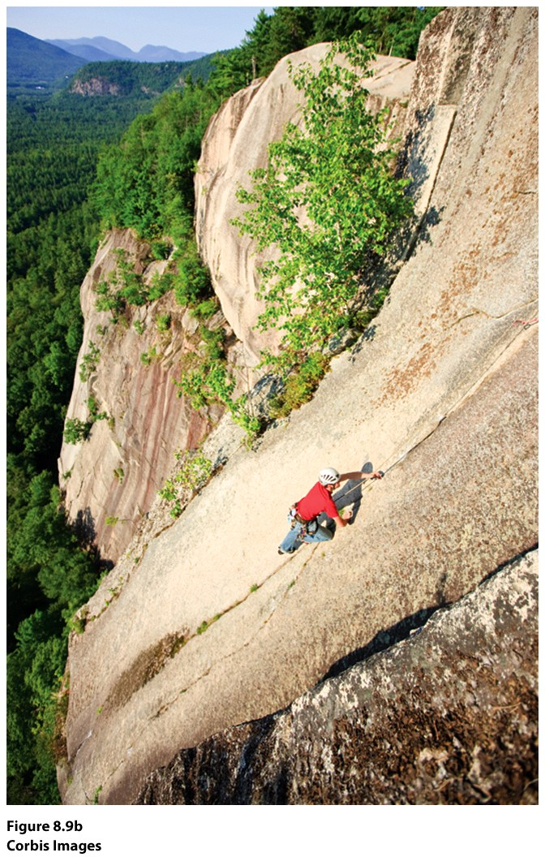
Granite is a type of igneous (intrusive), that is very resistant to erosion and decay.
Intrusive igneous cool slowly, so develop visible mineral crystals

Slide 16
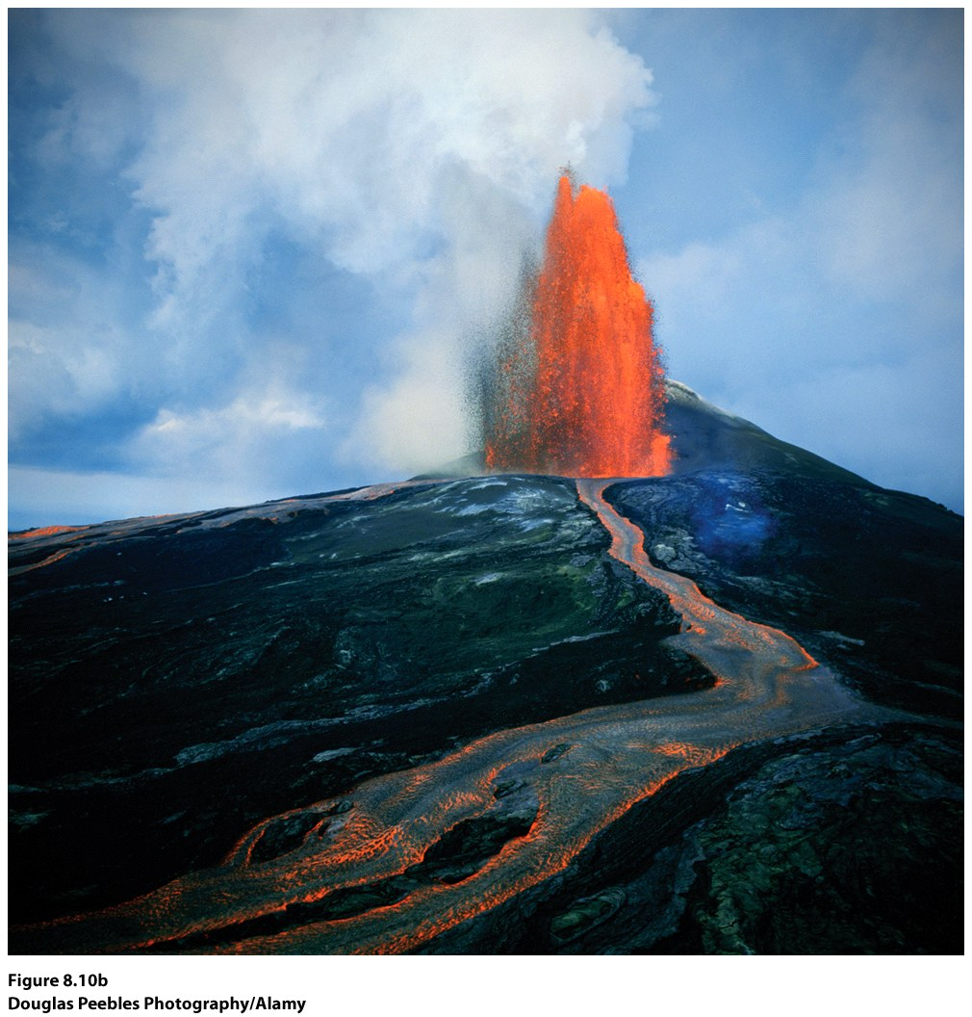
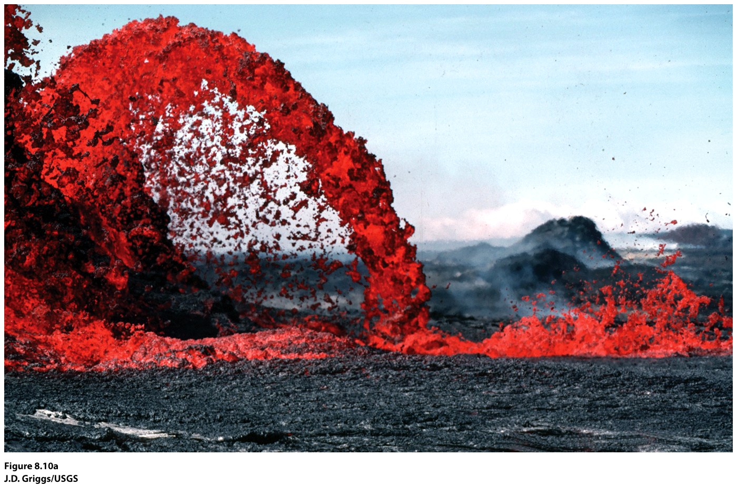
Lava—igneous rock that cools and hardens above Earth’s surface.
Extrusive igneous rock cools much faster and only has microscopic crystals
Volcanic eruption, Hawaii’s Kilauea volcano, Hawaii Volcanoes National Park.

Slide 17
Most igneous rocks contain silicates—minerals containing silicon and oxygen
Very hard rock
Quartz, silicon dioxide most common
How much silica is present determines its appearance: felsic (more silica, so less dense and lighter in color) or mafic (less silica, so more dense, and darker)

Slide 18
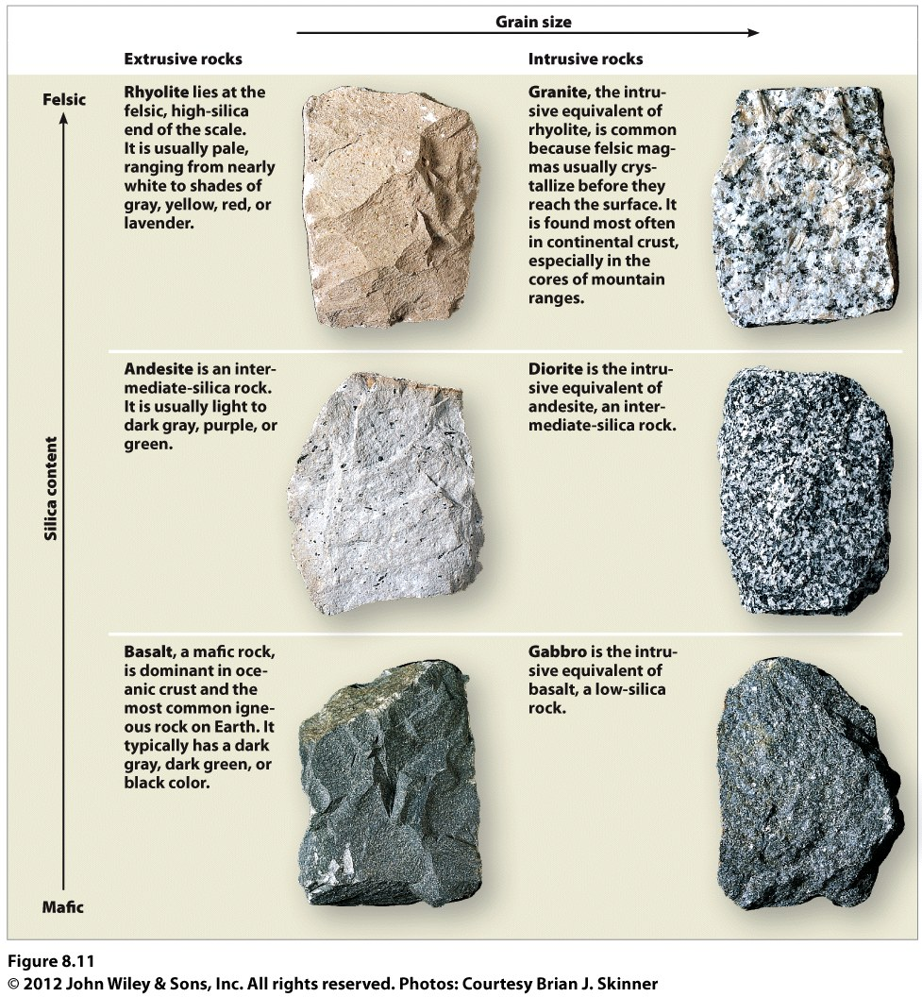
Felsic: more silica
Grain size determined by intrusive (larger/coarser grain--granite) or extrusive (smaller/finer grain--rhyolite)
Mafic: less silica
Basalt—most common type
Of volcanic rock

Slide 19
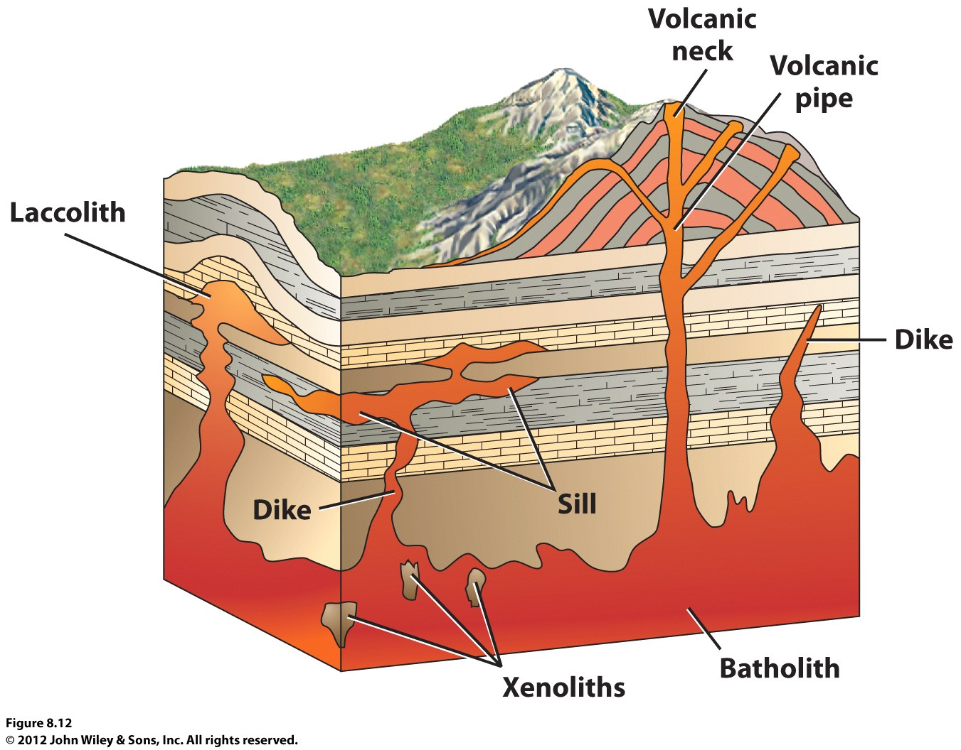
Intrusive Igneous Rock Forms
Plutons
Batholiths
Sills
Dikes
Laccoliths
The grain sizes in the rock formed by the surface lava flow would be ______________ compared to the grain sizes found in the rock formed in a sill.

Slide 20
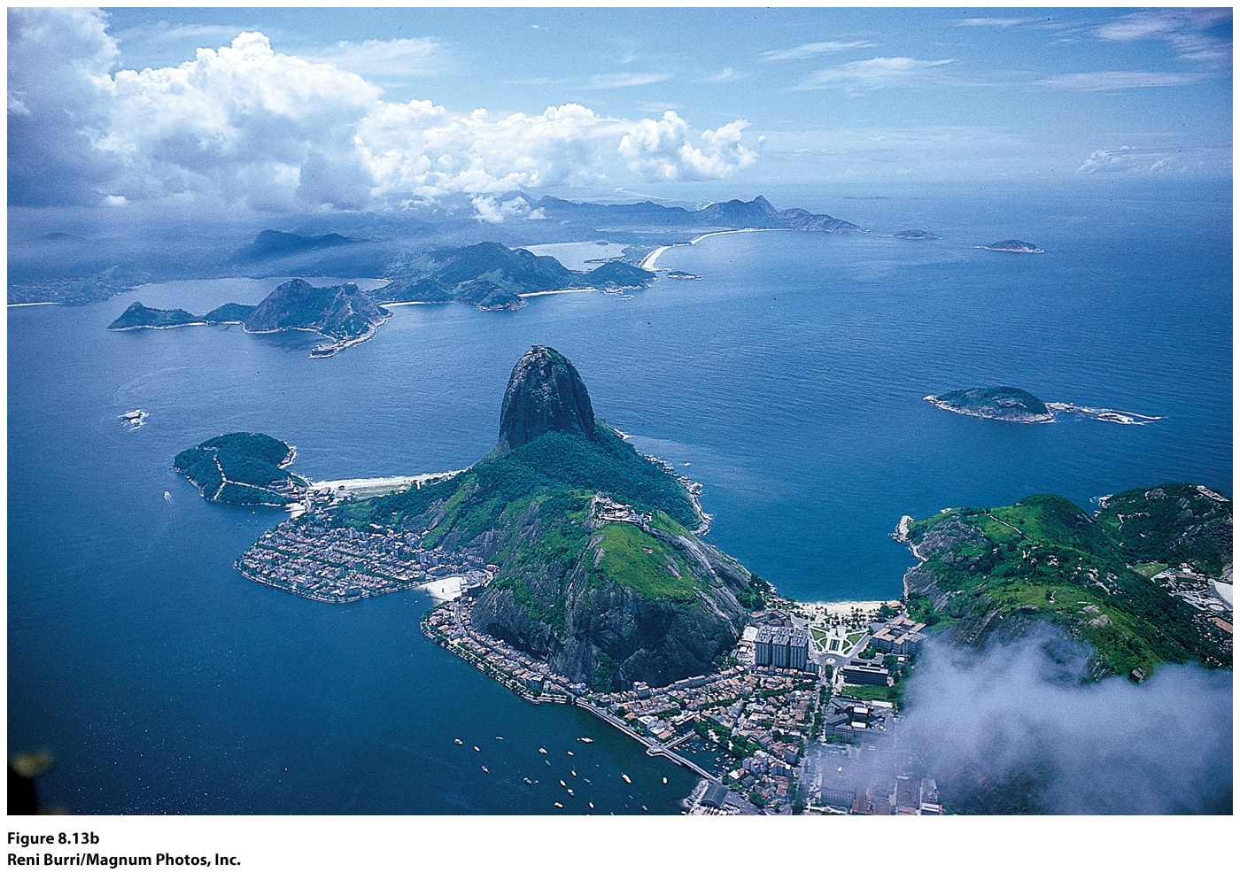
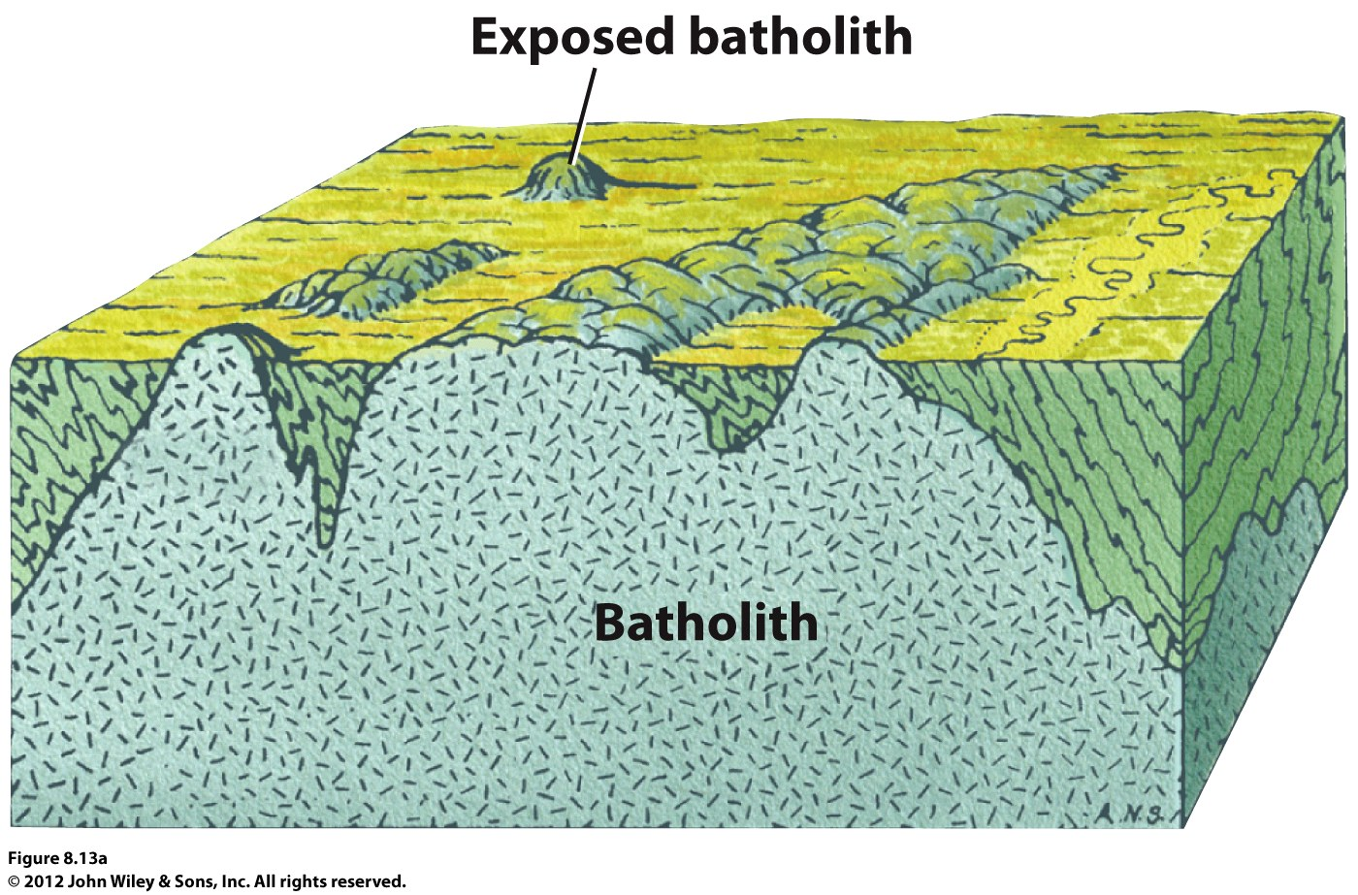
Batholiths can be exposed with erosion.
Examples: Idaho batholith, Sierra Nevada batholith (high central).
Sugar Loaf Mountain, Rio de Janeiro, Brazil, small granite dome-like projection of a batholith.

Slide 21
Sedimentary Rock
Made from layers of mineral particles found in other rocks
Have been carried by weathering
Can include newly formed material, plant and animal material
Physical weathering break down rock at the Earth’s surface
Chemical weathering actually changes the chemical composition of mineral grains (usually through exposure to oxygen and water).
When these particles are transported, they’re called sediment
Have distinctive layers or strata

Slide 22
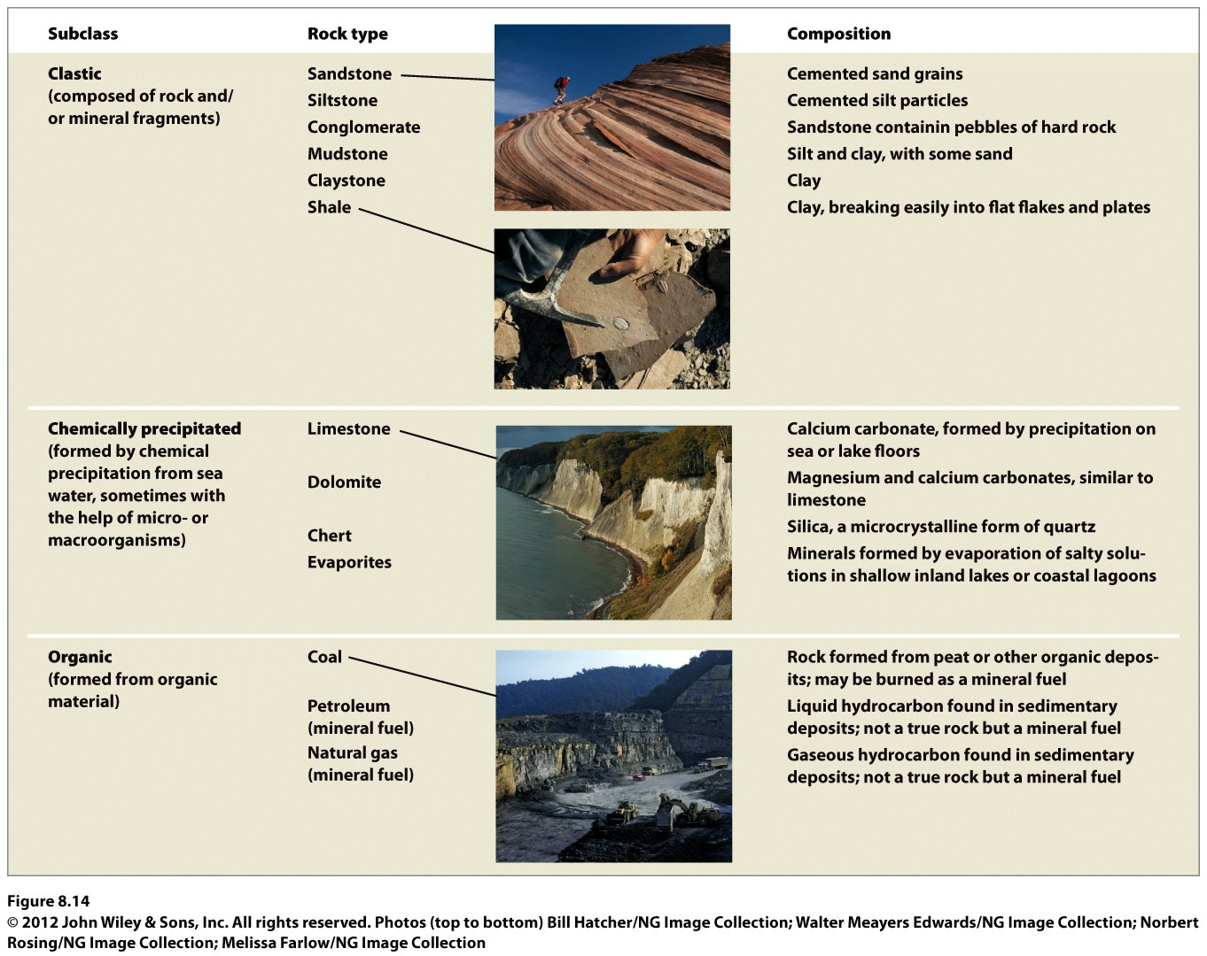

Slide 23
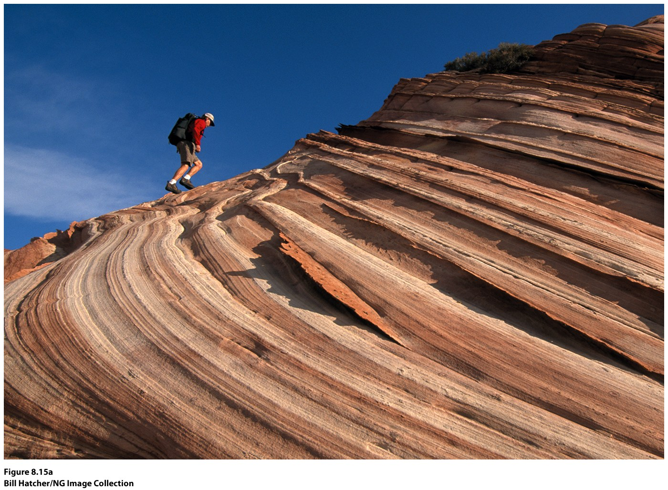
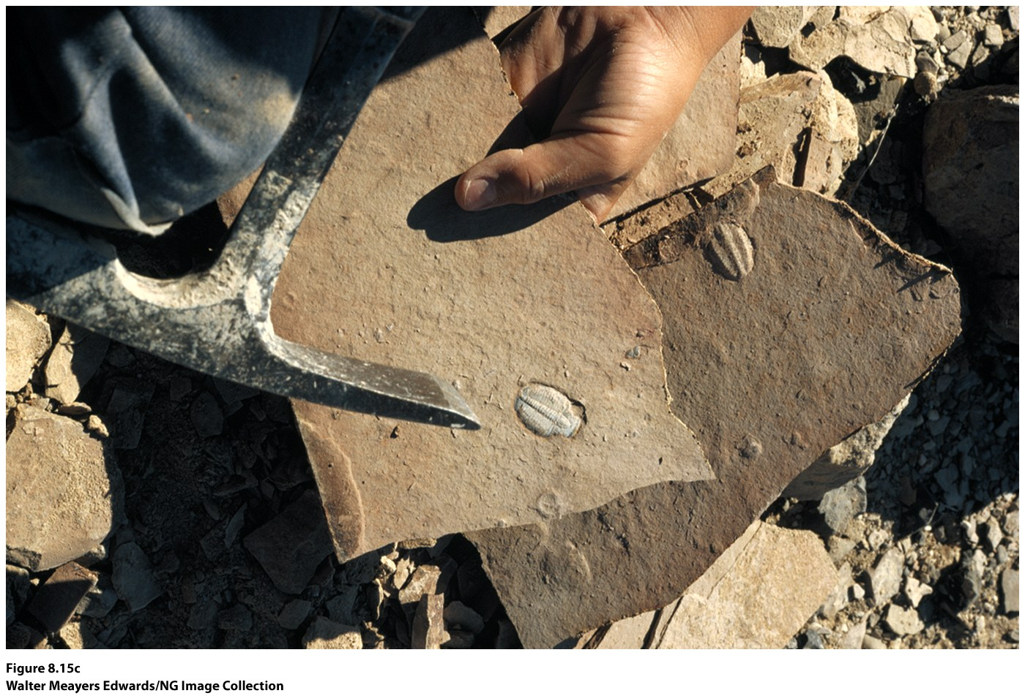
Clastic sedimentary rock
Inorganic rock and mineral fragments
Varying size and sources (become sorted)
Layers build until they become cemented—pressure compacts the sediments, squeezing out water and dissolved minerals recrystallize.
Sandstone. Colorado Plateau. Originally Shale. Fine textured particles
deposited in layers by moving sand dunes. deposited in calm waters. Antelope
Springs, Utah. Many contain fossils.

Slide 24
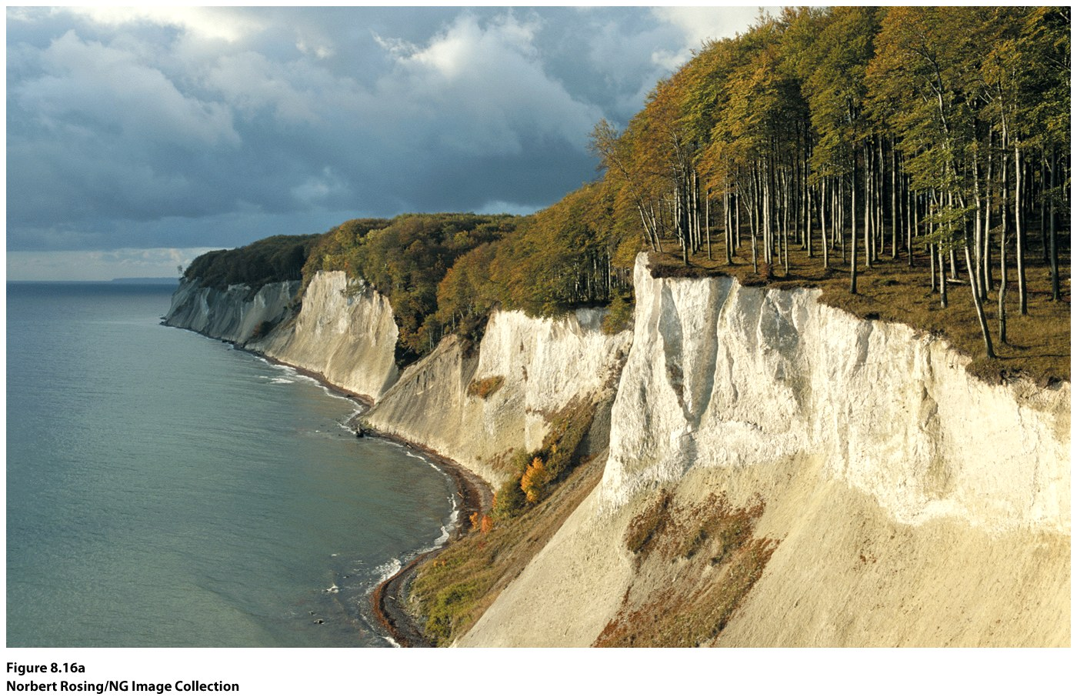
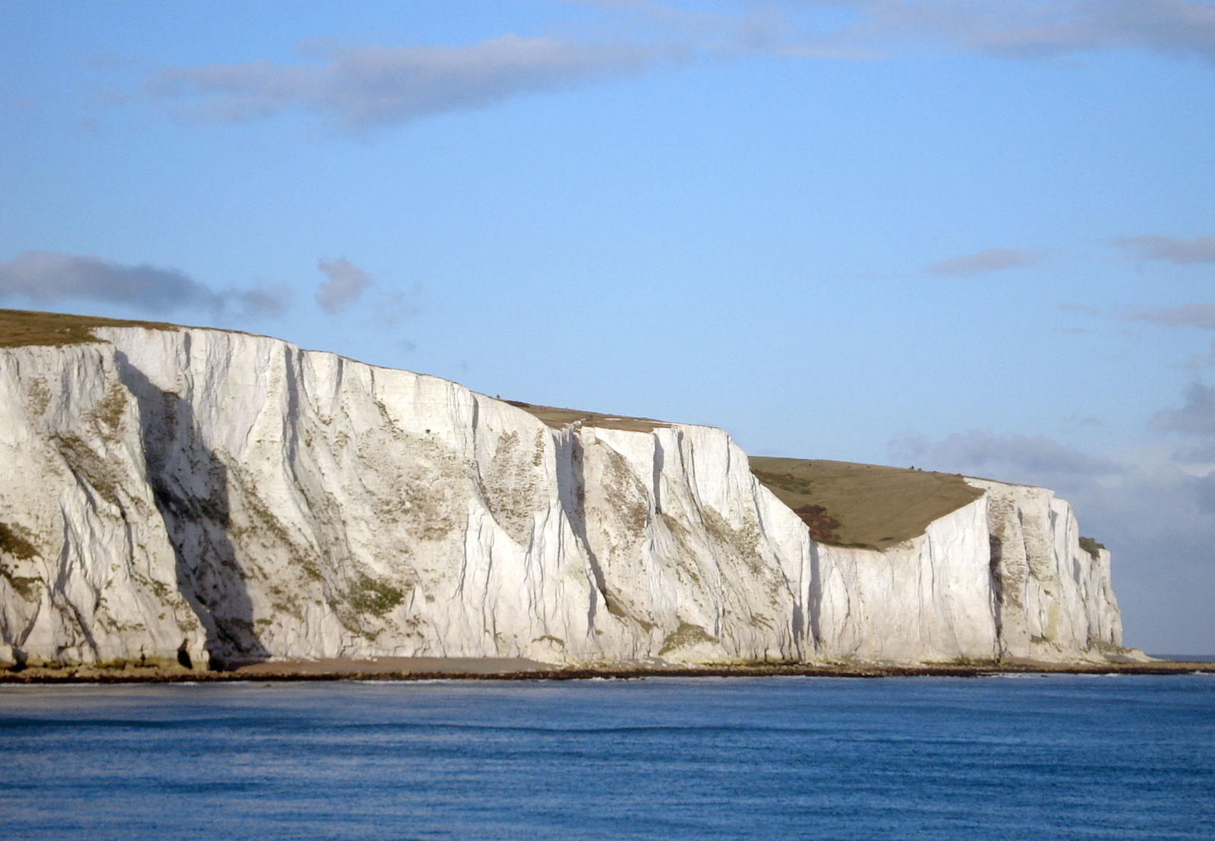
Chemically Precipitated Sedimentary Rock
Solid, inorganic mineral compounds that separate out from saltwater solutions or from the shells of microorganisms
Limestone—shells of microscopic organisms
Rugen Island, Germany, white chalk cliffs. The White Cliffs of Dover, England.

Slide 25
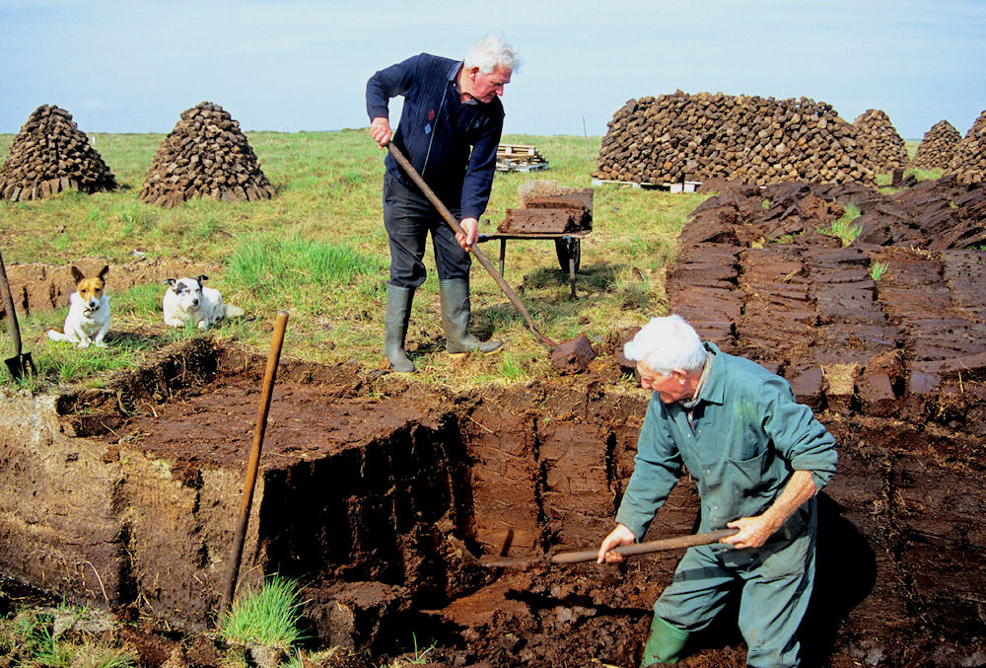
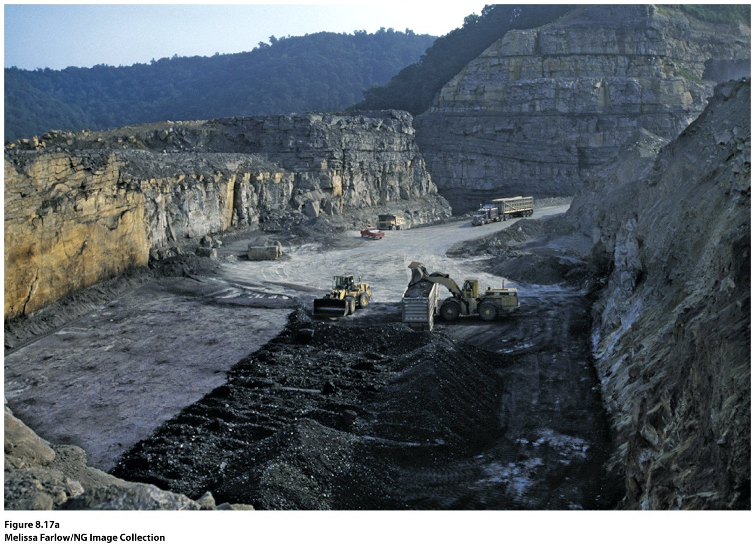
Organic Sedimentary Rock
Made up of tissues or biomass of plants & animals
Peat—found in bogs/marshes where acidic water prevents total decay
Peat is a hydrocarbon, the most important type of organic sediment—source of fossil fuel (can be solid, liquid, or gas)
Irish peat for fuel. Strip mining for coal.

Slide 26
Metamorphic Rock
Altering of rock due to very high pressure and temperature resulting from mountain-building processes
Rock is changed in texture and structure
More resistant to weathering than their parent rocks: Shale becomes Slate; Sandstone becomes Quartzite; Limestone becomes Marble
Occurs where magma intrudes into crustal rocks, and where tectonic activities are occurring—slate, schist, gneiss.

Slide 27
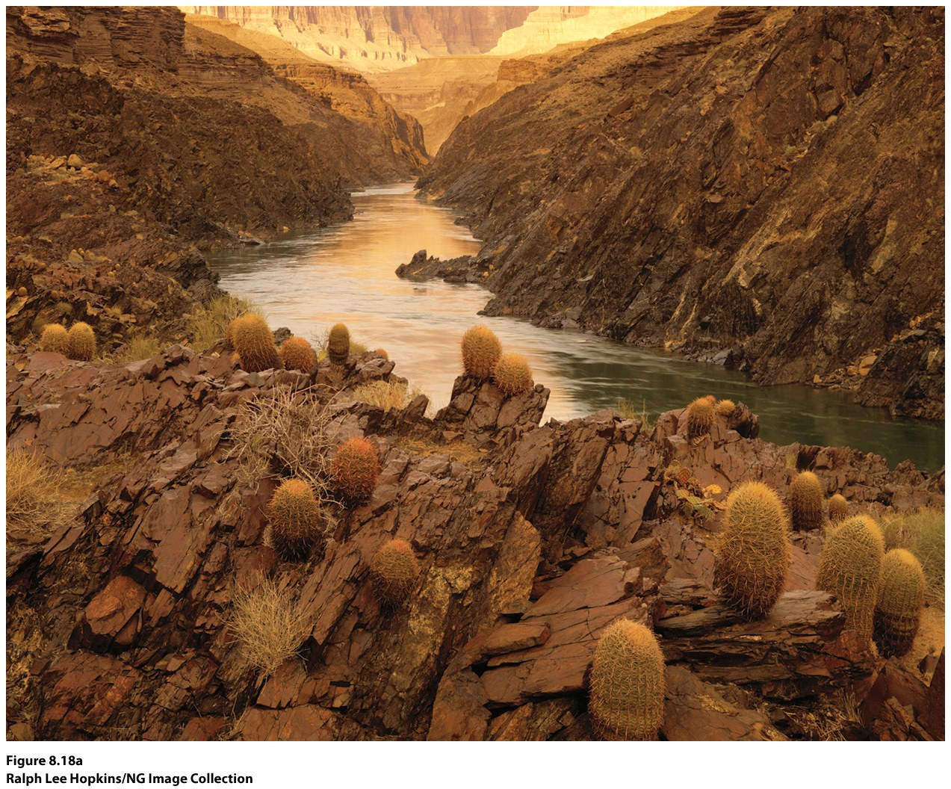

Slide 28
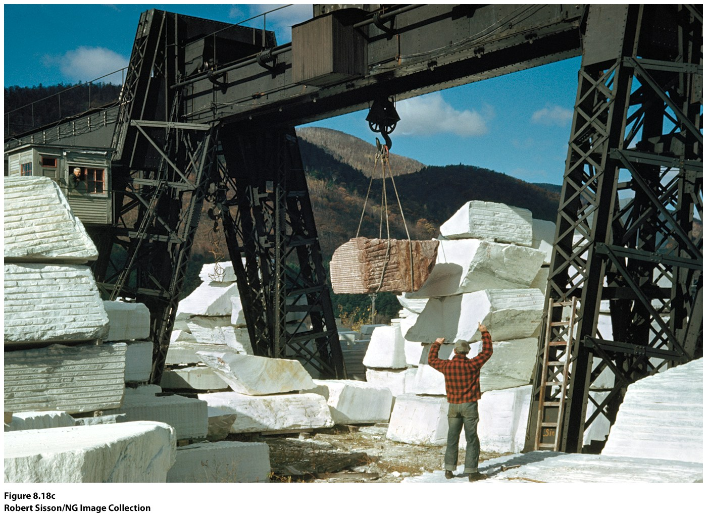

Slide 29
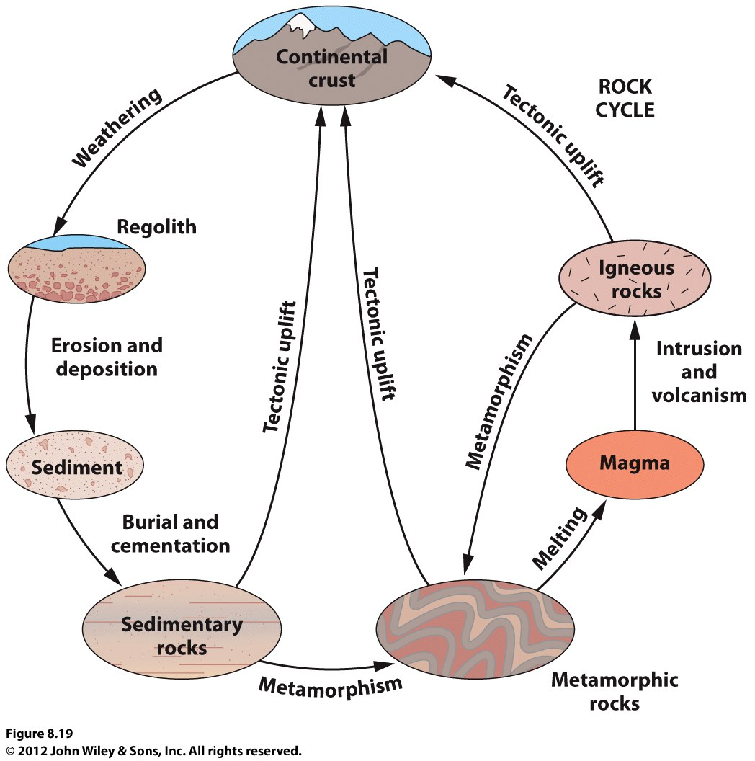
Rock Cycle
Rocks are constantly
being transformed

Slide 30
Earth’s Topography
Topography—major surface features of crust
Relief features—mountain chains, midoceanic ridges, high plateaus, ocean trenches
Continental & Oceanic Features

Slide 31
Continental Features
Alpine Chains
Active
Narrow zones on margins of plates
High, rugged
Can grow two ways: volcanism, tectonic activity
Continental Shields
Older, inactive
Areas of low-lying igneous and metamorphic rock that haven’t eroded
Continent building material
Continental landforms
Six types:

Slide 32
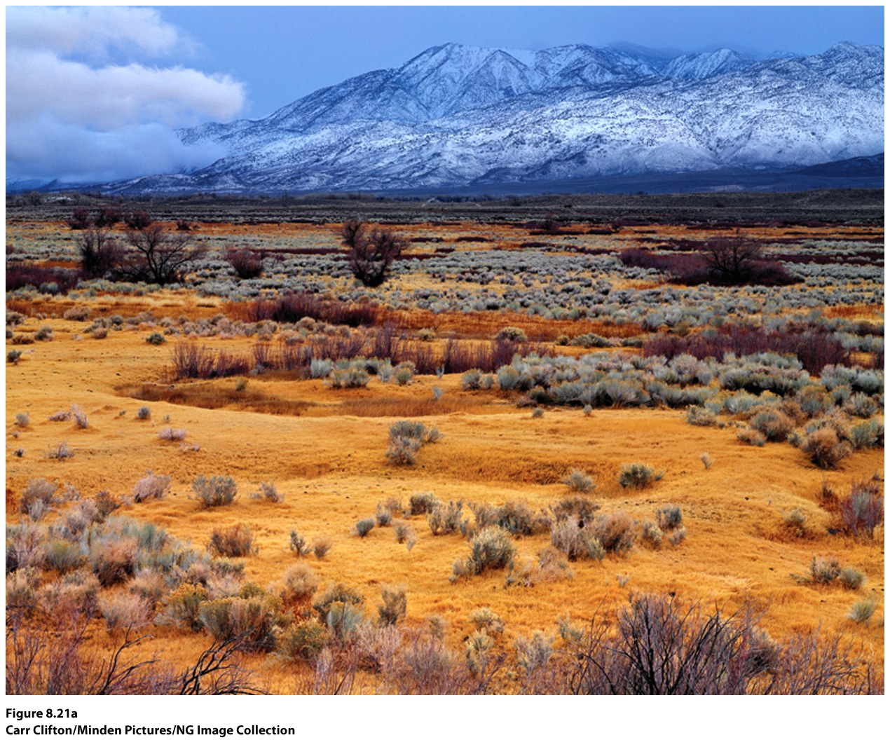
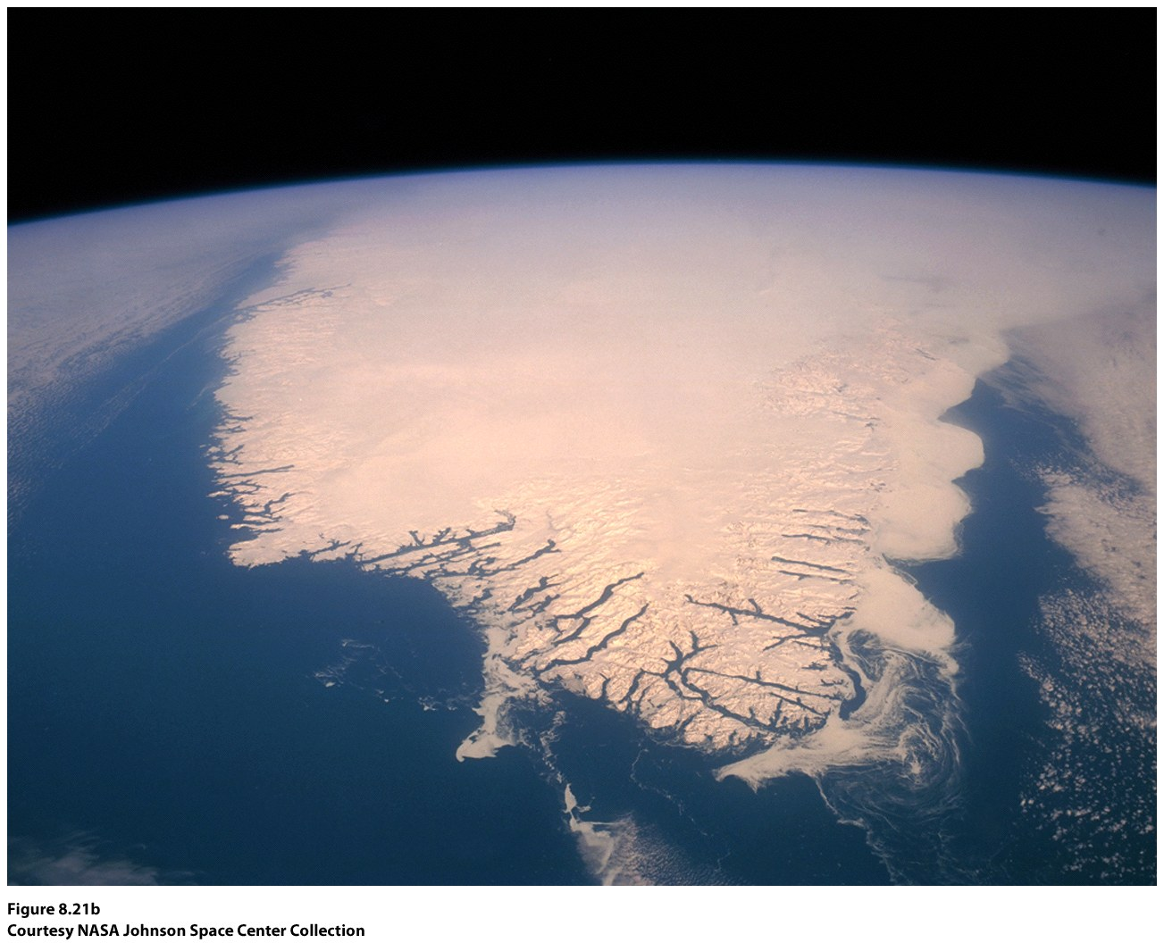
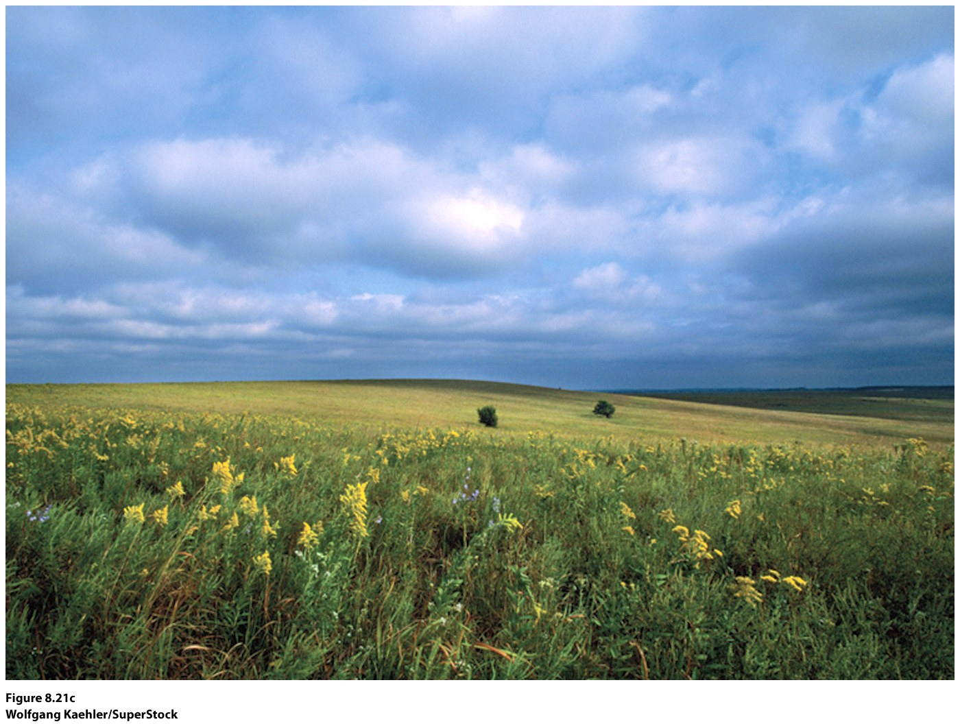
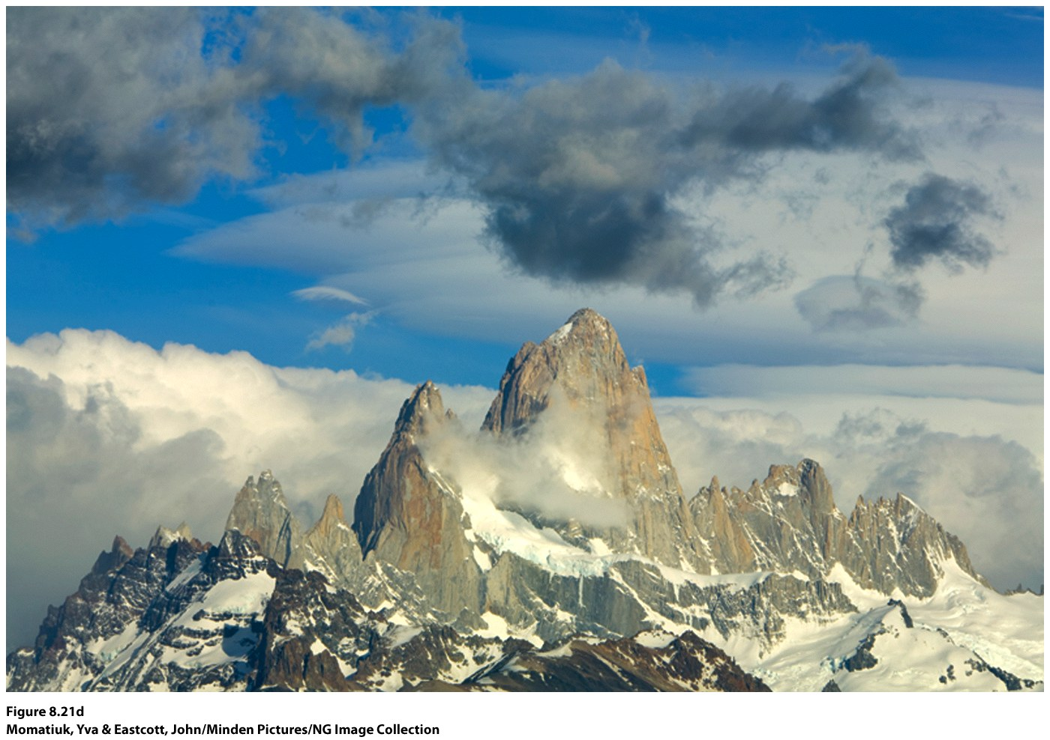
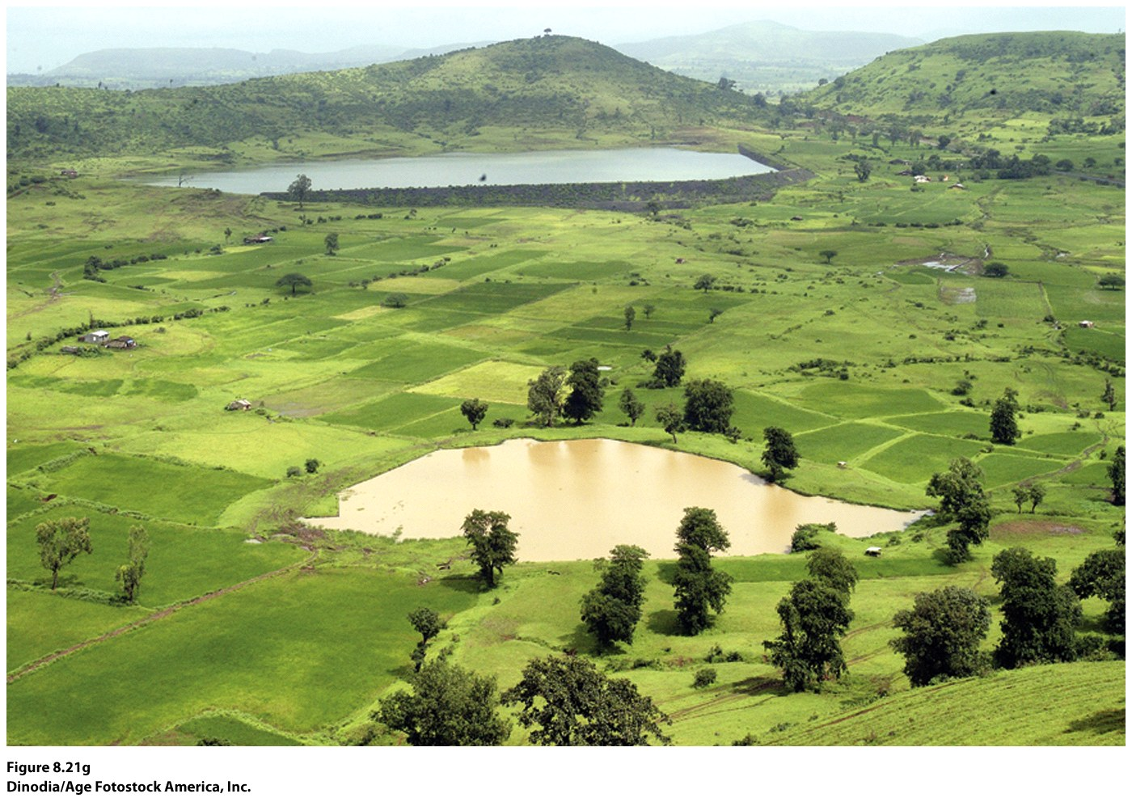
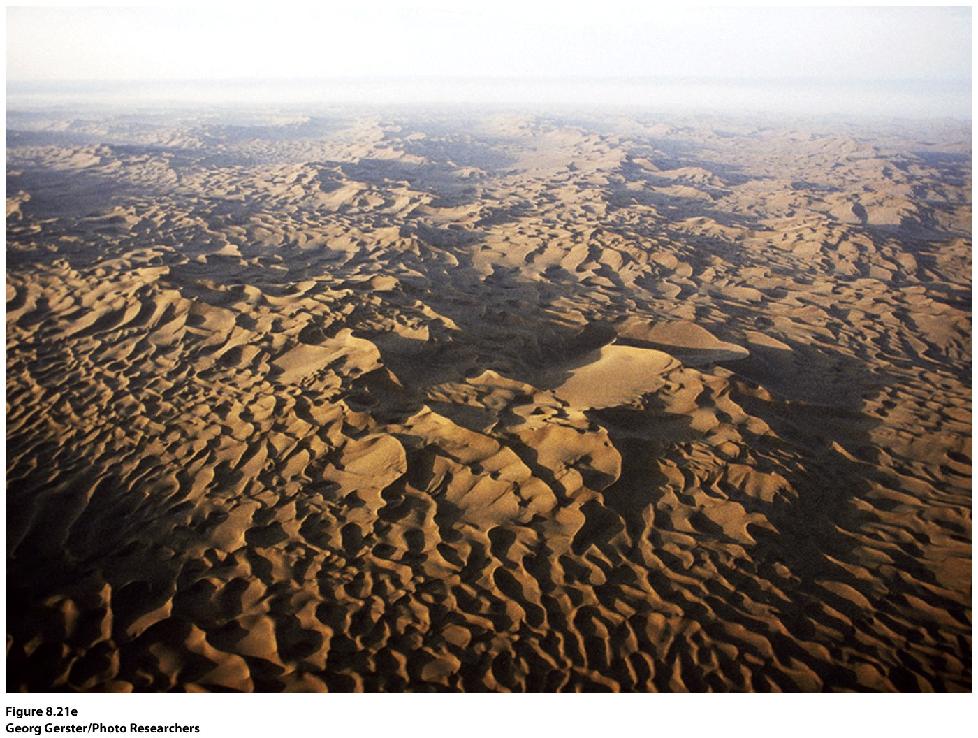
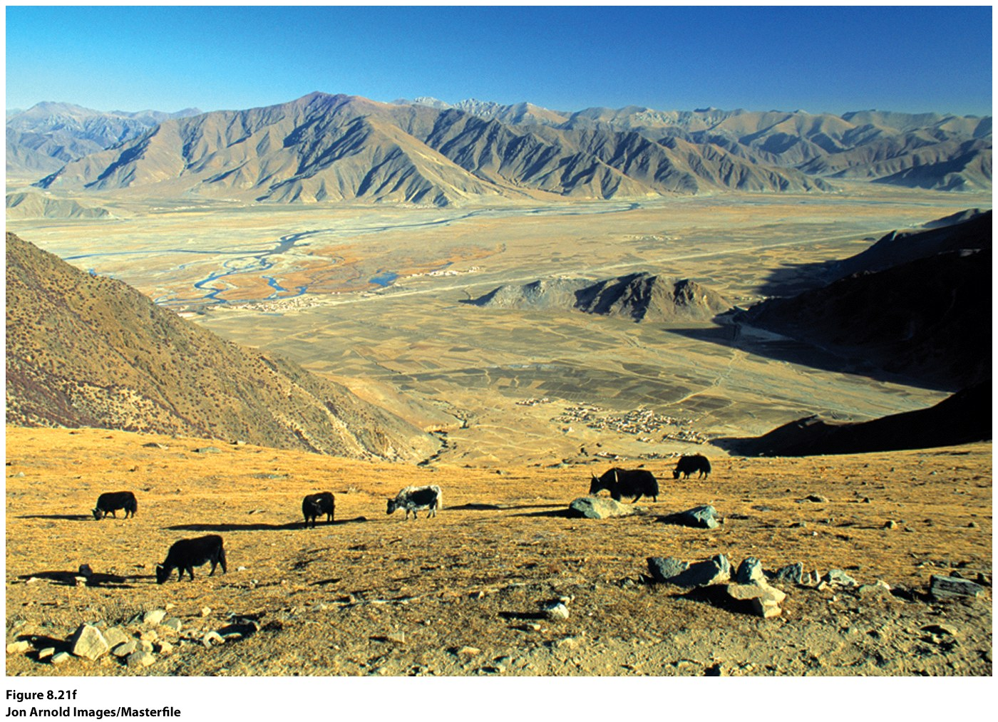

Slide 33
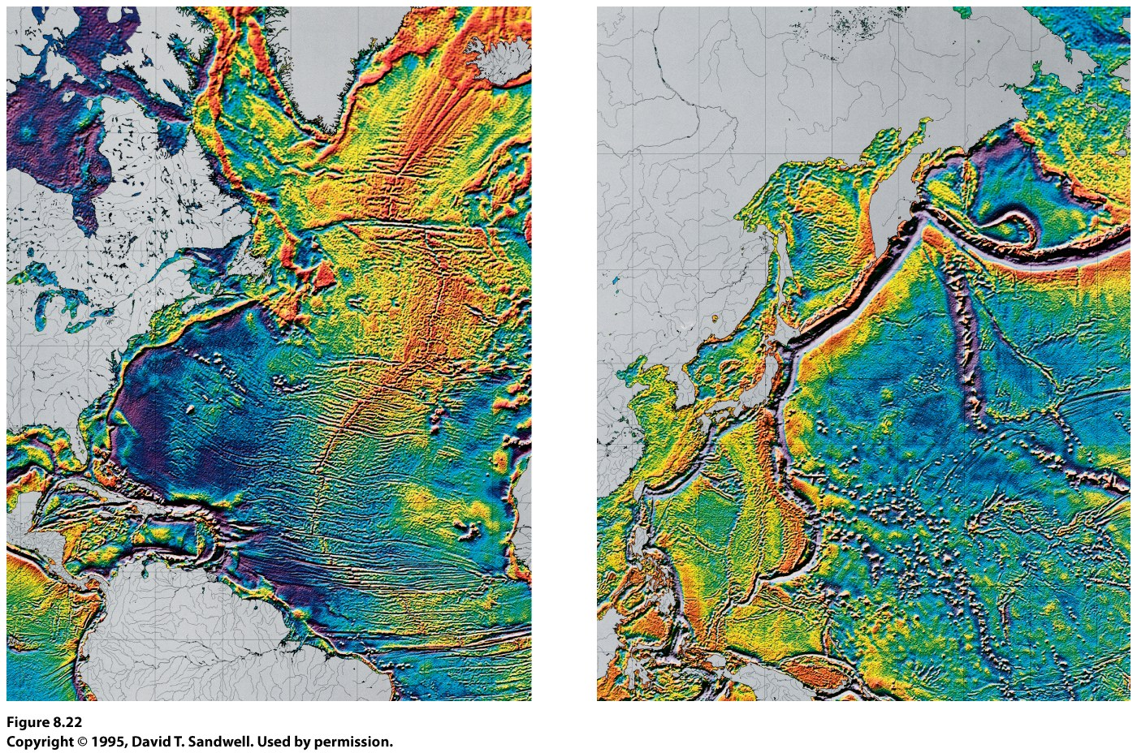
Oceanic Landforms
Younger material (less than 60 my old)
Midoceanic ridges
Deep ocean trenches
Active continental margins: deep offshore trenches, volcanic activity
Two tectonic plates are spreading apart along the Mid-Atlantic Ridge.

Slide 34
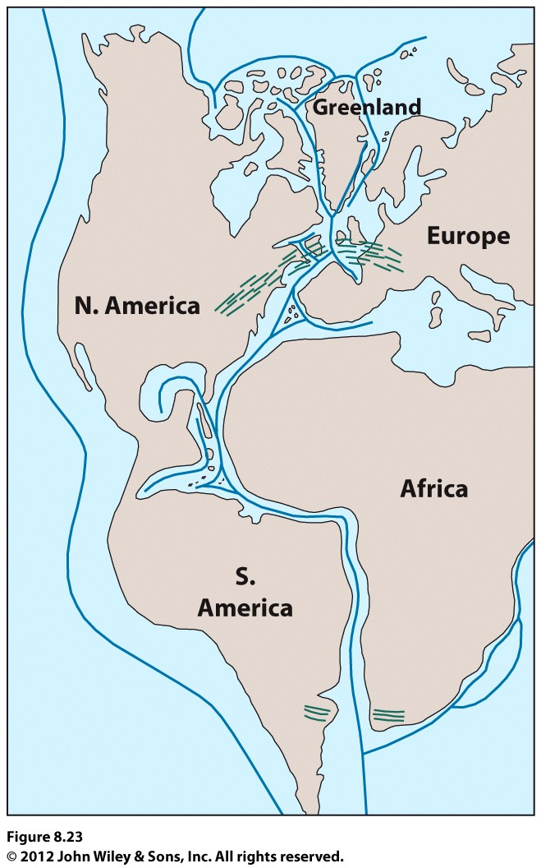
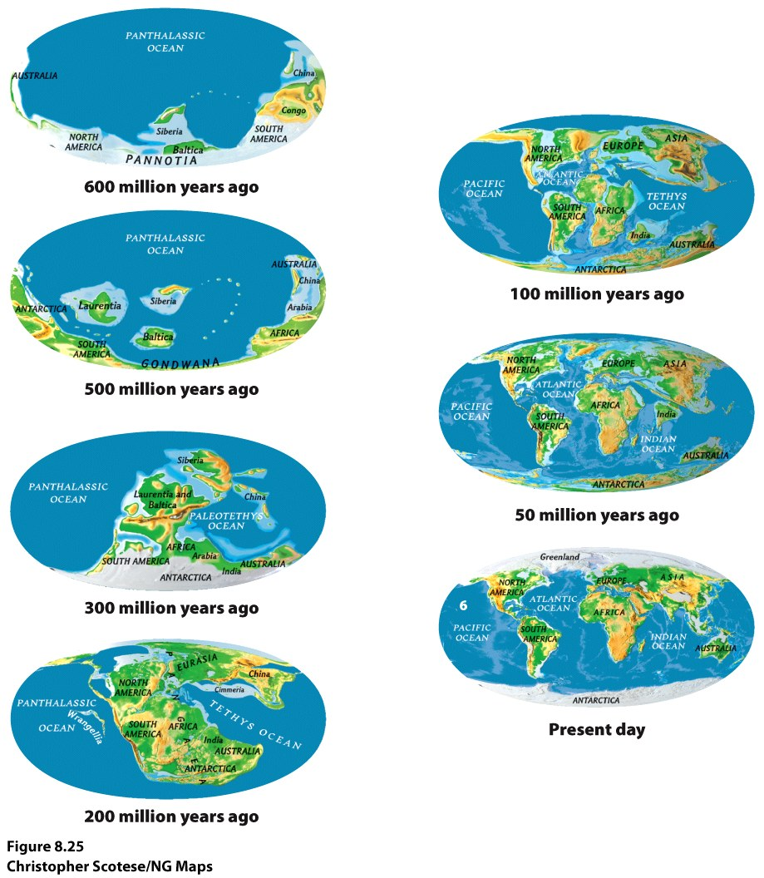
Configuration of the Continents
The Theory of continental drift
Wegener’s Pangea

Slide 35
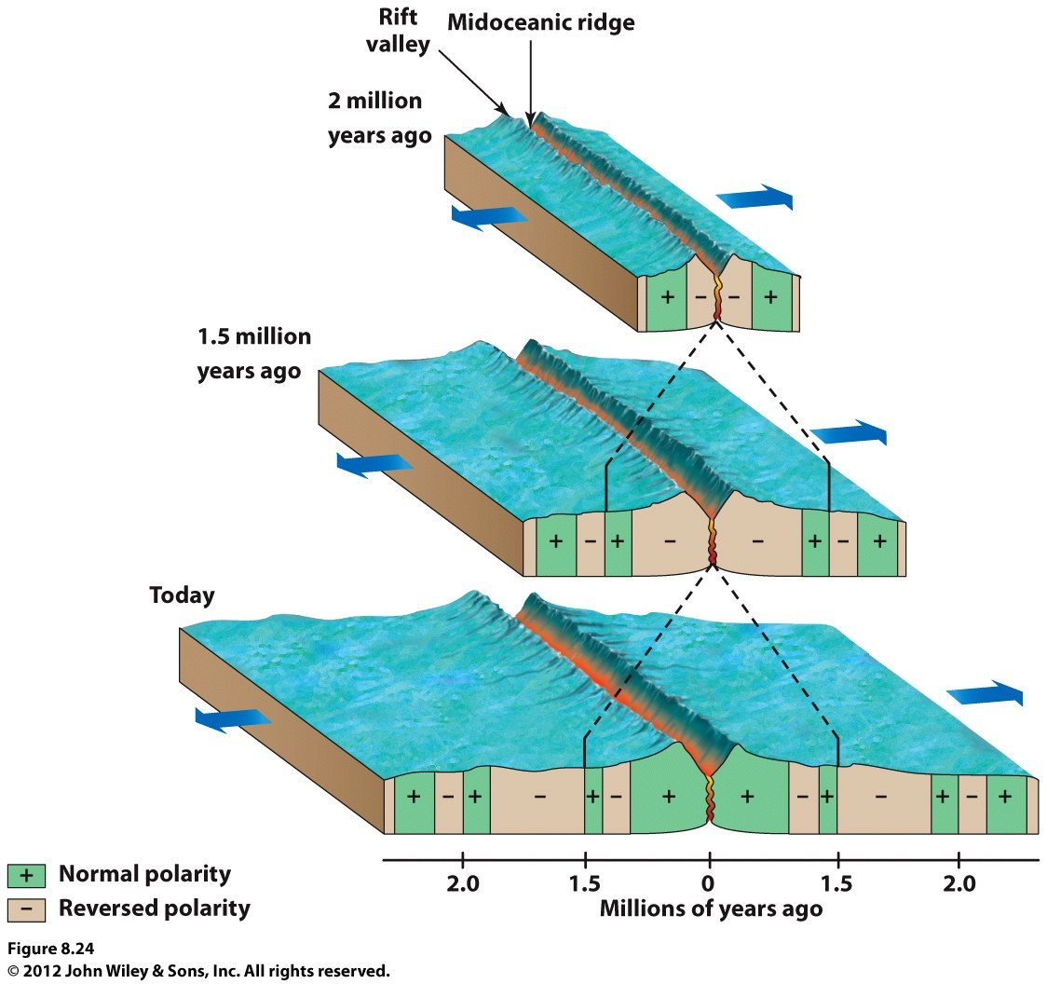
Topography of the Earth
Seafloor Spreading
Notes:
Insert Figure 8.24. Insert http://www.wiley.com/college/strahler/0471480533/animations/ch13_animations/divergent_plates.html

