Slide 1
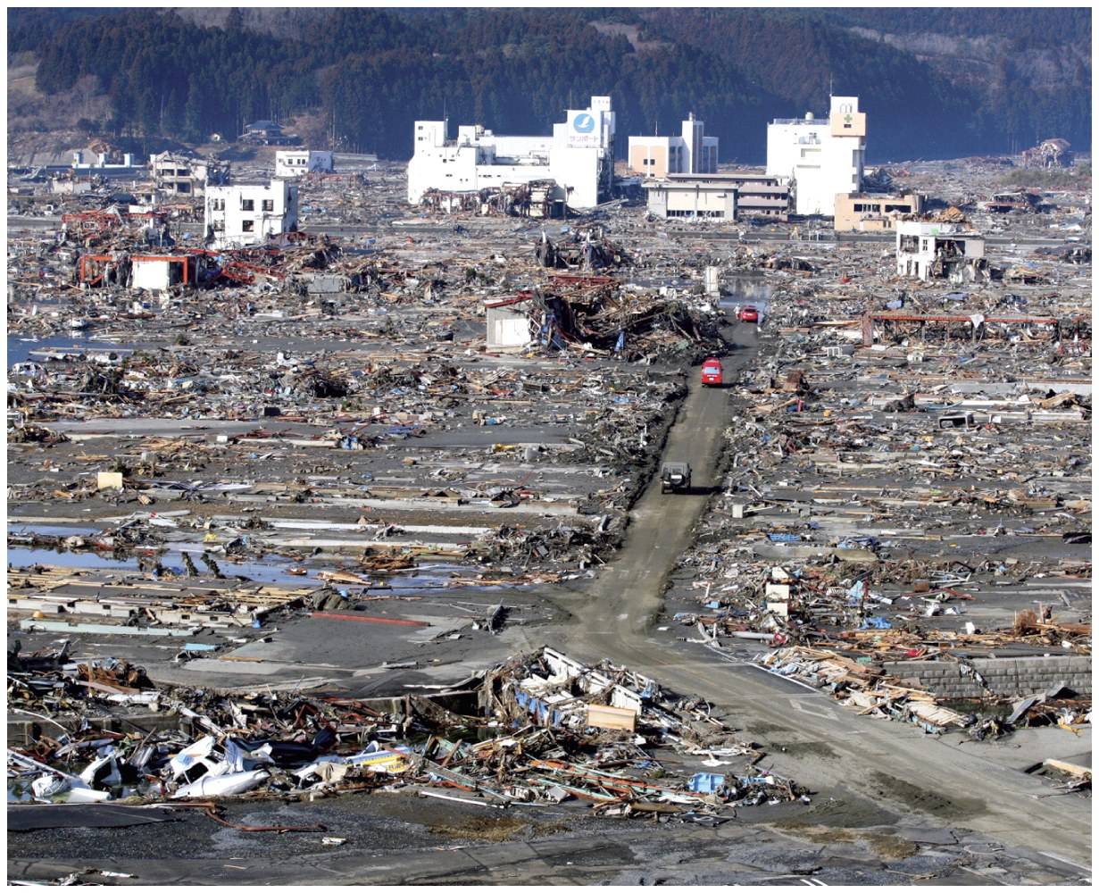
Chapter 9 Volcanic and Tectonic Landforms
© Getty Images

Slide 2
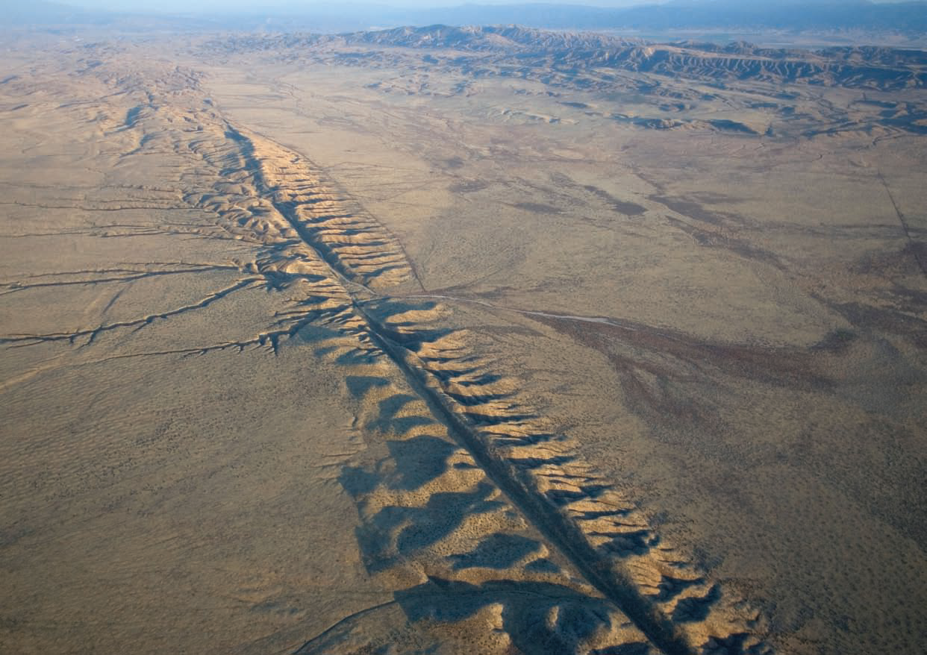
Chapter Overview
Plate Tectonics
Tectonic Activity and Earthquakes
Volcanic Activity and Landforms
© Aurora Photos/Alamy

Slide 3
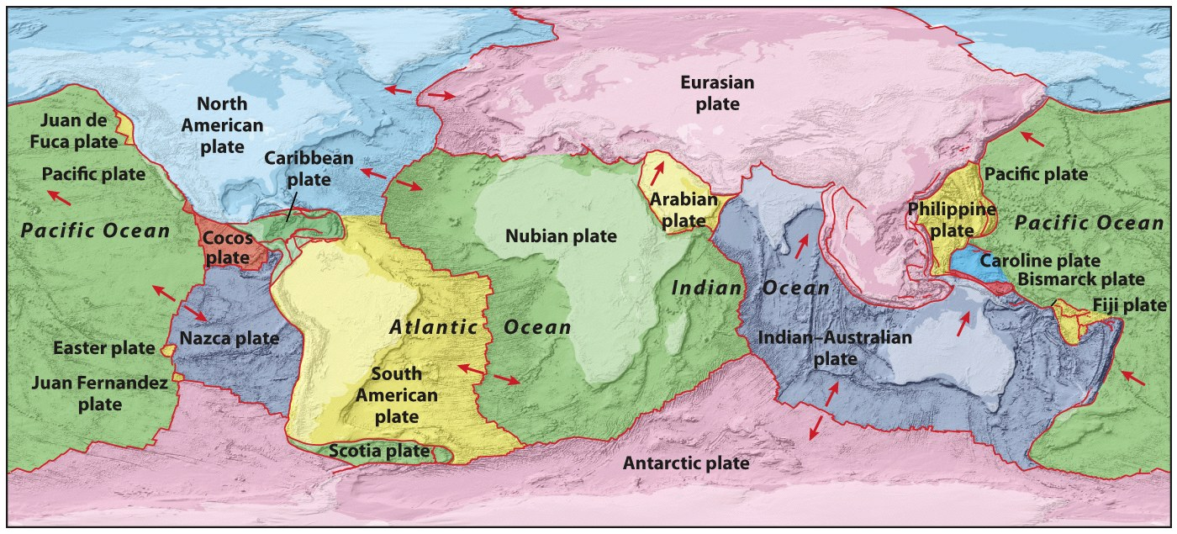
Plate Tectonics
Major and minor lithospheric plates of the globes
Plate tectonics = The theory of tectonic activity, which deals with lithospheric plates and their motions
Movement of these plates is driven by heat from Earth’s core
© John Wiley & Sons, Inc.

Slide 4
Alfred Wegener “The Origin of Continents and Oceans”, 1915
Argued for a supercontinent “Pangaea”
Argued it broke apart 250 mya

Slide 5
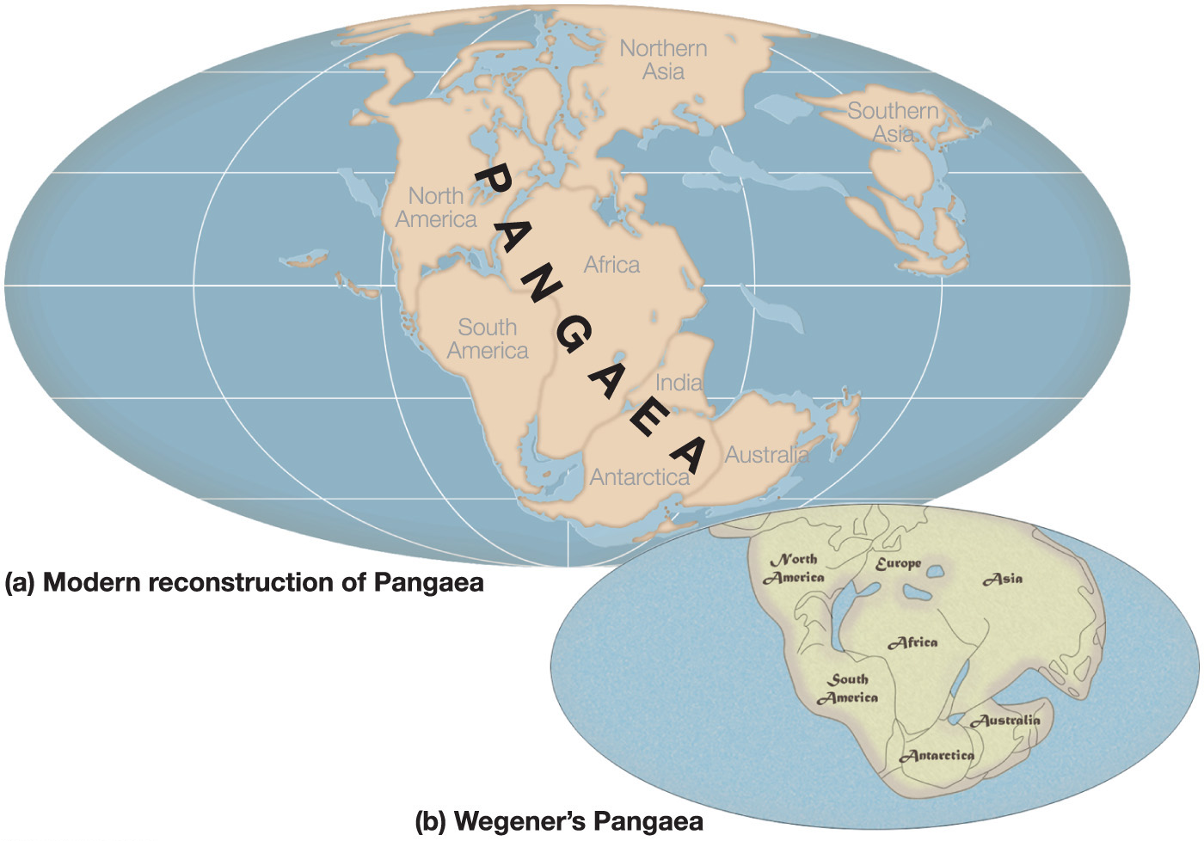
Notes:
Chapter 14, Figure 14.1 Labeled

Slide 6
Evidence?
Puzzle-piece fit of the continents

Slide 7
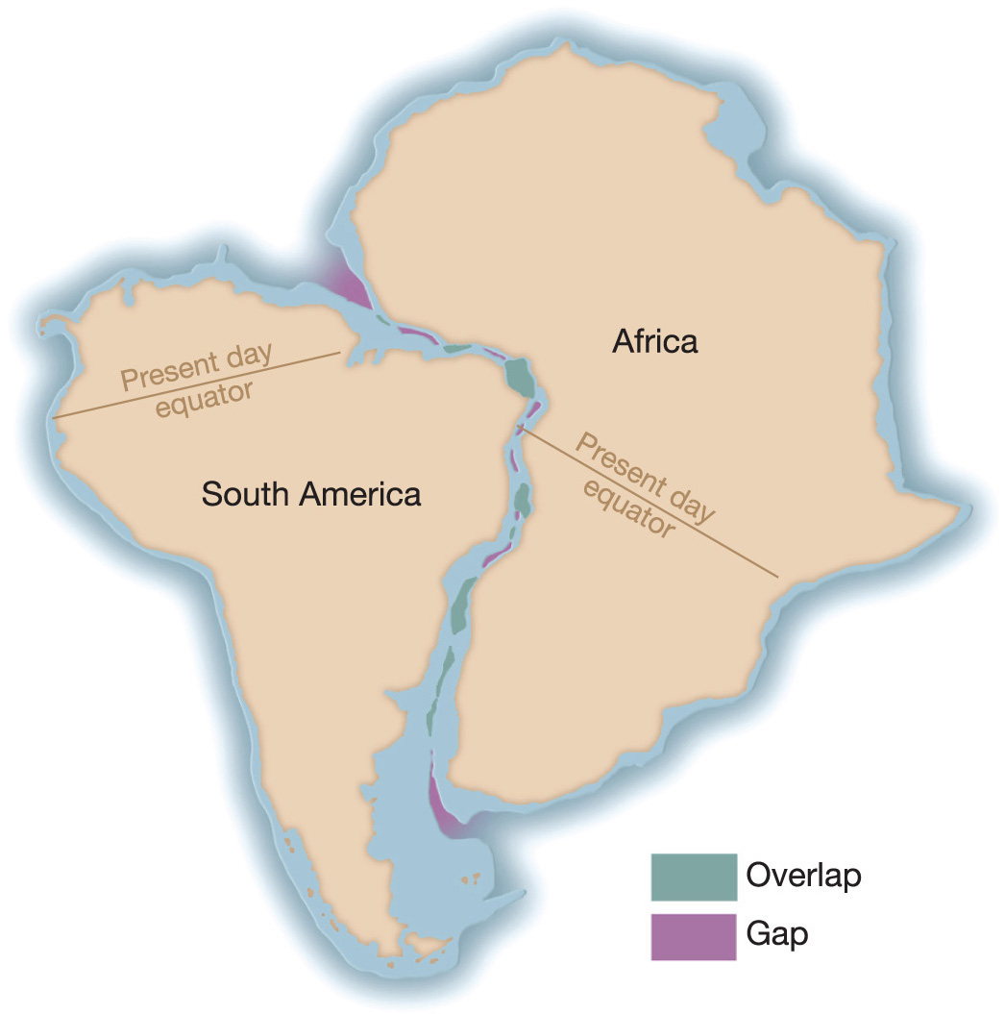
The matching of the coastlines of Africa and South America. When the continental shapes are compared at a depth of about 900 meters along the continental slope, there are few large gaps or overlaps.
Notes:
Chapter 14, Figure 14.2 Labeled

Slide 8
Evidence?
Petrologic Record—organic sedimentary rock (coal)
Mountain Belts

Slide 9
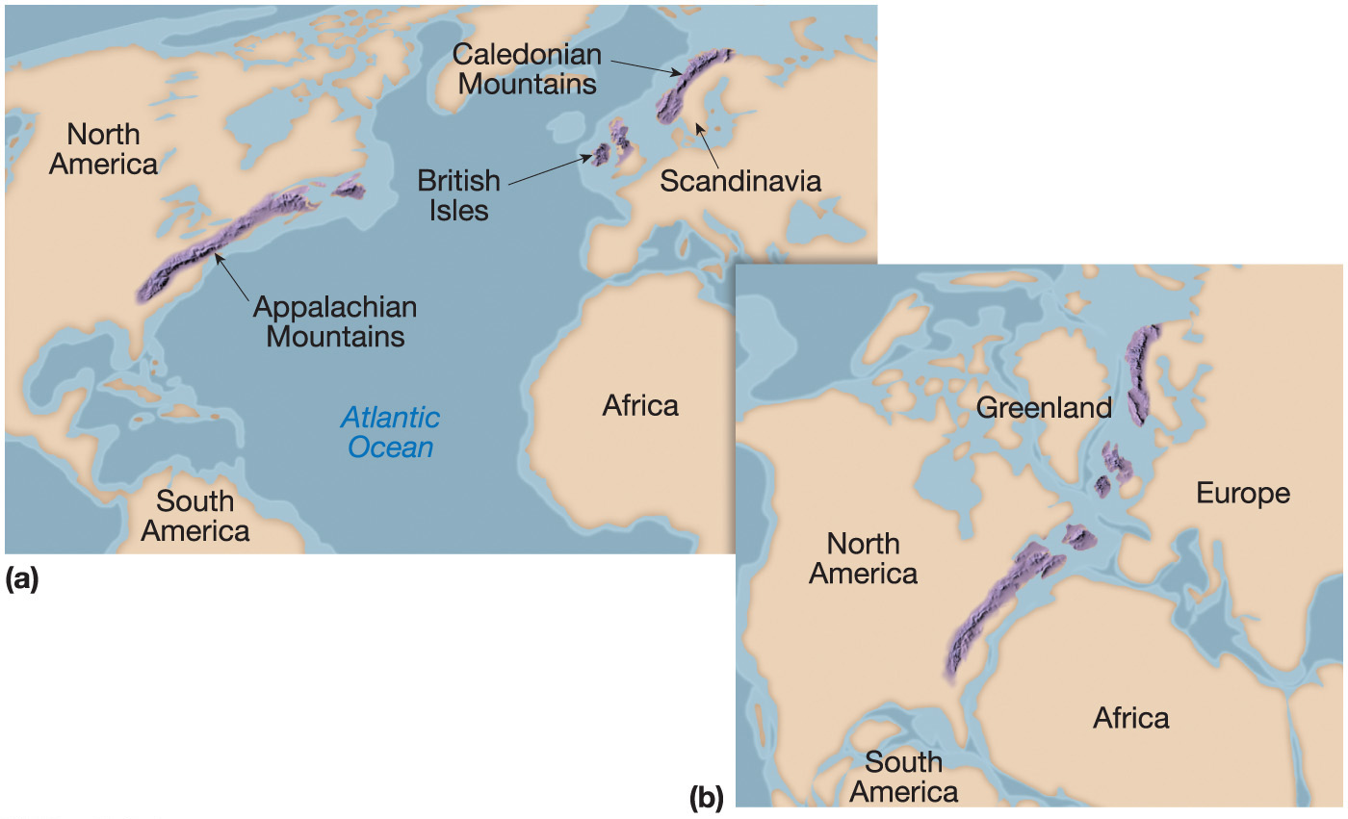
Mountain ranges match on both sides
Of the North Atlantic Ocean.
The Appalachian Mtns are of similar age and structure to those found in the British Isles and Scandinavia
Before Pangaea rifted apart, these mountain belts formed a nearly continuous chain
Notes:
Chapter 14, Figure 14.3 Labeled

Slide 10
Evidence?
Fossil Record
Dinosaurs
Plant species
Reconstruction of Past Climates with Koppen
Evidence of glaciation in large areas of the southern continents & India (300 mya)

Slide 11
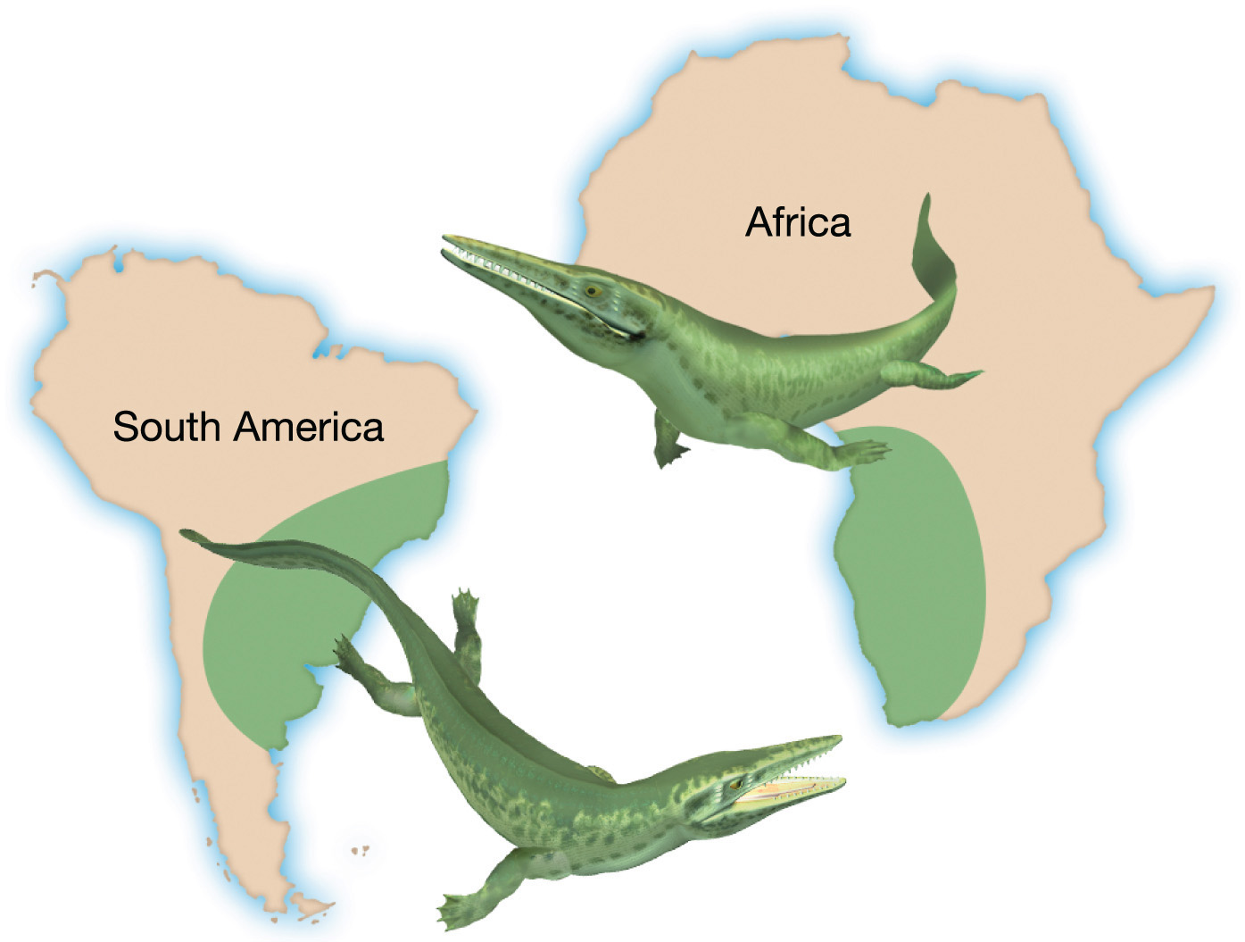
Notes:
Chapter 14, Figure 14.4 Labeled

Slide 12
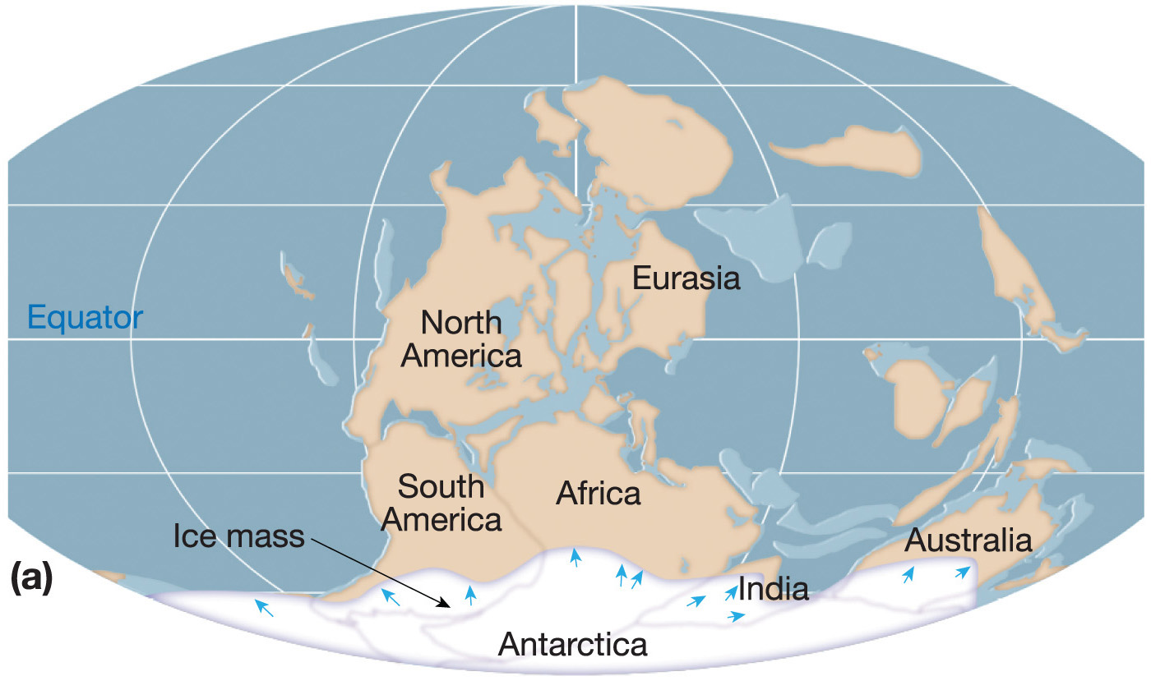
300 mya large areas of Pangaea were heavily glaciated.
Notes:
Chapter 14, Figure 14.5a Labeled

Slide 13
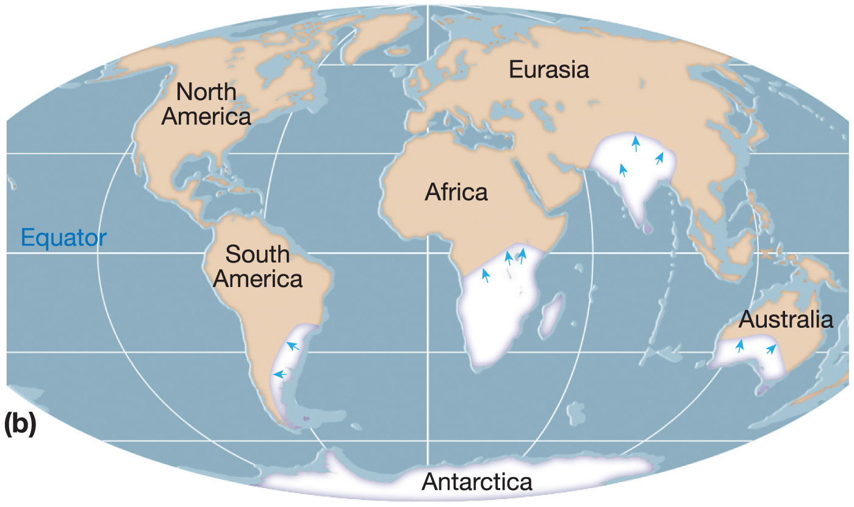
Patterns of glaciation and ice movement make sense when their former positions are considered.
Notes:
Chapter 14, Figure 14.5b Labeled

Slide 14
Wegener’s theory, Continental Drift, was largely rejected by the scientific community
What fuels this movement of land?
How does rigid rock move and plow through other areas of rigid rock?
Died on an Arctic expedition in 1930

Slide 15
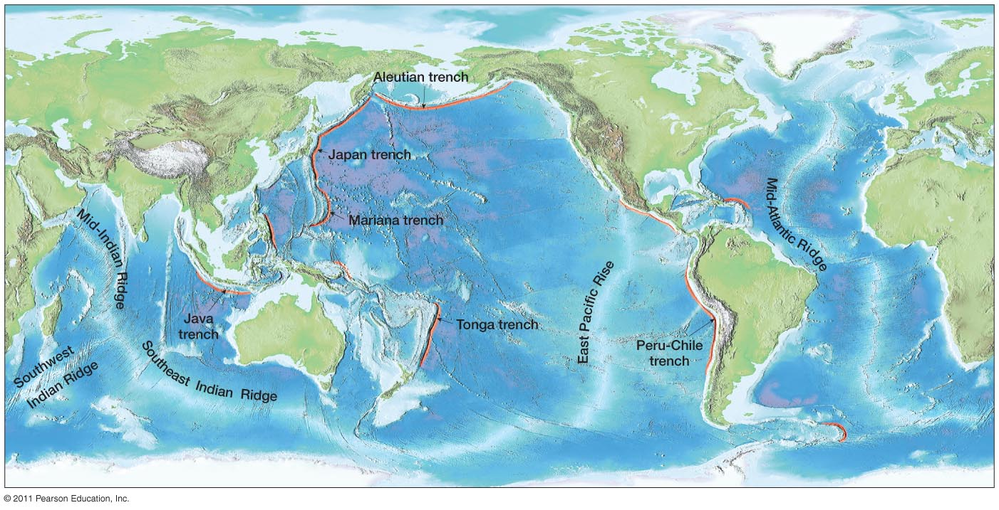
A clear pattern emerged: a continuous system of ridges and deep ocean trenches.
1950s—new evidence. Mapping of the sea floor leads to ‘discovery’ of underwater volcanoes, deep ocean trenches, ocean ridges.
Notes:
Figure 14-6
15

Slide 16
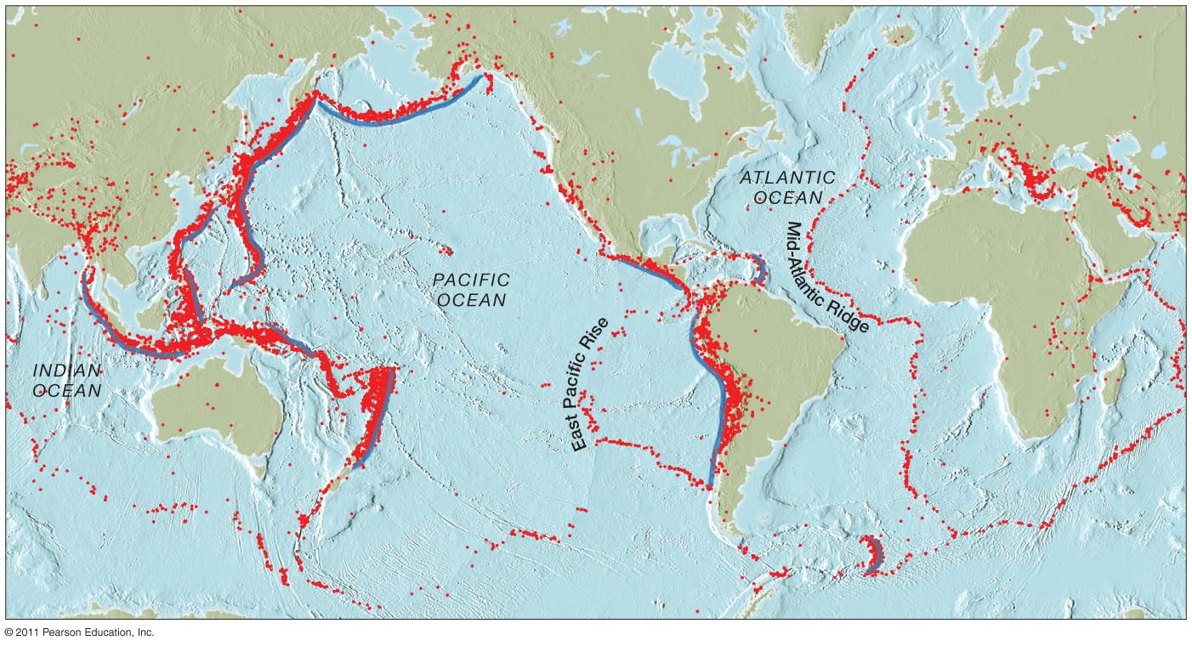
When a map of earthquake epicenters (5.0 or greater) is overlaid on the map of the ocean floor, striking overlaps appear.
Notes:
Figure 14-7
16

Slide 17
Harry Hess
How to explain this overlap?
Sea-floor spreading
Ridges are evidence of new ocean rock, older rock is being dragged downwards at trenches
Rocks on continents cannot be subducted.
Only oceanic rock is ‘recycled’
So Wegener’s theory was only wrong about one thing:
The continents are not drifting but are on a conveyor belt (the thicker lithospheric plates) moving out from the oceanic ridges toward the trenches.

Slide 18
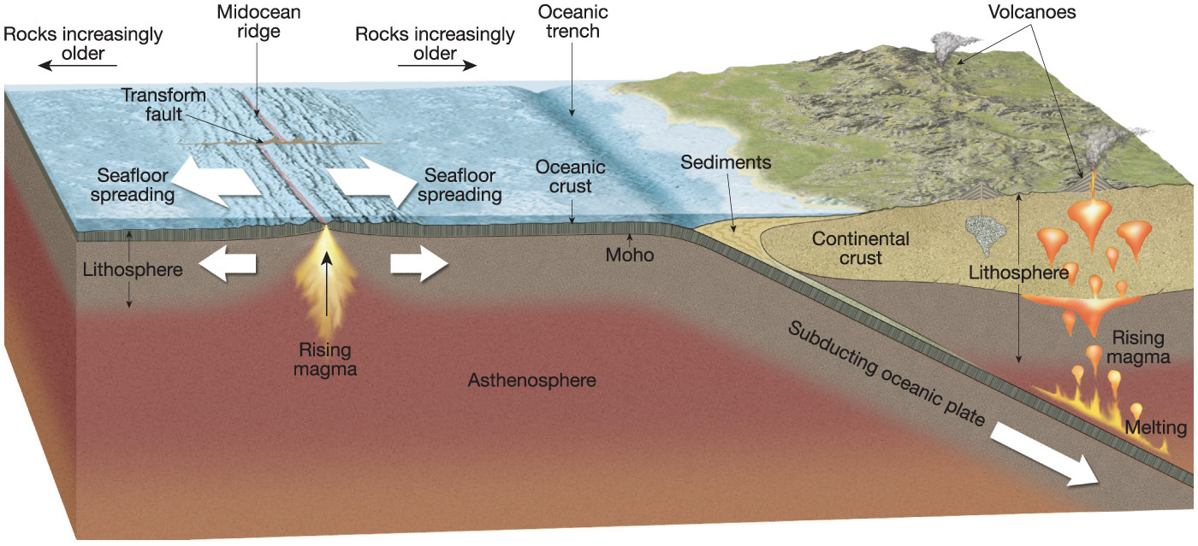
Plate tectonics, 1968
The lithosphere is a series of rigid plates.
These plates float over the more flexible asthenosphere (plastic).
Notes:
Chapter 14, Figure 14.8 Labeled

Slide 19
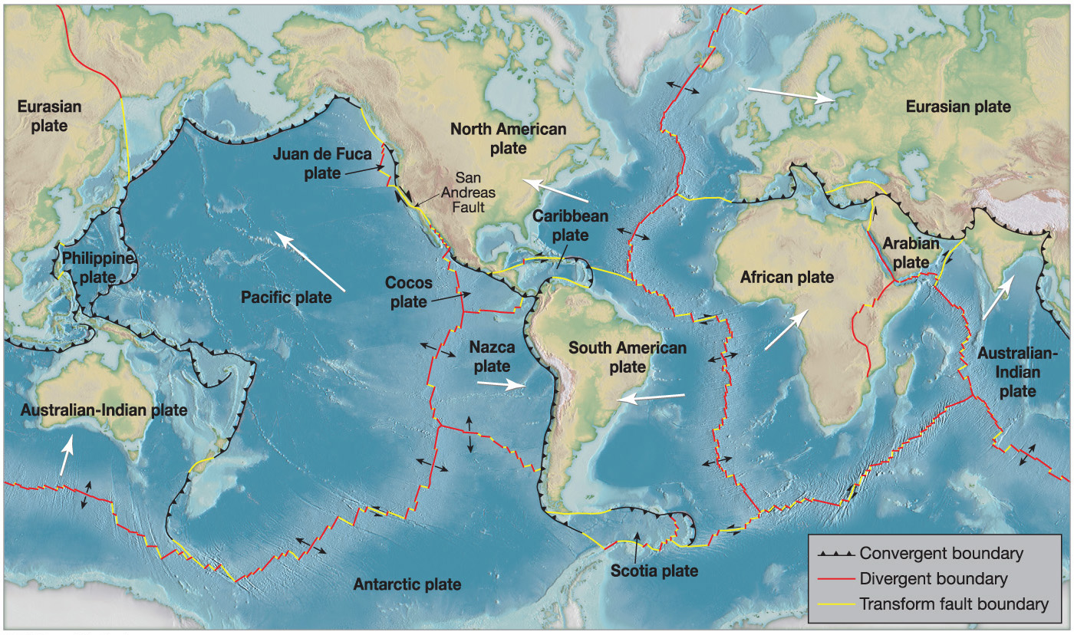
--The number of plates and their boundaries not totally clear.
--7 major and 7 intermediate sized plates; 12 smaller (many remnants of once-larger plates)
--Energy from convective currents in Earth’s mantle.
Notes:
Chapter 14, Figure 14.11 Labeled

Slide 20
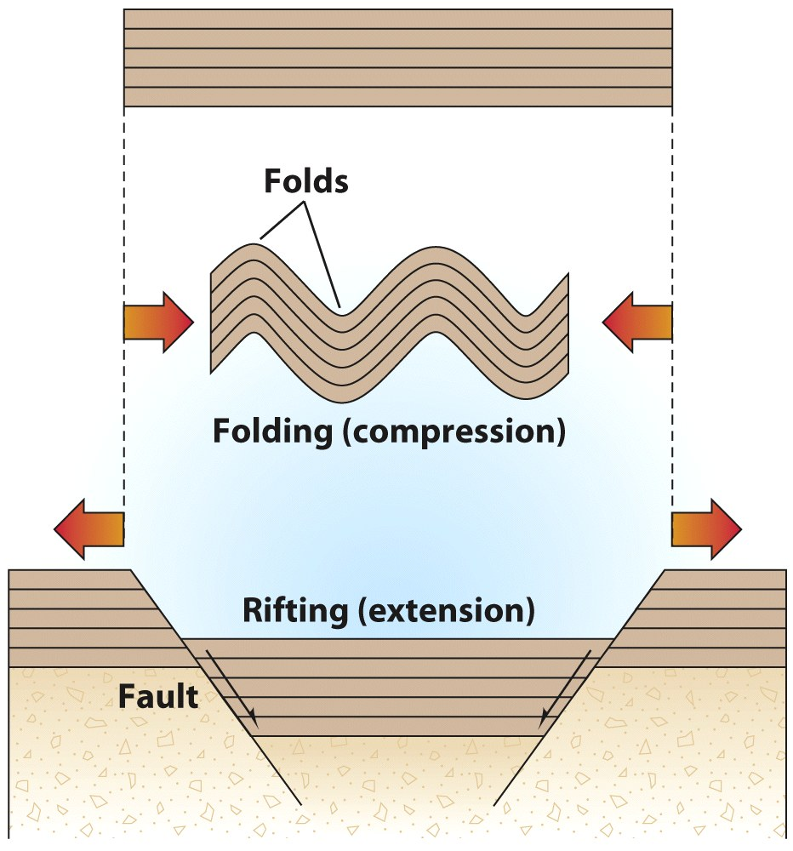
Plate Tectonics
Types of Plate Boundaries
Extensional tectonic activity
Spreading or Divergent boundary
Plates pulled apart
Compressional tectonic activity
Converging boundary
Plates pushed together
Plates move past each other
Transform boundary
Transform faults
© A.N. Strahler

Slide 21
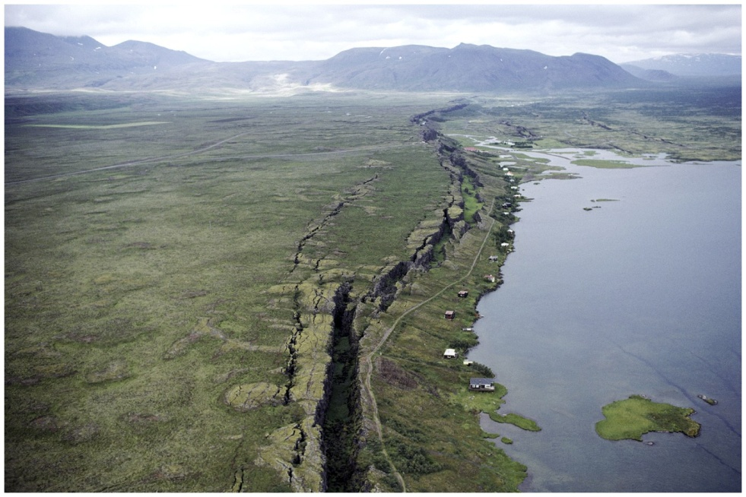
Spreading Boundaries
A boundary where two lithospheric plates move apart
Mid-ocean ridge—sea floor spreading
© NG Image Collection

Slide 24
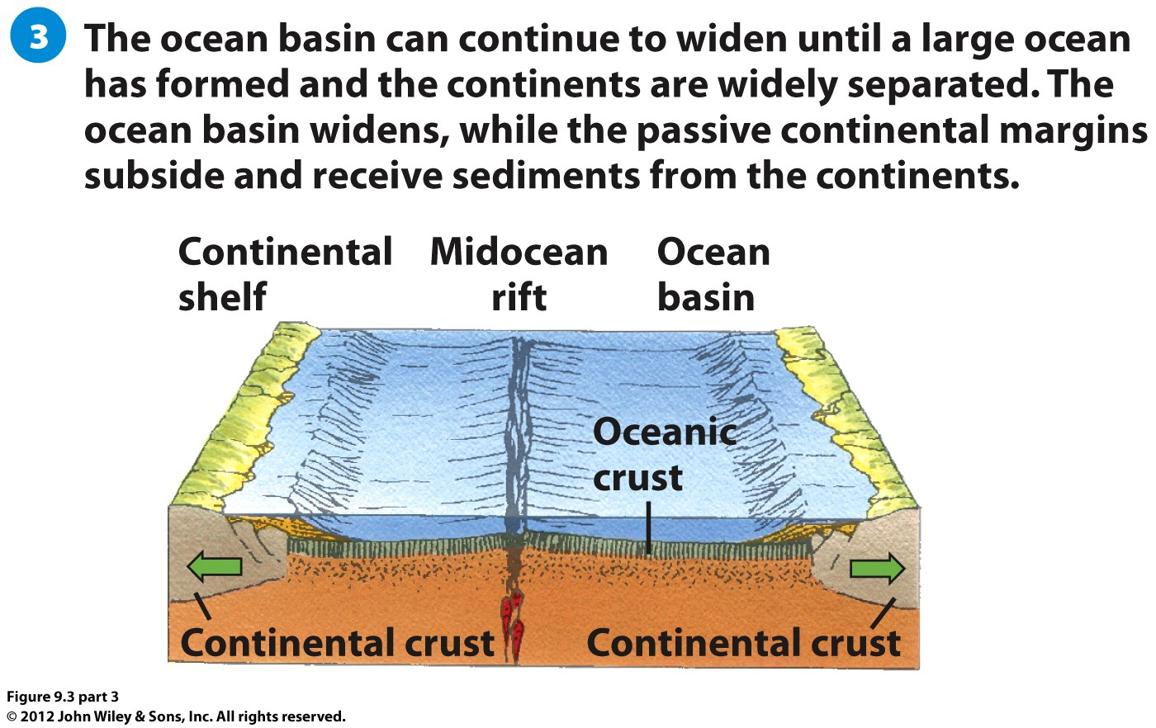

Slide 25
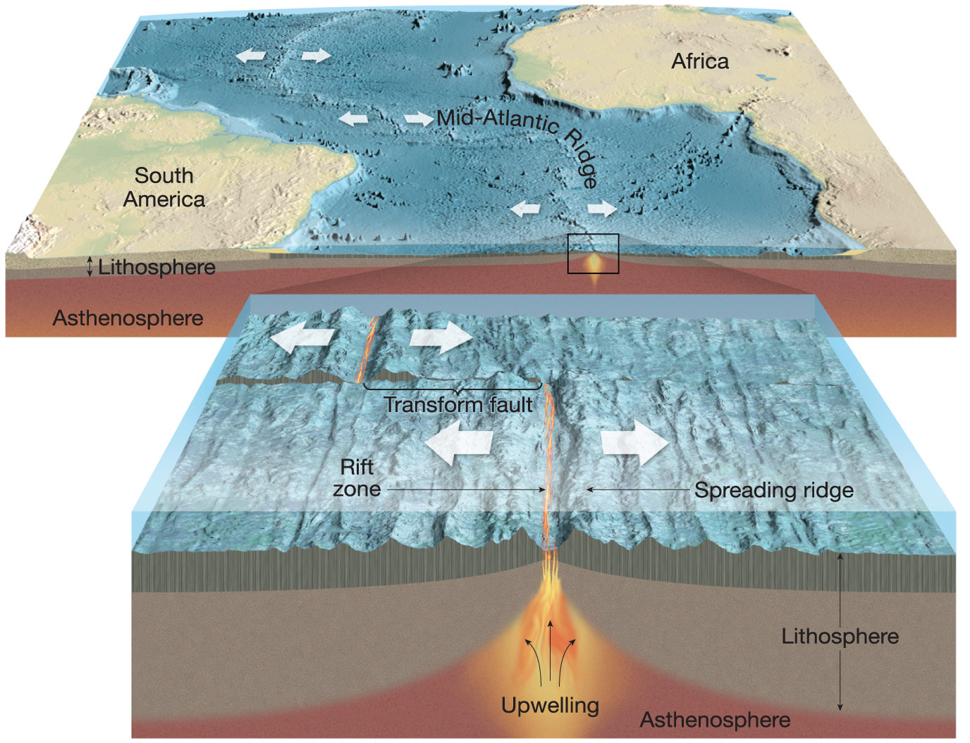
Sea-Floor Spreading
Divergent plate boundaries: constructive boundaries, material added.
Continental Rifting
Notes:
Chapter 14, Figure 14.13 Labeled

Slide 26
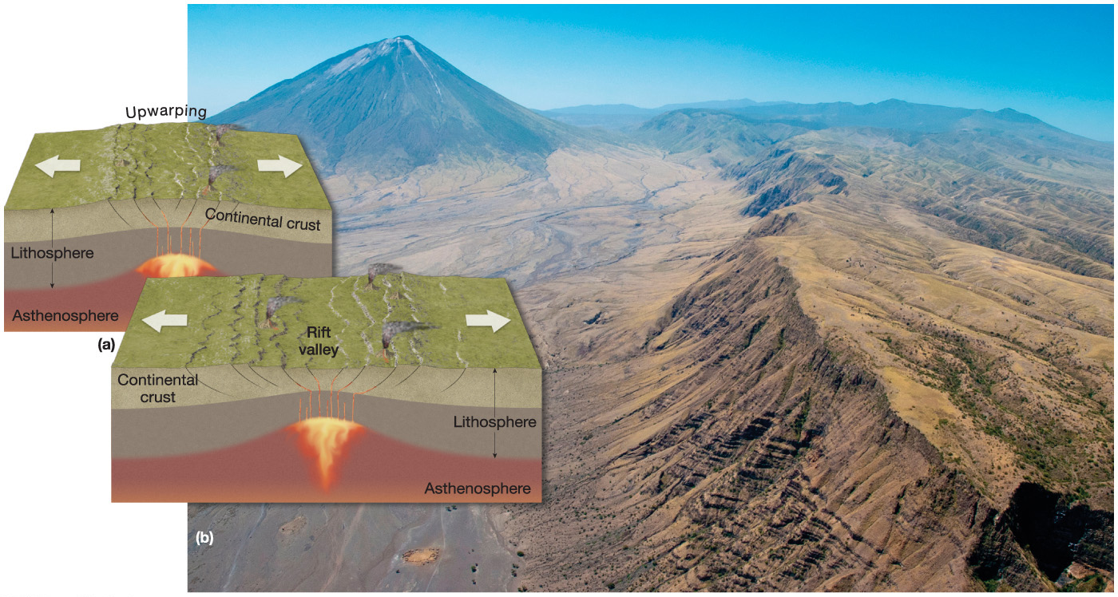
Continental rift valley. As the continental plate separates, blocks of crust drop down to form the rift valley. East African Rift Valley in Tanzania with the Lengai volcano in the distance.
Notes:
Chapter 14, Figure 14.14 Labeled

Slide 27
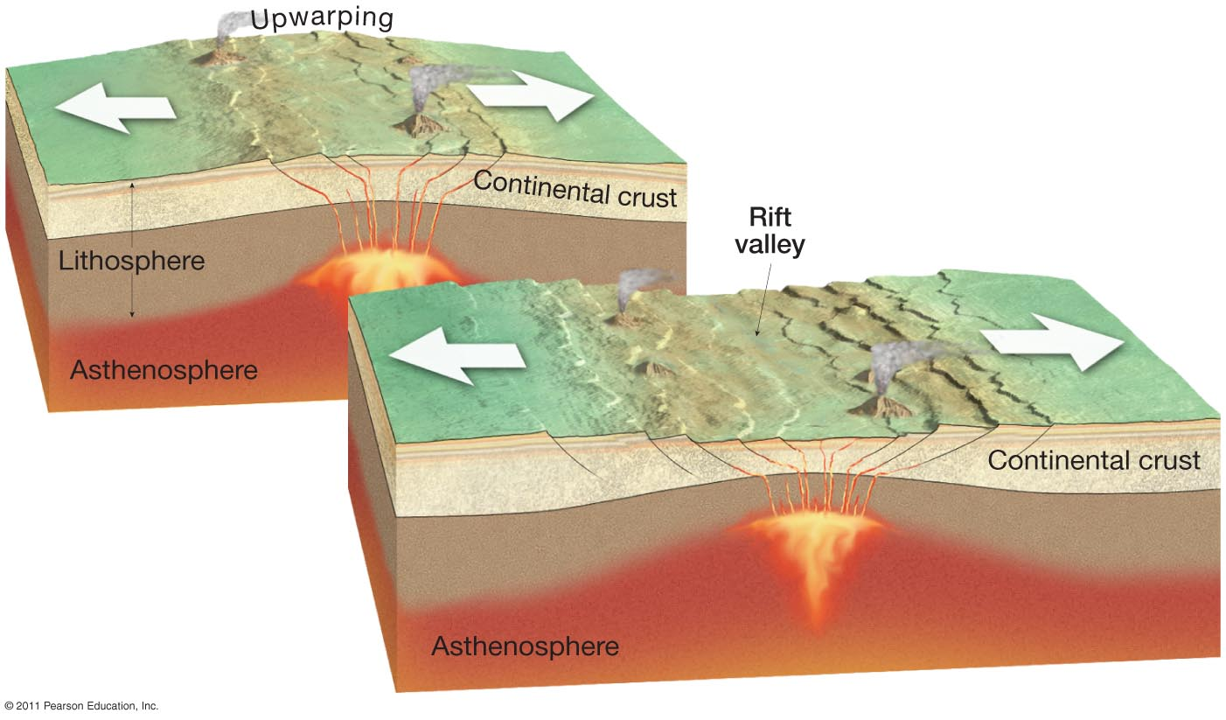
Notes:
Figure 14-14
27

Slide 28
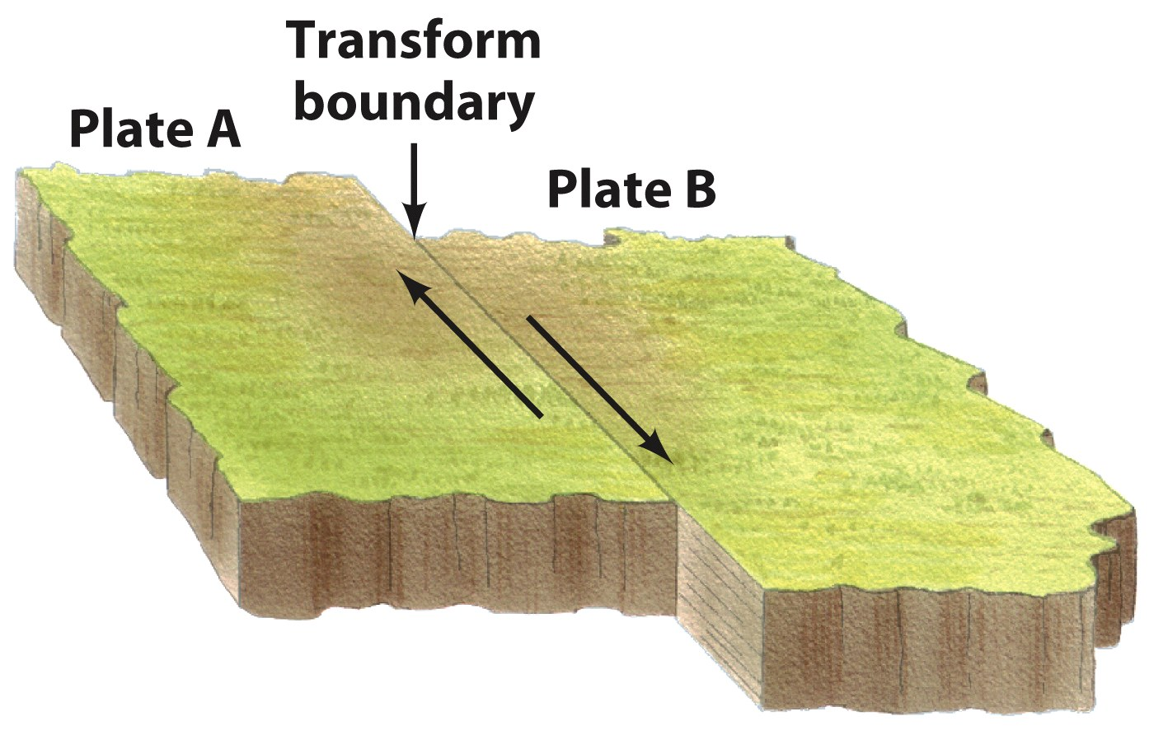
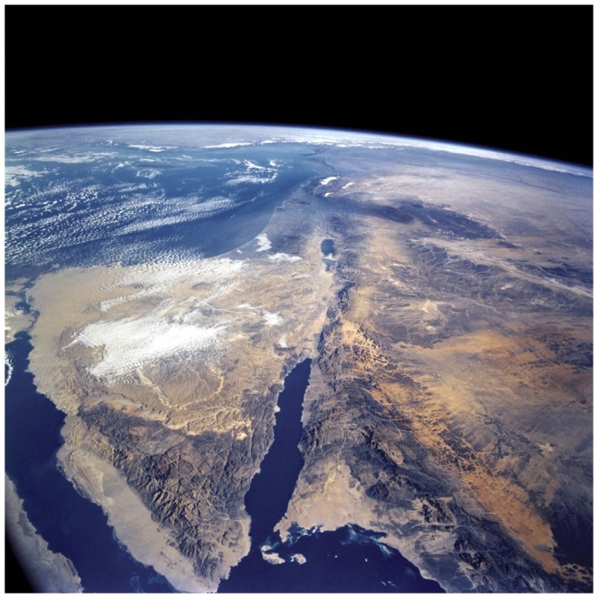
Transform Boundaries
Plates slide past each other without colliding
The Dead Sea Fault marks the transform boundary between the African Plate on the west and the Arabian Plate on the east.
The San Andreas Fault marks the transform boundary between the Pacific Plate on the west and the North American plate on the east.
Courtesy NASA Images
© A.N. Strahler

Slide 29
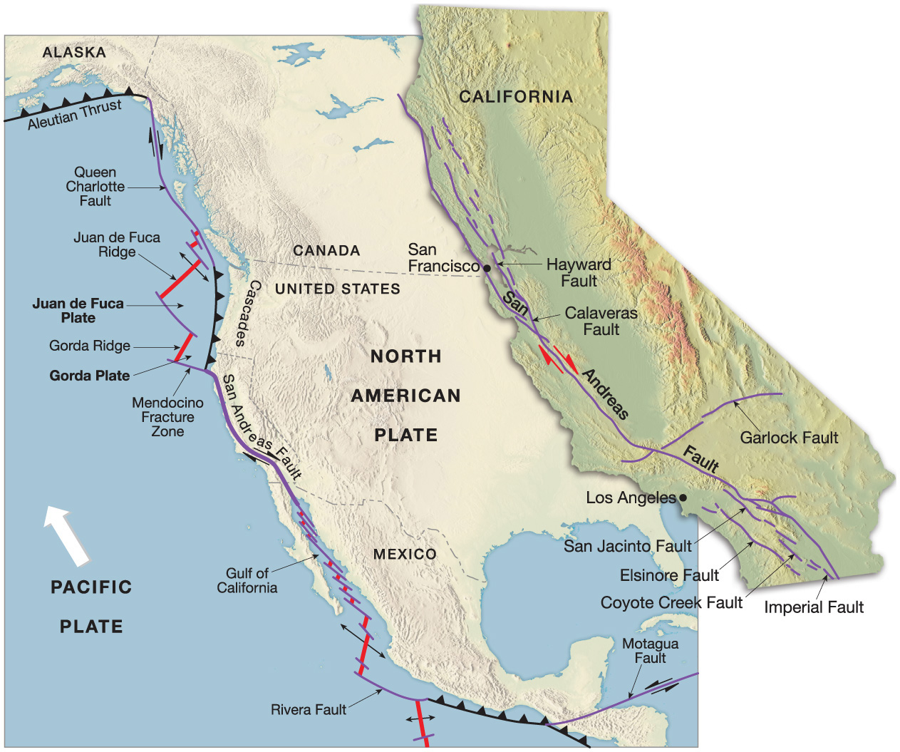
Transform Plate Boundaries: lateral movement of plates along vertical fractures of crust.
Neither destructive nor constructive, but a lot of seismic activity—shallow focus earthquakes.
Notes:
Chapter 14, Figure 14.18 Labeled

Slide 30
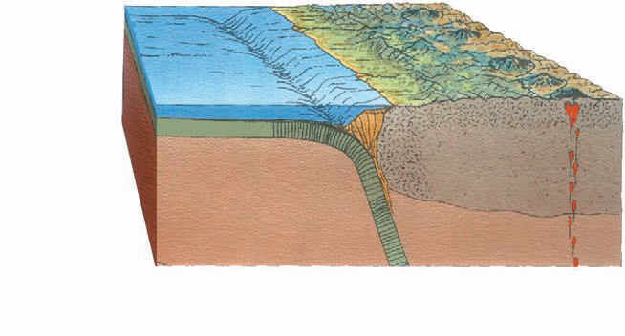
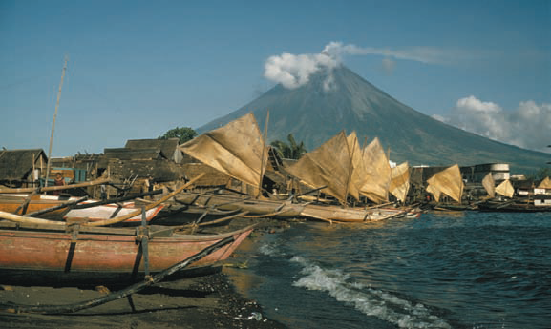
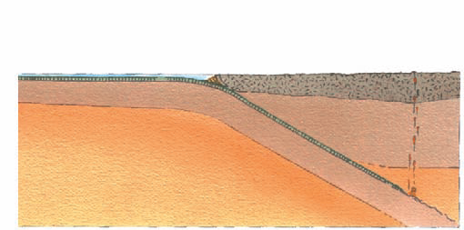
Convergent Boundaries
Subduction zones = Descent of the edge of a lithospheric plate under an adjoining plate and into the asthenosphere
Oceanic trenches
Mariana Trench
Japan Trench responsible for Great Tohoku earthquake of 2012
Andes mountains
© NG Image Collection
Mt. Mayon, the Philippines

Slide 31
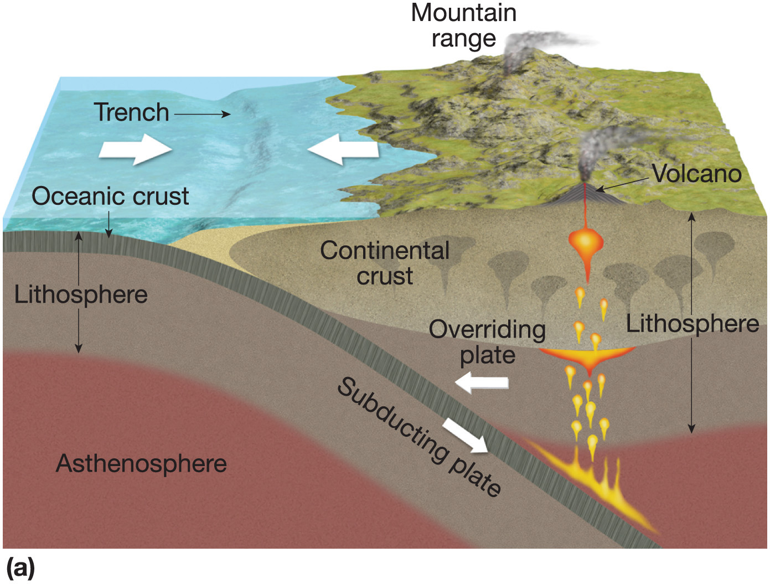
Ocean-Continent Convergence
Notes:
Chapter 14, Figure 14.15a Labeled

Slide 32
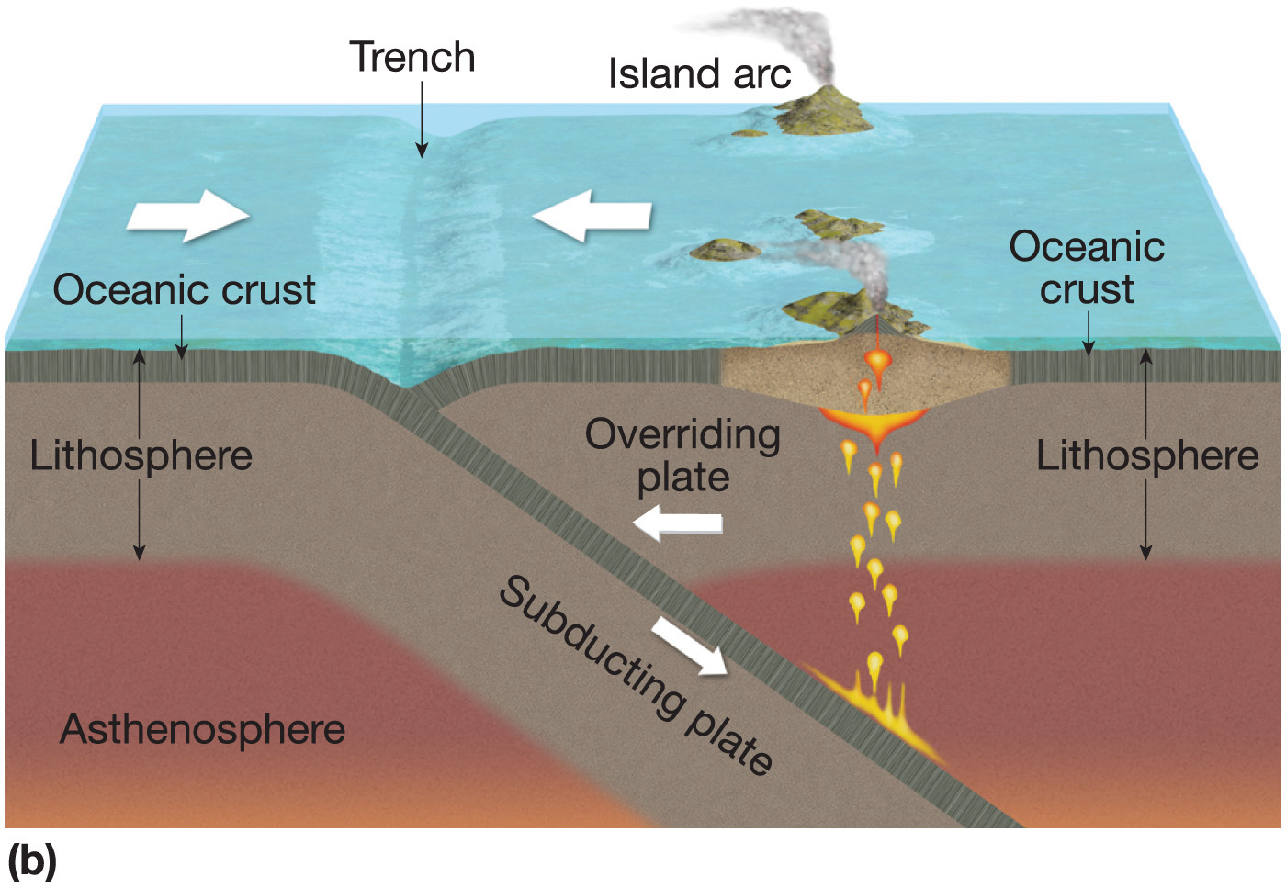
Ocean-Ocean Convergence
Notes:
Chapter 14, Figure 14.15b Labeled

Slide 33
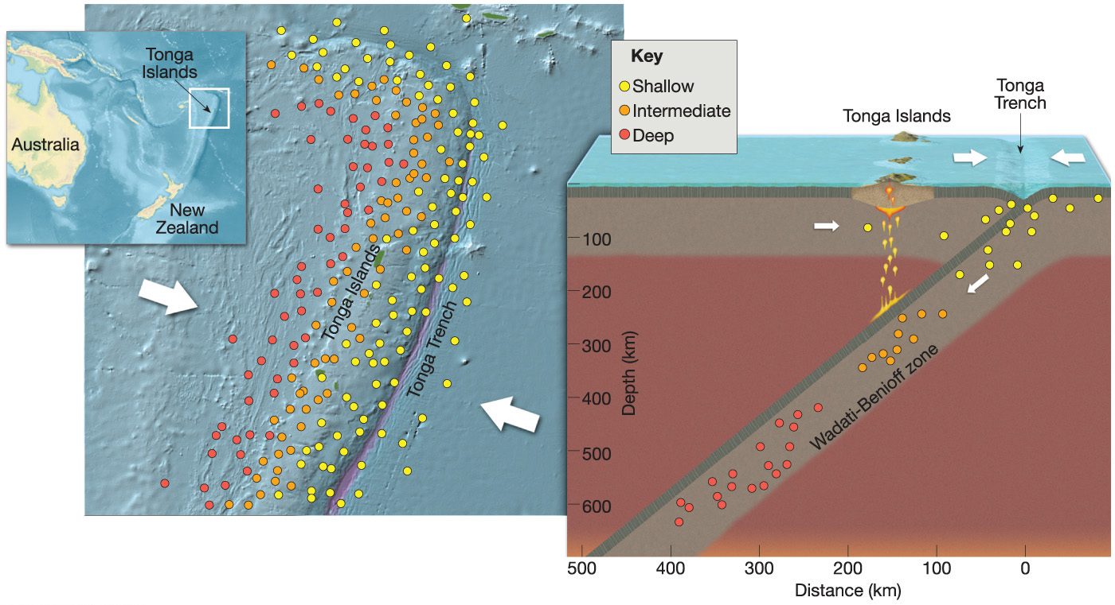
Earthquake patterns along the Tonga Trench subduction zone. Both shallow and
deep focus earthquakes occur.
Notes:
Chapter 14, Figure 14.16 Labeled

Slide 34
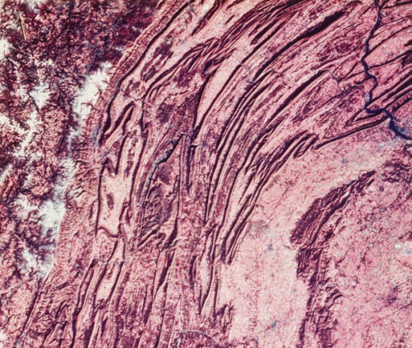
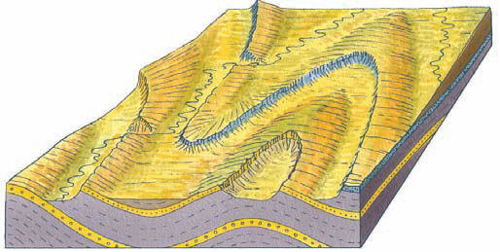
Convergent Boundaries
Anticline
Syncline
Continental Collision
Continental plates collide
Folds
Orogeny is a mountain building process
Himalayas
Appalachian
Synclines
Anticlines
Overthrust faults
© John Wiley & Sons, Inc.
C
Anticline
D
Syncline
© Science Source/Photo Researchers
© John Wiley & Sons, Inc.

Slide 35
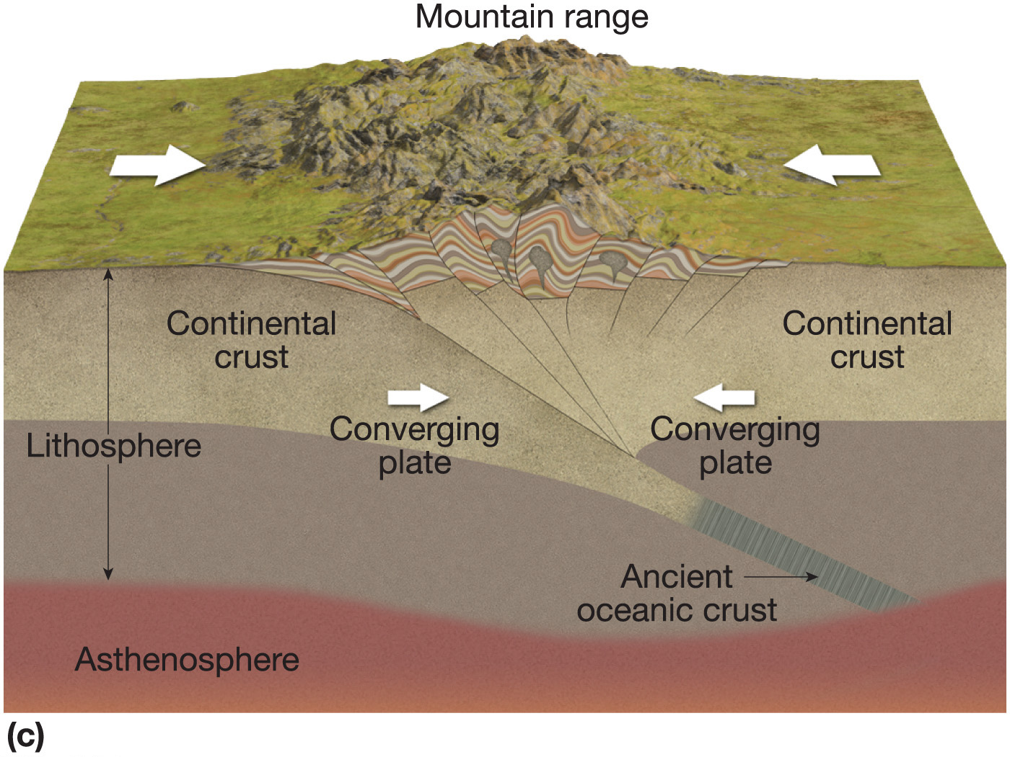
Continental Collision
Notes:
Chapter 14, Figure 14.15c Labeled

Slide 36
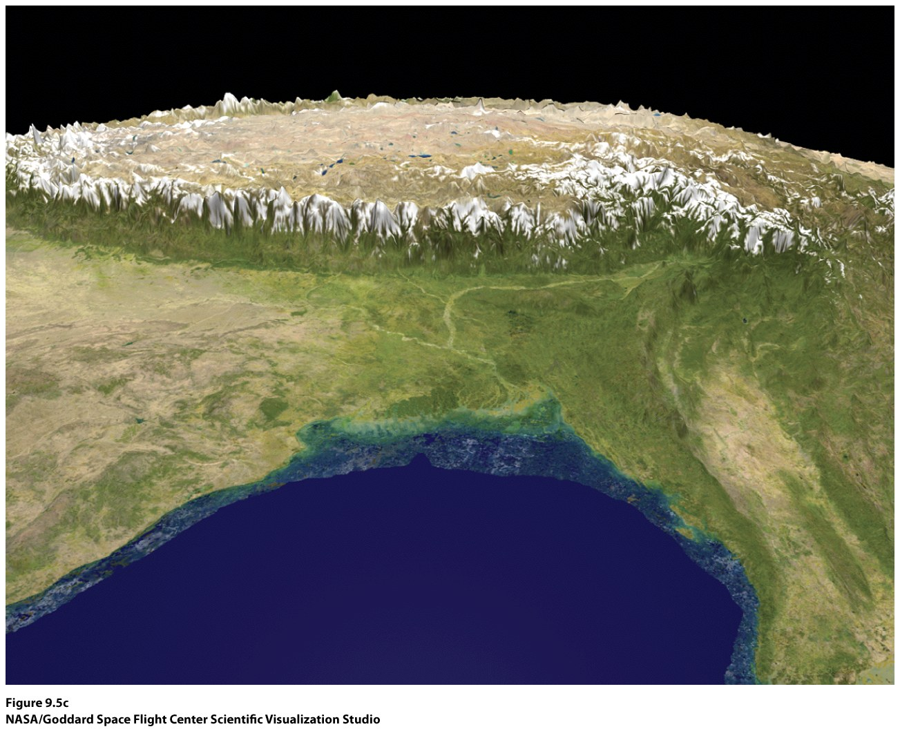

Slide 37
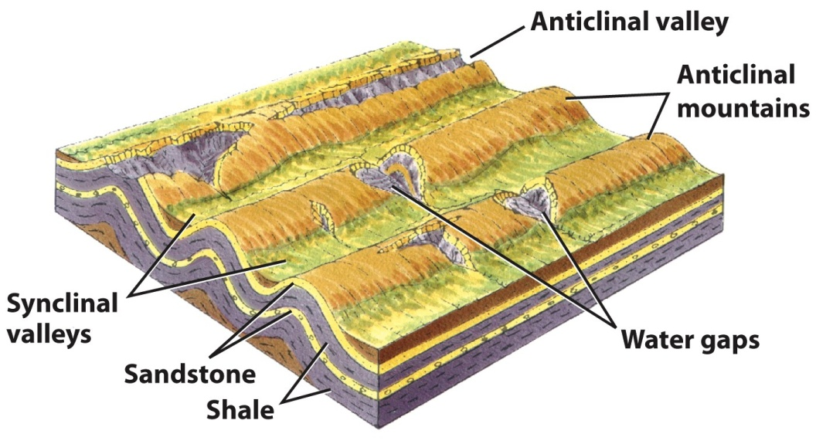
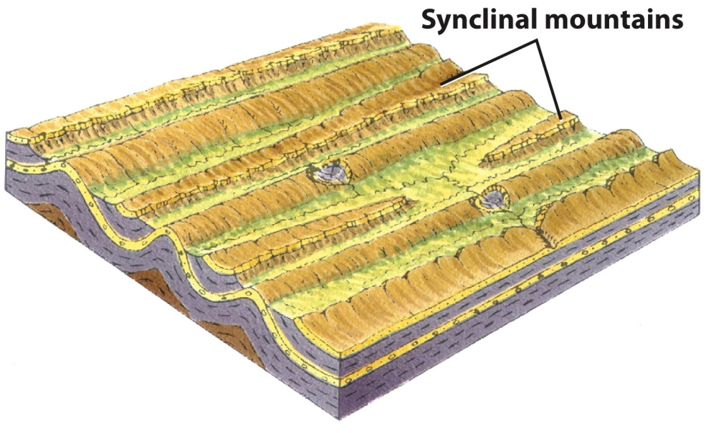
Differential Erosion
The ways fold areas erode to form sequential landforms depends on the rock strengths of different strata
Weaker formations (shale and limestone) erode away to leave long, narrow ridges of hard strata (sandstone or quartzite)
© A.N. Strahler

Slide 38
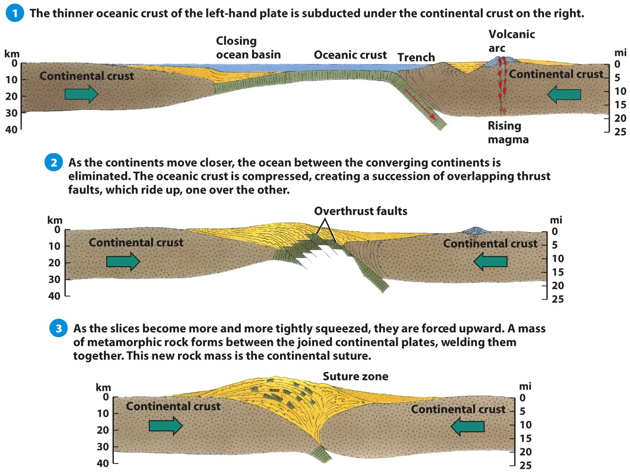
Continental Suture
Two continents can converge to eliminate an ocean between them
A continental suture permanently unites the two plates, so that there is no further tectonic activity along that collision zone
Appalachian and
Ural mountains
© A.N. Strahler

Slide 39
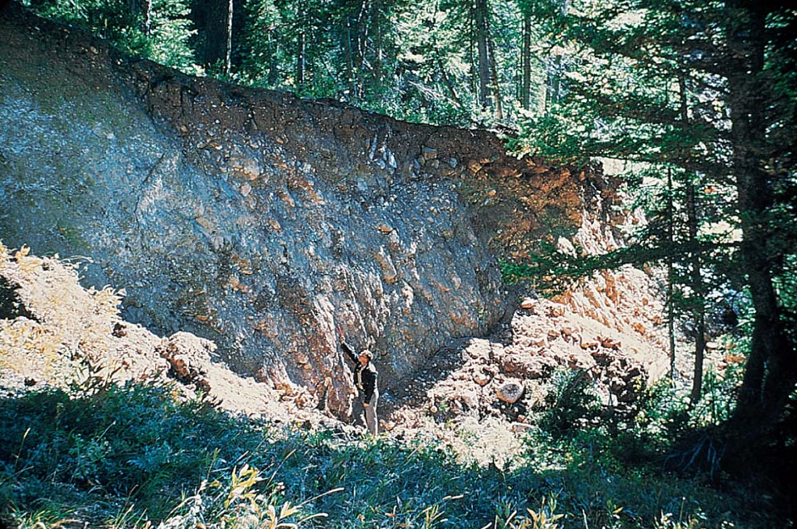
Faults & Fault Landforms
Fault scarp—Hebgen Lake, Montana.
Formed during earthquake in 1959
Faults occur when a sharp break associated with a slippage of the crustal block on one side of a tectonic plate with respect to another
Depth can be several kilometers
Fault slippage varies (1 cm to 15 m)
Four main types of faults
Normal
Strike-slip
Reverse
Overthrust
© A.N. Strahler
Normal Fault

Slide 40
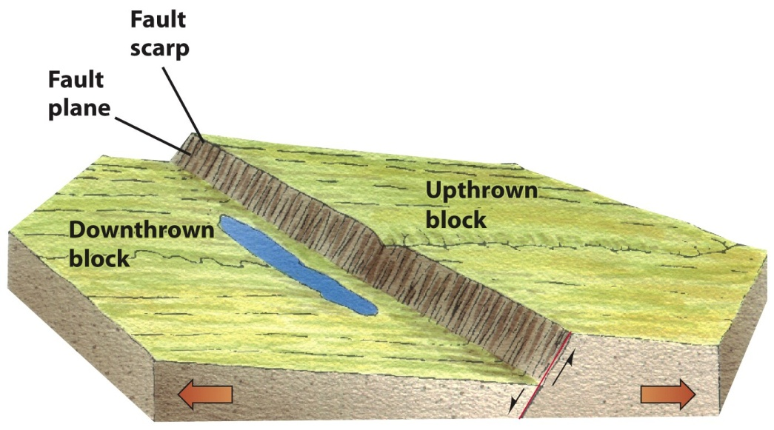
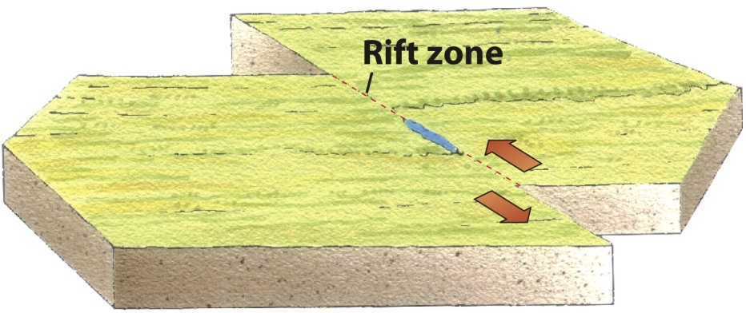
Faults & Fault Landforms
Normal faults occur when the crust on one side of normal fault drops down relative to the other side.
Strike-slip faults are produced when tectonic plates move past each other horizontally
© A.N. Strahler

Slide 41
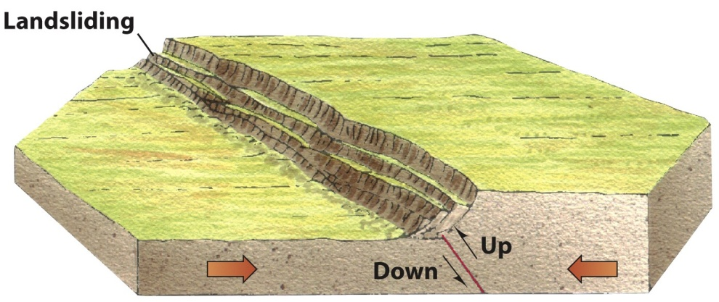
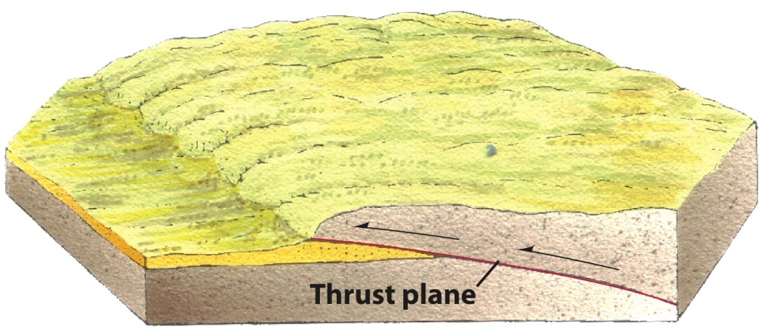
Faults & Fault Landforms
Reverse faults are produced by compression in the crust
Overthrust faults involve mostly horizontal movement. One slice of rock rides over the adjacent ground surface.
© A.N. Strahler

Slide 42
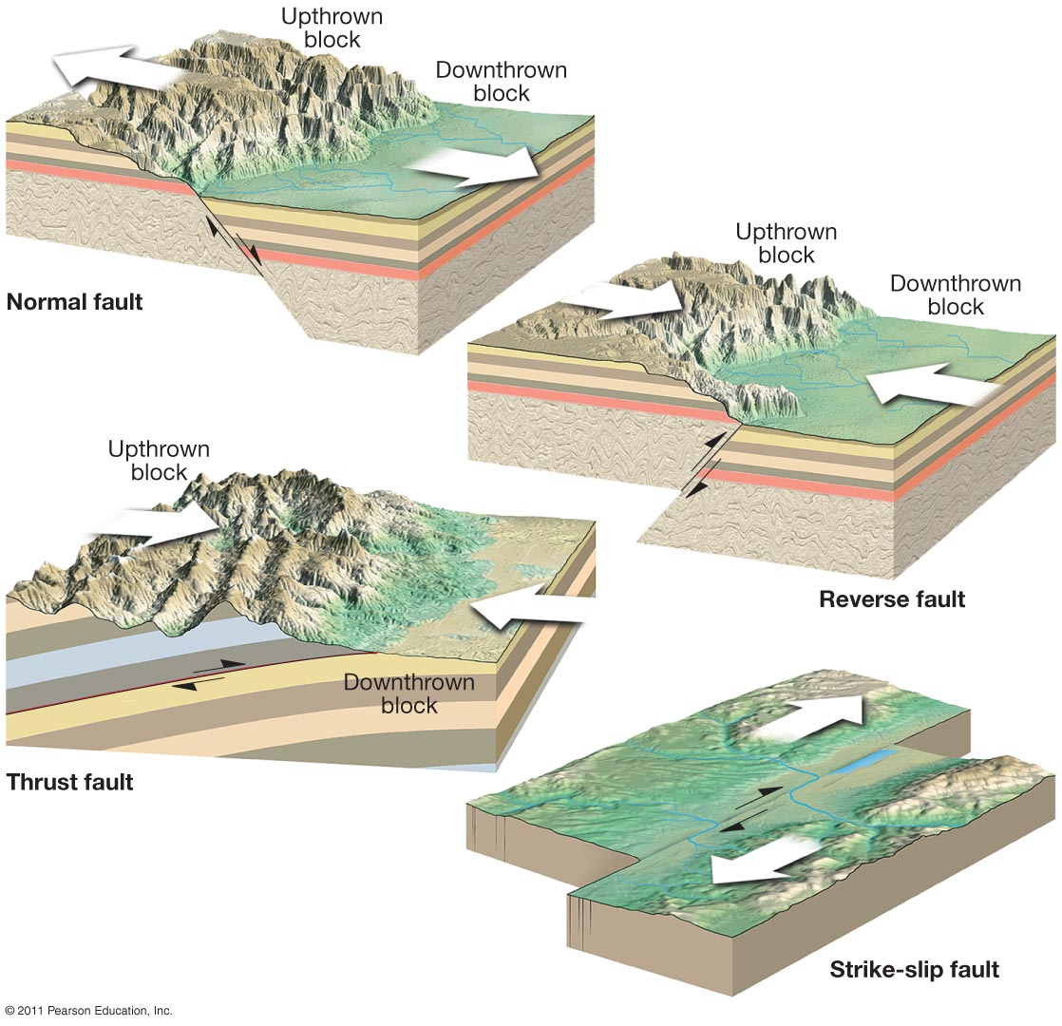
Notes:
Figure 14-55
42

Slide 43
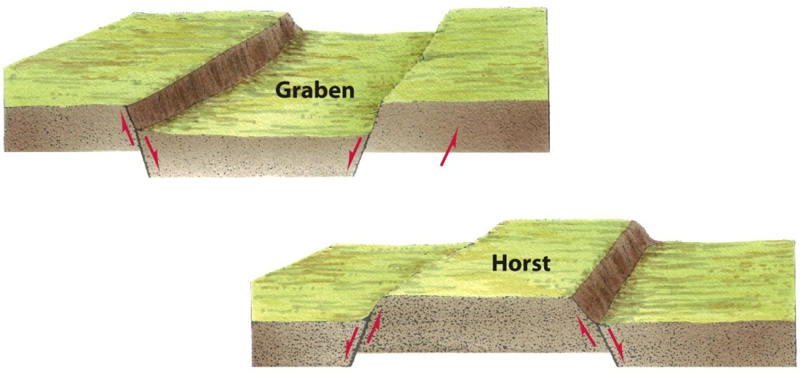
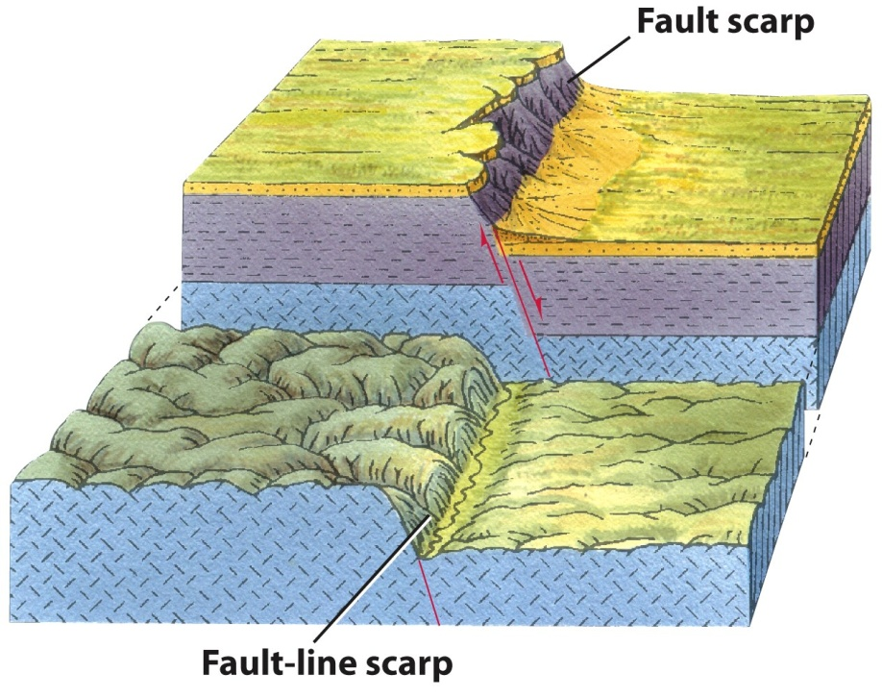
Tectonic Activity and Earthquakes
Faults and fault landforms
Grabens = a crustal block is dropped down between two normal faults.
Horst = A crustal block
pushed up between
two normal faults.
Fault scarps
© A.N. Strahler

Slide 44
Western slope of the Sierra Nevadas is long and gentle, whereas the eastern slope is short and steep. This gentle-steep combination is the result of enormous block faulting on the eastern side.
Notes:
Figure 14-57
44

Slide 45
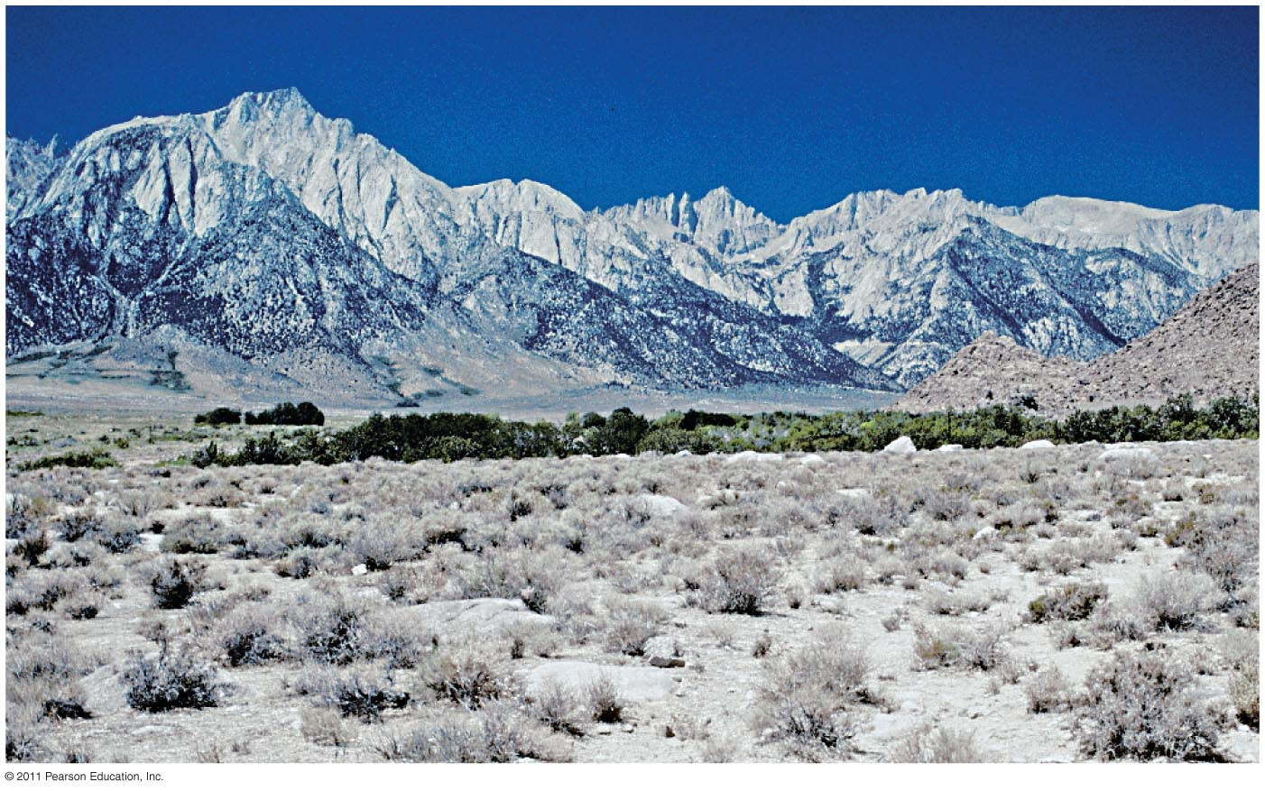
Eastern Sierras. Steep east slope, a prominent fault scarp.
Notes:
Figure 14-58
45

Slide 46
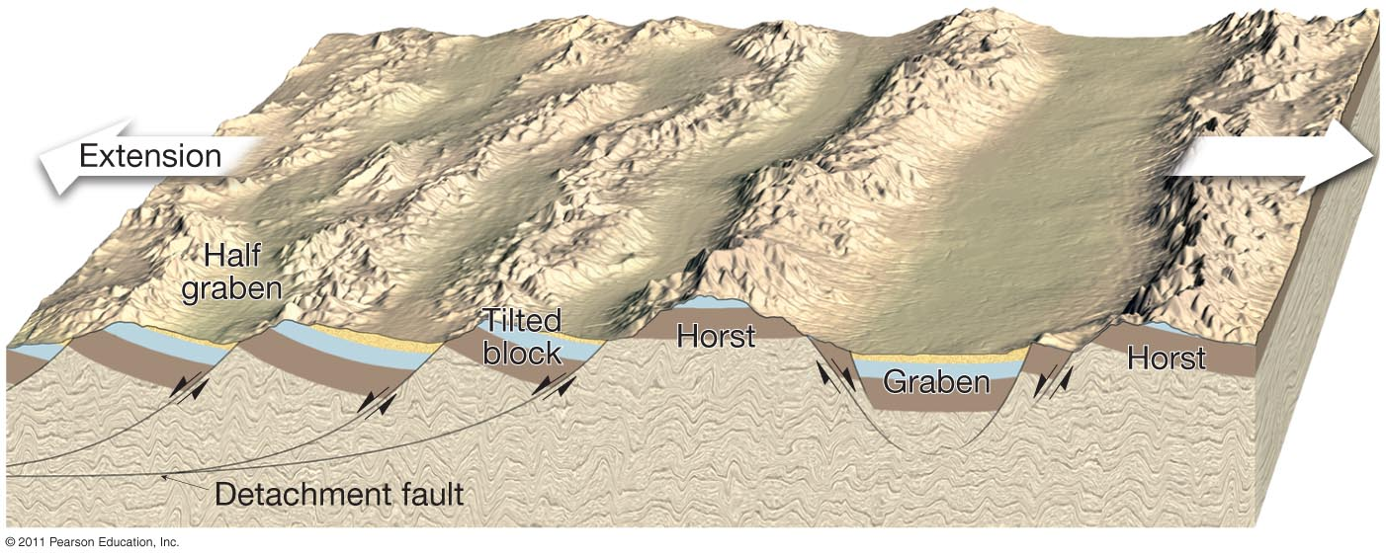
Landform features associated with normal faulting. Horsts and grabens appear where there is faulting on both sides. Tilted blocks appear where faulting is on one side only.
Notes:
Figure 14-59
46

Slide 47
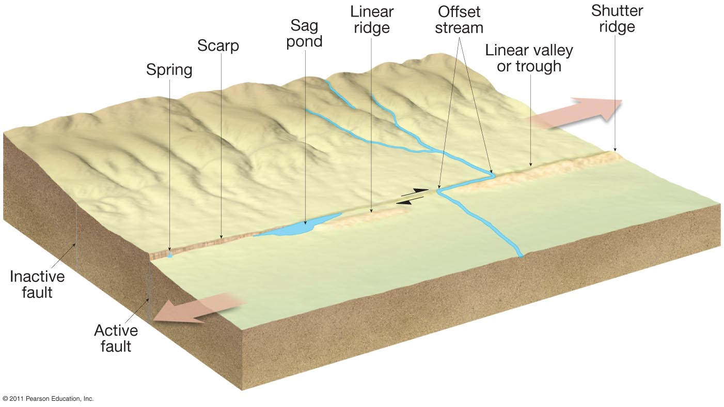
Landform features of strike-slip faulting.
Notes:
Figure 14-60
47

Slide 48
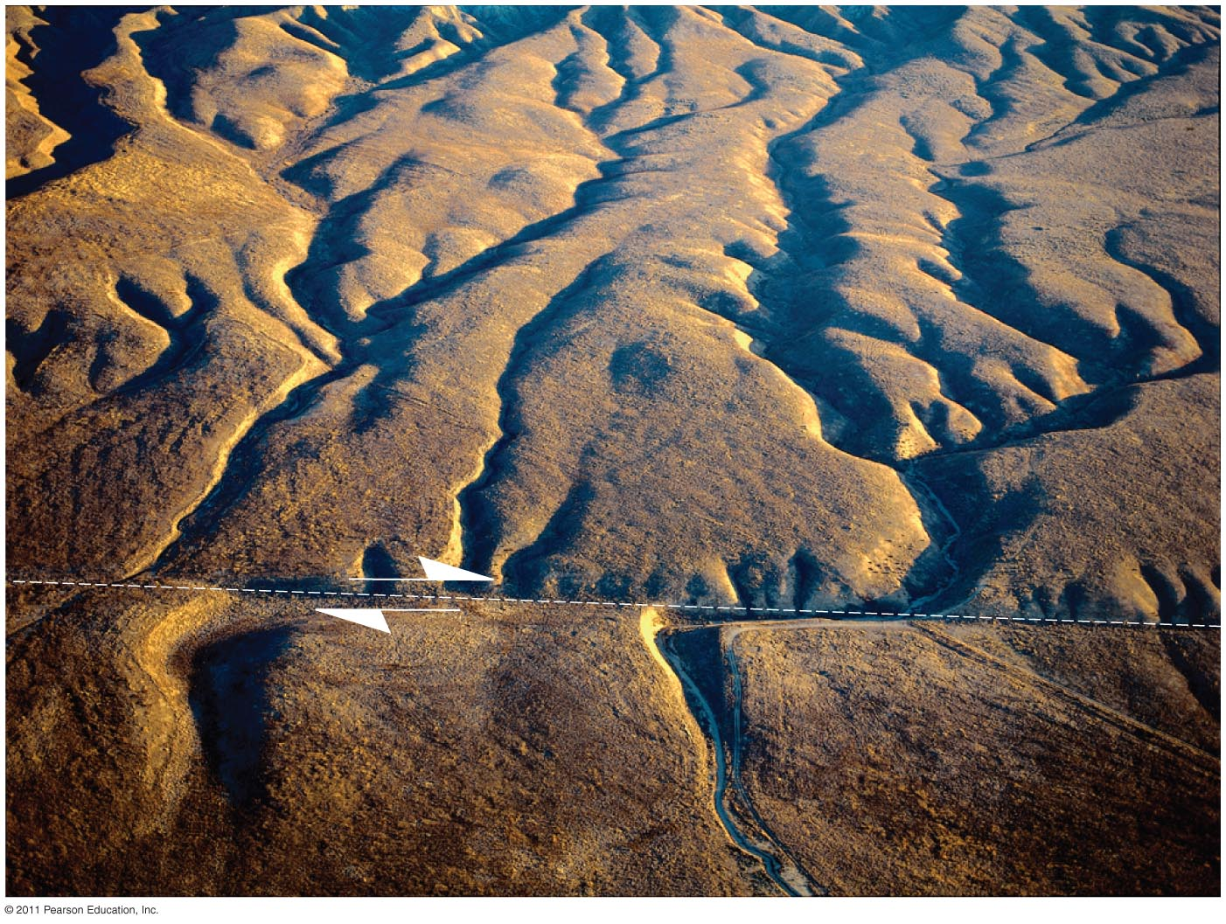
Offset stream along the San Andreas Fault, Temblor Range, CA
Notes:
Figure 14-61
48

Slide 49
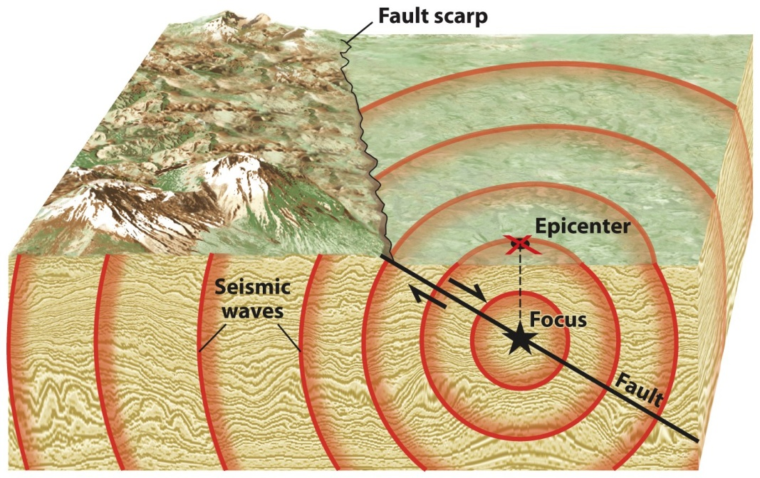
Tectonic Activity and Earthquakes
Earthquakes
Earthquakes = A trembling or shaking of the ground produced by movements along a fault.
Focus = Location where fault slipped
Epicenter = The location on the Earth’s surface directly above where a fault slipped to produce an earthquake
Subduction Zone Earthquakes
Greatest earthquakes, including those in Japan, Alaska, North America, Central America, and Chile
Java Trench 9.0 earthquake and resulting tsunami (2004)
Tohoku 9.0 earthquake and tsunami (2012)
© John Wiley & Sons

Slide 50
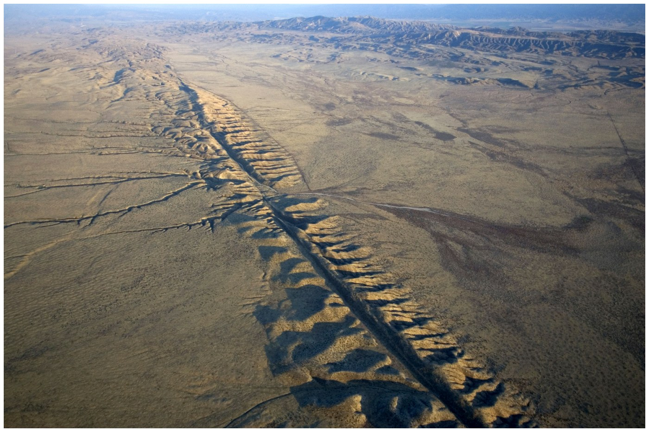
Transform Boundary Earthquakes
San Andreas Fault in California
1906 San Francisco Quake
1989 Loma Prieta Quake
1992 Landers Quake
© Aurora Photos/Alamy

Slide 51
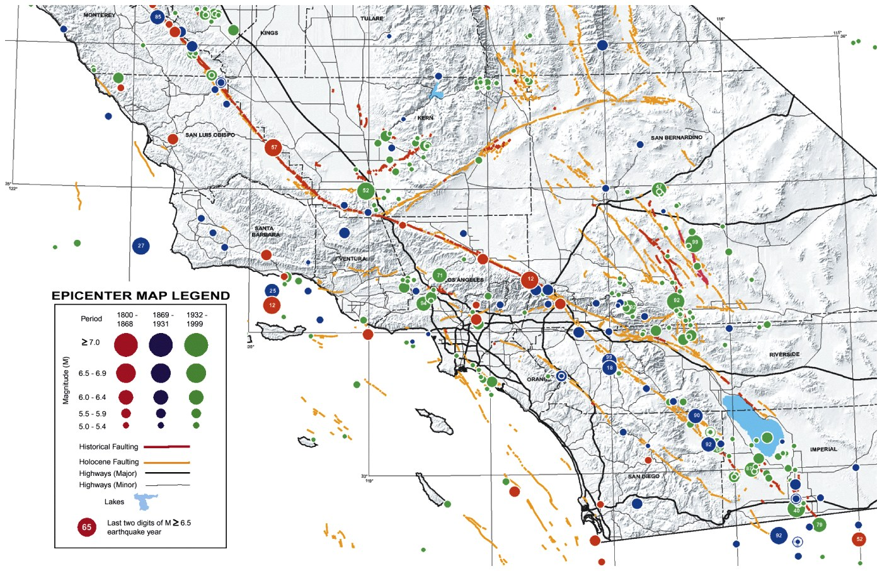
Southern California Earthquakes
California earthquakes, identified as circles with size proportional to the earthquake magnitude, are overlaid on top of delineated and mapped fault lines.
© John Wiley & Sons, Inc.

Slide 52
Divergent Boundary Earthquakes
Spreading center earthquakes mostly occur along mid-ocean ridges
Sometimes earthquakes happen far from plate boundaries.
The New Madrid earthquakes of 1811 is an example of quakes away from plate boundaries
© John Wiley & Sons, Inc.

Slide 53
Earthquakes along blind faults
Barn, Iran 2003 Quake
© NG Maps
©Christine Osborne Pictures/Alamy
© AFT/Getty Images

Slide 54
Notes:
Table 14-2
54

Slide 55
Tectonic Activity and Earthquakes
Tectonic environments of earthquakes
Pacific Ring of Fire
© John Wiley & Sons

Slide 56
Liquefaction. 1989 Loma Prieta quake, 7.0. Greatest damage along areas of soft mud (dashed line) for the Cypress Freeway in Oakland, CA. Seismographs show shaking was greater on soft mud than on nearby bedrock
Notes:
Figure 14-63
56

Slide 57
Volcanic Activity and Landforms
Volcano = conical, circular structure built by accumulation of lava flows and tephra (volcanic ash)
Magma
© Chris Johns/NG Image Collection
© John Wiley & Sons, Inc.

Slide 58
Volcanic Activity and Landforms
Dots show the locations of volcanoes known or believed to have erupted within the past 12,000 years. Each dot represents a single volcano or cluster of volcanoes.
This map shows the principal tectonic features of the world such as mid-oceanic ridges, trenches and subduction boundaries. Many volcanoes occur along these features—for example, the Ring of Fire around the Pacific Rim occurs on subduction boundaries.
© A.N. Strahler

Slide 59
Iceland is constructed entirely of eruptions of basalt emerging from the Mid-Atlantic Ridge. The volcanic cone on the right, christened Eldfell, is surrounded by lava flows extending into the ocean. Note the tongue of fresh lava from Eldfell invading the right side of the town. Eldfell’s older sister, Helgafell, is on the left.

Slide 60
Volcanism: all phenomena connected with the origin and movement of molten rock. Magma=beneath surface; lava=above.
Primarily found along plate boundaries.
Pacific Rim of Fire—Andesite Line—75% of the world’s volcanoes.

Slide 61
What is considered active volcanism?
If it’s erupted at least once within historical times
If it’s expected to do so again
550 active volcanoes in the world
15 erupt a week, 55 a year,
160 a decade
More than ¾ of this
volcanism is underwater
In the US only 1 volcano was classified as active, Mt. Lassen, in CA, until Mt St Helen erupted in 1980!
Mt Baker, Mt Rainier in WA
Yellowstone Caldera in WY
Mt Shasta, Long Valley Caldera, CA
New volcanic island in the Red Sea, Dec. 2011. Along the Red Sea Rift, west of Yemen, Zubair Group of islands.

Slide 62
Volcanoes are vital to the planet
Release of water vapor
Magma has important elements for fertile soil
The force and violence of volcanic eruptions varies
Some include solid rock fragments, solidified lava blobs, cinders, called pyrocalstics
Krakatau, Indonesia, 1883. Island disappeared. Noise heard in Australia. Generated tsunamis drowning more than 30,000.

Slide 63
Volcanic activity
Hot spots = A center
of volcanic activity
thought to be located
over a rising mantle
plume.
© John Wiley & Sons, Inc.
© John Wiley & Sons, Inc.

Slide 64
Fluid basaltic lava flow from Kilauea Volcano, Hawaii.
Notes:
Figure 14-26
64

Slide 65
Volcanic eruptions
When lava is forced out of a volcano violently, in the form of a volcanic eruption, it is a severe hazard
Mt. Pelée on the island of Martinique in 1902
Clouds of incandescent gases move down the slopes
Lava flows
Showers of ash, cinders, solidified masses of lava
Mudflow—lahar, from melted snow and hot ash
© John Wiley & Sons, Inc.

Slide 66
Volcanic eruptions
Atmospheric impacts from volcanic ash and gases have been shown to affect global weather and surface temperatures for months or years after an event
Mt. Tambora in 1815 was the year without a summer
Data from NOAA

Slide 67
Volcanic eruptions
Types of Volcanoes
shape, size, and explosiveness depend on the type of magma
Magma comes from two main types of igneous rocks: felsic and mafic
© Chris Johns/NG Image Collection
© Frans Lanting

Slide 68
Volcano Peaks
Shield
Composite/Stratovolcano
Lava Dome
Caldera

Slide 69
How much silica?
High-Silica Felsic
Greater viscosity or thickness
Cooler, lava flows are thick and slow moving
Gas pockets become trapped in the thick magma building pressure, creating explosive eruptions
Low-Silica Mafic
Less viscosity, so hotter and more fluid
Gases bubble out easily
Eruption includes lots of lava, but little pyroclastics, not very explosive
Intermediate-Silica Andesitic
Both fluid lava flows and pyroclastics
Can be very explosive
Typical of volcanoes near subduction zones

Slide 70
Volcanic eruptions
Stratovolcano = volcano constructed of multiple layers of lava and tephra (volcanic ash)
Felsic lavas
Rhyolite, andesite
Thick, resistant to flow
Builds steep slopes around volcanic vents
Tall, steep cone, with crater
© John Wiley & Sons, Inc.
© Chris Johns/NG Image Collection

Slide 71
Composite Volcano: stratovolcano; steep sided; pyroclastics and lava.
Notes:
Chapter 14, Figure 14.35 Labeled

Slide 72
Volcan Popocatepetl
erupting in 2005.
Notes:
Chapter 14, Figure 14.36 Labeled

Slide 73
Volcano Popocatepetl
erupting in 1998.
Notes:
Figure 14-35
73

Slide 74
Volcanic eruptions
Stratovolcano
Most active stratovolcanoes on circum-Pacific mountain belt
Associated with subduction zones
Felsic lavas produce explosive eruptions
Caldera
© Kevin West/Getty Images
©Randy Wells/Getty Images

Slide 75
Volcanic eruptions
Stages of stratovolcano erosion
© NG Image collection
1
3
2
4
©Randy Wells/Getty Images
© NG Image collection

Slide 76
Volcanic eruptions
Shield Volcano = low, often large, dome-like accumulation of basalt lava flows emerging from long , radial fissures on flanks
Mafic lava (basalt) is thin, not viscous
Holds little gas
Usually quiet eruptions
© Frans Lanting
© John Wiley & Sons, Inc.

Slide 77
Shield Volcanoes: basaltic lava, broad, low-lying.
Notes:
Chapter 14, Figure 14.32 Labeled

Slide 78
Volcanic eruptions
Erosion of shield Volcanoes
1
2
3
© Frans Lanting
Mauna Kea, Hawaii
© John Wiley & Sons, Inc.

Slide 79
Lava Dome: also called a plug dome; high silica lava, very thick, cannot flow far. Lava bulges up from the vent and the dome expands, growing larger.
Notes:
Chapter 14, Figure 14.37 Labeled

Slide 80
Mono Craters, east of Yosemite. Irregular summits from the bulging, viscous lava.
Notes:
Chapter 14, Figure 14.38 Labeled

Slide 81
Notes:
Figure 14-37
81

Slide 82
Other volcanic landforms
Flood basalts
Cinder cones
Wizard Island in Crater Lake
© A.N. Strahler
Continental flood basalts, Columbia Plateau, U.S.
©Randy Wells/Getty Images

Slide 83
Formation of a Caldera
Notes:
Chapter 14, Figure 14.42 Labeled

Slide 84
Crater Lake, Oregon. Wizard Island represents a subsidiary volcanic cone.
Depth of 4,000 feet.
Notes:
Figure 14-40
84

Slide 85
The formation of Crater Lake. Mount Mazama about 7700 years ago.
Notes:
Chapter 14, Figure 14.42a Labeled

Slide 86
A cataclysmic eruption caused an enormous amount of pyroclastic material to erupt from the magma chamber and the volcano collapsed, forming a caldera 4000 feet deep.
Notes:
Chapter 14, Figure 14.42b Labeled

Slide 87
The caldera filled with water to form a lake. A new fissure formed the volcano that is now Wizard Island.
Notes:
Chapter 14, Figure 14.42c Labeled

Slide 88
Notes:
Figure 14-42
88

Slide 89
Volcanic Hazards:
Gases
Lava Flows
Eruption Column & Ash
Pyroclastic Flows
Mud flows (Lahars)
Notes:
Chapter 14, Figure 14.44 Labeled

Slide 90
Gases
Mostly water vapor, but also CO₂, Sulfur Dioxide, Hydrogen Sulfide, Fluorine
Can be very dangerous—Cameroon, 1986, sudden release of CO₂ from magma chamber beneath Lake Nyos killed 1700.
Can produce acid rainfall
Can alter global weather patterns

Slide 91
Lava Flows
Not as dangerous, but can damage property
Speed and distance determined by viscosity (silica content)
Basaltic lava (low silica) is faster moving

Slide 92
Eruption Column & Pyroclastic Flows
Up to 10 miles high; can have dangerous fragments of rock; create pyroclastic flows;
Notes:
Chapter 14, Figure 14.45 Labeled

Slide 93
Notes:
Figure 14-45a
93

Slide 94
Notes:
Figure 14-45b
94

Slide 95
Pyroclastic flow of Unzen volcano, Japan. 1993. Pyroclastic flows can move very rapidly, up to 100 mph. 1902 Martinique, flow from Mt. Pelee killed all but one of the 28,000 people on the island.
Notes:
Figure 14-46
95

Slide 96
Lahars—mud flows. Heat from the eruption and pyroclastics can quickly melt snow and glaciers on the volcano. Result is a rapid flow of mud and boulders, up to 30 mph.
1985 Nevado del Riz volcano in Columbia produced a mudflow that killed more than 20,000 people.
Lahar from Mt. Ruapehu in New Zealand. 2007.
Notes:
Chapter 14, Figure 14.46 Labeled

Slide 97
Monitoring volcanoes.
Measure for any changes in slope, earthquake activity, measure gas composition.
Notes:
Chapter 14, Figure 14.47 Labeled

