Slide 1
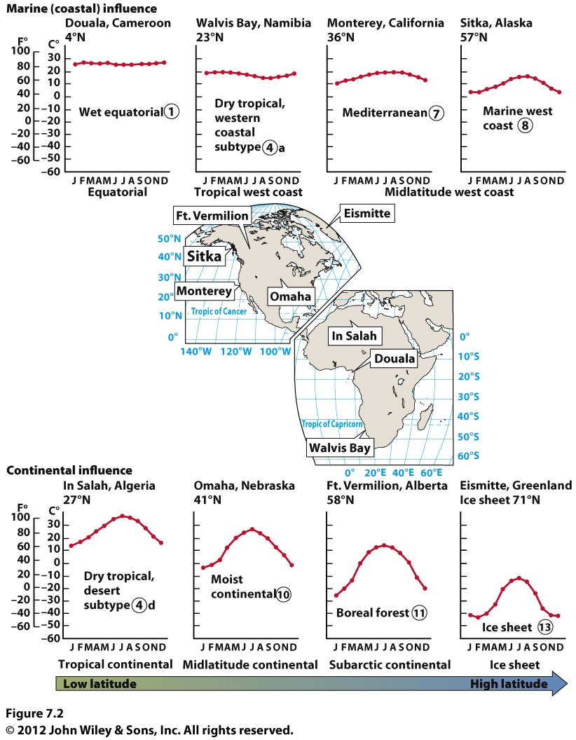
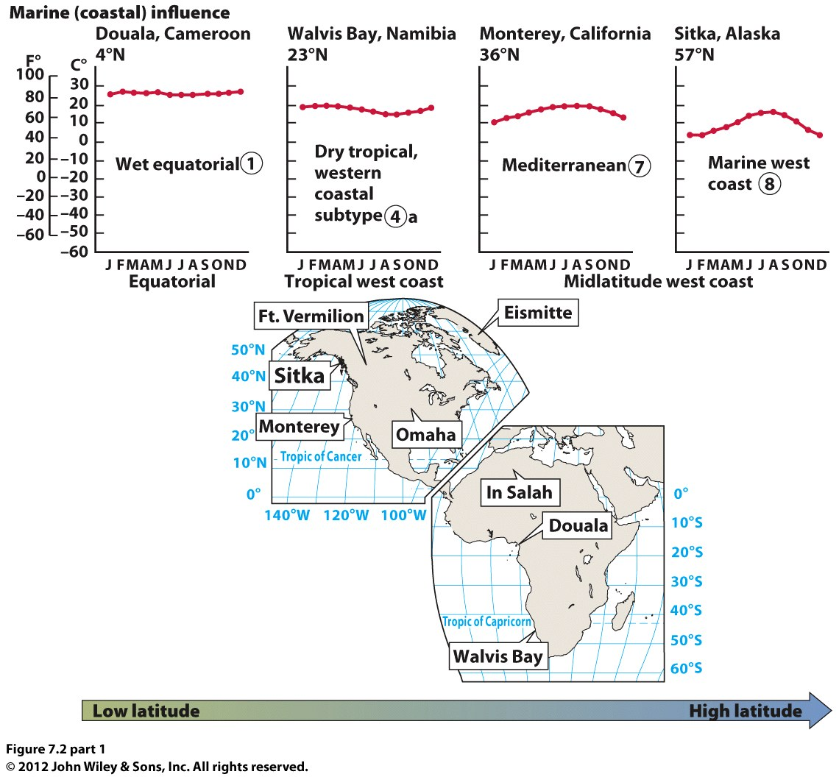
Chapter 7 Global Climates

Slide 2
What is Climate?
30 years of data
Temperature & Precipitation
Mean annual temperature
Mean annual precipitation
How much seasonal variation in temp & precip?

Slide 3
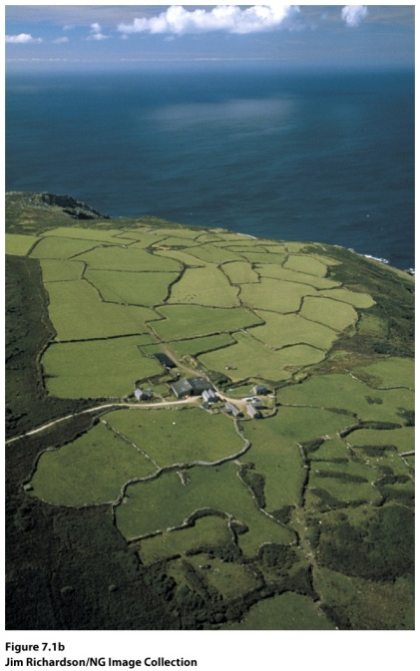
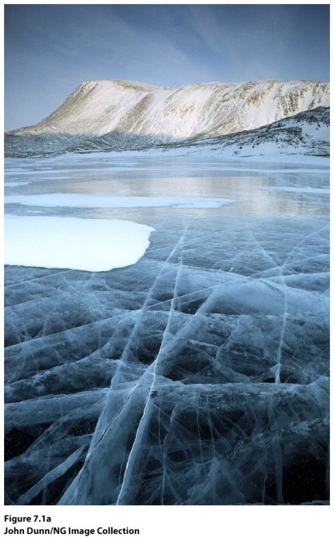
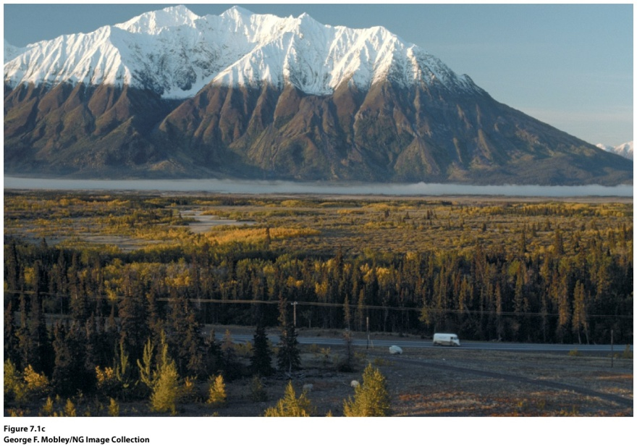
Global Temperature Patterns
Latitude
Location
Elevation
Cornwall, England, UK
Nunavut, Canada
Kluane National Park, Canada

Slide 4
Latitude
© John Wiley & Sons, Inc.

Slide 5
Location
Maritime vs Continental
© John Wiley & Sons, Inc.

Slide 6
© John Wiley & Sons, Inc.
A location between Sitka, Alaska, and Ft. Vermilion, Alberta, if located at a similar elevation, would most likely have a ____.
a. greater mean annual temperature than Sitka
b. greater mean annual temperature than Ft. Vermilion
c. greater annual temperature range than Ft. Vermilion
d. lower annual temperature range than Sitka

Slide 7
Global Precipitation Patterns
Air masses (continental vs maritime air masses)
Prevailing winds (atmospheric circulation)
Ocean currents
Topography
Latitude
Persistent high and low pressure centers

Slide 8
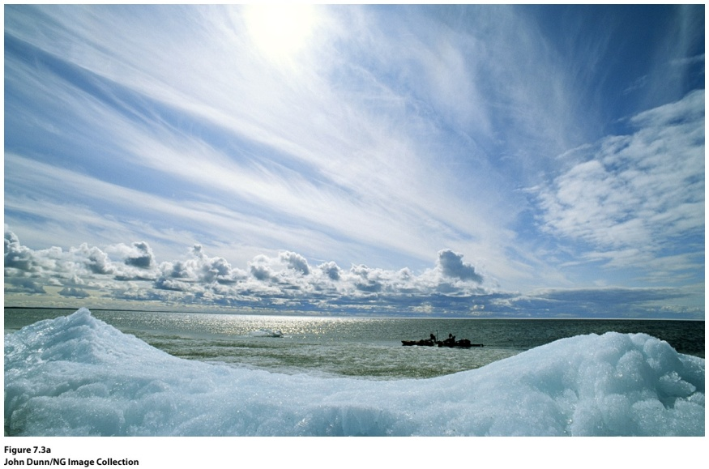
Air Masses
Continental air masses bring drier conditions
Marine air masses bring moisture
Areas that have colliding air masses will have storms
Baffin Island, Canada.
mP air mass influence.
© NG Image Collection

Slide 9
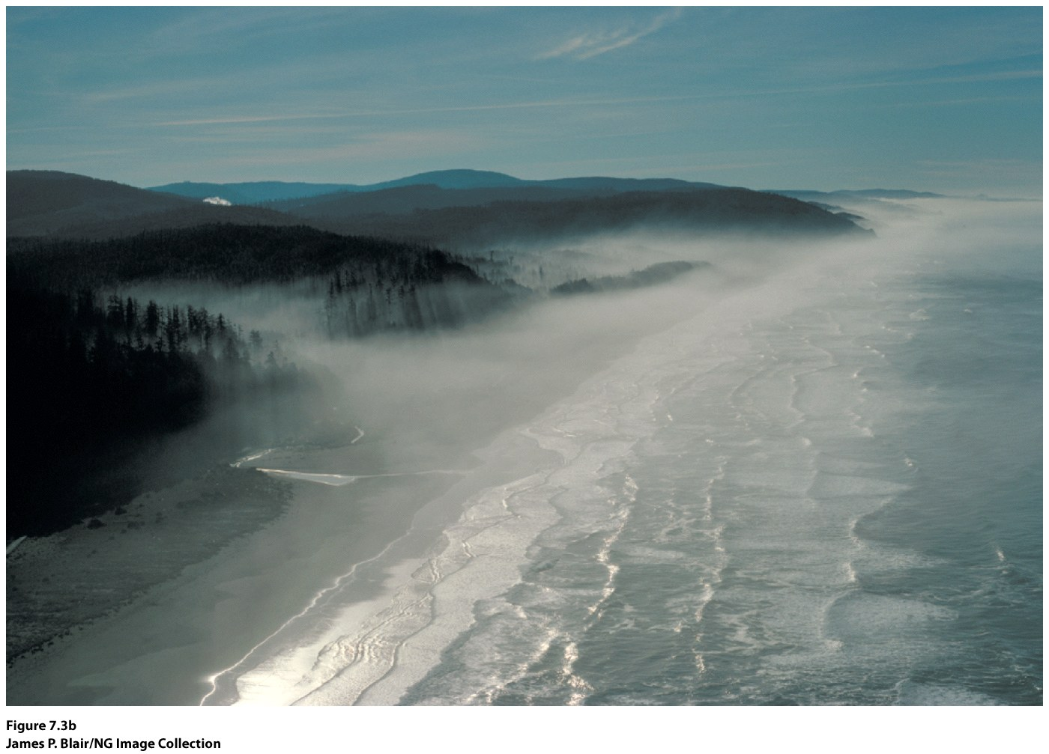
Prevailing Winds & Ocean Currents
Warm or Cold ocean currents determined by prevailing winds
Midlatitude west coast:
Drier summers as a result of the cooler, more stable air off the west coast
Moist winters as a result of the westerlies and the southward shift of the polar jet stream (L)
Midlatitude east coast = wetter summers as a result of the warmer waters of the east coast:
Moist winters as a result of the westerlies and the southward shift of the polar jet stream (L)
California coast.

Slide 10
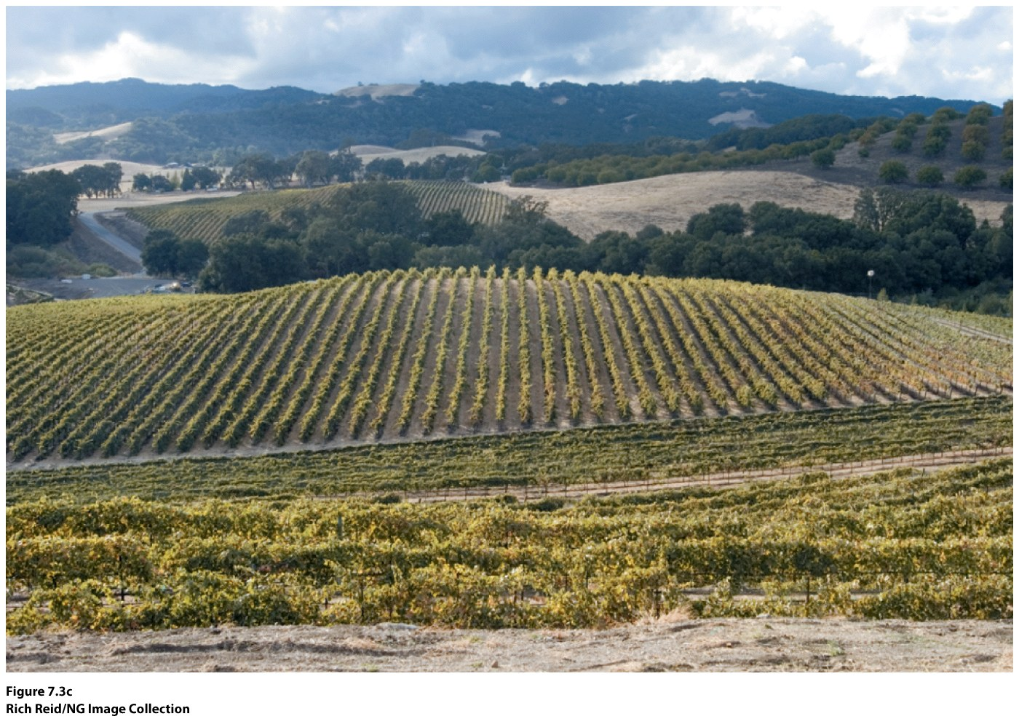
Topography
Mountains increase precipitation on their windward side, decrease precipitation on their leeward side
CA winery nestled in the Coast Ranges gets orographic precipitation.

Slide 11
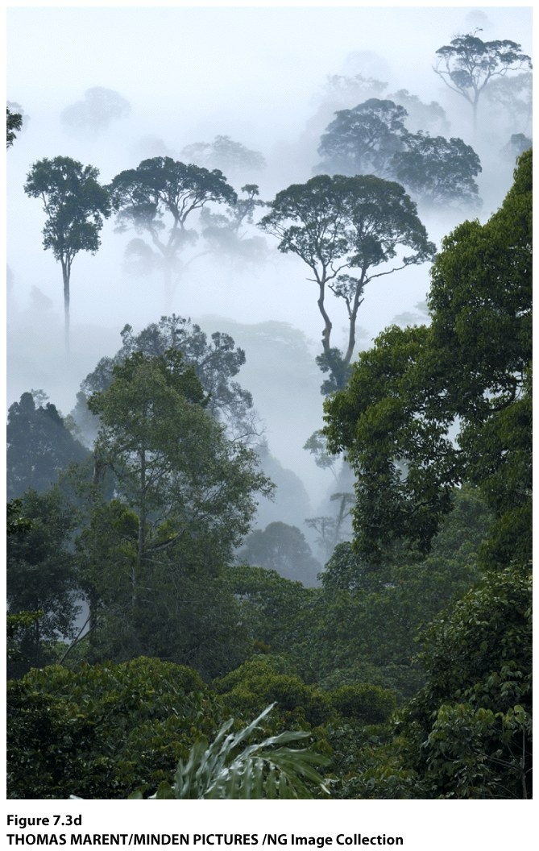
Latitude
Areas nearer the equator will have warmer air, which can hold more moisture
Lower latitude locations will, therefore, have more precipitation than higher latitude regions.
Tropical rainforest in Borneo,
Indonesia.

Slide 12
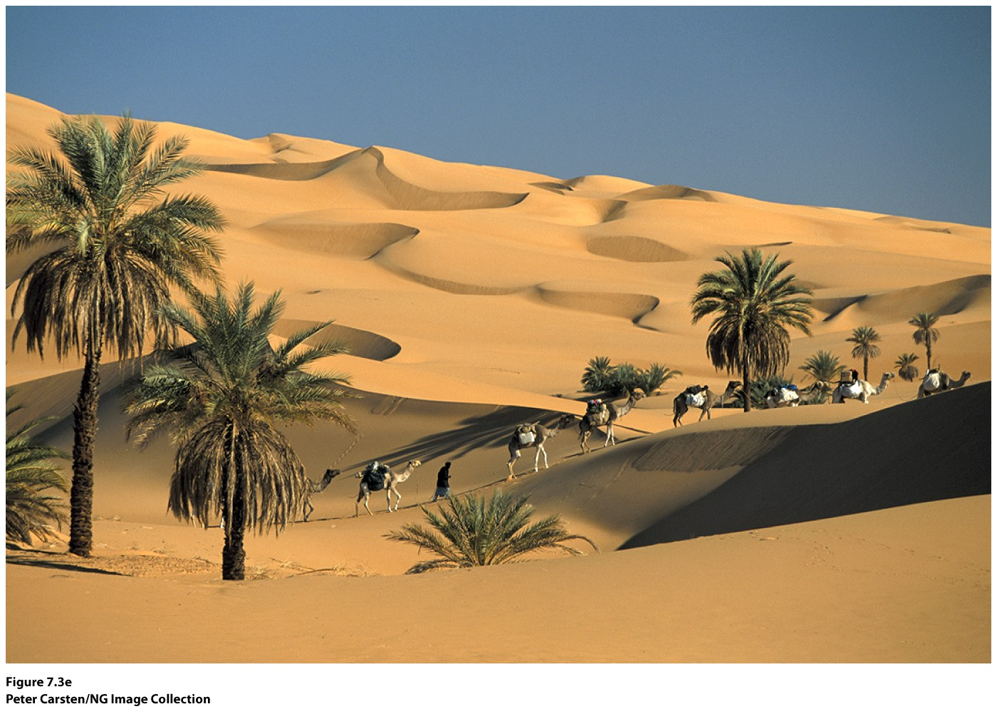
Persistent High & Low Pressure Systems
Low pressure areas (equator, midlatitudes) have converging, rising air. ITCZ
High pressure areas (subtropics, poles) have diverging, sinking air. STH
Sahara Desert, Africa.

Slide 13
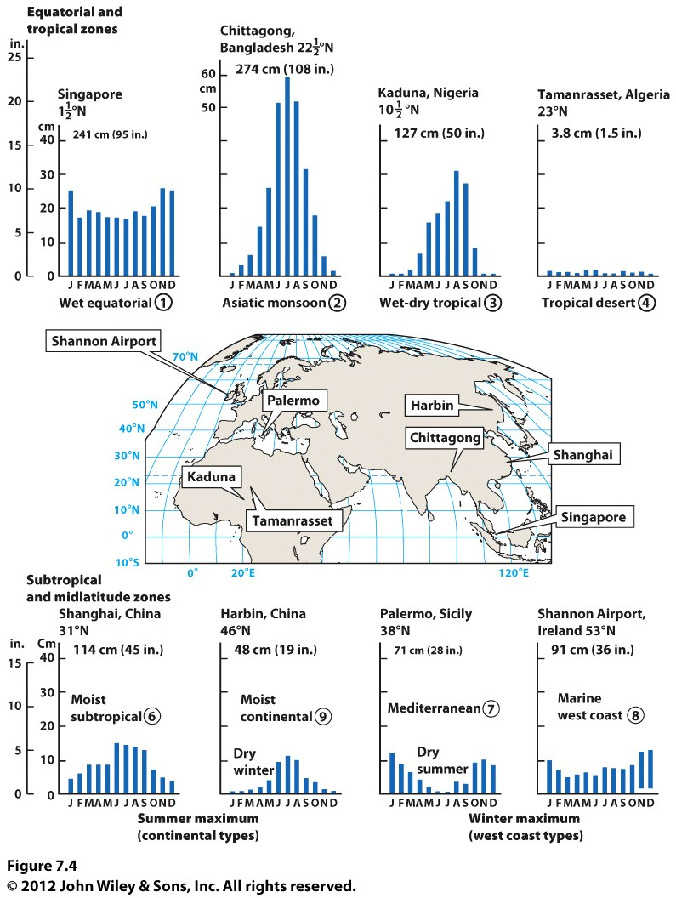
Three Patterns of Seasonal Rainfall:
Uniform throughout year—ITCZ or marine west coast location (air masses & polar front).
Summer maximum—Asia, air masses from warm waters (eastern U.S.)
Winter maximum—seasonal migration of polar front & STH
Climates With Little to no rainfall:
Arid—STH all year
Semiarid (steppe)—migration of STH and ITCZ

Slide 14
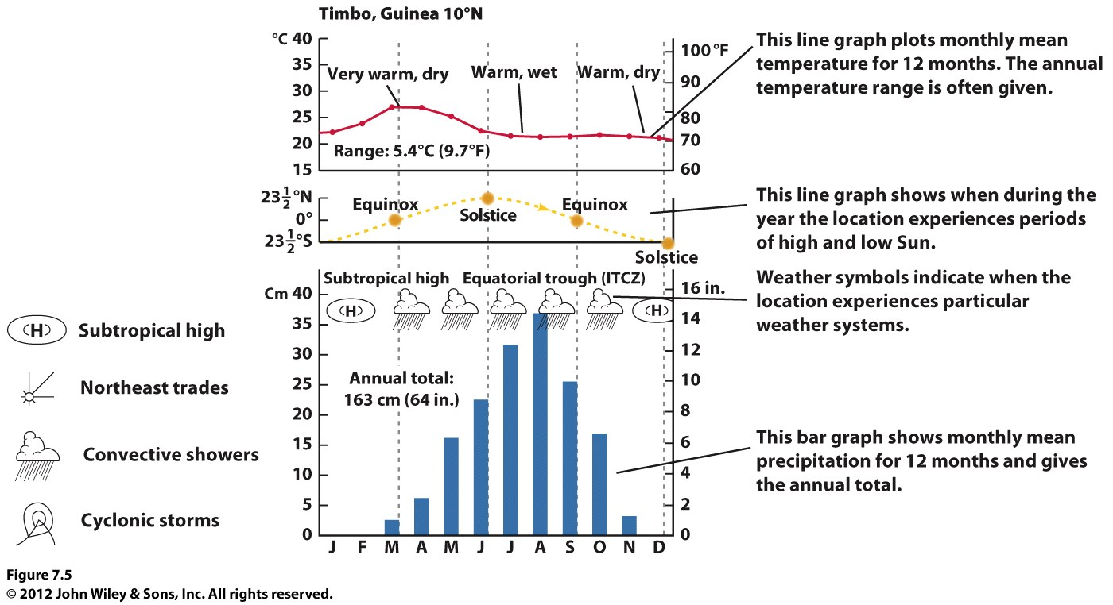
Climographs

Slide 15
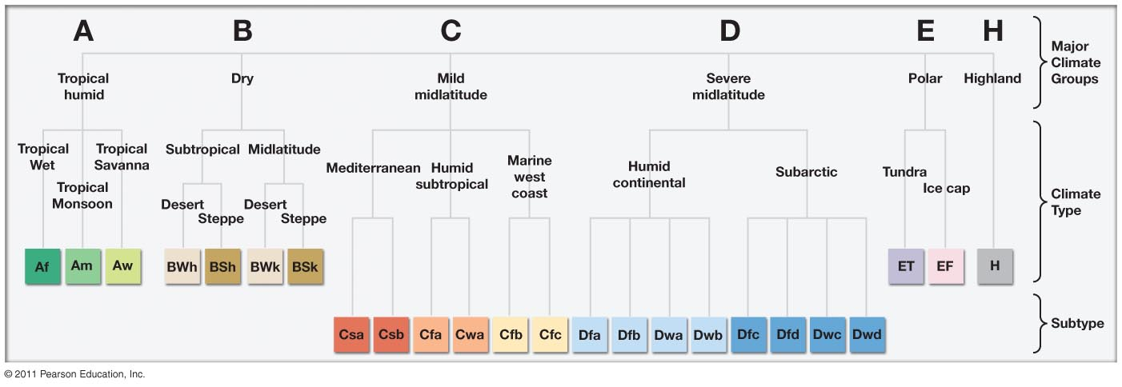
Climatology
Science of analyzing climate
Look to the past and present to predict the future
Use classification systems:
Koppen: uses monthly precip & temp
Strahler: uses air mass movement, frontal zones
The Koppen Classification System.

Slide 16
Koppen & Strahler Compared
Koppen Strahler
Low Latitudes
Af—tropical rainforest 1—wet equaotorial Am—tropical monsoon 2—monsoon & trade-wind coastal
Aw—tropical savanna 3—wet-dry tropical
Midlatitudes
Cs—Mediterranean 7—Mediterranean
Cfa—Humid subtropical 6—Moist subtropical
Cfb—Marine west coast 8—Marine west-coast
High Latitudes
Df—Humid continental 10—Moist continental
Dw—Dry winter continental 11—Boreal forest
Polar
ET—Arctic Tundra 12
EF—Polar Ice Cap 13
Arid/Semiarid
BS—Semiarid, steppe 4s, 5s, 9s (the number refers to temp range, latitude)
BW—Desert 4a, 5a, 9a

Slide 17
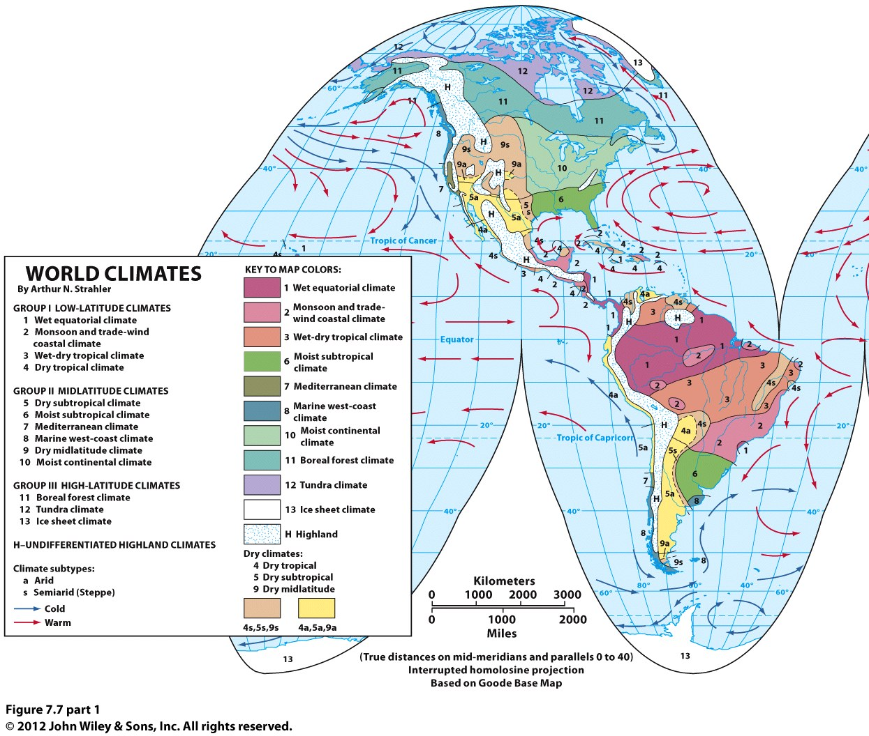

Slide 18
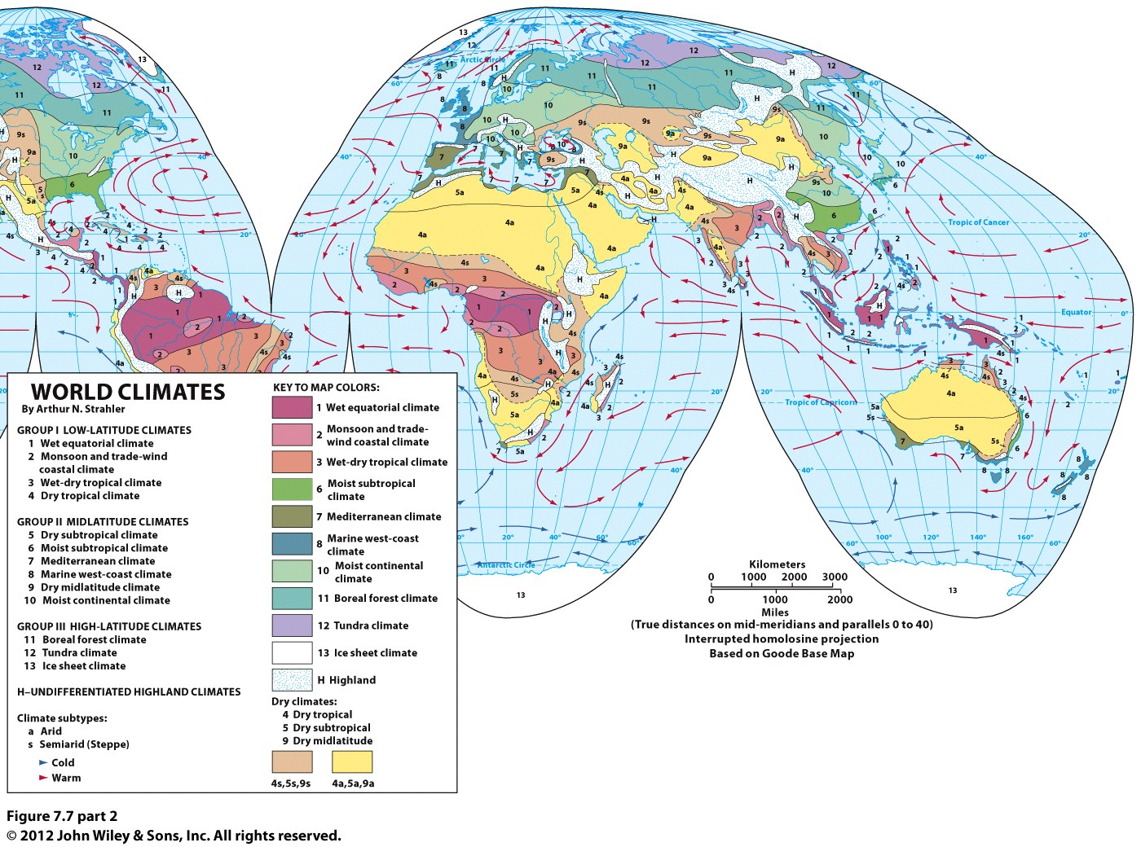

Slide 19
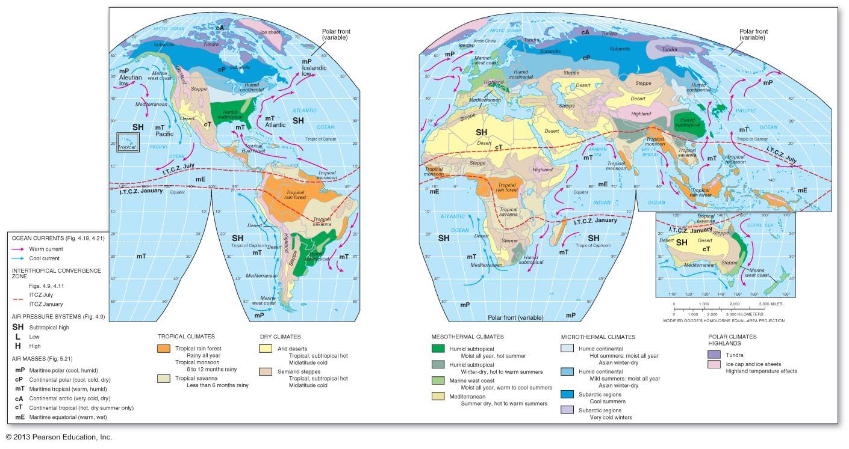

Slide 20
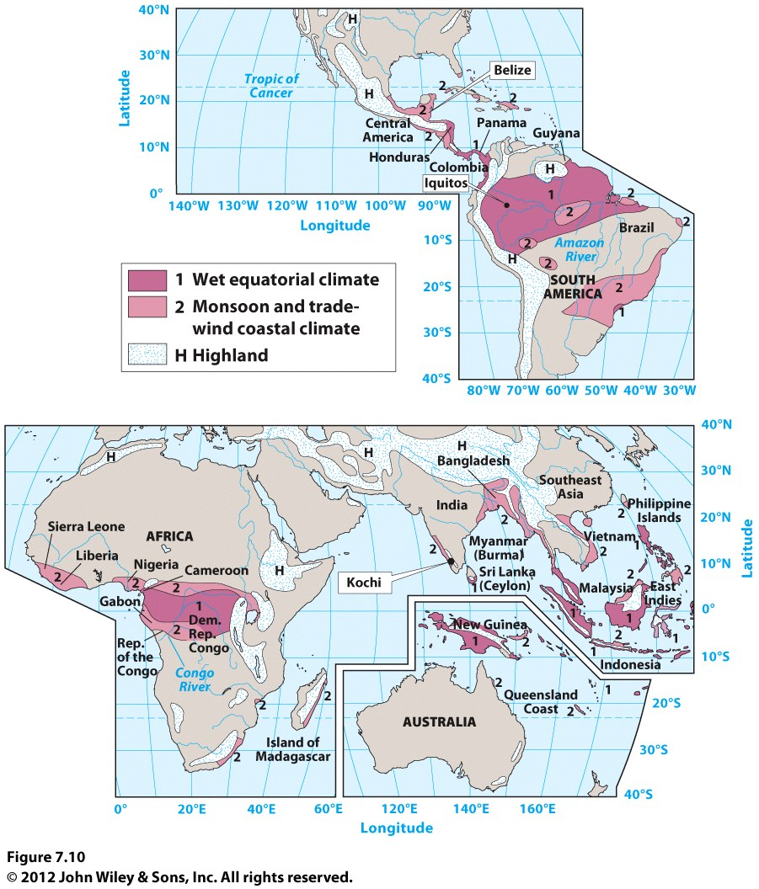
Tropical, low latitude climates—no seasons, constant temperature, varying precipitation.
1, 2,3 & 4.
Notes:
UNNUMBERED FIGURE 2 Pg.219

Slide 21
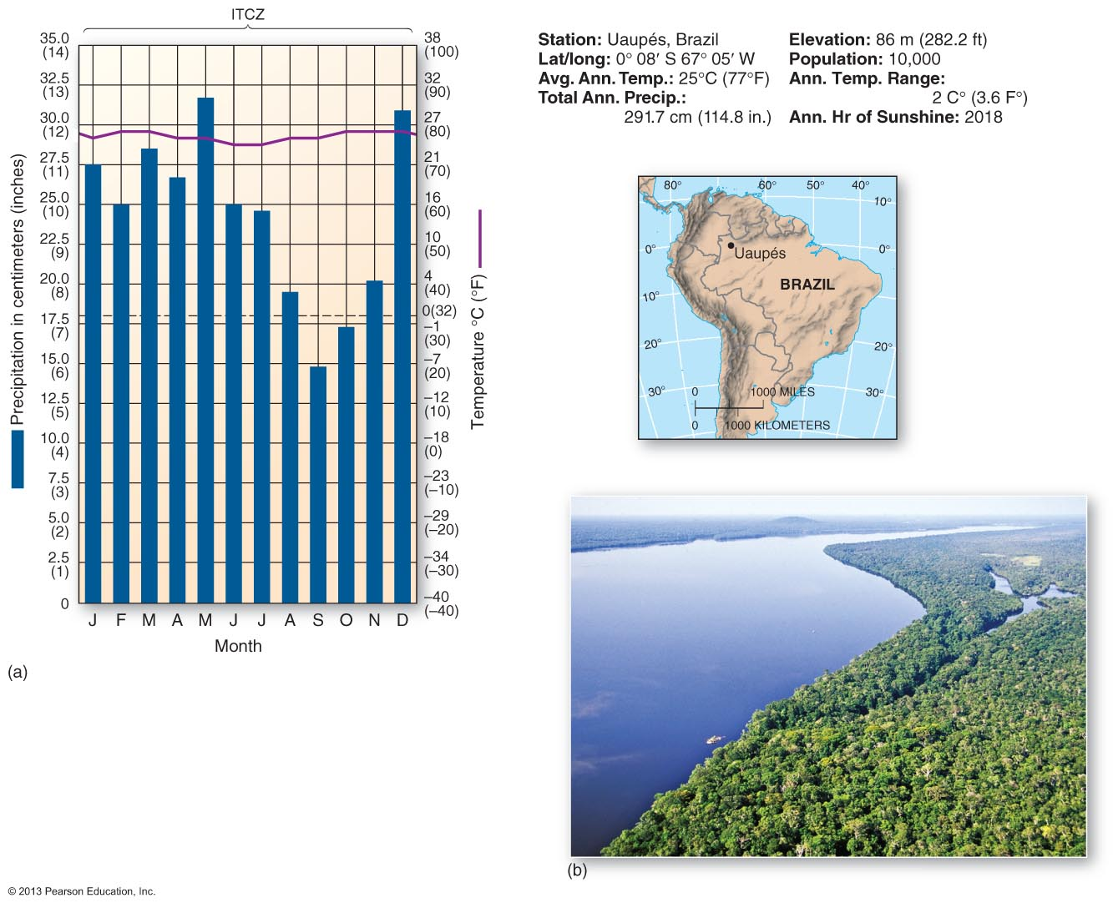
Uaupes, Brazil (1): Wet equatorial
climate.
Notes:
Figure 7.3

Slide 22
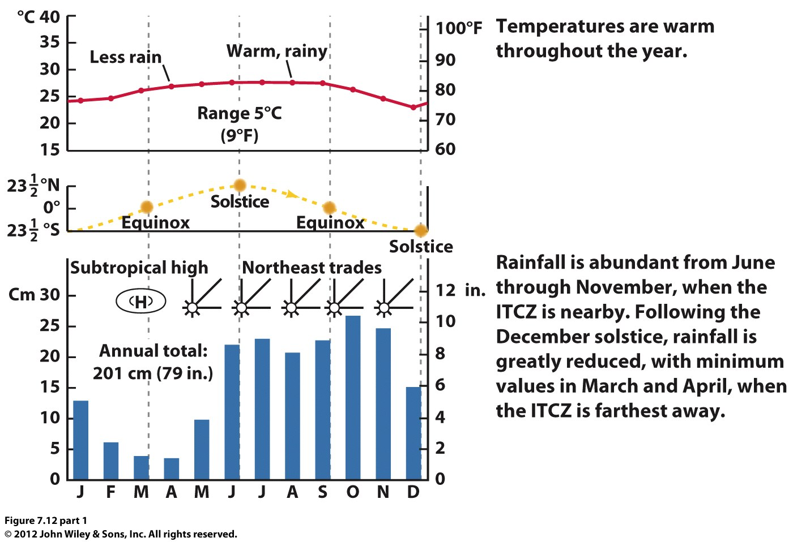
Iquitos, Peru. Wet equatorial climate.

Slide 23
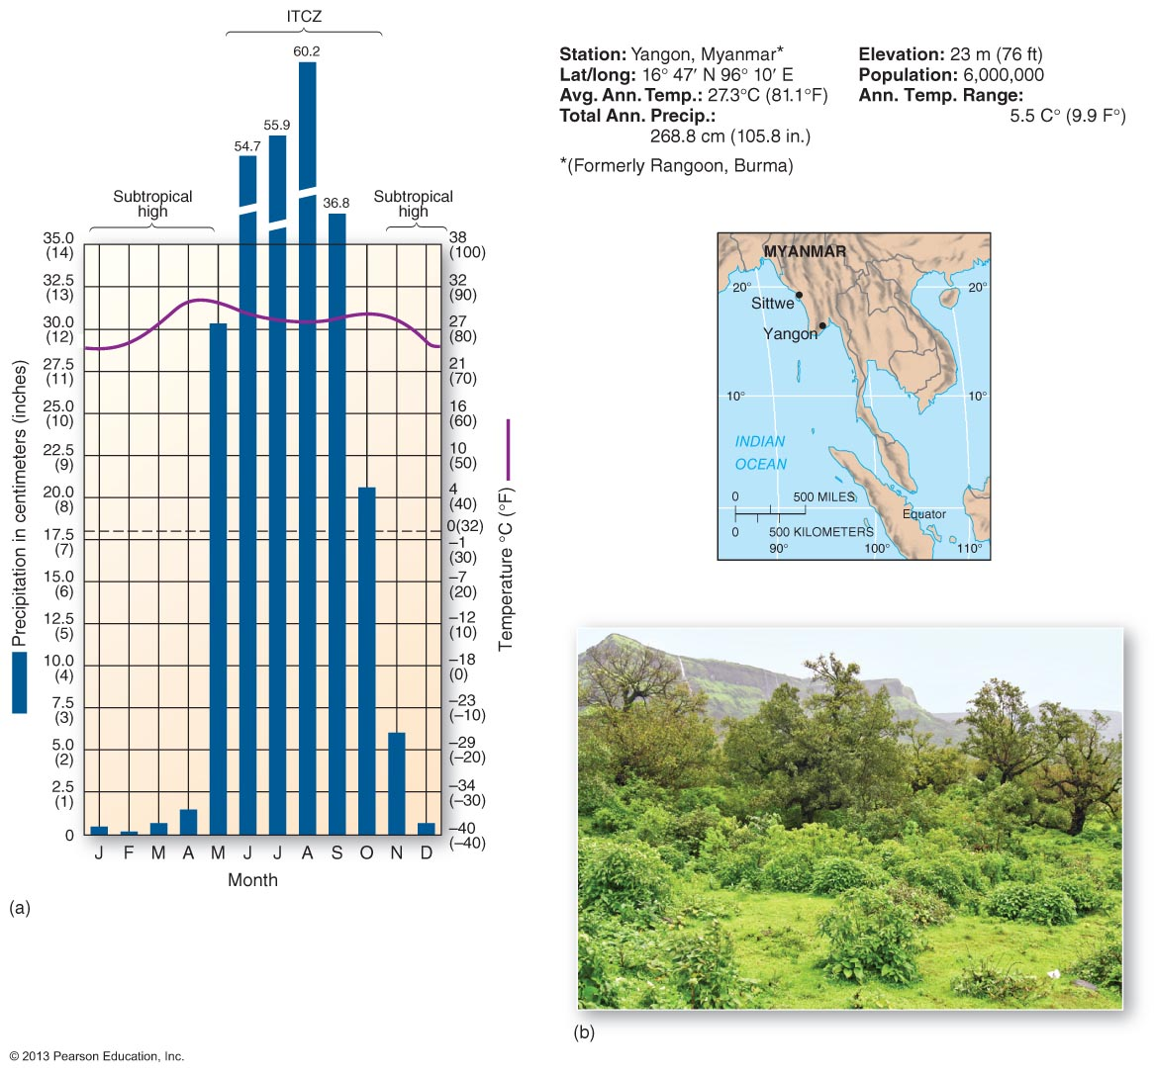
Yangon, Myanmar (2):
Monsoon and trade-wind coastal climate
Notes:
Figure 7.4

Slide 24
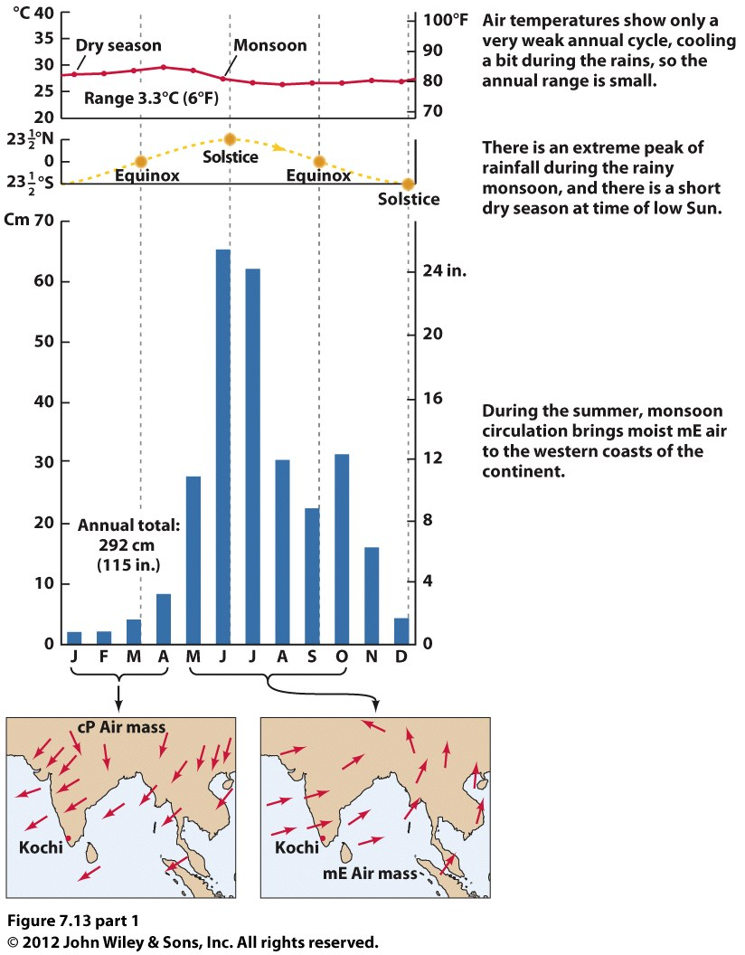
Kochi, India
Monsoon climate.

Slide 25
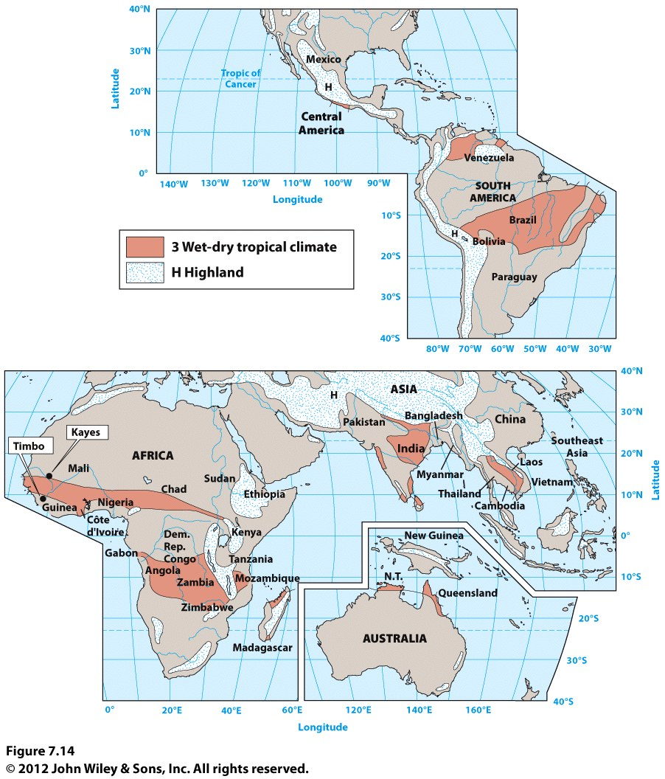

Slide 26
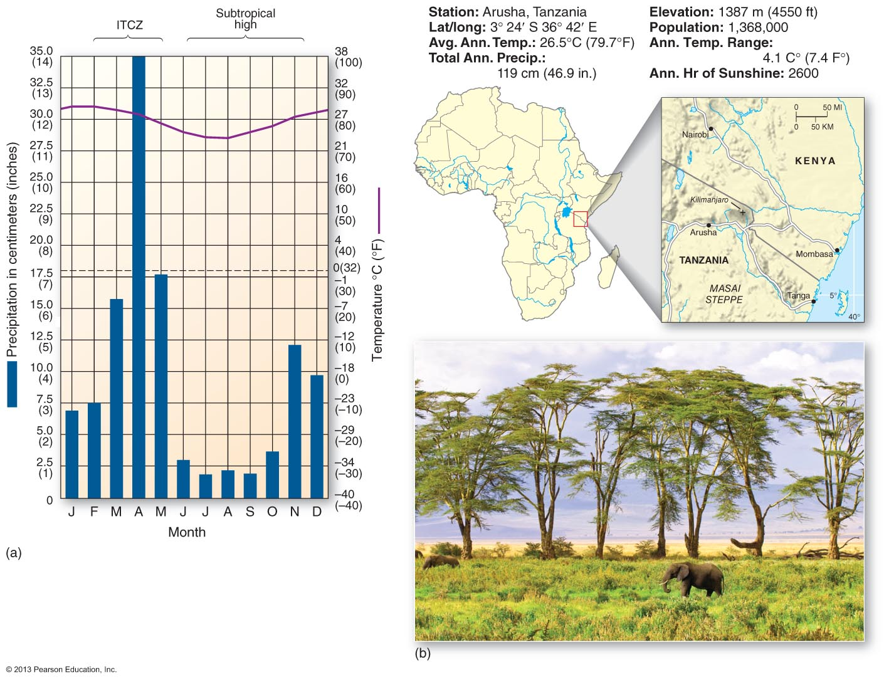
Arusha, Tanzania (3): wet-dry
Tropical climate

Slide 27
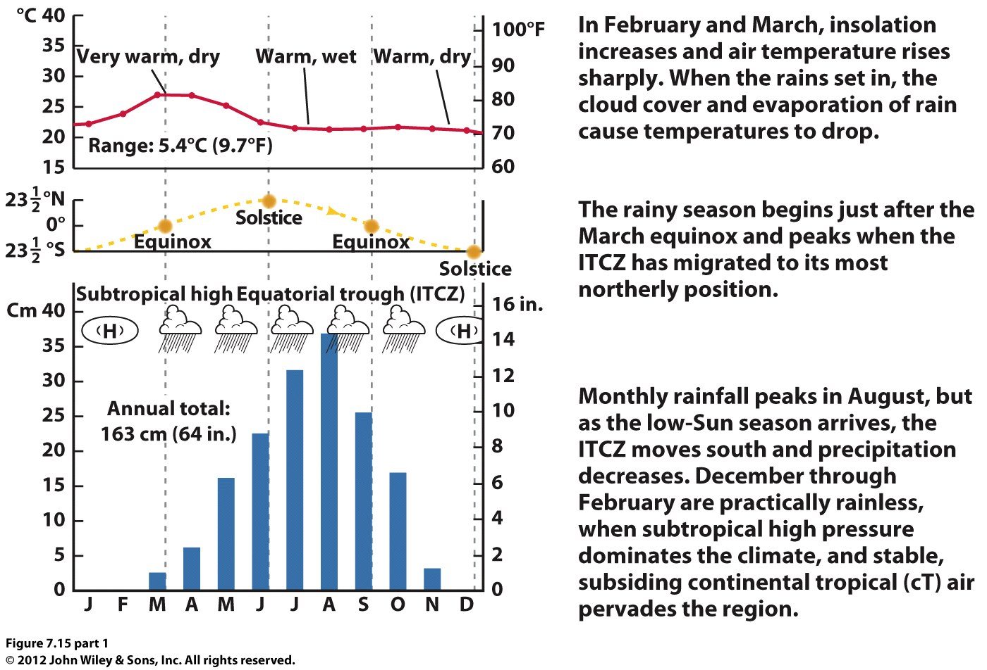
Timbo, Guinea, 10N, wet-dry, tropical savanna climate.

Slide 28
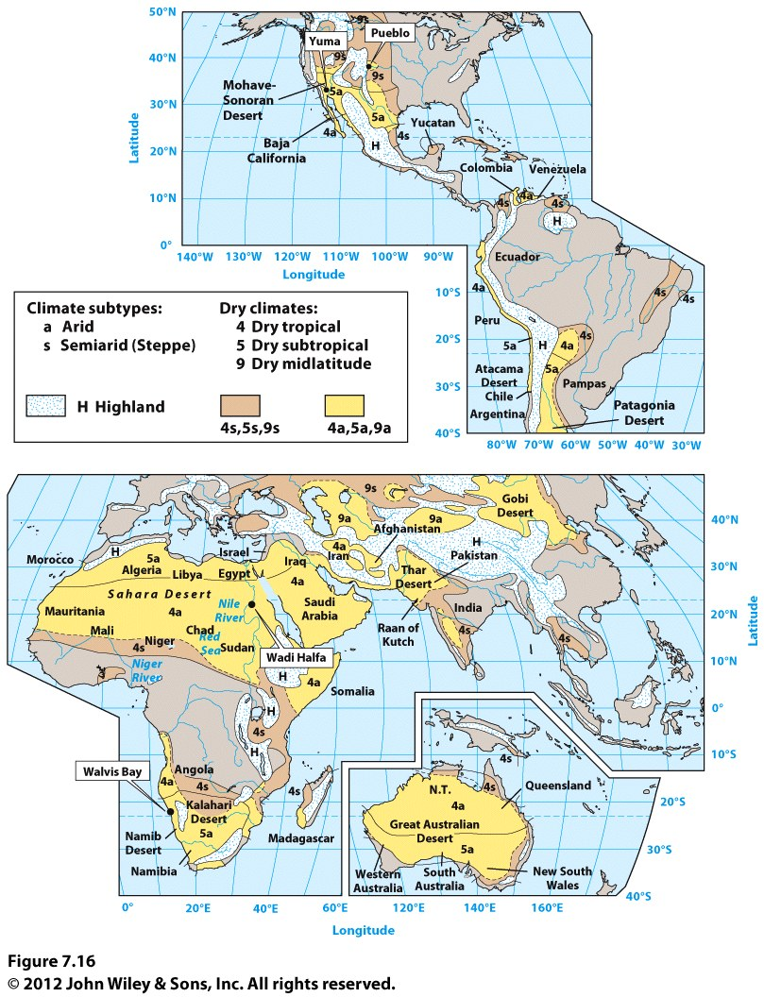
Tropical Dry
Climates

Slide 29
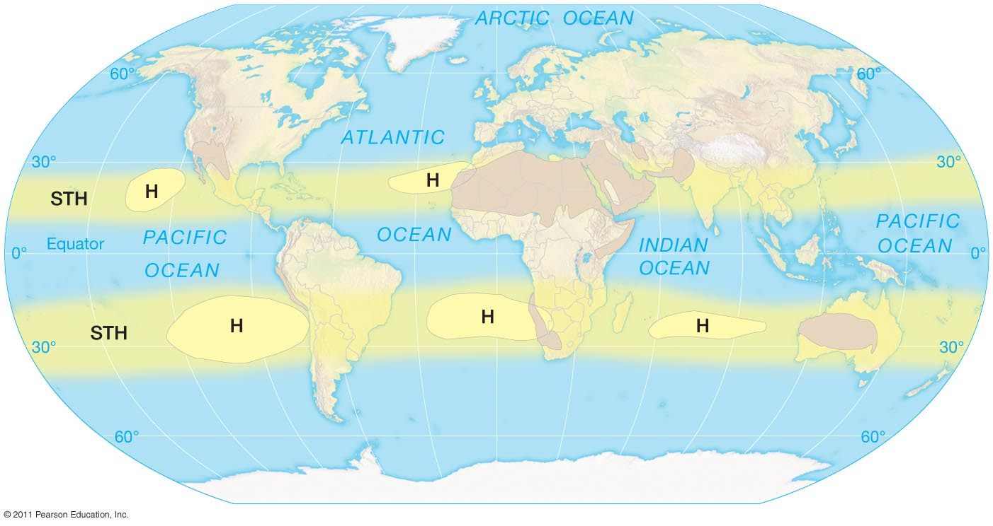
In addition to the influence of the STH, deserts are determined by:
--mountain barriers (think of the western U.S.)
--colder ocean currents (think of the coast of Chile)
Notes:
Figure 8-13

Slide 30
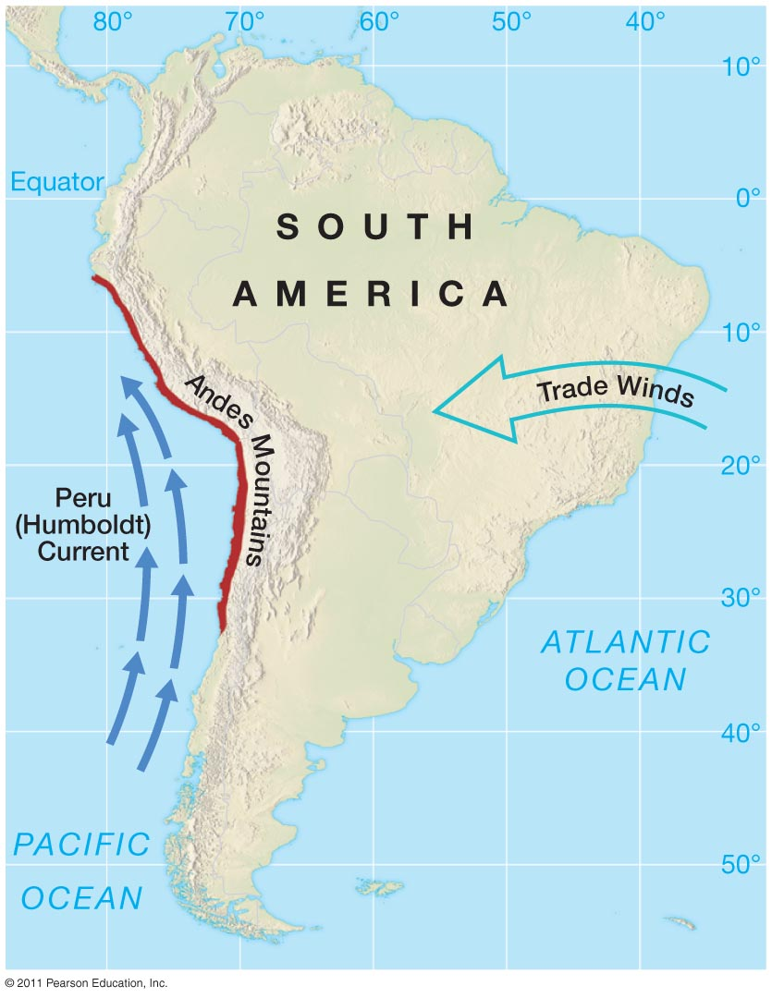

Slide 31
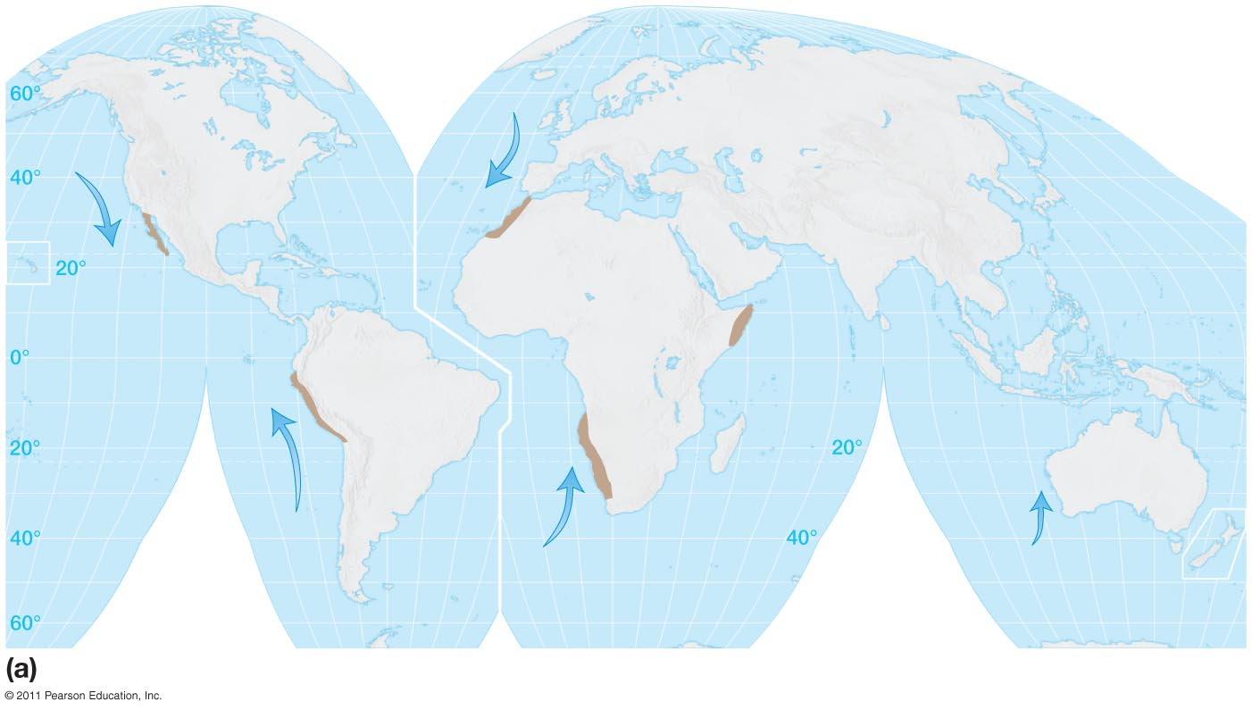
Proximity to cold ocean currents intensifies aridity, but can also produce important coastal fog belts.
Notes:
Figure 8-16a

Slide 32
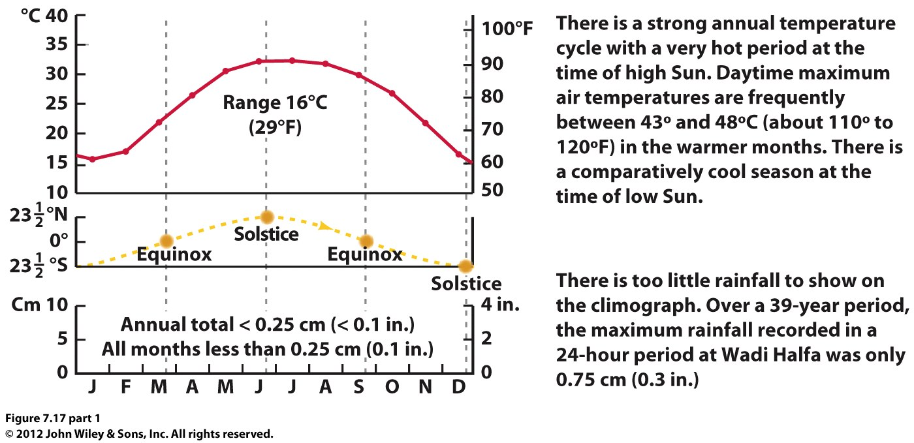
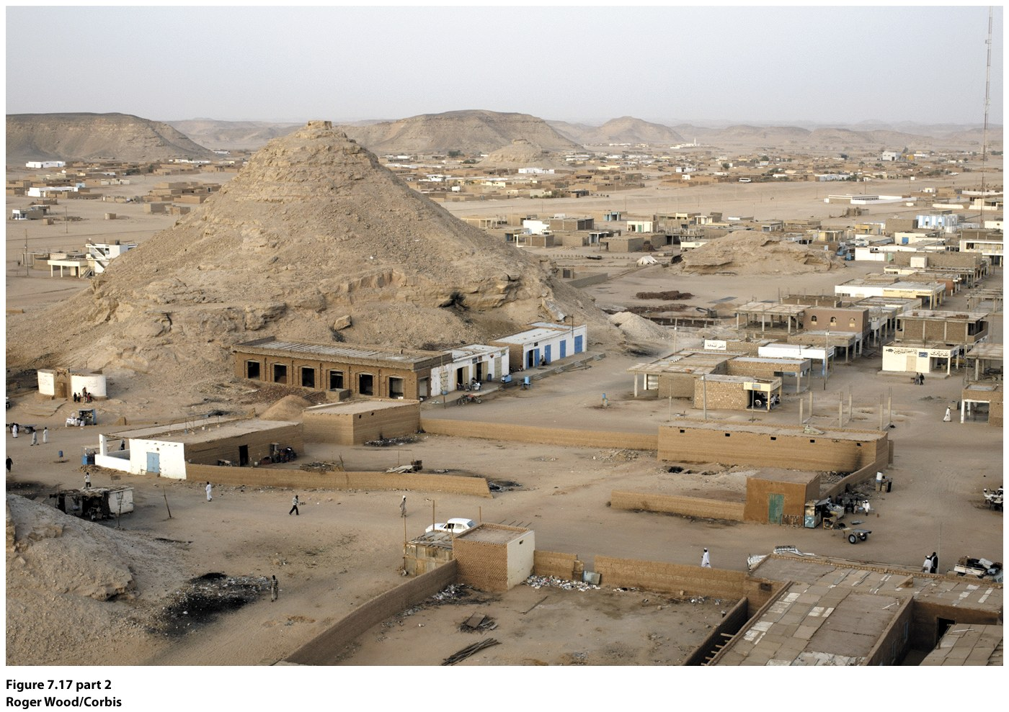
Wadi Halfa, Sudan (4): Tropical Dry

Slide 33
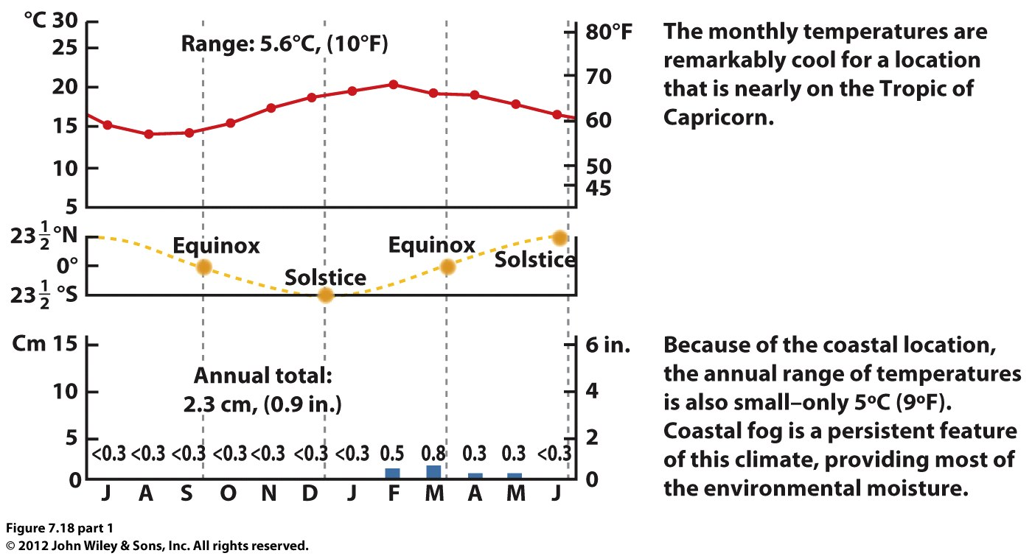
Walvis Bay, Namibia (4): Tropical dry on a coast

Slide 34
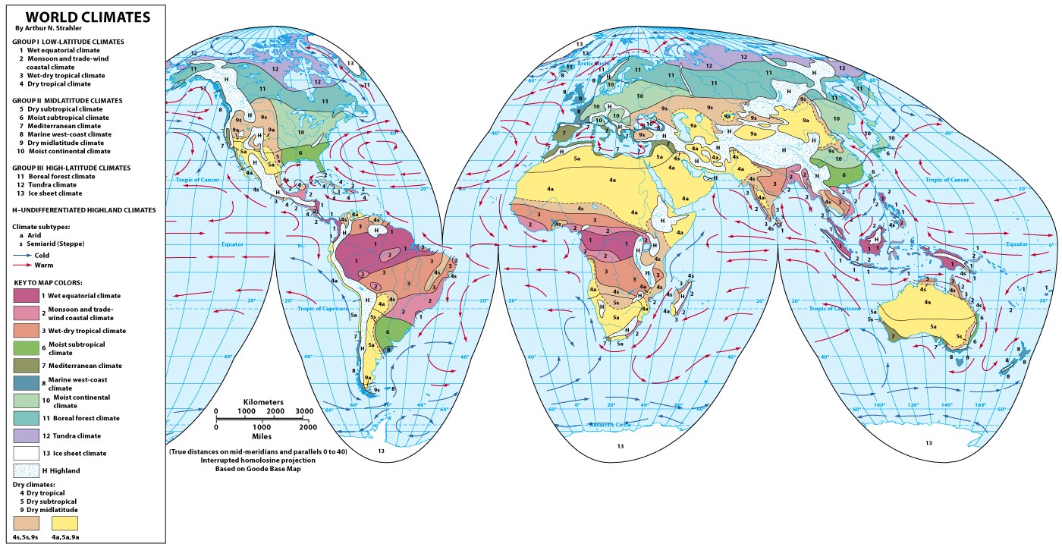
Midlatitude Climates
Five midlatitude climates:
5. Dry Subtropical
6. Moist Subtropical
7. Mediterranean
8. Marine West-coast
9. Dry midlatitude
© A. N. Strahler

Slide 35
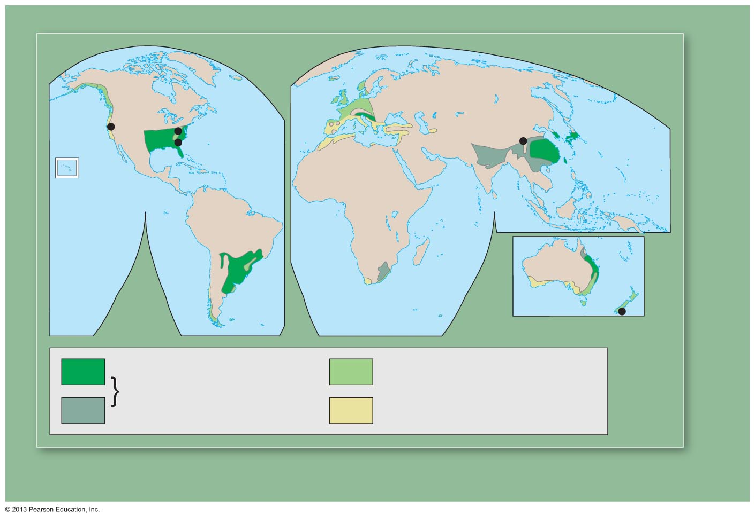
Midlatitude Climates—mild winters, varying precipitation.
5, 6, 7, 8, 9
Any pattern to where these climates are located?
Why do these climates extend into the upper latitudes on west coasts (northern hemisphere) but not on east coasts?
San Francisco, CA
Columbia,
South Carolina
Chengdu, China
Notes:
UNNUMBERED FIGURE 3 Pg.224_U

Slide 36
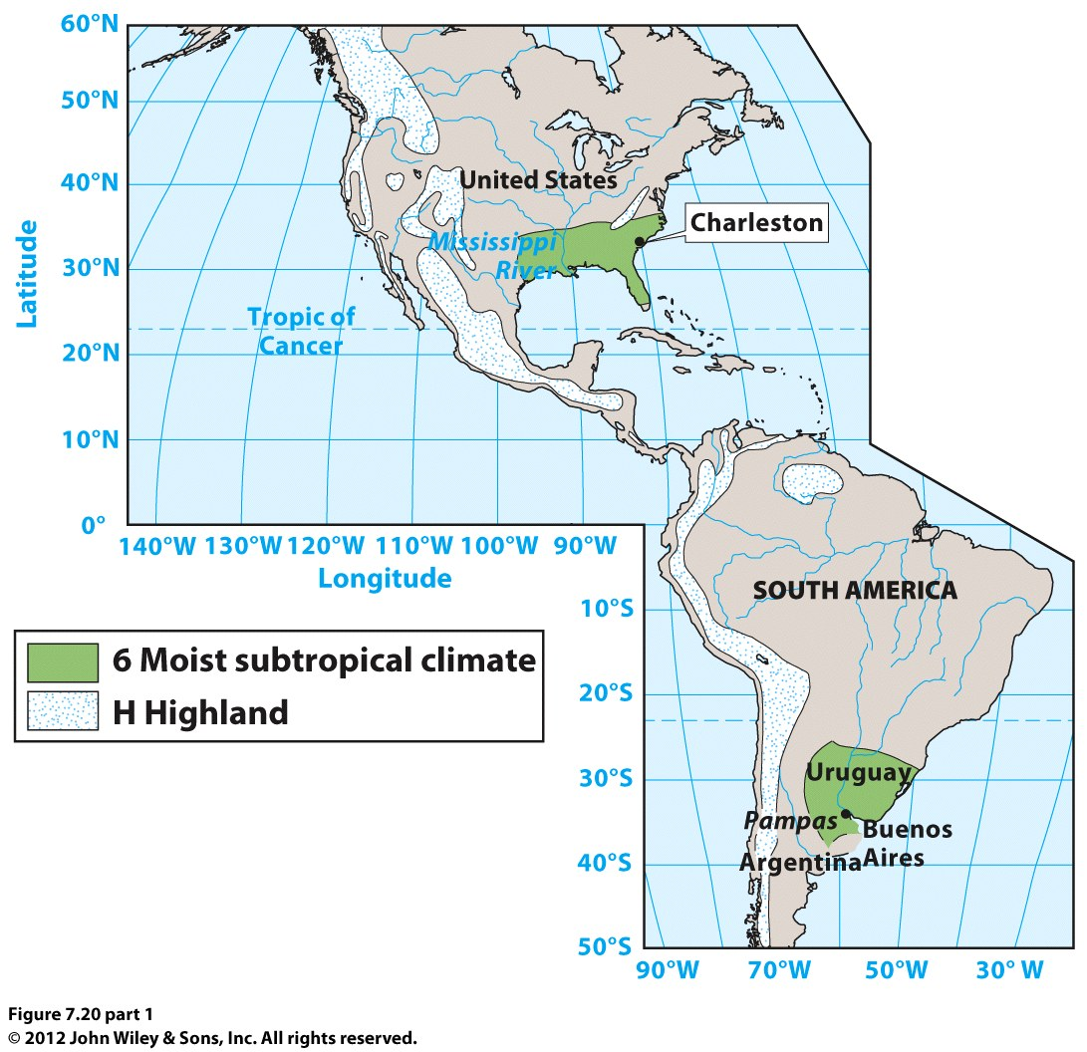

Slide 37
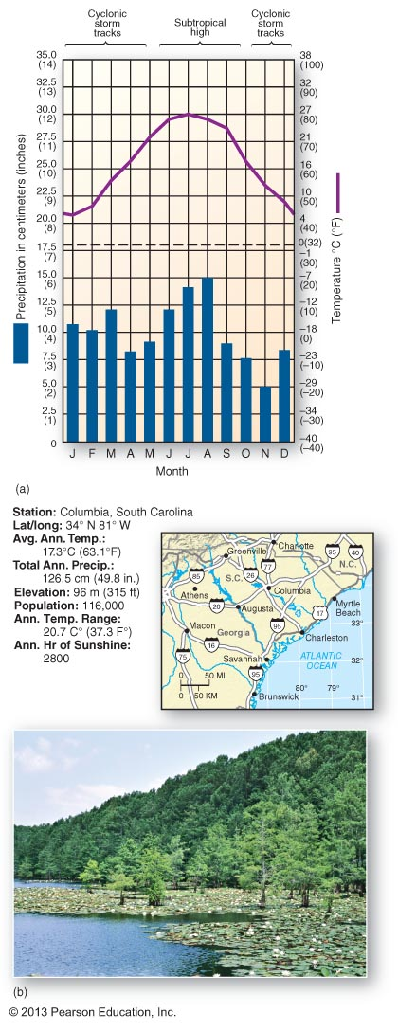
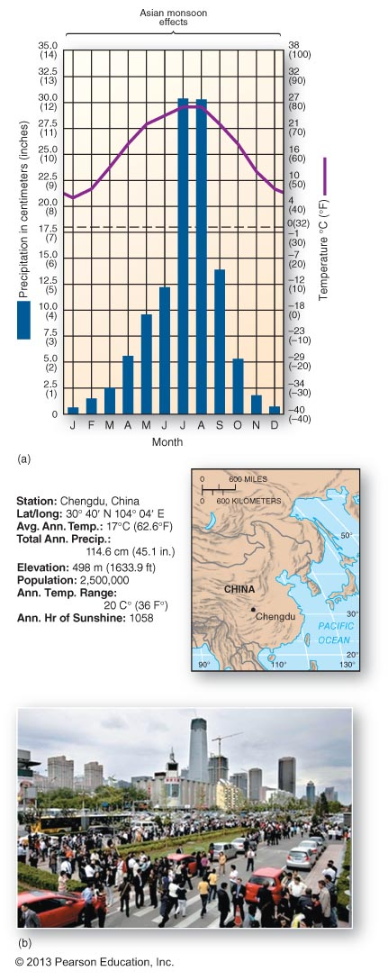
6: Moist subtropical
Notes:
Figure 7.6

Slide 38
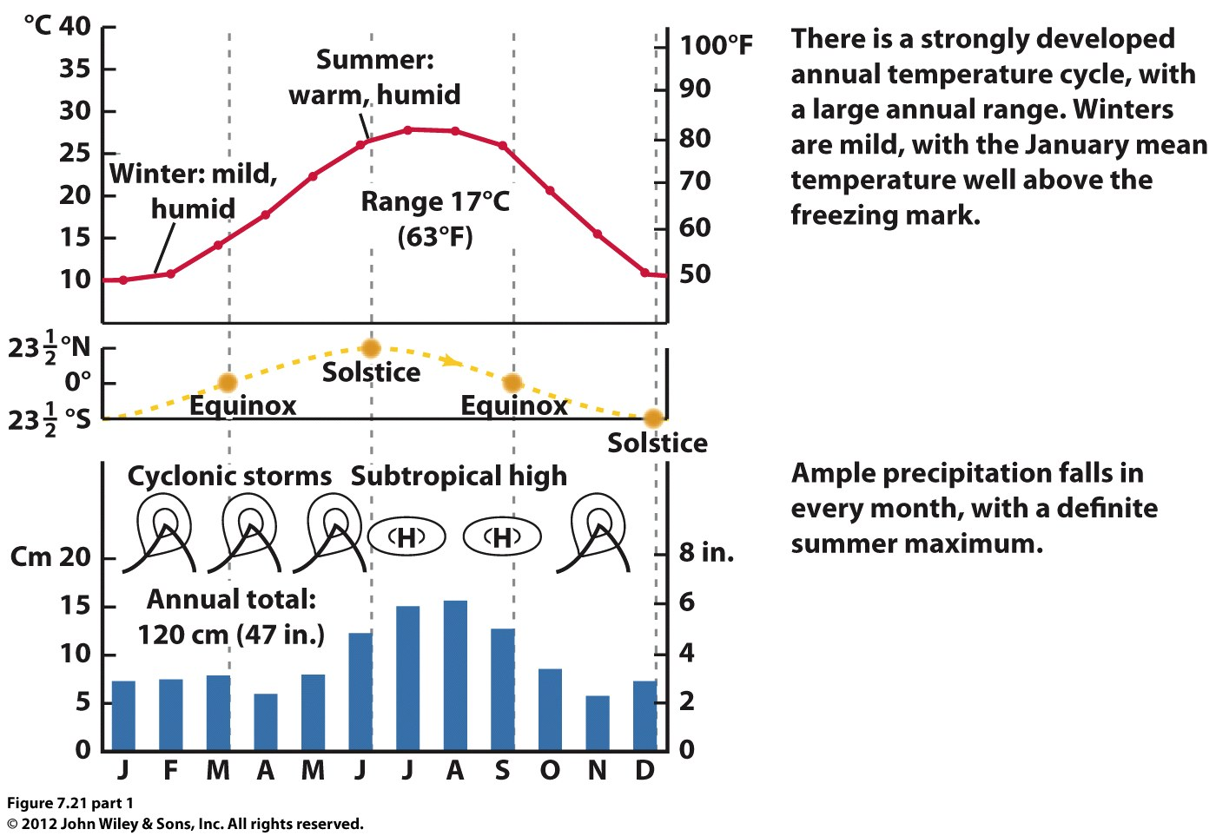
Charleston, South Carolina

Slide 39
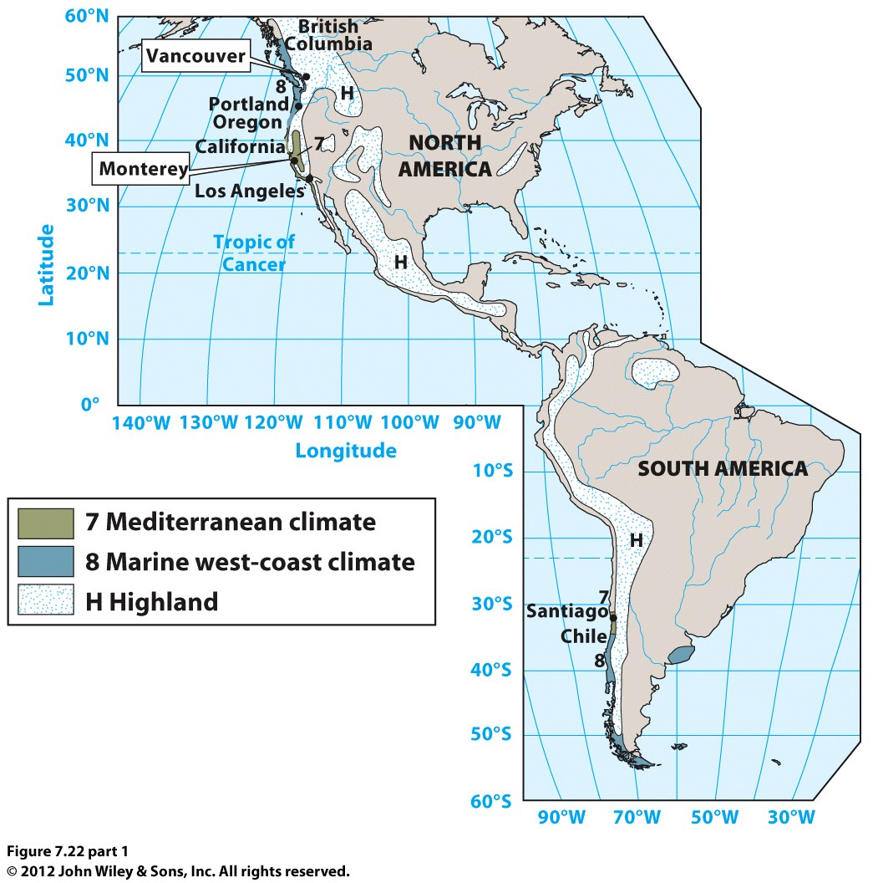

Slide 40
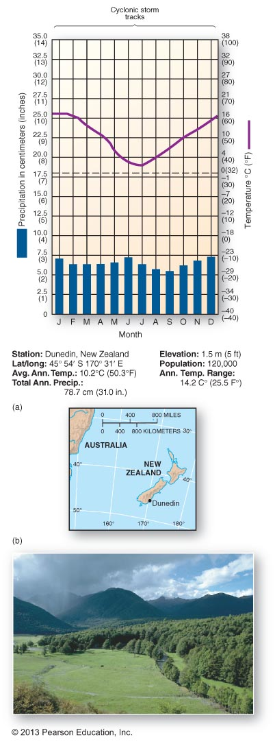
8: Marine West Coast
Rain all year, cool
Wettest climate in the mid-latitudes
Notes:
Figure 7.8

Slide 41
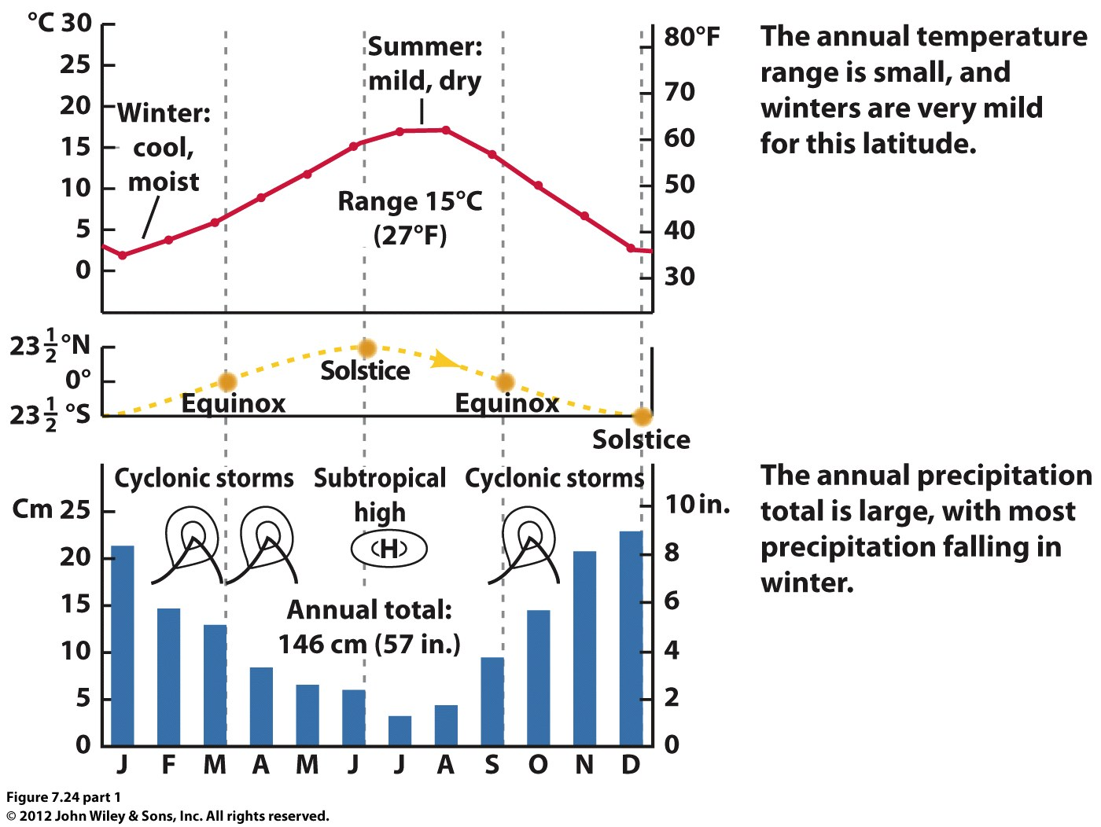
Vancouver, British Columbia

Slide 42
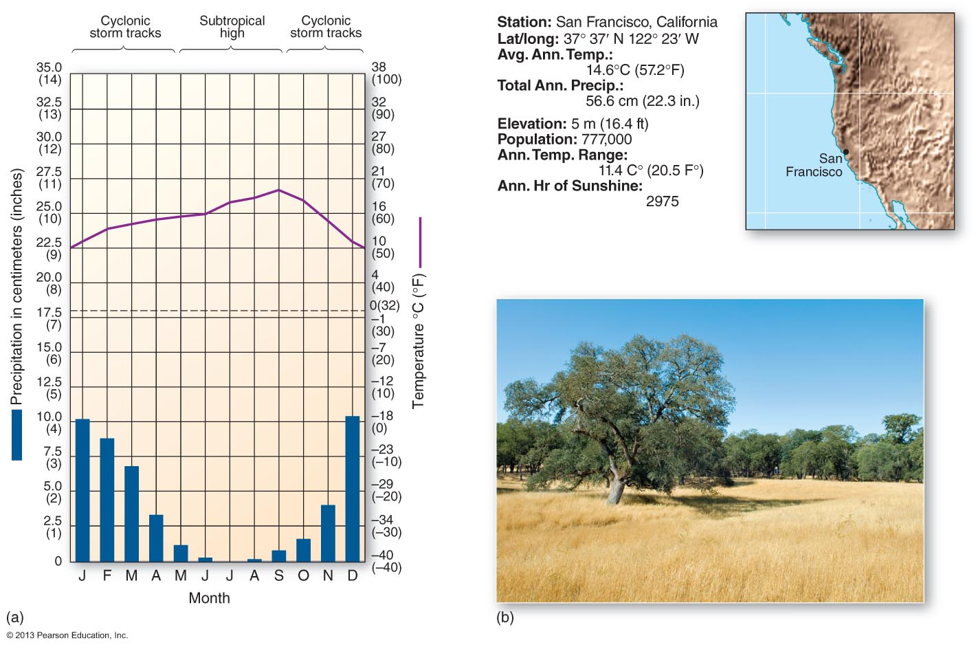
7: Mediterranean
Notes:
Figure 7.10

Slide 43
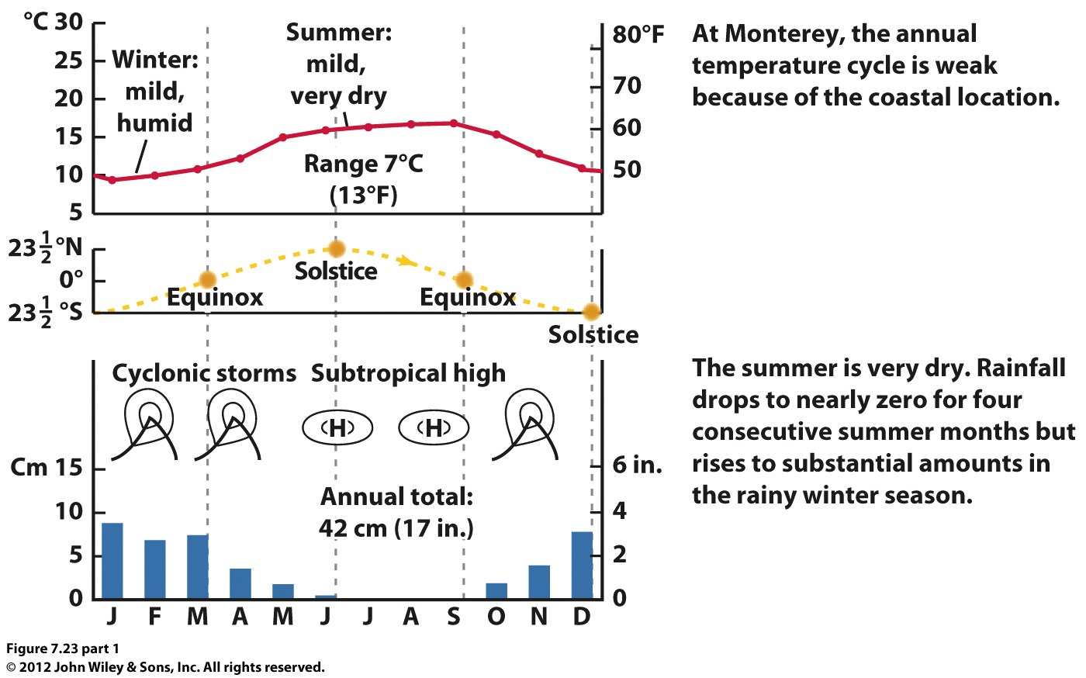
Monterey, California

Slide 44
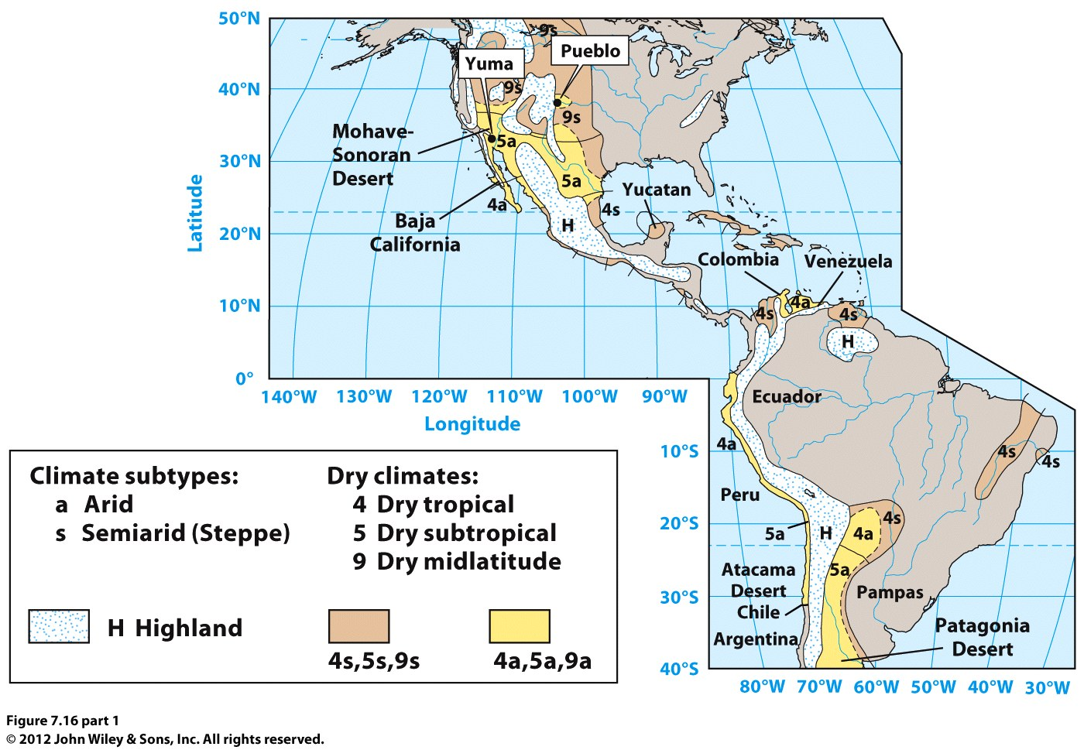
Dry climates in the midlatitudes
Dry subtropical (5) & Dry midlatitude (9)

Slide 45
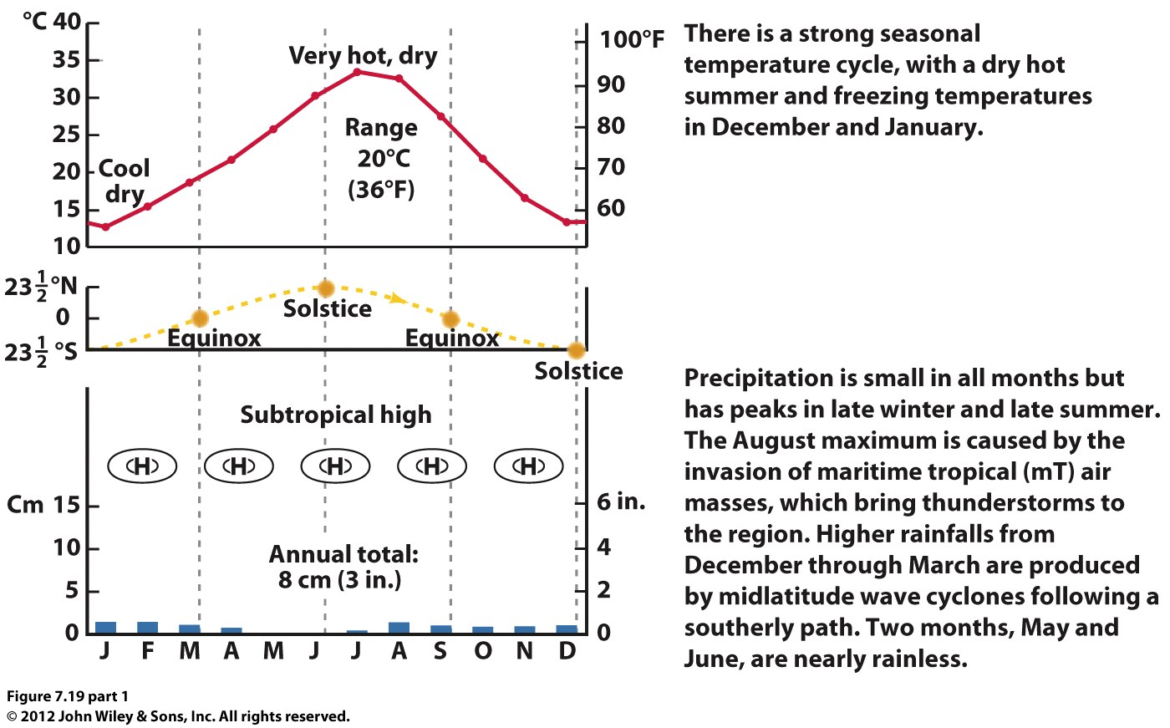
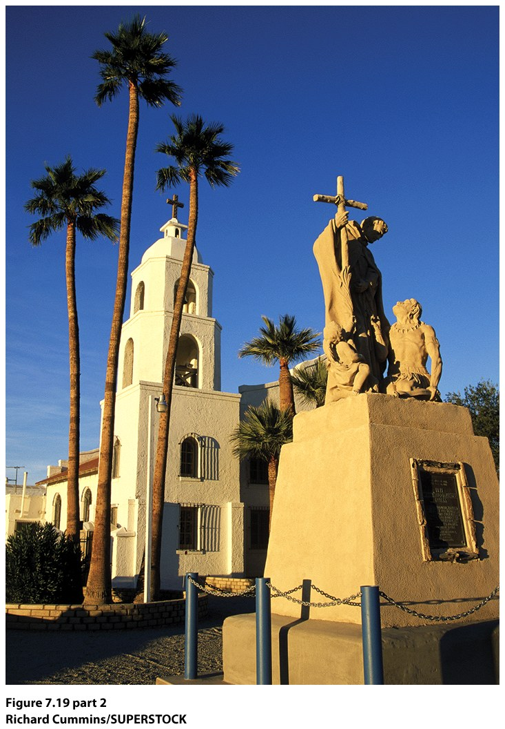
Dry Subtropical (5): Yuma, Arizona

Slide 46
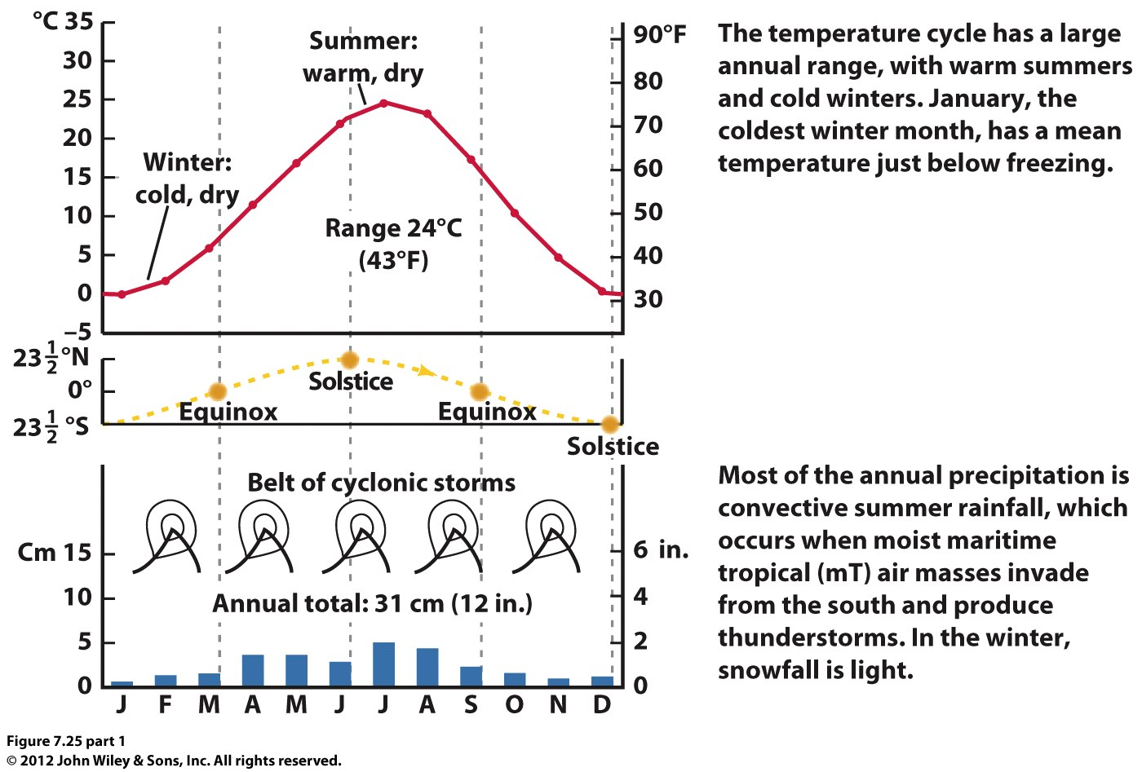
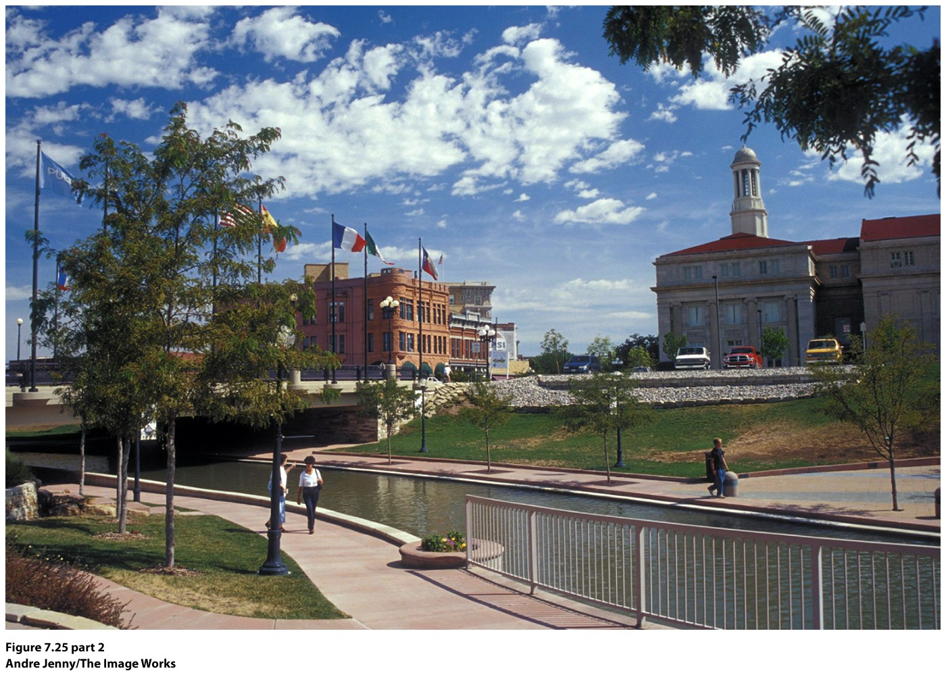
Dry Midlatitude (9): Pueblo, Colorado

Slide 47
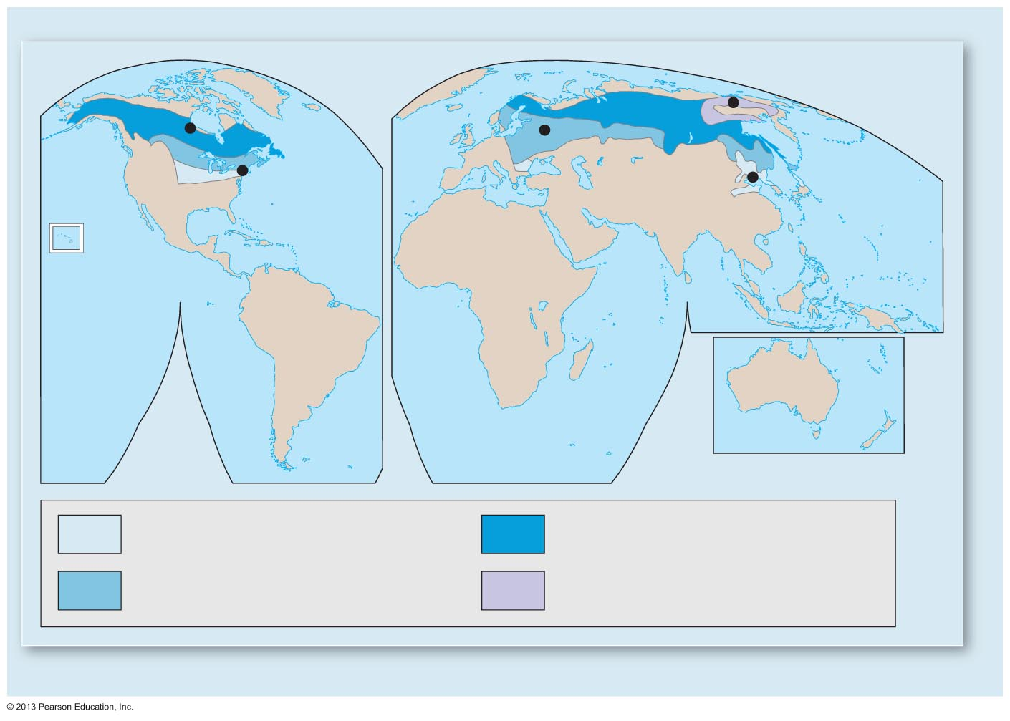
High latitude and severe winter climates (10, 11, 12 & 13): all have very cold winters, varying precipitation.
Churchill, Manitoba
Verkhoyansk, Russia
Moscow, Russia
New York, NY

Slide 48
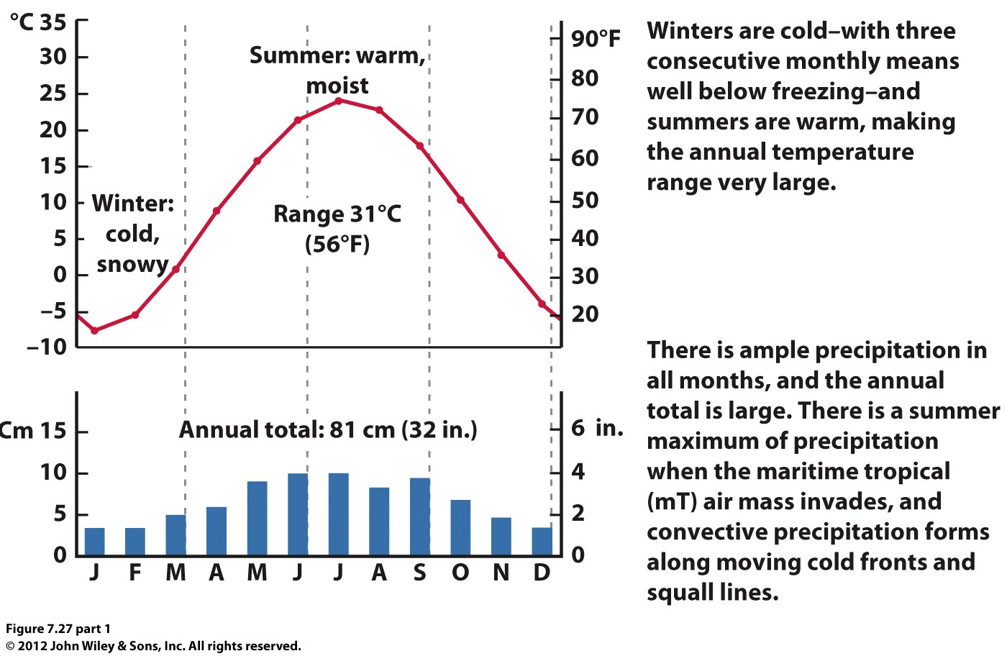
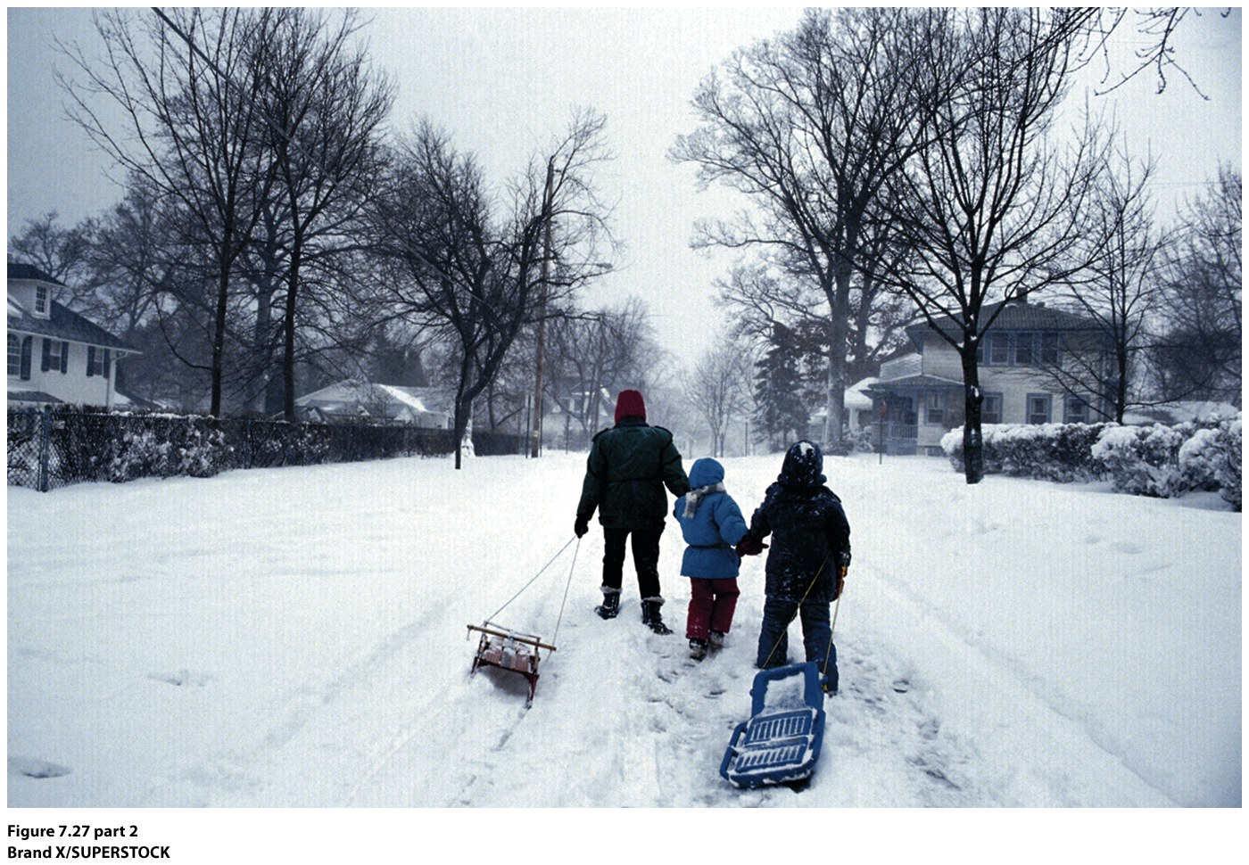
Moist Continental (10): Madison, Wisconsin

Slide 49
New York, NY, (10)

Slide 51
Fort Vermillion,
Alberta, Canada
(11)

Slide 55
Upernavik, Iceland (12)
Eismitte, Greenland (13)

Slide 56
Climate Change
© John Wiley & Sons, Inc.
©John Wiley & Sons, Inc
If the Arctic continues to warm, which of the following transformations is most likely?
a. The tundra climate region will expand in all directions.
b. The boreal forest climate will expand in all directions.
c. The boreal forest climate will move into areas once considered tundra climate.
d. The tundra climate will move into areas once considered boreal forest climate.

