Slide 1
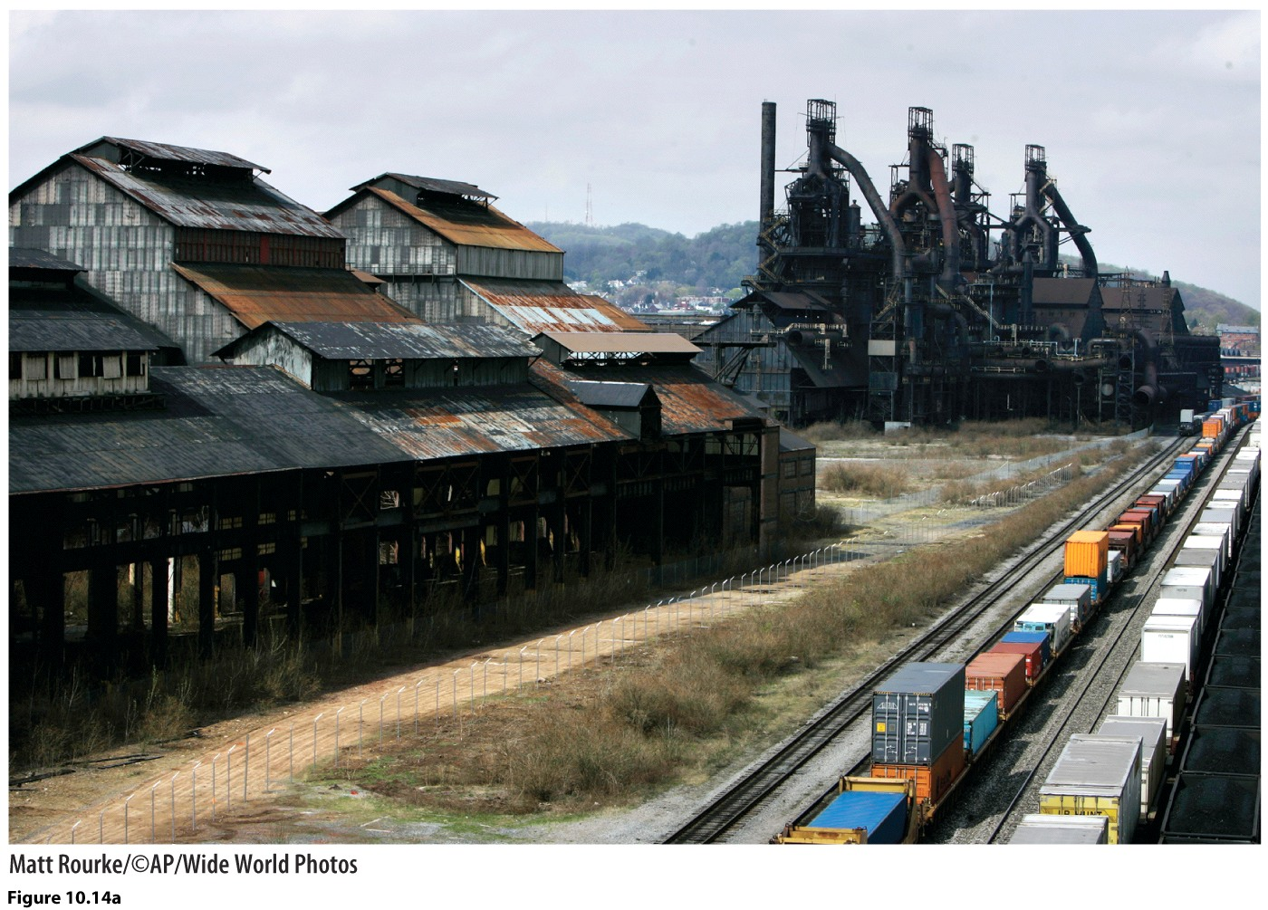
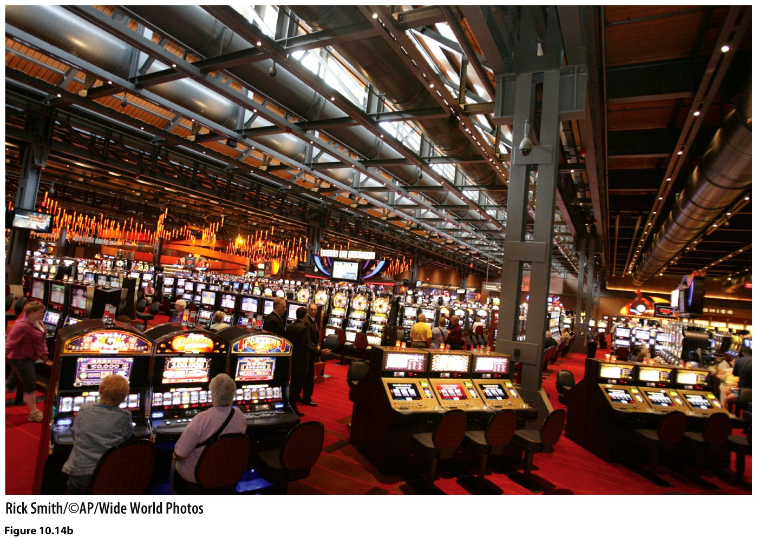
Chapter 10: Changing Geographies of Industry

Slide 2
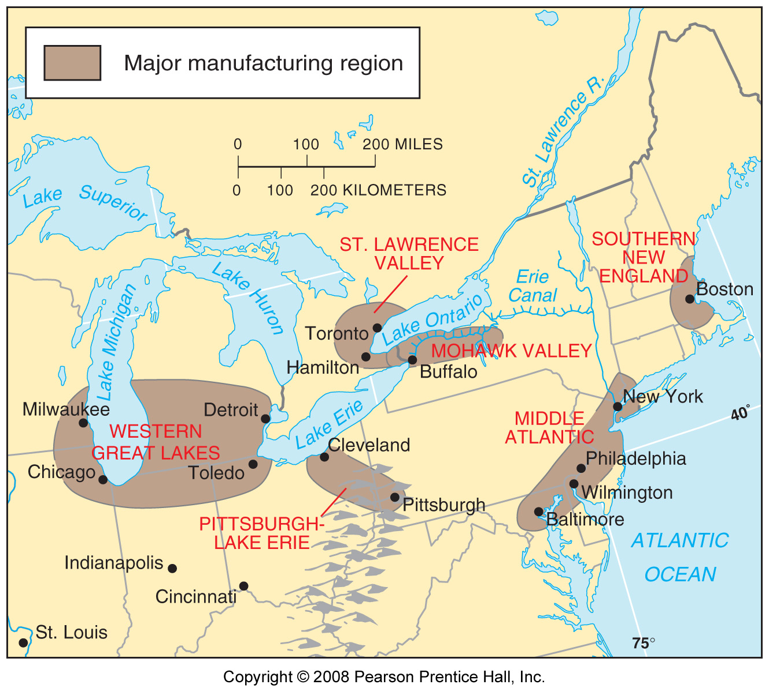
In US, industry clustered in the northeast—near iron ore deposits and near water transportation networks.

Slide 3
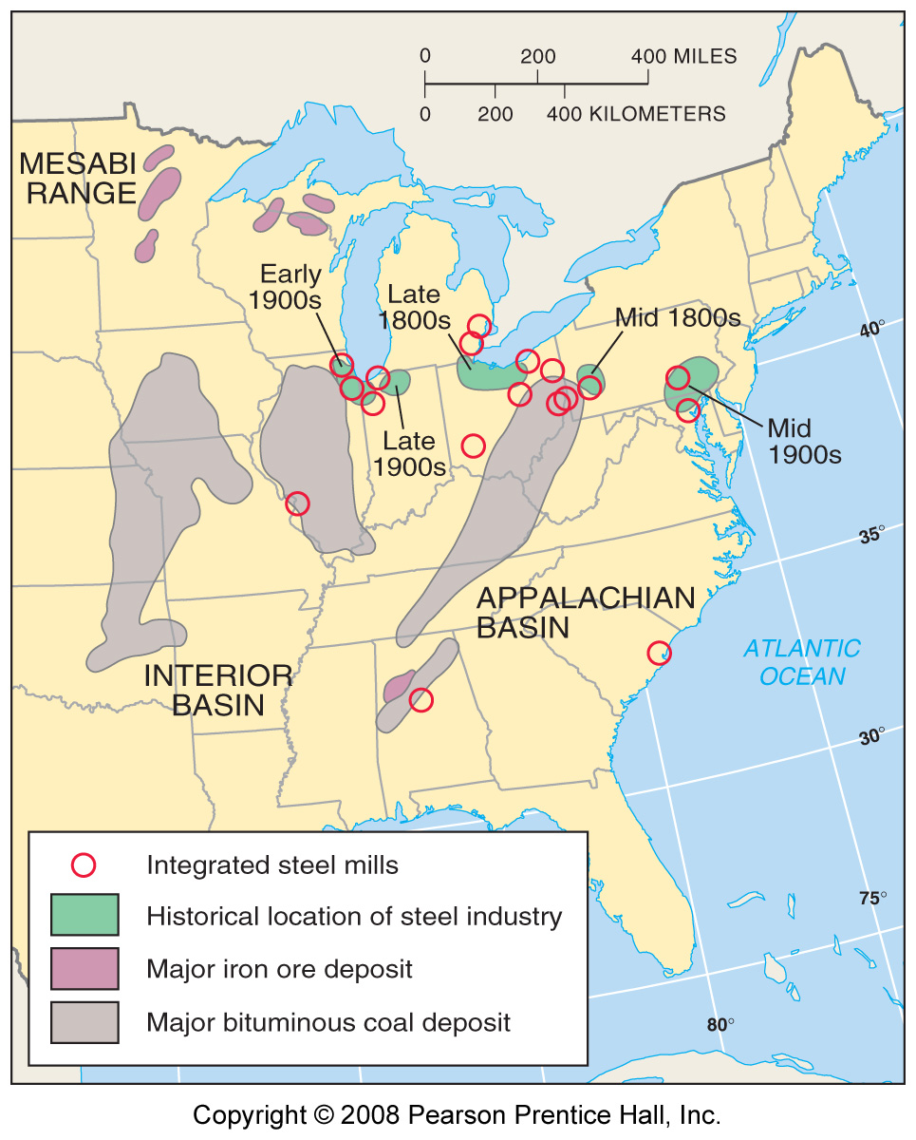
Steel mills clustered near the Great Lakes to minimize transportation costs.

Slide 4
US Steel Mill, Gary, Indiana.

Slide 5
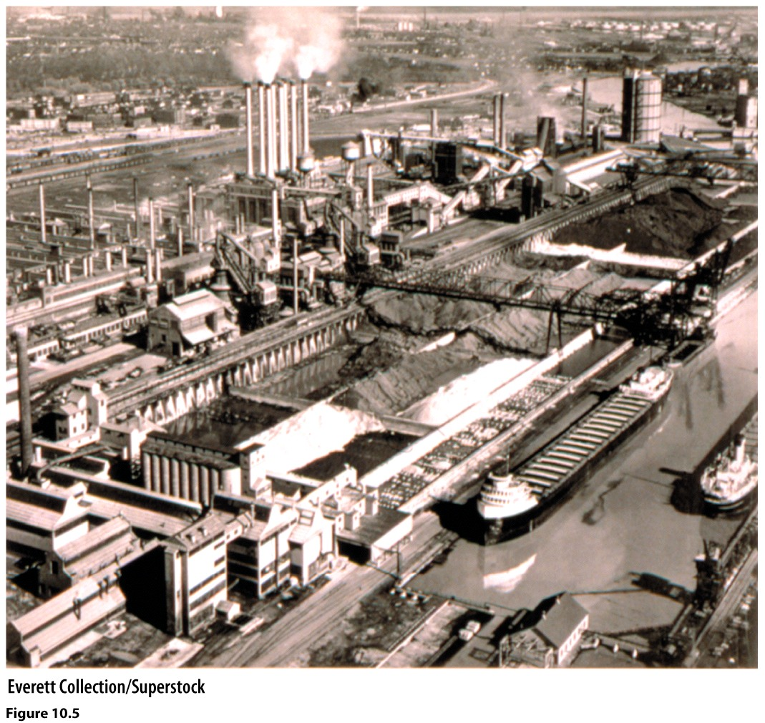
Figure 10.5. By the 1940s, Ford owned mines, quarries, and forests in different states and built facilities at the River Rouge plant to manufacture iron, steel, tires, glass and lumber used in the production of cars. These massive coal and ore bins are a testament to the vast scale of Ford’s operations made possible by vertical integration.

Slide 6
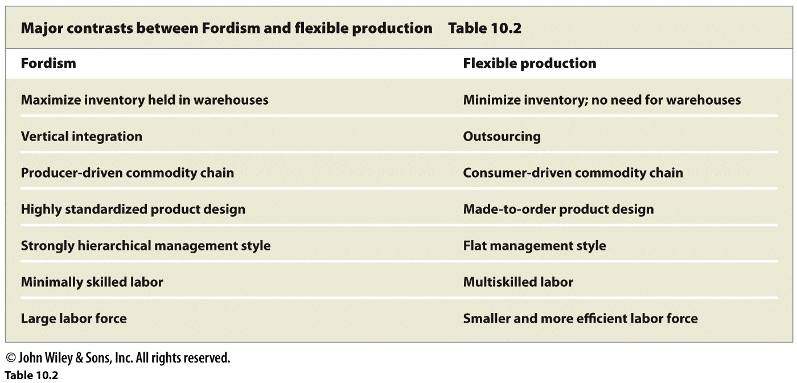

Slide 7
Hourly wages around the world compared.

Slide 8
The decline of US made textiles. Production has declined sharply since the 1950s while imports of such products have increased.

Slide 9
In the 1980s, MDCs accounted for more than 80% of world steel production, but had dropped to only 45% by 2005. LDCs increased from 20% to 55% and China is now the world’s largest producer of steel. This is a good illustration of the process of de-industrialization of the First World and industrialization of the Third World that the globalization of industry has produced.

Slide 10
