Slide 1
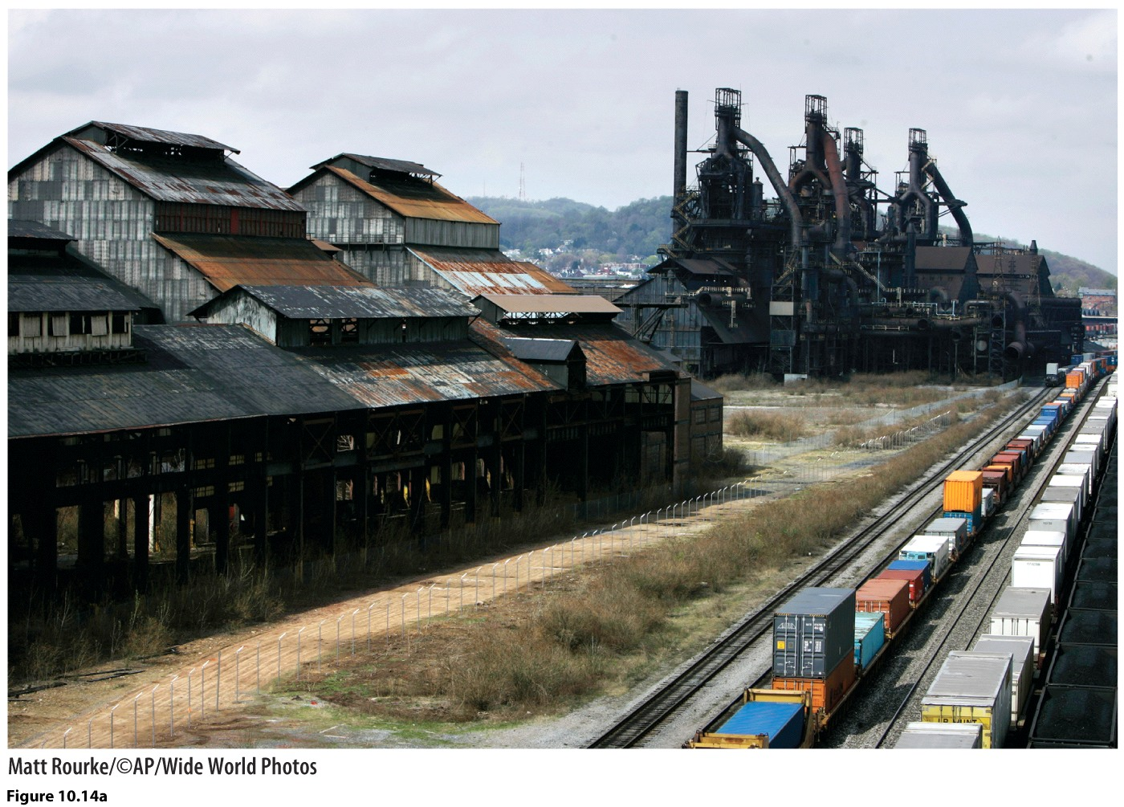
Chapter 10: Changing Geographies of Industry

Slide 2
Primary
Secondary
Tertiary

Slide 3
Primary industries
Commodities
Uneven distribution
Creates connections between places

Slide 4
Staple Theory: the resource geography of a place shapes its economic system through linkages
Mackintosh & Innis

Slide 5
Linkages—other economic activities that emerge in connection with a primary industry
Forward Linkages
Backward Linkages
Demand Linkages

Slide 6
Local and regional economies are shaped by the staple
Area may be only a hinterland at the national and global scales

Slide 7
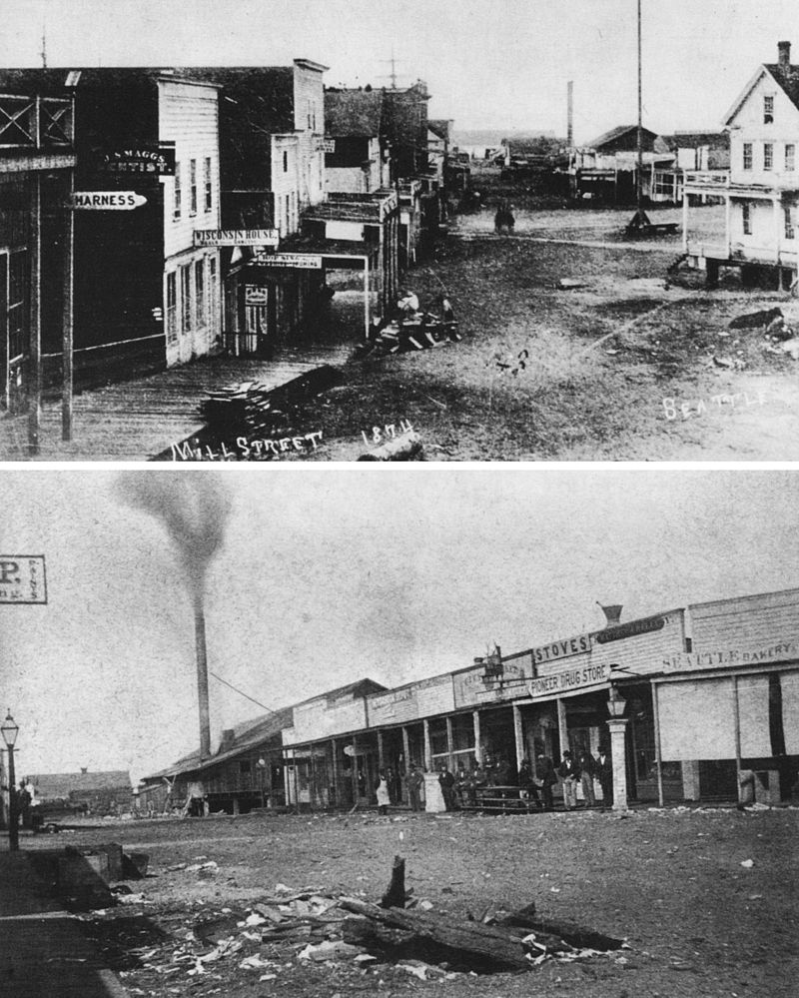
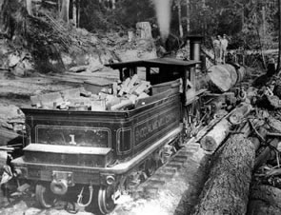

Slide 8
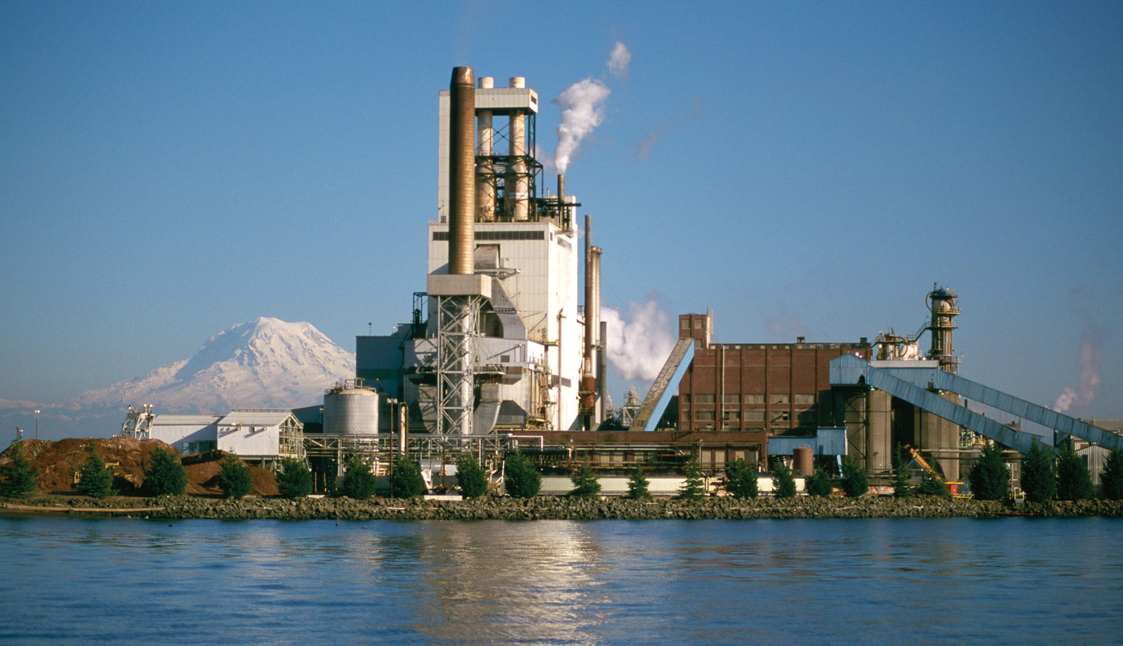

Slide 9
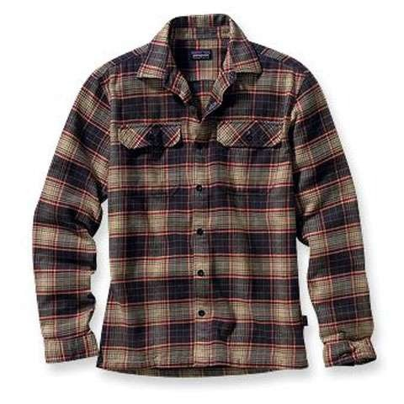

Slide 10
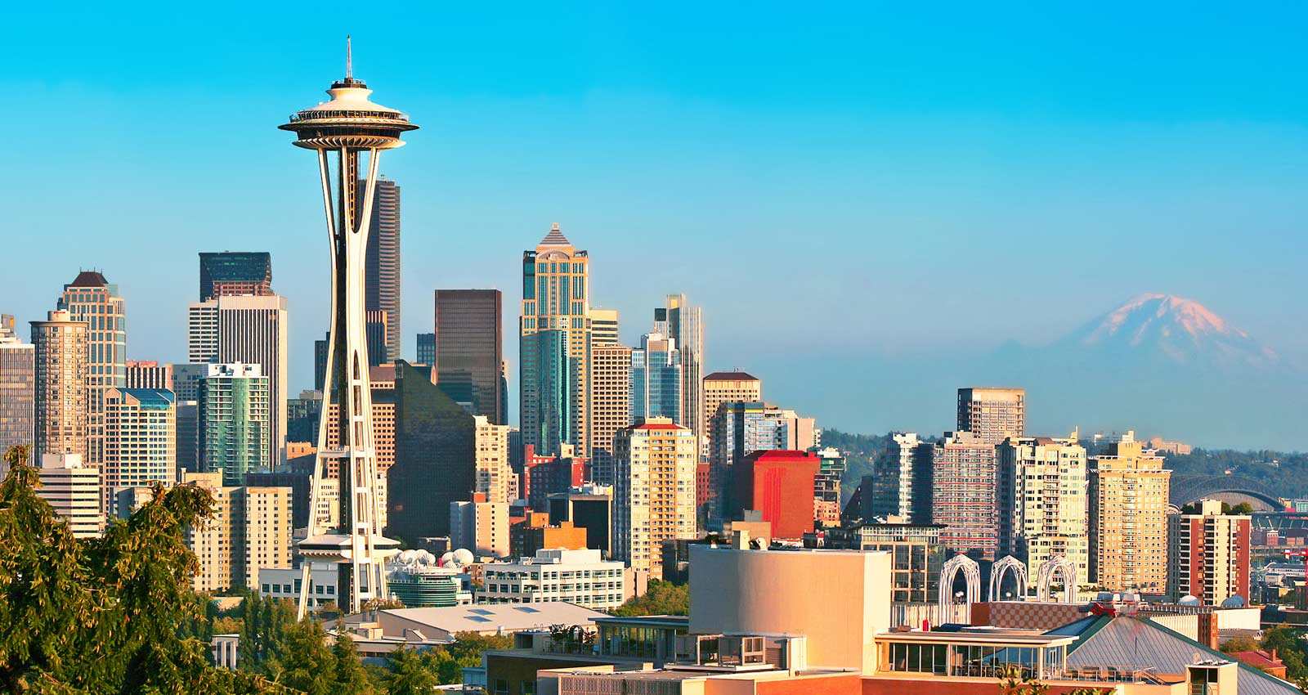

Slide 12
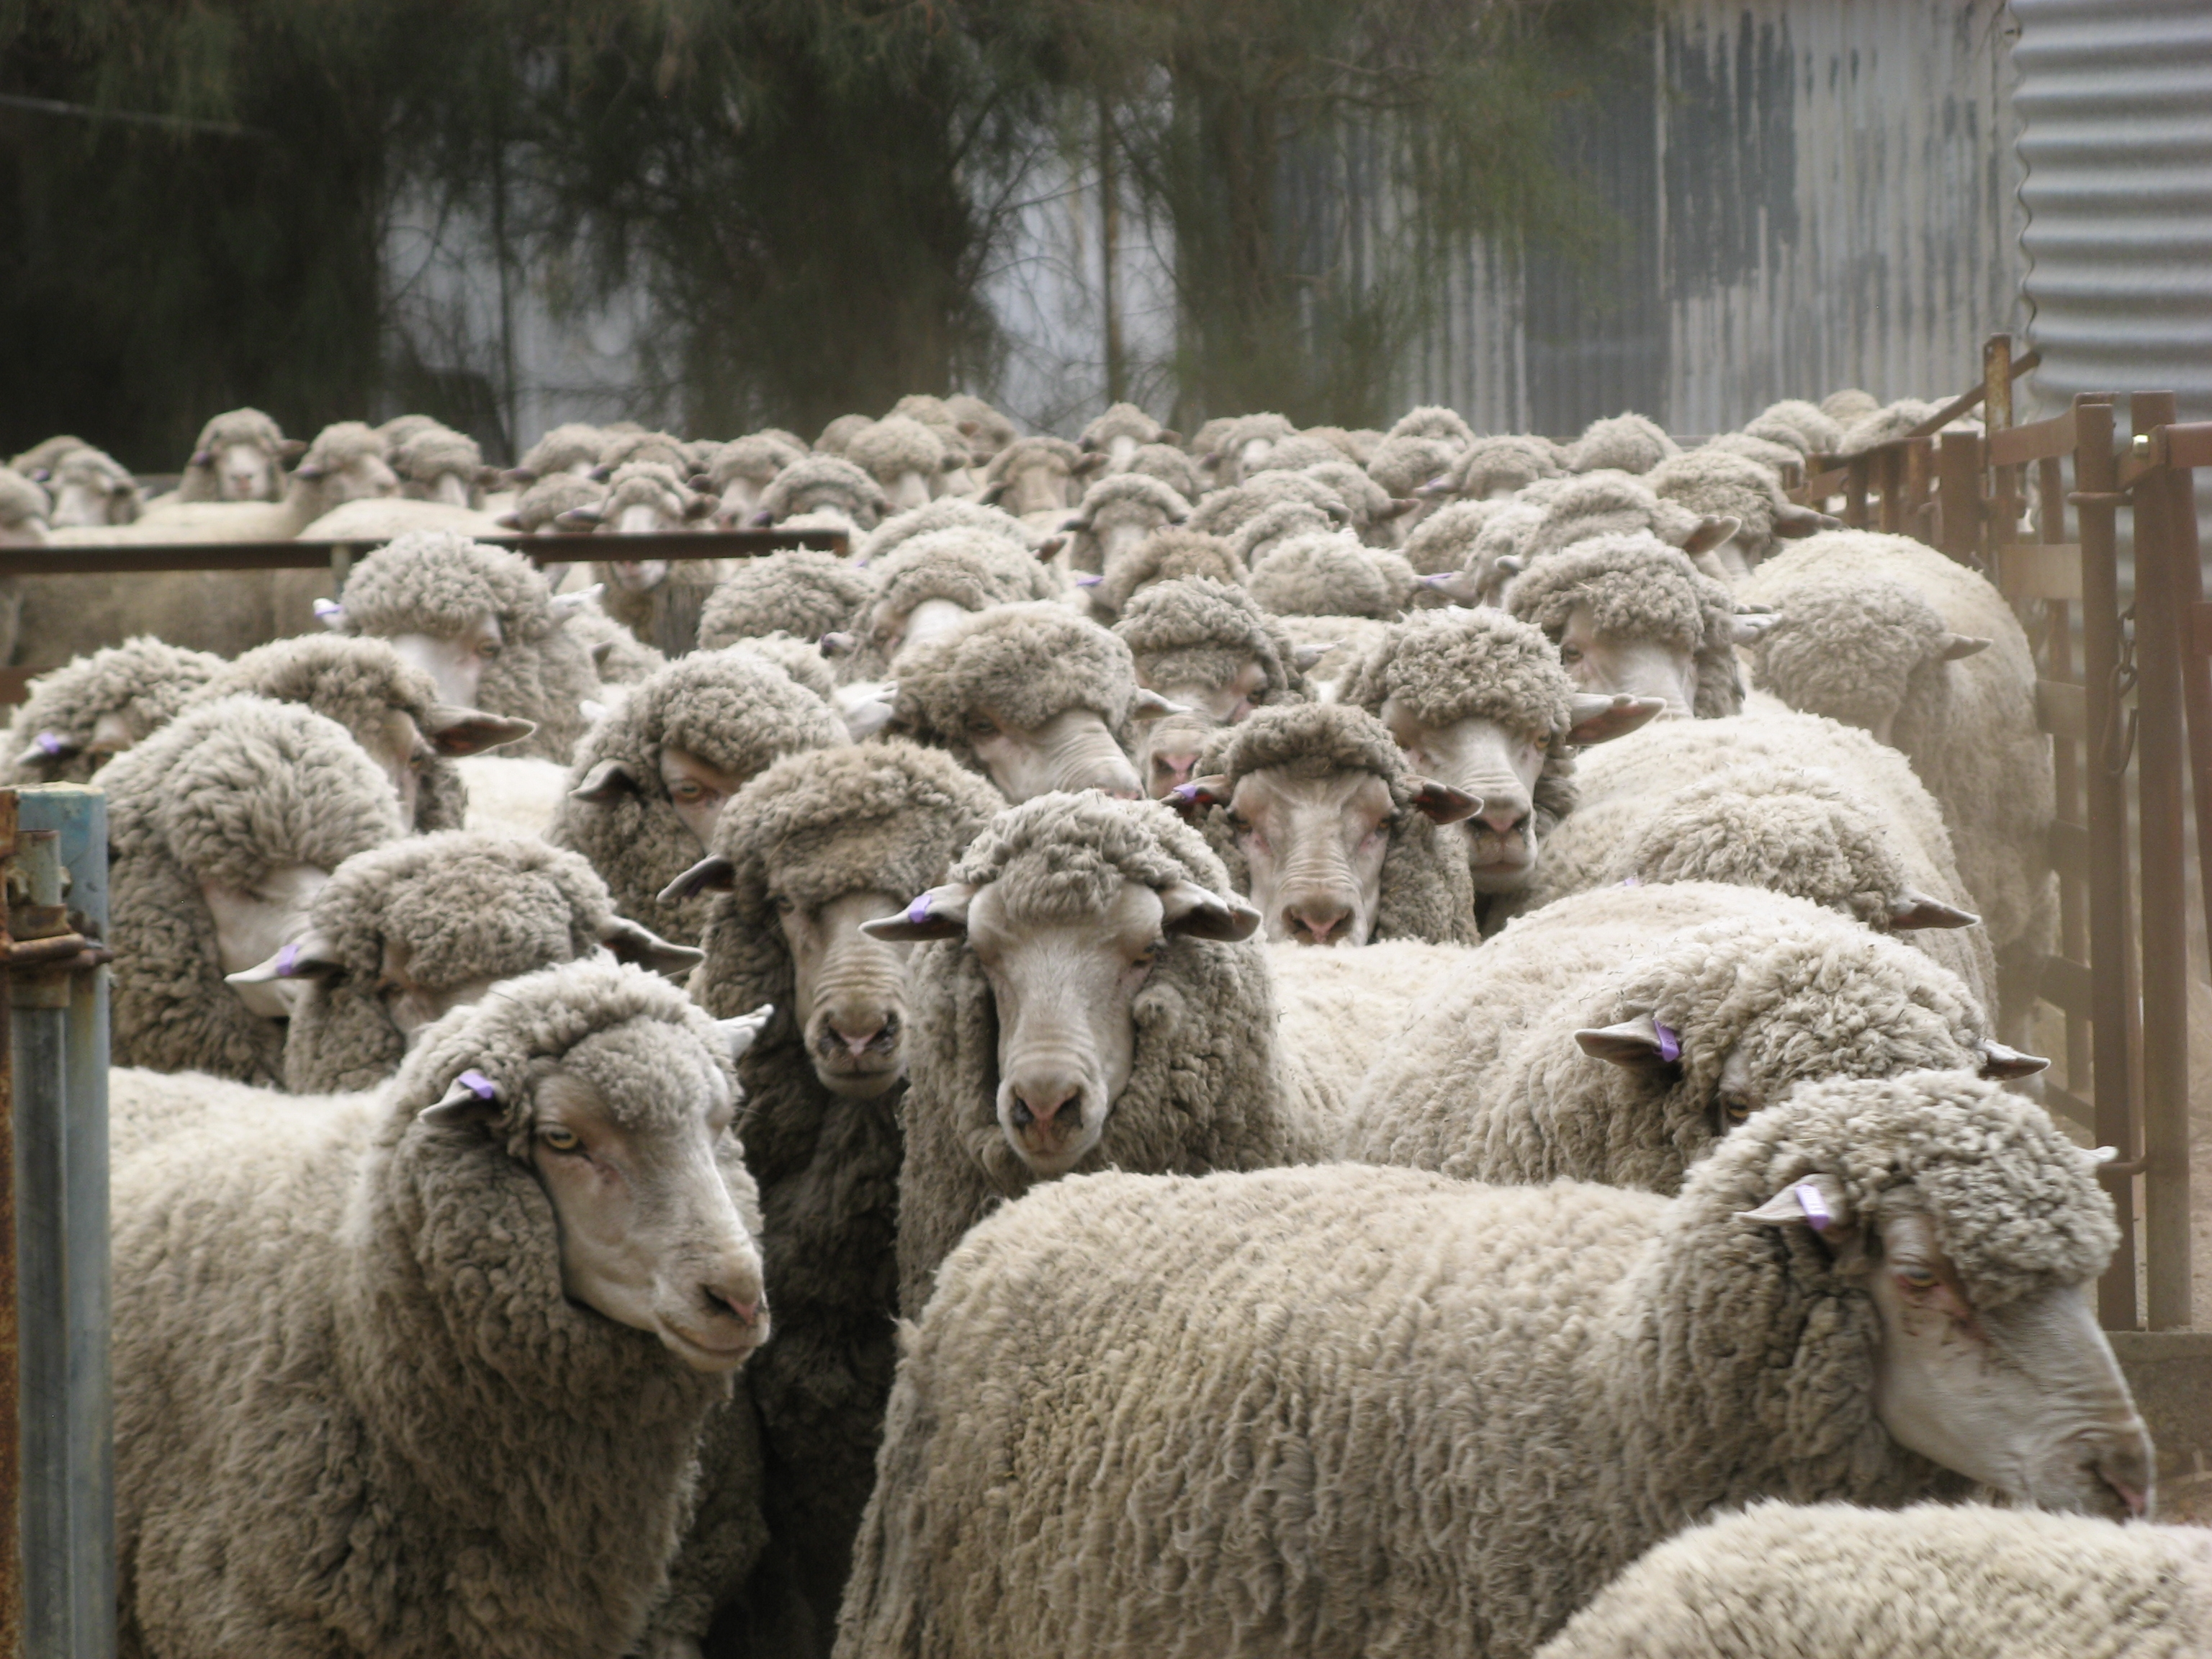
Impact of Commodities
Mackintosh: industrial development
Innis: inhibits growth, creates dependency
Australia’s Wool Industry

Slide 13
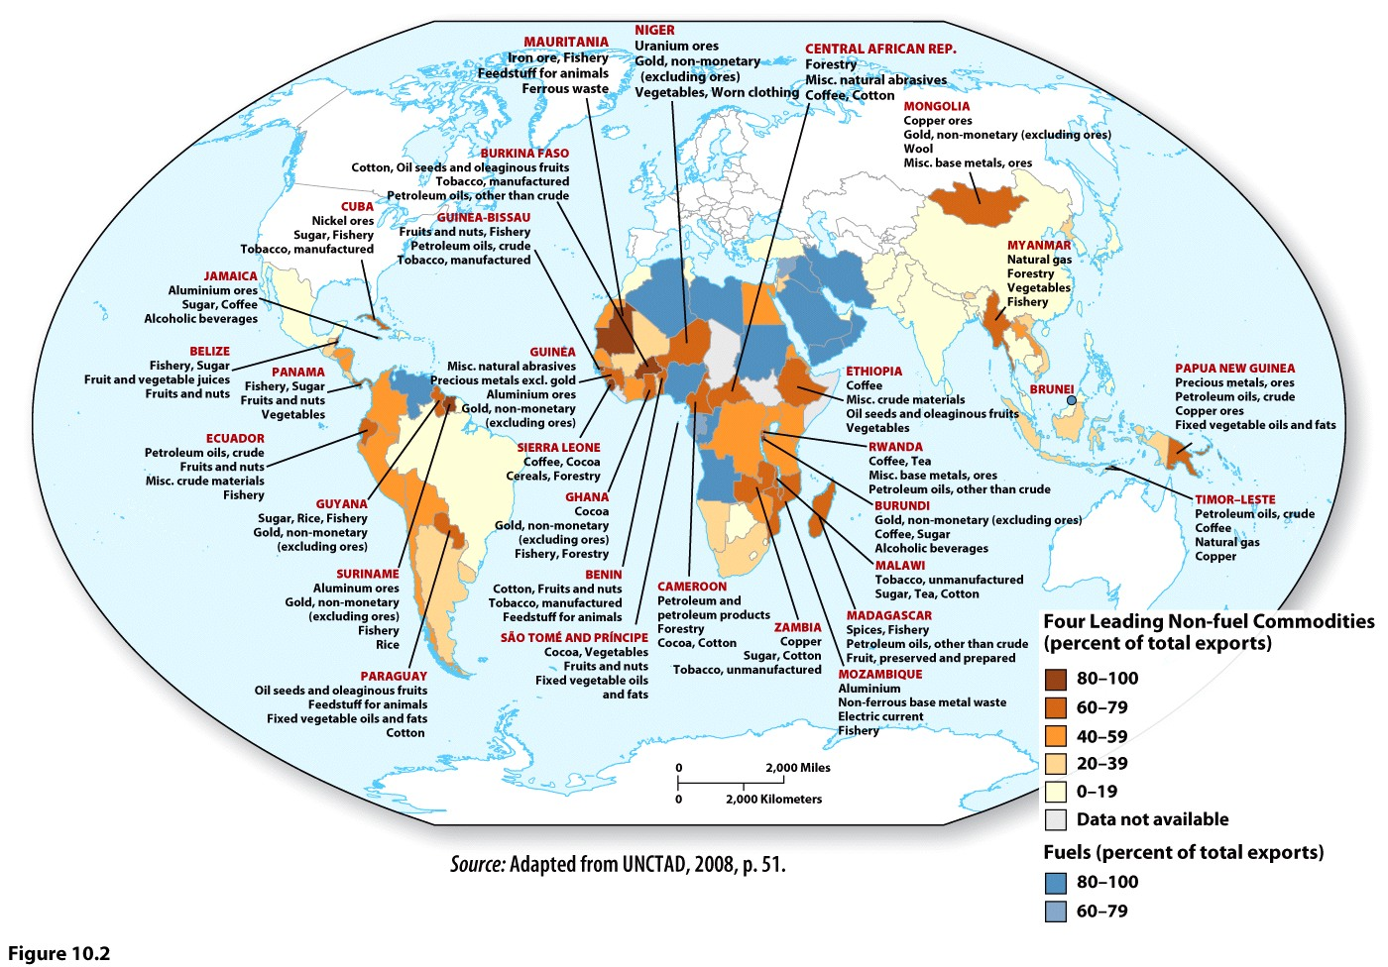
Commodity dependence
Volatility, stagnation, lack of diversification
CDDC—commodity dependent developing countries

Slide 14
Worldmapper.org

Slide 15
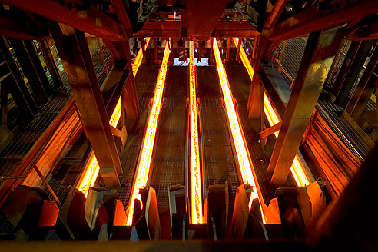
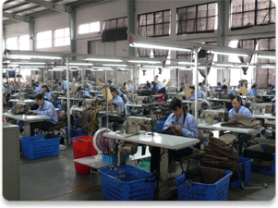
Secondary industries
Light vs. Heavy

Slide 16
Industrial Revolution
Radical changes in system of production
Cottage industries
Greater capital accumulation
Technological innovations—spinning jenny (1764), steam engine (1769)
Diffusion---three phases
urbanization

Slide 17
Industrialization in the U.S.
Early centers?
Later centers?
A core-periphery pattern?

Slide 18
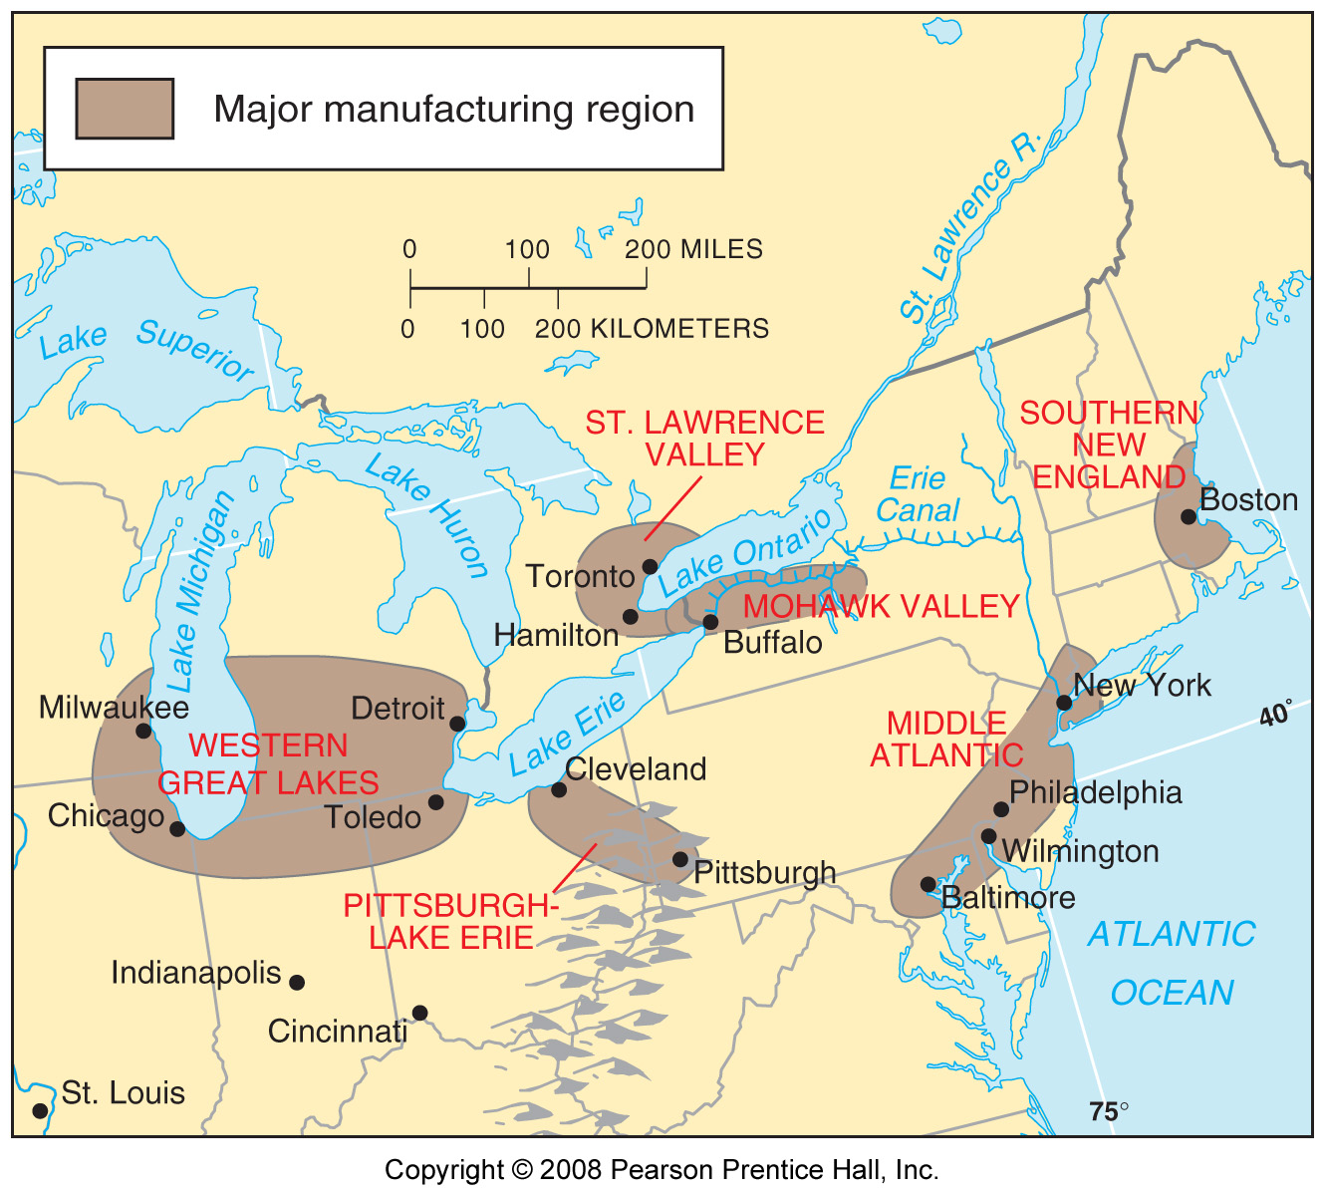

Slide 19
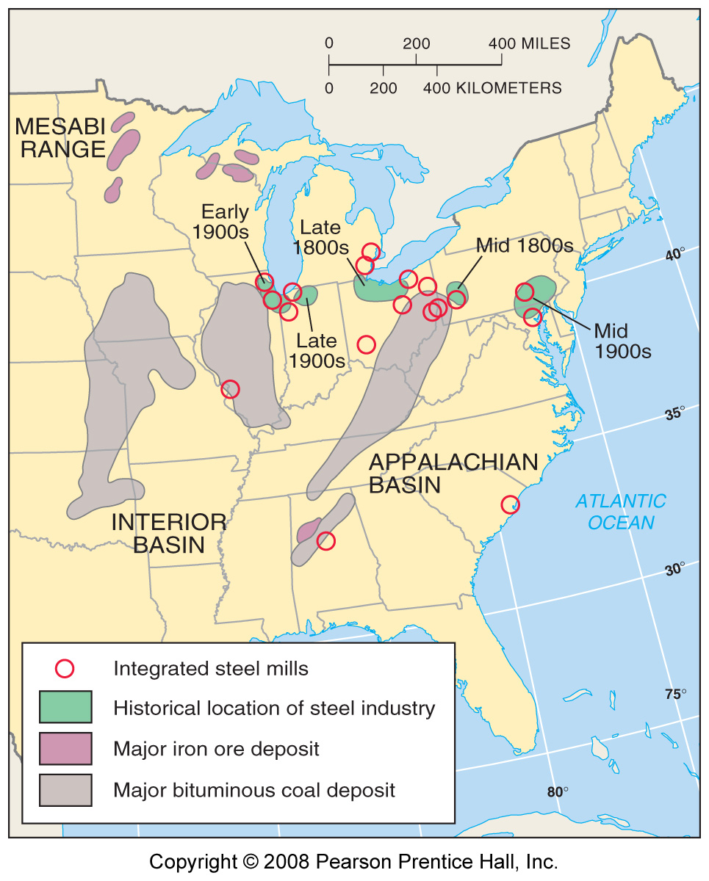
Steel mills clustered near the Great Lakes to minimize transportation costs.

Slide 20
US Steel Mill, Gary, Indiana.

Slide 21
Taylorism and Fordism
De-skilling of labor
Rigid social hierarchy between worker and management
Rise of MNCs

Slide 22
Fordist production
Steady supply of inputs and need to store it
Constant maintenance of machines
Mass market, endless consumption
Boring, monotonous work
Higher salaries
Vertical integration

Slide 23
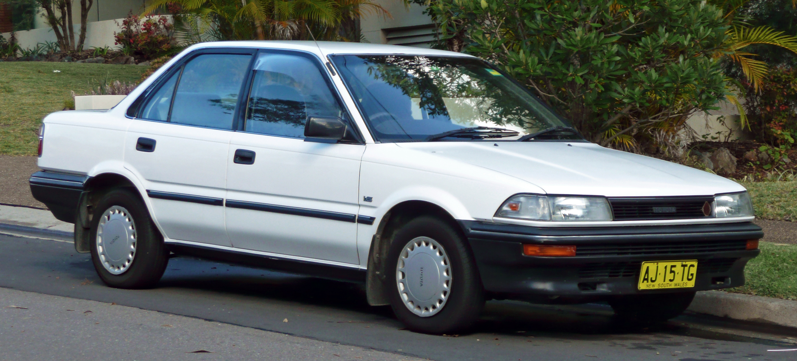
Fordist production creates
Producer-driven commodity chains
What problems does this create?

Slide 24
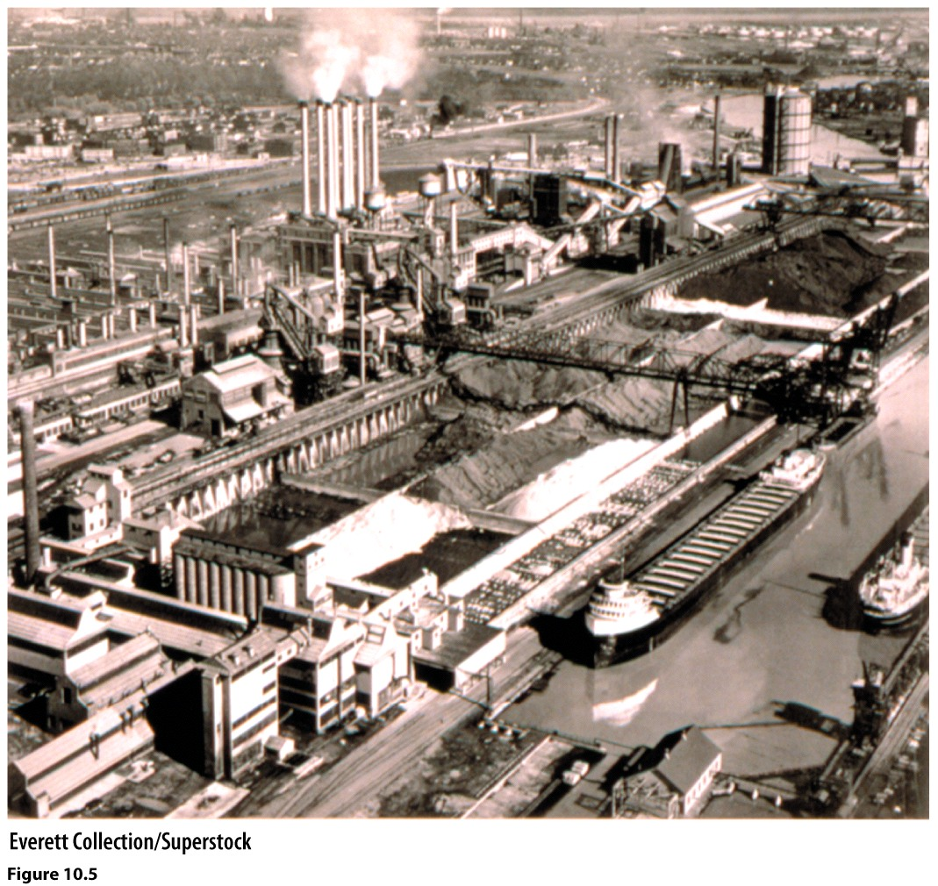
Figure 10.5. By the 1940s, Ford owned mines, quarries, and forests in different states and built facilities at the River Rouge plant to manufacture iron, steel, tires, glass and lumber used in the production of cars. These massive coal and ore bins are a testament to the vast scale of Ford’s operations made possible by vertical integration.

Slide 25
What did Fordism do for America?
Why does it end?

Slide 26
Assembly line
Mass production
Living wage
Repetitive tasks
Interchangeable parts

Slide 27
De-skilling of labor
Hierarchy of management-worker
Labor organization, unions
Growth of middle class
Rise of MNCs
Social and economic change for the USA

Slide 28
Weaknesses of Fordism
Boring work
Months supplies of inputs
Maintenance of machines
Inflexibility, only one type of car per assembly line
Assumes unlimited growth in sales and production
Vertical integration
Producer-driven commodity chains

Slide 29
Crisis of Fordism
OPEC
Technology
Japan
Rising labor costs and conflicts
EPA
Producer, not consumer driven
Rise of neoliberalism, free trade

Slide 30
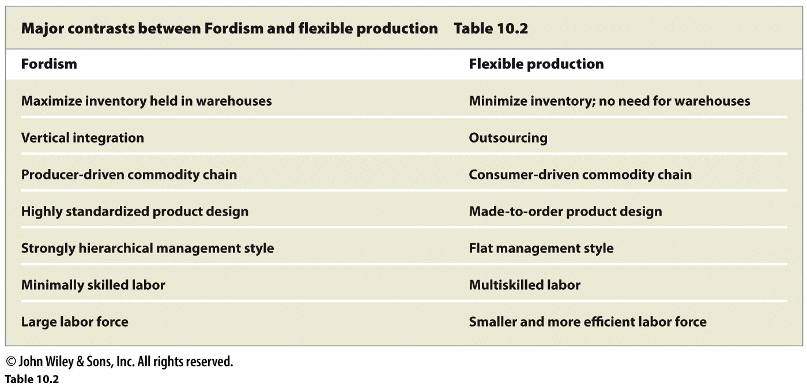

Slide 31
Post-Fordist production
Just in-time delivery
Outsourcing
Offshoring
Vertical disintegration

Slide 32
The Changing Geography of Manufacturing
--First shift was within the core, to Japan
--Second shift was to peripheral countries in Asia

Slide 33
Hourly wages around the world compared.

Slide 34
The decline of US made textiles. Production has declined sharply since the 1950s while imports of such products have increased.

Slide 35
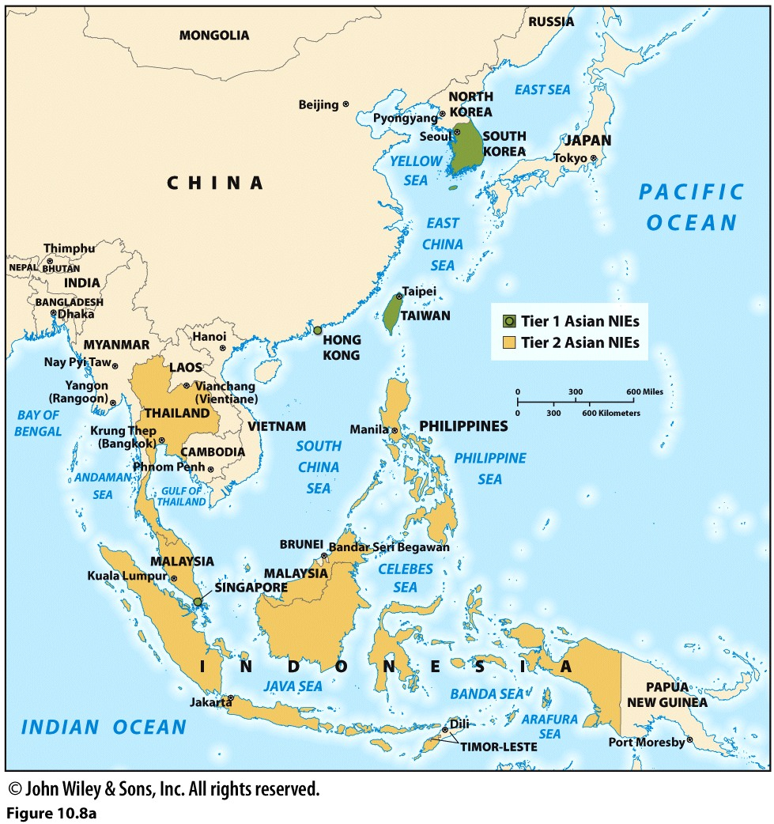
The Four Asian Tigers
Hong Kong
Singapore
Taiwan
South Korea
Second Tier NIEs
Indonesia
Malaysia
Philippines
Thailand

Slide 36
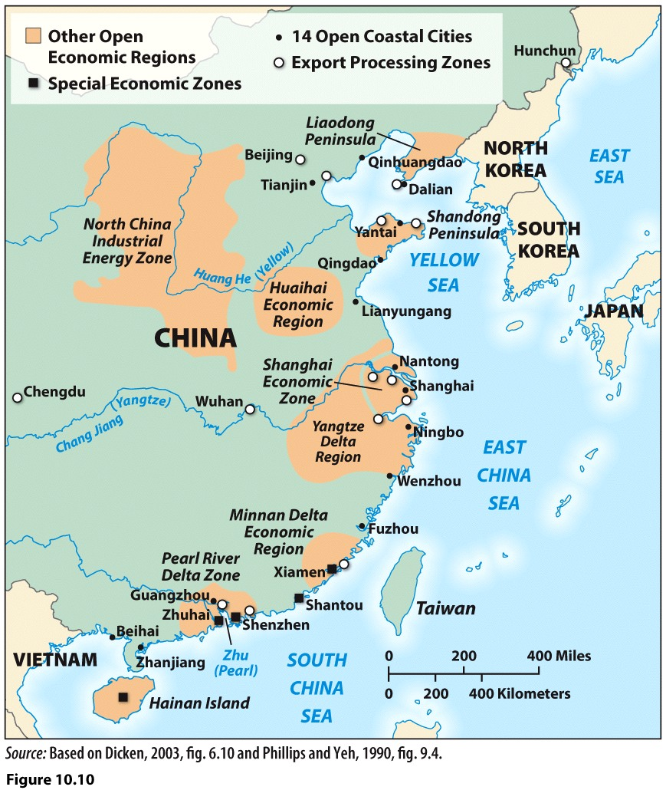
EPZs
Maquiladoras
SEZs

Slide 37
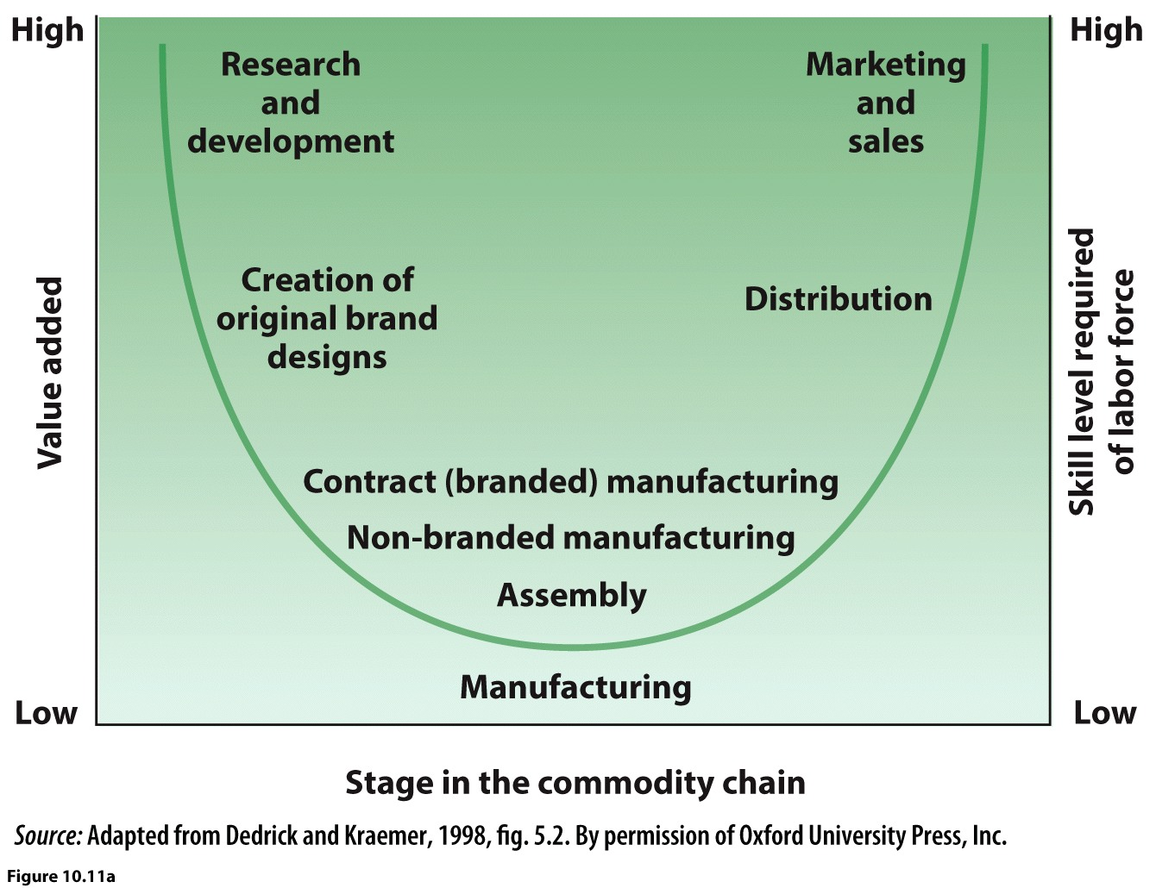
Value added in manufacturing increases with the required skill level of the worker.
Greater value added for R&D than for assembly line work.

Slide 38
Contract or Branded Manufacturing
Most MNCs do not own any manufacturing plants
Offshoring, outsourcing
Nike: 61% to Southeast Asia, 38% to China
Sub-subcontractors
Outcomes:
Manufacturing has become global
NIDL
Geography of profit has changed

Slide 39
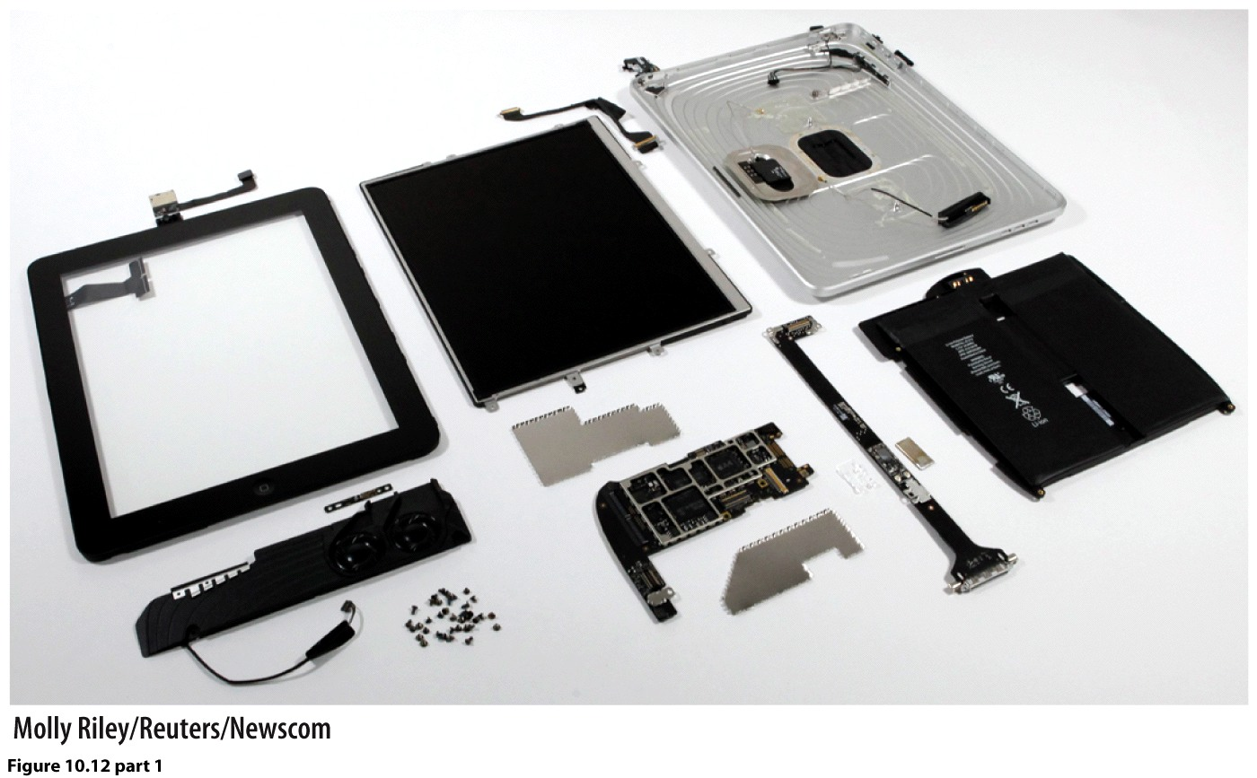
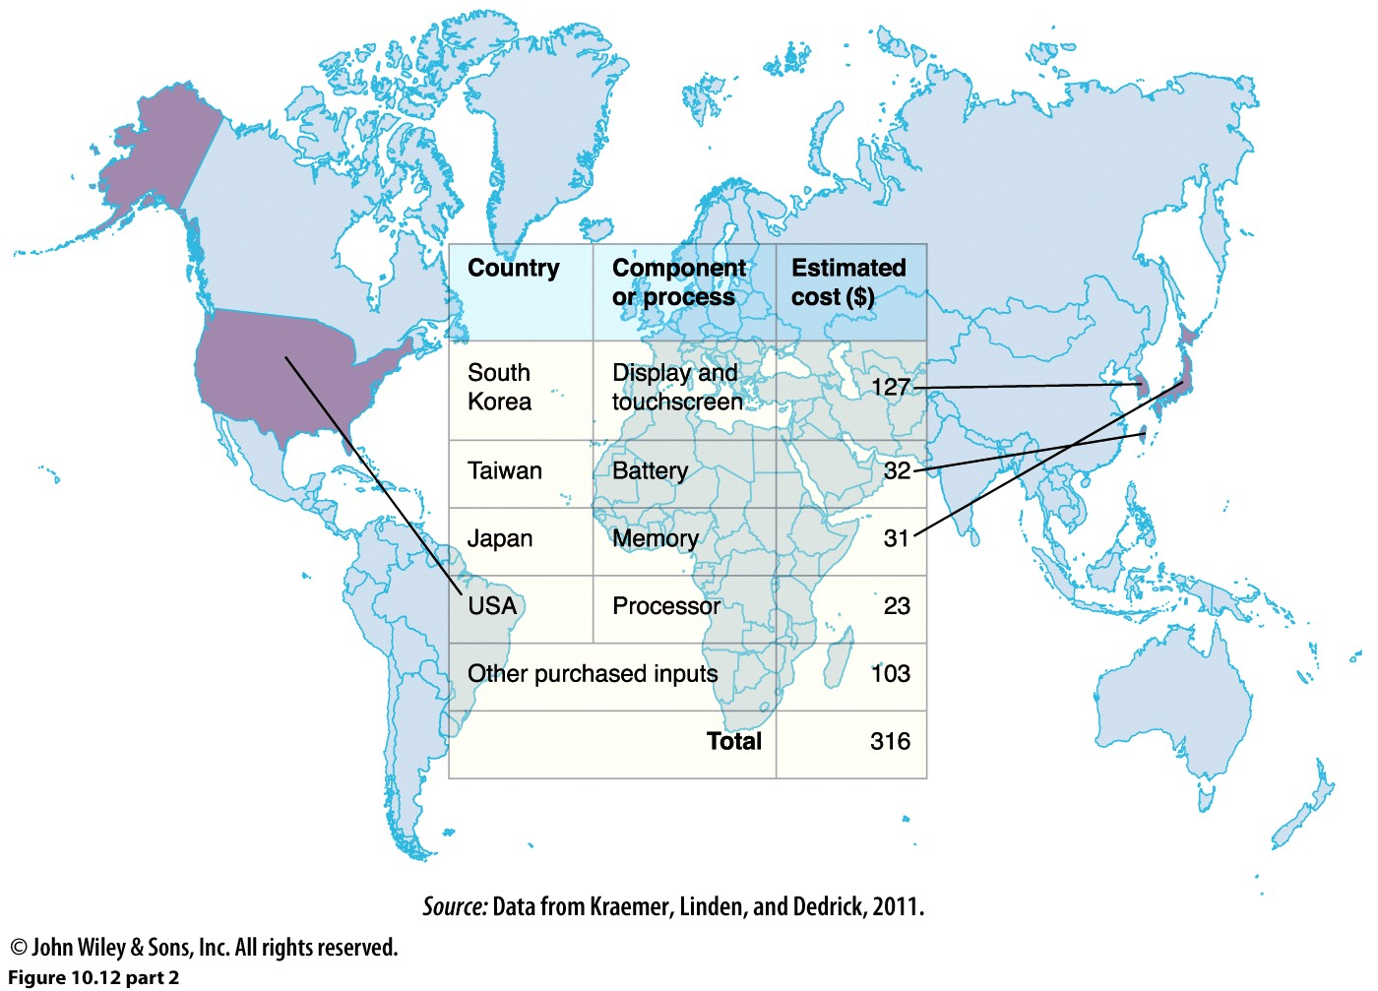
The MVA and profit geography of an iPad.
Cost to produce: $316. Retails for $499.
This generates an MVP of $183.
Design & development.
Apple, based in the US
Develops the design, the
Brand, marketing, and
Distribution. They also
Decide where to manufacture
It.
2. MVA. Apple outsources the
manufacturing of the iPad. Numerous
companies are involved in its production.
South Korea captures most of the MVA
because the most expensive parts are made
there.

Slide 40
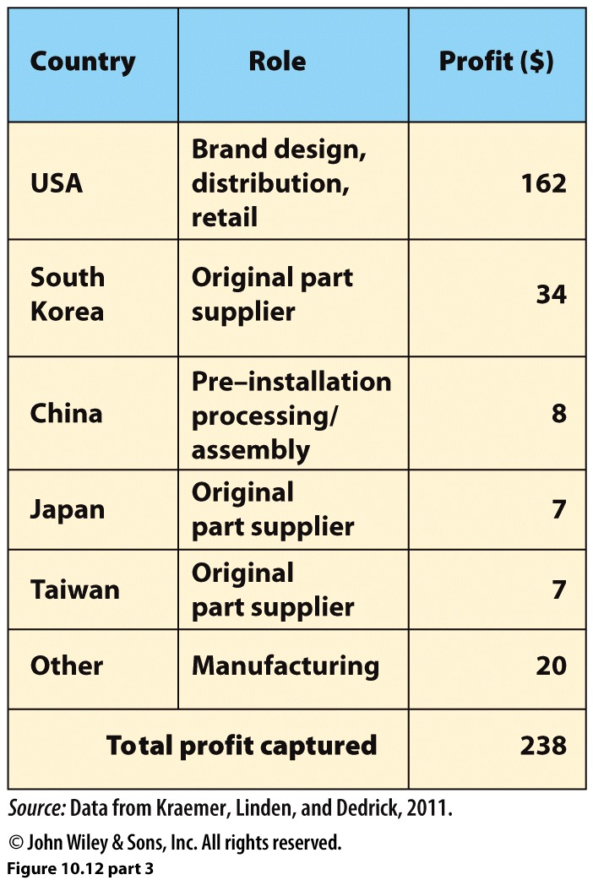
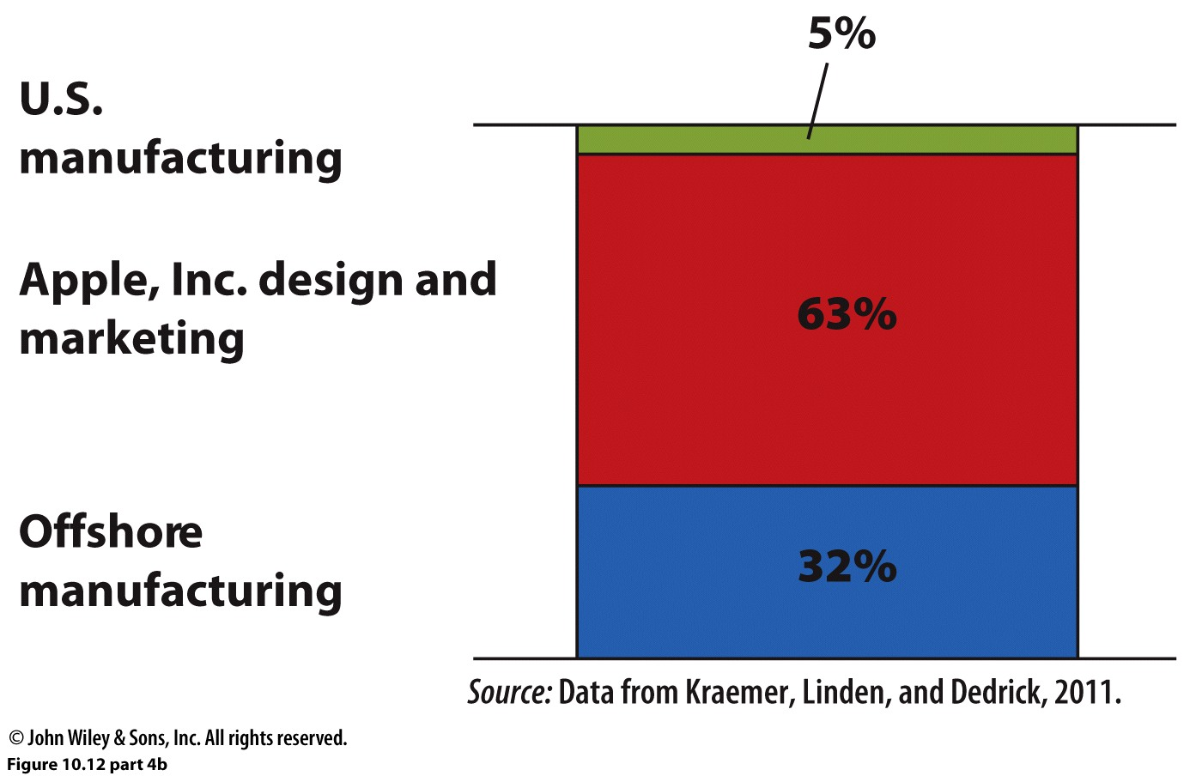
Profit captured. Profit geography
differs from MVA geography. China’s small
profit is a reflection of the Taiwanese ownership
of factories. So most of China’s profit comes
from wages.
Total profit captured, in the commodity
chain. Most of the profits are returned to Apple,
but about 1/3 are distributed among
offshore manufacturers.

