Slide 1
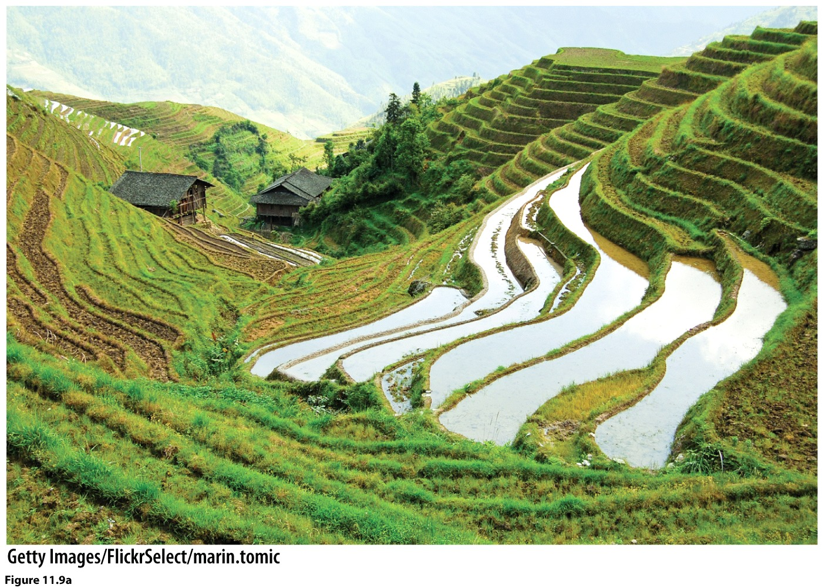
Chapter 11: Agricultural Geographies

Slide 2
What is agriculture?
Domestication
Before agriculture?
Hunting & Gathering
What changes did agriculture bring to human societies?
Sedentary Societies

Slide 3
Origins of agriculture
Independent innovation: Carl Sauer
Fertile crescent & Sub-Saharan Africa
Asia
Mesoamerica

Slide 4
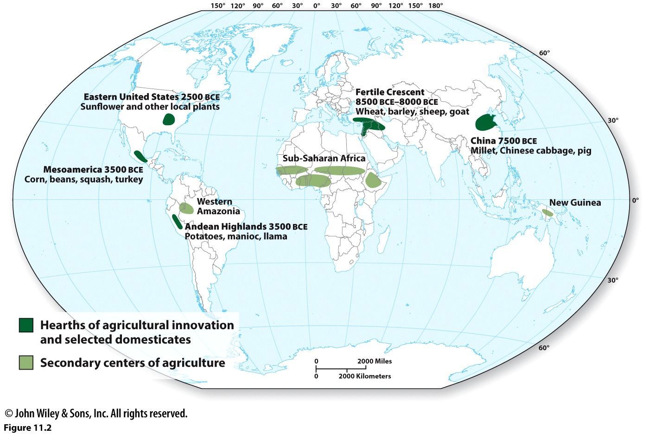

Slide 5
The agricultural continuum
Subsistence Commercial
Intensive Intensive
Wet rice farming --Dairy
--Fruits, Veg.
Extensive *Extensive
Slash & Burn/Swidden/ --Cereal Grains
Shifting Cultivation --Ranching
--Pastoralism *Plantation

Slide 6
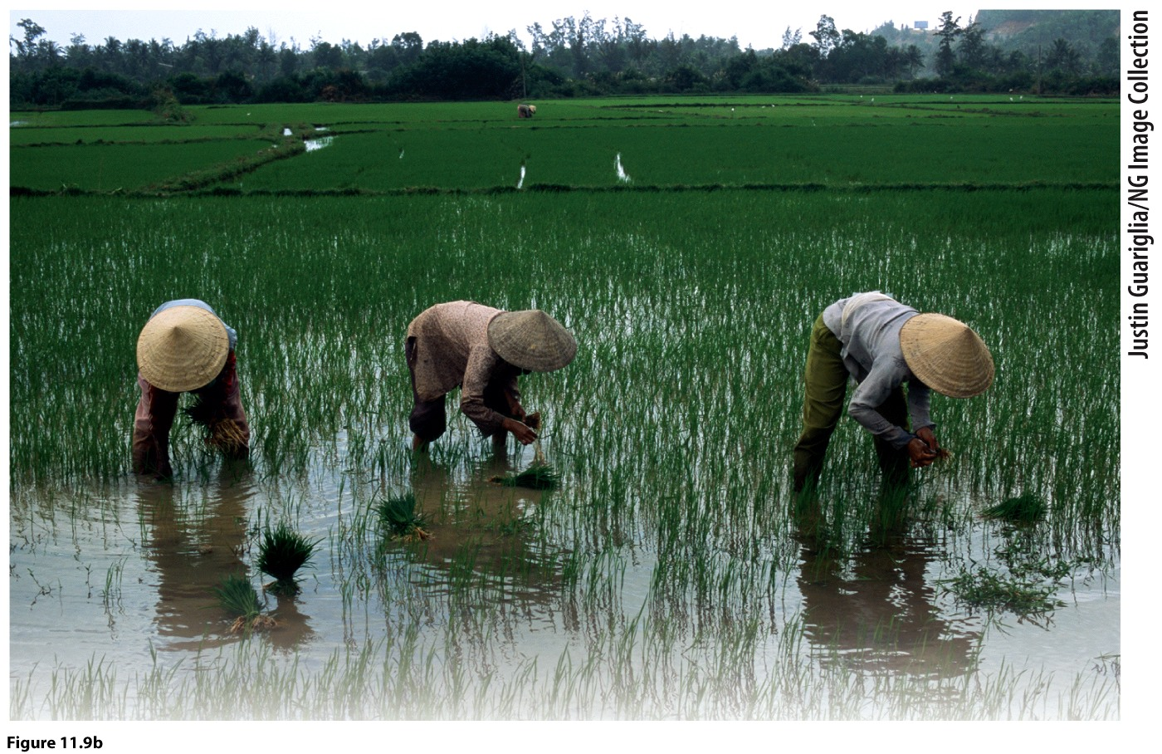
Intensive: wet-rice

Slide 7
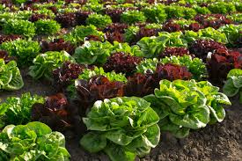
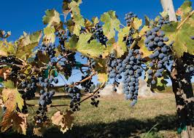
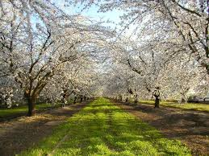
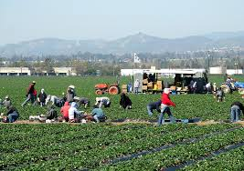
Intensive commercial

Slide 8
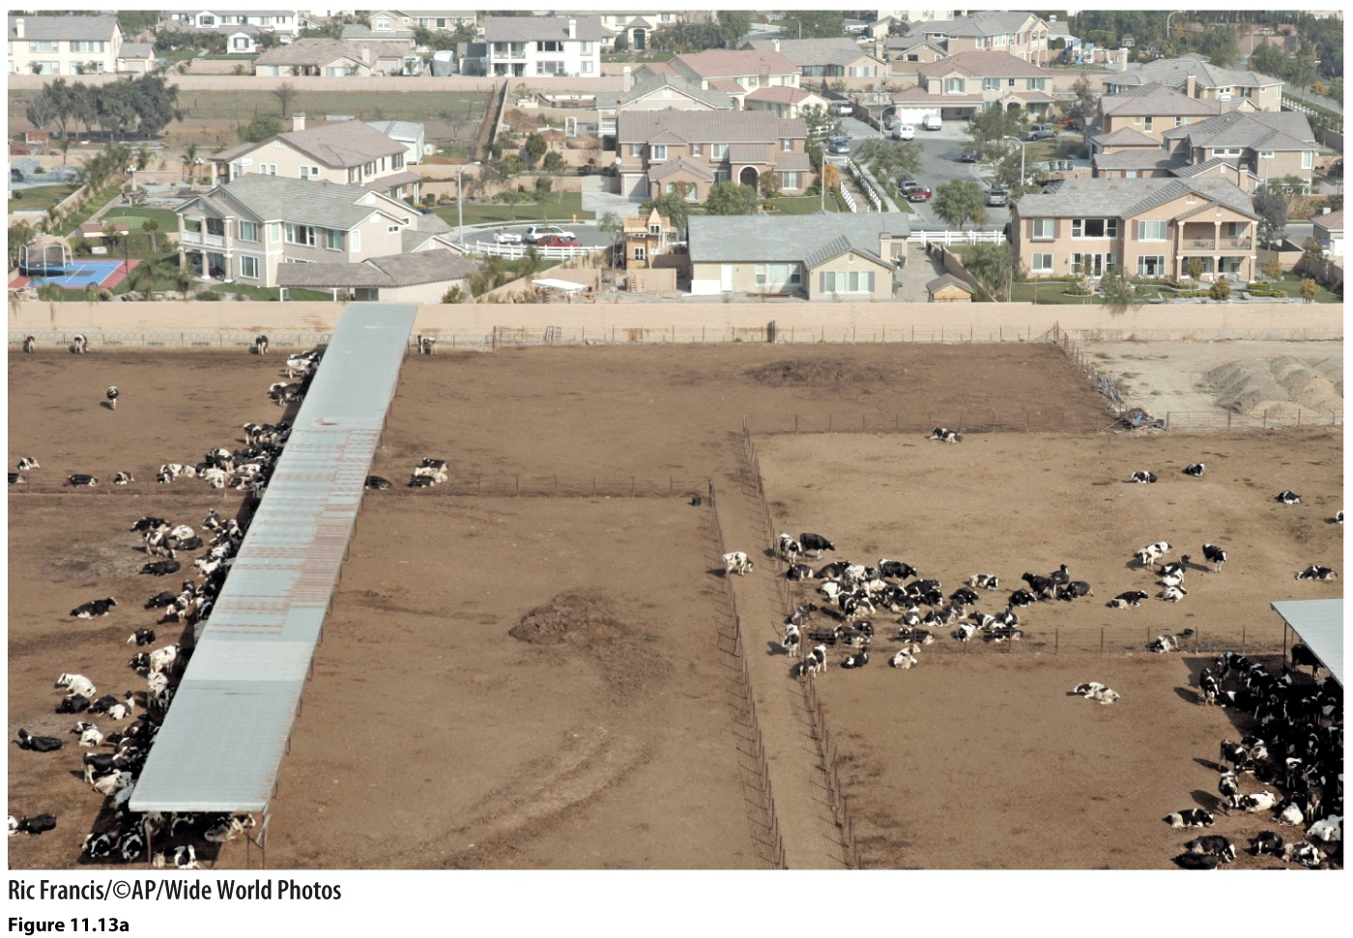

Slide 9
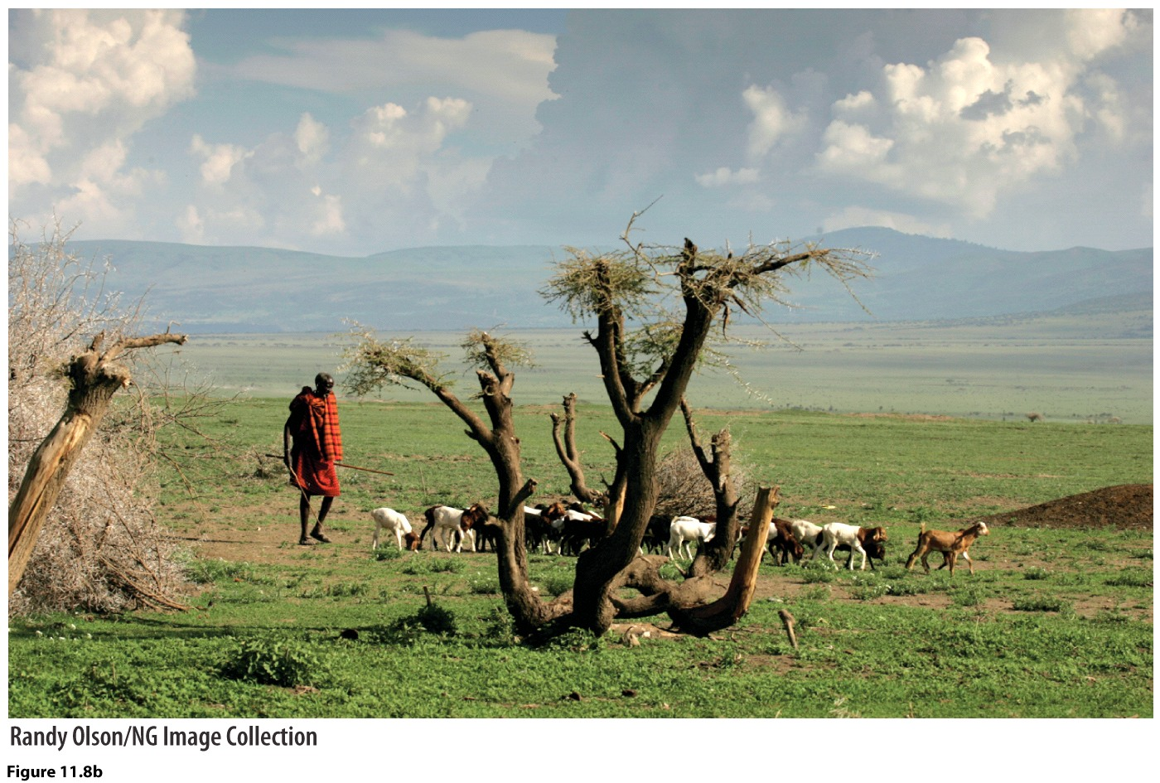
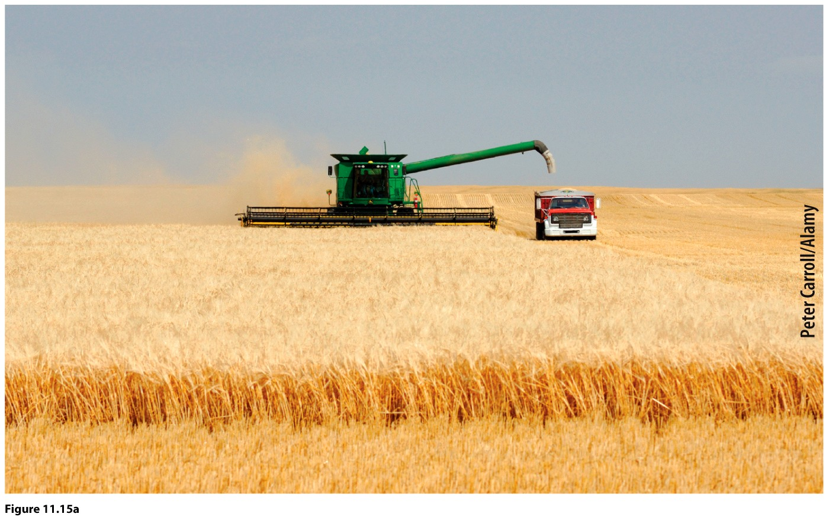
Extensive subsistence
Extensive commercial

Slide 10
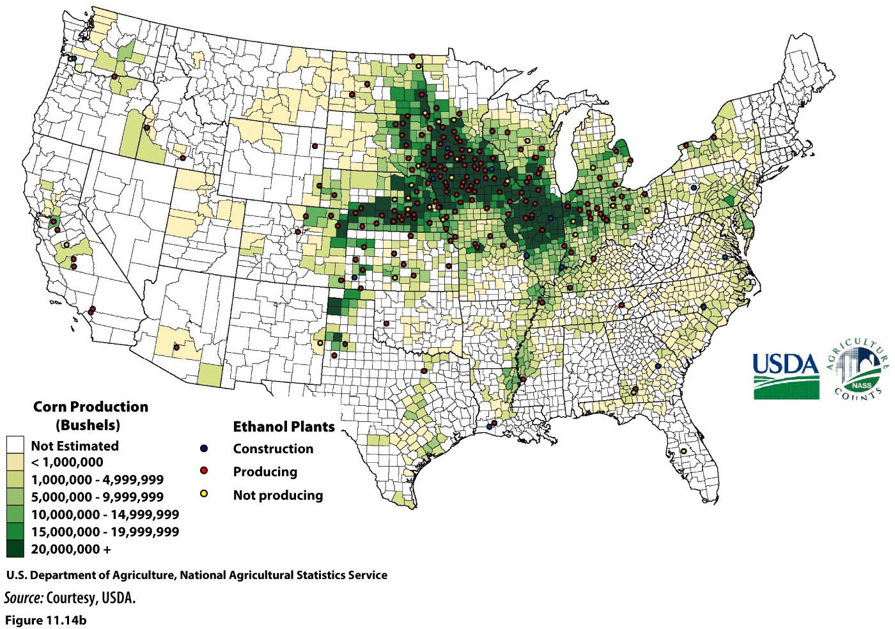

Slide 11
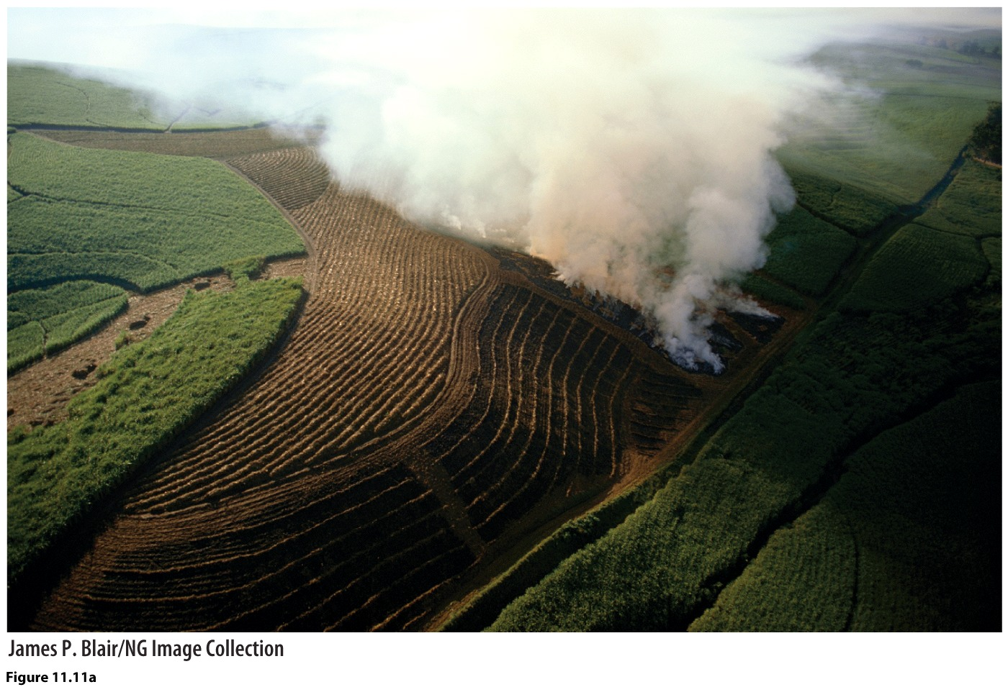
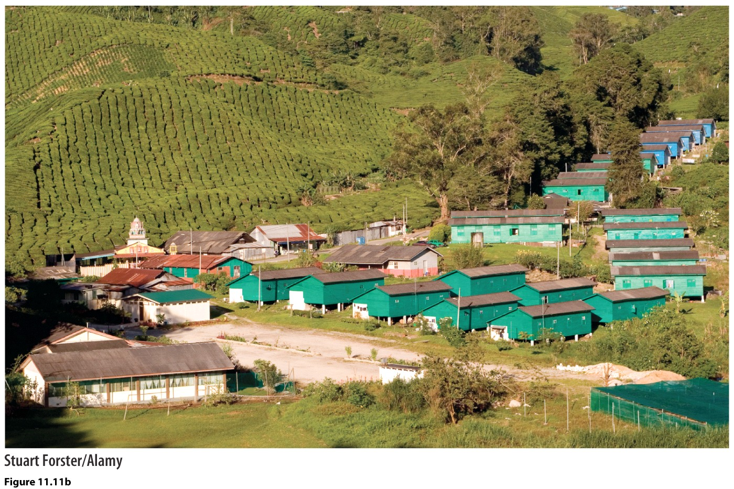
Plantation Agriculture
Coffee plantation, Durban, South Africa
Tea plantation, Malaysia

Slide 12
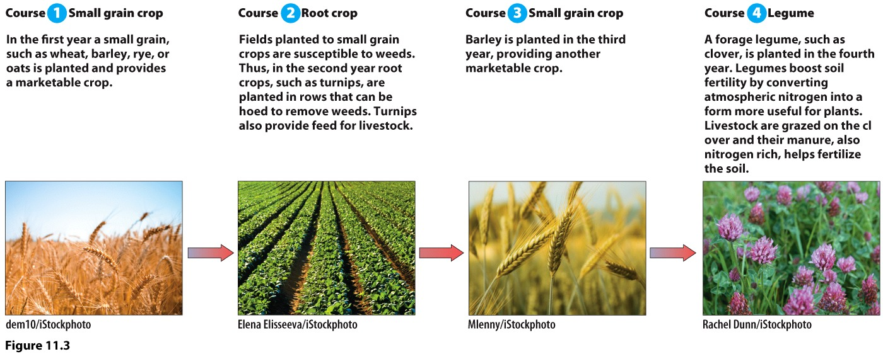
2nd Agricultural Revolution: 17th-18th C, Europe
Moldboard plow
Horse collar (faster than oxen)
Crop rotation—boosts yields, eliminates fallow time

Slide 13
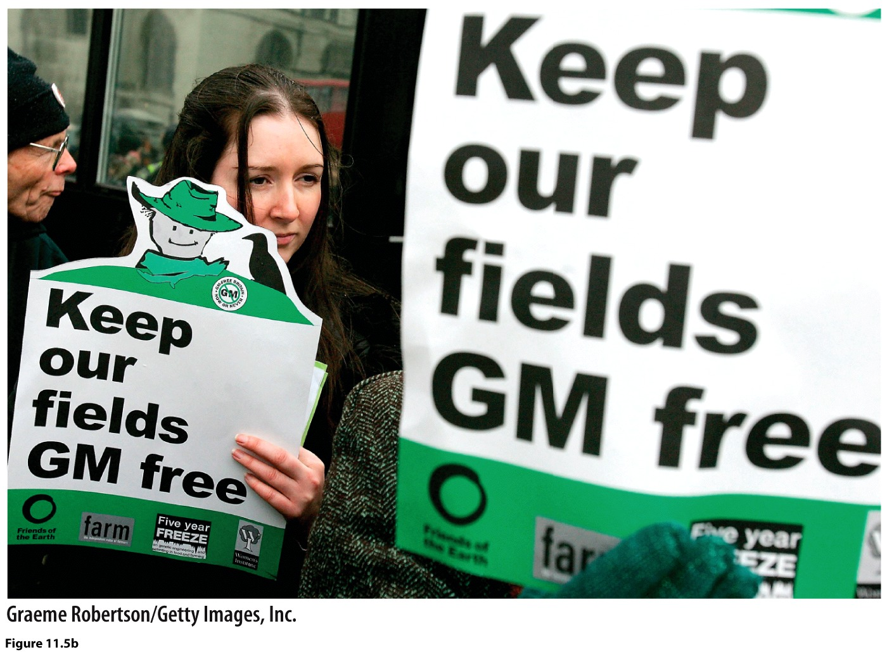
The 3rd Agricultural Revolution—early 20th C
Internal combustion engine allowed for mechanization
Rise of monoculture
Technology, scientific farming: The Green Revolution
Changes in the who and how of farming
Rise of agribusiness
Rise of industrial agriculture

Slide 14
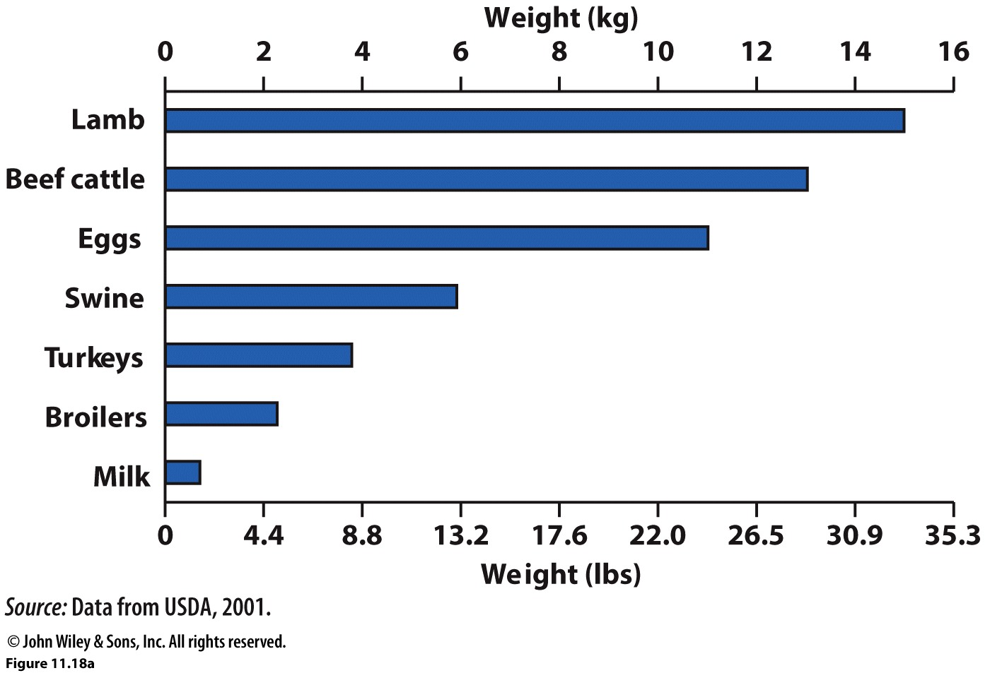
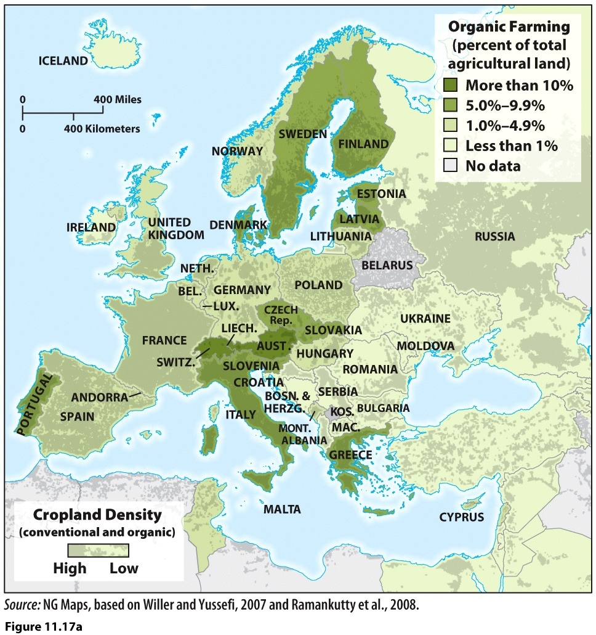
What is sustainable agriculture?
The amount of grain needed to produce 1 kg (2.2 lbs) of meat or other animal product. Livestock are inefficient producers of protein and consume inordinate amounts of grain to generate adequate weight gain to produce meat.

Slide 15
