Slide 1
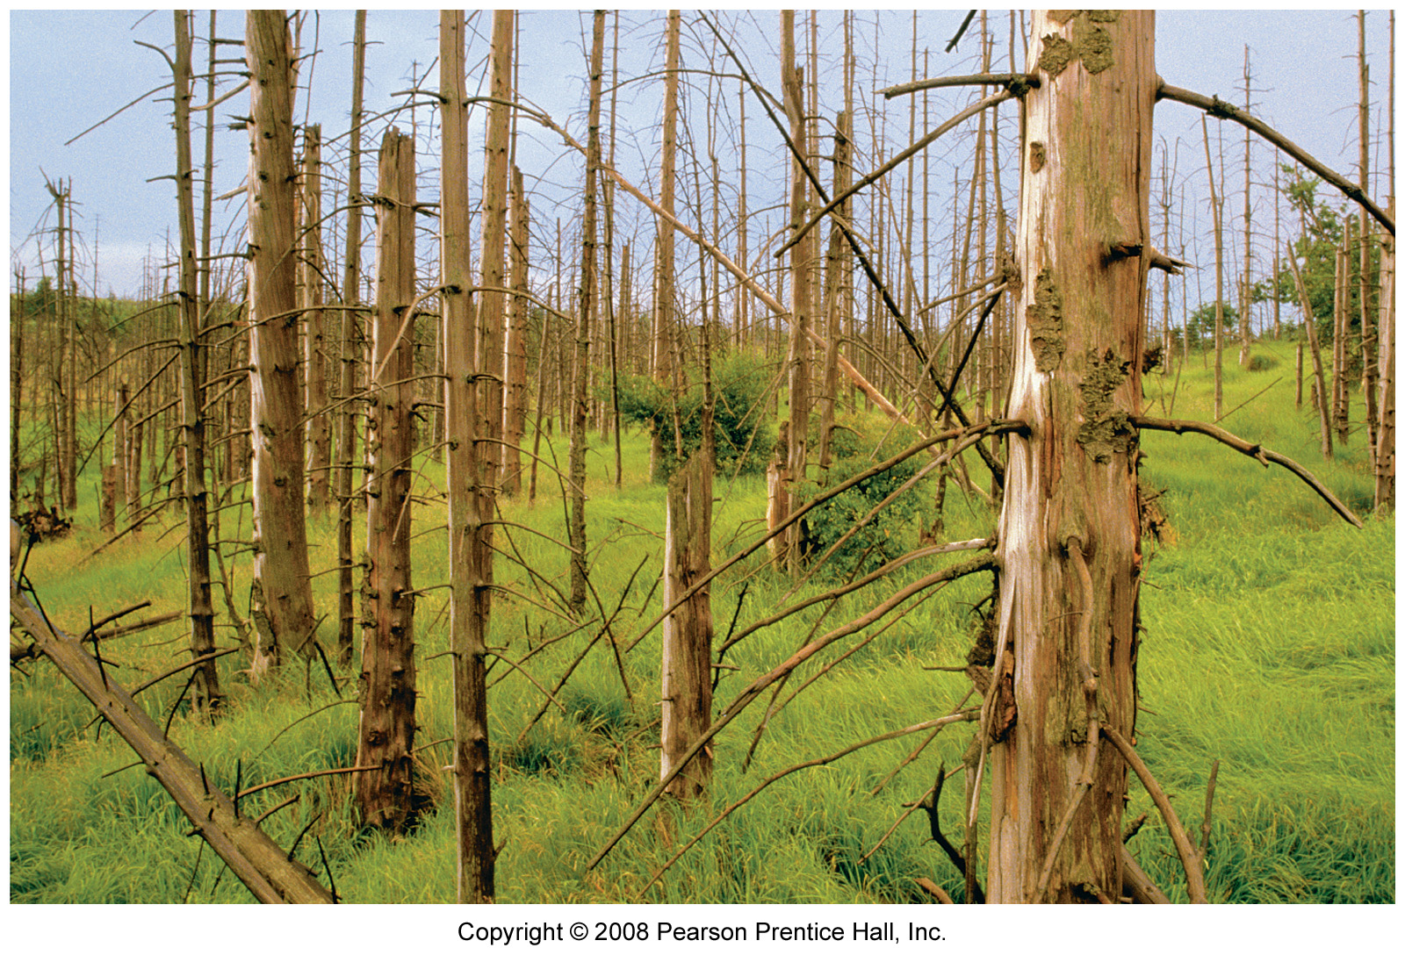
Chapter 12: Natural Resource Geography and Environmental Challenges
Acid rain: forest in the Czech Republic that has been destroyed by acid rain.

Slide 2
What is the environment?
All living and non-living factors with which people, animals and other organisms coexist.
Comprised of ecosystems at a variety of scales
Complexity of ecosystems comes from biodiversity
What is the most complex ecosystem?

Slide 3
Ecology
Garrett Hardin, First Law of Ecology
“We can never do merely one thing.”
Awareness of how human actions impact the environment.
Natural Capital
Goods & services provided by nature.
Make the functioning of economies possible—economies are based on the human use of resources.

Slide 4
Non renewable resources
Finite—don’t self replenish or take a very long time to do so.
Will humans use all nonrenewables?
Concept of economic depletion
When 80% of the resources has been extracted.
Cost of extraction exceeds economic value of it.
Renewable resources
Sustainable yield—maximum quantity that can be harvested or used without impairing its ability to replenish or renew itself.
Ecologically sustainable yield

Slide 5
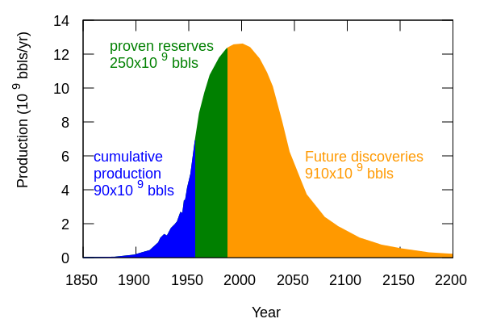
Peak Oil
1950s
M. King Hubbert
Optimistic:
Peak in 2020
Pessimistic:
Peaked in 2007
Hubbert warns of coming energy transition
Hubbert’s model for world oil production in 1956. It includes historical data and future production. It has a peak of 12.5 billion barrels per year in about the year 2000

Slide 6
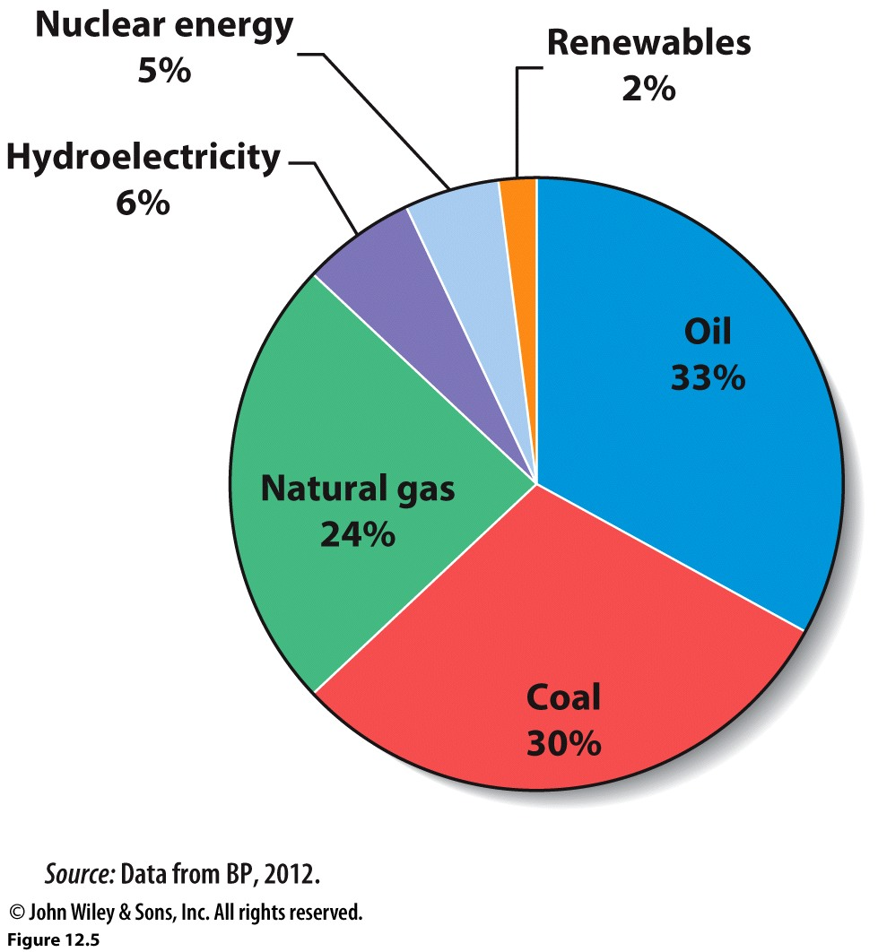
Energy Resources
Almost 90% of the energy consumed globally comes from fossil fuels.

Slide 7
Fossil Fuels: Oil, Natural Gas and Coal
Pros
Cons
Infrastructure to support its extraction and processing already exists.
Basis of world economy.
Relatively cheap.
Finite
Economic depletion
Local, regional, global impacts on environment
Foreign suppliers

Slide 8
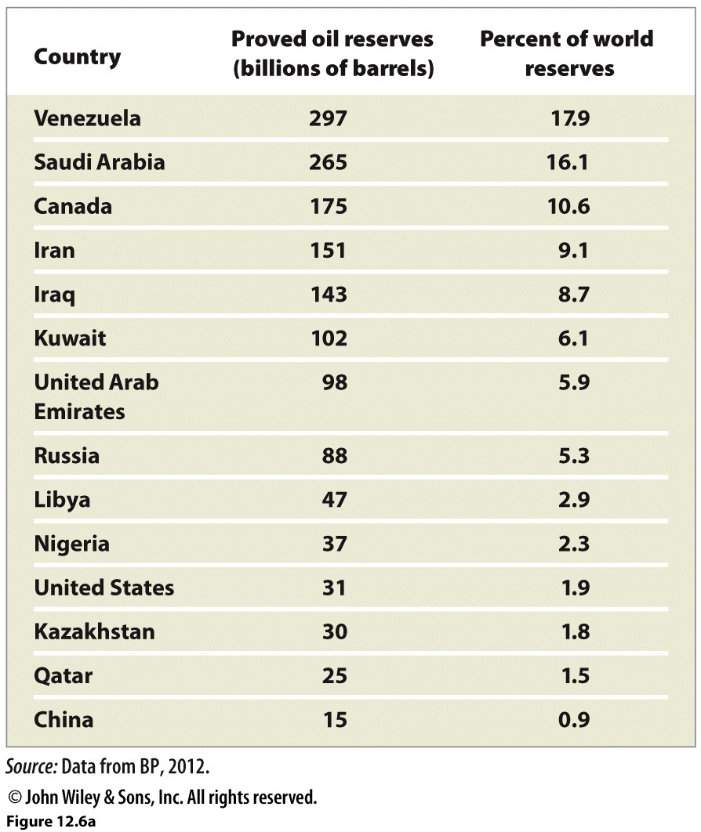
Countries with largest proven oil reserves. Venezuela has surpassed Saudi Arabia to have the largest oil reserves. Canada’s reserves include oil sands. Instead of being drilled, oil sands are mined in open pits. The product first recovered is bitumen, a much lower grade of crude oil that must be upgraded before it can be refined.

Slide 9
Oil Consumption
US is 3rd largest global oil producer, but consumers 2x what China does.
Saudi Arabia is the largest producer but not even in the top 5 consumers.
2.4 people for every car in the U.S. (compared to 2316 per car in Bangladesh).
China is 2nd largest consumer of oil.
1997-2010 China’s consumption of oil doubled
India grew by 84%
The world as a whole only grew by 19% and Japan DROPPED its use by 22%!

Slide 10
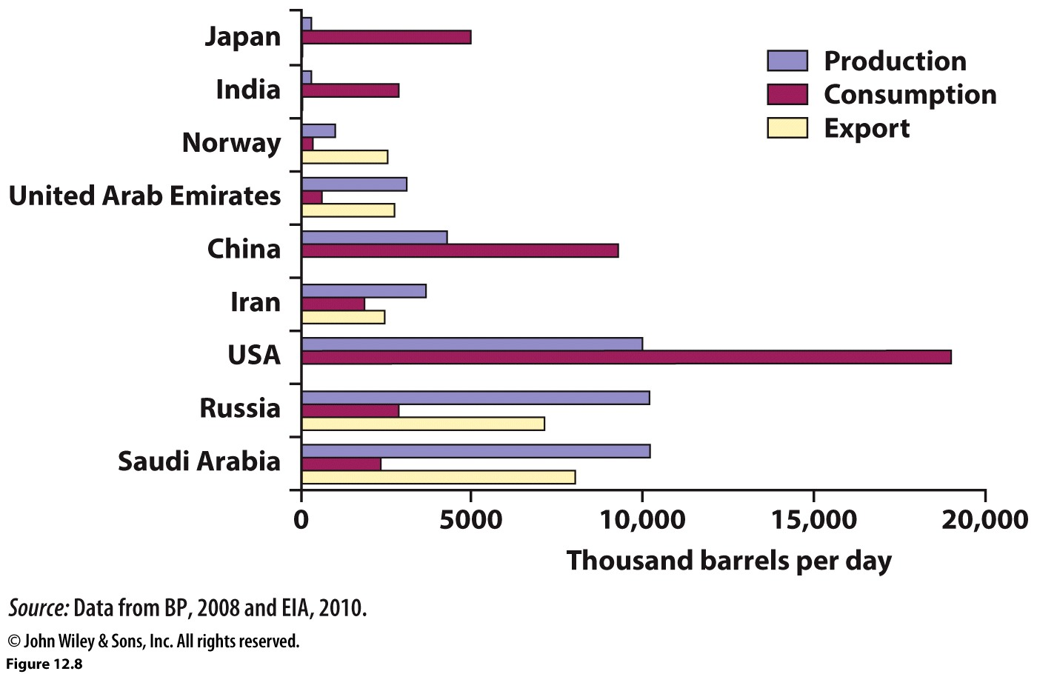
Who produces? Who consumes?
Average daily volumes, illustrate that 5 leading consumer nations account for 45% of global oil consumption. The U.S. consumes about 2x as much oil as it produces and exports very little.

Slide 11
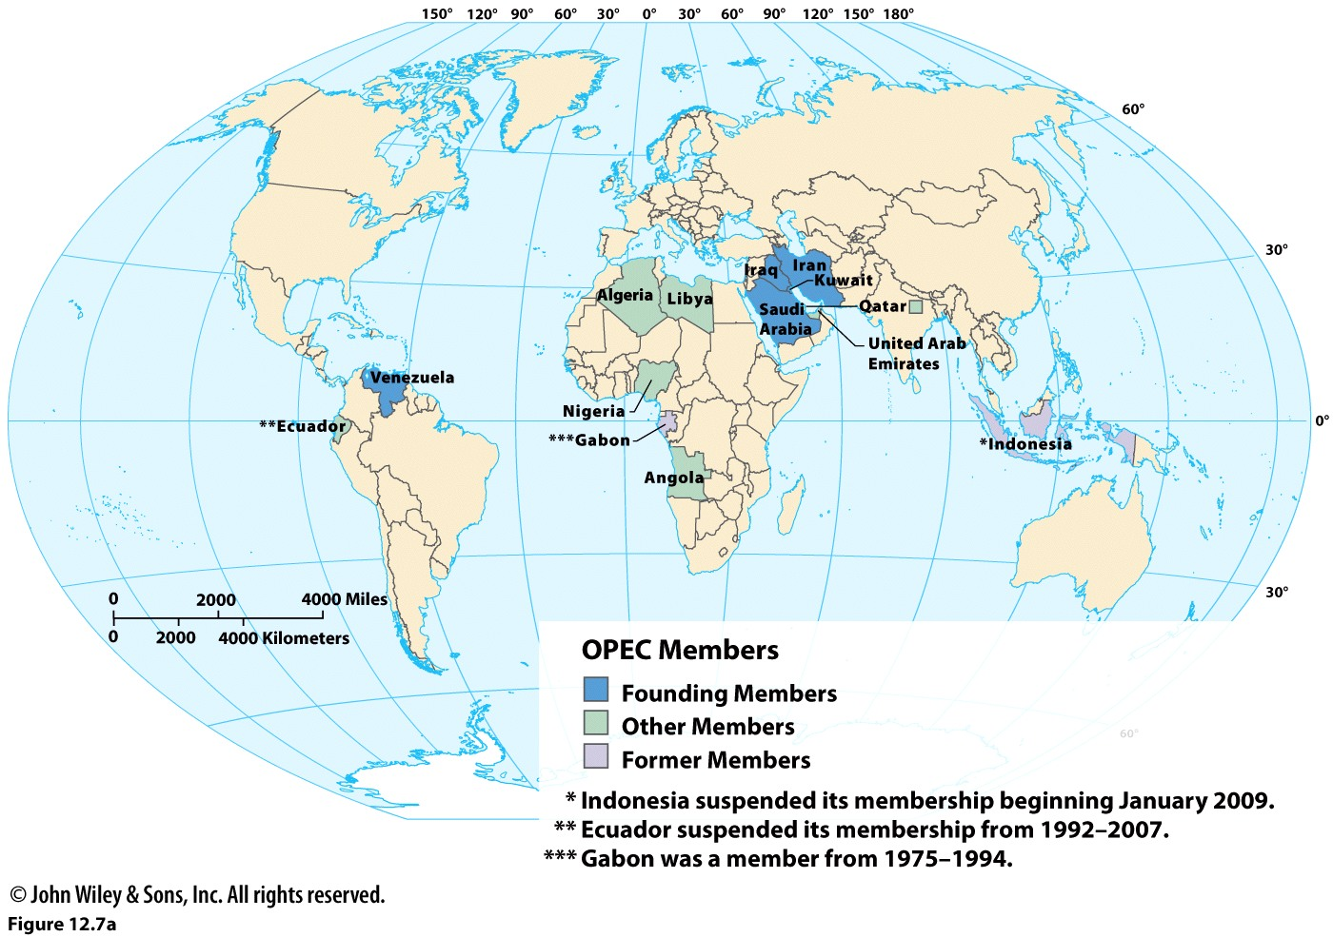

Slide 12
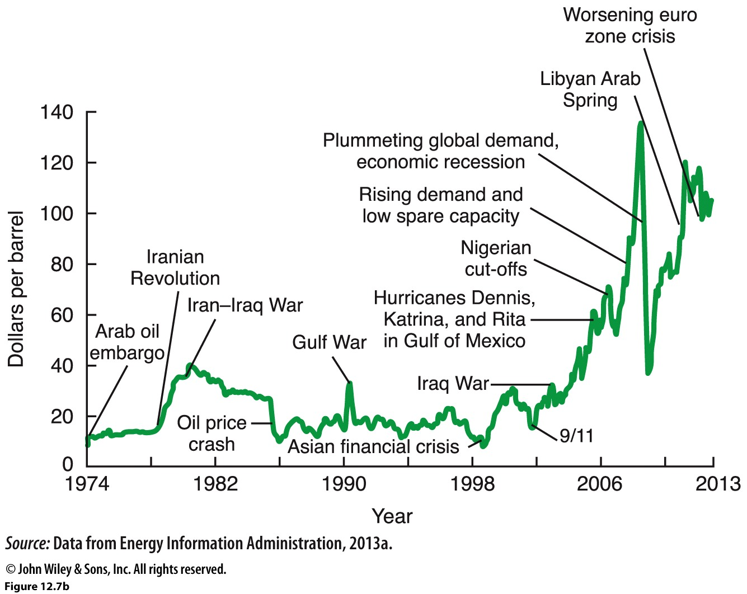
Changes in the price per barrel of oil. High oil prices usually mean high prices at the gas pump. Notice that many events labeled on this graph directly involve OPEC countries. Thus, OPEC’s oil production policies influence and are influenced by regional and global affairs.

Slide 13
Energy Consumption
U.S. & Canada combined consume 26% of the world’s energy resources.
Central America 1%
Africa 4%
Russia 18%
Europe 23%
Middle East 2%

Slide 14
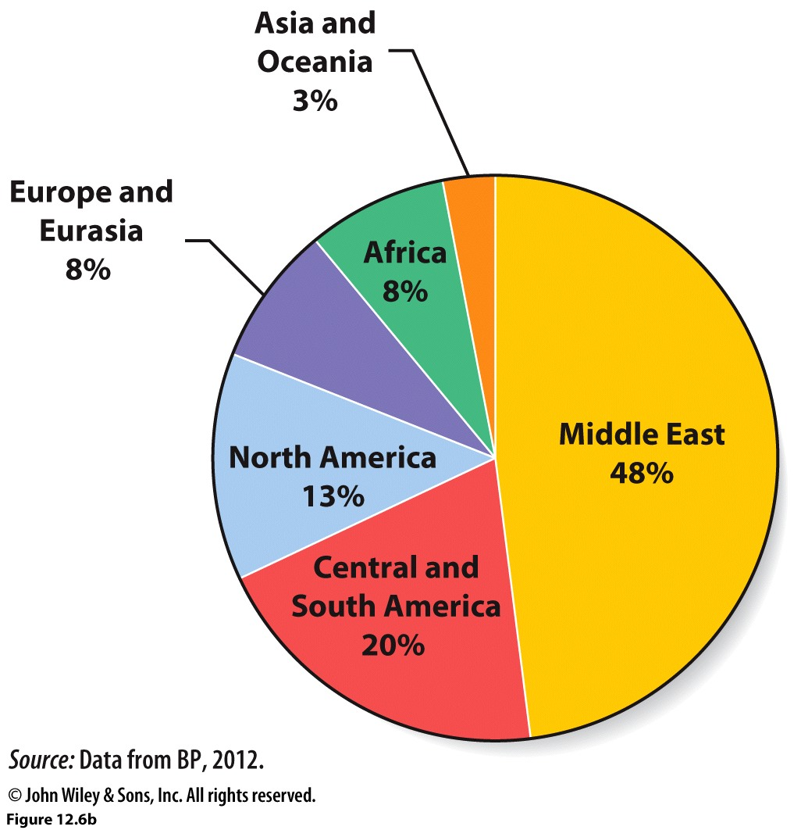
% of global proved reserves by region. The Middle East has by far the largest share of proved oil reserves, but that percentage has declined from over 60% to 48% as proved oil reserves have increased in the Americas.

Slide 15
Outlook for world petroleum production. Proven oil reserves are in decline and new sources are sought. However, many of these new sources will be from areas that require much more extensive and difficult extraction of the resource, increasing the cost of extraction.

Slide 16
The US does have some of its own oil reserves and Alaska is one such place. However, the extraction of this oil is controversial as it will require ever extensive intrusion into wildlife areas. Below is the Alaskan pipeline that brings oil from Alaska into the United States.

Slide 17
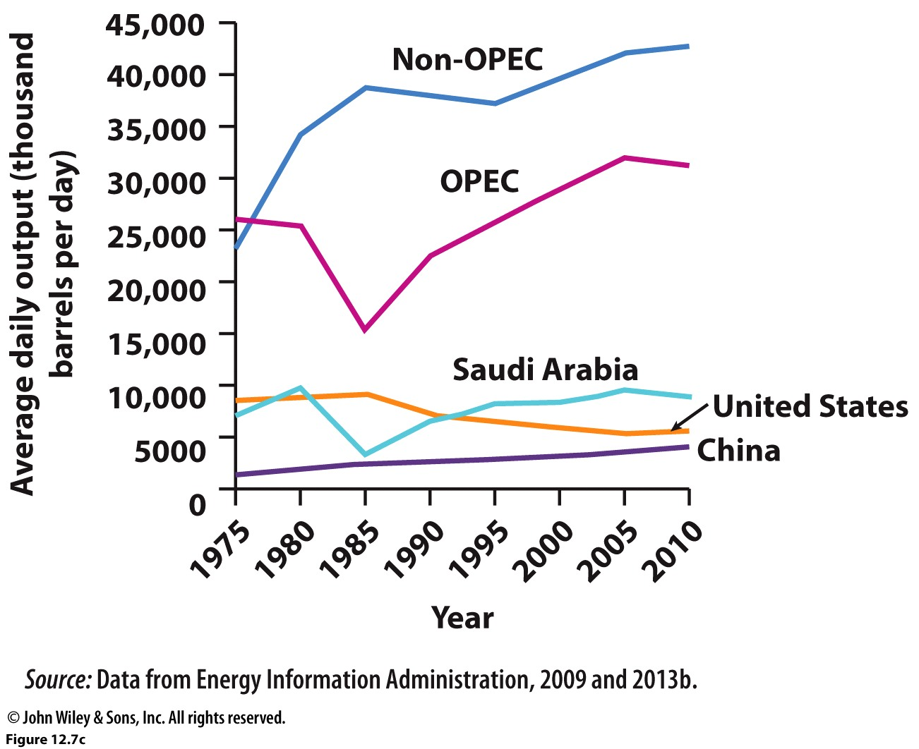
Oil production over time. OPEC produces about 43% of the world’s oil; however, analysts predict OPEC’s share of global production to approach 50% by 2030.

Slide 18
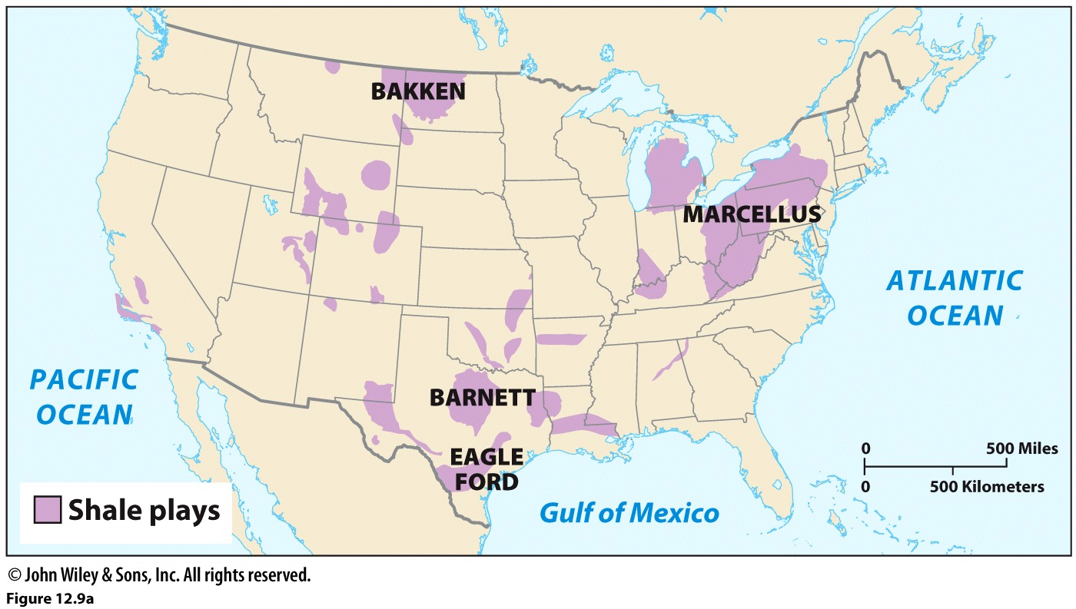
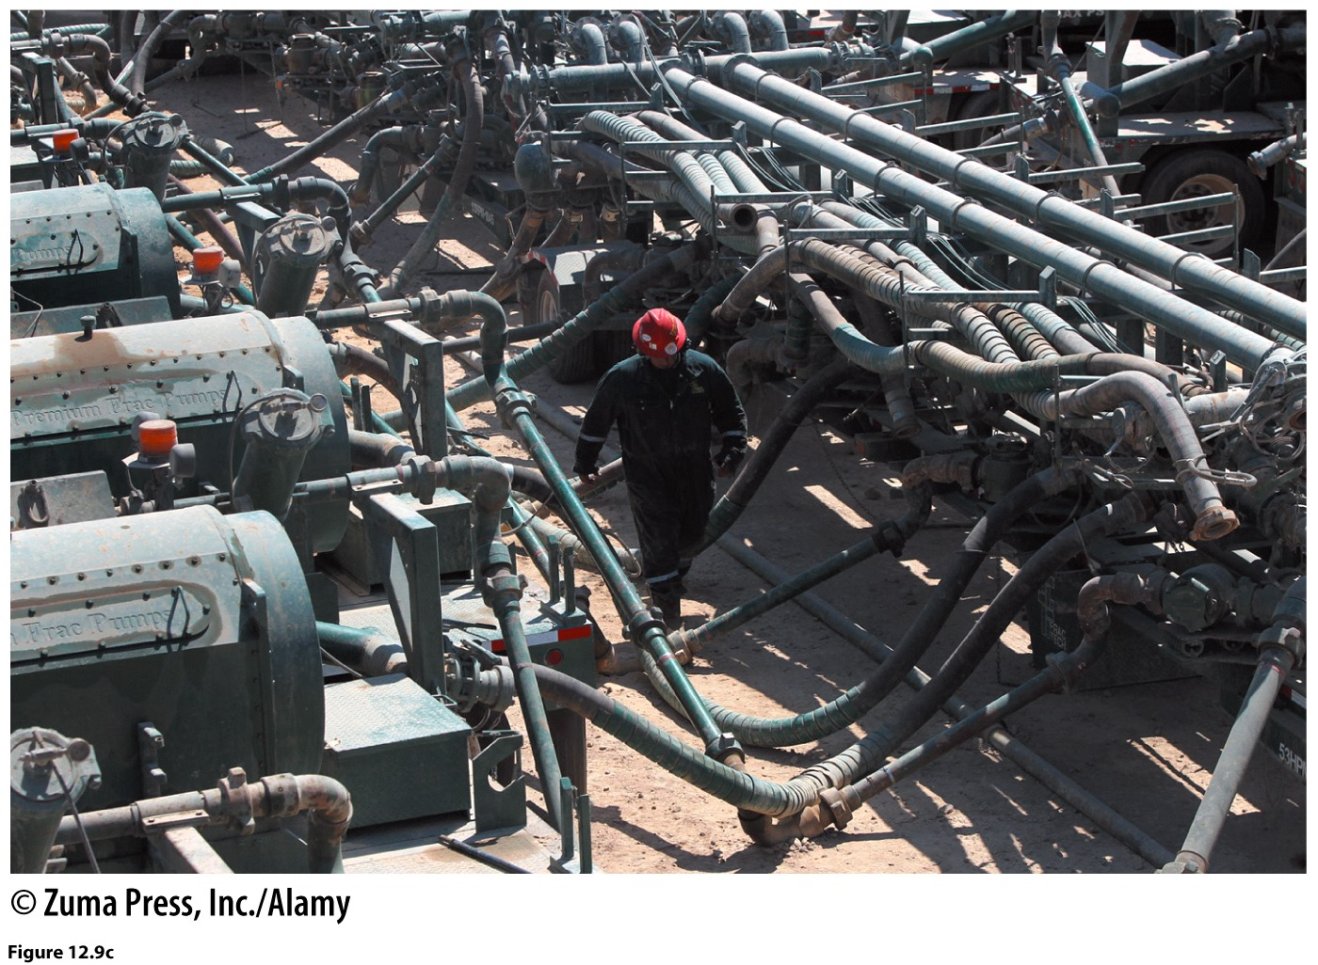
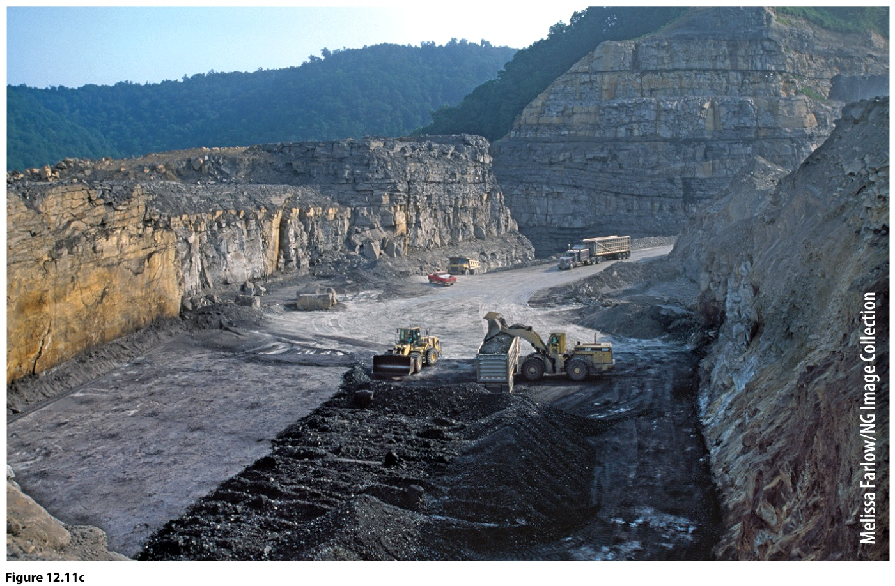
Other Sources? Shale and Tar Sands?
Costly
Fracking
Coal
MTR, Mercury, Acid Rain
Frack pumps. Pressurized to inject water and chemicals into bedrock.
MTR. Massive landscape change. Alters watersheds.

Slide 19
What are the impacts of continued reliance on nonrenewable resources?
Environmental considerations: global to local?
Political considerations?

Slide 20
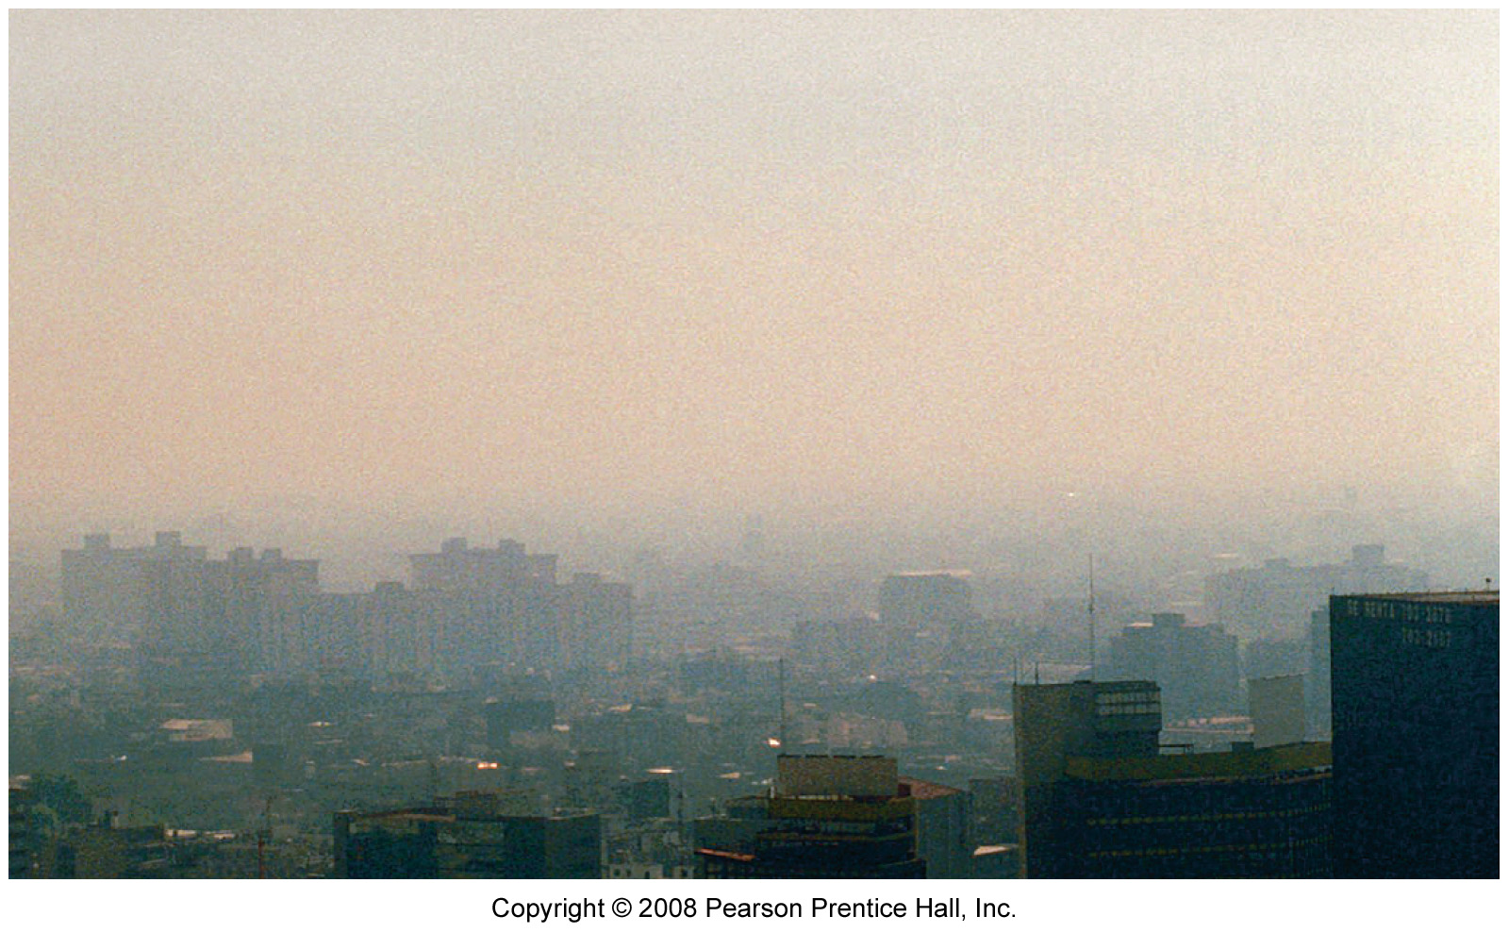
Local air pollution issues: smog
Mexico City Smog—result of Mexico City’s location in a basin which limits the dispersion of air pollutants (similar to Los Angeles) spewed by its many cars.

Slide 21
Same view as previous slide, looking south from Paseo de la Reforma, on a clear day.

Slide 22
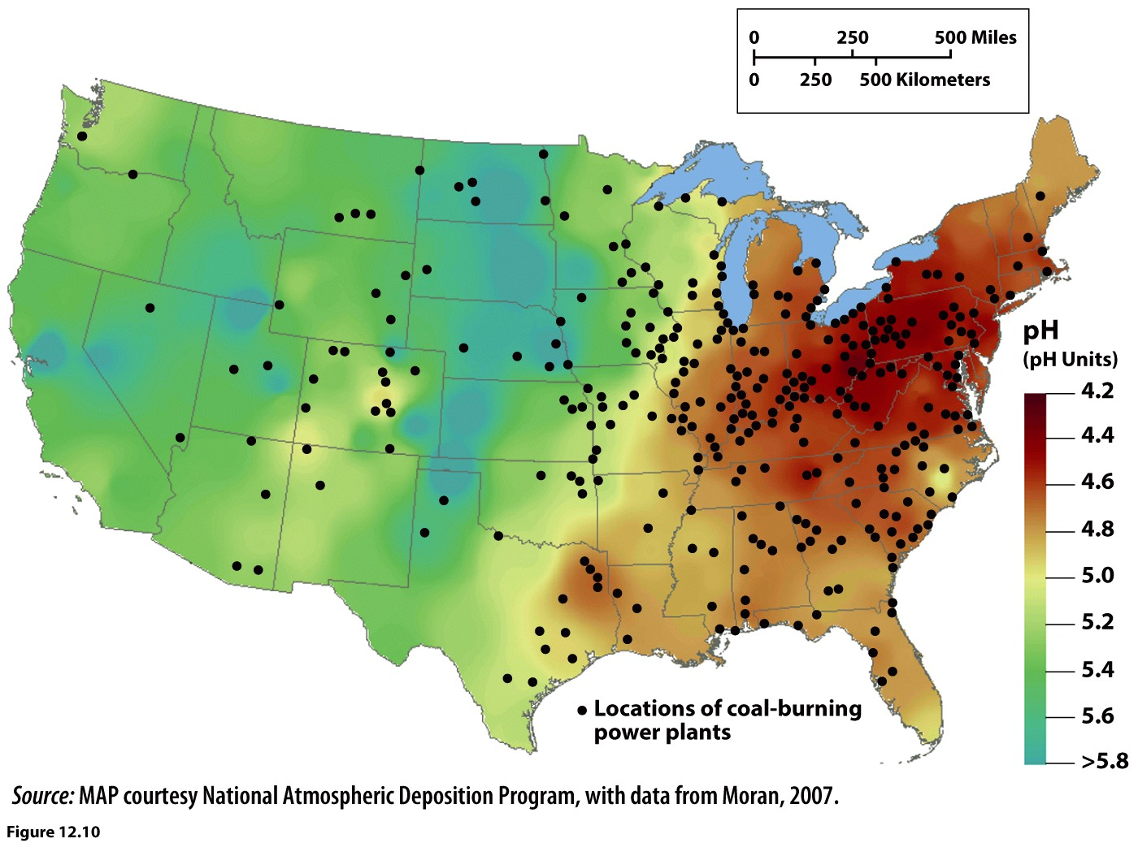
The pH measured acidity of rainwater. Values below 7 are acidic, the lower the value the greater the acidity. Unpolluted rainwater is about 5.6.

Slide 23
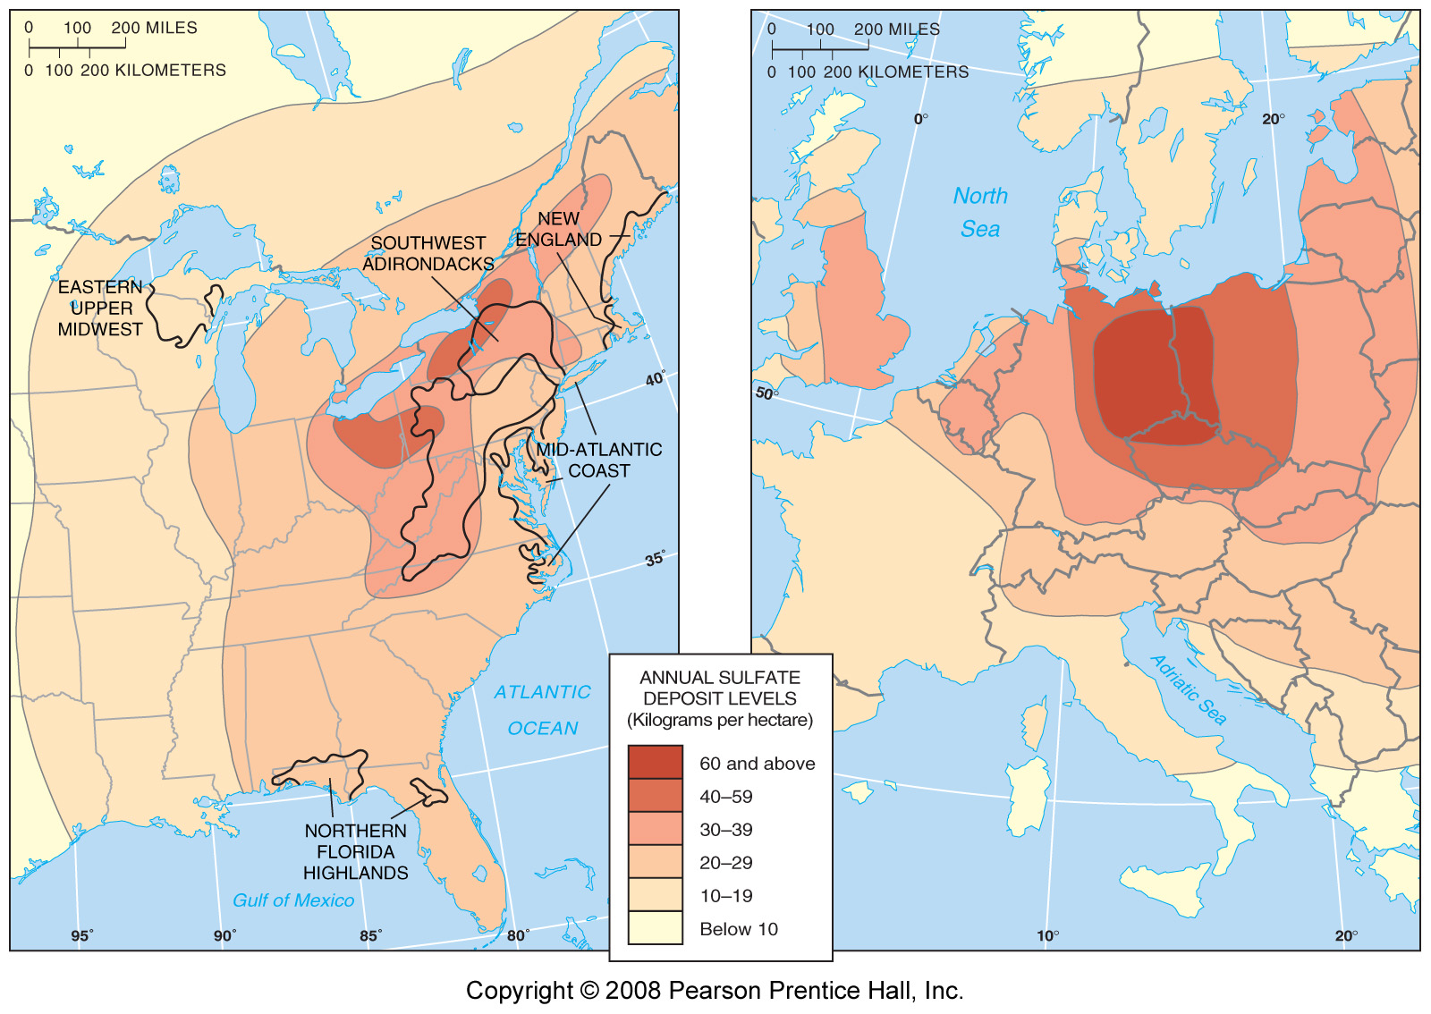
Regional air pollution issues: acid rain
Because of prevailing winds, the highest sulfate deposit levels in North America lie east of the emission sources. Deposit levels in eastern Germany are higher than they are in the U.S.

Slide 24
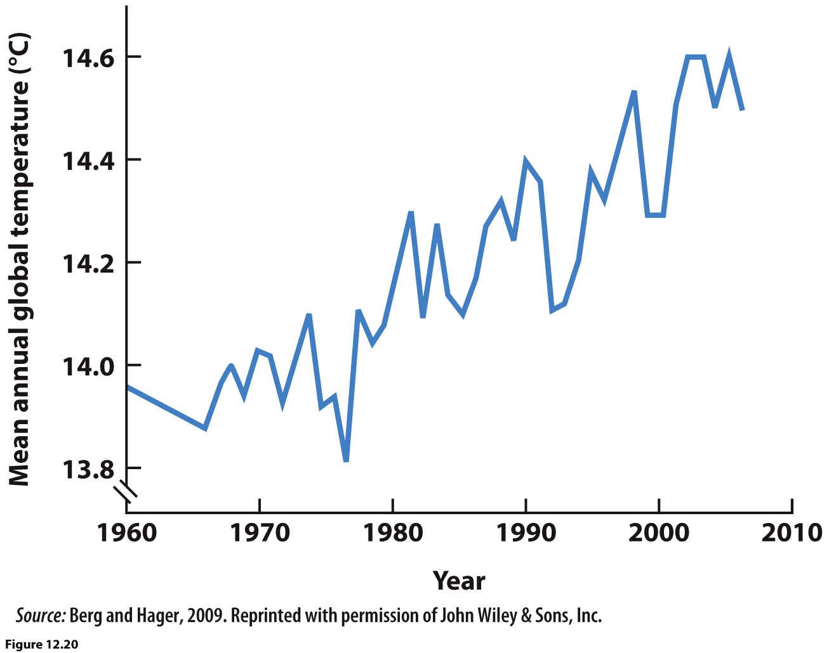
Global issues of air pollution: global warming
The four most important greenhouse gasses, responsible for the warming of global temperatures are: Carbon Dioxide, Nitrous Oxide (also responsible for smog), Methane (from cows, garbage…), and Chloroflourocarbons (CFCs from aerosol cans, refrigerated air). There is direct connection between increased levels of Carbon Dioxide in the earth’s atmosphere and an increase in global temperatures.

Slide 25
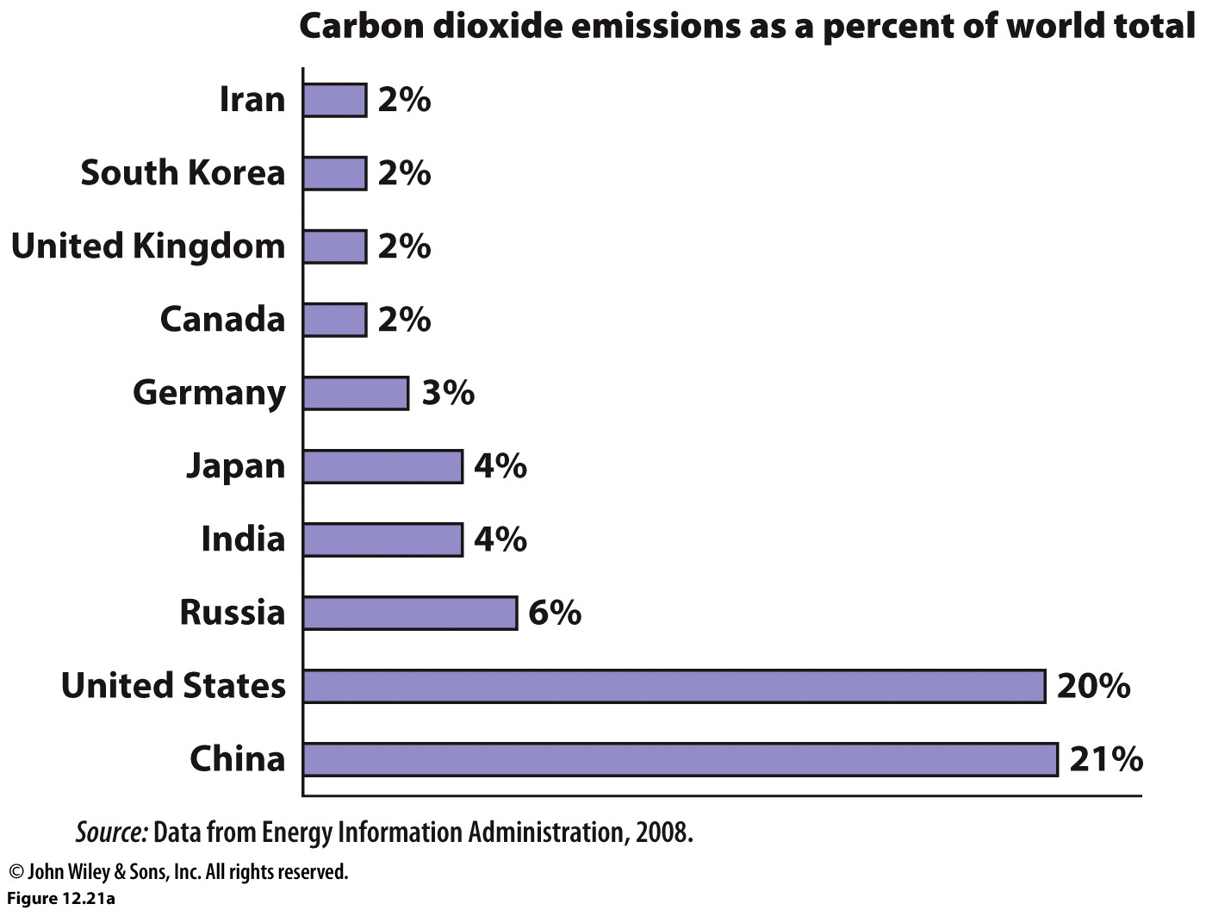
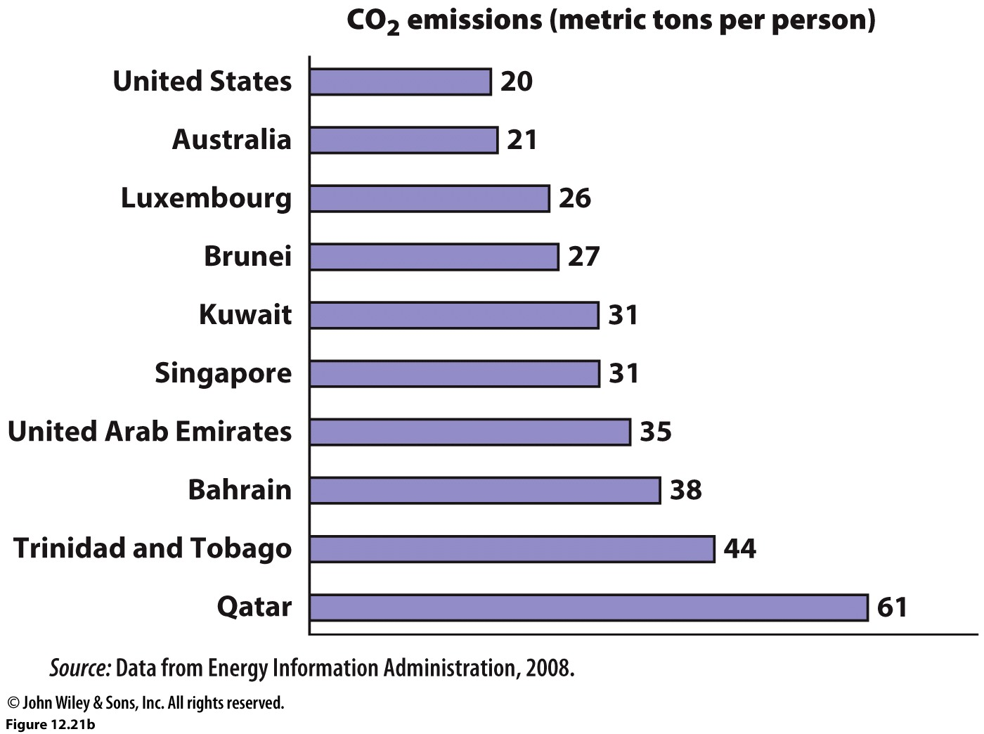

Slide 26
Global Solutions?
Kyoto Protocol, Earth Summits
Carbon Farming http://www.carbonfarmersofaustralia.com.au/About/what-is-carbon-farming
What are the alternatives? Renewable resources…
Nuclear?

Slide 27
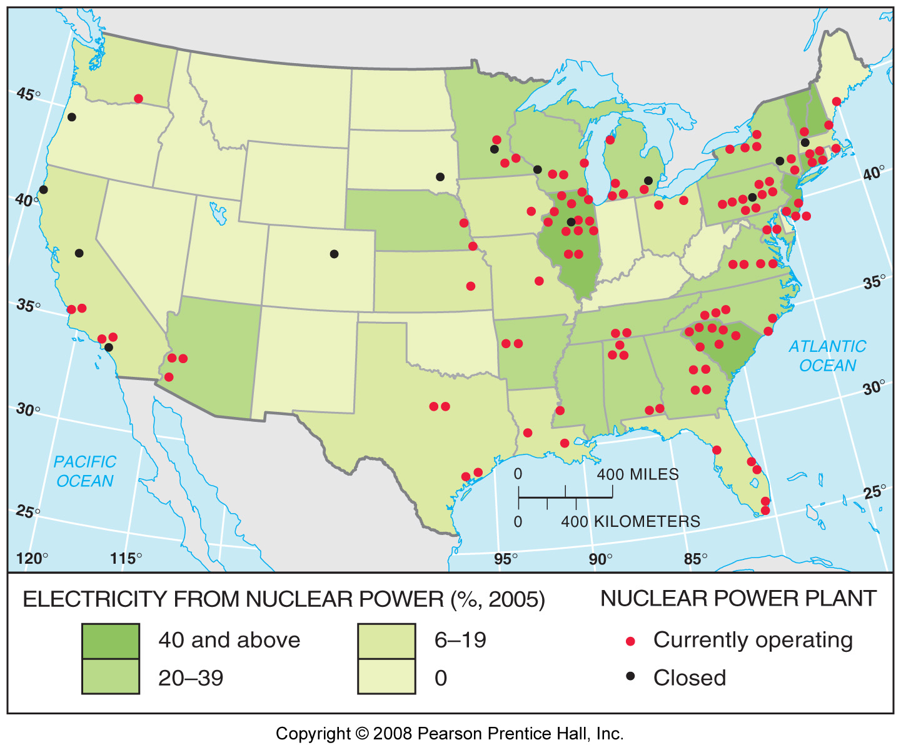
The United States does have active nuclear power plants generating electricity. Most are found in the eastern US, although California has two notable ones just south of the Orange County line in San Onofre.
Nuclear Power?
What are the Pros and Cons?
Stewart Bland talks about nuclear sourced energy

Slide 28
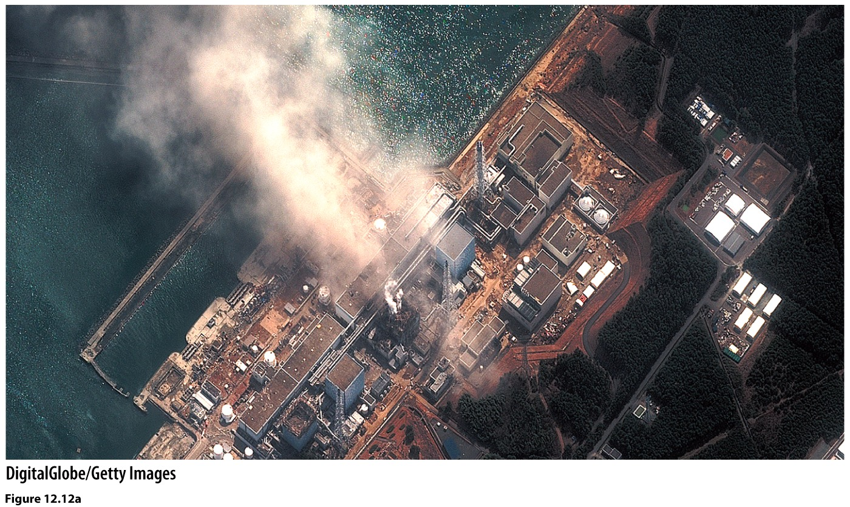
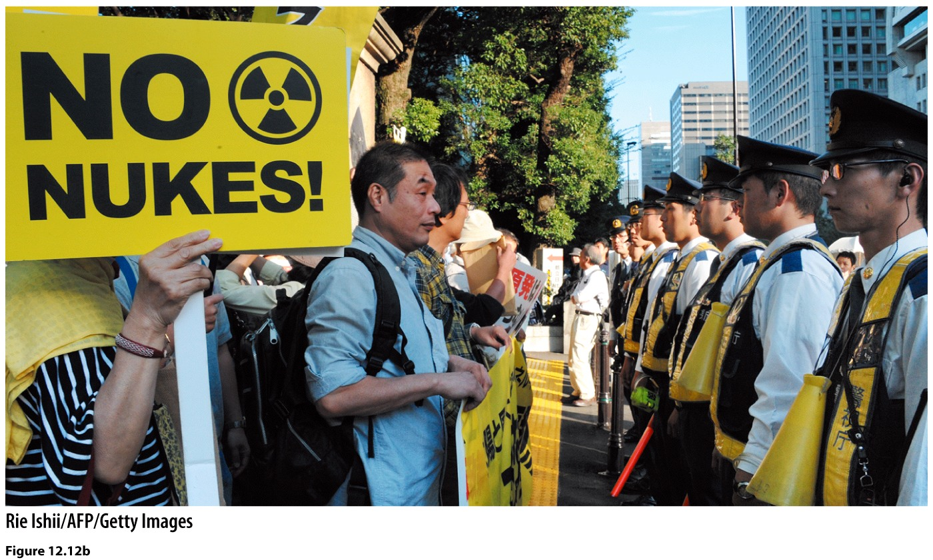
Explosion at the Fukushima Daiichi nuclear power plant. The plant had been built to withstand a tsunami about 20’ high, but not a nearly 50’ high one like that which struck the facility.

Slide 29
Germany 23% nuclear
France 53%
UK 12.3%
Italy 0%
Spain 7.6%
Sweden 25%
Norway 0%
Iceland 0%, hydroelectric 72.9%
Bulgaria 20.3%
source: CIA World Factbook, 2013

Slide 30
In addition to issues surrounding radioactive byproducts and the potential for deadly accidents, nuclear energy also requires the mineral resource, uranium. The pie chart below illustrates the distribution of global uranium reserves.

Slide 31
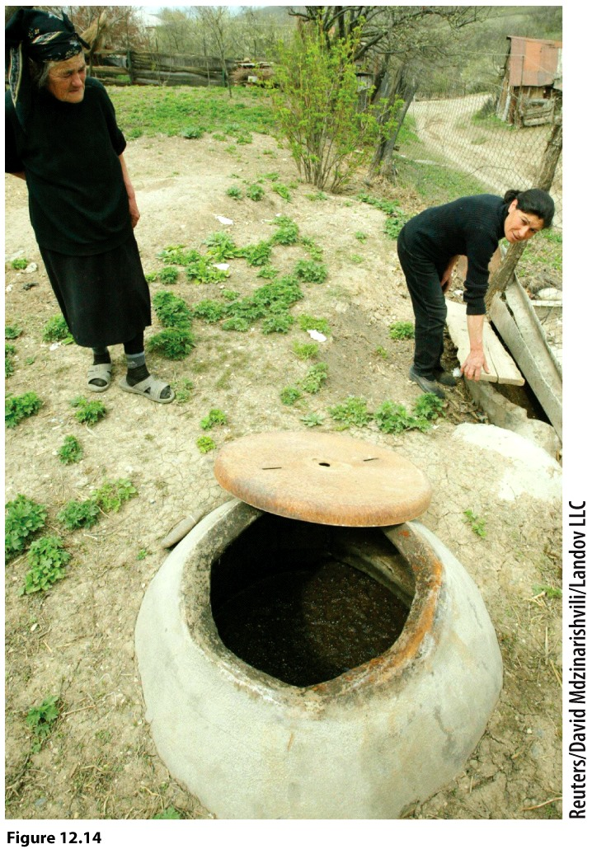
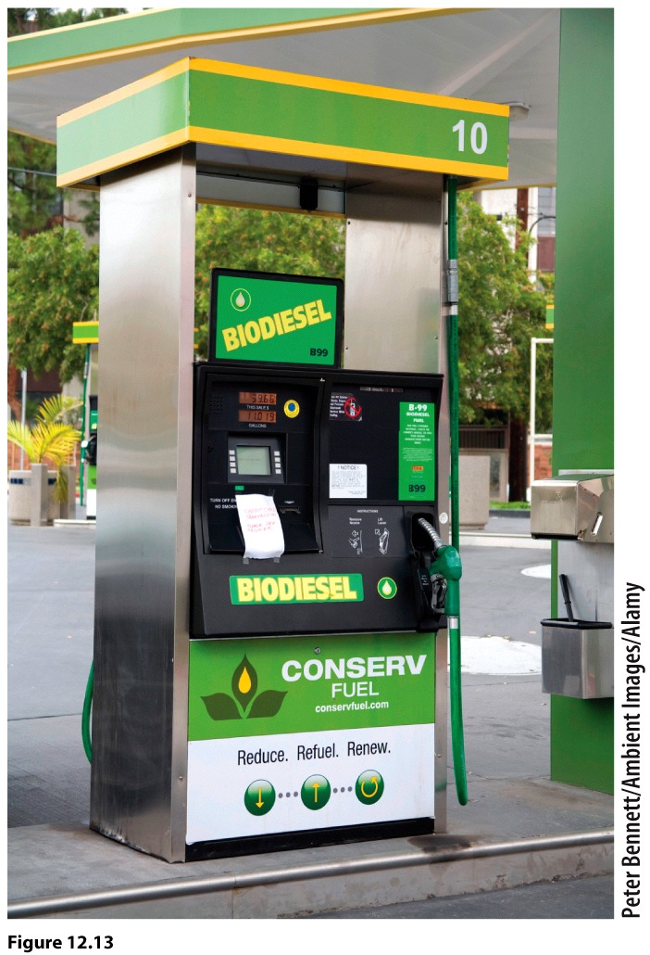
Biomass?
Energy from organic material….plant or animal
Wood, charcoal, crop stalks, manure, corn!
How to convert it to energy?
Direct or Indirect

Slide 32
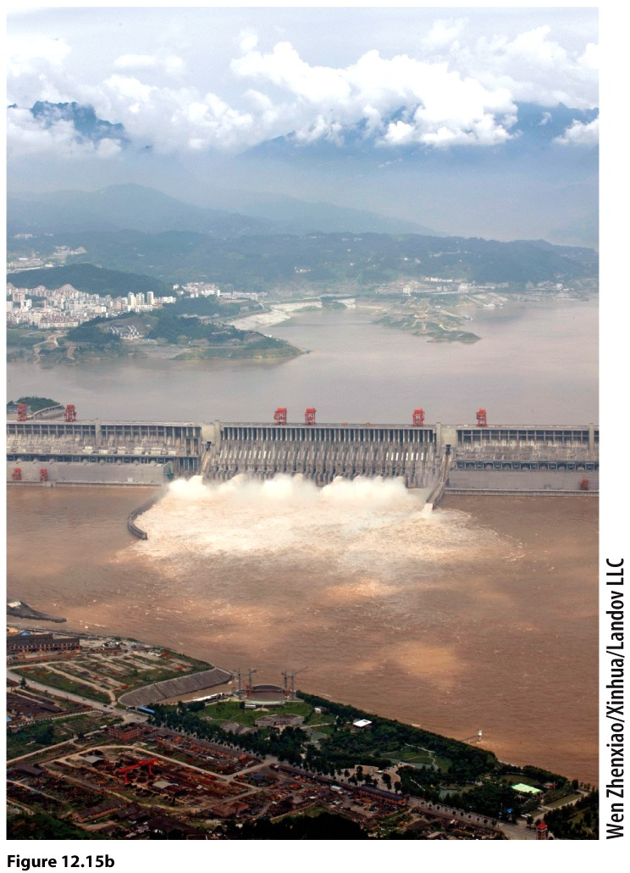
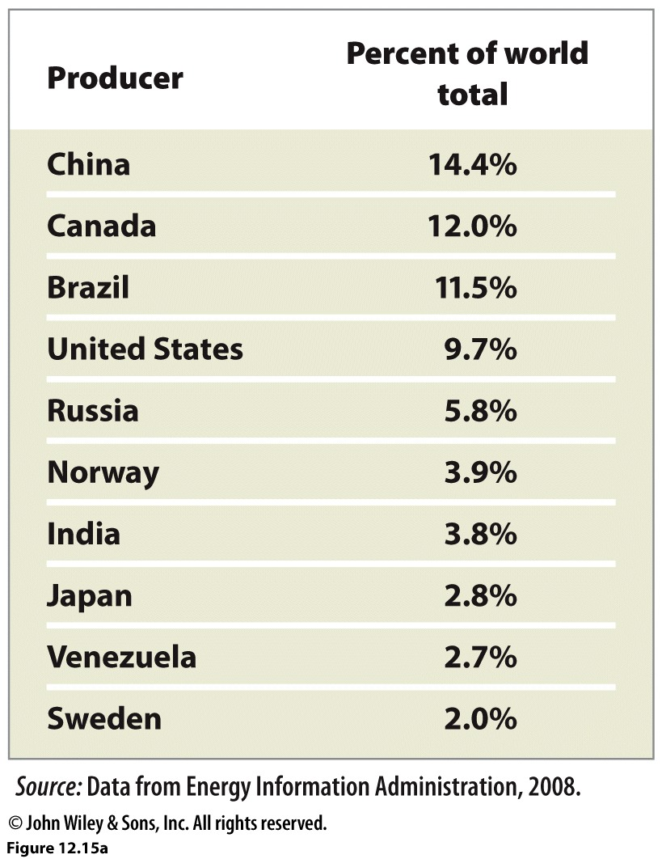
Hydropower

Slide 33
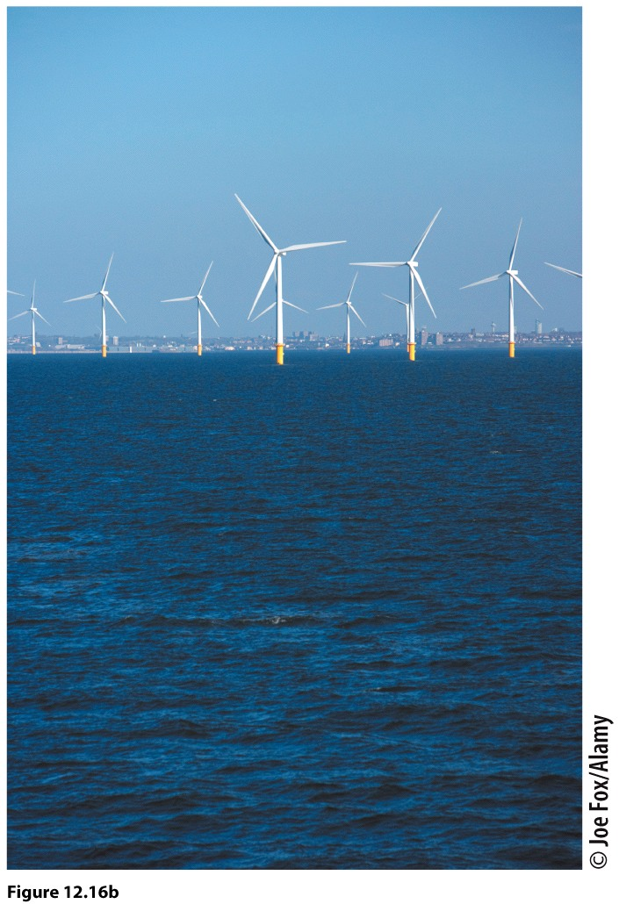
Wind
Denmark gets 20% of its energy from wind.
U.S. about 2%

Slide 34
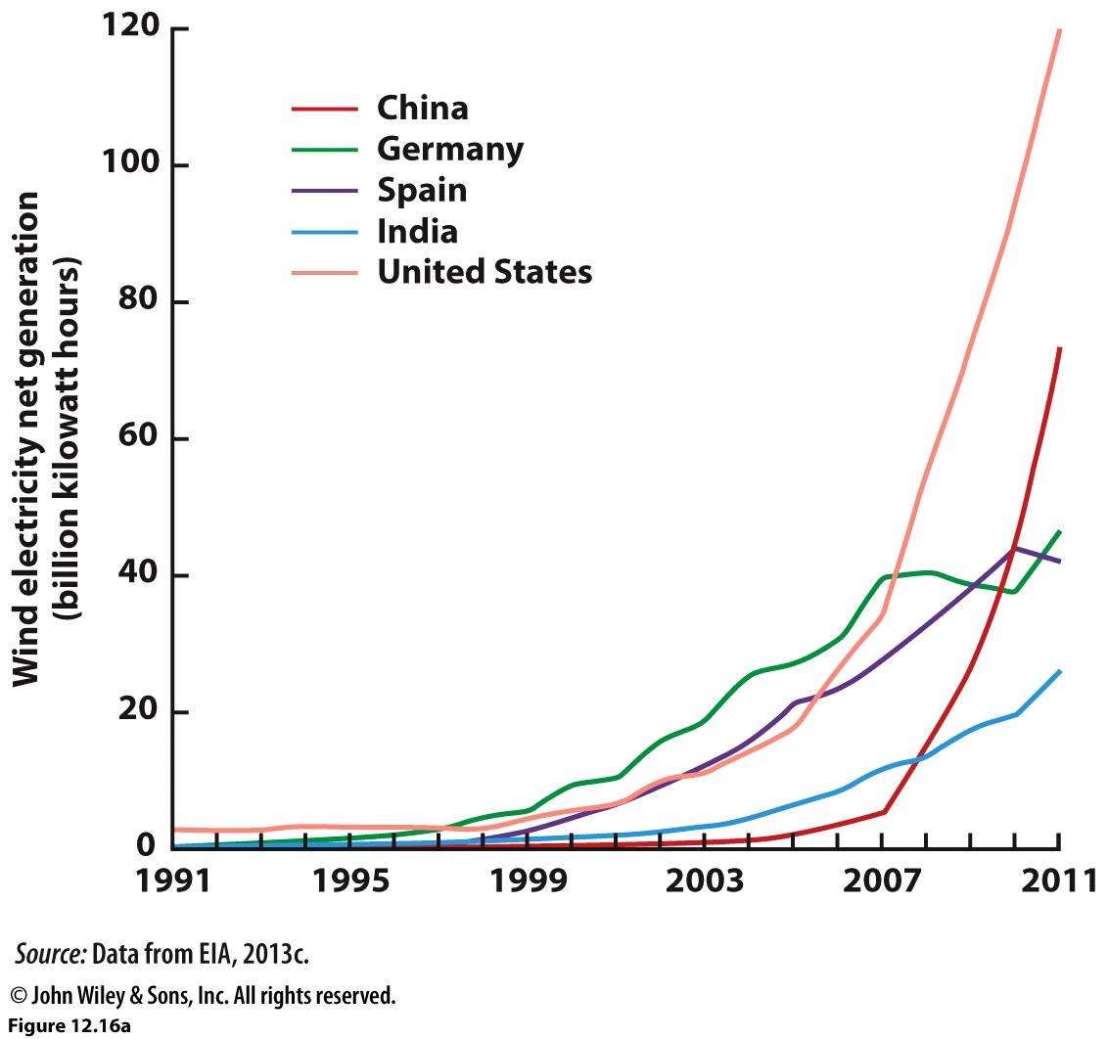

Slide 35
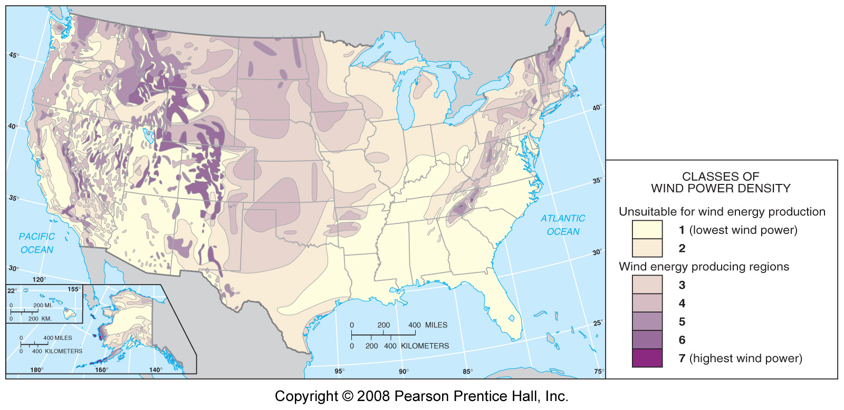
U.S. Wind Power Potential
Winds are strong enough to support substantial wind power generation in the U.S. Plains as well as other regions in some of the East and much of the West.

Slide 36
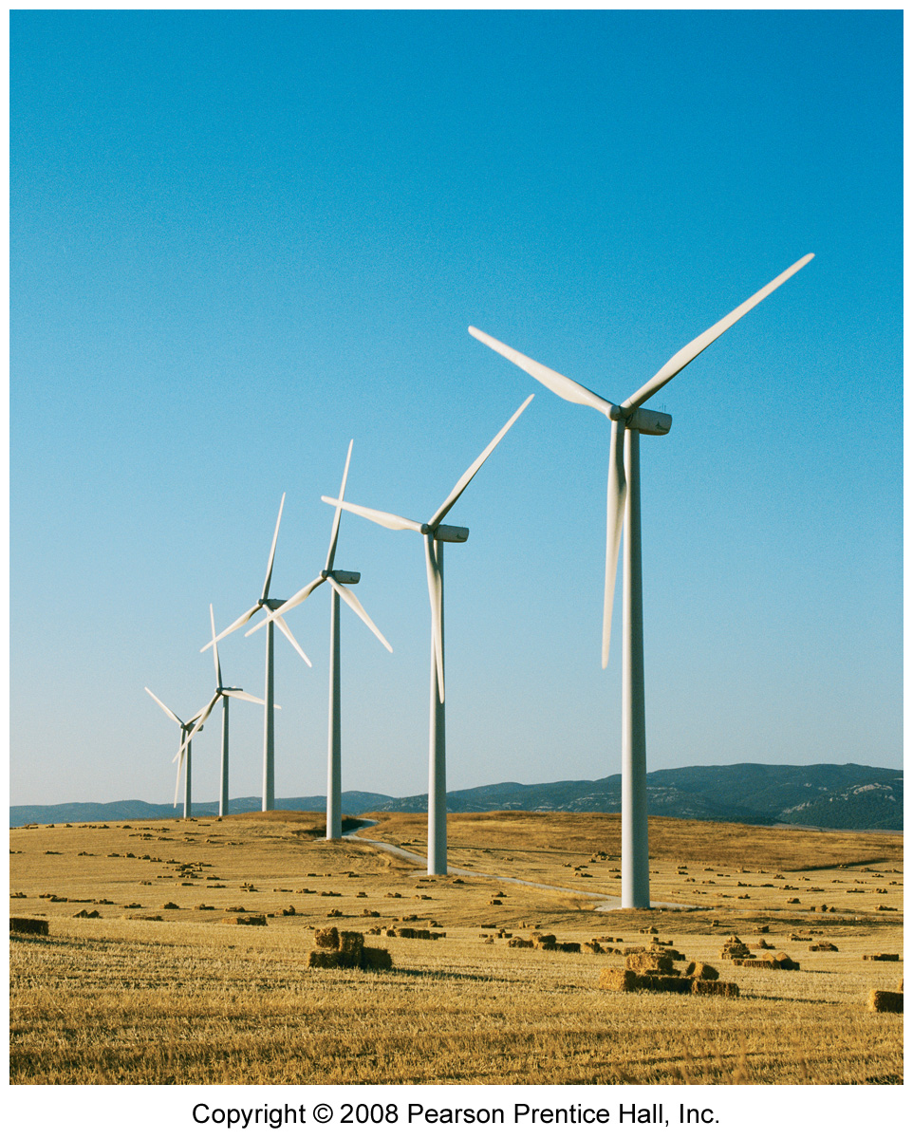
A wind farm in Tarifa, Andalucia, Spain.

Slide 37
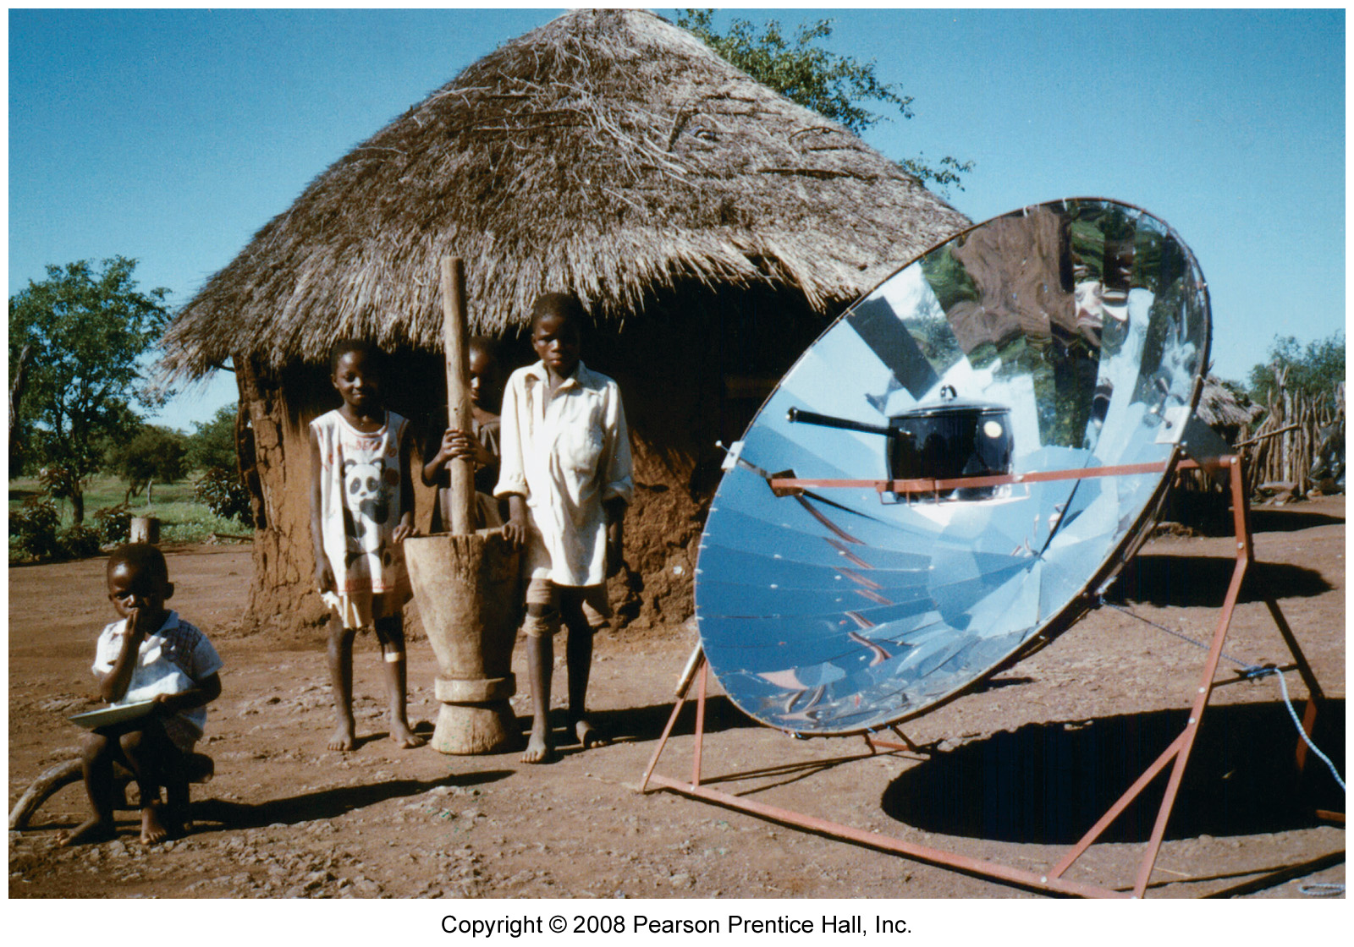
Solar
Passive vs Active solar collection. The Solar Stove.

Slide 38
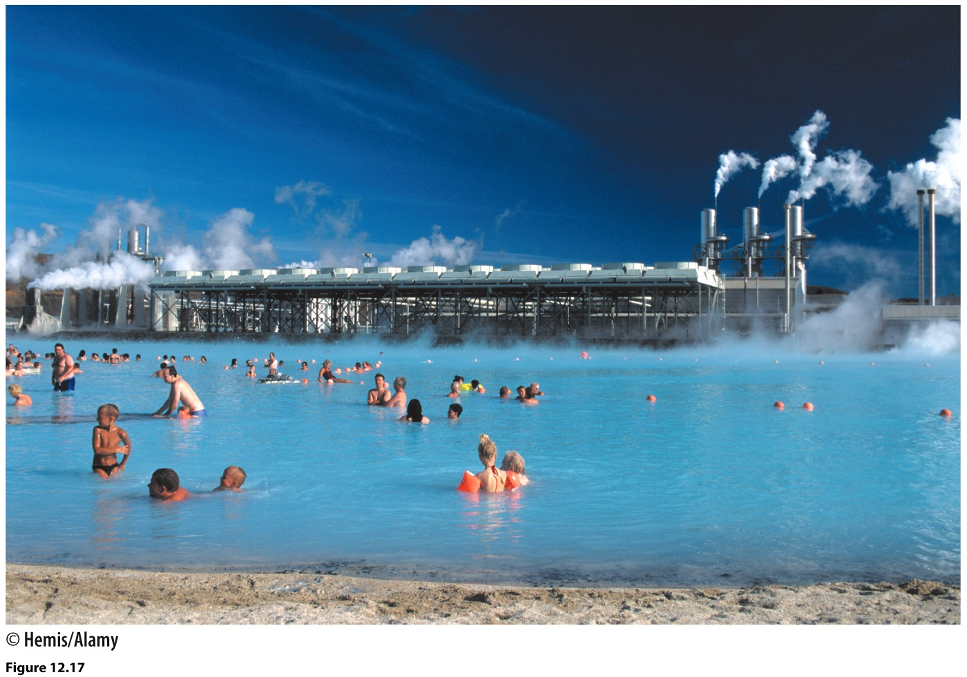
Geothermal

Slide 39
For more on energy resources
http://www.wri.org/

Slide 40
Other Environmental Concerns: Deforestation, Tropical Rainforest Loss
Tropical rainforests are being devastated at an unprecedented rate
Each year an area of tropical rainforest the size of Pennsylvania is lost.
Almost half of this activity is occurring in Brazil’s Amazon Basin.
But rates of deforestation are actually faster in Southeast Asia.
If estimates are correct, Southeast Asia will be completely stripped of forests within 15 years.
Demand for tropical woods (Japan is a huge consumer)
Increased global demand for beef—forests are cleared for ranching of cattle, especially in Brazil’s Amazon.
Forest is also being cleared to accommodate human settlement.
The crisis of rainforest loss
the cutting and burning of these forests is releasing Carbon Dioxide into the atmosphere.
20% of all human-caused greenhouse gas emissions are from cutting and burning tropical forests.
Loss of Biodiversity is another effect: tropical forests are only 6% of the earth’s land area, but have at least 50% of the earth’s species living within them.

Slide 41
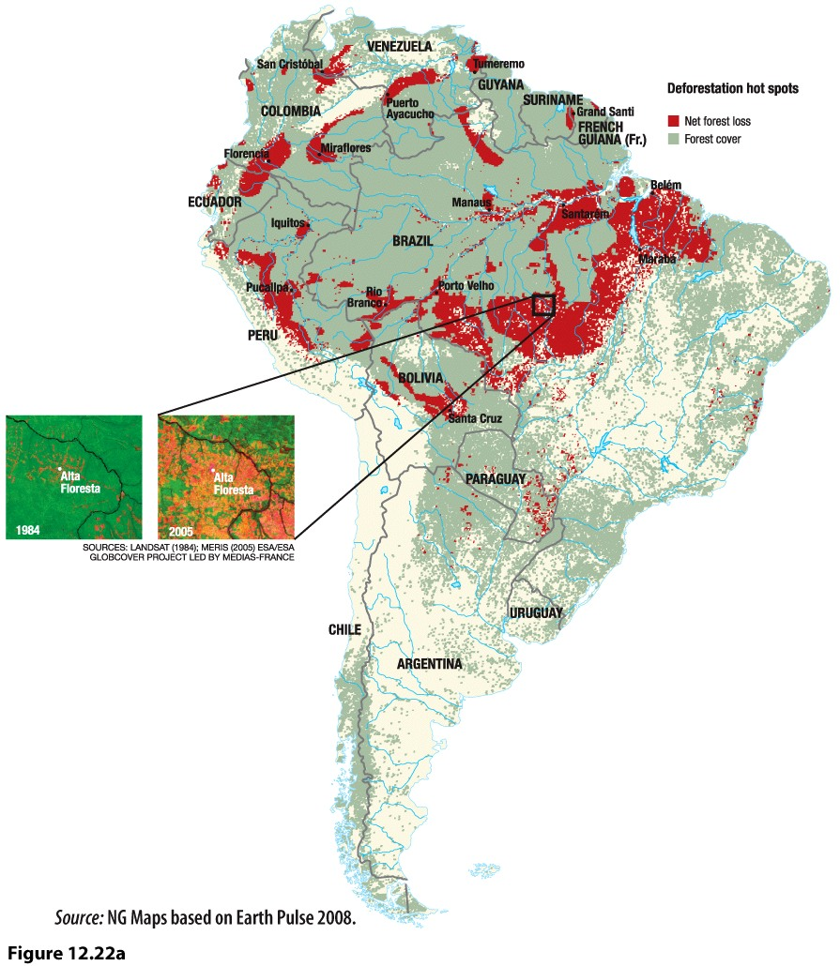

Slide 42
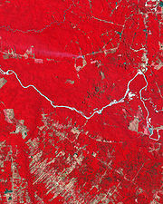
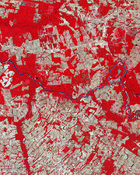
Deforestation in the Amazon. To quickly establish soybean farms or cattle ranches, trees are burned. This practice destroys a natural “sink” of carbon dioxide, reduces biodiversity, and releases significant amounts of carbon dioxide into the atmosphere.
Deforestation in Mato Grosso, Brazil Deforestation in Mato Grosso, 1992 Brazil, 2006

Slide 43
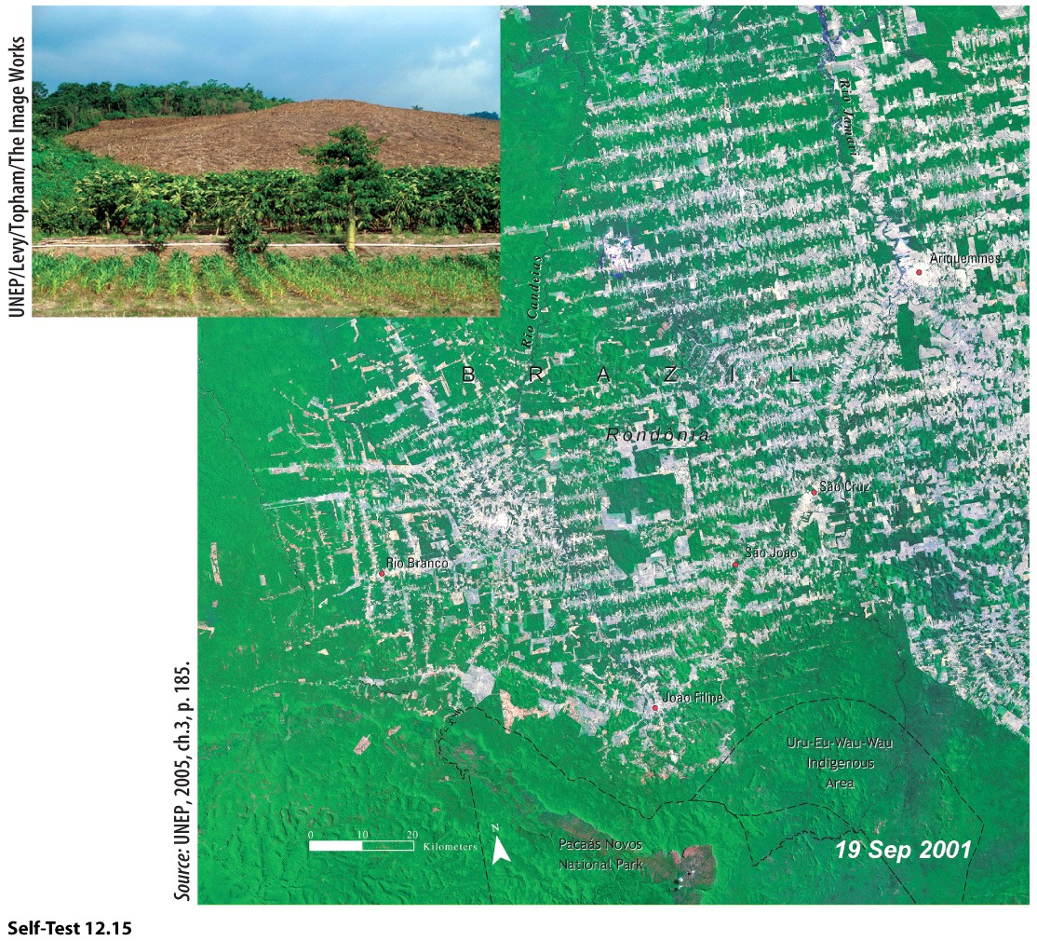

Slide 44
