Slide 1
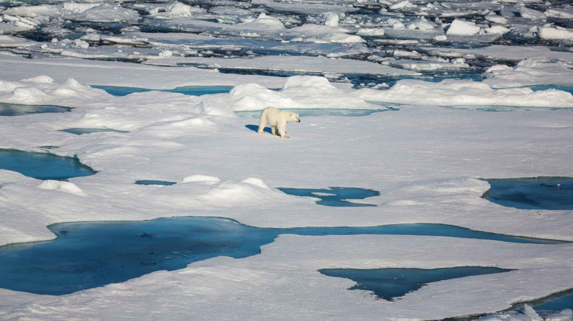
Chapter 12: Environmental Challenges

Slide 2
Environment
One’s surroundings
All living and non-living factors
Ecosystems
Interactions between different components of the environment
Visible & nonvisible components—heat, oxygen, carbon dioxide, people…
Scale: Earth, oceans, deserts, your backyard
Complexity: based on how biodiverse it is
Most complex?
Tropical rainforests
Sloth in Yasuni National Park, Ecuador.
Source: conservation.org

Slide 3
Ecology
Garrett Hardin
First law of ecology: “we can never do merely one thing.”
Natural Capital
Goods, services provided by nature
The basis of a functioning economy, human use of natural resources.
Nonrenewable resources
Finite—cannot replenish or take too long to do so.
Renewable resources
Replenish naturally or through human intervention

Slide 4
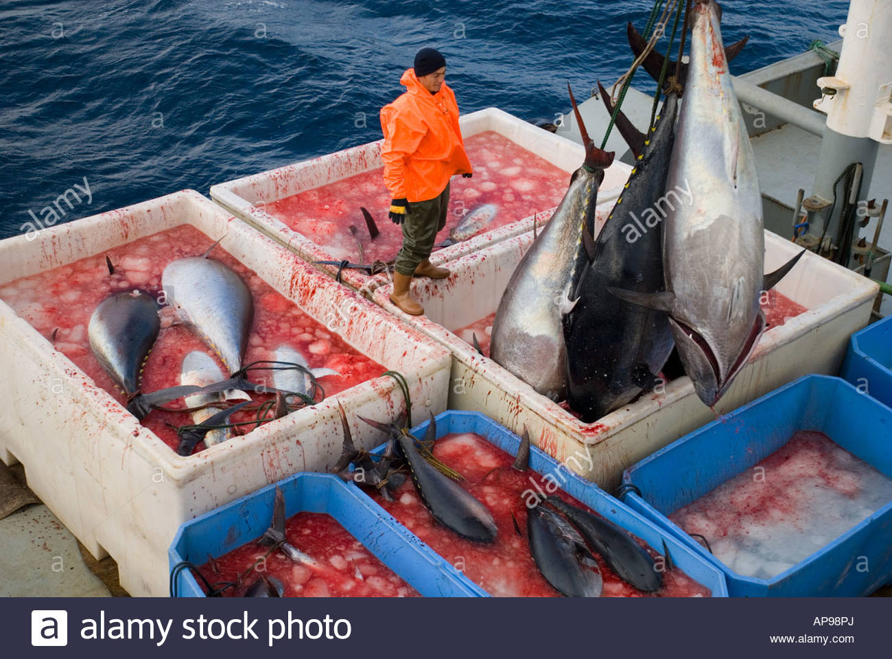
Use of Resources
Economic Depletion
Occurs when 80% of the resource has been extracted.
The cost of the extraction exceeds resource’s economic value.
Sustainable Yield
Maximum quantity that can be extracted without impairing ability to replenish
Often only applied on a species-specific basis, doesn’t always consider ecosystem impact.
Ecologically sustainable yield.
Bluefin tuna, caught in eastern Mediterranean.
Harvested at more than 3x sustainable yield.

Slide 5
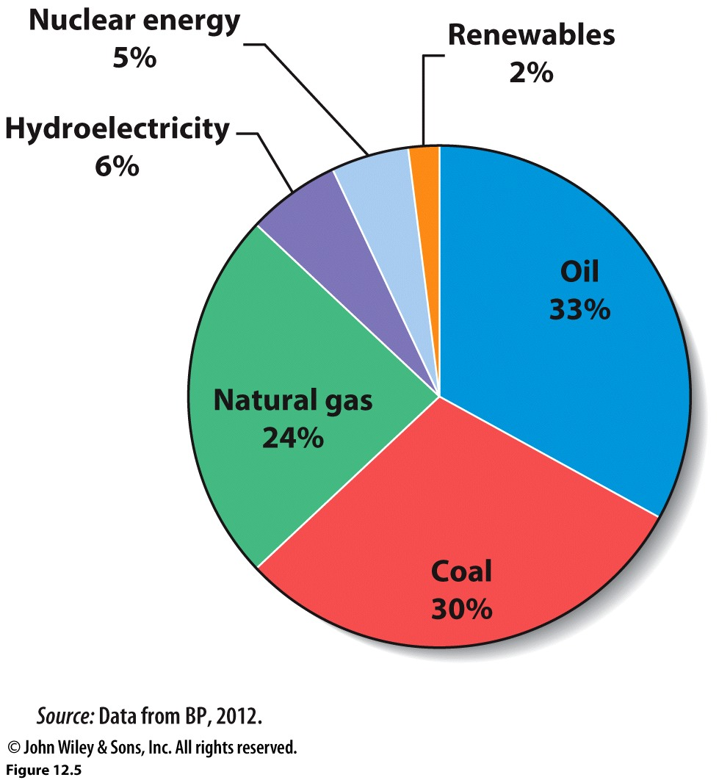
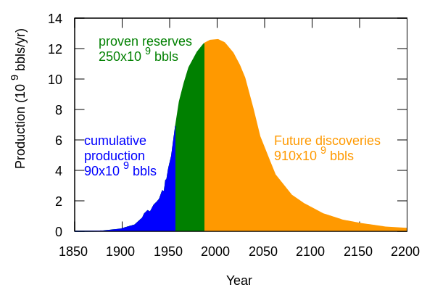
Nonrenewable Energy Resources
Fossil Fuels
Oil, petroleum
Natural gas
Coal
Peak Oil
M. King Hubbert, 1950s
Optimistic: 2020
Pessimistic: 2007
Warned of the coming “energy transition”
Global energy consumption by fuel.
Hubbert’s model in 1956. His model shows a peak of 12.5 bb/yr in about 2000. As of 2016, 29.4 bb/yr

Slide 6
Outcomes of Fossil Fuel Reliance
Pros
Infrastructure already in place to support it (extract, process).
Current basis of world economy.
Relatively cheap.
Cons
Finite amount, economic depletion
Environmental impacts
Local
Regional
Global
Geopolitical consequences
What countries have oil?

Slide 7
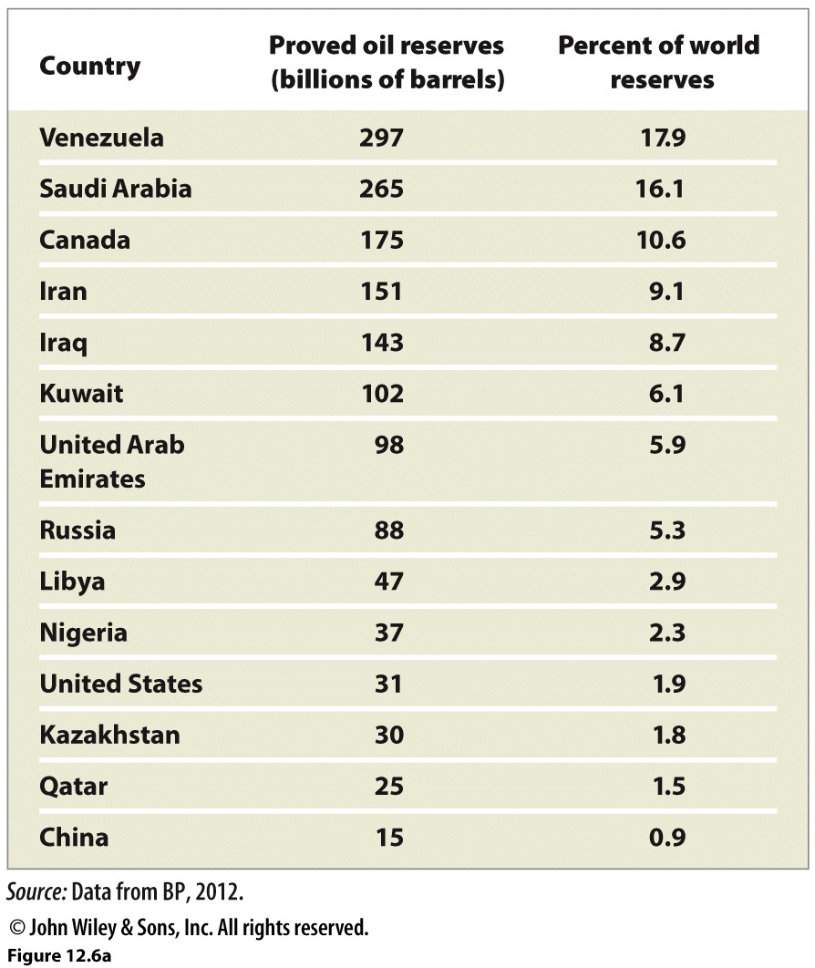
Countries with largest proven oil reserves.
Venezuela has surpassed Saudi Arabia.
Canada’s (and much of the U.S.’s) reserves include oil sands. Instead of being drilled, oil sands are mined in open pits. The product first recovered is bitumen, a much lower grade of crude oil that must be upgraded before it can be refined.

Slide 8
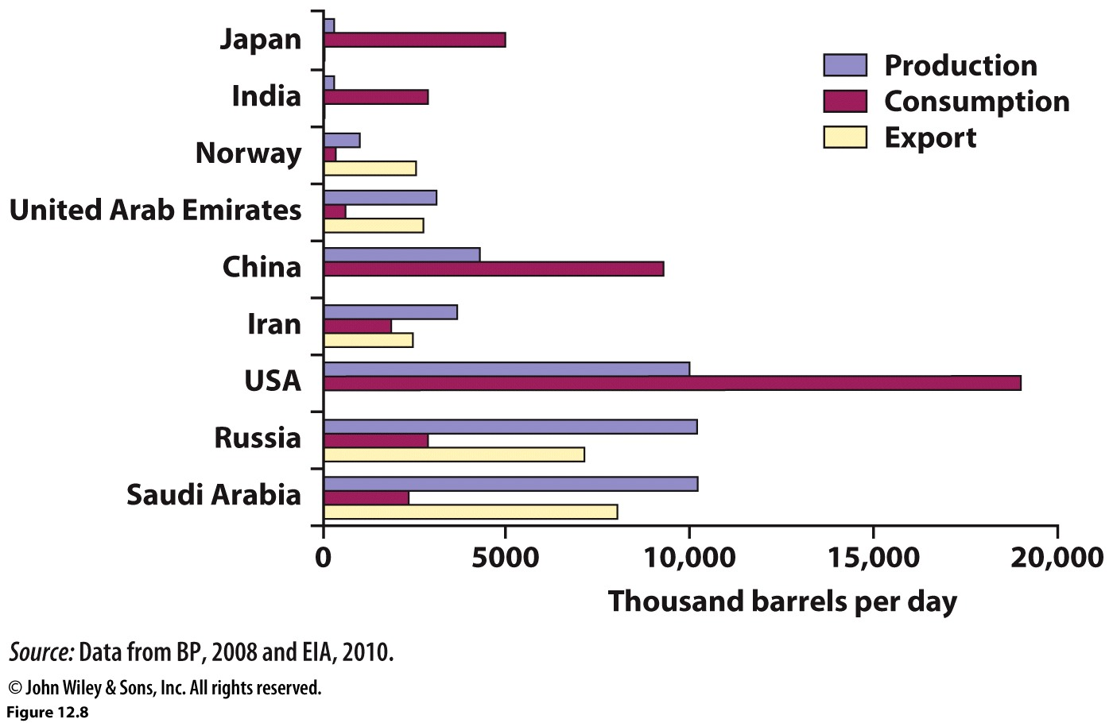
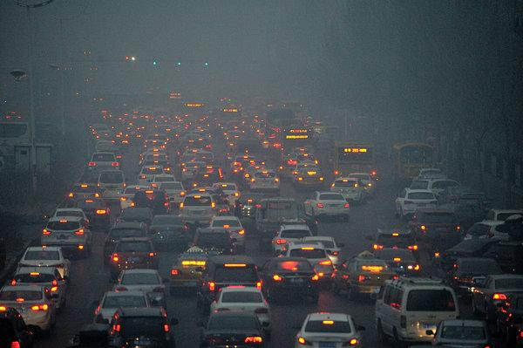
The Geography of Oil Production and Consumption
Harbin, China
US is 3rd largest global oil producer, but consumers 2x what China does.
Saudi Arabia is the largest producer but not even in the top 5 consumers.
2.4 people for every car in the U.S. (compared to 2316 per car in Bangladesh).
China is 2nd largest consumer of oil. Consumption DOUBLED between 1990s-2010.
India’s consumption of oil has grown by 84% from 1990s-2010.
World’s consumption grew by 19% during same time
Japan actually reduced its use by 22%

Slide 9
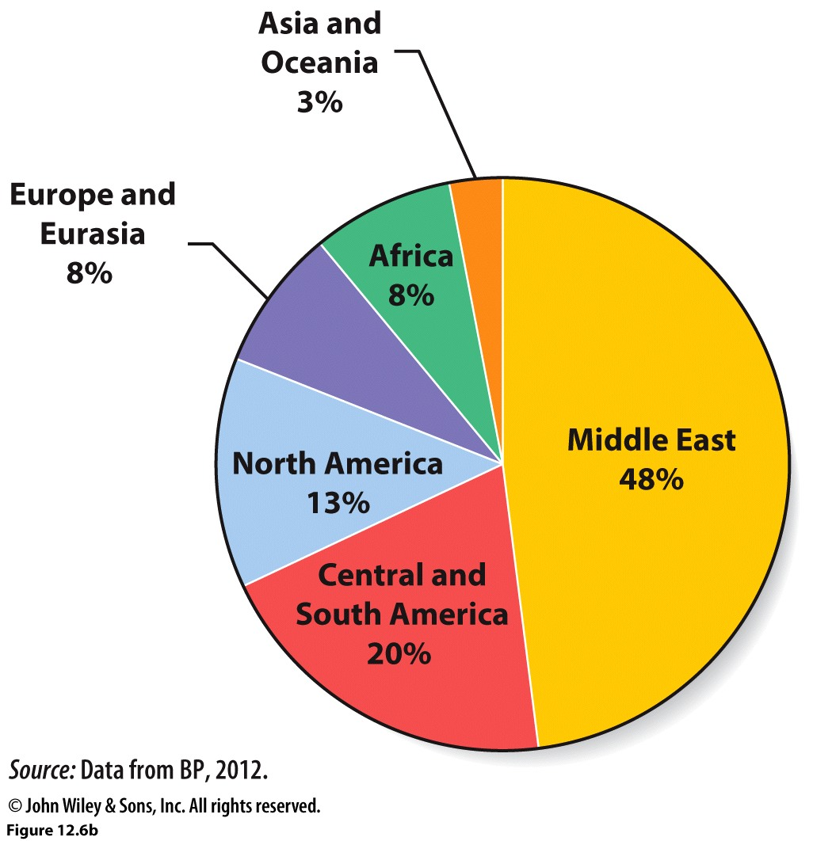
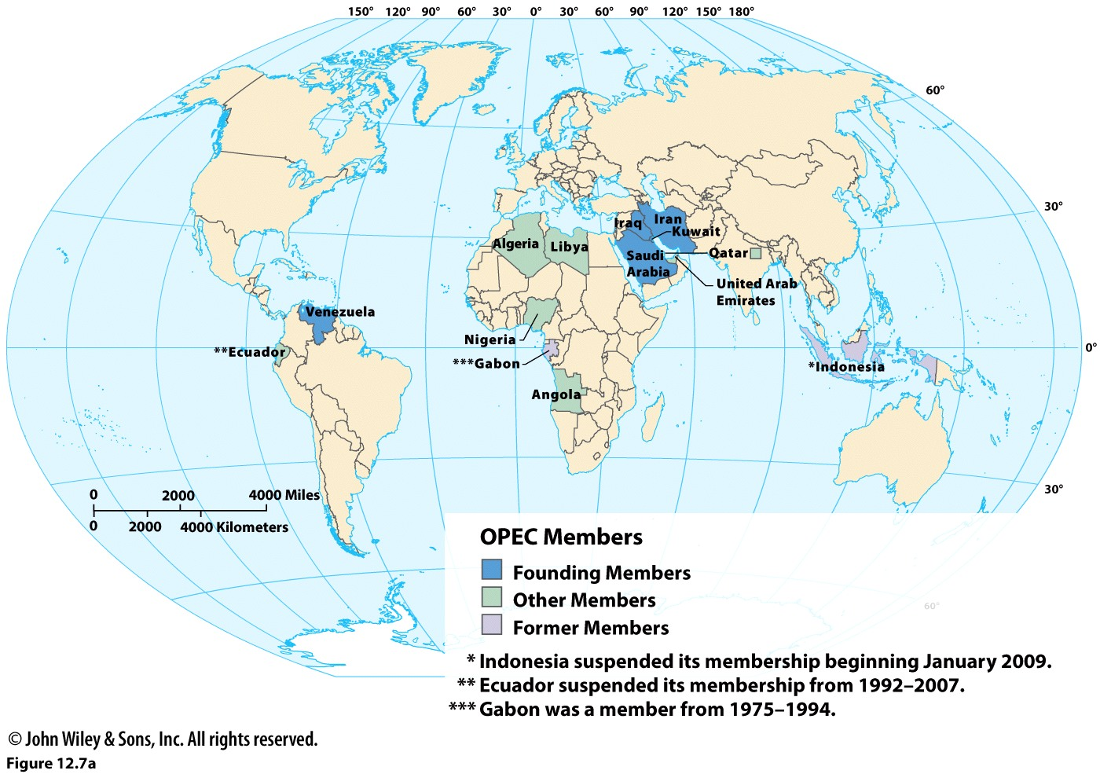
% of global proved reserves by region. The Middle East has by far the largest share of proved oil reserves, but that percentage has declined from over 60% to 48% as proved oil reserves have increased in the Americas.

Slide 10
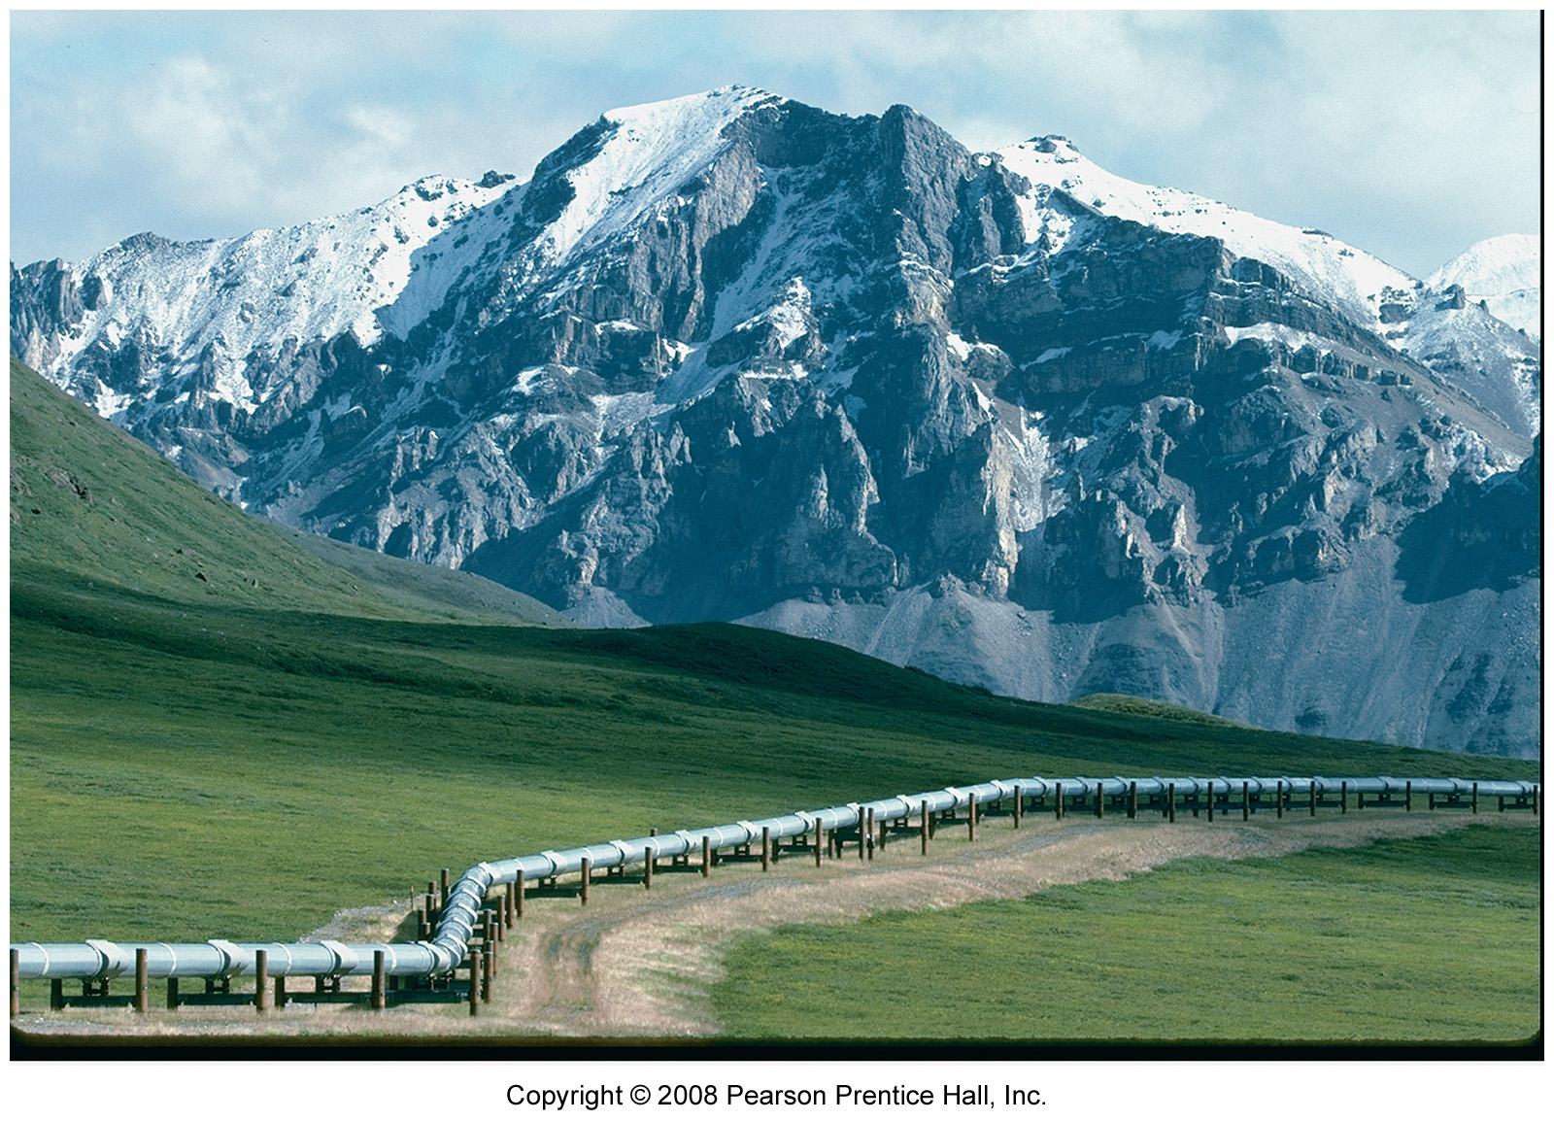
The US does have some of its own oil reserves and Alaska is one such place. However, the extraction of this oil is controversial as it will require ever extensive intrusion into wildlife areas. Below is the Alaskan pipeline that brings oil from Alaska into the United States.
OPEC produces about 43% of the world’s oil; however, analysts predict OPEC’s share of global production to approach 50% by 2030.

Slide 11
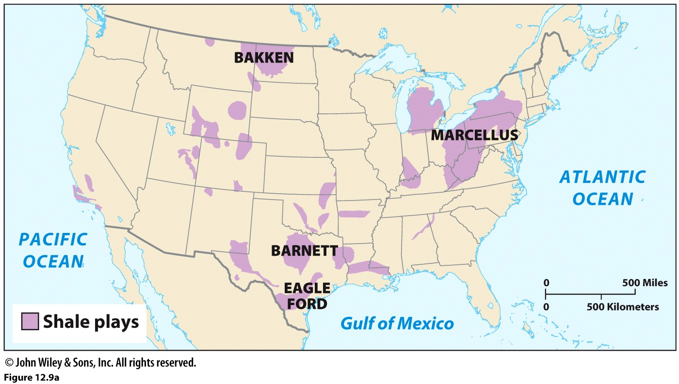
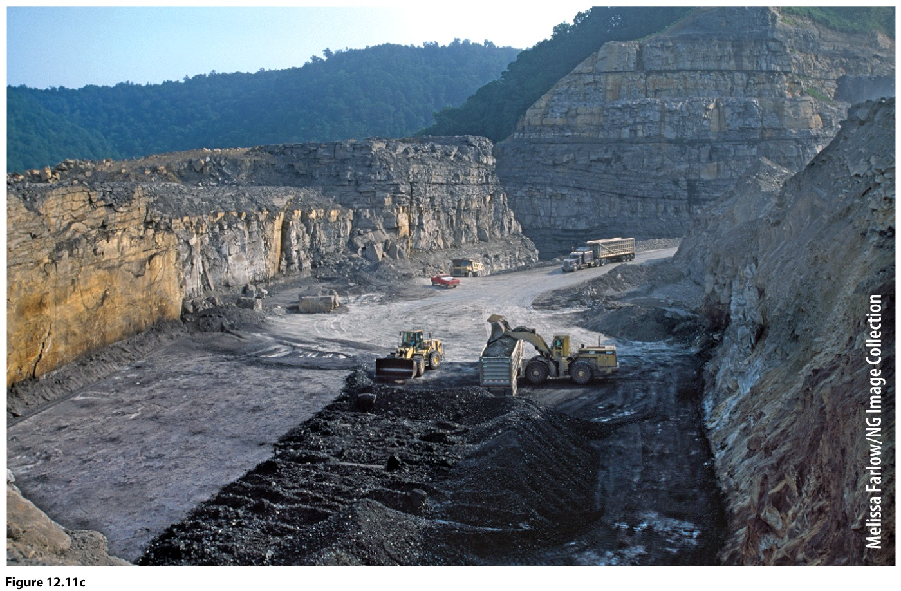
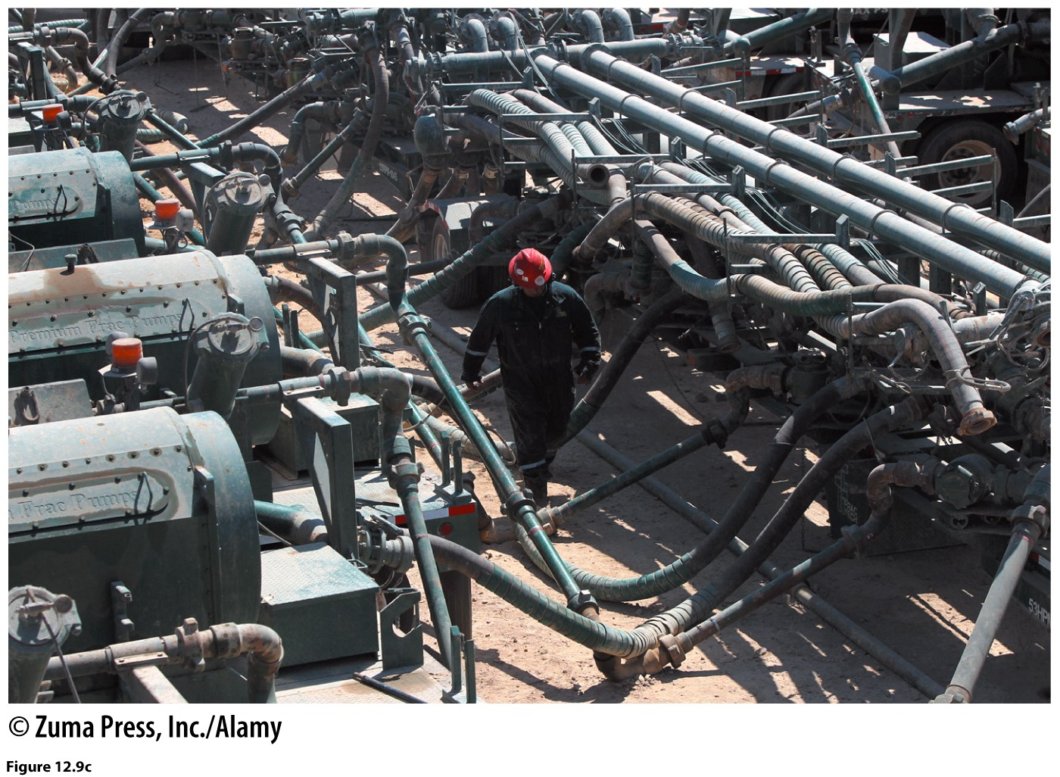
Other Fossil Fuel Sources
Shale, tar sands
Coal
Frack pumps. Pressurized to inject water and chemicals into bedrock.
MTR. Destructive landscape change. Alters watersheds.

Slide 12
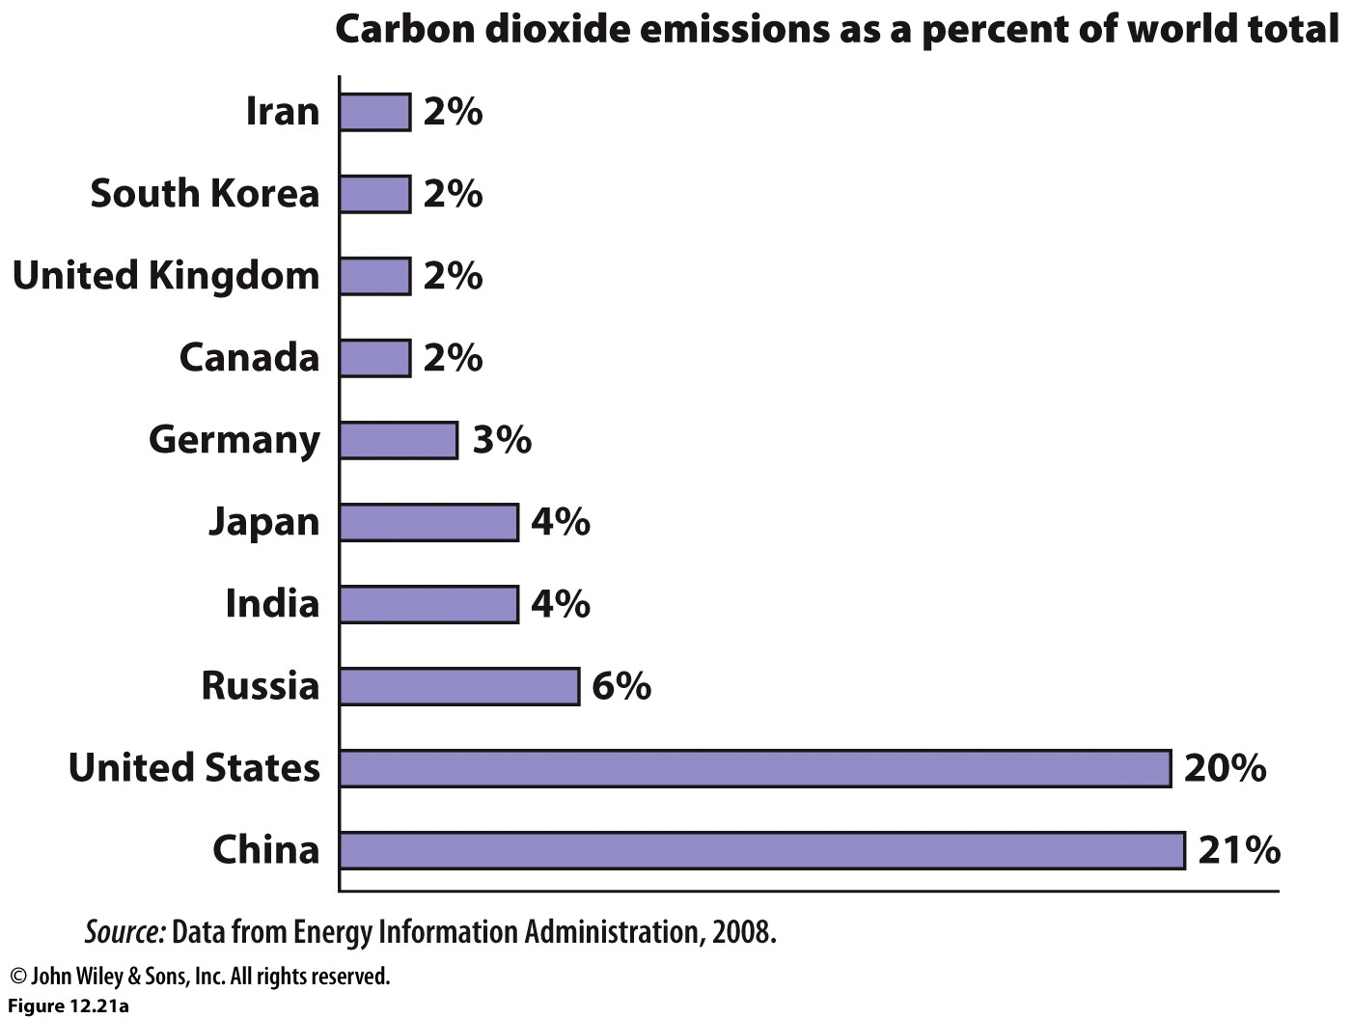
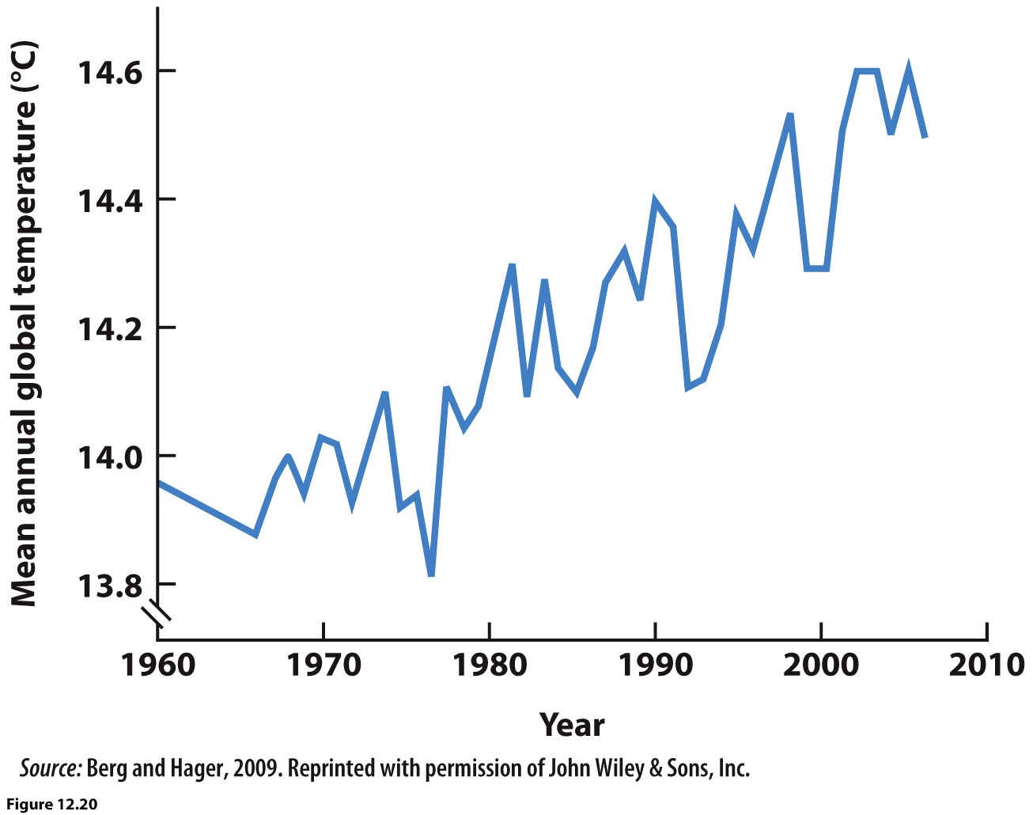
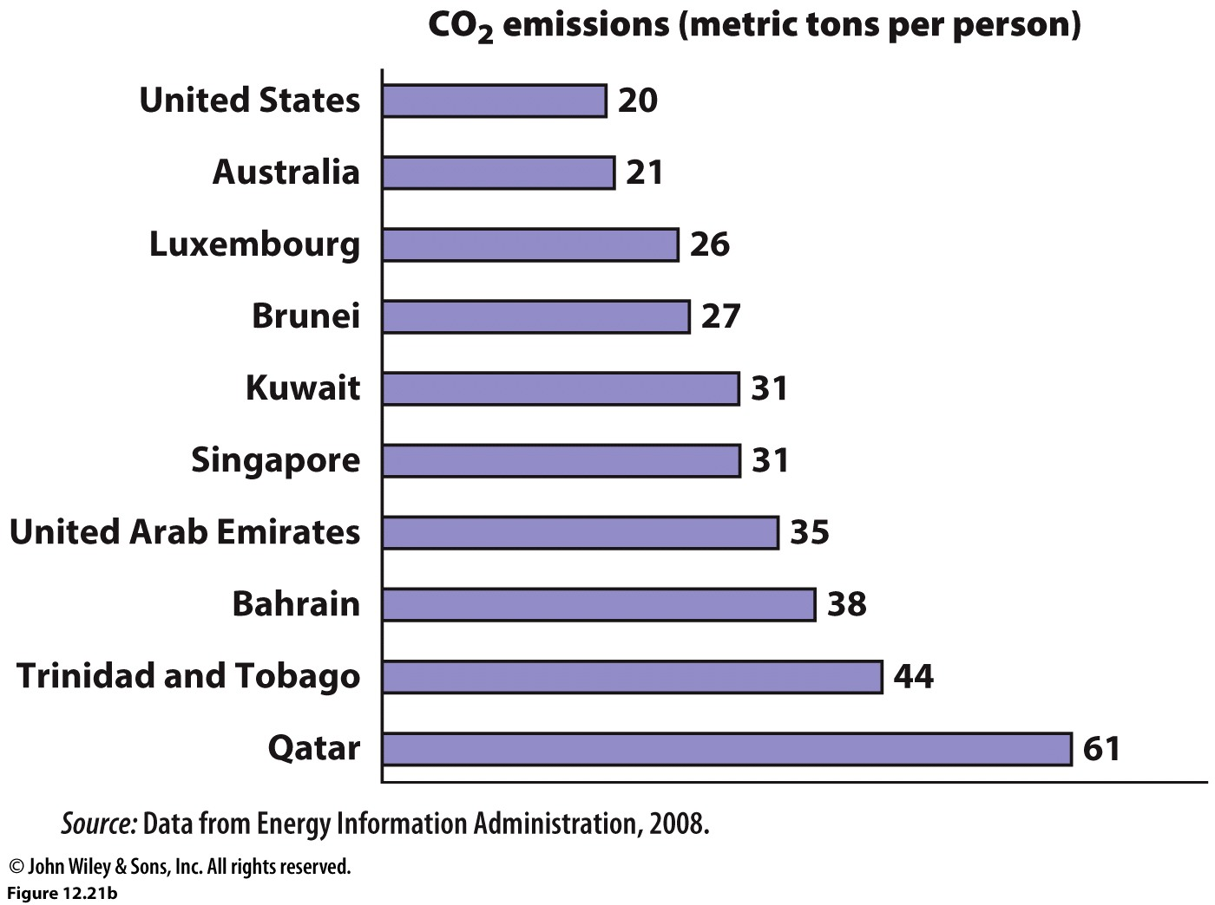
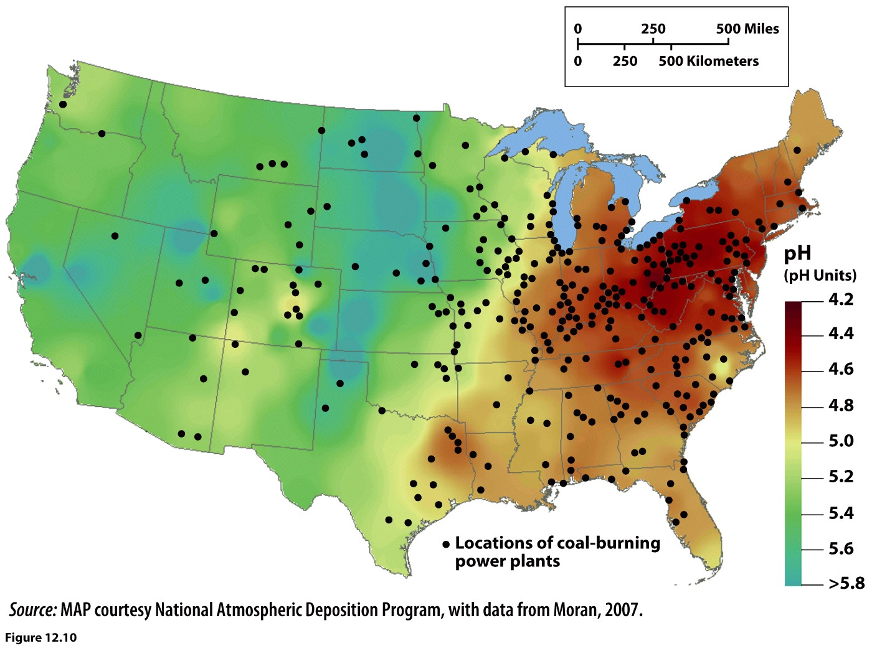
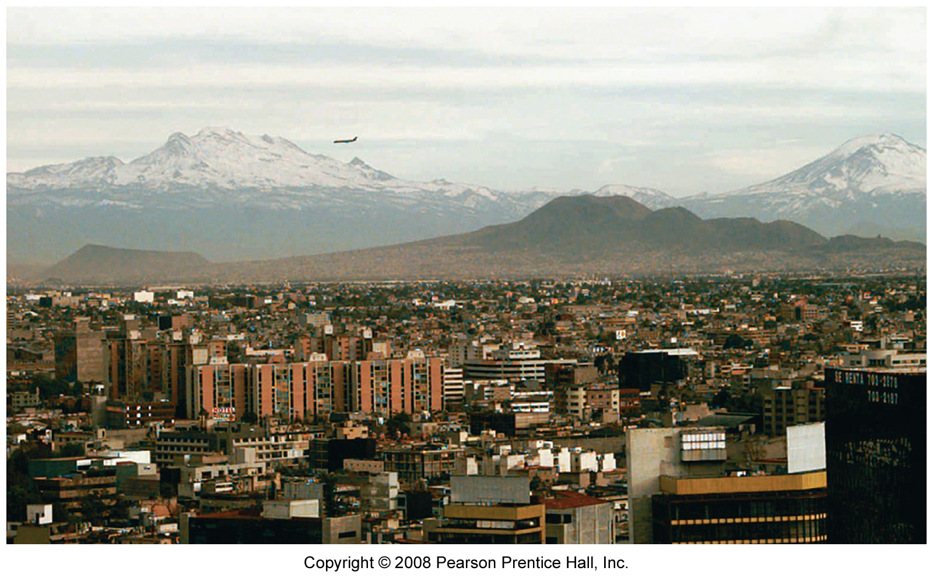
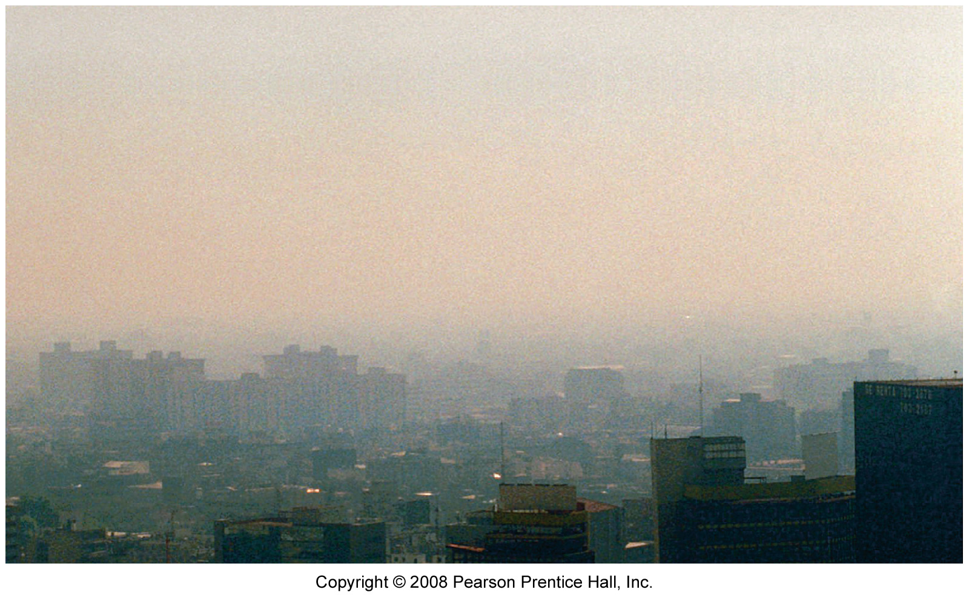
Environmental Impacts
The four most important greenhouse gasses, responsible for the warming of global temperatures are: Carbon Dioxide, Nitrous Oxide (also responsible for smog), Methane (from cows, garbage…), and Chloroflourocarbons (CFCs from aerosol cans, refrigerated air). There is direct connection between increased levels of Carbon Dioxide in the earth’s atmosphere and an increase in global temperatures.
The pH measured acidity of rainwater. Values below 7 are acidic, the lower the value the greater the acidity. Unpolluted rainwater is about 5.6.
Global, regional, local
Air pollution
Acid rain
Pollution of soil, groundwater
Global warming, climate change

Slide 13
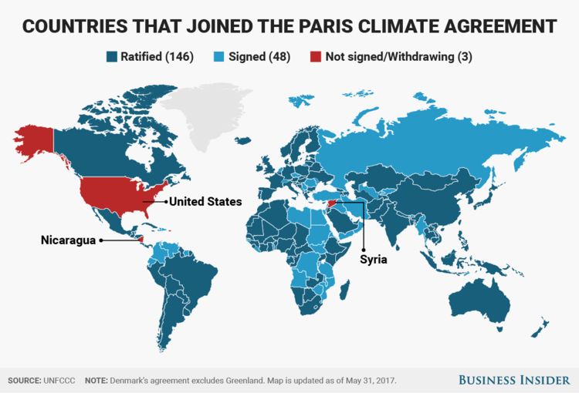
International Efforts
Earth Summit
1992 Rio de Janeiro
Global Warming Accord
Biodiversity Accord
Kyoto, Japan
Kyoto Protocol
Paris Climate Accord

Slide 14
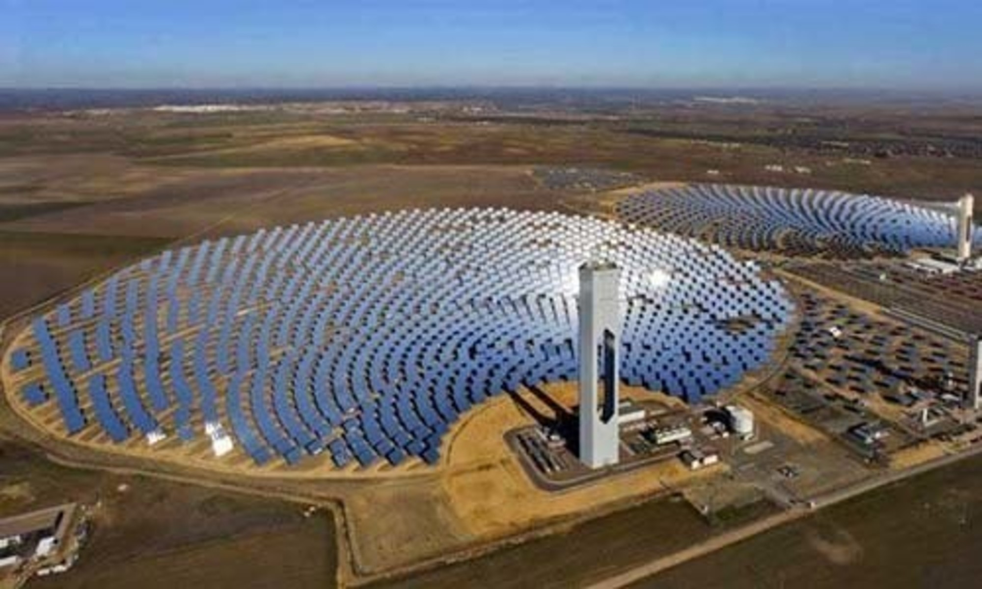
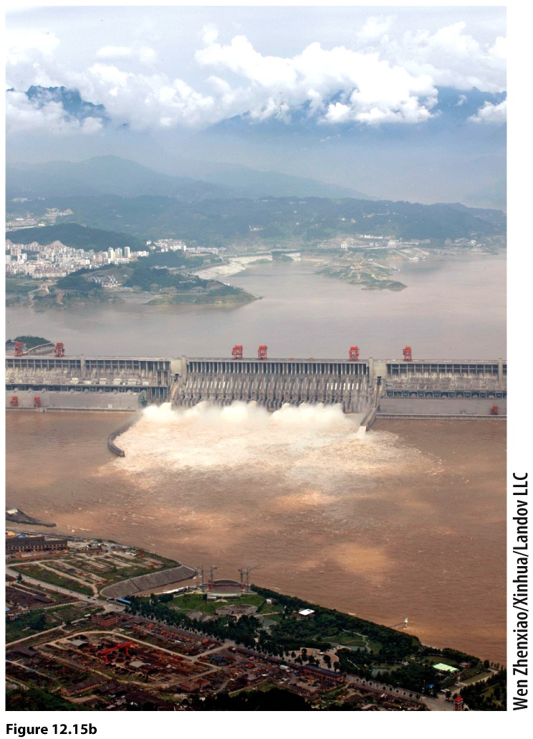
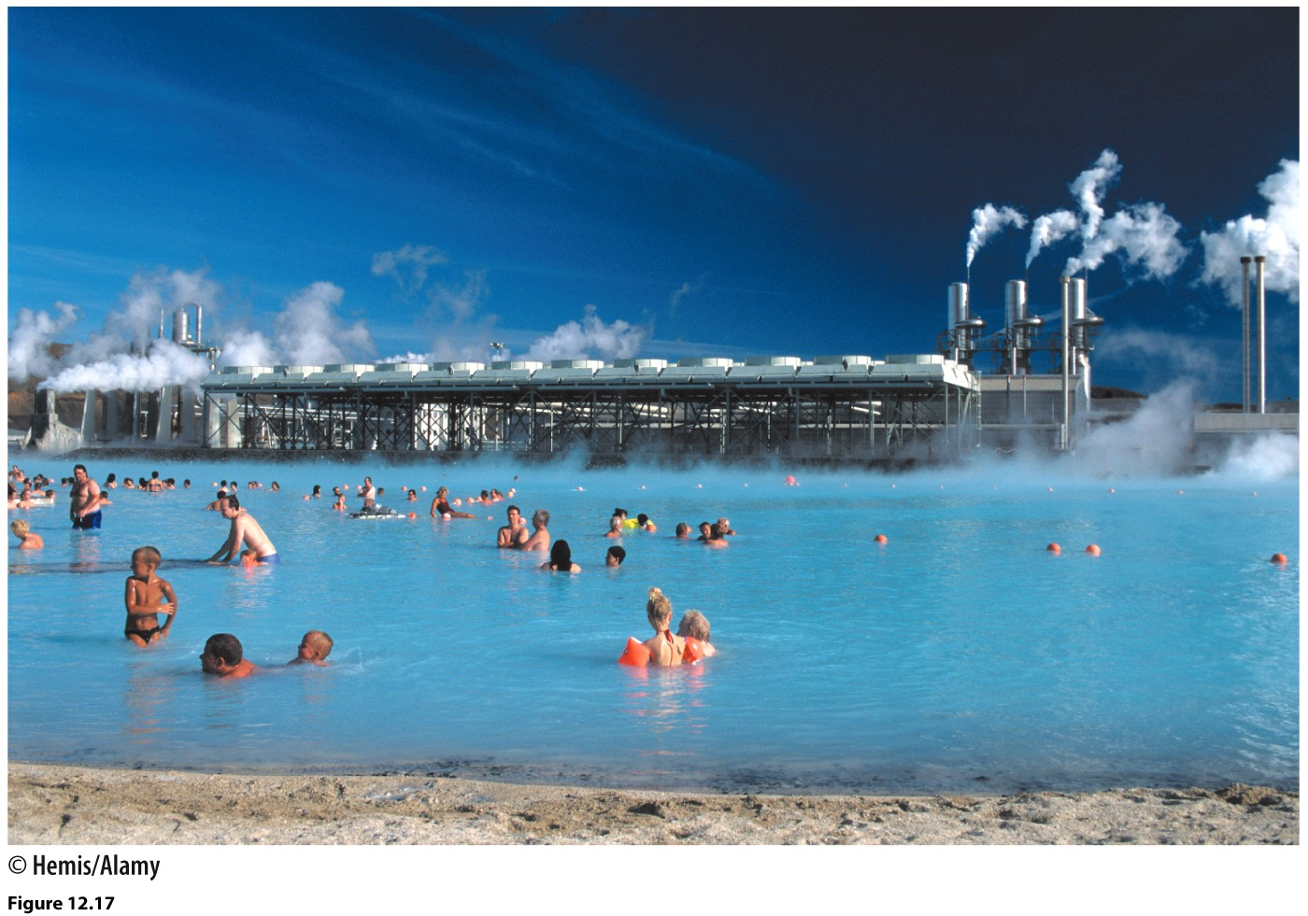
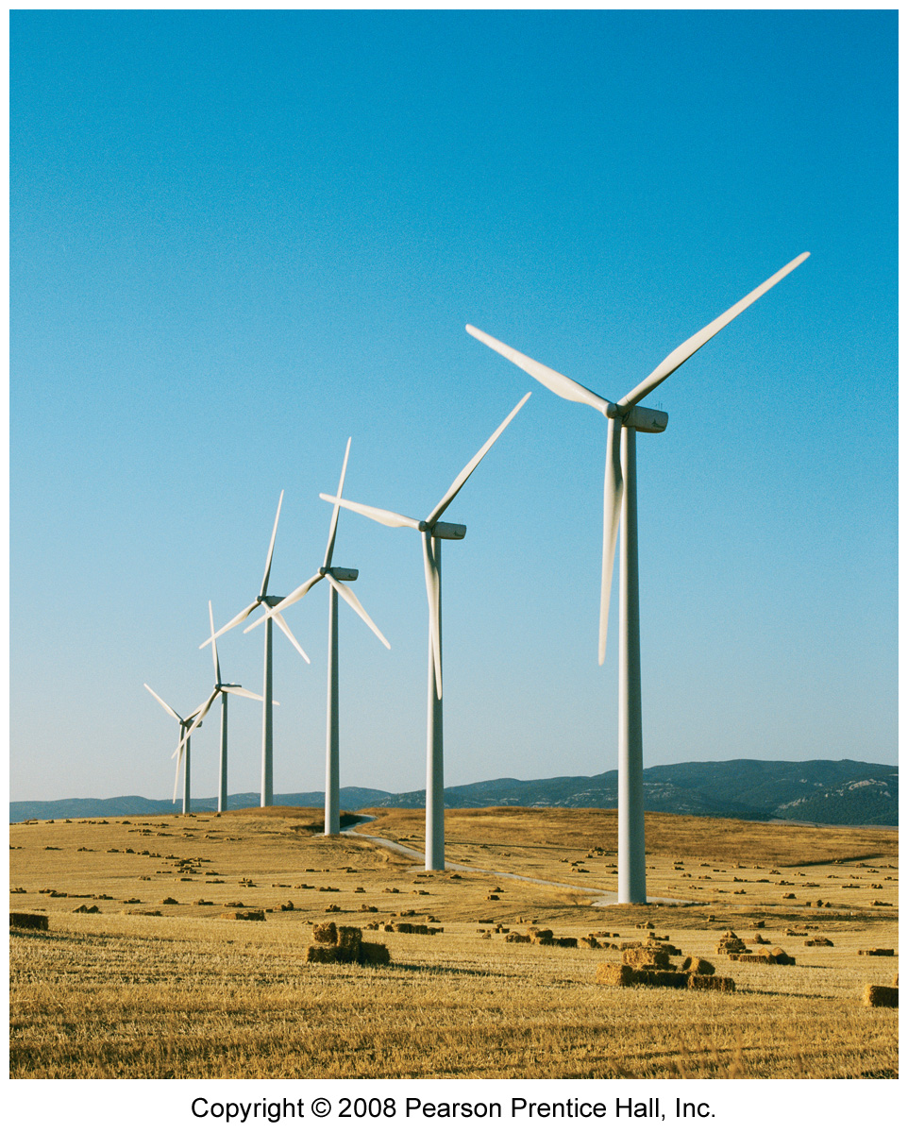
Solutions?
Renewable energy resources
Solar
Wind
Geothermal
Hydropower

Slide 15
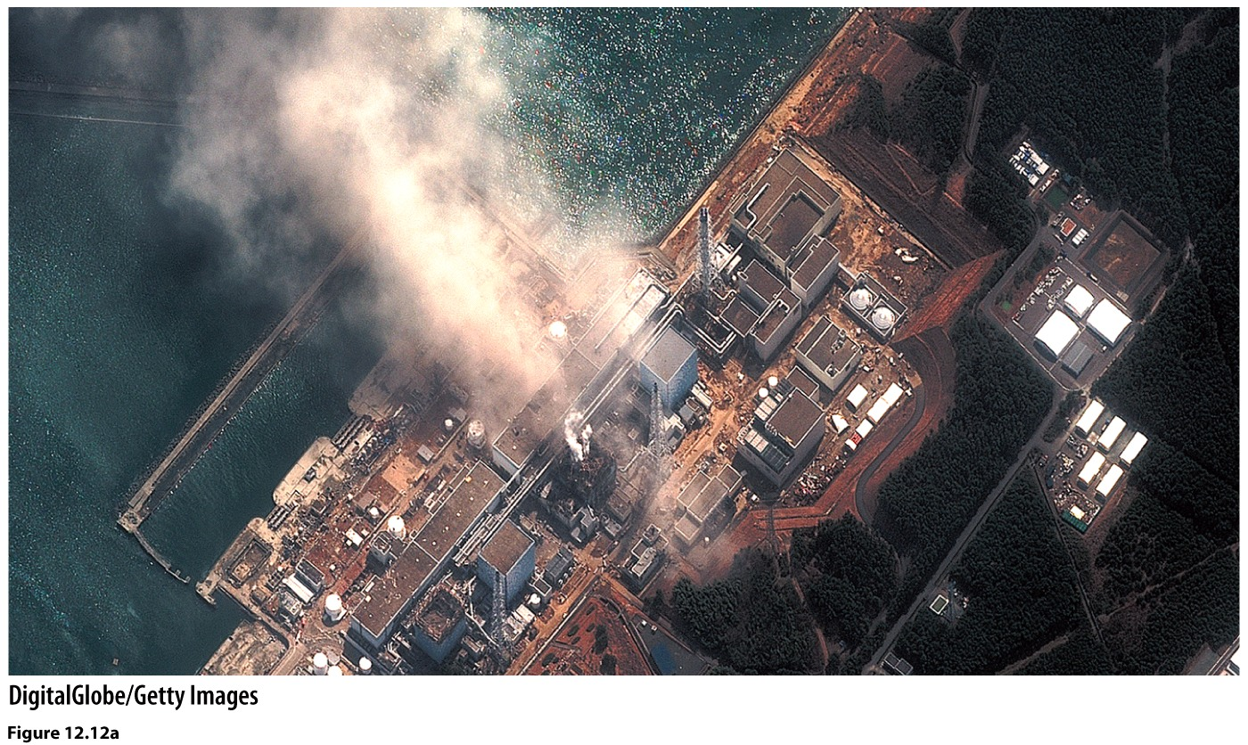
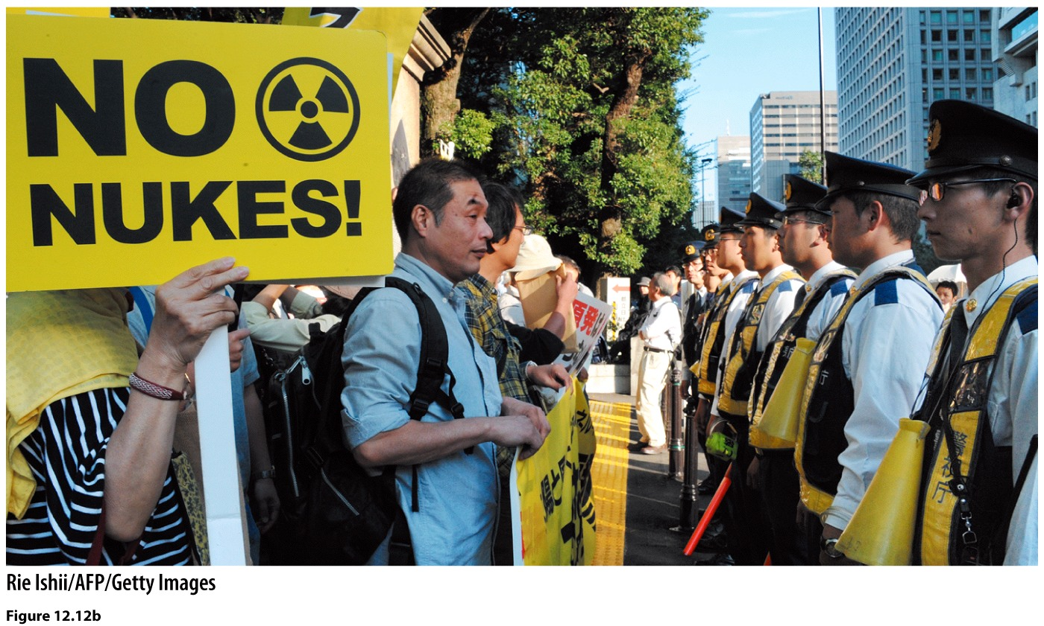
Nuclear?
Pros
Can produce a lot of energy
No carbon emissions
Cons
Radioactive waste
Potential to weaponize
Expensive to start
Accidents
Explosion at the Fukushima Daiichi nuclear power plant. The plant had been built to withstand a tsunami about 20’ high, but not a nearly 50’ high one like that which struck the facility.

Slide 16
Who Uses Nuclear?
Germany 23%
France 53%
UK 12.3%
Italy 0%
Spain 7.6%
Sweden 25%
Norway 0%
Iceland 0%, hydroelectric 72.9%
Bulgaria 20.3%
source: CIA World Factbook, 2013
Stewart Brand on Nuclear
James Hansen on Nuclear
James Hansen’s global warming predictions

Slide 17
Biodiesel
2007 George W. Bush pledges “energy independence”
Pours money to developing biofuels
Base of biofuels corn AND palm oil
Palm oil is the leading cause of tropical deforestation in Southeast Asia
Removal of Southeast Asian rainforest is adding even more carbon to atmosphere.
The problem with palm oil

Slide 18
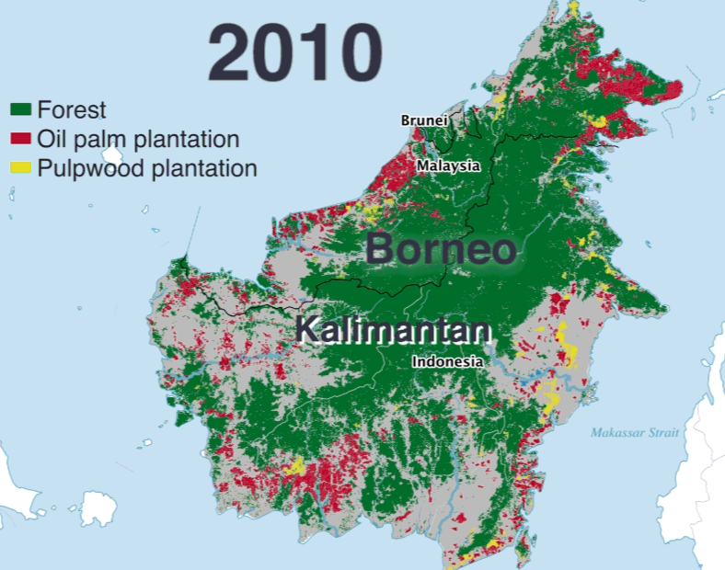
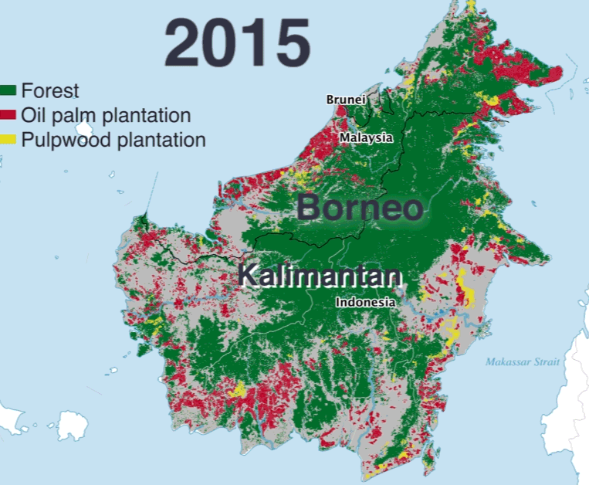
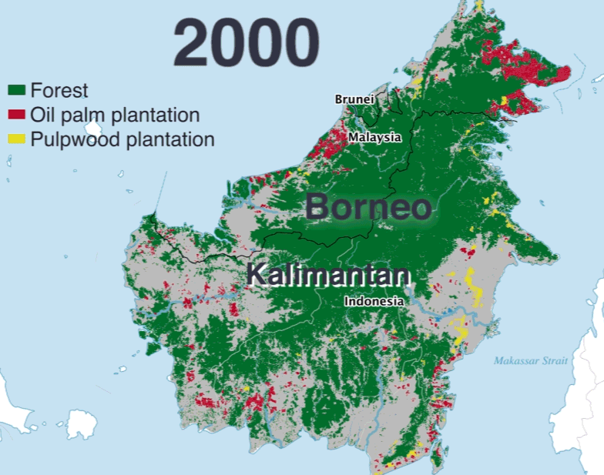
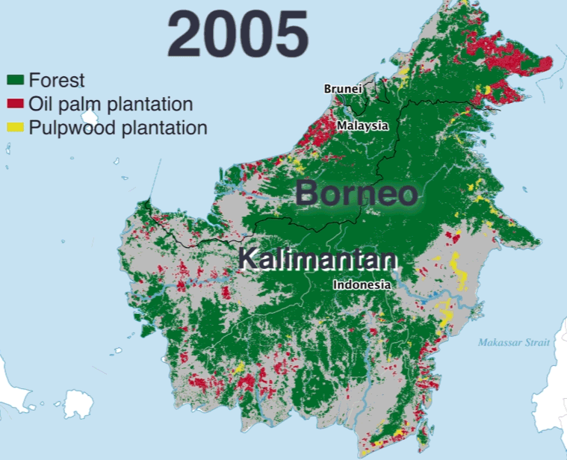
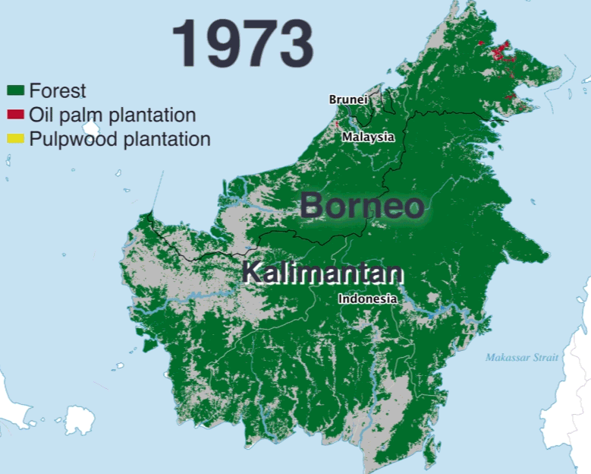
Borneo’s Disappearing Forest
Source:
https://www.pri.org/stories/2016-12-30/indonesia-s-rapidly-disappearing-forests-four-charts
PRI’s The World, 12/ 2016

