Slide 1
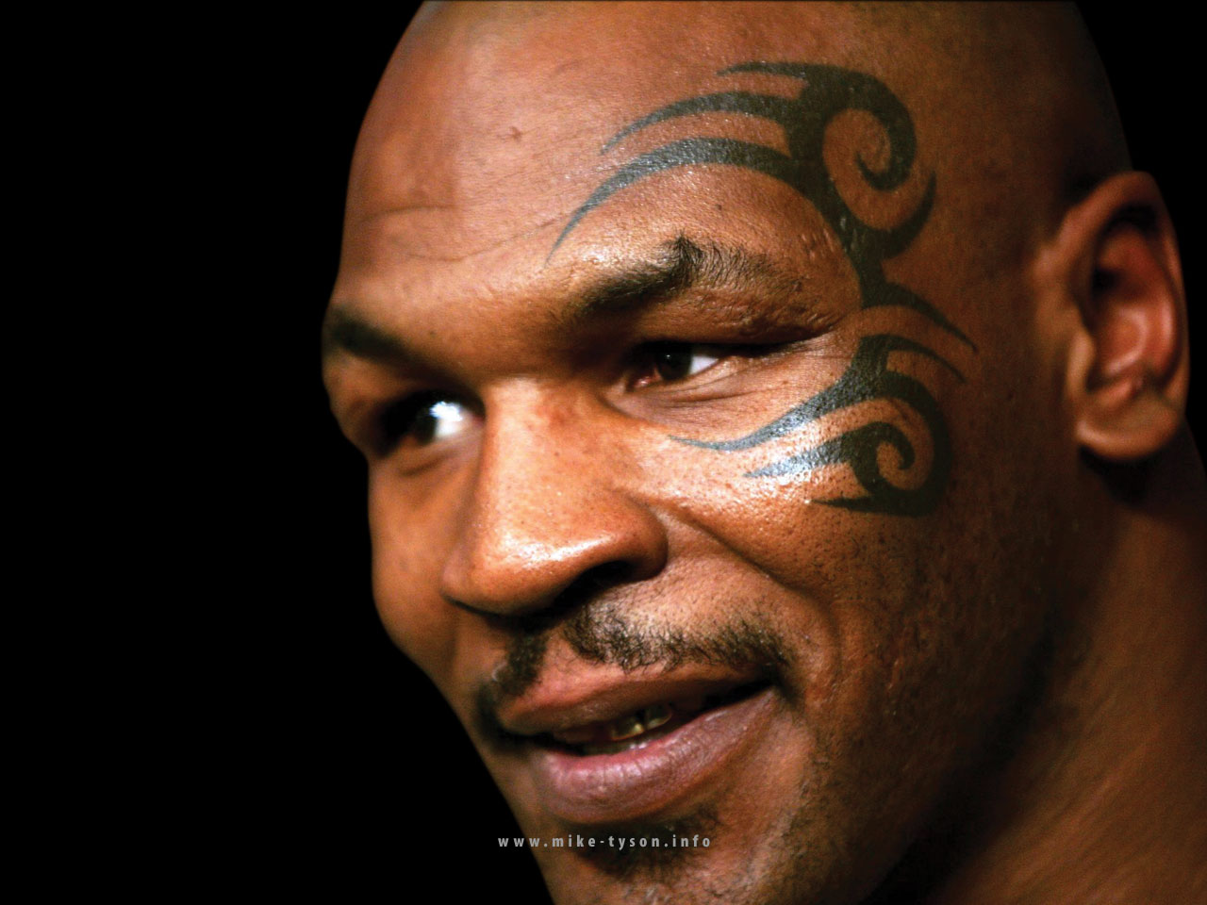
Chapter 2: Globalization & Culture

Slide 2
What is Globalization?
Economic, social, political
Horizontal and vertical expansion
Is a cause and an effect of spatial interaction
Five factors
Global markets
Technology
Lower costs
Mobility of capital
Policy

Slide 3
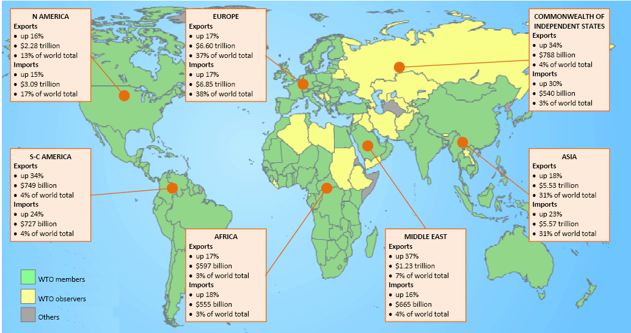
Membership in the WTO, World Trade Organization
Source: wto.org

Slide 4
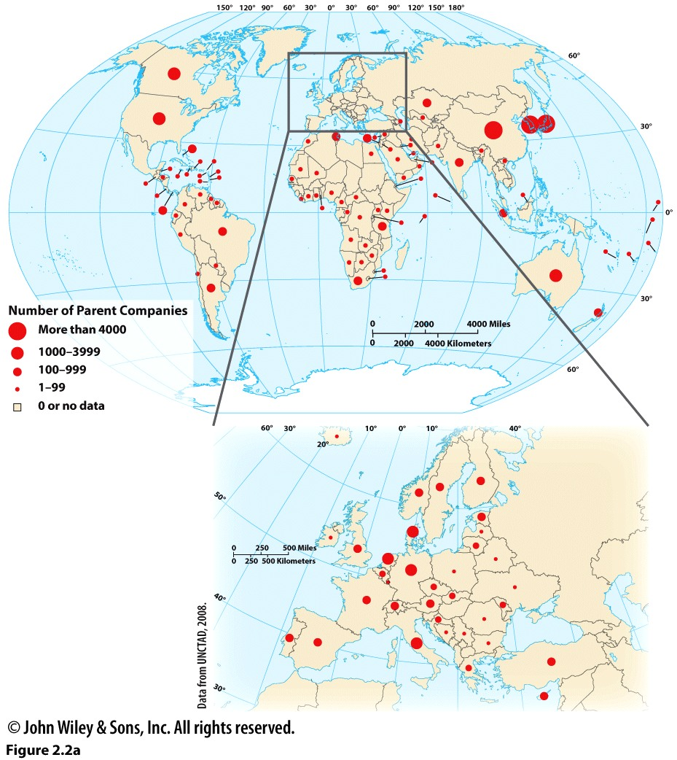
The Global Flow of Capital
MNCs/TNCs
FDI
Today:
82,000 MNCs with 810,000 foreign
affiliates
1990s:
37,000 MNCs with 170,000 foreign
affiliates

Slide 5
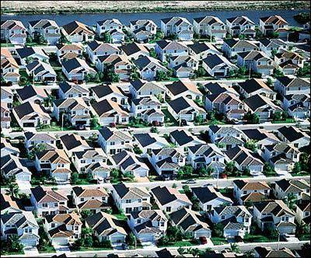
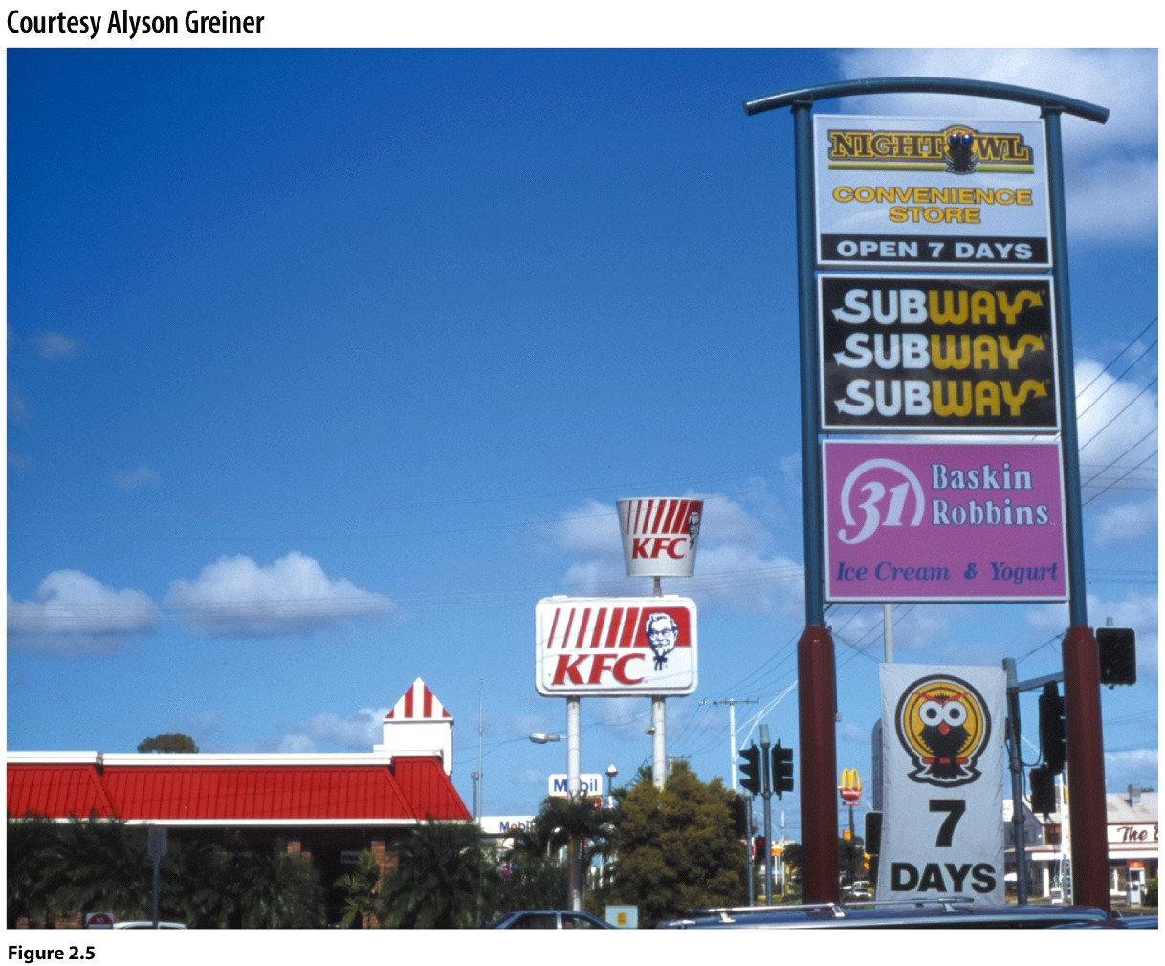
Impacts of Globalization on Culture
Homogenization—The Geography of Nowhere
Placelessness—Edward Relph

Slide 6
Homogenization due to Americanization
Americanization a function of global capitalism and American economic dominance
Spread of values too?
McDonaldization: spread of American fast food as a standard for how the world eats.
Television, entertainment
Clothing
Coca-Colonization
Global capitalism re-establishing colonial relationships
MNCs create a hegemony with inherent power relations
MNCs benefit from their global spread, not the individual countries

Slide 7
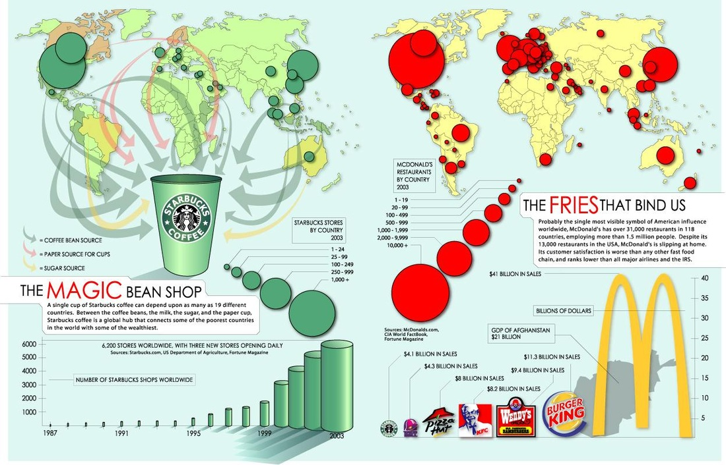

Slide 8
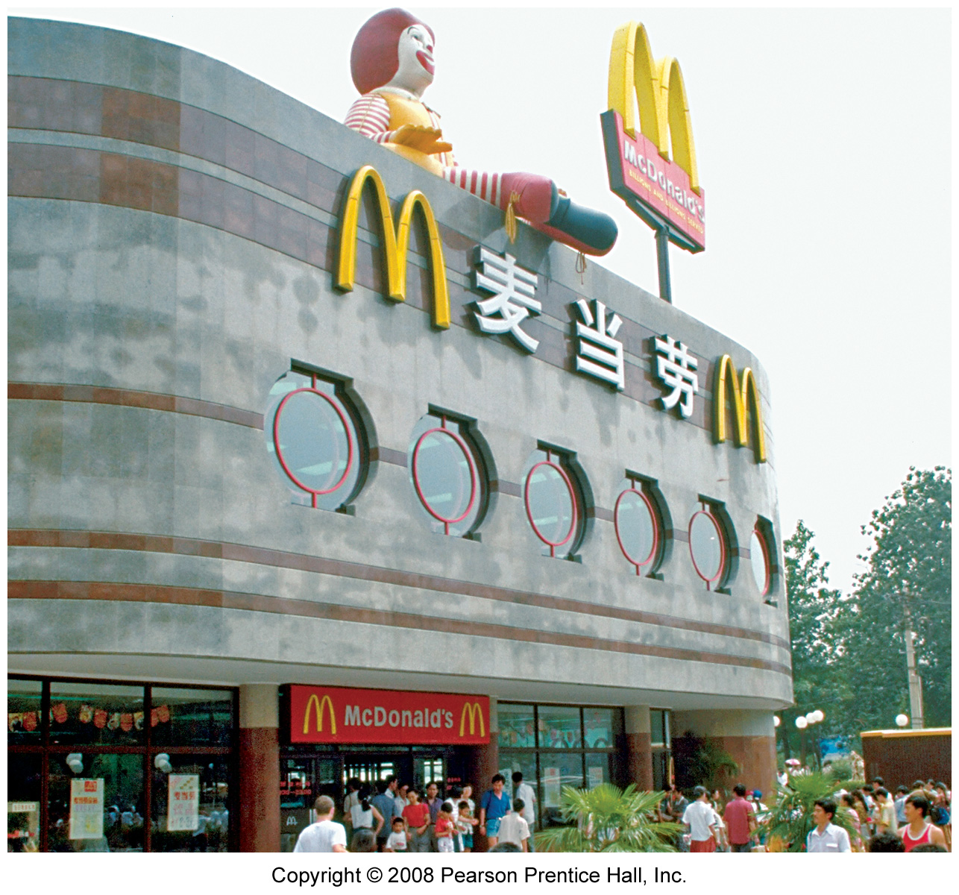

Slide 9
Polarization
Globalization has destabilized societies
Backlash to the homogenization
Rise of ethnic separatism, battles over identity
Dangerous—global terrorism, criminal networks
Criticism of Polarization & Homogenization Theories
Is uniformity inevitable?
Is it really this simple?
Neolocalism—renewed local awareness
Flow of ideas and practices is not unilateral

Slide 10
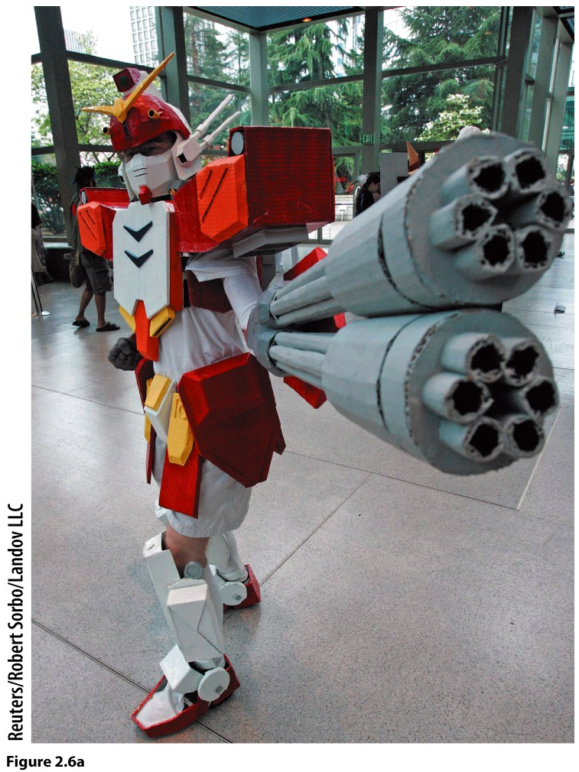
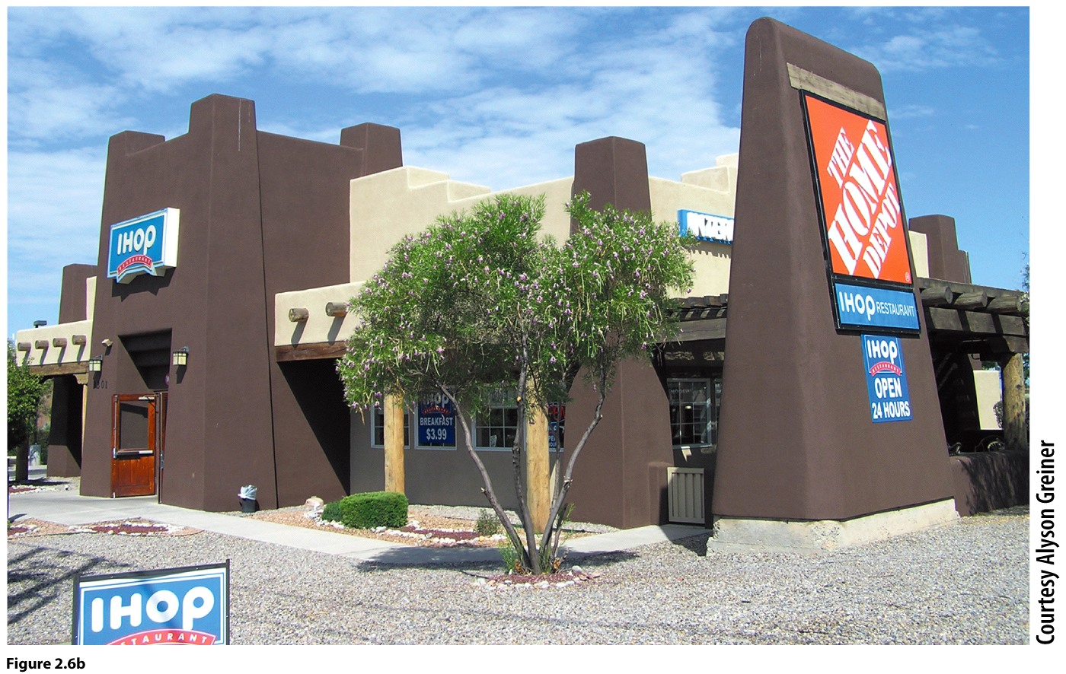
Flow is not always from the U.S. to other countries. The popularity of Japanese anime in North America,
Europe and Australia is evidence of this.
Resisting homogeneity—local
ordinances require buildings
to conform with local aesthetics
in Santa Fe, NM

Slide 11
Glocalization
The local-global nexus
Both are changed
Dynamic nature of local and global relations
Local forces become globalized & global forces become localized!
True heterogeneity or disguise for business as usual?

Slide 12
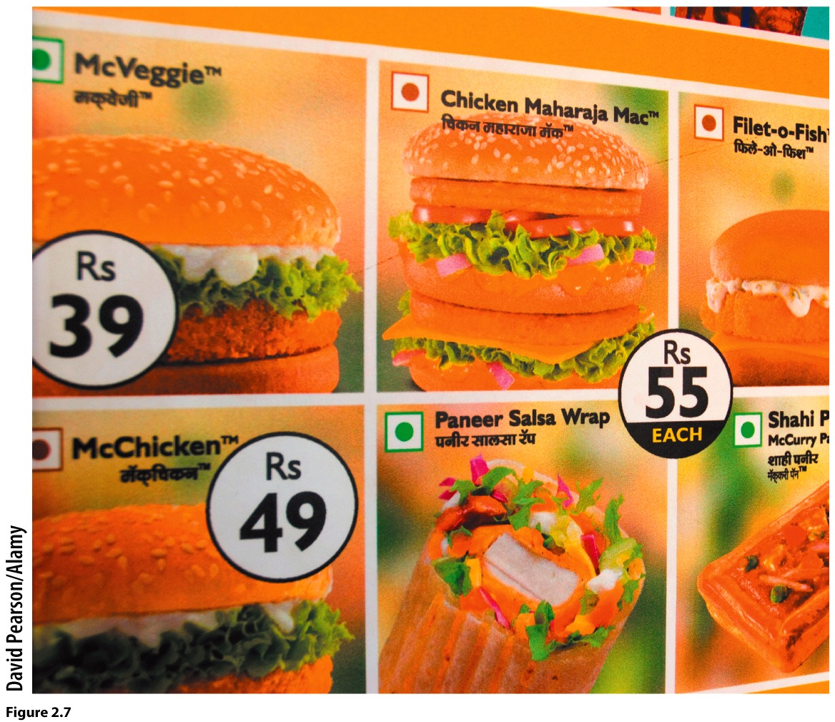

Slide 13
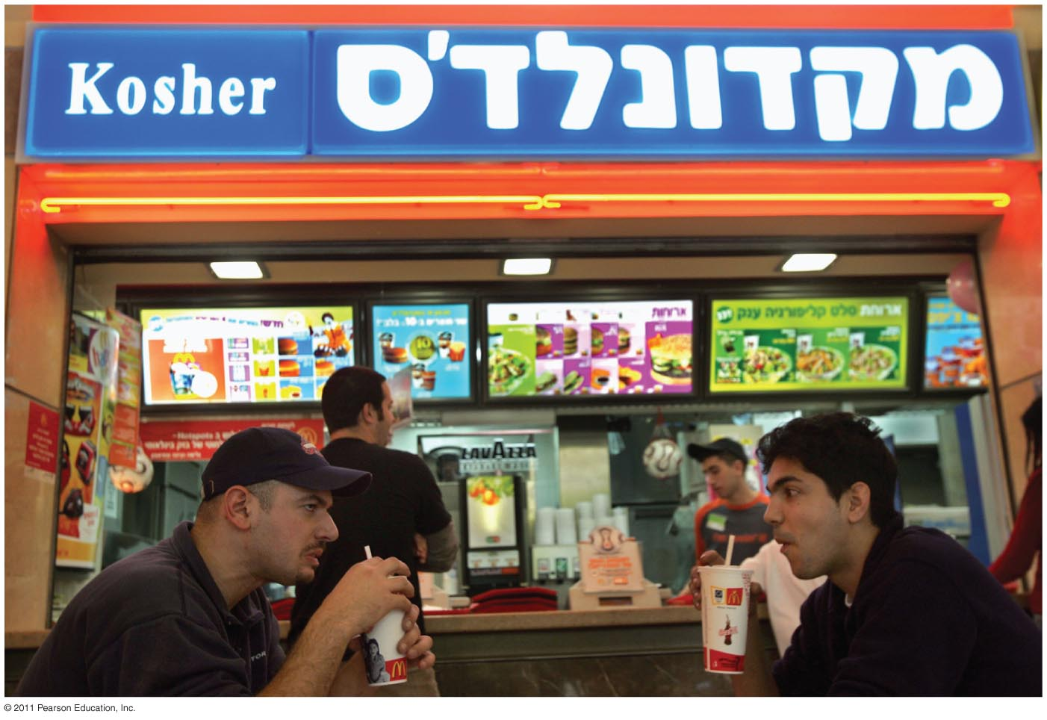

Slide 14
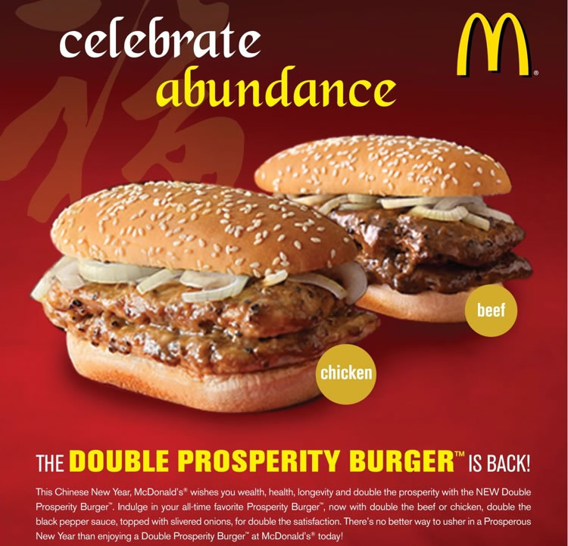

Slide 15
Commodification of Culture
What processes define cultural preferences?
Who owns culture? How is culture connected to identity?

Slide 16
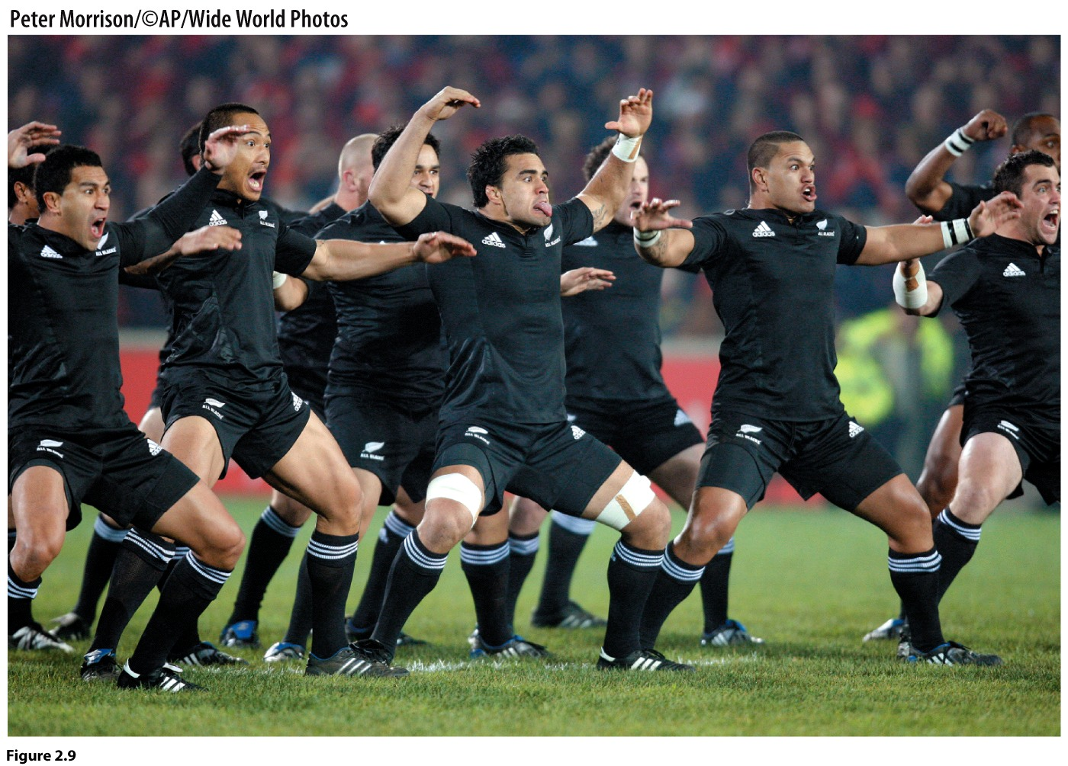
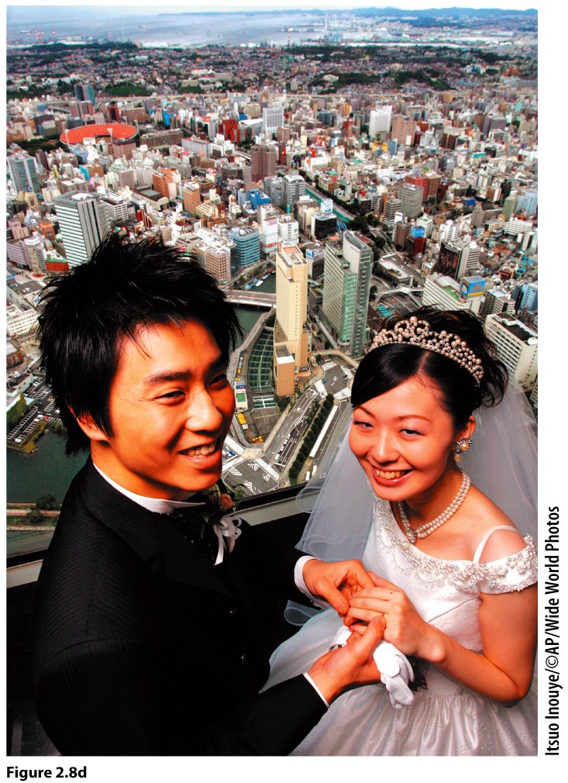
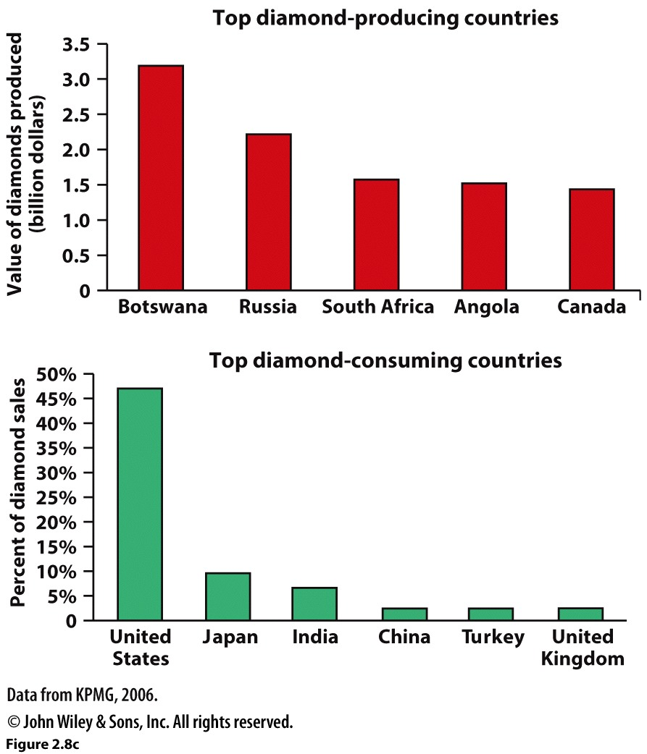

Slide 17
Commodification of the past: heritage industry
Dissonance—inconsistent
Generates conflict, contestation
Opposing uses of heritage (sacred site vs. tourism)
Particularism – whose heritage?

Slide 18
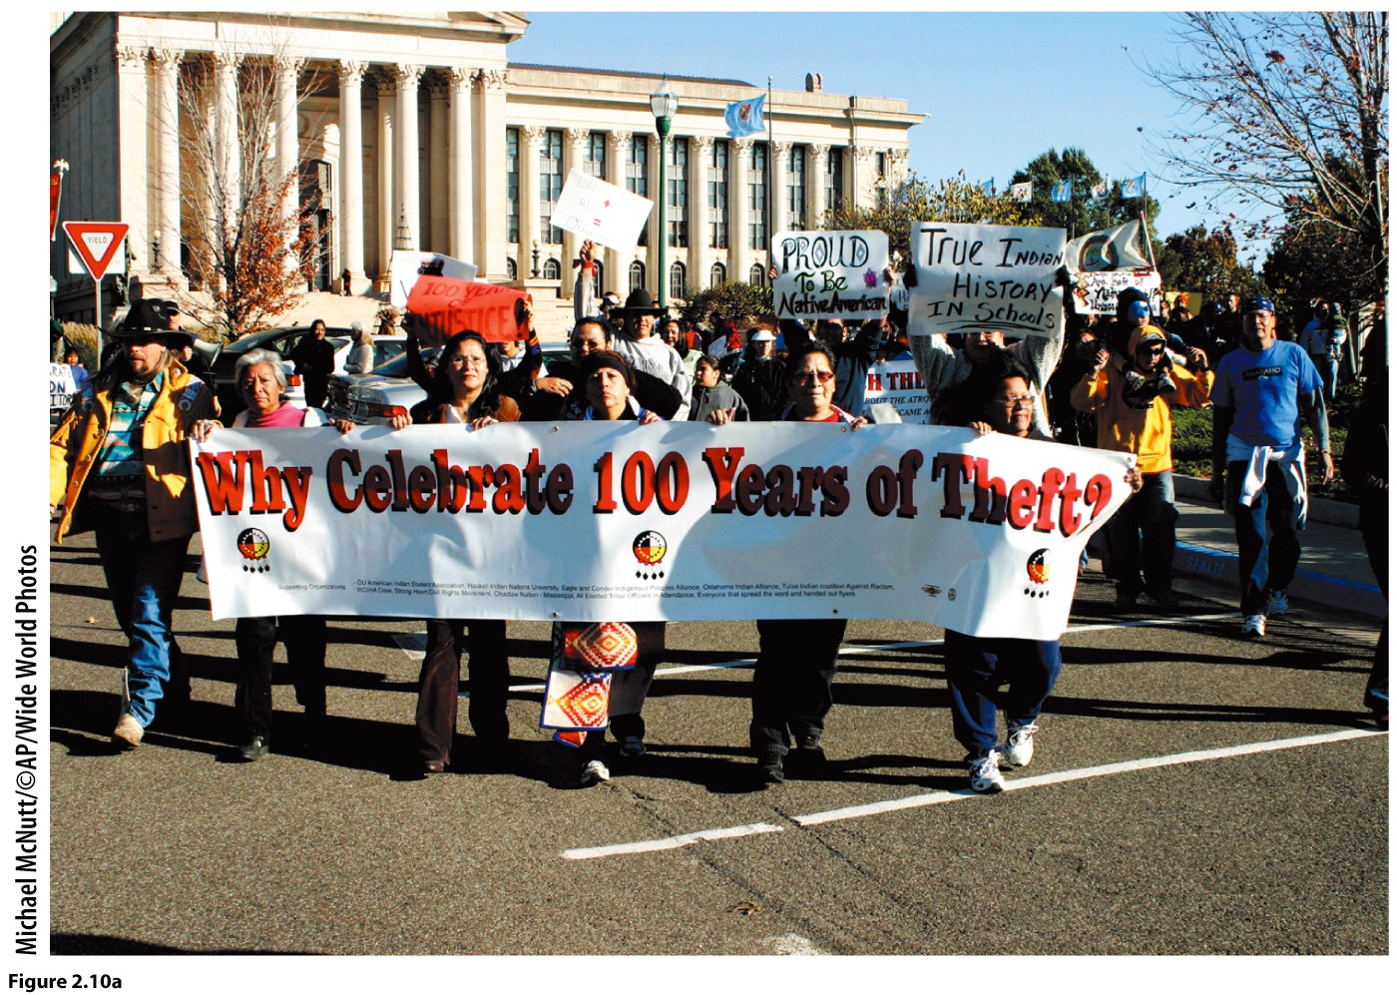
Native Americans protest at
the 100 year celebration of
Oklahoma statehood (2007).
Is there a Global Heritage? UNESCO World Heritage List

