Slide 1
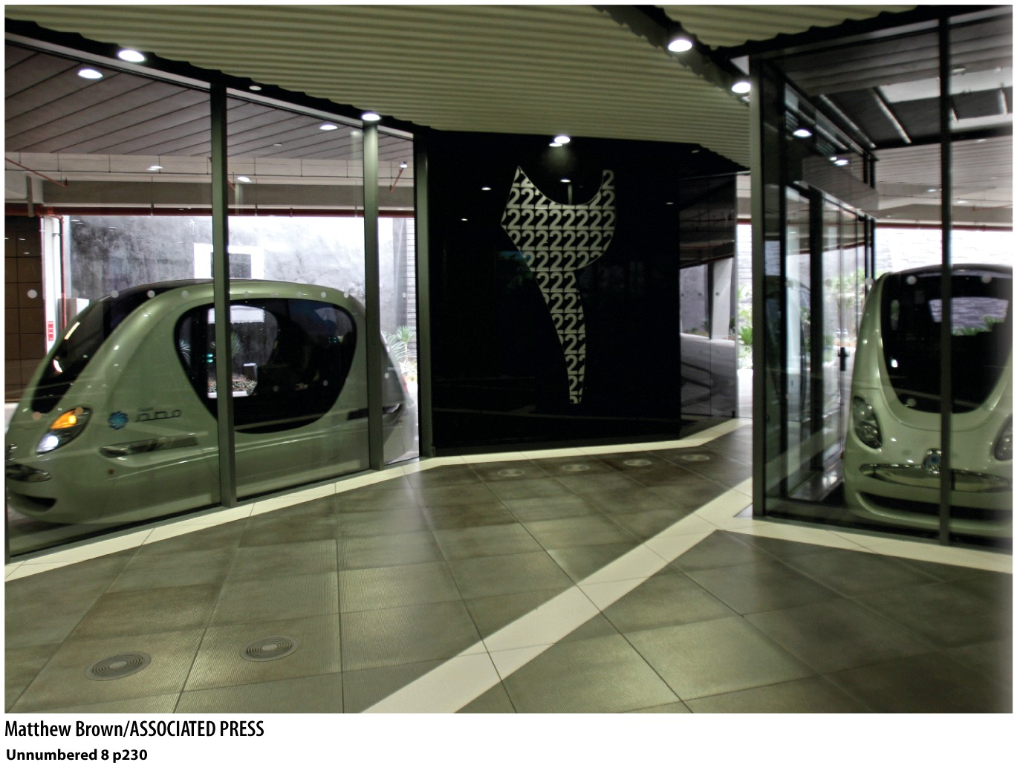
Chapter 8: Urban Geographies
Masadar City, U.A.E.
The sustainable city of the future?

Slide 2
“The only consistent thing about cities is that they are always changing.”
Tim Hall
“The mortality of persons contrasts sharply with the immortality of cities.”
James Vance

Slide 3
What are cities?
Cities have existed for almost 10,000 years.
The six characteristics of cities.
Dense concentrations of people
Functional complexity (unlike rural areas)
Centers of power—business, government, cultural
Dynamic, complex land-use patterns
Linked (via trade, transportation…)
Full of contradictions

Slide 4
No international standard of how many people make a “city”
US Census Bureau says 2500 or more, density of at least 1000/sq mile
Now use the term “urbanized”—50,000+ people

Slide 5
What are suburbs?
Should they be included in city numbers?
Should Pasadena, sitting next to Los Angeles, be included as part of the city of LA?
Consider suburbs and cities as functioning as a whole
Census Bureau defines these as MSA, Metropolitan Statistical Areas.

Slide 6
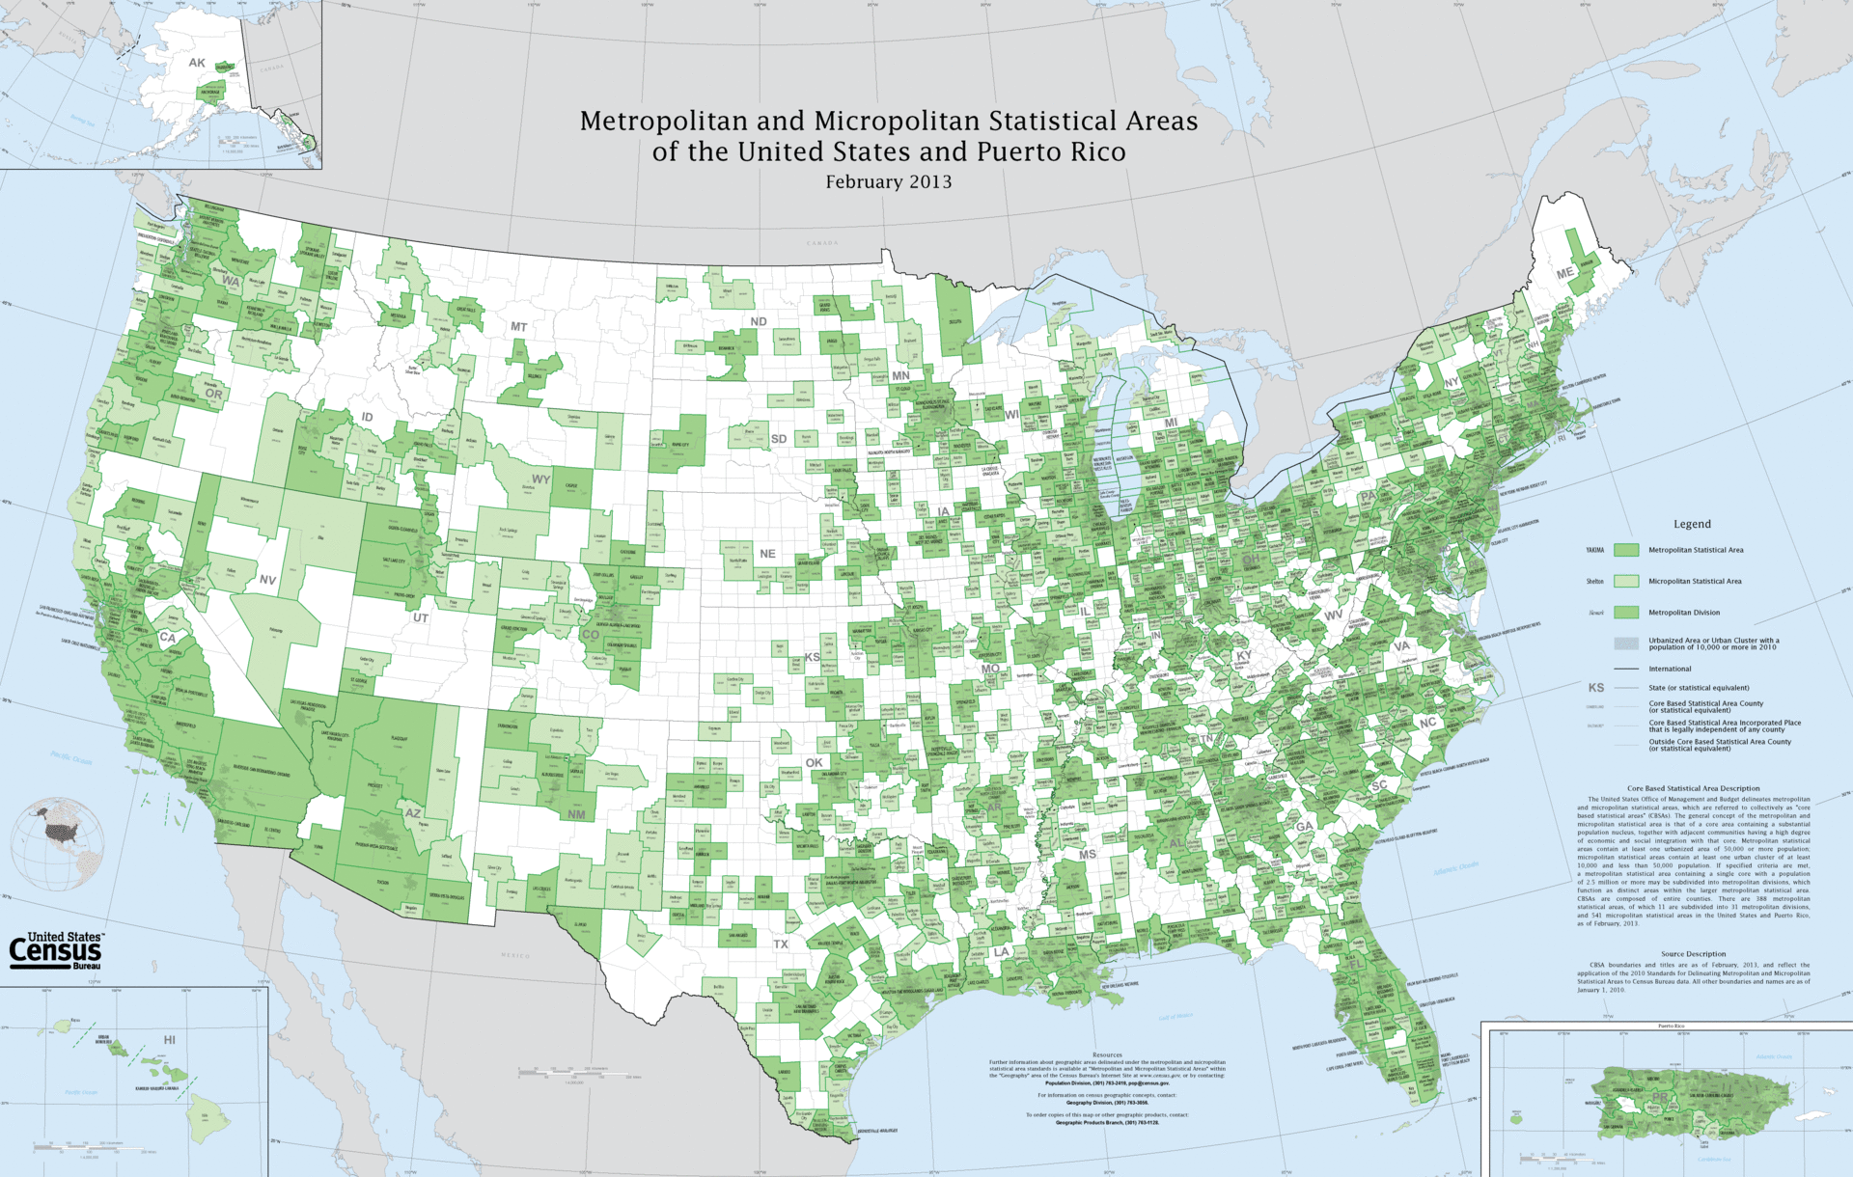
80% of Americans live in an MSA.
Green areas are considered part of an MSA. Remember the cut-off is 50,000 so a large portion of the country falls into an MSA.

Slide 7
Consolidated Statistical Areas
MSAs that are neighbors and function like one giant metropolis
Los Angeles CSA is 2nd largest in US, 18 mill (includes 5 counties).
New York is largest, 22 mill
San Francisco CSA is 6th (includes 10 counties), 7.5mill
Chicago 3rd, Baltimore-Washington 4th, Boston 5th.

Slide 8
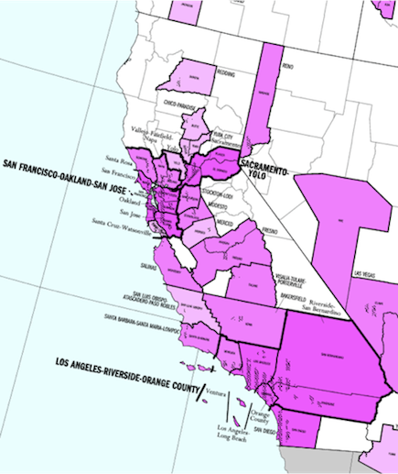

Slide 9
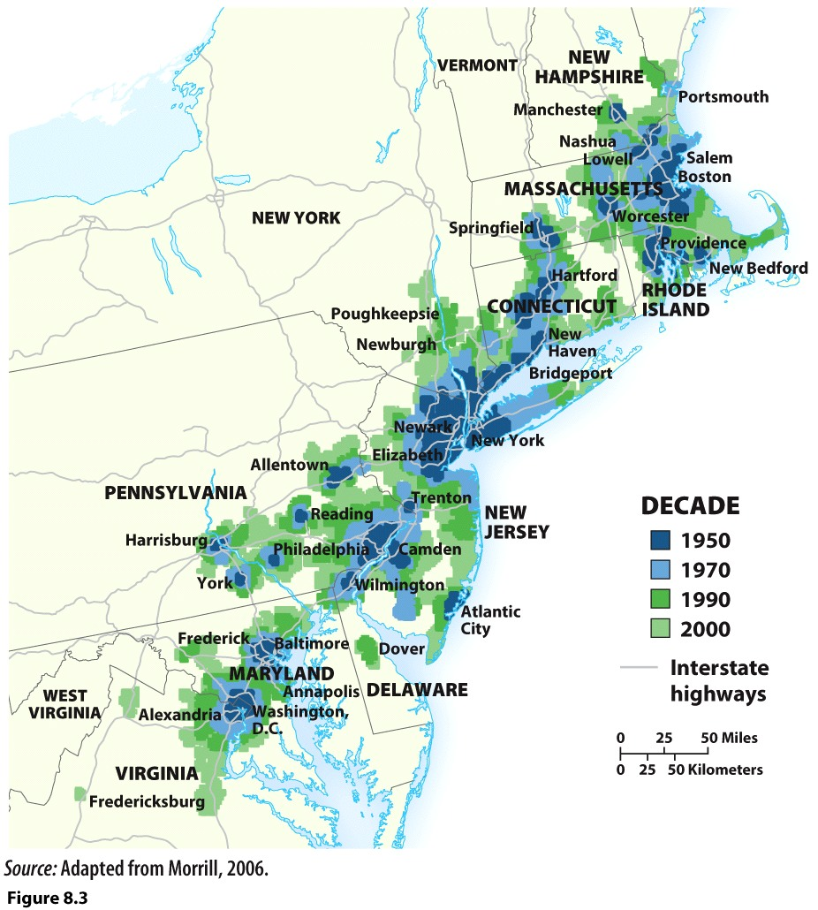
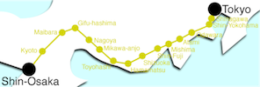
Megalopolis
Conurbation
Jean Gottman
2 or more adjacent metropolitan areas
Urban areas very close, but not contiguous
Labor markets not merged
Cities, towns, urban areas that have merged in to continuous urban area
Polycentric urbanized area with transportation linking the areas to create a single urban labor market
The Tokaido Corridor
The Bos-Wash Corridor

Slide 10
Percent Urban
Rate of Urban Growth
Percent of the country that lives in a city
Country is considered “urbanized” if 50% or more of its population lives in a city.
1900: 13% of world was urban
1950: 29% of world was urban
2005: 50%
By 2050: 70%
In 1970 about 1.4 billion people lived in a city
Today about 3.6 billion people live in a city
Developed countries have highest percent, rapidly losing rural populations
Percent growth (annually)
2-4%=high urban growth
1970-2011 was about 2.4% globally
Currently about 1.8%
Highest urban growth for next 20 years is in developing world’s cities (about 2%)
Higher RNIs
Larger volumes of rural people

Slide 11
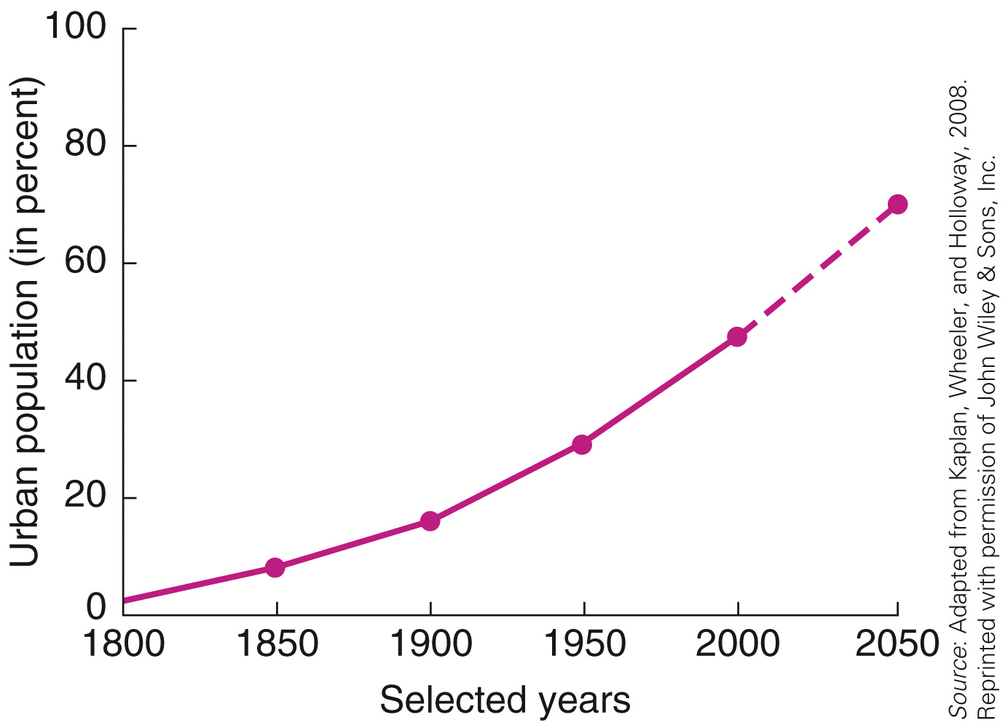

Slide 12
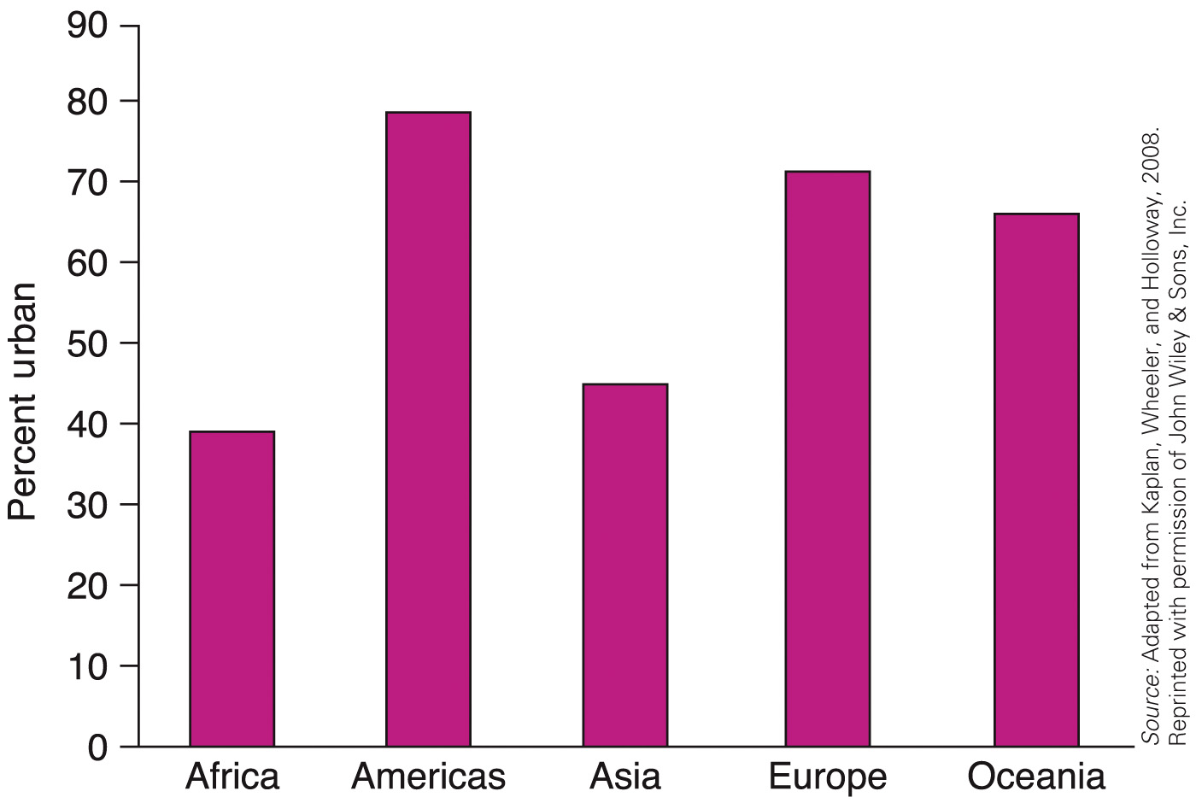

Slide 13
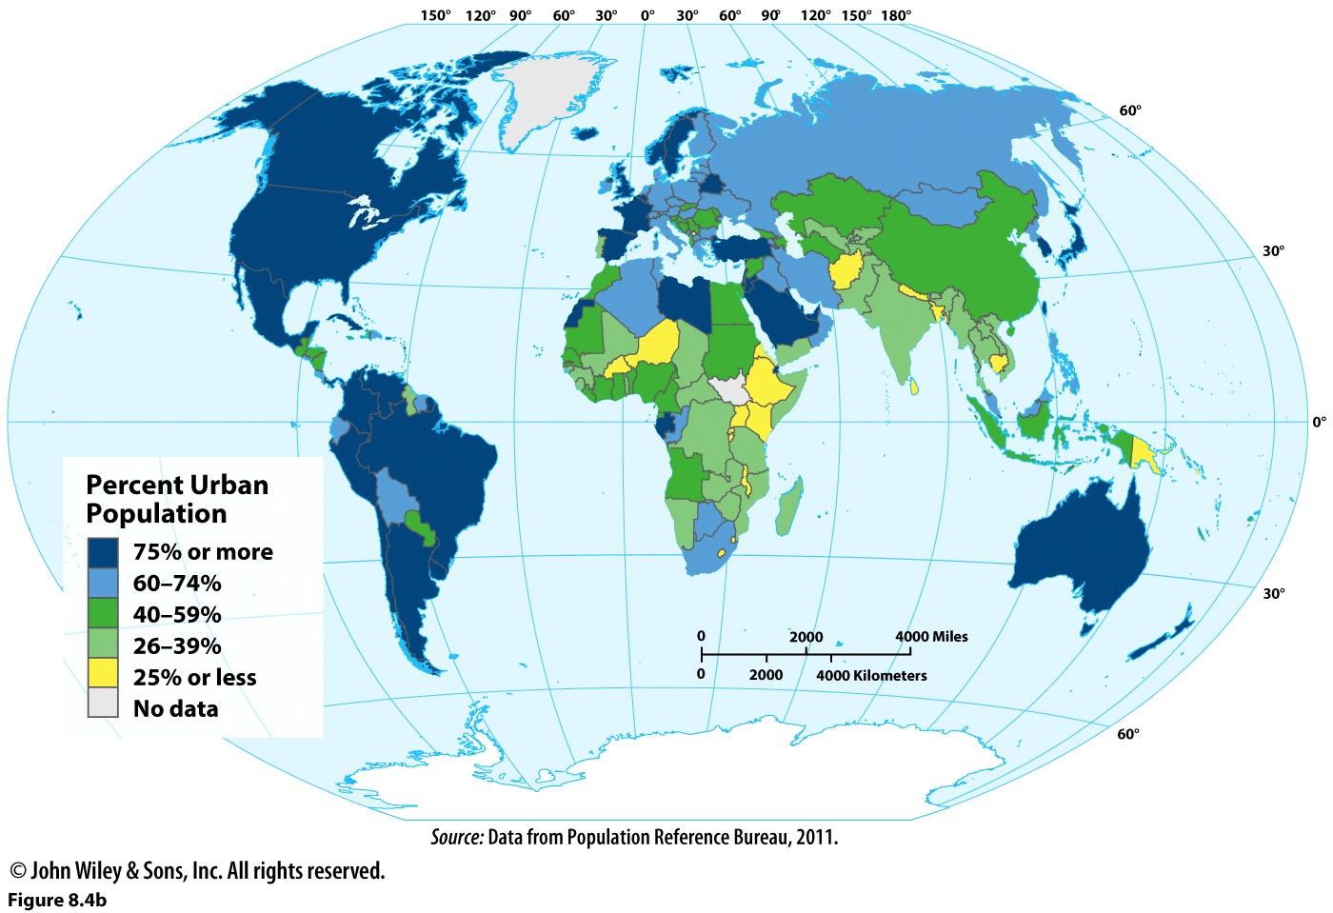

Slide 14
Causes of Urbanization
Industrialization
Mechanization in farming
1800: 7.3% of world lived in a city
US at 65 urban in 1800
1900: 16.4% of world lived in a city
US at 40% urban in 1900

Slide 15
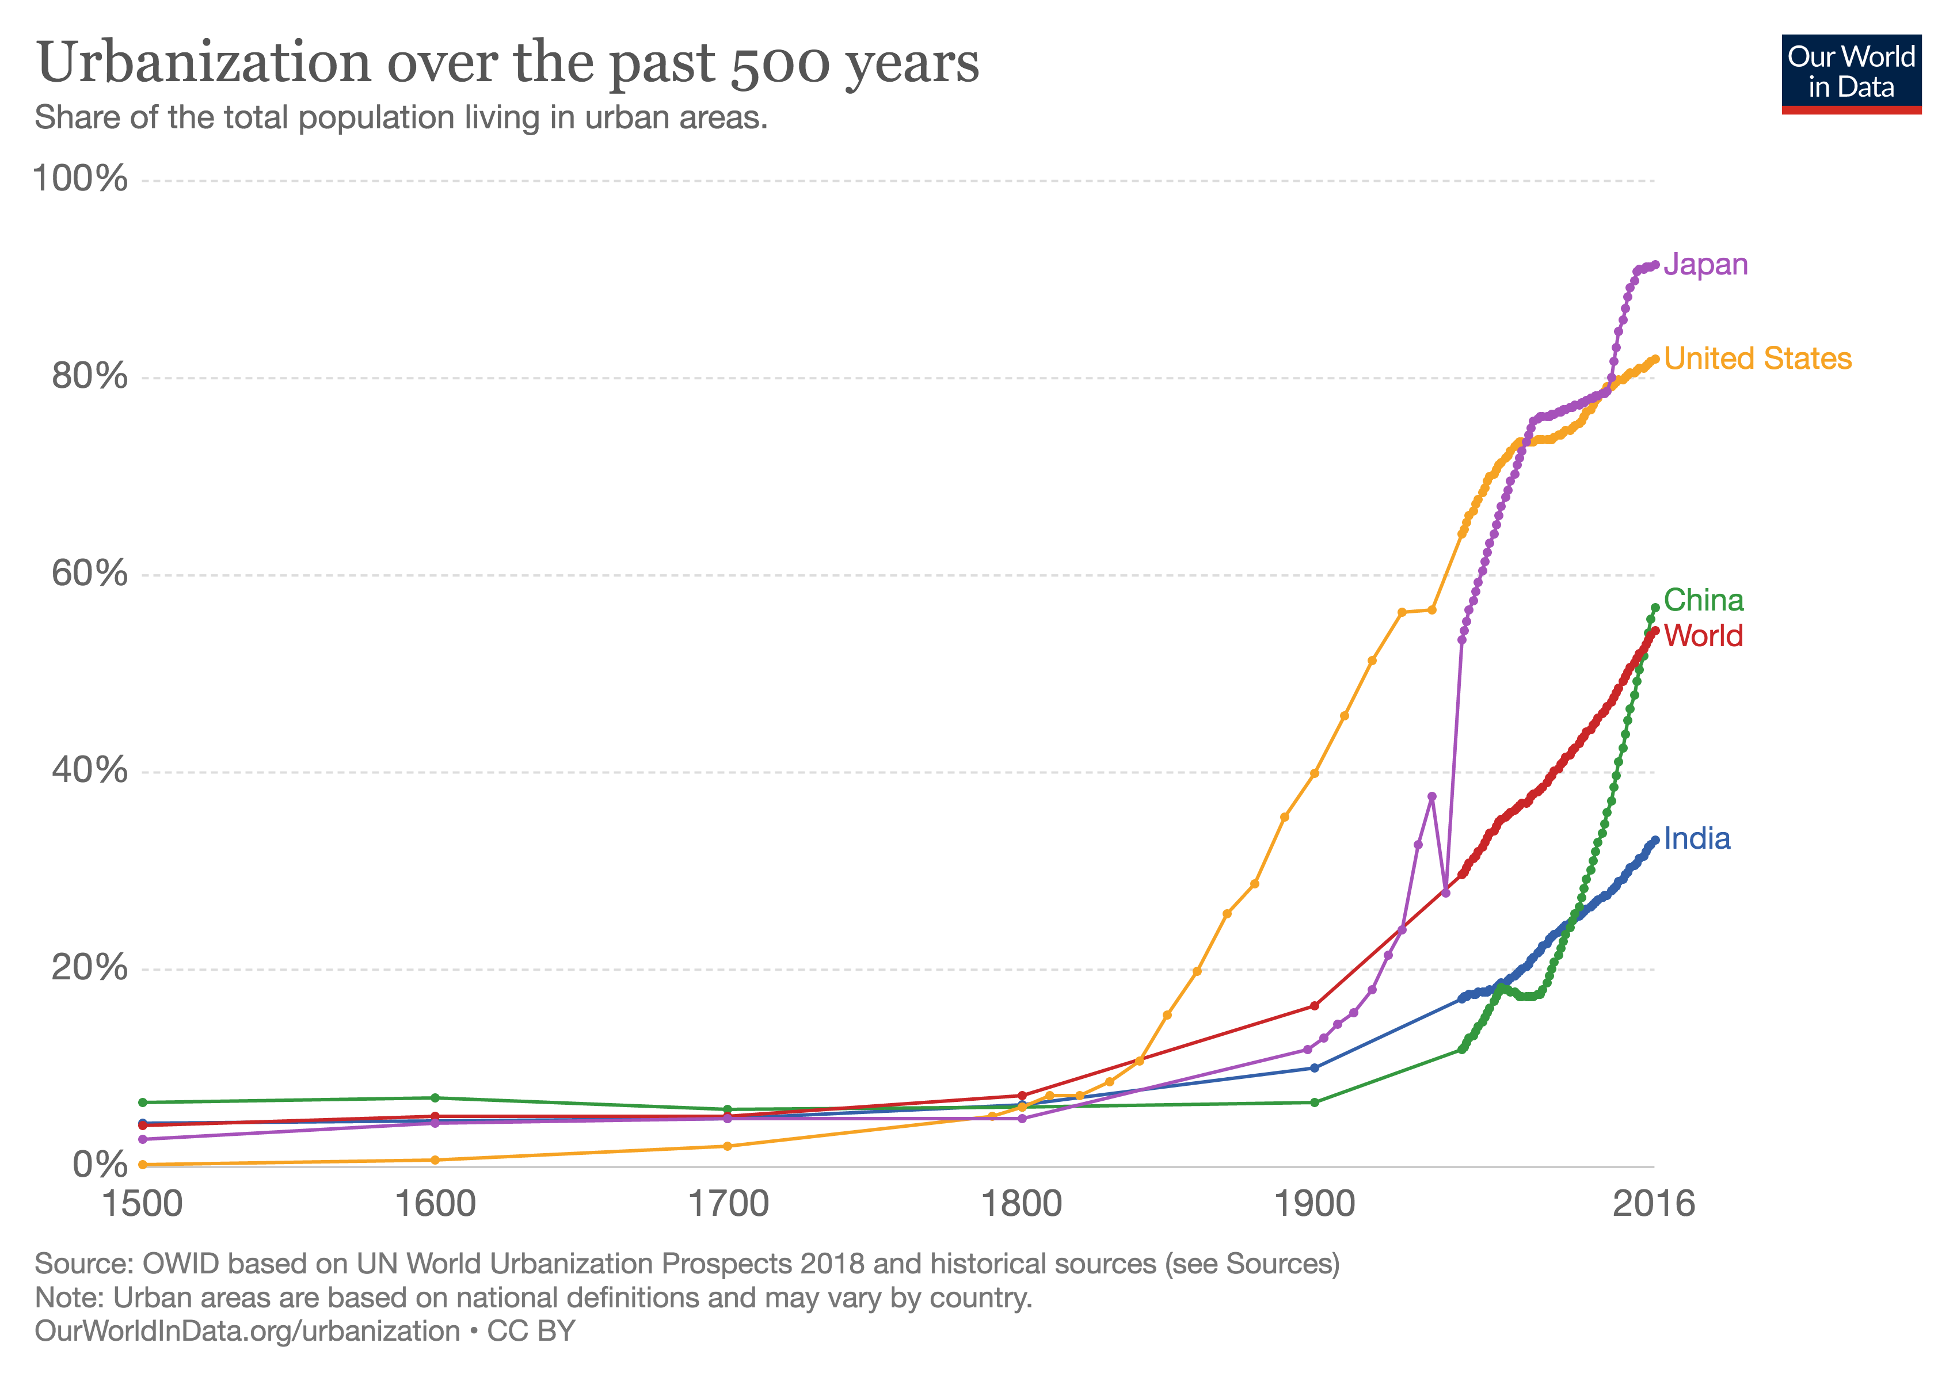

Slide 16
Megacities
For most of 20th C, largest cities in the world were in developed regions—Europe, Japan, U.S.
Since 1975, growth of megacities (10 mill or more)
1950: 2
Tokyo 11 mill, NYC 12 mill)
1975: 3
Tokyo 27 mill, NYC 16 mill, Mexico City 11 mill
2009: 21
3 cities go “super”, more than 20 mill: Tokyo, Delhi, Sao Paulo
2025: 29
9 exceed 20 mill
China & Japan = 7 megacities
India, Pakistan, Bangladesh = 6 megacities
South America = 5
US/Mexico = 3
Turkey/Egypt = 2
Europe/Russia = 2
1975: 53 mill lived a city of 10 mill or more
2011: 283 million did

Slide 17
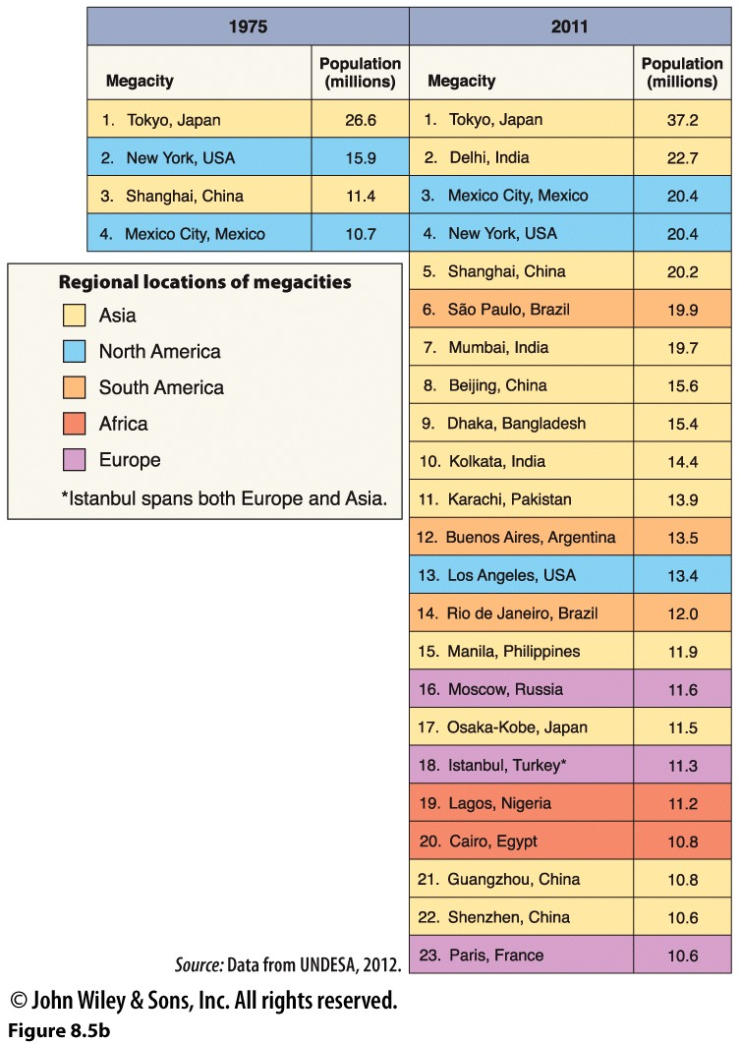
Note Africa:
*Once a center of ancient urbanism but largely rural population through the 20th C.
*Now has several urban giants: Lagos and Cairo.
Africa’s urban population already exceeds North America’s and will soon be as large as Europe’s.
Note Asia
*largest number of city dwellers

Slide 18
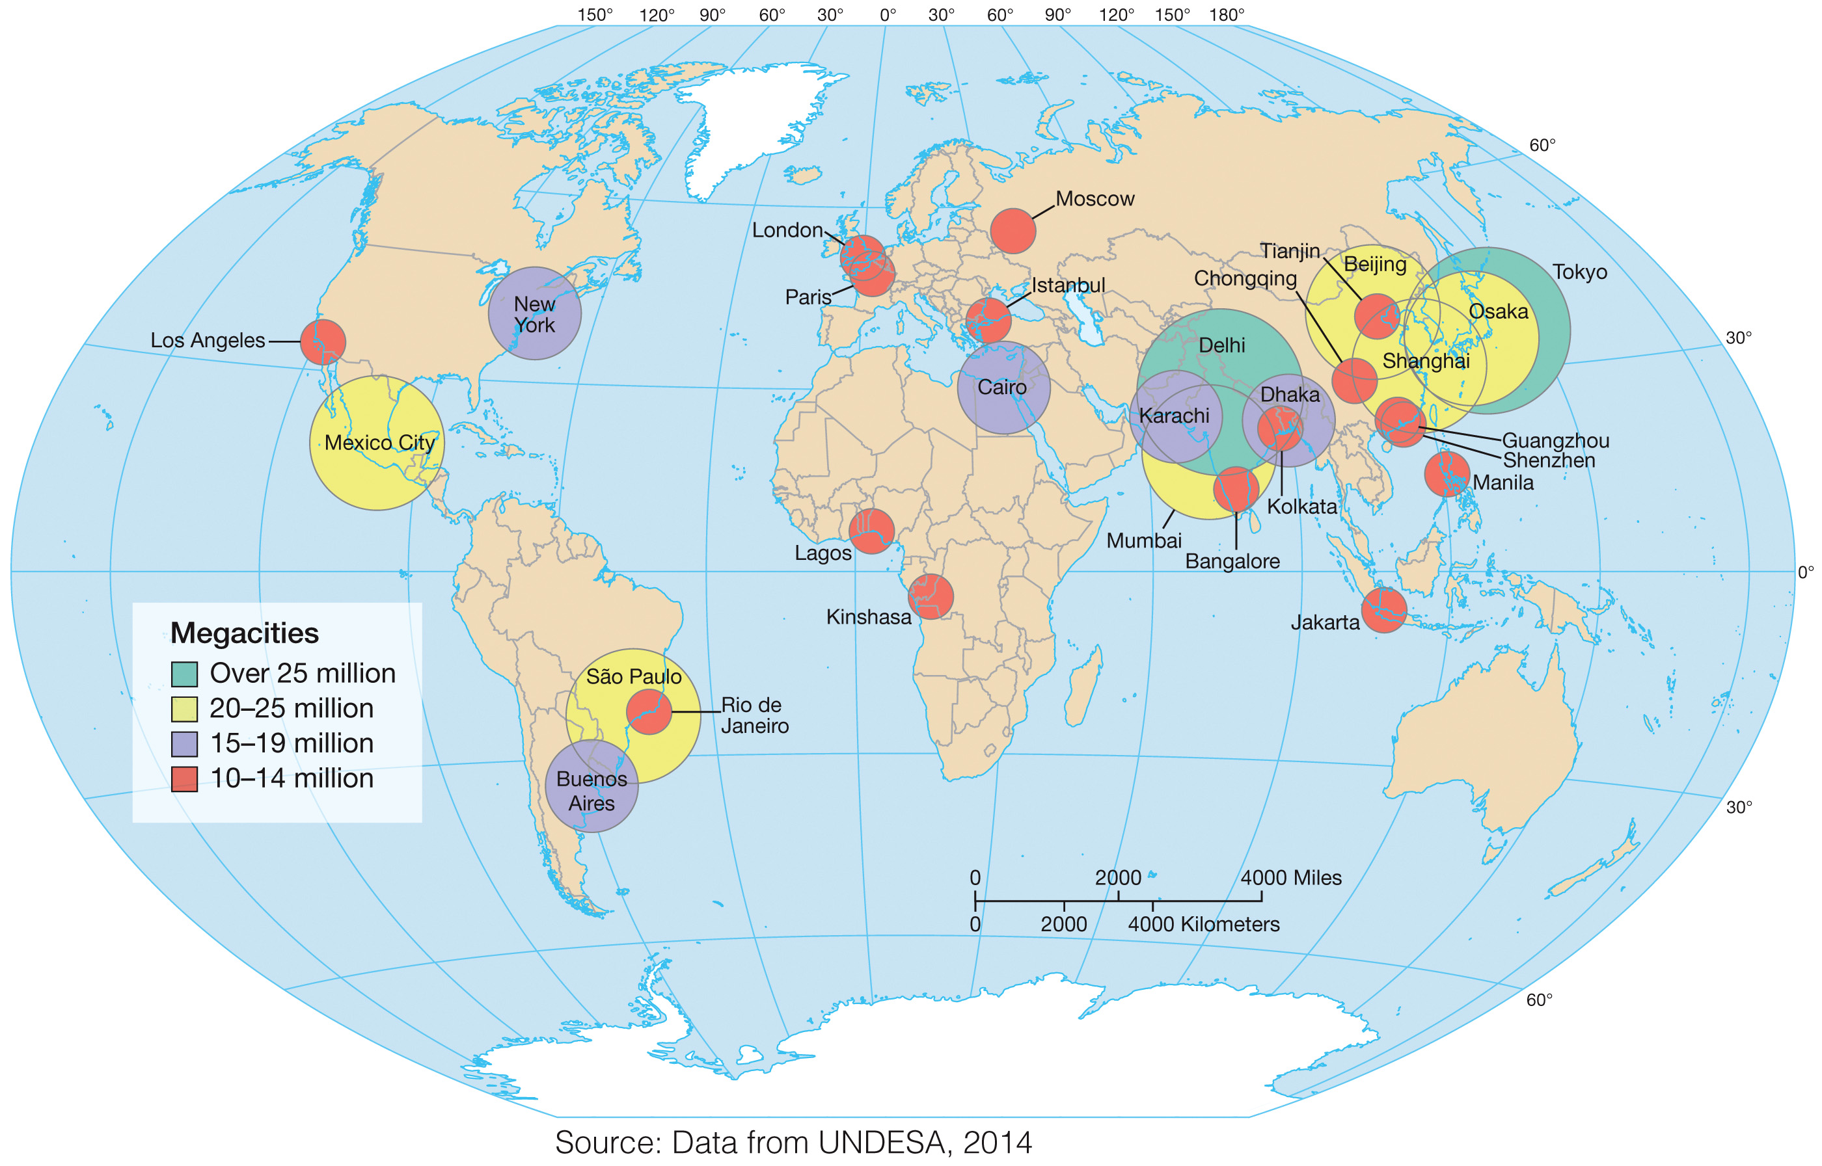

Slide 19
Cities & Progress
Do more urban dwellers indicate progress?
True global development?
Or does it mean more entrenched poverty, concentrated inequality in the megacities of LDCs (and MDCs…)?

Slide 20
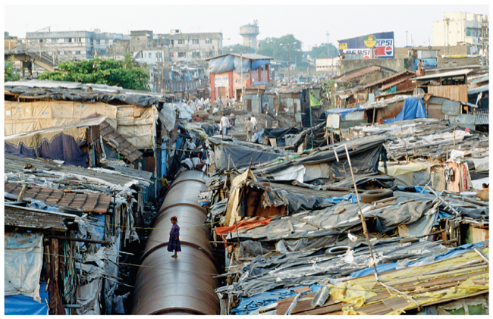
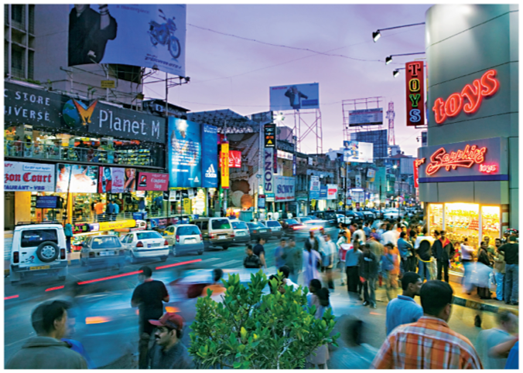
Cities: landscapes of contrast.
Were or are American cities landscapes of contrast?
Mumbai, India
Bangalore, India

Slide 21
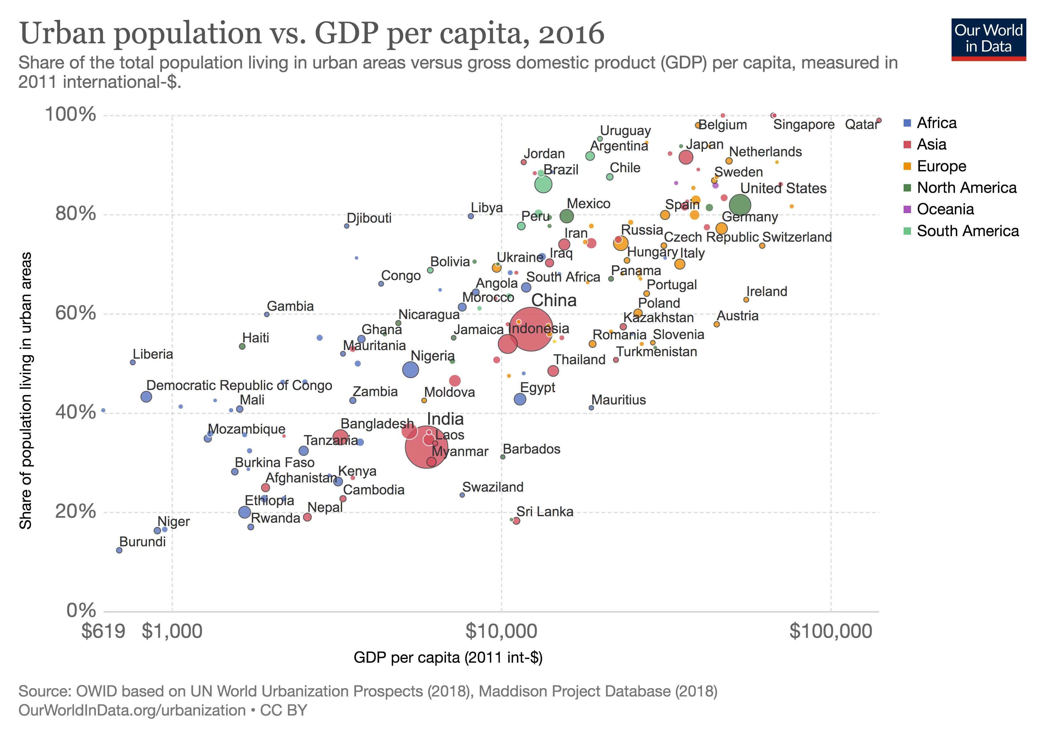

Slide 22
Urban Populations Have Higher Living Standards
In nearly all countries electricity access is higher in urban areas than rural areas.
Access to improved sanitation is higher in urban areas.
Access to clean fuels for cooking and heating is higher in urban areas.
Child malnutrition is lower in urban settings.

Slide 23
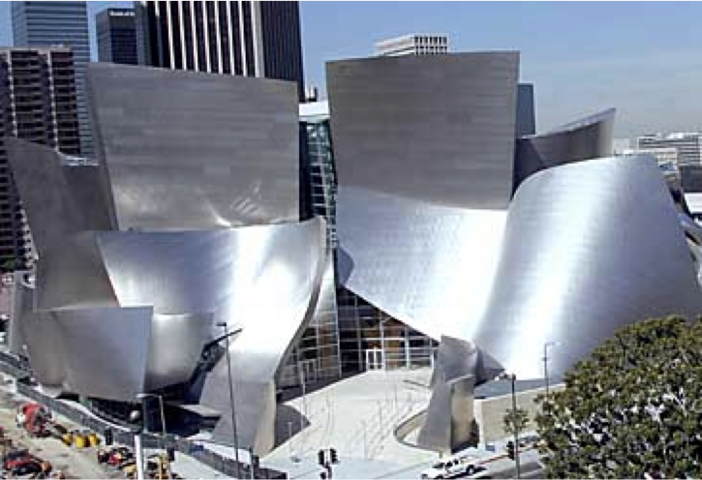
World Cities
Have arisen with globalization
Defined by influence not size
Headquarter location of gov’t, corporations
Nodes of interaction and exchange (airports, ocean ports, specialized markets).
Financial, producer services
Tourism, elite consumption, centers of culture, entertainment, media.

Slide 24
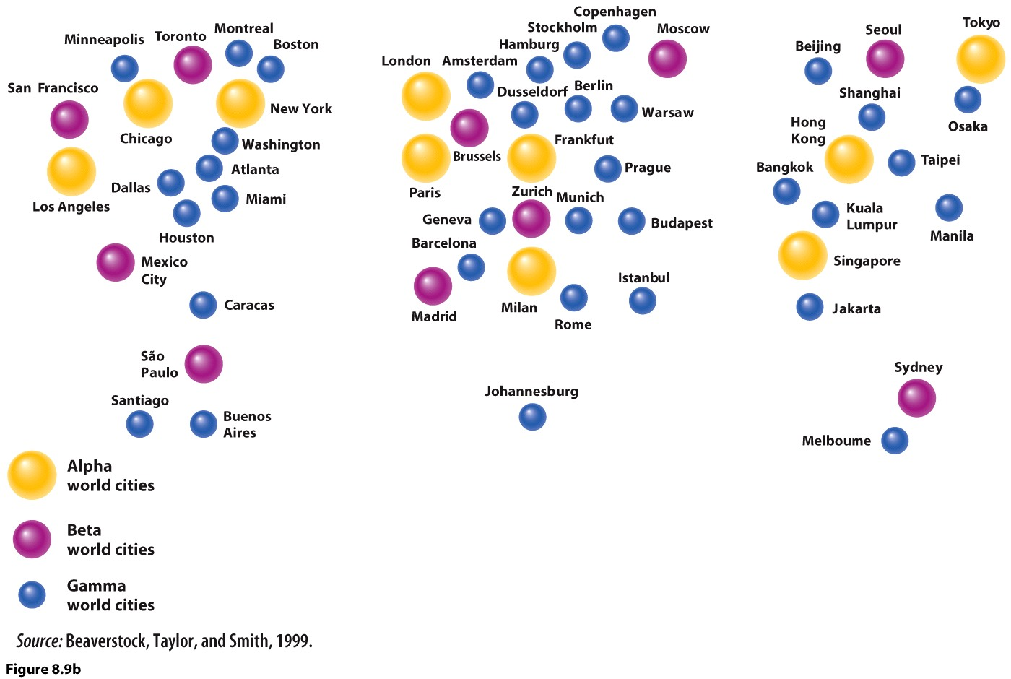
Map showing world cities based on the geographies of dominant firms in 4 sectors: accounting, advertising, banking, legal services.
What does this illustrate about the geography of globalization?

Slide 25
Why Some Cities are NOT World Cities
John Rennie Short
High levels of poverty
Social collapse
Avoidance of risk (hostile to immigrants)
Exclusion from or resistance to globalization
Can a city lose its status as a world city?

Slide 26
American Cities: Policy, Segregation and Suburbs
FHA created to revitalize home construction and increase home ownership during the Depression
VA made loans to veterans after WWII
Selective about what homes they would back
Redlining: “high risk” given to older neighborhoods, and areas with non-whites.
Led to neglect of inner cities and favoring of single-family houses on larger lots in the suburbs
Blockbusting: further excludes “non-whites,” especially African-Americans.

Slide 27
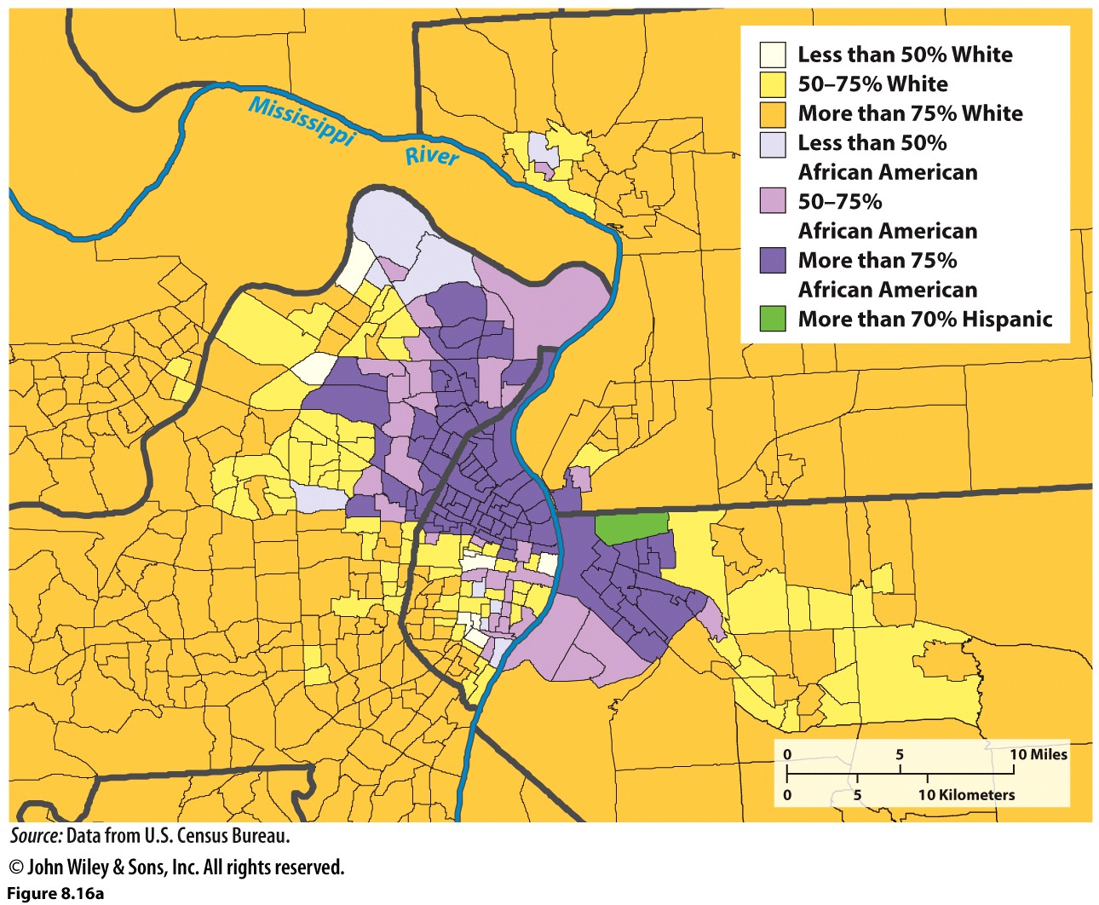
St. Louis became one of the most segregated city in America by 1980.

Slide 28
Urban Development/Urban Renewal
Get rid of sub-par housing in neglected inner cities
Use eminent domain to take land/property
Replace with?

Slide 29
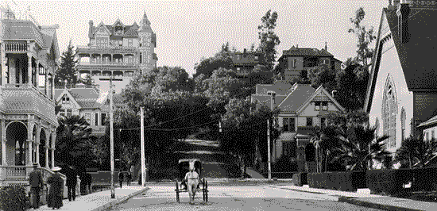

Slide 30
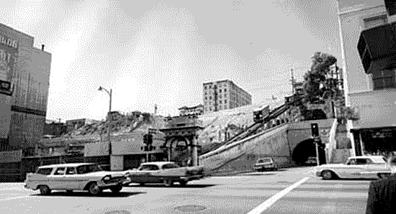

Slide 31
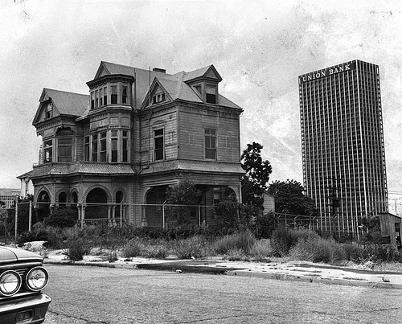

Slide 32
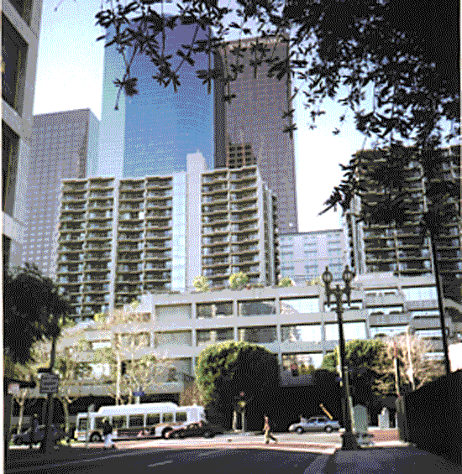

Slide 33
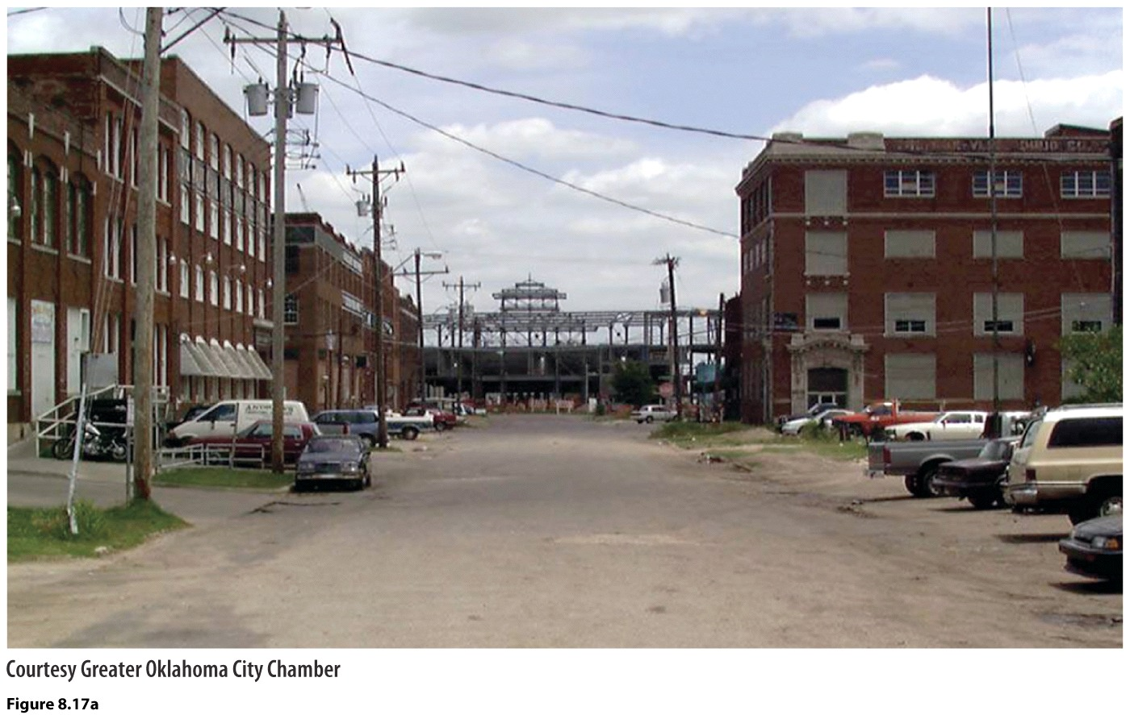
What is gentrification? Pros/cons?

Slide 34
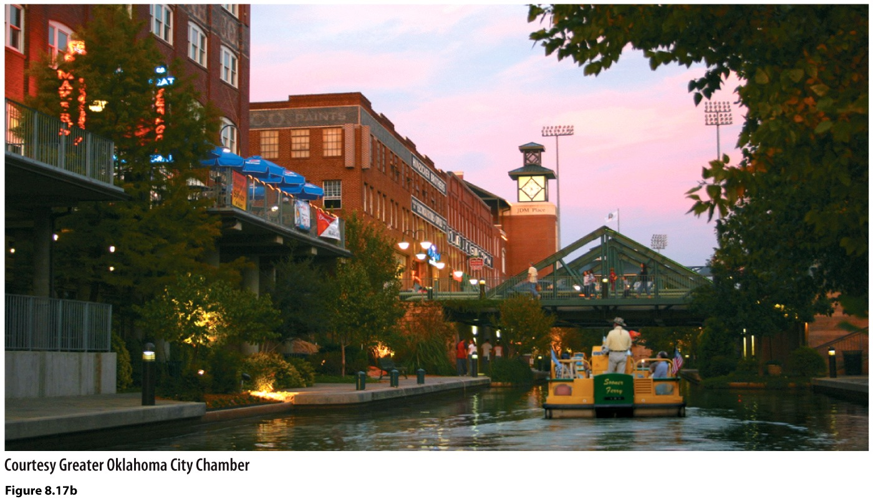

Slide 35
Can cities help with more sustainable forms of living? Can they reduce our carbon footprint?
Yes, especially if they’re dense!
Move people around without cars
Deliver services—food, garbage collection, etc. in a smaller area, more efficient
Urban farming
Less air con—build streets more narrow, plant more trees, paint roofs white, plant on top of buildings…
Use permeable surfaces on roadways
Live closer to where we work—affordability!?
Make cities more livable—Vision Zero
Plant more trees!!!: “There are about 60-200 million spaces along our city streets where trees could be planted. This translates to the potential to absorb 33 million more tons of CO2 every year, saving $4 billion in energy costs.” (National League of Sustainable Cities)

Slide 36
Sprawl—not sustainable!
Rate at which land is urbanized greatly exceeds the rate of population growth in a given period of time.
Low-density
Exurbs—low density residential developments FAR from urban centers and even FAR from suburbs, really in rural areas.
Costs: extending water, electricity, ambulance, fire, police, buses, etc. very high cost!
Usually not served by public transit, so very auto dependent.
More asphalt, more impervious surfaces, heat islands grow…
Housing collapse of 2008 stopped sprawl somewhat…will it creep back? How to stop it?

