Slide 1
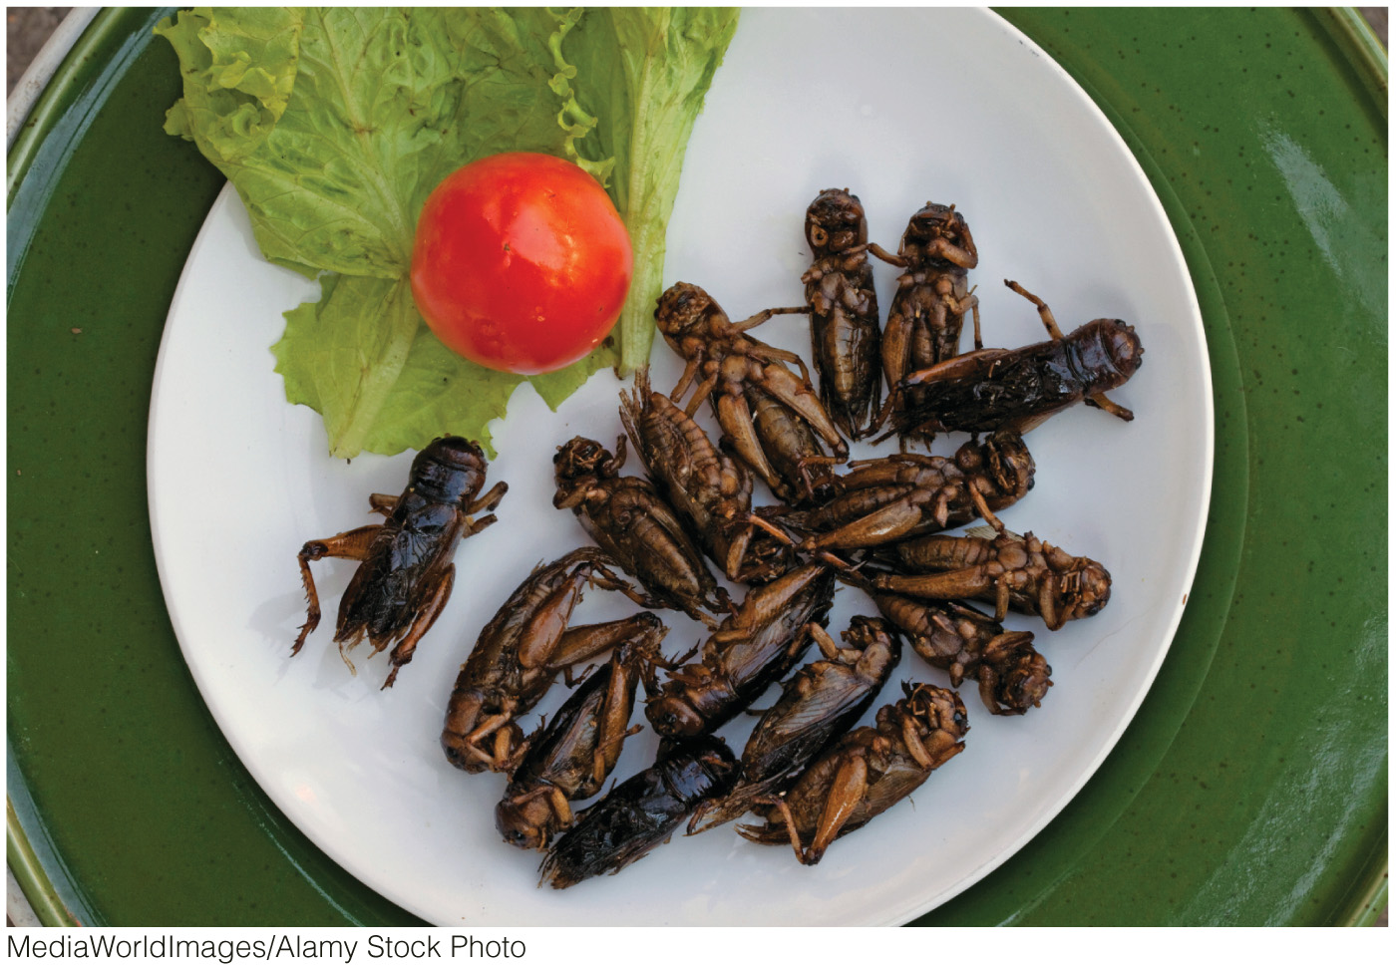
Chapter 9: Agricultural Geographies

Slide 2
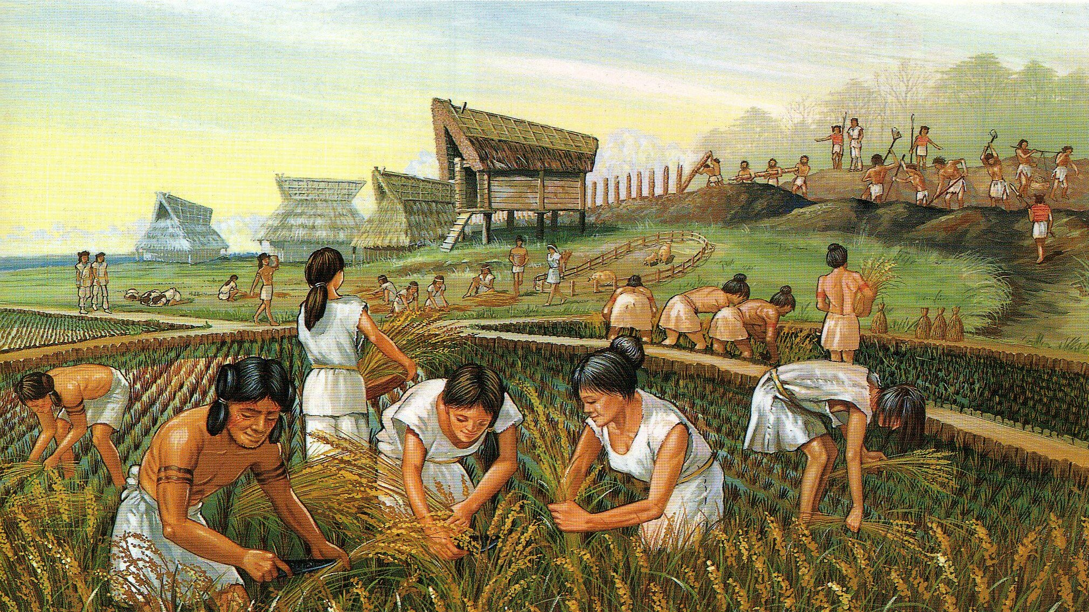
What is Agriculture?
Domestication
Transformative

Slide 3
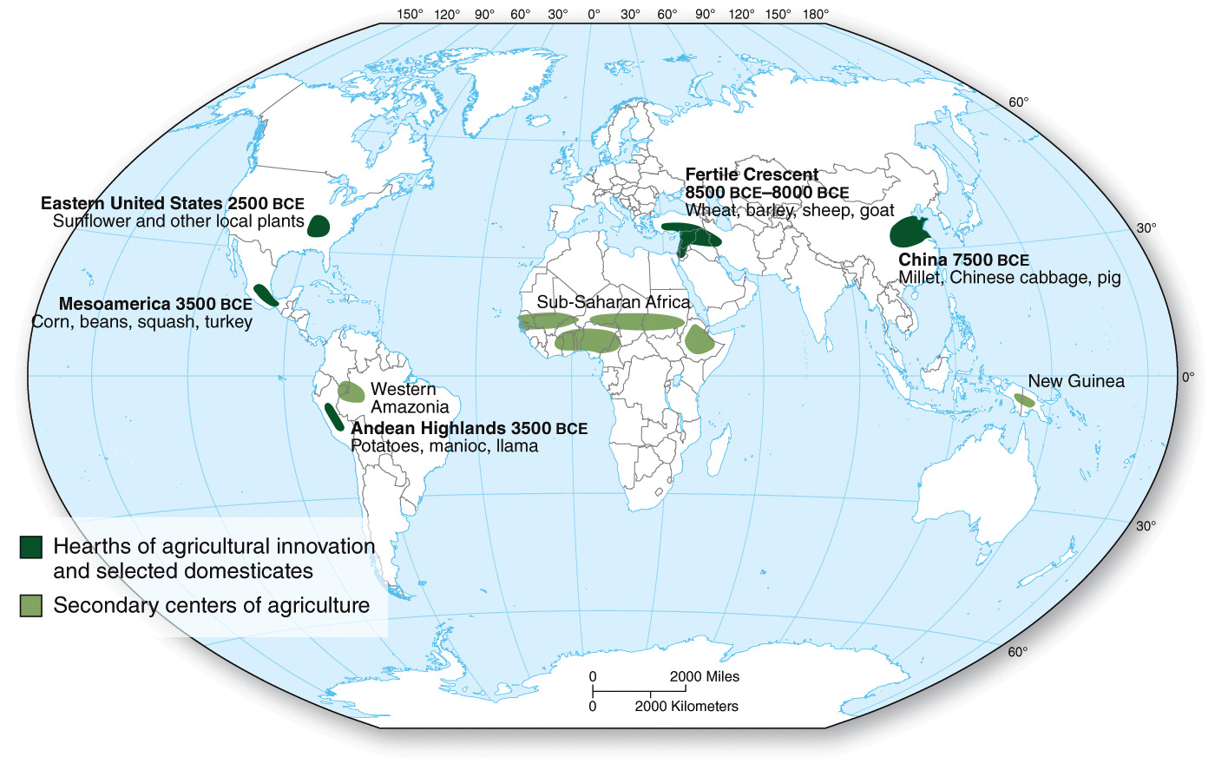
Origins of Agriculture
Carl Sauer, Agricultures Origins & Dispersals
The First Agricultural Revolution

Slide 4
Agricultural Systems
Subsistence Agriculture
Extensive: slash and burn, swidden, shifting cultivation; pastoralism
Intensive: wet-rice, double cropping; small-holder crop & livestock
Commercial Agriculture
Extensive: grain, livestock ranching
Intensive: truck farming, dairy, slaughterhouses

Slide 5
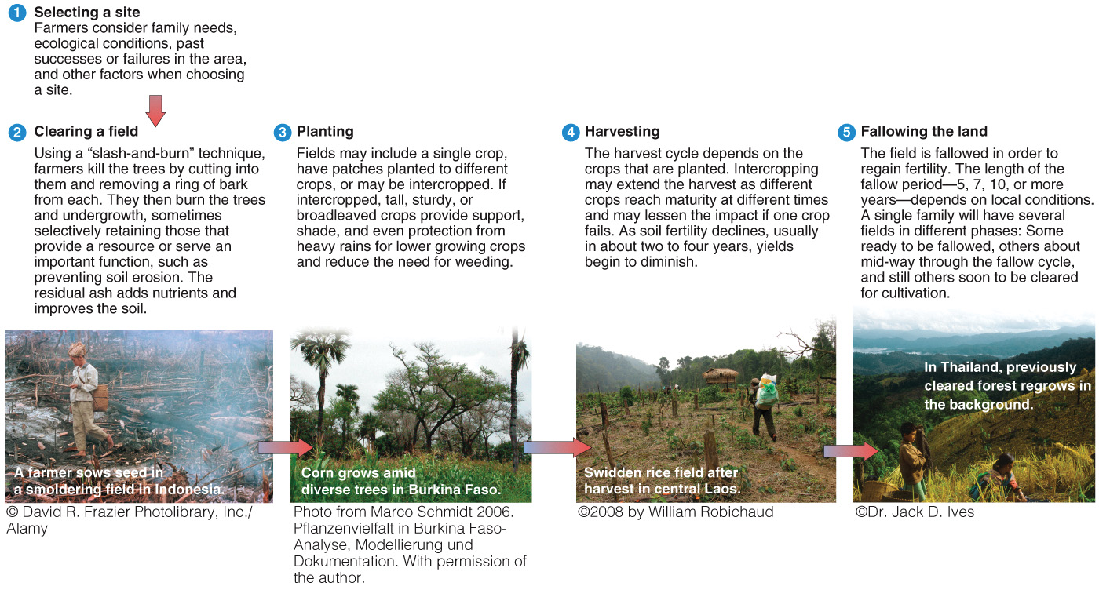
Slash-and-burn agriculture.

Slide 6
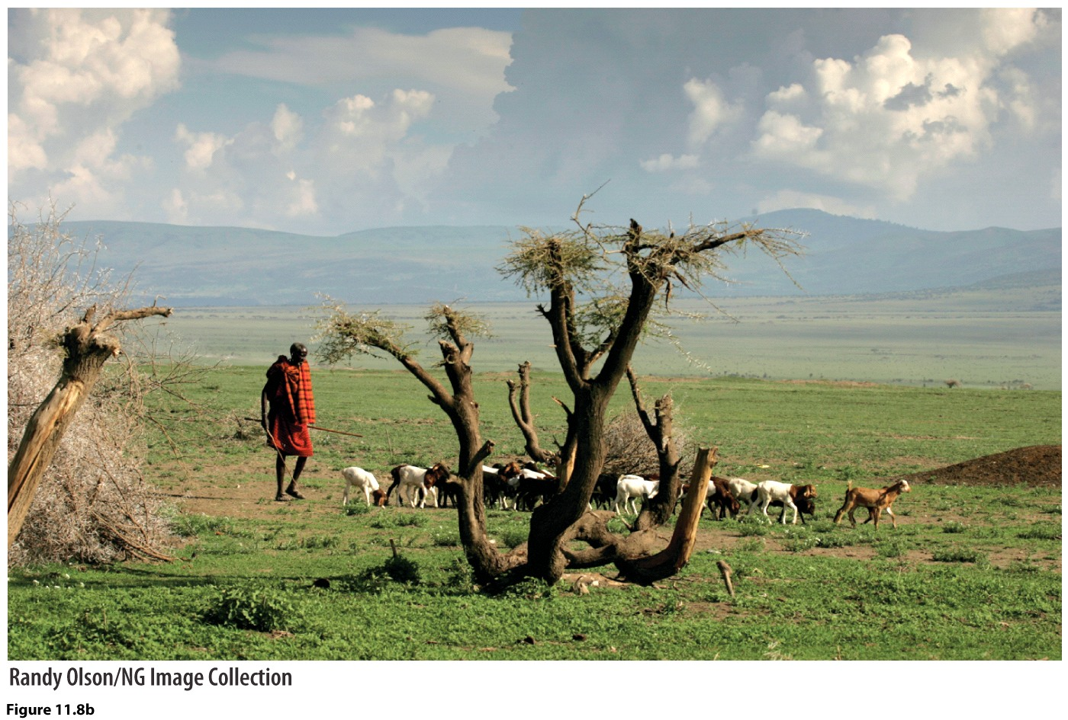
Pastoralism

Slide 7
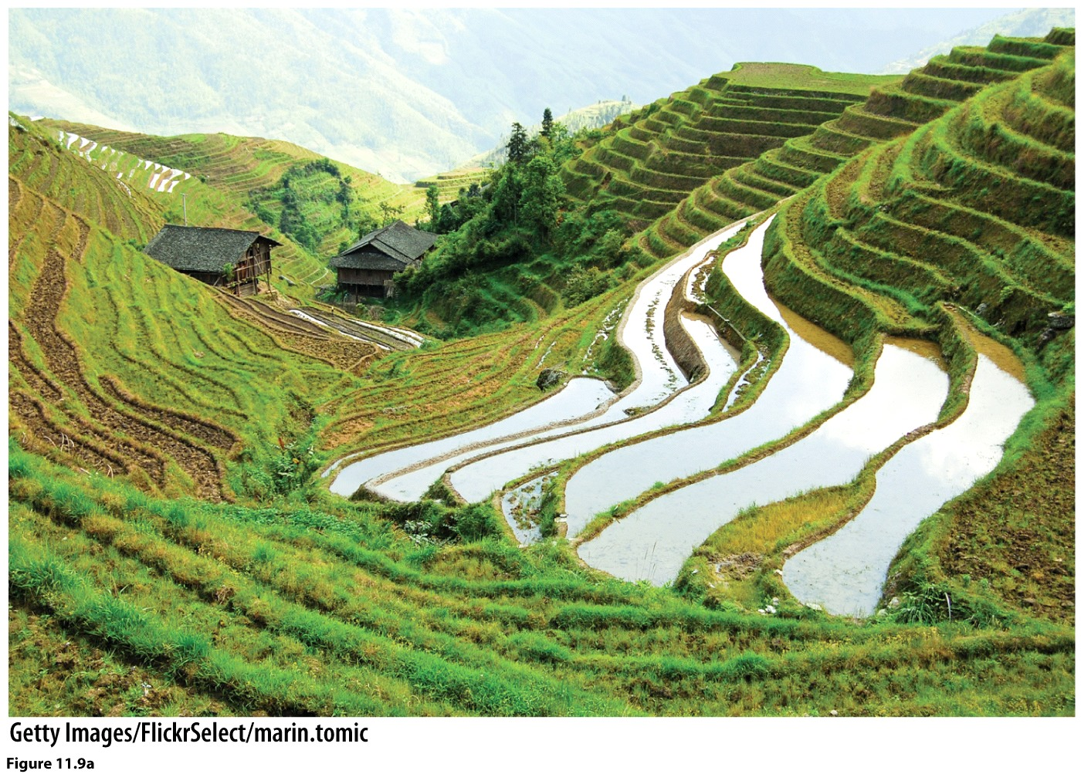
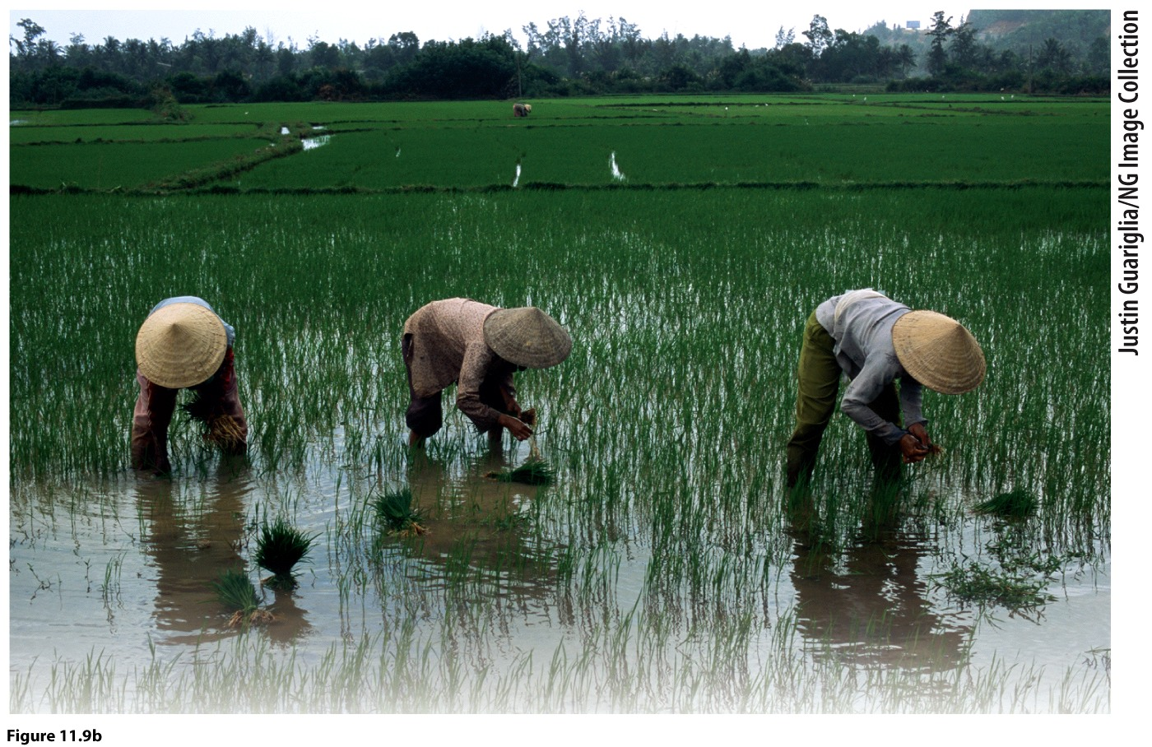
Wet-rice production

Slide 8
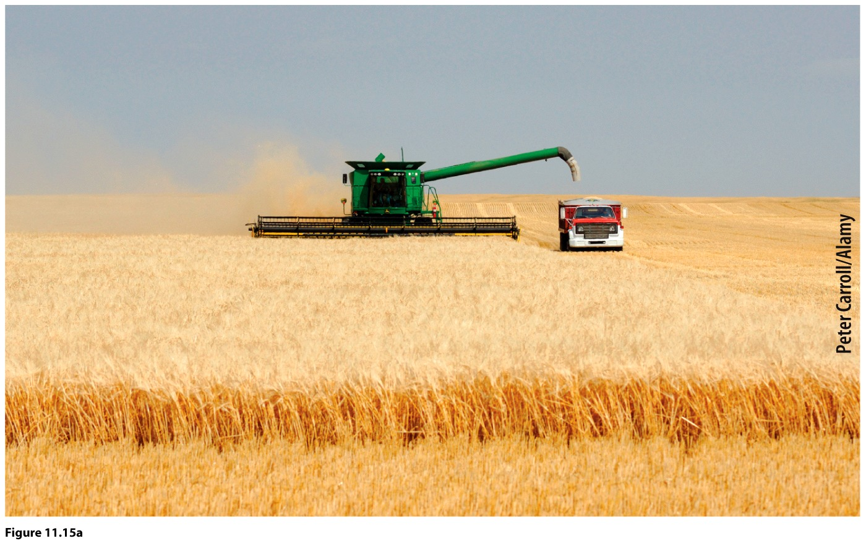
Commercial: extensive—wheat production in Saskatchewan, Canada.

Slide 9
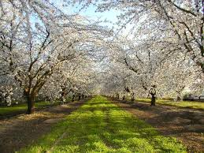
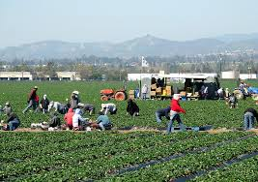
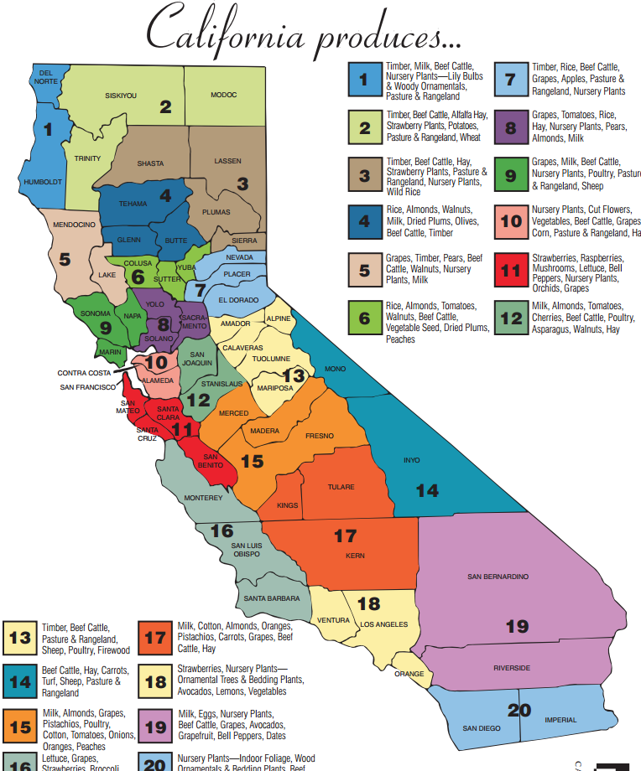
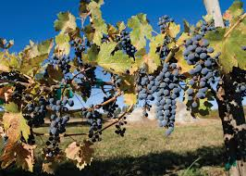

Slide 10
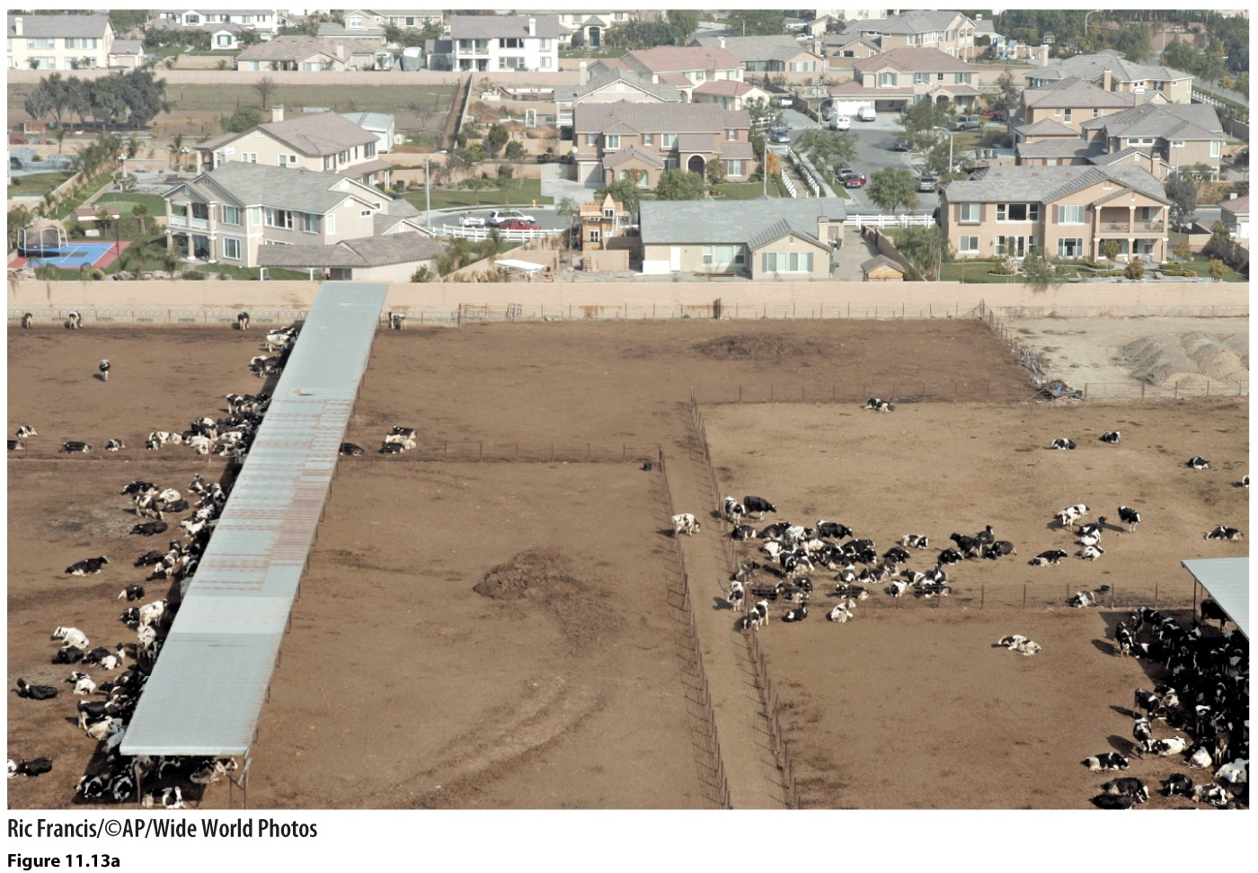
Intensive Commercial: dairy farming; dry-lot dairy in CA; can hold up to 600 dairy cows, no pasture, only sun shades. Dairy farms in upper midwest usually only hold about 70 pasture-fed cows.

Slide 11
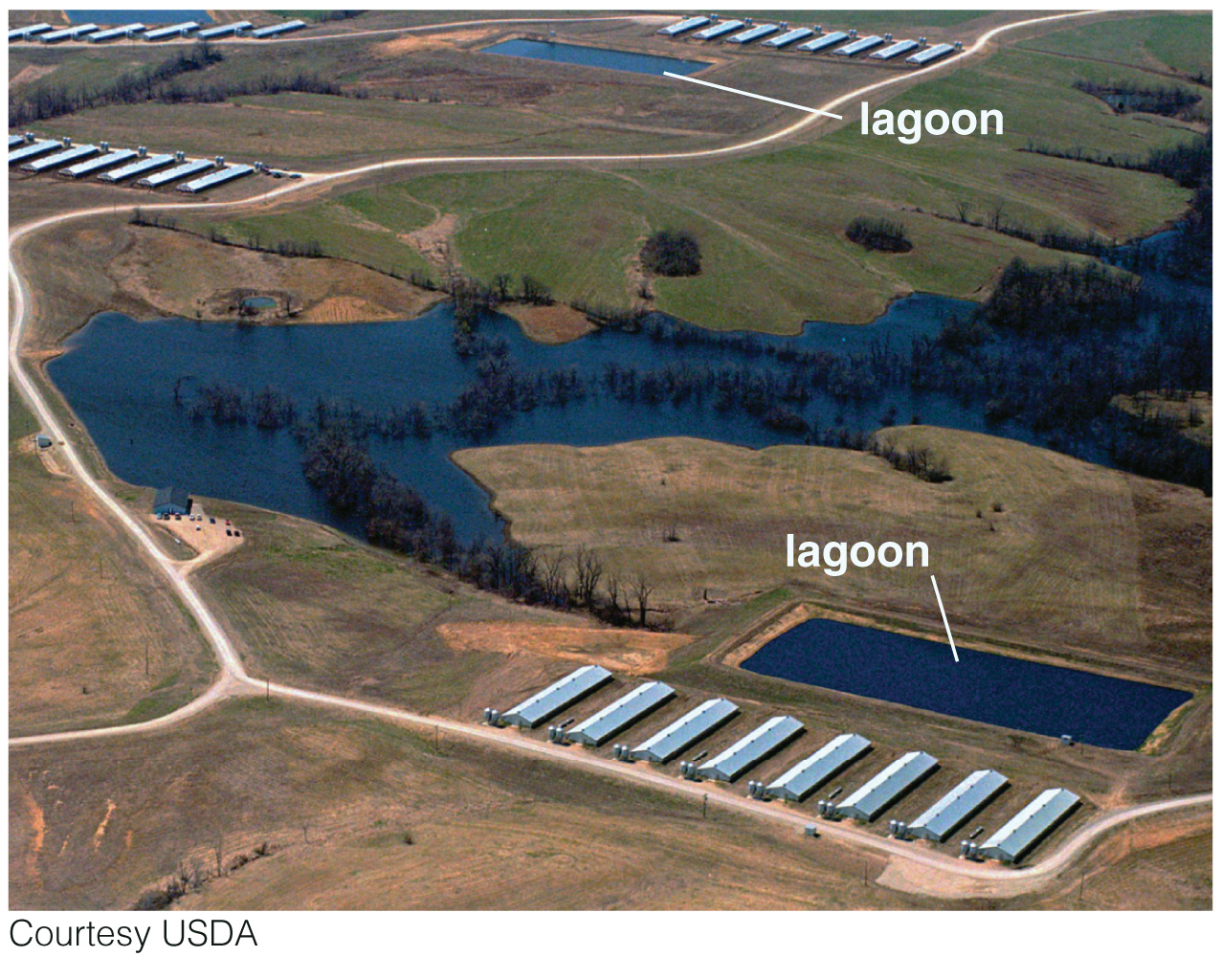
Intensive commercial: hog farm. Long, rectangular buildings near a lagoon. Lagoon holds waste from pigs. Some of the largest hog farms produce more than 200,000 hogs/year. The one pictured is in Milan, Missouri.

Slide 12
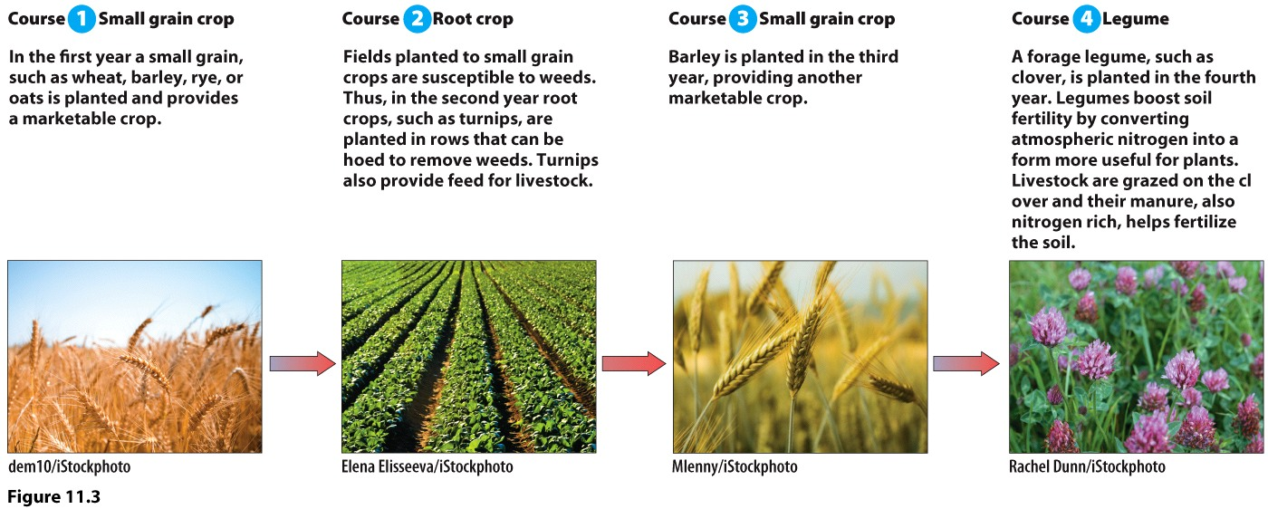
How has Agricultural Production Changed?
Second Agricultural Revolution
Europe, Middle Ages (13th C)
Curved metal plate: moldboard plow
Horse collar
17th & 18th C
Four course rotation system

Slide 13
How has Agricultural Production Changed?
The Green Revolution
Late 1800s-early 1900s
Internal combustion engine
Tractor, mechanization
Scientific farming
Hybrid seeds, fertilizer, other synthetic chemicals
Irrigation
Grow in semi-arid areas, expand areas to grow in

Slide 14
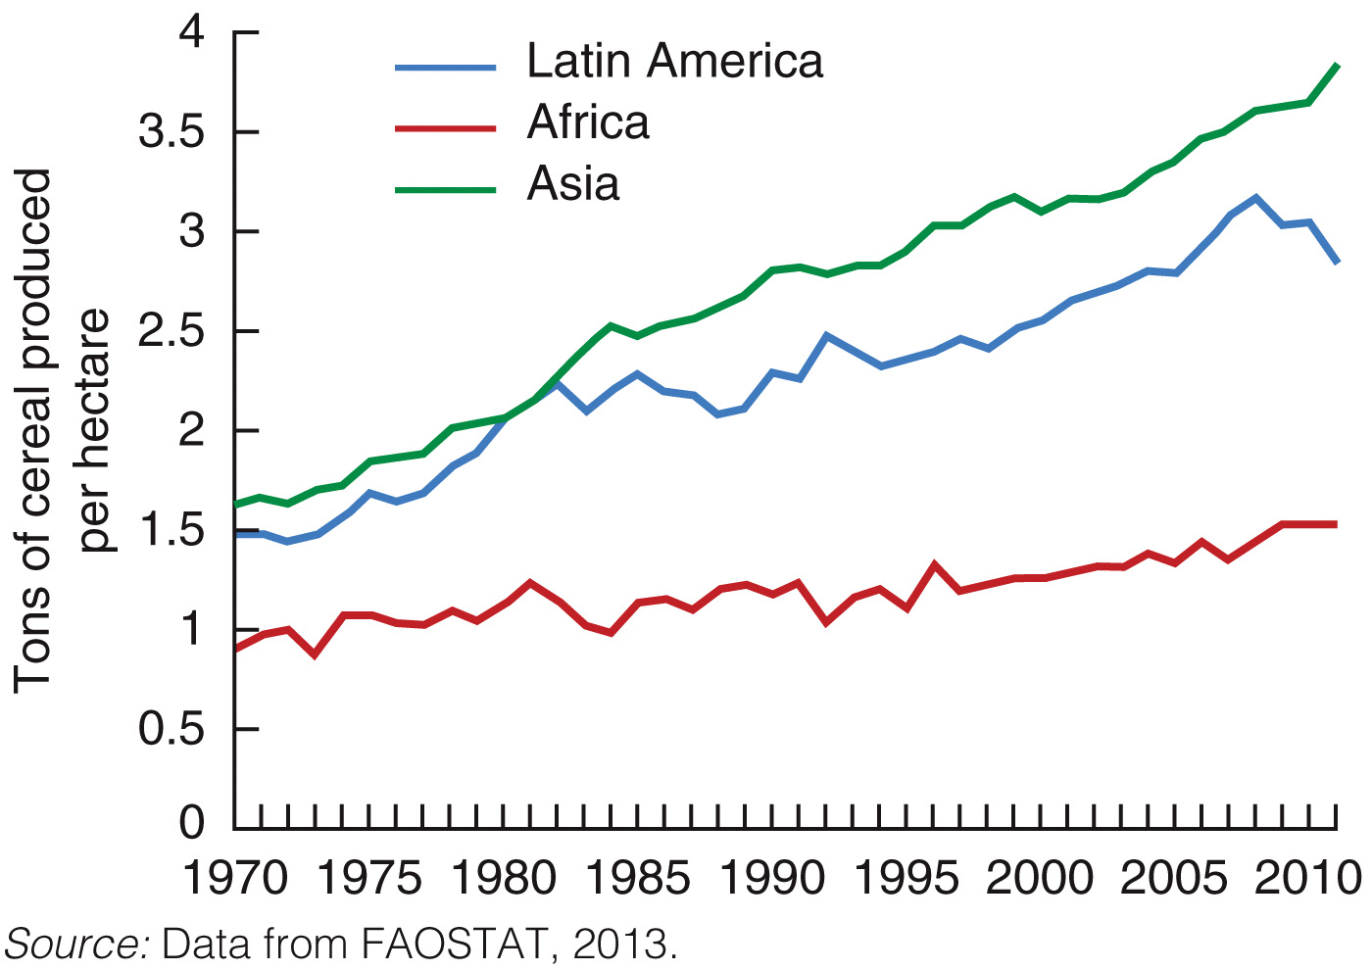
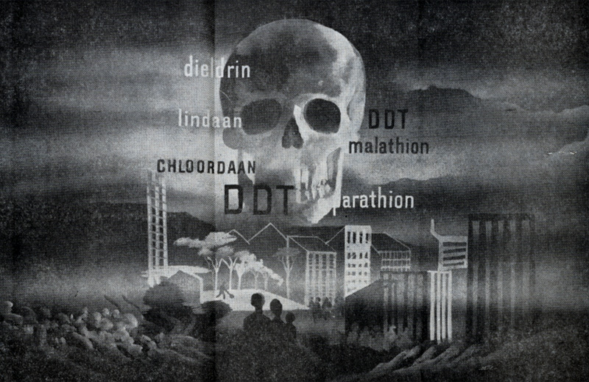
Outcomes of the Green Revolution
Pros
Cons
Prevented famine in Asia, bolstered India
Publically held technology
Over-irrigation
Environmental and public health damage
Expensive package
From Rachel Carson’s Silent Spring, 1962.

Slide 15
Rise of Agribusiness and Factory Farming: The Gene Revolution
Changes in Who produces
Changes in How food is produced
Large corporations, MNCs
No longer publically held technology, but patented.
Horizontal integration in the industry
ConAgra, Monsanto, PepsiCo, Nestle, Philip-Morris, etc.
GMOs, hybrid seeds, like terminator seeds, “Frankenstein foods”
Reliance on inputs: hormones, pesticides, other synthetic chemicals, antibiotics
Vertical integration: from “seed to supermarket”
Industrial farming: monoculture & factory farming; dry-lot dairies, feedlots, CAFOs (concentrated animal feeding operations). Cheap meat—nutrition transition.

Slide 16
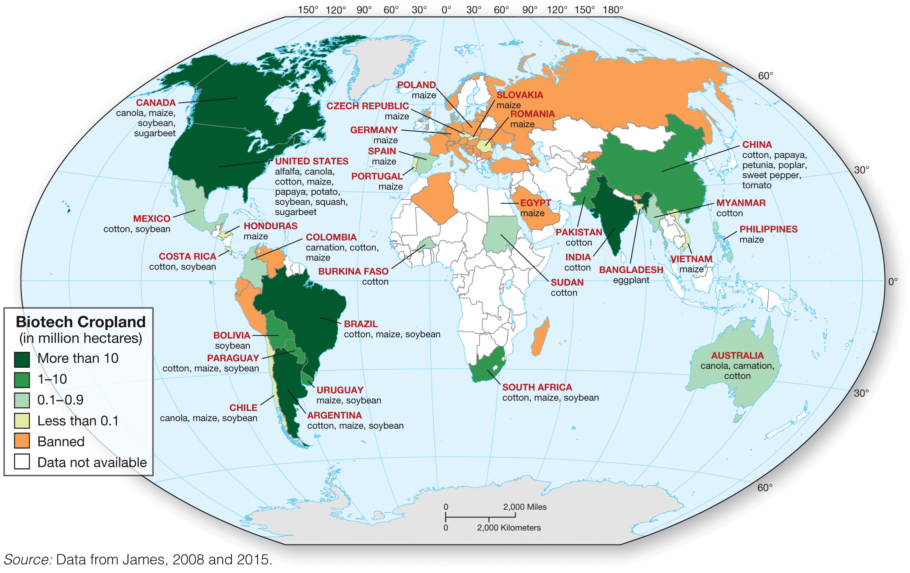

Slide 17
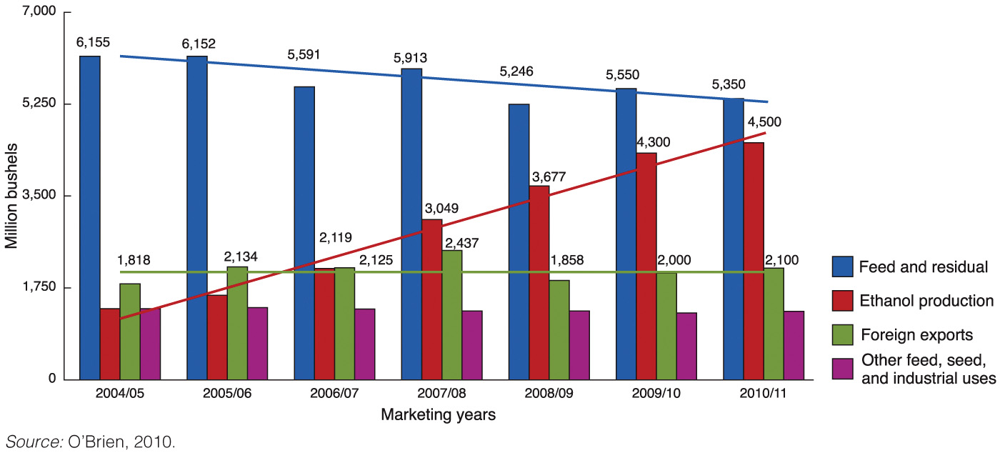
Grains produced in the U.S. are often not for direct consumption by humans, and often are not being used as food at all!

Slide 18
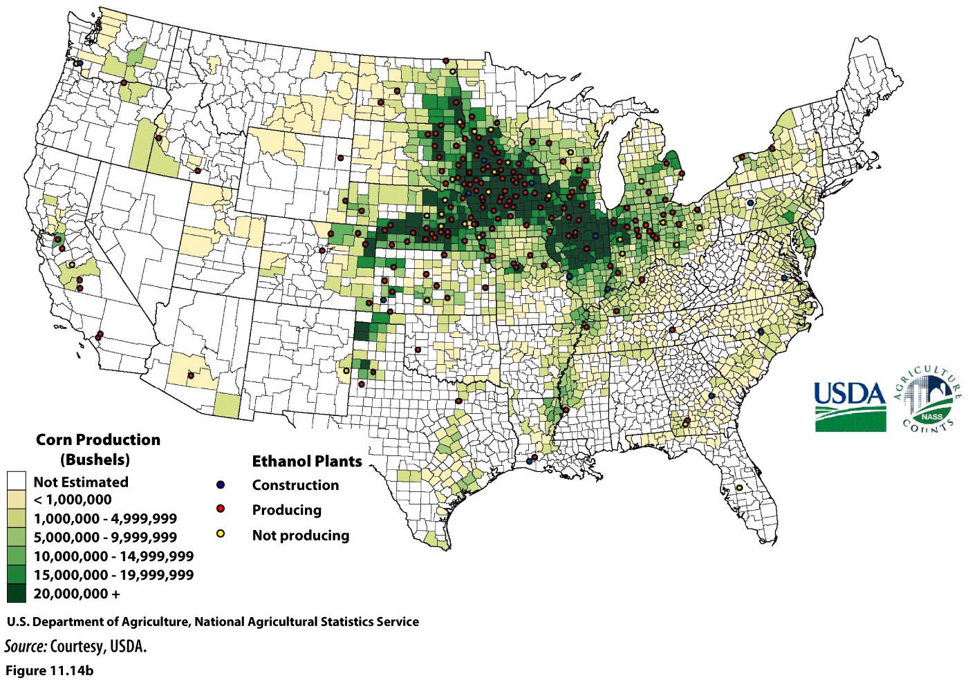

Slide 19
Can Agriculture be Sustainable?
Organic production
Contour plowing
Strip cropping
No-till farming
Crop rotation
Precision agriculture

Slide 20
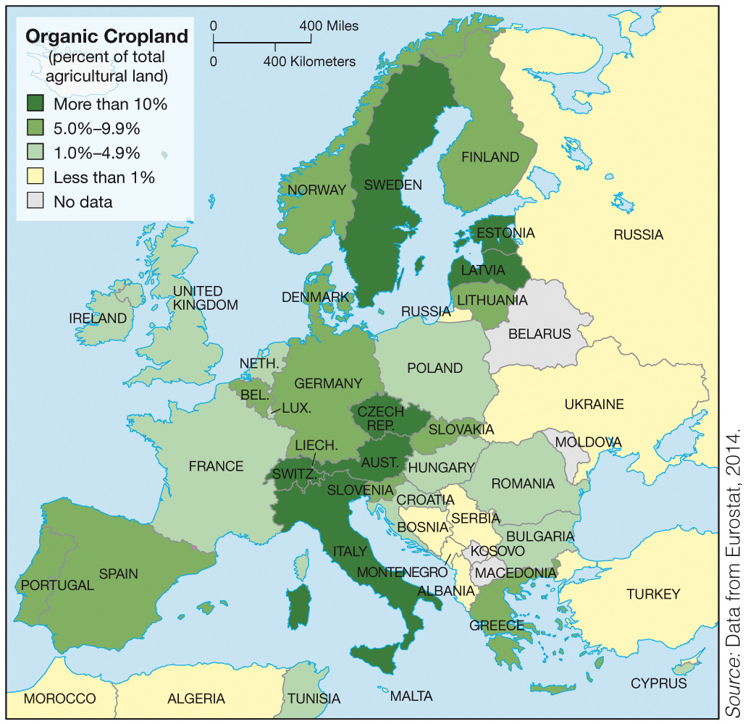

Slide 21
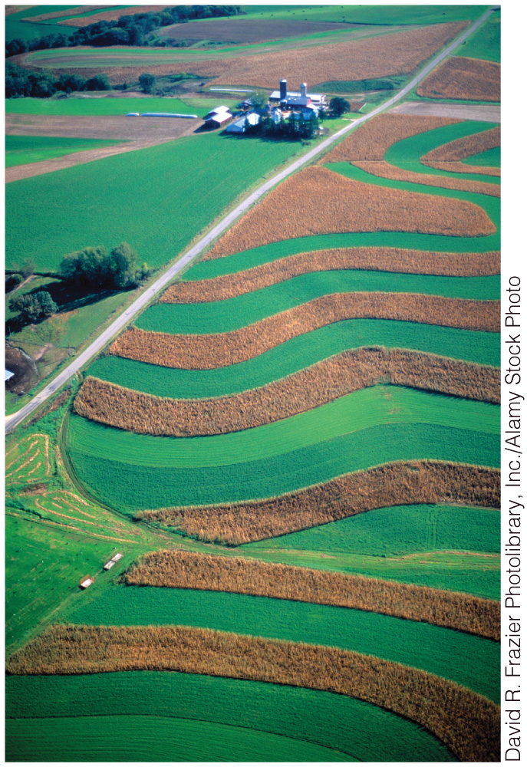
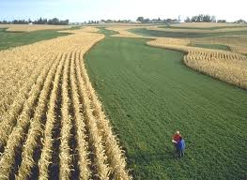
Contour plowing and strip cropping in SW Wisconsin. The green strips are alfalfa hay which alternate with taller strips of corn. The alfalfa slows runoff, helps prevent erosion.

Slide 22
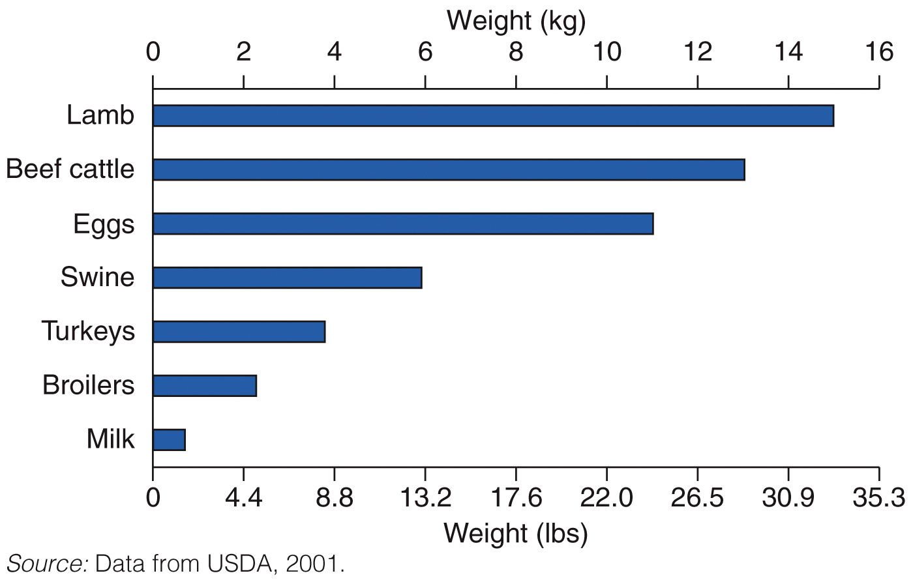
The amount of grain needed to produce 1 kg (about 2.2lbs) of meat or other animal product. Livestock are inefficient producers of protein, and, as shown here, must consume inordinate amounts of grain to generate adequate weight gain to produce meat.

Slide 23
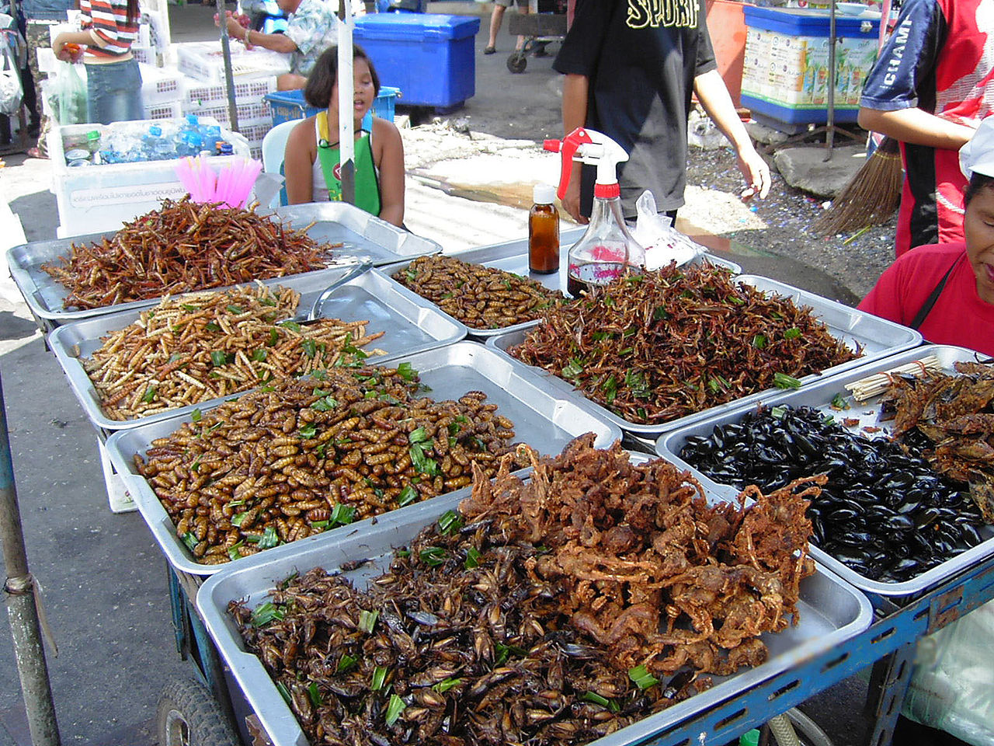
Deep-fried insects for sale at a market in Thailand.

