Slide 1
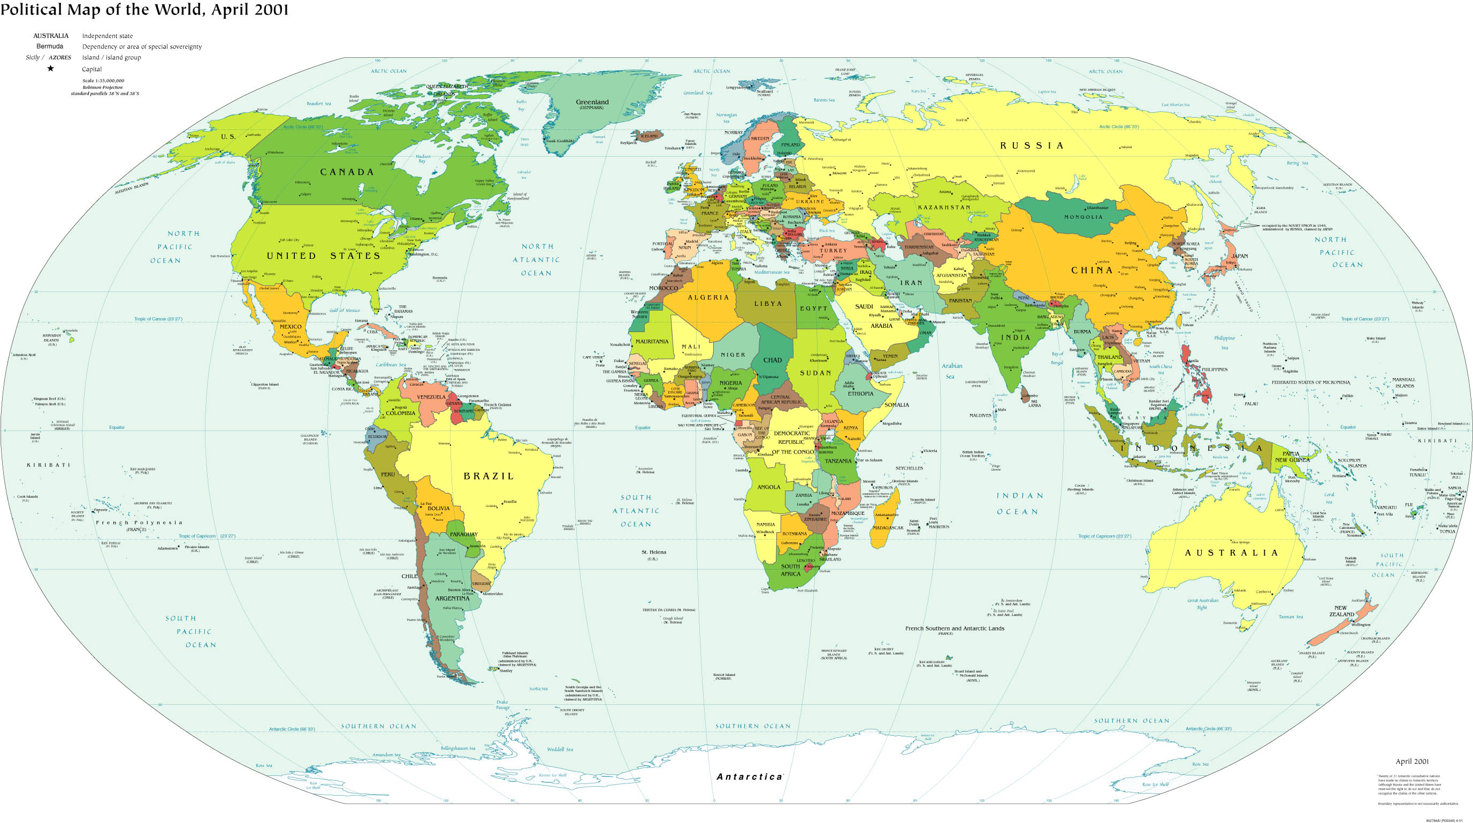
Chapter 1: Introduction to Human Geography

Slide 2
What is Geography?
The human-environment relationship
Spatial science
Maps
Geography is the science of place and space. Geographers ask where things are located on the surface of the earth, why they are located where they are, how places differ from one another, and how people interact with the environment—Association of American Geographers (the AAG).

Slide 3
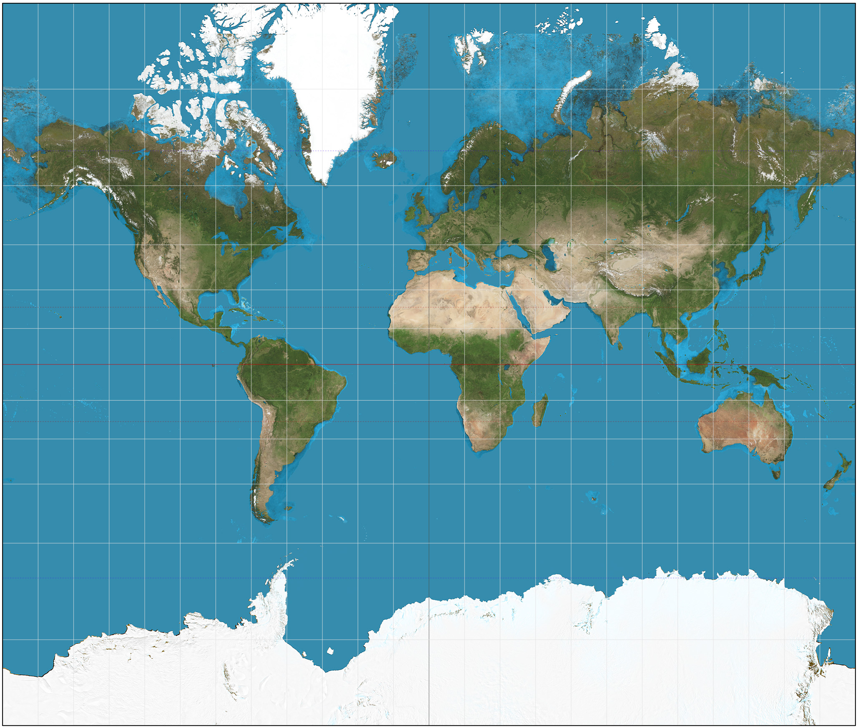
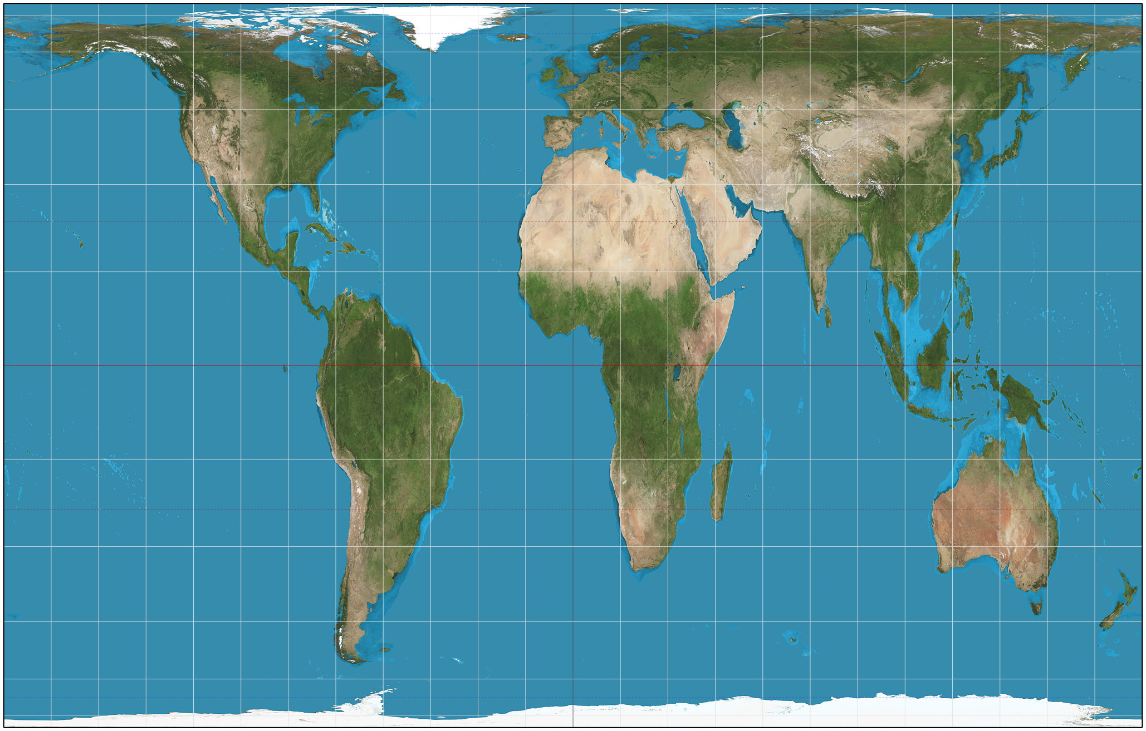
Cartography
All maps lie—distortion
Cylindrical projections—the Mercator Projection
Better representations of the Earth? Peters Projection
The Gall-Peters projection distorts shapes but preserves size. The Mercator projection preserves shape but distorts size.
Note the distortion of landmasses close to the North Pole.

Slide 4
How have humans seen their relationship with the environment?
18th Century Europe: dualism
Early 20th Century: Environmental determinism
Today—no separation between humans and “nature”
Actor-network theory—Jared Diamond, Paul Robbins
Possibilism
The cultural landscape—Carl Sauer

Slide 5
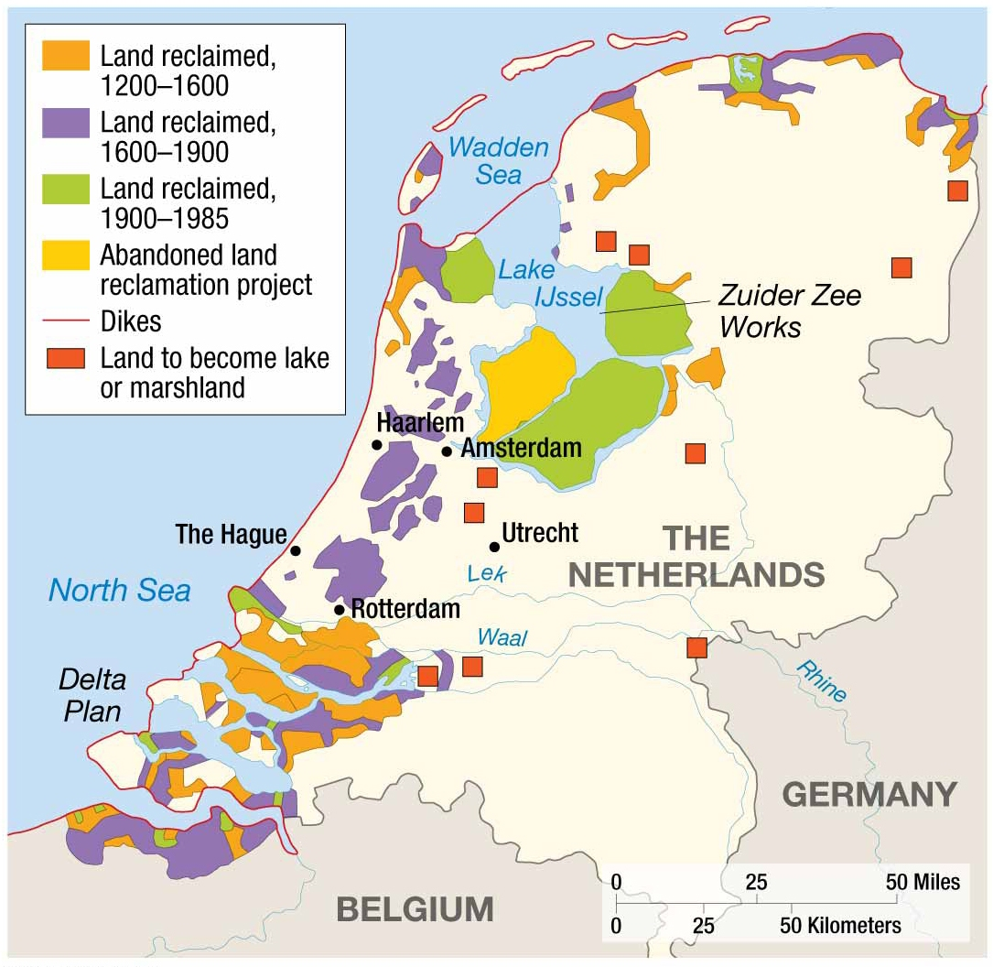
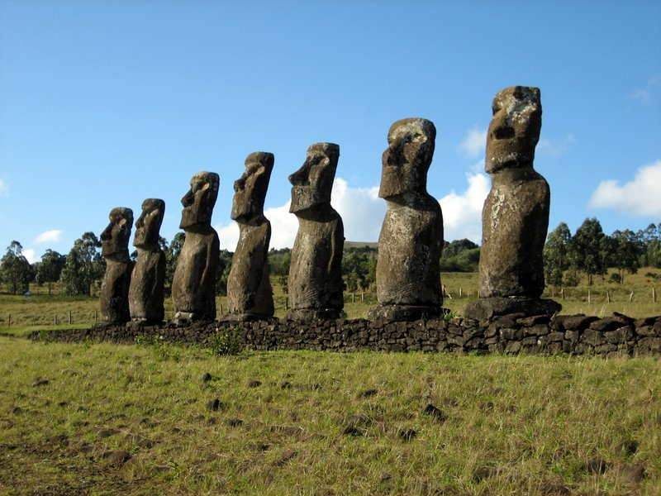
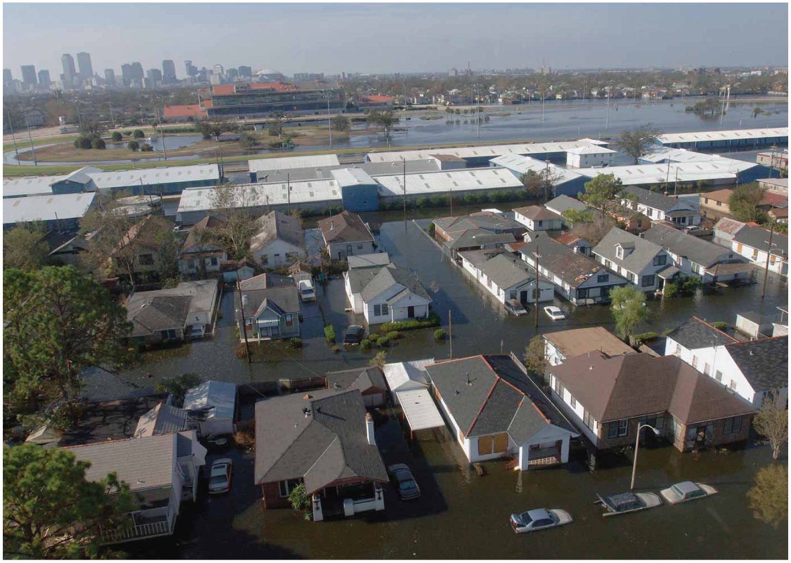
Do humans always make good decisions about using natural resources?
Can societies fail?
What does sustainability mean?
Easter Island
New Orleans, LA

Slide 6
How do geographers define location?
Absolute
Uses the grid system of latitude & longitude
Relative
Uses the idea of “site” and “situation”
Site: location relative to physical features
Consider: can humans alter the site of a location?
Situation: location relative cultural features
Consider: can the situation of a location change over time?

Slide 7
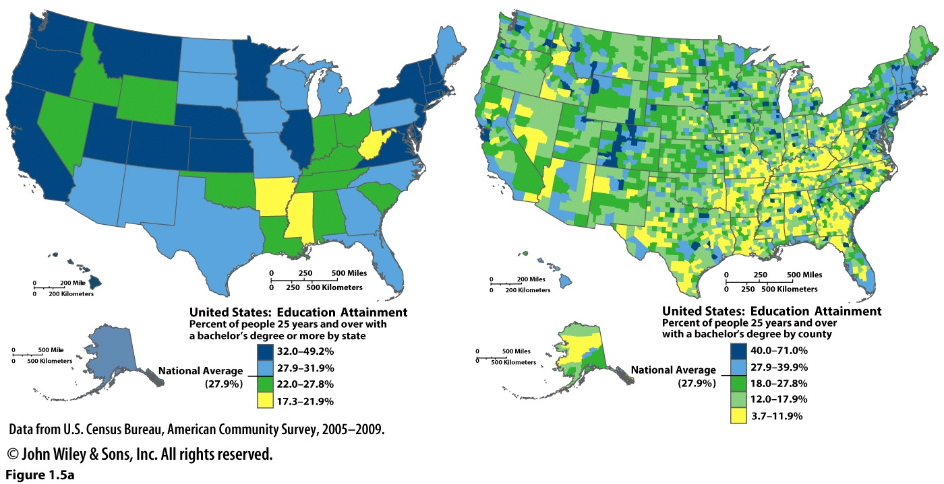
How do geographers organize space?
Regions
Formal regions: share a characteristic (physical or cultural)
Functional regions: organized around an activity
Perceptual regions: also called “vernacular” because they are local and a part of locals’ perception of place
We can create a formal region using almost any shared characteristic. In the case of these maps it is educational attainment. Notice the difference in scale. The first map is by state while the second is by country

Slide 8
How do phenomenon spread from one area to another?
Diffusion
Relocation
Contagious
Hierarchical
Stimulus
Reverse Hierarchical

Slide 9
How do places interact with each other?
Edward Ullman—Spatial Interaction
Complementarity
Short or long distances
Oil from Saudi Arabia to markets in North America
Your journey to a movie theater
Spatial variability: not all places on earth have oil, not every corner has a movie theater
Spatial variability may also be influenced by cost—where is it cheaper to produce a good/service?
Transferability
The cost of moving an item, and its relative value determine its transferability
What types of goods have high transferability?
What types have low transferability?
What has changed to reduce the friction of distance?
Intervening opportunities
New location arises that can provide a good more economically
Where do you go to fill up your car with gasoline?
How is this impacted by accessibility? Is distance always the primary determinant of accessibility?

