Slide 1
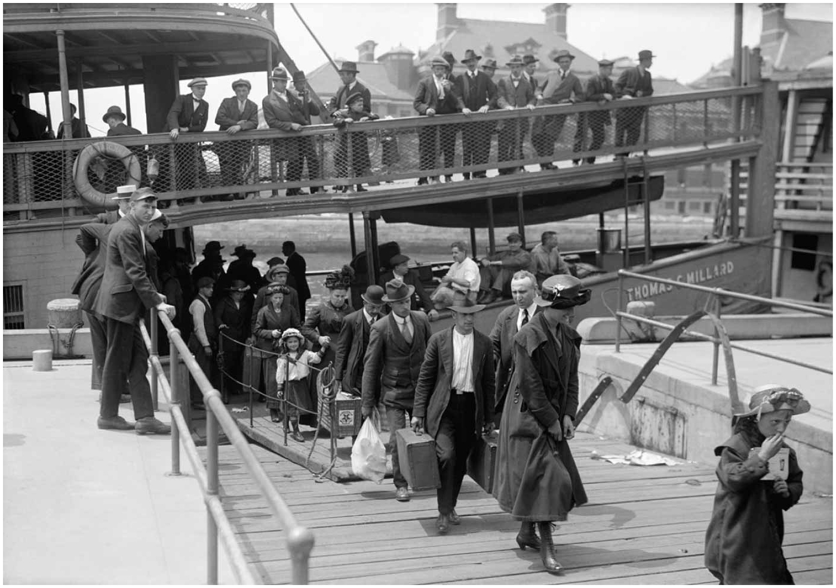
Chapter 3: Migration
Disembarking at Ellis Island, 1907

Slide 2
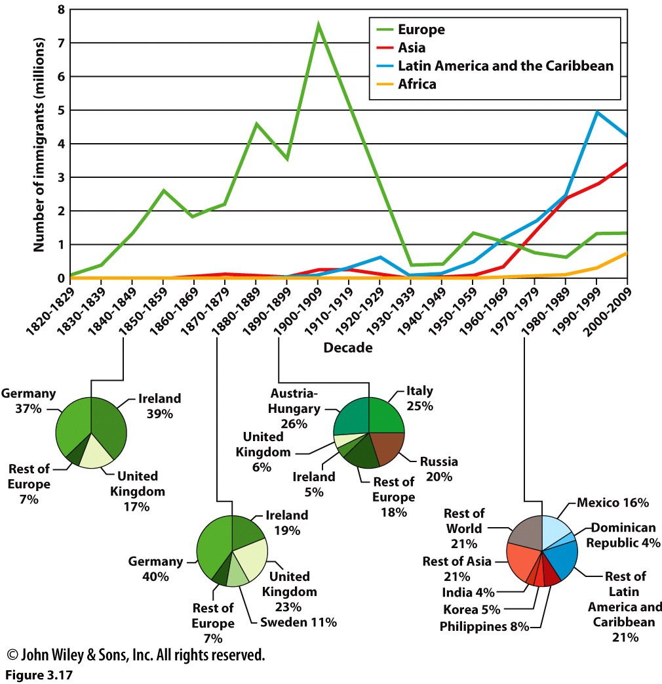
Understanding the terminology
Emigration
Immigration
Net Migration
Refugee

Slide 3
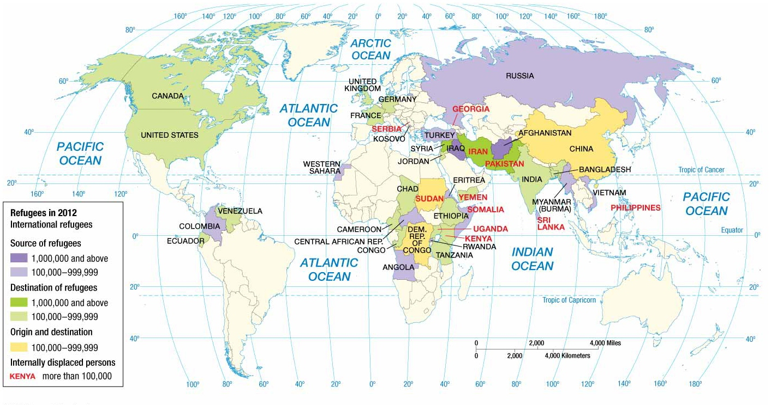
What groups has the US granted refugee status to?
Consider the case of Cubans:
Why Are Cubans Granted Refugee Status?
http://www.wnyc.org/story/99820-why-do-we-still-call-cuban-immigrants-refugees/
Read a college student’s assessment of US refugee policy:
The Haitian Dilemma
http://twp.duke.edu/uploads/assets/Daniels.pdf

Slide 4
Internal migration patterns
Interregional
Rural to urban
Urban to urban
Intraregional
Urban to suburban
Suburban to exurban

Slide 5
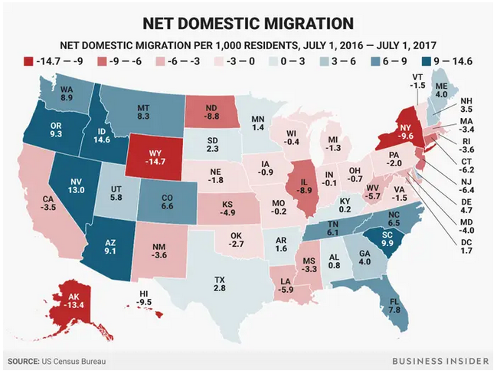

Slide 6
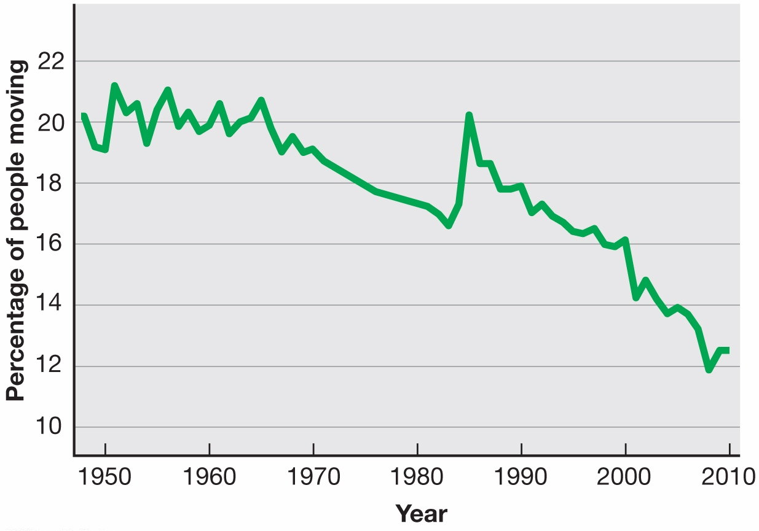
The percentage has declined from 20% in the late 1980s to 12 percent by the 2010s

Slide 7
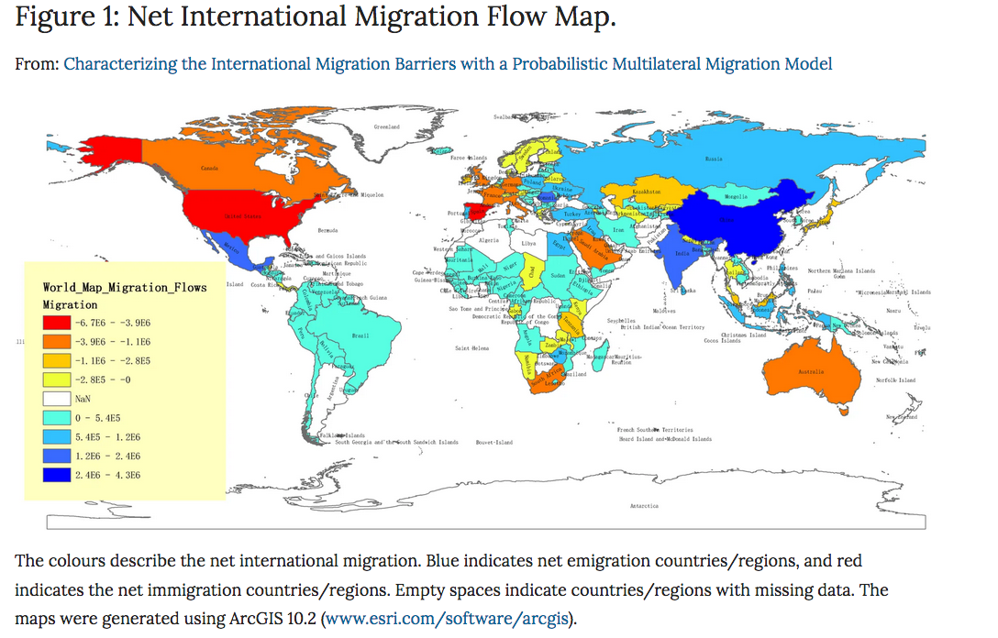
International Migration

Slide 8
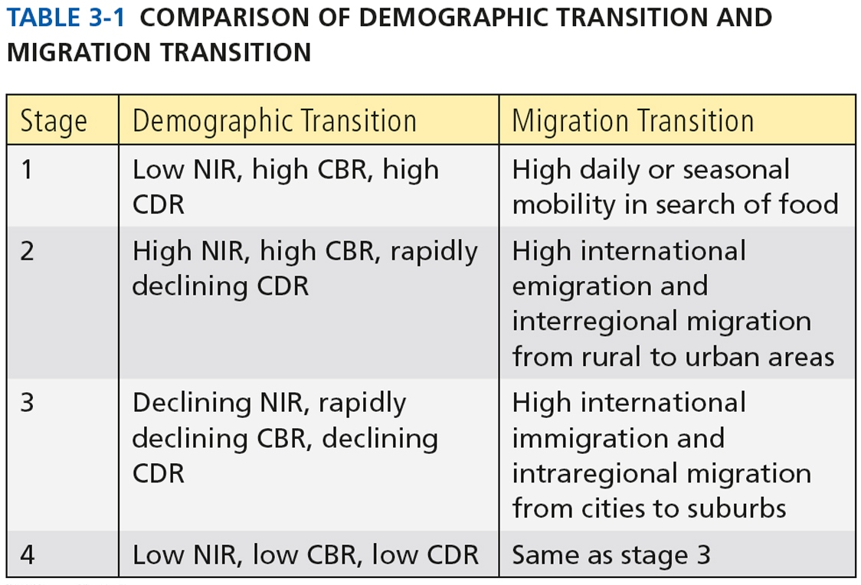
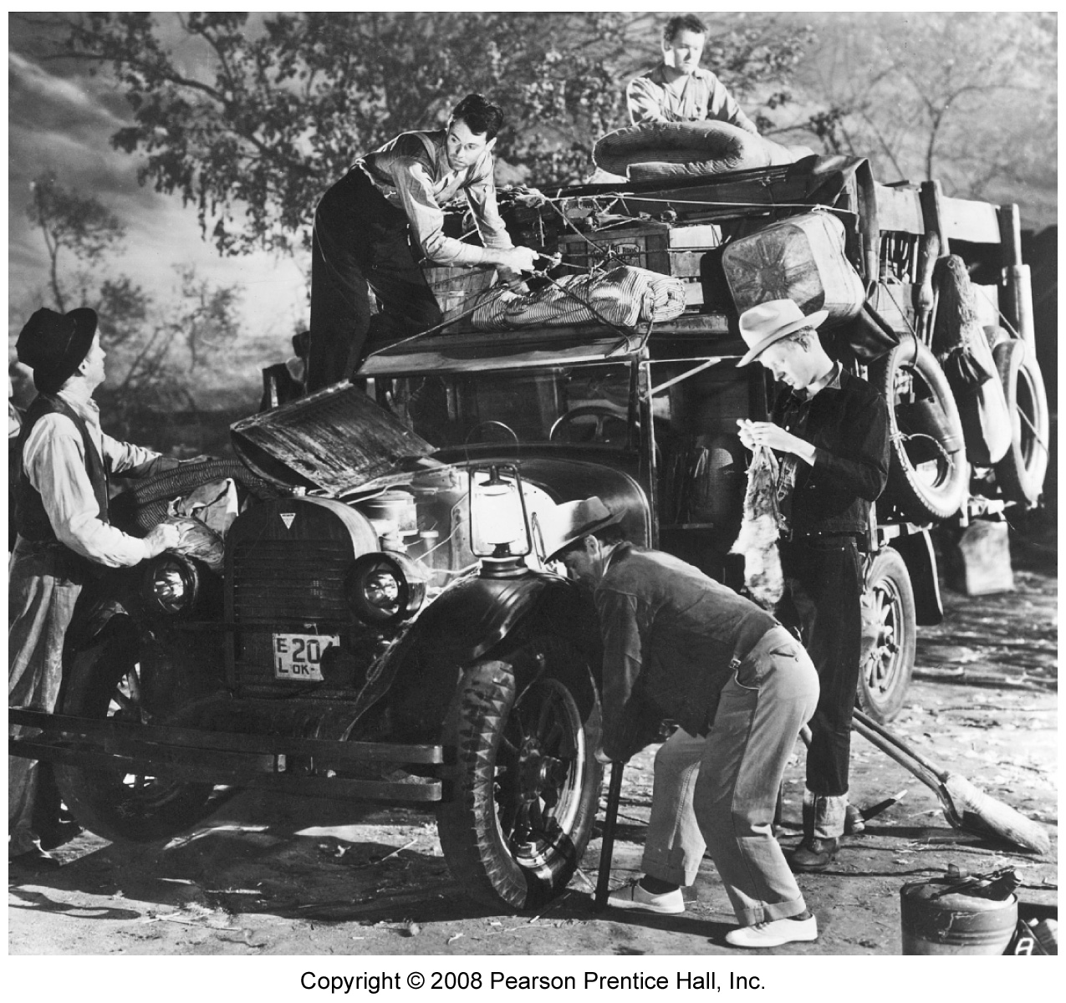
What are the causes of migration?
Push/Pull Factors
Economic
Social
Environmental
Migration Transition
Zelinsky
Government Policies
The Okies arrive in California—a scene from The Grapes of Wrath

Slide 9
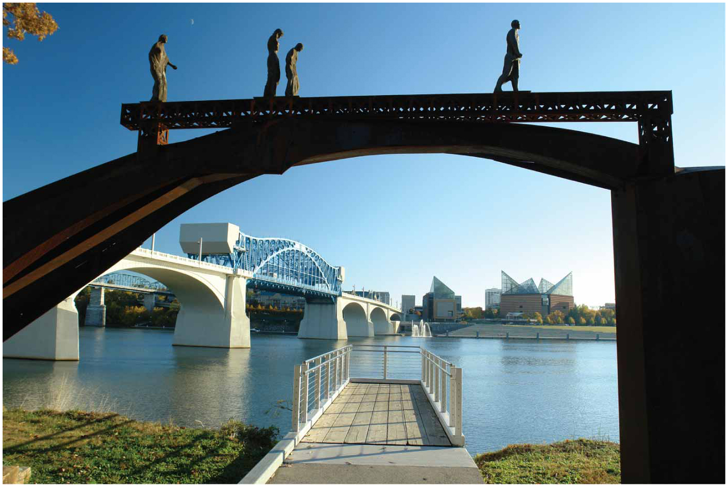
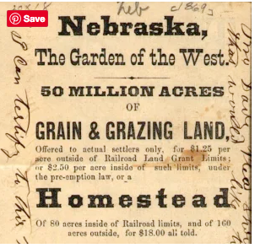
How has U.S. policy shaped internal migration flows?
Trail of Tears Sculpture, Chattanooga, TN. Start of the path the Cherokee were forced to take to Oklahoma in 1838.
The US government’s Homestead Act of 1862, encouraged migration to the West.

Slide 10
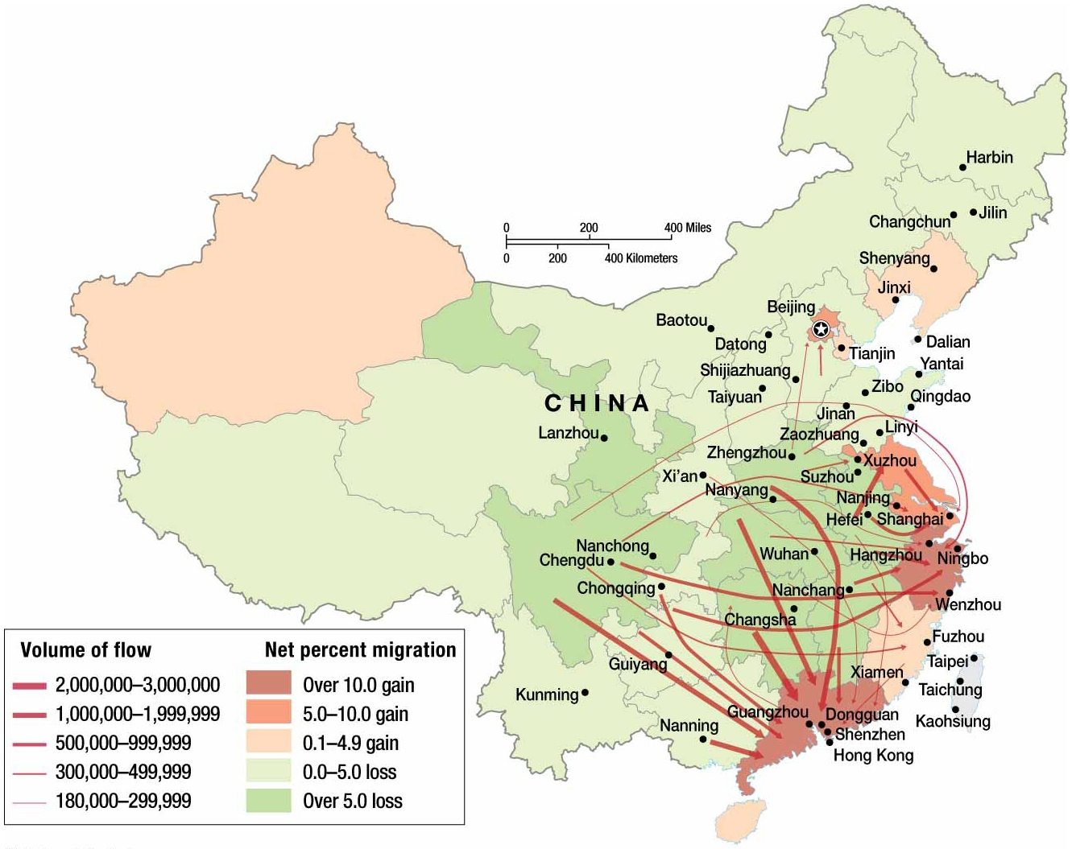
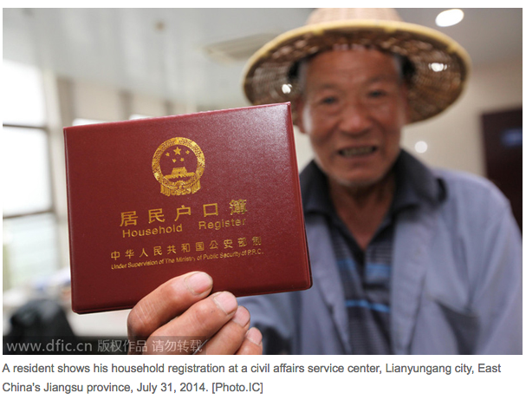
Do other countries control internal migration flows?

Slide 11
How do governments shape flows of international migration?
US Refugee policy
Cubans, Vietnamese, Salvadorans
US Immigration Reform Act, 1965
From quota system to family, money, skill
Filipinos--brain drain and remittances
Guest Worker Programs
Europe
Middle East

Slide 12
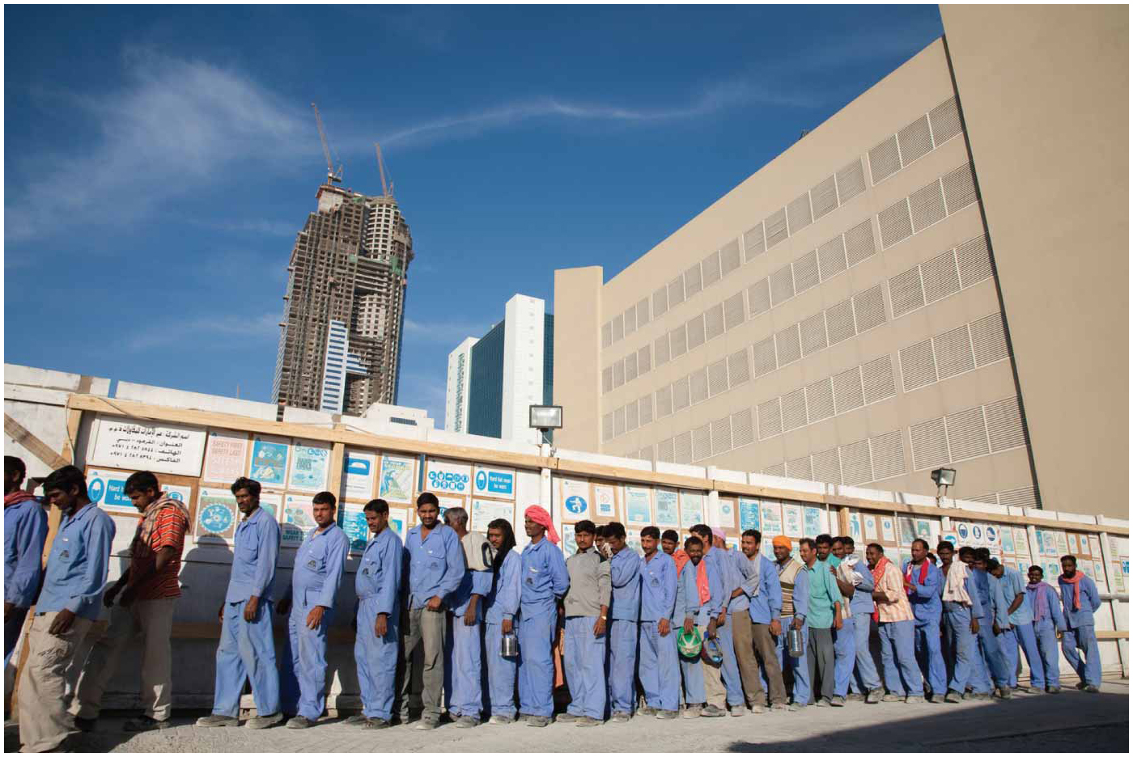
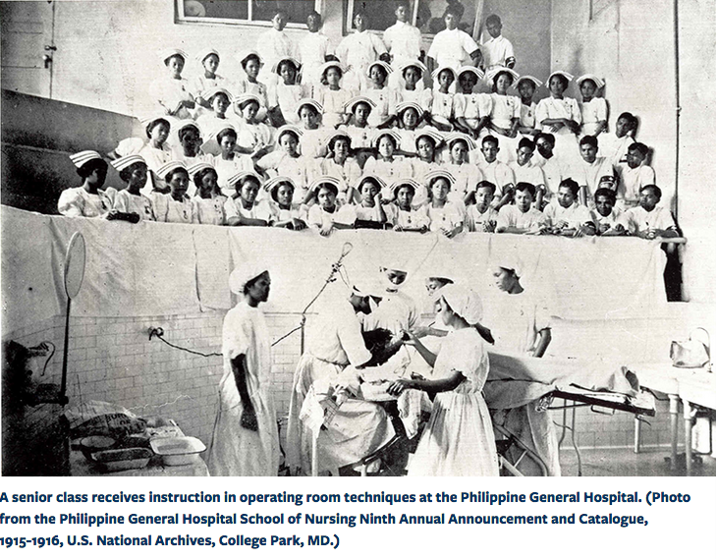
Construction workers in Dubai
Cleaning the Paris streets.

Slide 13
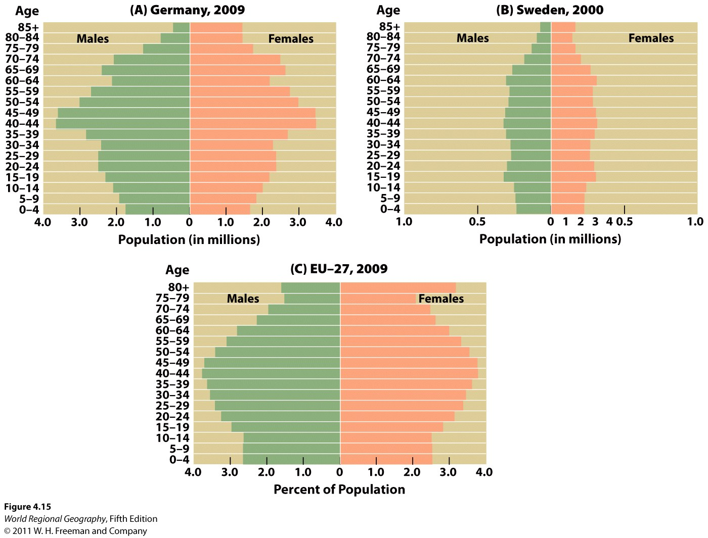
The EU will need 3 million immigrants each year to fill labor force demands.

Slide 14
Case Study: France & Algeria
European Colonialism
Establishment of rule by a sovereign power over an alien and subordinate people
White Man’s Burden
Mercantile Colonialism: 1500-1780
Industrial Colonialism: 1780-1870
Classical Colonialism: 1870-1914
End stage of Colonialism: 1914-today

Slide 15
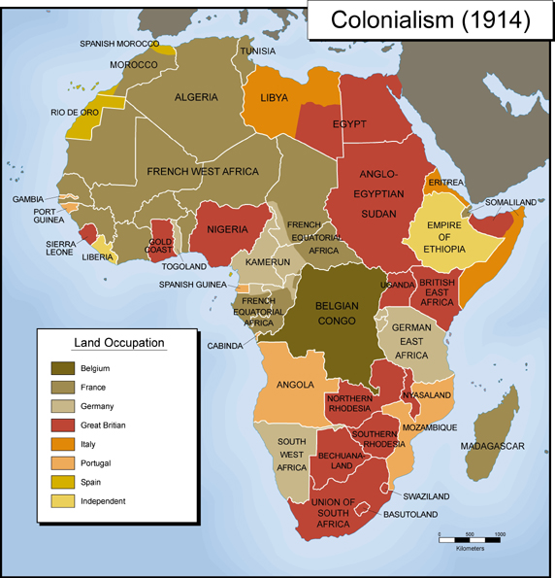

Slide 16
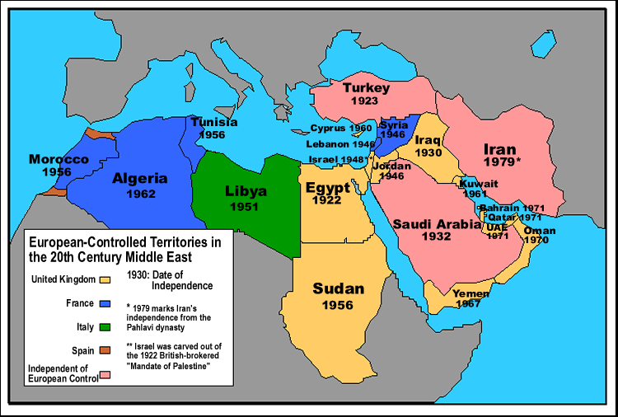

Slide 17
France colonizes Algeria
1830 invasion
1871 Warnier’s Law
Algerian independence, 1954-1962
Pied noir

Slide 18
Jean-Marie LePen at a rally on March 7, 2010. The sign reads “No to Islamism.
You’re with LePen” and shows a map of France covered by an Algerian flag and
Minarets. Source: Reuters

