Slide 1
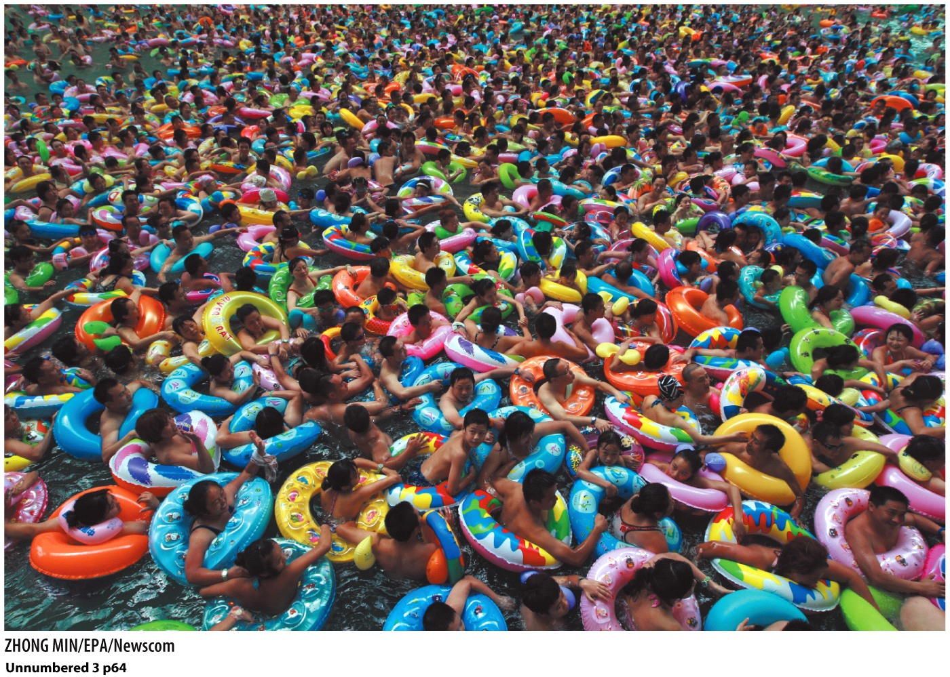
Chapter 3: Population Geography

Slide 2
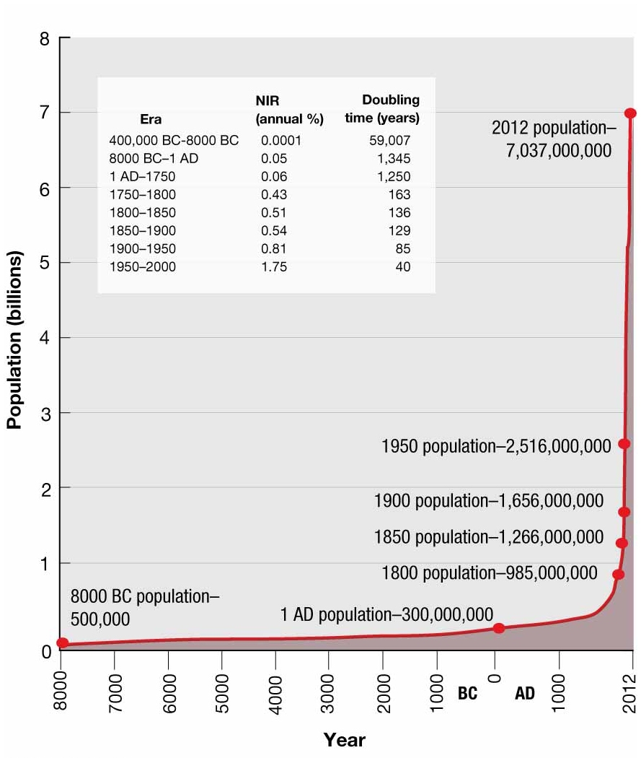
How fast is human population growing?
Human population did not change much until the 20th Century:
1800=1 bill.
1900=2bill.
1965=3.3 bill.
2011=7 bill.
The Earth’s population will double in size in about 35 years. This is called “doubling time.” The lower the number, the faster the growth.

Slide 3
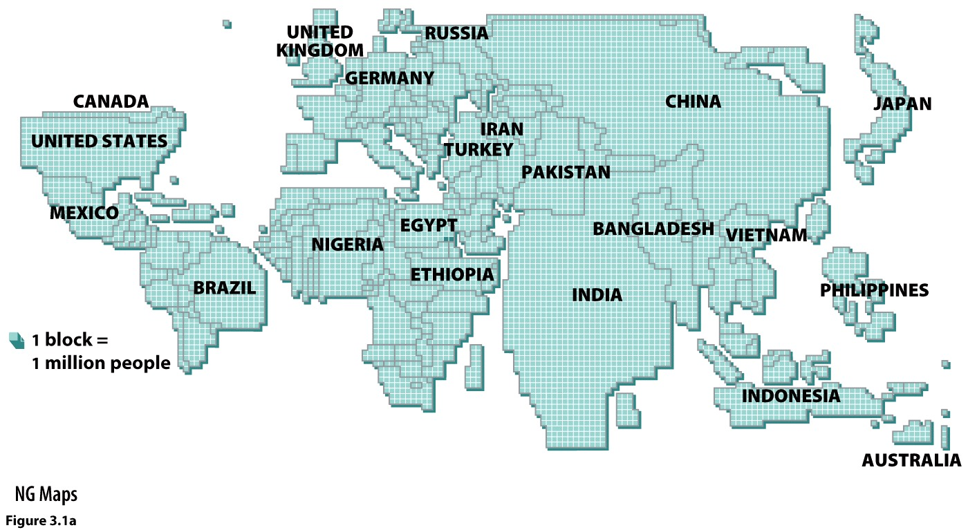
Where is human population located?
Largest countries currently (2019 data):
China 1.398 bill.
India 1.391.9 bill.
USA 329 mill.
Indonesia 268.4 mill.
Pakistan 216.6 mill.

Slide 4
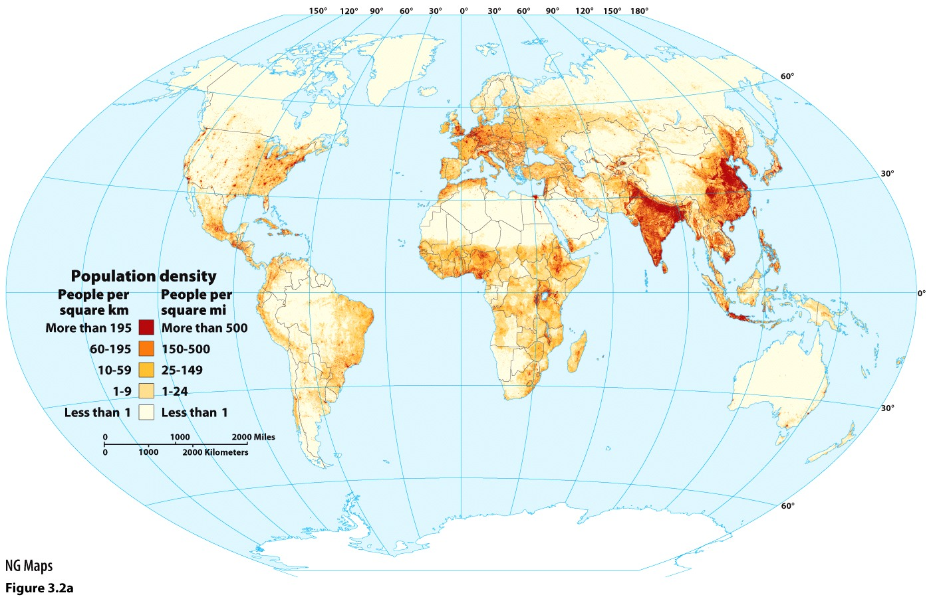
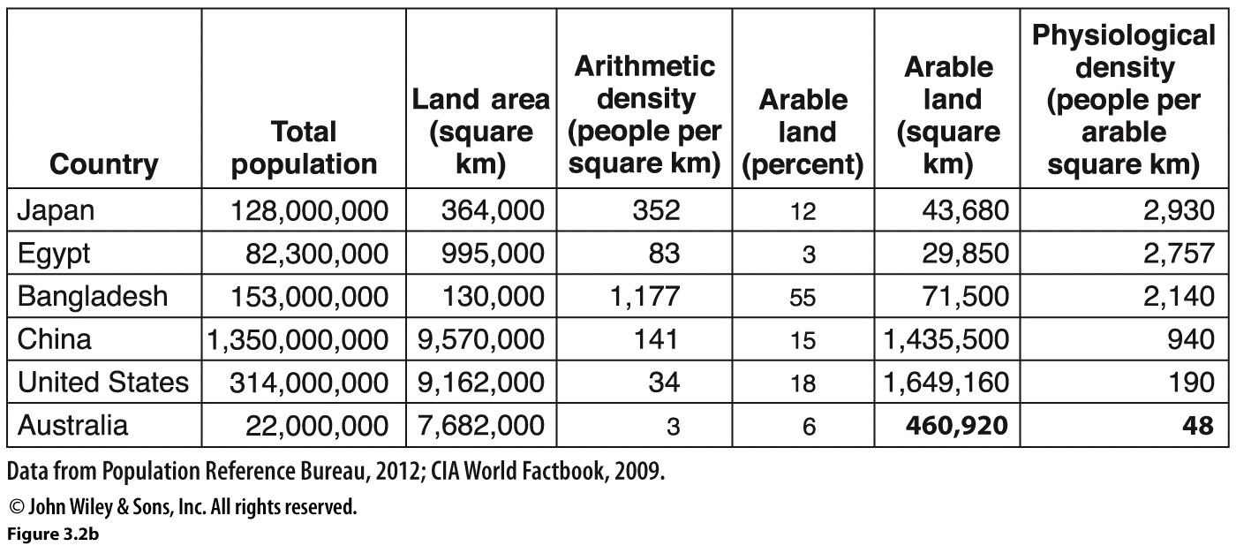
How close together are humans?
Density
Arithmetic
Physiological
A crowded subway in Tokyo.
NOTE: Physiological density tells us much more about access to resources. The greater the physiological density, the greater the pressure on land use for farming.

Slide 5
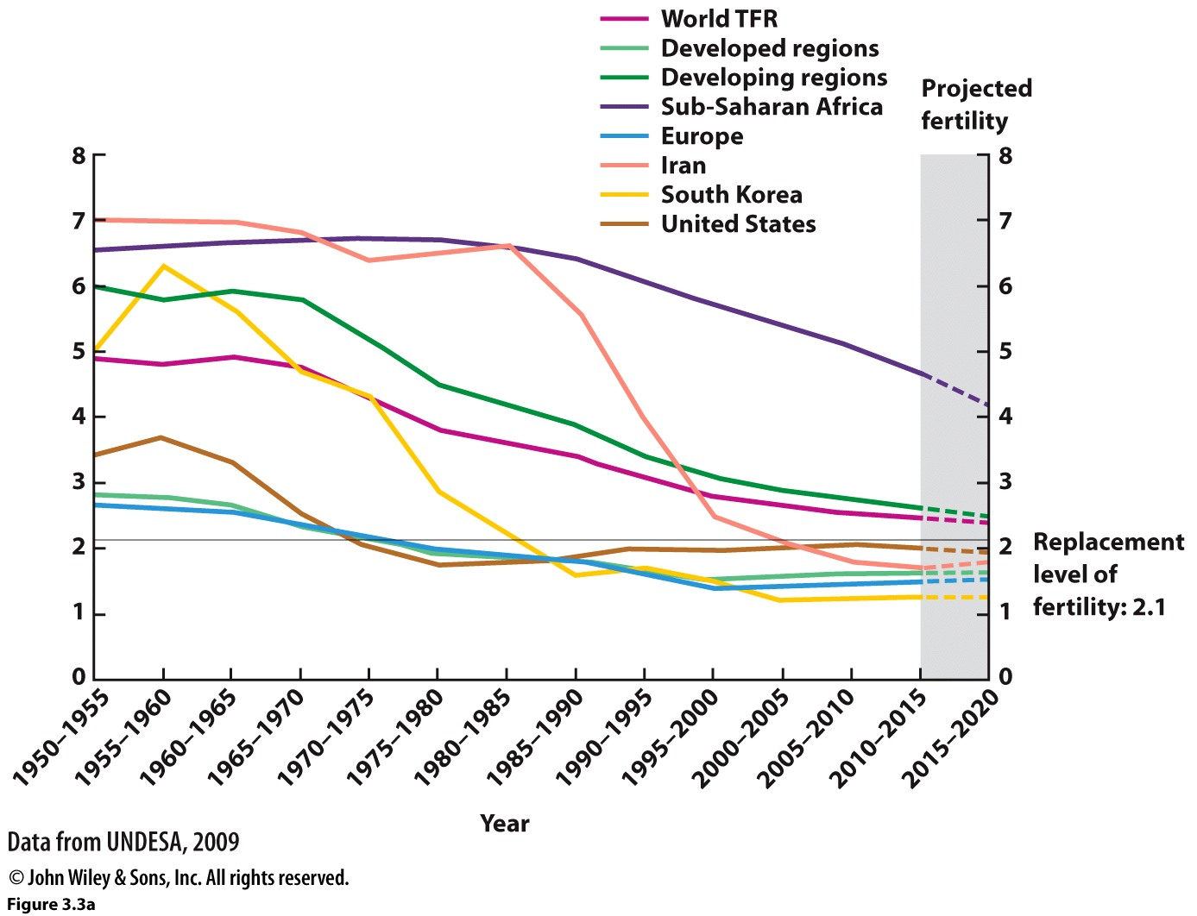
How do we measure population change and predict population growth?
Total fertility rate (TFR)
Over 2.1 and population grows
Under 2.1 and population shrinks
Lowest in world is South Korea and Andorra at 1.
Highest in world is Niger at 7.
Natural Increase Rate (NIR or RNI, rate of natural increase)
Subtracts deaths from births (CBR-CDR)
Lowest CBR in world is South Korea and Monaco at 6 births for every 1000 persons.
Highest CBR in world is Niger at 47.

Slide 6
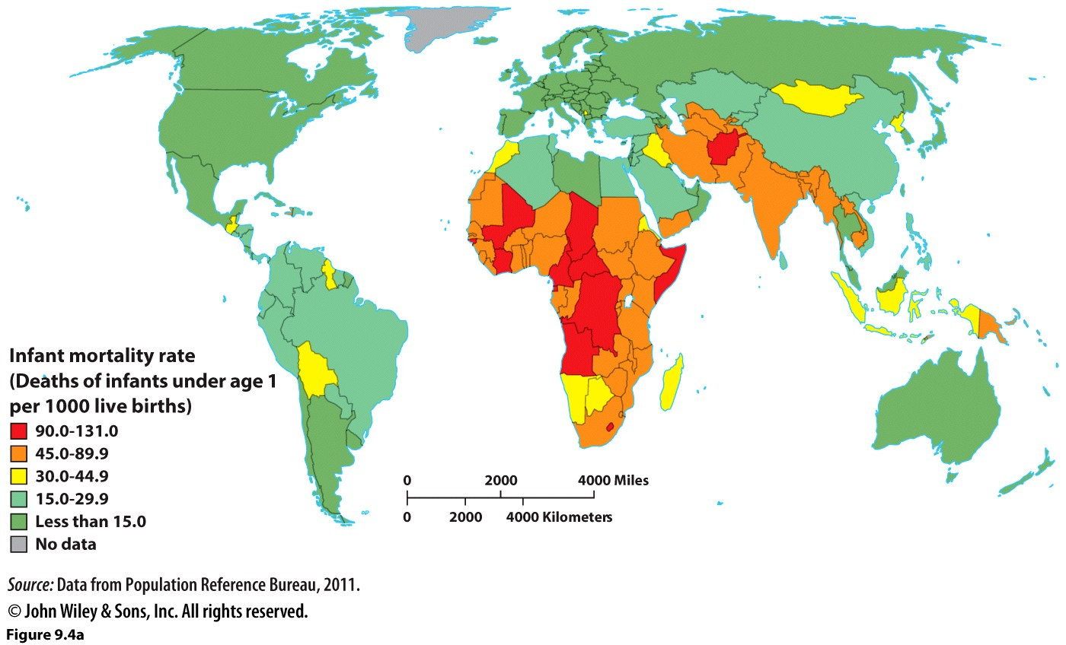
Why do people have large (or small) families?
Gender equality
Do women have the ability to support themselves economically?
How young are women marrying?
How strongly is a son preferred?
Healthcare
Are babies living? (IMR)
Do women (or men) have access to contraception?
State policies
Anti-natalist
Pro-natalist

Slide 7
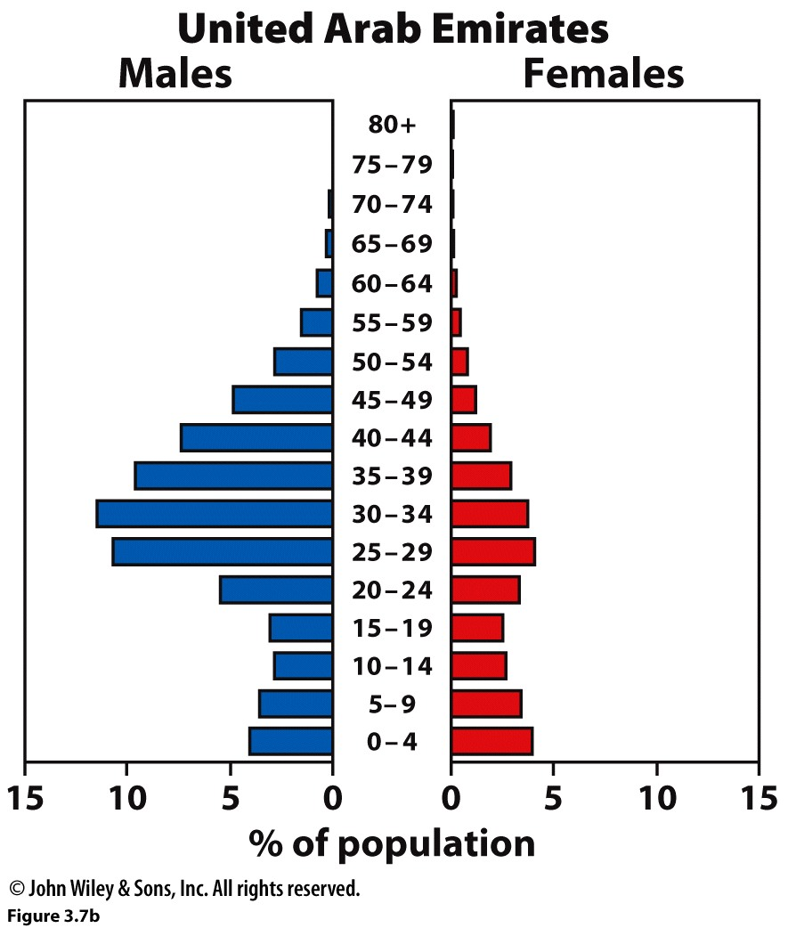
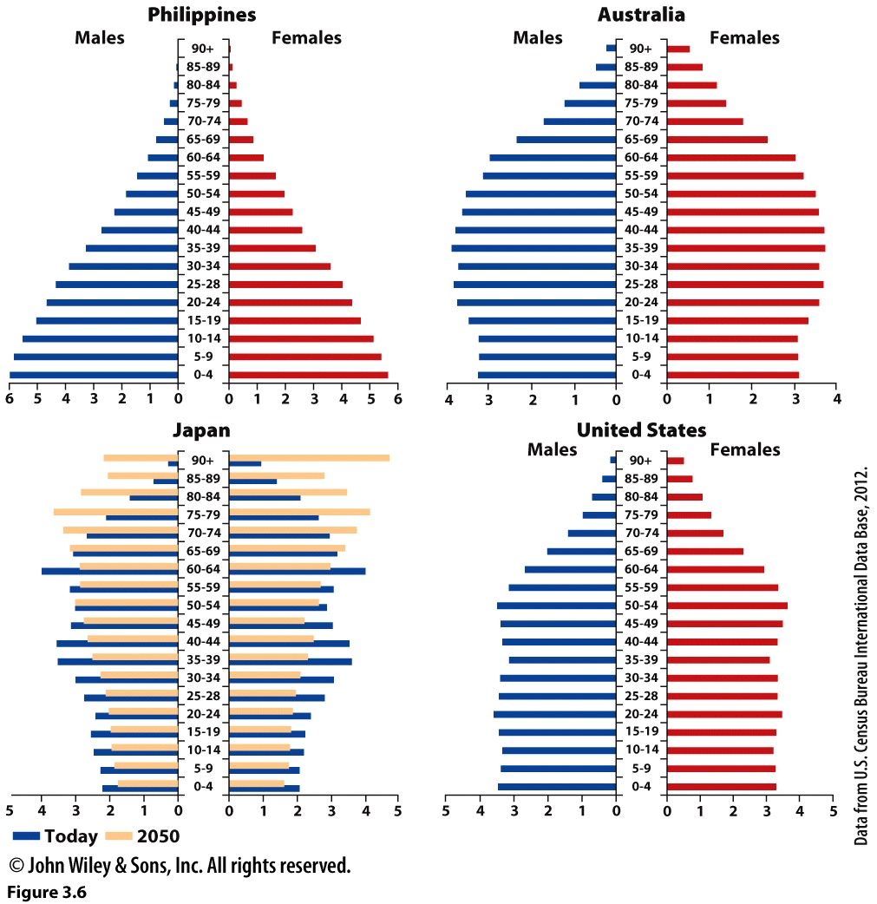
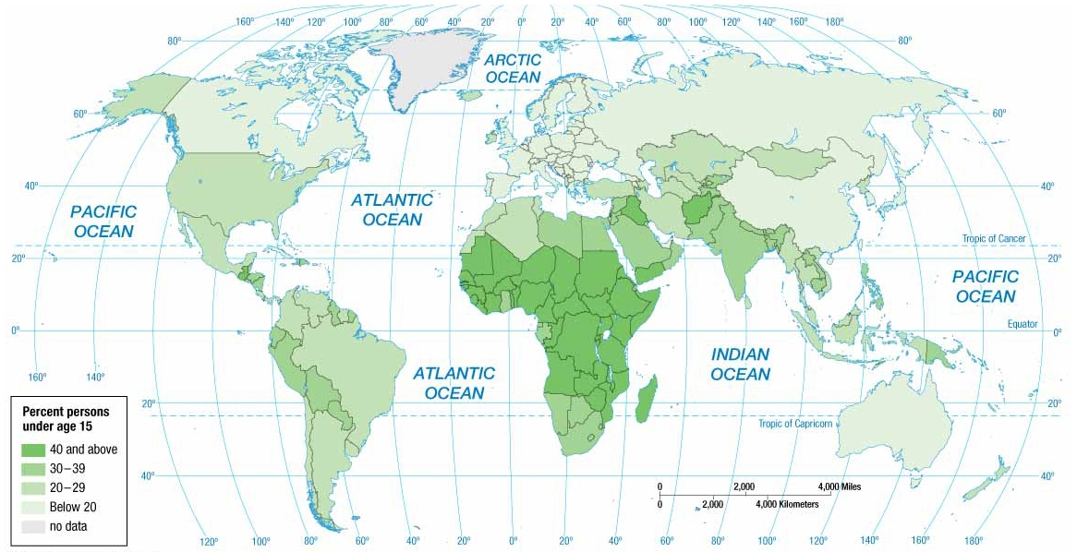
What does the structure of the population tell us?
Population pyramids
Age dependency ratios
Sex ratios

Slide 8
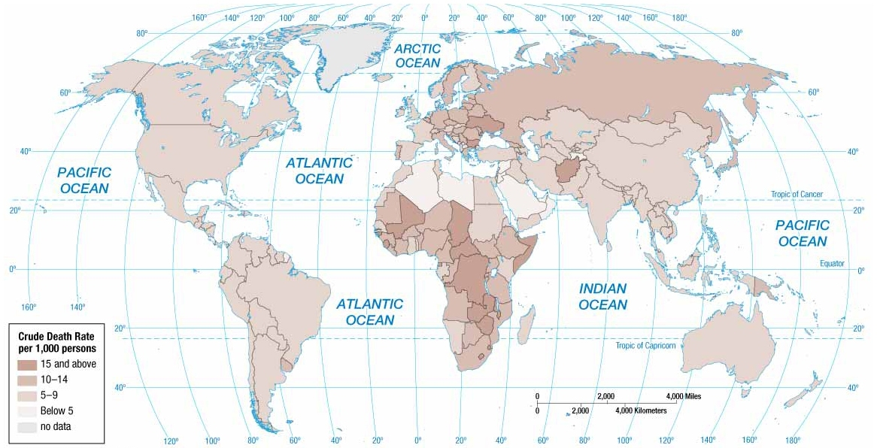
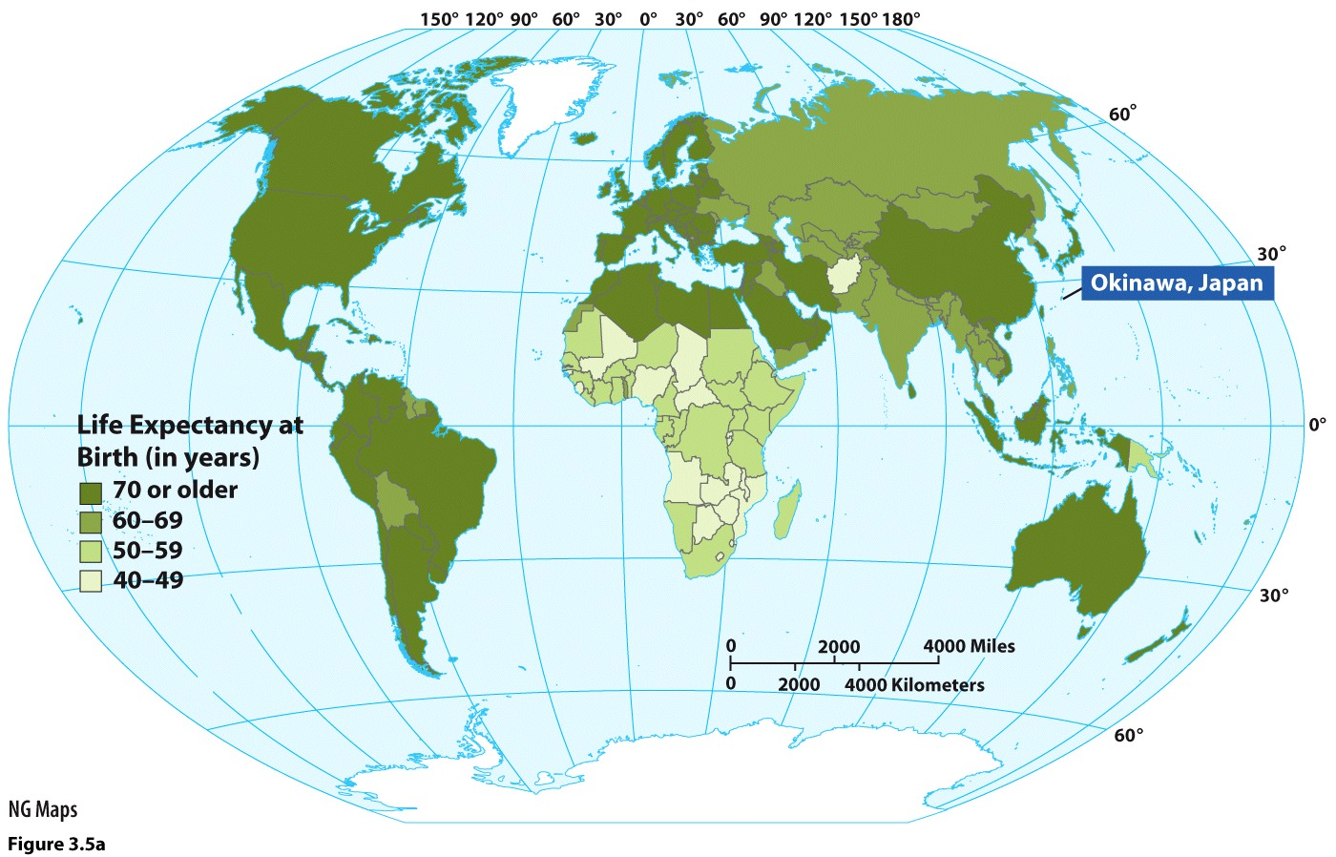
How long do people live?
Crude death rate
Lowest are in the Middle East
Highest in Sub-Saharan Africa
Reflects: war or natural disaster; access to health care/sanitation; aging populations
Life expectancy
Blue Zones: Okinawa, Japan has 50 centenarians for every 100,000 people (about 4-5x higher than any other country

Slide 9
Theories on population change
Demographic transition model
Thomas Malthus
Optimists/Cornucopians
Social critics

Slide 10
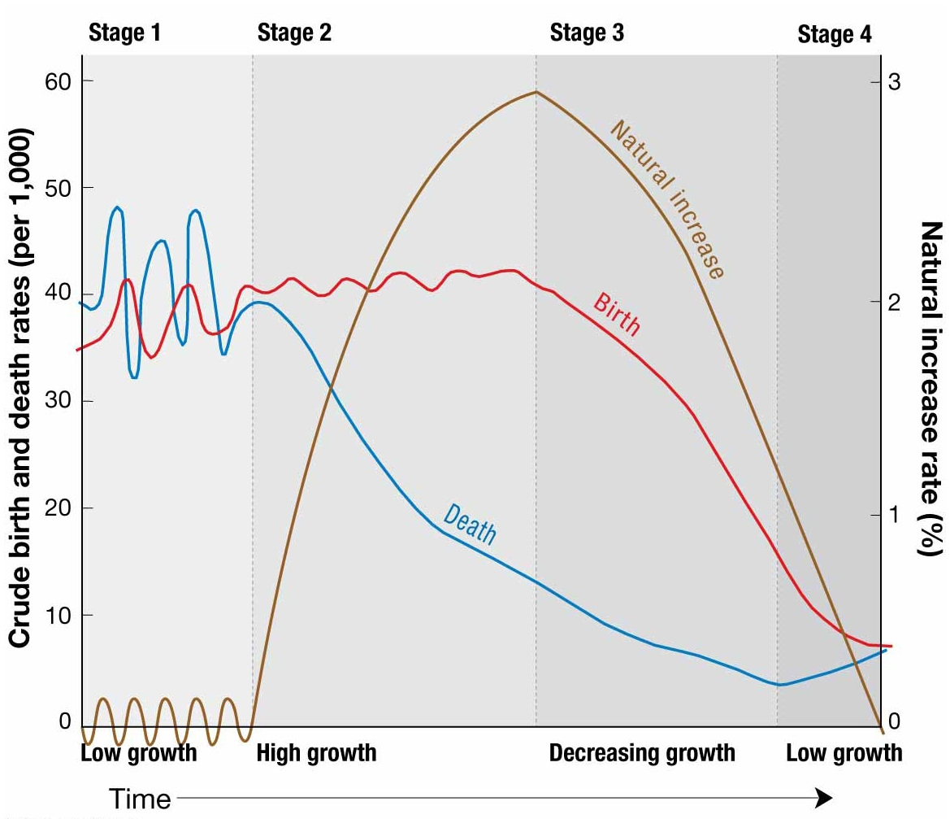
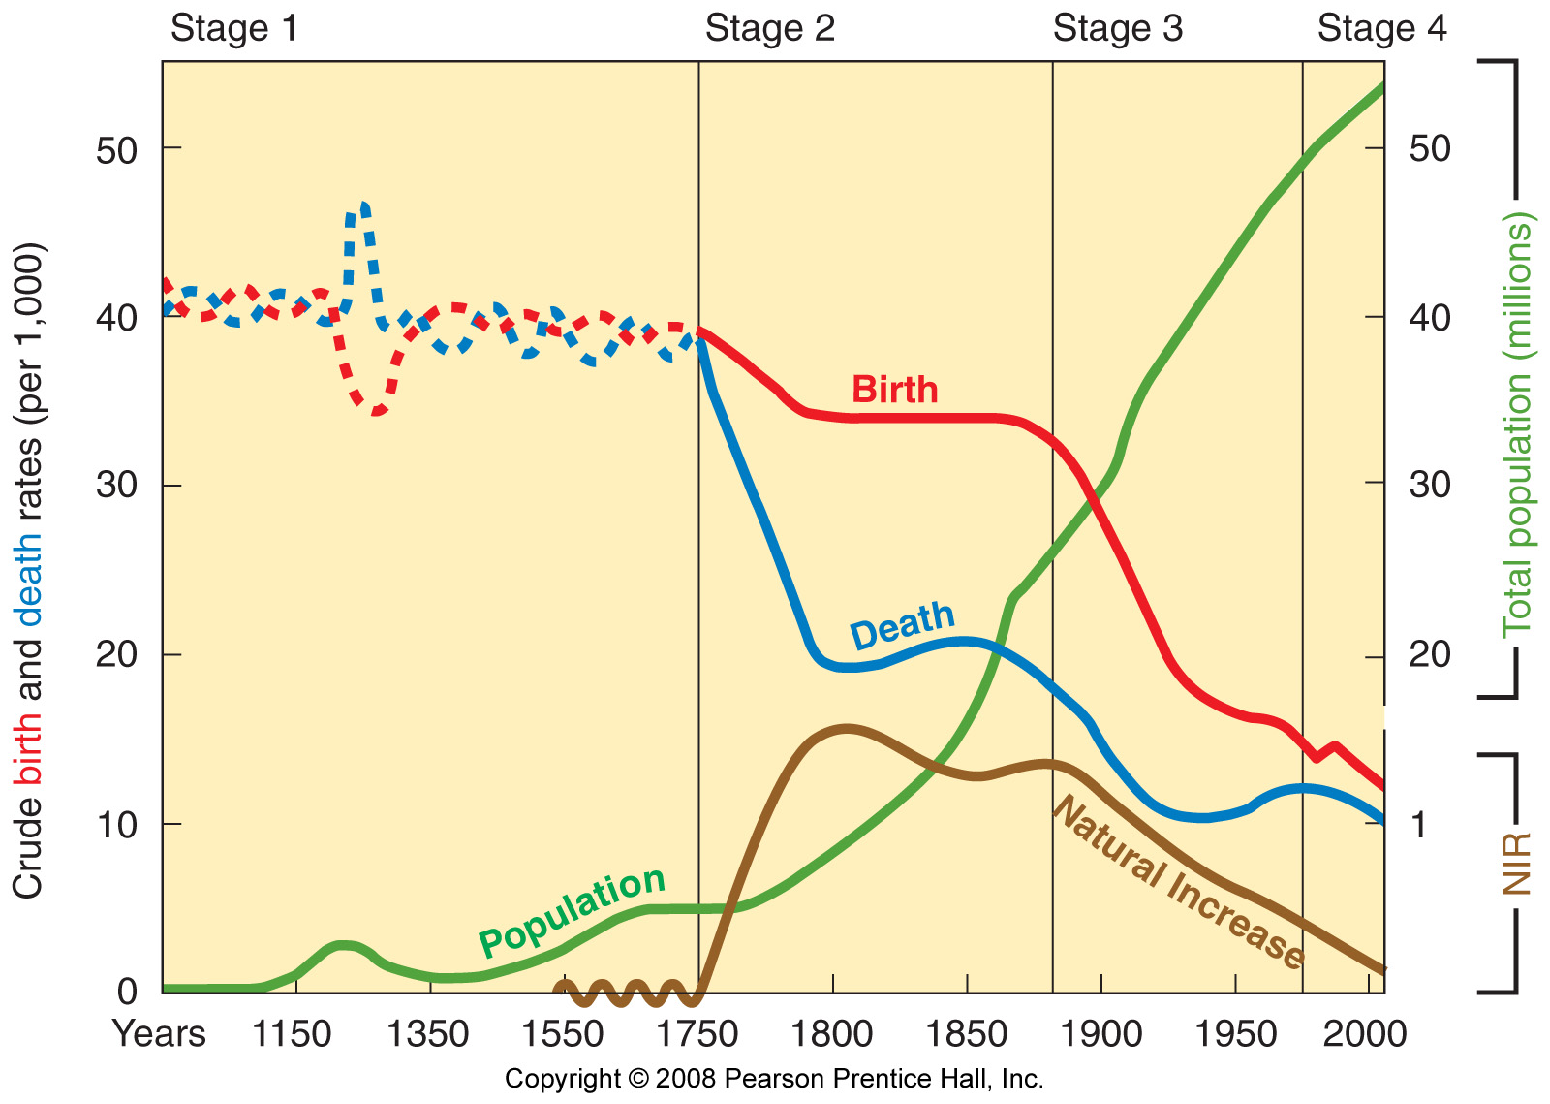
Demographic Transition
Says all countries experience four stages of demographic change
Model is based on the experiences of England

Slide 11
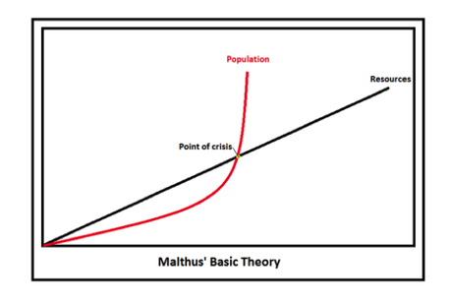
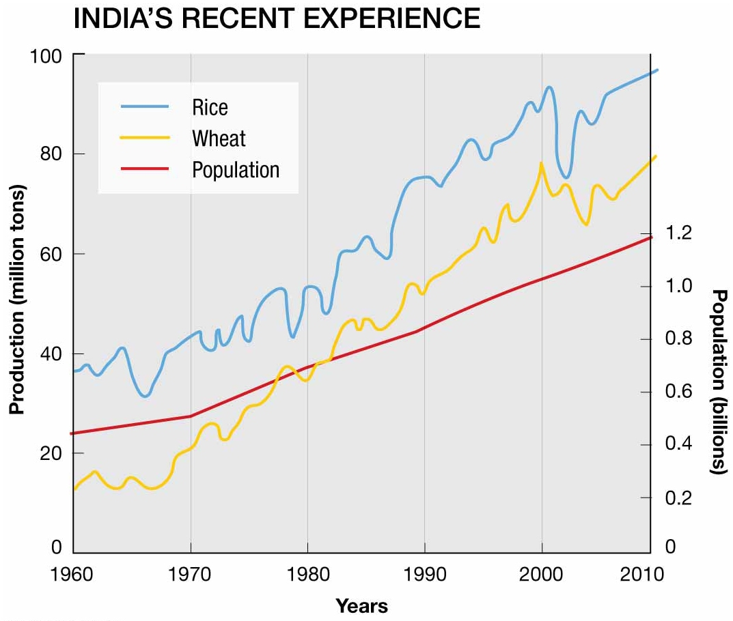
Thomas Malthus
Wrote: An Essay on the Principle of Population

Slide 12
Cornucopian/Optimist Theory
Esther Boserup
Julius Simon
Social critics: overpopulation does not explain food insecurity

Slide 13
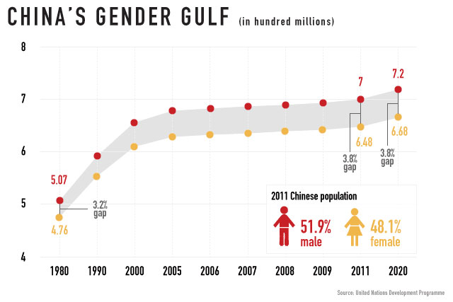
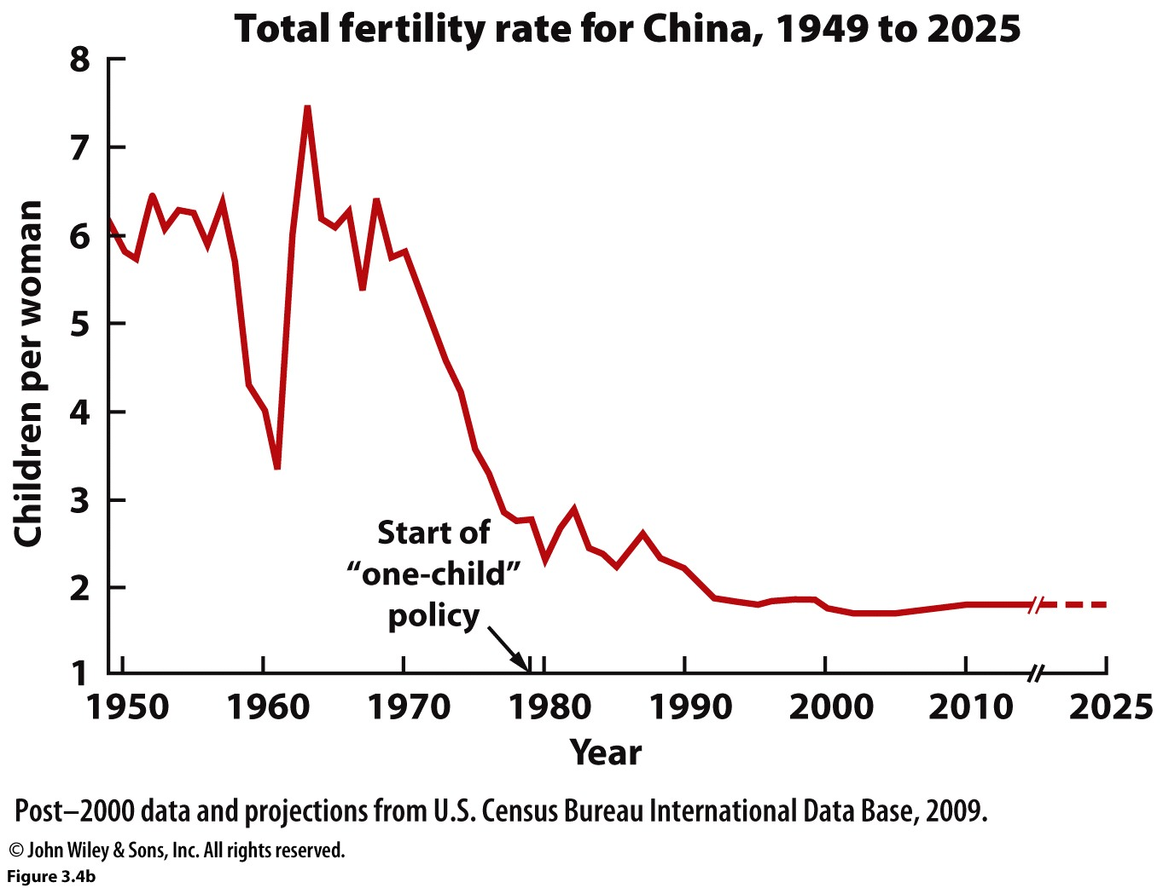
Anti-Natalist Policy: China
China’s One Child Policy
1979
Incentives & Disincentives
Outcomes
Sex imbalance
Aging populations
Little Emperors…

Slide 14
Romania: pro-natalist policy
Romania, children in an orphanage in mid 1990s. Photograph: Romano Cagnoni/Getty Images

Slide 15
Kerala, India
Mobile clinics (CHADs)
Education
Strong social safety net
Land redistribution

