Slide 1
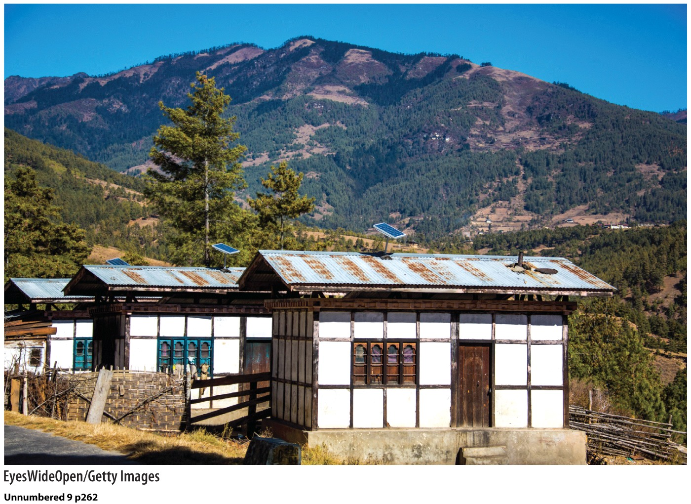
Chapter 11: Geographies of Development
Bhutan has rejected conventional measures of development and instead works to achieve ”Gross National Happiness.”

Slide 2
What is development?
Normative
Economic
Social
Environmental
HDI
Conventional vs Sustainable

Slide 3
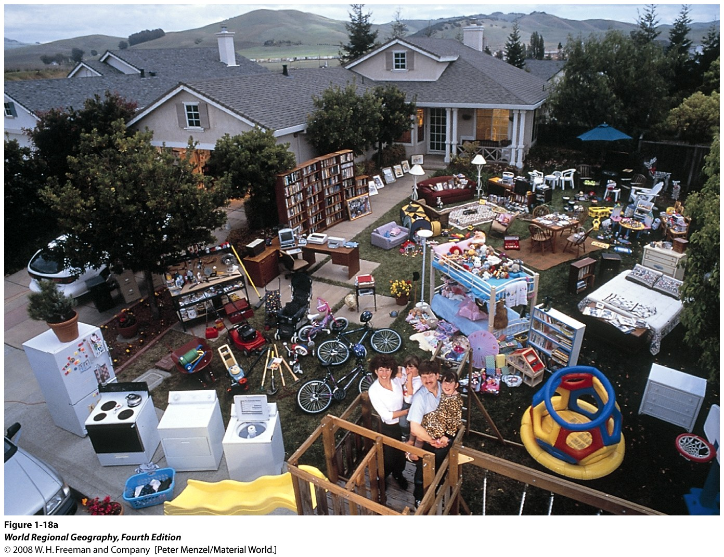
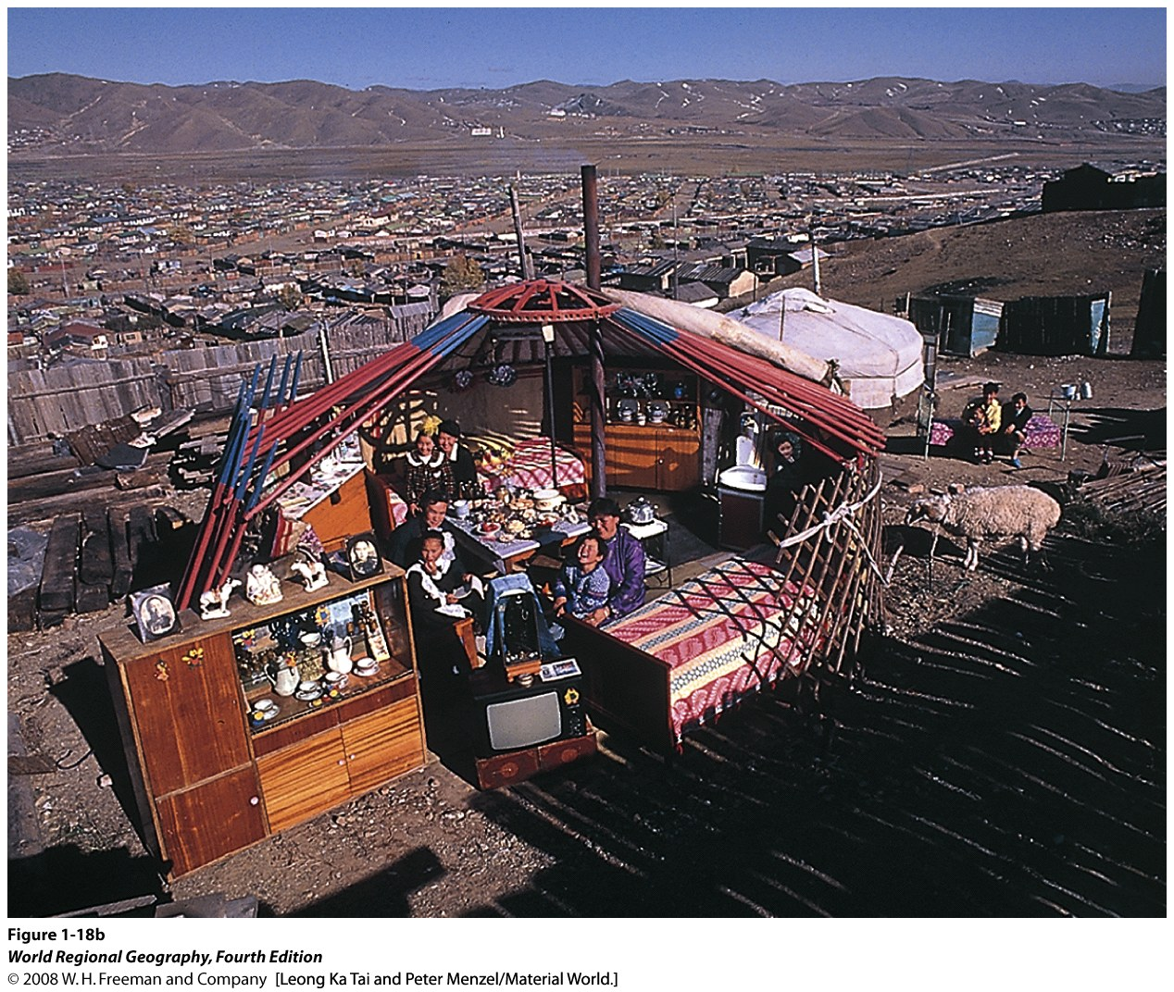

Slide 4
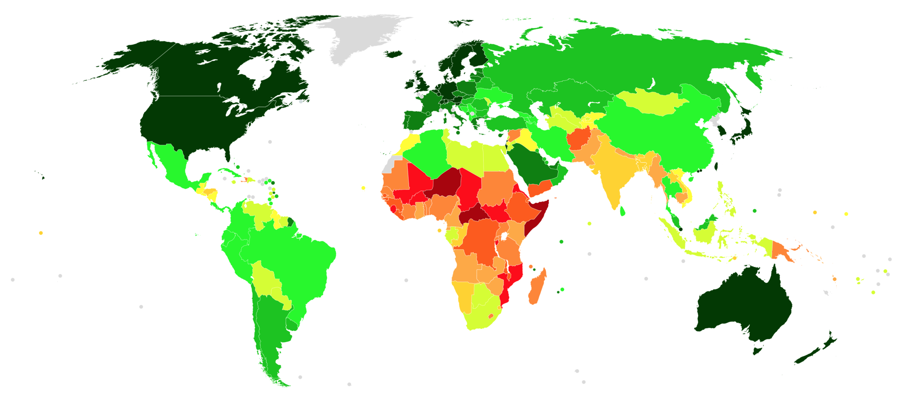
Human development index, 2018
The HDI considers wealth, life expectancy and years of schooling.

Slide 5
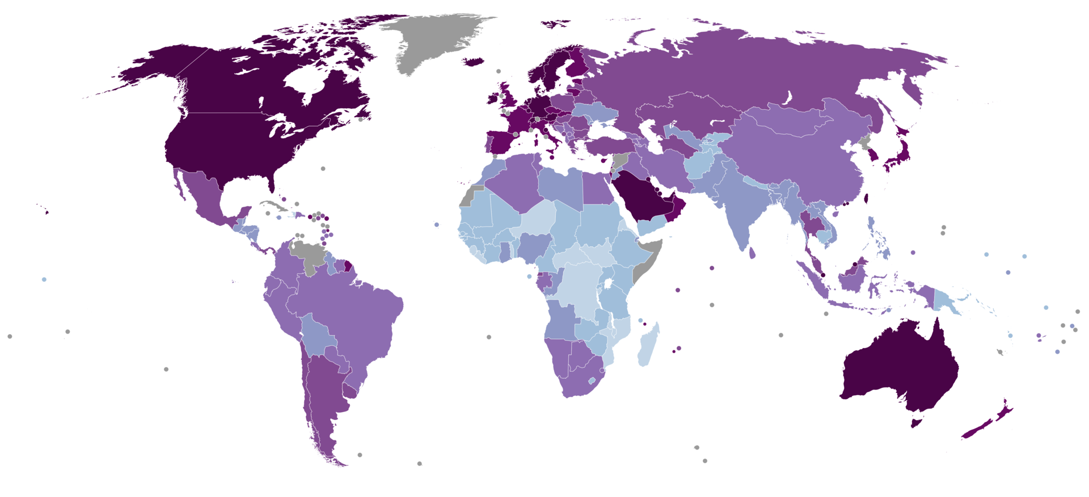
How do we measure economic development?
Economic indicators
Gross National Income (GNI)
Gross Domestic Product (GDP)

Slide 6
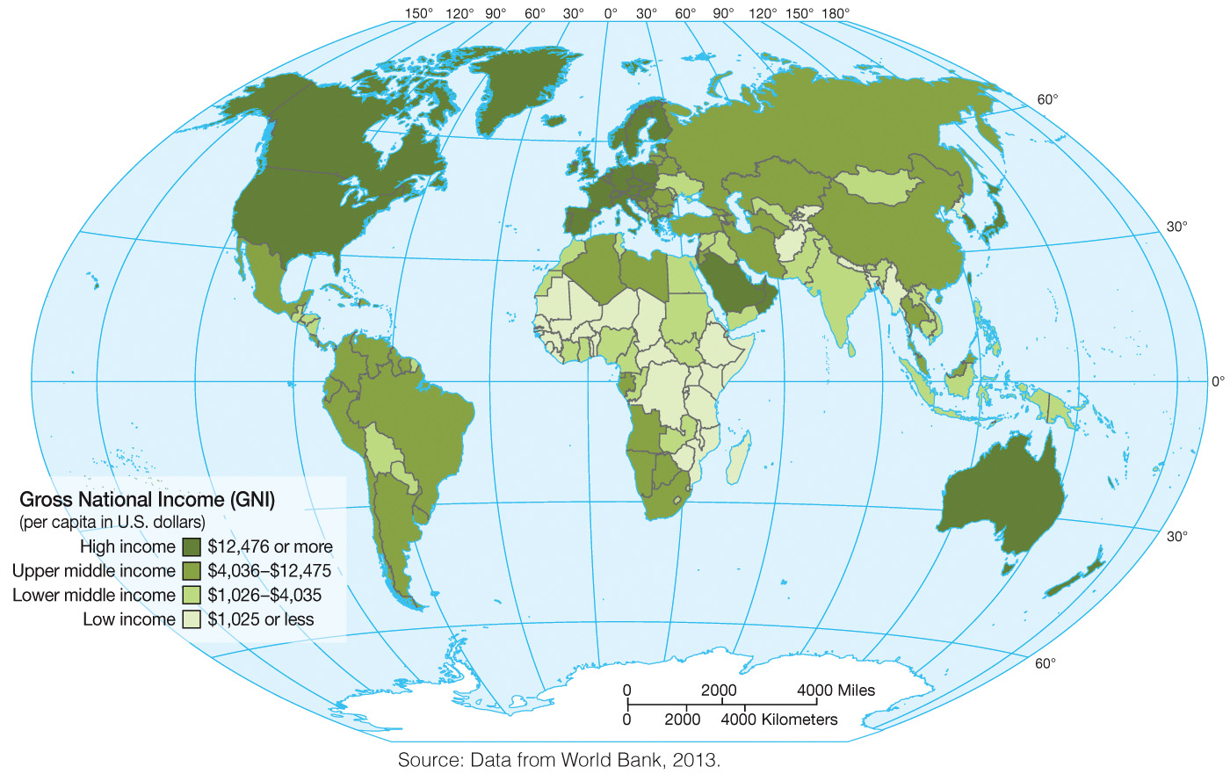

Slide 7
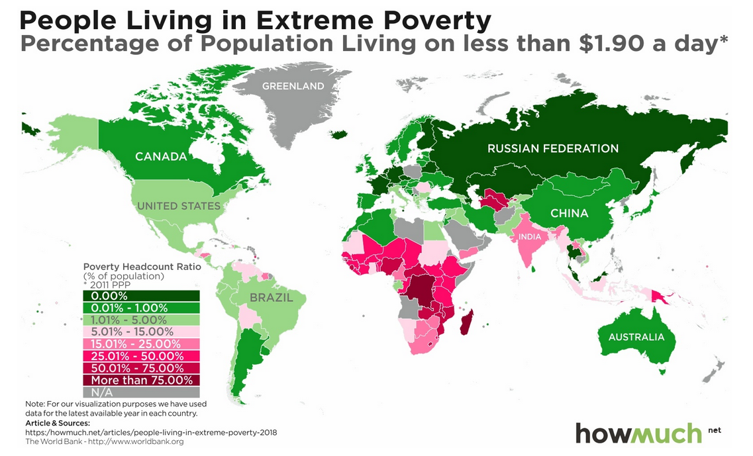

Slide 8
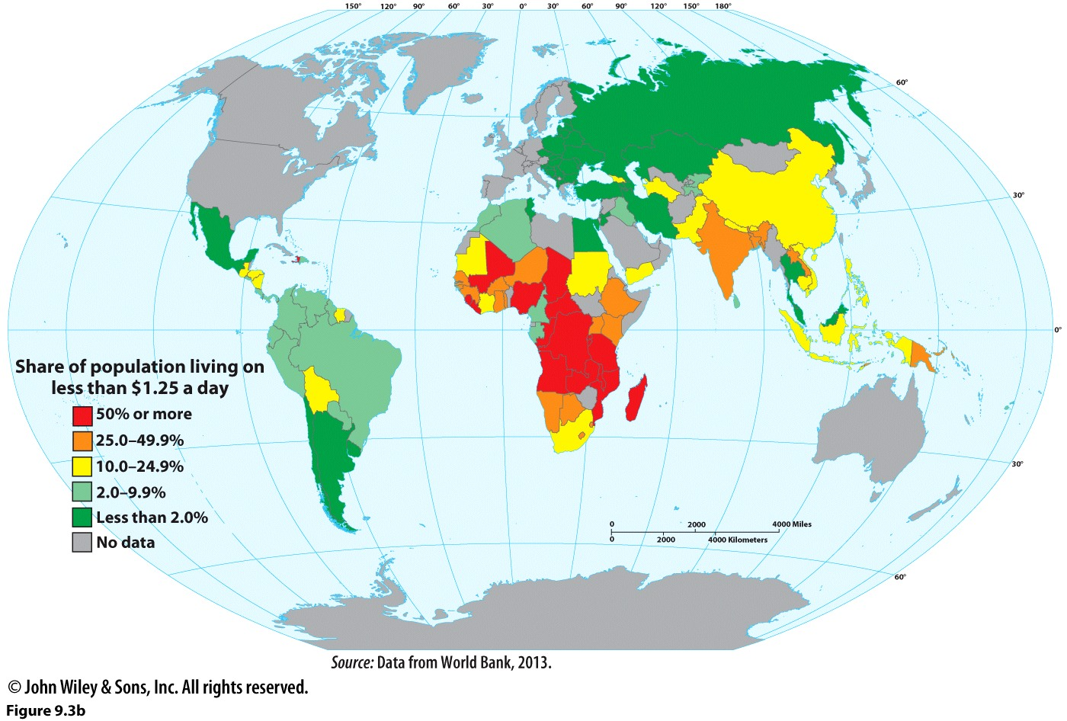

Slide 9
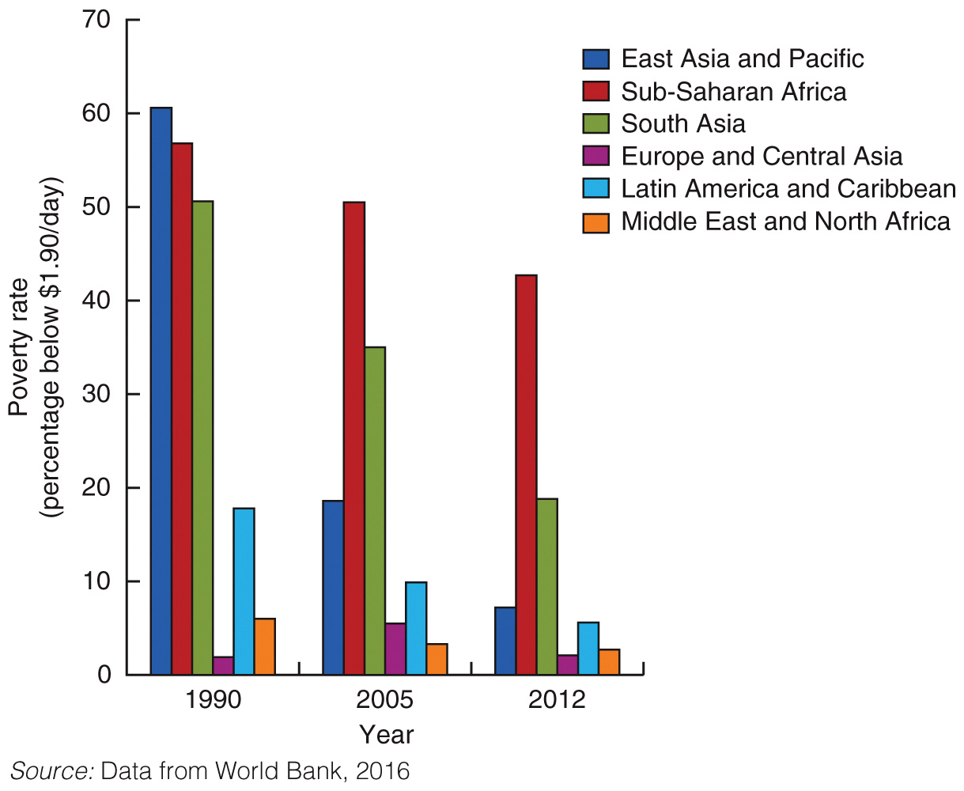

Slide 10
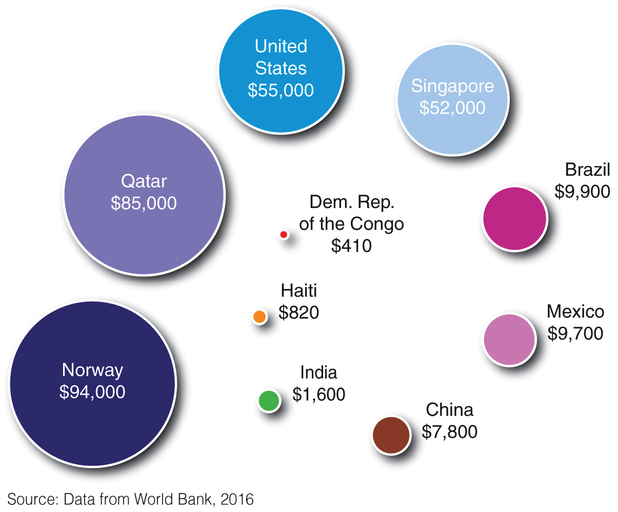

Slide 11
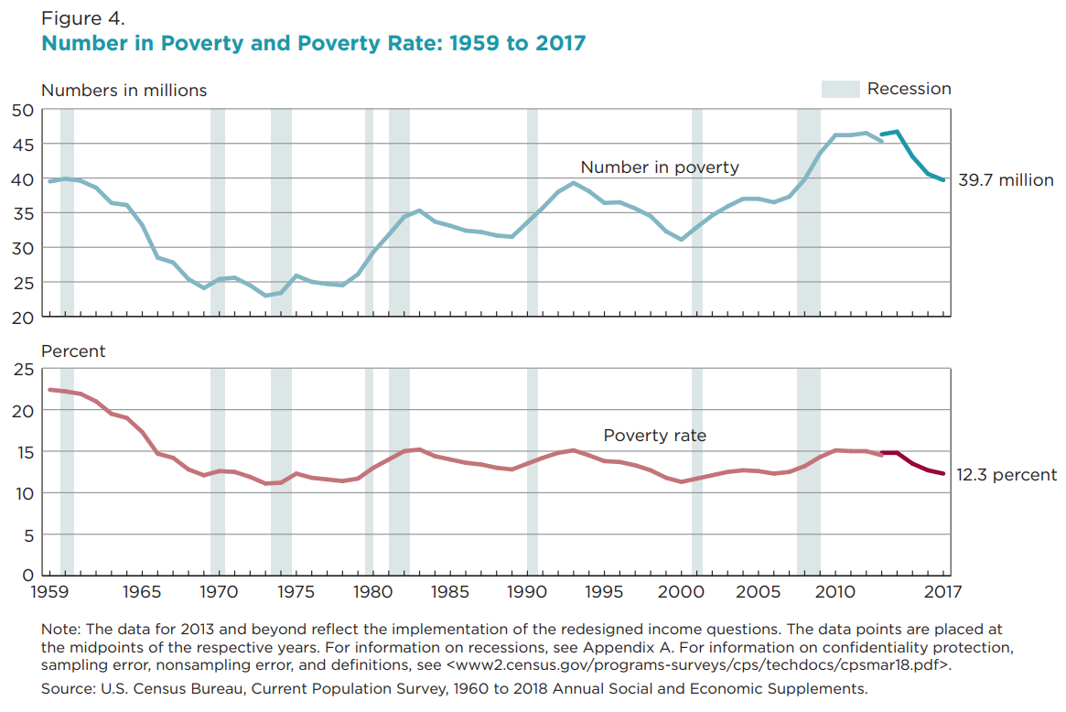
In 2018, 11.8% of Americans lived below poverty. Less than $25,000 for a family of 4.
Native Americans have a much higher poverty rate—about 29%.

Slide 12
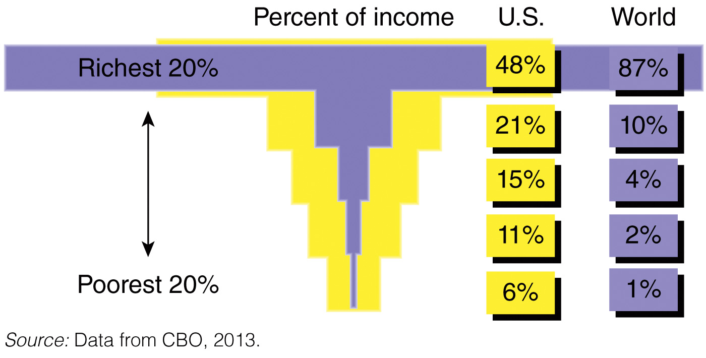

Slide 13
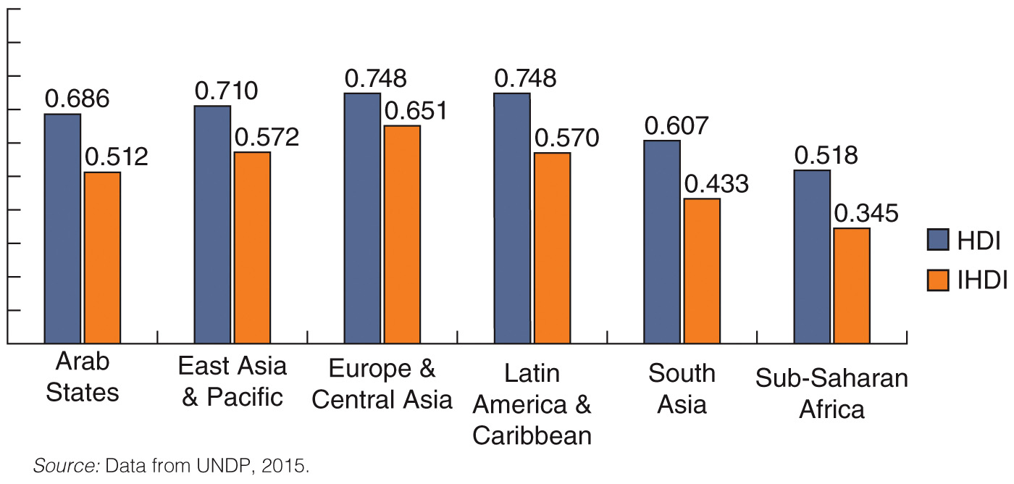

Slide 14
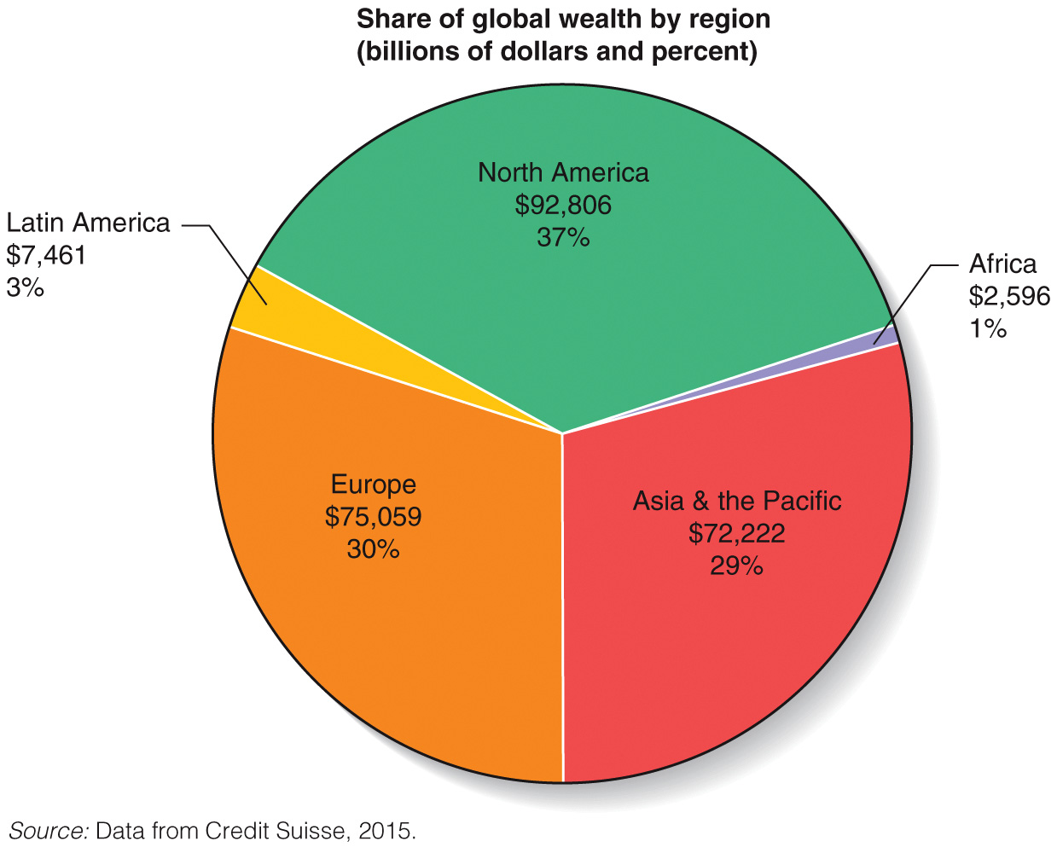

Slide 15
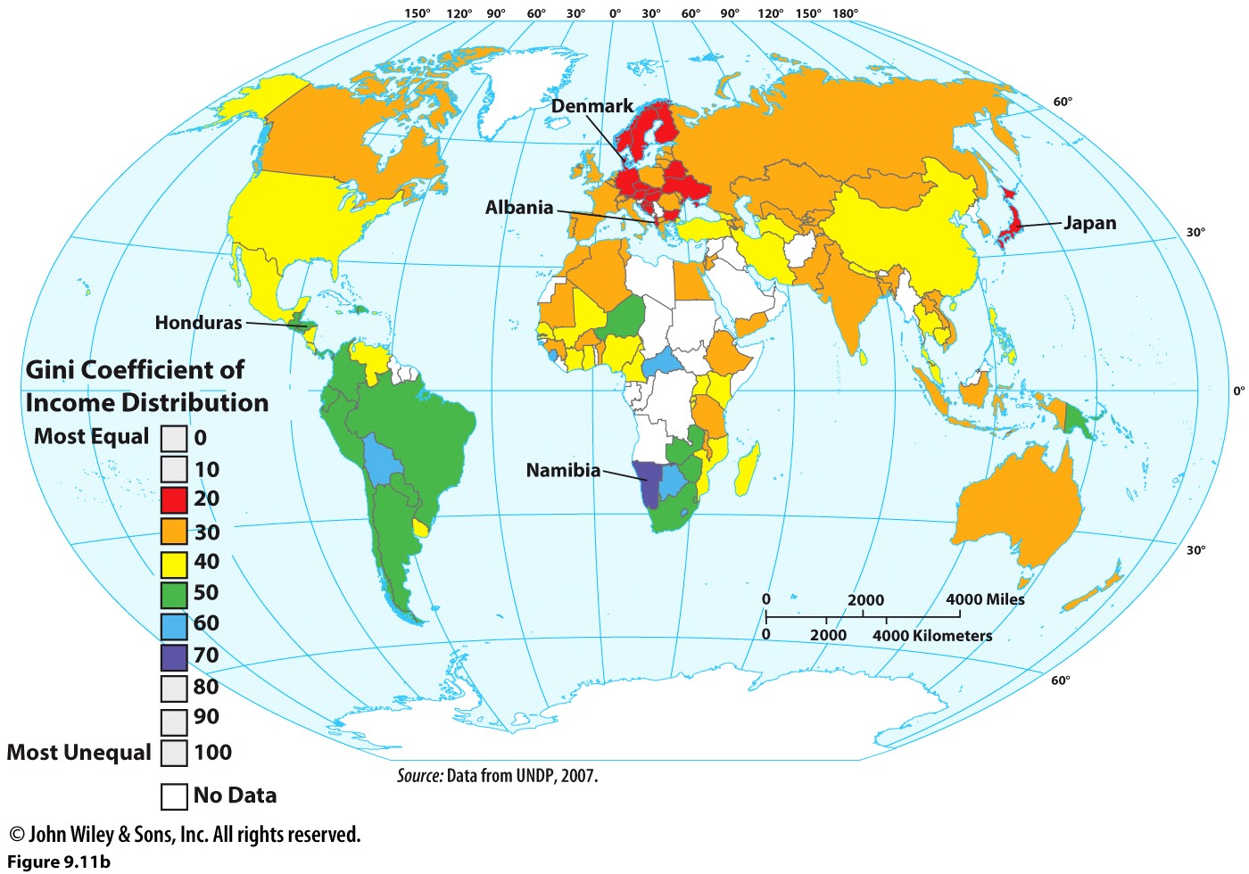

Slide 16
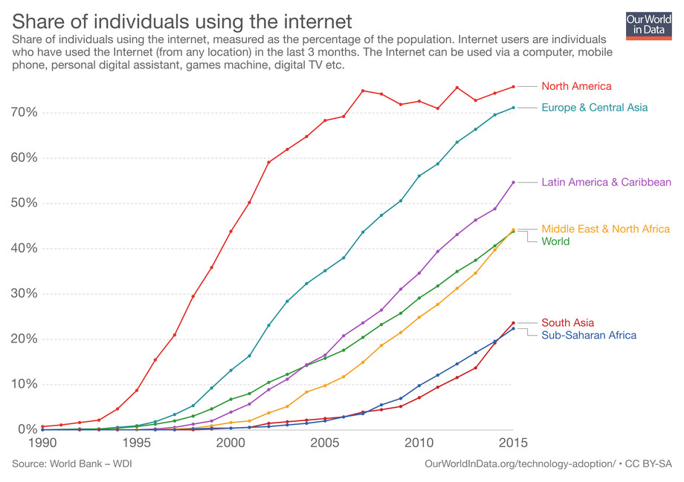

Slide 17
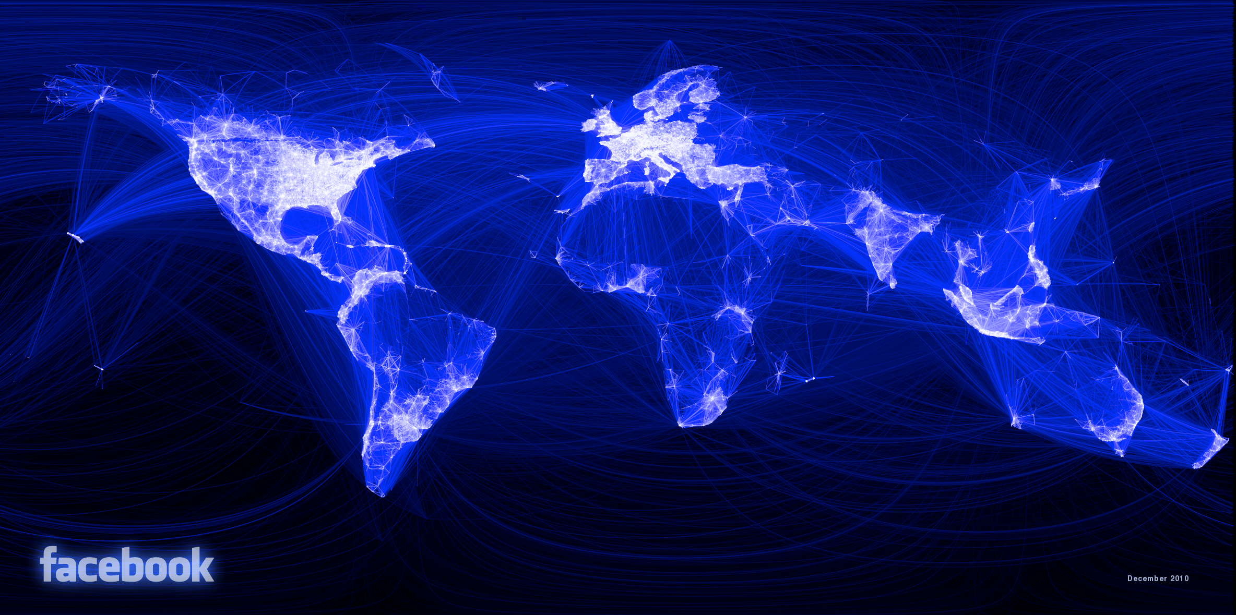

Slide 18
How do we measure social development?
Health
Life expectancy
Infant mortality
Education
Literacy
Average years of schooling
Teacher : Student ratios
Gender equality
Maternal mortality
Teen pregnancy

Slide 19
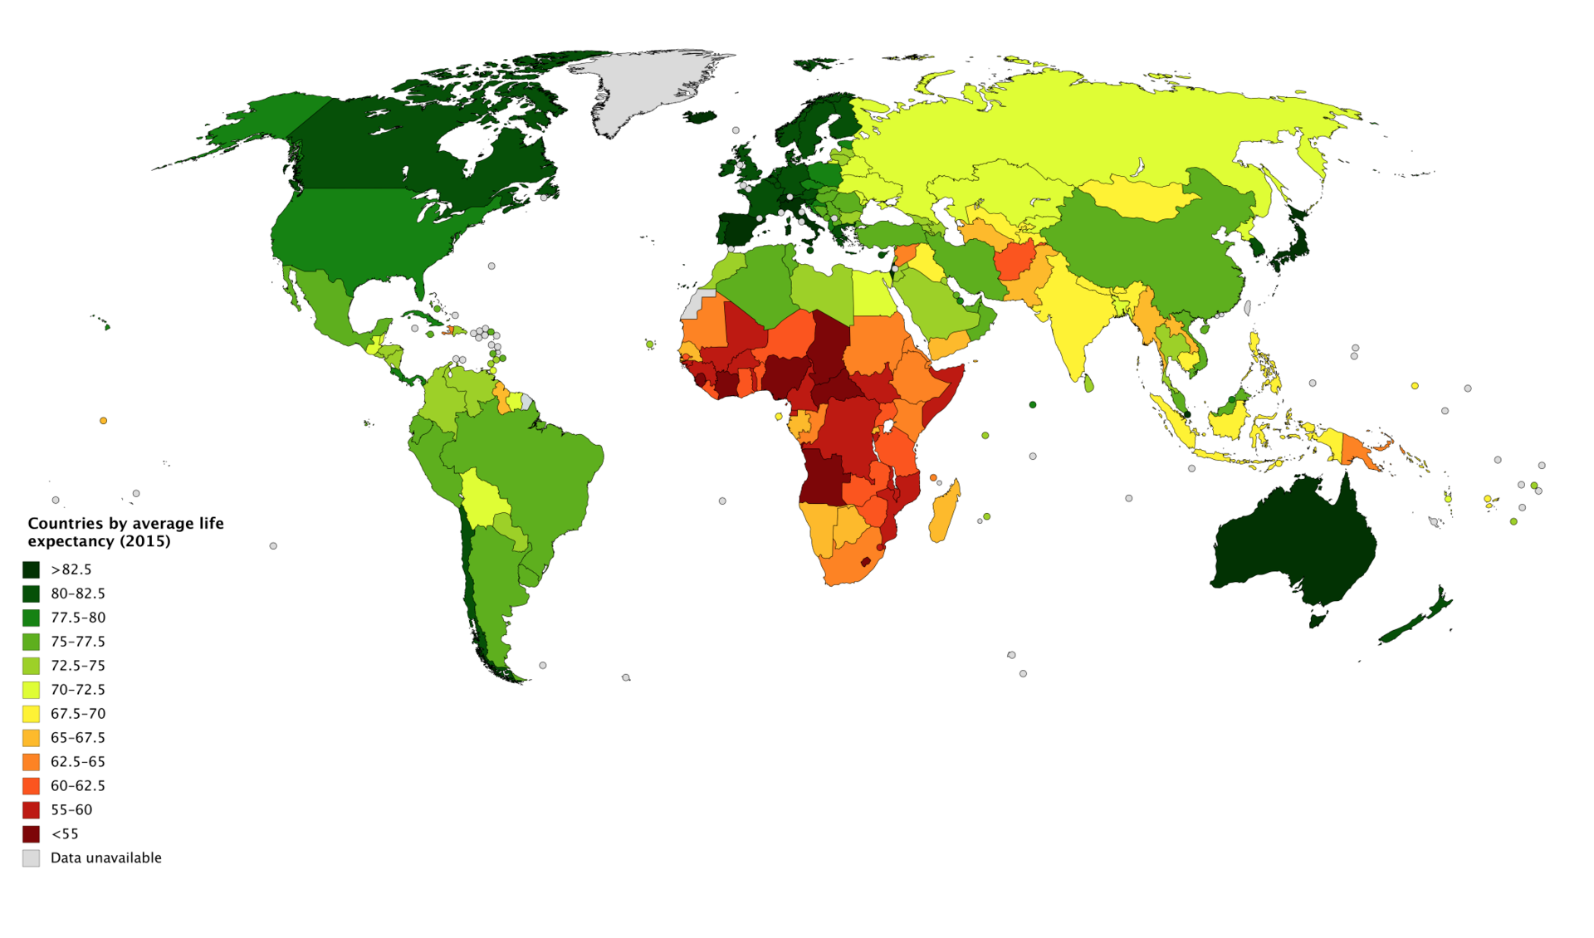

Slide 20
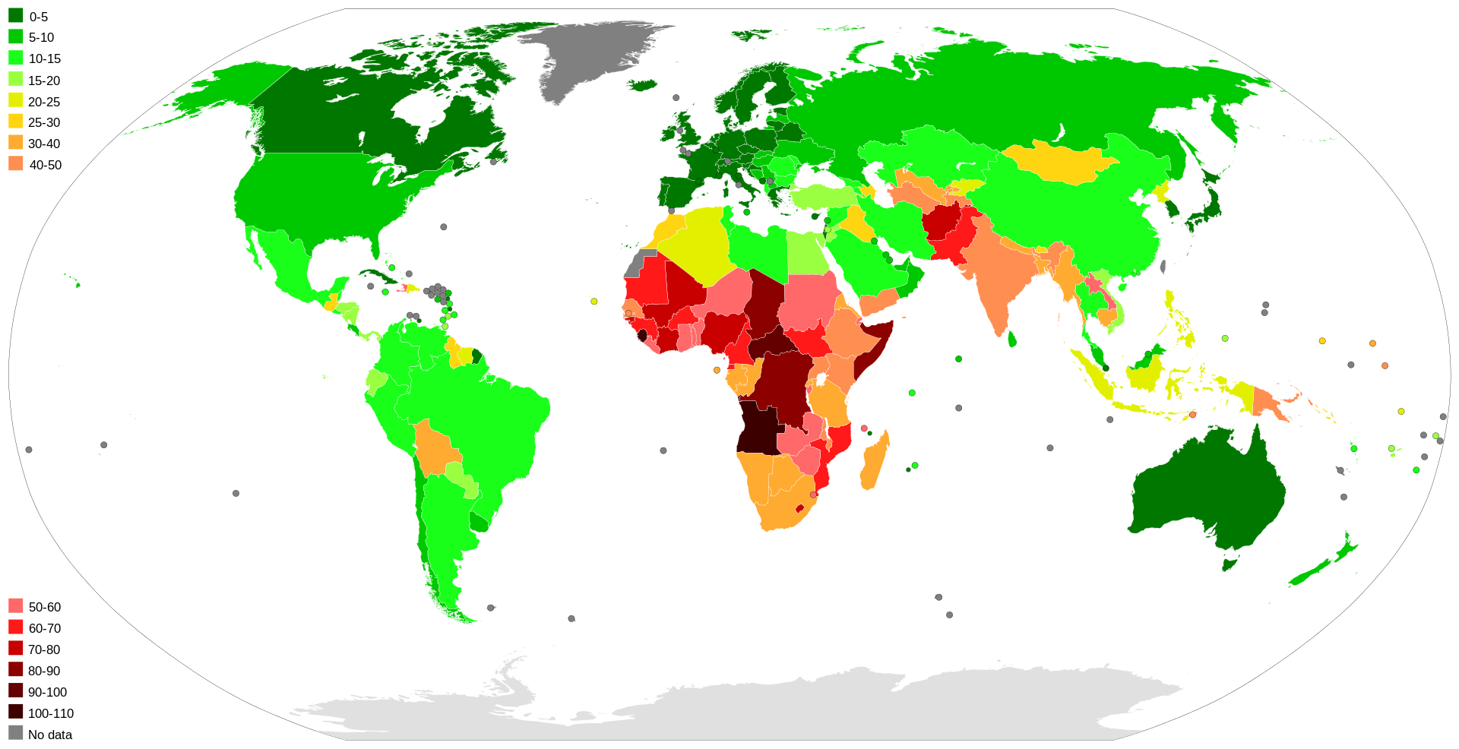
Infant mortality rates. Number of babies who die before age 1/1000 live births.

Slide 21
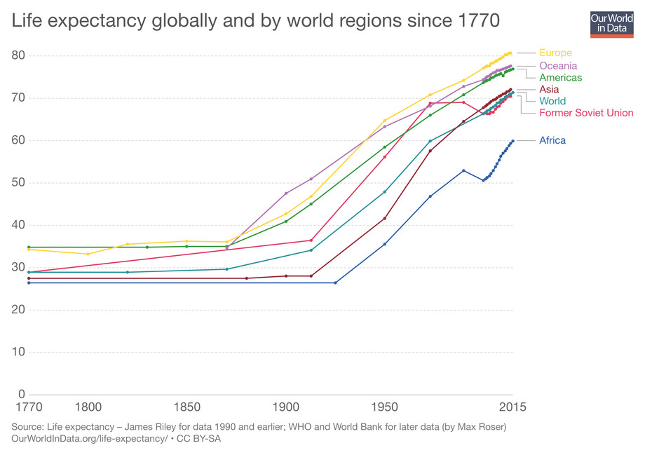

Slide 22
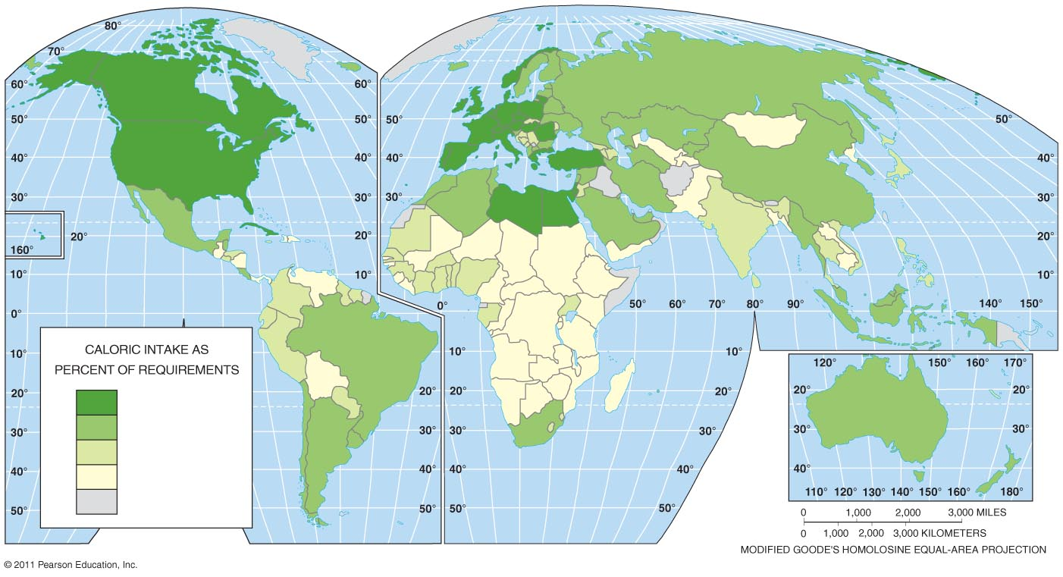
140 – above 120 – 139 100 – 119 Below 100 No Data

Slide 23
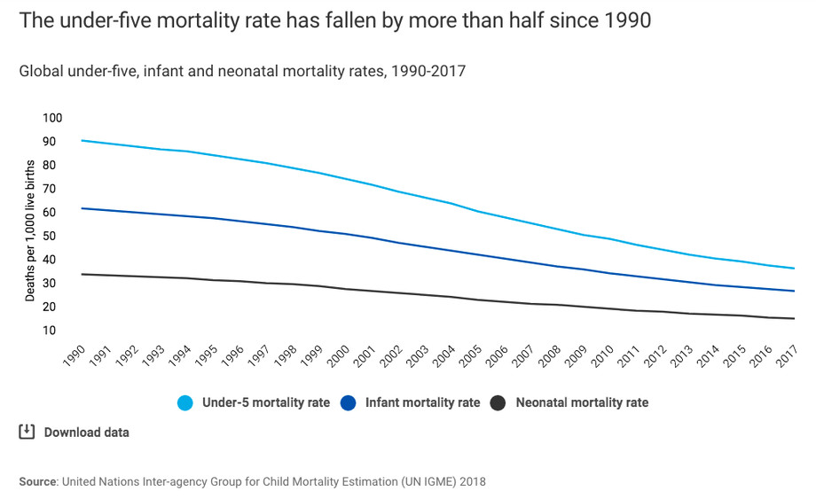

Slide 24
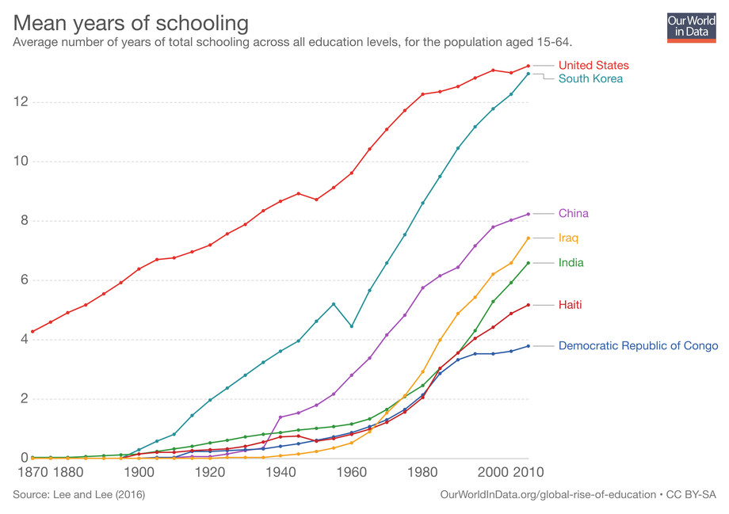

Slide 25
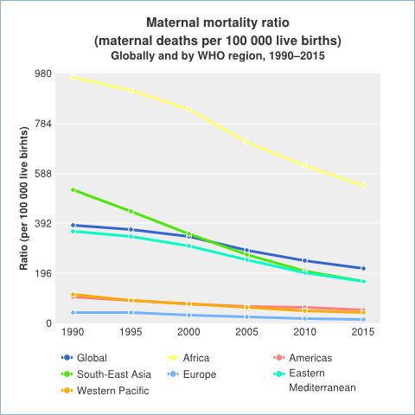

Slide 26
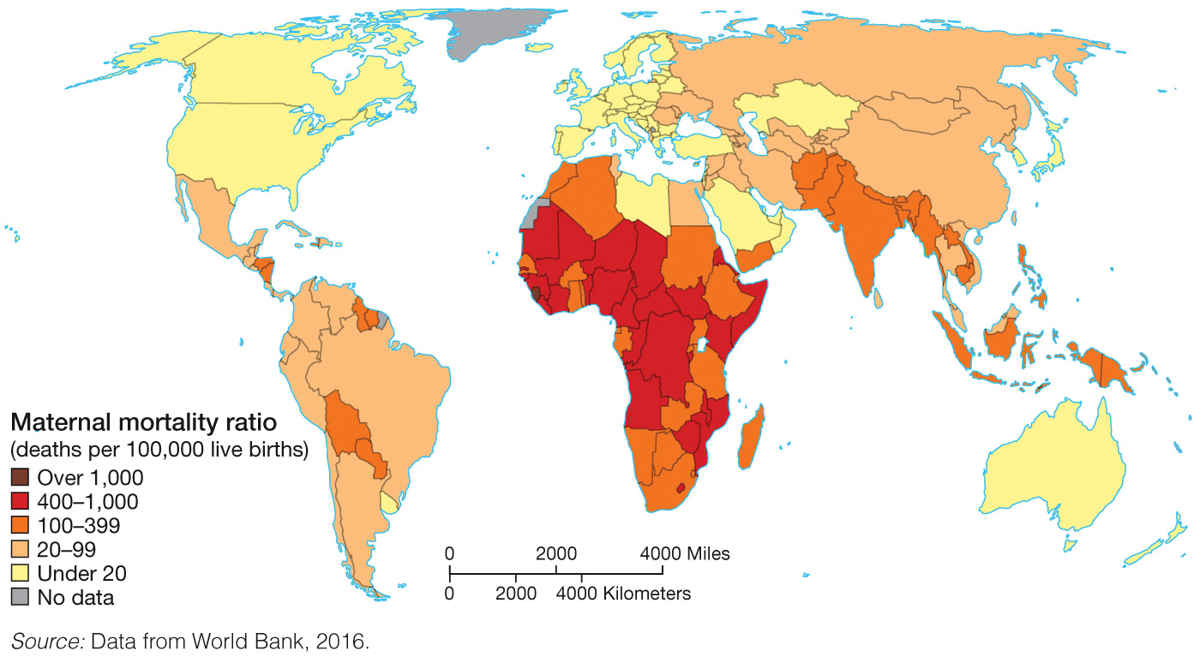

Slide 27
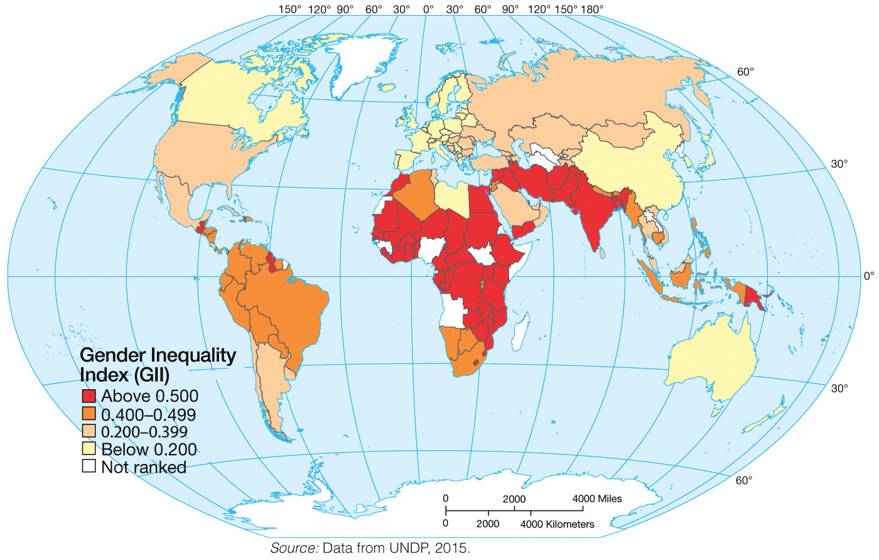
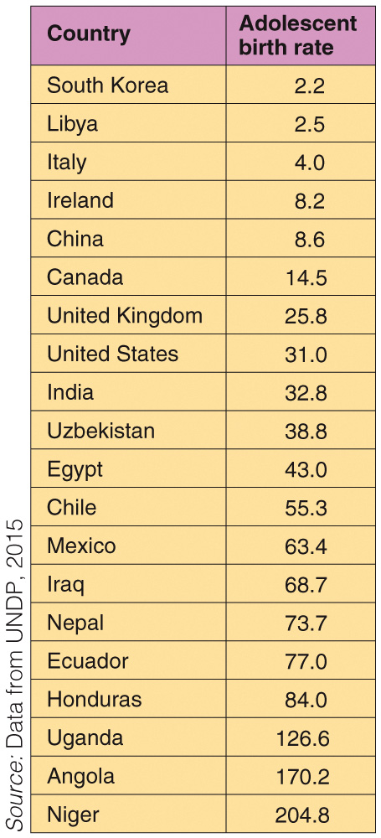

Slide 28
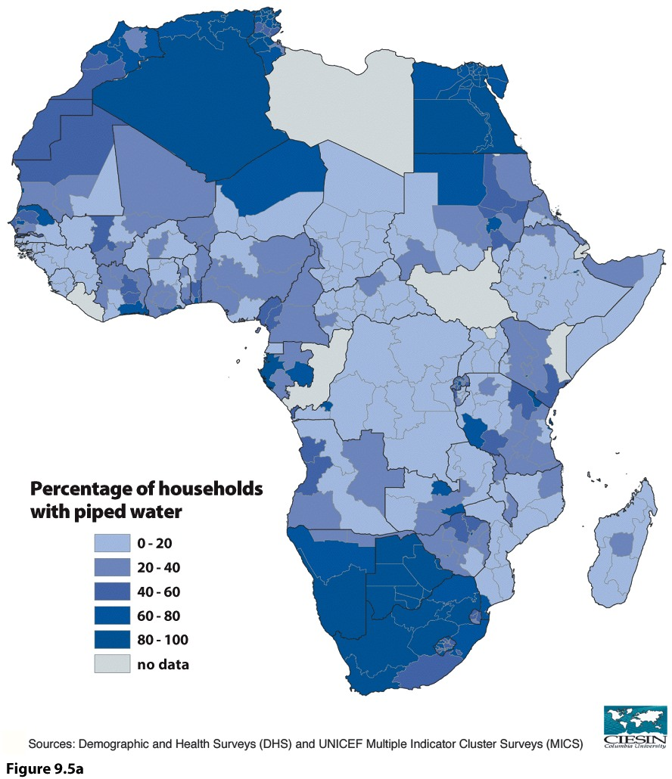
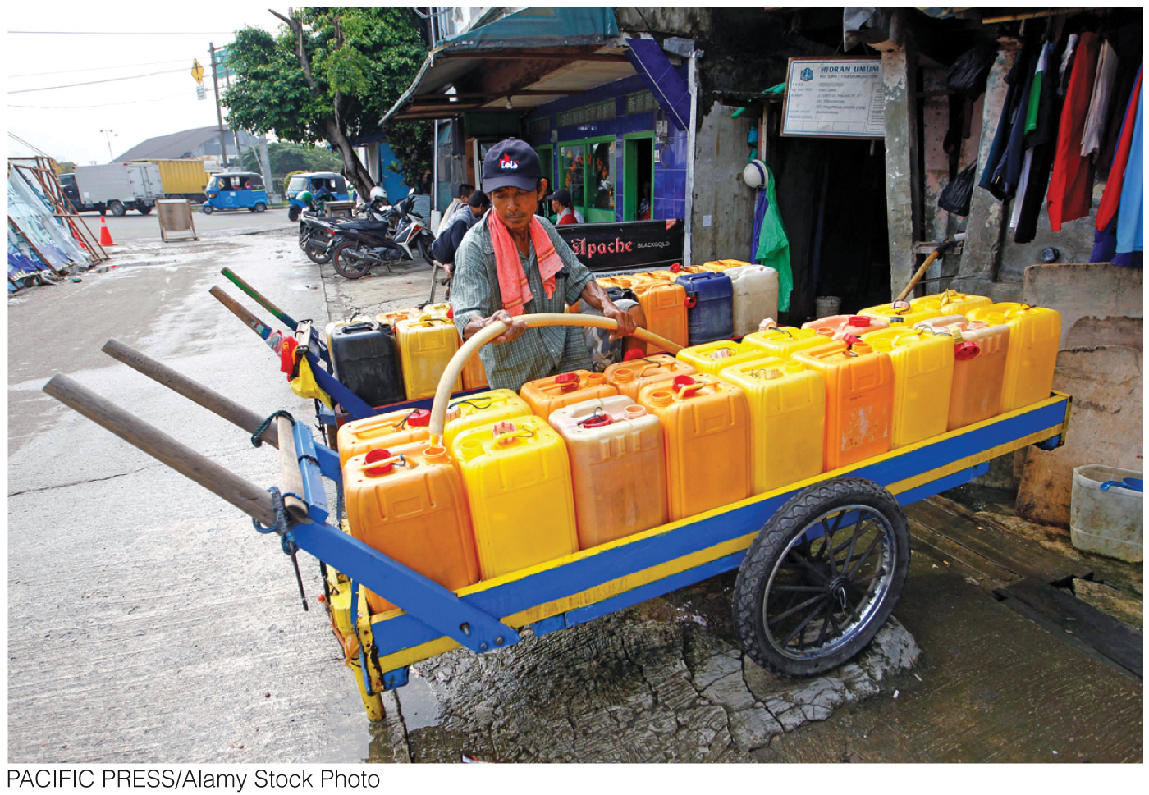
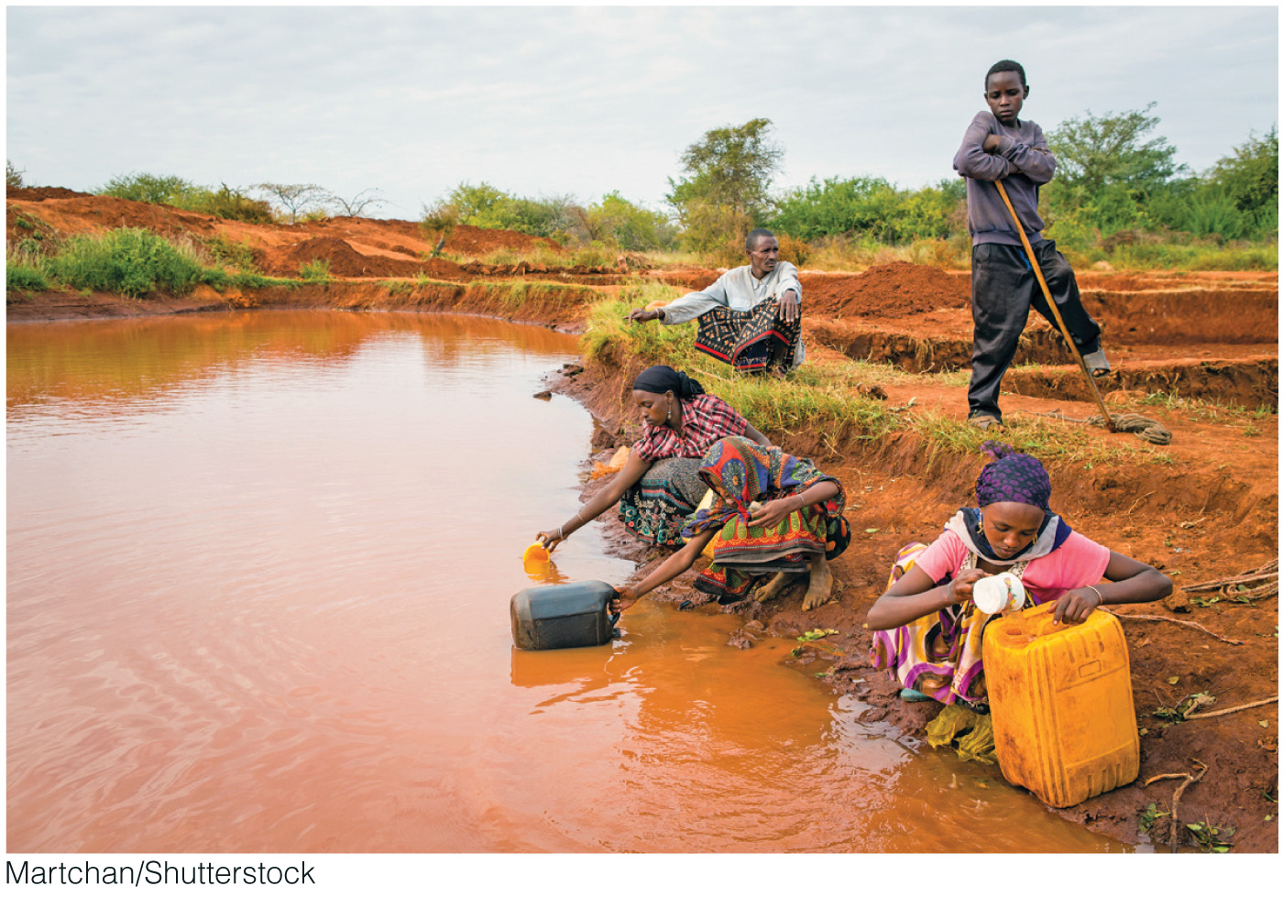
What are environmental measures of development?

Slide 29
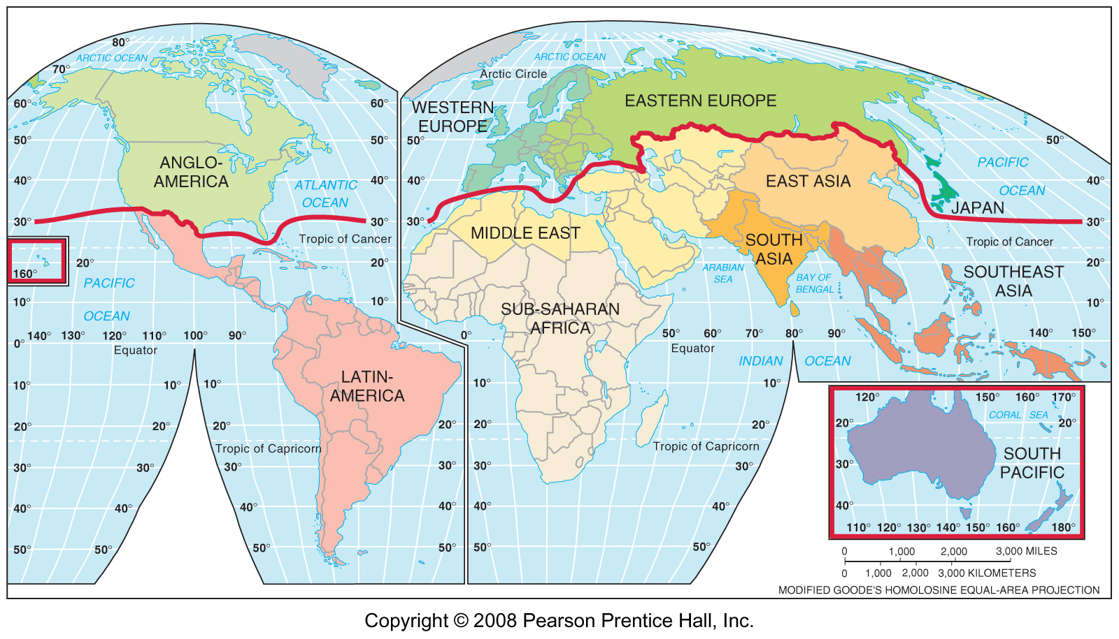
What terms are used to describe development?
Global North/Global South
MDC/LDC
Developed/Developing
First World/Third World
Global North/Global South
First World/Third World
More Developed/Loess Developed

Slide 30
Why Variability in Development?
Environment?
Resources?
Inequality?
Historical experiences?
Internal issues?

Slide 31
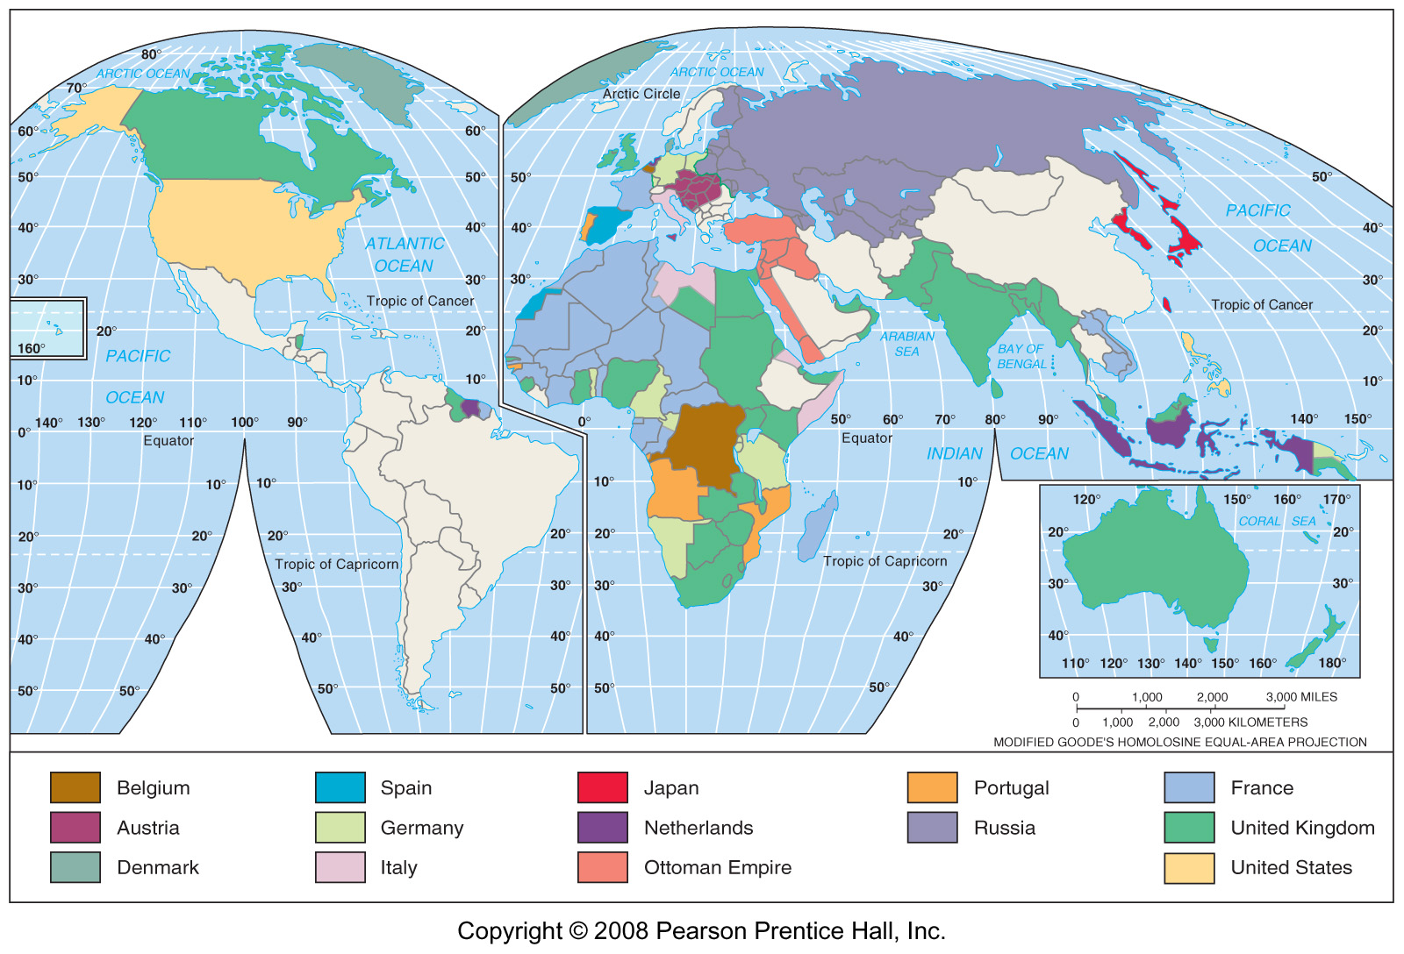
European Colonialism & Development Theory
Colonial Possessions, 1912
Post WWII & Cold War
Aligned/Non-aligned: First World/Third World
European Colonialism
Ideology: The White Man’s Burden
“The conquest of the earth, which mostly means the taking it away from those who have a different complexion or slightly flatter noses than ourselves, is not a pretty thing when you look into it too much”—Joseph Conrad
Mercantile Stage 1570-1780
Industrial Stage 1780-1870
Classical Stage 1870-1912
End Stage 1912--?

Slide 32
Development Theories
Export-Oriented
Traditional model (Classical model)
Walter Rostow
Self-Sufficiency
Based on Dependency theory, the “Dependistas”
World Systems
Immanuel Wallerstein, 1974
Critique of capitalism
Core, periphery, semi-periphery
Neoliberalism
1980s
Free trade,
de-regulation,
government disinvestment,
Privatization

Slide 33
Financing Development
World Bank
International Monetary Fund (IMF)
Debt
Structural Adjustments

Slide 34
Dams as Development Projects
Why a Dam?
Environmental, Social Costs of Dams
Sri Lanka—Mahawelli River Project
China—Three Gorges Dam Project
Egypt—Aswan High Dam Project

Slide 35
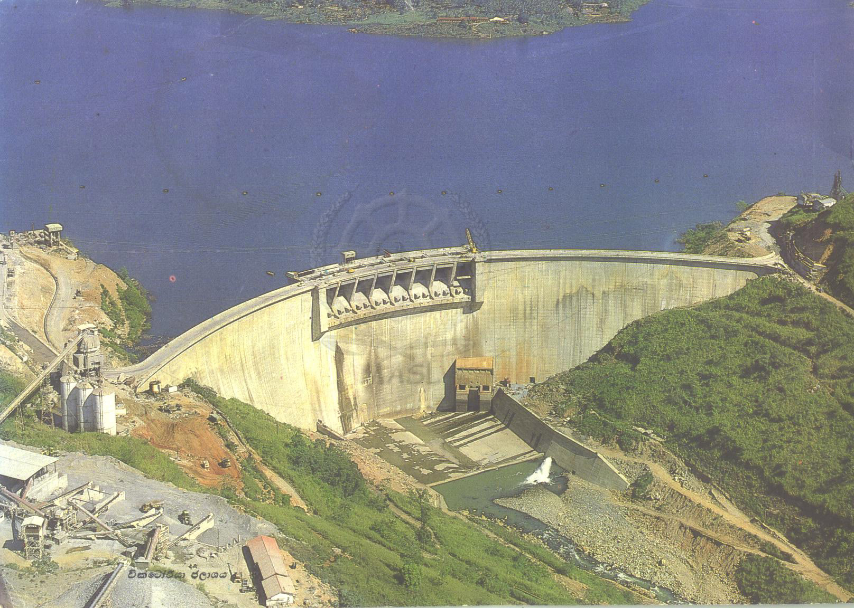
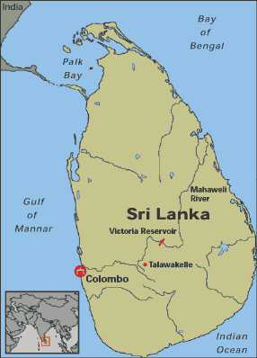
Mahawelli Dam
Sri Lanka, 1960s
Formerly Ceylon, poor, ethnic conflict, high pop growth
Goals
Self-sufficiency in rice
Irrigate arid north
Largest project of its kind in South Asia at time
The Project
650,000 acres irrigated (40% of land in north)
Relocate 1.5 million people
Switch from subsistence (millet) to commercial (rice)
Outcomes
Borrowed 4x more
Defaulted on loans
Currency devalued, inflation, end of gov’t food subsidies
97% of farmers could not produce enough to feed families
Malnutrition
Out-migration

Slide 36
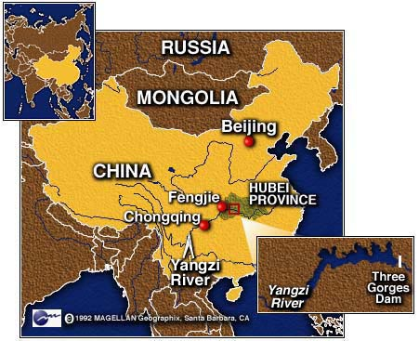
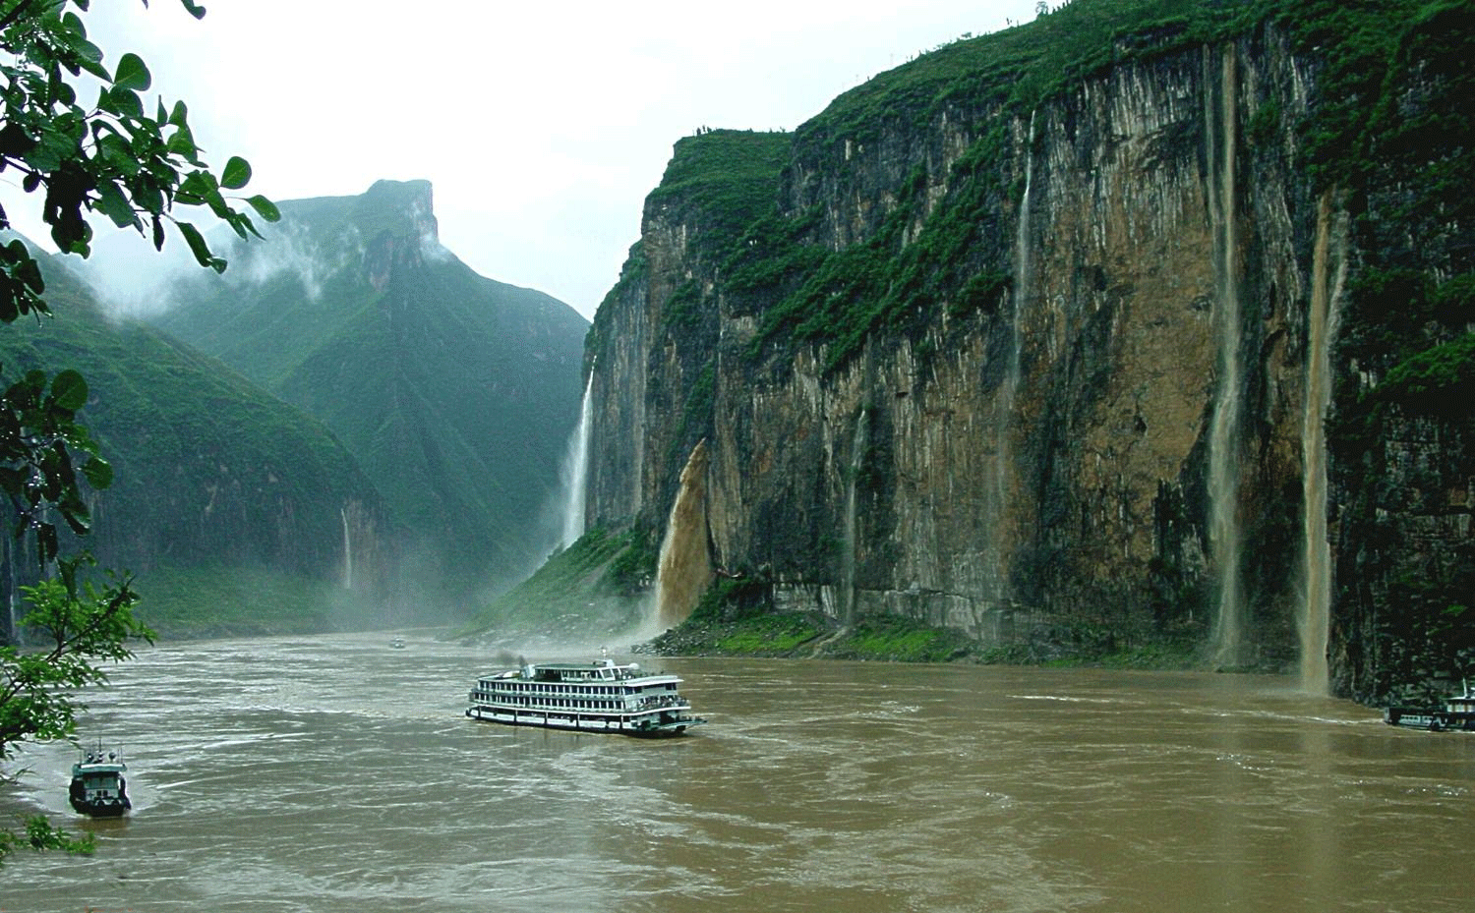
The Three Gorges Dam
Yangtze River
4th largest river in world
Most historic and beautiful part of river
Goals
Hydroelectricity
Container ships (up to 10,000 ton vessels can travel 1500 miles upriver to Chongqing)
Control floods
Political legitimacy? Modernization?
Outcomes
Relocation of 2 million
Submerged 13 cities, 300 villages, 1600 factories, 140 towns
1.2 miles wide, 607’ high, reservoir 370 miles long.
$7 billion start of project; could top $75 billion.
Could it break?

Slide 37
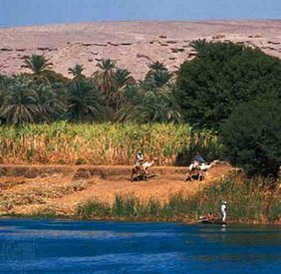
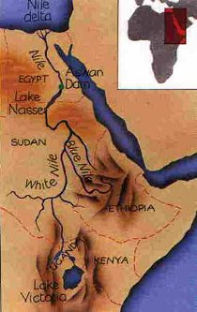
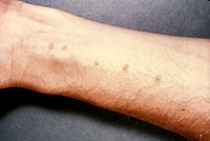
Aswan High Dam
Nile River
1960-76
Goals
Irrigate farmlands
Produce hydroelectricity
Outcomes
Submerged ancient Egyptian temples of Abu Simbel, declared a UNESCO world heritage site and saved.
Dam disease (schistosomiasis)
Fishing industry in Mediterranean collapsed
Relocation of 150,000 people

Slide 38
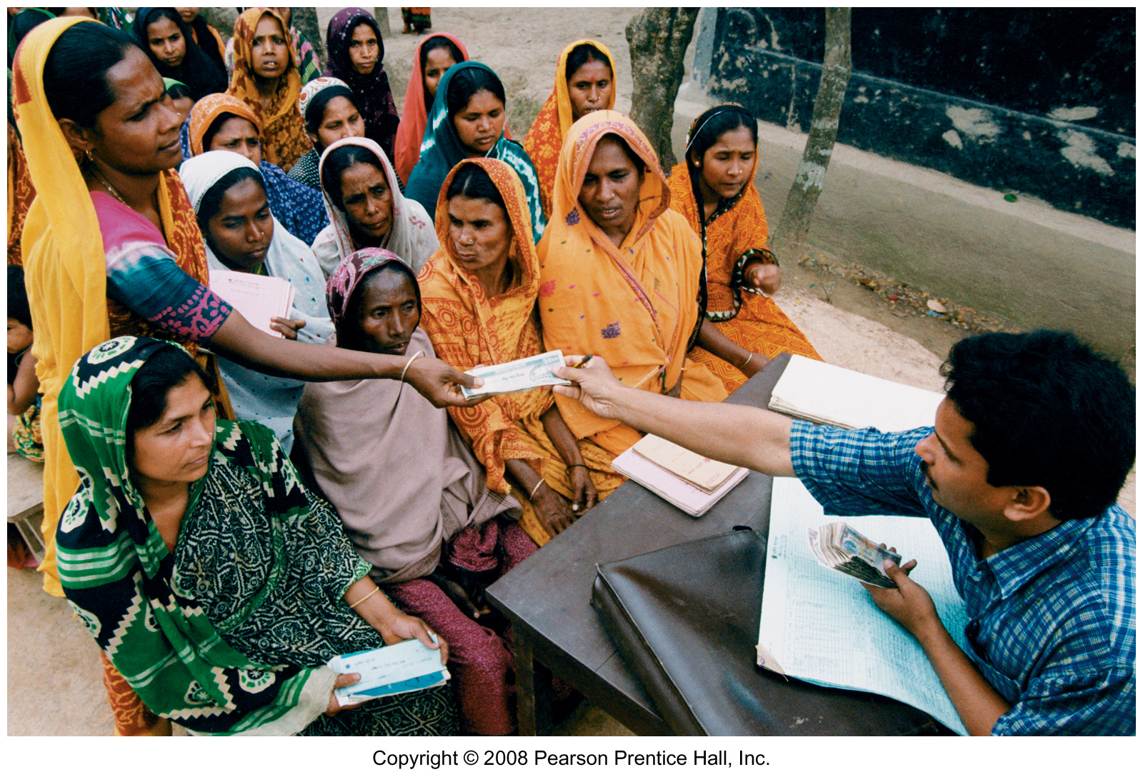
Small-Scale Development Projects
Microloans, fair trade
Poverty reduction theory
United Nation’s “Millennium Development Goals”

