Slide 1
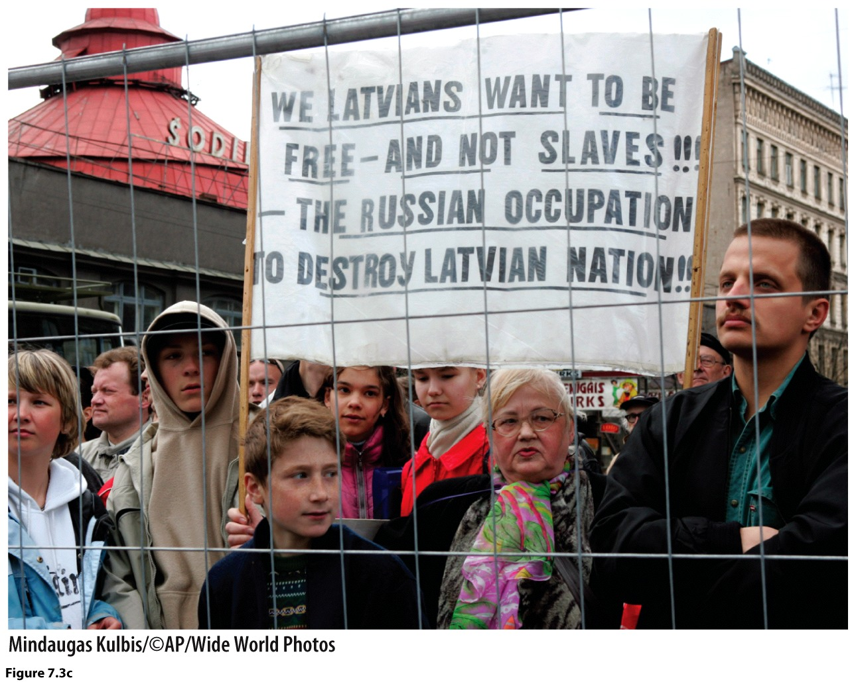
Chapter 7: Political Geographies

Slide 2
Keywords
Race
Racism
Ethnicity
Nationality
Nationalism
Fascism
State
Nation
Nation-State
Centripetal
Centrifugal
Devolution
Separatism
Balkanization
Serb
Croat
Kosovo
Bosnian
Israel
Palestine
Kurd
Shi’ite
Sunni
Ba’athist
ISIS

Slide 3
Defining Territory, Politically
State
Sovereign, recognized borders
No ethnic uniformity
Nation-State
Sovereign, recognized borders
Ethnic Uniformity
Homeland
Nation
Not sovereign, borders contested
Ethnic Uniformity
Homeland

Slide 4
Defining Territory and Identity
Ethnicity
Peoples with shared history, culture and “homeland”
Race
Social construct arguing genetic differentiation based on physical typology
No shared culture, no shared “homeland”
Nationality
Identity associated with citizenship
Nationalism
Support for the “nation.”
Often linked to ethnic identity
Exalts one nation above others, requires loyalty
Fascism
Exalts the “nation” above others
Authoritarian
Restore the nation to former greatness
Purify the nation

Slide 5
Forces that Impact Political Geography
Centripetal forces
Forces that unify, strengthen the state
Centrifugal forces
Forces that pull apart, weaken the state
Devolution of a state
Decentralization of power
Separatism
Nation to a nation-state
Balkanization
State to a nation-state

Slide 6
The United Kingdom (purple color).
How many nations exist within the UK?
Is there one missing?
Cornwall
Notes:
TCL_11e_Figure_07_25_L

Slide 7
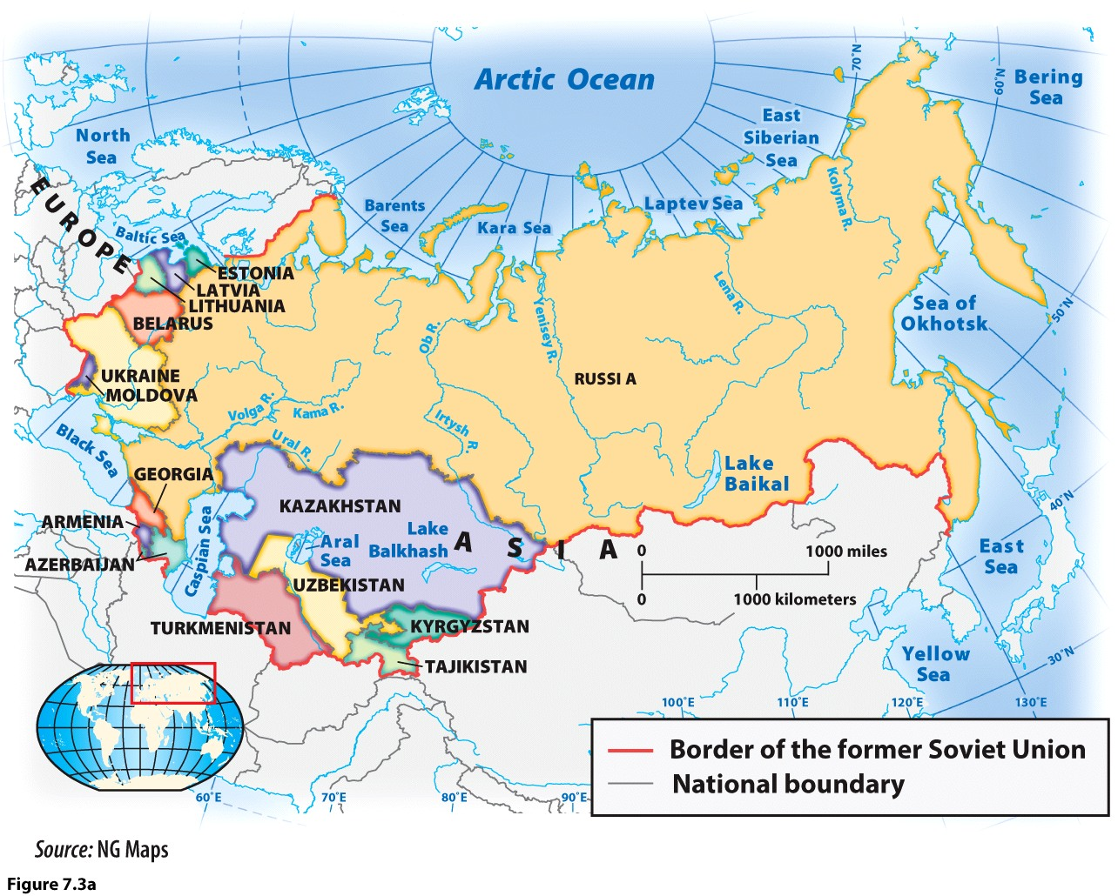
The USSR, a state, and its internal nations, many of which became nation-states

Slide 8
Ukrainian independence, August, 1991.
Notes:
TCL_11e_Figure_07_26_L

Slide 9
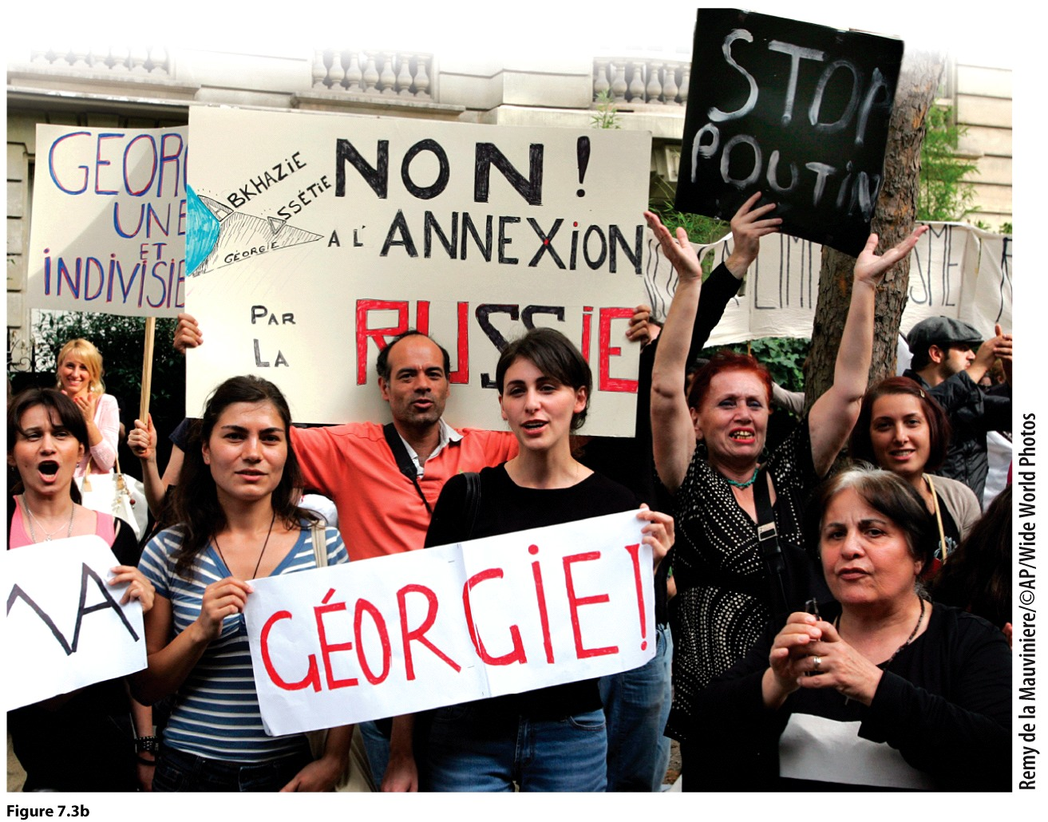
Calls for independence for the Republic of Georgia following the fall of the USSR

Slide 10
Iraq—a state with multiple ethnicities.
Notes:
TCL_11e_Figure_07_36_L

Slide 11
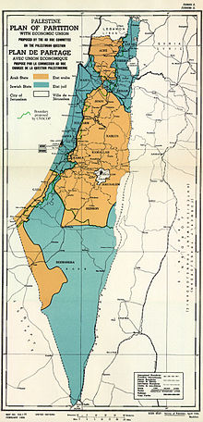

Slide 12
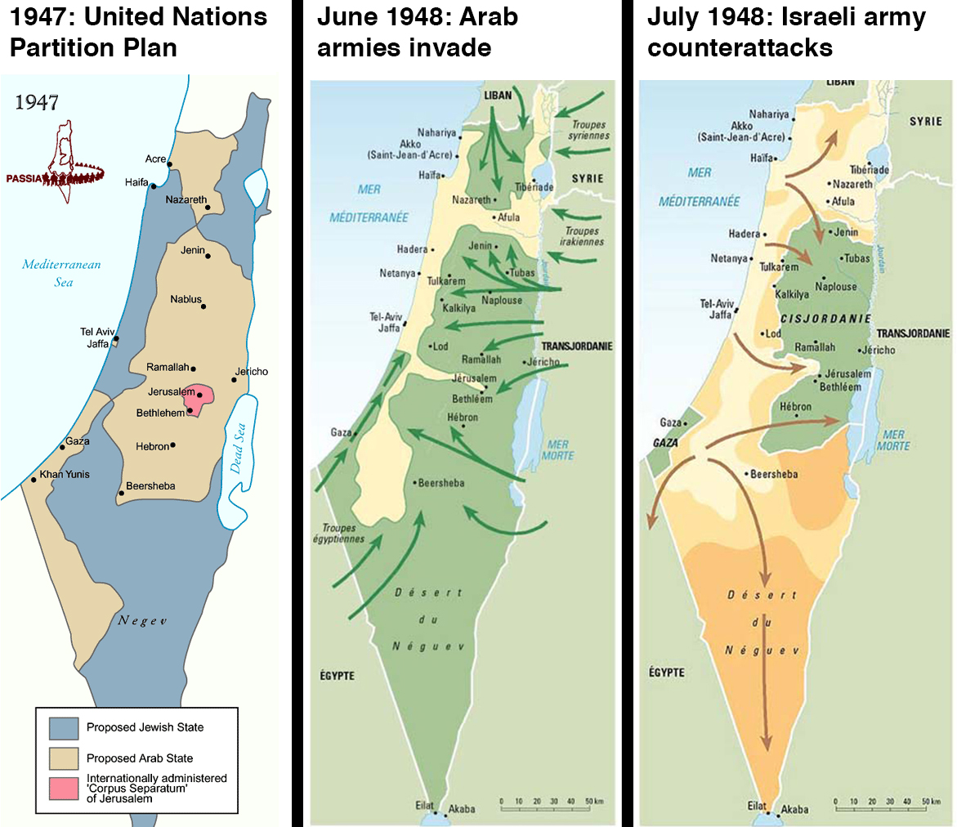

Slide 13
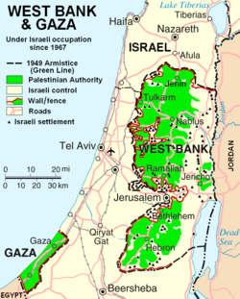

Slide 14
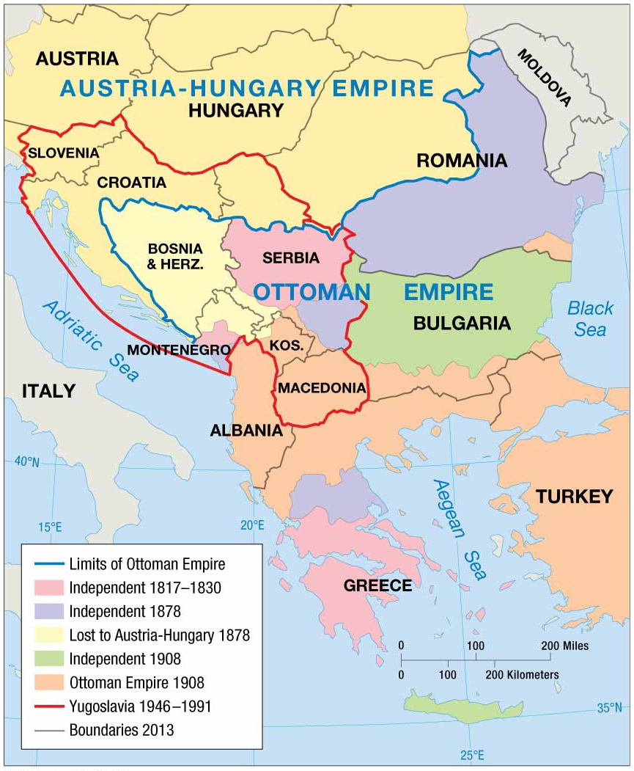
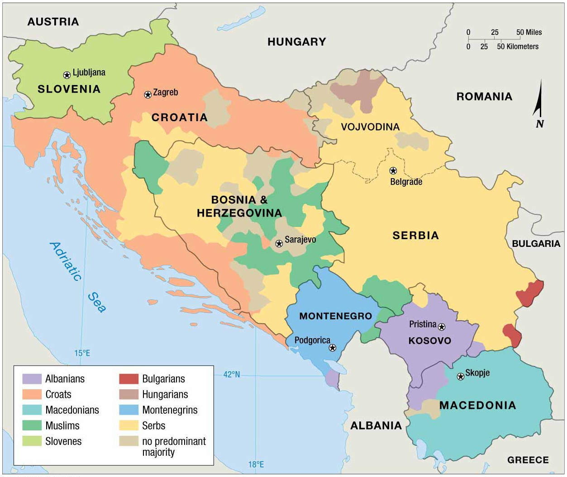
The Balkans in 1914
Ethnic makeup of the Balkans

Slide 15
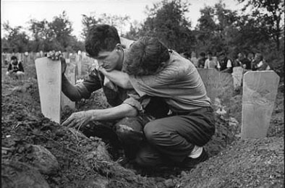
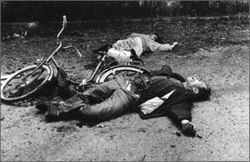
The Balkan War lasted from 1991-1995.
More than 130,000 were killed—the largest loss of life in Europe since WWII.
Bosnia-Herzegovina suffered the largest loss of life at approximately 100,000 dead.

Slide 16
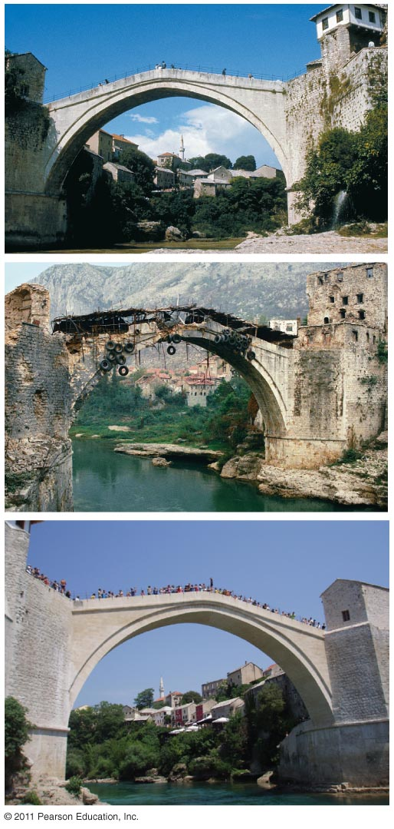
The Stari Most Bridge, Croatia
Became an icon of the war in the Balkans
Built in 1566 by the Ottomans in Mostar, Bosnia
Blown up by Serbian forces in 1993
Rebuilt in 2004
Notes:
FIGURE 7-32

Slide 17
Ethnic cleansing in Kosovo, 1999.

Slide 18
The impacts of ethnic cleansing on Bosnia-Herzegovina
Notes:
TCL_11e_Figure_07_43_L

