Slide 1
Southwest Asia & North Africa
Chapter 8

Slide 3
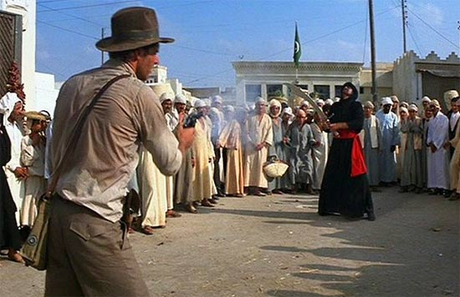
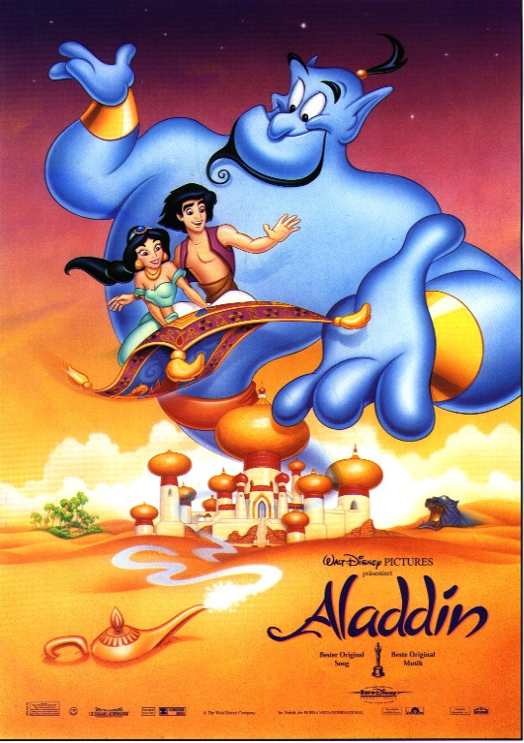
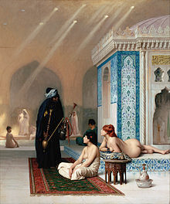
The Exotic (and backwards) Orient

Slide 4
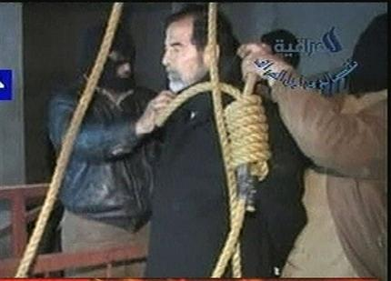
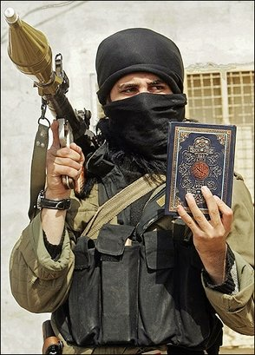
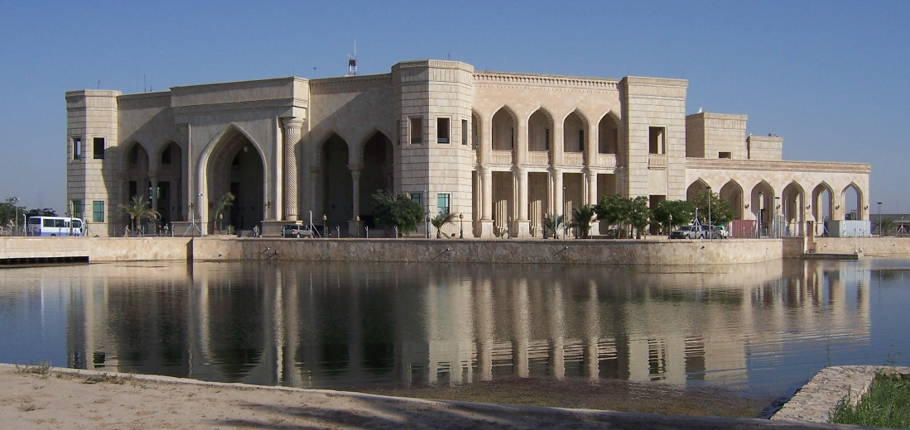
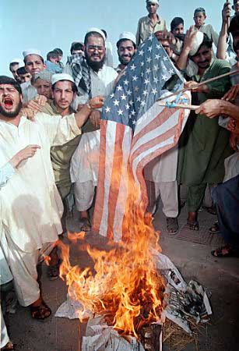
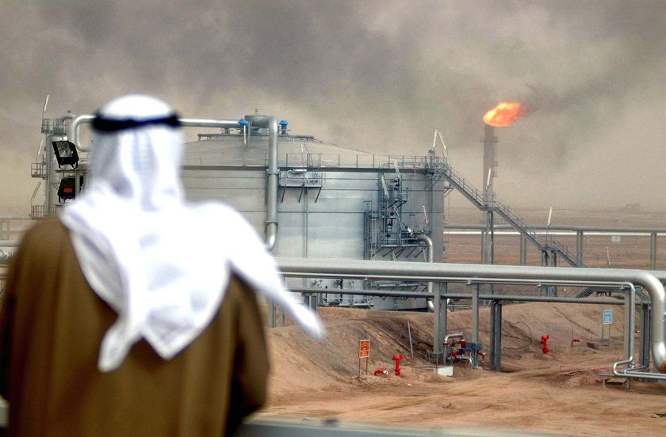
The Dangerous
Contemporary Middle East

Slide 5
Orientalism
So far as the United States seems to be concerned, it is only a
slight overstatement to say that Muslims and Arabs are essentially
seen as either oil suppliers or potential terrorists. Very little of the
detail, the human density, the passion of Arab-Moslem life has
entered the awareness…instead is a sense of
crude, essentialized caricatures of the Islamic world presented
in such a way as to make the world vulnerable to military aggression.
Edward Said, The Nation, April 1980.

Slide 6
A Desert
Most of the population live in a Mediterranean (c) climate
The Levant
Israel, Lebanon, Gaza, Syria
The Maghreb
Very fertile valleys at foothills of Atlas Mts.
Algeria, Morocco, Libya
Very urban population (except Tuareg)
Strongly connected to Europe
95% of export money is from oil (Algeria & Libya)
Export low-wage workers to Europe (only 9 miles between Spain & Morocco).
Vast areas are uninhabited

Slide 7
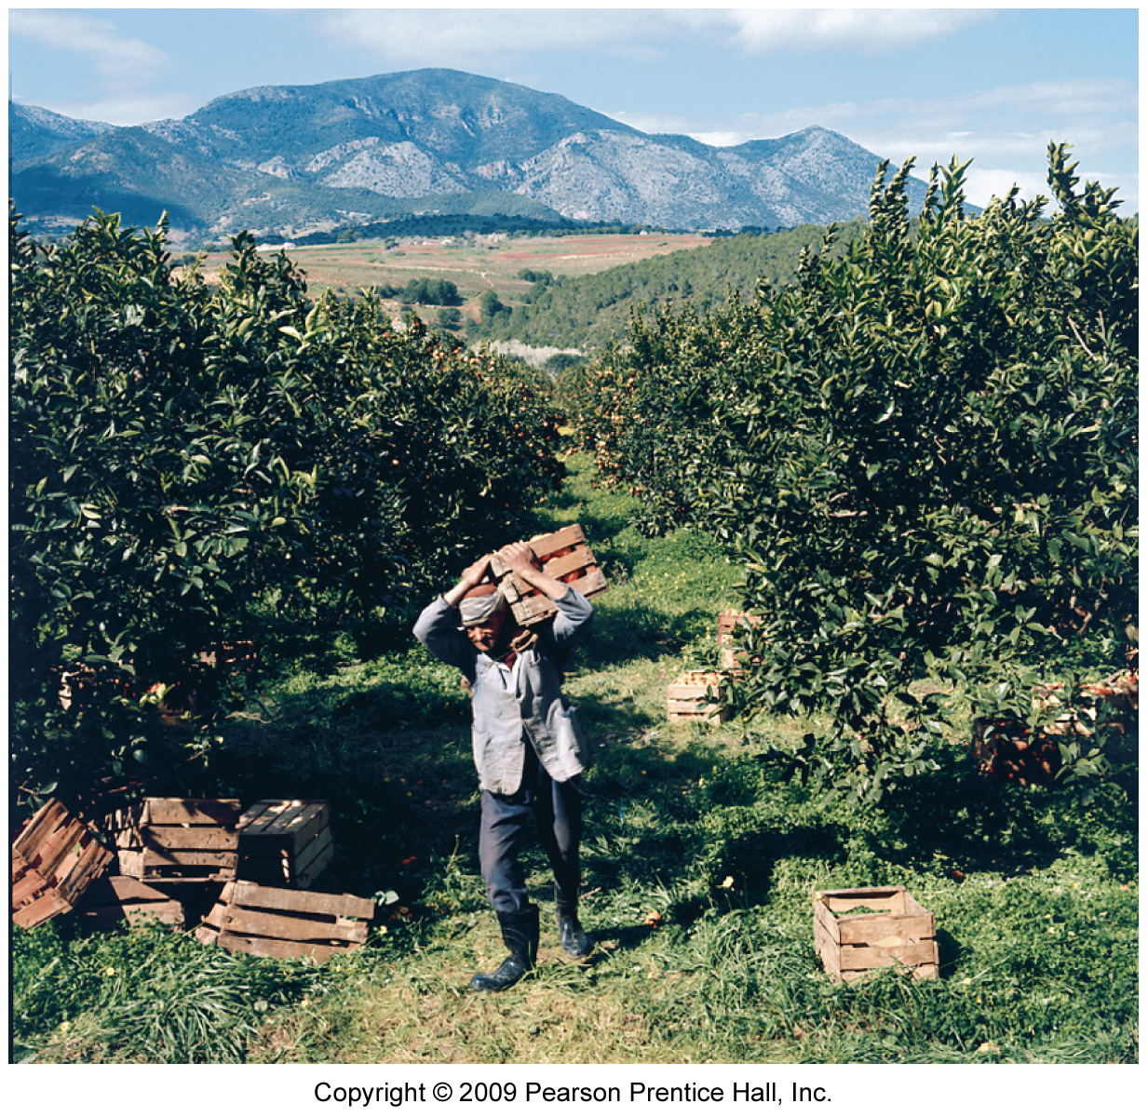
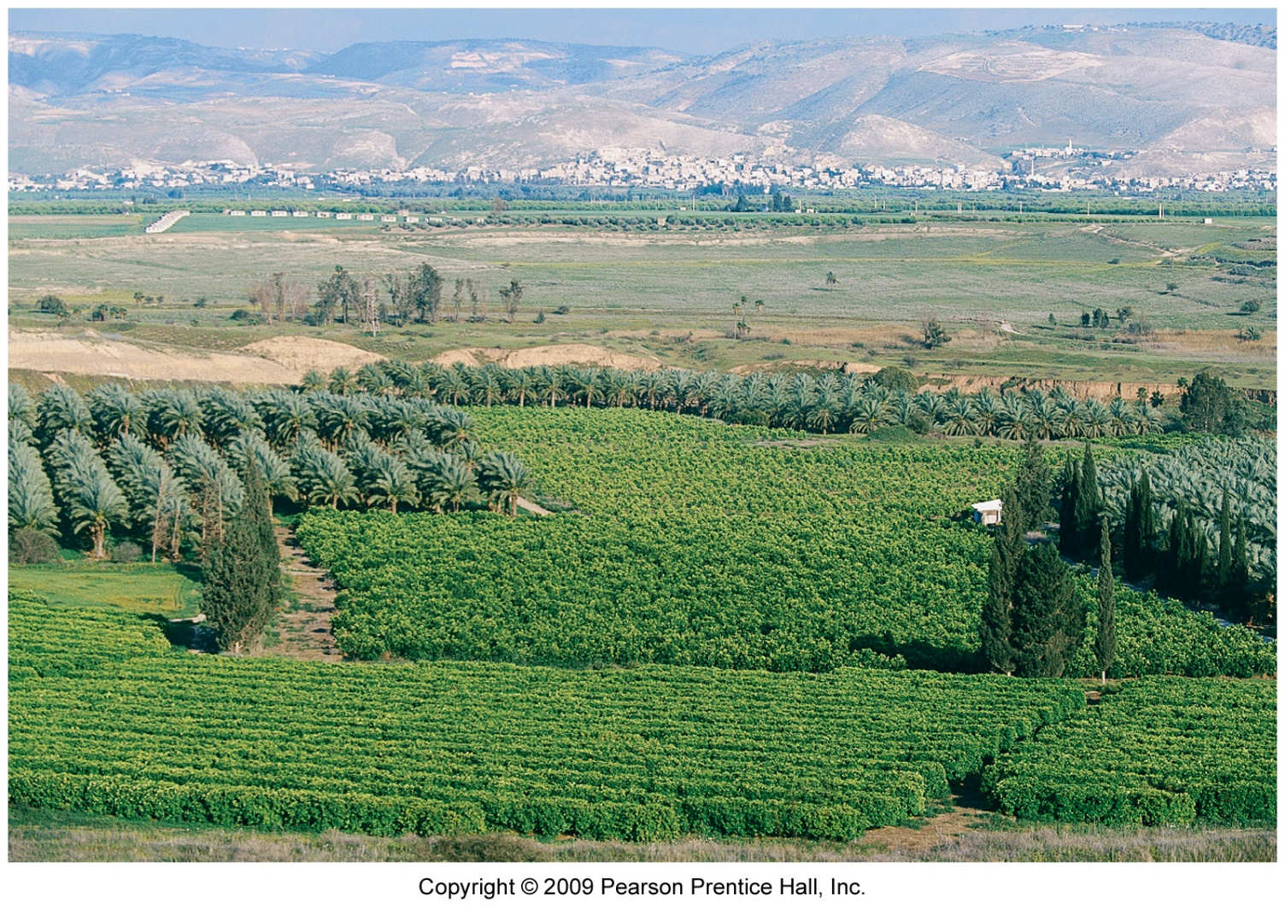
The Jordan River Valley in the Levant.
The Maghreb at the foothills of the 13,000’
Atlas mountains. 10-30” of rain a year.

Slide 8
An Arab World
Jews
Armenians
Turks
Persians/Iranians
Berbers
Tuaregs

Slide 9
A Muslim World
Christians—Catholics in Lebanon, Palestinian Christians, Armenian Christians, Assyrian Christians
Jews
Bah’ai
Zoroastrians (Parsi)
Druze
Divisions within Islam—Sunni, Shia, Sufi Wahhabi

Slide 10
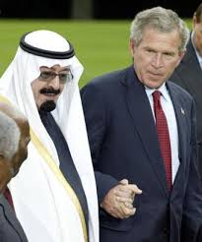
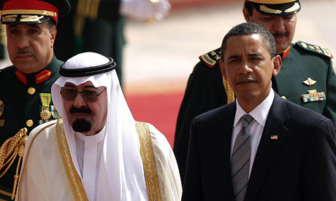
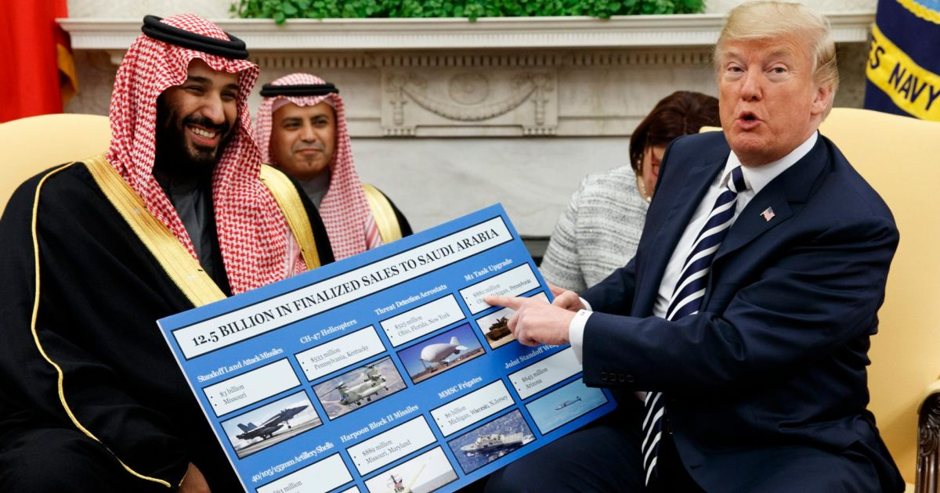
Anti-Western

Slide 11
A Backwards Region
Mesopotamia/Fertile Crescent
Tigris and Euphrates
Developed heavy irrigation usage
Supported large cities, as long as 5000 BCE: Ur, Babylon, Nineveh
Damascus & Jericho are two of the oldest continually inhabited cities
Nile River Valley
Relied on spring flooding for fertile soils
3100 BCE first dynasty unites upper and lower Nile
Great Sphinx built about 10000 BCE
Origins of Western Culture—myths, religions, rituals, agriculture, cities…

Slide 12
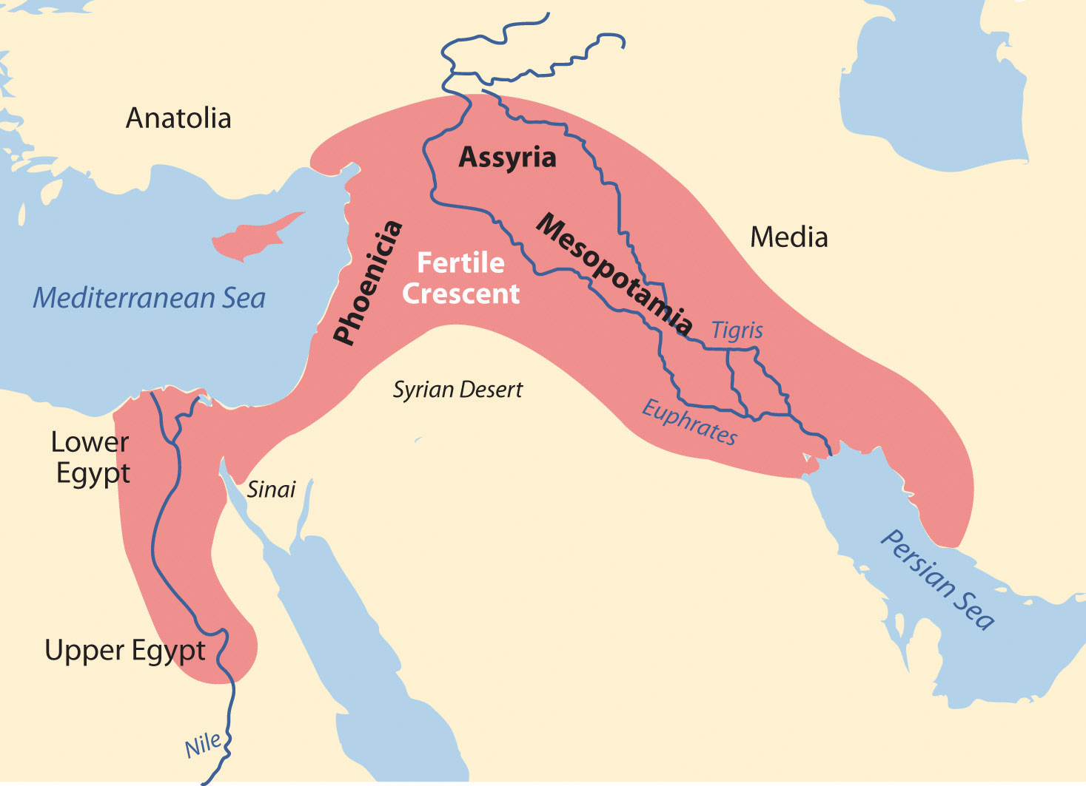

Slide 13
Oil Rich Region
Persian Gulf States, Libya & Algeria
Some natural gas (Syria, Iran)
Oil, Islam and “The West”
Timothy Mitchell: McJihad (from “Carbon Democracy”)
The West “needs” autocratic regimes in the Middle East
These regimes assure access to oil
These regimes rely on religious fundamentalists/extremists to keep their power (Saudi Arabia).

Slide 14
Water: the true “conflict resource”?
Libya
Fossil water
Great Man Made River
Egypt
Aswan High Dam
Salinization from over-irrigation
Tigris & Euphrates
Origins are in Turkey
Ataturk Dam
Israel
PBS NewsHour on Israel’s Water Technology 2015
Updated PBS NewsHour Israel Water 2018
Grey water recycling
Drip irrigation
Techniques to reduce transpiration
Iran
Qanats—collect and divert water from mountains
Arabia
Rely on fossil water and aquifers
Some desalinization in wealthy oil states
Terracing in Yemen

Slide 15
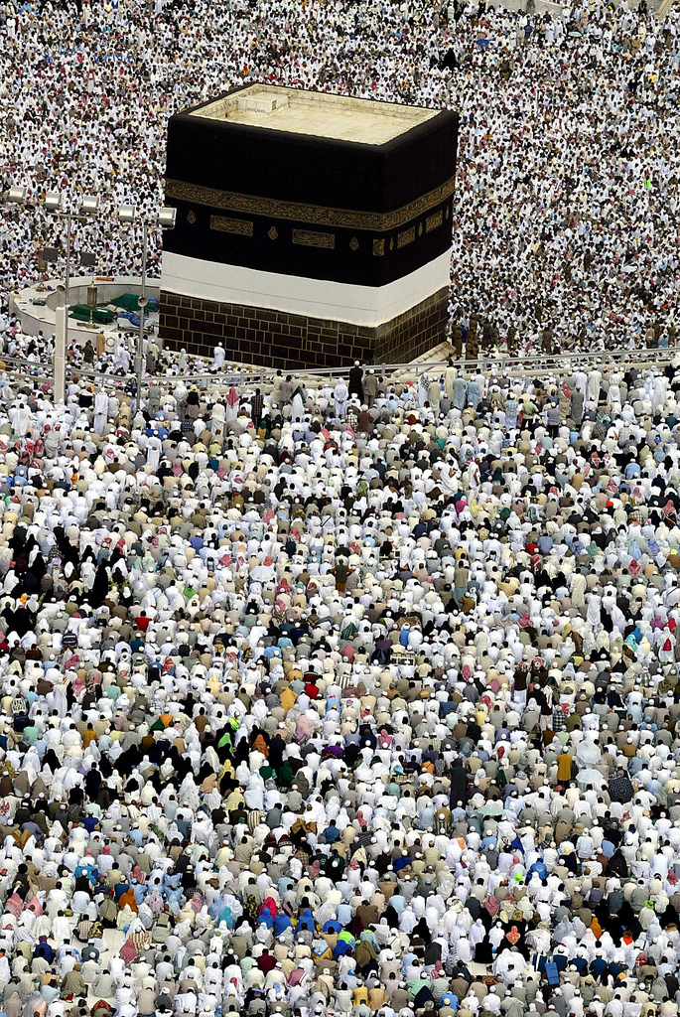
Islam
Muhammed
Mecca, Medina
610 AD, angel Gabriel
Qur’an
Five Pillars of Faith
Sunni, Shia
Islamic vs Secular states

Slide 16
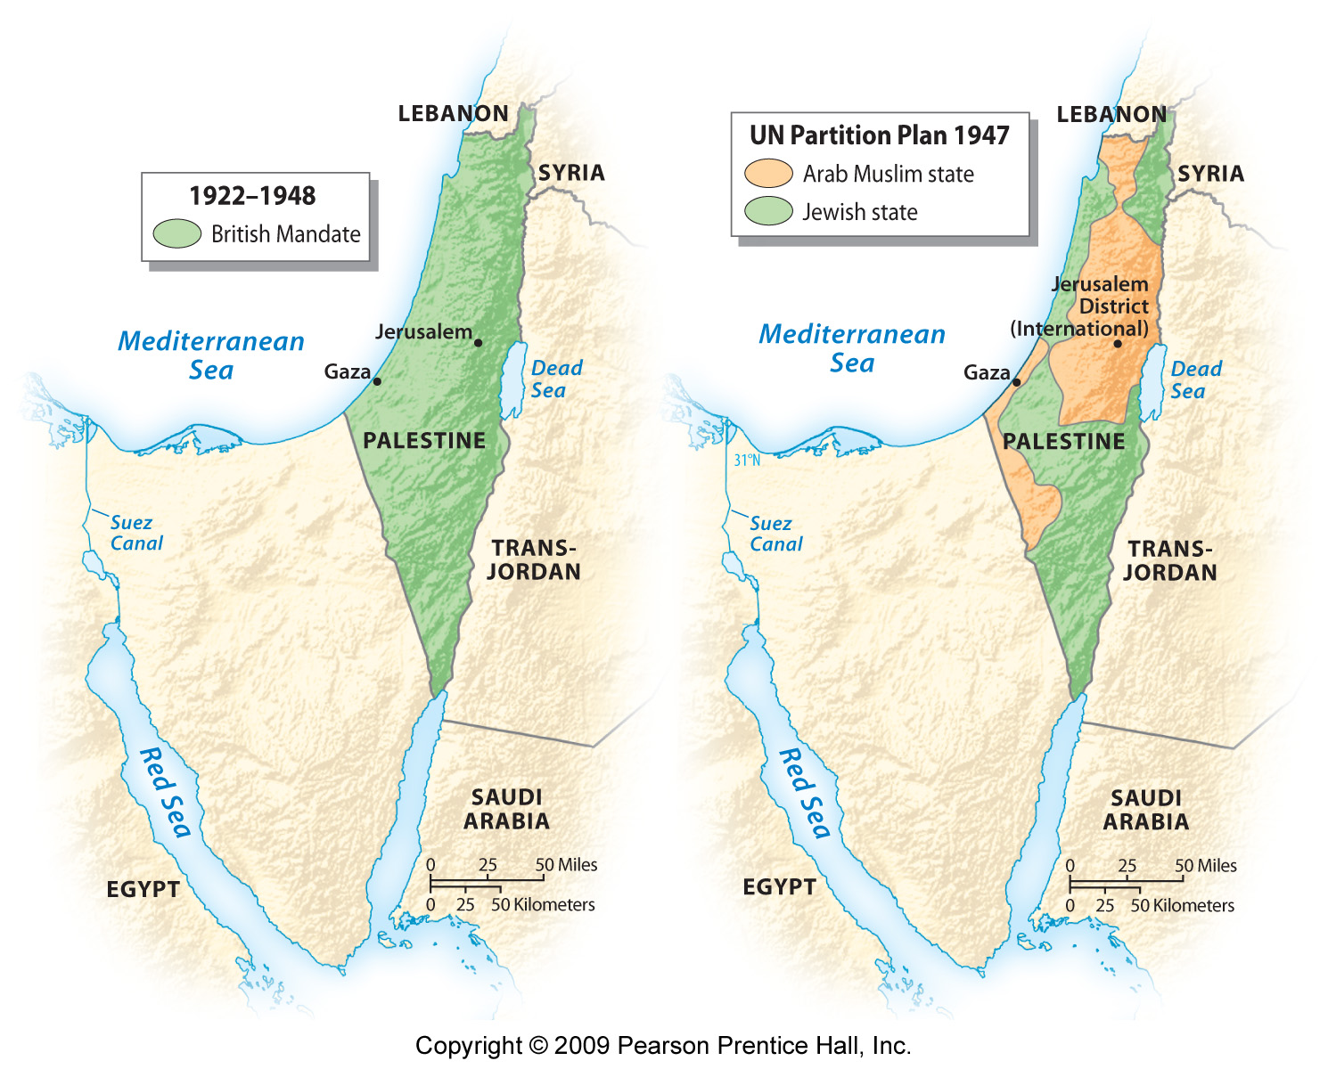
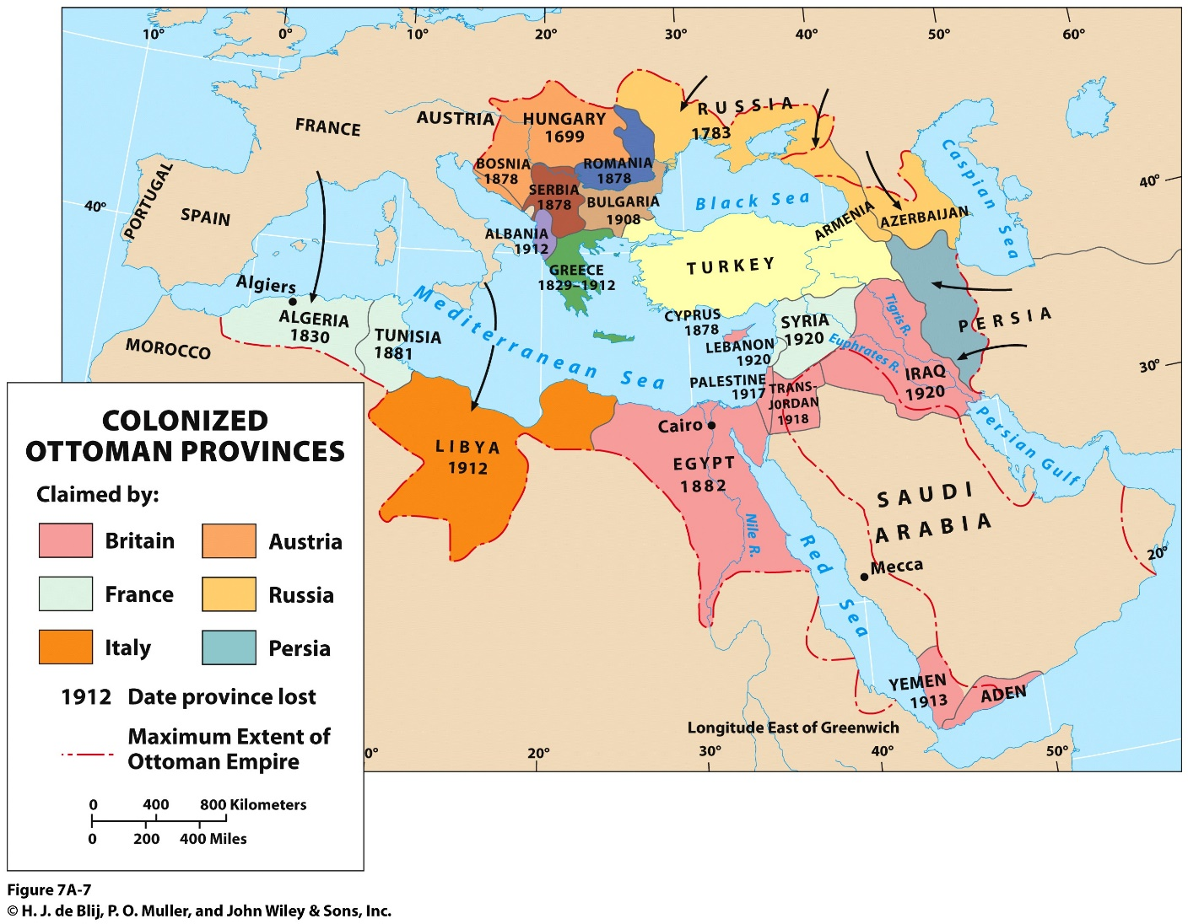
Israel

Slide 17
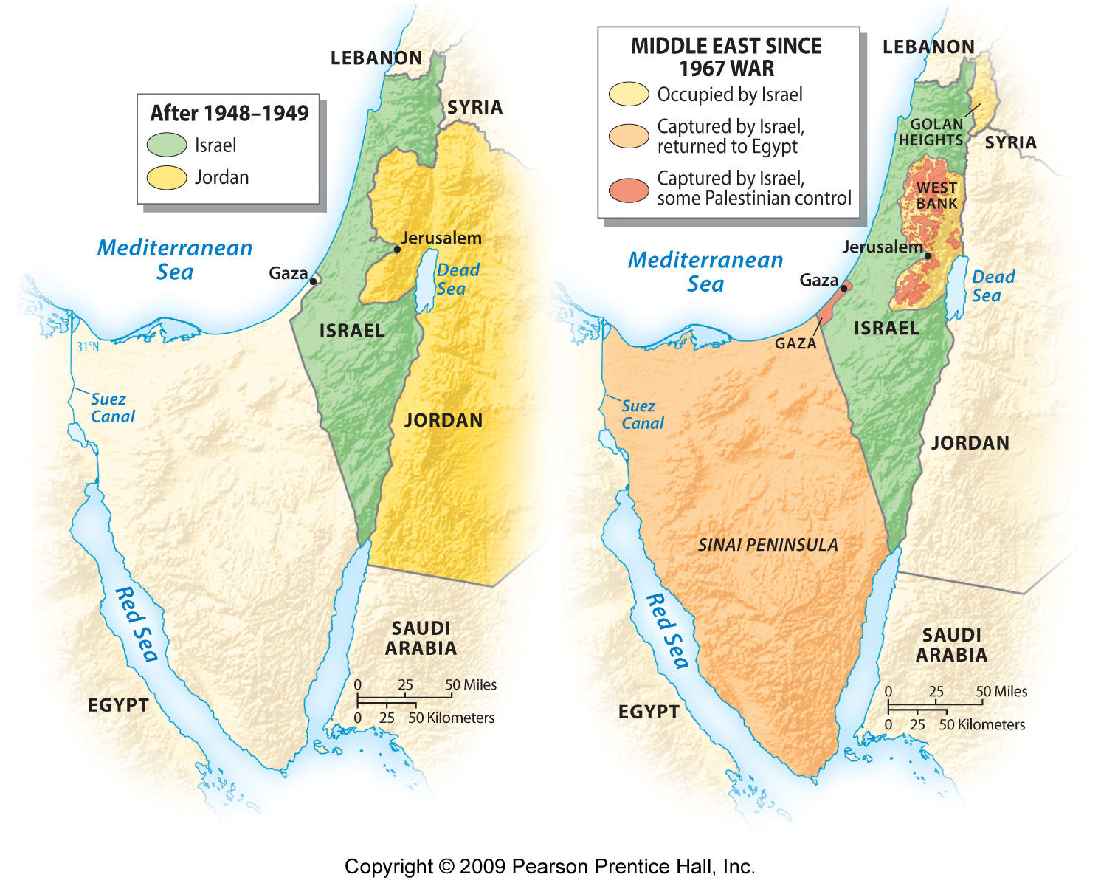

Slide 18
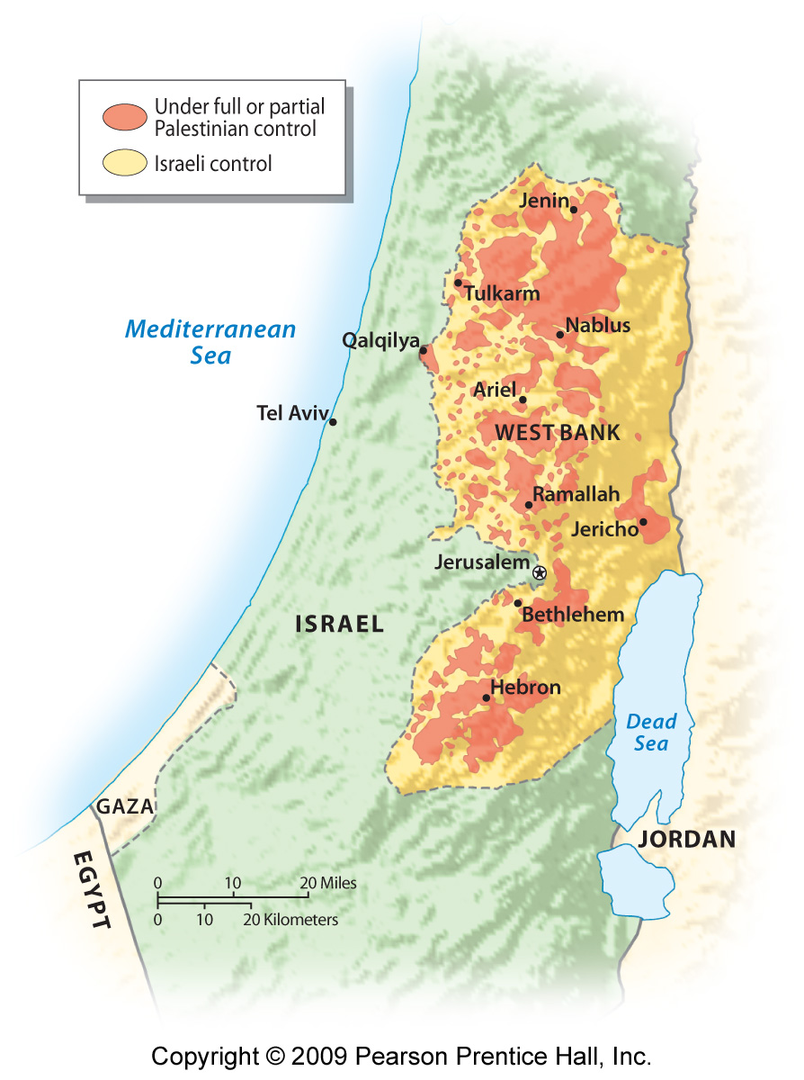
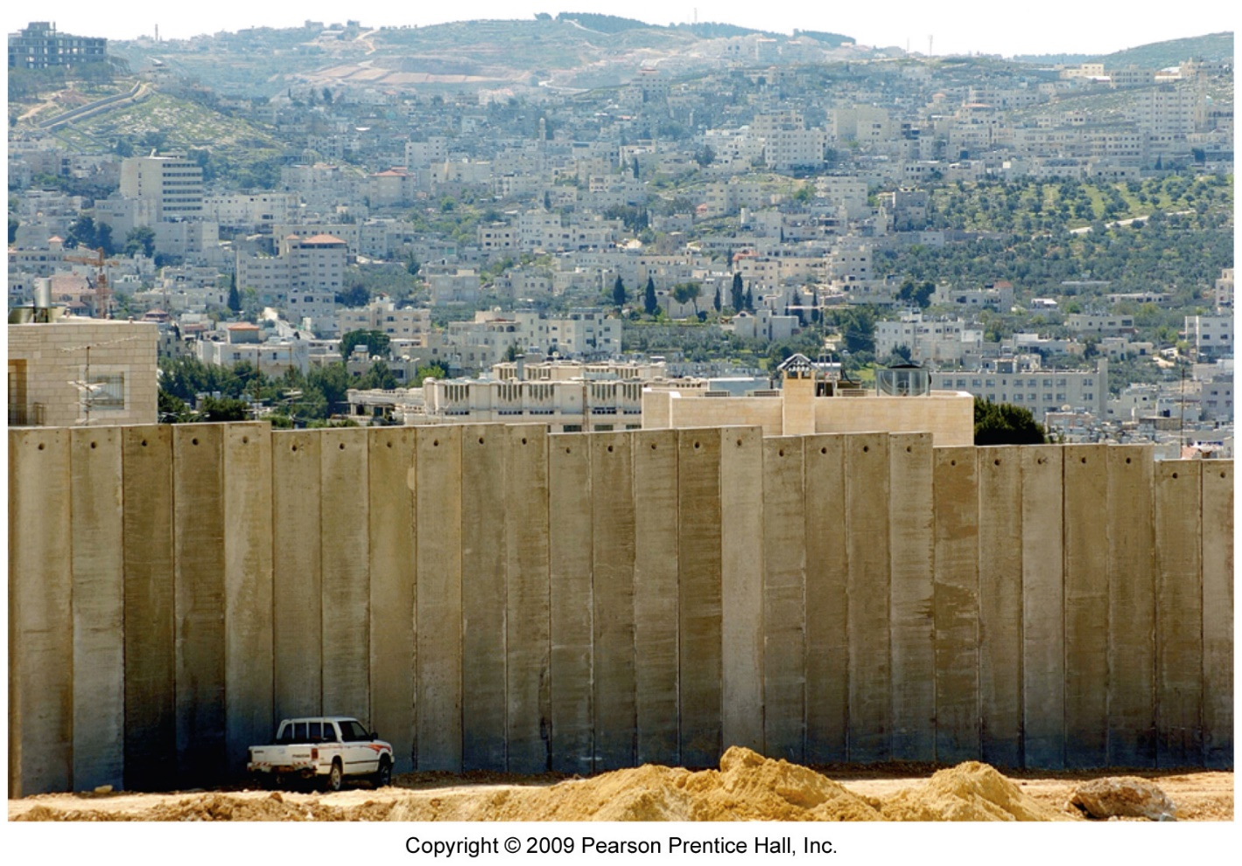
Palestinian territory split between the West Bank and the Gaza Strip.
Gaza elected Hamas as their government.
Fatah government in West Bank.

Slide 19
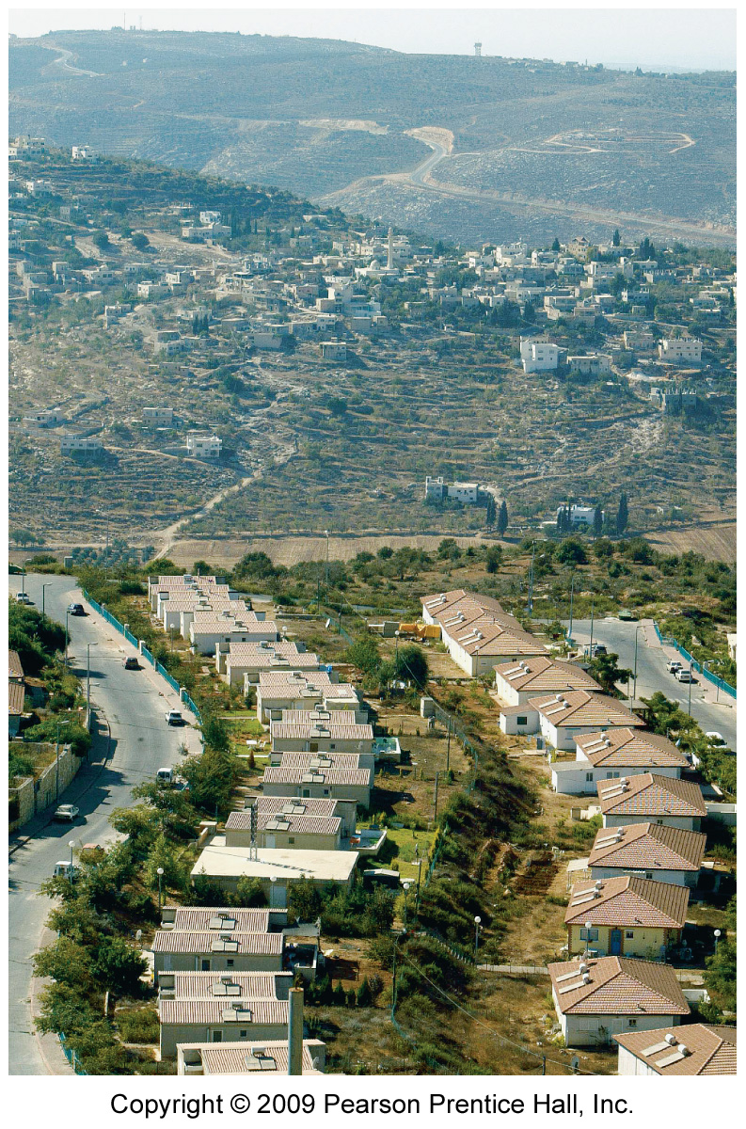
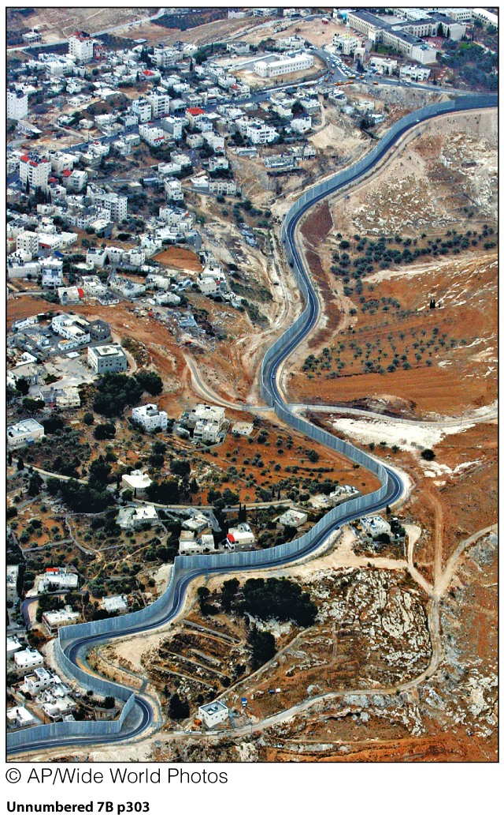

Slide 20
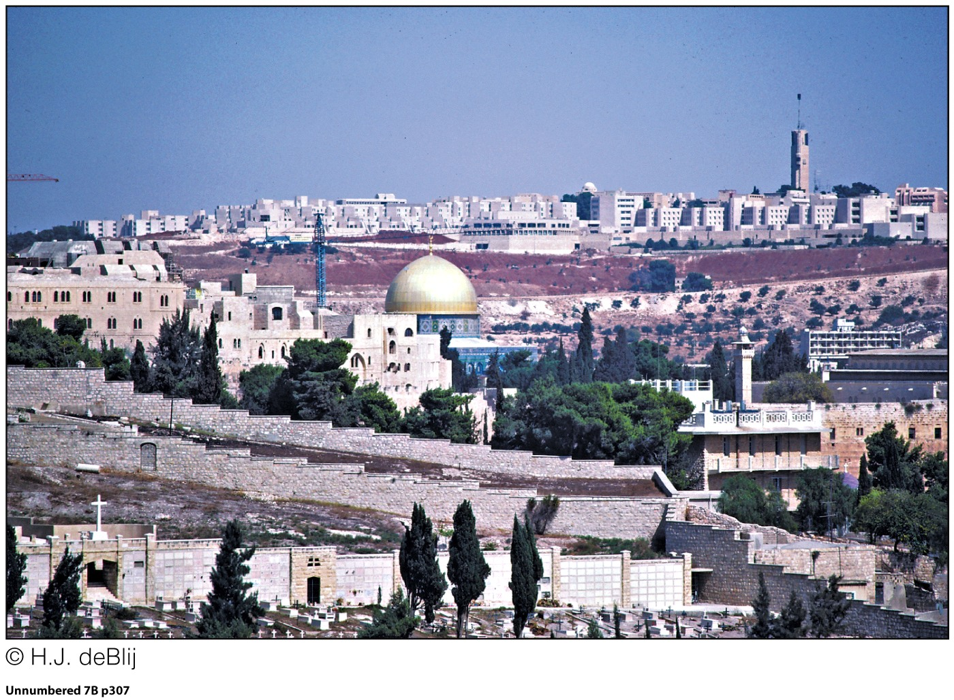
The Temple Mount for Jews or Haram al-Sharif for Muslims. Holiest site in Judaism; important for Muslims, Muhammed’s ascent to heaven
Solutions?
Camp David Accords, 1977
One State Solution
Two-State Solution
Question of Jerusalem

Slide 21
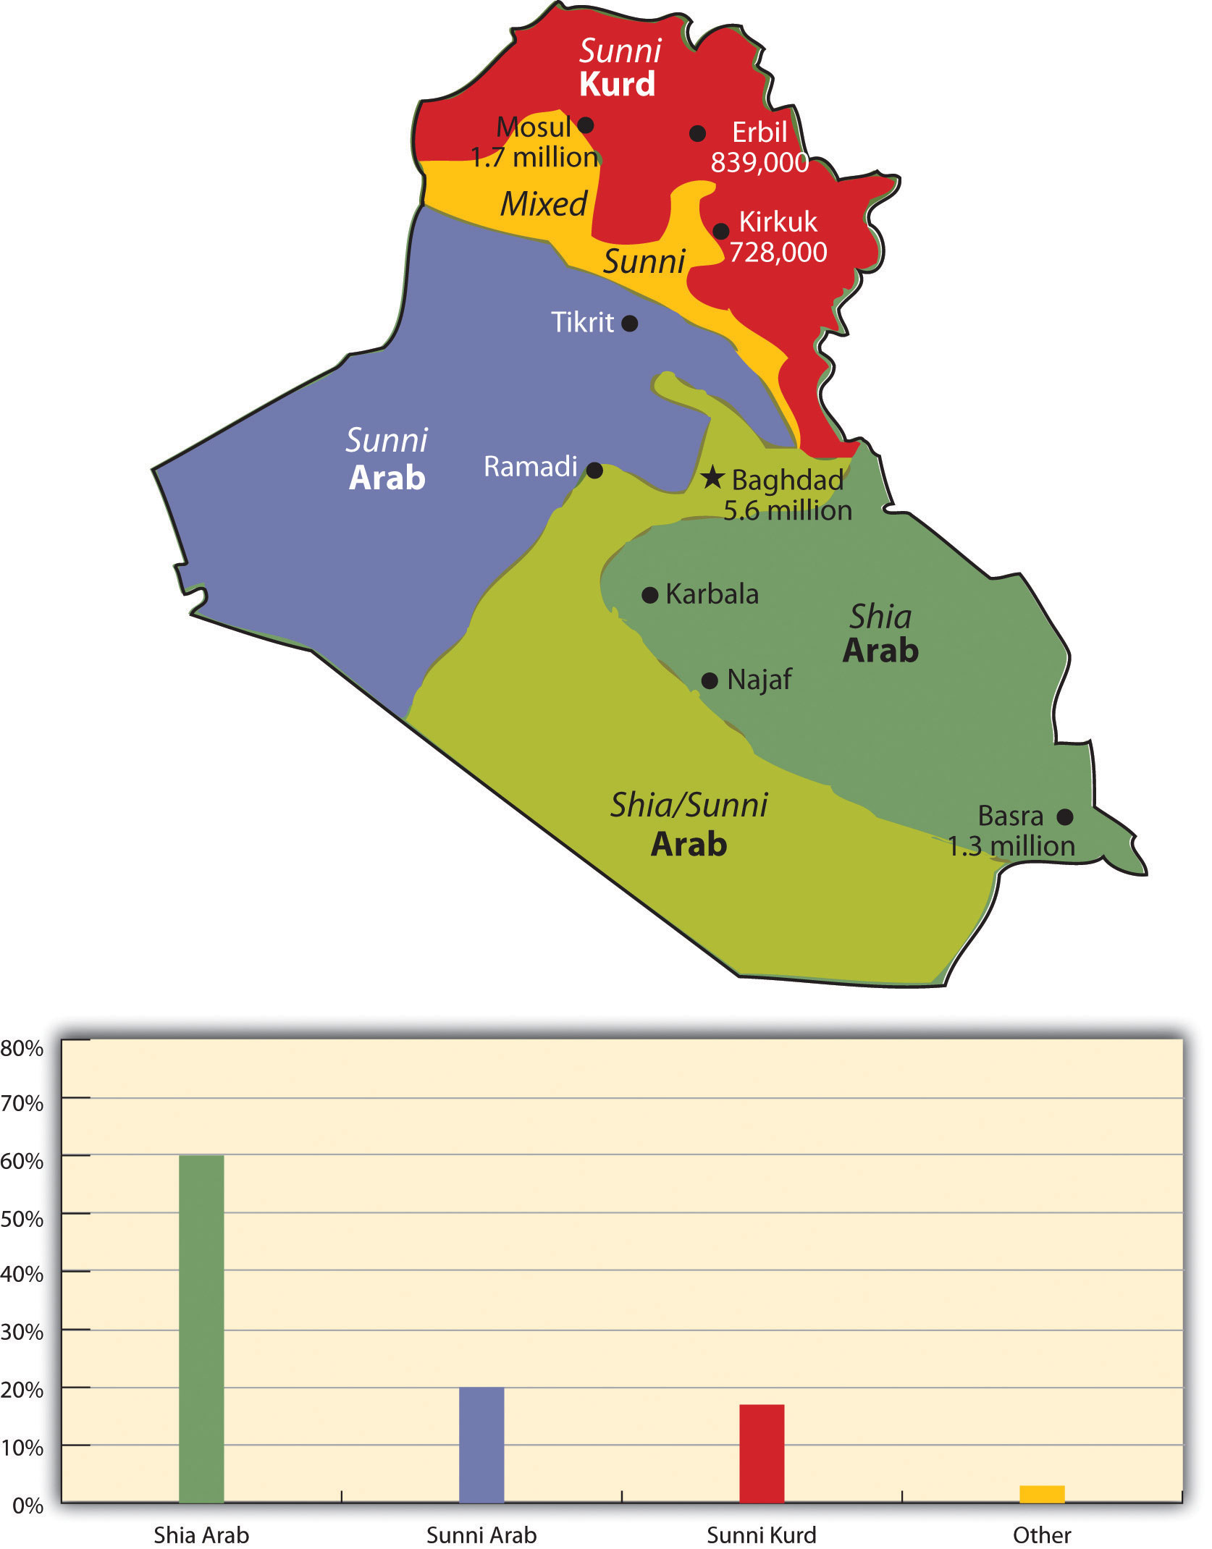
Iraq
Saddam Hussein 1979
Iran-Iraq war 1980-1989
Invasion of Kuwait 1990
Operation Desert Storm January, 1991
Kurdish Security Zone
2003 Operation Iraqi Freedom
Post US invasion Shia government
ISIS

Slide 22
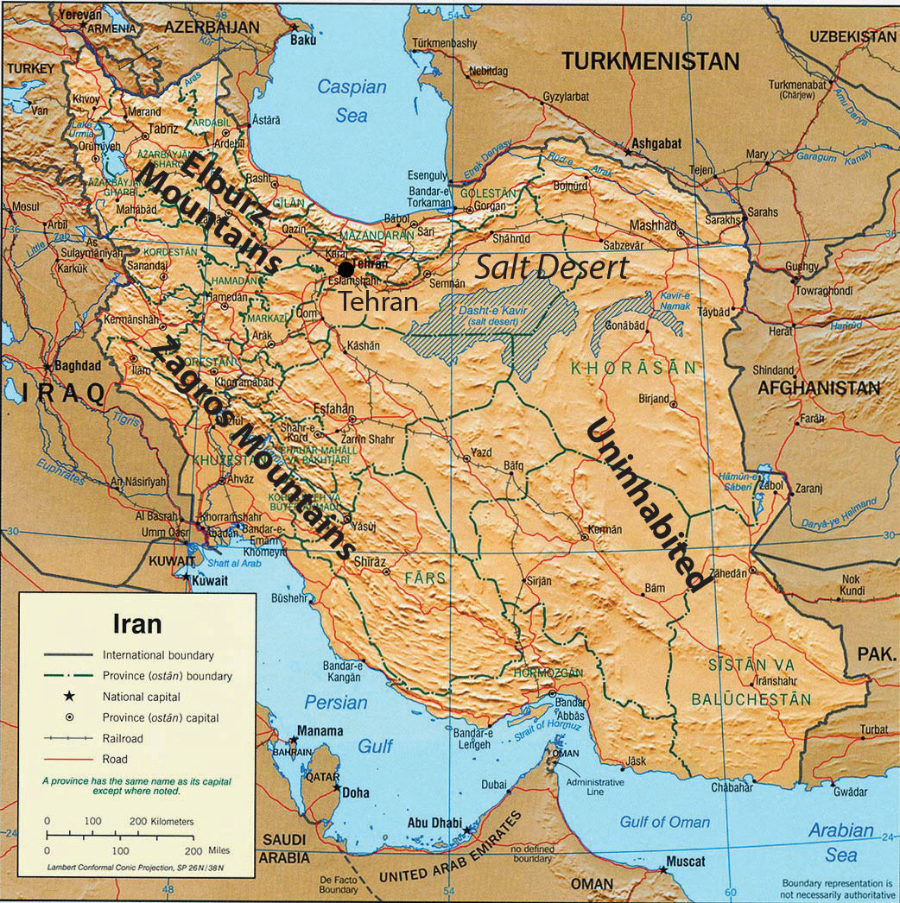
Iran
1953 coup
Removed Mosaddegh
Installed Shah Pahlavi (US ally)
1979 Islamic Revolution
Ayatollah Khomeini
1980-89 Iran-Iraq War
Support for Assad in Syria
Allied with Russia
Hezbollah

Slide 23
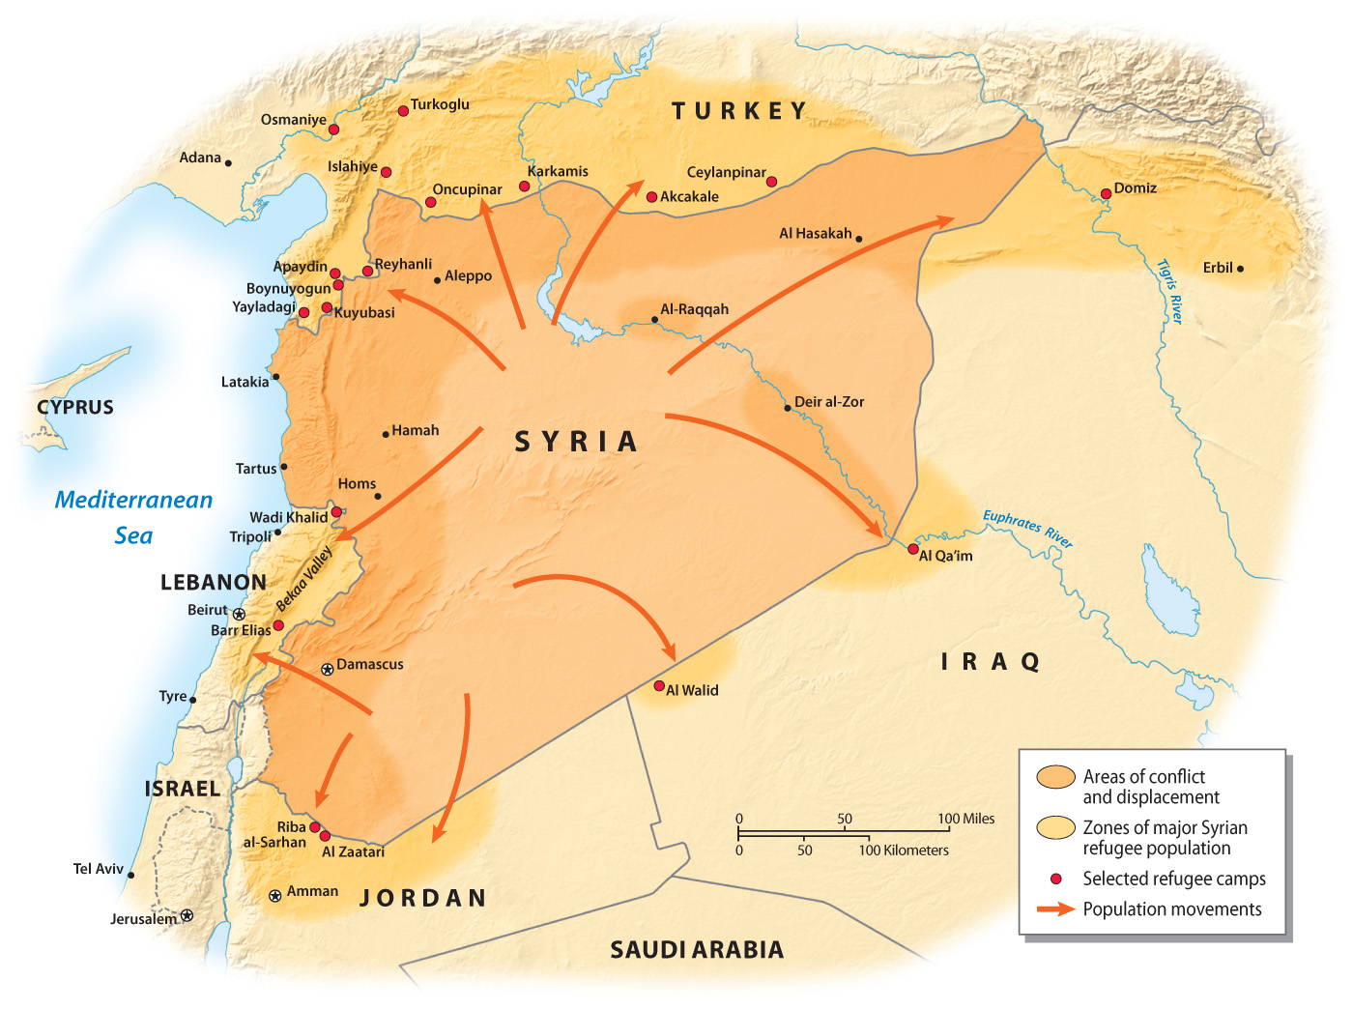
Syria
Ruled by Assad family
Bashar alAssad
Alowite, Shia minority
Allied with Russia & Iran

Slide 24
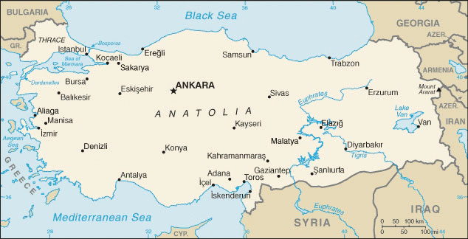
Turkey
Former Ottoman Empire
Turks (not Arabs); speak Turkish
Armenian minority
Armenian genocide (1914)
Kurdish minority
Kurdistan Workers Party(PKK)
President Erdogan since 2014

Slide 25
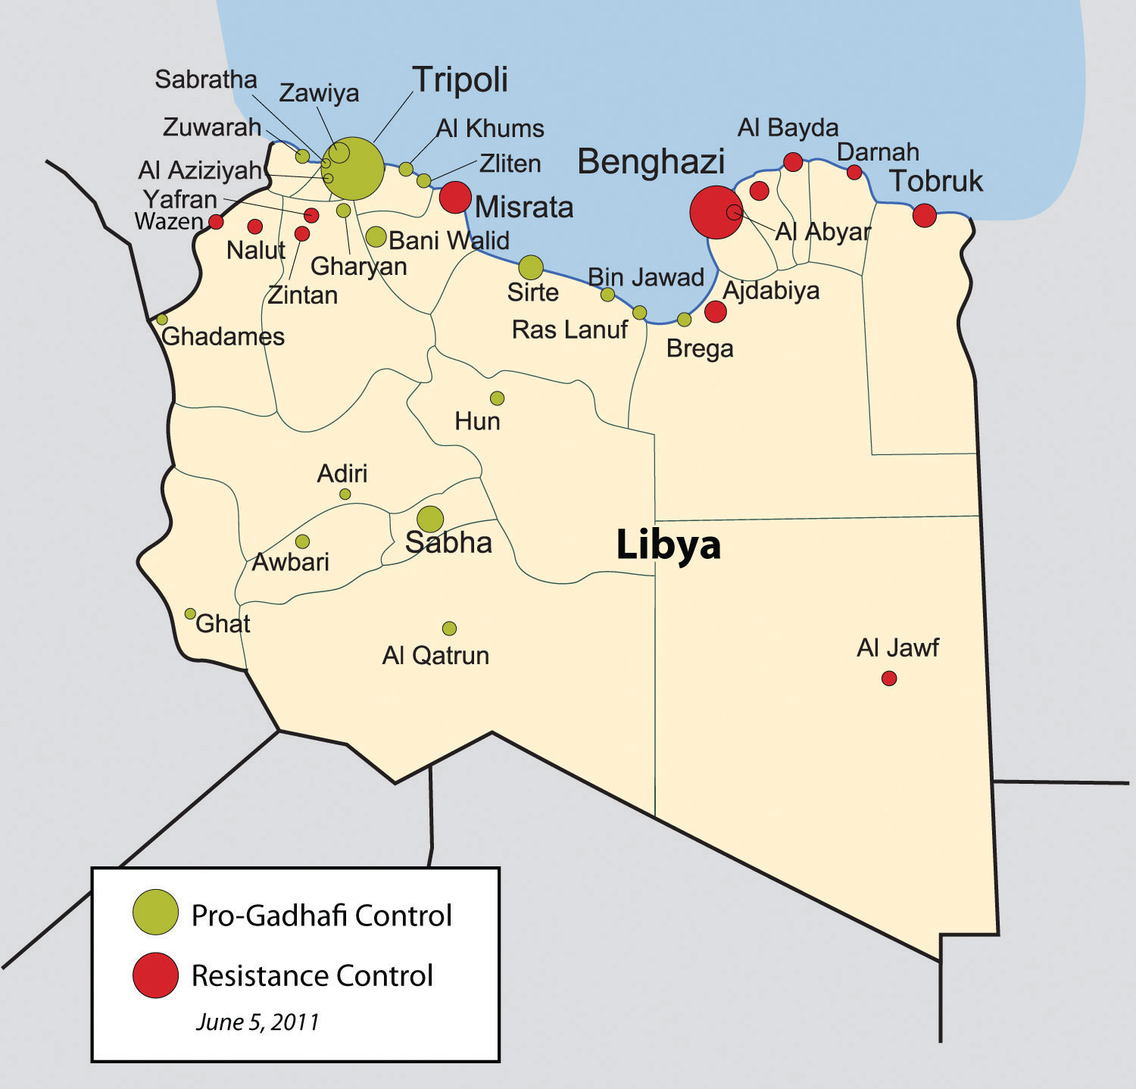
Libya
Gadhafi, 1969
Nationalized oil in 1986
US airstrikes
Libyan state-sponsored terrorism
Pan Am,Lockerbie, Scotland
Post 9/11
Arab Spring 2011
Civil War since 2014
ISIS occupied 2017

Slide 26
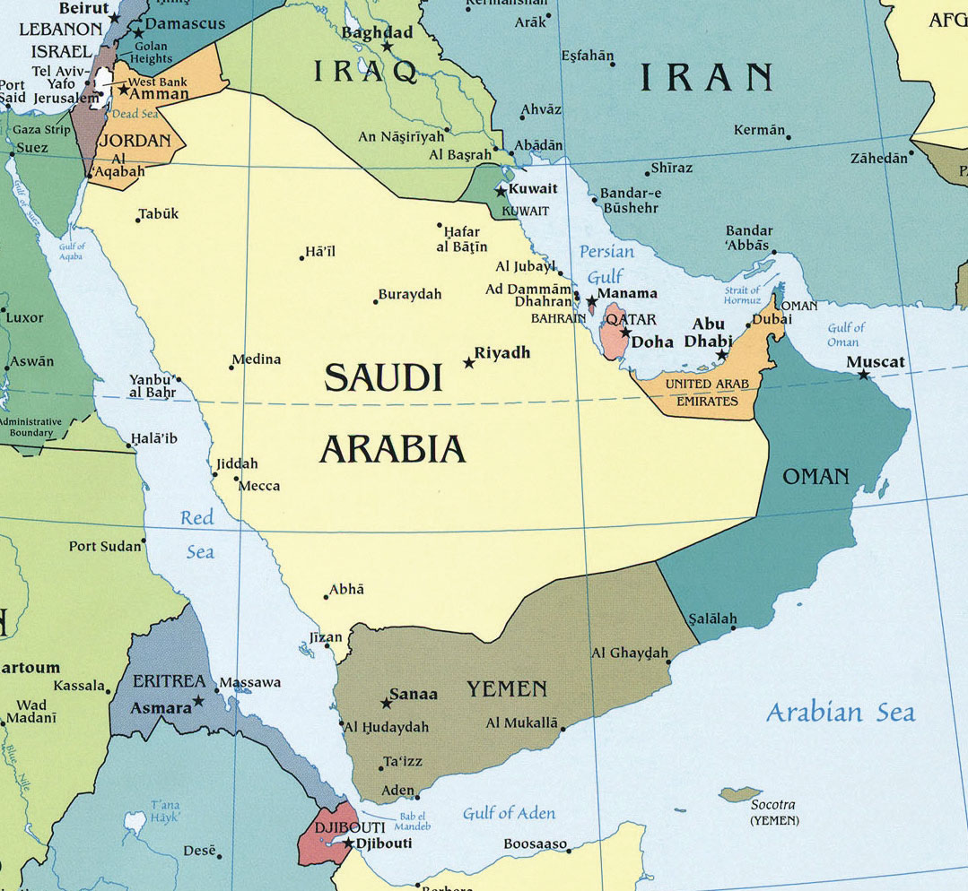
Saudi Arabia
Ottoman occupied until 1918
Growth of Wahhabism
British controlled until 1932
“Given” to Ibn al Saud, 1932
Oil industry emerges 1930s
Strong relationship with West
Strong relationship with US
State-sponsored terrorism
9/11

Slide 27
Saudi Arabia and State Sponsored Terrorism
The Saud Royal family becomes exceedingly wealthy after OPEC forms
But most Saudis remain very poor
Discontent grows in religious schools—madrasas
Anger over persistent poverty
Anger over Western influence and Western (“outsiders”) control of oil wealth
Mujahedeen
Wahhabist extremists are integrated into Saudi government positions
Saudi Arabia funds export of “holy warriors” to fight Soviets
Osama bin Laden—CIA asset
More than 12,000 Saudi mujahedeen go to Afghanistan
War in Afghanistan 1979-89
Over 1 million die, including more than 50,000 Soviet troops
Breaks the Soviet Union and leaves a power vacuum
Rise of Taliban
Sunni Muslims; defeat Northern Alliance in 1996)
Lawlessness
Terrorist networks (Al Qaeda) take advantage of areas of Afghanistan that aren’t governed to run training camps for terrorists.

Slide 28
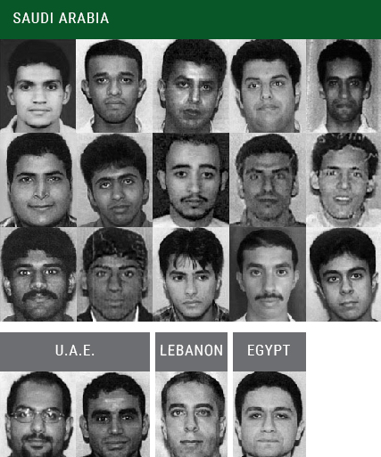
The 9/11 hijackers.
15 were from Saudi Arabia.
2 were from the U.A.E.
1 was from Lebanon.
1 was from Egypt.
Who orchestrates these attacks and why?
US invades Afghanistan in 2001.
Operation Enduring Freedom.
Osama bin Laden escaped to Pakistan.
Killed by Navy SEALS in 2011.

Slide 29
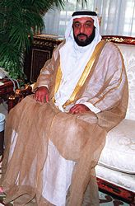
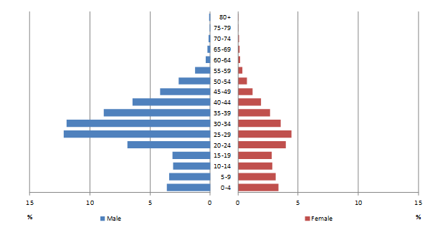
Oil Wealth for Country “X”
What Country?
A bit smaller than Maine
.77% of its land is arable
Created in 1971
World’s 16th highest GDP at $40,000
Demographics:
Ages 15-64: 2.6 million men and only 933,000 women (2010)
Khalifa bin Zayed al Nahayn

Slide 30
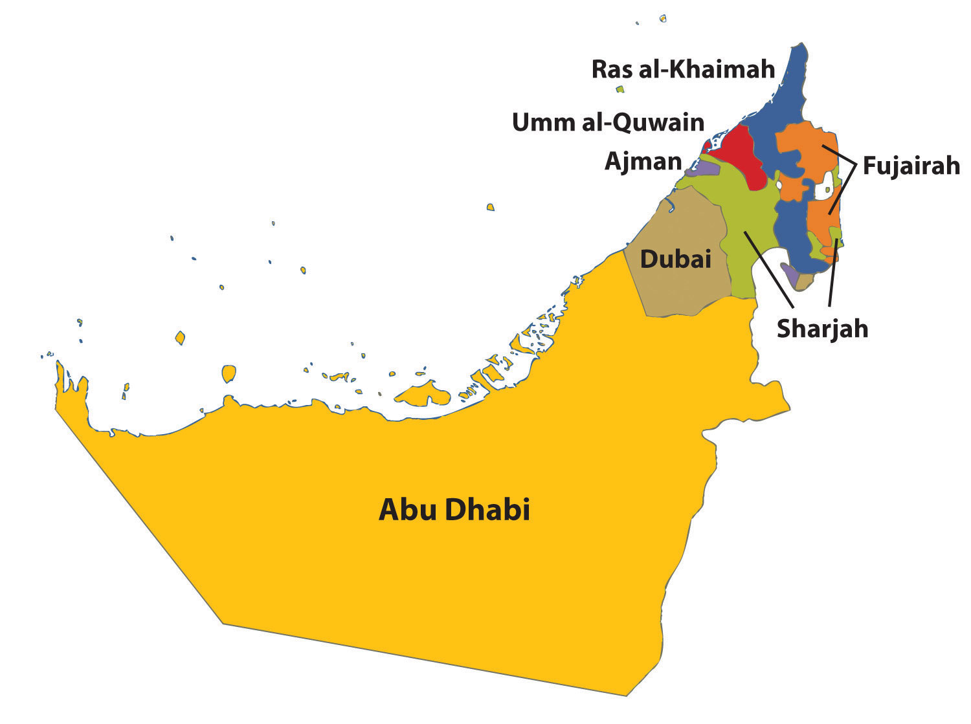
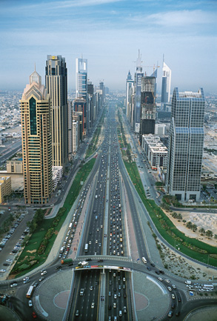
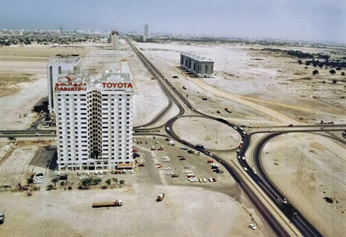
United Arab Emirates
Tremendous oil wealth
Attempts to diversify economy
Modernize country
Dubai's Sheikh Zayed Road
Early 1990s and today…

Slide 31
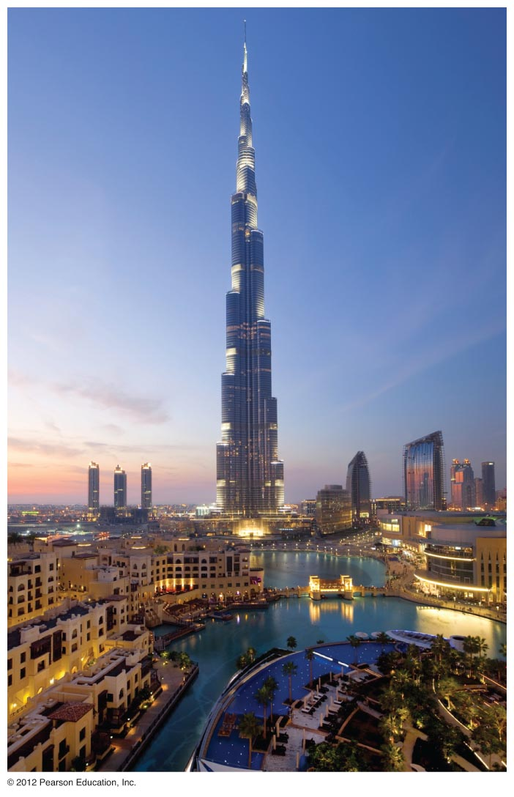
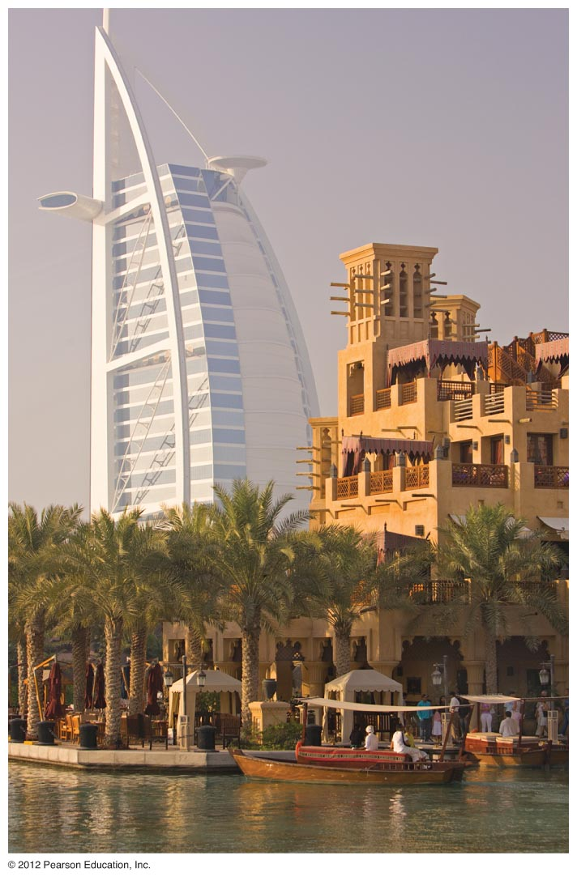
Tourism and International Recognition
Tallest building in world—Burj Khalifa
World’s first “seven star” hotel
Madinat Jumeirah Arabian Resort
Burj al Arab Hotel

Slide 32
Development
The Palm Islands—Palm Jumeirah
8th wonder of the world
Islands, over 400 villas, apartments, spas, diving, theaters
Doubled Dubai’s 45 mile coastline
Each island is 1 billion cubic meters of dredged sand and stone
The World Islands
Individual islands for sale
Suffered during global recession of 2008-10, lots of vacancies
Only about 4 of the islands have been developed.

Slide 33
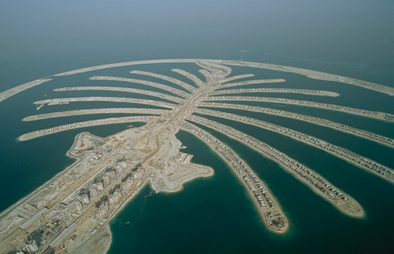
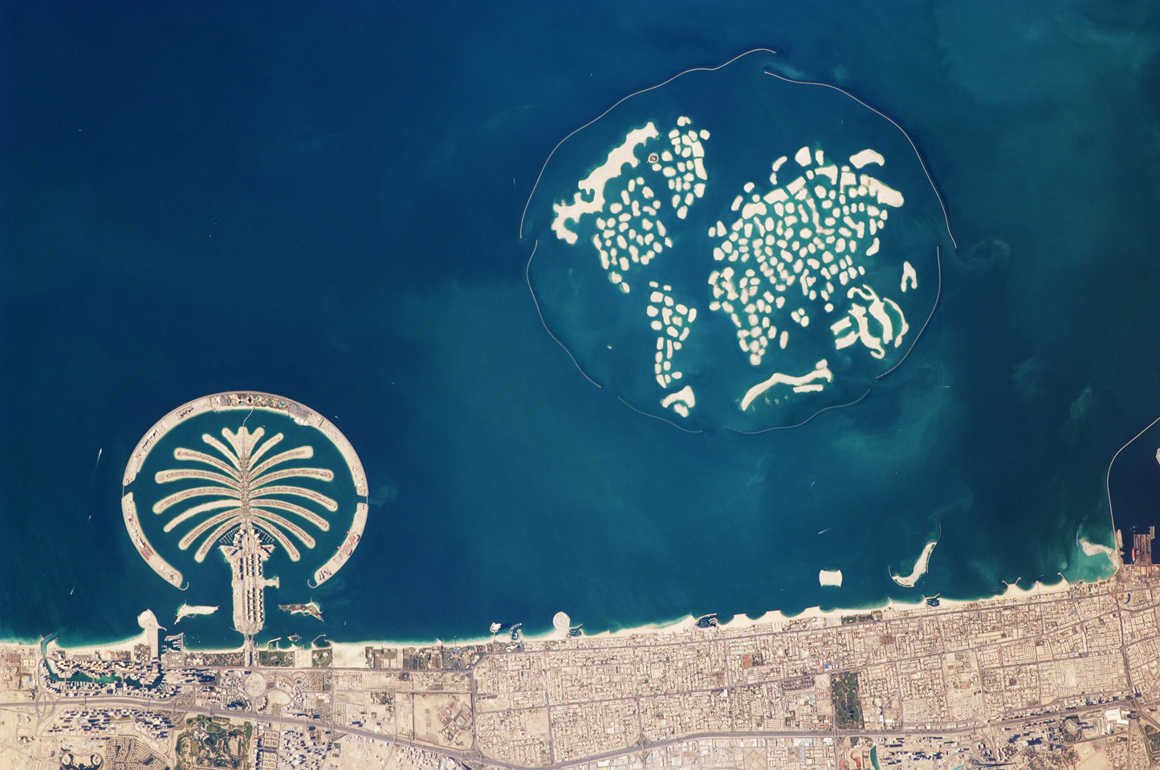
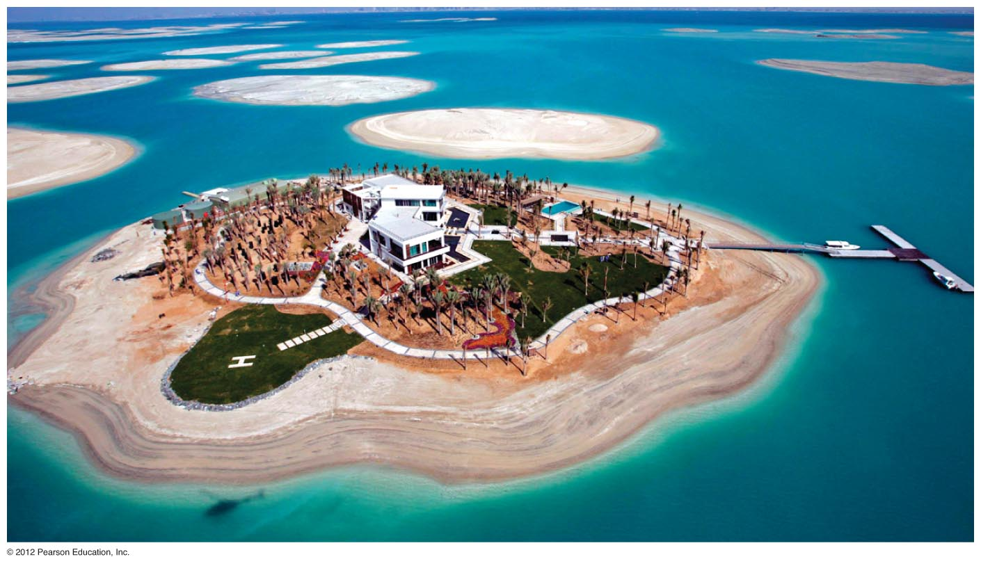

Slide 34
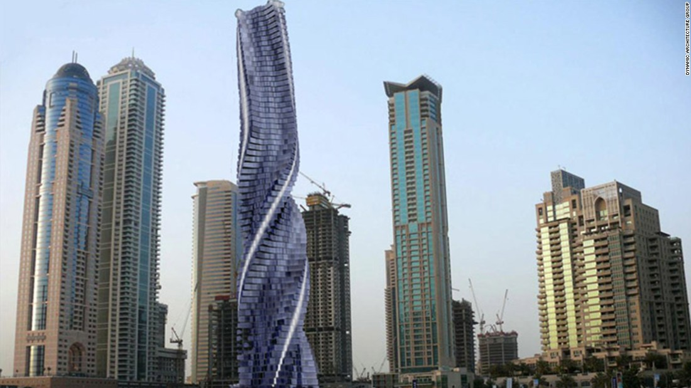
Dubai’s 80-story, 1273 foot tower. Floors will rotate 360 degrees in all directions.

Slide 35
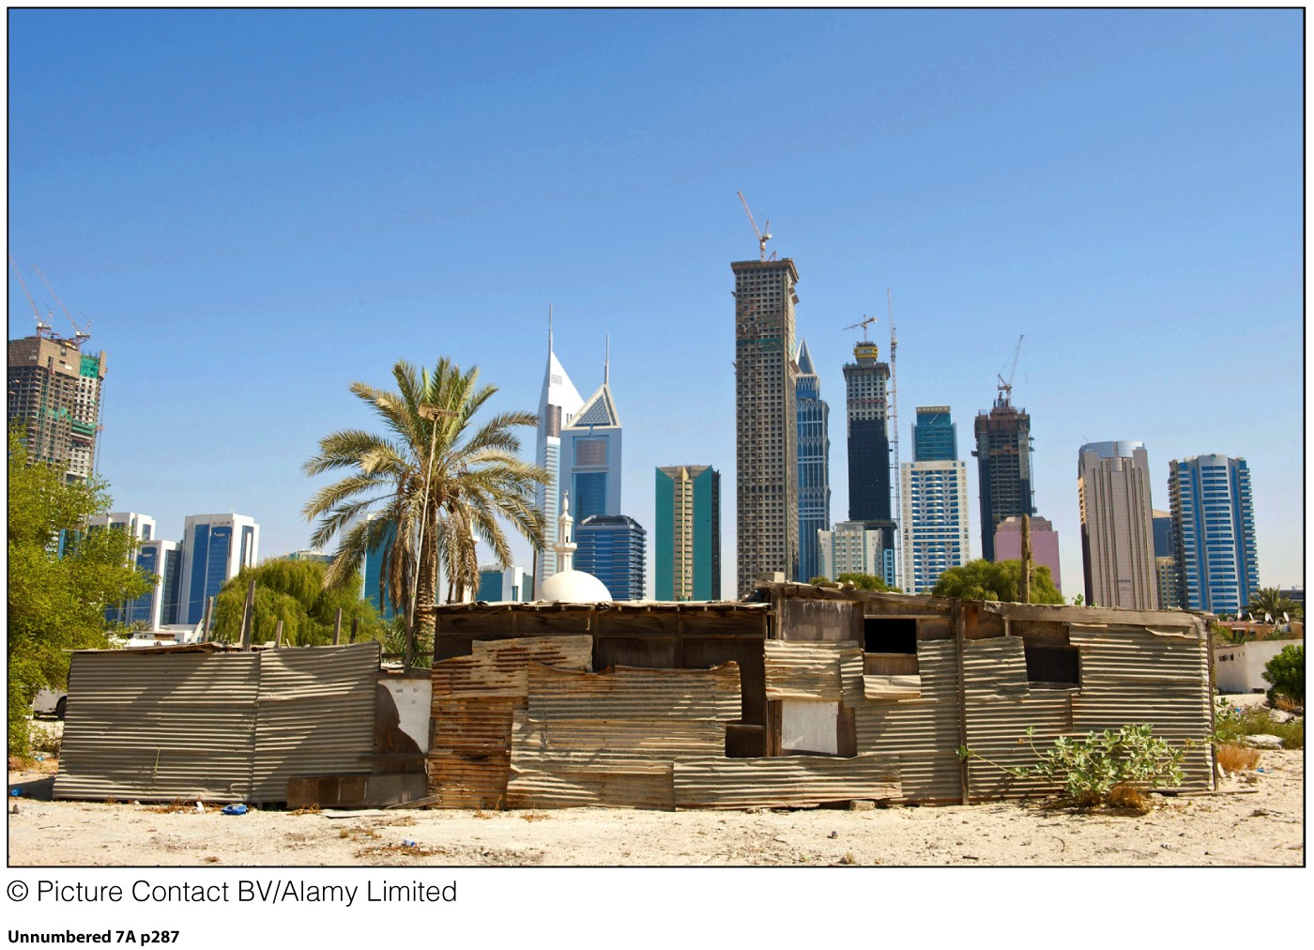
Just miles from Dubai’s center are the homes of immigrants. These immigrants are
Guest Workers, recruited to do low-skilled, low-wage jobs in the region.

Slide 36
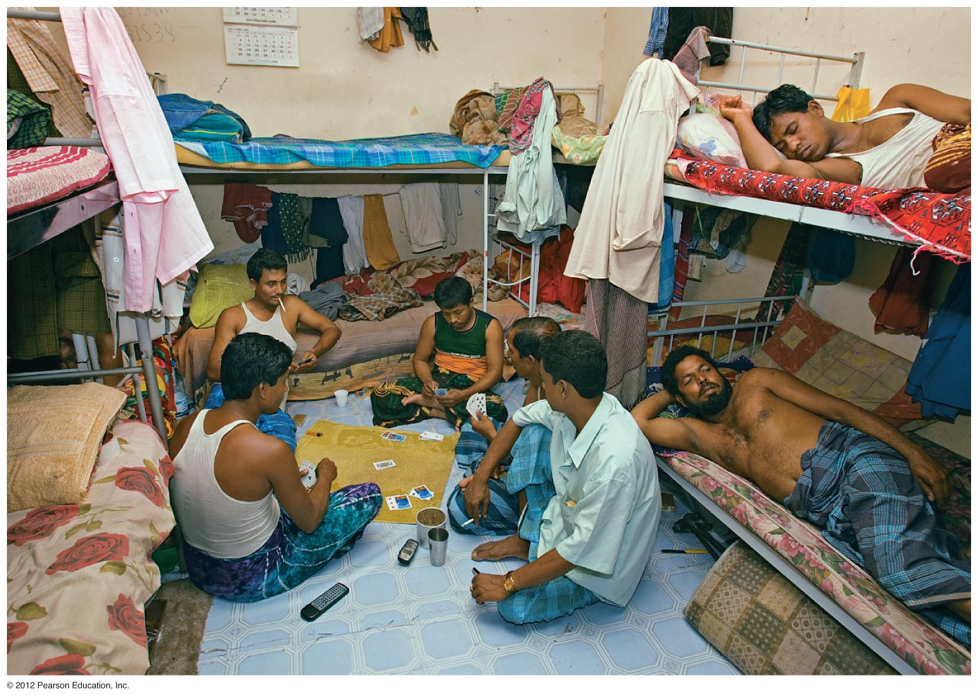
The UAE’s growth has been on the backs of imported labor.
Guest Workers face terrible living and working conditions and raise human rights concerns.
Notes:
Figure 7.25

Slide 37
Oil Wealth in the Region Has…
Brought Urban Transformation
Modern cities
Brought volatile income streams
Note: Dubai suffered during great recession
Brought huge spending on infrastructure
Roads, Buildings, Airports…
Brought large regional disparities in wealth
Countries that remain very poor sit next to countries with great wealth
Brought new migration patterns
Migration within the region—Palestinians, Shia Muslims drawn to oil-rich states
Migration from outside the region—Pakistanis, Indians, Sri Lankans, Bangladeshis, Filipinos
85% of the population of the UAE are foreign workers
5 million of Saudi Arabia’s 30 million people are foreign workers

