Slide 1
Sub-Saharan Africa
Images of the Region
Physical Geography of the Region
African Agriculture
Race and the Social Landscape

Slide 2
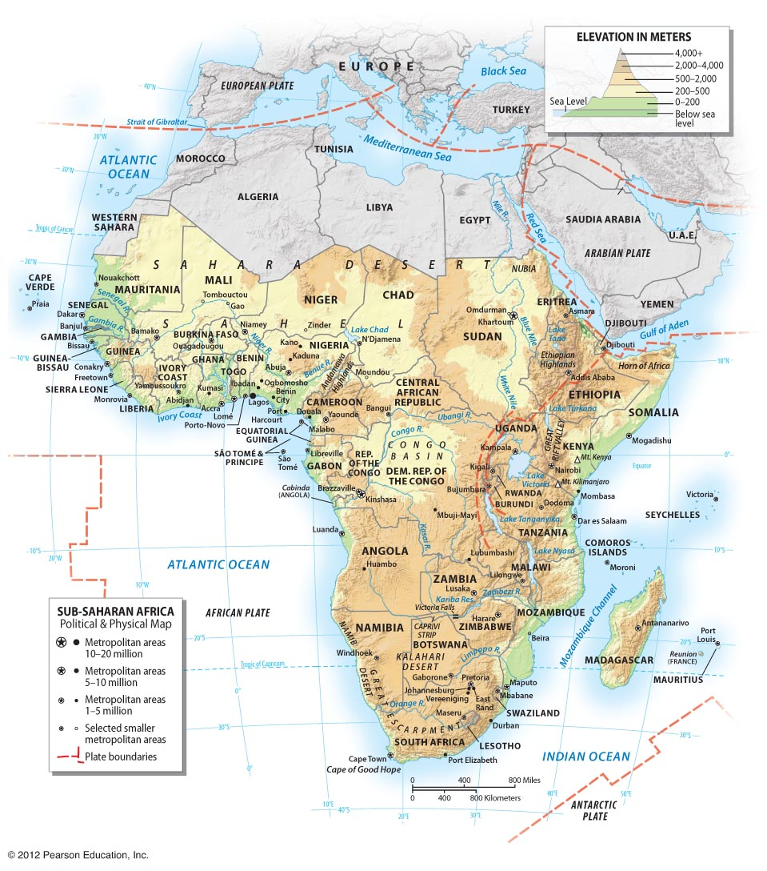
Sub-Saharan Africa
Africa occupies 20% of world’s landmass
865 million people, 12% of world’s pop
70% is rural
43% under age 15
Images of the region
Land of ‘overpopulation’ and political conflict
What are the roots of these problems?

Slide 3
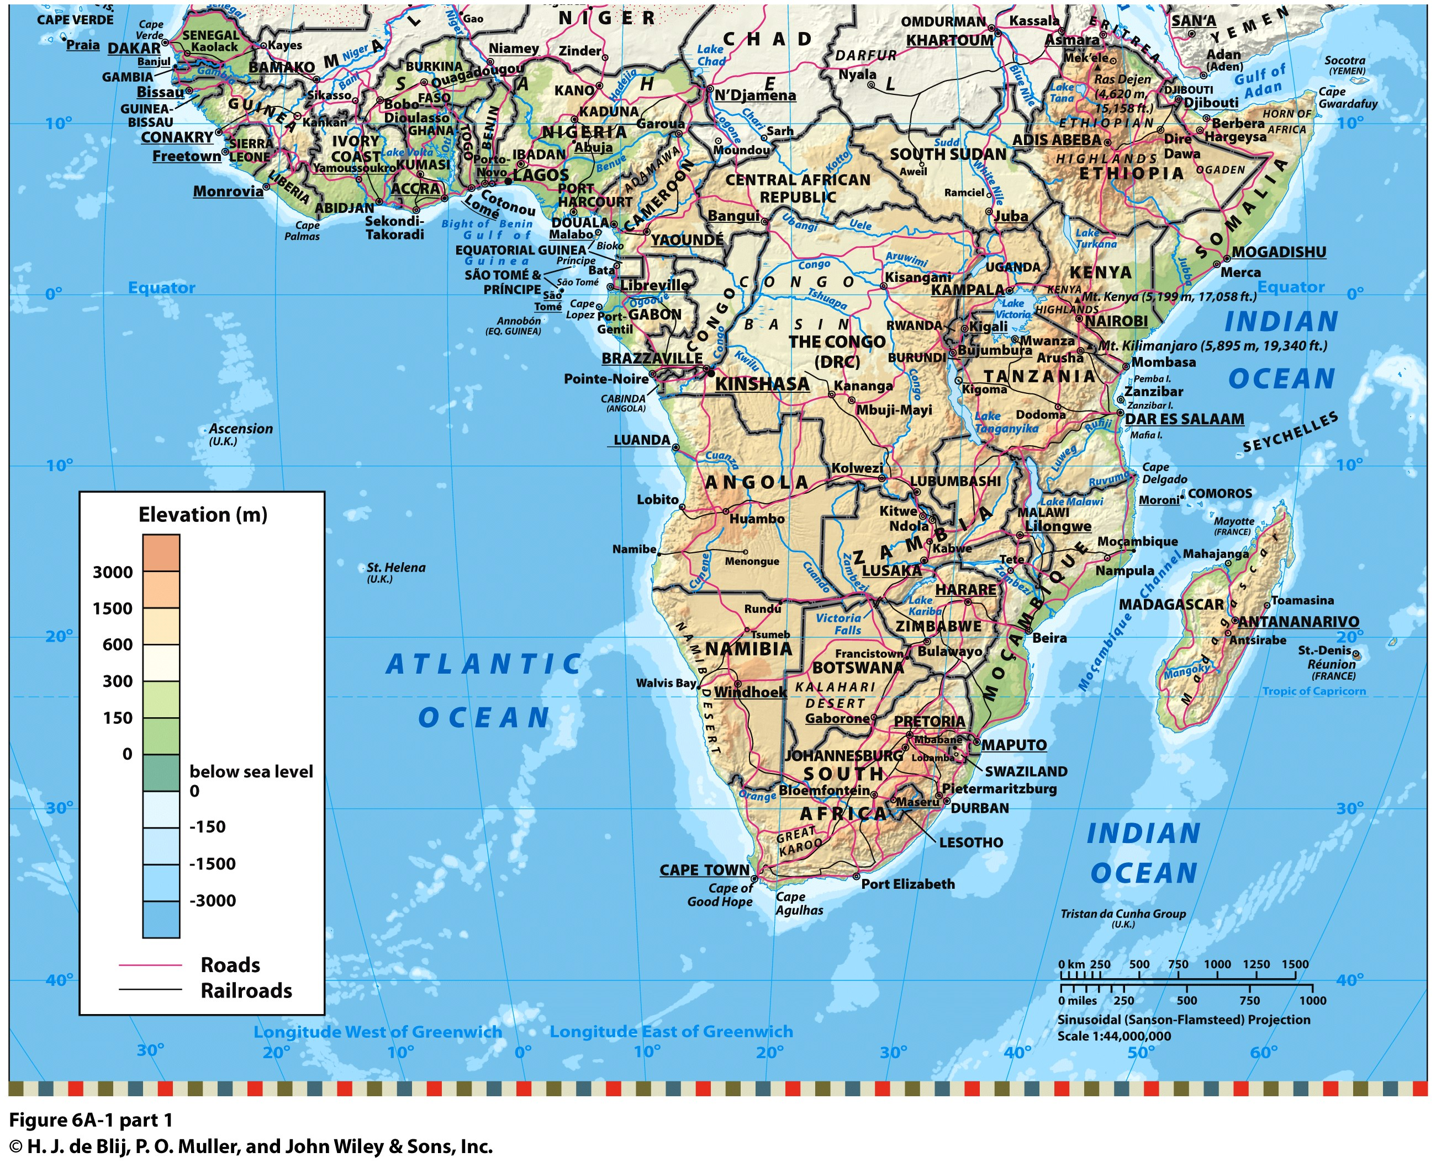
Africa’s Unique Physical Geography
*Largest landmass to straddle the equator *Influence of high pressure belts
*Far from ocean influences

Slide 4
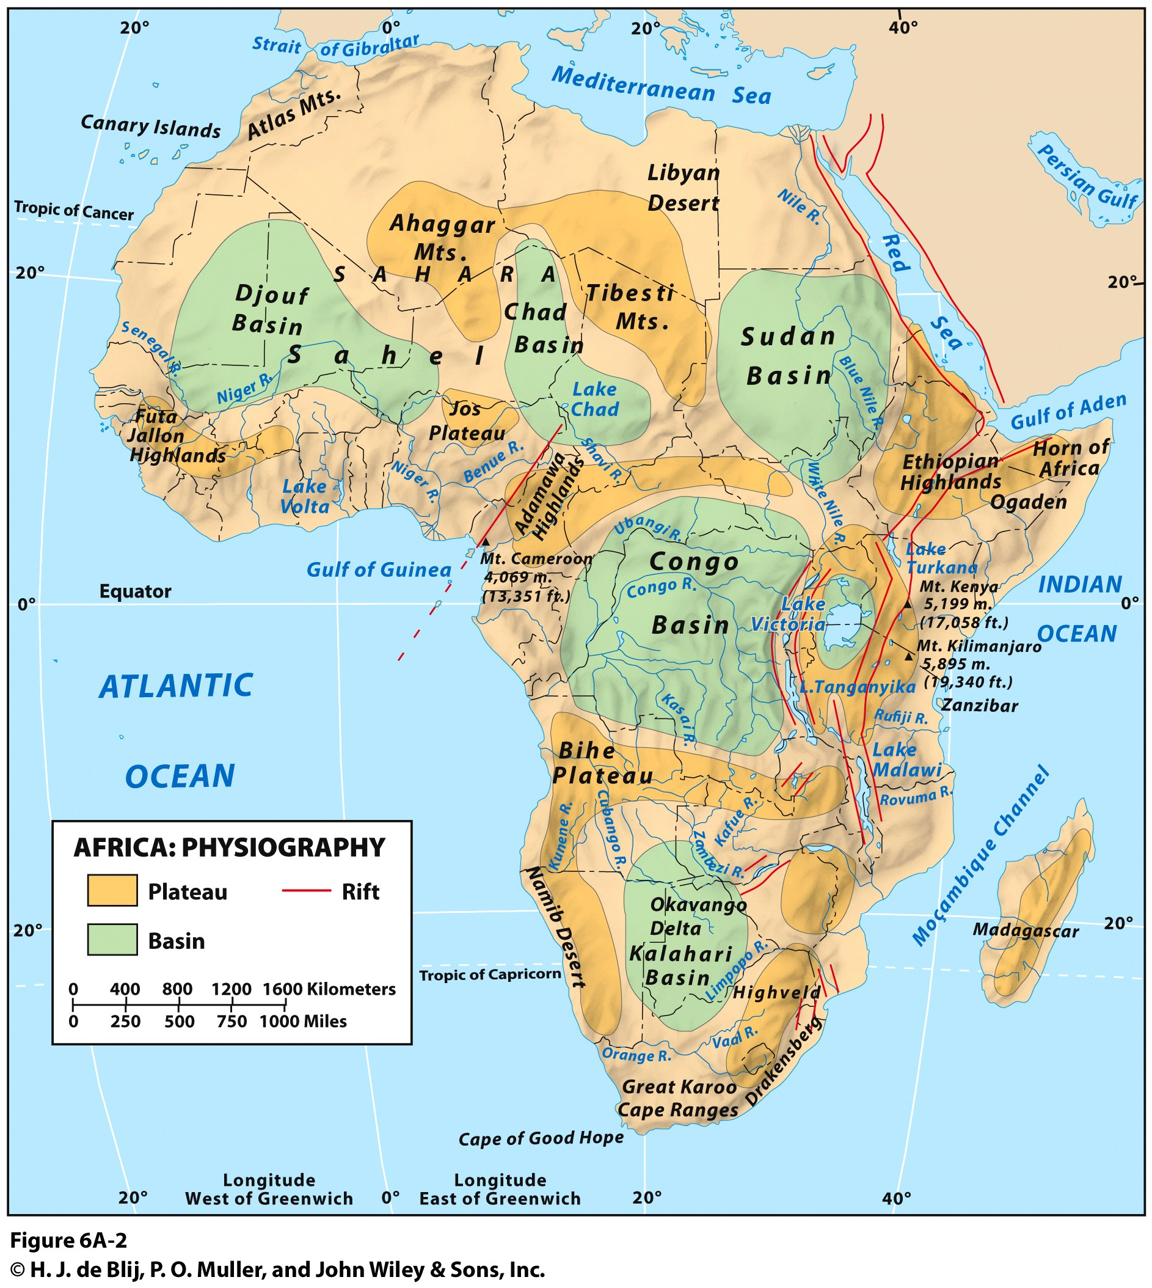
Africa’s Physiography:
No major mountain range
Mt Kilimanjaro, 19000’
Mt Kenya, 17000’
A plateau continent
Ethiopian Highlands
South Africa, Great Escarpment
Most of region above 1000’
A set of Great Lakes
Rift Valleys (red lines)
Several major river basins
Nile
Niger
Congo
Zambezi

Slide 5
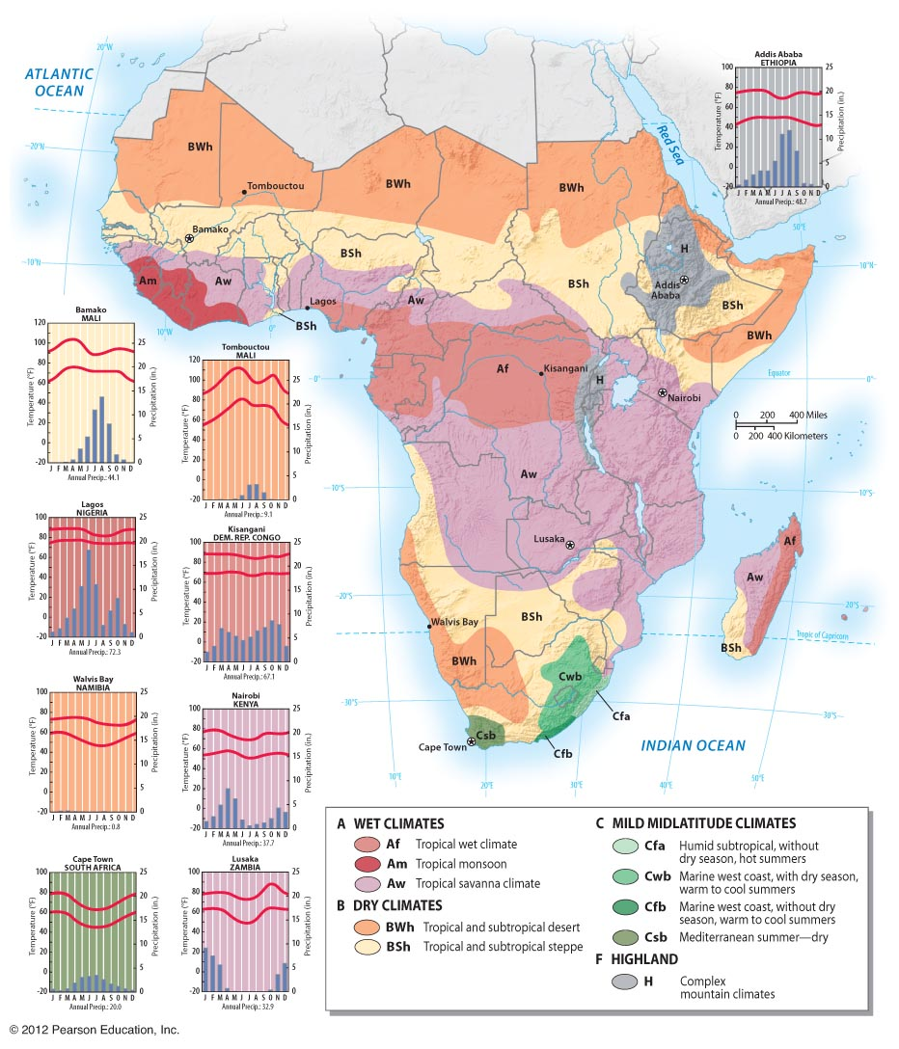
African Climate Zones
BW/BS
*no ocean influences
*high pressure belts
Af/Aw
*latitude
*migration of high pressure
Cf/Cs
*latitude
*marine ‘west coast’

Slide 6
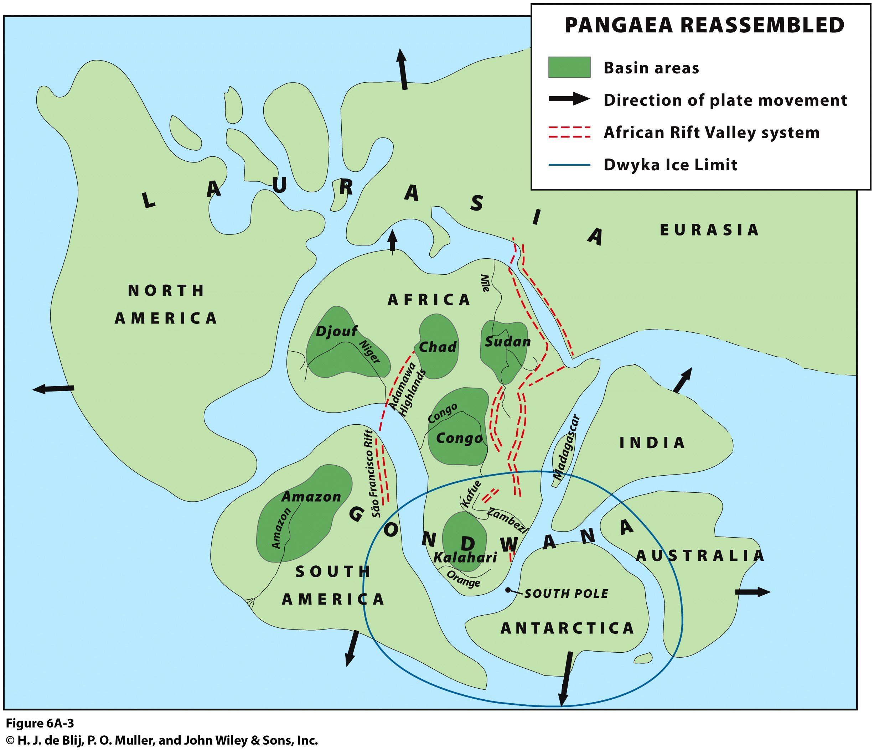

Slide 7
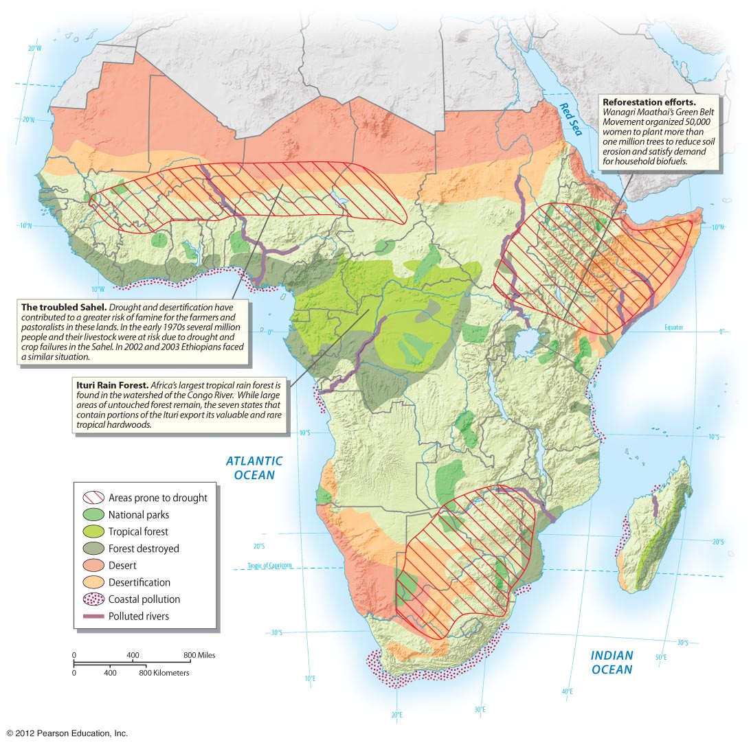
Environmental Geography
*Desertification
*Wildlife Management

Slide 8
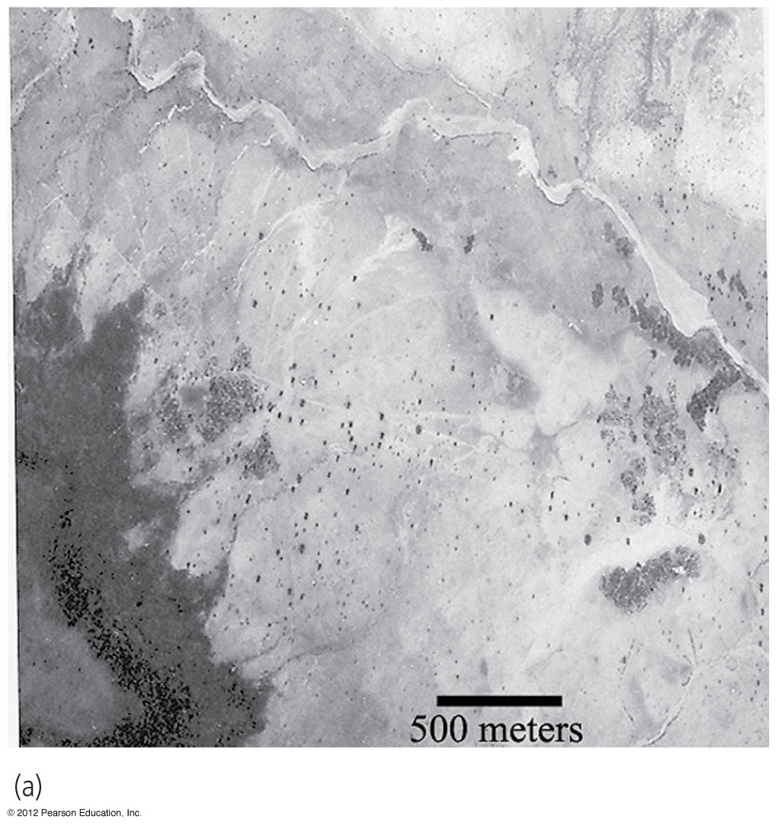
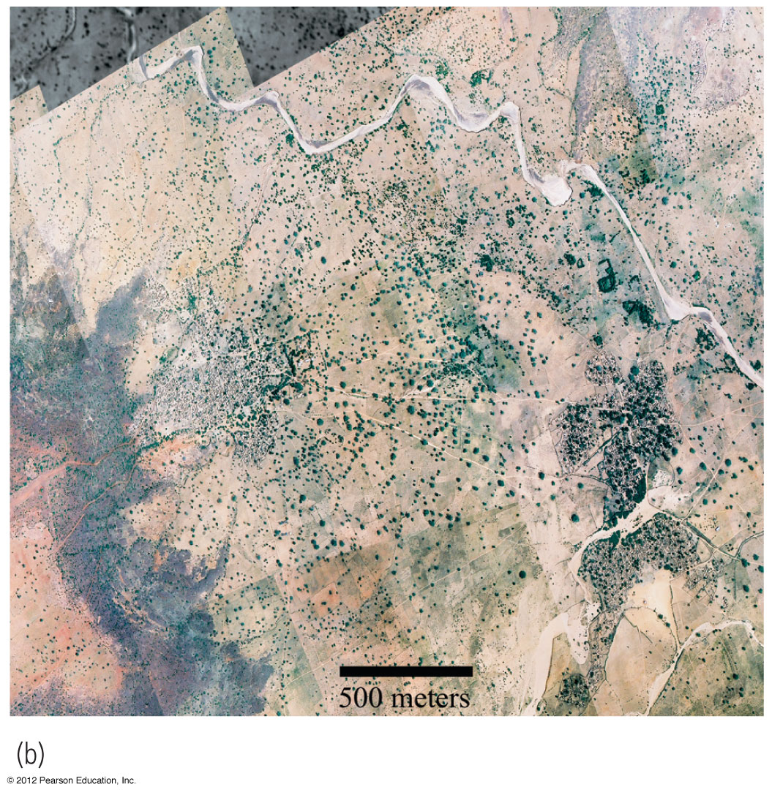
Desertification: what is to blame?
Efforts to change?
1975
Niger
2003
Niger

Slide 9
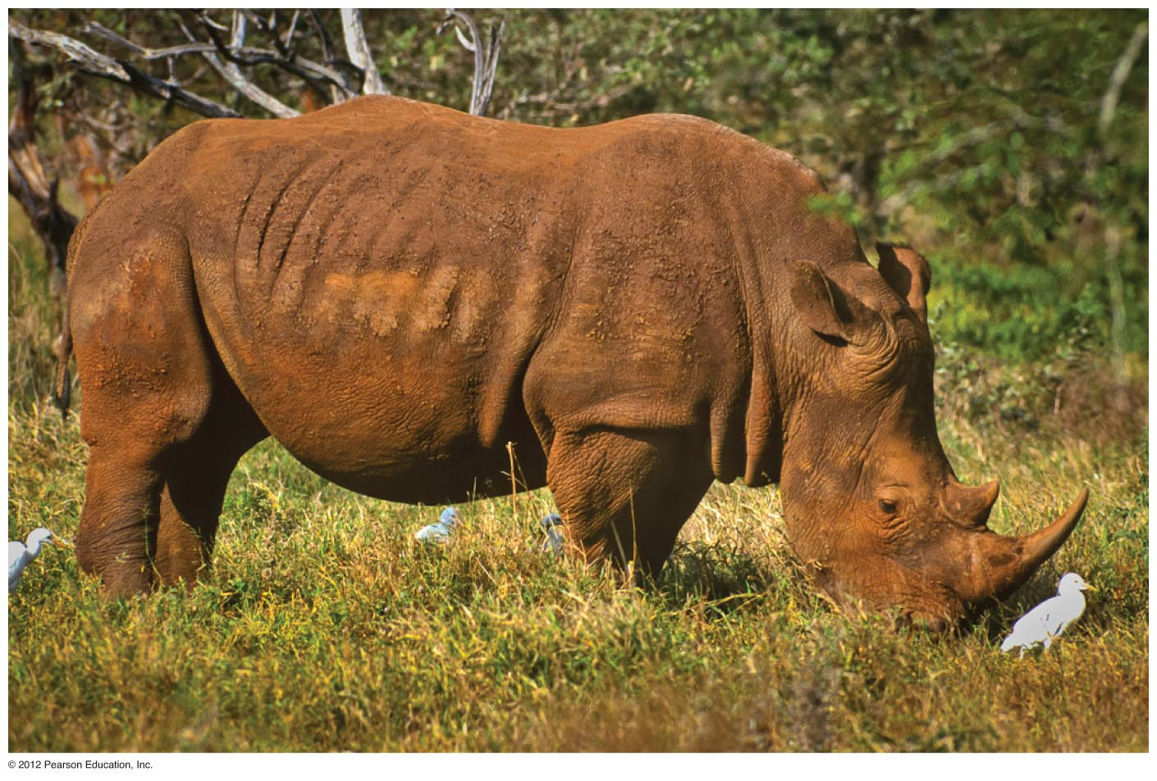
A white rhinoceros in Kruger National Park, South Africa.

Slide 10
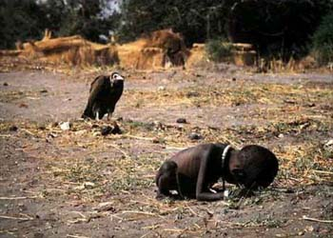
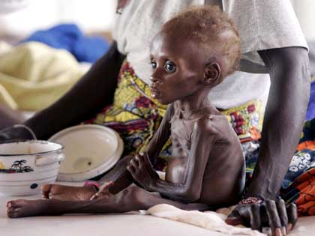
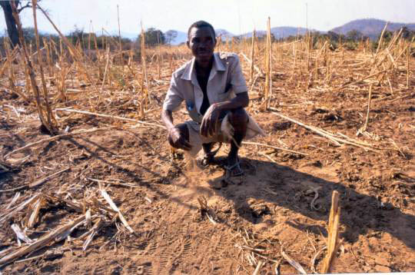
Images of African Agriculture
Images of agriculture
failure
BUT, African countries supply massive quantities of coffee,
cotton, sugar, tea, cocoa
& vegetables to European &
American markets

Slide 11
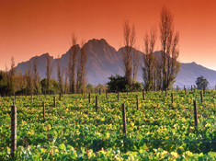
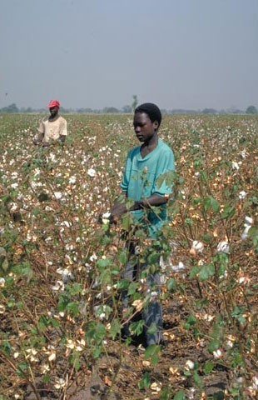
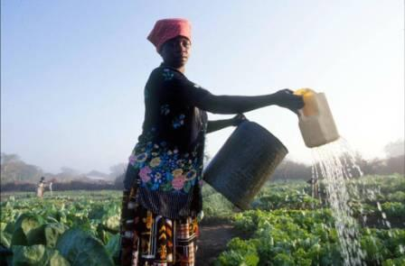
Re-imagining African agriculture

Slide 12
What is Food Insecurity?
Neo-Malthusianism: Thomas Malthus, an 18th century political economist, argued that people’s insatiable desire to reproduce, drives populations up while simultaneously placing greater pressure on food supplies. This leads inexorably to food insecurity and famine.
Amartya Sen: 1998 Nobel Prize winning economist argued that food insecurity is not a problem of production. Rather food insecurity is the product of a lack of capabilities to access sufficient food.

Slide 13
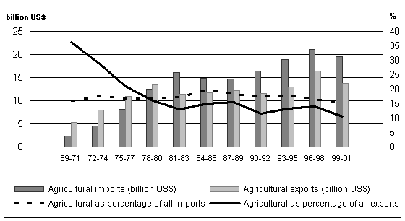
Increases in food imports
The paradox of African agriculture: Despite the majority of the population being engaged in agriculture, and high levels of exported agriculture goods, Africa has recently become a net importer of food. All this while levels of food insecurity have risen.

Slide 14
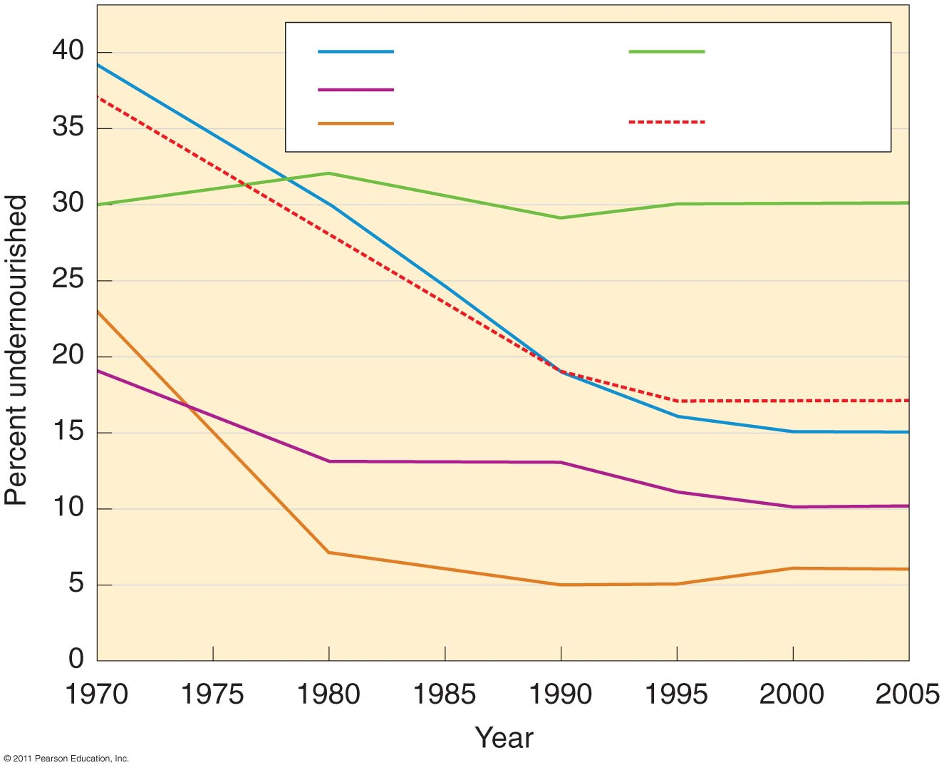
Percent of population undernourished. 1/3 of Africans are considered
undernourished.
Asia
Latin America
Southwest Asia
Sub-Saharan Africa
All LDCs

Slide 15
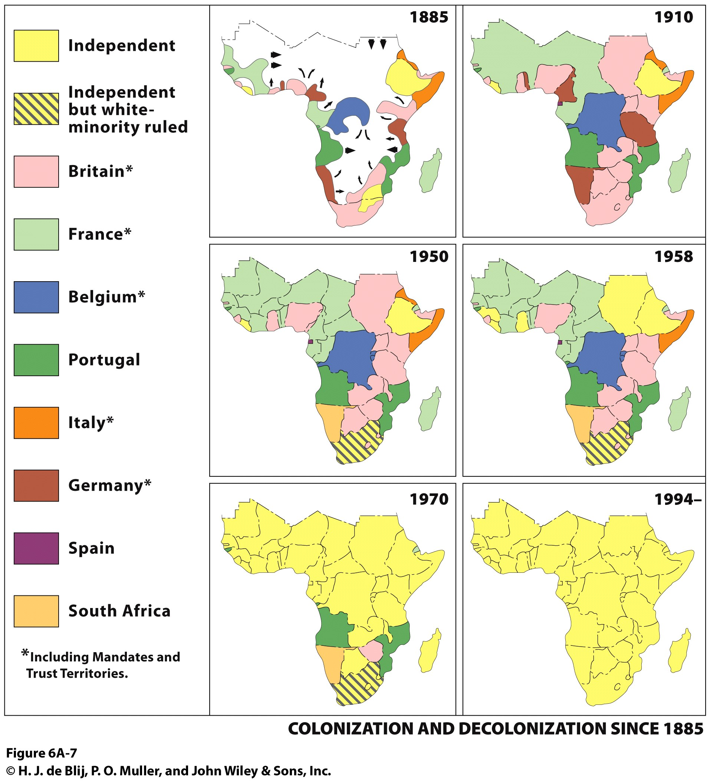
The Colonial Legacy in African
Agriculture
*Peasant Producers
*Hut Taxes
*Cash Cropping

Slide 16
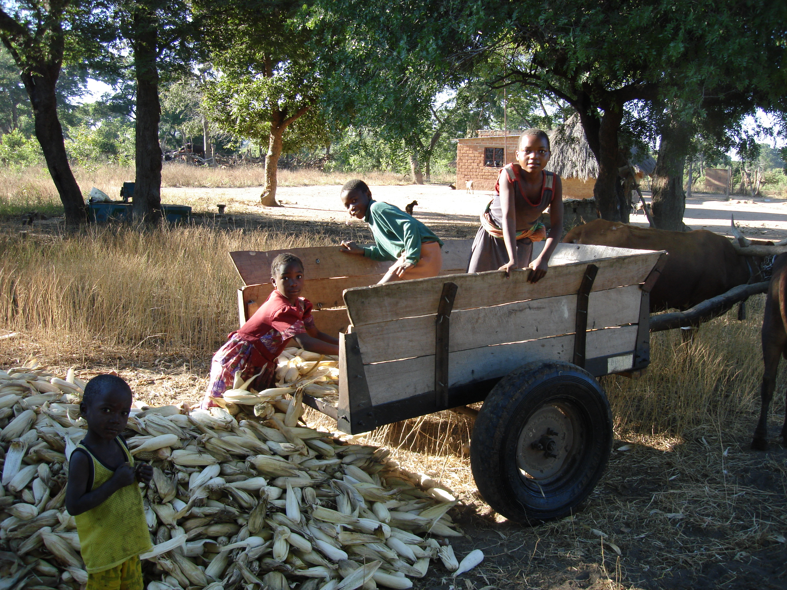
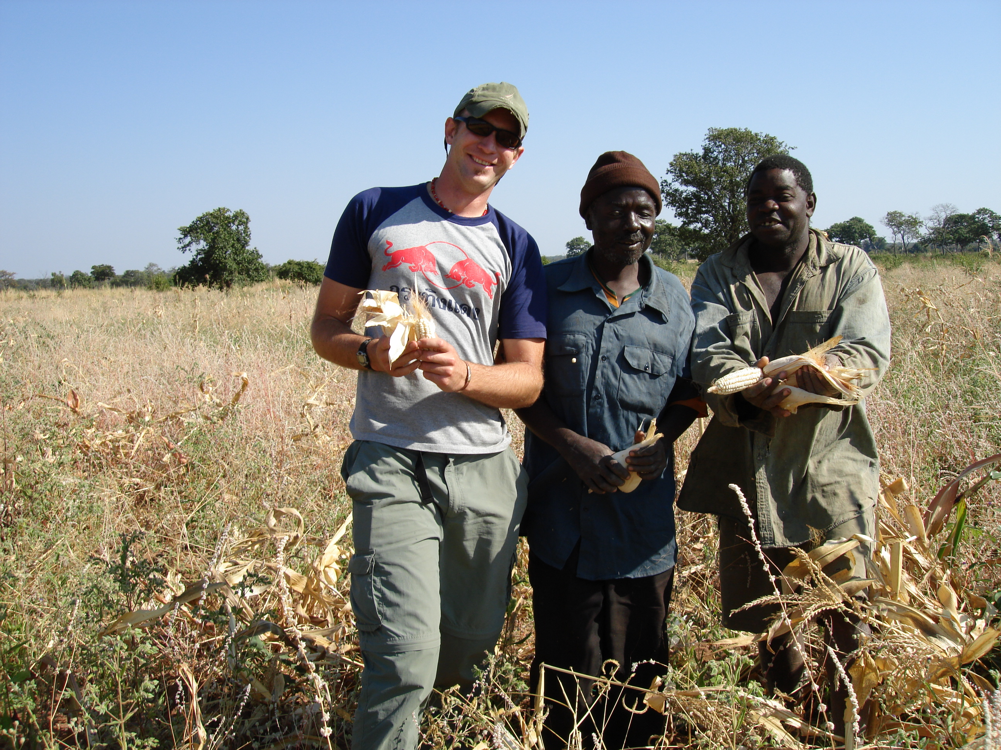
Independence and Western Aid
*Rural Development—dams, irrigation projects
*Food Security—subsidies including guaranteed pricing, specter of Sahel famine, 1970s
*Green Revolution—modernize peasant agriculture, maize
*Increased yields

Slide 17
African Agricultural Success Short-Lived:
Oil Crisis
*Unsustainable Subsidies
Slowing economies, rising transportation costs
*Turn to Imports
African farmers lose competitive edge, imports become cheaper,
support urban populations
Neoliberal Solutions
*Rising Debt
--The 1980s is the “Lost Decade” for African countries
*IMF Intervention
--An Ideological Shift--less government involvement.
--Loss of $$ for rural health, education, infrastructure, agricultural support programs.
--Favoring export cash crops—most of which are inedible.

Slide 18
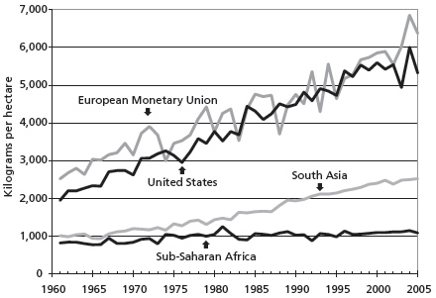
Chart 1. African cereal yields in comparison with other regions
Source: FAO statistics cited in WDI indicators, 2009,

Slide 19
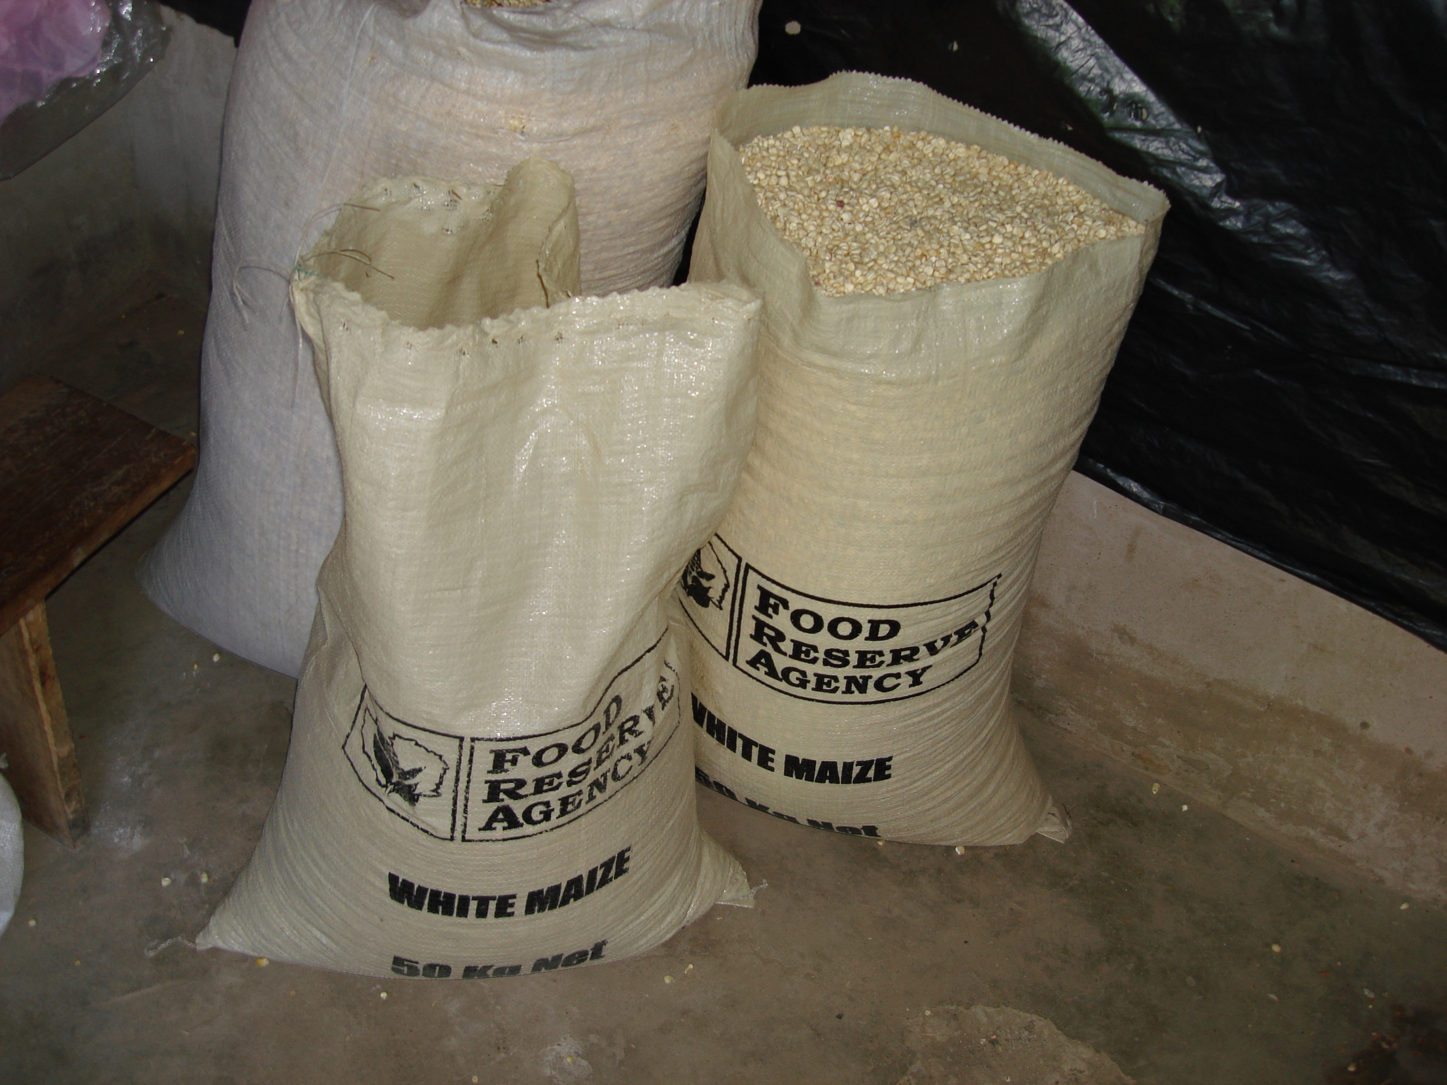
Impacts of Neoliberalism for African Agriculture:
Food Insecurity
*Abandonment of rural peasant producers
--largely laissez-faire attitude towards these producers
--peasants have been displaced before in history
--will these peasants be integrated economically?
--will the market care for the world’s poor?
--continued instability (ethnic conflicts, political conflicts)
*Increased reliance on food imports
--food imports are cheaper
--they are produced by MDCs that heavily subsidize their agricultural sectors
--benefit from negative images of African agriculture
*Consolidation of rural lands by agribusiness
--large corporate interests moving into SSA lands --some are producing, others speculative
--further displacement of rural peasantry
--rapid urbanization—what do the urban poor eat? How do they pay for it? Changing Diets…more wheat, less maize!

Slide 20
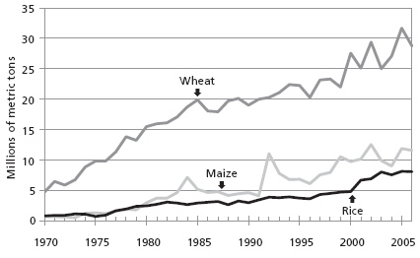
Chart 2. Grain imports to Africa, 1970–2006
Source: FAO trade statistics, 2009

Slide 21
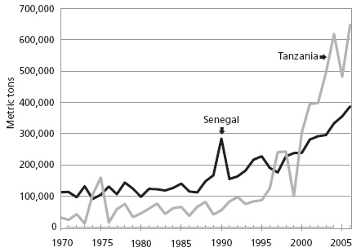
Wheat imports, 1970–2006
Source: FAO trade statistics, 2009, http://faostat.fao.org.
(Food and Agriculture Organization

Slide 22
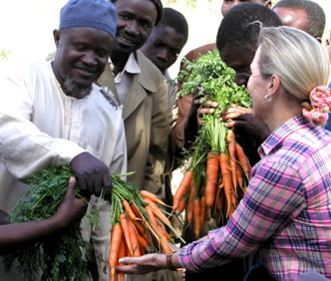
Food Aid, Neoliberalism, and Export Agriculture: A Destructive Conjuncture
Because export agriculture is privileged in neoliberal ideology (mostly as a way to pay foreign debt), infrastructure, training, and government /development spending go to supporting the production of export crops--most of which are inedible.
Loss of funding (government/development aid) for rural health, education, agricultural support programs.
The best land, irrigation schemes, and technological development are aimed at export agriculture.
Images of famine and hunger in Africa, which ignore the success of African export agriculture and result from the failure of subsistence agriculture, gives politicians in the west the political leverage they need to continue to subsidize their agriculture through food aid programs.
As a result, underproduction of staple food crops are made up for with food aid donations from highly subsidized agriculture from the “West”

Slide 23
Solutions?
Let small-scale agriculture die
Technology is the answer—biotechnology
Agribusiness
Revive small-scale farmers

Slide 24
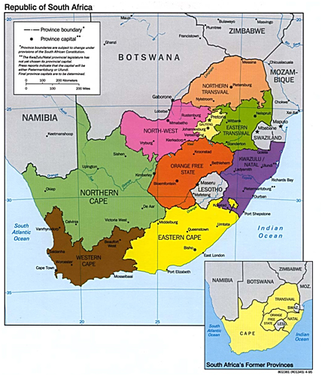
The Spatial Expression of Race and Racism
in South Africa
*Dutch & British South Africa
*Apartheid, 1948
*The Landscape of Racism
*Resistance

Slide 25
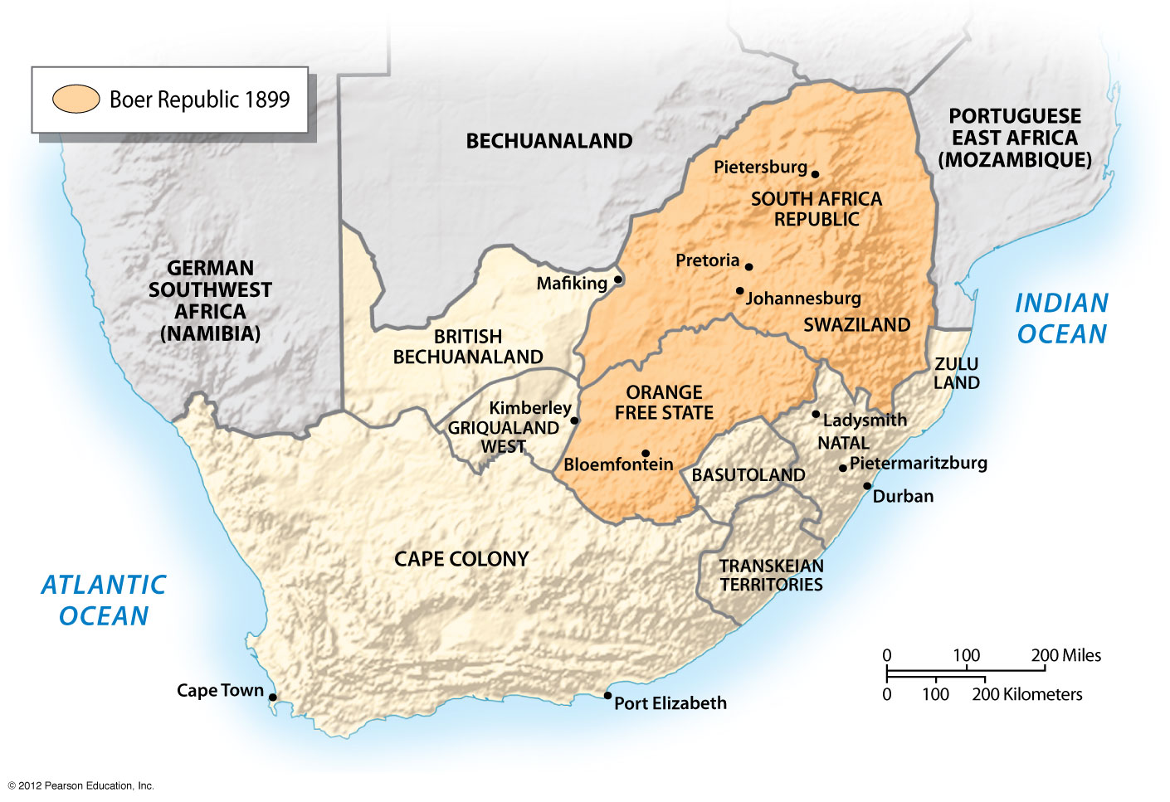
Dutch move away from the British but are threatened by the Zulus.
British intervene on their behalf and crush the Zulus, incorporating them into Natal.
Dutch are still unhappy and British discovered mineral wealth in Boer Republic.
Boer War; ended in 1905 and Republic of South Africa was born.
Independence from G.B. in 1910.
Notes:
Figure 6.36a

Slide 26
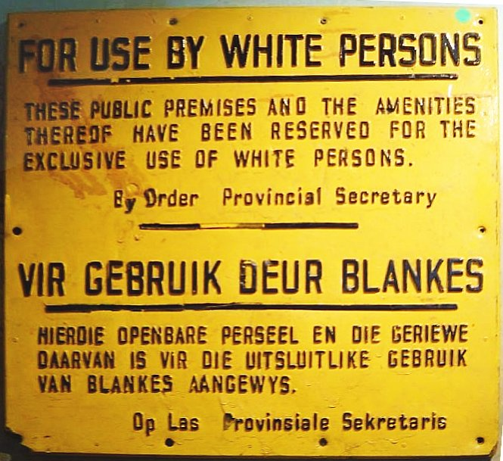
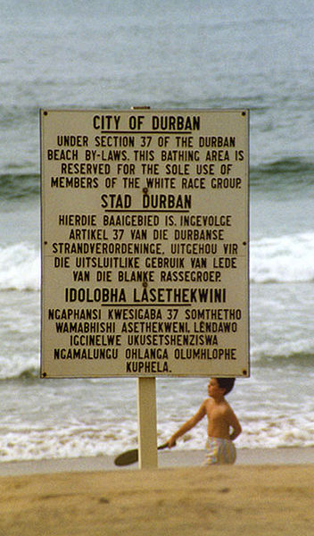
Examples of ‘petite’
Apartheid laws.

Slide 27
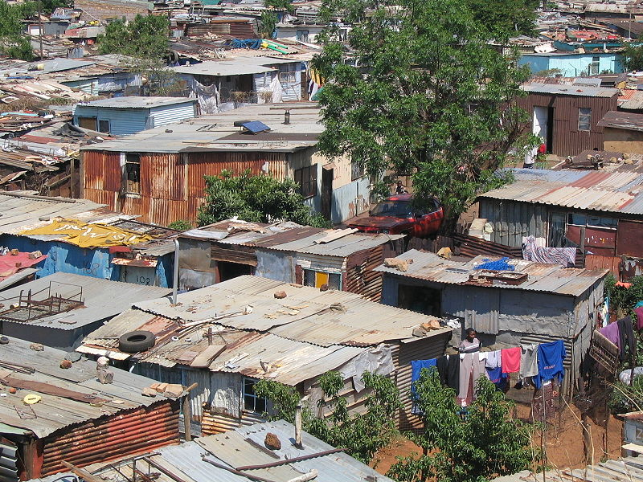
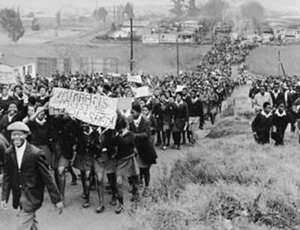
The ‘meso’ Apartheid laws enforced
residential segregation in Black Townships
Soweto Uprising, June 16, 1976
Soweto, former Black Township of
Johannesburg, South Africa

Slide 28
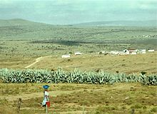
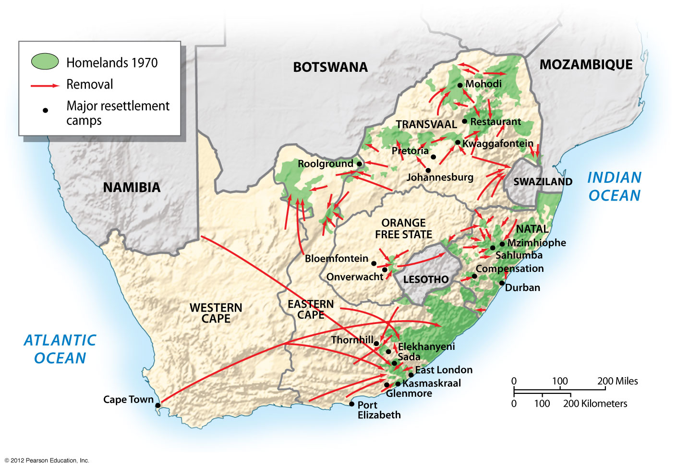
‘Grand’ Apartheid laws ensured removal
of blacks from cities and segregation into
Educational systems of ‘Bantu Education’
Rural Ciseki homeland
Notes:
Figure 6.36b

Slide 29
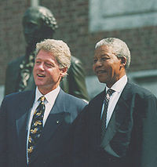
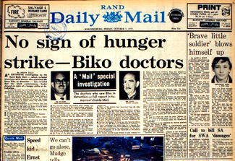
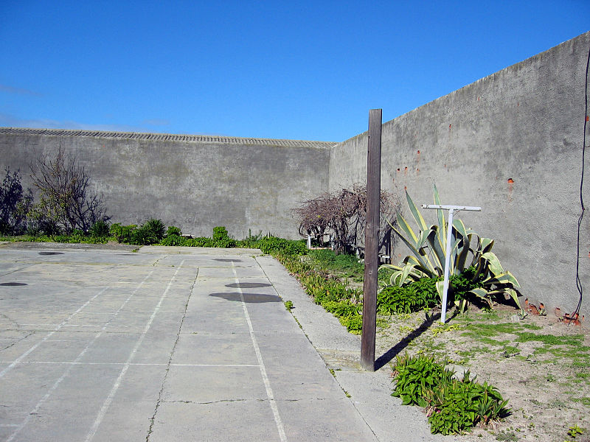
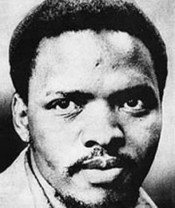
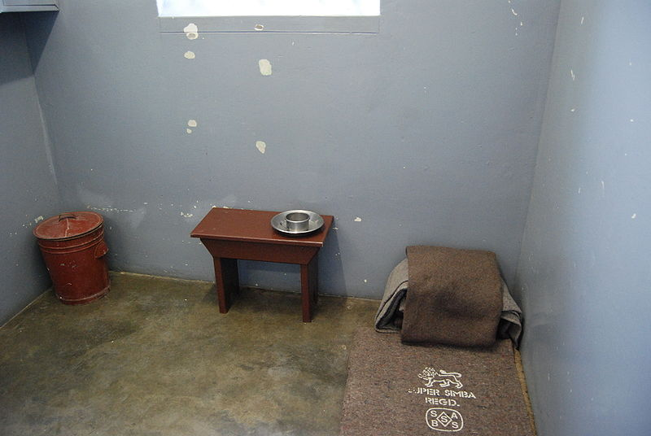
Resistance to Apartheid

Slide 30
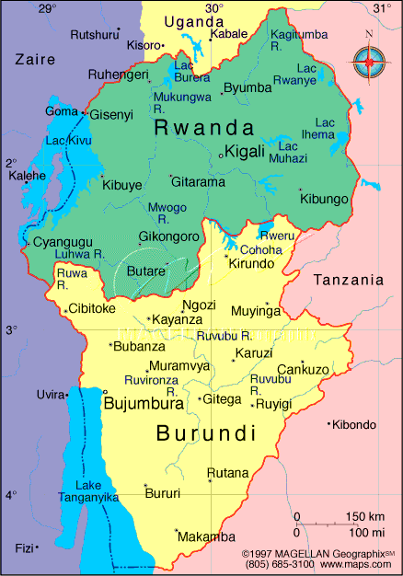
Ethnicity and Genocide in Rwanda

Slide 31
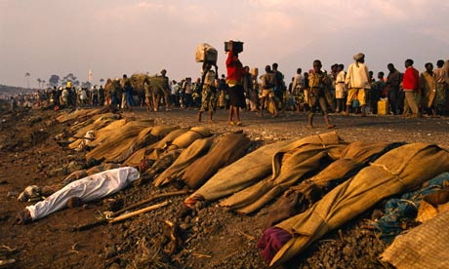
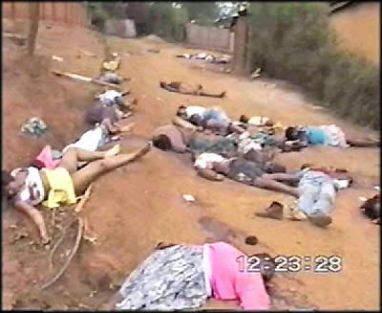
1994 Rwandan Genocide
The culmination of 4 years of civil war, waged along ethnic lines.
Beginning on April 7, more than 1 million men, women, and children lost their lives in a period of 100 days; primary weapon was machete.

Slide 32
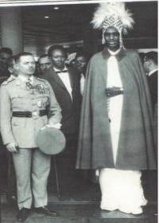
Pre-colonial ethnic divisions?
Are the divisions between Hutu and Tutsi ethnic or socio-economic?
Share language, religion, have intermarried, cohabitated
Privileged ‘social layer’: Tutsi means ‘rich in cattle’, Hutu means ‘servant’
Some physical differences
King of Rwanda with a Belgian General

Slide 33
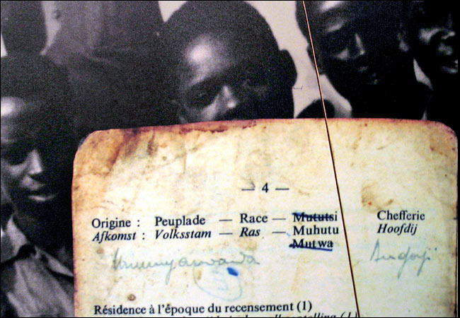
Colonial Rwanda: Fixing Ethnic Difference
German Rule 1894-WWI
Through Tutsi King
Belgian Rule WWI - 1961
Identity Cards
Empowered Tutsi to rule Hutu majority
Given weapons and support for rule
Official discourse: Tutsi more intelligent, reliable and hardworking
Administration and army jobs reserved for Tutsi

Slide 34
Imagined Communities
Benedict Anderson: Imagined communities.
Though precolonial divisions were probably quite fluid, the colonial experience in Rwanda helped to solidify and radicalize ethnic differences between Hutu and Tutsi. Ethnic differences became a powerful way of organizing social relations, politics, and individual sentiment
Racism “justifies not so much foreign wars as domestic repression and domination”

Slide 35
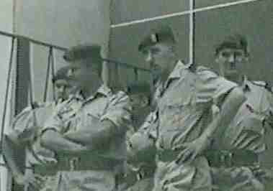
Ethnic hierarchy created under colonial rule
Tutsi to Hutu to Twa: Persons at each level having privileges denied to those at lower levels and disdaining those below them.
Served as a mechanism to divide and rule Rwanda

Slide 36
Decolonization and the Social Revolution
Decolonization by European colonizers and rise of Hutu elites against Tutsi oligarchy.
Ideology of the Social Revolution and rise of Hutu Nationalism:
Rwanda belongs to the Hutu, its original inhabitants, who had been brutally subjugated for centuries by the foreign masters, the Tutsi.
Ethnic interpretation of history
Discourse of democracy had a powerful legitimizing affect on international community

Slide 37
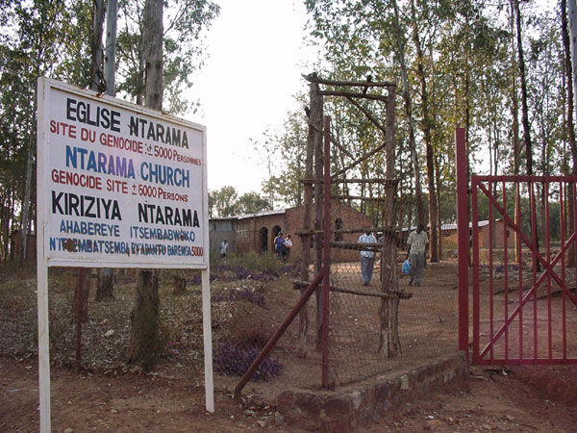
Post-Colonial Rwanda: Institutionalized Discrimination
Quota system to limit Tutsi access to higher education and state jobs.
Continuation of ethnic ID cards.
Army, diplomatic service and parliamentary positions reserved for Hutu

Slide 38
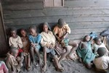
How does this lead to Genocide?
Rwanda remains poor
Created distrust, dissatisfaction
Military threats
International pressure to share power
Racism as a political tool of deflection
Mobs organized to attack Tutsis
Tutsis described in media, political rallies as ‘enemy within’
Create an environment of ‘ethnic fear,’ organizing, legitimizing violence—desensitize people to violence

Slide 39
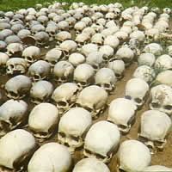
Three Phases of Mass Violence Kelman & Hamilton: Crimes of Obedience: Toward a Social Psychology of Authority and Responsibility
Authorization
Absolves individuals of responsibility to make moral choices
Routinization
Action becomes so normalized that there is no opportunity to raise moral questions
Dehumanization
Actors’ attitude toward the targets and toward themselves become so structured that it is neither necessary nor possible for them to view the relationship in moral terms

Slide 40
Conclusion
Racism and ethnic prejudice are social constructs that are mobilized by those in power to serve as political tools of control and repression.
Fomenting a belief in ethnic and racial differences can help to divert people’s attention away from the causes of their own impoverishment. Redirect people away from class divisions (material differences in wealth and power) and toward immaterial racial and ethnic differences.
The genocide in Rwanda, though an ethnically based conflict, was the result of political efforts to maintain power and control.

