Slide 1
Geography 8
Lecture 10: Responses to the Centrifugal City

Slide 2
Keywords
5th Amendment “takings clause”
Eminent domain
Kelo v New London CT
Urban government
Stakeholders
Comprehensive Zoning
Standard State Zoning Act, 1926
NIMBY
LULU
Exclusive-use zoning
Comprehensive Plan
Urban livability
New Urbanism
Mixed-Use
Growth Boundaries
Impact Fees

Slide 3
New Landscapes of Sprawl
The Geography of Nowhere
Mass Consumption
It’s All About the Car
Bulkification

Slide 4
The Geography of Nowhere
Mass produced communities
Uniform landscapes
No sense of “place”
The FHA House

Slide 5
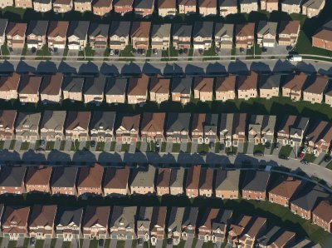
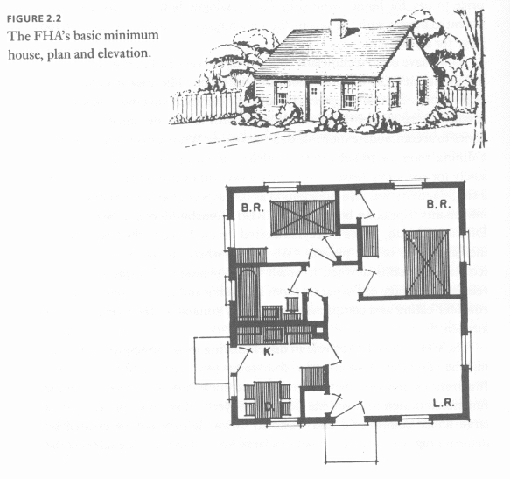
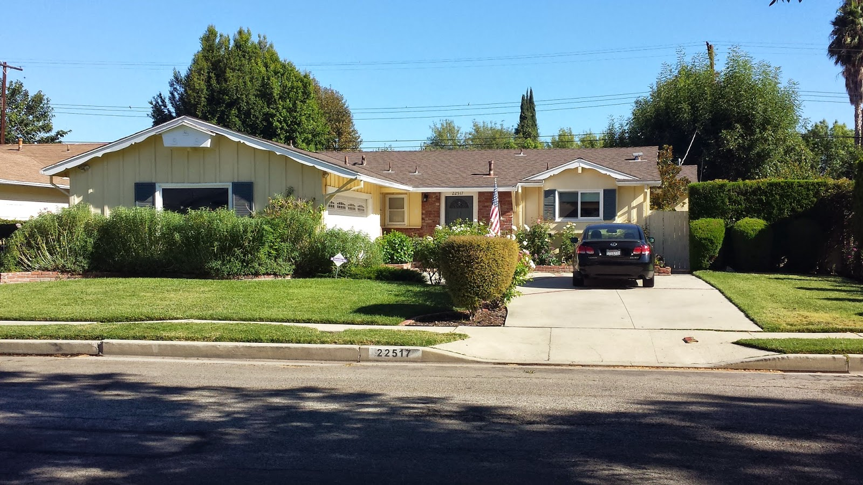
Standard design: promoted by the FHA and Fannie Mae: generic housing, affordable, efficient: living room, bathroom, kitchen, 2 bedrooms. Model of efficient modern living for the working-class nuclear family.

Slide 6
Mass Consumption
Search for bigger, better
More room to put all the stuff
Size drives market
bigger house=more wealth
The car gets a room of its own
The garage: from small shed in the back to 3, even 4-car garages
“Bulkification”
Larry Ford, McMansions

Slide 7
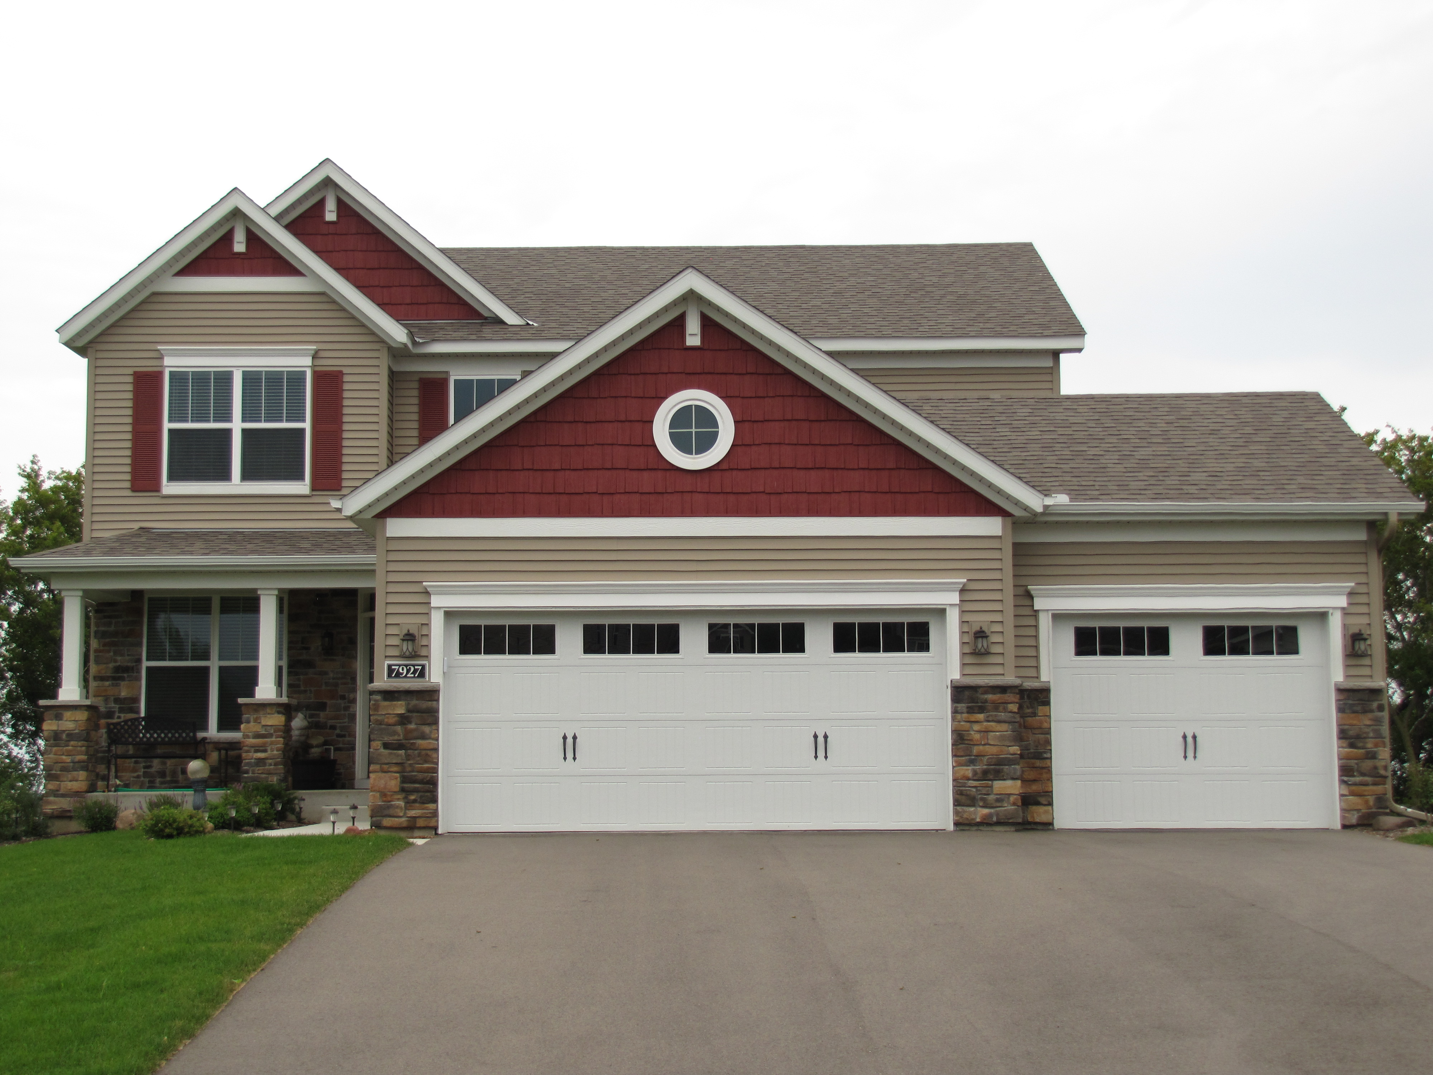
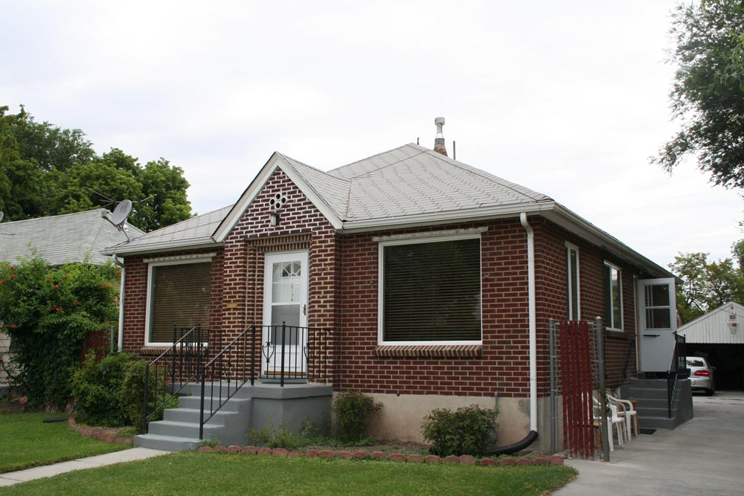
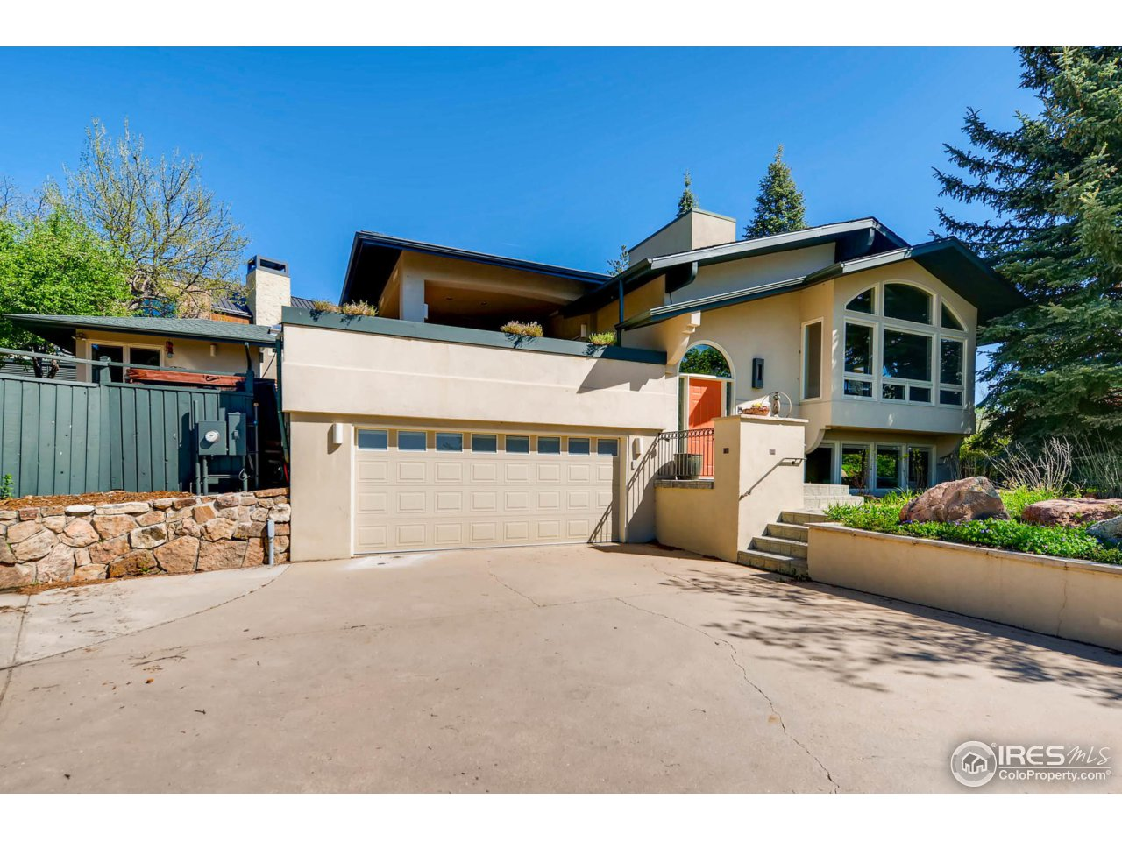
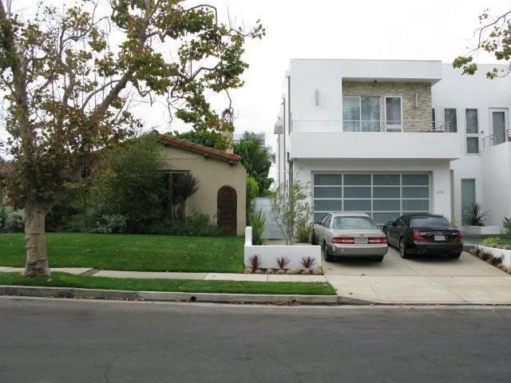
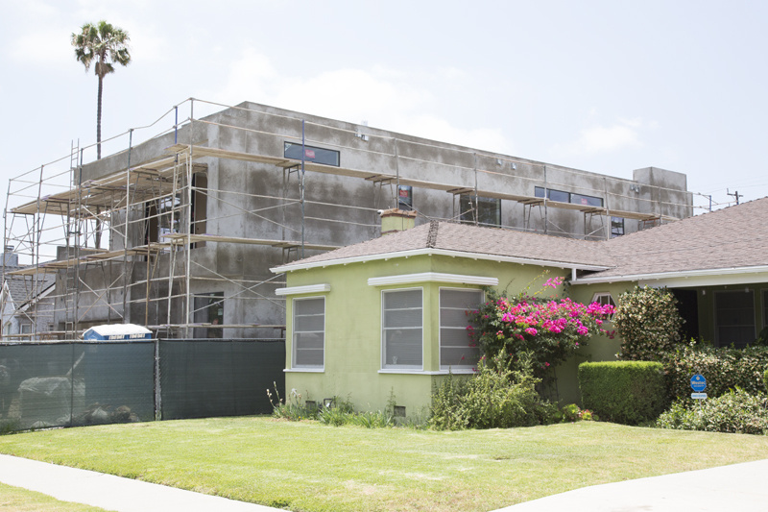

Slide 8
The Problems with Sprawl
Wasteful: land, energy, our time.
It creates an affluence that is shallow, superficial, crass and materialistic.
Makes rational, long-term planning almost impossible.
Most planning is at the municipal level—city government.
Focus is on a) Zoning
And on b) Livability

Slide 9
City Government
What are the functions of city governments?
More & more services during the 20th C become city’s responsibility
Maintenance: buildings, roads, sewers, utilities…
Public safety: police (county, city) & fire (county, city)
Public spaces: parks (county, city), libraries, schools
Regulations: regulate private activities/enterprises
Increasing privatization today
How do cities generate revenue?
Property taxes
Collected by the county
Have diminished after “Tax Revolts”, CA led the way with Prop 13 in 1978
Sales taxes
Is this regressive?
Income taxes?
Other sources?
Car rental, hotel taxes (taxing visitors)
How can a city pay for projects like a bridge, a school, an airport a fire station a library, police headquarters, sewage treatment facility?
Complex mix of sources: municipal bonds issued by confusing array of cities, counties, metro-wide governments, special districts….!!!!! A fragmented landscape of sprawling cities.
Many stakeholders: private, public, local, non-local, individual, household!!!
HUGE CHALLENGE: how to plan effectively? How to make it fair? Run-down schools in poor areas…..equitable?

Slide 10
Zoning
Control land use
What types of activities
Size of a building
1926 Standard State Zoning Enabling Act
Map every address in the city and give it a general land-use category
R=residential
R1=single family homes
R2, R3, R4, more dense residential
C= commercial use
New zones: overlays, like Historic Overlay Zones

Slide 11
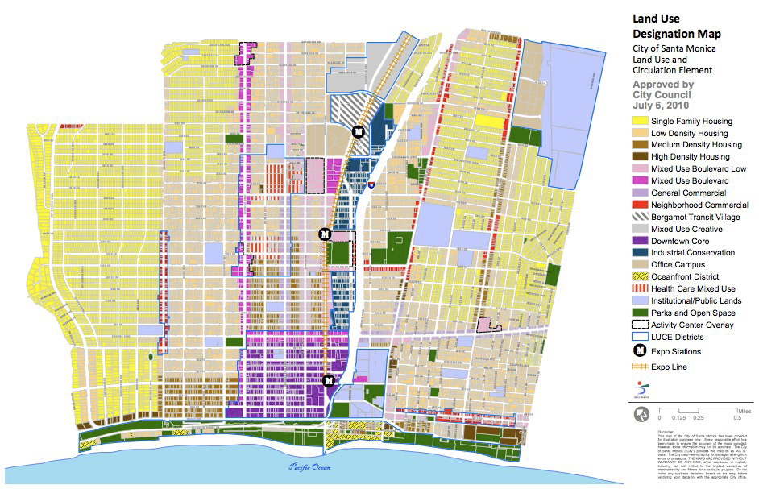
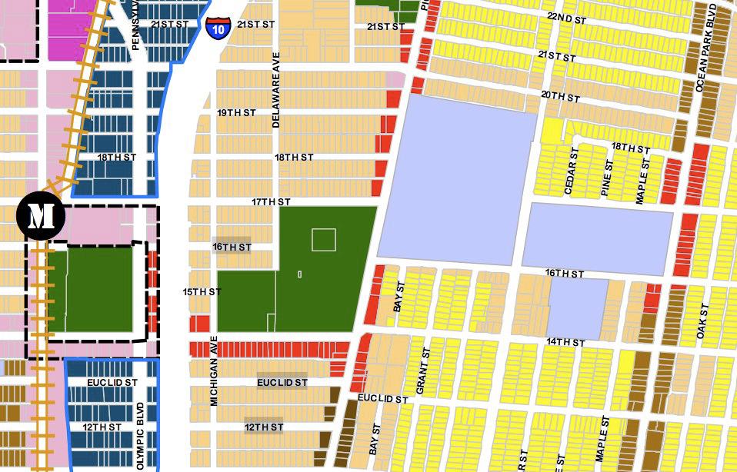
City of Santa Monica’s
Land Use and Circulation Element.
LUCE
Note extension of Metro Expo
To have a station at the 3rd St
Promenade.

Slide 12
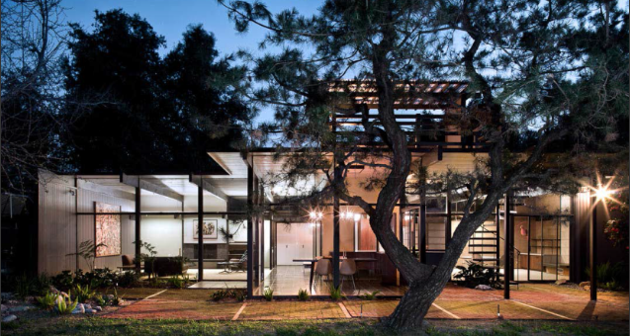
LA County Board of Supervisors designated the McLeod House as a historic landmark.
It is in West Claremont, an unincorporated community in LA county. 717 Baseline Rd.
LA County Department of Regional Planning: Historic Preservation

Slide 13
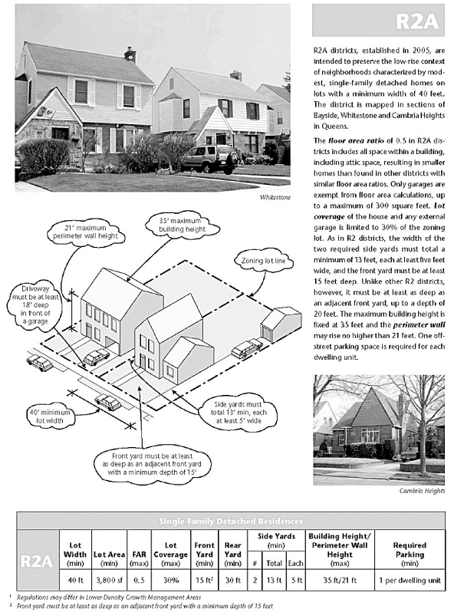
New historic overlay in Queens, NY. Meant to preserve 1950s-era homes and neighborhoods.
Put strict height limits and density limits.

Slide 14
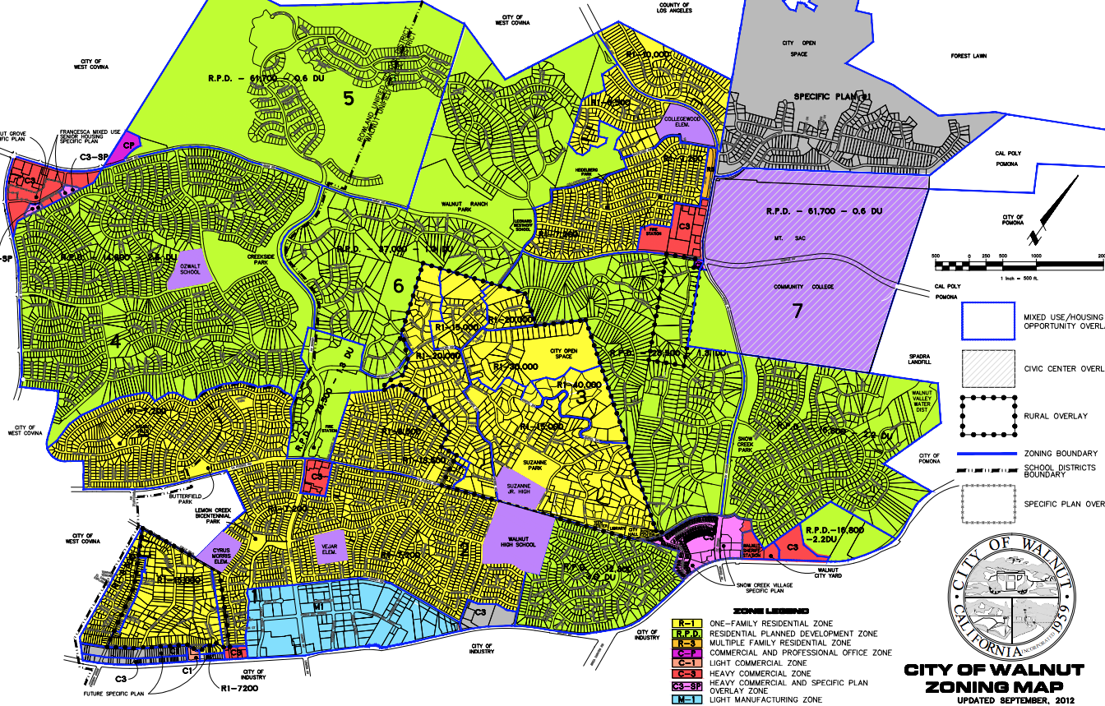

Slide 15
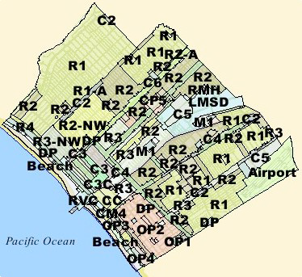

Slide 16
What’s Wrong with Zoning?
Conservative argument
Interferes with free market
Interferes with private property rights
Progressive argument
Leaves pathway for corruption
Developers “cozy” with politicians
Plays out in unequal ways
the powerful get variances or re-zoning

Slide 17
Other Criticisms of Zoning
Limits ability to do mixed-use development
Could exacerbate segregation (especially socio-economic)
Functionally segregates city and, therefore, promotes car use, car-based living

Slide 18
Eminent Domain
5th Amendment: “takings clause”
Land owner must be “compensated”
Take-over must be for “public good”
Kelo v New London, CT
Urban renewal project
Person’s home was taken by city and then given to private developer
Ruled 5-4 in favor of developer

Slide 19
Livable Cities
New Urbanism—what is it?
Compact, mixed-use
TOD, transit-oriented design
Non-generic architecture
Runaway growth: NIMBYs and LULUs
Growth vs management
What makes a city “livable?
A “Happy City”: Charles Montgomery
Technology to make a better city: MIT’s Kent Larson
A “Walkable City”: Jeff Speck, urban planner

