Slide 1
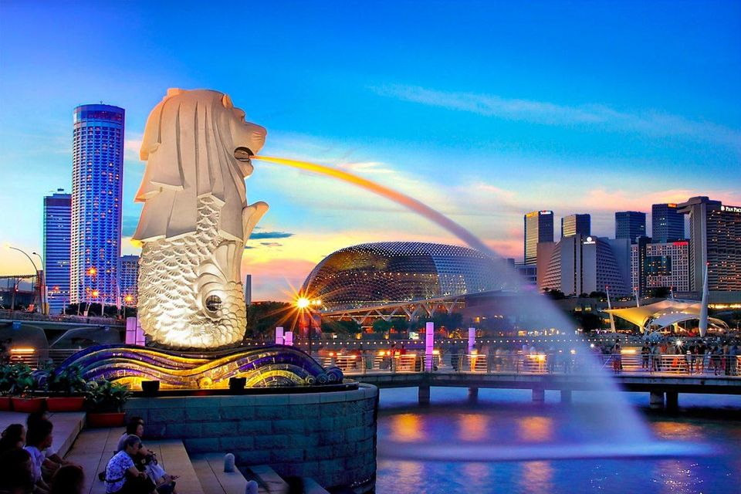
Geography 8: The Economies of Cities & Globalization
Singapore, a city that has risen to the top as a result of globalization.

Slide 2
Keywords—Weeks 2 & 3
Urbanization | 3rd world | 1st world | Rural-to-urban migration | Industrialized
Urban growth | Urbanized | Megacity | Double megacity | GDP and GNI
Social measures | Environmental measures | Extreme poverty | Rate of natural increase | Demographic transition
Modernization theory | Political economy theory | Urbanization gap | Globalization | Capitalism
Multi-national corporation | High-level specialization | Basic activities | Nonbasic activities | Multiplier effect
Forward linkage | Backward linkage | Indirect multiplier | Demand linkage | Agglomeration economies
Localization economies | Urbanization economies | Rust Belt | Sunbelt | Fordist
Flexible production | Vertical integration | Reverse multiplier effect | Producer or consumer driven | World city
Elite consumption

Slide 3
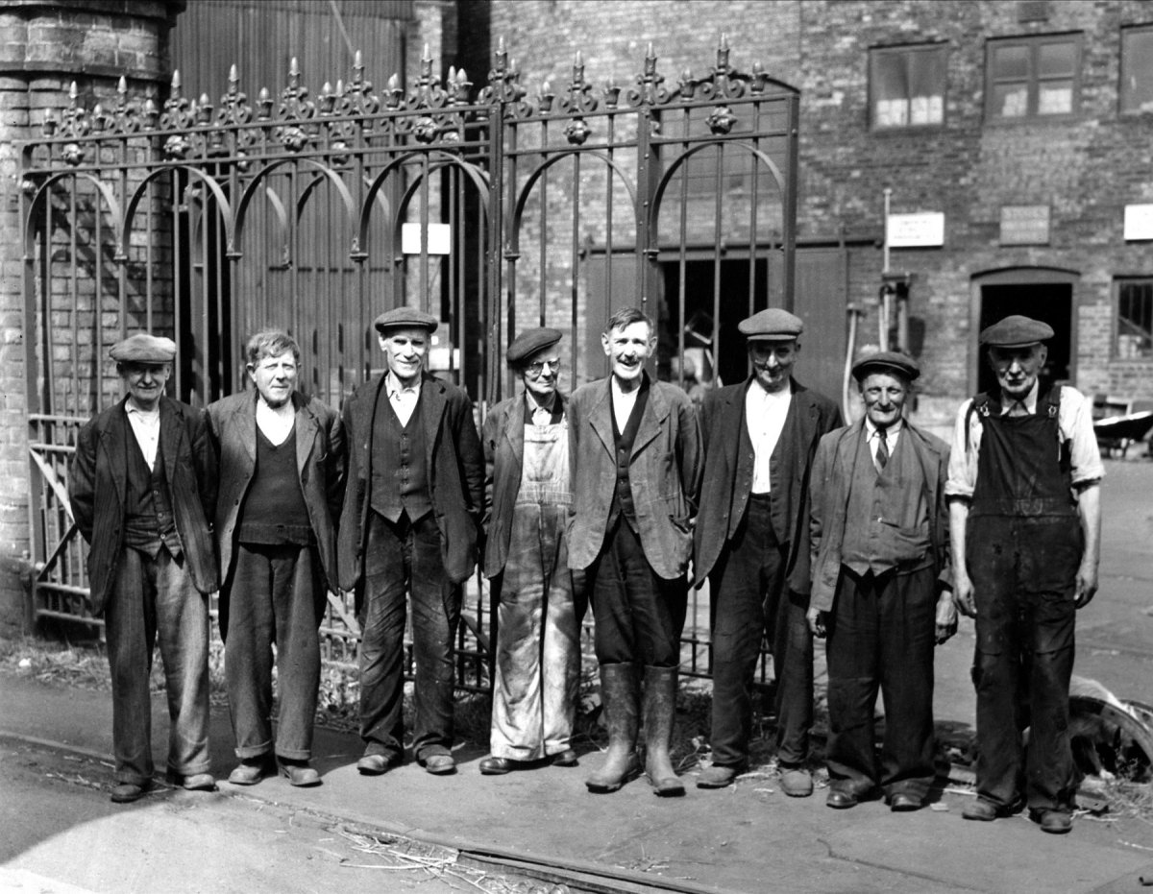
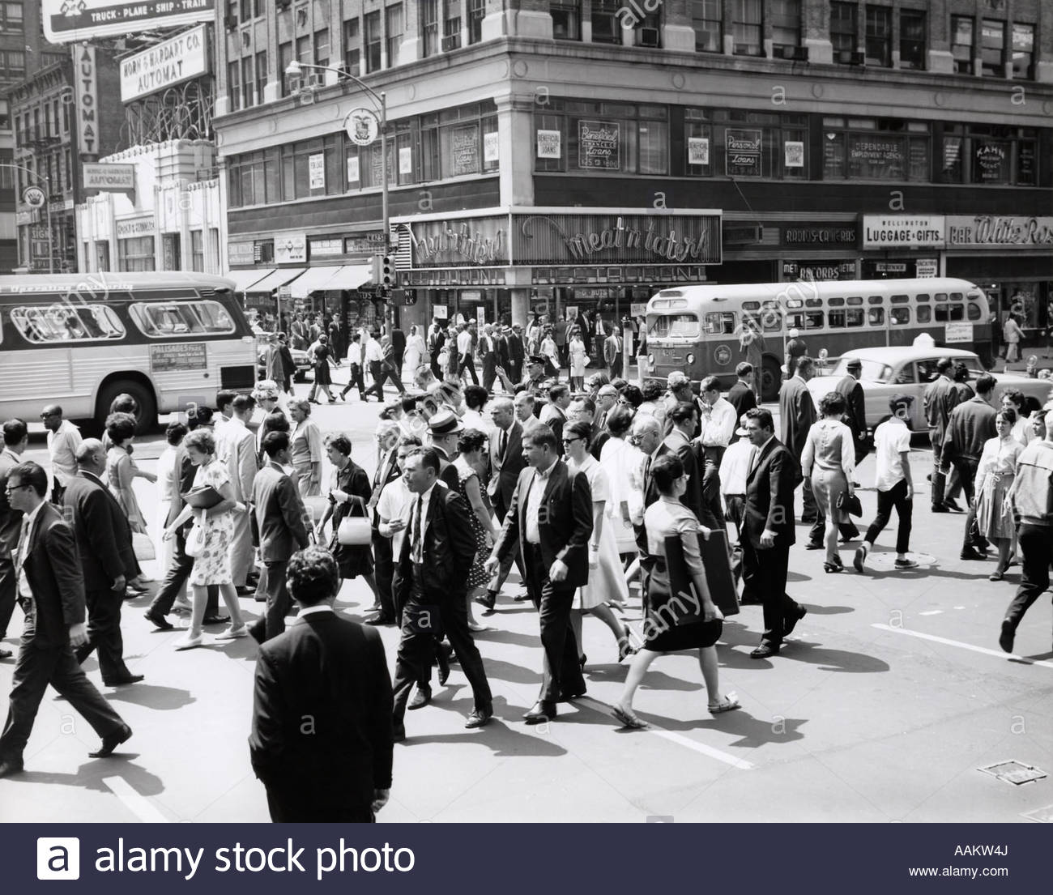
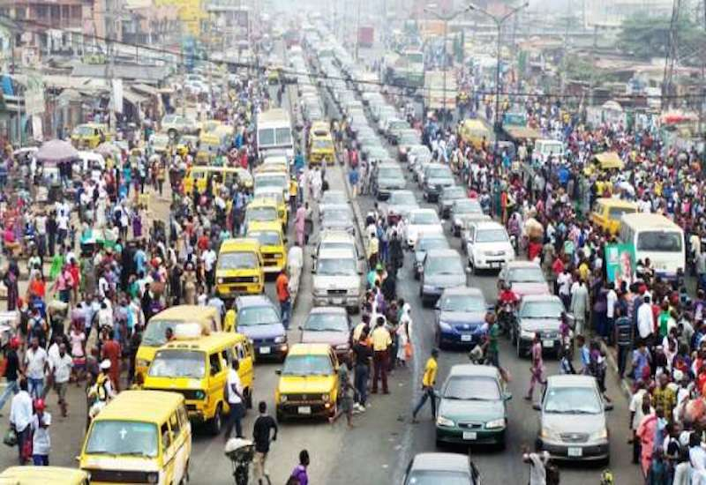
The urban experience, then and now…
1850
1960
* ½ of human population lives in a city today.
* By 2030, 5 billion in a city!
Today

Slide 4
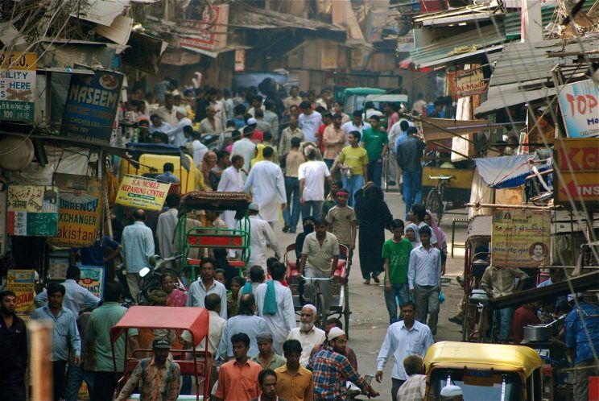
What’s surprising about urban growth?
It’s occurring outside of North America & Europe, in the developing world.
Cities are getting even bigger.
1950: 15% of 3rd world lived in a city.
Today more live in a 3rd world city than in 1st world cities.
Asia most urbanized.
Delhi, India is home to more than 18 million people.

Slide 5
How do we measure urban growth?
Urbanization
The % of the population that live in a city
Connected to development
Urban Growth Rate
The % of increase each year a city experiences
Urban growth rates are declining in the developed world—why?

Slide 6
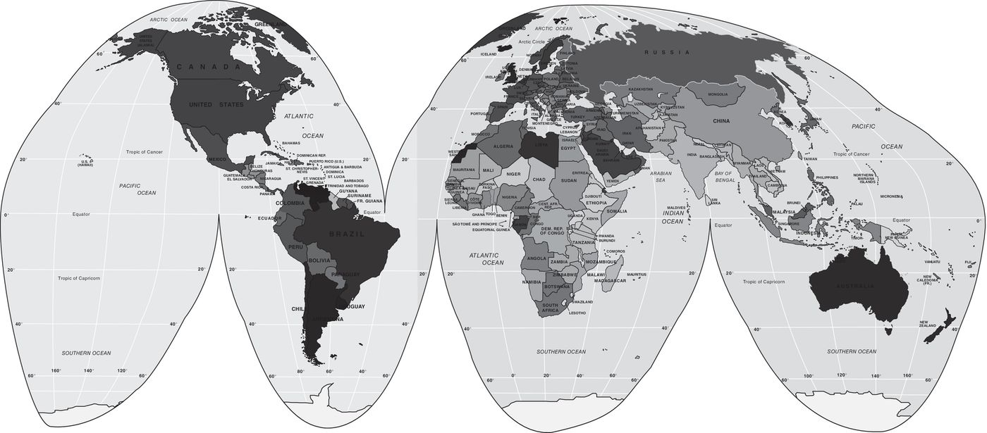
Figure 14.1 Map of world, by percent urban. The darkest shades indicate urbanization rates over 70%. The lighter shades indicate urbanization under 40%.

Slide 7
Megacities
UN definition: 10 million or more
Only 2 in 1950: NYC & Tokyo
Today 24 megacities
By 2025 there will be 30, with most being in the developing world
By 2025 Los Angeles will be 16th in the world
Double megacities: 20 million or more
Tokyo nearly 30 million
Mexico City, Sao Paulo, Delhi
By 2025: 9 cities will exceed 20 million

Slide 8
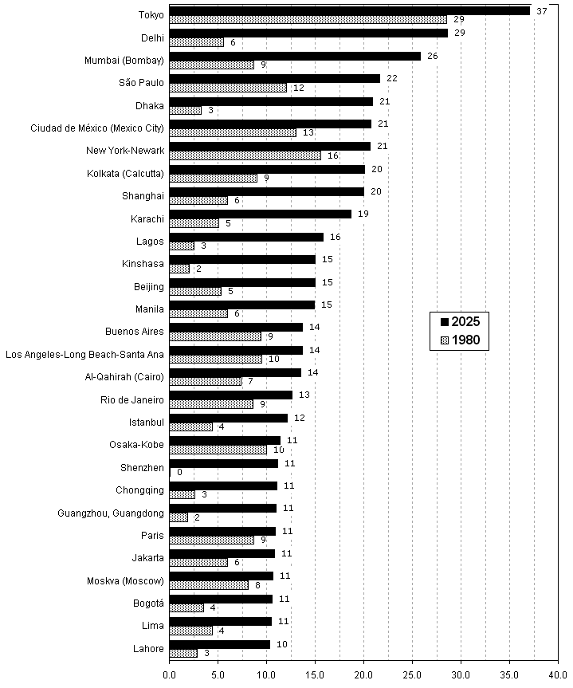
Megacities in 1980 and in 2025.
Geography of megacities by 2025:
China: 7
South Asia: 6
South America: 5
North America: 3
Egypt & Turkey: 2
Europe: 2

Slide 9
Measuring and defining development
The “more” or “less” developed world
First World
Third World
Measures
Economic
GDP vs GNI
Extreme poverty
Income inequality
Social
Health
Education
Environmental
Sanitation
Degradation

Slide 10
Why is urbanization so rapid in developing world?
Higher rates of natural increase
More rural-to-urban migration

Slide 11
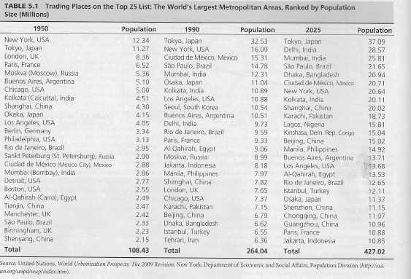

Slide 12
Theories about development and urbanization
Modernization Theory
Development causes urbanization
Shift in economy from agrarian to industrial
Demographic transition—high NIR
Huge income gap develops between rural and urban areas
Guatemala: 72% of rural dwellers below poverty and only about 29% or urban are.
Problems with this theory
Africa: declines in GDP but urban growth rising

Slide 13
Political Economy Theory
Not linear development
Urbanization may occur for other reasons
Colonial past
Global trade
Internal & external factors
Which came first?
--does development cause urbanization?
--does urbanization prompt development?

Slide 14
What is the urbanization gap?
First world more urbanized than third world
Paradox:
Although First World more urbanized, Third World has more urban dwellers
1950: 59% of urban dweller were in First World
Today: only 27% of urban dwellers are in First World
Third world only about 45%=2.5 billion people!

Slide 15
Does urban mean progress?
What does it mean that so many urban dwellers live in very poor countries?
Is this a sign of progress?
Or is it evidence of entrenched poverty?

Slide 16
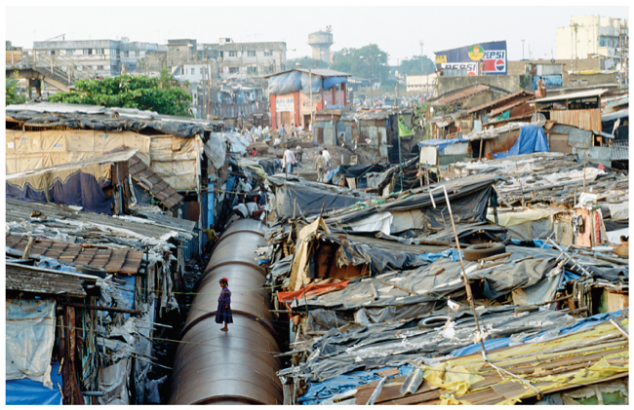
The slums of Mumbai, India.
Does this remind you of our own urban past?

Slide 17
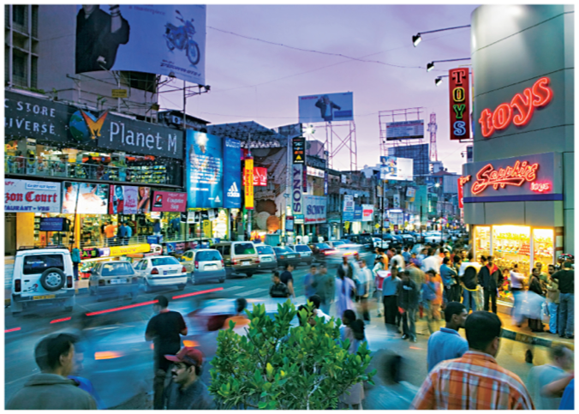
India’s own Silicon Valley—Bangalore.

Slide 18
What else is causing rapid urbanization?
Globalization
Movement of capital, information, goods and services by MNCs
Technology
Movement of people
New geographies of production
Capitalism
Economic system
Labor becomes a commodity

Slide 19
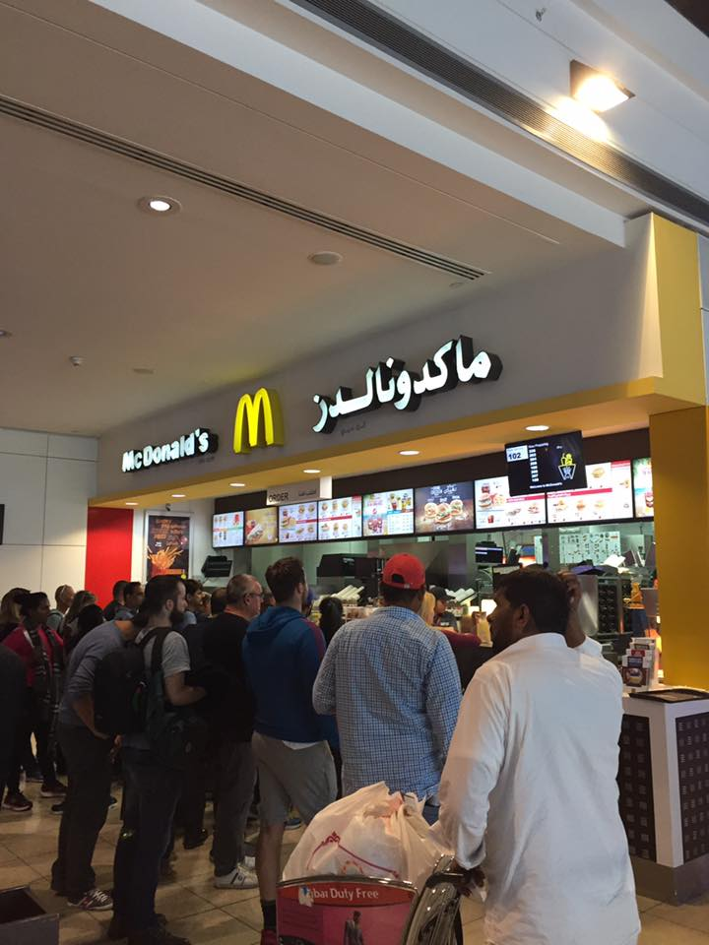
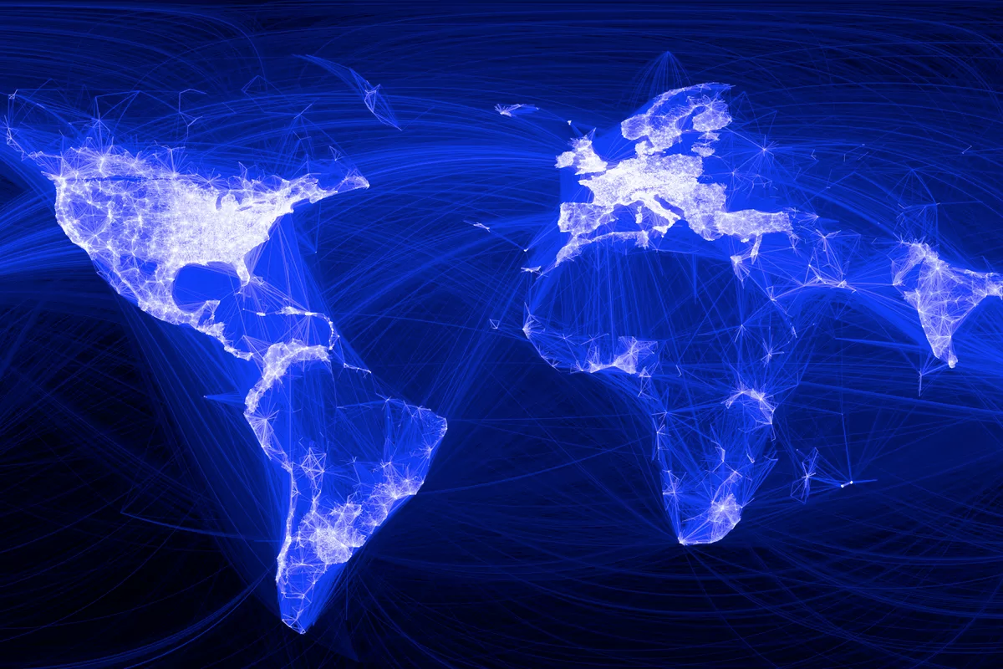

Slide 20
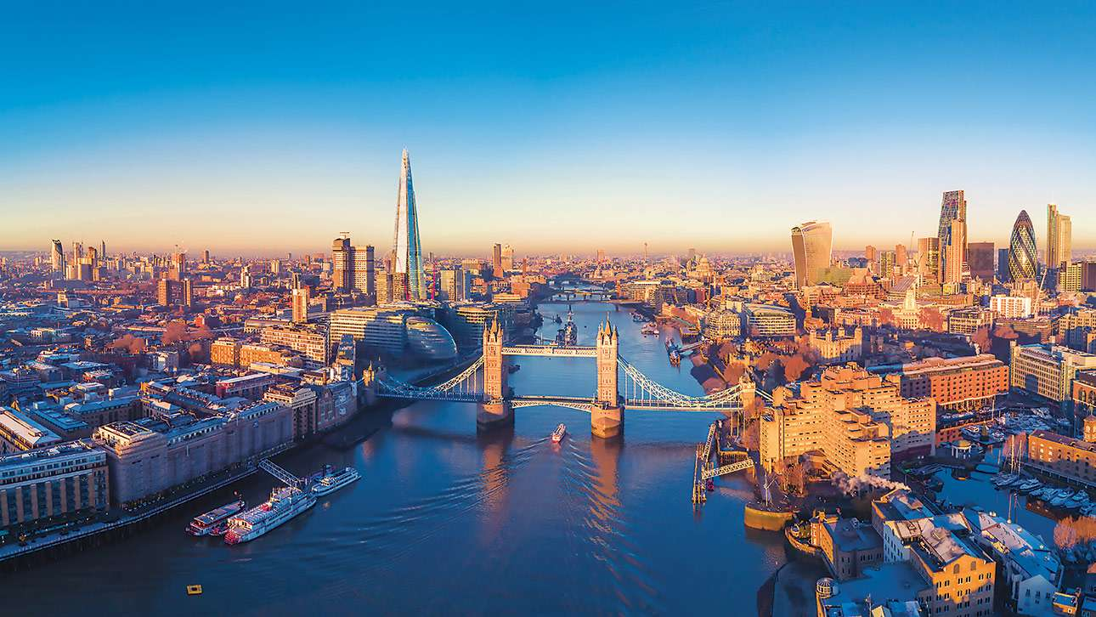
How has globalization changed cities?
The rise of very powerful cities, “World Cities”
Changed the internal functioning of cities
London, UK

Slide 21
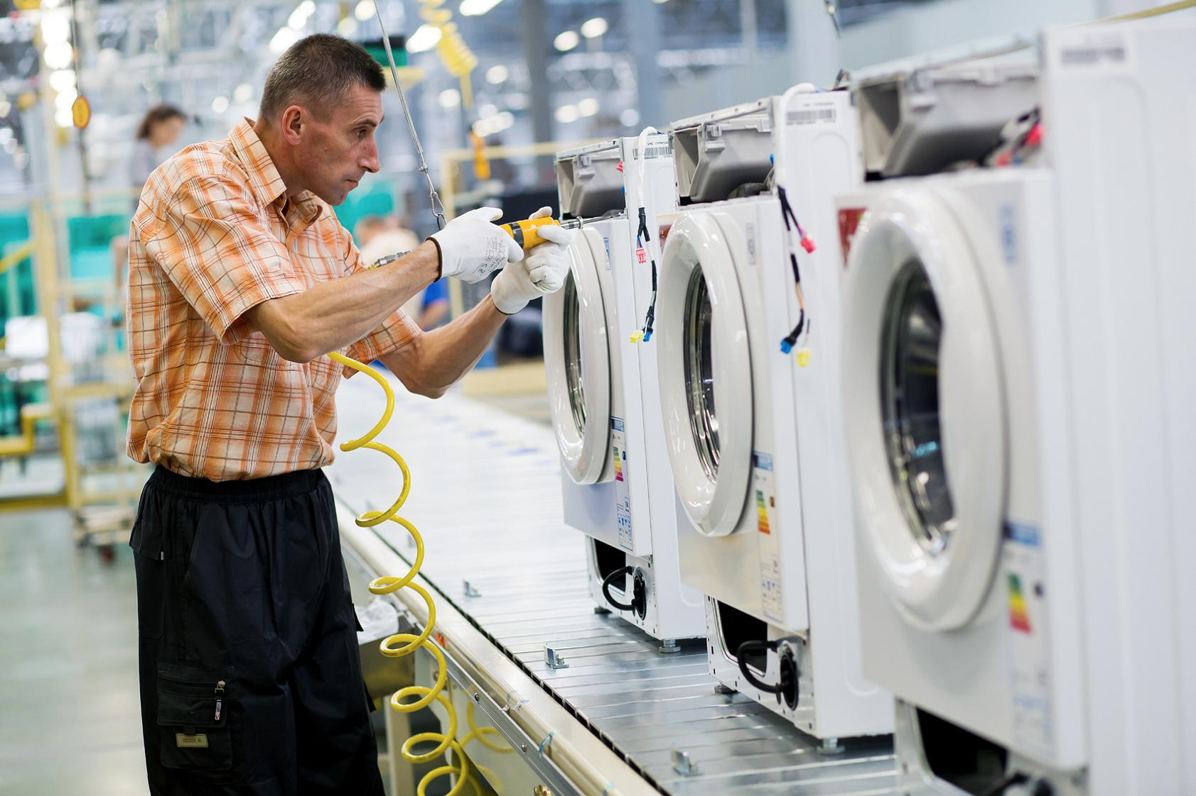
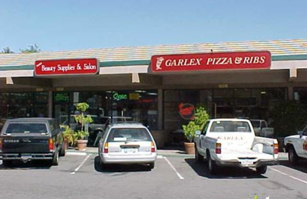
How are city economies structured?
Basic Activities
Generate income from outside the city
Manufacturing traditionally
Nonbasic Activities
Circulate money between local residents of city
Service activities, government activities

Slide 22
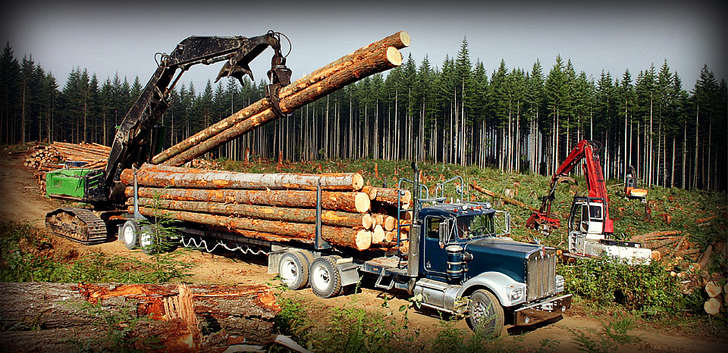
Multiplier Effects
Forward linkages
Processing the extracted raw material
Backward linkages
Items necessary to extract the raw material
Indirect multiplier/demand linkages
Money circulated by the workers and those who serve them

Slide 23
How has globalization changed basic and nonbasic activities?
Basic activities leave
Traditional basic activities move away
New geographies of production
Nonbasic activities become basic
Restaurants (tourism)
Specialized services (law, accounting)
Education?!

Slide 24
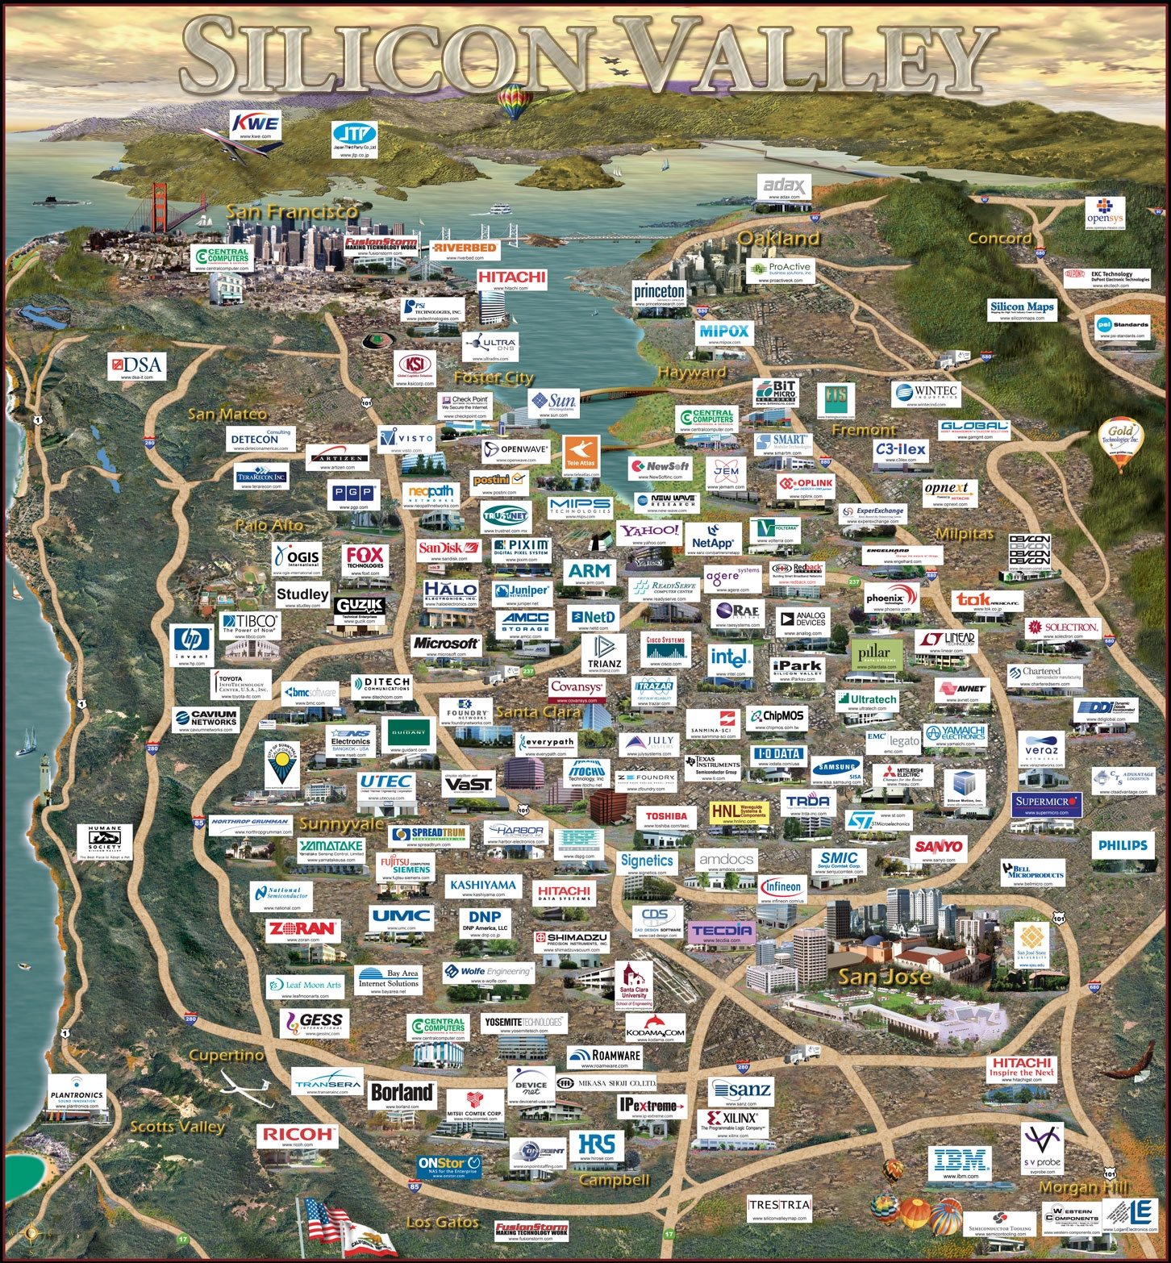
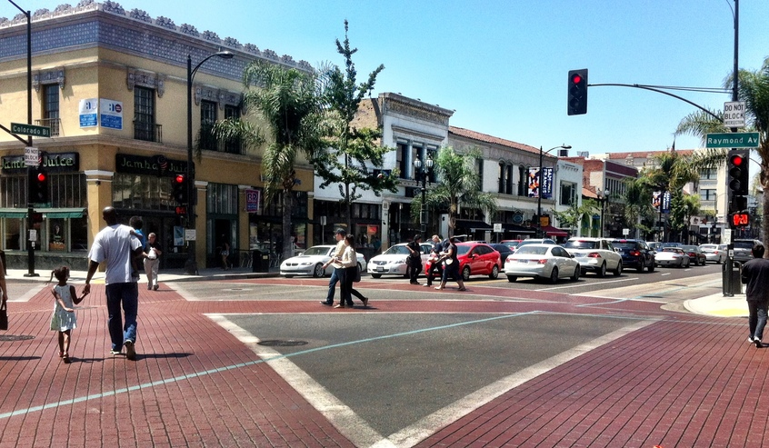
Agglomeration economies
Localization economies
Same types of businesses cluster

Slide 25
Urbanization economies
Unalike businesses cluster in cities
Benefit from shared costs like infrastructure
Benefit from access to a shared consumer market, labor pool
Benefit from the “privileges” of the city

Slide 26
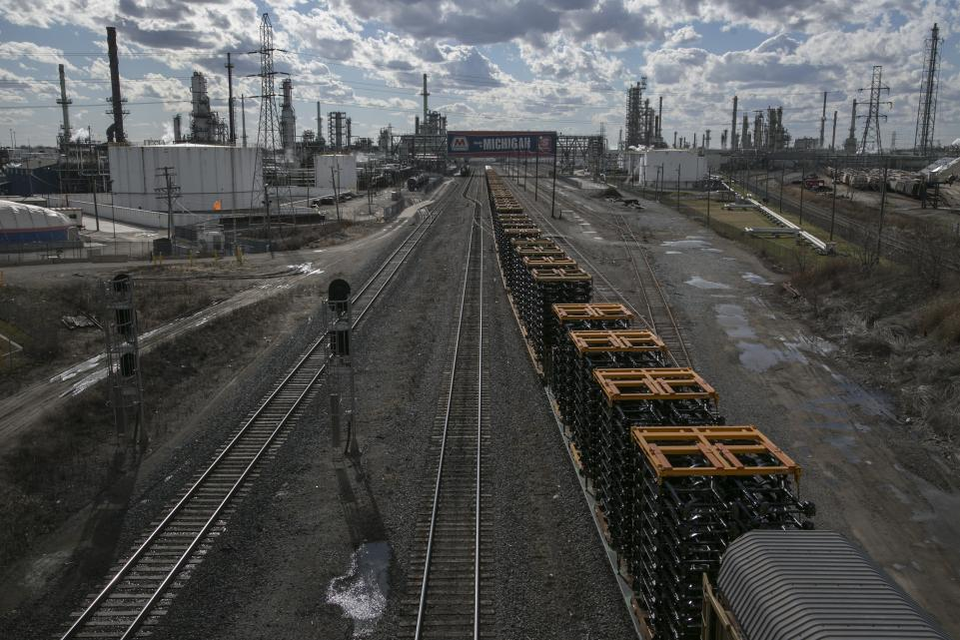
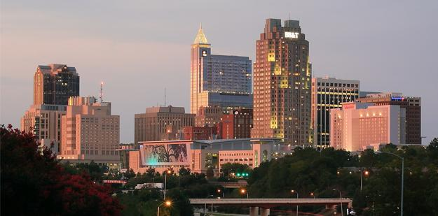
Uneven geographies of urban places
Geographic Shifts
Rust Belt cities
Sunbelt cities
Shifting US economy from NE to West/South
Detroit, MI
Raleigh-Durham, NC

Slide 27
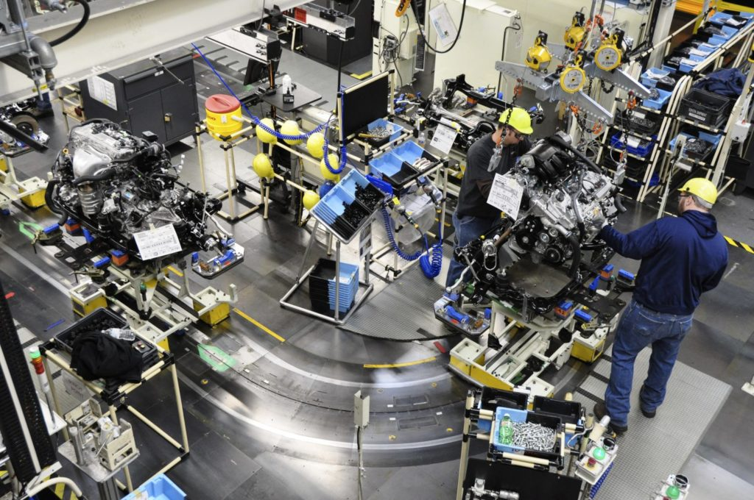
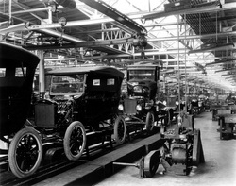
Structural change
Out: Fordist model, vertical integration, producer driven
In: flexible production, consumer driven, vertical and geographic disintegration, tertiarization.

Slide 28
The world city
Capitalist world now divided into specialized activities occurring at different locations—economist John Friedman, Brown U.
Less creative or skilled activity=place with low wages.
More creative, skilled, management, finance=places with high wages.

Slide 29
High wage cities have become the core of the capitalist world
In the U.S.
New York
Los Angeles
In Europe
London
Paris
Frankfurt
Rotterdam
Zurich

Slide 30
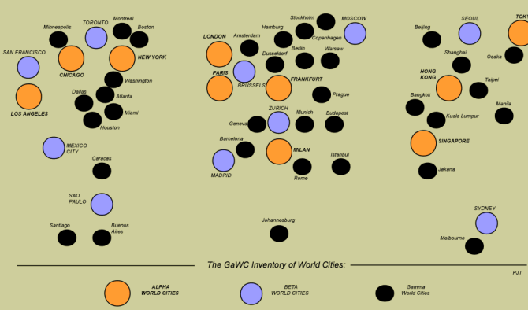
GaWC’s rankings of “alpha”, “beta” and “gamma” world cities. GaWC is an academic think
Tank based at Loughborough University in the UK.

Slide 31
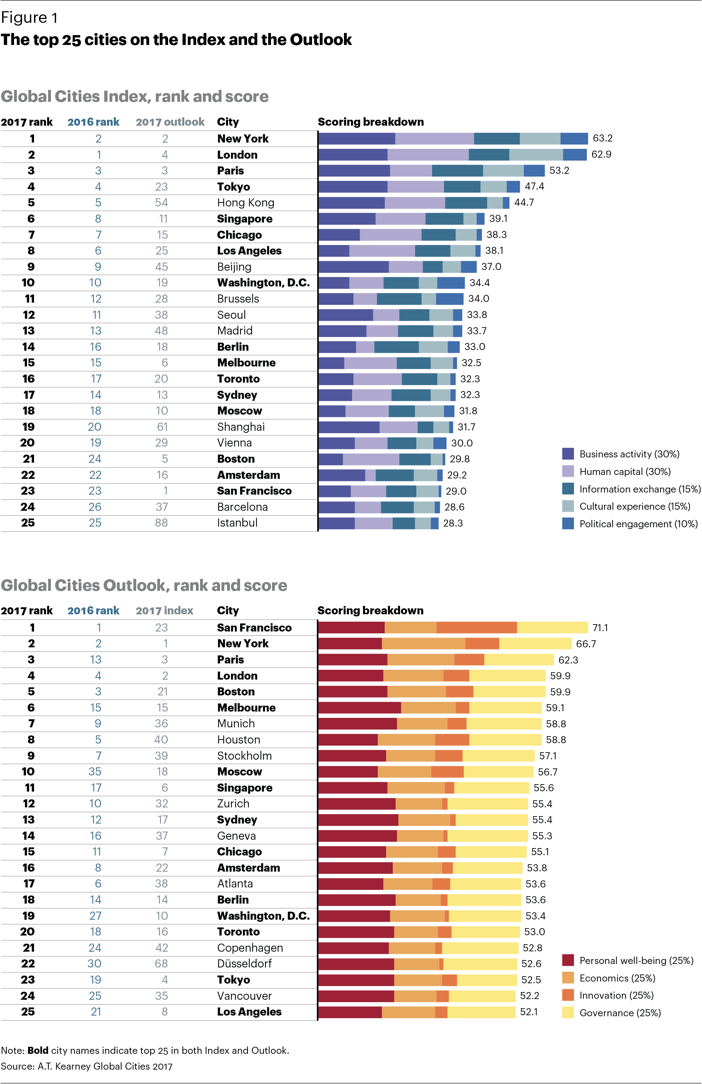
AT Kerney

Slide 33
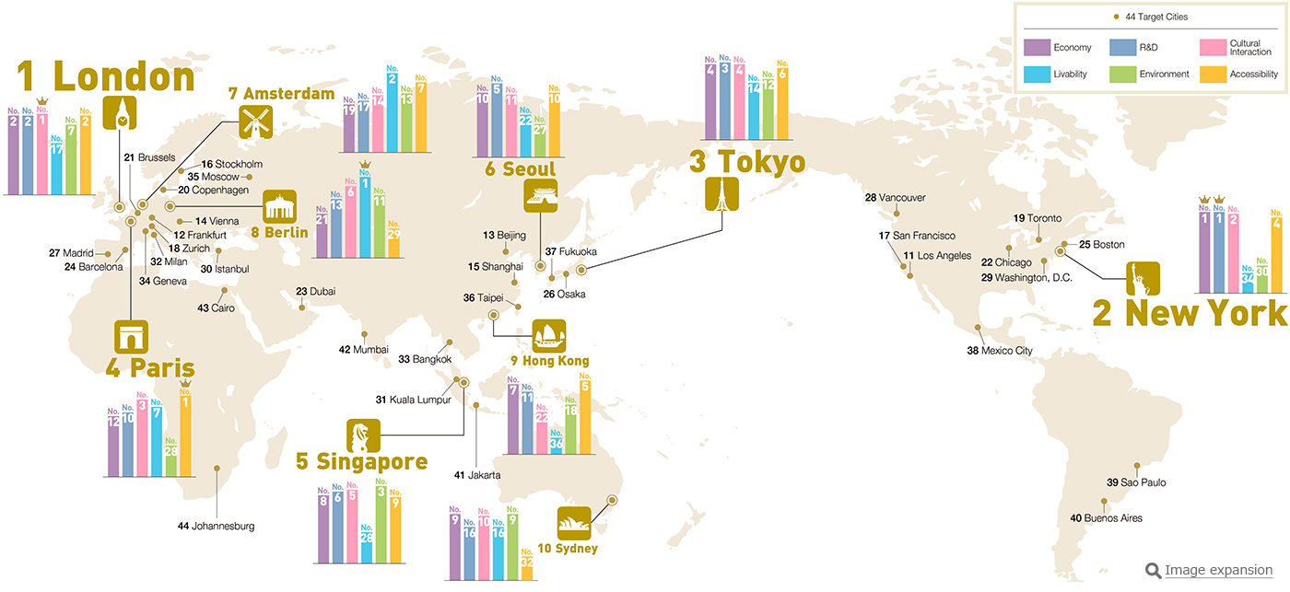
Source: Institute for Urban Strategies. Based on evaluating 6 functions: economy, R&D,
Cultural interaction, livability, environment, accessibility.
https://www.youtube.com/watch?time_continue=134&v=JTbdhrLju90

Slide 34
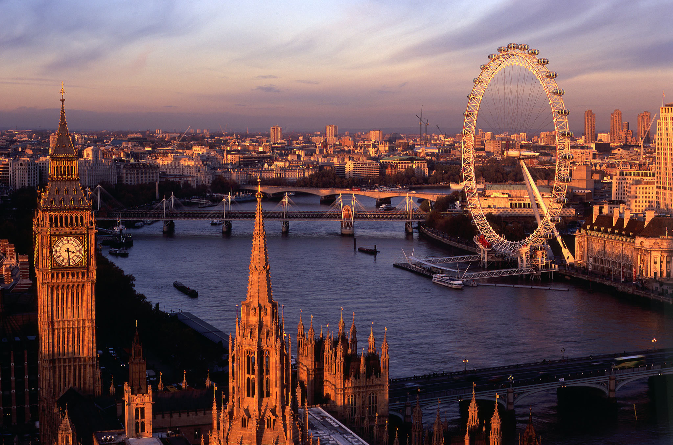
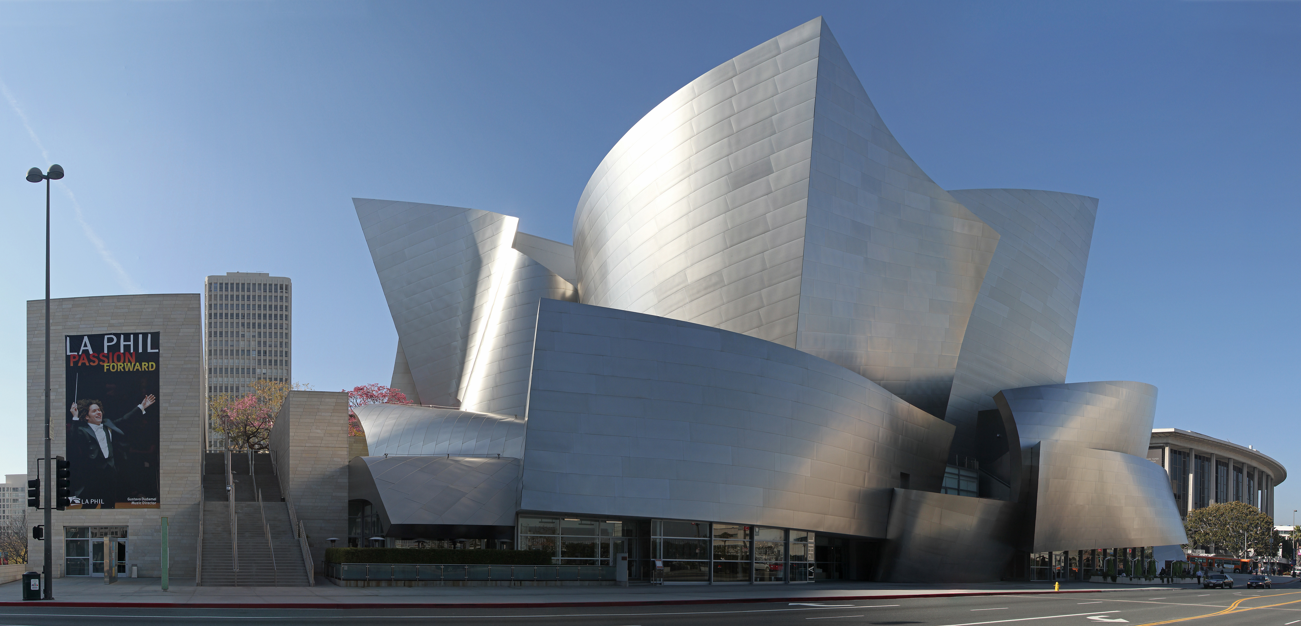
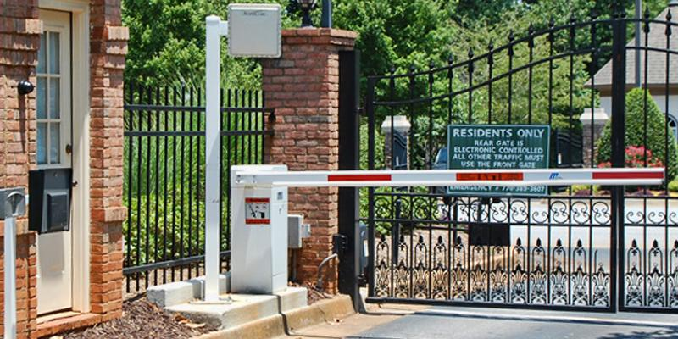
Characteristics of a World City
Headquarters of corporations and/or government
Connected through airports, ports, specialized markets (stock, commodity exchanges)
High-level services: law, finance, banks
Tourism: highly visible centers of consumption, both elite and popular
Spectacle events
Highly visible landmarks
Class segregation: economic underclass of immigrants and highly skilled “creative class”, creating dual or divided cities

