Slide 1
Geography 8
The History of Cities
5500 years ago – industrial revolution

Slide 2
Keywords
Acropolis
Agora
Burgher House
Cathedral
Citadel
Civlization
Dar al-Islam
Feudalism
Forum
Free Merchants Towns
Ghetto
Gridiron Plan
Guild
Hanseatic League
Hydraulic Civilization
Indus Valley
La Citta Vecchia/die Alstadt
Medinah
Merchant class (burghers)
Mesopotamia
Mosque
New towns and bastides
Planned city vs. Organic city
Polis
Roman Empire
Souk/Bazaar
Synekism
Urban Revolution/Transformation
Zhouli Design
Ziggurat

Slide 3
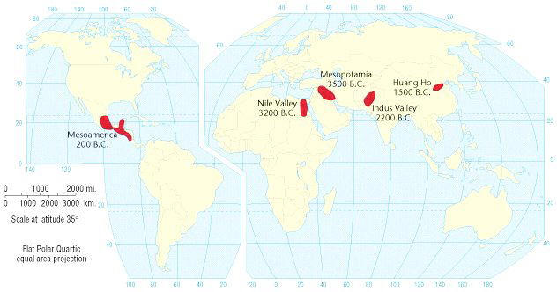
The Revolution Theory of History
Gordon Childe, Australian archaeologist
10,000 yrs ago Agricultural Revolution
5000 yrs ago Urban Revolution
200 yrs ago Industrial Revolution

Slide 4
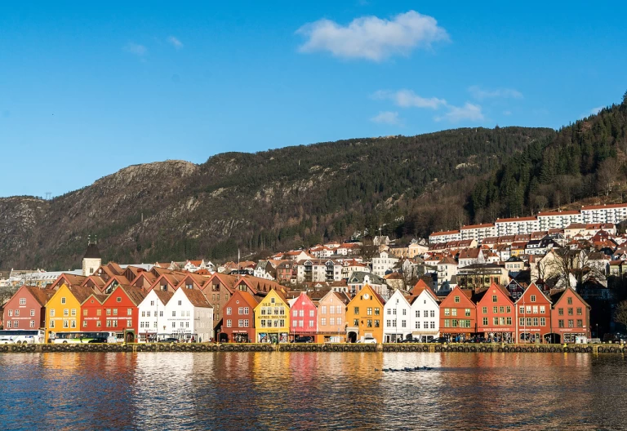
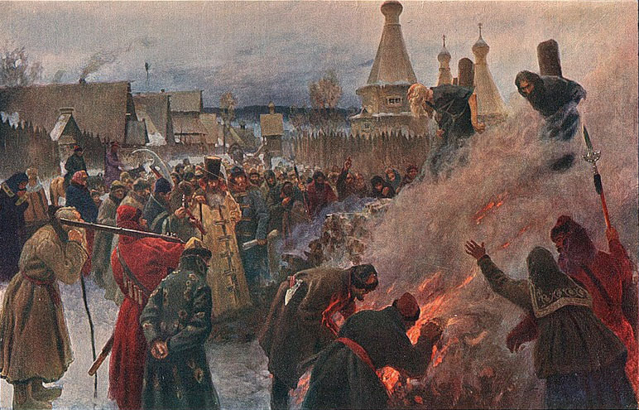
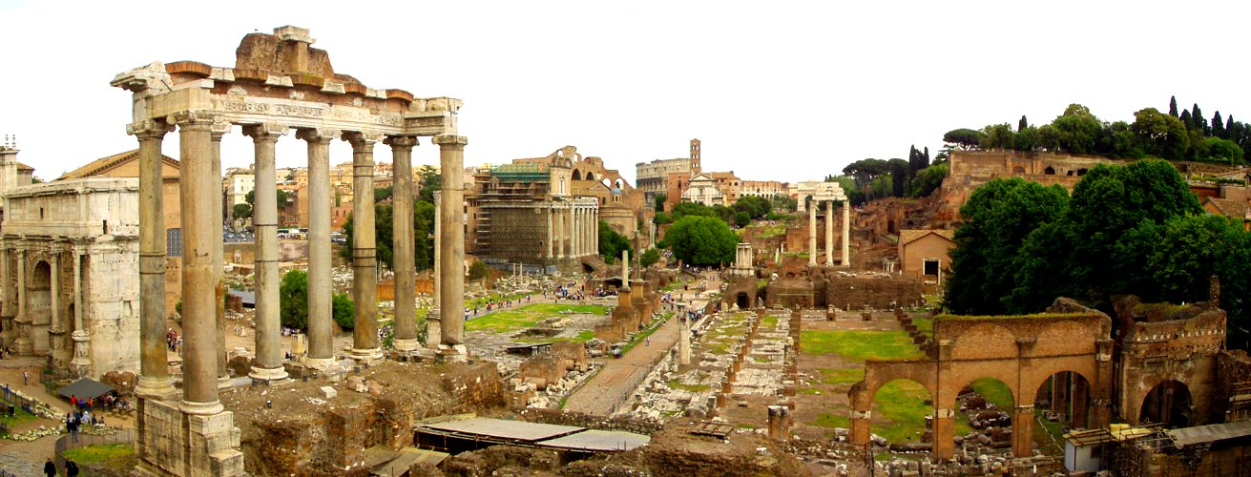
Spread of Urbanism
By 1000 years ago, empires centered on city-states
Greek, Roman, Byzantine
But has been precarious & uneven
Fall of Roman Empire
Dark Ages in Europe
Rise of Mercantile Capitalism

Slide 5
Why?
Agricultural Surplus
Childe & Woolley
Excess food required management, admin, centralized functions
Social stratification, specialization
Hydraulic Civilization
Wittfogel--cities arose in civilizations using irrigated agriculture.
Early cities were in arid/semi-arid areas
Large irrigation projects required large-scale cooperation, money, specialized skills, centralization, bureaucracy.
Trading
Merchant class evolves as trade intensifies, becomes less intermittent and seasonal.
Need for a system to administer formal exchange of goods.
Cities driven by long-distance trade.
Defense
Max Weber
People gather for protection, or as Wittfogel said, to protect valuable irrigation systems.
While defense may not have been the initial reason for clustering, it intensified the process. Led to specialization—warrior class.
Religion
All early cities have temples or other related structures.
Elites may have controlled these altar offerings.
Led to social stratification, specialization.
Wheatley: religion needed to keep people in line with rapidly changing societies.
Synekism
Ed Soja, UCLA
Organic—put enough people in a small space and creativity ensues.

Slide 6
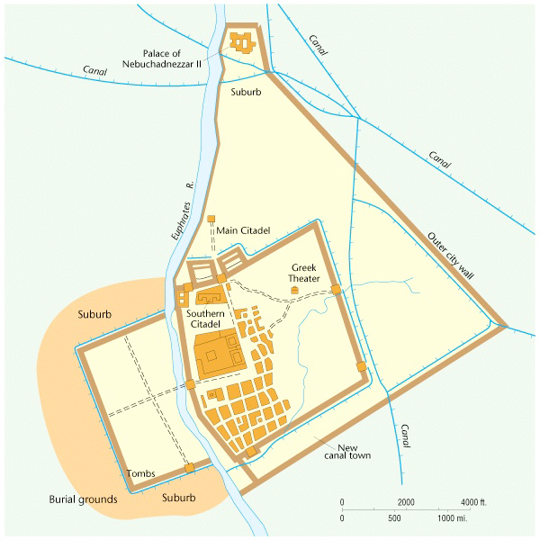
What Do Cities Share?
They are central places
Centers of wealth, power, population, religion
They are areas of specialization
Merchants, priests, bureaucrats, laborers, leaders
They have citadels
A city within a city
Monument or monumental structure
Identifies the city’s center, heart
Symbolizes the culture, civilization
Could be a pyramid-like temple
Often a compound including temple, palace, gathering space
Walled off to define it as an elite space
Mesopotamia’s Ur. Note the citadel center, a place demarcating an elite central space within the larger walled city beyond.

Slide 7
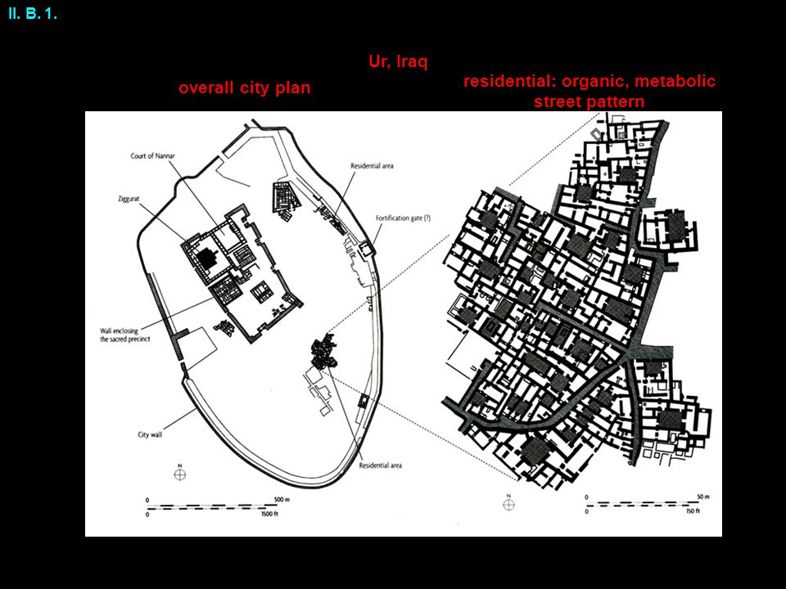
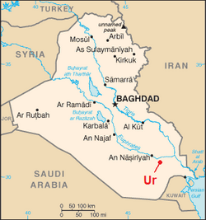
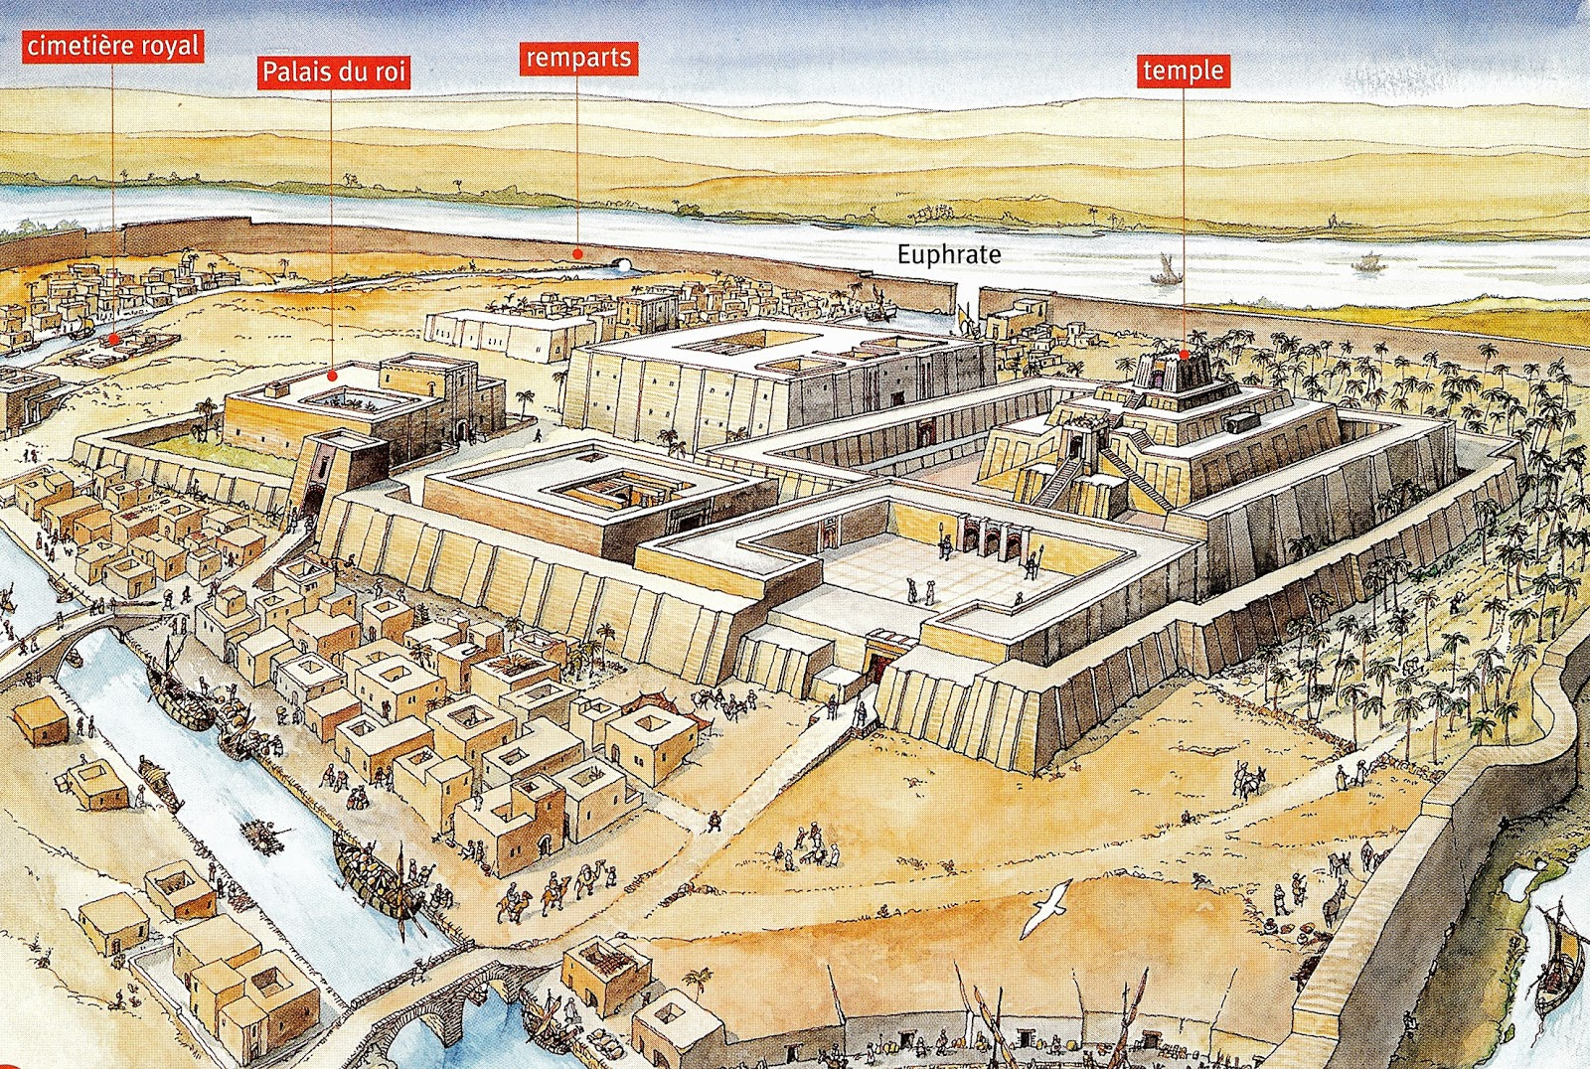
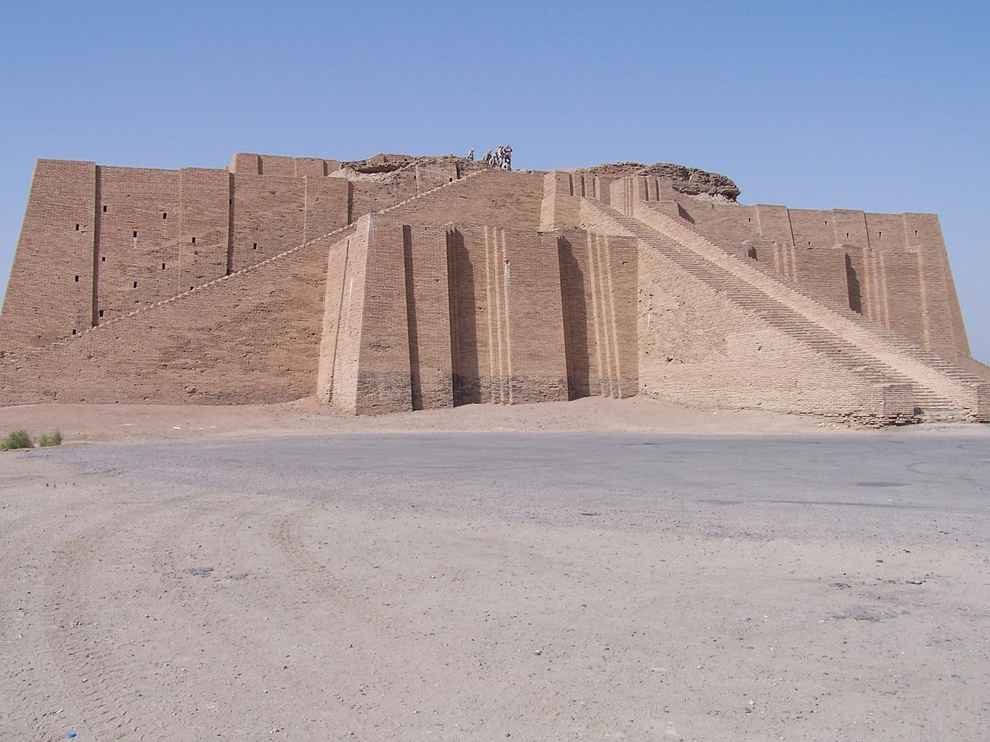
Mesopotamia
Ur—2300 – 2180 BCE, Sumerian Empire
Irrigated agriculture
Highly stratified society: rulers to slaves
Extensive long-distance trade.
Center of the city: pyramidal ziggurat.
Around the center a maze of streets.
No planning, organic.
Even a suburban zone with more than 200,000 people!
70’ high, walled temple to the moon god, Nannar. A sacred center.

Slide 8
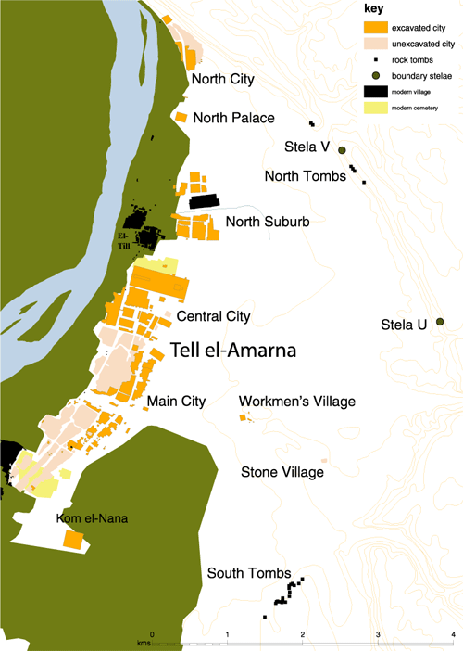
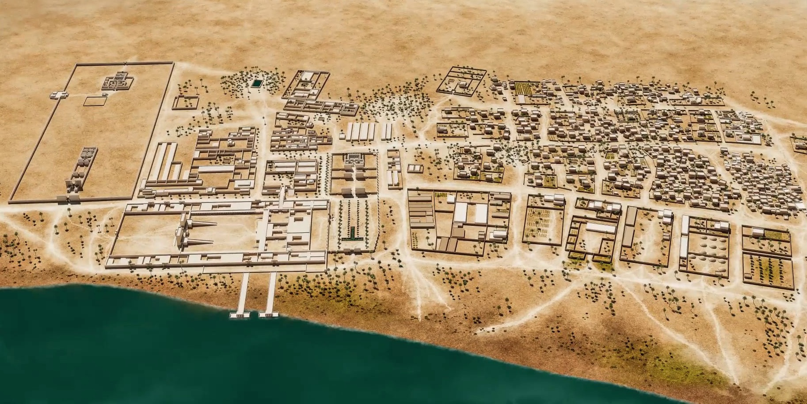
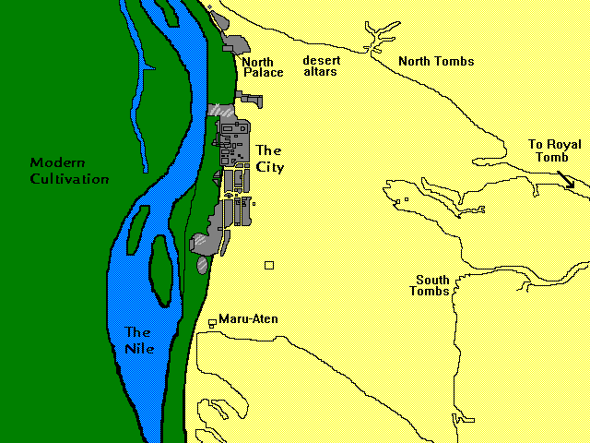
Ancient Egypt Akhetaten, Tal al-Amarna
Akhetaten stretched 5 miles along the Nile.
Egyptian civilization was small and no real defense needs.
Cities housed the elites—the Pharaoh and his Royal Court
Heavily stratified and this is reflected in the city’s structure:
Walled temple/Palace
Slums
Suburbs to north & south
Workingmen’s homes to east

Slide 9
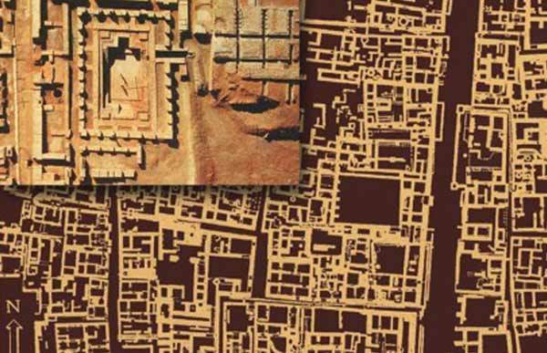
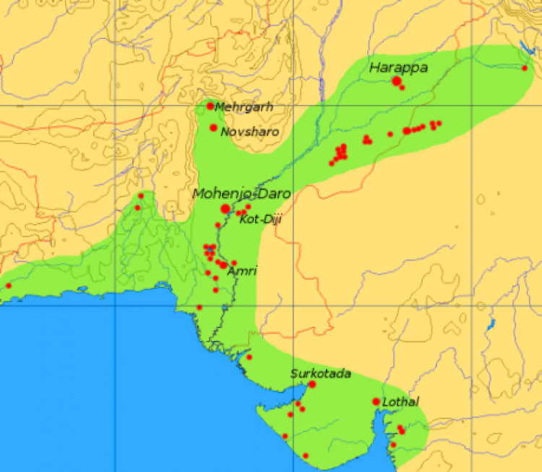
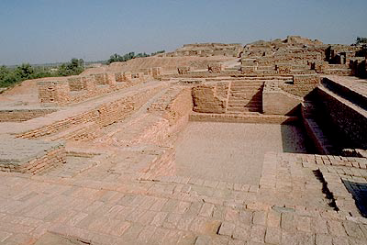
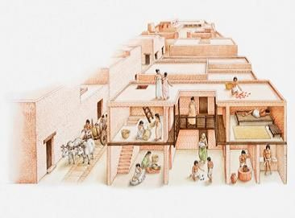
Indus Valle Harappa & Mohenjo -Daro
1st planned towns –grid
Very dense: 1 square mile, 35,000 people.
Engineering marvels—wells, canals, baths, drainage
systems for waste.
Unique Citadel: to west of city, on a mud platform, illuminated by the
setting sun. Citadel not for religious purposes as much as civic.
Housing: some one room, one story, others two story with courtyards;
Workingmen’s homes were rows of identical 2-room houses.

Slide 10
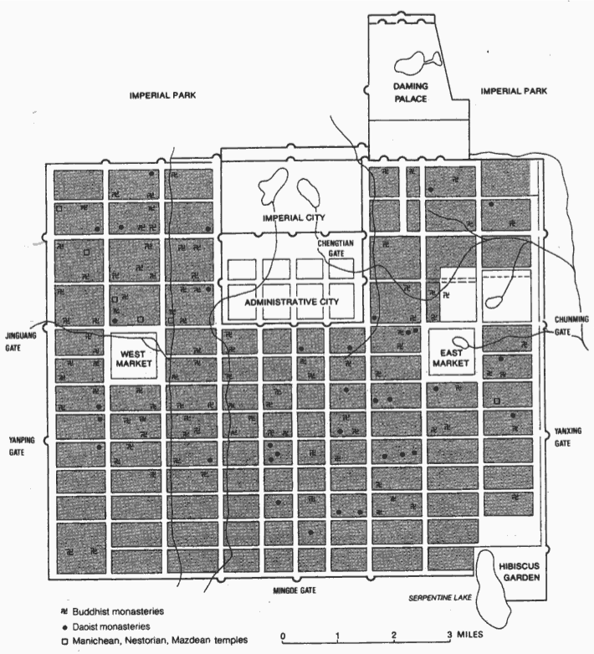
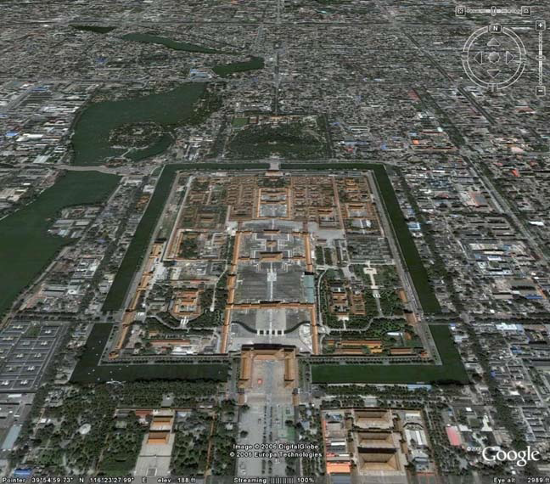
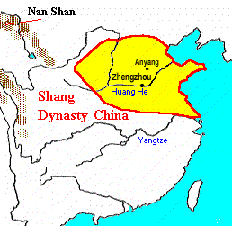
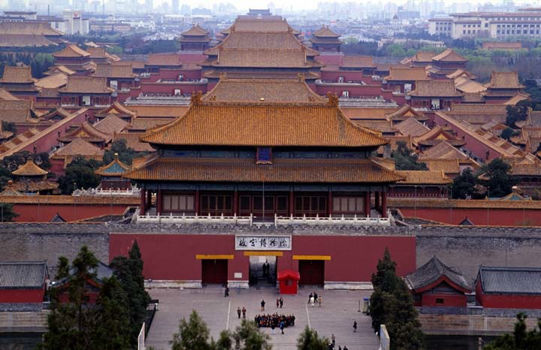
Northern China—Chengchow, An’yang
Yellow (Huang He) River
Irrigation, semi-arid environment
Centered on irrigated agriculture.
Significantly different than the West:
Merchant class less important and markets were not even included in the central city (out on the periphery).
Cities were Imperial centers for the Emperor and elites
Zhouli Design—the Zhouli Kaogongji, 3x3 grid; each grid has gate to outside, except the central one which houses the Emperor—the Gate to Heaven.
Chinese empires viewed China as the “Middle Kingdom” where “earth and sky meet.”
Shang Dynasty, Yellow River, 1800 BCE

Slide 11
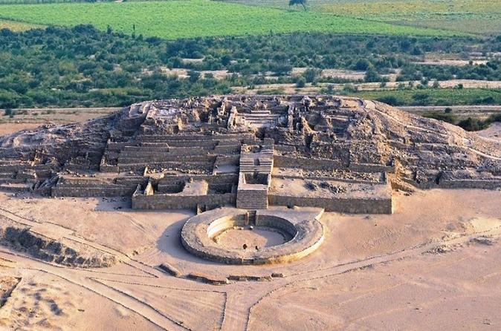
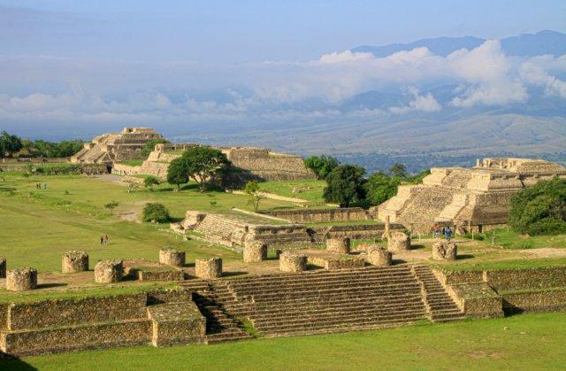
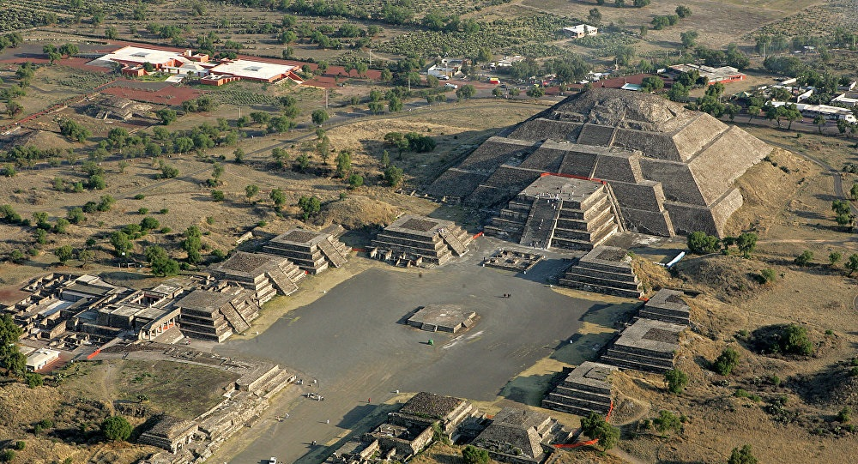
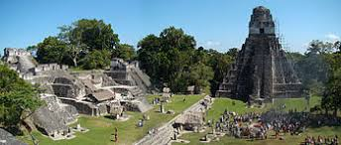
Mesoamerica
Central Andes city Caral-Supe, 3000 BCE—largest buildings are religious, ceremonial.
Oldest city dates to 3000 BCE, Caral-Supe, in the central Andes.
Others:
Zapotecs in Mexico—Monte Alban.
Aztecs in Mexico—Teotihuacan, about 200,000 people.
Mayans, Yucatan—Tikal, Uaxactun, 50,000+, very little agricultural innovation or technology, in decline by the time Spanish arrive.
Structure of these cities
Biggest buildings were religious, ceremonial
Temples, palaces in center
Homes of wealthy near center
Low density huts, agricultural, craft workers in periphery
Monte Alban—Zapotec civilization, southern Mexico
Teotihuacan, Mexico (present day Mexico City)
300-700 CE, about 200,000 people.
Elites and wealthy lived near the center, huts in low-density neighborhoods on outskirts of agricultural workers or craftspeople.
100 BCE, Yucatan Peninsula. 50,000 people, city of Tikal.

Slide 12
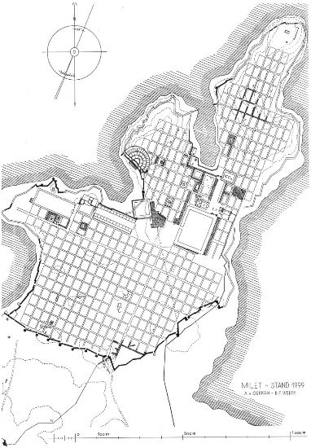
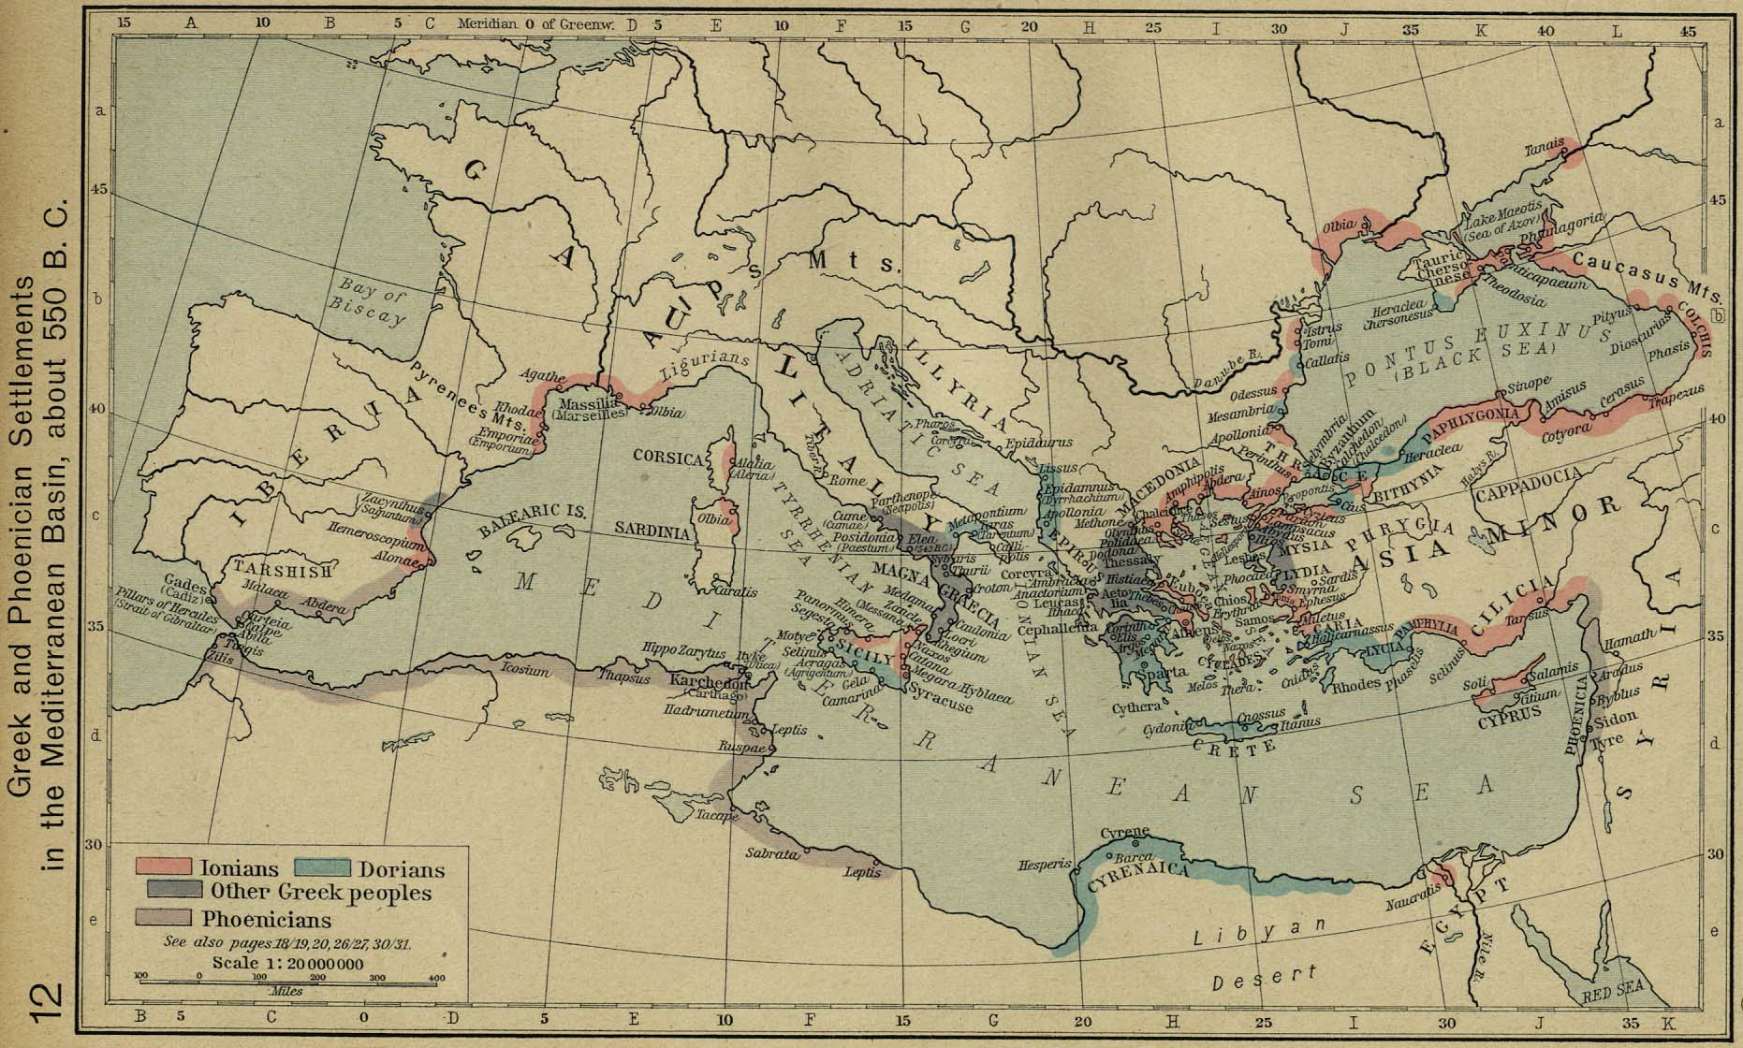
Rise of European Urbanism Greece
Until the rise of the Greeks, Europe an urban backwater
By 400 bce Athens rises, has 250,000 residents
It is an unplanned, chaotic city in form
Greeks later introduce planning through the gridiron, first urban planner is Hippodamus, and Miletus (Turkey) is built on gridiron design.
Greek settlements, 500 BCE

Slide 13
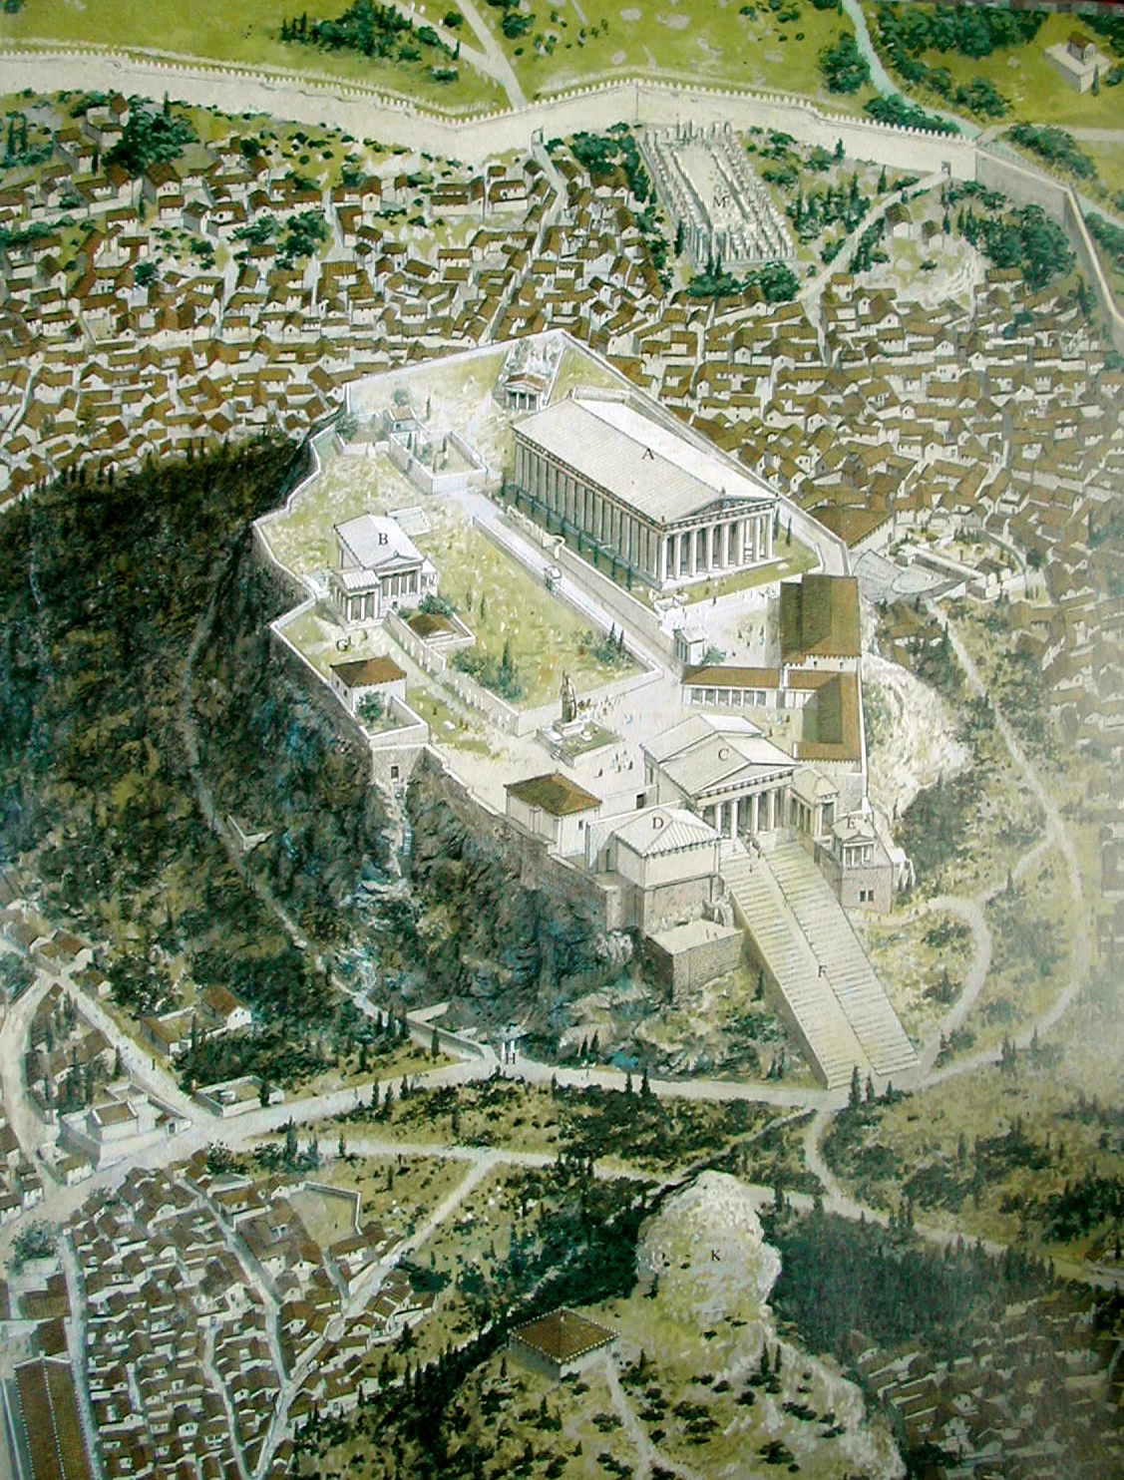
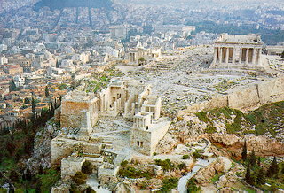
The Classical Greek City: Athens
Monumental citadel—the Acropolis
Very compact, crowded narrow streets around the Acropolis.
Walled city that looked like cities that came before it
But…a new lifestyle
Democracy—new kind of society
Authority didn’t reside only with priest or warrior elites
Flawed, though—no rights for women or slaves (about 1/3 of the population are slaves).

Slide 14
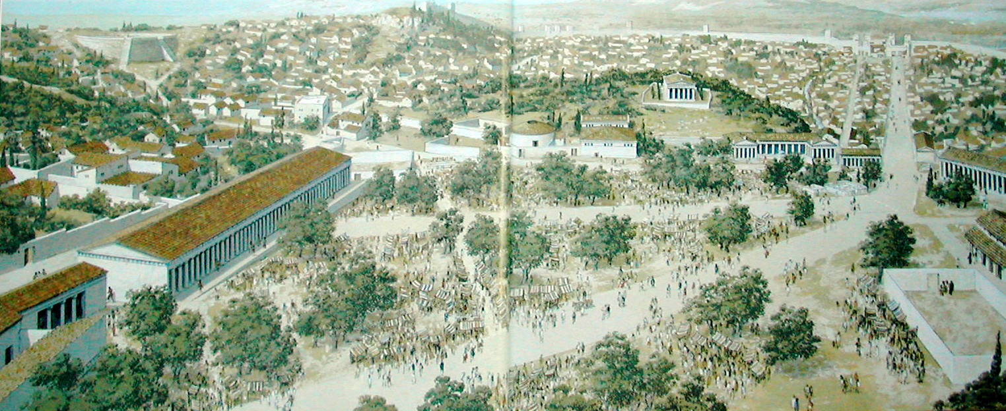
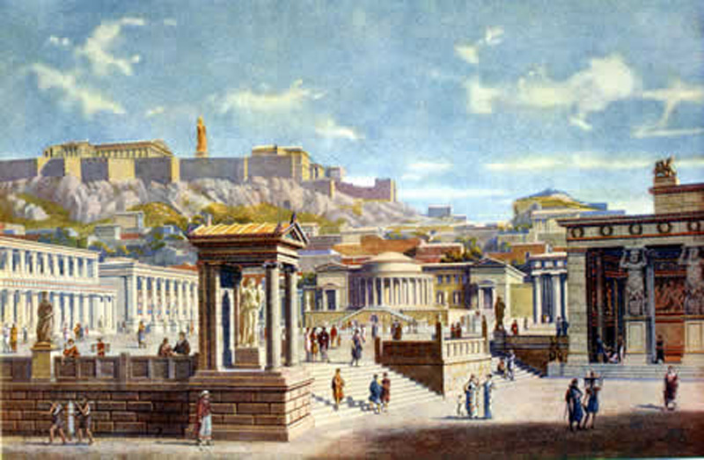
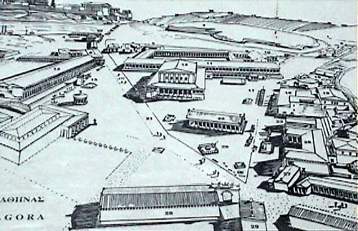
The Agora—a new urban form
Open, public space
Not just for trade, but for social and cultural exchange.
Do democracies need such spaces?
Such space increasingly rare in modern cities—think LA!
The agora
Athens today, red outline is the original walled Athens.

Slide 15
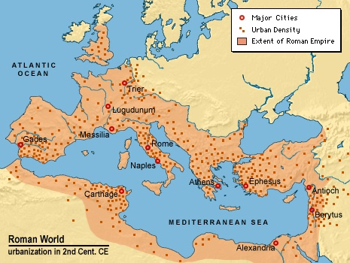
European Urbanism: The Rise of Rome
The Romans create an urban network that spanned Europe.
London, Paris, Brussels, Cologne, Vienna, Sofia, Belgrade…
Most were small 2000-5000.
Rome was largest, about 1 million by 200 ce.
Cities were not independent (like the Greek city-states), but connected to Rome through tribute & trade.
An urban hierarchy.
Peaceful period, trade flourished.

Slide 16
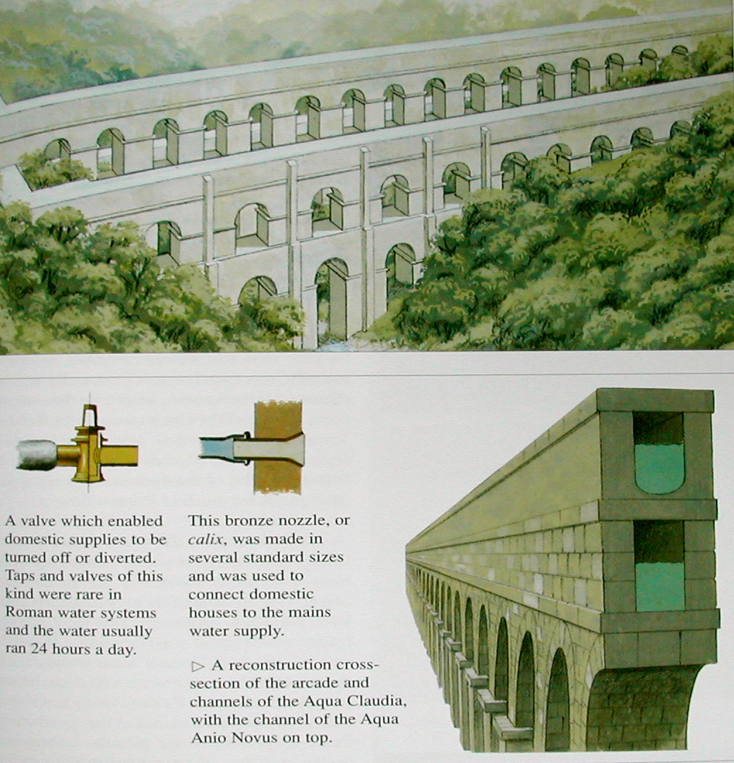
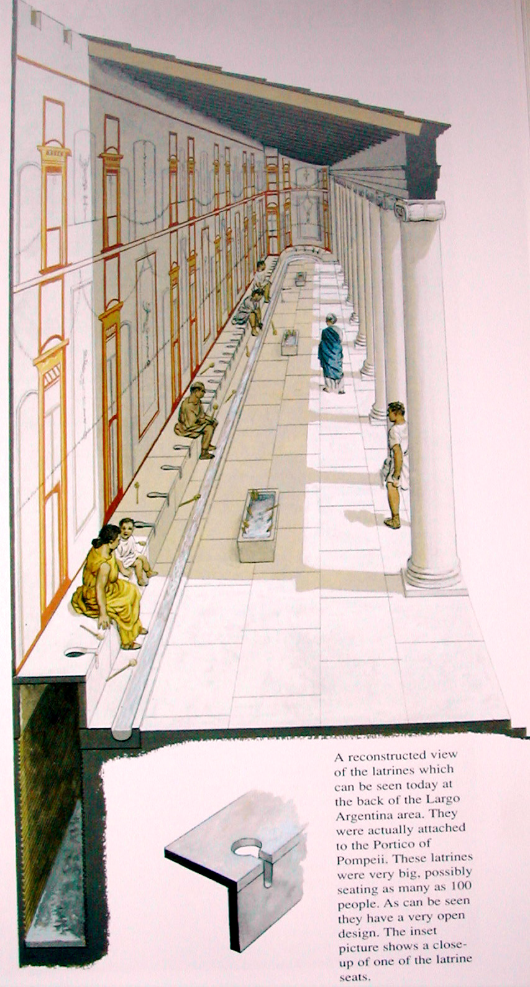
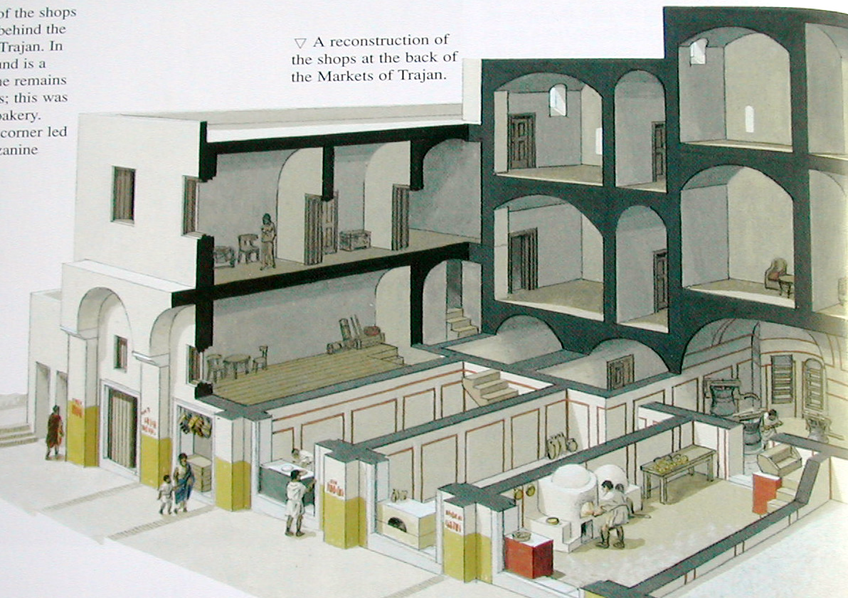
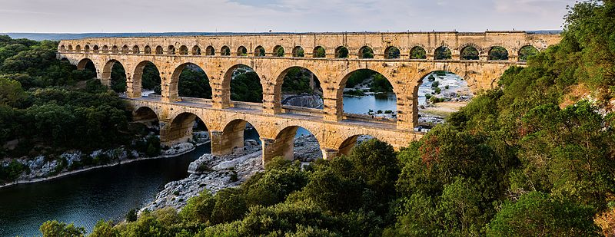
The Roman City
Used a gridiron pattern.
Were walled
Complex and sophisticated infrastructure:
*Roads (trade, defense, communication)
*Sewage (all underground)
*Water (aqueducts for 300 miles, carrying about 60 mill cubic feet)
*Apartment buildings (insula)
*Public bathrooms
Central place: The Forum

Slide 17
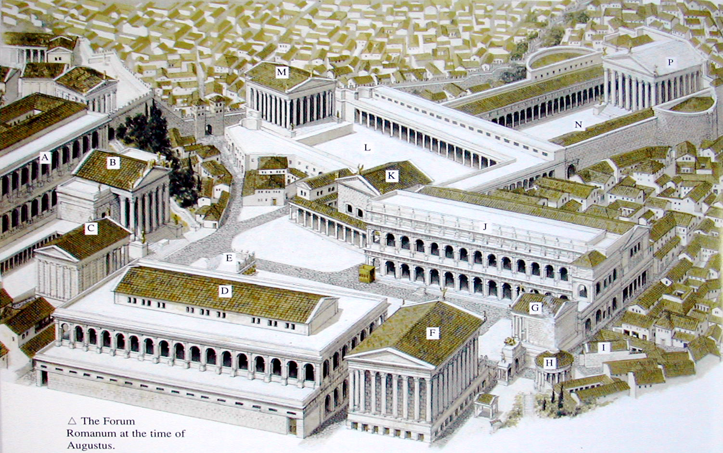
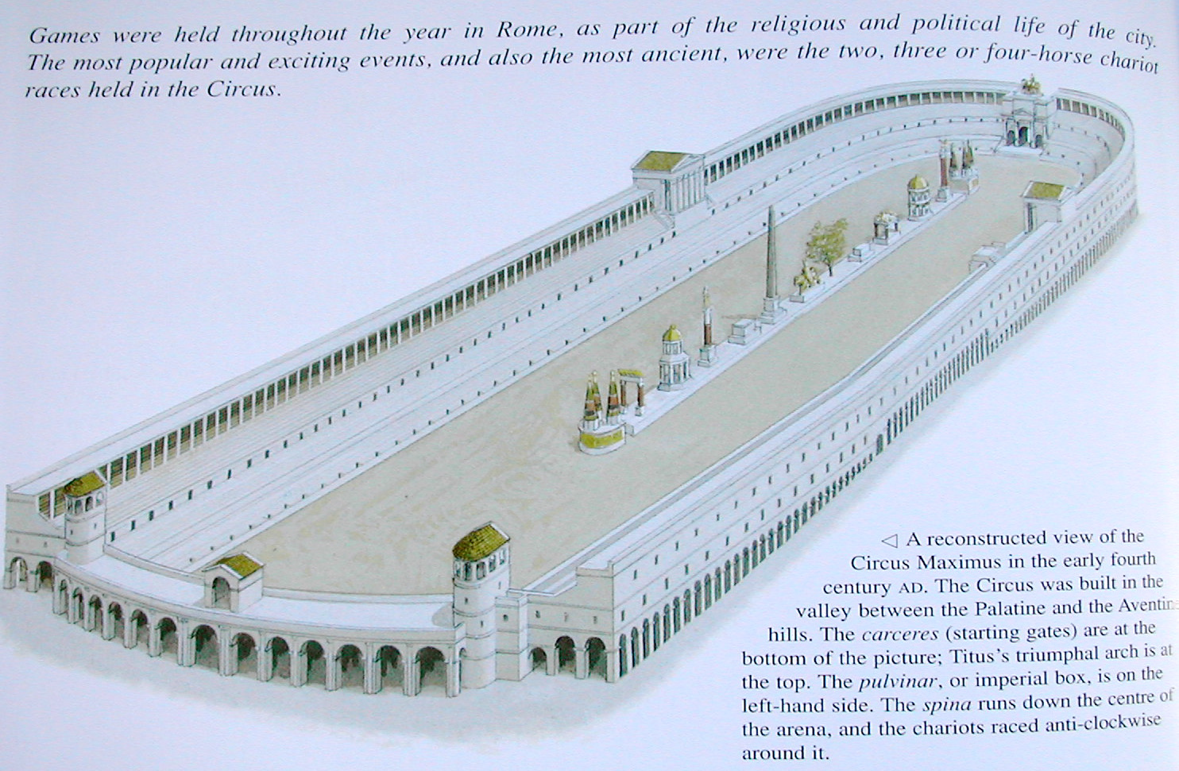
The Center of Roman Cities: The Forum
Circus Maximus.
The Forum.
Began as something similar to the agora of the Greek city—public gathering space, trade, exchange of ideas.
Republic becomes Empire and its use shifts--becomes a symbolic center of power (a citadel)—each Emperor would add a structure of complex.
Blood sport—huge stadiums to entertain the masses.
Assert the power of the Empire and appease the masses.
Symbol of the moral decay of the Empire?....

Slide 18
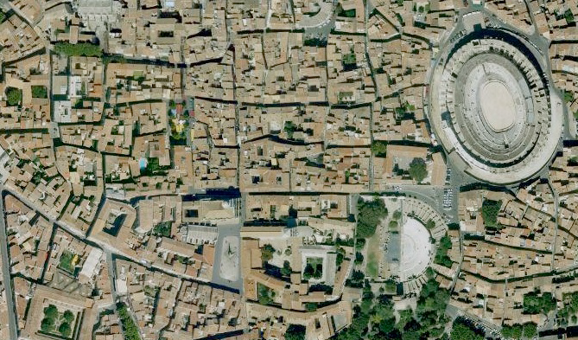
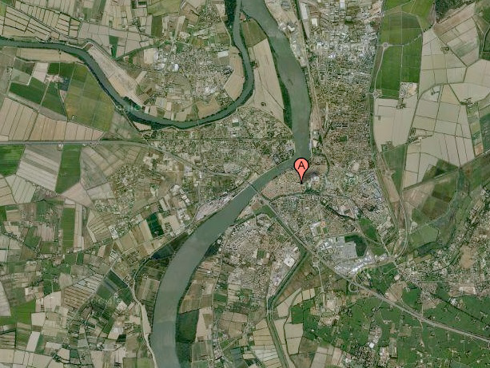
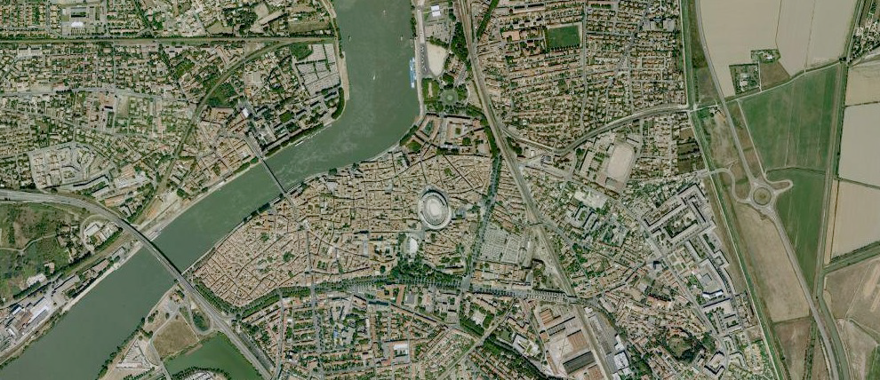
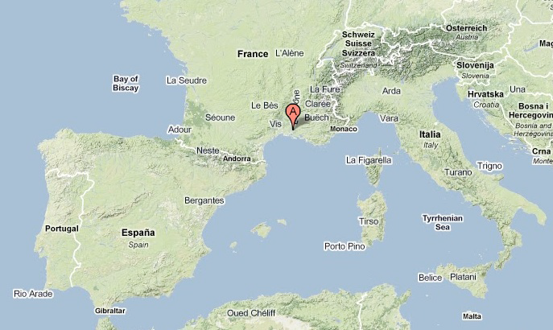
The Legacy of the Roman City—Arles, France

Slide 19
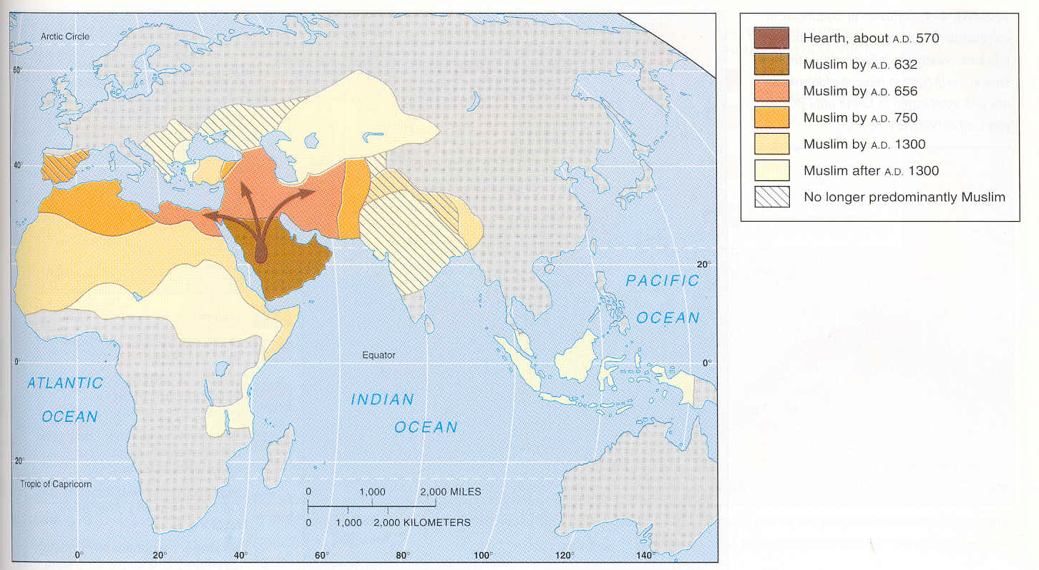
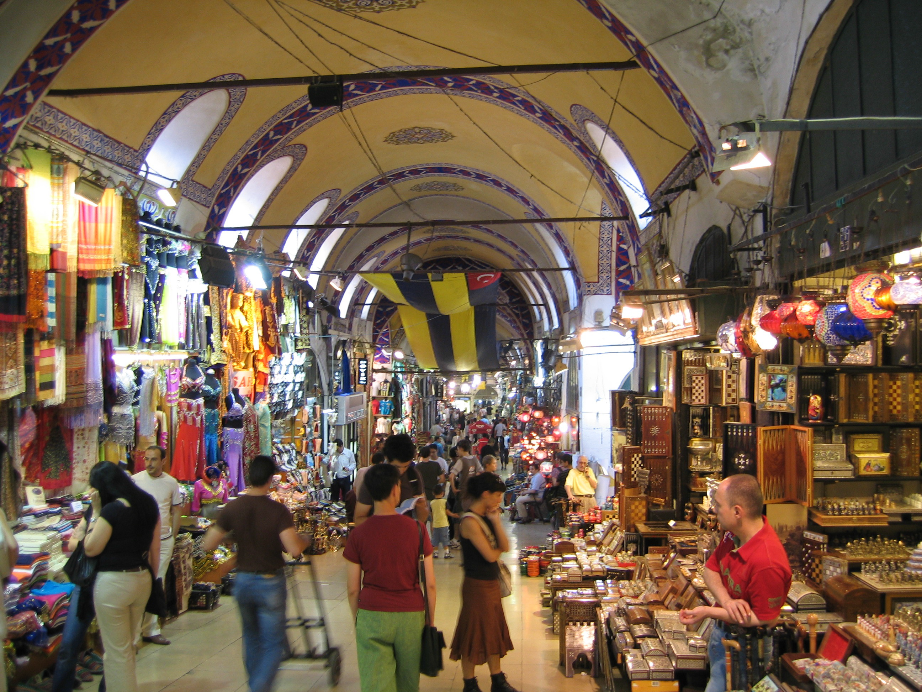
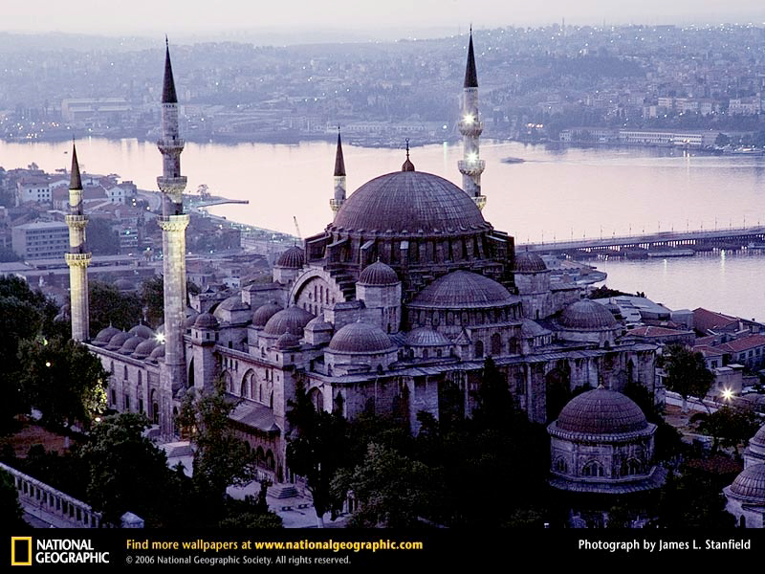
Dar al-Islam: The Golden Age of Islam
The Grand Bazaar, Istanbul
Istanbul’s Blue Mosque
Islam—600 ce, spreads via empire, first into Arab world, then North Africa, then Iberia.
Centered on cities: Damascus (660-750), Baghdad (750-1258), Cairo (969-1171), Istanbul (1453-1923).
Iberian peninsula—Granada, Seville, and Cordova.
Ottoman Empire consolidates Muslim World when it takes Istanbul in 1453. Ends 1000 years of Christian rule (Constantinople).
Islamic cities centered on trade—at center was the bazaar or souk.
At center also religious—mosque at the center with its minarets define the skyline.
Muslim cities were also defined by tolerance with significant minority populations of Christians and Jews.
There were also important cities in Sub-Saharan Africa (outisde of the Islamic influence) including Timbuctoo (Mali), Kano (Nigeria) and Mombasa (Kenya).

Slide 20
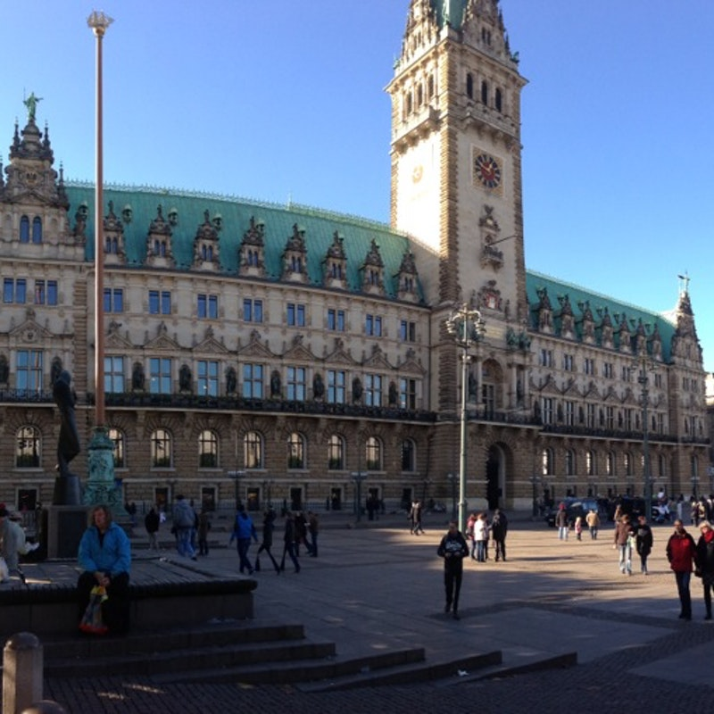
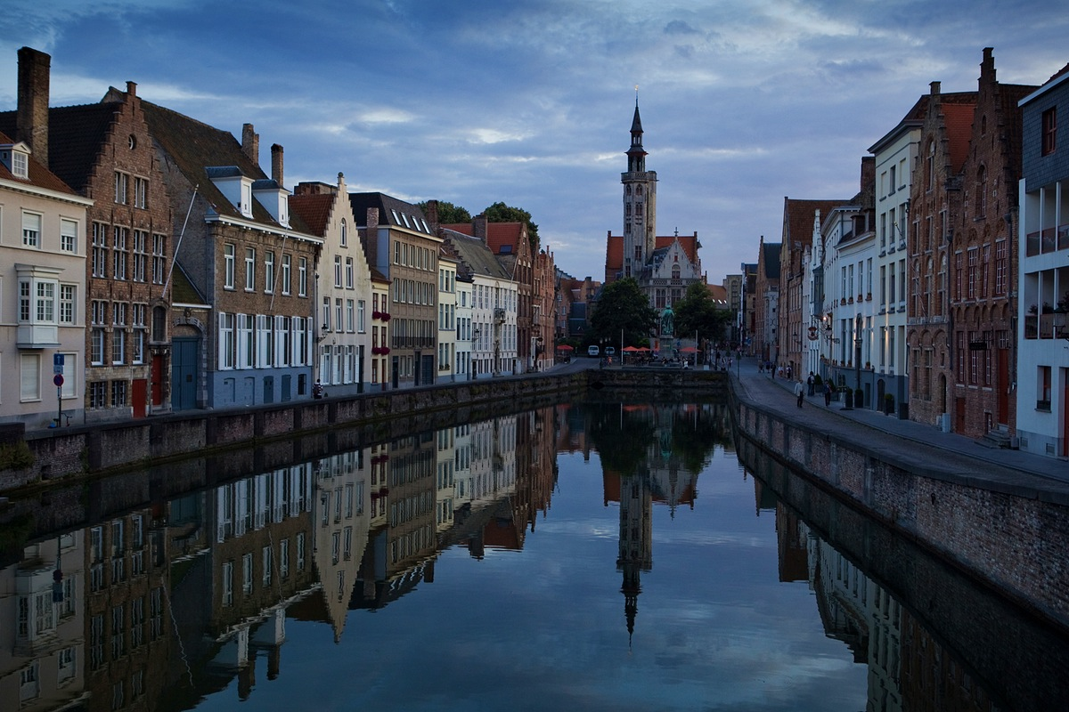
Europe’s Rebirth: The Medieval City
Hamburg,
Guildhall.
Even as recently as 500 years ago it would have been hard to imagine Europe’s cities being influential globally, or perhaps even existing at all!
During Dark Ages cities only persisted as fortified towns for feudal landowners to protect their territories.
Cities re-emerge in the 11th century (1000 ce): with the rise of a new class, the burghers or bourgeoisie
Why?
Heavy taxation prompted increased trade.
Opening of long-distance trade by the Crusades.
Cities became vital, grew in size and had a growing merchant class. They are also largely “free” areas—serfs, farmers, etc. could be independent of their feudal masters.
Merchant becomes powerful—politically, economically, socially. They lend cash to the feudal Lords.
City life is centered around the guild—merchant associations organized by trade—and the guildhall. Other than the Cathedral, the Guildhall is the most important structure in town.
These Merchant Free Towns are politically independent, more like city-republics, such as Venice, Genoa.
Cooperative leagues of guilds form joining city-republics. Hanseatic League of northern Europe included 100s of towns like Hamburg and Bruges.
The Merchant Town of Bruges, Belgium

Slide 21
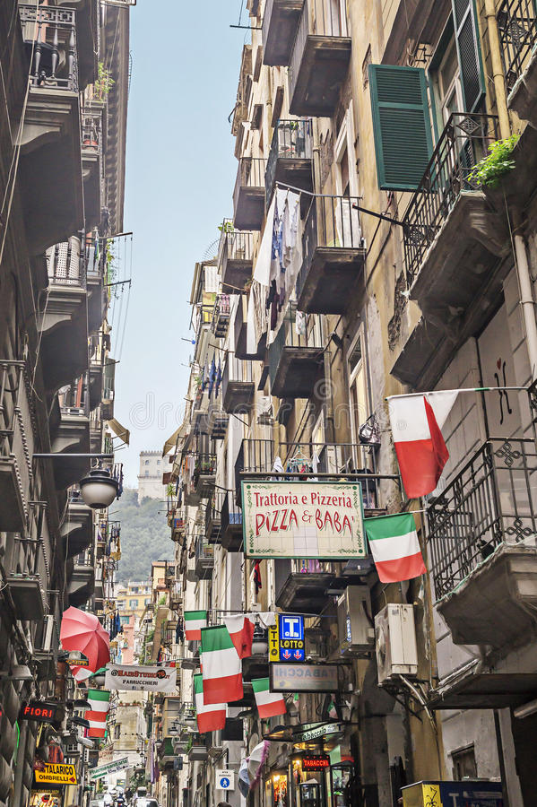
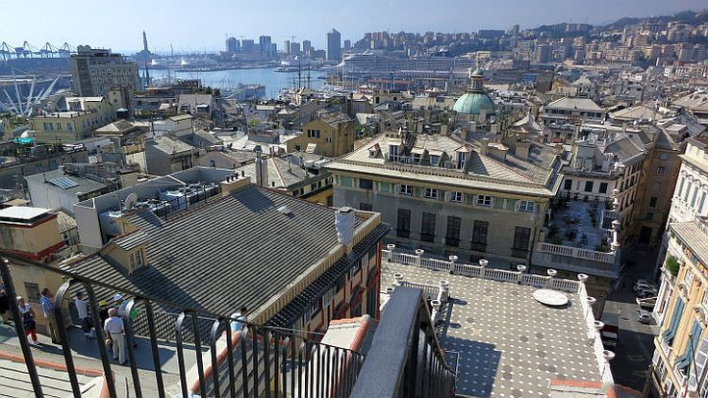
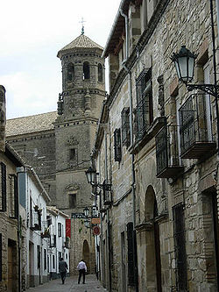
--The Medieval neighborhoods of European cities continue to give them their distinctive character.
--Little to no socio-economic segregation, nor functional segregation.
--Exception is the Jewish neighborhood.
--Burgher House.

Slide 22
Bastides
Philippeville, Belgium
Palmanova, Italy
Planned “new towns” of the Medieval period
Built by Lord or Prince for defense, but also became source of income
Elaborate defense design.

Slide 23
Bruges: the iconic Medieval Town
End of the Tours de Flanders race.

