Slide 1
Geography 8
Industrial Revolution and the Rise of the Modern City

Slide 2
Keywords
Industrial revolution
Cottage industry
Factory
Mass production
Colonialism/imperialism
Autocracy
Mechanization
Demographic transition
Natural increase rate (NIR)
Overproduction, wage deflation
Squalor
Slum
Backjams/backland tenements
Tenements
Blight vs Community
Dumbbell design—1867 Tenement House Act, NYC
CBD—central business district
Land use specialization
The “Frame” or “zone of transition” or “zone of assimilation”
Skyscraper
Iron girders, wall curtains
Mass transit
Peak land value intersection (PLVI)
Ford’s Skyline Score

Slide 3
A New Human Experience
The “old” city
The industrial city
Compact
Pedestrian-oriented
Organic form
No separation of activities
No separation of groups of people—rich people live near poor people, etc.
Work and home close to each other
The human experience becomes urbanized
Cities connected to one another, no longer “islands”

Slide 4
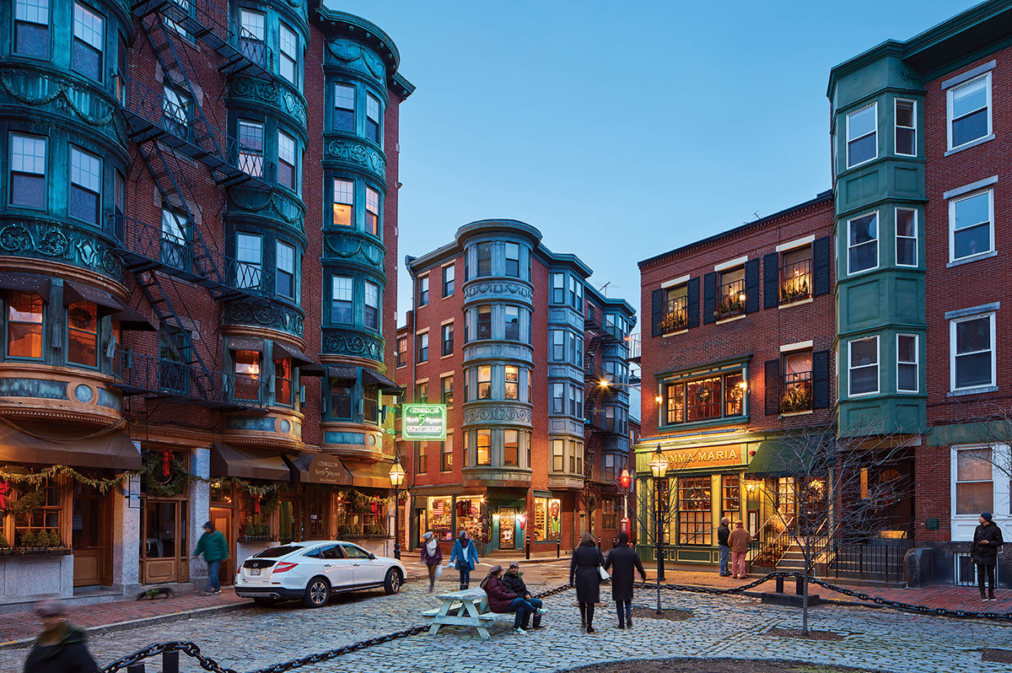

Slide 5
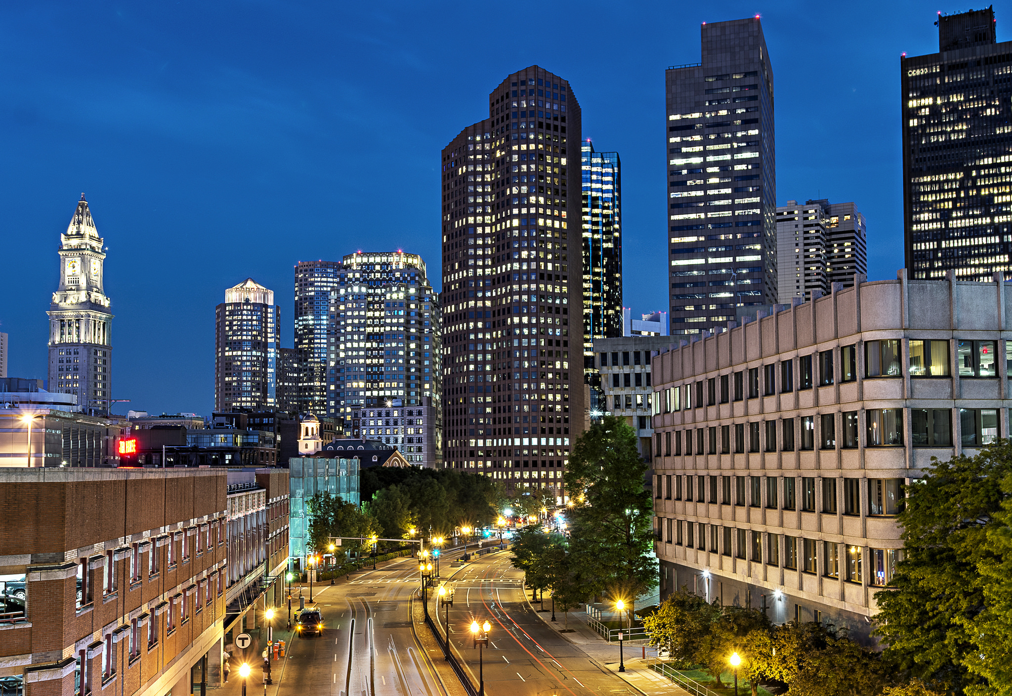

Slide 6
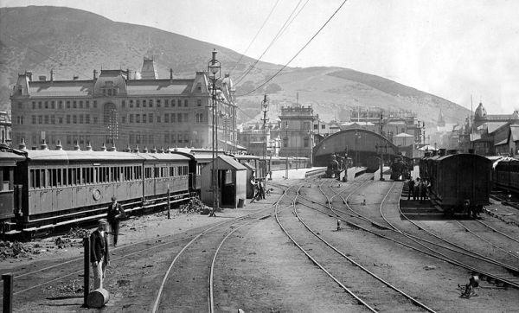
3 Big Changes
Transportation
Railroad
Light rail
Planning
Control the chaos
Efficiency
Sorting
Social, cultural
economic

Slide 7
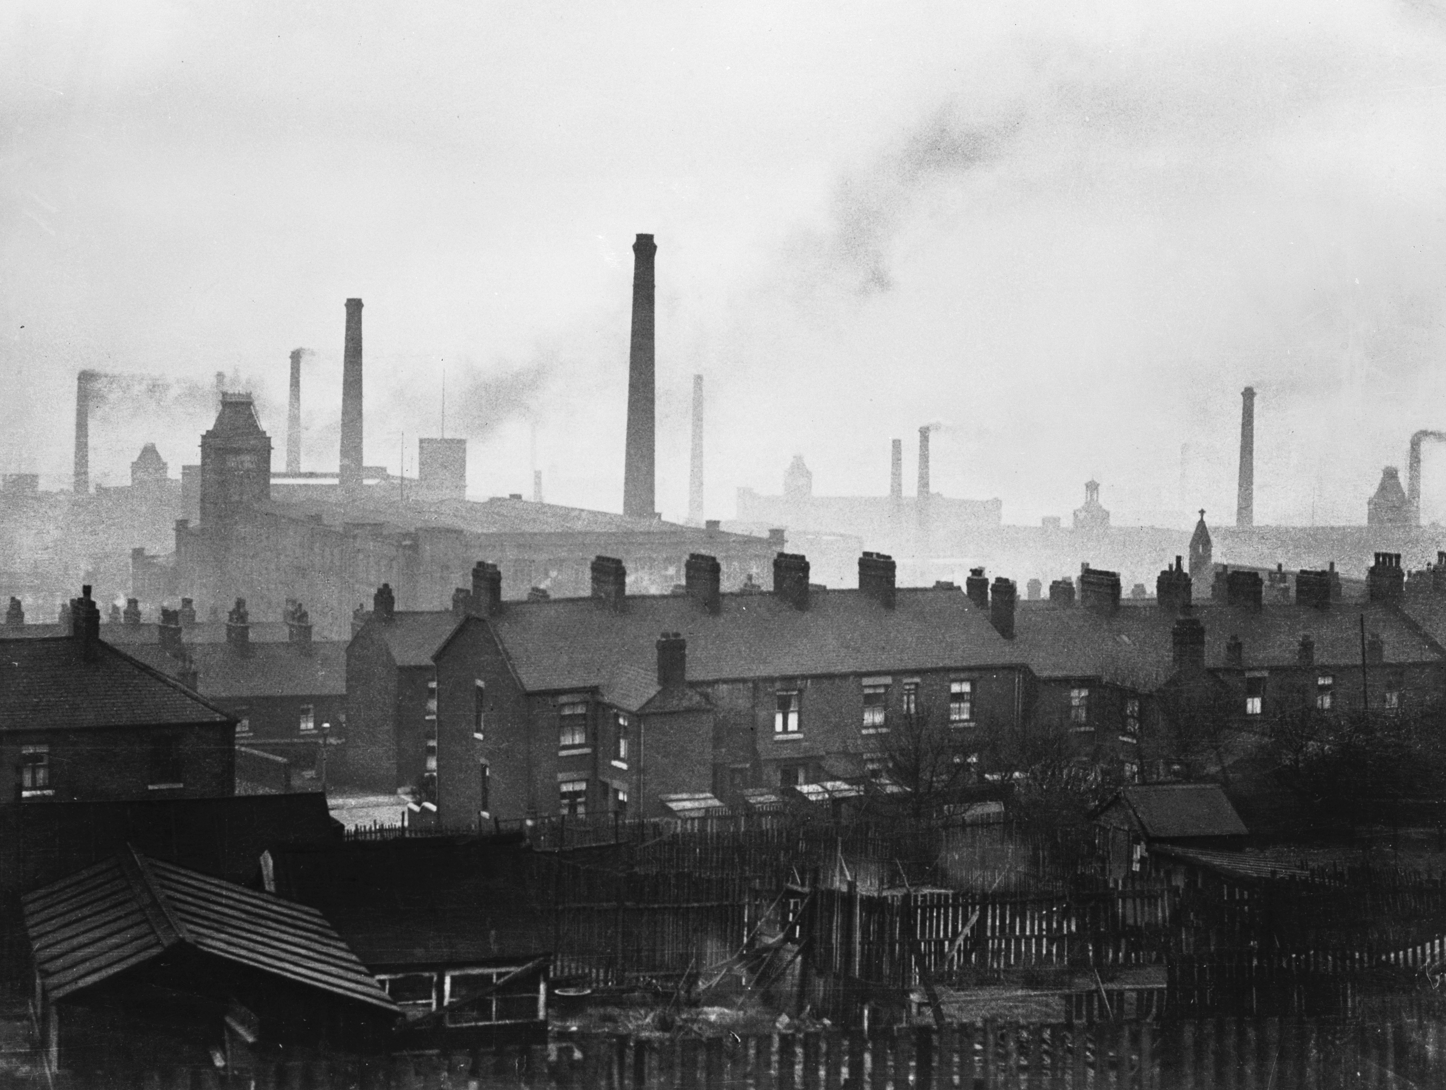
Changes in Urban Morphology
The Railroad
RR need lots of flat land—Station, Rail Yards, etc.
Railroad “cuts-off” neighborhoods or areas
Railroad prioritized over public good
CBD
In a new location, away from ports or wharfs, oriented next to Rail Station
Next to Train Station are shops, hotels, restaurants, department stores (later)
Eventually—skyscrapers in this PLVI (peak land value intersection).
Industrial Belts
Along rail lines
Stockyards, factories, warehouses, low-grade housing
Heavily polluted
Public transit
People could live farther from center
Spatial sorting, often on economic lines
Wealthy could escape the degraded inner city
City becomes FRAGMENTED

Slide 8
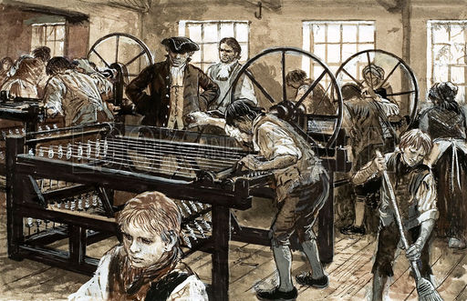
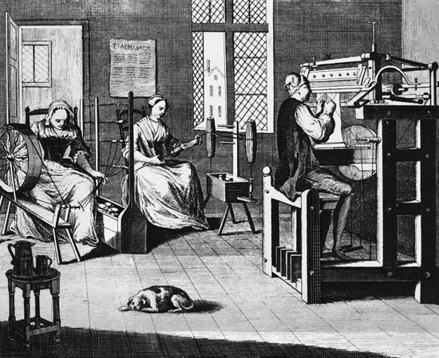
The Industrial Revolution
Changes in Labor Organization & Ways Goods are produced
Cottage Industry
Factory

Slide 9
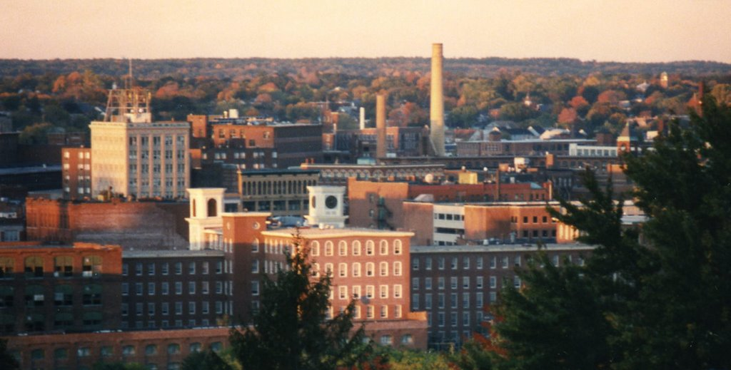
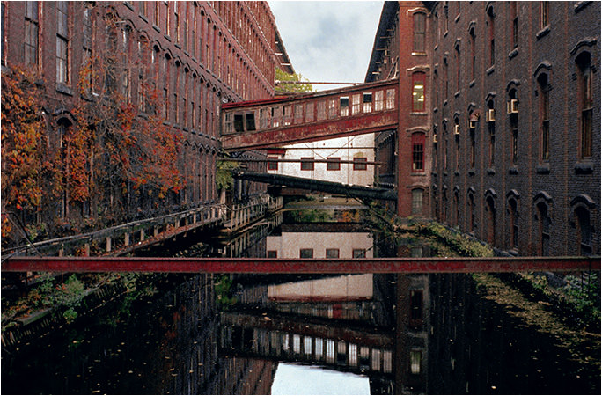
New Cities
Cities grow around factories
Factories locate near water
Factory owners provide housing

Slide 10
Labor for Factories
Mechanization of Agriculture
Horse-drawn plow
Seed drill (Jethro Tull)
Reduced need for farm labor, peasants displaced
Increased Yields of Food Stuffs
Plenty of food to feed urban/factory workforce
Very high NIR
High rates of immigration
Manufacturing of Tools/Machines
Workers make the tools/machines need for mechanized agriculture
Keeps the whole system working

Slide 11
Coal & Competition
Coal
Factories move to be close to mines, cities follow
Surplus labor
From immigration, from high NIR
More efficient production
Machines continue to make production better
Produce more goods
More competition
Industrial revolution spreads to Europe, then to North America
They are competitors, driving prices down (of products)
Wages get cut
Factory owners cut wages to remain profitable
Worker is “squeezed”
Workers can’t afford housing
Lack of affordable housing

Slide 12
Housing for the Workers
Competition over land near city center
Row houses for workers constructed on very narrow lots.
People crowded together to be able to afford housing

Slide 13
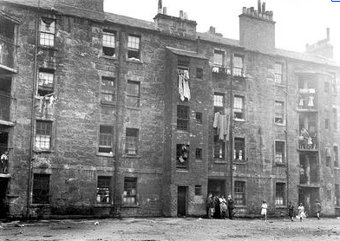

Slide 14
The Tenement
Often former homes of individual wealthy families
Rents kept low by subdividing single-family home and filling the lots
Subcontractor “managed” the properties
Workers had few other options
Became places of disease, poor sanitation
In 1861 2/3s of Glasgow’s population of 394,864 lived in houses with only one or two rooms,
and of these 60% shared a room with at least four others. Overcrowding was intensified by
property speculators building on any available open space to produce “backjams” and
“backlands” tenements, which were either added to existing buildings or erected in the
erstwhile gardens of the formerly wealthy burgher residences. By the mid-19th century
the old city was a congeries of poor-quality housing. One shelter visited in a dark ravine
of a close housed a husband, wife and two children and
comprised of a “sort of hole in the wall” measuring six shoe lengths in breadth, between
eight and nine in length from the bed to the fireplace, and of a height which made it difficult
to stand upright. Densities of 1000 persons per acre were commonplace.

Slide 15
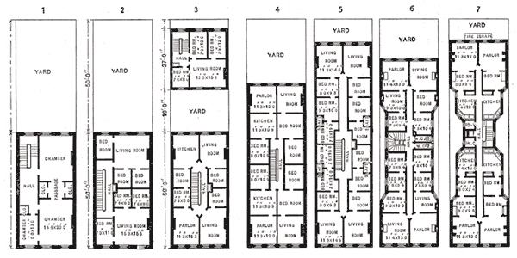
Tenement Structure
Very narrow lots, many former merchant homes, 3-4 stories on front half of lot.
By Stage 3: adding to the lot, “backjams” or “backlands”
Sometimes original house torn down and tenement built, 6-7 stories
Stage 4-7: standard layout: four separate units around a central stairwell.
Each unit had 3-4 rooms; largest had a window (probably about the size of a walk in closet by today’s standards)
Maybe 1 toilet, but most likely outhouse for about 100 people to use.
Stage 6-7: new dumbbell design after 1867

Slide 16
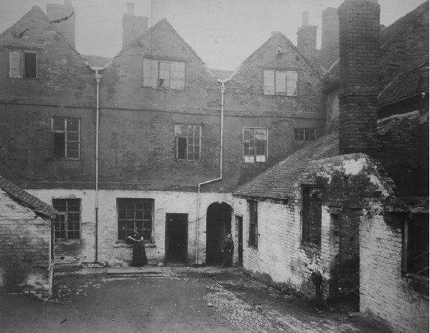

Slide 17
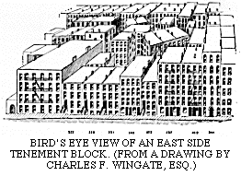

Slide 18
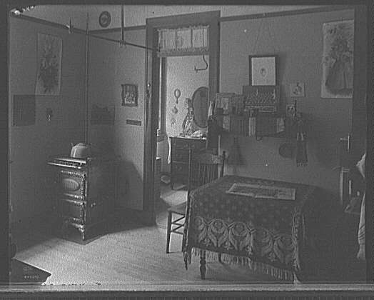

Slide 19
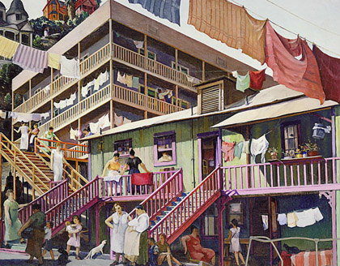

Slide 20
Tenement Life
Jacob Riis
John Green’s Crash Course on US History: growth, cities and immigration
NY Times “Tenement Memories”
The Tenement Museum

Slide 21
New Urban Core: the CBD & the Frame
Next to city’s rail station
Skyscraper—reflects Peak Land Value (PLVI)
Iron girders with curtain walls
Elevator
Just outside of CBD—The Frame
Just outside of the CBD
Buildings lower in height (lower land value)
A “zone of transition”, today a “zone of assimilation”
Warehouses, cheap housing, now being converted to major sport arenas

Slide 22
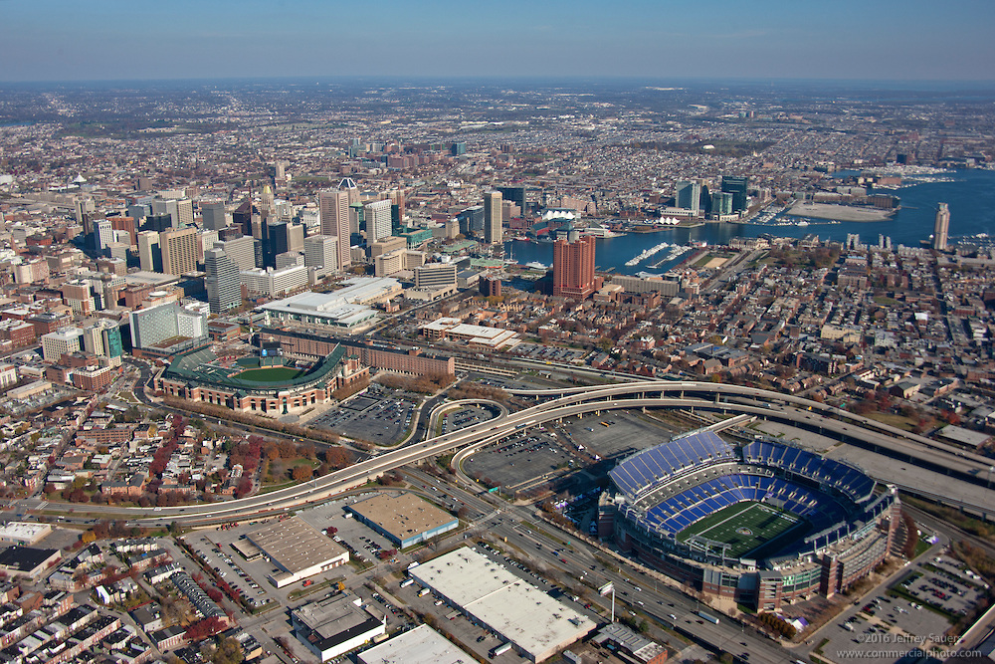
Baltimore

Slide 23
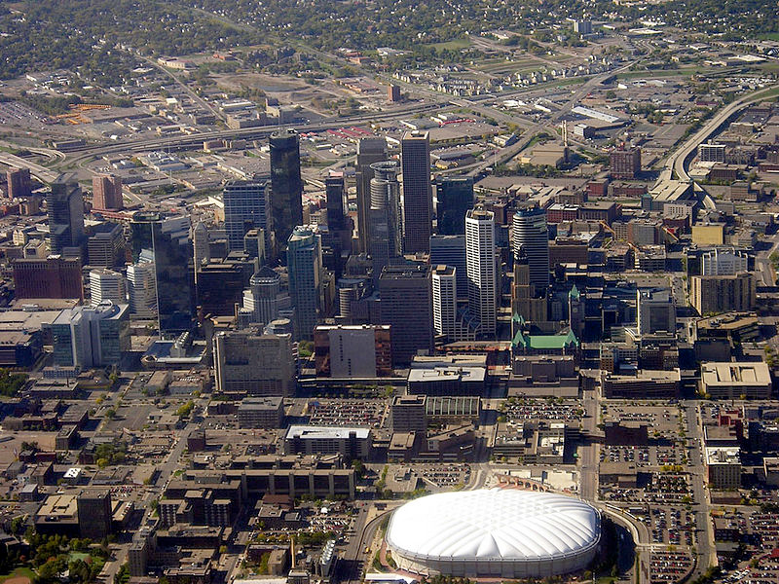
Minneapolis

Slide 24
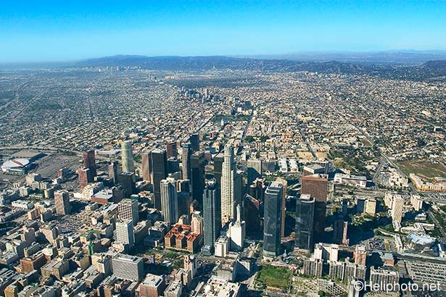
Los Angeles

Slide 25
RR Shapes the City
Odd-shaped land fragments/blight/ “wrong side of the tracks”
Industrial belts of heavy pollution
Low-grade housing along rail lines
Wealthy escape, commuters created (light rail, subway)

Slide 26
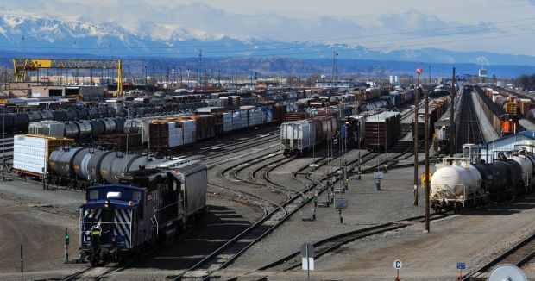
Billings, Montana

Slide 27
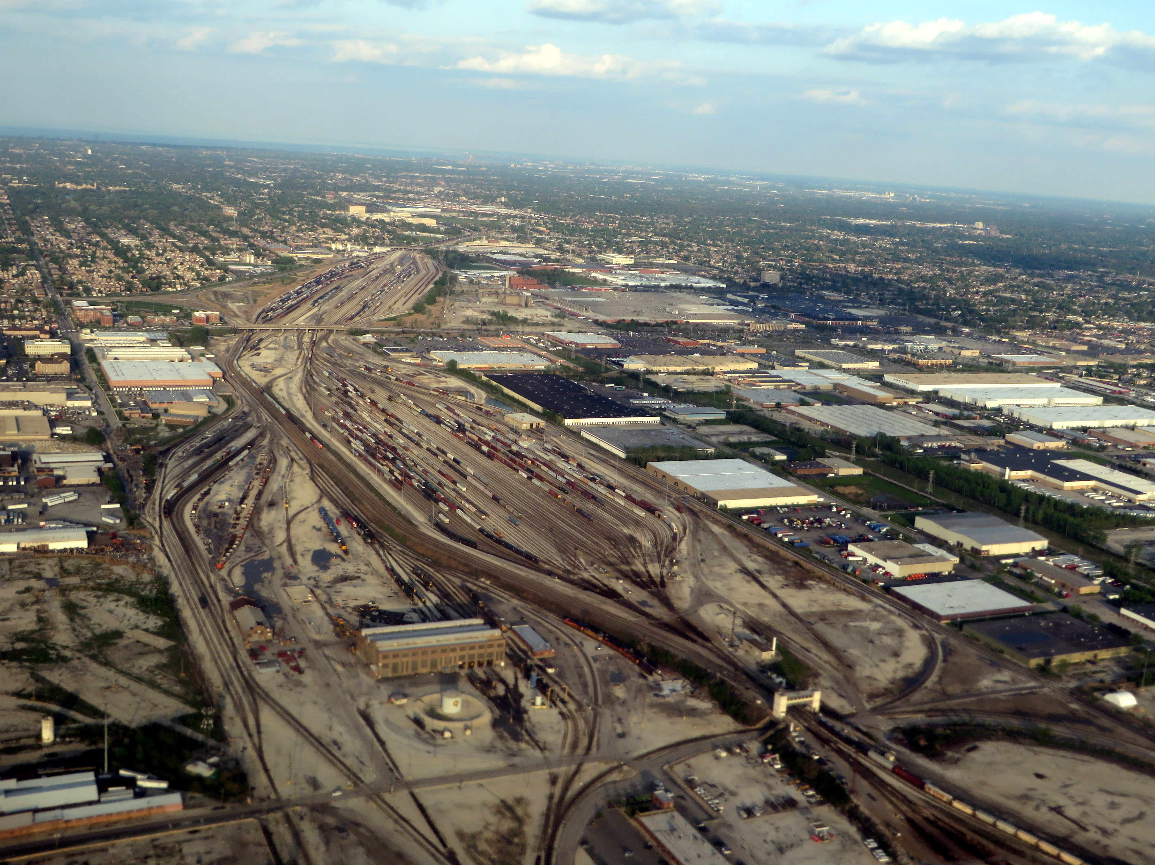
Chicago, south side

Slide 28
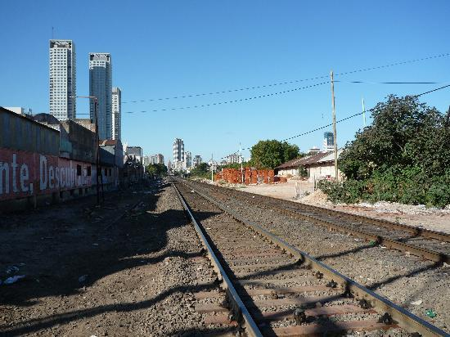

Slide 29
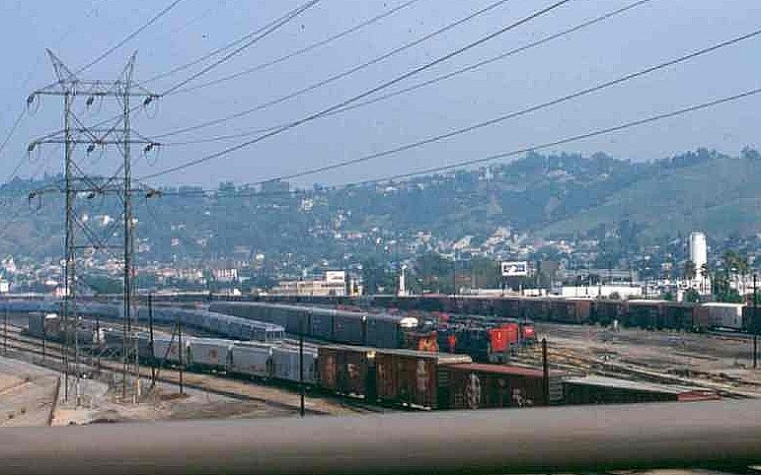
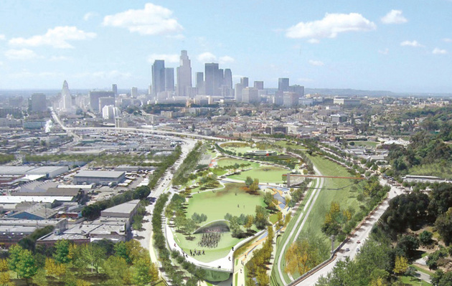
Los Angeles, Taylor Yard

Slide 30
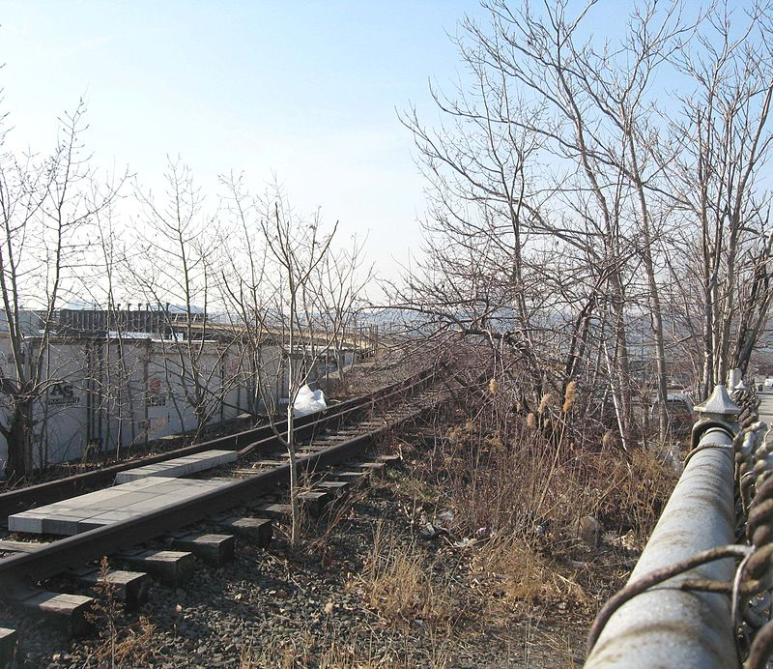
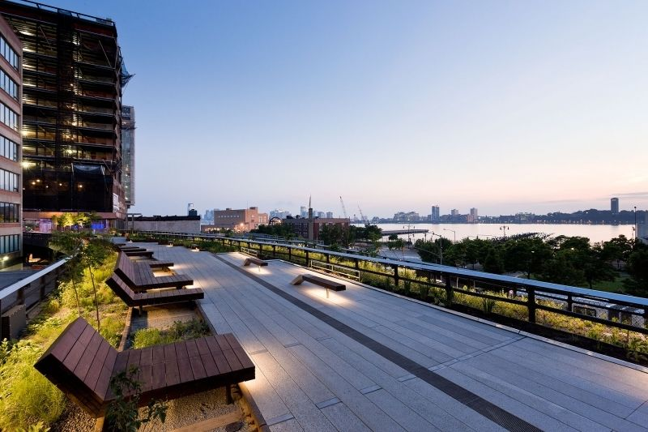
NYC’s High-Line Park

Slide 31
Industry Shapes the City
Land use becomes more specialized
Wealth determined who used what land
Poor, workers in sub-standard housing

Slide 32
The Skyscraper—the product of modern, industrial Capitalism
Reflects the high value of land at the CBD (PLVI)
Go up (vertical) to maximize efficiency
Made possible by new technologies
Elevator (1853)
Steel-frame construction (late 1800s)
Possible to go higher than 7 or 8 stories
Made possible by new mass transit systems
Skyscraper holds a lot of workers
Where are they all going to live?
Symbolic of…..?
More than just a solution to a lack of space (pretty expensive solution)
A new citadel?
A new symbol of power—but what kind of power?
The power of business? Or residence? (Trump Tower)
Are they a reflection of our social values?

Slide 33
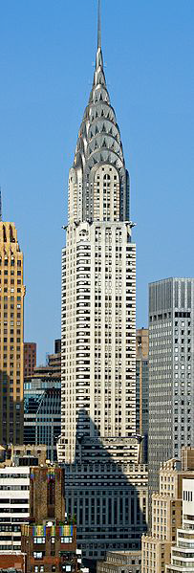
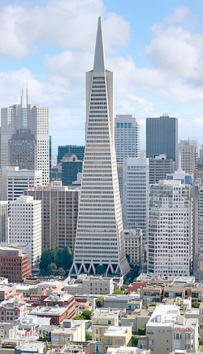
New York’s Chrysler Building
San Francisco’s
Transamerica
Building

Slide 34
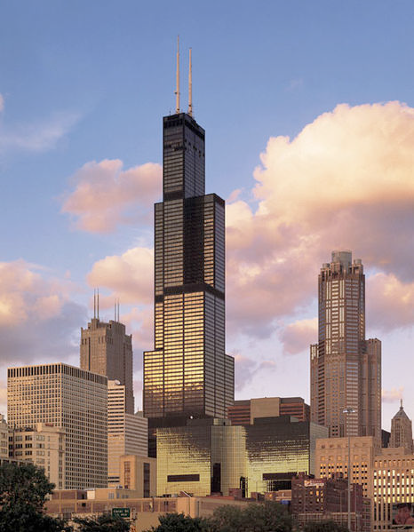
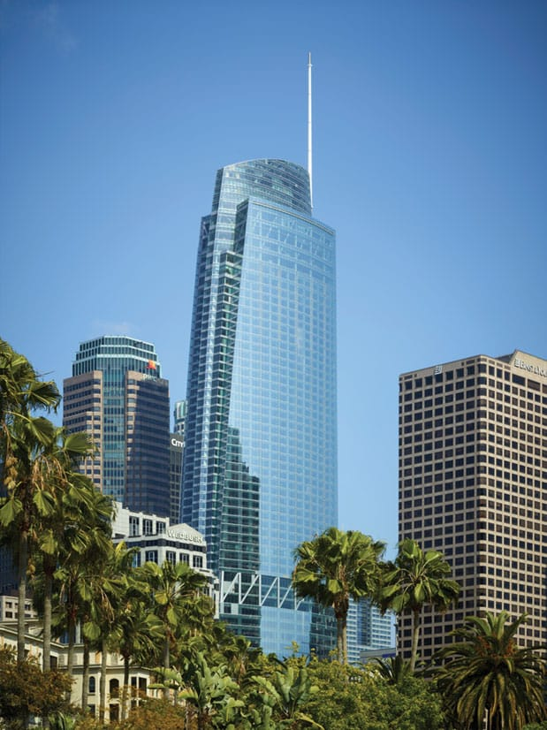
Chicago’s Willis Tower (formerly Sears Tower)
LA’s own Wilshire Grand.

Slide 35
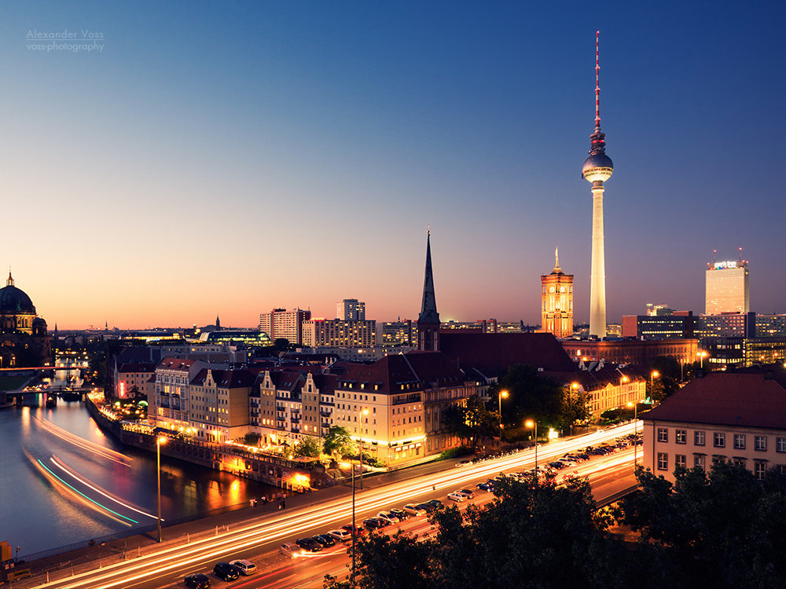
The Geography of Skyscrapers
Berlin, Germany
Berlin’s two tallest are only about 400’
Calgary, Canada
Calgary has two buildings over 700’ and 32 taller than Berlin.

Slide 36
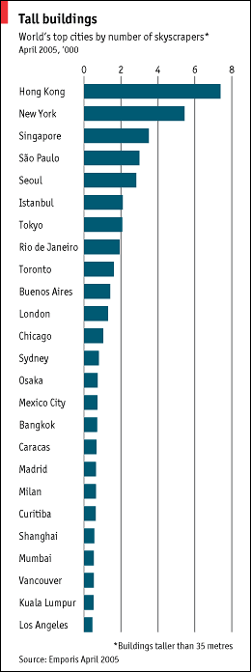
Evaluating Skylines
Should we just count the number of tall buildings?
Who decides what “tall” is?
Economist magazine: sets “tall” as only 115’ and then counts number over that height
Produces a “skewed” sense of skyline—London & Istanbul look more impressive than Chicago.

Slide 37
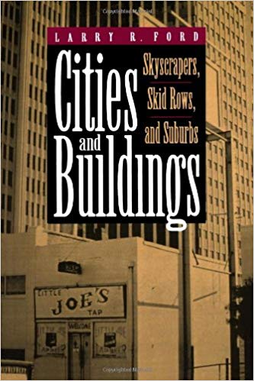
Larry Ford’s Skyline Score
Create a score for cities’ skylines
Skyline Score (S)=BxH
P
B=# of buildings more than 300’ high H=combined height of 3 tallest buildings
P=city’s population

Slide 38
Skyline Scores
Toronto, Canada
B=65 (65 buildings over 300’ tall)
H=2.736 (combined height in 1000s of feet of the three tallest buildings)
P=4.9 mill
Skyline Score=36.3 (between 0 & 100)

Slide 39
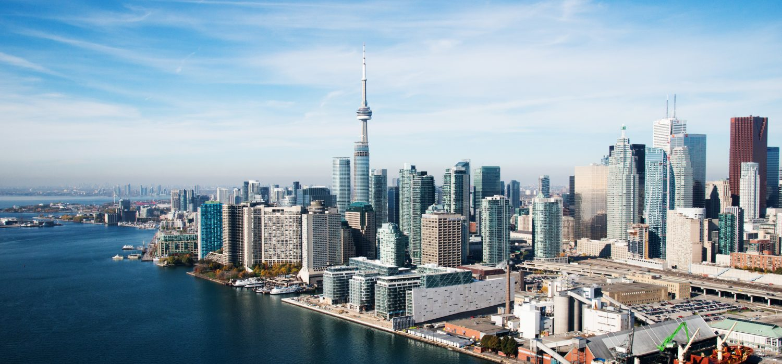
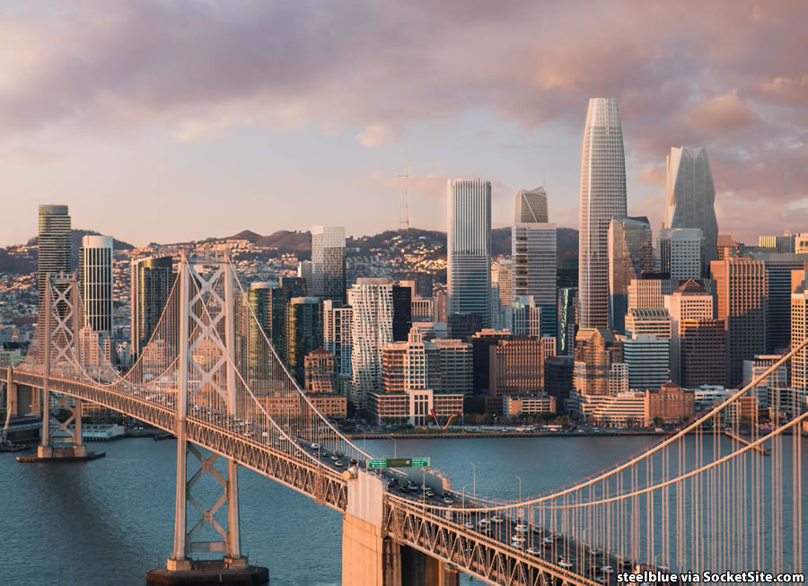
Toronto
San Francisco

Slide 40
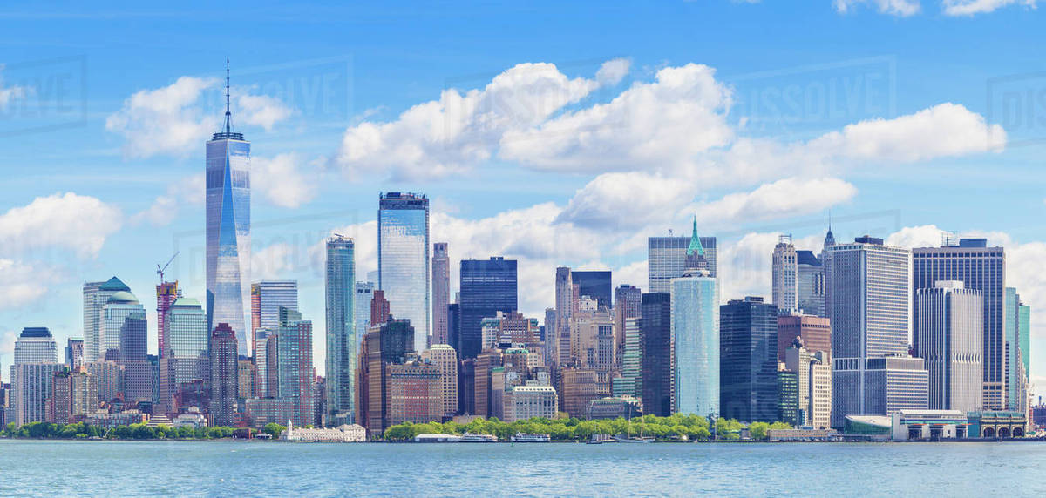
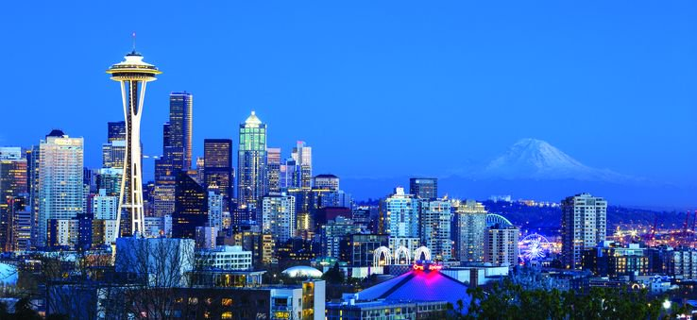
New York City
Seattle

Slide 41
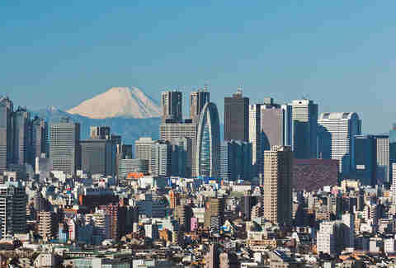
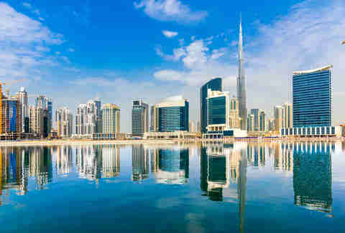
Tokyo
Dubai

Slide 42
What do Skyline Scores Reveal?
If score is high
Spatially constrained CBD
A rival city
Cities that are momentarily flush with cash
Explains Calgary—a city flus with oil money and downtown real estate became an outlet for investment of that cash

