Slide 1
Geography 8
Suburbanization—sprawl of the centrifugal city

Slide 2
Keywords
Suburbanization
Fogelson and Ford
PLVI
Agglomeration
Decentralization
White flight
Erickson and Hartshorn model
Edge cities
Bedroom communities
Commercial strip
Triple dream of suburbia
Street car suburbs
Light frame construction
FHA
VA
Fannie Mae, Freddie Mac
Minimum house
Mansions/Bulkification
Suburban sprawl
Neighborhood unit planning

Slide 3
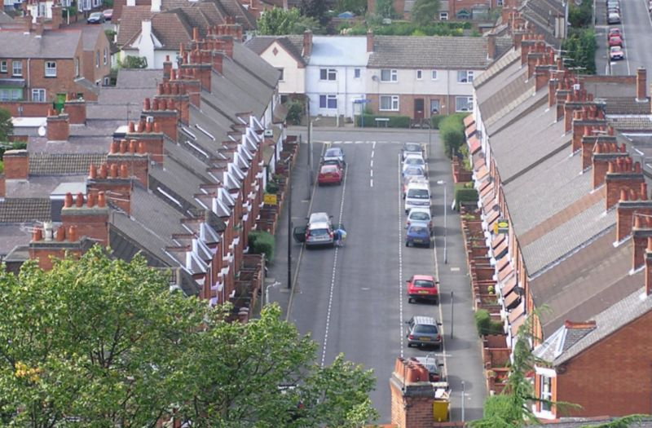
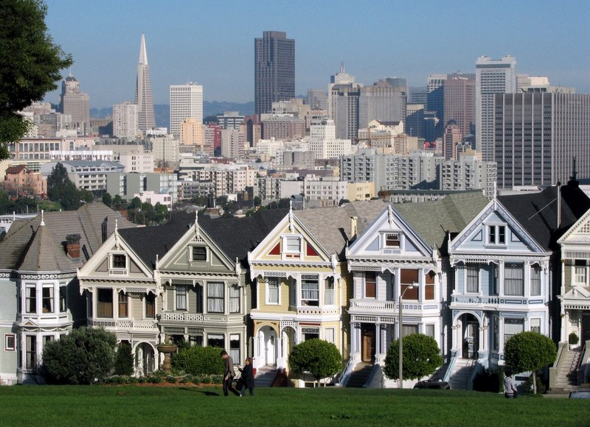
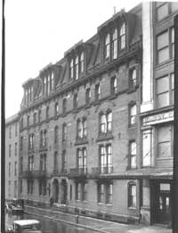
Urban Housing
The single-family detatched home is not typical urban housing
Terraced housing in Great
Britain
San Francisco
townhomes
French “Flat” Apartments
Row housing: single-family, but attached. No side yards, abuts neighbor, probably shared
open space, high density, narrow lots.

Slide 4
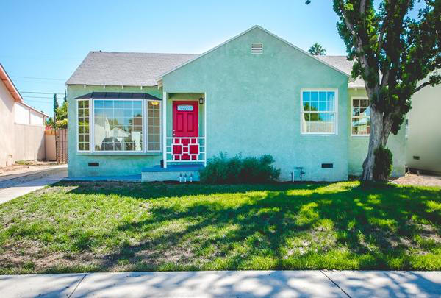
The Dream of the Suburbs
Nothing more powerful in shaping our idea of the suburb than the detached single-family home.

Slide 5
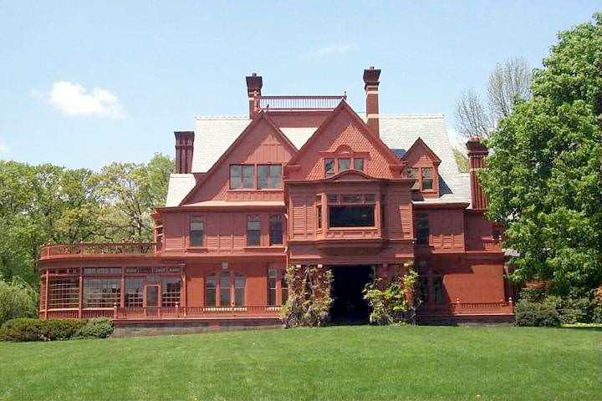
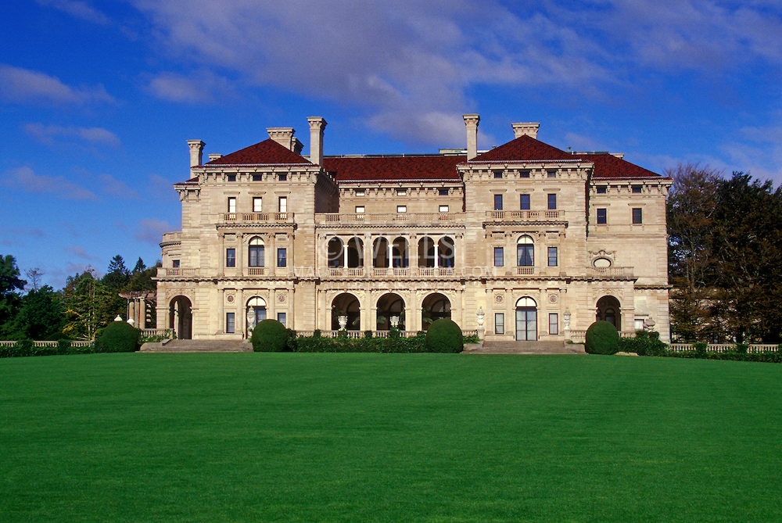
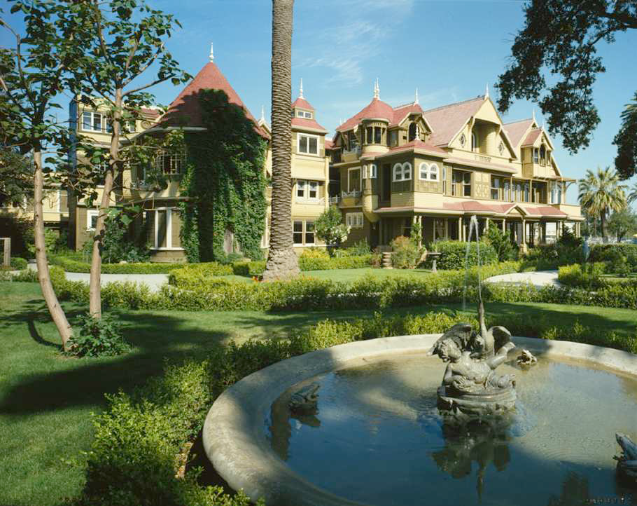
The Country Estate
Thomas Edison’s Glenmont Estate in Llewellyn Park, NJ
Vanderbilt “The Breakers” House
Newport, RI
The sure sign of wealth—think Bruce Wayne, Jay Gatsby.
But out of reach for all but the super wealthy.
Far from the city (how to get back and forth?), costly to maintain. Usually required a full staff.
Sarah Winchester’s “Mystery House”
In San Jose, CA

Slide 6
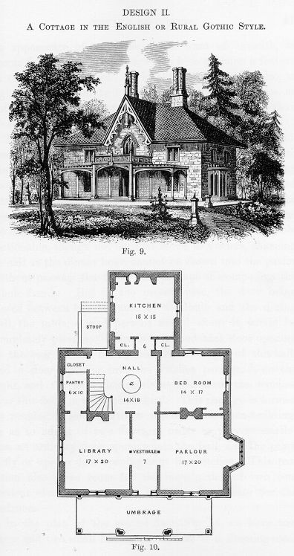
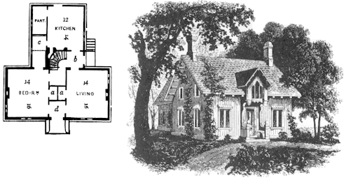
The Triple Dream
Dolores Hayden (historian): own your home in a rural-like private nature with a community.
Live in a “borderland” with the best of both worlds
Promoted through magazines, by architects like Alexander Jackson Downing and Catharine Esther Beecher.
Much like Sunset Magazine today or Martha Stewart

Slide 7
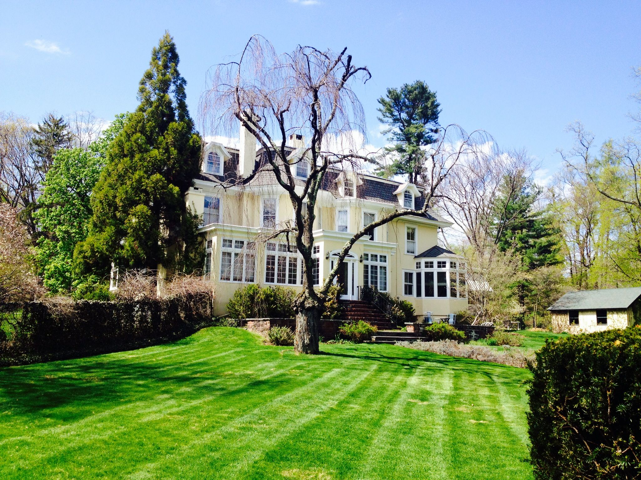
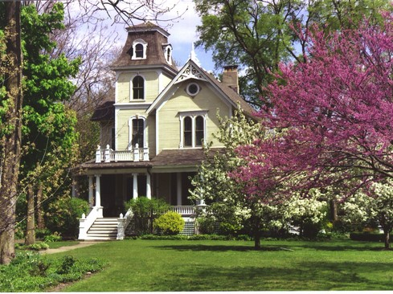
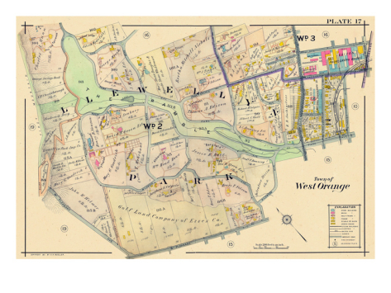
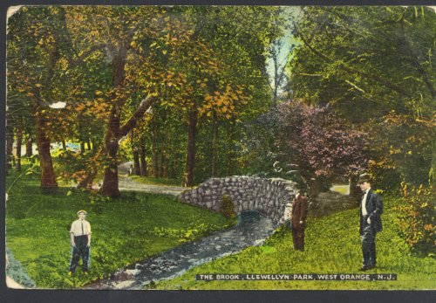
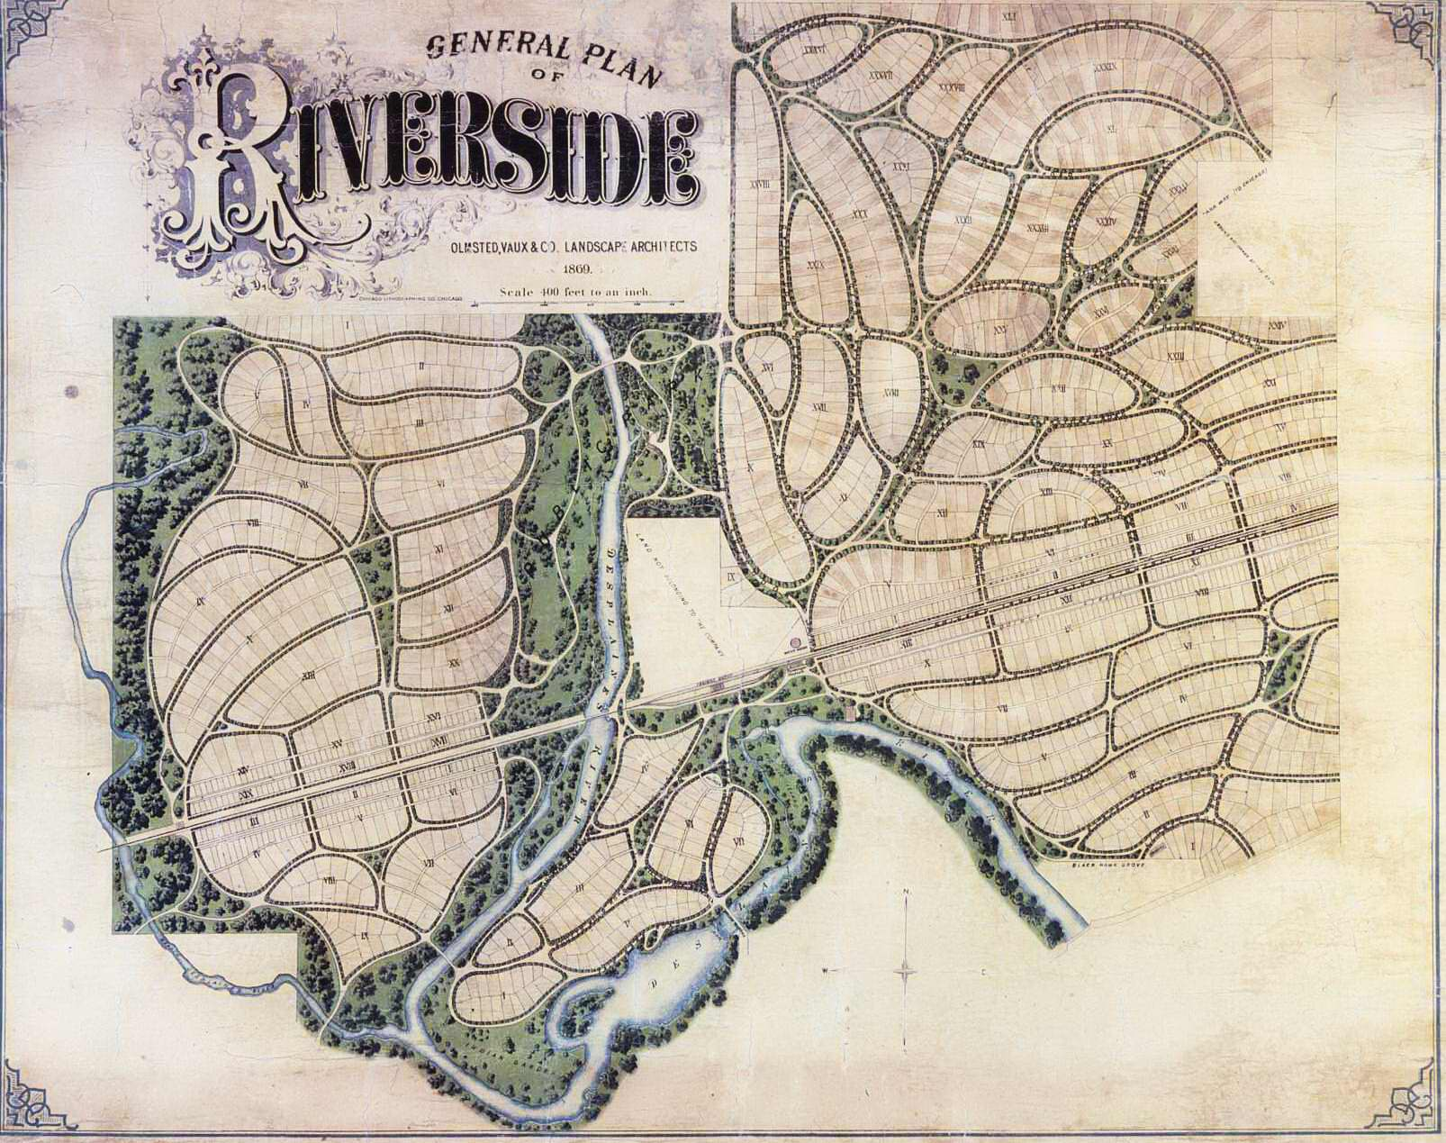
The Picturesque Enclave: the early suburb
1850s—began to see planning of suburban communities, not just estates in the countryside.
Alexander Jackson Davis’s Llewellyn Park, NJ and Frederick Law Olmsted’s Riverside, IL.
Llewelyn Park was organized around a shared outdoor area called “The Ramble”—a natural area with rivers, pathways.
Riverside, IL was less exclusive, had a town center, a railroad station, curvilinear design.

Slide 8
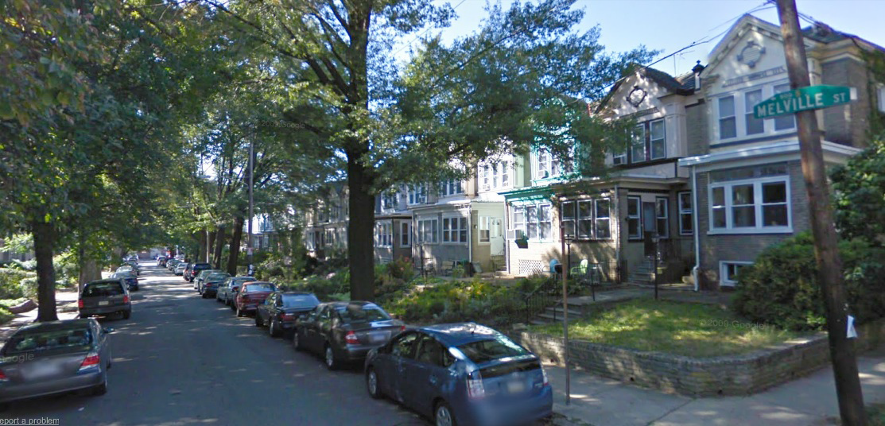
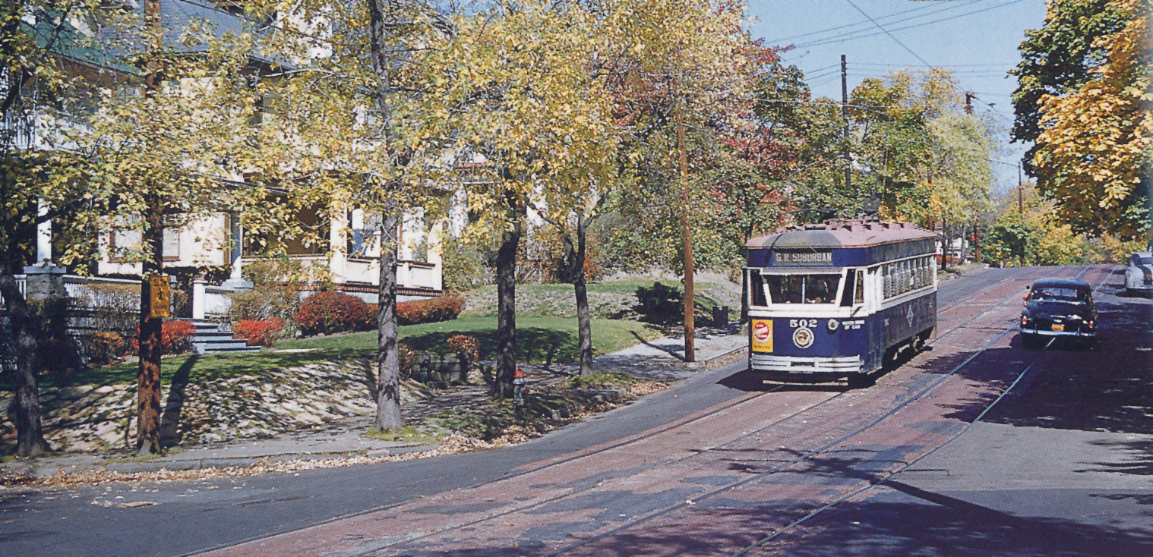
The Streetcar Suburb
Not until late 1800s. Really the first suburbs for the working class.
Just beyond city center, modest homes, narrow lots, walk to transit (light rail, streetcar).
Have since evolved to accommodate cars, but few have garages.
Becoming desirable today—gentrification, new urbanism…

Slide 9
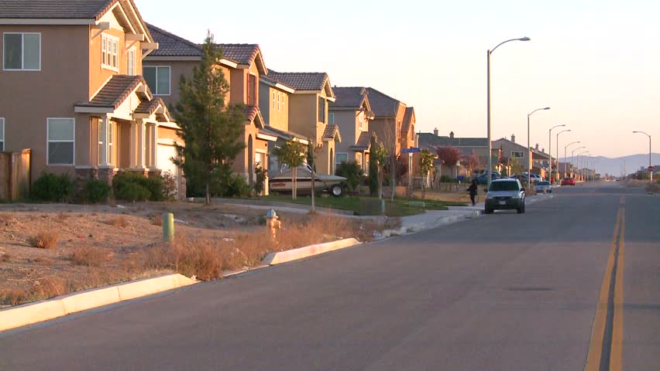
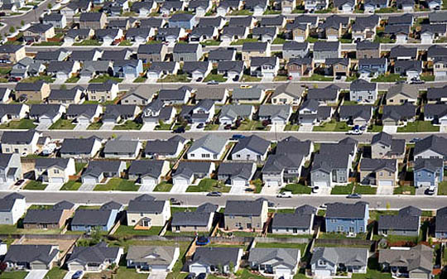
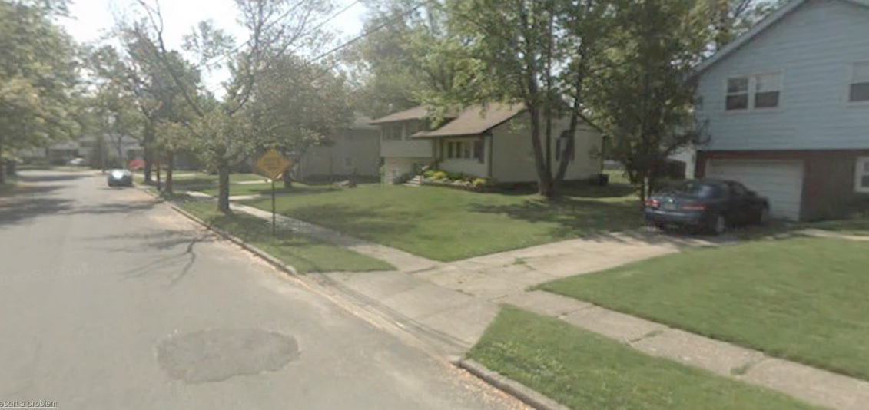
The Mass Suburb: American Icon
Mid-20th C, car-led expansion, radically increases footprint of metropolitan areas.
The “triple dream” fulfilled—private home ownership and one’s own piece of nature.
Bedroom communities emerge along freeways. Like Cherry Hill, NJ along I-295 outside Phil.
Single-family homes, off-street parking, spacious, grassy front and back yards: the middle-class nuclear family’s standard dwelling. The AMERICAN DREAM.

Slide 10
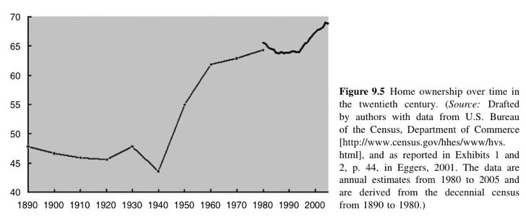
Suburban Dreams, Federal Subsidies
How did Americans become homeowners in such large numbers?
In 1940, 44% of households were owner-occupied
In 1960 that increased to 60%
In 2000, 69%
Not just a response to the free market—made possible by subsidies and policies of the federal government

Slide 11
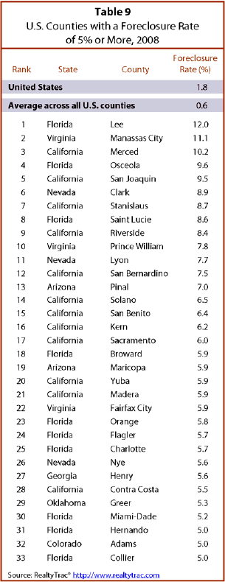
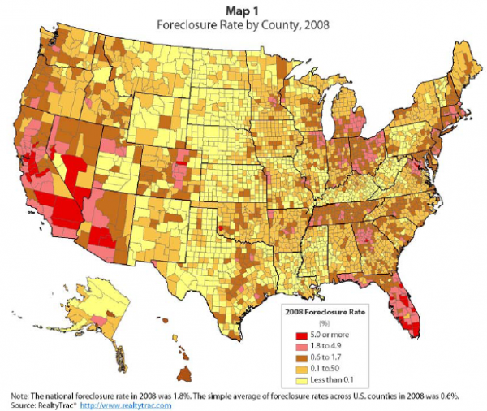
Who Owns the Housing?
Supply Side
Housing becomes mass produced
Innovators: Eli Broad, Donald Bren (both CA residents)
Created a standard home design, standard materials, standardized techniques
Building homes becomes almost factory-like process
Labor cheaper (less skill) and more productive.
Before WWII, only about 350,00 houses built each yr in US
Since the 1950s has averaged 1 million/yr (sometimes has topped 2 million)
Demand Side
Even with cheaper homes, most Americans could not afford to buy
How could people of modest incomes afford a home? A loan that would allow them to pay off over a very long period—20 to 30 years!
Makes the down payment & monthly payment affordable for most Americans.
Today, about 2/3 of Americans have an outstanding mortgage.
Federal programs for borrowing
1834 FHA—insured home loans (made them less risky to banks), and created national standards for home-loan and construction industries.
Fannie Mae—Federal National Mortgage Association. Private company, sponsored by the Feds—mortgage bundling, mortgage backed securities, fixed rate of return.
2007—system implodes; how will this impact homeownership in long term?

Slide 12
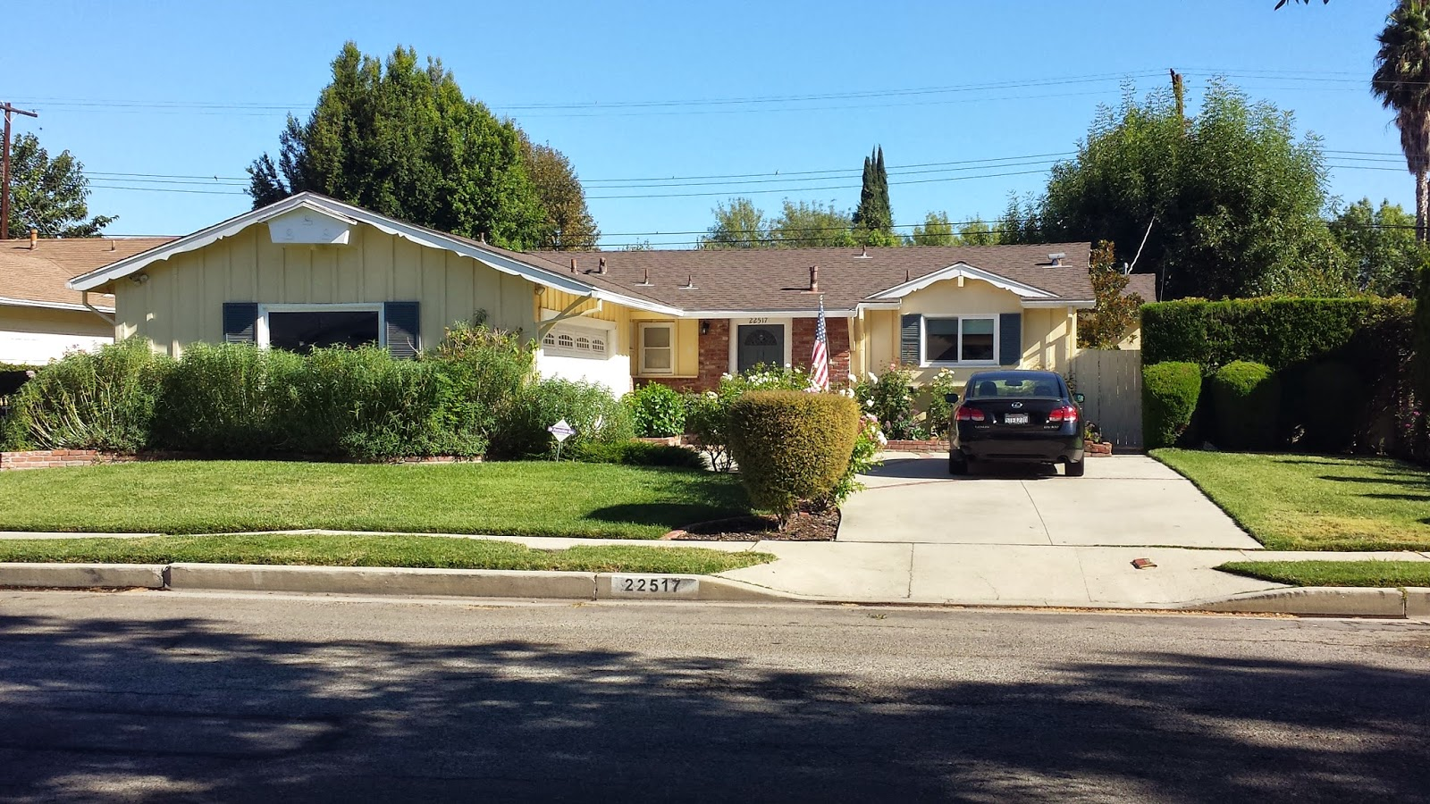
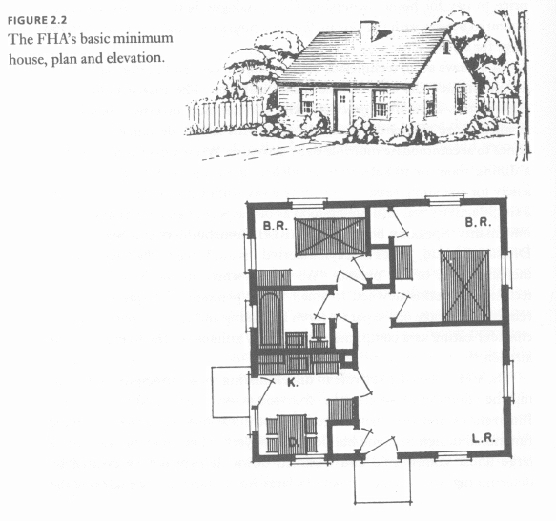
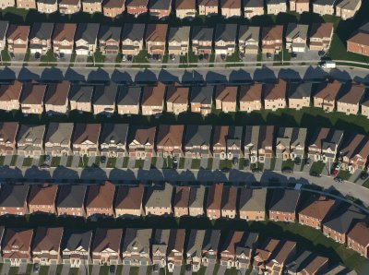
A Uniform Landscape: the geography of nowhere
Mass produced landscapes; cookie-cutter homogeneity.
Low density, car dependent.
Standard design: promoted by the FHA and Fannie Mae: generic housing, affordable, efficient: living room, bathroom, kitchen, 2 bedrooms. Model of efficient modern living for the working-class nuclear family.

Slide 13
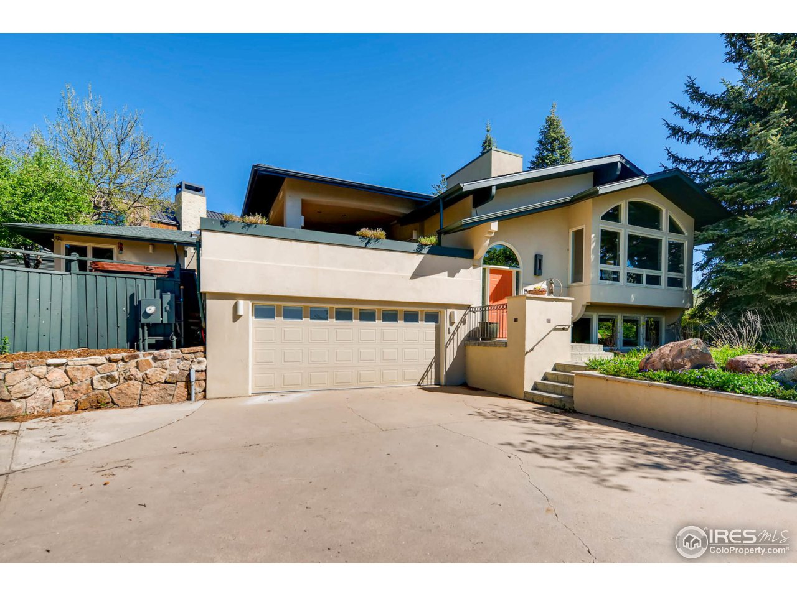
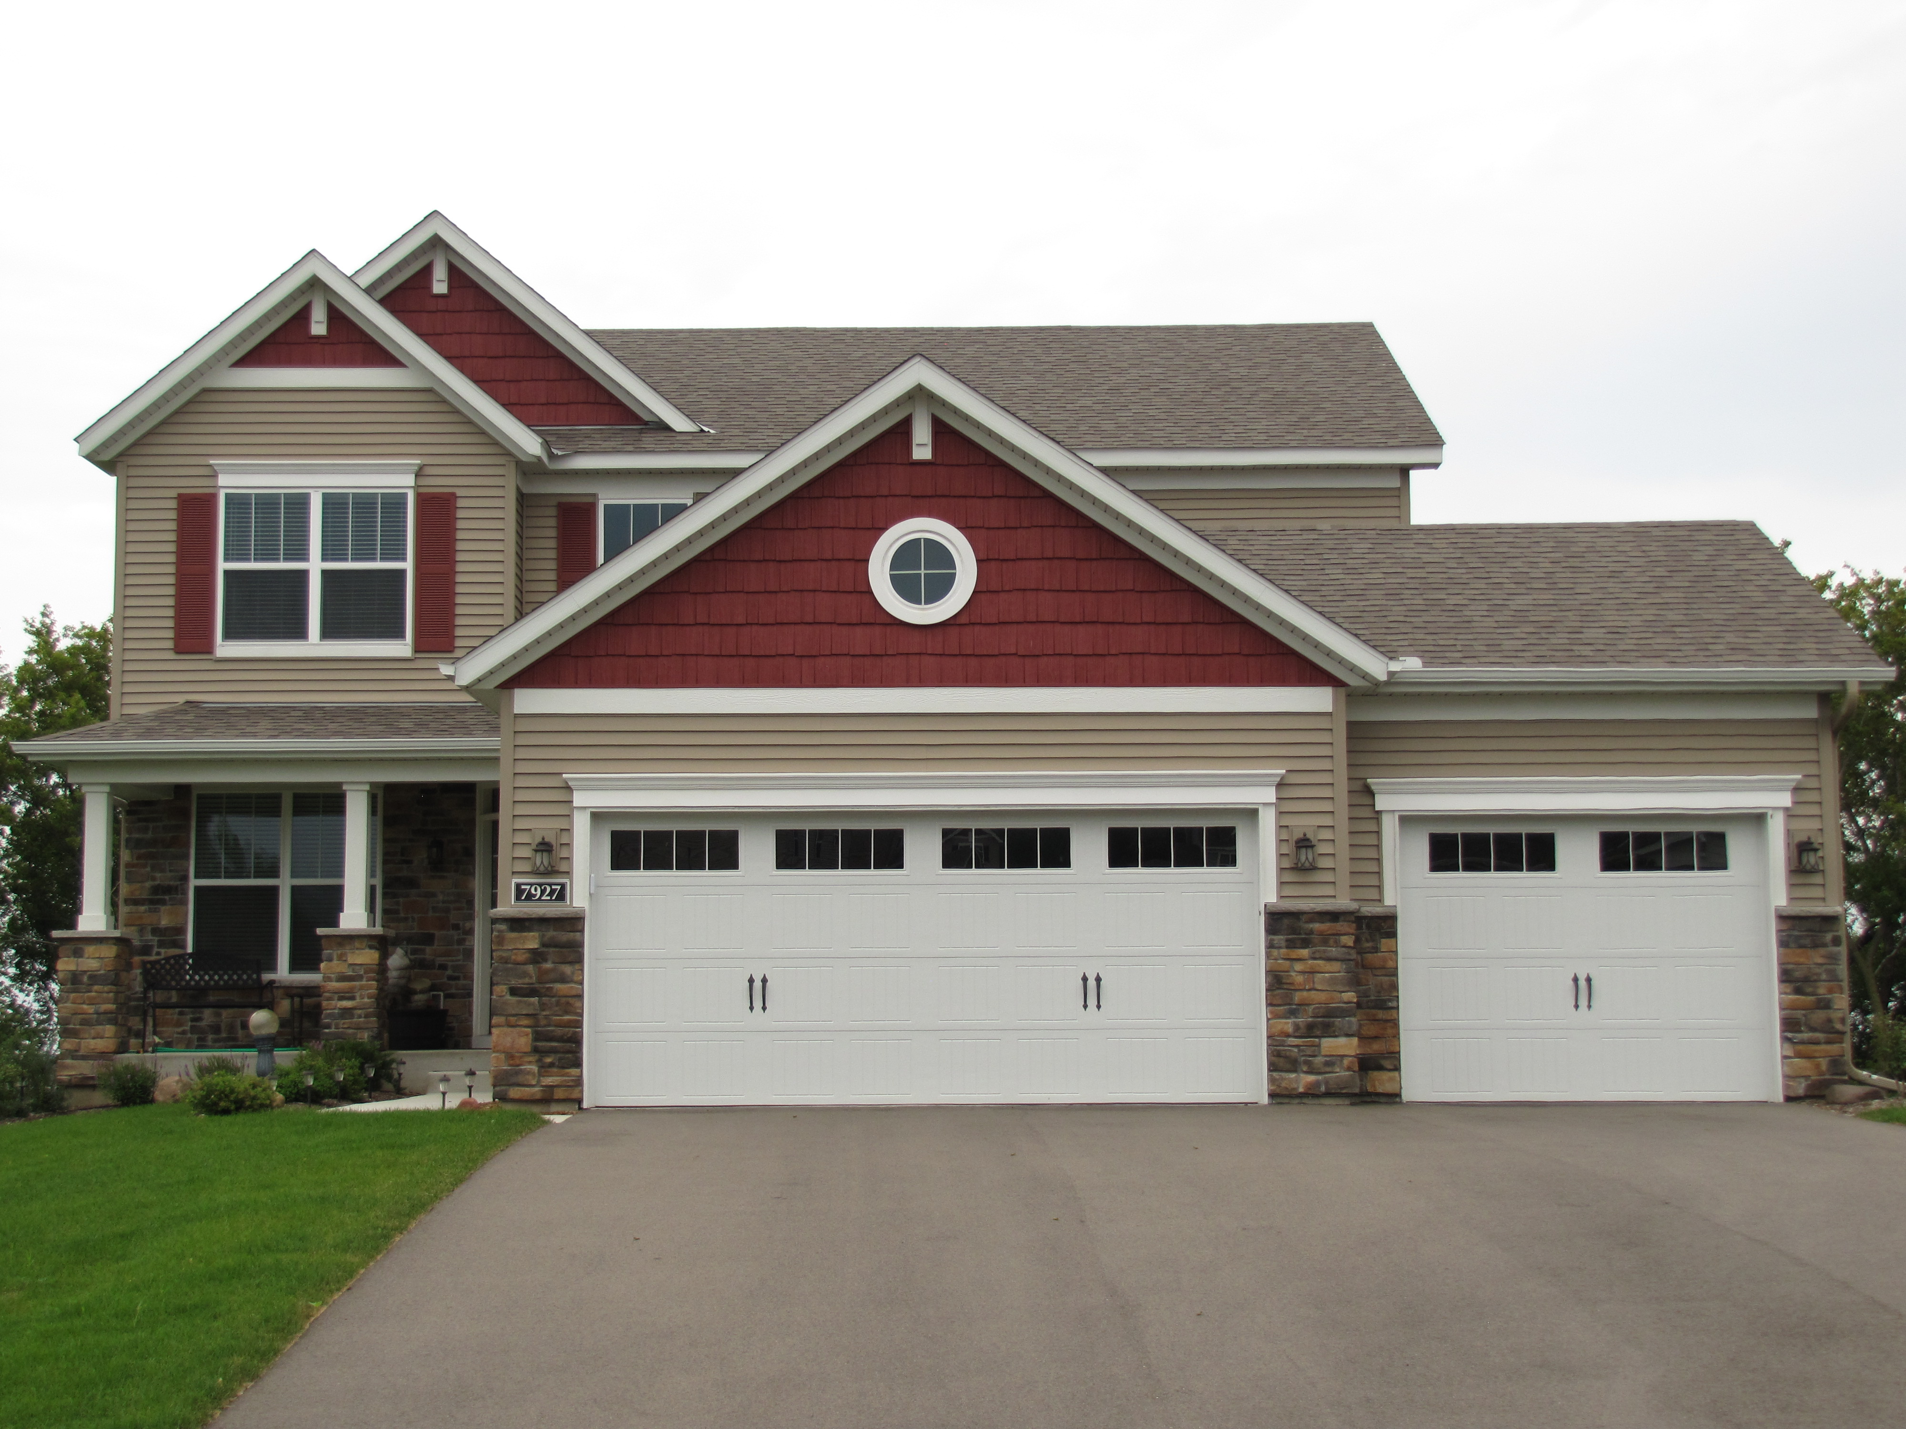
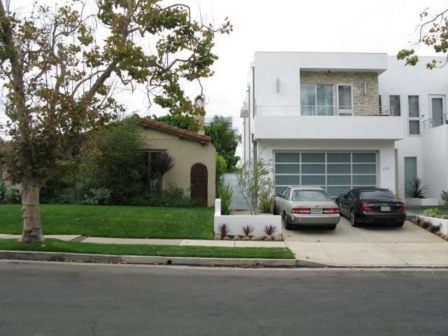
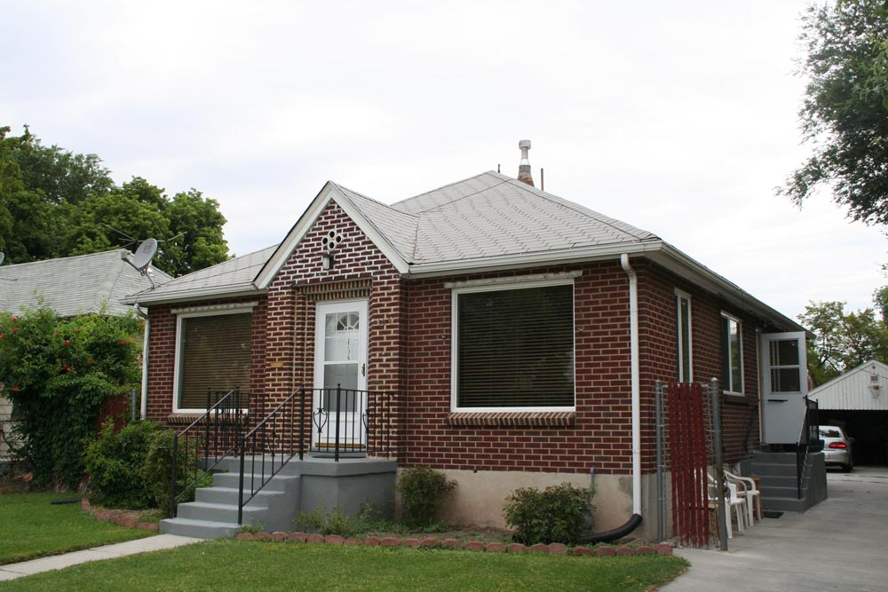
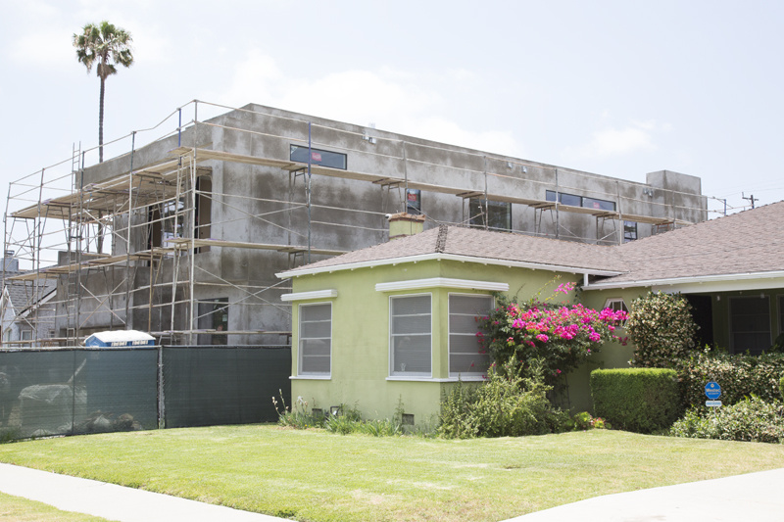
More Stuff
As middle-class wealth grows with rising home values, Americans gain more “stuff.”
Where to put it all? Need to “move up.”
Size becomes a primary determinant of a home’s value (no longer location alone). My bigger home is now a visible symbol of my “bigger” wealth.
And…my car: need a “room” for my car. The garage emerges.
What began as a small shed in the back of the property, turns into a 2-car forward facing garage attached to the main house.
3, even 4 car garages.
McMansions emerge; what Larry Ford calls “bulkification.”

Slide 14
The Problems with Sprawl
Wasteful: land, energy, our time.
It creates an affluence that is shallow, superficial, crass and materialistic.
Makes rational, long-term planning almost impossible.

