Slide 1
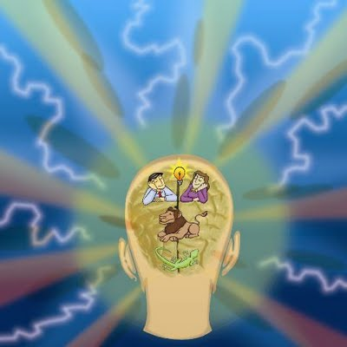
The Triune Brain and Learning
Lori Walker, Ph.D.

Slide 2
What is the “Triune Brain”?
Tri = ???
Tri = Three
Une = ???
Une = One
Triune =
Three parts that make up the one human brain
__________________________________
Reptilian = Instinctual Brain = Physical Body
Limbic = Emotional Brain = Emotions
Neocortex = Thinking Brain = The Mind

Slide 3
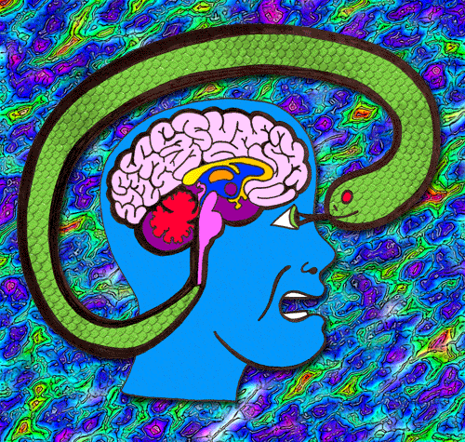
        The Reptilian Brain
oldest and smallest
does not think!
instinctual and past-oriented
concerned with basic needs:
breathing, heartbeat, food,
sleep, etc.
So, why should students care…?
Reptilian Brain = your subconscious brain!
Control the Reptilian = Control yourSELF

Slide 4

You are of “Two” Minds…
#1 – The Conscious Mind (Thinking Brain)
  Voice in your head – “Self-Talk”
  Rational and Logical
  Visionary – Can imagine a future
#2 = The Subconscious Mind (Reptilian Brain)
  Instinctual
  Stores old memories/habits
  Cannot tell the difference between a
    real event OR
    an old memory OR
    an imaginary event!
_________________________________________
But, which mind really controls you?

Slide 5
“Brain research strongly indicates that the subconscious mind controls 90% of our choices, and the conscious mind controls 10%.”
_________________________
Richard Granger
Professor of Psychological & Brain Sciences, Dartmouth
Big Brain: The Origins and Future of Human Intelligence

Slide 6
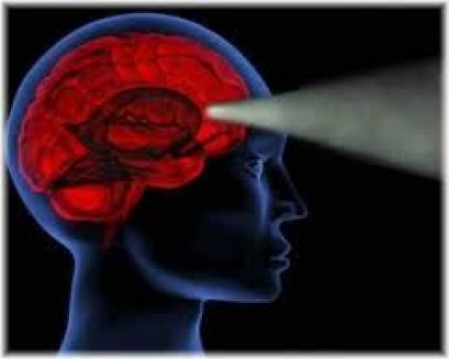
How do you control your subconscious?
Learn how to be aware of your thought
patterns
Recognize the subconscious learns
from pictures, strong emotions, and
repetition
Set clear goals
Retrain your brain!

Slide 7
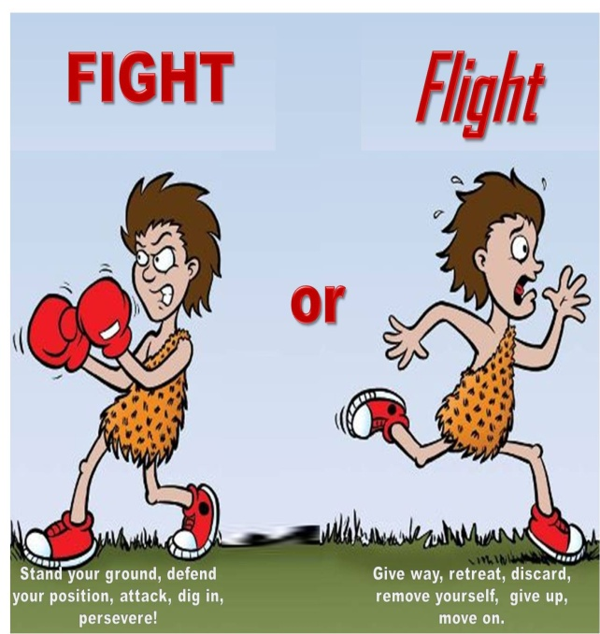
The Reptilian = The RAS
RAS = Reticular Activating System
= Fight or Flight Response
= Body’s Response to Stress
= Gateway to thinking brain
Stress = RAS activated
= thinking brain stops!
stress = test anxiety, freezing, out of
control emotions, mind block
_______________________________
Control the RAS =
control your thinking brain!

Slide 8
How do you control your RAS?
You program it with your beliefs about life.
If your beliefs = positive, RAS
  accepts positive information
  screens out negative information
____________________________________
Our RAS notices and records things that confirm our beliefs.
The stronger your beliefs, the more your RAS screens things out that do not agree with your beliefs!
Self-Awareness is key!

Slide 9
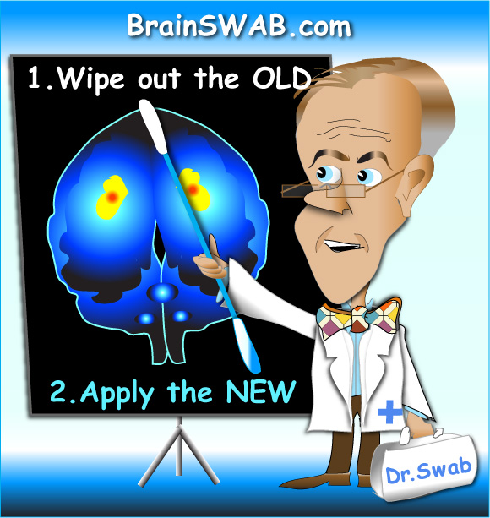
        The Limbic Brain - The Emotions
common to all mammals
does not think!
brain's emotion factory
controls memory formation
more emotion = more memory
memory = 1) thought + 2) emotion
emotion = protein peptides
protein peptides : emotions, colors, music, some foods
more protein peptides = more memory!

Slide 10
Limbic Brain = Addiction to Emotions
We ALL have emotional addictions!
The Addiction Process:
  Thought
  Emotion (called Protein Peptides)
  Protein peptides move through bloodstream to cells
  Peptides “dock” on cells
  Changes occur within nucleus of the cell
  When cell divides, the NEXT cell has dedicated receptor sites for whatever emotions “docked” on the original cell
  As same emotions are experienced, new cells will have increasingly MORE and MORE receptor sites for those emotion(s)
  More receptor sites = more addiction!
  http://www.youtube.com/watch?v=7ZZzFnLIMXU
  http://www.youtube.com/watch?v=pa9fmHjqeHU

Slide 11
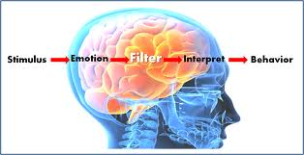
How do you control your emotions/addictions?
Increase your emotional intelligence
Self-Awareness
Self-Management
Social Awareness
Relationship Management

Slide 12
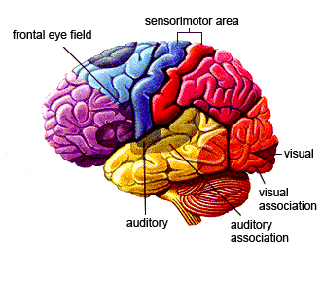
        The Neocortex - The Thinking Brain
largest part of brain
capable of thought!
future-oriented
logical and rational
controls creative thought,
language, and critical thinking
So, why should students care…?

Slide 13
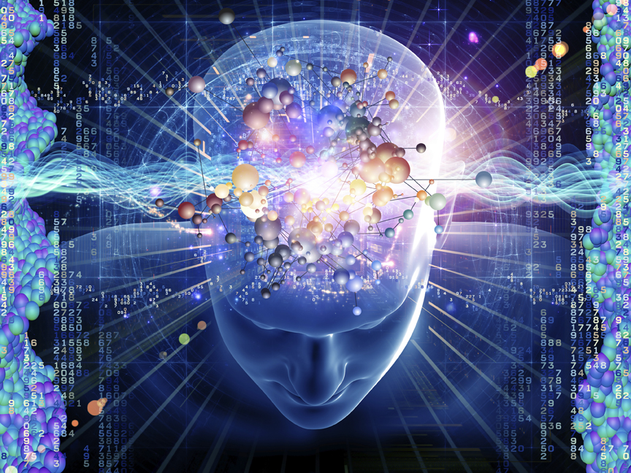
        Remember!
The Neocortex is conscious!
It can CHANGE how the Reptilian and Limbic
work!
So, why should students care…?

Slide 14
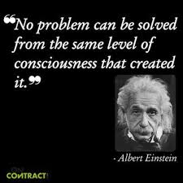

Slide 15
What can you do with the Neocortex?
EVERYTHING!
Retrain your brain
Increase your emotional intelligence
Create new patterns
Reduce/manage stress
Improve goal setting strategies
Discover new studying techniques

Slide 16

Interesting
stuff…
…but why focus on this “Triune Brain” idea?

Slide 17
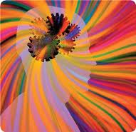
        The Triune Brain and Education
Traditional education was designed for the Neocortex
This misses a basic brain fact: ALL of the brain is
interconnected!
There must be a working connection between ALL parts
of the brain for the total brain to work properly!
If even one area “shuts down,” the brain cannot learn
So, why should students care?
If you want to be able to learn and control your brain, you must be sure that all three areas are always working for you!

Slide 18
You have brains in your head
You have feet in your shoes
You can steer yourself any direction you choose!
~ Dr. Seuss

