Slide 1
Chapter 1
Humans, Geology, and the Environment

Slide 2
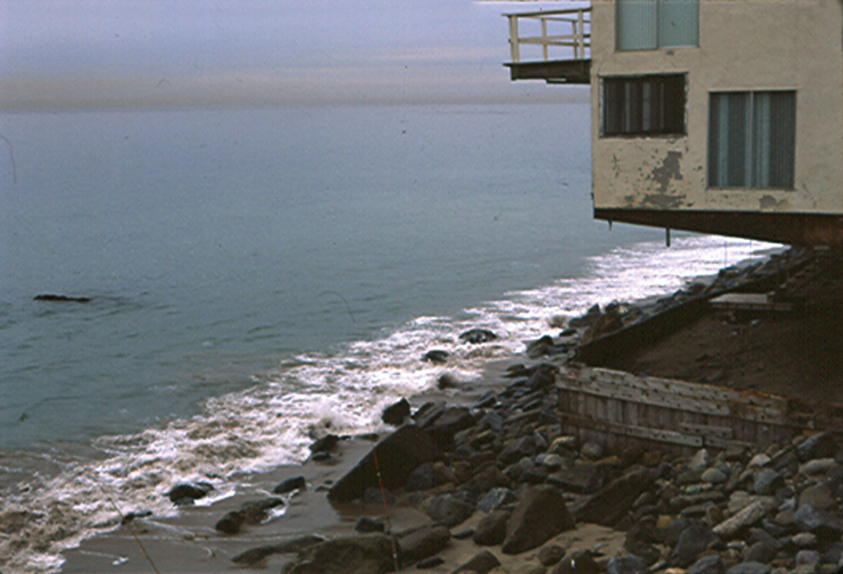
Figure 1, p. 2
Notes:
FIGURE 1 Home versus the ocean (Malibu, California)—Hmmm, what a view! What’s it like in a storm, though?

Slide 3
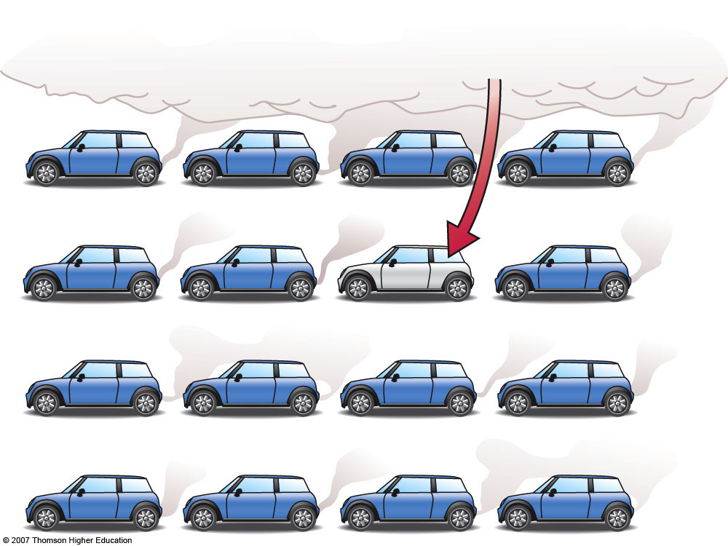
1) Only one person drives a hybrid electric vehicle...
The 16 cars above are producing 90-95 tons of atmospheric CO₂ / year (average U.S. driving).
Fig. 1-1, p. 4
Notes:
FIGURE 1.1 Collective behavior can change the global-scale environment, but lone behavior usually counts for little.

Slide 4
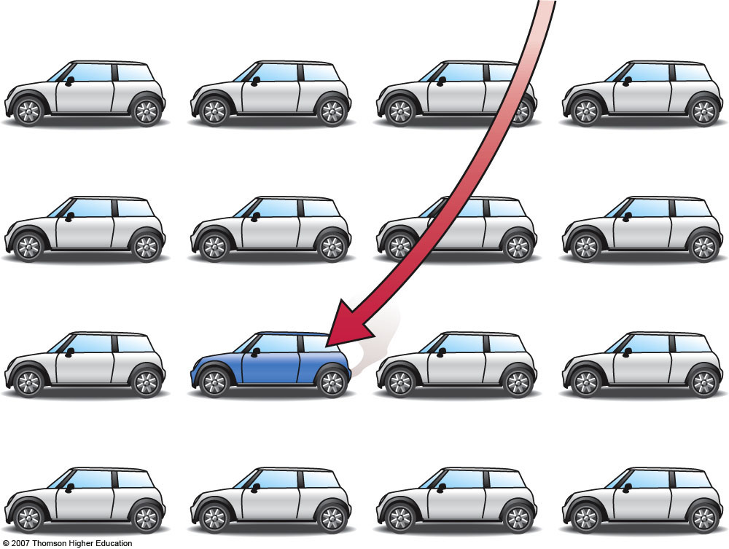
2) Only one person DOESN’T drive a hybrid electric vehicle...
The 16 cars above are producing 35-50 tons of atmospheric CO₂ / year (average U.S. driving).
Fig. 1-1, p. 4
Notes:
FIGURE 1.1 Collective behavior can change the global-scale environment, but lone behavior usually counts for little.

Slide 5
GLOBAL-SCALE ENVIRONMENTAL CHANGE CAN IMPACT INDIVIDUAL BEHAVIOR...
Hierarchy of Scales
Large
Small
Union City
River
West
3. AT THE LOCAL LEVEL
Diminished water supply means higher water bills, and rationing.
4. IN YOUR HOME
You respond by purchasing water-conserving appliances, putting drought-tolerant plants in your garden, and taking shorter, fewer showers.
2. AT THE REGIONAL LEVEL
Onset of persistent drought dries out land and annual snow pack dwindles.
1. GLOBAL CLIMATE CHANGE
Fig. 1-2, p. 5
Notes:
FIGURE 1.2 Human-Earth interaction is a two-way street.

Slide 6
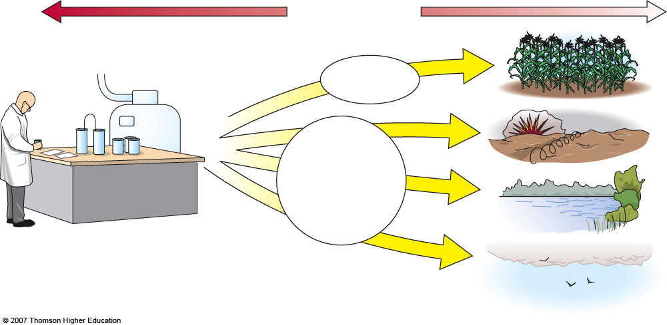
INDIVIDUAL BEHAVIOR CAN CHANGE THE GLOBAL-SCALE ENVIRONMENT
Small
Hierarchy of Scales
Large
2a. Farm yields boosted worldwide.
INTENDED (Good)
2b. Cheap manufacture of military ordnance (World War I, II).
UNINTENDED CONSEQUENCES (Not so good)
2c. Worldwide waterways and shallow seas suffer oxygen depletion, causing dead zones.
1. Fritz Haber fixes nitrogen, enabling development of artificial fertilizers and other commercial nitrates.
2d. Nitrous oxide global air pollution worsens.
Fig. 1-2, p. 5
Notes:
FIGURE 1.2 Human-Earth interaction is a two-way street.

Slide 7
IPAT Equation
I = P + A + T
I = Impact on Environment
P = Population
A = Affluence
T = Technology
Qualitative, with no exact numbers

Slide 8
IPAT Equation Consequences
Wealthy developed countries use far more resources and cause more pollution per capita than poorer countries
Average American consumes 35x resources of the average Indian
I = P for less-developed countries – environmental problems more obvious

Slide 9
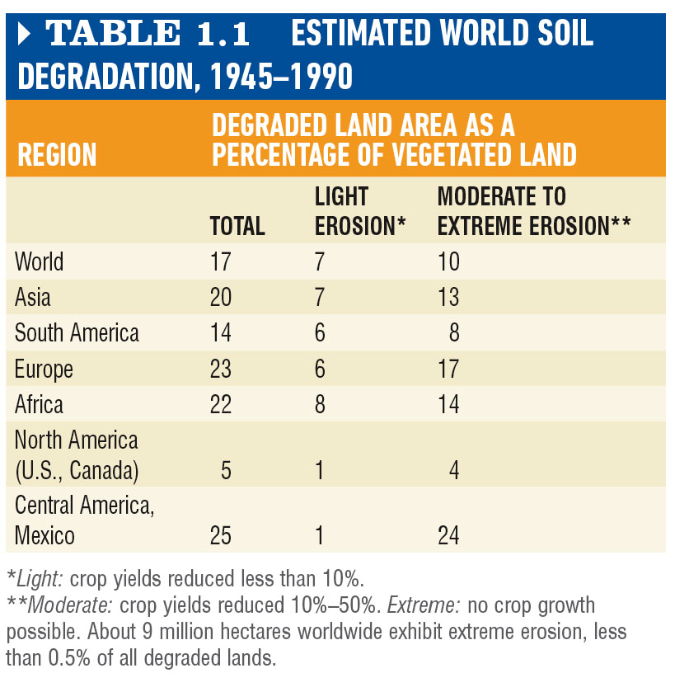
Table 1-1, p. 6

Slide 10
Carrying Capacity
Maximum size of a population that can be maintained indefinitely
Wolf population dependent upon size of deer population
Deer population dependent upon amount of edible vegetation
Ecological overshoot: population size exceeds resources and dies back

Slide 11
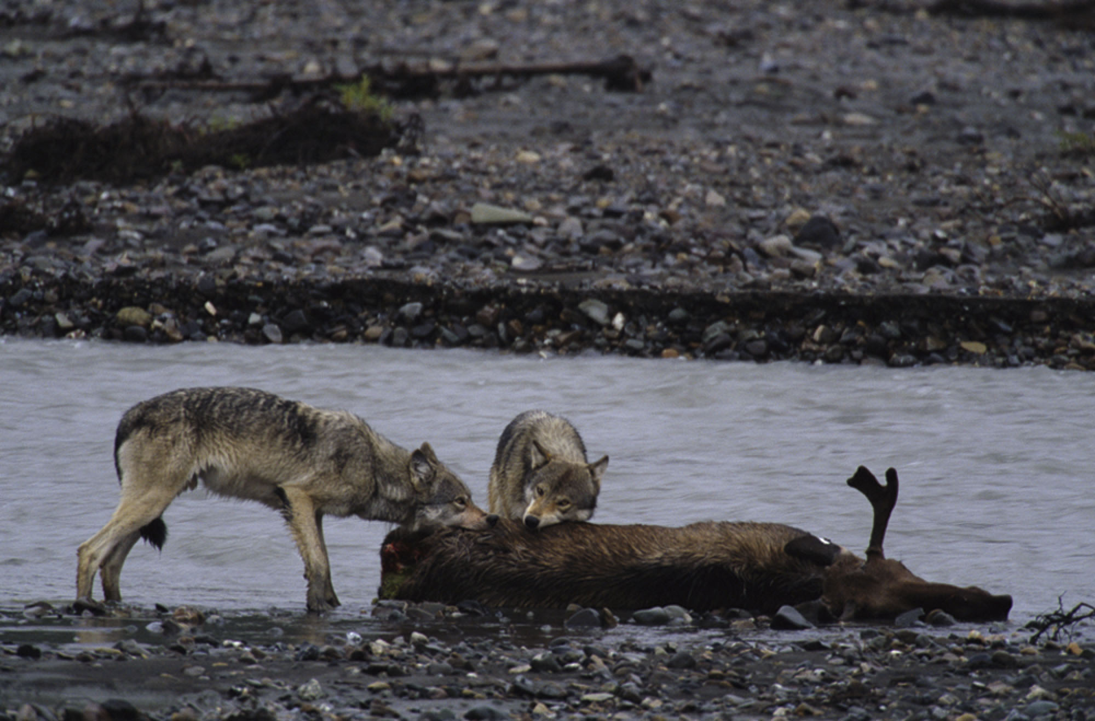
Fig. 1-4, p. 7
Notes:
FIGURE 1.4 Populations of predator and prey are dependent upon natural carrying-capacity limits.

Slide 12
Ecological Overshoot
Carrying capacity is diminished when consumption exceeds carrying capacity, resulting in both rapid population decline and ecological degradation.

Slide 13
Human Carrying Capacity
Thomas Malthus, 1798: human population size is limited by food supply
Science increased the food supply:
Fertilizers
Genetic modification of foods
Pesticides and herbicides
Unintended Results:
Soil erosion and depleted groundwater
Is human population sustainable?

Slide 14
Fig. 1-7, p. 9
Notes:
FIGURE 1.7 Agricultural pests and diseases reduce human carrying capacity. Pesticides, herbicides, fungicides, and other chemical applications help boost yields from farmlands, expanding carrying capacity for people but often causing serious environmental problems.

Slide 15
Fig. 1-8, p. 9
Notes:
FIGURE 1.8 The fastest-growing segment of human population in recent decades has been poor and urban. Vulnerability to natural disasters and environmental problems is high for this part of humanity.

Slide 16
Human Population Growth
The first 1 billion humans was reached in 1800, the second in 1930, the third in 1960, the fourth in 1975, the fifth in 1987, the 6th in 2000, and the 9th billion around 2050. http://www.census.gov/population/international/

Slide 17
Case Study: Population Growth and Its Effects, cont.
Doubling time = 70/growth rate
Countries with greatest environmental impact usually have lowest growth rates
High growth rates in poor countries
Women not empowered
Incentive to have children for old-age care
Lack of family planning knowledge and methods

Slide 18
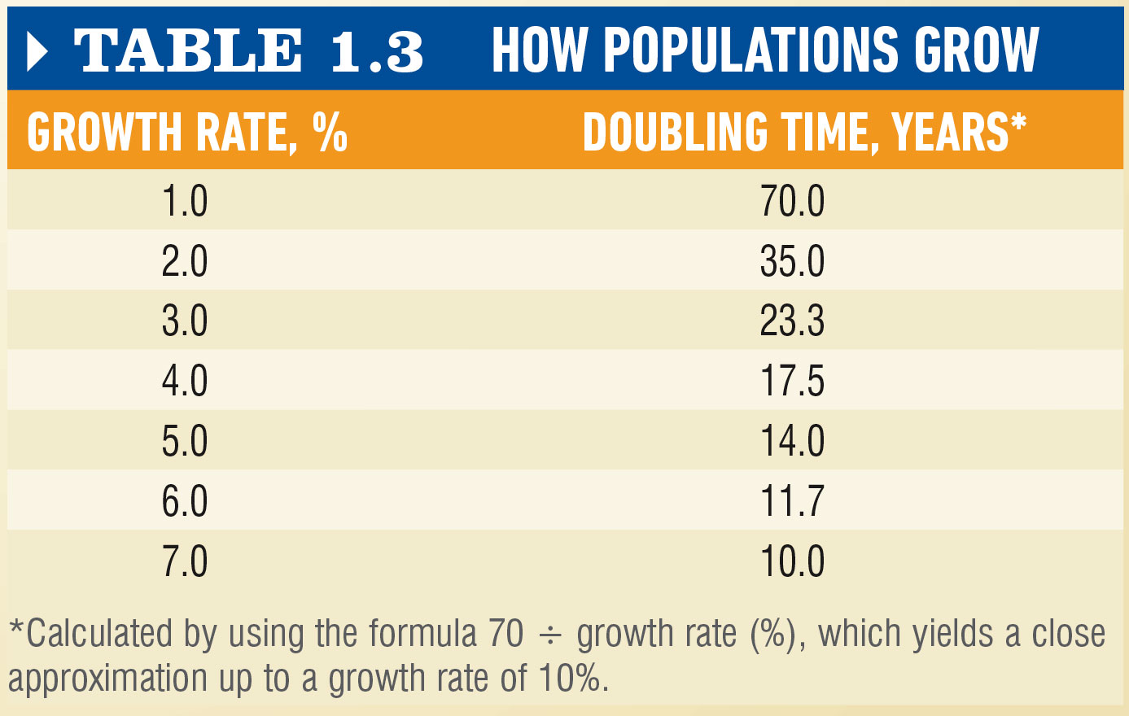
Table 1-3, p. 14

Slide 19
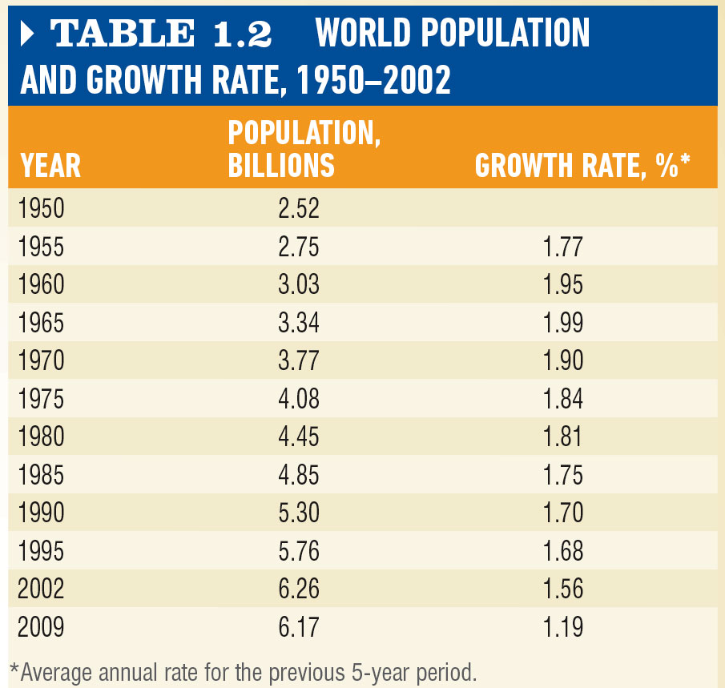
Table 1-2, p. 14

Slide 20
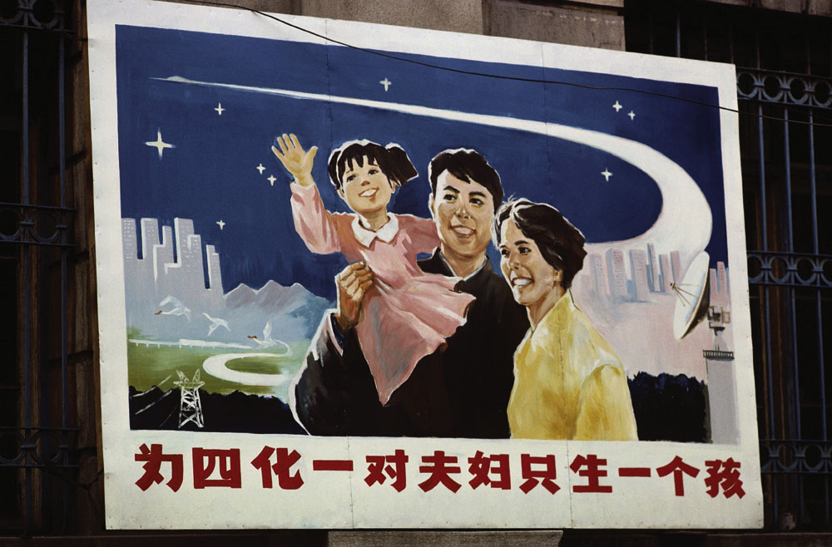
Figure 3, p. 17
Notes:
FIGURE 3 A model Chinese family in front of a billboard encouraging the one-child family. Although the People’s Republic of China is pushing population control, its population of more than a billion people makes continued growth inevitable.

Slide 21
Figure 1, p. 16
Notes:
FIGURE 1 Coney Island beach in the 1930s, when the U.S. population was a fraction of what it is today. Imagine this beach on a summer weekend today.

Slide 22
IPAT Equation
I = P + A + T, where
I = Impact,
P = Population,
A = Affluence (standard of living), and
T = Technology
HOMEWORK: Calculate your Ecological Footprint at: http://tinyurl.com/cjw9tt and write a paragraph about what you learned!
Email it to me by the beginning of class time on Thursday!

Slide 23
The Structure and Origin
of the Solar System

Slide 24
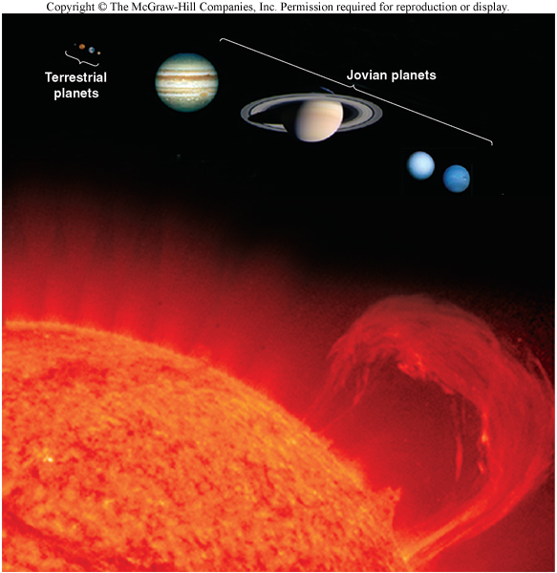
Components of the Solar System
The vast majority of the Solar System’s mass resides in the Sun
All the planets, asteroids and comets make up less than 1/700 of the mass of the Solar System!
The rocky inner planets (Mercury, Venus, Earth and Mars) are called Terrestrial planets
The gaseous outer planets (Jupiter, Saturn, Uranus and Neptune) are the Jovian planets
A belt of asteroids separates the inner and outer planets
The outermost icy planet, Pluto, is now called a “Dwarf Planet” and belongs to a group of objects called…

Slide 25
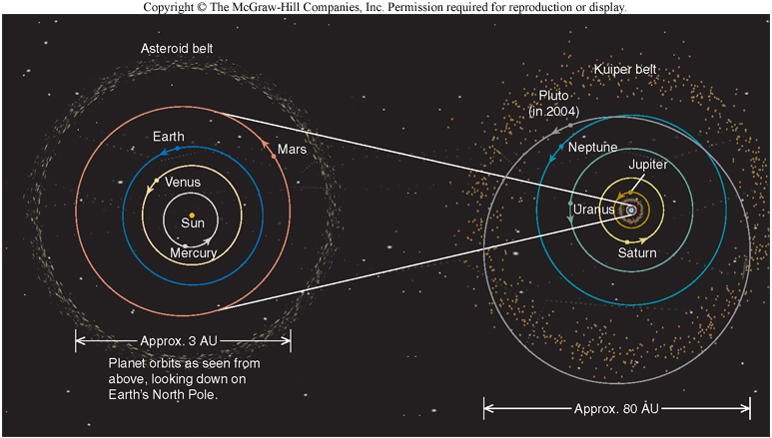
The Kuiper Belt
Outside the orbit of Neptune lies the Kuiper Belt
Located around 40 AU from the Sun
Kuiper Belt Objects (KBOs) are found here
Many bodies, both smaller and larger than Pluto have been found here

Slide 26
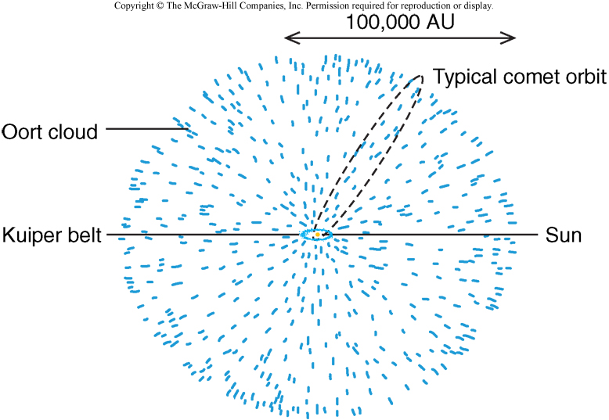
The Oort Cloud
The Solar System is surrounded by a cloud of cometary bodies
Located around 50,000 AU from the Sun
Gravitational influences from passing stars occasionally send comets into the Solar System

Slide 27
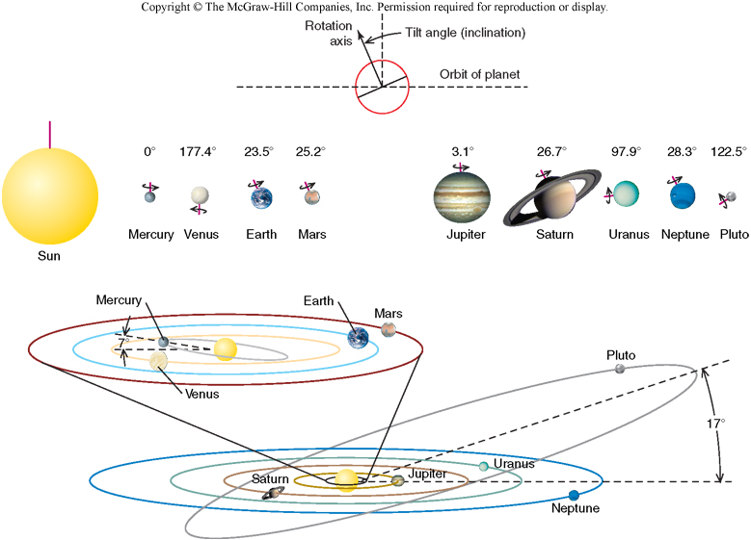
Rotation and Revolution in the Solar System
Because of the principle of Conservation of Angular Momentum, all planets revolve around the Sun in the same direction and in more or less the same plane
Mercury’s orbit is tipped by 7⁰
Pluto’s is tipped by 17⁰!
Most of the planets also rotate in the same direction
Counterclockwise as viewed from above Earth’s N Pole
Venus rotates clockwise as viewed from above
Uranus and Pluto’s rotational axes are tipped significantly!

Slide 28
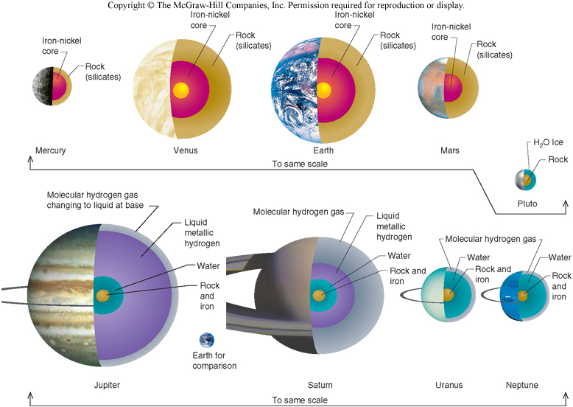
Average Density shows us a lot!
Inner planets have high average densities (~5 kg/liter)
Small bodies
Mostly rock and iron
Outer planets have lower densities (~1 kg/liter)
Larger bodies
Gasses, ices and other volatiles
Ices include H₂0, CO₂, NH₃, & CH₄
Any model of solar system formation must explain all of these data!

Slide 29
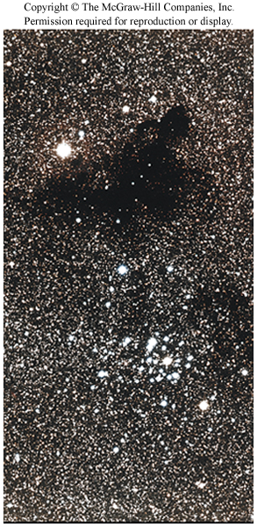
A Model of Solar System Formation
Any model of the Solar System’s formation must account for all observations:
Planets must revolve around the Sun more or less in the same plane
Planets must rotate about their axes in the same direction as they revolve around the Sun
Rocky, dense planets must be found close to the Sun, and gaseous/icy bodies must be farther from the Sun

Slide 30
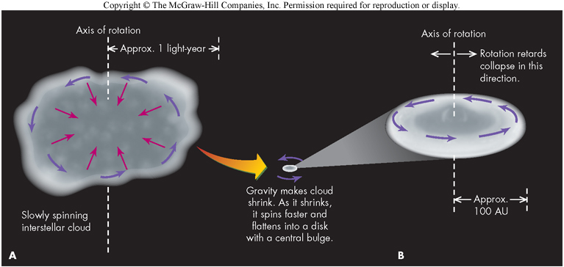
Solar Nebula Theory
The most successful model of Solar System formation is the Solar Nebula Theory (Nebular Hypothesis):
The Solar System originated from a rotating, disk-shaped cloud of gas and dust, with the outer part of the disk becoming the planets, and the inner part becoming the Sun
4.5 billion years ago, the immense cloud of gas and dust that would become our Solar System began to contract.
As it contracted, the whole mess flattened into a disk and began to spin faster (Conservation of Angular Momentum)
Most of the material in the cloud fell into the center to become the Sun.

Slide 31
Condensation and the Formation of the Planets
As the material falling to the center gathered into a ball, its temperature increased
The rest of the disk began to cool; farther out, some of the gases condensed to ice
Close to the center, where the temperature was highest, only silicates and metals could condense
Farther out, volatile gases (H₂O, CO₂, CH₄, NH₃) were in solid form, and thus better able to accrete than gases (H₂, He)
Hence the distinction between Terrestrial and Jovian planets

Slide 32
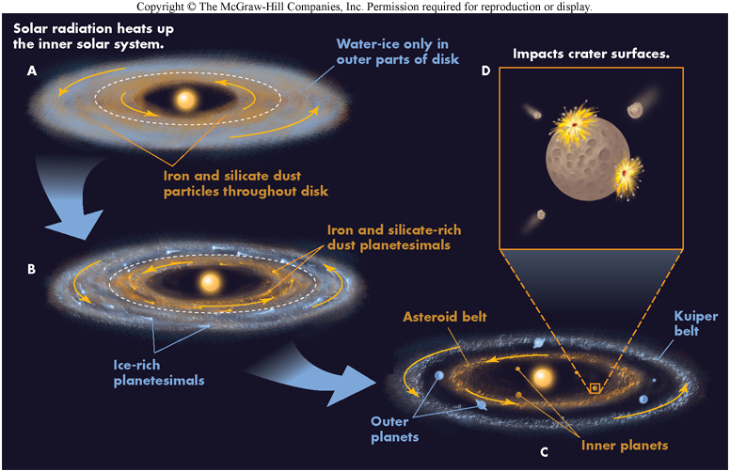
Planetesimal Formation
In the inner solar system, silicate (rocky) and metal grains accreted (stuck together) over time, to form rocky planetesimals. These would become the terrestrial planets.
In the outer solar system, icy planetesimals formed.
These planetesimals collided and gathered over millions of years to form the planets

Slide 33
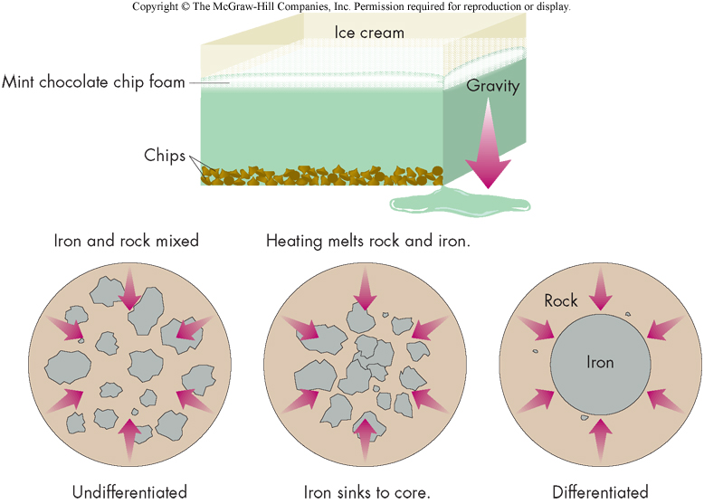
Protoplanets and differentiation
Planetesimals grew through accretion into protoplanets, which were heated by collisions and by radioactive decay
Denser (Fe-rich) material sank toward the center of the bodies, and lighter material floated toward the surface
This separation process is called differentiation.

Slide 34
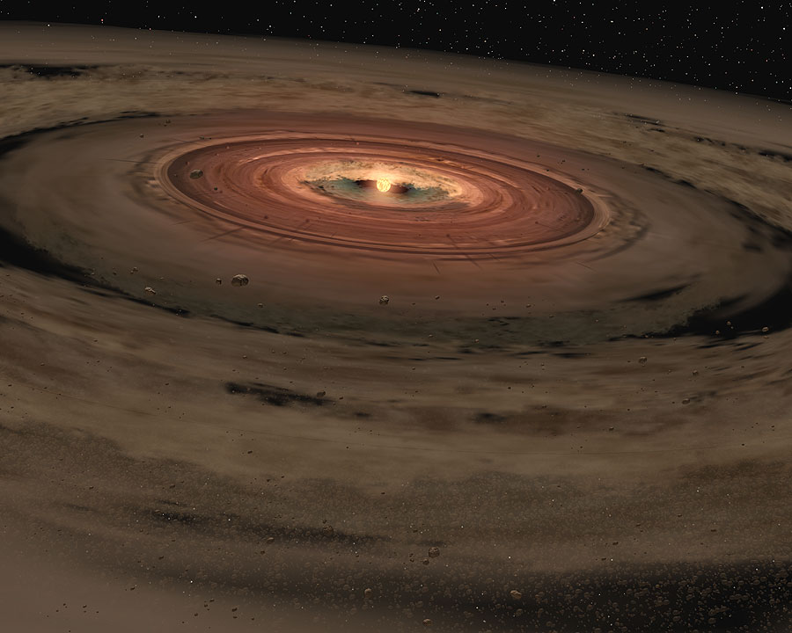
T-Tauri Stage of the Sun
Meanwhile, the Protosun accumulated most of the material
Temperature (T) and Pressure (P) in core rose to “astronomical” levels
The T/P conditions finally got to the point where Nuclear Fusion began in the core
(4 H → 1 He + ENERGY)
Ignition of nuclear furnace created the Solar Wind
Solar Wind blew away any material that had not yet been accumulated into the 4 inner planets

Slide 35
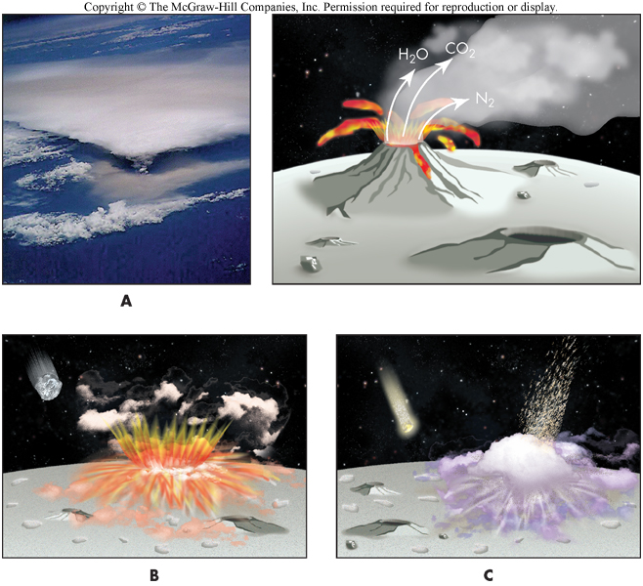
Atmospheres
The atmospheres of the terrestrial planets formed last, by either (or both):
Outgassing
Volatiles trapped inside the planet escape through volcanoes or other processes
Collisions
Volatiles could have been freed from the planet’s crust by collisions, or via direct delivery by comets!

Slide 36
The Scientific Method
Geologist poses an interesting question
Geologist makes observations and collects data
Geologist formulates hypothesis to explain observations and data
Geologist announces conclusions – often tentative

Slide 37
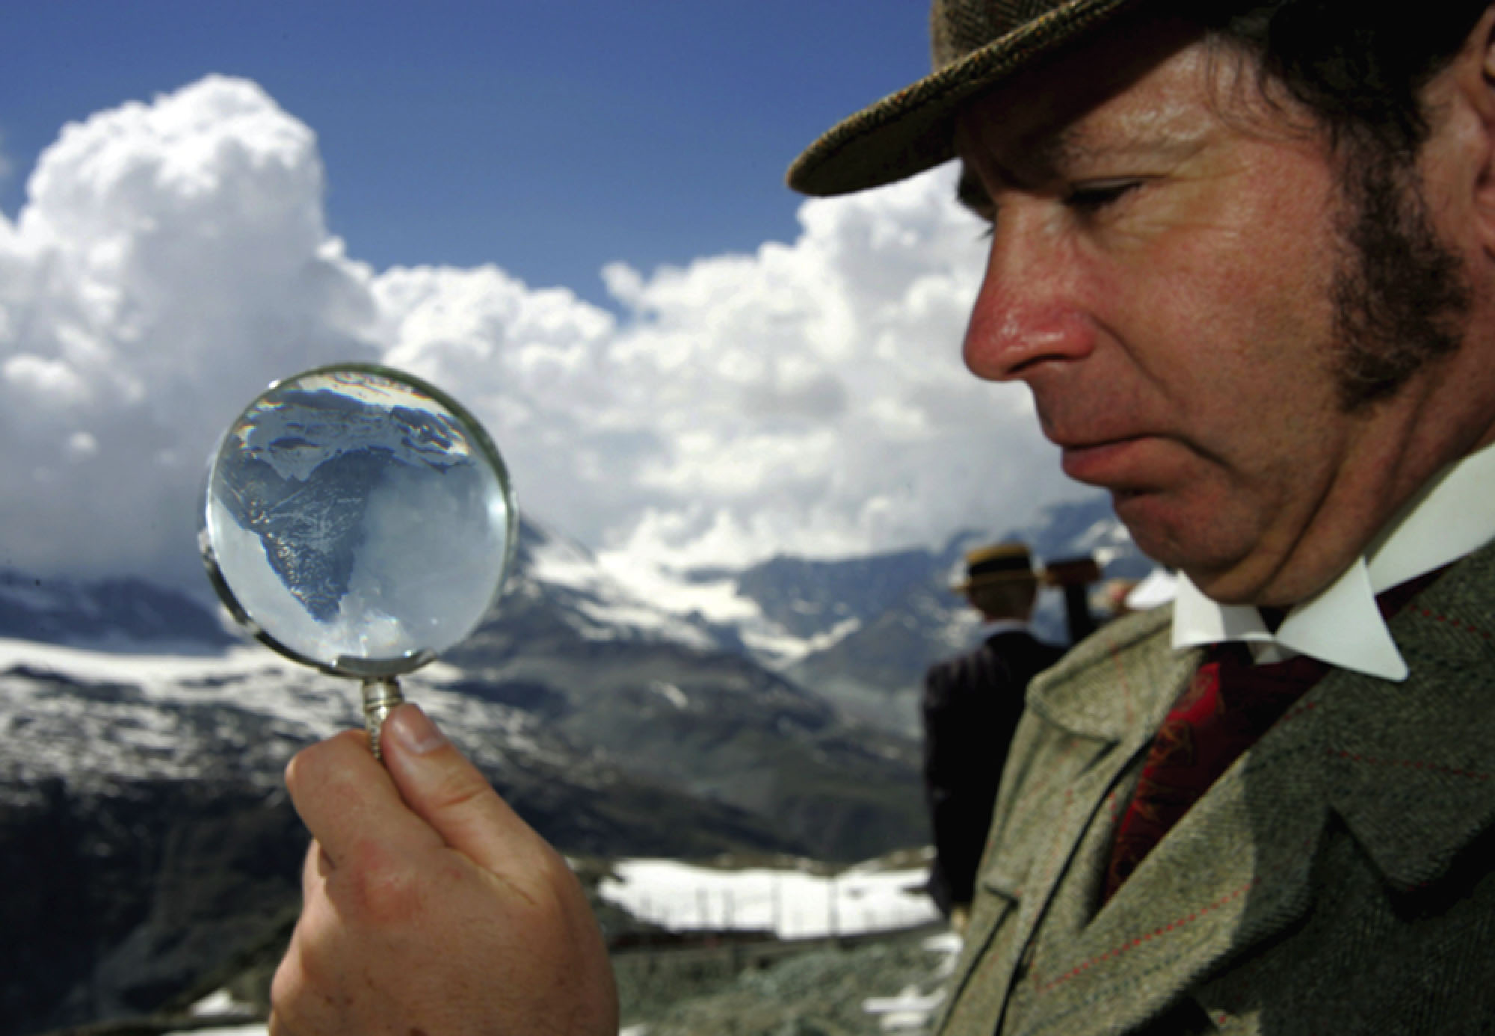
Fig. 1-9, p. 10
Notes:
FIGURE 1.9 Detectives are scientists, and scientists are detectives.

Slide 38
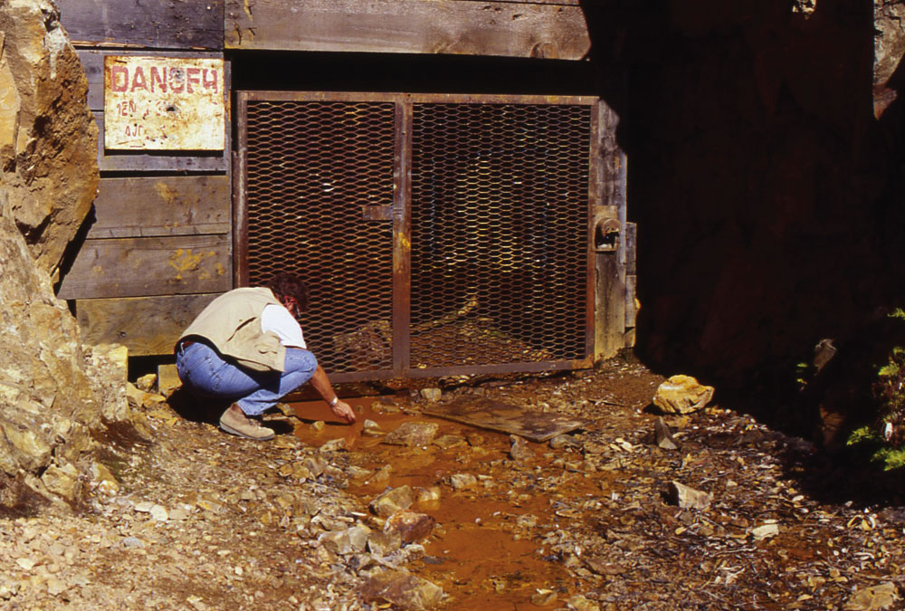
Fig. 1-10, p. 10
Notes:
FIGURE 1.10 Acidic mine water draining from the abandoned Friday-Loudan Mine, Shasta County, California. A U.S. Forest Service geologist is measuring the pH of the mine drainage. The water has a pH of 3.9, and it carries dissolved copper, iron, zinc, and other heavy metals into the stream, which eventually flow into the sport fishing waters of Shasta Lake.

Slide 39
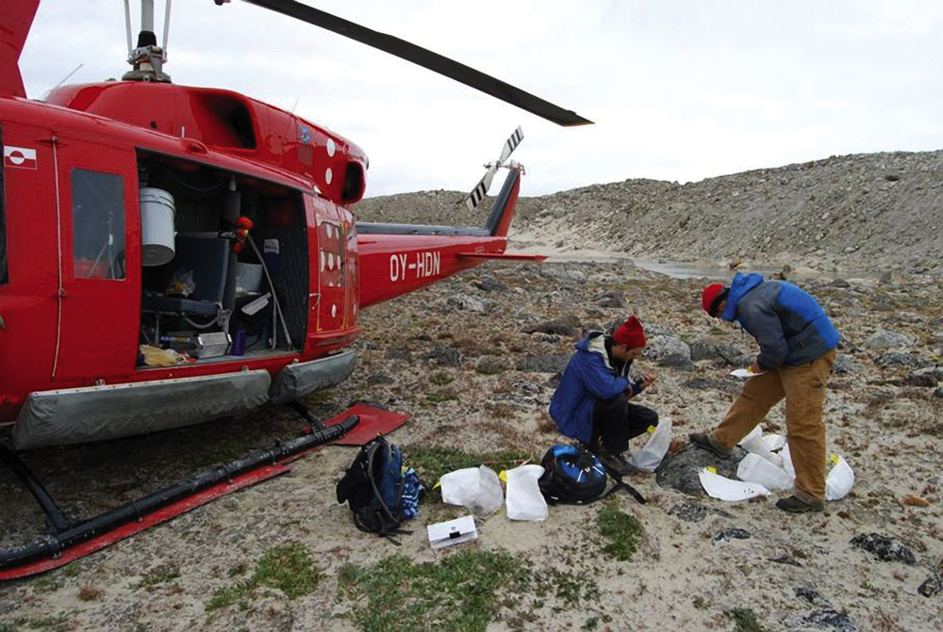
Fig. 1-11, p. 10
Notes:
FIGURE 1.11 Environmental geologists 50 km from Upernavik, a town of 900 people on an island in northwestern Greenland. They and their field vehicle, a helicopter, are on a nunatak, an island of rock surrounded by the ice sheet. The geologists are organizing rock samples to take to the laboratory for analysis. These samples will be dated to determine when and how much the Greenland ice sheet has grown and shrunk in response to climate change.

Slide 40
Tools: Maps
Topographic maps
Geological maps
Faults
Springs
Scarps
Rock layer angles: strike and dip
Soil characteristics
Water table depths

Slide 41
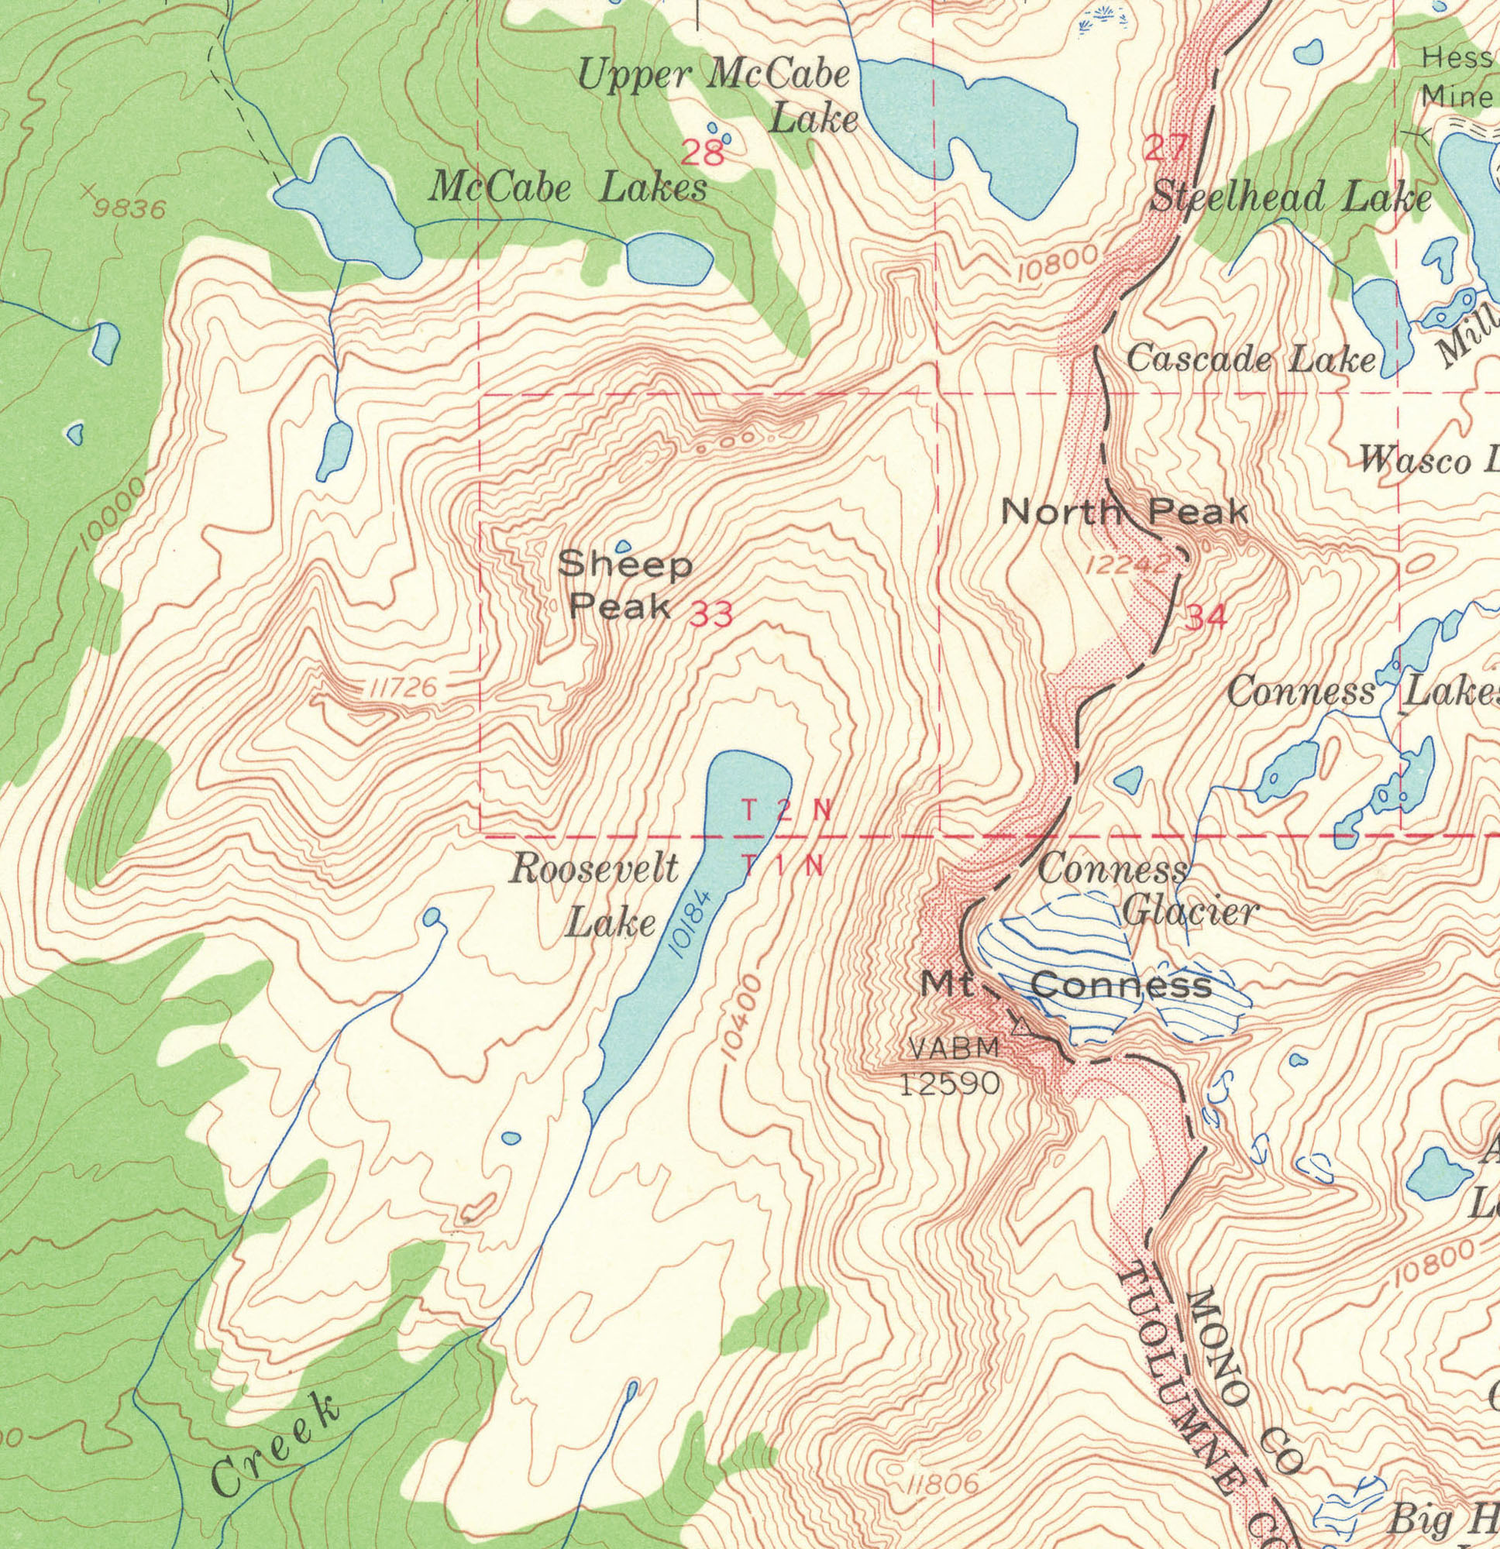
Fig. 1-12, p. 11
Notes:
FIGURE 1.12 (a) A topographic map shows the roughness and vegetative cover of a landscape, using lines of equal elevation called contours and colors to represent vegetation, clear areas, and water bodies. (b) A geological map uses a topographic contour base to show where different kinds of bedrock are distributed in a landscape. (c) A derivative map takes data collected from various research studies to show information of use for a particular purpose—in this case, seismic hazards in the central San Francisco Bay area.

Slide 42
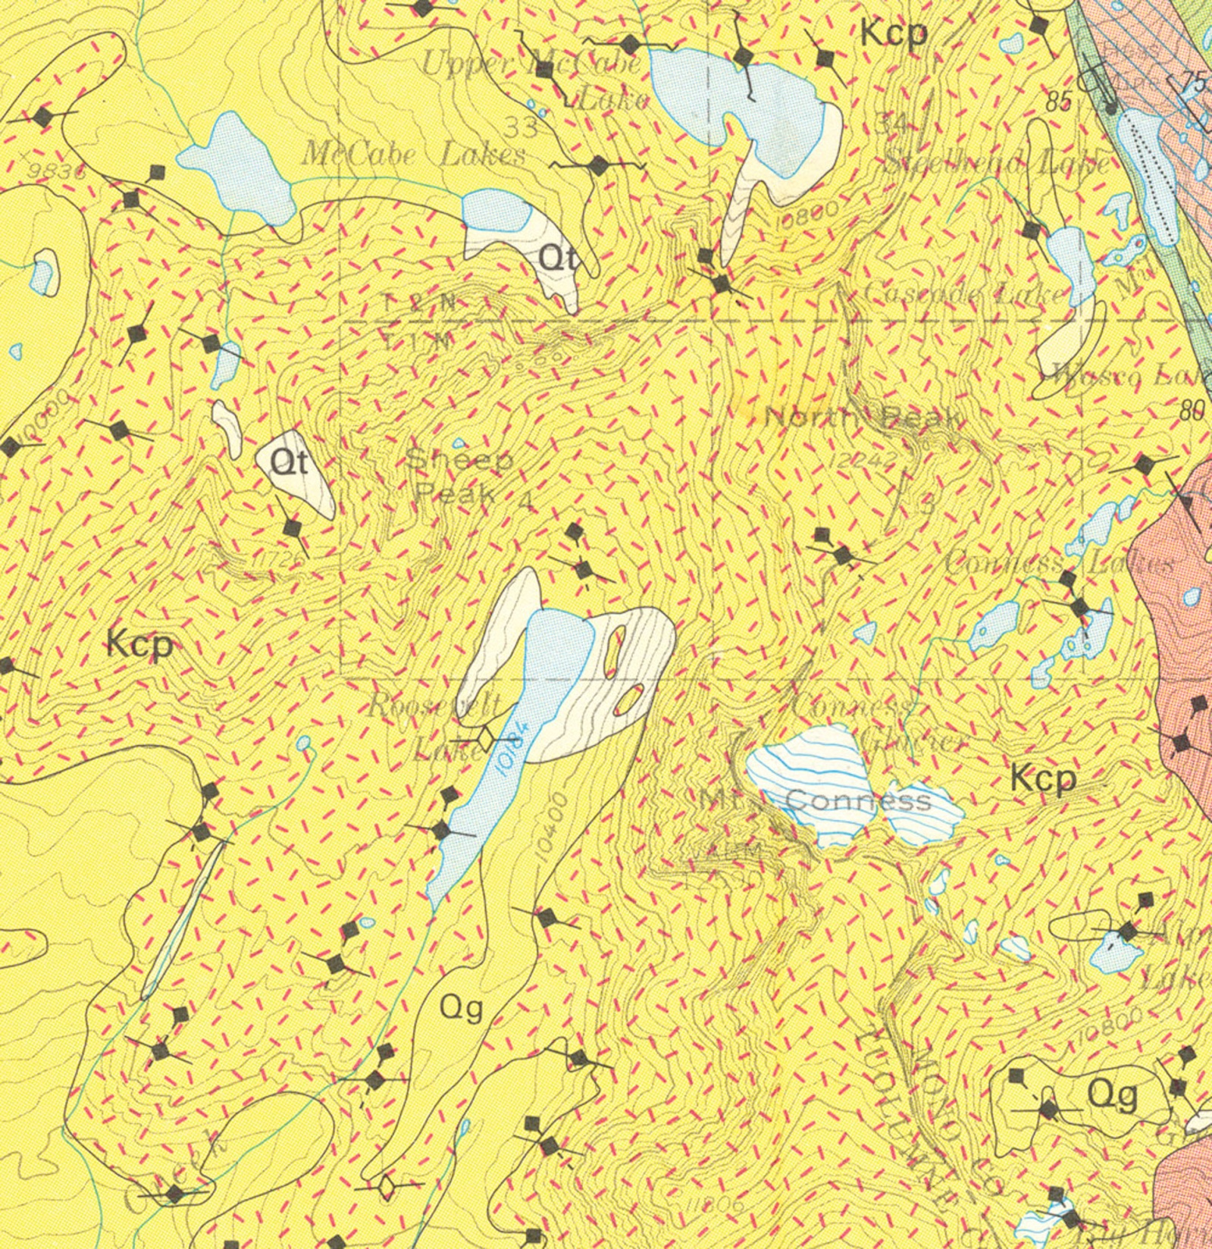
Fig. 1-12, p. 11
Notes:
FIGURE 1.12 (a) A topographic map shows the roughness and vegetative cover of a landscape, using lines of equal elevation called contours and colors to represent vegetation, clear areas, and water bodies. (b) A geological map uses a topographic contour base to show where different kinds of bedrock are distributed in a landscape. (c) A derivative map takes data collected from various research studies to show information of use for a particular purpose—in this case, seismic hazards in the central San Francisco Bay area.

Slide 43
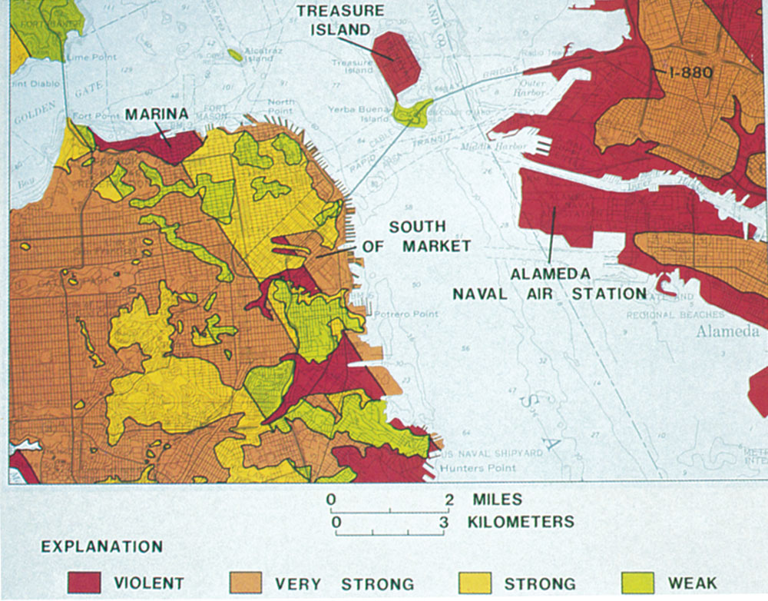
Fig. 1-12, p. 11
Notes:
FIGURE 1.12 (a) A topographic map shows the roughness and vegetative cover of a landscape, using lines of equal elevation called contours and colors to represent vegetation, clear areas, and water bodies. (b) A geological map uses a topographic contour base to show where different kinds of bedrock are distributed in a landscape. (c) A derivative map takes data collected from various research studies to show information of use for a particular purpose—in this case, seismic hazards in the central San Francisco Bay area.

Slide 44
Tools: Gadgets and More
Compass
Surveying tools
Global position systems (GPS)
Derivative maps
Geographic information systems (GIS)

Slide 45
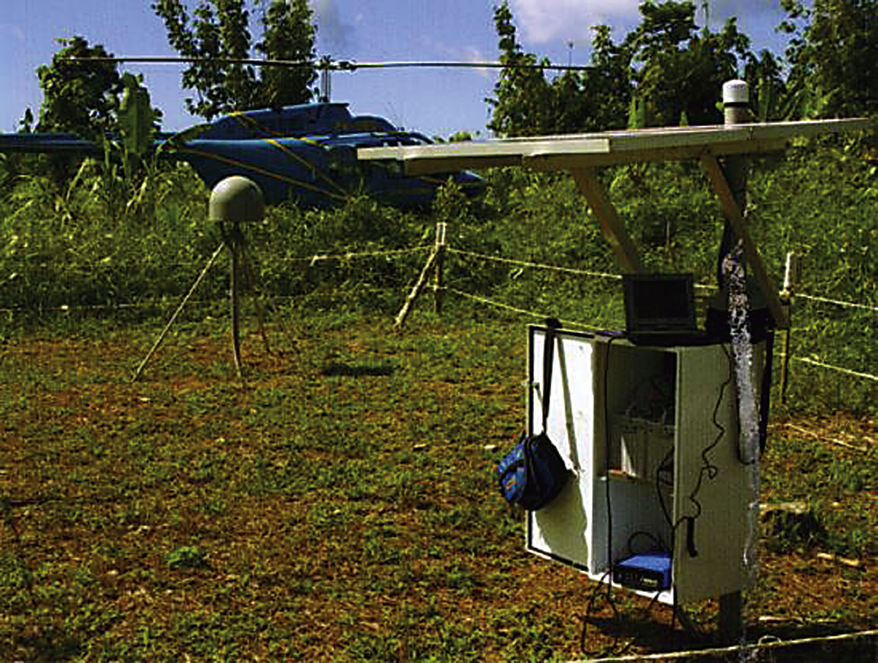
Fig. 1-13, p. 12
Notes:
FIGURE 1.13 Porites coral heads at the GPS survey station NGNG on one of the island soff the west coast of Sumatra. The coral heads were uplifted about 90 centimeters (35 in) by the December 26, 2004, Great Sumatran earthquake.

Slide 46
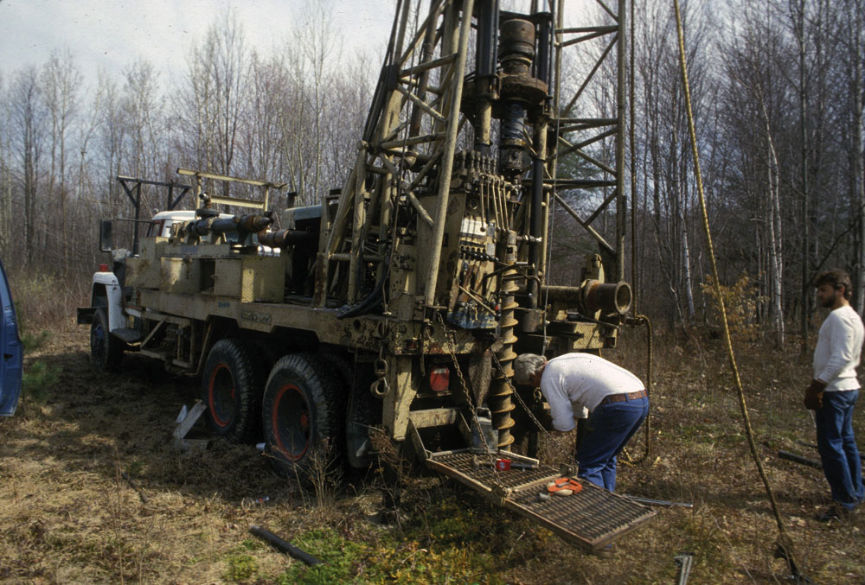
Fig. 1-14, p. 12
Notes:
FIGURE 1.14 (a) Geologists with an auger drilling rig installing a groundwater monitoring well through floodplain deposits along the Hoosic River near a landfill at Williamstown, Massachusetts. Their goal is to determine whether the groundwater has been contaminated by seepage from the landfill waste. (b) Geologists carefully log the sidewalls of a trench across the San Andreas faulty near Wrightwood, California, to find and age date the youngest rupture (an 1857 earthquake) and then earlier breaks. The data will allow the determination of earthquake recurrence intervals for the fault.

Slide 47
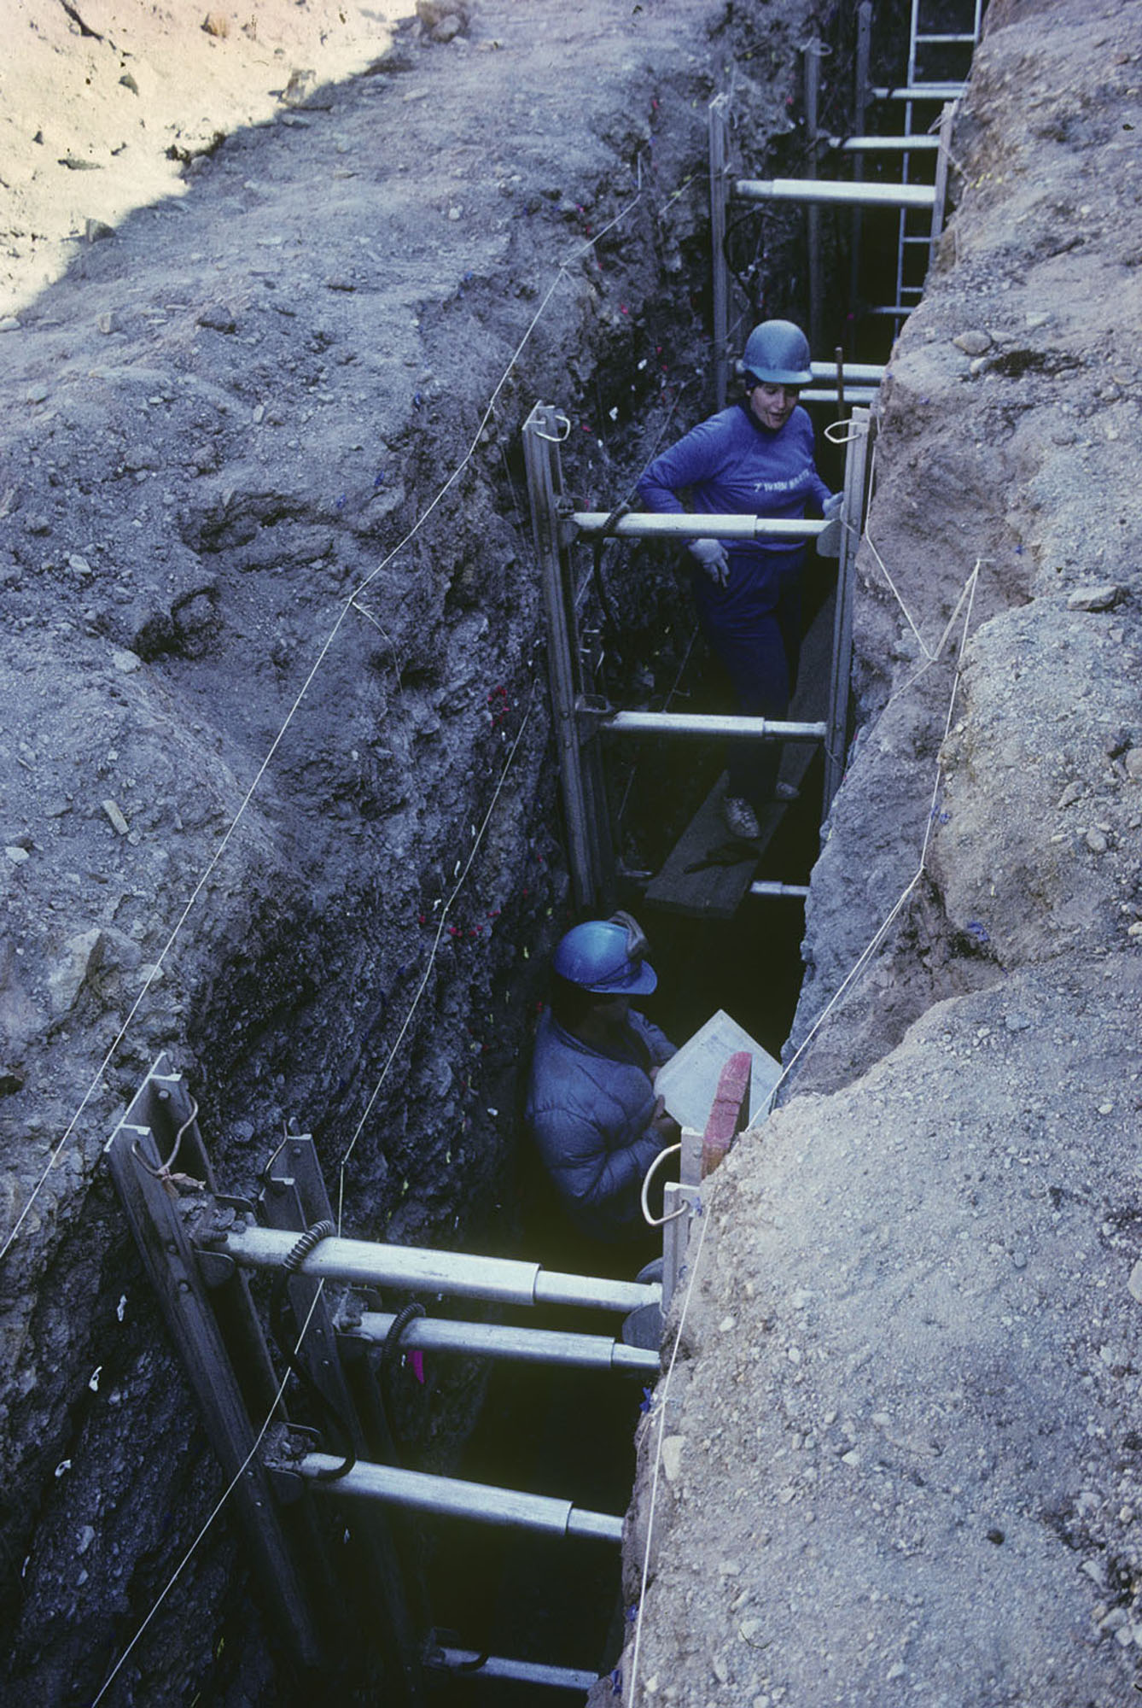
Fig. 1-14, p. 12
Notes:
FIGURE 1.14 (a) Geologists with an auger drilling rig installing a groundwater monitoring well through floodplain deposits along the Hoosic River near a landfill at Williamstown, Massachusetts. Their goal is to determine whether the groundwater has been contaminated by seepage from the landfill waste. (b) Geologists carefully log the sidewalls of a trench across the San Andreas faulty near Wrightwood, California, to find and age date the youngest rupture (an 1857 earthquake) and then earlier breaks. The data will allow the determination of earthquake recurrence intervals for the fault.

Slide 48
Typical Projects
Pollution in soil and water
Land destabilization
Natural disaster risks
Soil properties of proposed construction sites
Coastal erosion
Storage of solid and liquid wastes
Dam site location and evaluation

Slide 49
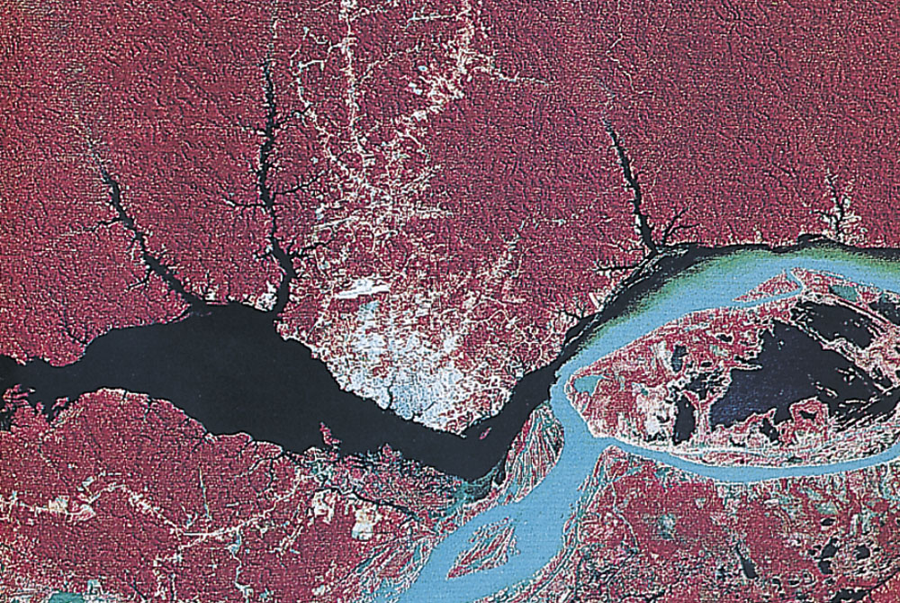
Figure 2, p. 16
Notes:
FIGURE 2 Deforestation near the city of Manaus in Amazonia, Brazil’s largest state. (a) A false-color satellite photo of the confluence of the Rio Negro (black) and the sediment-laden Amazon River (light green). Healthy rain forest is shown in red, and deforested areas appear in light colors. Manaus is on the point of land that extends into the Rio Negro. The waters of the Rio Negro are recognizable for more than 80 kilometers (48 mi) downstream in the Amazon. (b) Adjacent rain forests have been removed as the population of the area has grown. Manaus’ population is now more than a million people, and the city is rapidly expanding into areas that were once sparsely populated.

Slide 50
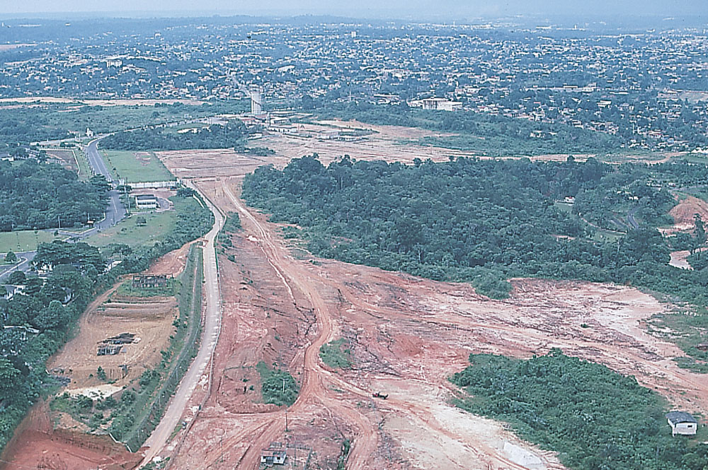
Figure 2, p. 16
Notes:
FIGURE 2 Deforestation near the city of Manaus in Amazonia, Brazil’s largest state. (a) A false-color satellite photo of the confluence of the Rio Negro (black) and the sediment-laden Amazon River (light green). Healthy rain forest is shown in red, and deforested areas appear in light colors. Manaus is on the point of land that extends into the Rio Negro. The waters of the Rio Negro are recognizable for more than 80 kilometers (48 mi) downstream in the Amazon. (b) Adjacent rain forests have been removed as the population of the area has grown. Manaus’ population is now more than a million people, and the city is rapidly expanding into areas that were once sparsely populated.

