Slide 1
Chapter 3
The Solid Earth

Slide 2
Origin of the Solar System
The outer large Jovian planets formed from the solar nebula
The smaller inner planets formed from rocky material
Rocks from Mars and the Moon are similar to Earth rocks

Slide 3
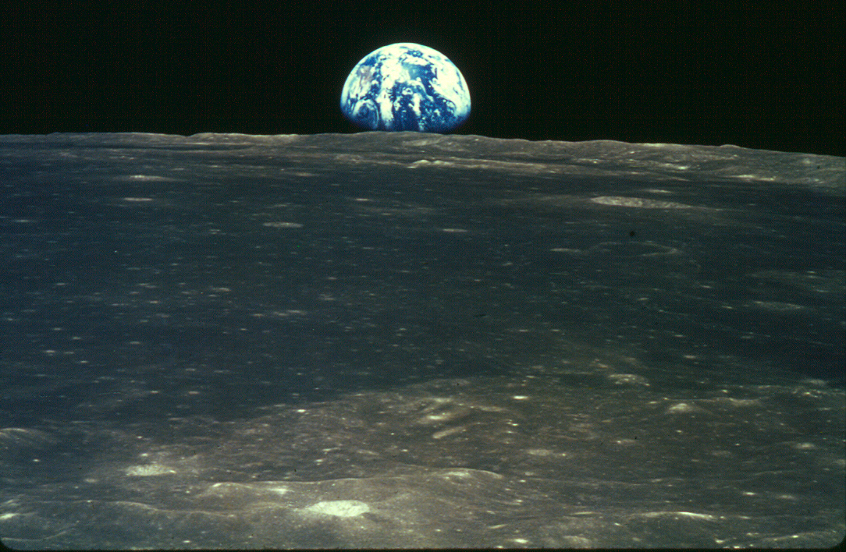
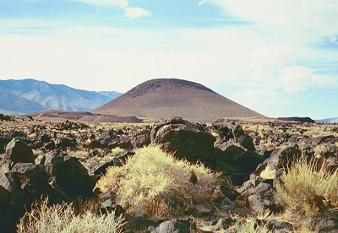
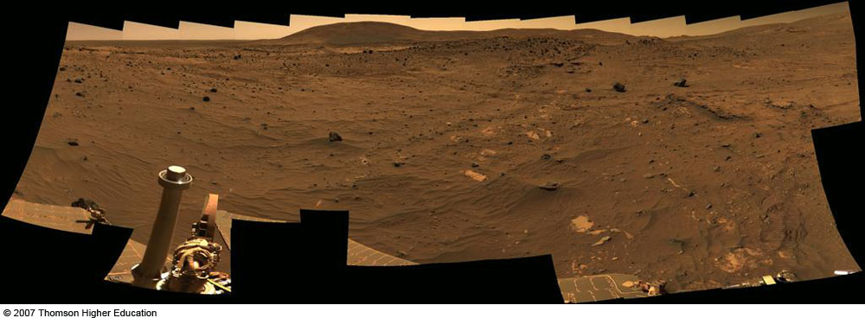
So…which is which?

Slide 4
Earth Systems (spheres)
Solid Earth (lithosphere, soil)
Atmosphere
Hydrosphere
Biosphere
Extraterrestrial

Slide 5
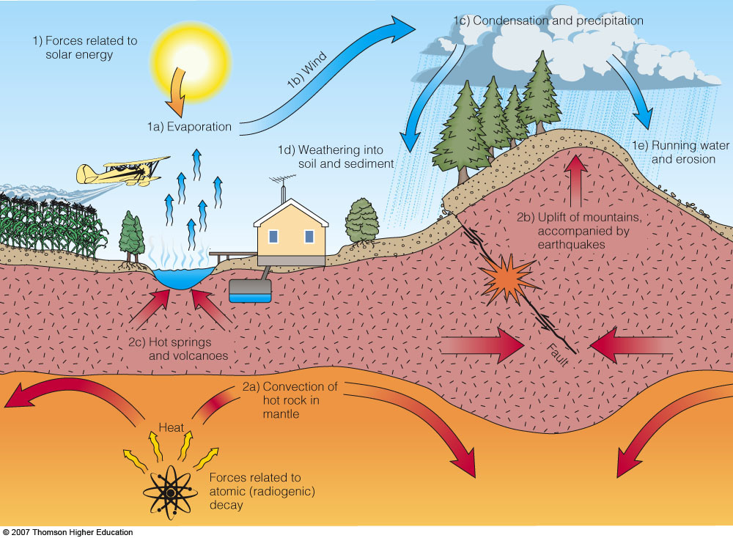
Cycles of Earth and Water
Rock Cycle and Water Cycle are closed systems
Energy from sun and internal heat of Earth drive these systems

Slide 6
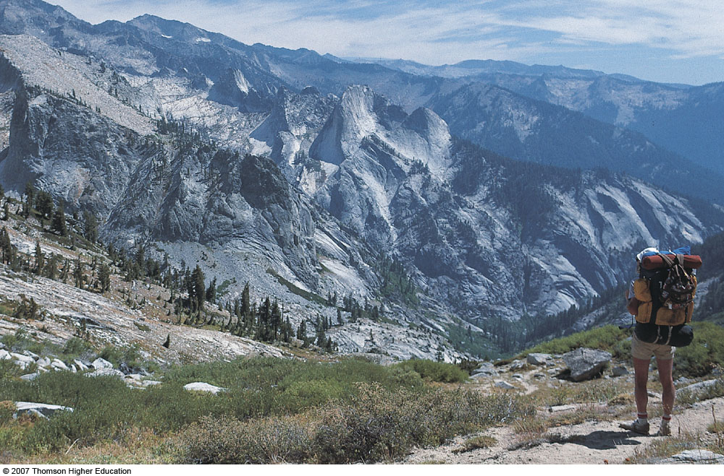
Lone Pine Canyon in Sequoia National Park, California. This landscape is the product of mountain uplift powered by Earth’s internal heat engine, interacting with erosion by glaciers, weathering, and running water powered by Earth’s external heat engine, the Sun. Contrast this image with Figure 2.1. How generally do these landscapes differ? (Mars has a less active internal heat engine than Earth, is farther from the Sun, and as far as we know, has no life.)

Slide 7
Minerals
Geologic Definition:
Naturally occurring
Inorganic
Crystalline Solid
Narrow range of chemical composition
Defining set of physical properties

Slide 8
Why Distinguish Minerals?
They form in equilibrium with:
Temperature
Pressure
Availability of H₂O
Availability of mineral components
Know the Mineral, Know the Environment!

Slide 9
Minerals are made of Atoms
Proton
3 fundamental particles:
Protons: +1 charge
Electrons: -1 charge
Neutrons: no charge
# of protons determines the nature of the atom
Controls its chemical behavior
Electron
Proton
Nucleus
Neutron
Electron

Slide 10
Mineral Groups
Mineral Group | Negatively Charged Ion or Ion Group | Examples | Composition
Carbonate | (CO₃⁾⁻² | Calcite Dolomite | CaCO₃ CaMg(CO₃)₂
Halide | Cl⁻¹, F⁻¹ | Halite | NaCl
Hydroxide | (OH⁾⁻¹ | Limonite | FeO(OH) . H₂O
Native Element | - | Gold Diamond | Au C
Oxide | O⁻² | Hematite | Fe₂O₃
Silicate | (SiO₄⁾⁻⁴ | Quartz Olivine | SiO₂ (Mg,Fe)₂SiO₄
Sulfate | (SO₄⁾⁻² | Gypsum | CaSO₄ . 2H₂O
Sulfide | S⁻² | Galena | PbS

Slide 11
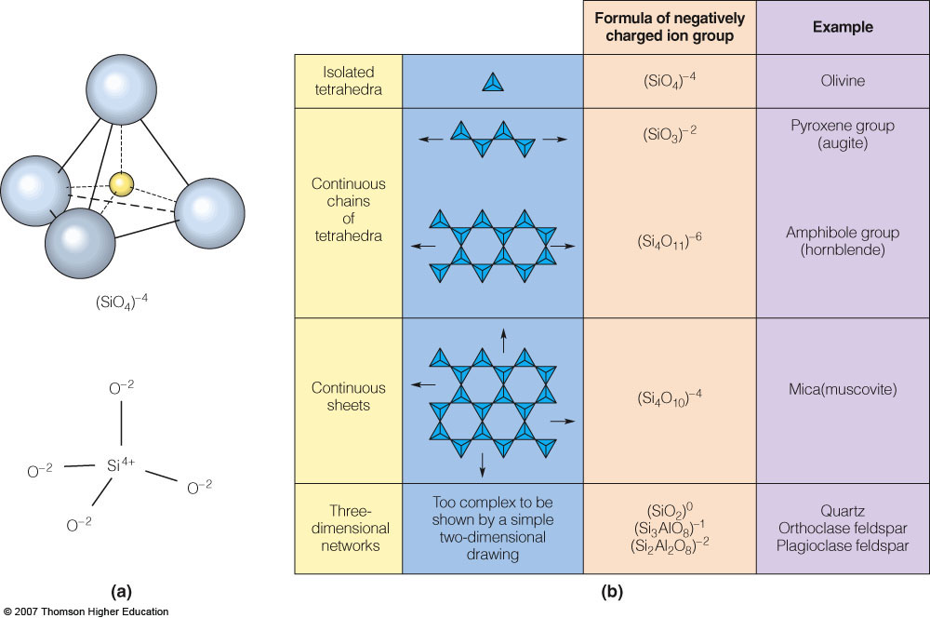
Common Rock-forming Minerals (Silicates)

Slide 12
A more involved figure…

Slide 13
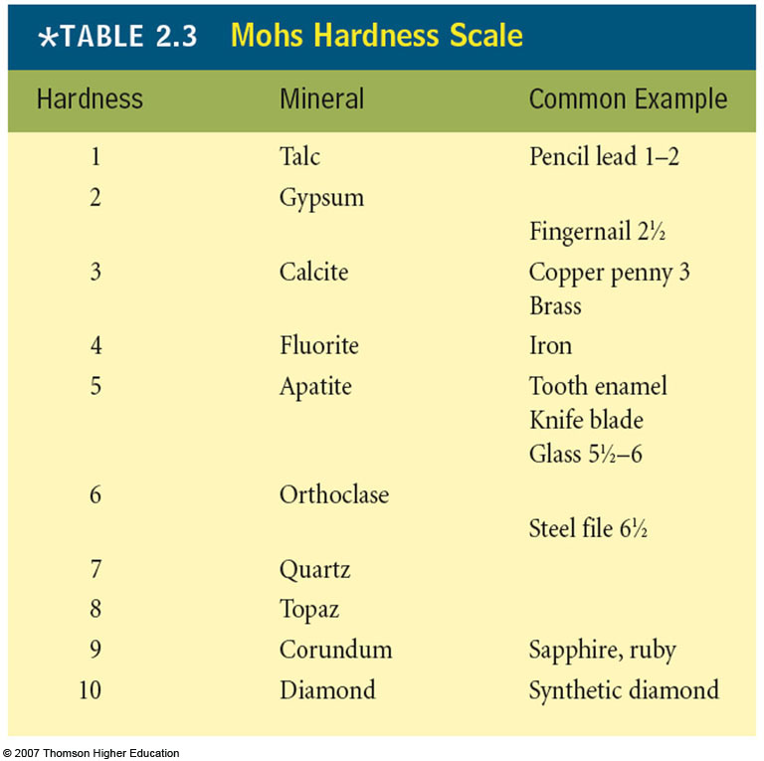
Mineral Identification (examples of Physical Properties)
Minerals are USEFUL for their properties…
Hardness
A measure of the mineral’s resistance to abrasion
Gypsum scratches Talc

Slide 14
Mineral Identification (examples of Physical Properties)
Cleavage
Plane of weakness in the crystal structure
Not A Defect!

Slide 15
Mineral Identification (more examples of Physical Properties)
Crystal Structure or Form
Fracture Pattern
Luster
Streak
Specific Gravity (density)
Etc.

Slide 16
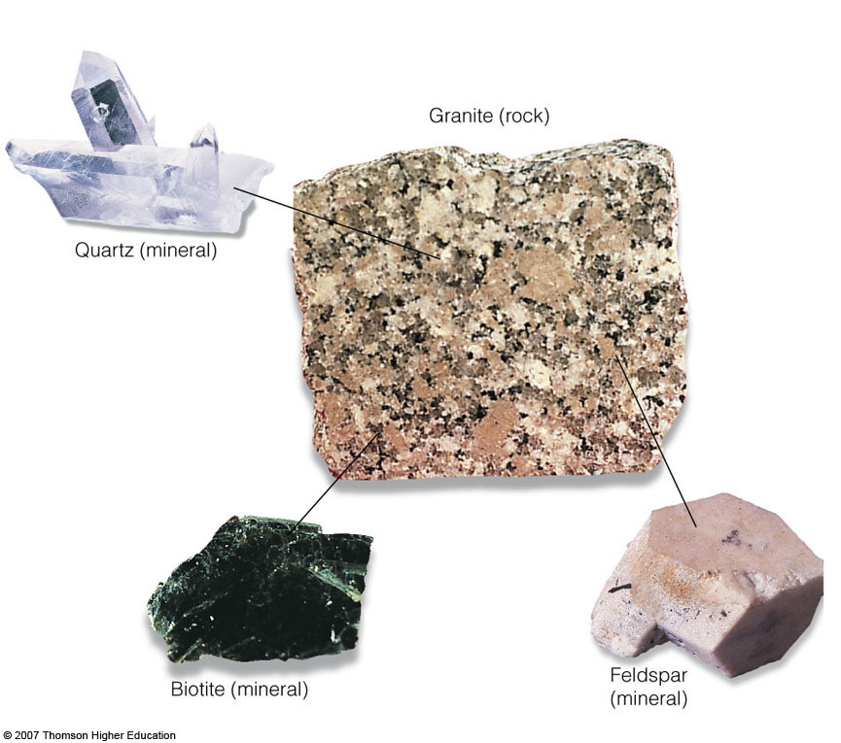
Rocks
Consolidated or poorly consolidated aggregates of one or more minerals, glass, or solidified organic matter that cover a significant part of the Earth’s crust

Slide 17
Igneous Rocks
Rock crystallized from molten or partially molten material (magma)
Extrusive = Volcanic: cooled at Earth’s surface
Aphanitic
Intrusive = Plutonic: cooled below earth’s surface
Phaneritic

Slide 18
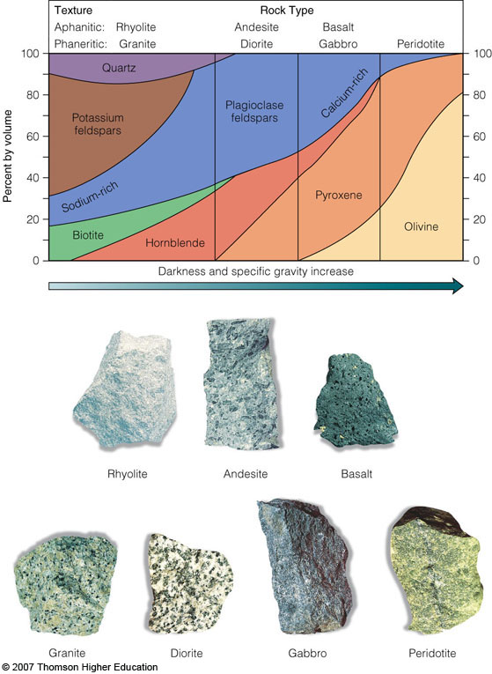
Fig. 2-13, p. 26
Notes:
Figure 2.13: Classification of common igneous rocks by their mineralogy and texture. Relative proportions of mineral components are shown for each rock type. Fine-grained aphanitic texture results from rapid cooling of molten material. Coarse-grained phaneritic texture results from slow cooling.
Rock photos courtesy Sue Monroe.

Slide 19
Sedimentary Rocks
Layered rock resulting from consolidation and lithification of sediment
Clastic or Detrital sedimentary rocks
Chemical sedimentary rocks

Slide 20
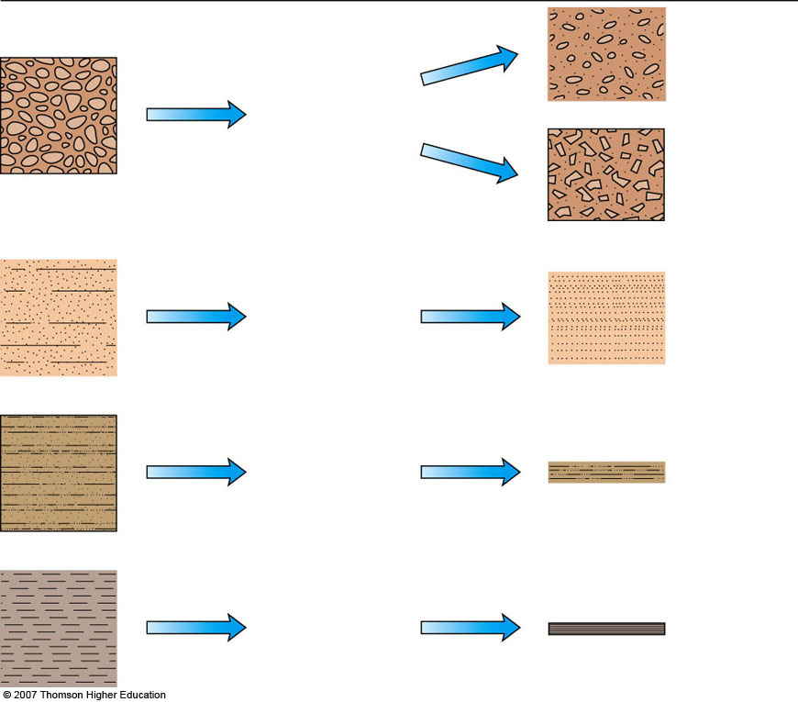
Sediment
Process
Rock
Gravel > 2 mm
Conglomerate
Compaction/ cementation
Rounded
clasts
Breccia
Angular
clasts
Sand 2 mm–.062 mm
Compaction/ cementation
Sandstone
Silt .062 mm–.004 mm
Compaction/ cementation
Siltstone
Clay <.004 mm
Compaction
Shale
Fig. 2-15, p. 27
Notes:
Figure 2.15: How sediments are transformed into clastic sedimentary rocks. The sequence of lithification is deposition to compaction to cementation to hard rock.

Slide 21
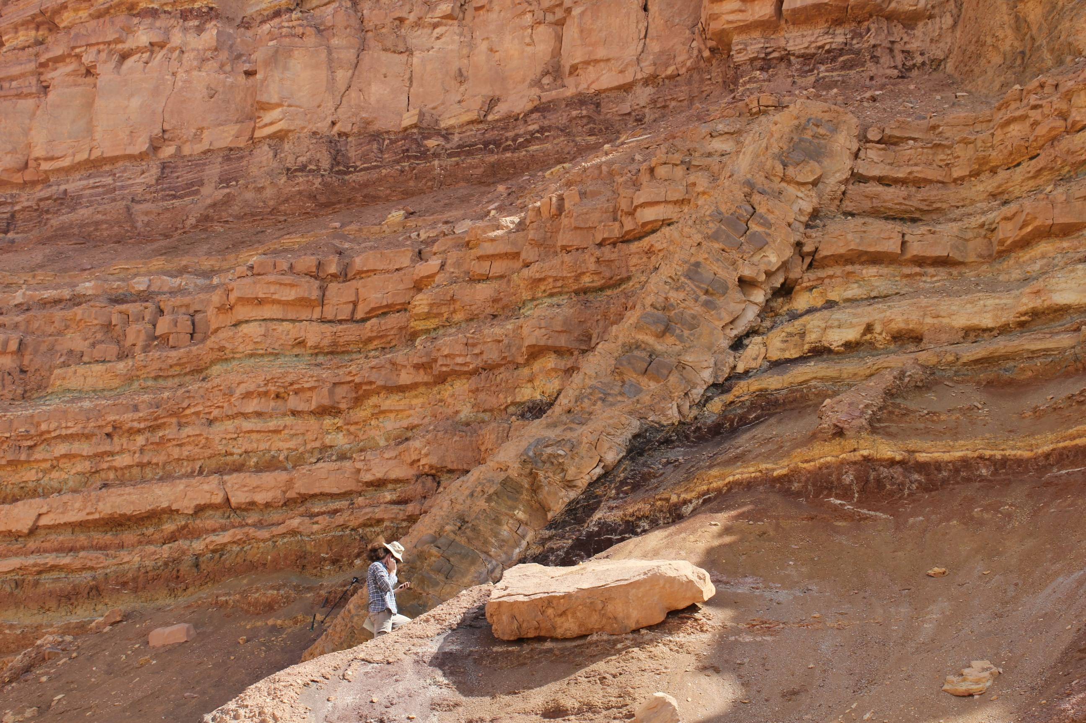
Structures - Stratification
Layering is a key feature identifying rocks as sedimentary

Slide 22
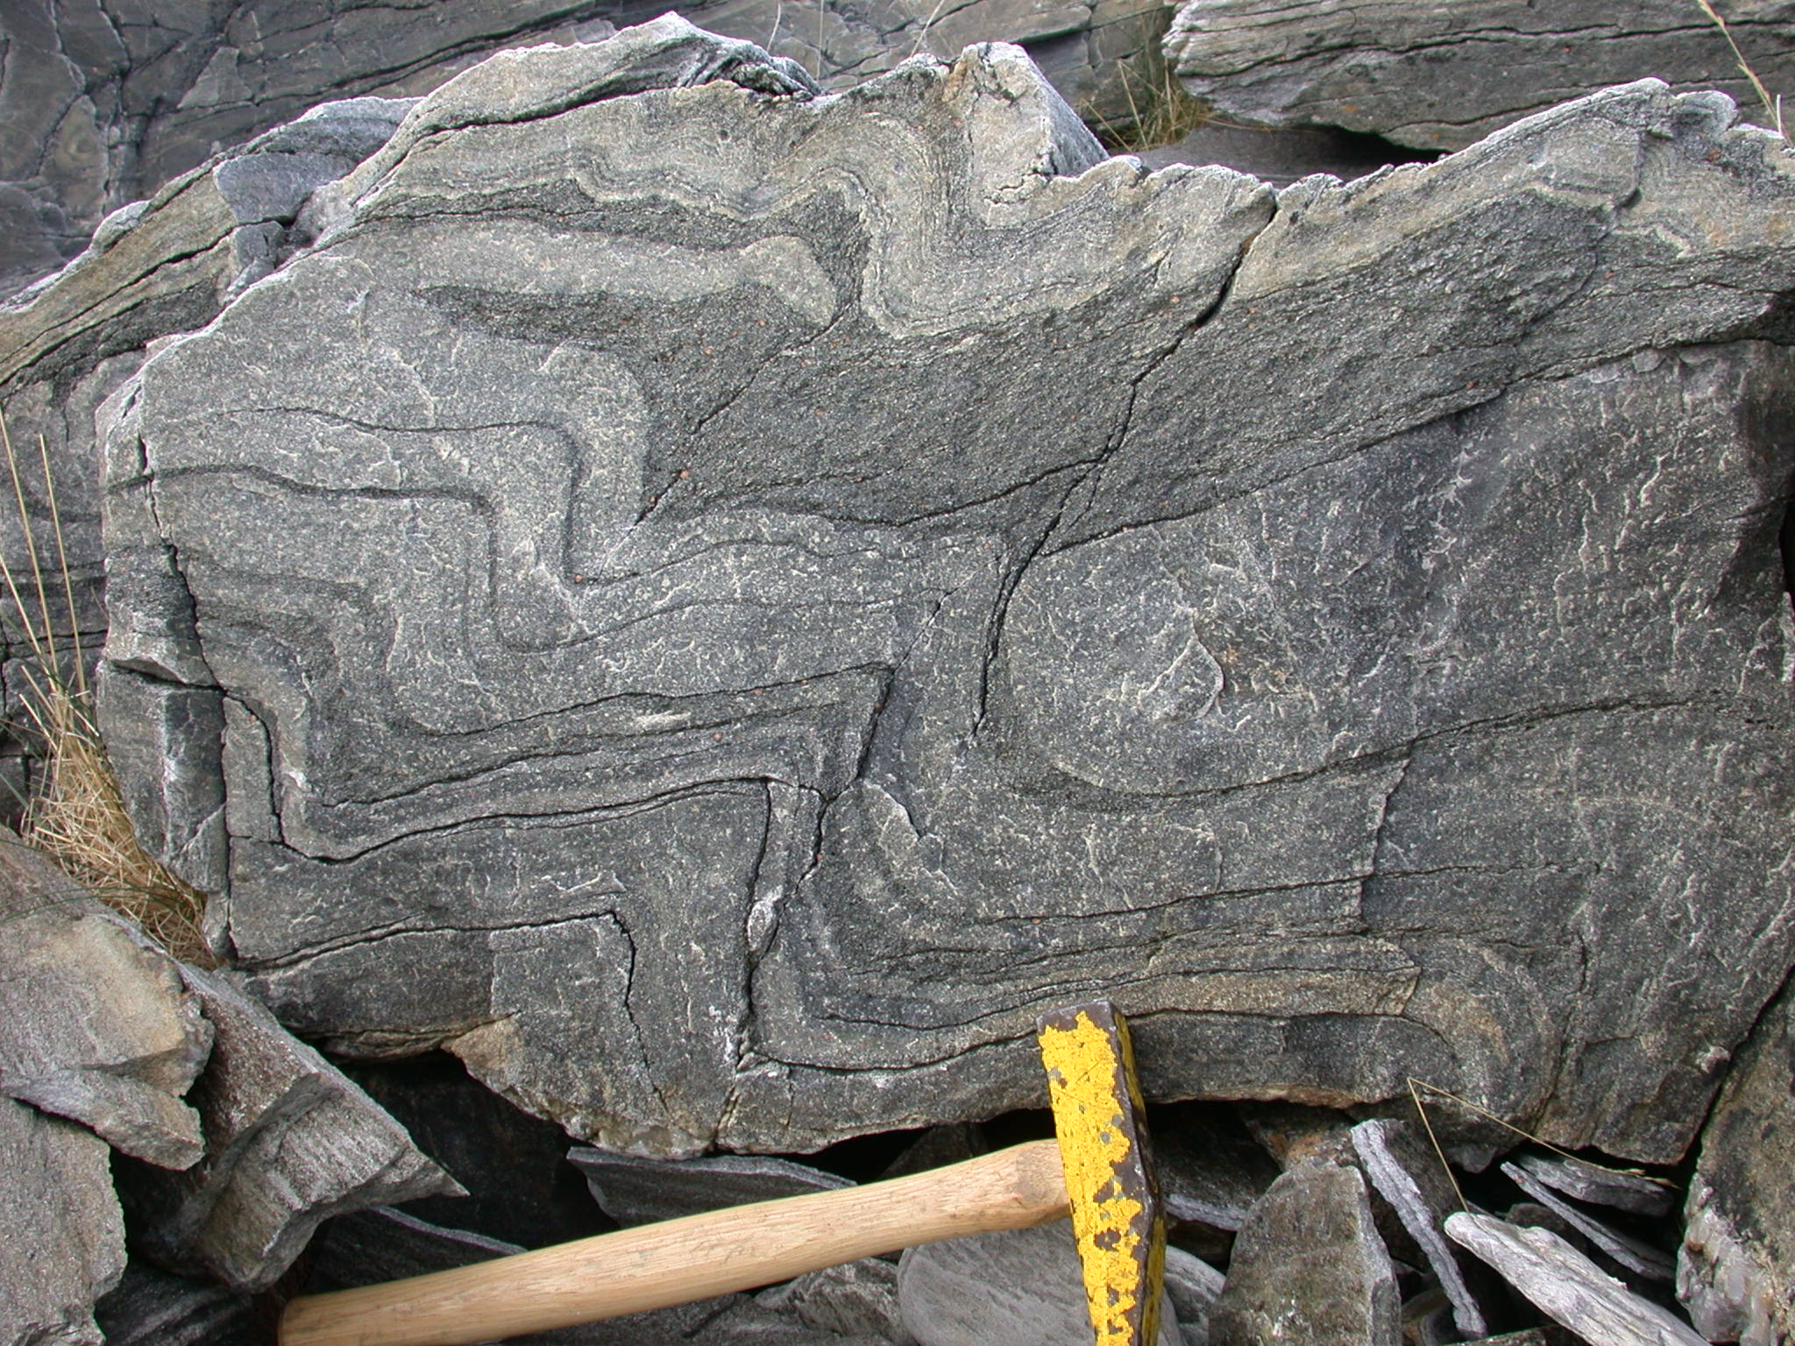
Metamorphic Rocks
Rocks changed from preexisting rocks by heat, pressure or chemical processes
Changes occur in the solid state
Minerals and Textures are changed

Slide 23
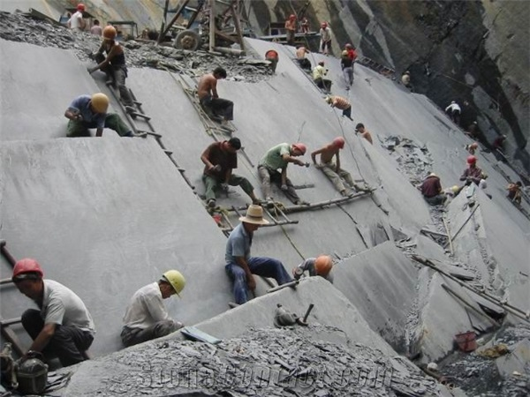
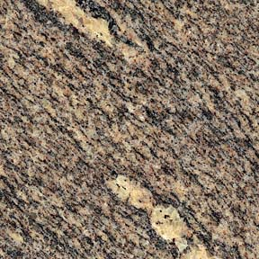
Metamorphic Foliation
Flattening and alignment of minerals caused by non-uniform stress

Slide 24
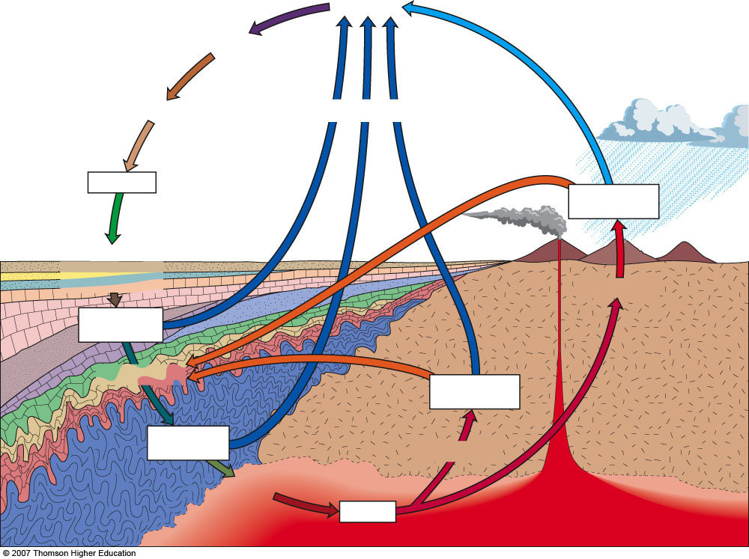
Weathering
Transportation
Deposition
Uplift and exposure
Sediments
Igneous rocks (extrusive)
Lithification
(compaction and cementation
Consolidation
Sedimentary
rocks
Metamorphism
Igneous rocks
(intrusive)
Metamorphic
rocks
Crystallization
Melting
Magma
Notes:
Figure 2.11: The rock cycle. The three rock types are interrelated by internal and external processes involving the atmosphere, ocean, biosphere, crust, and upper mantle.

Slide 25
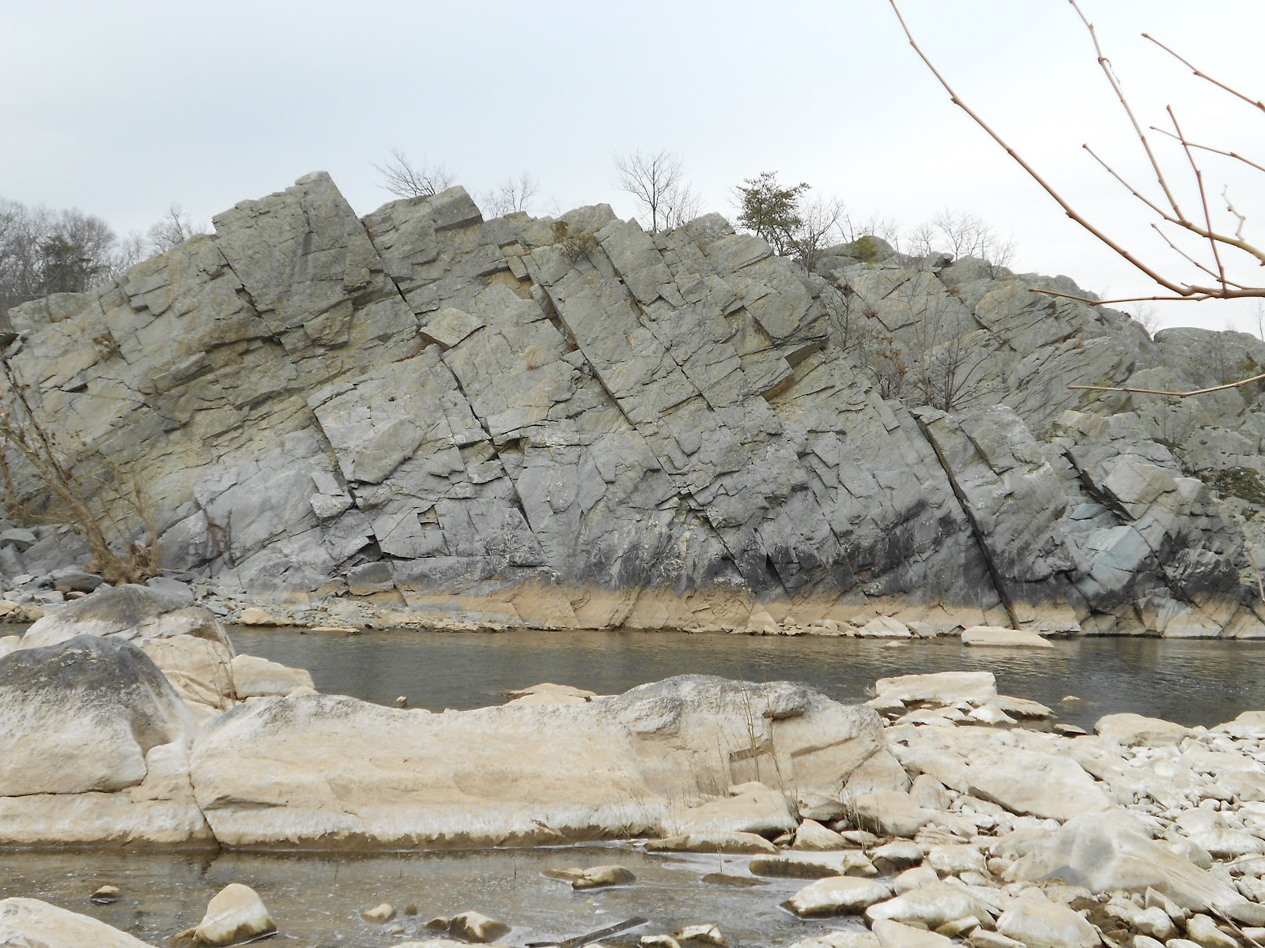
Joints
Fractures in crustal rocks
No displacement on either side of fracture

Slide 26
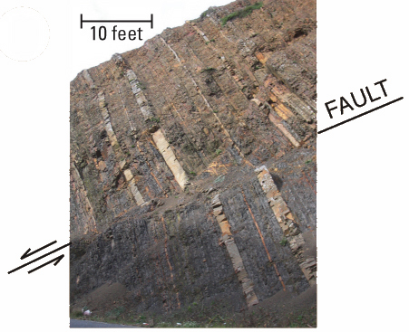
Faults
Fractures in crustal rocks along which displacement has occurred along the fault surface
Implies brittle, near-surface conditions

Slide 27
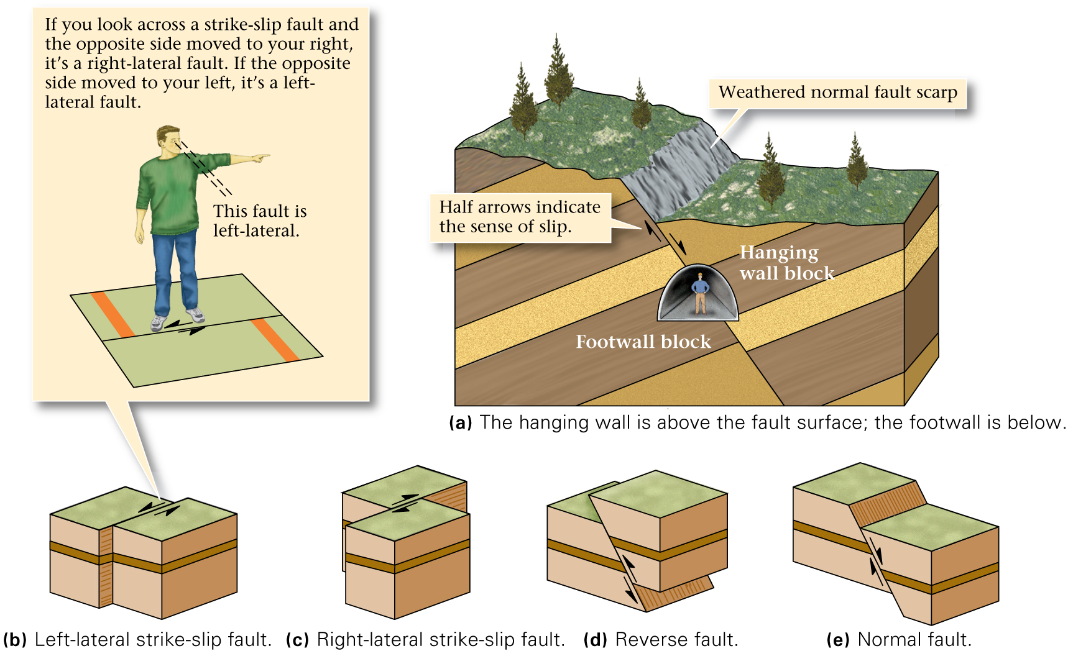
Fault Types

Slide 28
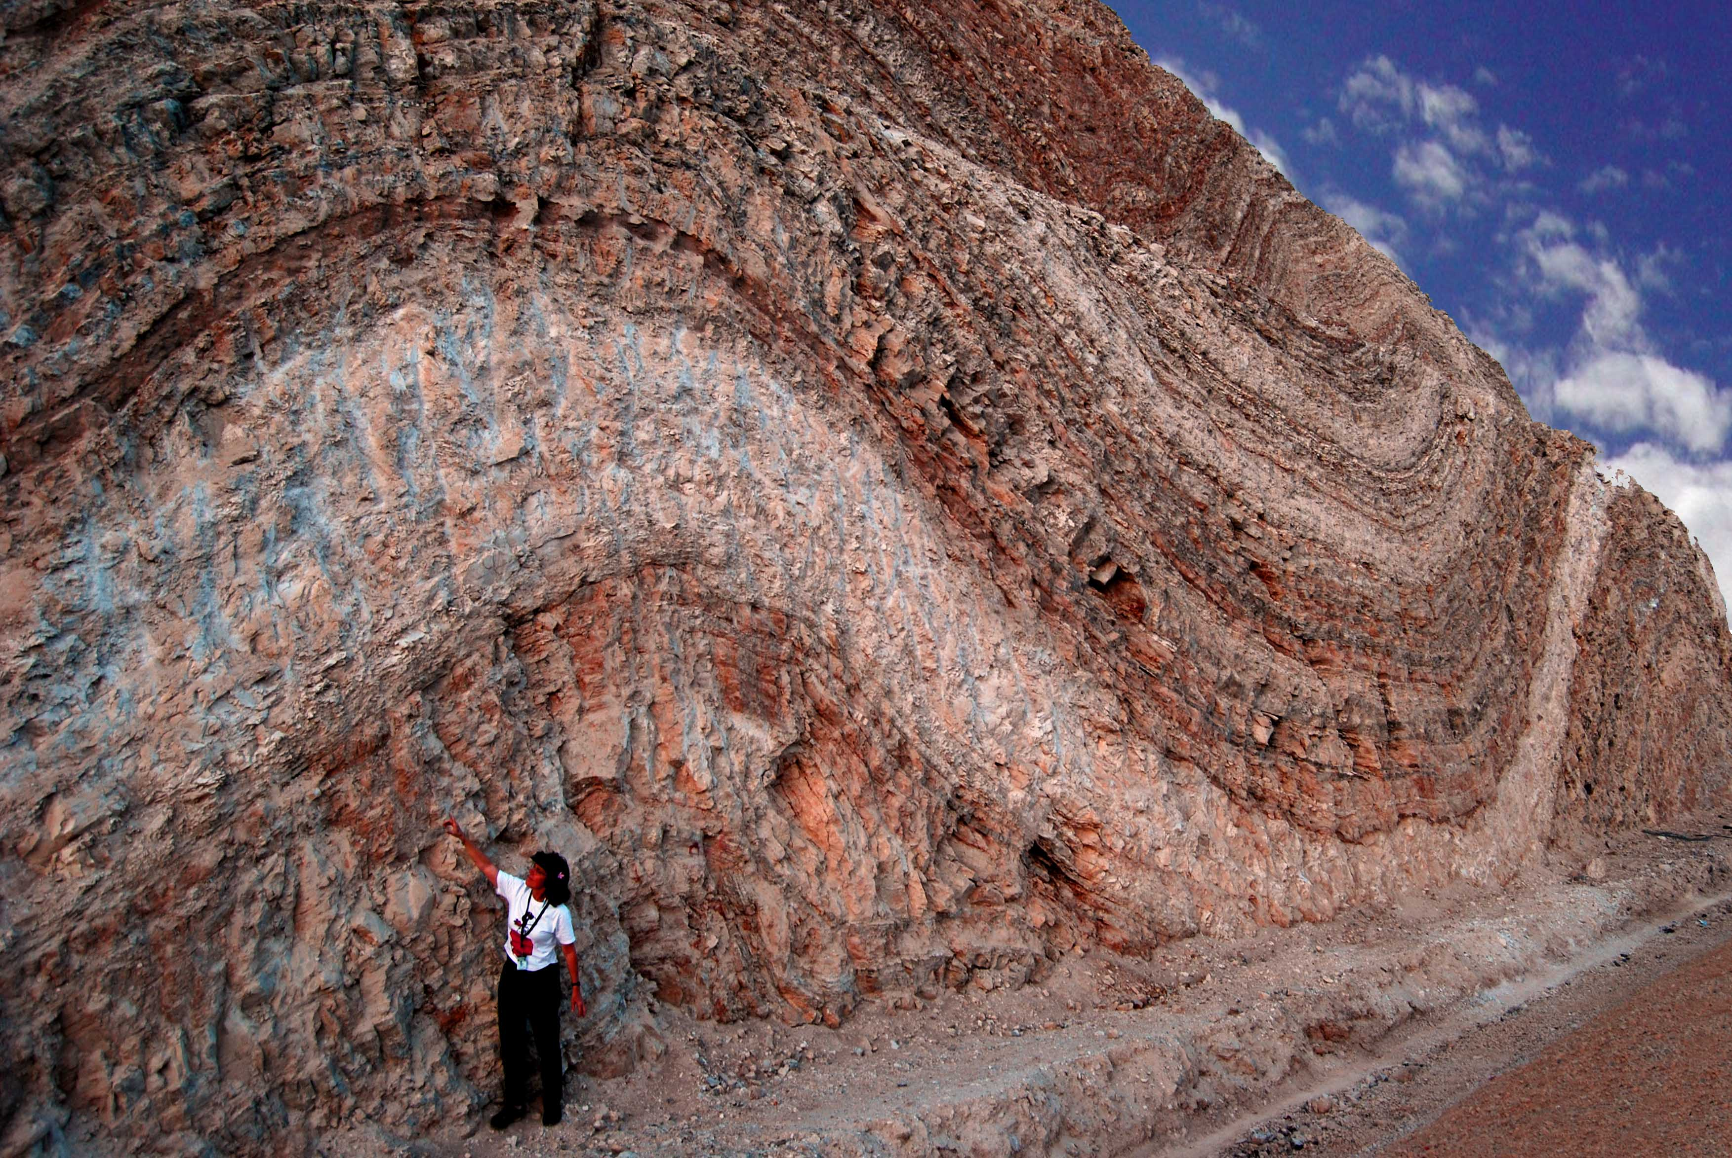
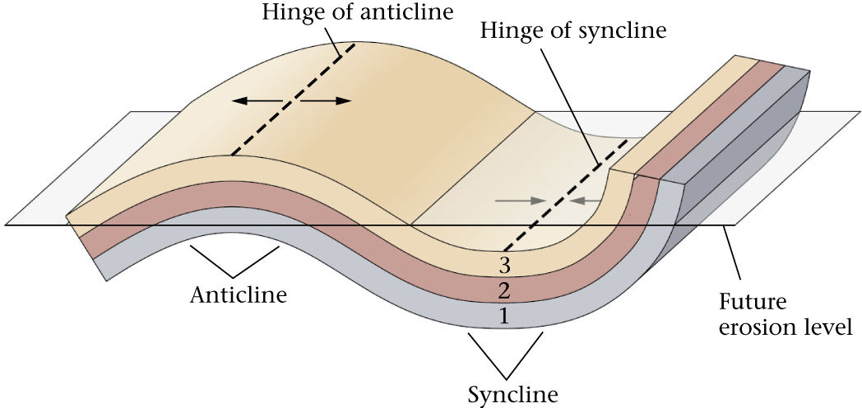
Folds

Slide 29
Geologic Time
Relative-age dating determines the sequence of geologic events that has taken place
Absolute-age dating determines the actual ages of rocks in years before present

Slide 30
Geologic Time Scale
Relative Dating:
Original Horizontality
Lateral Continuity
Law of Superposition
Law of Cross-cutting Relationships
Law of Inclusion
Law of Faunal Succession
Involves NO numbers in its creation!

Slide 31
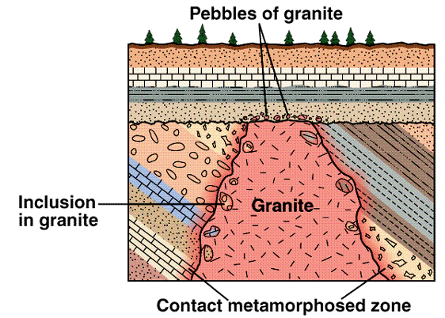
What’s the history here?

Slide 32
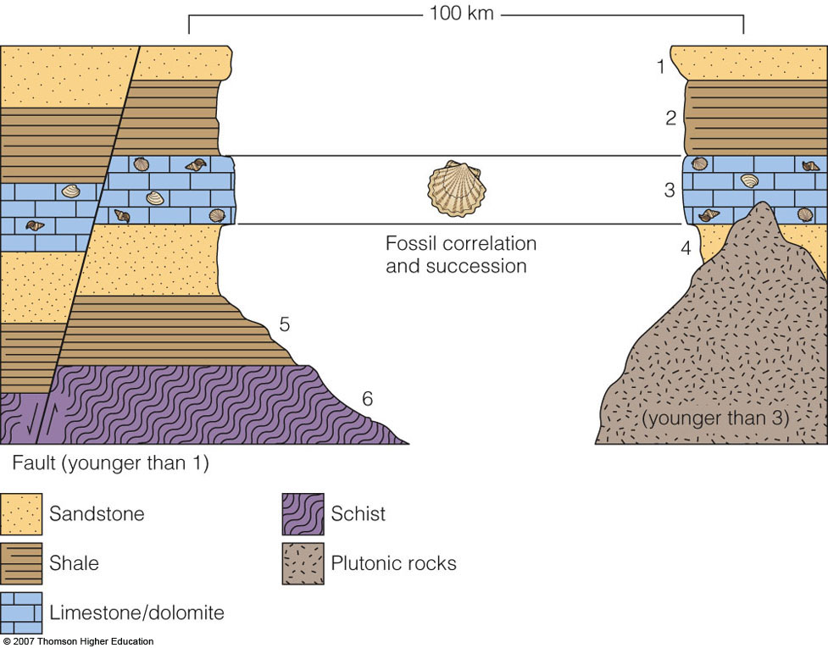
Notes:
Figure 2.23: Geologic cross sections illustrating the Laws of Superposition, Cross-cutting Relationships (intrusion and faulting), and Fossil Succession. The limestone beds are correlative because they contain the same fossils. The numerals indicate relative ages, with 1 being the youngest.

Slide 33
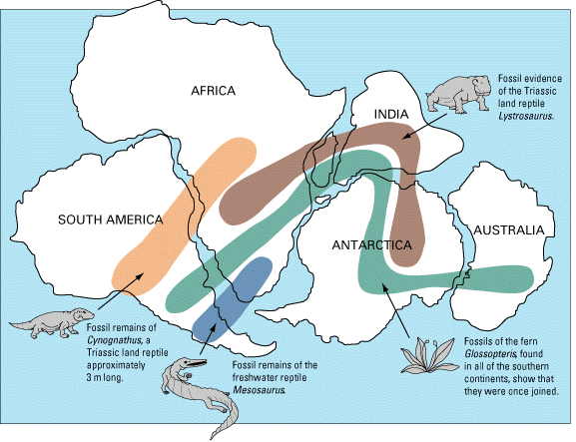

Slide 34
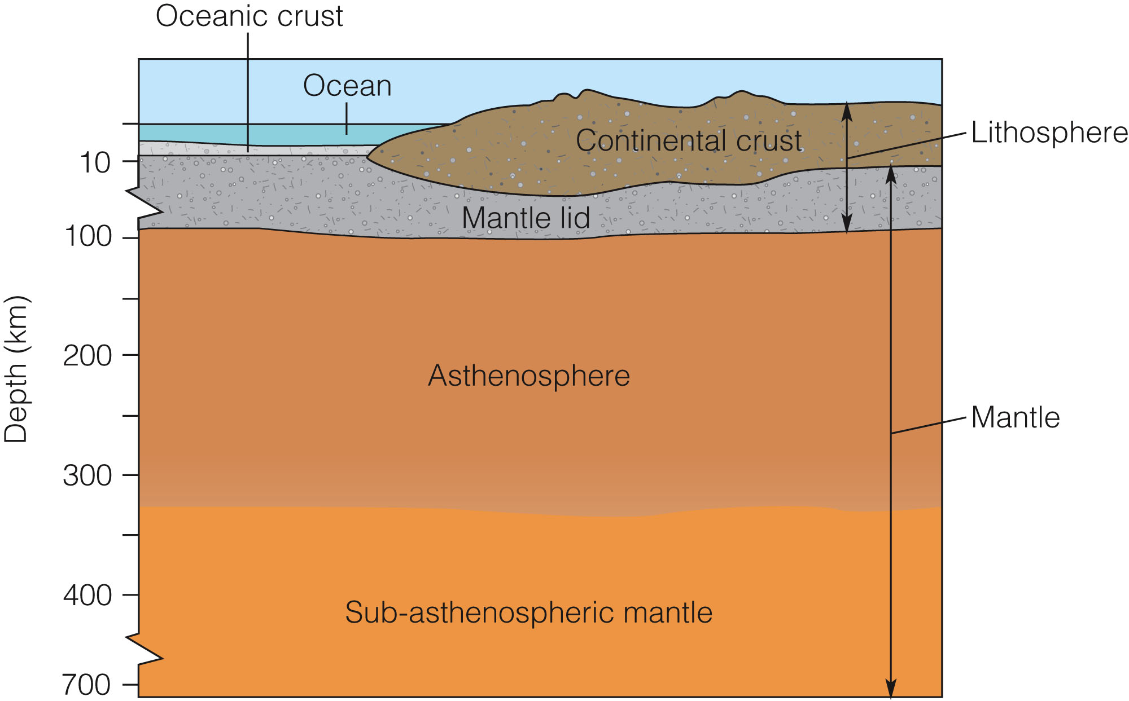
Notes:
Figure 3.21 Earth’s outer layers are divided into crust and mantle based on rock type, and into lithosphere and asthenosphere based on rigidity.

Slide 35
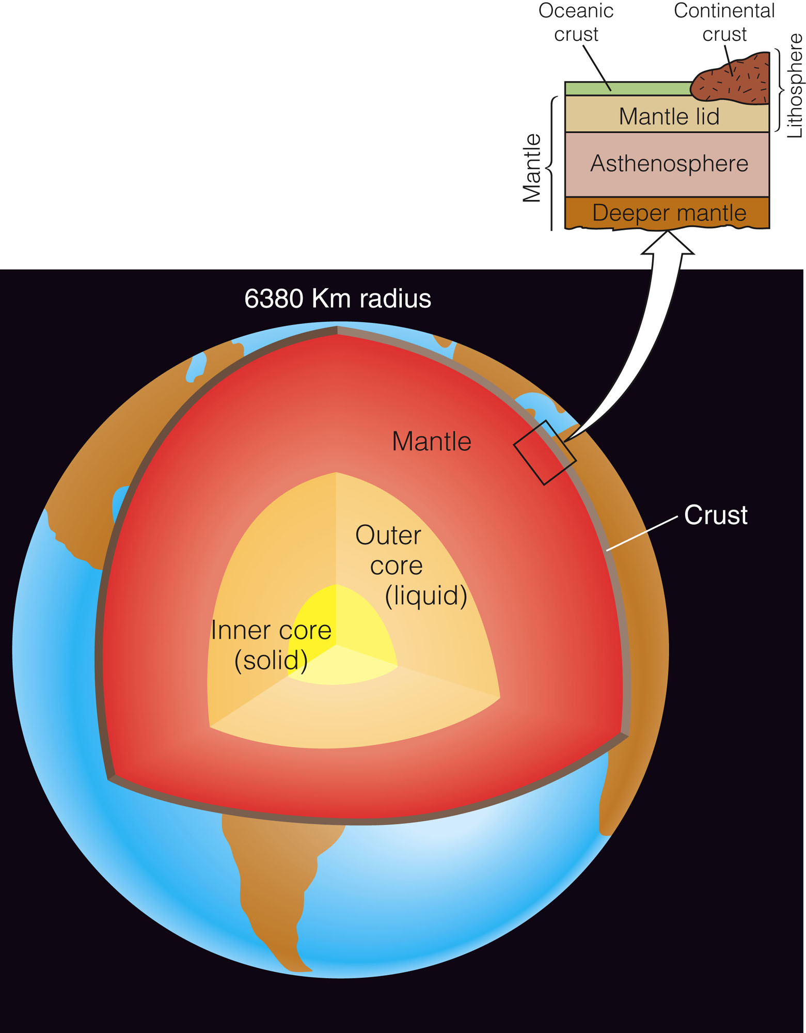
Notes:
Figure 3.20 Cross section of Earth’s interior.

Slide 36
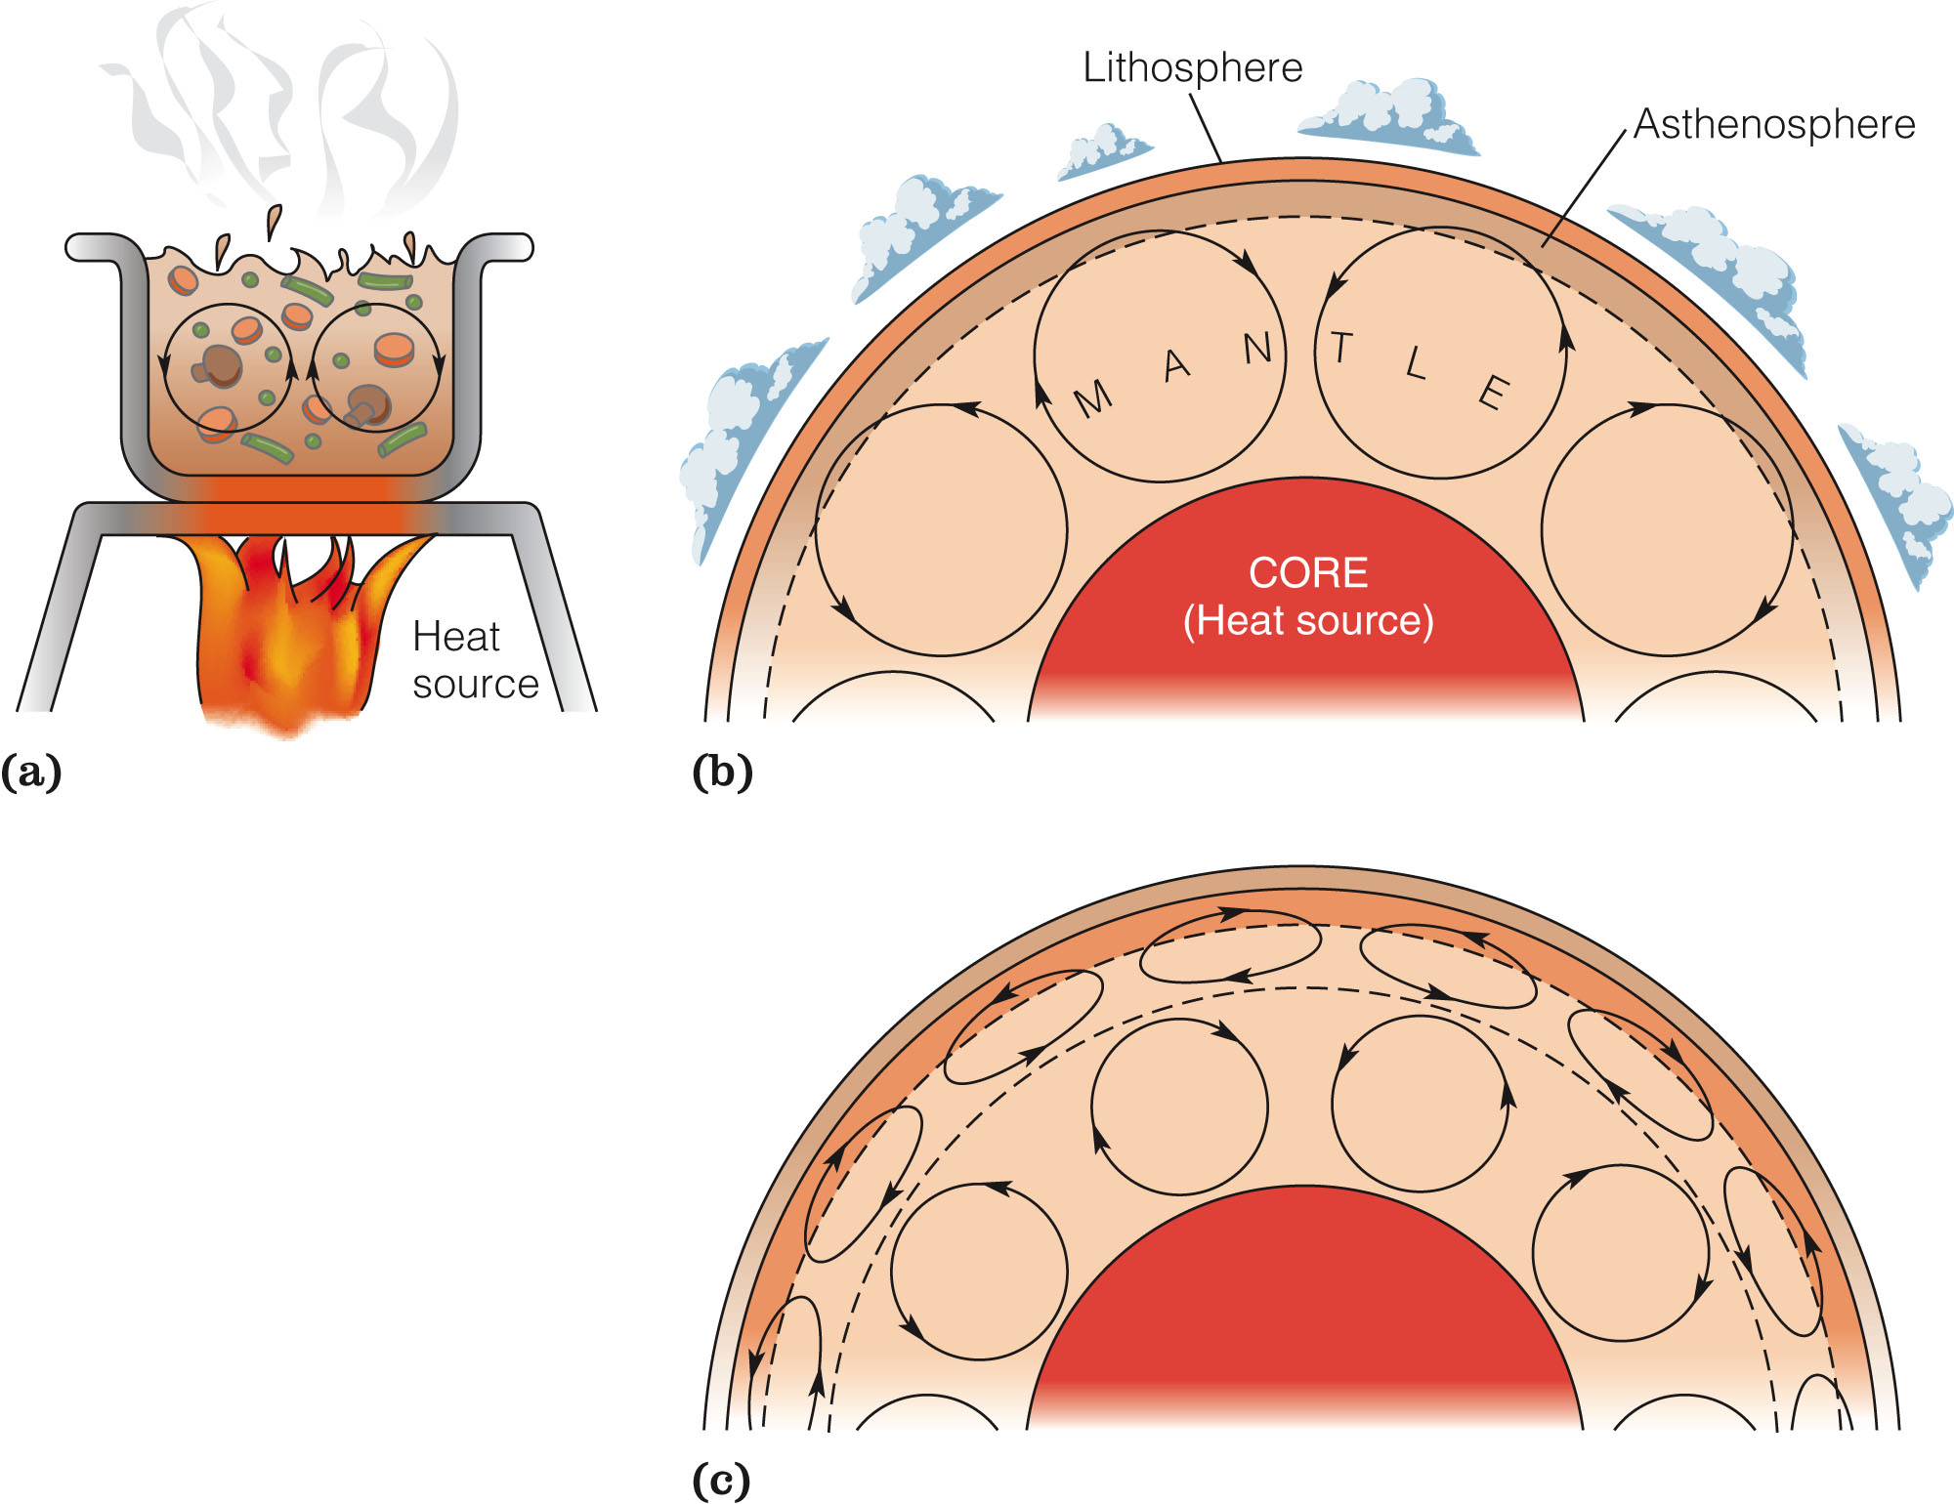
Notes:
Figure 3.22 Convection (a) in a pot of soup or rolled oats on a stove; (b) in the mantle, involving “whole mantle” overturn. (c) An alternate model of mantle convection involving multiple layers, which is probably closer to reality than (b).

Slide 37
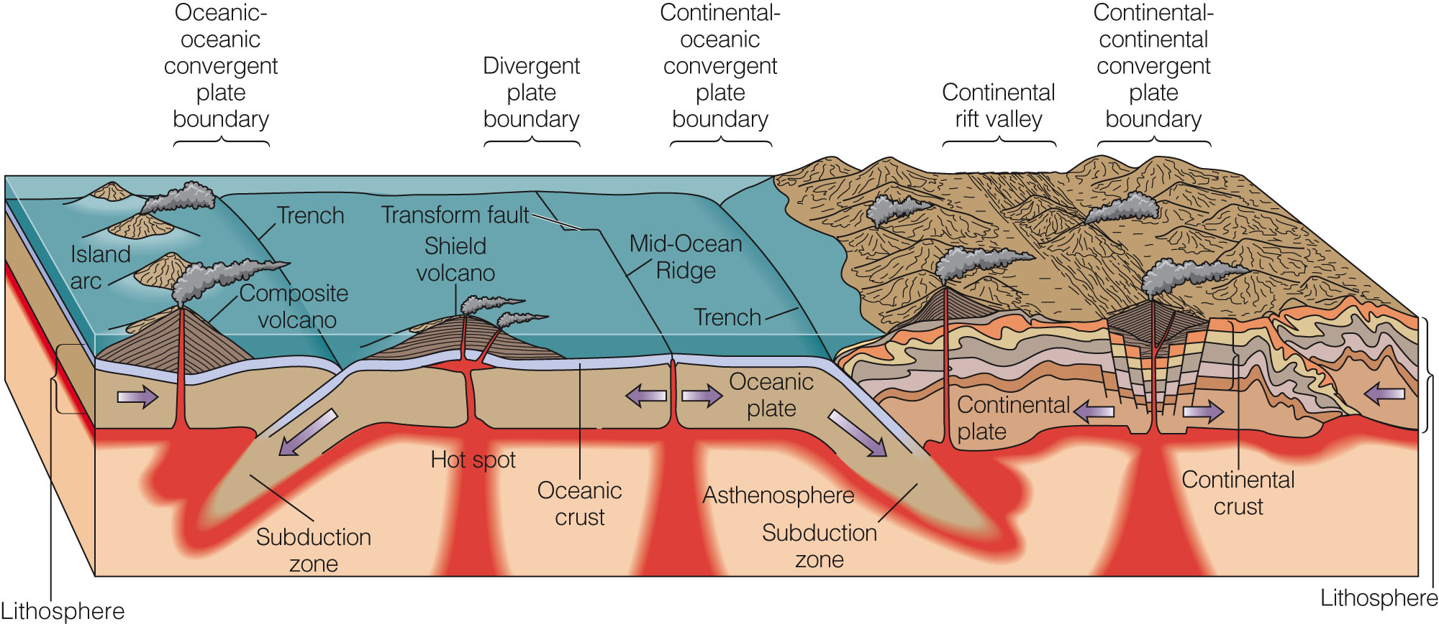
Notes:
Active Figure 3.24 The plate tectonic model. Divergent and convergent boundaries and their relationships to seafloor and continental volcanoes are shown. Transform faults on the seafloor are transform boundaries linking different segments of the Mid-Ocean Ridge. Rift-valley formation as a result of divergence under the continent is also shown.

Slide 38
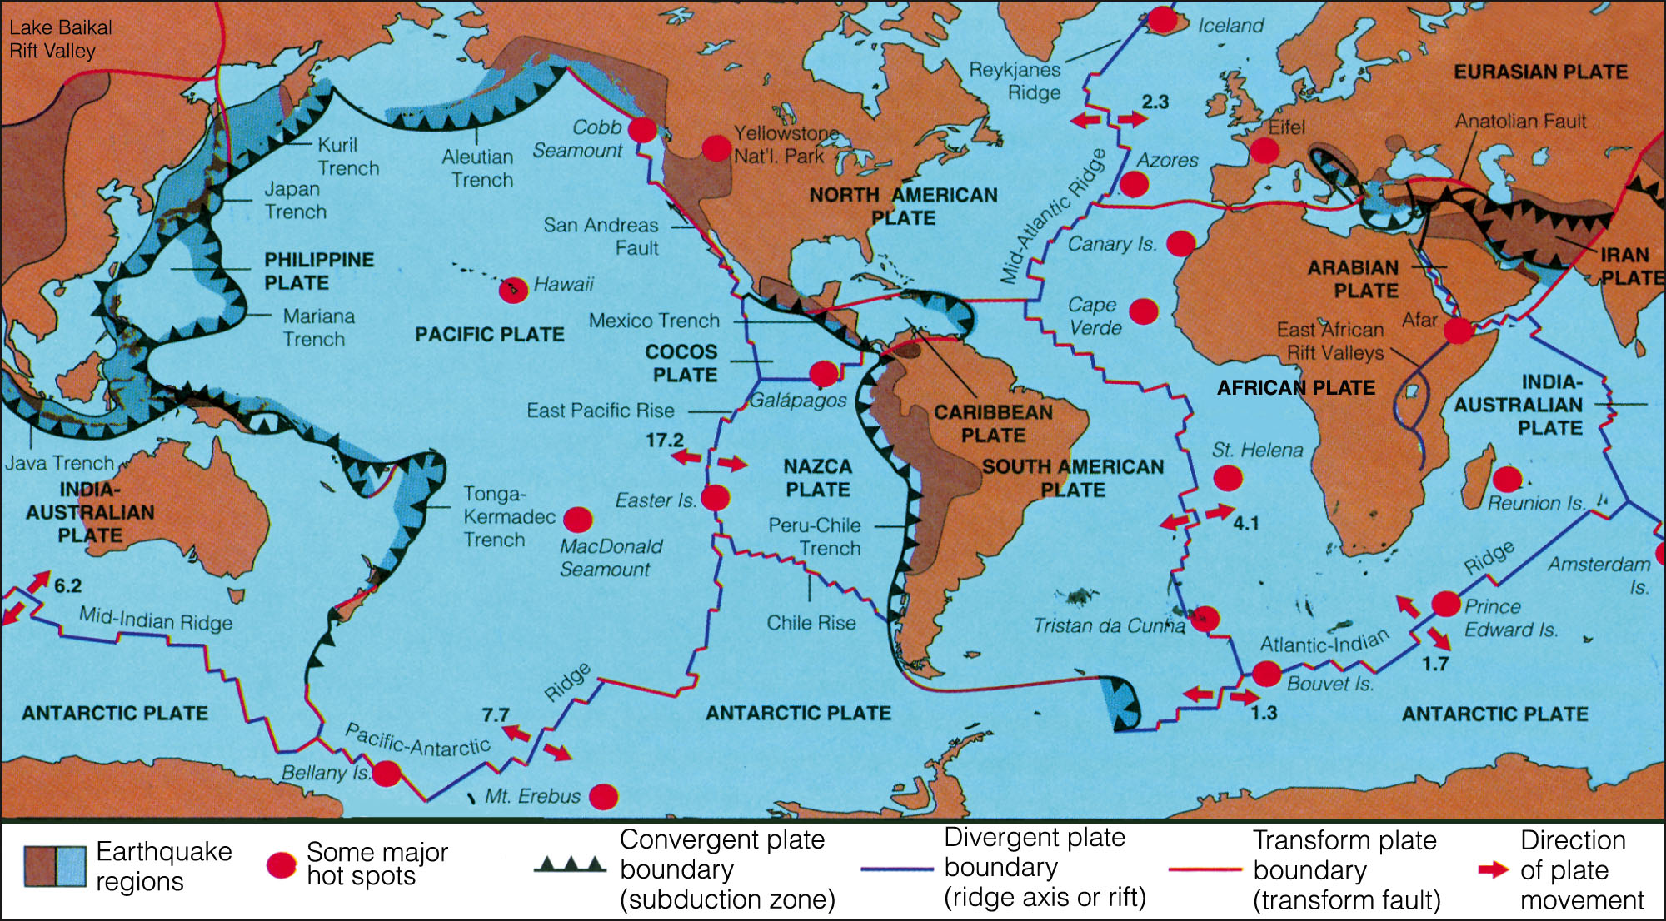
Notes:
Active Figure 3.23 Earth’s major tectonic plates and types of plate boundaries. Regardless of the type of plate boundary, each one is delineated by earthquake epicenters (not shown). The arrows indicate the present direction of plate motion; the numbers, the rate of spreading in centimeters per year. The rate of spreading is determined by dividing the distance to a magnetic anomaly (or rock) of known age in kilometers (3x105=cm) by the age of that anomaly in years (5 cm/yr).

Slide 39
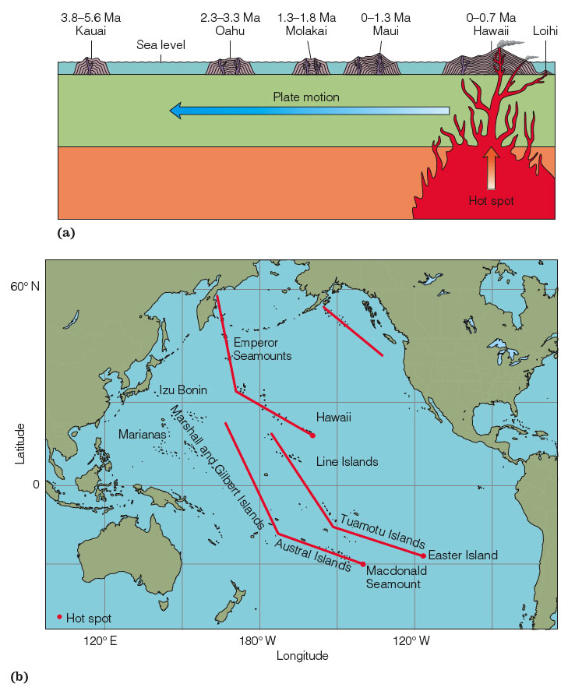
Notes:
Active Figure 3.26 (a) Cross section of six islands formed and forming over the Hawaiian hot spot. The Hawaiian Islands are sequentially older in a northwest direction. The new volcano, Loihi, is forming under water off the southeast end of the Hawaiian chain. (b) Kinked hot spot trajectories in the Pacific. The kink in each island chain occurred about 40 million years ago due to a change in the Pacific plate’s direction of motion. From MURPHY/NANCE. Earth Science Today, 1E. © 2001 Wadsworth, a part of Cengage Learning, Inc. Reproduced by permission. www.cengage.com/permissions

Slide 40
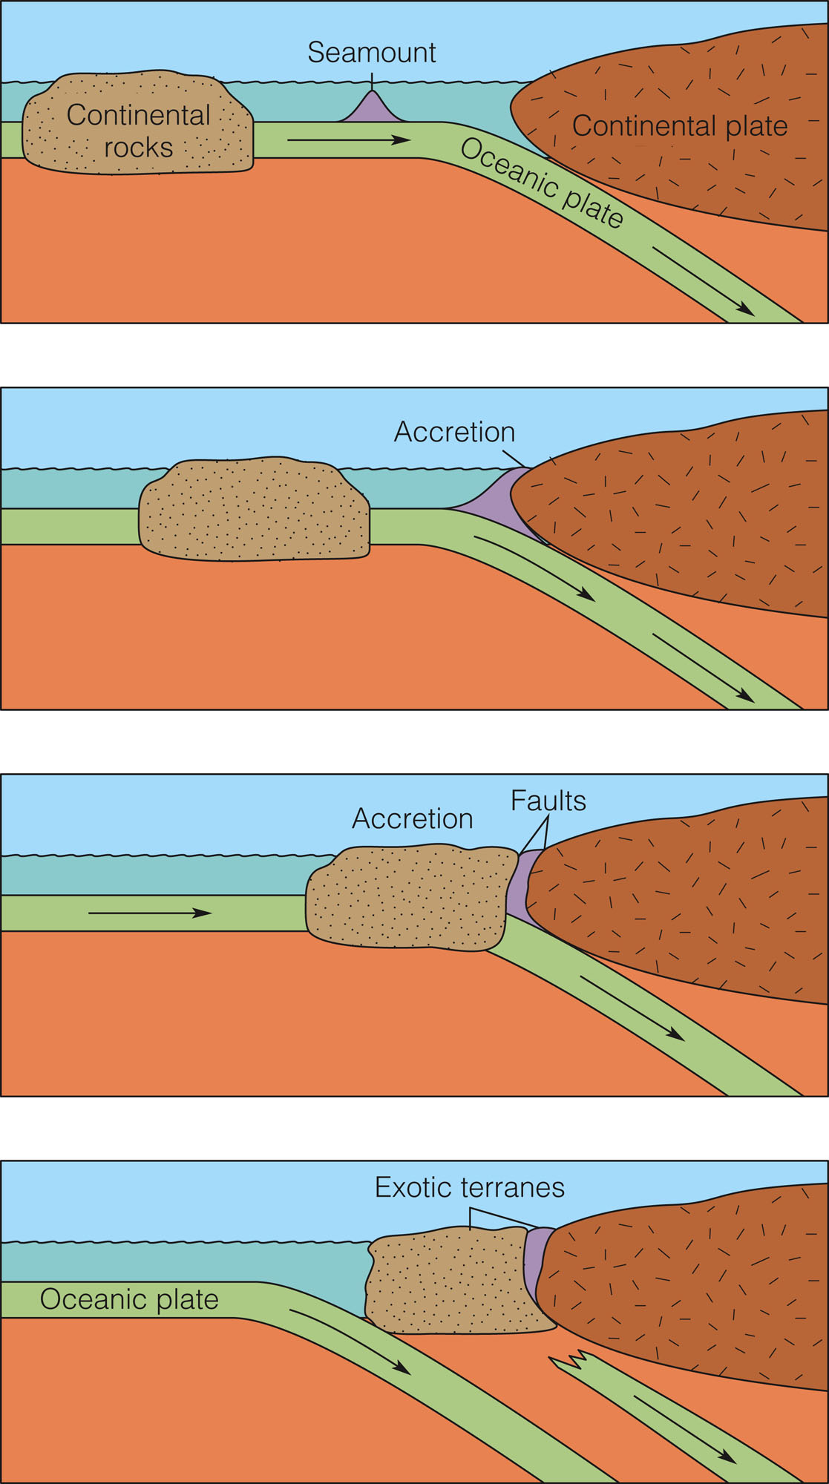
Notes:
Figure 3 Formation of exotic terranes by a small continental mass and a submarine volcano being scraped off from the subducting plate and onto the continental mass. Many portions of the west coasts of the United States and Canada have grown in this manner.

Slide 41
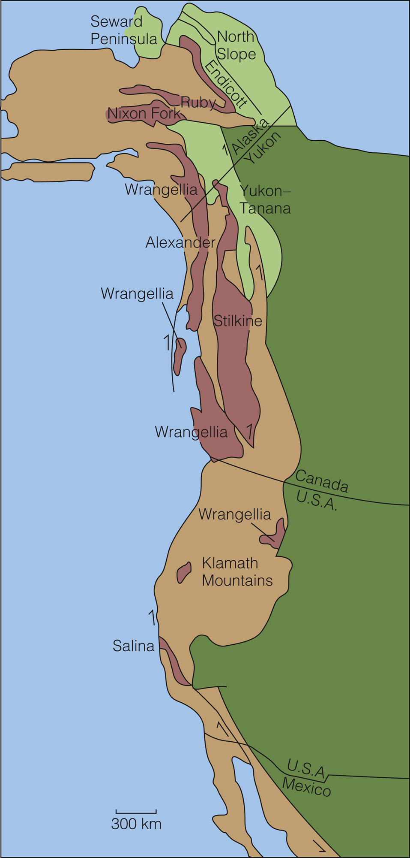
Figure 1, p. 71
Notes:
Figure 1 Accreted terranes of the west coast of the United States and Canada. The Salina, Wrangellia, Alexander, Stikine, Klamath Mountains, Ruby, and Nixon Fork blocks (dark brown) were probably once parts of other continents and have been displaced long distances. The terranes shown as light-green areas are probably displaced parts of North America, the stable North American craton (darker green). The lighter-brown areas represent rocks that have not traveled great distances from their places of origin.

Slide 42
Absolute age: Radiometric dating
Radioactive decay of elements in rocks and minerals allows the absolute dating of geologic events, such as volcanic eruptions and species extinctions

Slide 43
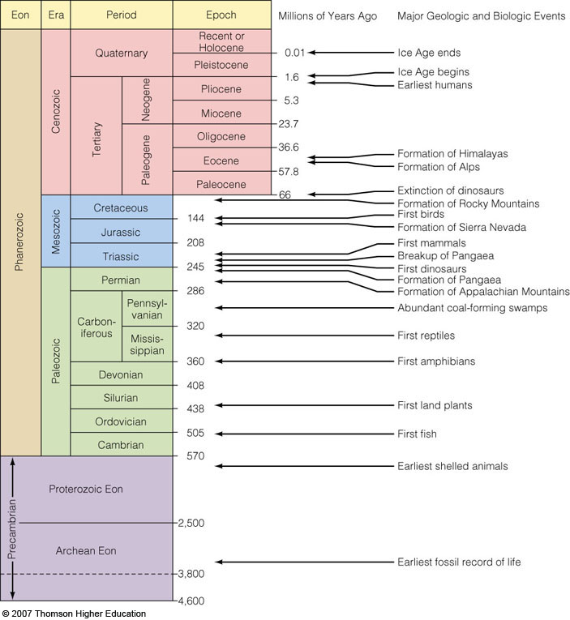
Fig. 2-24, p. 32
Notes:
Figure 2.24: Geologic time scale.
Adapted from A. R. Palmer, Geology, 1983, 504.

Slide 44
Age of the Earth
The Acasta Gneiss of Canada is 3.96 b.y. old
Detrital zircons from western Australia are 4.0-4.3 b.y. old

