Slide 1
Coastal Environments and Humans

Slide 2
The Shoreline: A Dynamic Interface
The shoreline is a dynamic interface (common boundary) between air, land, and the ocean
The shoreline is constantly being modified by wind-generated waves
Today the coastal zone is experiencing intense human activity

Slide 3
Waves
Waves
Energy traveling along the interface between ocean and atmosphere
Most waves derive their energy and motion from wind
Parts and Characteristics
Crest
Trough
Wave Base is the depth below which there is no motion associated with a particular wave

Slide 4
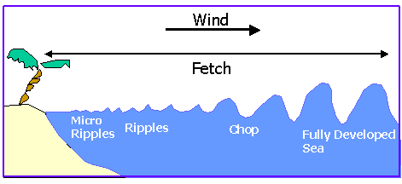
Waves
Wind-generated waves provide most of the energy that shapes and modifies shorelines
Height, length, and period of a wave depend on:
Wind speed
Length of time (Duration) wind has blown
Fetch: the distance that the wind has traveled across open water

Slide 5
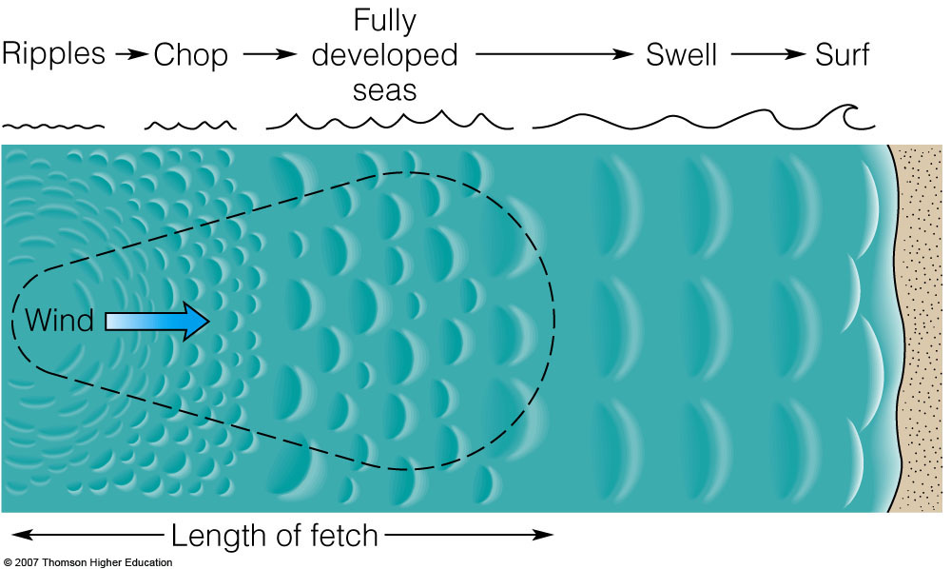
Wind blowing over water creates:

Slide 6
Deep Water Motion
As the wave travels, the water passes energy along by moving in a circle
In deep water, the energy does not carry the water molecules along

Slide 7
More Wave Characteristics
Wave height (H)
The distance between a trough and a crest
Equal to the diameter of circular motion!
Wavelength (L)
The horizontal distance between successive crests (or troughs)
Velocity (V)
Speed of the wave through the water
Wave period (T)
The time interval for one full wave to pass a fixed position

Slide 8
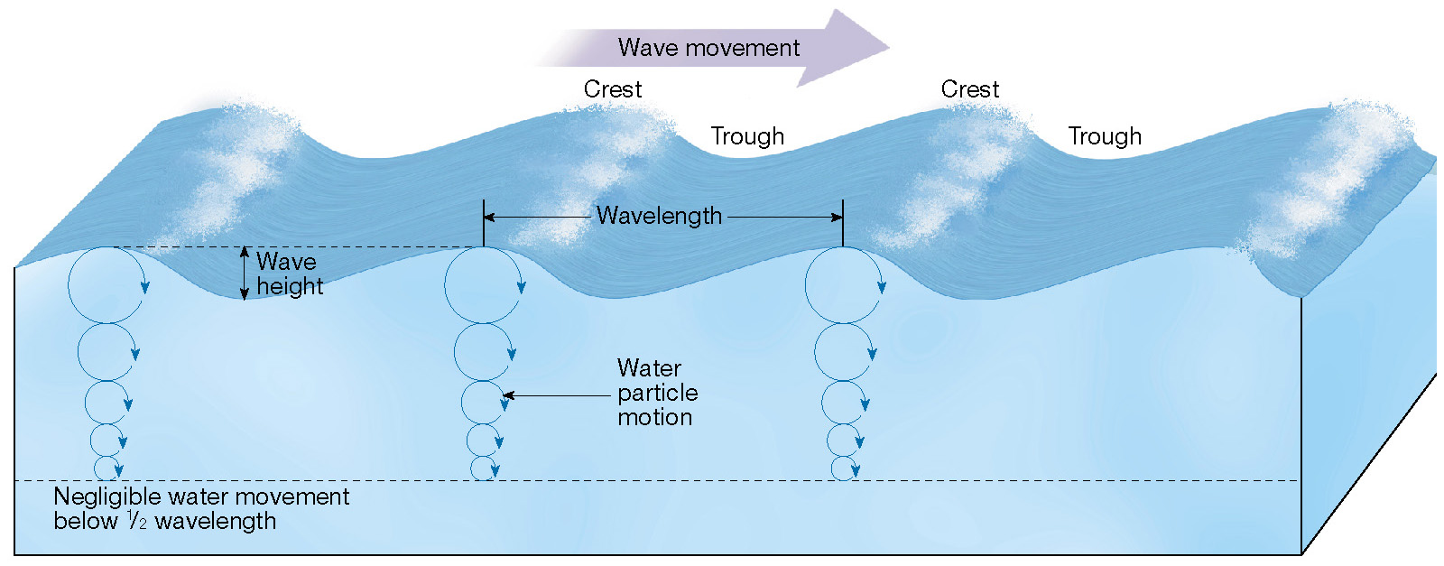
Characteristics and Movement of “Deep-water” Waves

Slide 9
Wave Motion
Water movement within waves
Oscillation (Orbital Motion)
Wave energy moves forward, not the water itself
Occurs in the open sea in deep water
Translational motion
Begins to form in shallower water when the water-depth is about one-half the wavelength and the wave begins to “feel bottom”
Surge of water when the wave breaks

Slide 10
Wave Motion
Translational Motion
As the speed and length of the wave diminish, the wave grows higher
The steep wave front collapses and the wave breaks along the shore
Turbulent water advances up the shore and forms surf
“Moving Water Carries Particles”

Slide 11
Changes That Occur When a Wave Moves onto Shore
BEACH is defined by:

Slide 12
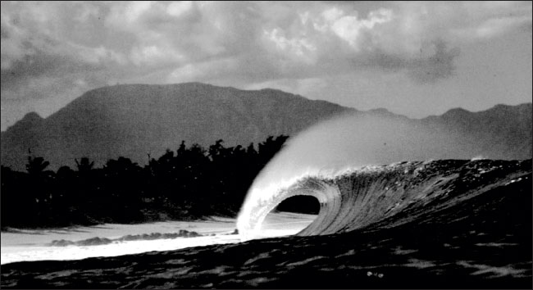
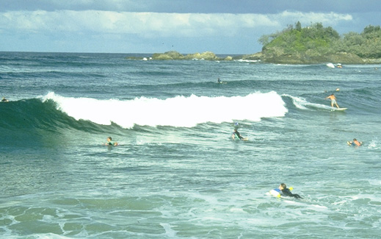
Types of Breakers
Water physically moves shoreward when waves break in the surf zone
Plunging Breakers - steep offshore slopes
Spilling Breakers - gentle offshore slopes

Slide 13
Wave refraction and longshore transport
Wave refraction
Bending of a wave as it changes velocity
Causes waves to arrive nearly parallel to the shore
Consequences of wave refraction
Wave energy is concentrated against the sides and ends of headlands

Slide 14
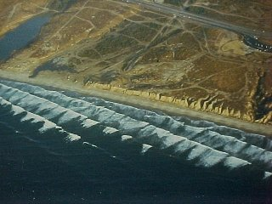
Wave Refraction Along a Straight Coastline

Slide 15
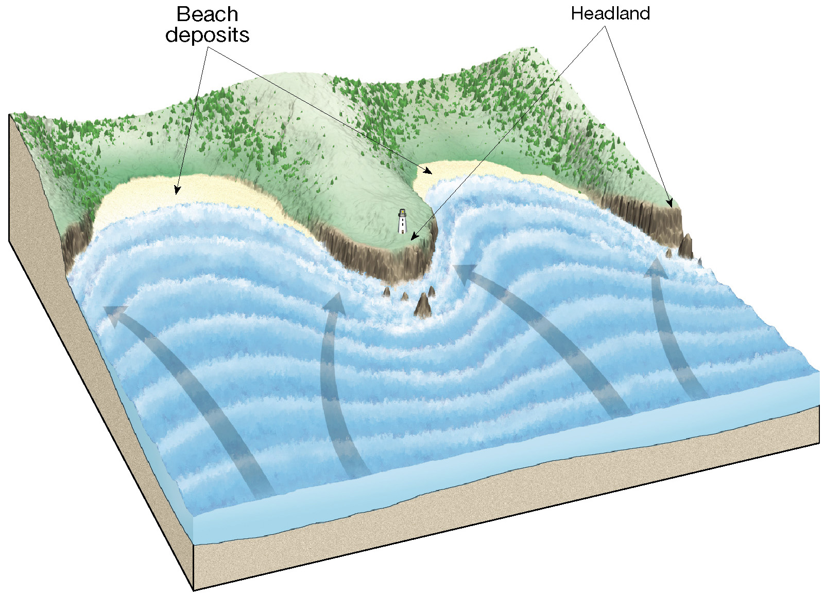
Wave Refraction Along an Irregular Coastline
Figure 10.12

Slide 16
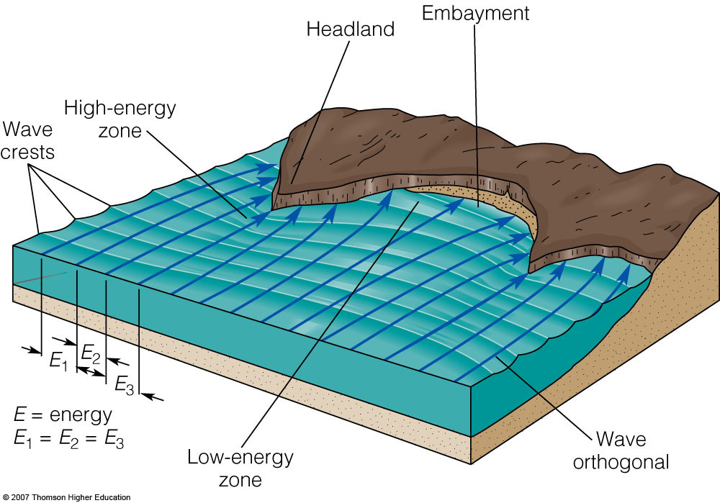

Slide 17
Beaches and Shoreline Processes
Longshore transport
Beach drift—Sediment moves in a zigzag pattern along the beach face
Longshore current
Current in surf zone
Flows parallel to the shore
Moves substantially more sediment than beach drift
Wave Energy drives these!
Waves get energy from the Wind…

Slide 18
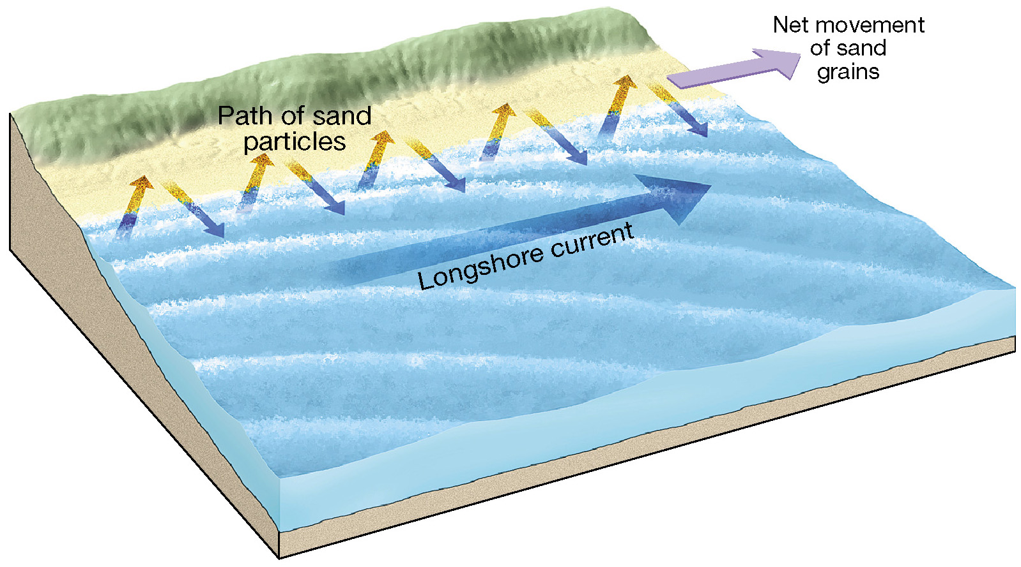
Beach Drift and Longshore Currents
Figure 10.13

Slide 19
Beaches and Budgets
Beaches are composed of whatever material is available
Beach Sand Comes and Goes
Input from three major sources
MOST material comes from Streams
Some beaches have a significant biological component
Last Resort: Cliff Erosion!

Slide 20
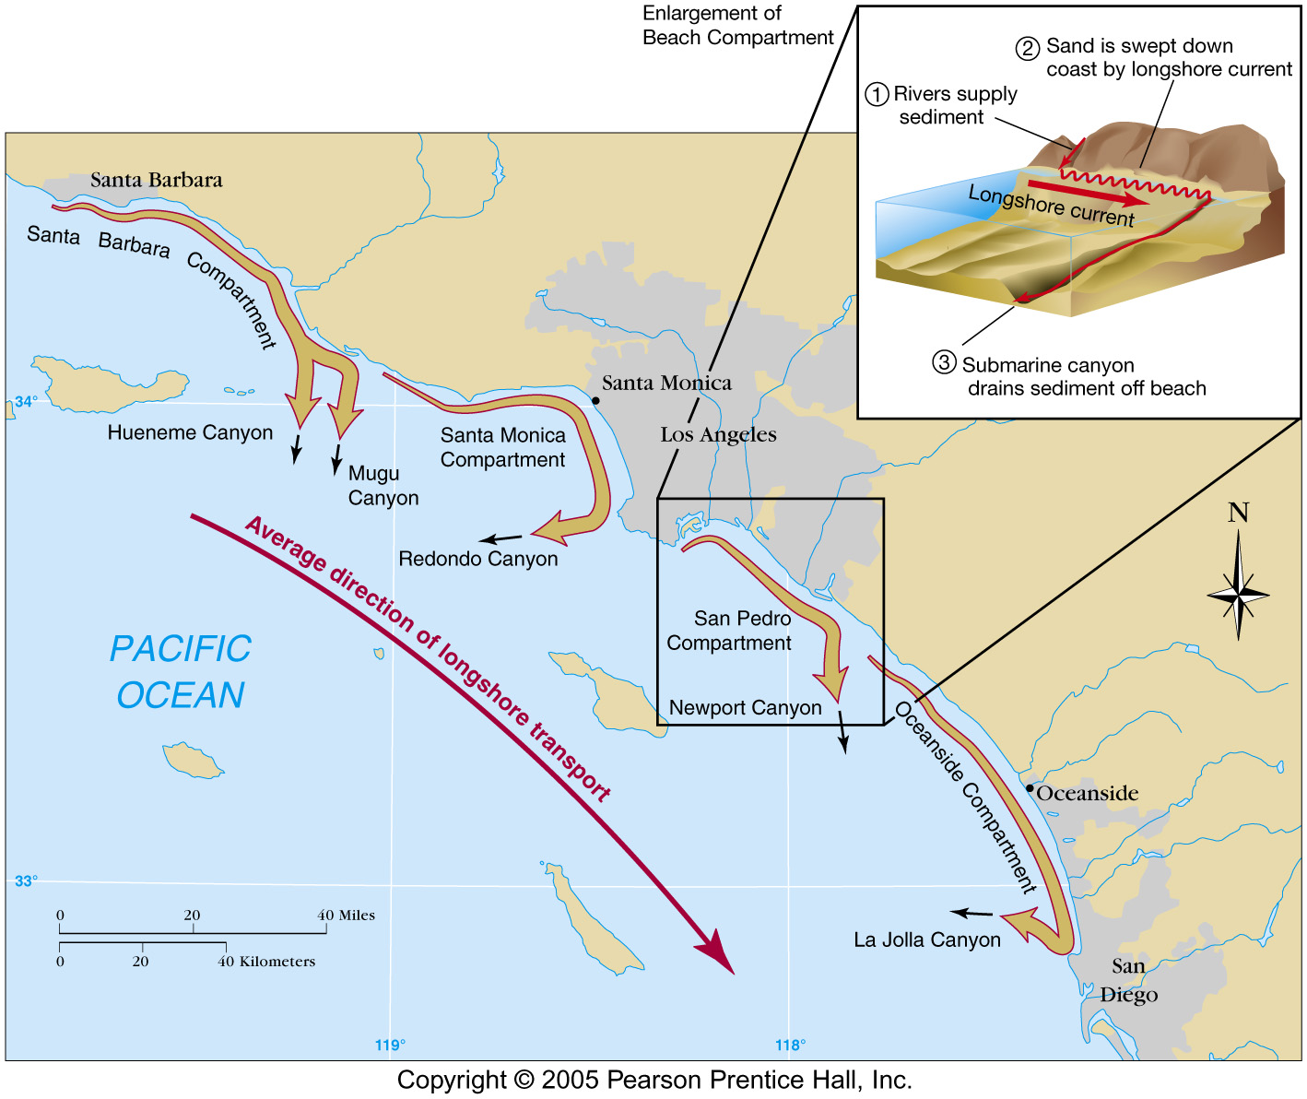
Beaches and Budgets
Material does not stay in one place
Sand on the beach is like money in the bank
Moves around via long-shore current, beach drift
Sand leaves the beach by two major processes
Beach → Compartments and Sedimentary Budgets

Slide 21
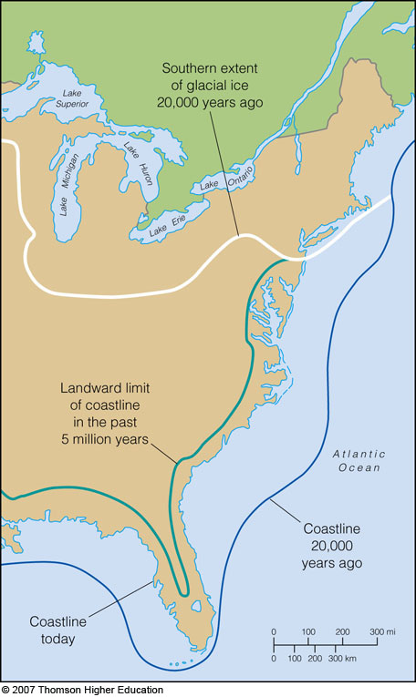
Shoreline features
Features vary depending on several factors including
The rocks, sand and other sedimentary materials along the shore
Currents
Wave intensity
Whether the coast is stable, sinking, or rising relative to sea level (glaciation?)

Slide 22
Beach Erosion
Sand supply has diminished
Humans take it away in some places
Drought
Dams?
Rising sea level

Slide 23
Erosional Shoreline Features
Erosional features include:
Wave-cut cliff
Wave-cut platform
Marine terraces are uplifted platforms
Features associated with headlands
Sea arch
Sea stack

Slide 24
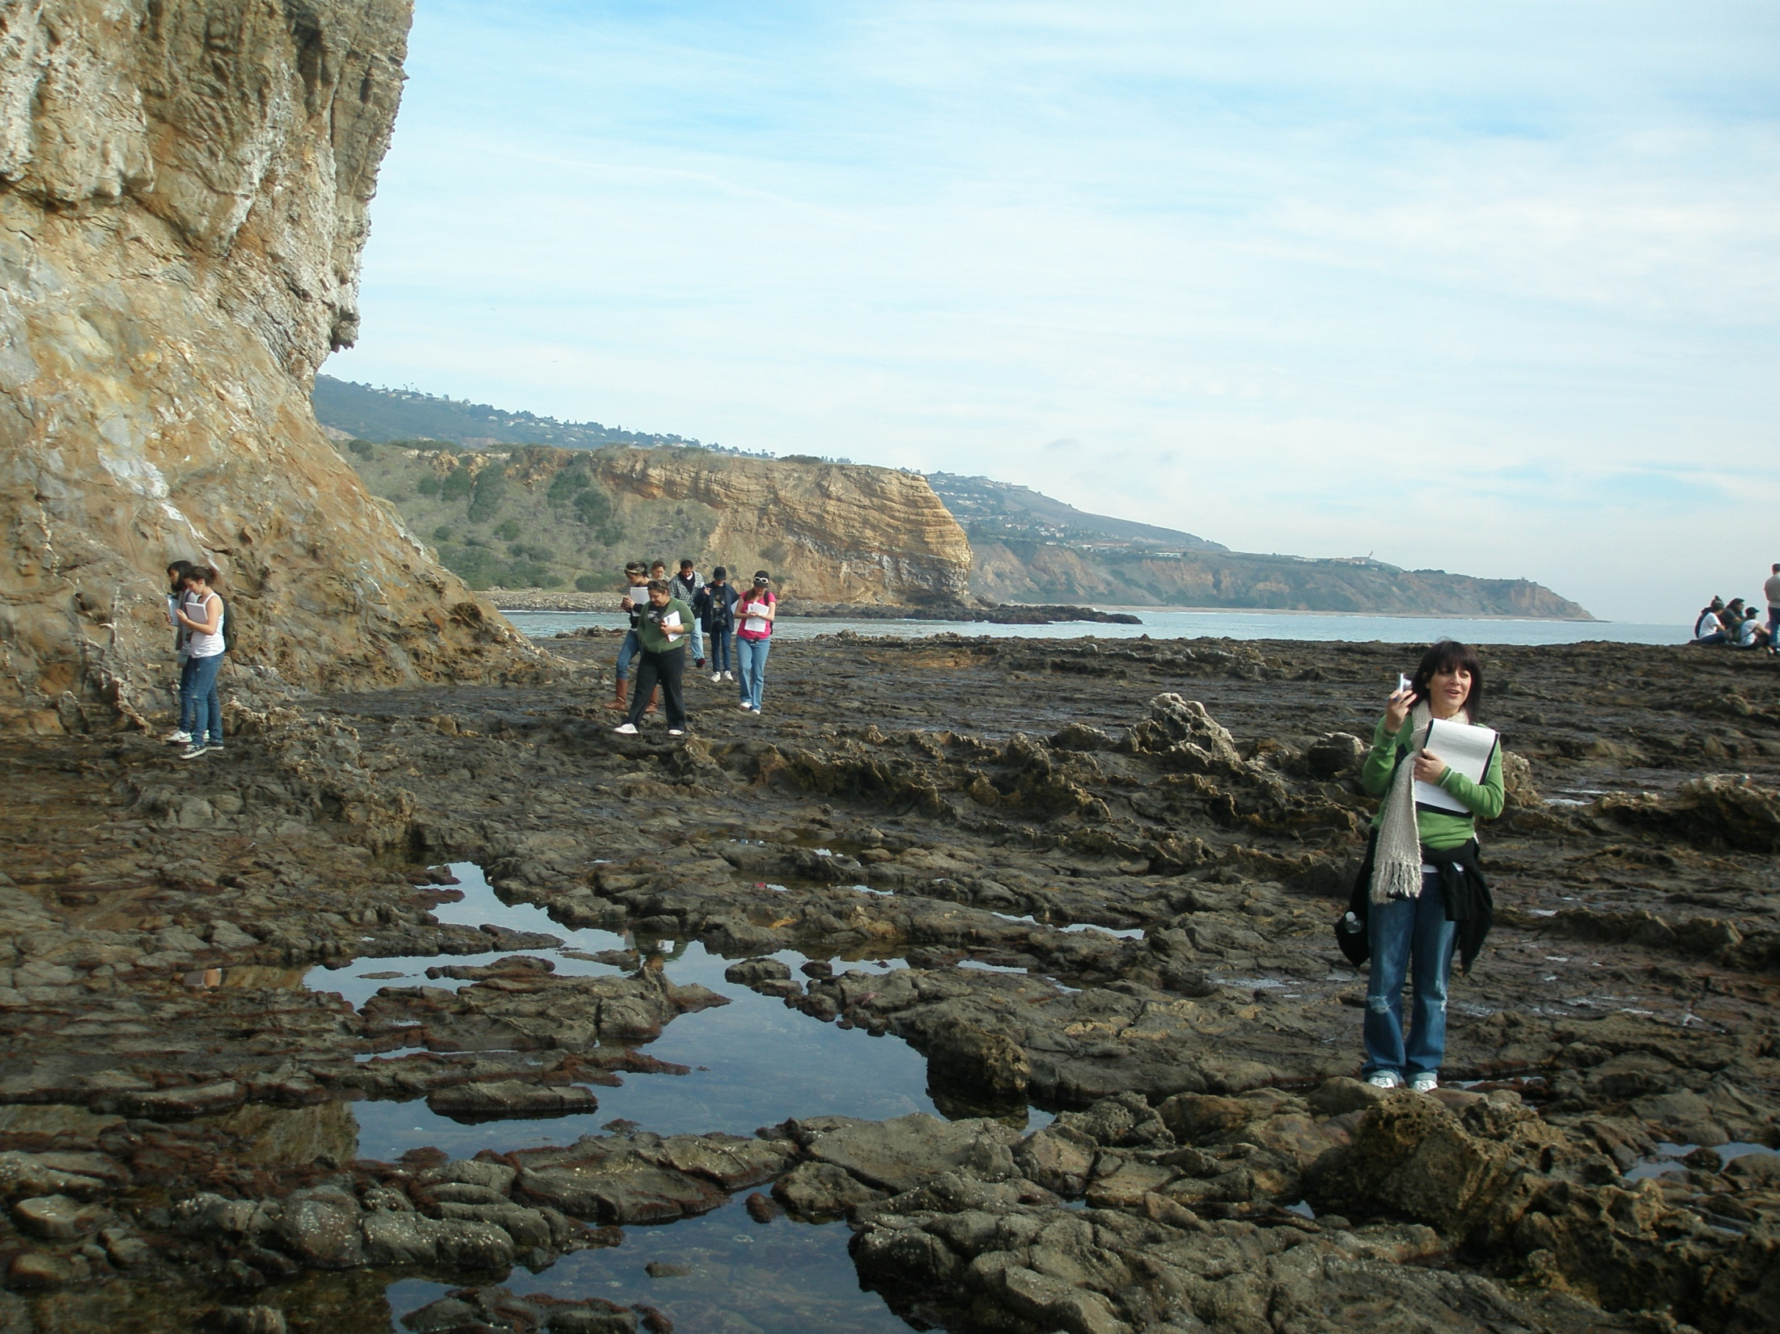
Sea Cliff/Wave-cut Platform
formed and/or maintained by wave action
Erosion rates of cm to tens of cm per year

Slide 25
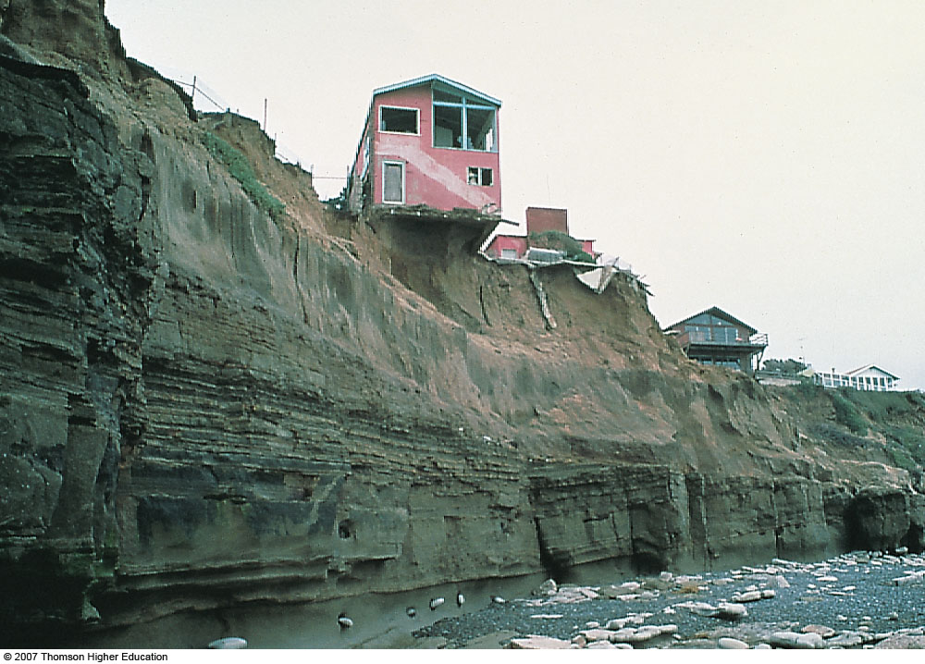
San Diego County
Notes:
Figure 10.23b: Drastic undercutting by wave action has left this house in San Diego County, California, in a precarious position. The near-vertical cliff and the rounded cobbles at the base indicate that this is an active sea cliff.

Slide 26
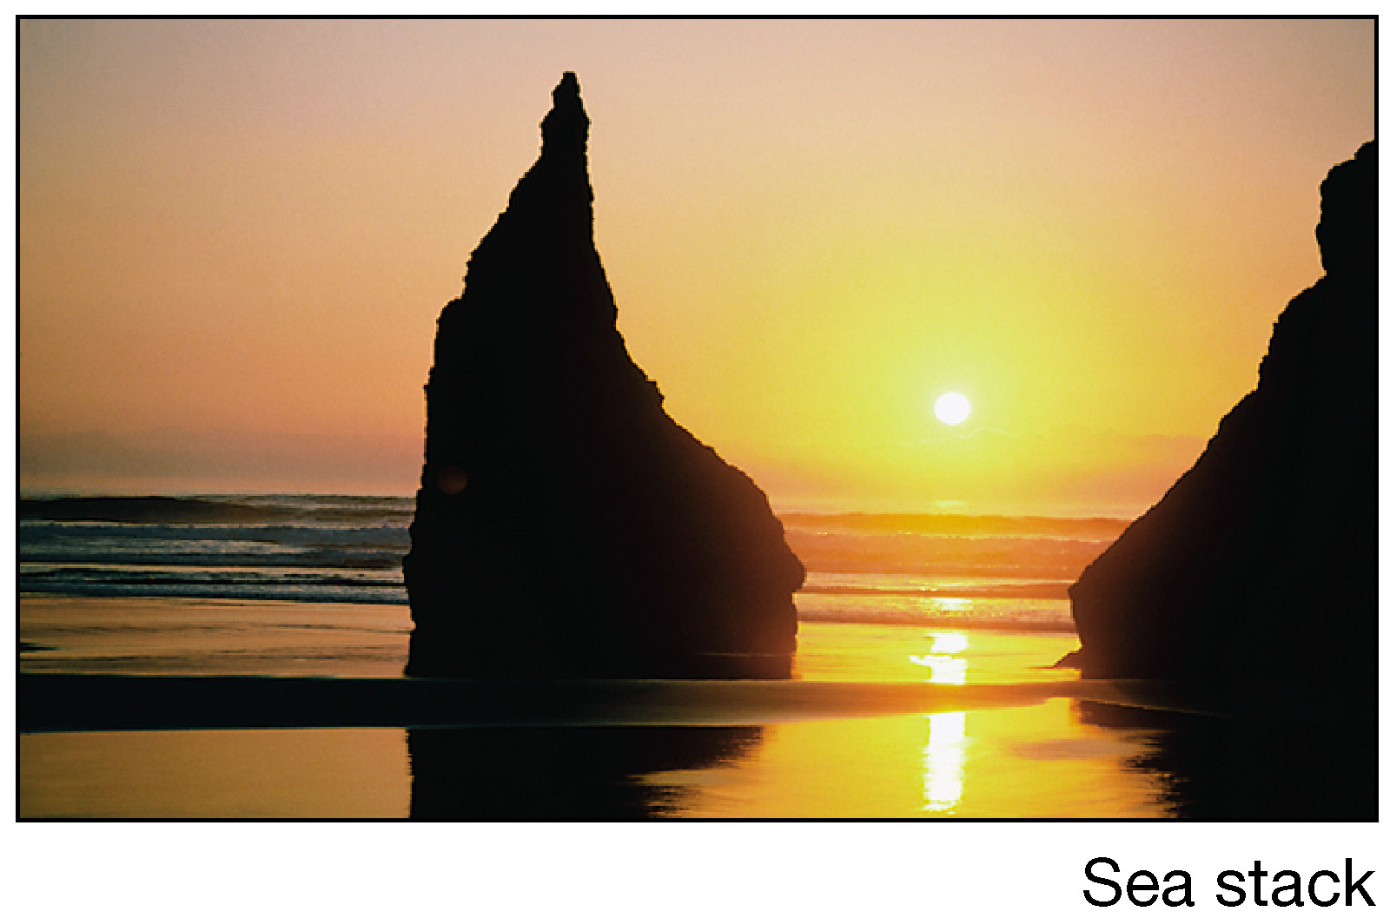
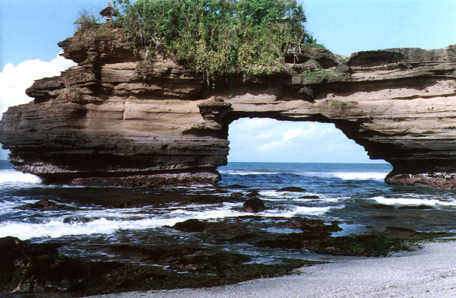
<- Sea Arch

Slide 27
Shoreline Features
Depositional features
Spit —A ridge of sand extending from the land into the mouth of an adjacent bay with an end that often hooks landward
Baymouth bar —A sand bar that completely crosses a bay
Tombolo—A ridge of sand that connects an island to the mainland

Slide 28
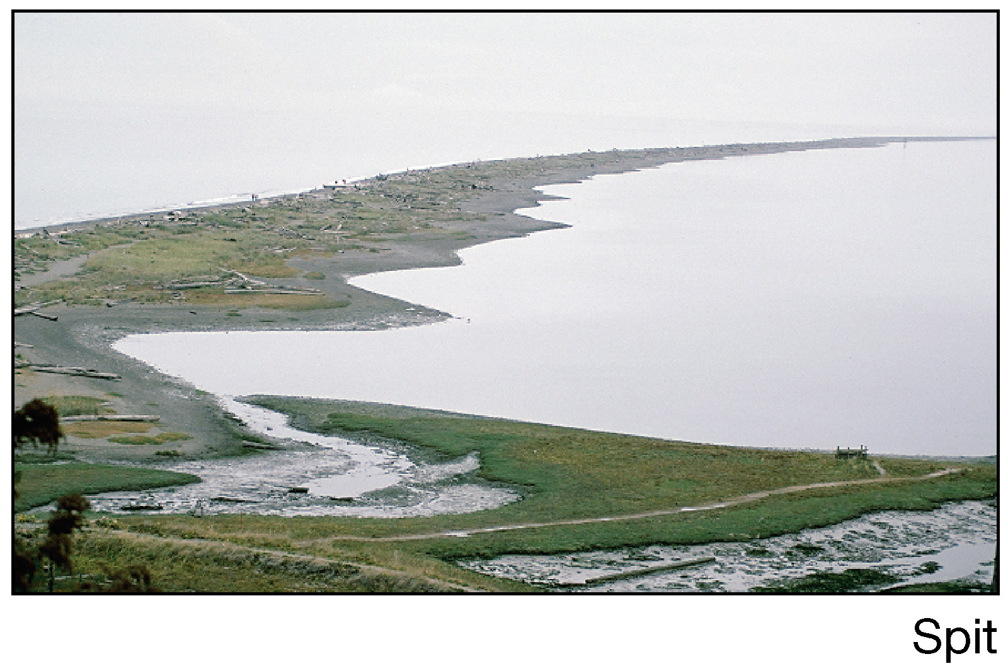
Spit
Figure 10.18

Slide 29
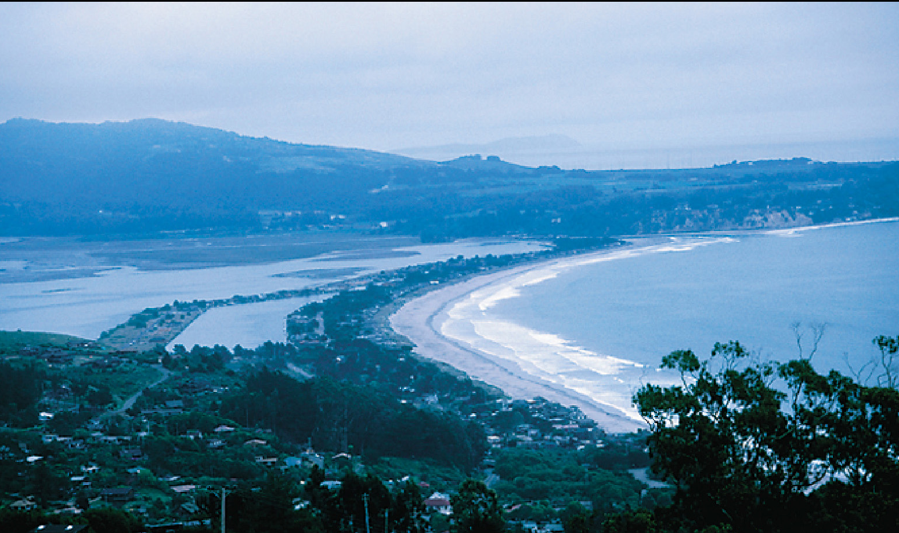
Baymouth Bar

Slide 30
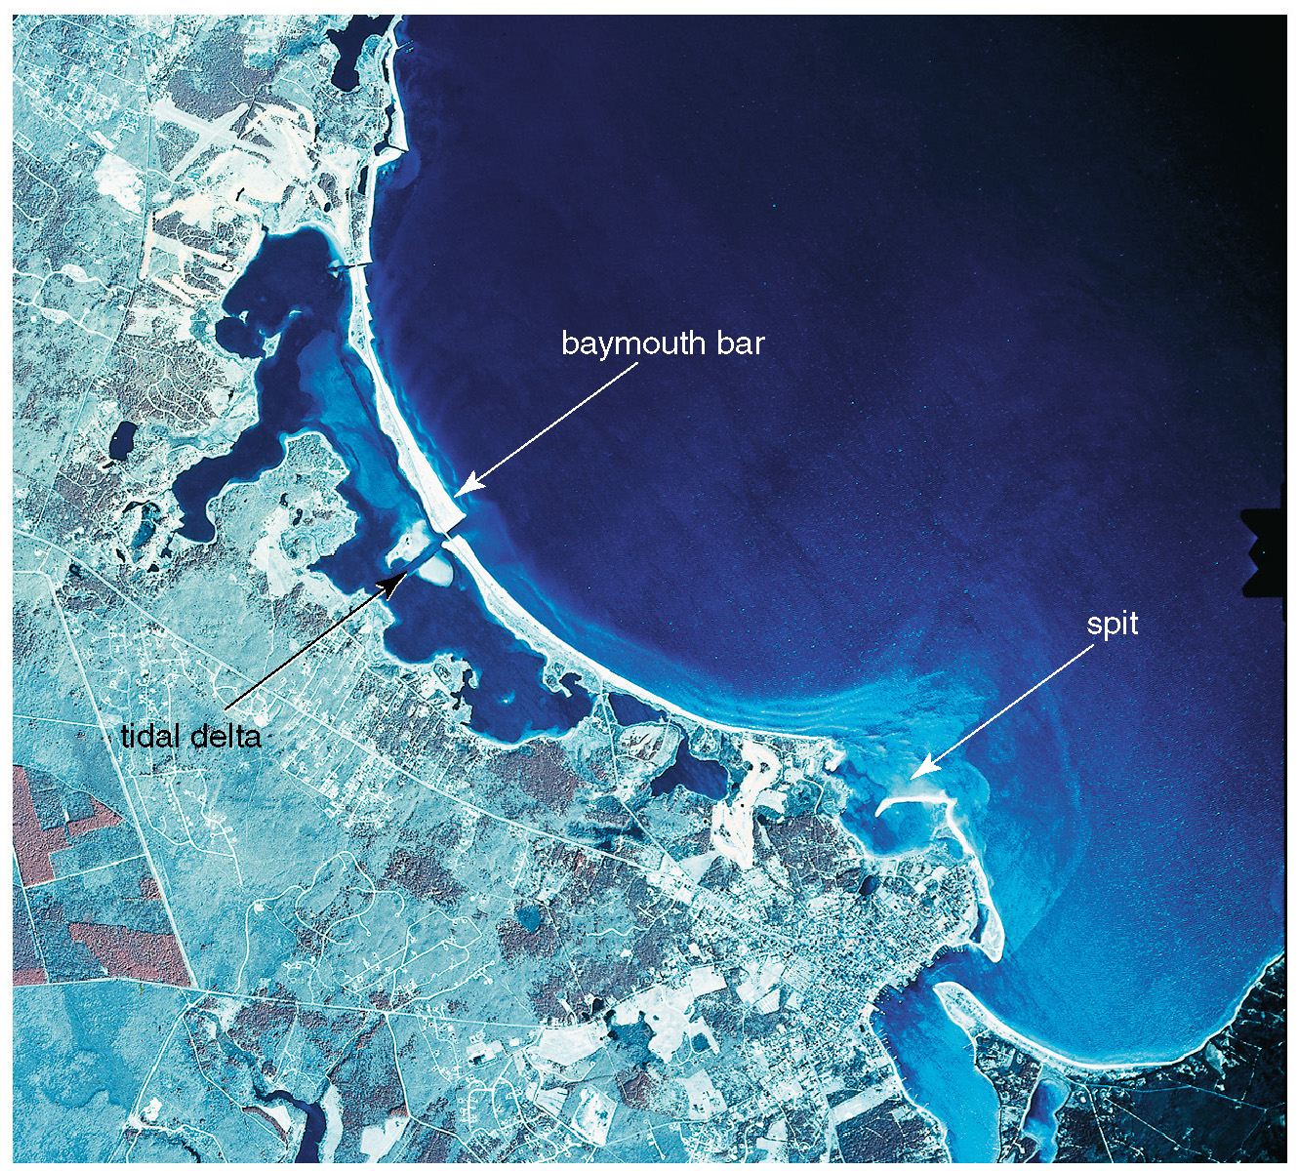
Aerial View of a Spit and Baymouth Bar Along the Massachusetts Coastline

Slide 31
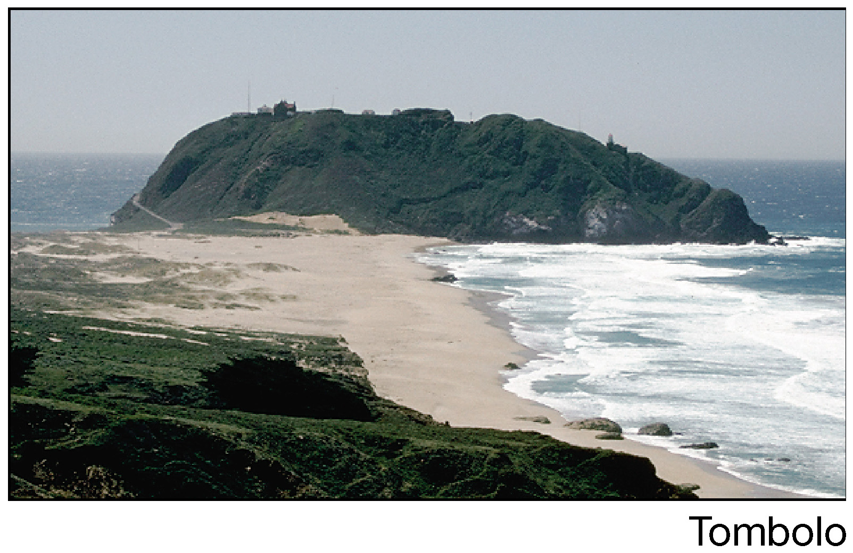
Tombolo
Figure 10.18

Slide 32
Estuaries
Basins open to the sea in which fresh water mixes with seawater

Slide 33
Estuaries
Coastal-plain estuaries, drowned river valleys
Chesapeake Bay
Fiords, drowned glacial valleys

Slide 34
Estuaries
Block-faulted estuaries - San Francisco Bay
Bar-formed estuaries landward of barrier beaches
Estuaries and wetlands are areas of high biological productivity
CA has lost 95% of its estuaries!

Slide 35
Stabilizing the Shore
Shoreline erosion is influenced by the local factors:
Proximity to sediment-laden rivers
Degree of tectonic activity
Topography and composition of the land
Prevailing wind and weather patterns
Configuration of the coastline

Slide 36
Stabilizing the Shore
Erosion problems along U.S. Coasts
Shoreline erosion problems are different along the opposite coasts
Atlantic and Gulf Coasts
Development occurs mainly on barrier islands
Face open ocean
Receive full force of storms (hurricanes)
Development has taken place more rapidly than our understanding of barrier island dynamics

Slide 37
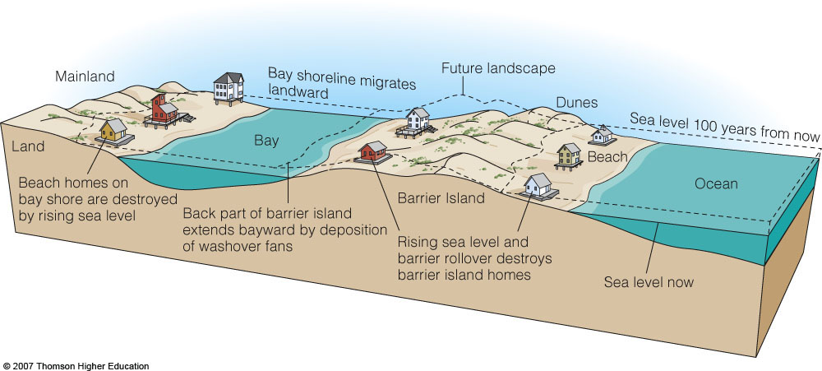
Barrier Islands

Slide 38
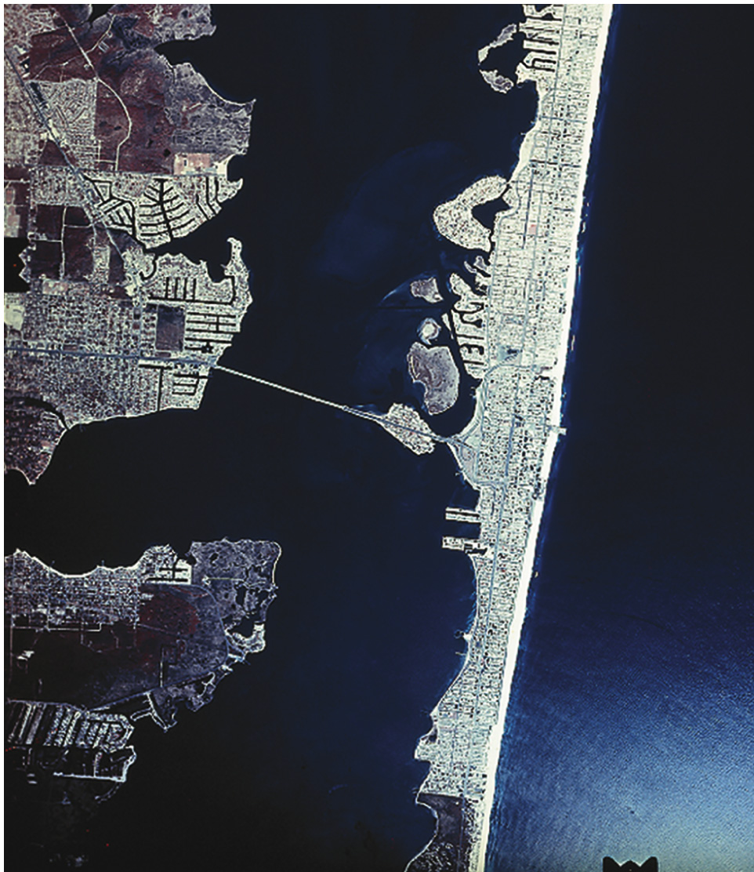
Barrier Island Urban Development
Texas
New Jersey

Slide 39
Stabilizing the Shore
Erosion problems along U.S. Coasts
Pacific Coast
Characterized by relatively narrow beaches backed by steep cliffs and mountain ranges
Major problem is the narrowing of the beaches
Sediment for beaches is interrupted by dams and reservoirs
Rapid erosion occurs along the beaches
Sedimentary Budget has been upset!

Slide 40
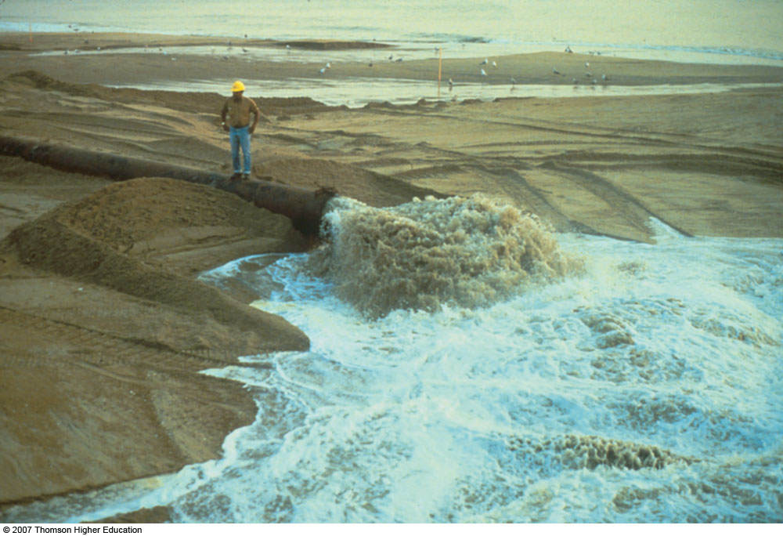
Stabilizing the Shore
Soft Stabilization
Alternative to hard stabilization
Beach nourishment involves adding sand to the beach system

Slide 41
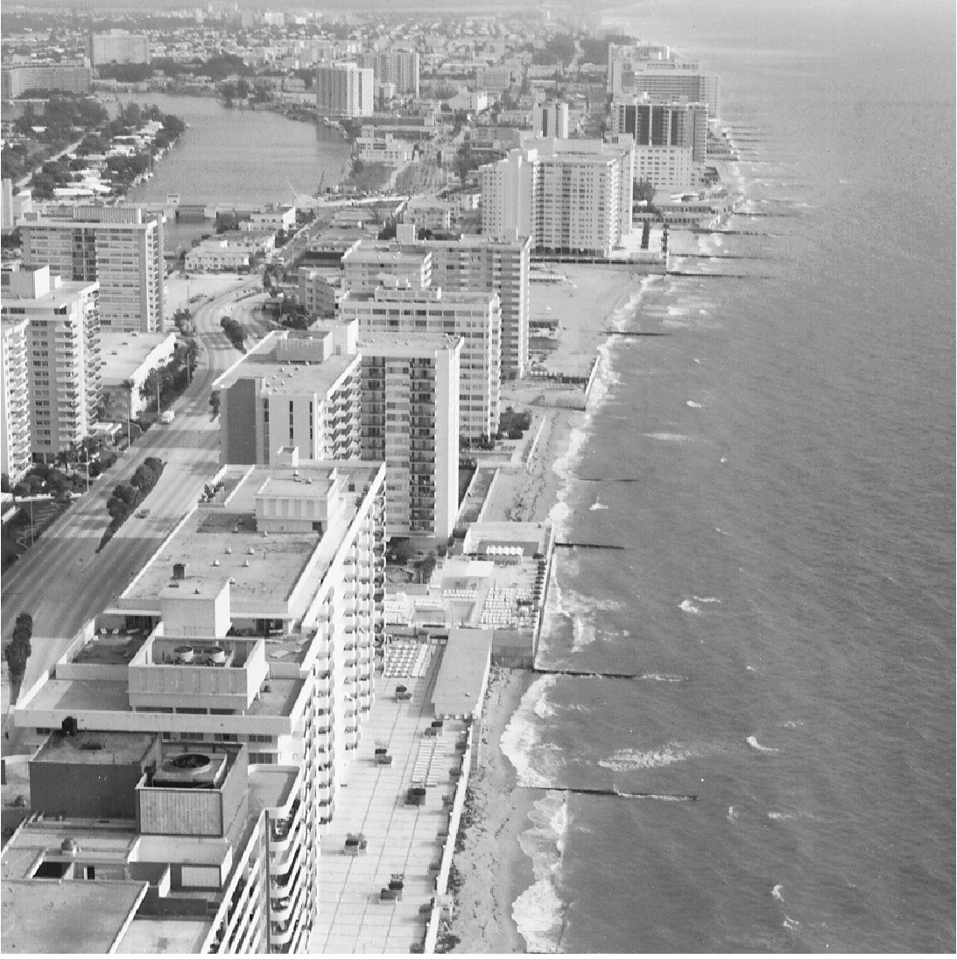
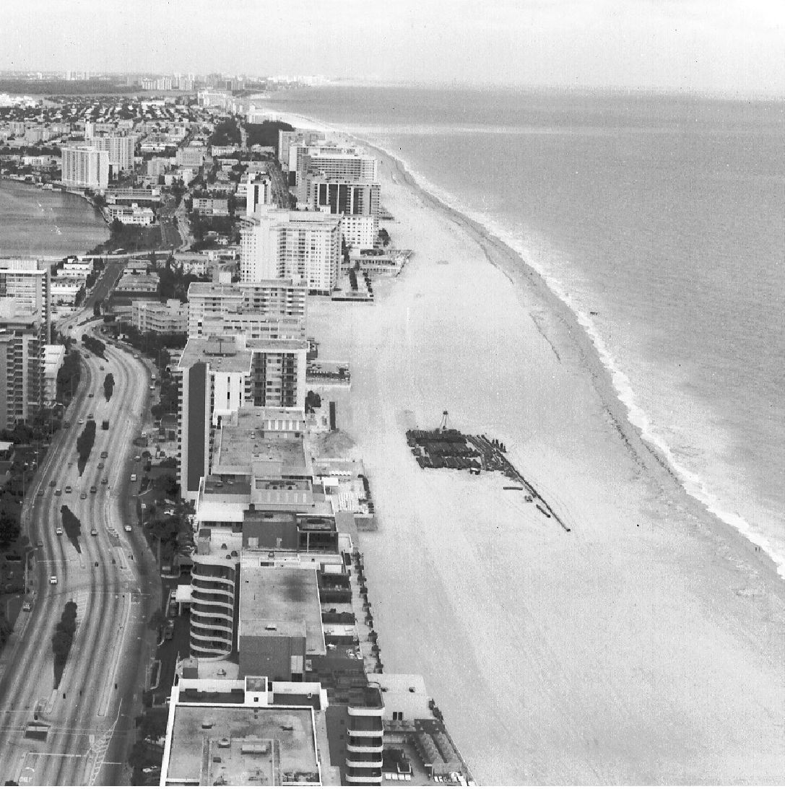
Miami Beach Beach Nourishment
Before After

Slide 42
Stabilizing the Shore
Responses to erosion problems
Hard stabilization—Building structures
Structures defined on their PURPOSE:
Groins —Barriers built at a right angle to the beach that are designed to trap sand
Breakwaters —Barriers built offshore and parallel to the coast to protect boats from breaking waves
Seawalls —Armors the coast against the force of breaking waves
Often these structures are not effective

Slide 43
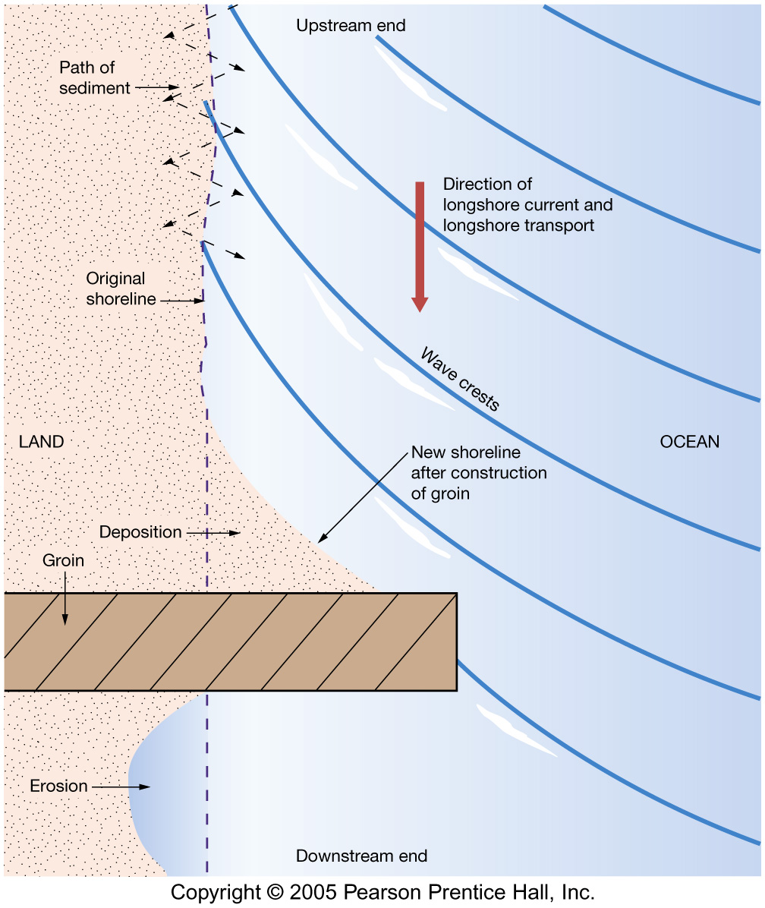
Groin
Wall built perpendicular to shore
Acts as a dam on the “river of sand”

Slide 44
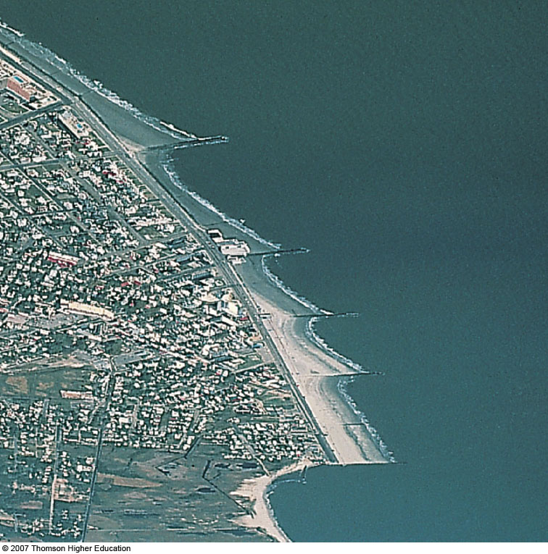
Fig. 10-7, p. 280
Notes:
Figure 10.7: Groin field at Cape May, New Jersey. Note the breadknife, or sawtooth, appearance that has resulted from sand accretion and erosion above and below the groins. Can you use information in the image to determine which direction the longshore drift is moving the sand?

Slide 45
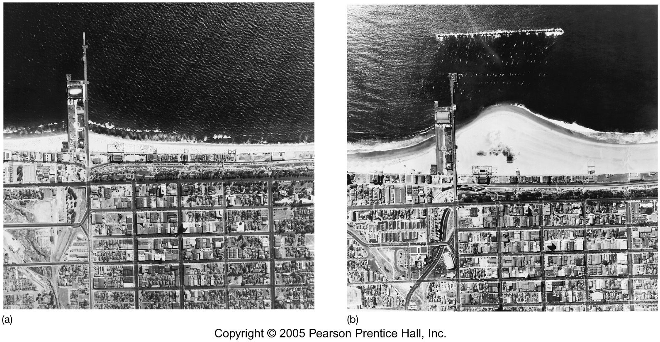
Breakwater
Santa Monica Pier
Before (left) and After (right)
Note growth of Tombolo!

Slide 46
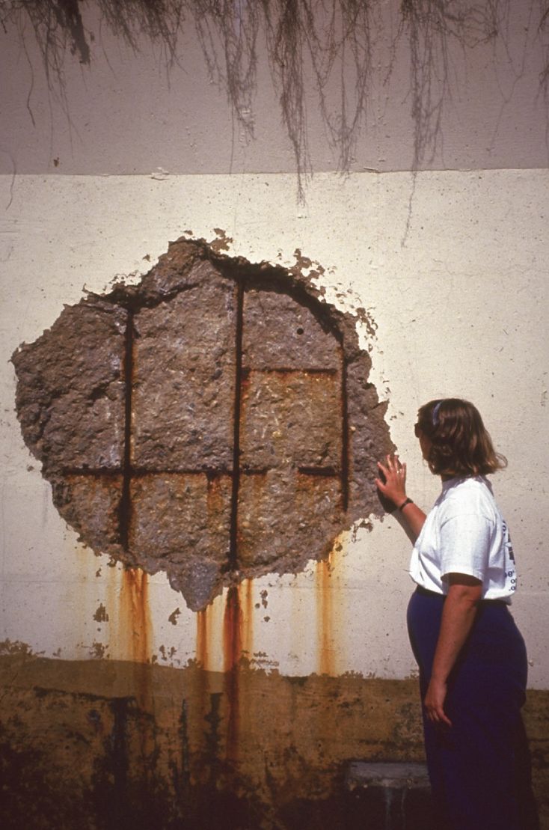
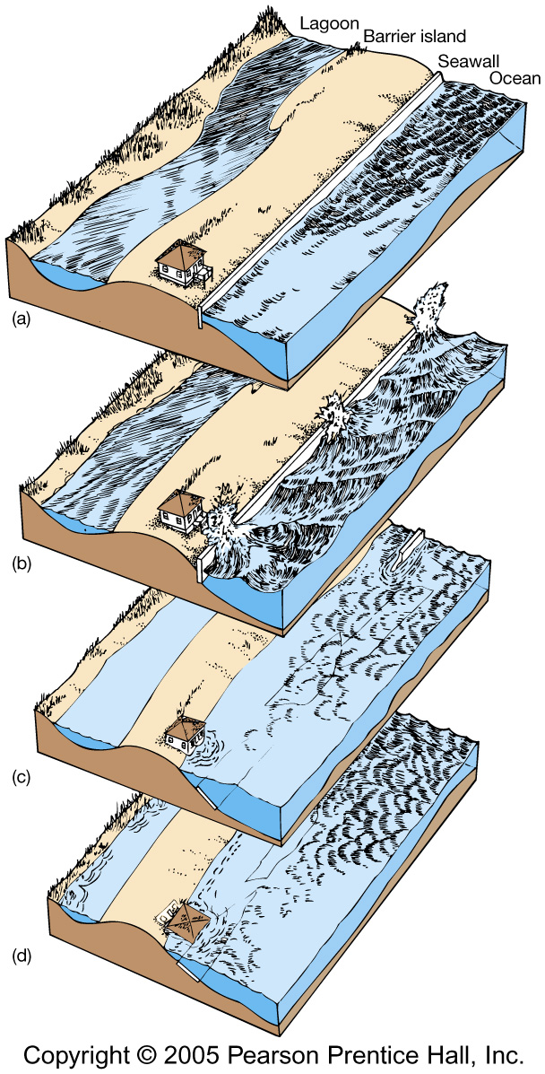
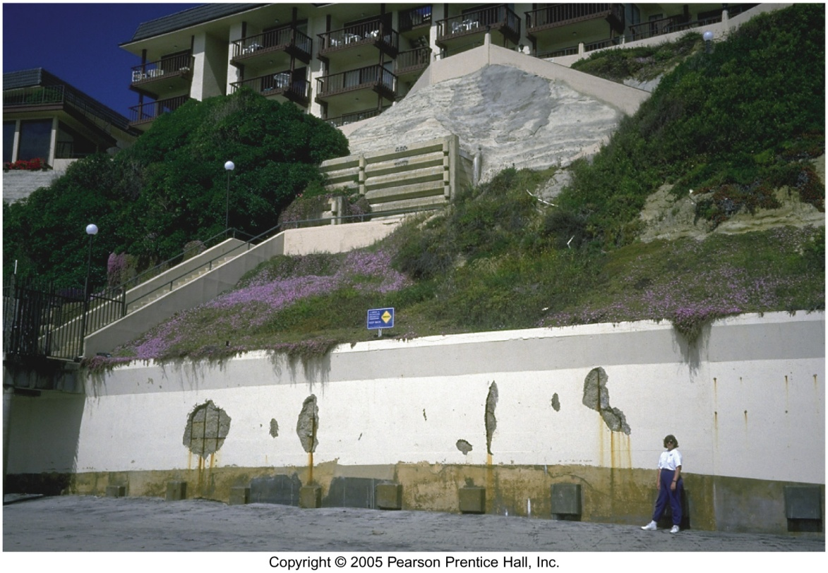
Seawall
Last-ditch effort?
Time to get the For Sale sign…

Slide 47
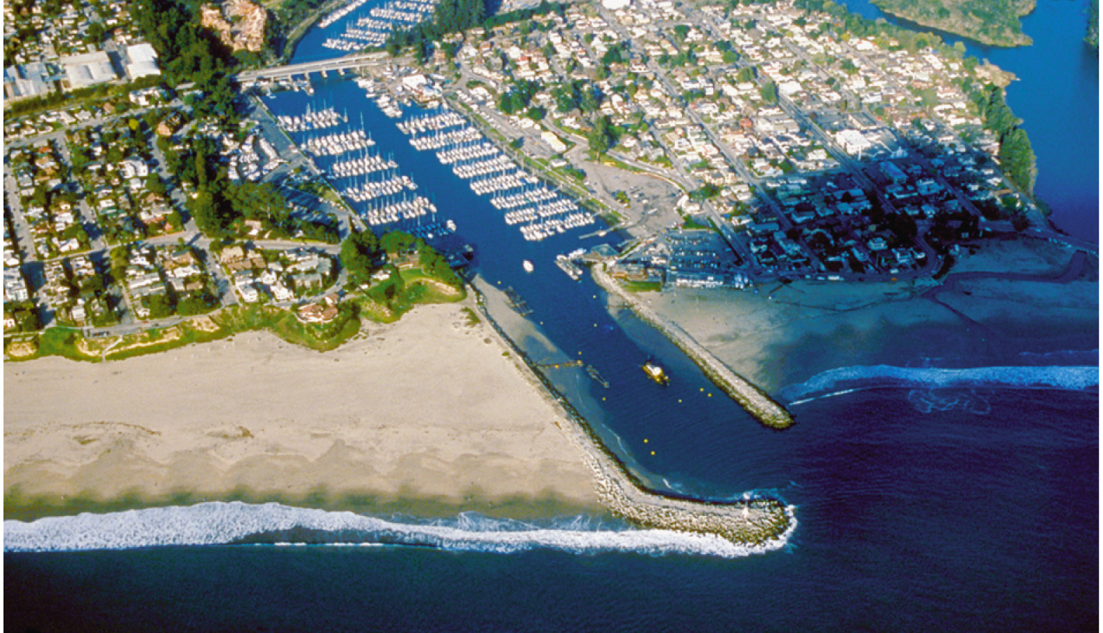
Jetty
Jetties come as a PAIR of walls on either side of the entrance to a Harbor
Maintain entrance by using the action of the Tides

Slide 48
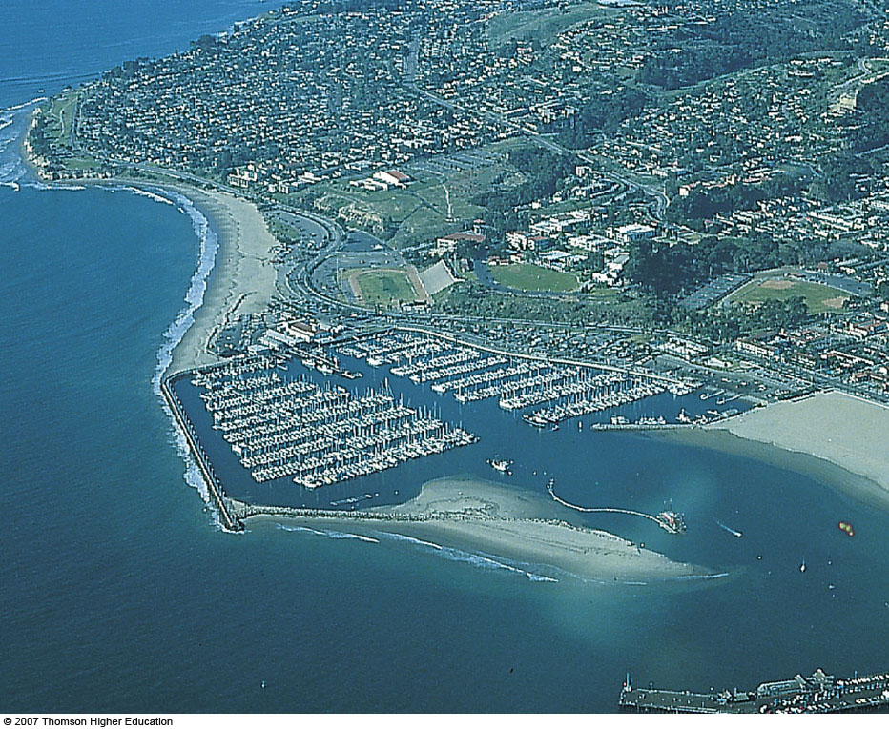
Fig. 10-22, p. 290
Notes:
Figure 10.22: The Santa Barbara, California, breakwater in 1988. Sand accumulation in the harbor is clearly visible, as is the dredge used to pump sand to the beaches downdrift.

Slide 49
Impulsively Generated Waves
Tsunami
Long wavelength, low amplitude in deep water
Transform to huge breakers or surge at the shoreline
Mostly generated by seismic activity, but are also by
underwater volcanic action
Landslides
bolide impacts

Slide 50
El Nino (ENSO)
Associated with floods, landslides, and accelerated beach erosion, decreased hurricane activity in the Atlantic
Hawaii experiences hurricanes only in El Nino years

Slide 51
Hurricane Prediction
Utilizes models of steering winds and data on tropospheric winds, West African climate, El Nino, sea-surface temperature and atmospheric pressure
Heat is the fuel that drives hurricanes

Slide 52
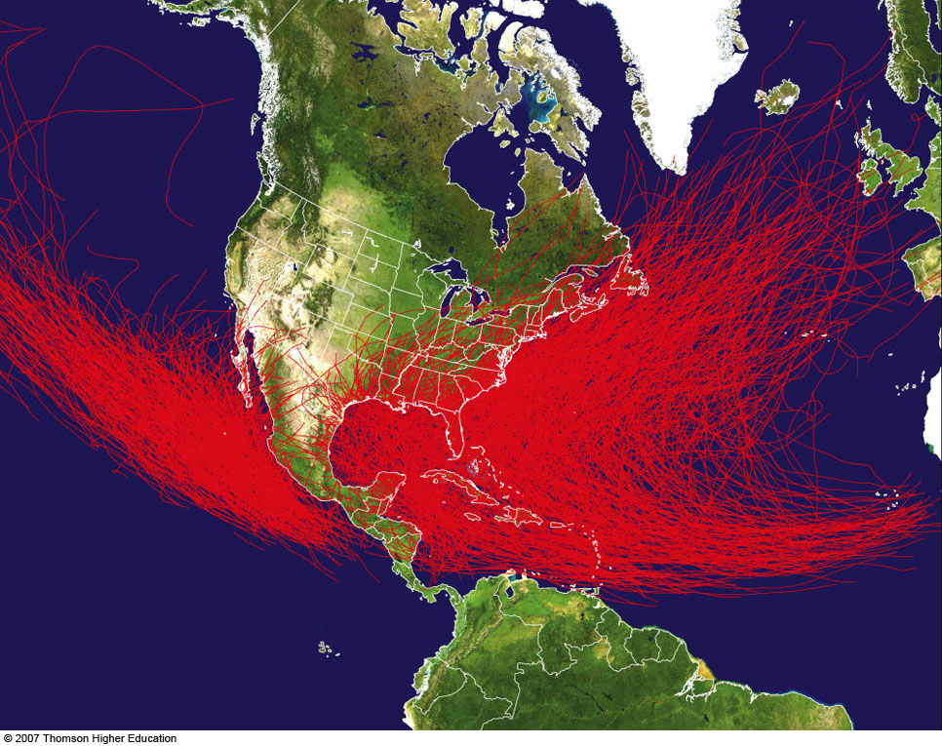
Fig. 10-27, p. 294
Notes:
Figure 10.27: Hurricanes follow many different paths from their birth place in the tropical Atlantic to their demise, usually far to the west and north. Shown are tracks of all hurricanes from 1851 to 2006.
IMSG/NOAA/Ethan Gibney.

Slide 53
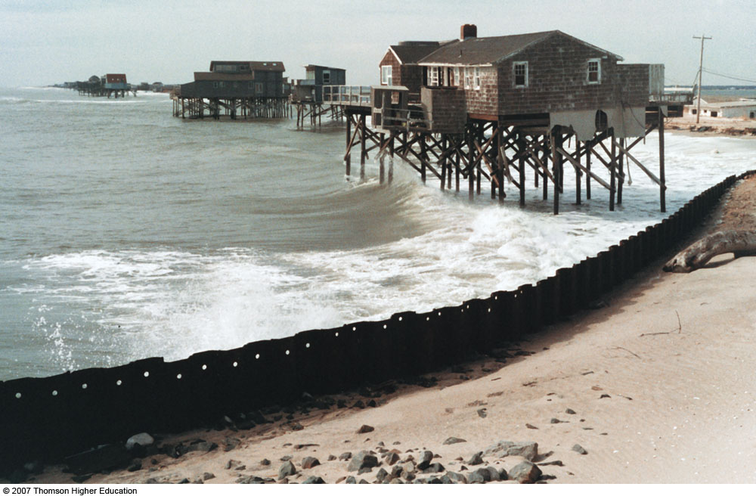
“Watch that first step!” Strong waves reduced the beach level almost four meters during one storm; Westhampton, New York.
Notes:
Figure 3: “Watch that first step!” would be a good warning to anyone exiting these stilt houses that once rested on the beach. Strong waves reduced the beach level almost four meters during one storm; Westhampton, New York.

