Slide 1
Glaciers, Climate, and Global Warming

Slide 2
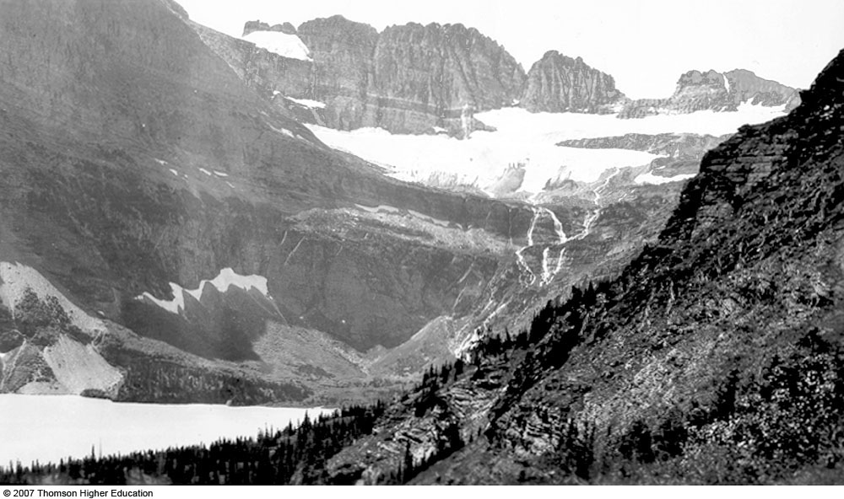
Glaciers
Large masses of ice that form on land
for a number of years, more snow falls in winter than melts in summer
deform and flow due to their own weight
force of gravity
strength of ice

Slide 3
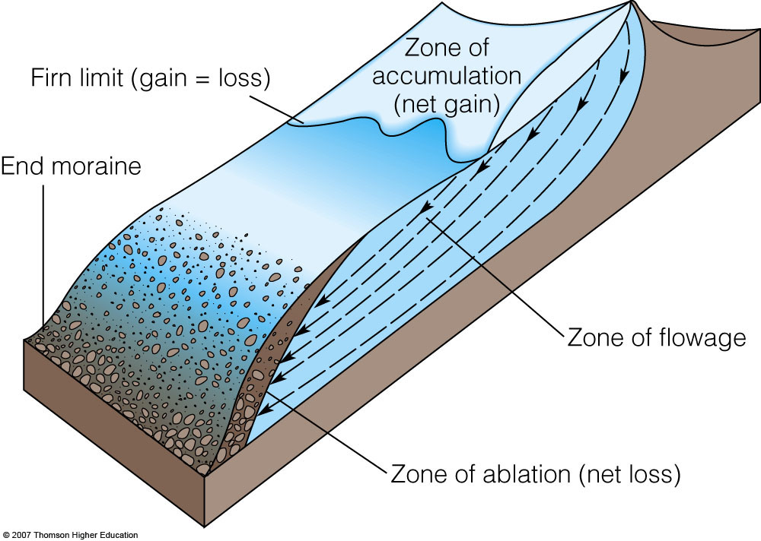
Glacial Budget

Slide 4
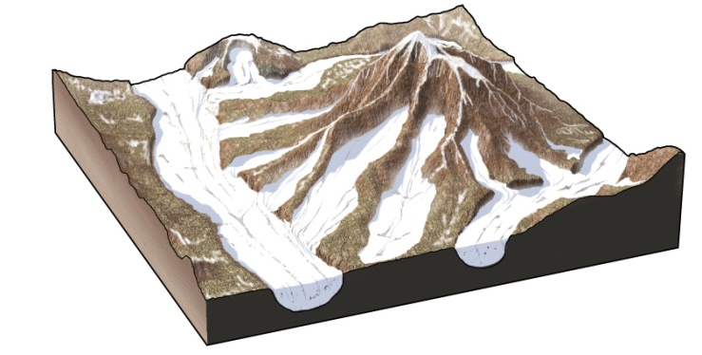
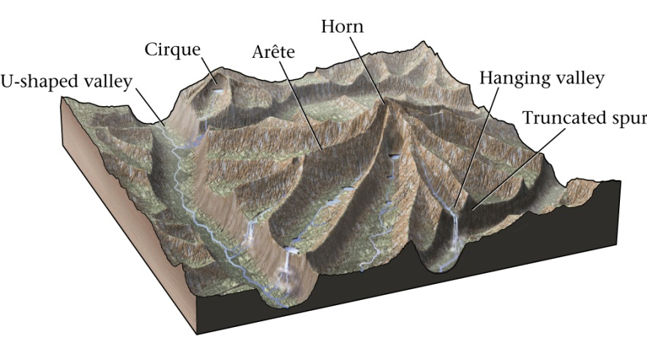
Features of Glacial Erosion
U-shaped canyons
fjords

Slide 5
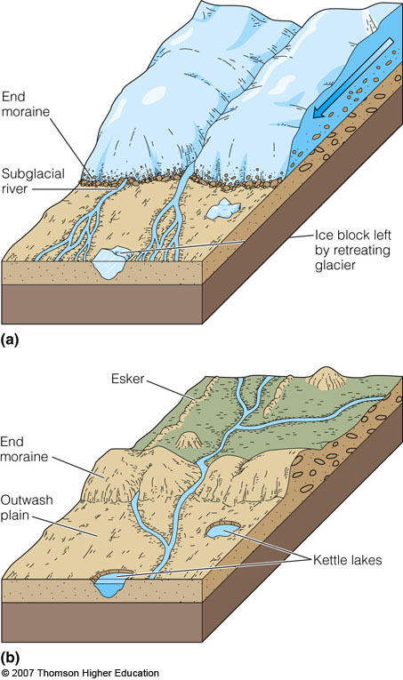
Depositional Features
End (terminal) moraine
Kettle lakes

Slide 6
Changing Glaciers
Stationary Glacier
Accumulation = Ablation
Receding Glacier
Accumulation < Ablation
Advancing Glacier
Accumulation > Ablation
How can you tell?

Slide 7
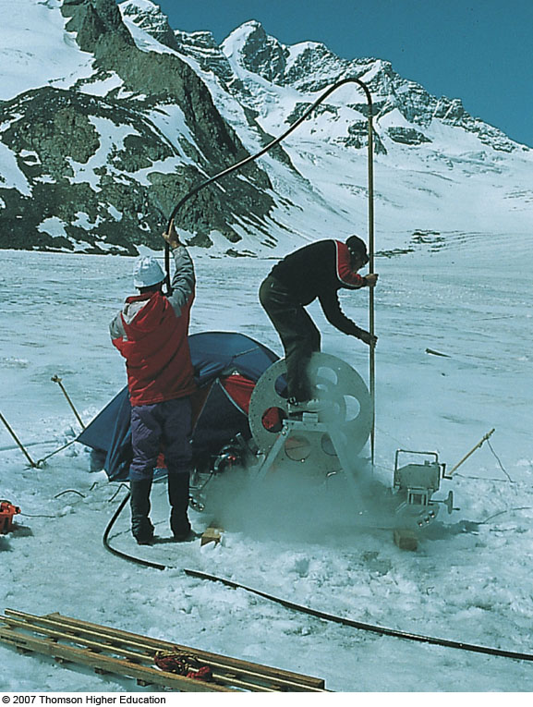
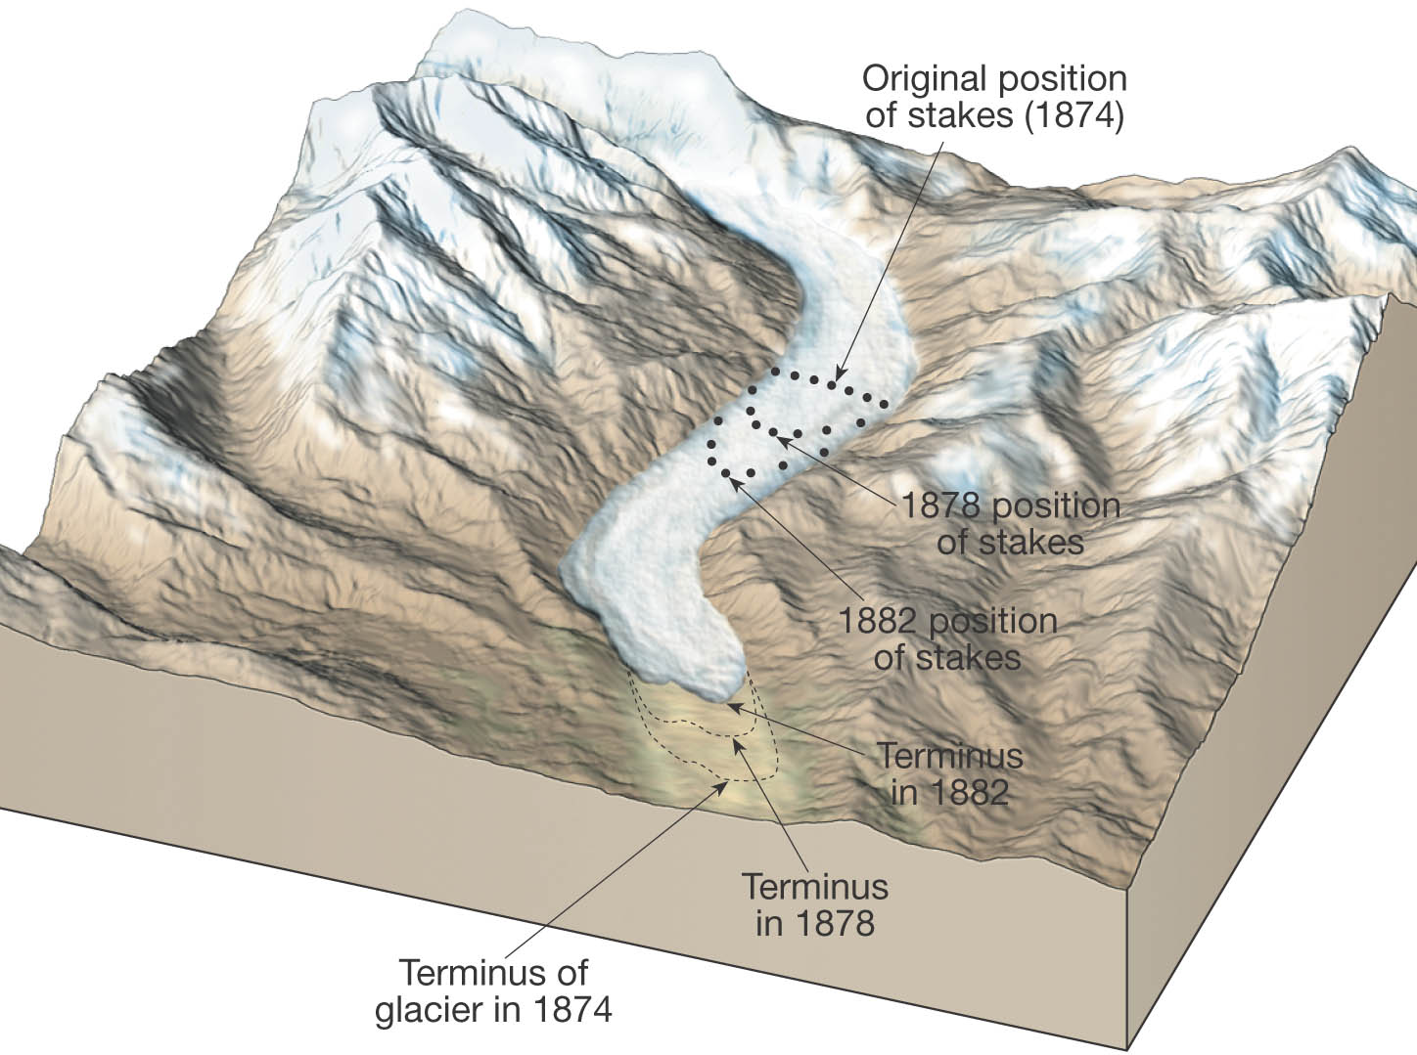
Measure Them:

Slide 8
Pleistocene Glaciation
Note Changes:
Soil conditions
Local groundwater
Shoreline configuration due to sea-level changes and isostatic rebound
Human Transport Routes

Slide 9
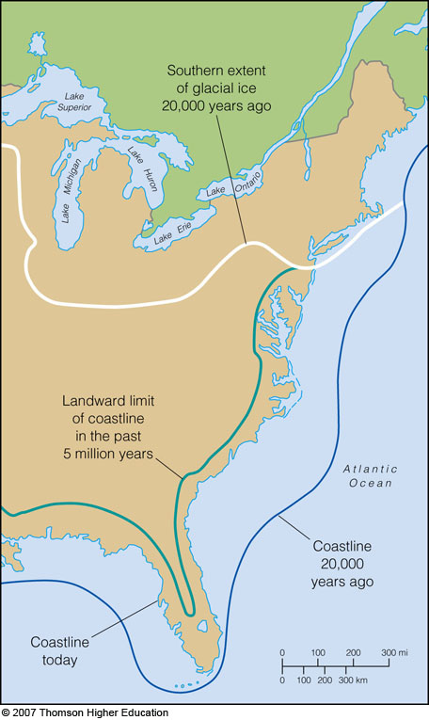
Glacial epochs come and go
Called Glacial and Interglacial periods
Controlled by Climate
Shoreline moves!

Slide 10
Weather vs. Climate
Both deal with atmospheric phenomena
Weather denotes the state of the atmosphere over short time scales - hours or days
Climate denotes these phenomena over long time scales -many years or centuries
Seasons denote an intermediate time scale of months.

Slide 11
What Do We Measure?
“ELEMENTS” of weather are different from “elements” of the Periodic Table:
Air Temperature (measured in the shade)
Humidity
Type/Amount of Cloudiness
Type/Amount of Precipitation
Air Pressure
Wind Speed and Direction.

Slide 12
Atmospheric Pressure “The Weight of the Overlying Molecules”
Measured with a Barometer
“baro-” = pressure, “-meter” = measuring device
Pressure of One Atmosphere = 1 bar
Variations in pressure at the surface of the Earth are measured in thousandths of a bar = millibars
Avg pressure @ sea level = 1.013 bars = 1013 mb
Variations result from:
Changes in altitude
Changes in the direction of net movement of air.

Slide 13
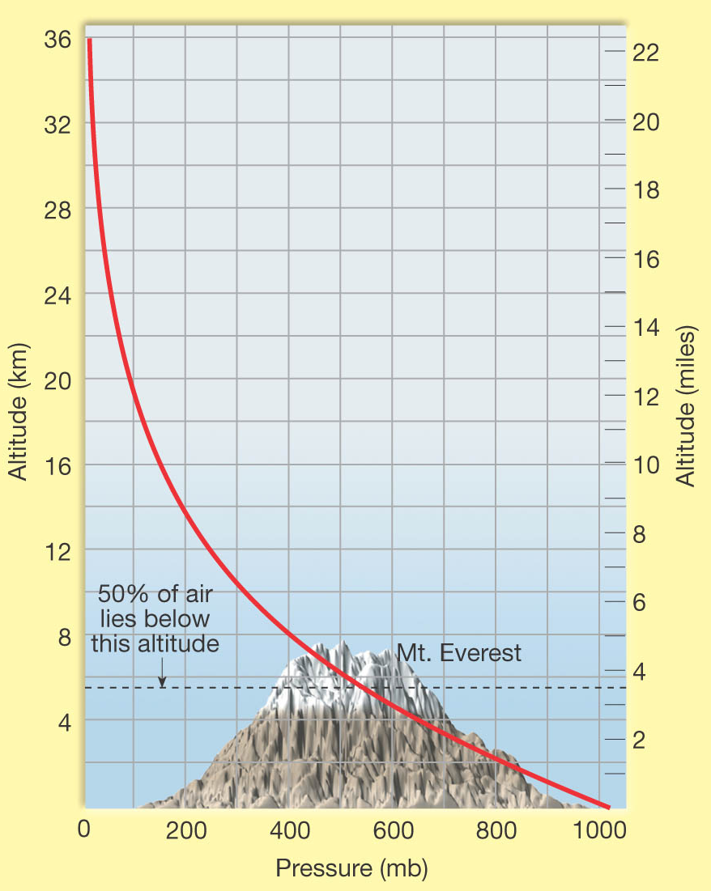
Pressure Changes: Altitude
Gravity holds air molecules close to Earth
Air is “concentrated” nearest the Earth
Fewer air molecules at higher altitudes
Only light or energetic molecules can bounce to higher altitudes
Pressure can be a measure of the “proportion of air:”
At 500 mb, half the air is above, half below
500 mb occurs at about 5.6 km elevation.

Slide 14
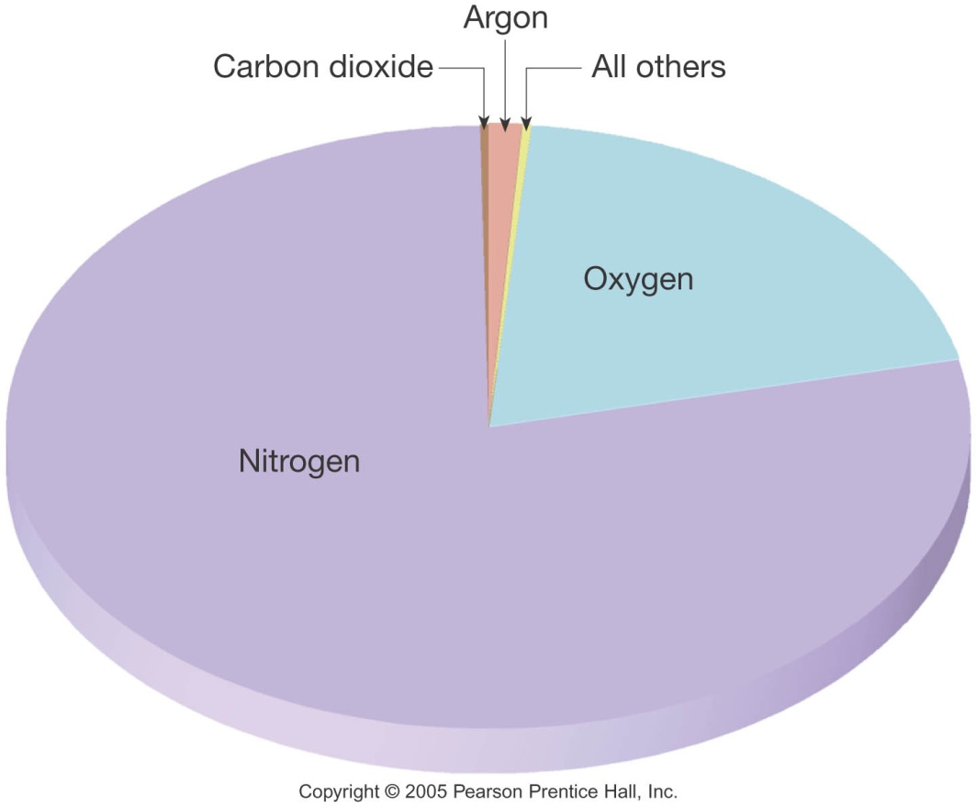
Composition of Dry Air
Air is composed of molecules in gaseous form
DRY air (excluding H2O) contains:
71% Nitrogen (mostly N₂)
21% Oxygen (O₂, some O₃)
0.93% Argon gas (Noble Gas!)
~0.035% CO₂
~0.035% other components
Some of these constituents have important properties...
Notes:
Last = Pie Chart

Slide 15
Variable Components: DUST
Dust is made of (for example):
Silicate materials
Salt crystals
Dust plays some very important roles:
Reflects sunlight back into space
There was a ½° DROP in average global temperature after the eruption of Mt. Pinatubo in 1992!
Absorbs sunlight
Helps to warm the atmosphere
Important nucleus for condensation
Every raindrop initially forms around a particle.

Slide 16
Variable Components: Ozone
Ozone (O₃) can act as a POLLUTANT...
Smell of “burnt air” after a lightning strike
Not good for us to breathe
...but also acts as a PROTECTANT
Ozone is a strong absorber of ultraviolet (UV) radiation that can kill living organisms
More on this later...

Slide 17
The Ozone Hole Problem
The “ozone hole” is a well-defined, large-scale destruction of the ozone layer over Antarctica that occurs each Antarctic spring.
The word "hole" is a misnomer; the hole is really a significant reduction in ozone concentrations which results in the destruction of up to 70% of the ozone normally found over Antarctica
Ozone is very reactive, easily losing its third oxygen atom in the presence of other highly reactive compounds called radicals, which contain chlorine, hydrogen, nitrogen, or bromine. Minute quantities of these radicals can cause large decreases in ozone because they are not consumed in the reaction. This is called a catalytic cycle.

Slide 18
Ozone Hole and CFCs
Humans have introduced Chlorofluorocarbons (CFCs) that interact with ozone
CFCs are INERT at the Earth’s surface
Make great aerosol propellants
Drift up into the stratosphere
CFCs are broken down by UV rays (like ozone)
Products re-unite with that free oxygen atom...
...so Ozone cannot reform
CFCs continue to deplete the supply of ozone...

Slide 19
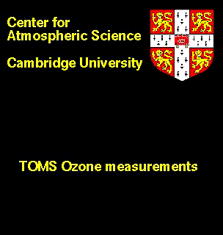
Ozone Hole is Seasonal
In Antarctica, it grows in the Spring (October) and shrinks in the Fall (March).

Slide 20
Variable Components: CO₂ + H₂O
Gases are TRANSPARENT to Visible Light
They allow sunlight to pass through the atmosphere
How do we know this? Hmm...
CO₂ & H₂O ABSORB IR Radiation from Earth
They help keep atmosphere warm
Any increase in their abundance means warmer temperatures
These are two important Greenhouse Gases.

Slide 21
Temperature A Specific Definition
Temperature is often a relative measure:
“This porridge is too hot!”
“This porridge is too cold!”
“Temperature is a measure of the average kinetic energy (thermal energy of motion) of the particles of a substance.”
We will use a more objective measure:
Thermometer measures T in °C
Freezing pt of Water = 32°F = 0°C
Boiling pt of water = 212°F = 100°C

Slide 22
Heating = Transfer of Thermal Energy
Some Physics:
Hot objects have molecules with lots of thermal energy
They try to give that energy to objects that are “less fortunate” (cold objects) – or to empty space
Hot objects heat cool objects
We don’t say that a cold object is cooling a hot object
“Hot coffee warms the ice” in your Iced Mocha

Slide 23
More Physics
Newton’s Law of Cooling
“The rate of change of the temperature of an object is proportional to the difference between its own temperature and the ambient temperature (the temperature of its surroundings).”
ΔQ = mC_{P} ΔT
Δ = “difference in,” Q = Heat (in cal), m = mass (g), C_{P} = heat capacity (cal/g °C), T = temperature (°C)
Simply put, the larger the difference in temperature between an object and its surroundings, the faster the exchange of heat”

Slide 24
Heat Transfer: Conduction
Conduction works in Solids
Molecules that make a solid heat their neighbors
Energy spreads through matter that does not move
Ex: Iron Bar and Blowtorch.

Slide 25
Heat Transfer: Convection
Convection works in Fluids
Heated molecules move away (up)
Energy spreads when matter moves, carrying the energy
Ex: hot air rises.

Slide 26
Heat Transfer: Radiation
Works in Vacuum (between gas molecules)
”Photons” radiate through empty space from hot object
Energy spreads to matter that can absorb photons
Ex: Sun, Campfire
The closer you are to the heat source, the more photons you absorb.

Slide 27
The Nature of Light
Light is one STRANGE phenomenon!
Electric and magnetic forces are really two aspects of the same phenomenon, which we now call electromagnetism
Light exhibits BOTH wave-like (wavelength) AND particle-like (photon) natures

Slide 28
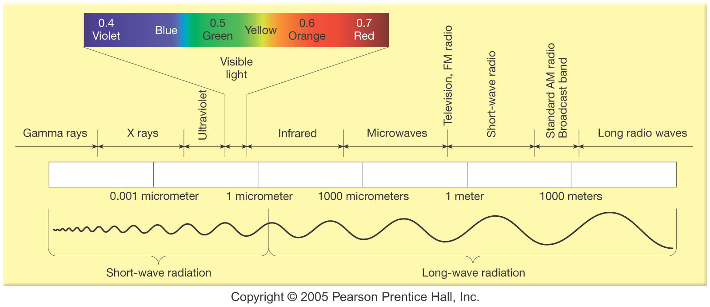
Electromagnetic Spectrum

Slide 29
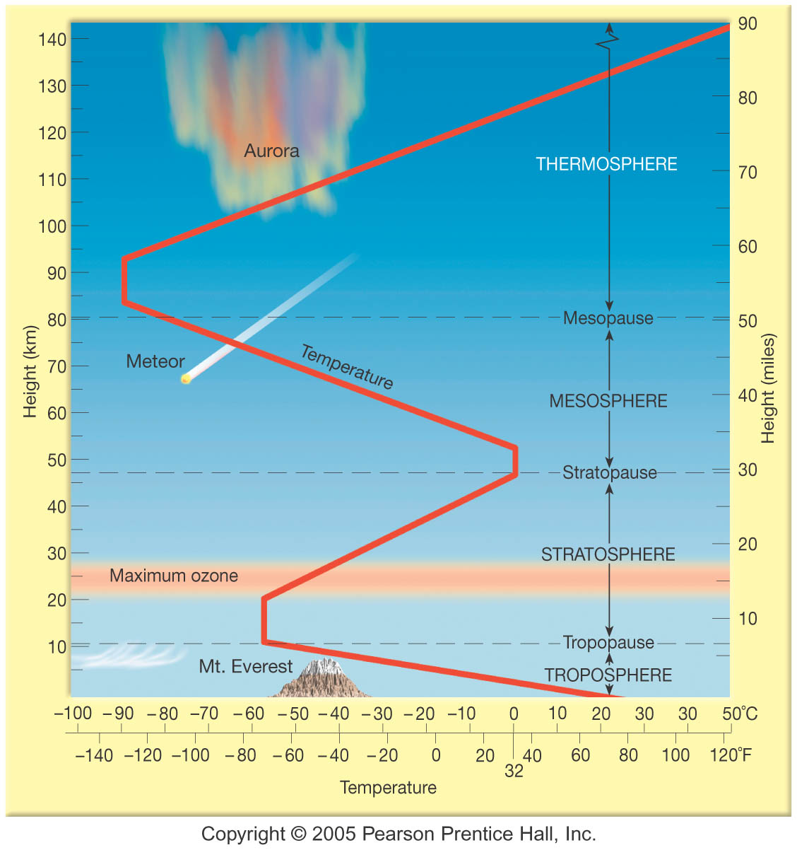

Slide 30
Troposphere: Where the Weather Happens
Temperature DROPS with altitude
Abundance of Greenhouse Gases
Heated by the Sun?
Gamma, X-rays absorbed in Thermosphere
UV absorbed in Stratosphere
VIS passes through it all!
How do we know that?

Slide 31
Albedo
Reflectivity of surface
Fresh snow:
Asphalt
Green Forest:

Slide 32
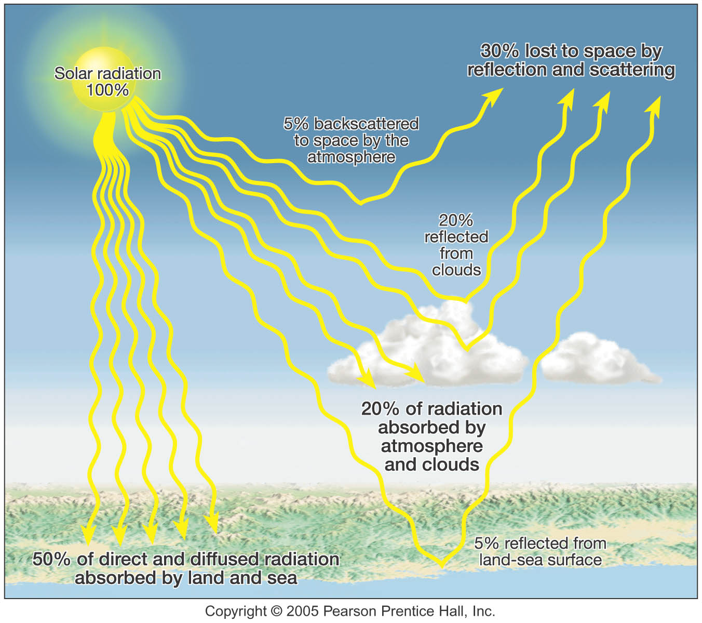

Slide 33
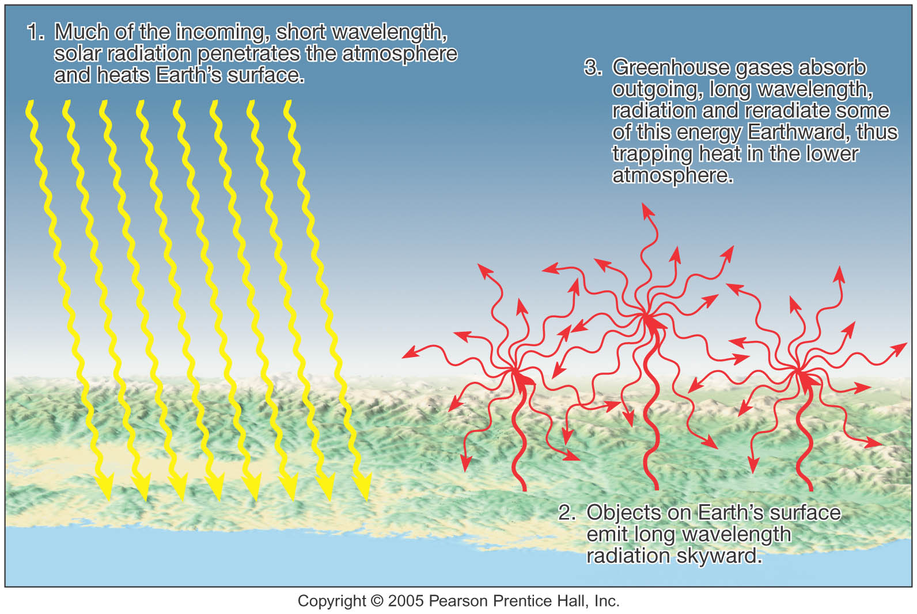
Greenhouse Effect

Slide 34
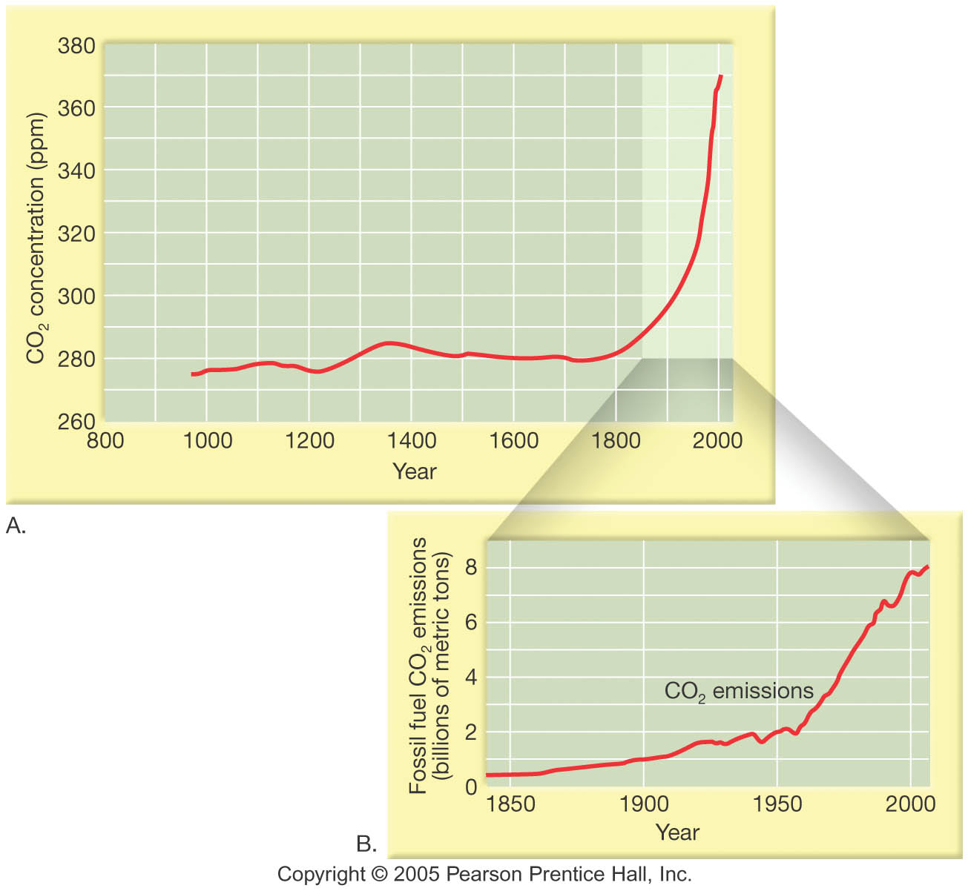
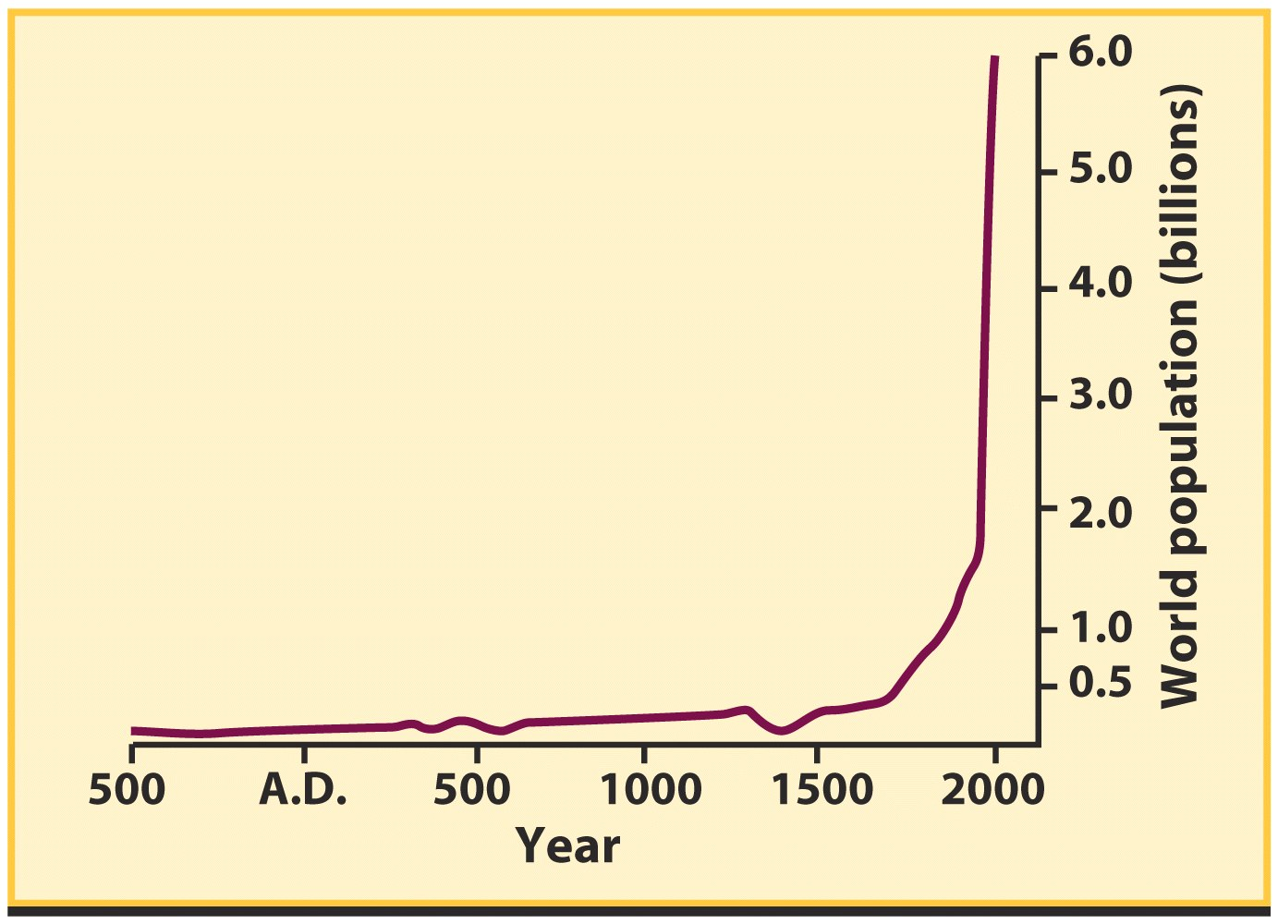
Analogy
Think of GHGs as baseball mitts…
Are mitts being added?

Slide 35
Adding Mitts?

Slide 36
Predictions of Climate Change
Globally, average surface temperatures will increase
Globally, average precipitation will increase, but its distribution is uncertain
Northern hemisphere ice will decrease, southern hemisphere ice may increase
Arctic land areas will experience wintertime warming
Sea level will rise at an increasing rate with drowning of low-level coastal plains
Decreasing soil moisture in the northern hemisphere may make farming nearly impossible in much of North America and Europe
Plants and animal ranges will expand in some cases, shrink or disappear altogether in others

