Slide 1
What Is an Earthquake?
An earthquake is the vibration of Earth produced by the rapid release of energy
Energy released radiates in all directions from its source, the focus
Energy is in the form of waves
Sensitive instruments around the world record the event

Slide 2
Locating an Earthquake
Terms
Focus—The place within Earth where earthquake waves originate
Epicenter —Location on the surface directly above the focus
Epicenter is located using the difference in velocities of P and S waves

Slide 3
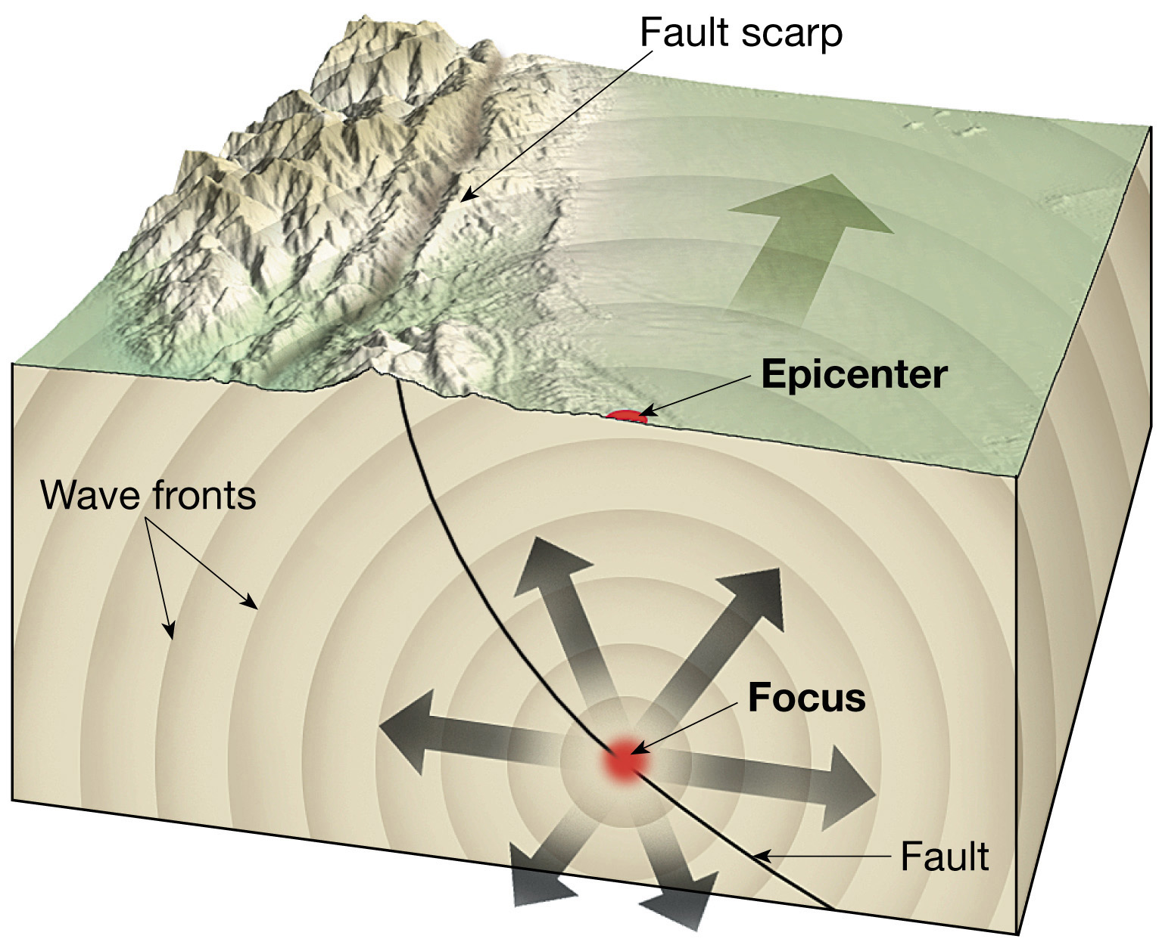
Earthquake Focus and Epicenter

Slide 4
What Is an Earthquake?
Earthquakes and faults
Movements that produce earthquakes are usually associated with large fractures in Earth’s crust called faults
Most of the motion along faults can be explained by the plate tectonics theory

Slide 5
What Is an earthquake?
Elastic rebound
Mechanism for earthquakes was first explained by H. F. Reid
Rocks on both sides of an existing fault are deformed by tectonic forces
Rocks bend and store elastic energy
Frictional resistance holding the rocks together is overcome

Slide 6
What Is An Earthquake?
Elastic rebound
Earthquake mechanism
Slippage at the weakest point (the focus) occurs
Vibrations (earthquakes) occur as the deformed rock “springs back” to its original shape (elastic rebound)

Slide 7
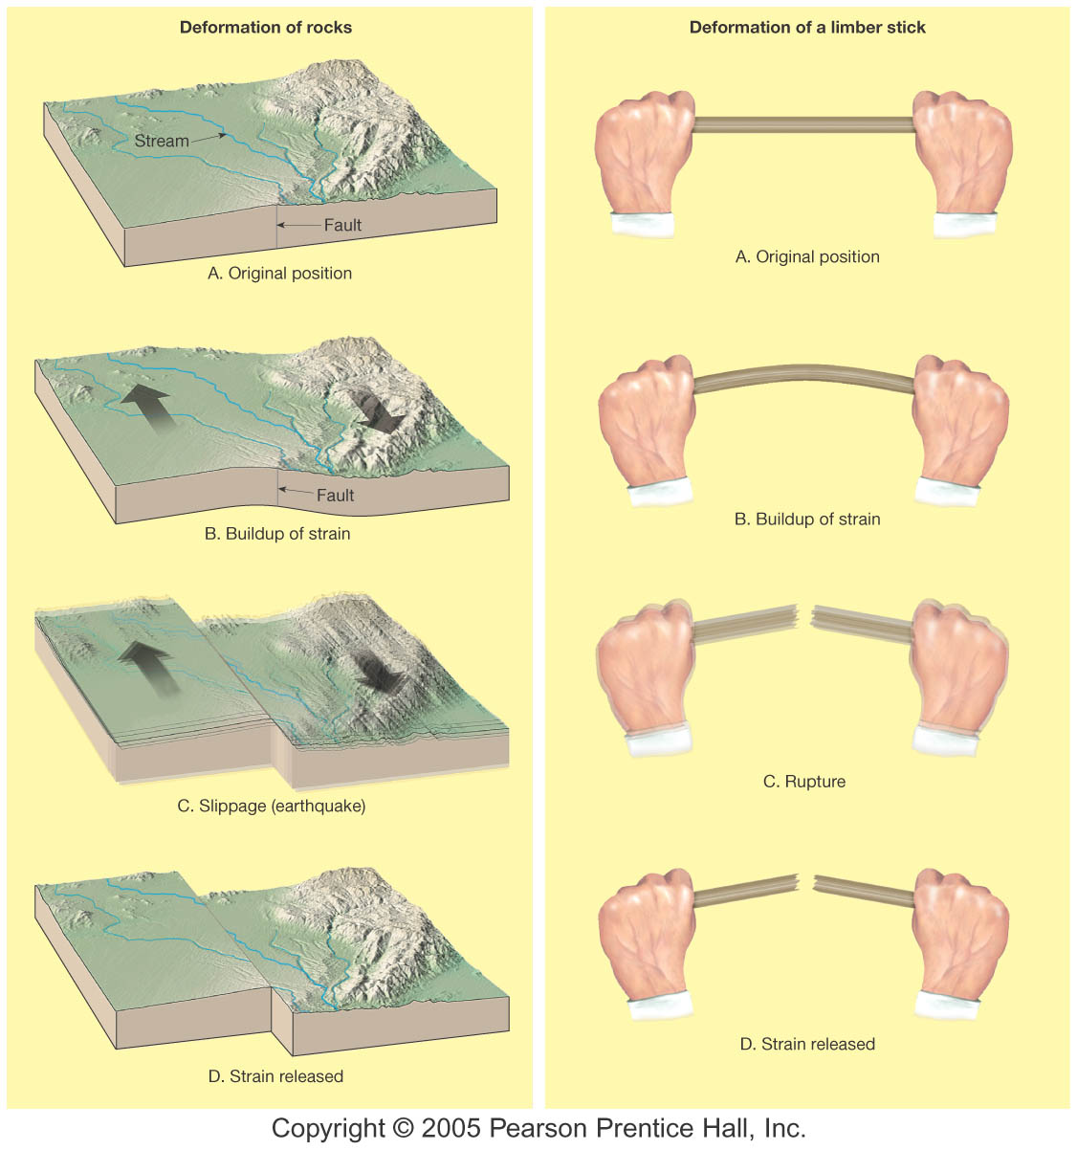

Slide 8
What Is an earthquake?
Foreshocks and aftershocks
Adjustments that follow a major earthquake often generate smaller earthquakes called aftershocks
Small earthquakes, called foreshocks, often precede a major earthquake by days or, in some cases, by as much as several years

Slide 9
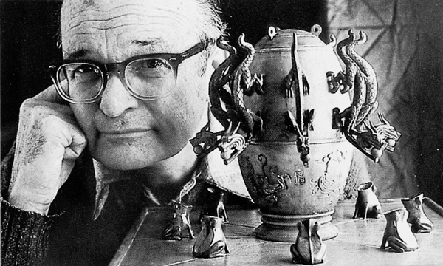
Seismology
The study of earthquake waves seismology, dates back almost 2000 years to the Chinese
Seismographs are instruments that record seismic waves
Record the movement of Earth in relation to a stationary mass on a rotating drum or magnetic tape

Slide 10
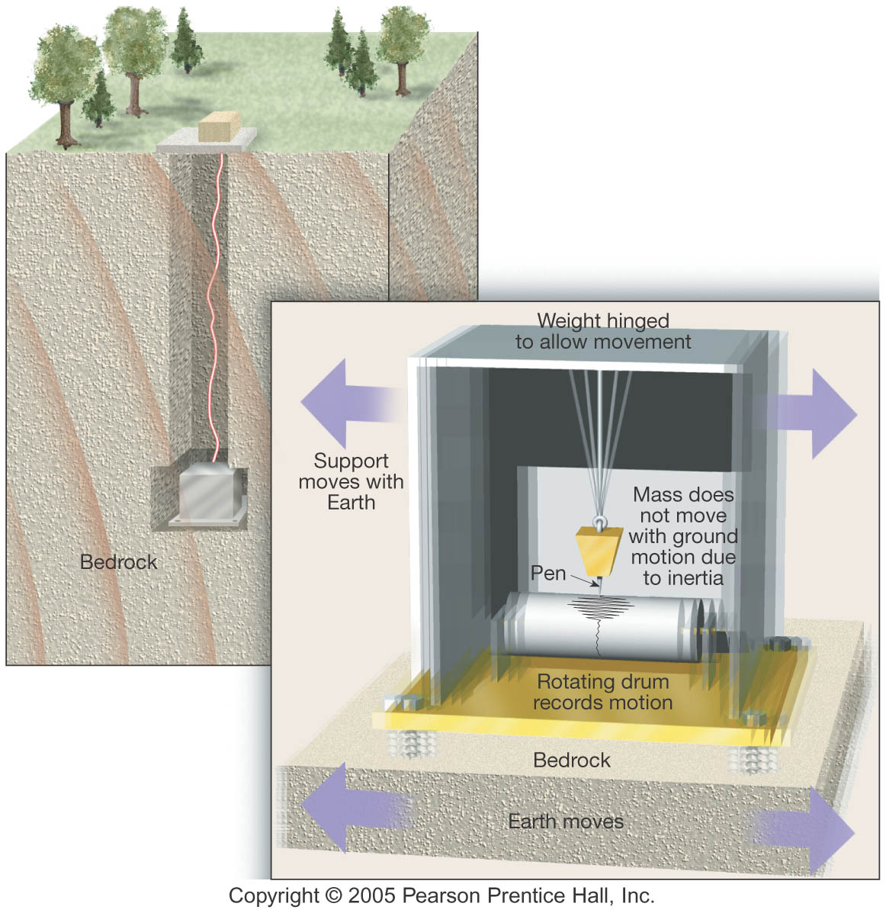
Basic Idea of a Seismograph

Slide 11
Seismology
Seismographs
More than one type of seismograph is needed to record both vertical and horizontal ground motion
Records obtained are called seismograms
Two types of seismic waves:
Body waves
Travel through Earth’s interior
Two types based on mode of travel
Surface waves (later)

Slide 12
Primary (P) waves
Push-pull (compress and expand) motion, changing the volume of the intervening material
Travel through solids, liquids, and gases
FASTEST through anything video

Slide 13
Secondary (S) waves
“Shake” motion at right angles to their direction of travel
Travel only through solids
Slower velocity than P waves video

Slide 14
Types of seismic waves
Surface waves
Travel along outer part of Earth
Complex motion
Cause greatest destruction
Exhibit greatest amplitude and slowest velocity

Slide 15
Surface Waves
Rayleigh Waves
Rolling action video
Love Waves
Shearing action
These are MOST DANGEROUS of all!
video

Slide 16
Locating an Earthquake
Locating the epicenter of an earthquake
Three station recordings are needed to locate an epicenter
Each station determines the time interval between the arrival of the first P wave and the first S wave at their location
A travel-time graph is used to determine each station’s distance to the epicenter

Slide 17
Seismogram Showing P, S, and Surface waves
Figure 6.7

Slide 18
A Travel-Time Graph
Figure 6.9

Slide 19
Locating an Earthquake
Locating the epicenter of an earthquake
A circle with a radius equal to the distance to the epicenter is drawn around each station
The point where all three circles intersect is the earthquake epicenter

Slide 20
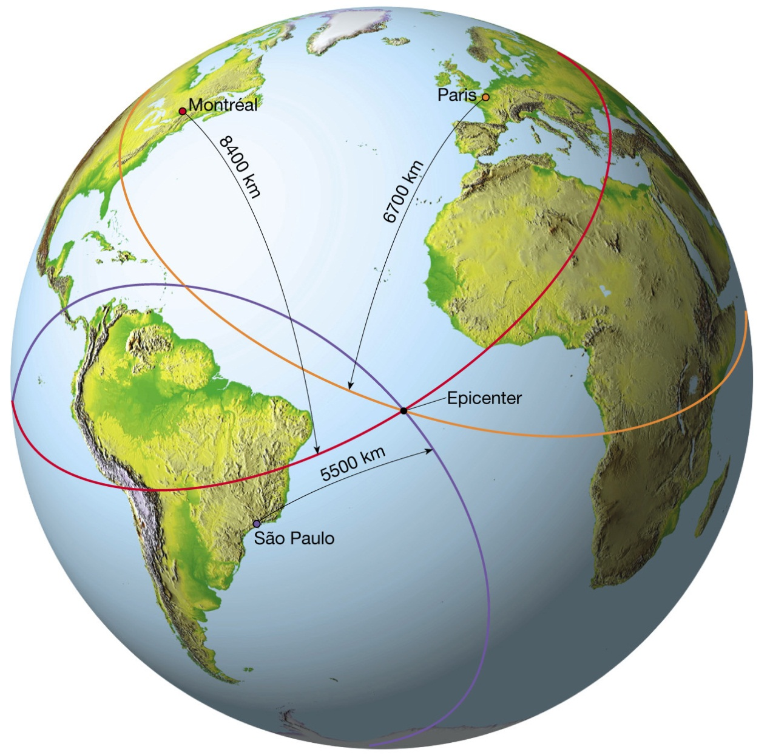
Finding an Earthquake Epicenter
Figure 6.10

Slide 21
Locating an Earthquake
Earthquake belts
About 95 percent of the energy released by earthquakes originates in a few relatively narrow zones that wind around the globe
Major earthquake zones include the Circum-Pacific belt and the Oceanic-Ridge system

Slide 22
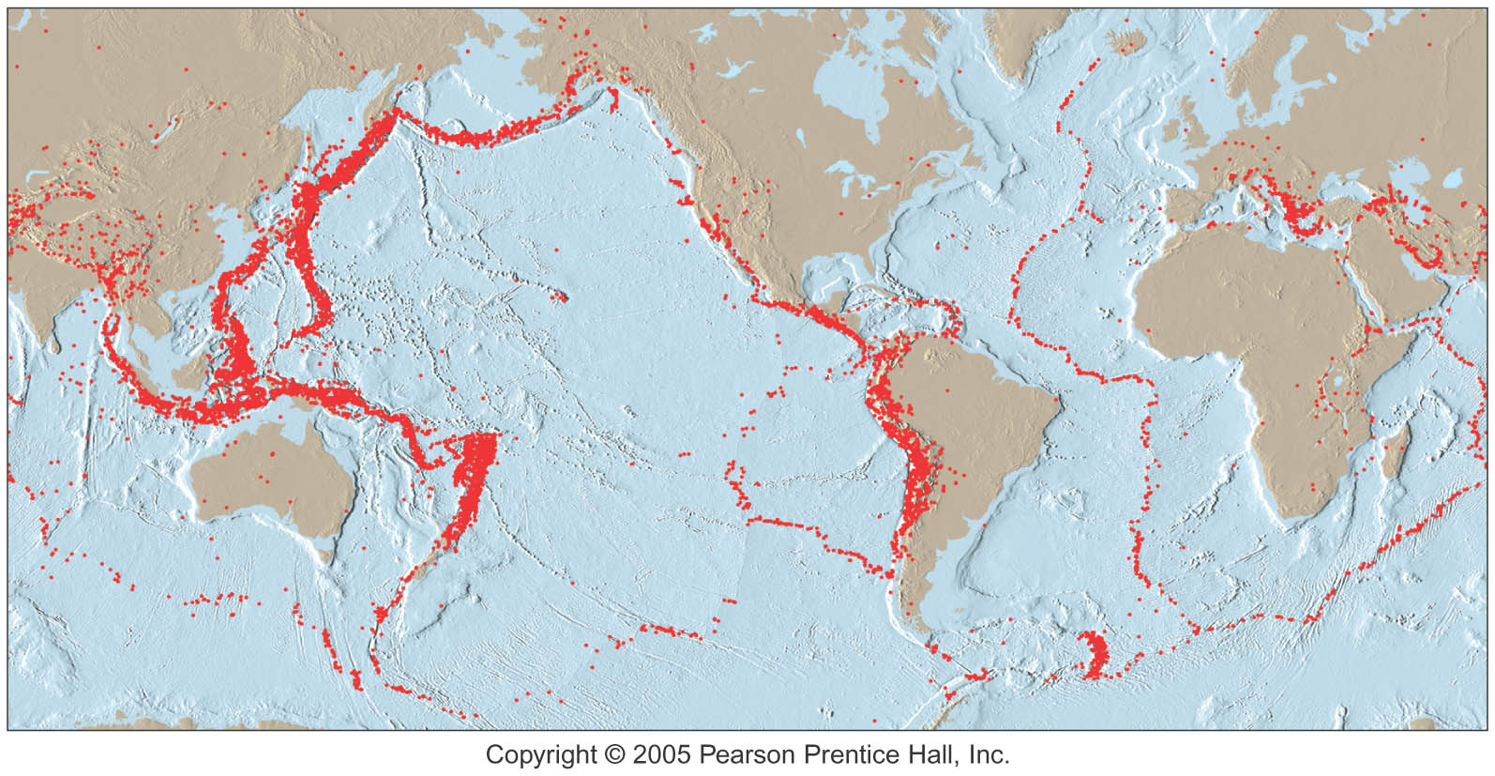
Earthquake Belts

Slide 23
Measuring the Size of Earthquakes
Two measurements that describe “how big” an earthquake is:
Intensity—A measure of the degree of earthquake shaking at a given locale
Based on the amount of damage
Magnitude—Allows for a comparison of the relative amount of energy released at the source of the earthquake
Based on the Amplitude of Displacement

Slide 24
Measuring the Size of Earthquakes
Intensity scale
Modified Mercalli Intensity Scale was developed using California buildings as its standard
The drawback of intensity scales is that destruction may not be a true measure of the earthquake’s actual severity

Slide 25
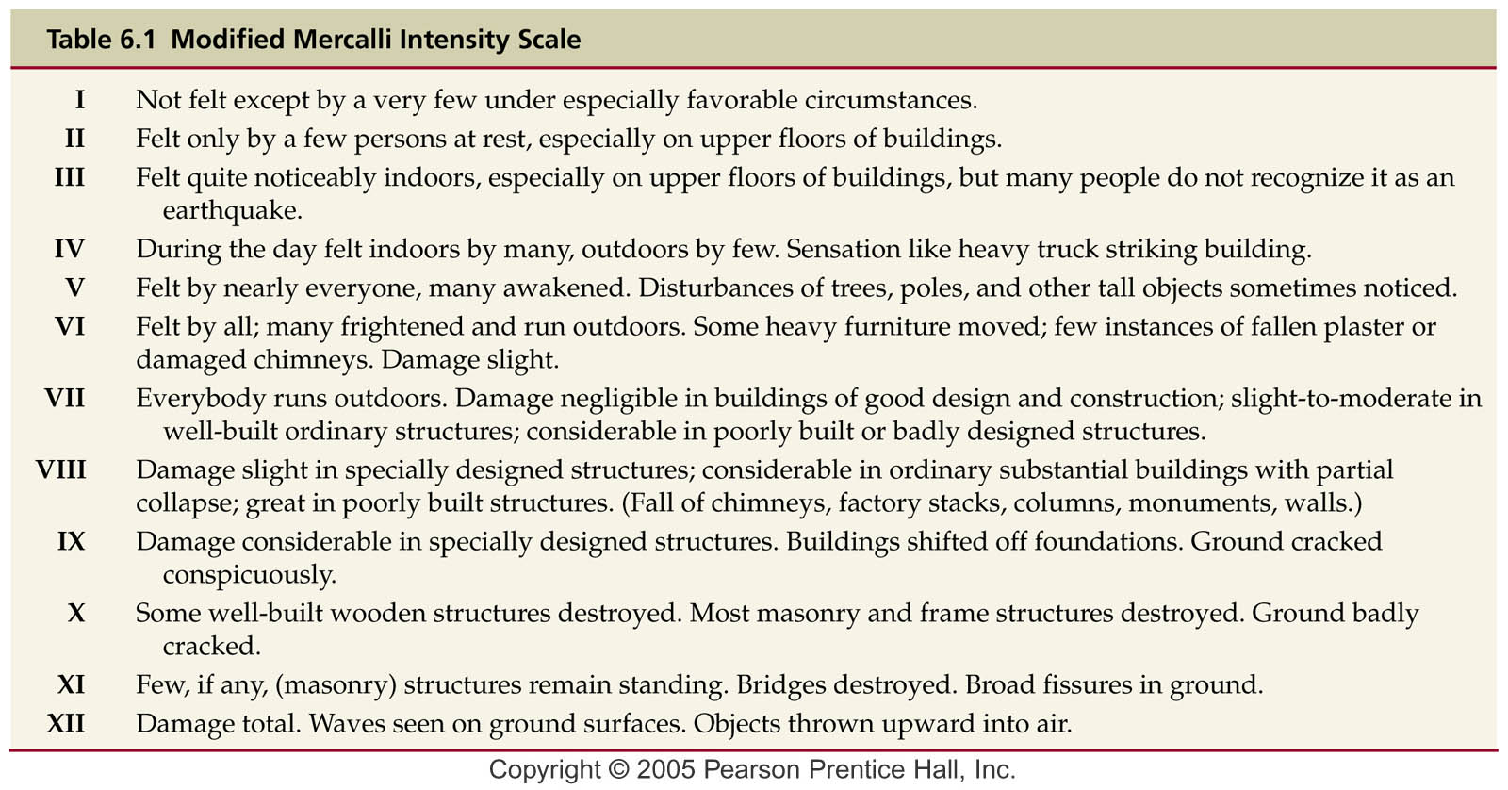

Slide 26
Measuring the Size of Earthquakes
Magnitude scales
Richter magnitude—Concept introduced by Charles Richter in 1935
Based on the amplitude of the largest seismic wave recorded
Accounts for the decrease in wave amplitude with increased distance
Each unit of Richter magnitude increase corresponds to a tenfold increase in wave amplitude and a 32-fold energy increase

Slide 27
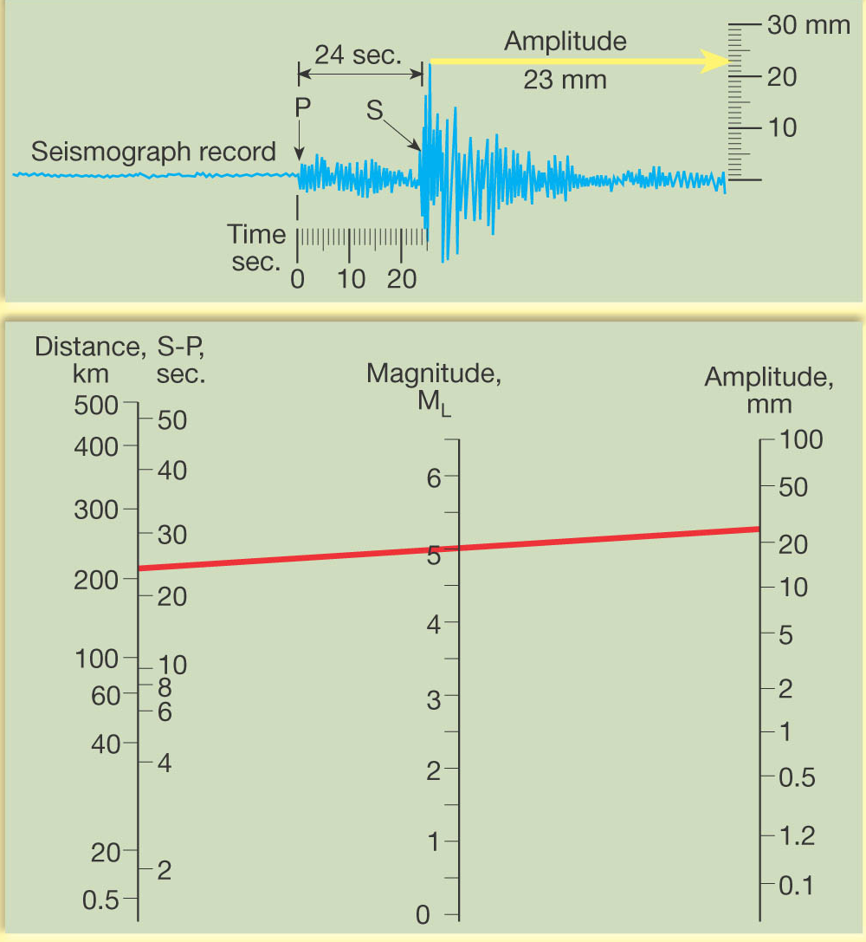
(Seismogram)

Slide 28
Other magnitude scales
Several “Richter-like” magnitude scales have been developed
Moment magnitude was developed because none of the “Richter-like” magnitude scales adequately estimates very large earthquakes
Derived from the amount of displacement that occurs along a fault

Slide 29
Moment Magnitude
Most “objective” – it’s the preferred method among seismologists
Measures “leverage of forces” across the area of the fault slip
Mw = rigidity x area of slip x amt of slip
“How strong are rocks”
“How much of a fault broke”
“How far did they move”

Slide 30
Earthquake Destruction
Amount of structural damage attributable to earthquake vibrations depends on
Intensity and duration of the vibrations
Nature of the material upon which the structure rests
Design of the structure

Slide 31
Earthquake Destruction
Destruction from seismic vibrations
Ground shaking
Regions within 20 to 50 kilometers of the epicenter will experience about the same intensity of ground shaking
However, destruction varies considerably mainly due to the nature of the ground on which the structures are built

Slide 32
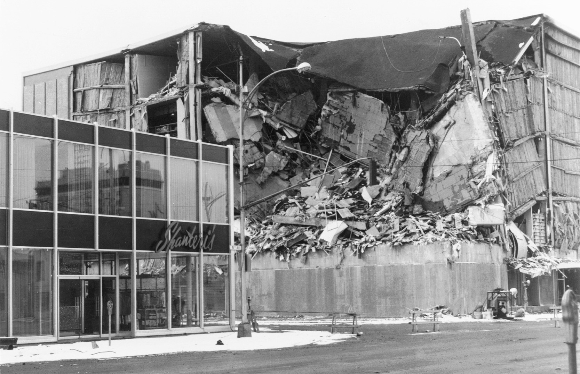
Damage Caused by the 1964 Anchorage, Alaska Quake
Figure 6.13

Slide 33
Earthquake Destruction
Liquefaction of the ground
Unconsolidated materials saturated with water turn into a mobile fluid
Tsunamis, or seismic sea waves
Destructive waves that are often inappropriately called “tidal waves”

Slide 34
Earthquake Destruction
Tsunamis, or seismic sea waves
Result from vertical displacement along a fault located on the ocean floor or a large undersea landslide triggered by an earthquake
In the open ocean wave height is usually < 1 meter
In shallower coastal waters the water piles up to heights over 30 meters!

Slide 35
Formation of a Tsunami
Figure 6.14

Slide 36
Earthquake Destruction
Landslides and ground subsidence
Fire
human influence – wouldn’t happen without the presence of gas lines and electrical wires, for example

Slide 37
It Would Be Nice To Know One Is Coming, Wouldn’t It?!
What Constitutes a Prediction?
Useful data include:
What are the chances?
How big?
Where?
When?

Slide 38
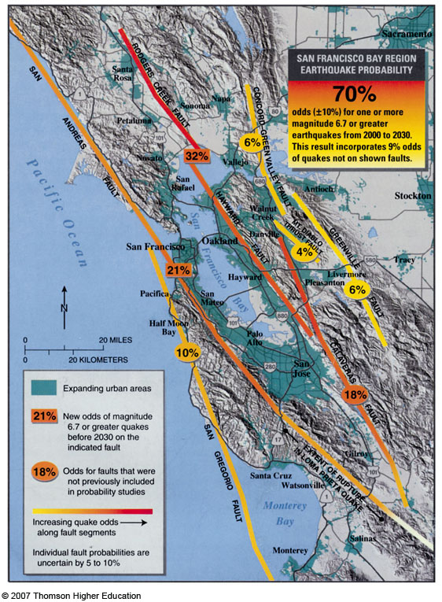
Earthquake Prediction
Earthquakes cannot be predicted, but seismologists can estimate the chance of an earthquake occurring on a particular fault segment during a given time frame

Slide 39
Earthquake Recurrence Intervals
Faults that have not ruptured for a long time and are not creeping are thought to be at high risk for a future earthquake
The last great Cascadia subduction zone quake was January, 1700

Slide 40
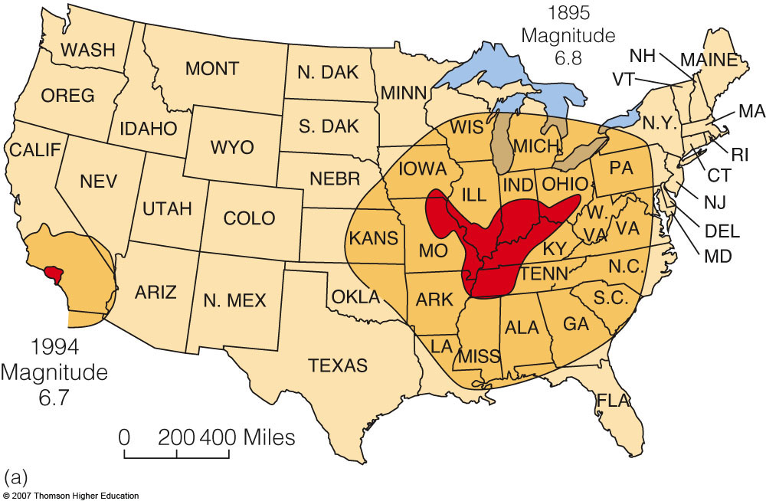
Fig. 4-30a, p. 93
Notes:
Figure 4.30: Mid-continent earthquakes.
(a) Comparison of the effects of two earthquakes of similar magnitude. The 1895 Charleston, Missouri, earthquake impacted a relatively huge area in the central United States, whereas the 1994 Northridge earthquake’s effects were limited to Southern California. Red indicates areas of minor-to-major damage to buildings and their contents. Yellow indicates areas where shaking was felt but there was little or no damage to objects, such as dishes.
Data from USGS.

Slide 41
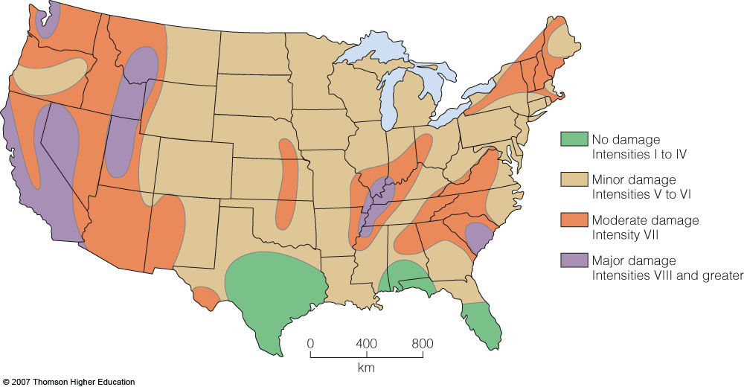
Seismic Risk

Slide 42
How Can You Prepare?
It’s gonna happen!
99.7% chance of a >6.7 in the next 30 years!
Since you can’t avoid it, you can make the best of it by being prepared…
Install shear walls!
Bold down the foundation of your house!
Make an Earthquake Survival Kit!
What else?

Slide 43
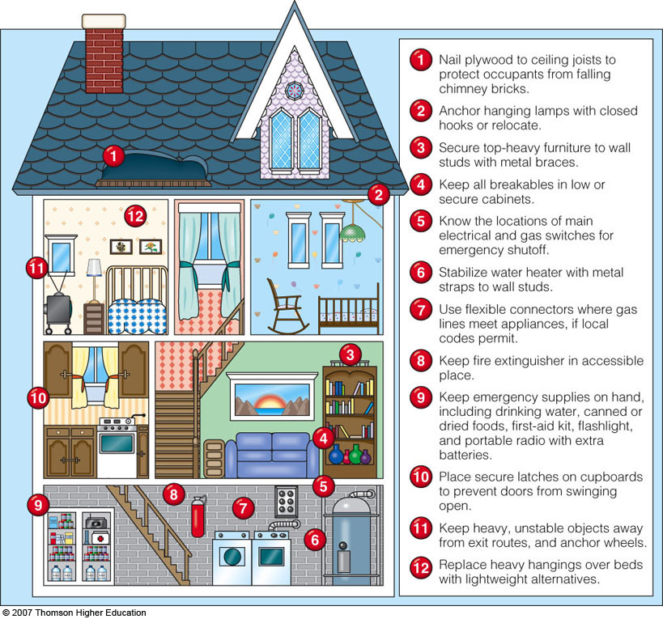
Fig. 4-42a, p. 100
Notes:
Figure 4.42a: How to minimize earthquake damage in the home in advance.
FEMA.

Slide 44
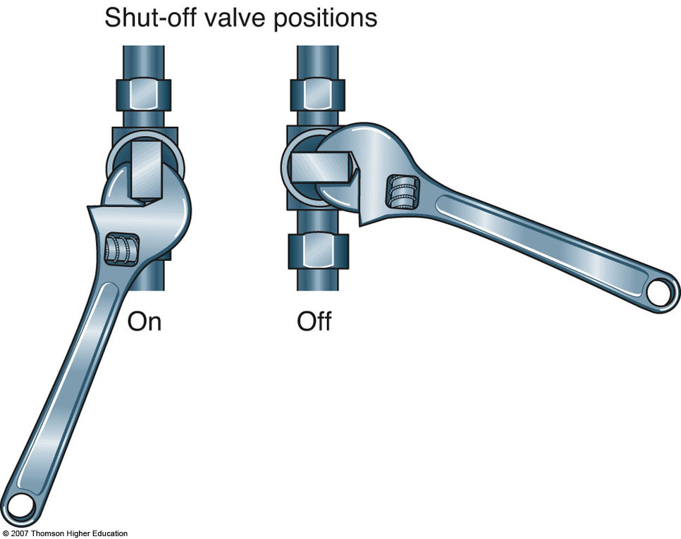
Fig. 4-42b, p. 100
Notes:
Figure 4.42b: Keep a small crescent wrench at the gas meter. Turn off the gas by turning the valve end 90°.
FEMA.

Slide 45
Earth’s Layered Structure
Layers can be defined by composition
Three principal compositional layers
Crust—The comparatively thin outer skin that ranges from 3 km (2 miles) at the oceanic ridges to 70 km (40 miles in some mountain belts)
MOHO separates the two!
Mantle—A solid rocky (silica-rich) shell that extends to a depth of about 2900 km (1800 miles)
Core—An iron-rich sphere having a radius of 3486 km (2161 miles)

Slide 46
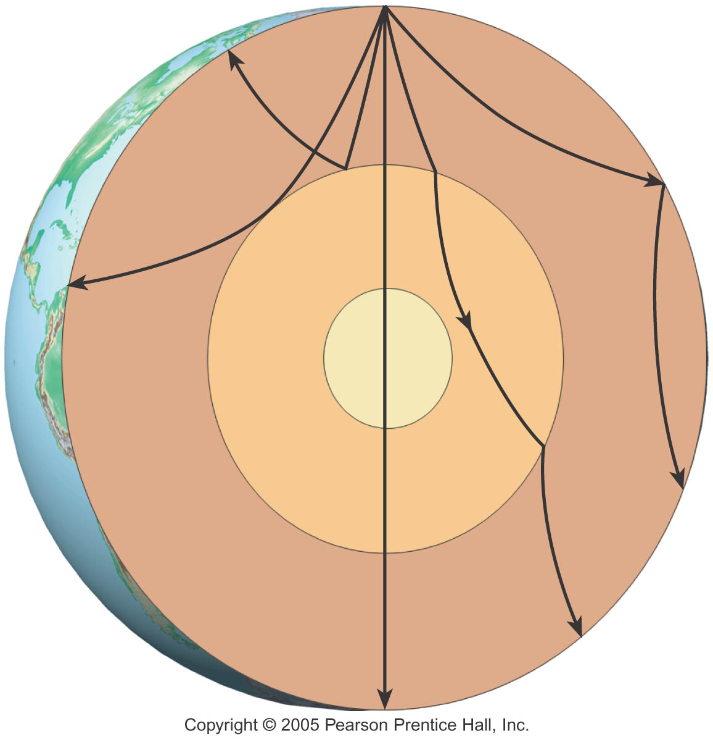
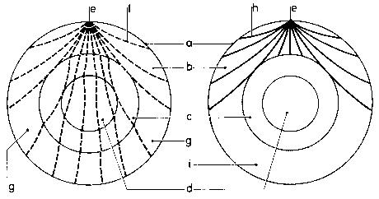
But We Haven’t BEEN There!
How do we know the interior structure of Earth?
P-waves
S-waves: don’t go thru liquids!!

Slide 47
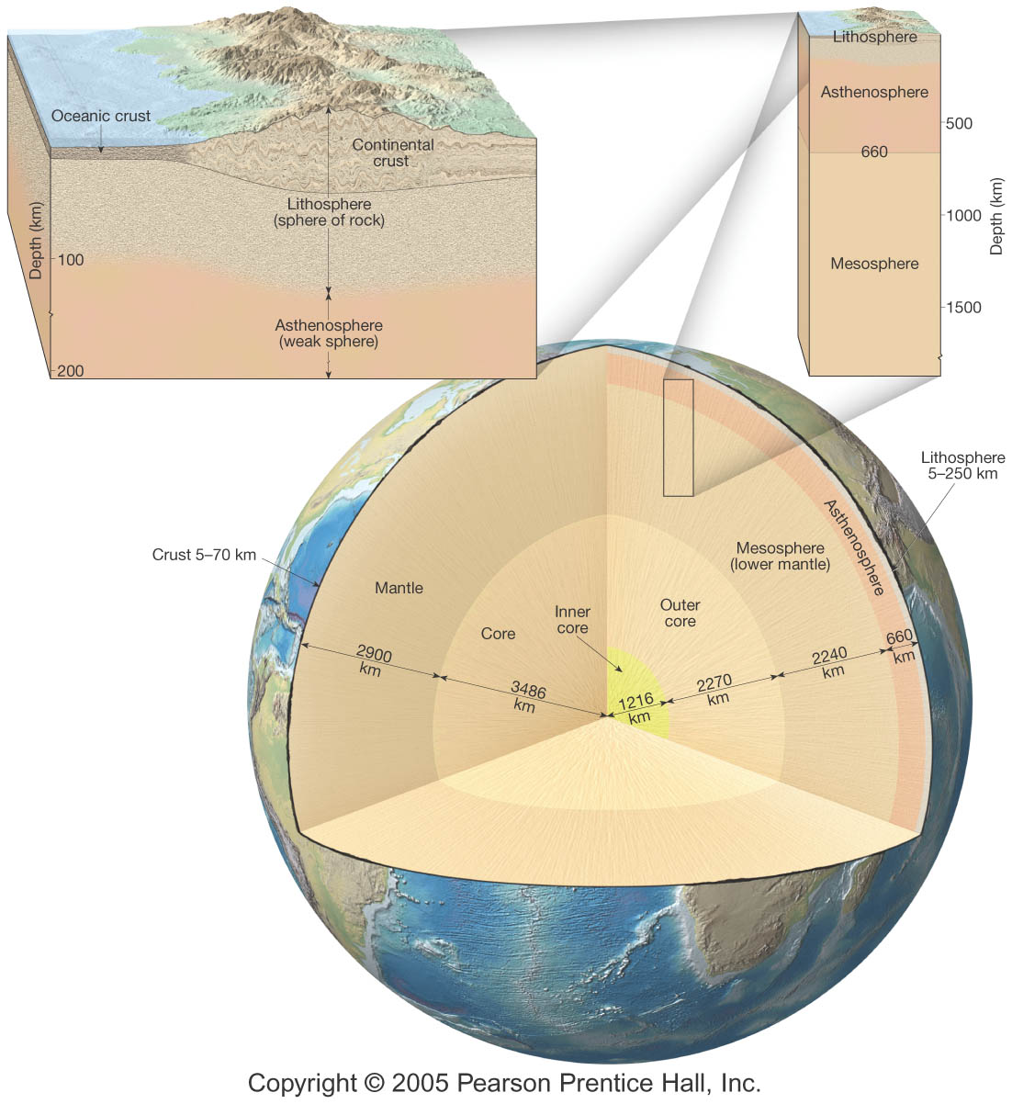
Earth’s Layered Structure: The Moho and other discontinuities

Slide 48
Earth’s Layered Structure
Layers can ALTERNATIVELY be defined by their physical properties
With increasing depth, Earth’s interior is characterized by gradual increases in temperature, pressure, and density
Main layers of Earth’s interior are based on physical properties and hence mechanical strength

Slide 49
Earth’s Layered Structure
Layers defined by physical properties
Lithosphere (sphere of rock)
Consists of the crust and uppermost mantle
Relatively cool, rigid shell
Averages about 100 km in thickness, but may be 250 km or more thick beneath the older portions of the continents

Slide 50
Earth’s Layered Structure
Layers defined by physical properties
Asthenosphere (weak sphere)
Beneath the lithosphere, in the upper mantle to a depth of about 600 km
Small amount of melting in the upper portion mechanically detaches the lithosphere from the layer below allowing the lithosphere to move independently of the asthenosphere

Slide 51
Earth’s Layered Structure
Layers defined by physical properties
Mesosphere or lower mantle
Rigid layer between the depths of 660 km and 2900 km
Rocks are very hot and capable of very gradual flow

Slide 52
Earth’s Layered Structure
Layers defined by physical properties
Outer core
Composed mostly of an iron-nickel alloy
Liquid layer
2270 km (1410 miles) thick
Convective flow within generates Earth’s magnetic field

Slide 53
Earth’s Layered Structure
Layers defined by physical properties
Inner core
Sphere with a radius of 3486 km (2161 miles)
Stronger than the outer core
Behaves like a solid

Slide 54
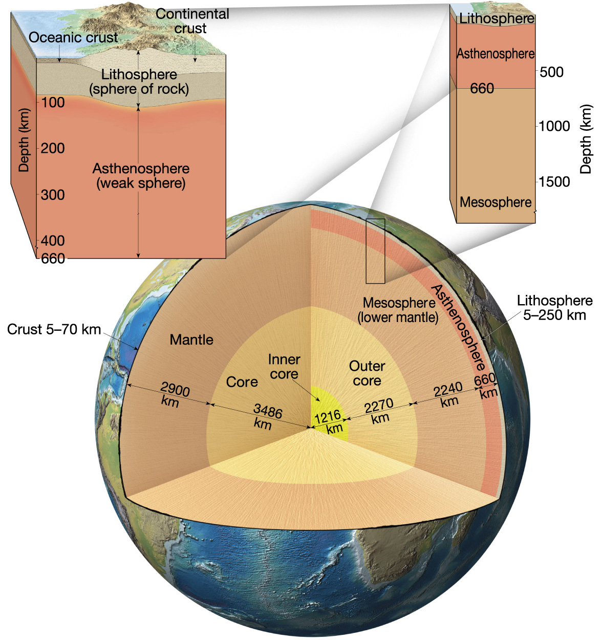
Earth’s
Layered
Structure

Slide 55
Deformation
Deformation is a general term that refers to all changes in the original form and/or size of a rock body
Most crustal deformation occurs along plate margins
Deformation involves
Stress—Force applied to a given area

Slide 56
Deformation
How rocks deform
General characteristics of rock deformation
Elastic deformation—The rock returns to nearly its original size and shape when the stress is removed
Once the elastic limit (strength) of a rock is surpassed, it either flows (ductile deformation) or fractures (brittle deformation)

Slide 57
Folds
During crustal deformation rocks are often bent into a series of wave-like undulations called folds
Characteristics of folds
Most folds result from compressional stresses which shorten and thicken the crust

Slide 58
Folds
Common types of folds
Anticline—Upfolded or arched rock layers
Syncline—Downfolds or troughs of rock layers
Depending on their orientation, anticlines and synclines can be described as
Symmetrical, asymmetrical, or recumbent (an overturned fold)

Slide 59
Anticlines and Synclines
Figure 6.20

Slide 60
Folds
Other types of folds
Dome
Upwarped displacement of rocks
Circular or slightly elongated structure
Oldest rocks in center, younger rocks on the flanks

Slide 61
Folds
Other types of folds
Basin
Circular or slightly elongated structure
Downwarped displacement of rocks
Youngest rocks are found near the center, oldest rocks on the flanks

Slide 62
Faults
Faults are fractures in rocks along which appreciable displacement has taken place
Sudden movements along faults are the cause of most earthquakes
Classified by their relative movement which can be
Horizontal, vertical, or oblique

Slide 63
Faults
Types of faults
Dip-slip faults
Movement is mainly parallel to the dip of the fault surface
May produce long, low cliffs called fault scarps
Parts of a dip-slip fault include the hanging wall (rock surface above the fault) and the footwall (rock surface below the fault)

Slide 64
Faults
Types of dip-slip faults
Normal fault
Hanging wall block moves down relative to the footwall block
Accommodates lengthening or extension of the crust
Larger scale normal faults are associated with structures called fault-block mountains

Slide 65
Normal Fault
Figure 6.24 A

Slide 66
Faults
Types of dip-slip faults
Reverse and thrust faults
Hanging wall block moves up relative to the footwall block
Reverse faults have dips greater than 45º and thrust faults have dips less than 45º
Strong compressional forces

Slide 67
Reverse Fault
Figure 6.24 B

Slide 68
Faults
Strike-slip fault
Dominant displacement is horizontal and parallel to the strike of the fault
Types of strike-slip faults
Right-lateral—As you face the fault, the opposite side of the fault moves to the right
Left-lateral—As you face the fault, the opposite side of the fault moves to the left

Slide 69
Strike-Slip fault
Figure 6.24 D

Slide 70
Faults
Strike-slip fault
Transform fault
Large strike-slip fault that cuts through the lithosphere
Accommodates motion between two large crustal plates

Slide 71
The San
Andreas
Fault
System
Figure 6.26

Slide 72
Mountain Building
Orogenesis—The processes that collectively produce a mountain belt
Include folding, thrust faulting, metamorphism, and igneous activity
Compressional forces producing folding and thrust faulting
Metamorphism
Igneous activity

Slide 73
Mountain Building at Convergent Boundaries
Island arcs
Where two ocean plates converge and one is subducted beneath the other
Volcanic island arcs result from the steady subduction of oceanic lithosphere
Continued development can result in the formation of mountainous topography consisting of igneous and metamorphic rocks

Slide 74
Volcanic Island Arc
Figure 6.28

Slide 75
Mountain Building at Convergent Boundaries
Andean-type mountain building
Mountain building along continental margins
Involves the convergence of an oceanic plate and a plate whose leading edge contains continental crust
Exemplified by the Andes Mountains

Slide 76
Mountain Building at Convergent Boundaries
Andean-type mountain building
Building a volcanic arc
Subduction and partial melting of mantle rock generates primary magmas
Differentiation of magma produces andesitic volcanism dominated by pyroclastics and lavas
A large percentage of the magma never reaches the surface and is emplaced as plutons

Slide 77
Andean-Type Plate Margin
Figure 6.29 B

Slide 78
Subduction and Mountain Building
Andean-type mountain building
Development of an accretionary wedge
An accretionary wedge is a chaotic accumulation of deformed and thrust-faulted sediments and scraps of oceanic crust
Prolonged subduction may thicken an accretionary wedge enough so it protrudes above sea level

Slide 79
Continental Collisions
Two lithospheric plates, both carrying continental crust
Continental collisions result in the development of compressional mountains that are characterized by shortened and thickened crust
Most compressional mountains exhibit a region of intense folding and thrust faulting called a fold-and-thrust-belt

Slide 80
Continental Collisions
Himalayan Mountains
Youthful mountains—Collision began about 45 million years ago
India collided with Eurasian plate
Similar but older collision occurred when the European continent collided with the Asian continent to produce the Ural mountains

Slide 81
Continental Collisions
Appalachian Mountains
Formed long ago and substantially lowered by erosion
Resulted from a collision among North America, Europe, and northern Africa

Slide 82
Terranes and Mountain Building
Another mechanism of orogenesis
The nature of terranes
Small crustal fragments collide and merge with continental margins
Accreted crustal blocks are called terranes (any crustal fragments whose geologic history is distinct from that of the adjoining terranes)

Slide 83
Terranes and Mountain Building
The nature of terranes
Prior to accretion some of the fragments may have been microcontinents
Others may have been island arcs, submerged crustal fragments, extinct volcanic islands, or submerged oceanic plateaus

Slide 84
Terranes and Mountain Building
Accretion and orogenesis
As oceanic plates move they carry embedded oceanic plateaus, island arcs, and microcontinents to Andean-type subduction zones
Thick oceanic plates carrying oceanic plateaus or “lighter” igneous rocks of island arcs may be too buoyant to subduct

Slide 85
Collision and
Accretion of an
Island Arc

Slide 86
Terranes and Mountain Building
Accretion and orogenesis
Collision of the fragments with the continental margin deforms both blocks adding to the zone of deformation and to the thickness of the continental margin
Many of the terranes found in the North American Cordillera were once scattered throughout the eastern Pacific

Slide 87
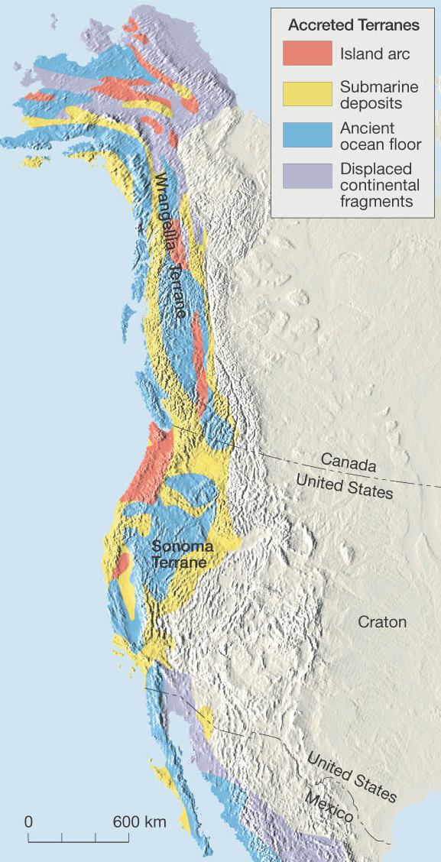
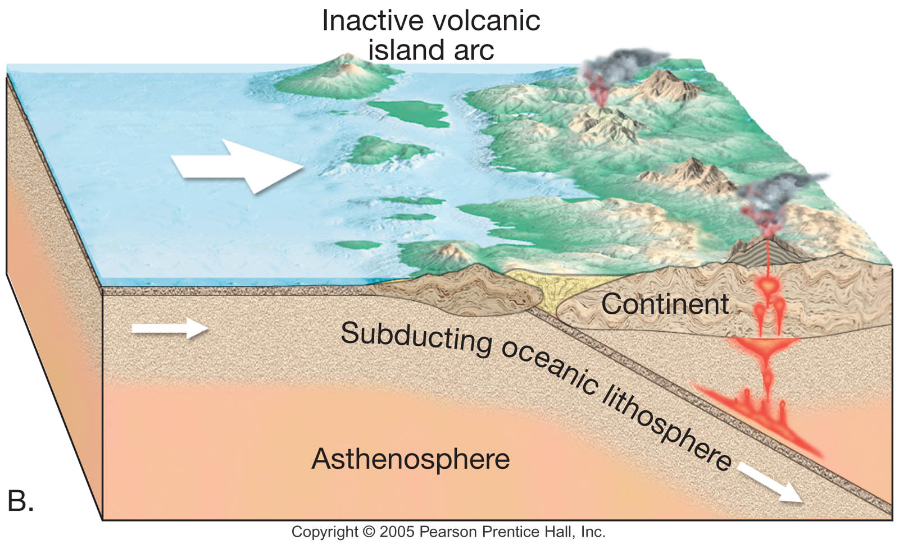
Growth of a Continent
Accretion occurs when a “block of rock” won’t be subducted

