Slide 1
Weathering and
Mass Wasting

Slide 2
Earth’s external processes
Weathering – the physical breakdown and / or chemical alteration of rock at or near Earth’s surface
Mass wasting – the transfer of rock and soil downslope under the influence of gravity
Erosion – the physical removal of material by mobile agents such as water, wind, ice, or gravity

Slide 3
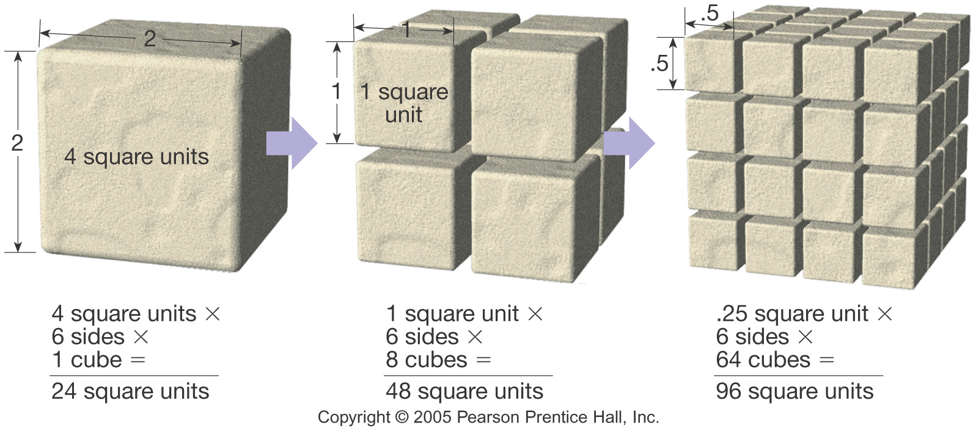
Two types of Weathering
Mechanical weathering – breaking of rocks into smaller pieces
Chemical weathering - alters the internal structure of minerals by removing and/or adding elements

Slide 4
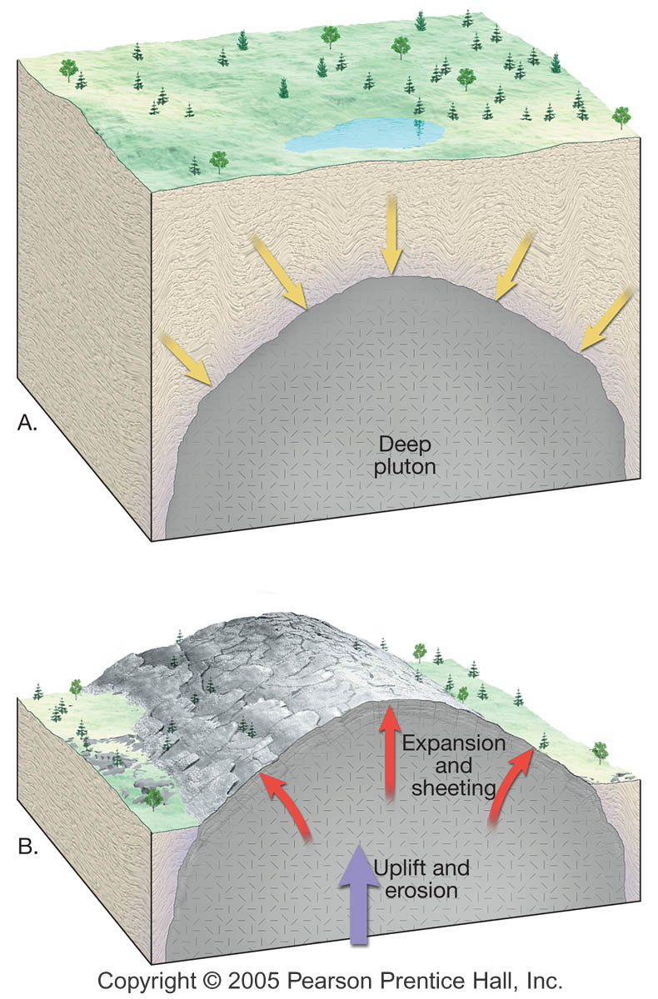
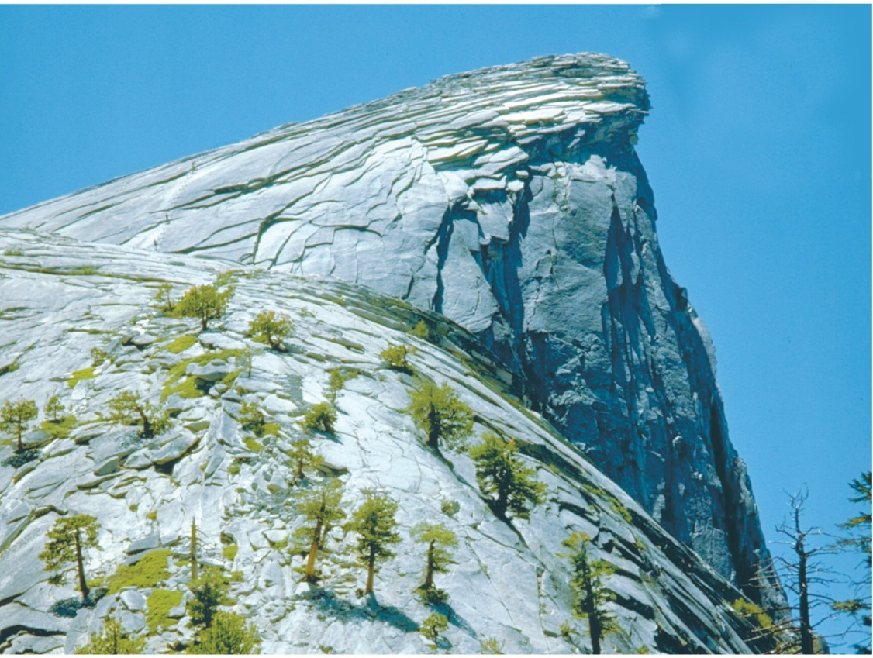
Mechanical Weathering
Unloading
Jointing of igneous and metamorphic rocks at the Earth’s surface due to a gradual reduction in confining pressure
Exfoliation due to a reduction in confining pressure at the surface

Slide 5
Mechanical Weathering
Frost wedging
3 Requirements:

Slide 6
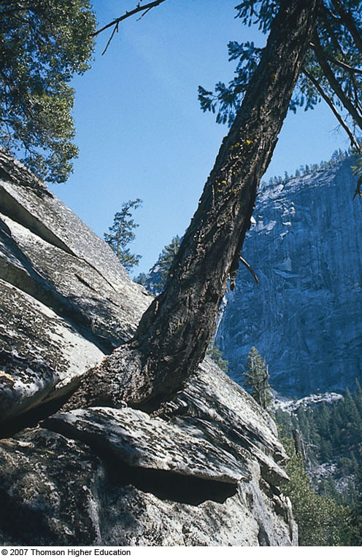
Mechanical Weathering
Abrasion – rocks hit each other!
Thermal expansion – alternate expansion and contraction due to heating and cooling
Biological activity – disintegration resulting from plants and animals

Slide 7
Chemical Weathering
Chemical Weathering
Breaks down rock components and the internal structures of minerals
Most important agent involved in chemical weathering is water (responsible for transport of ions and molecules involved in chemical processes)

Slide 8
Chemical Weathering
Dissolution
Aided by small amounts of acid in the water
Soluble ions are retained in the groundwater
Oxidation
Any chemical reaction in which a compound or radical loses electrons
Important in decomposing ferromagnesian minerals
Hydrolysis
The reaction of any substance with water
Hydrogen ion attacks and replaces other positive ions
Feldspar turns to Clay

Slide 9
Examples

Slide 11
Soil
Soil is a combination of mineral and organic matter, water, and air
That portion of the regolith (rock and mineral fragments produced by weathering) that supports the growth of plants
Who needs it, anyway?

Slide 12
Typical components in a soil that yield good plant growth

Slide 13
Factors controlling soil formation
Climate
Most influential control of soil formation
Key factors are temperature and precipitation
Organic Processes
Plants and animals
Organisms influence the soil’s physical and chemical properties
Also furnish organic matter to the soil

Slide 14
Factors controlling soil formation
Relief (Slope)
Steep slopes often have poorly developed soils
Optimum terrain is a flat-to-undulating upland surface
Parent material
Residual soil – parent material is the underlying bedrock
Transported soil – forms in place on parent material that has been carried from elsewhere and deposited

Slide 15
Factors controlling soil formation
Time
Important in all geologic processes
Amount of time for soil formation varies for different soils depending on geologic and climatic conditions
All Together: ClORPT!
Climate, Organics, Relief, Parent material, Time

Slide 16
Soil development

Slide 17
Soil
The soil profile
Soil forming processes operate from the surface downward
Vertical differences are called horizons – zones or layers of soil

Slide 18
Soil
The soil profile
O horizon – organic matter
A horizon – organic and mineral matter
High biological activity
Together the O and A horizons make up the topsoil
Sometimes it’s appropriate to include the E horizon – very little organic matter
Zone of eluviation and leaching
Occurs between A and B horizons

Slide 19
Soil
The soil profile
B horizon – zone of accumulation
C horizon – partially altered parent material
The O, A, (E) and B horizons together are called the solum, or “true soil”

Slide 20
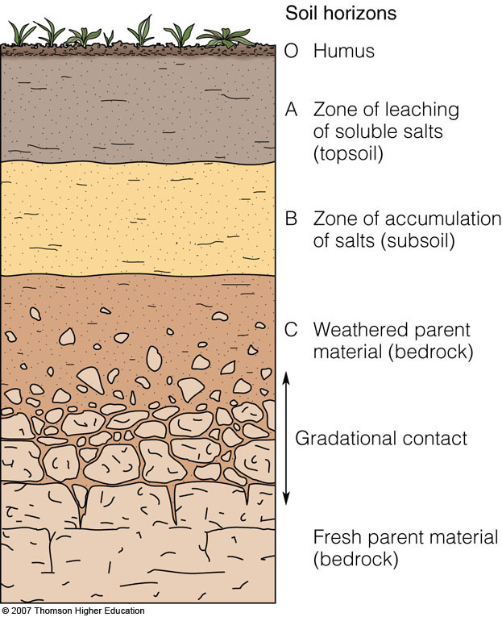
Idealized soil profiles

Slide 21
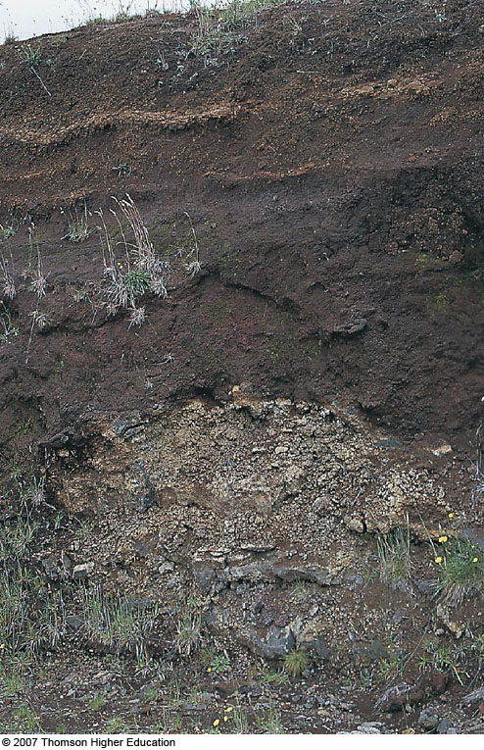
Notes:
FIGURE 6.11 Volcanic ash (horizontal layers) overlying weathered basalt; Pahala, Hawaii. This volcanic soil supports rich crops of sugar cane, pineapple, and macadamia nuts.

Slide 22
Soil
Soil types
Groups consist of items that have certain important characteristics in common
Soils are classified using a system known as the Soil Taxonomy
Based on physical and chemical properties of the soil profile

Slide 23
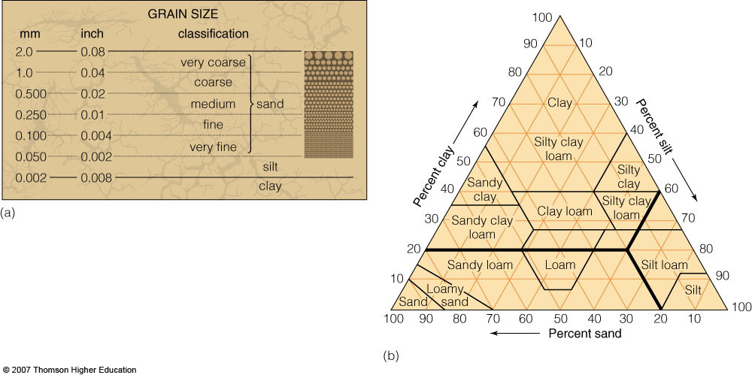
Soil Classification
Many schemes…

Slide 24
Soil Classification
Here’s one based on Climate
Where are WE?
Notes:
FIGURE 6.15 The Great Soil Groups and their climatic environments.

Slide 25
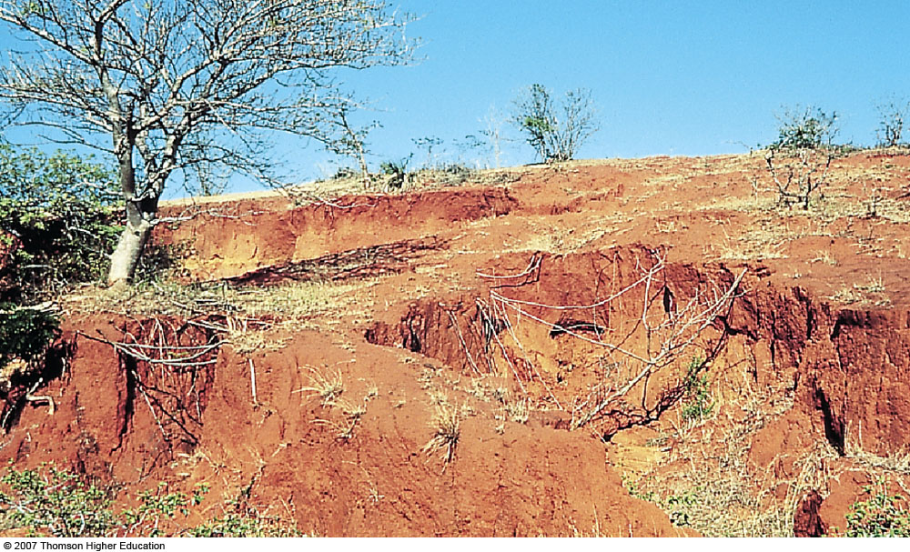
Laterite
Notes:
FIGURE 6.16 (a) Laterite, shown here in Madagascar, is a deep, red soil that forms in response to intense chemical weathering in the tropics. (b) Bauxite, the ore of aluminum, forms in horizon B of laterites derived from aluminum-rich parent materials.

Slide 26
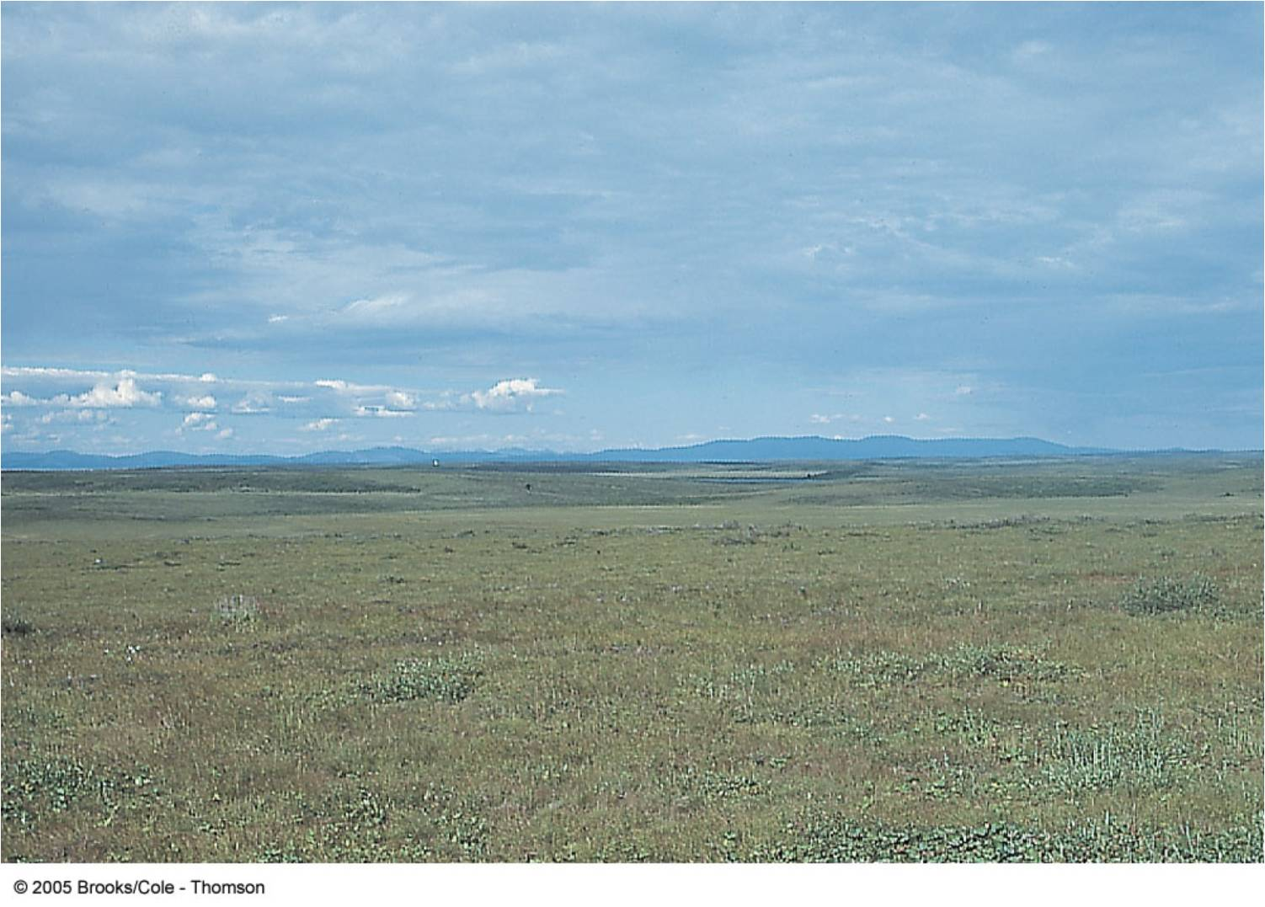
Tundra (See Permafrost below)
Notes:
FIGURE 6.17 Treeless tundra landscape near Kotzebue, Alaska. Most of the soil in tundra regions is frozen much of the year.

Slide 27
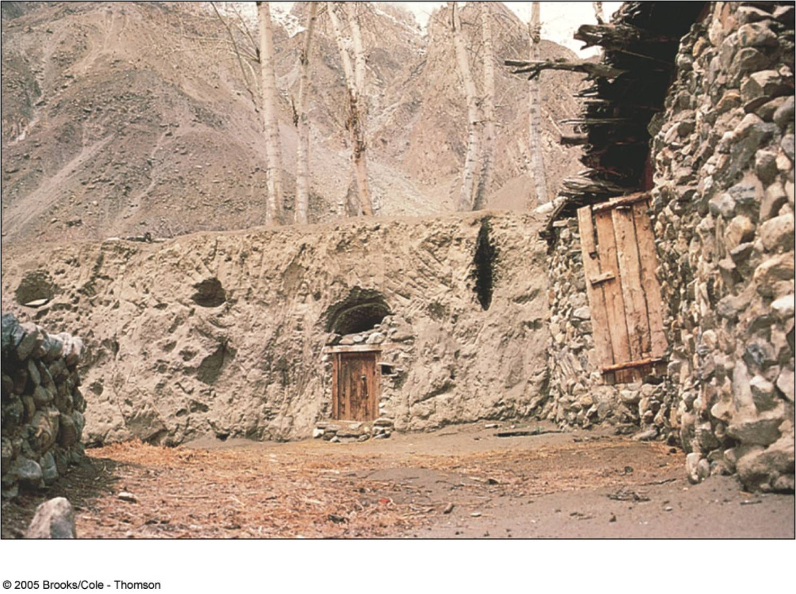
Loess
Wind-laid soils of the world
Fertile
“Strong”
Or…?

Slide 28
Loess Distribution

Slide 29
Soil Degradation
Erosion
Wind (opening picture)
Sheet (a.k.a. sheet wash)
Where water erosion starts
Rill
Water collects, runs faster, deeper
Gullying
Deep, wide
Can be facilitated by grazers (see future slide)

Slide 30
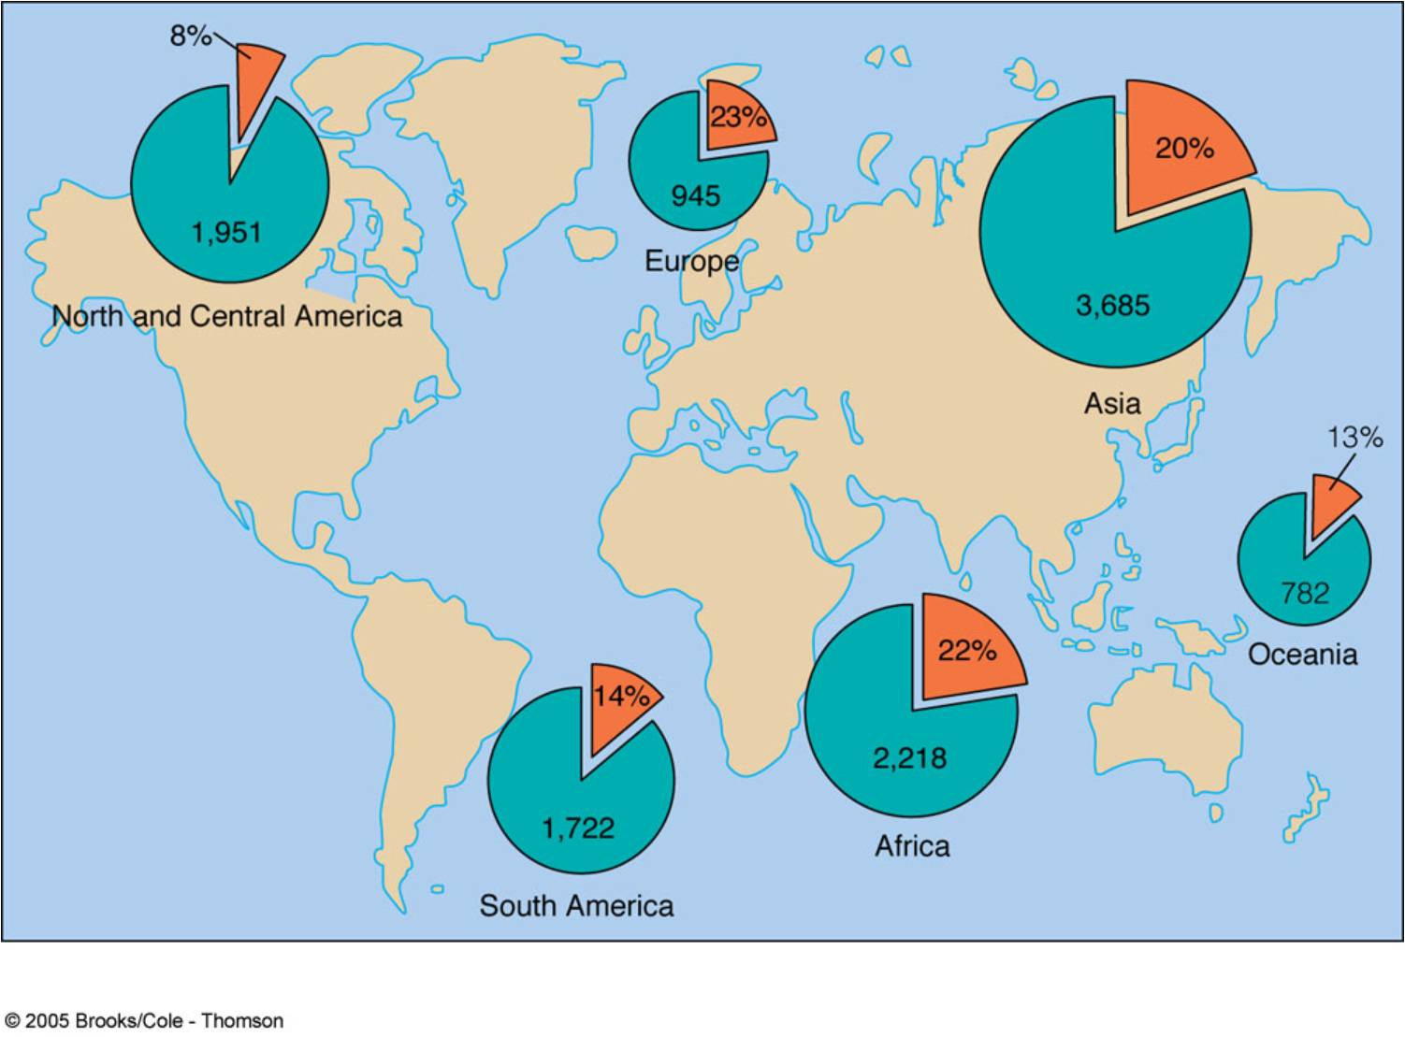
Soil Degradation – a worldwide problem!
Notes:
FIGURE 6.18 World soil degradation, 1945–1991. The areas degraded are given both in percentage of the arable area (pie-shaped areas in orange) and in hectares (a hectare is 10,000 square meters = 2.47 acres). Table 6.3 summarizes the various causes of soil degradation in the world.

Slide 31
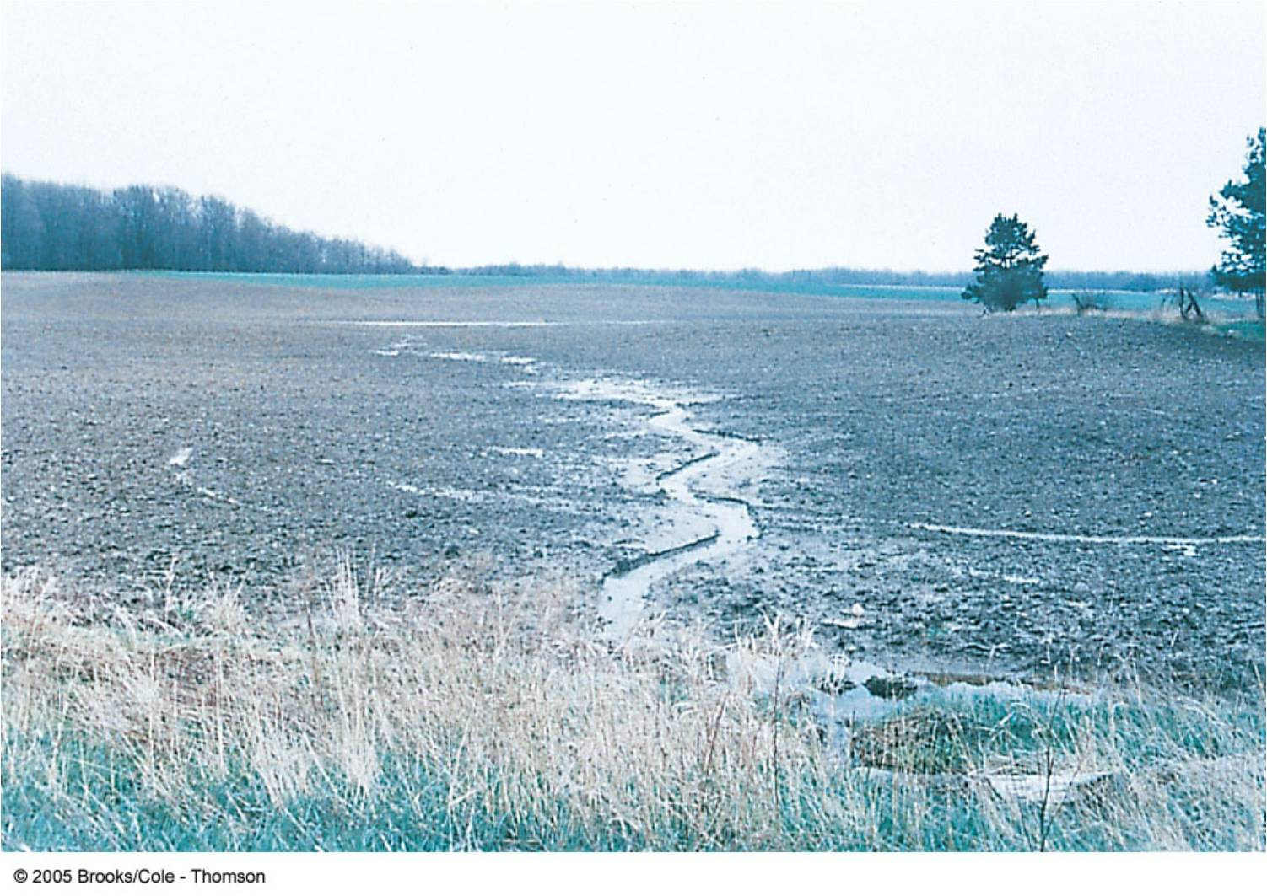
Sheet Wash forming Rills (GA)

Slide 32
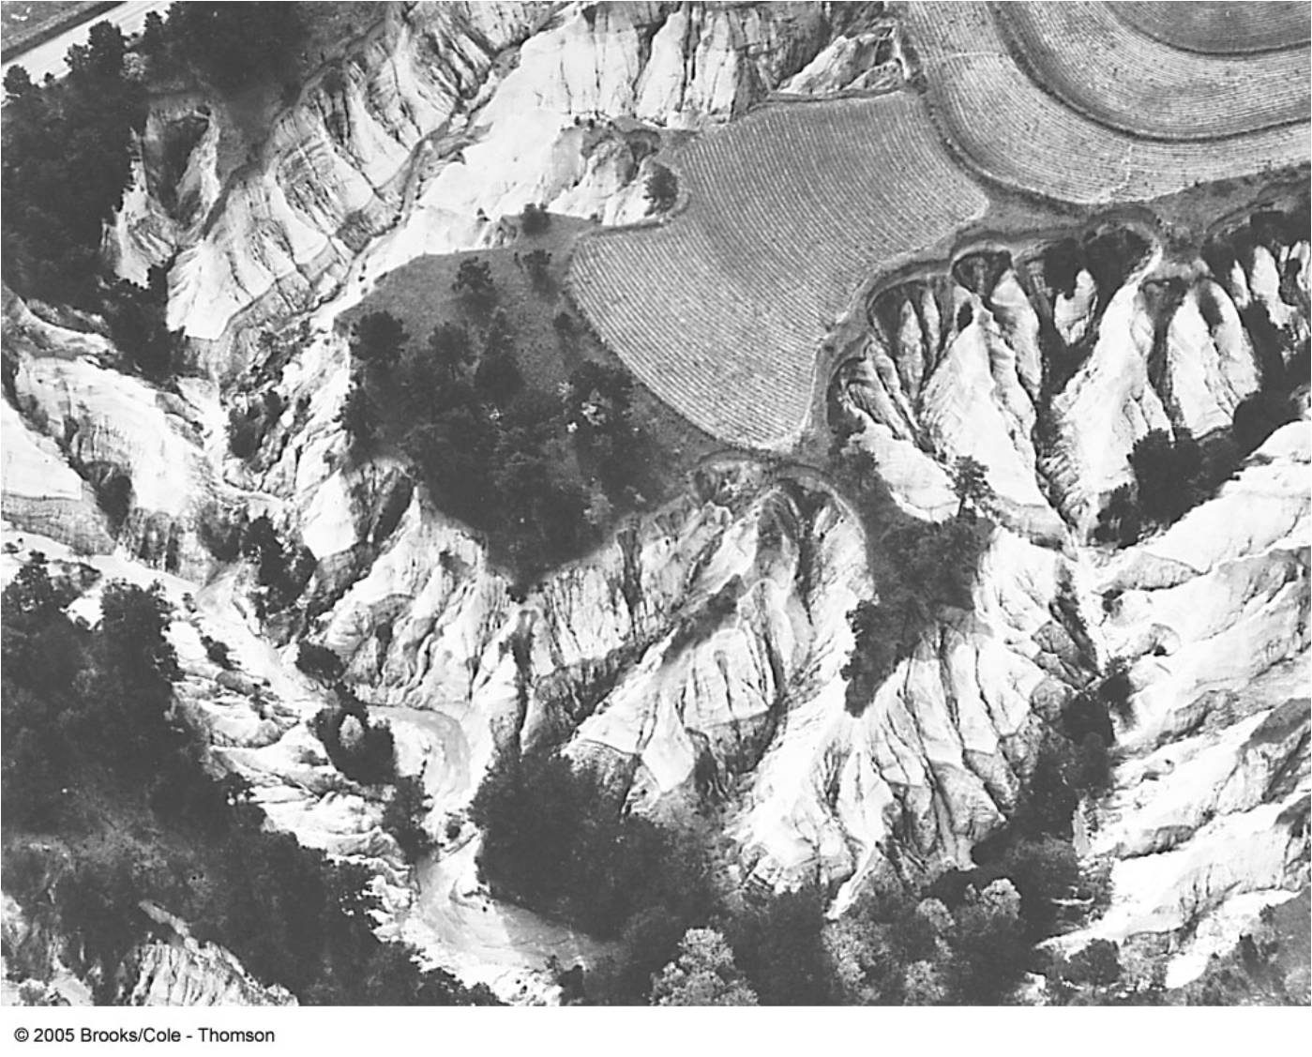
Rill in the middle background becomes a Gully in the foreground
Gullies (GA)
Fig. 6-19, p. 160
Notes:
FIGURE 6.19 A rill in the middle background becomes a gully in the foreground. Poor agricultural practice like this can lead to deep gullying and with it a loss of soil and productive land. From Gabler et al., Physical Geography, 6th ed., Brooks/Cole, p. 370

Slide 33
Notes:
FIGURE 6.20 Estimated annual rates of cropland soil loss in the United States, 1980. (a) Sheet and rill erosion losses. (b) Wind erosion losses in the Great Plains. (Light green represents _1 ton/acre per year.)

Slide 34
Notes:
FIGURE 6.20 Estimated annual rates of cropland soil loss in the United States, 1980. (a) Sheet and rill erosion losses. (b) Wind erosion losses in the Great Plains. (Light green represents _1 ton/acre per year.)

Slide 35
Mitigation of Soil Erosion
Terracing
Strip-cropping
Crop Rotation
Conservation-tillage
No-till or minimum-till

Slide 36
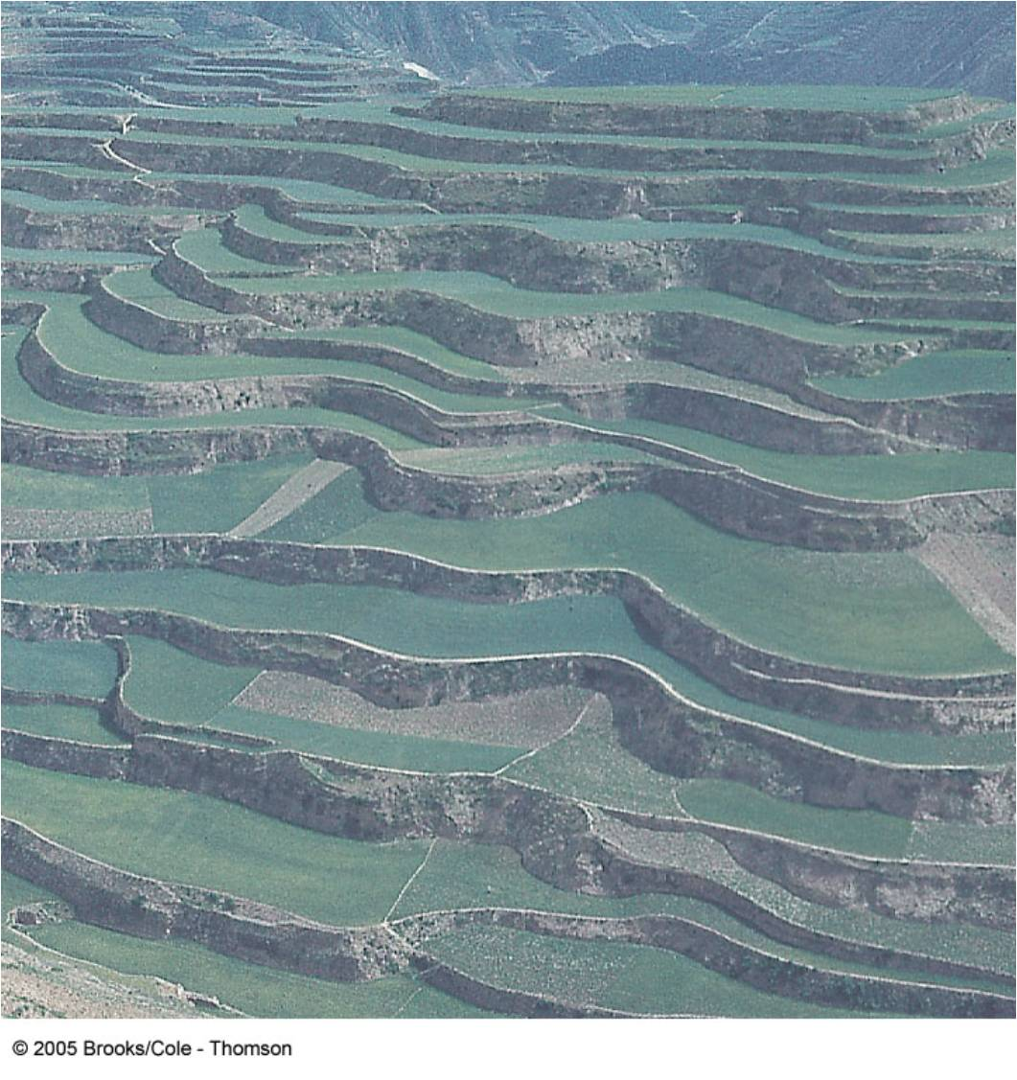
Notes:
FIGURE 6.24 Terracing steep hillsides is an ancient soil conservation practice; China.

Slide 37
Remediation of Expansive Soils
Problem: Expandable Clays
crush the foundation!
Fix:

Slide 38
Tundra and Permafrost
Notes:
FIGURE 6.28 Utility poles extruded from permafrost ground; Alaska. One solution is to place the poles in tripods on the ground surface.

Slide 39
(unfrozen layers)

Slide 40
Vehicle scars on Tundra
Notes:
FIGURE 6.29 Scars made by vehicles on tundra soil remain for many years; Alaska.

Slide 41
Notes:
FIGURE 6.30 Differential melting of permafrost caused this cabin to subside at one end. Note that part of the foundation of the cabin is open to the atmosphere, which prevented the permafrost from melting.

Slide 42
Notes:
FIGURE 6.31 Two methods of mitigating permafrost damage: (a) Raised WW-II Quonset hut; Nome, Alaska. (b) Heatdissipating foundation piers on a modern structure; Kotzebue, Alaska

Slide 43
Notes:
FIGURE 6.31 Two methods of mitigating permafrost damage: (a) Raised WW-II Quonset hut; Nome, Alaska. (b) Heatdissipating foundation piers on a modern structure; Kotzebue, Alaska

Slide 44
Notes:
FIGURE 6.32 The 800-mile Alaskan oil pipeline was constructed to accommodate permafrost and wildlife. (a) The meandering pattern allows for expansion and contraction of the pipe and for potential ground movement along the Denali fault, which it crosses. The pipeline supports feature heat-dissipating radiators. (b) Moose and caribou are able to pass beneath the elevated pipeline.

Slide 45
Notes:
FIGURE 6.32 The 800-mile Alaskan oil pipeline was constructed to accommodate permafrost and wildlife. (a) The meandering pattern allows for expansion and contraction of the pipe and for potential ground movement along the Denali fault, which it crosses. The pipeline supports feature heat-dissipating radiators. (b) Moose and caribou are able to pass beneath the elevated pipeline.

Slide 46
Settlement (not the same as Subsidence)
Ground lacks sufficient strength to support the structure

Slide 47
Chapter 7
Mass Wasting and Subsidence

Slide 48
Fig. 7-1, p. 176
Notes:
FIGURE 7.1 Severity of landsliding in the United States. Note that the most serious problems are found in the Appalachian Mountains, the Rocky Mountains, and the coastal mountain ranges of the Pacific Rim. J. P. Krohn and J. E. Slosson, “Landslide Potential in the U.S.,” California Geology 29, no. 10 (1976)

Slide 49
Mass Wasting
Downslope movement of rock and soil under the direct influence of gravity
Classified by:
Type of material
Type of movement
Moisture content
Velocity of movement

Slide 50
Fig. 7-2, p. 177
Notes:
FIGURE 7.2 Classification of landslides by mechanism, material, and velocity.

Slide 51
Rock Falls
Free fall of hard bedrock of any size from a steep slope or cliff
Yosemite Valley

Slide 52
Debris Fall
Collapse of weathered rock material and/or soil from a steep slope or cliff

Slide 53
Debris Flows
Mass movement of unconsolidated material in a plastic or semi-fluid state
Debris flow - dense fluid mixture of rock, sand, mud, and water that is fast-moving and destructive

Slide 54
Creep
Slow downslope movement of rock and soil particles
Caused by heavy rainfall on steep slopes with loose soil and sparse vegetation
Most common in arid, semiarid, and alpine climates, and soil exposed by forest fires
MOST EXPENSIVE!!

Slide 55
Notes:
FIGURE 7.3 (a) Diagram and (b) photograph of soil and rock creep; east slope of the Sierra Nevada, California.

Slide 56
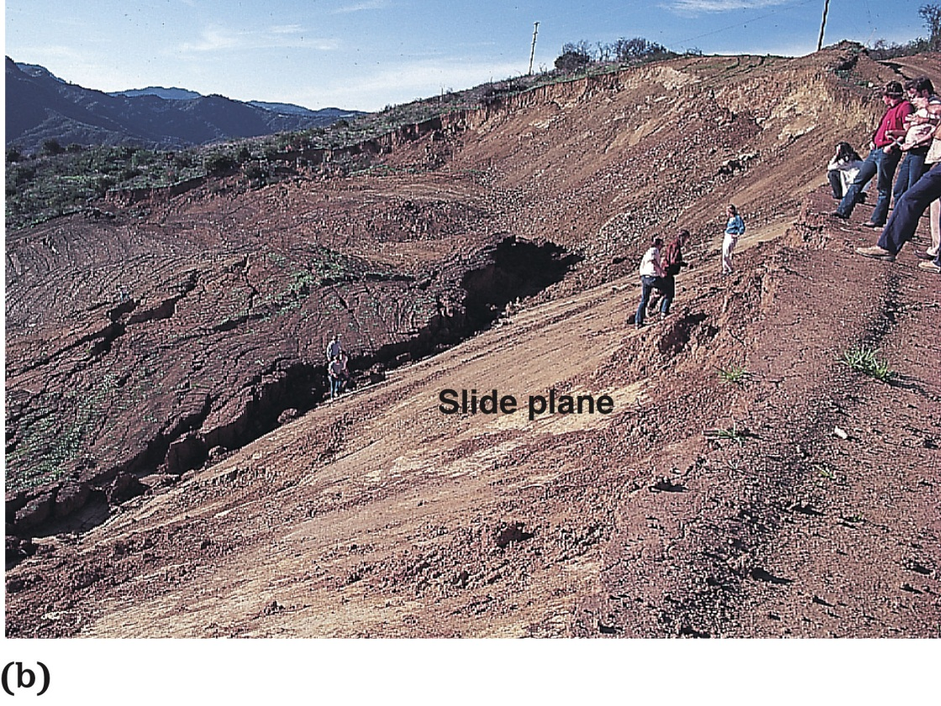
“Landslides”
Landslides are movements of rock or soil as a unit on a discrete failure surface or slide plane
Rotational landslides occur by movement on a curved, concave-upward surface
Translational landslides (block glide) occur on inclined planar surfaces

Slide 57
Landslide Mechanics
Landslides occur when the driving force (gravity) exceeds resisting forces (friction and cohesion)

Slide 58
Angle of Repose
Notes:
FIGURE 7.16 The angle of repose of granular material. (a) For dry sand the angle is 34°. Coarser material, such as that found on talus slopes, has a slightly steeper angle of repose. (b) The angle of repose depends not only upon the size of the material but also upon its moisture content. If one moistens beach sand, for example, one may build steep towers and walls with it. From Thompson and Turk, Modern Physical Geology, 2nd ed., Brooks/Cole

Slide 59
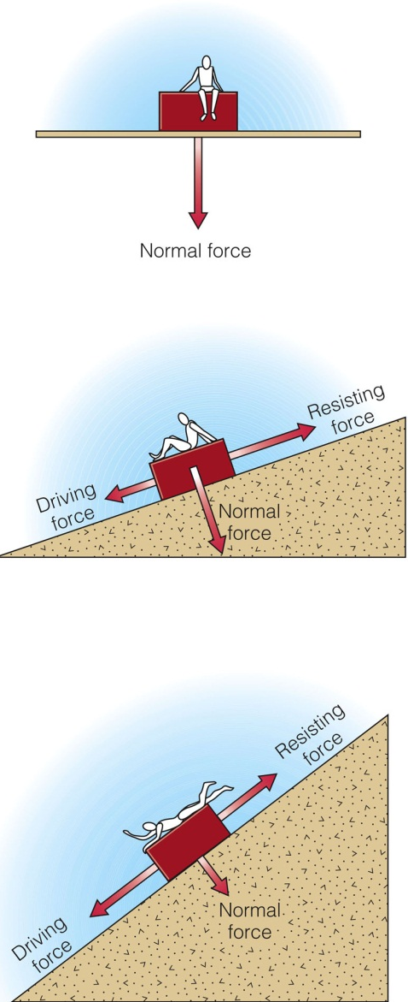
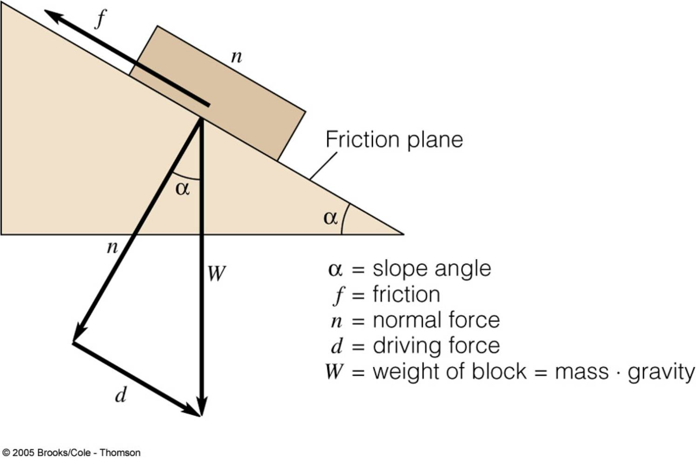
N
component
component
N = Normal force (strength of slope)
Notes:
FIGURE 7.14 Resolution of driving forces (d) and resisting forces (f n) acting on a slide plane inclined at an angle _.

Slide 60
Causes of Landslides
Weakening of slope material by saturation by water and weather if rock and soil
Steepening of the slope by artificial or natural undercutting of toe of slope
Addition of weight at top of slope
Change in the effective gravitational loading provided by earthquake shaking

Slide 61
Fig. 7-6, p. 180
Notes:
FIGURE 7.6 Rainfall thresholds for debris avalanches and landslides for two central California counties and California semiarid regions in general. For example, a rainfall intensity of 0.5 inch/hour for 8 hours is sufficient to initiate flows in Marin County. The same intensity for 14 hours is the threshold for Contra Costa County. California Geology data from CDMG

Slide 62
Fig. 7-7, p. 180
Notes:
FIGURE 7.7 Rainfall in excess of normal in the San Francisco Bay area during El Niño years 1982–1983 and 1997–1998. National Weather Service and NOAA

Slide 64
Fig. 7-11, p. 183
Notes:
FIGURE 7.11 The Point Fermin landslide at San Pedro, California, is a rock block glide that has moved intermittently since 1929. Damaged homes have been removed from the slide area in the foreground. The slide plane emerges just in front of the houses in the background, which are on relatively stable ground.

Slide 65
Mitigation of Landslide Damage
Geologic mapping to identify active and ancient landslide areas
Building codes that control steepness of slopes and surface-water drainage from site

Slide 66
Landslide Stabilization
Buttress fills and retaining devices
Drainpipes to de-water slide
Excavation
Rock bolts
Deflection devices

Slide 67
Notes:
FIGURE 7.10 Cutting a natural slope for homesites can lead to potential landslides on bedding or foliation planes. After cutting a natural slope for a building pad the manufactured slope exposes potential slide planes.

Slide 68
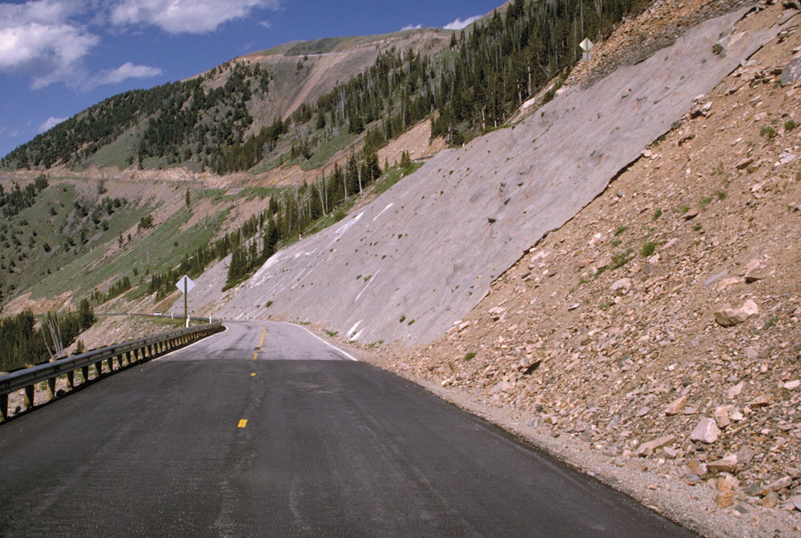
Grout

Slide 69
Notes:
FIGURE 7.21 (a)Typical retaining wall with drain (weep) holes to prevent water retention and the buildup of hydrostatic pressure behind the wall. The wall is constructed of concrete blocks with steel reinforcing rods and concrete in their hollow centers. (b) A steel cage is about to be placed in an 80-foot hole, which will then be filled with concrete. Thirty nine of these “caissons” were installed and tied together with a horizontal beam to retain ten homes at the top of a landslide.

Slide 70
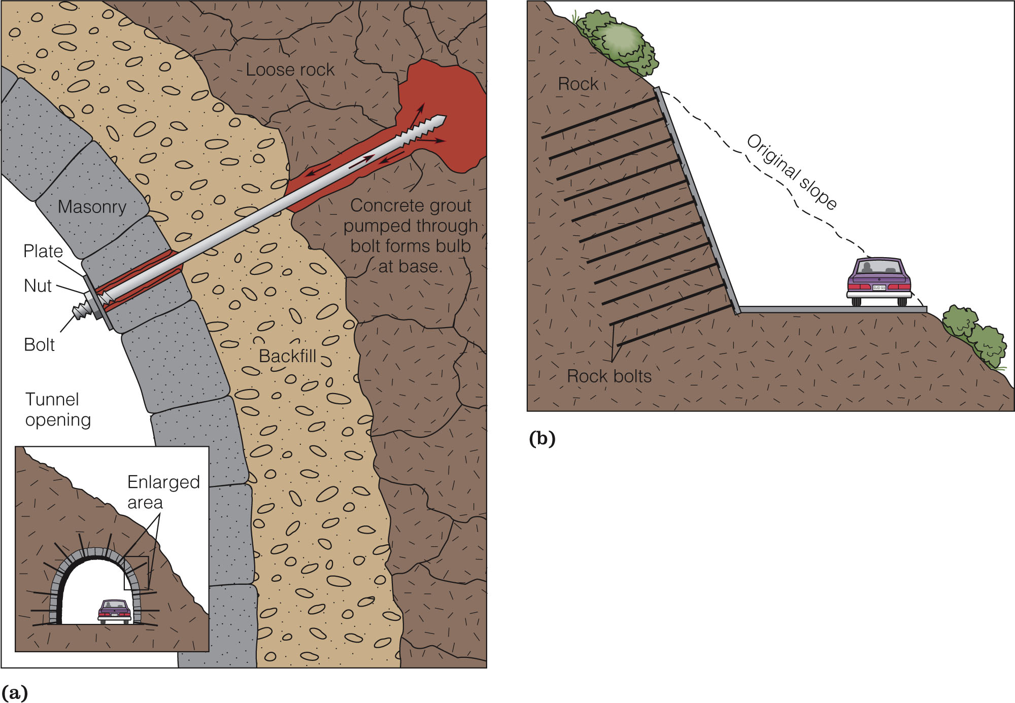
Roof Problems

Slide 71
Notes:
FIGURE 7.19 Excess water is the culprit in initiating many landslides. (a) Plastic sheeting placed over the head scarp of a landslide. This is, perhaps, closing the barn door after the cow has left but is common practice in landslide prone areas. (b) Surface-water erosion prevention measures on a graded slope, San Clemente, California. Whereas slope planting and terracing have kept the middle slope in good condition, the slope on the left has gullied badly and will need maintenance in the future.

Slide 72
Notes:
FIGURE 7.20 (a) Buttress fill with horizontal drains for removing water and surface drains for preventing erosion. The fill acts as a retaining wall to hold up unstable slopes such as those that result from excavation. (b) A slope with benches and surface drains built according to accepted standards.

Slide 73
Fig. 7-18, p. 188
Notes:
FIGURE 7.18 Part of a typical grading ordinance (code) that shows the limitation of cut-slope steepness, the required benches on slopes for collecting rainfall and reducing slopeface erosion, and an approved method of constructing a fill slope with bedrock benches for increased stability.

Slide 74
Subsidence
Sinking of earth’s surface caused by natural geologic processes or by human activity such as mining or pumping oil or water from the ground

Slide 75
Notes:
FIGURE 7.25 A reduction of pore pressure causes increased effective stress and rearrangement and compaction of sediment particles.

Slide 76
Deep Subsidence
Extraction of fluids from confined pore spaces at depth transfers the weight of the overburden to grain boundaries, causing grains to become more closely packed

Slide 77
Shallow Subsidence
Ground surface may collapse into mines or shallow caves (sinkholes) due to lowering of water table
Hydrocompaction

Slide 78
Shallow Subsidence
Compaction due to dewatering
New Orleans
Mexico City

Slide 79
Subsidence Problems
Ground cracking
Coastal Flooding
Pipelines, sewers, etc.

Slide 81
Notes:
FIGURE 7.28 (a) Location of the San Joaquin Valley. Collapsible soils occur almost entirely along the western border of the valley, whereas subsidence due to undergroundwater withdrawal is found throughout the valley. (b) Watersoaked test plot in the valley’s collapsible soils. Total subsidence at this plot is on the order of 3 meters (10 ft). State of Calif. data

