Slide 1
Sex and Mating!!!!
By Tim Revell

Slide 2
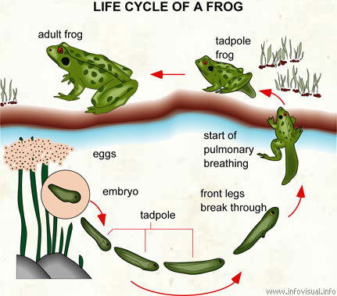
Life Cycle of an Animal

Slide 3
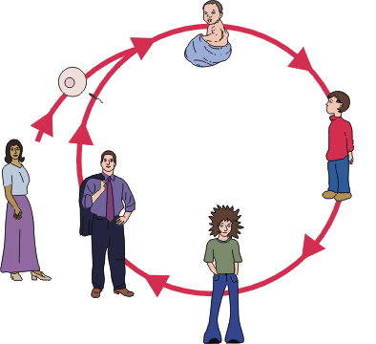
Another one….

Slide 4
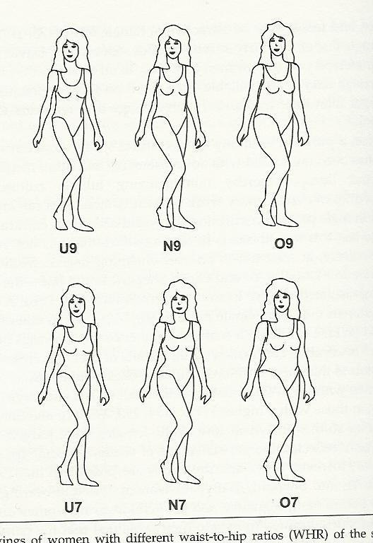
Decision?

Slide 5
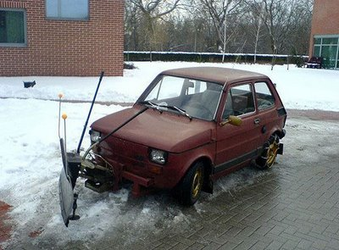

Slide 6
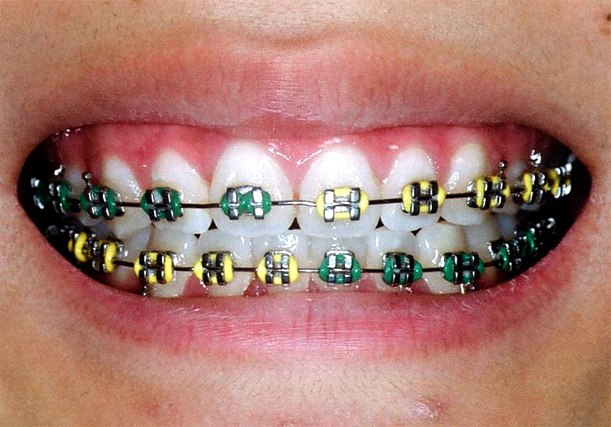
Honest Signals?

Slide 7
Who gets to choose??
Robert Trivers
Parental investment = higher, the more “choosier” sex
The other hypothesis?
Sex Ratio 1:1
Operational Sex Ratio

Slide 8
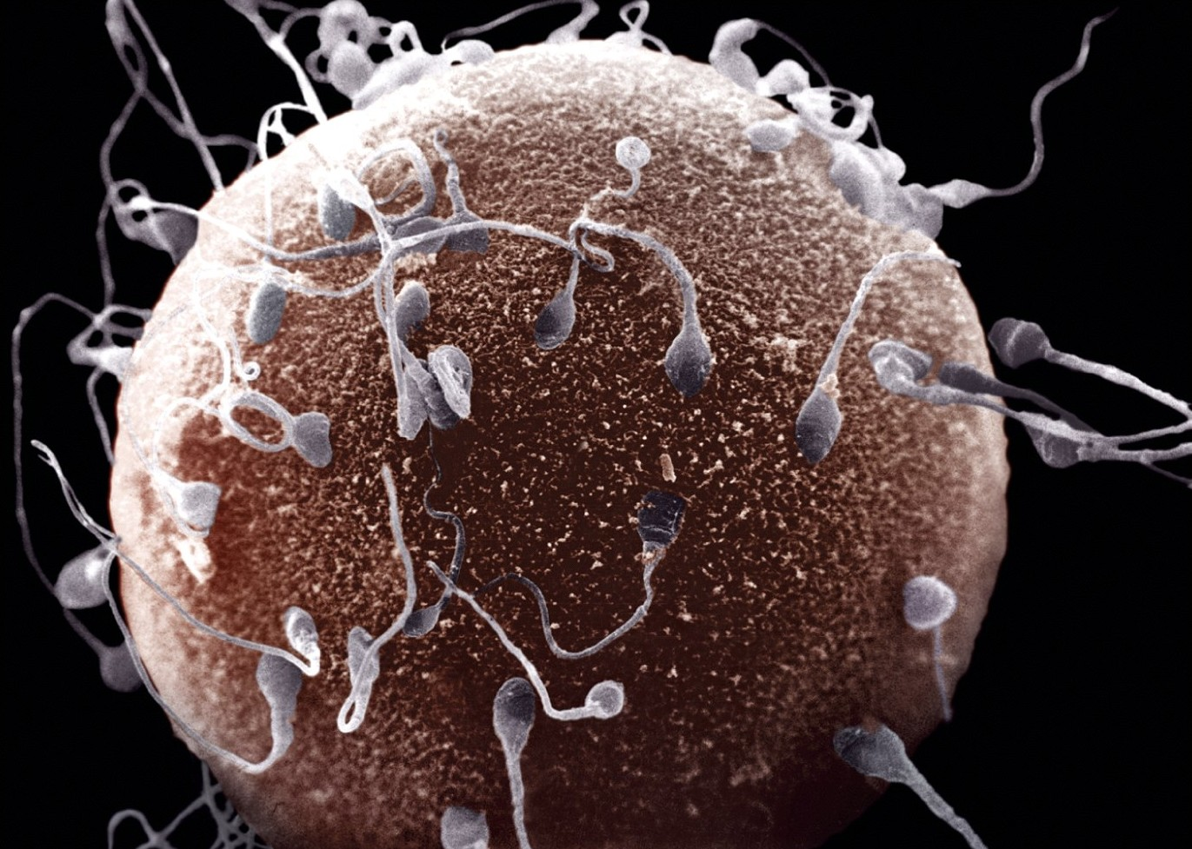

Slide 9
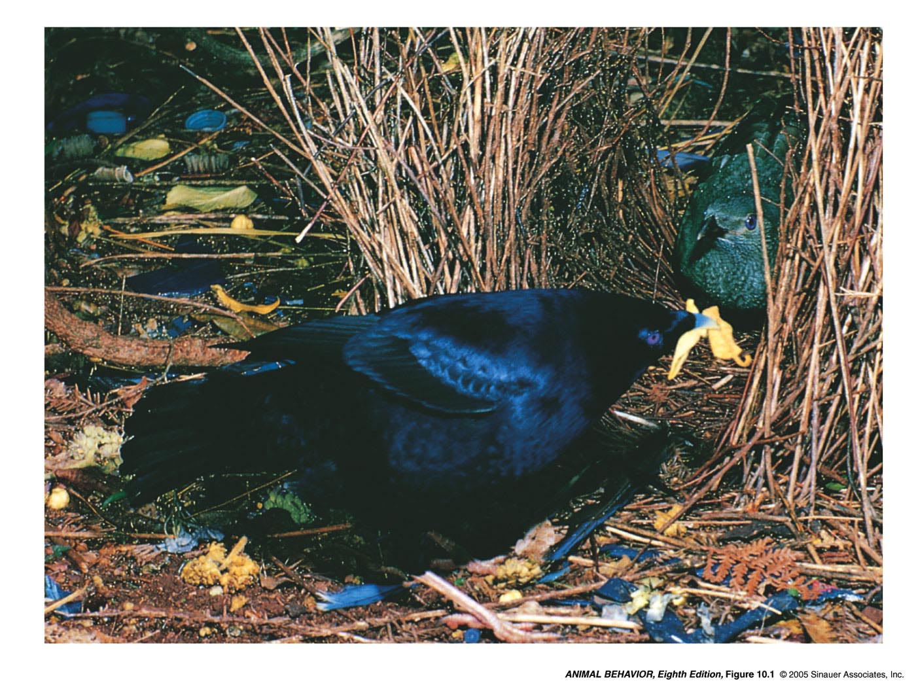

Slide 10
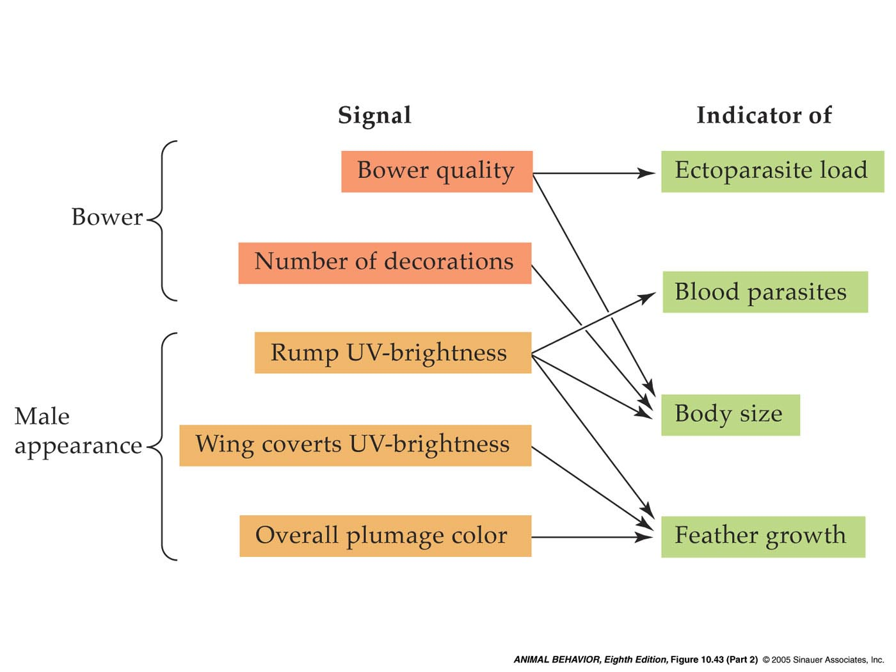
Honest signals?

Slide 11
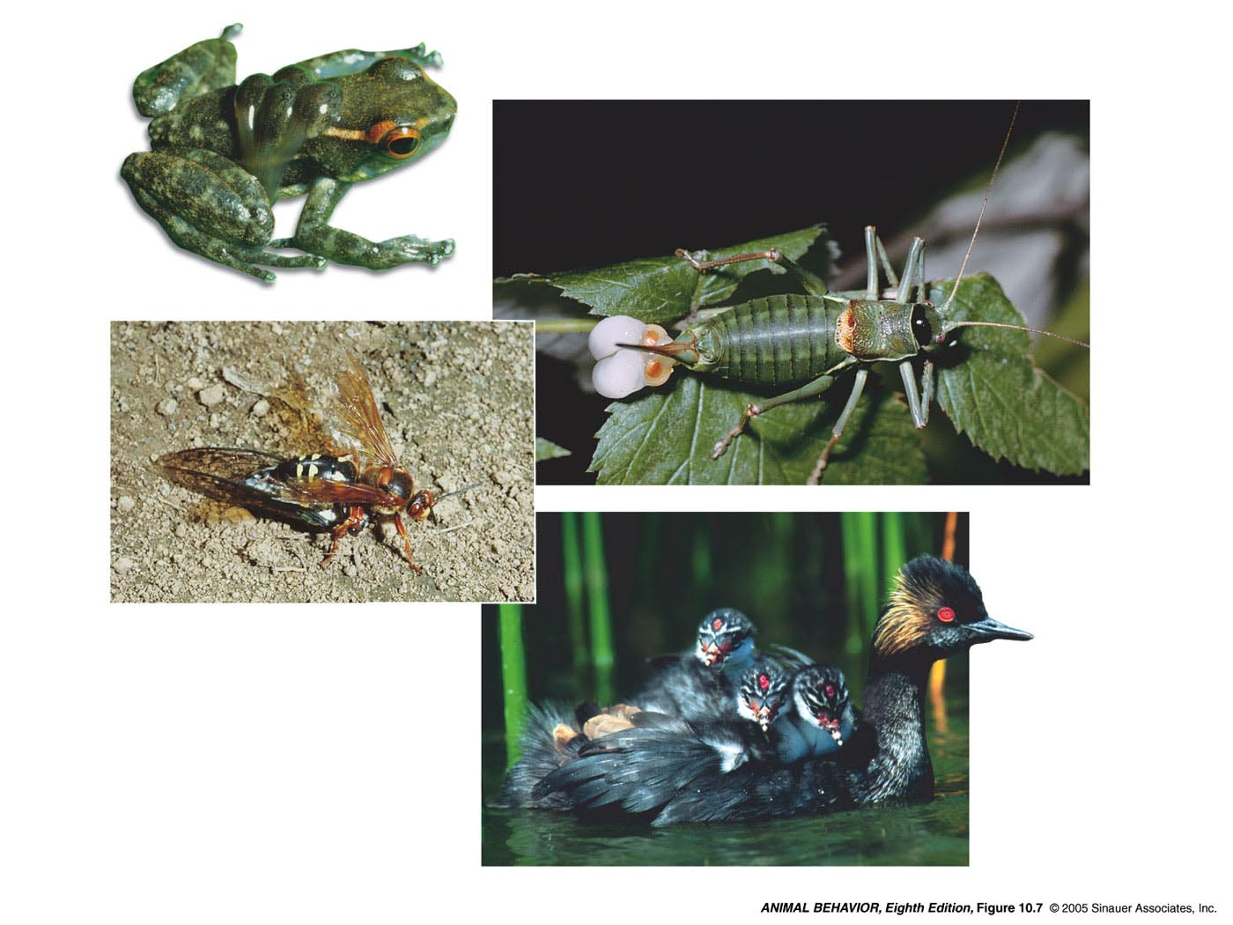
But not always the female…
Male Frog
Male Katydid - spermatophore
Females

Slide 12
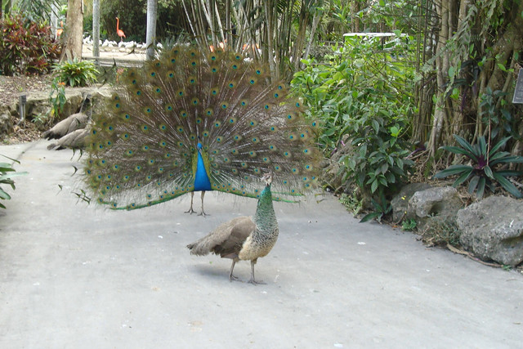
But can things get out of control?

Slide 13
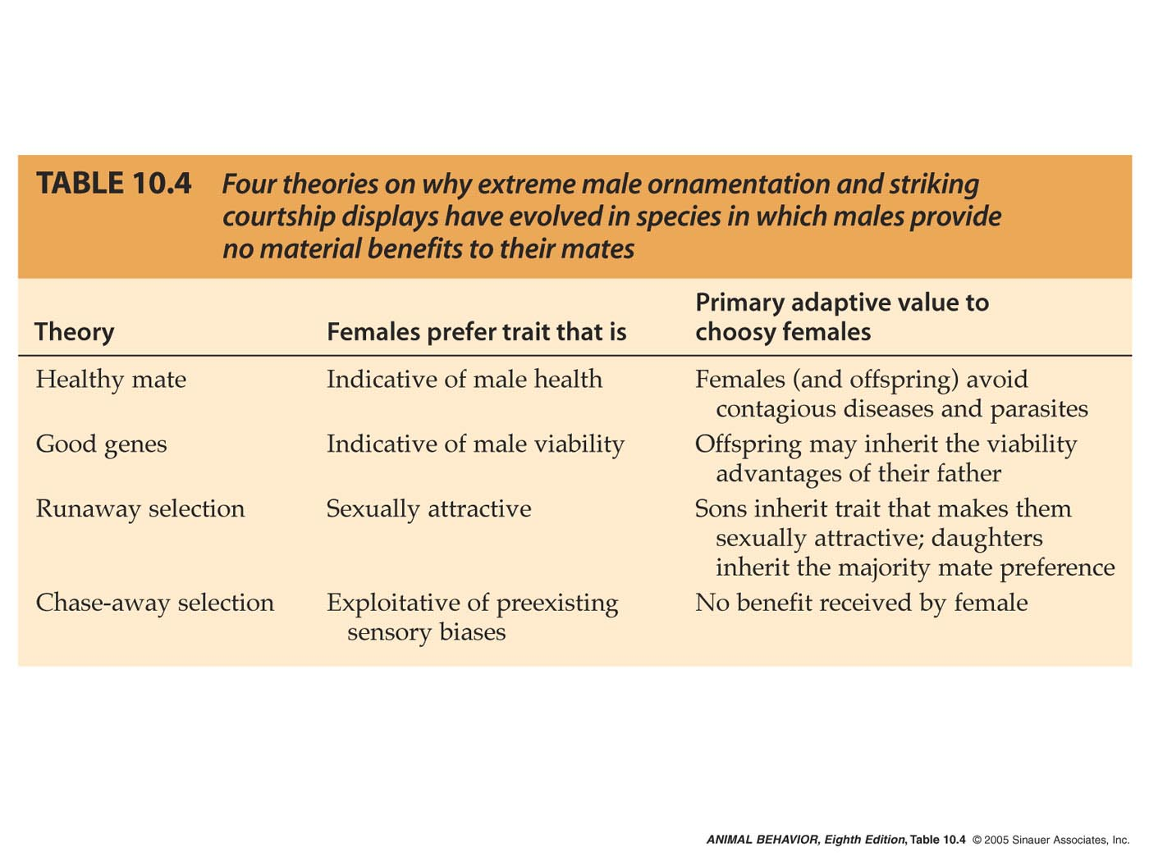
Theories to explain extreme traits..

Slide 14
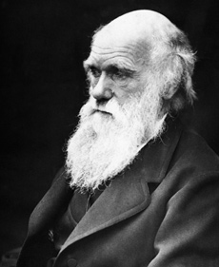
Sexual Selection

Slide 15
Mating Systems
Result from the strategies that males should do vs. those females should do

Slide 16
Mating Systems (Basics)..
Monogamy = Basically one male with one one female
Polygamy: Multiple mates….
Polygyny = One male tries to mate with multiple females (males generally compete for access to females).
Polyandry = One female attempts to mate with multiple males (females generally compete for access to males).

Slide 17
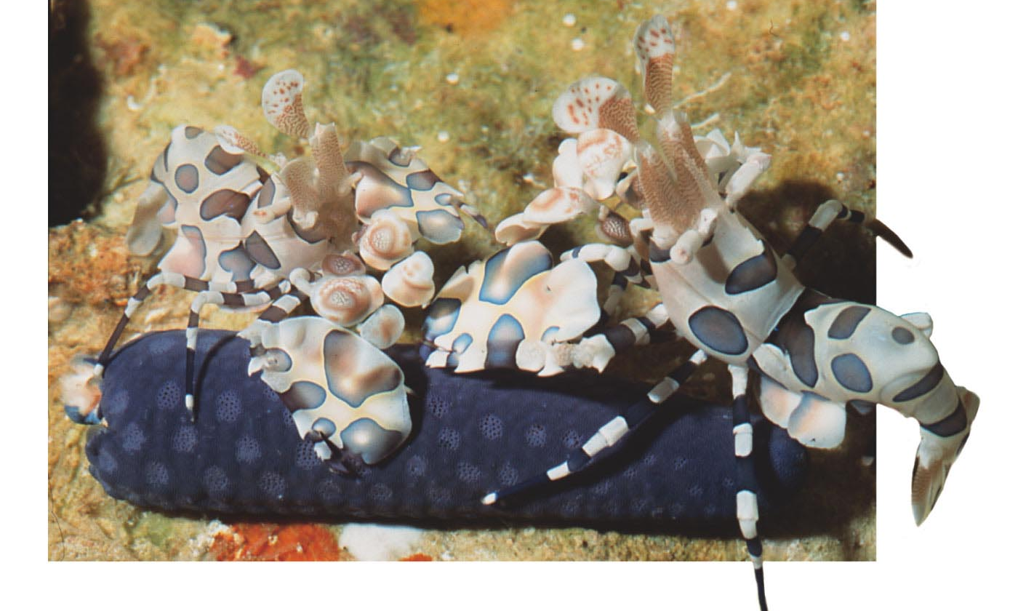
Examples of Mating Systems
Monogamy-Mate-guarding = rare to find a mate (Clown Shrimp)

Slide 18
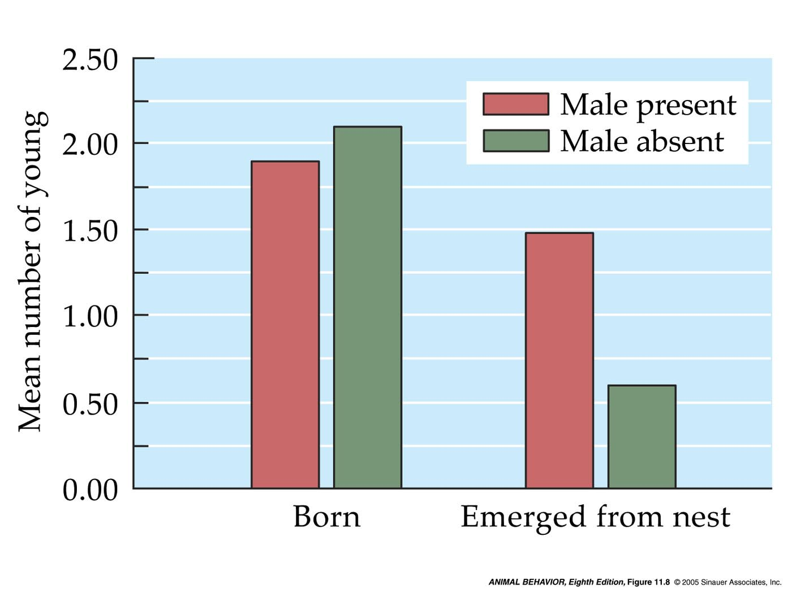
Examples of Mating Systems
Monogamy – Female assistance (California mouse) helps keep the pups warm

Slide 19
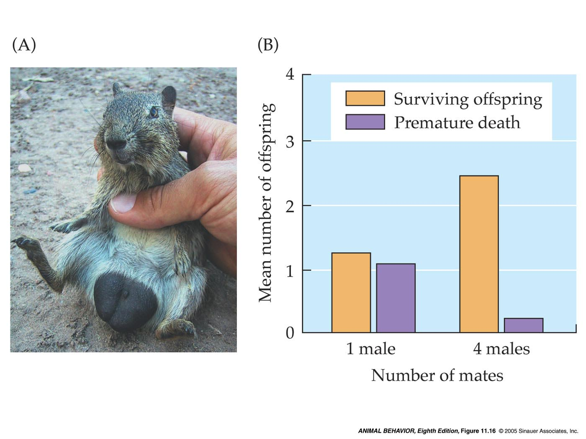
Examples of Mating Systems
Polyandry – Good Genes or Fertility Insurance with EPC (Male Yellow Toothed Cavy)

Slide 20
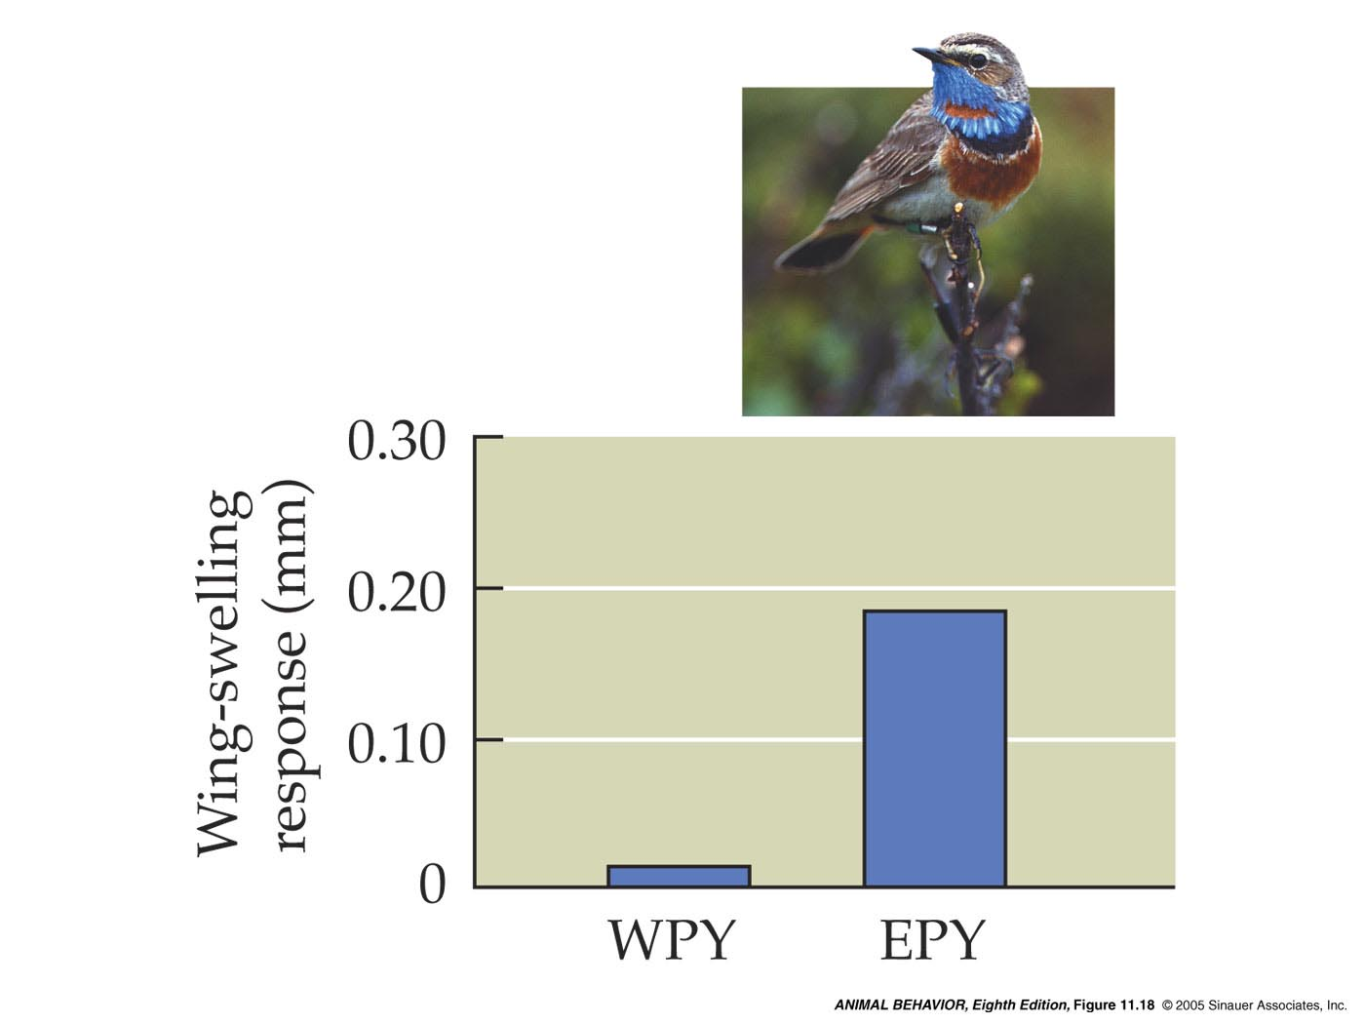
Examples of Mating Systems
Polyandry – Good Genes or Fertility Insurance with EPC (blue throat)

Slide 21
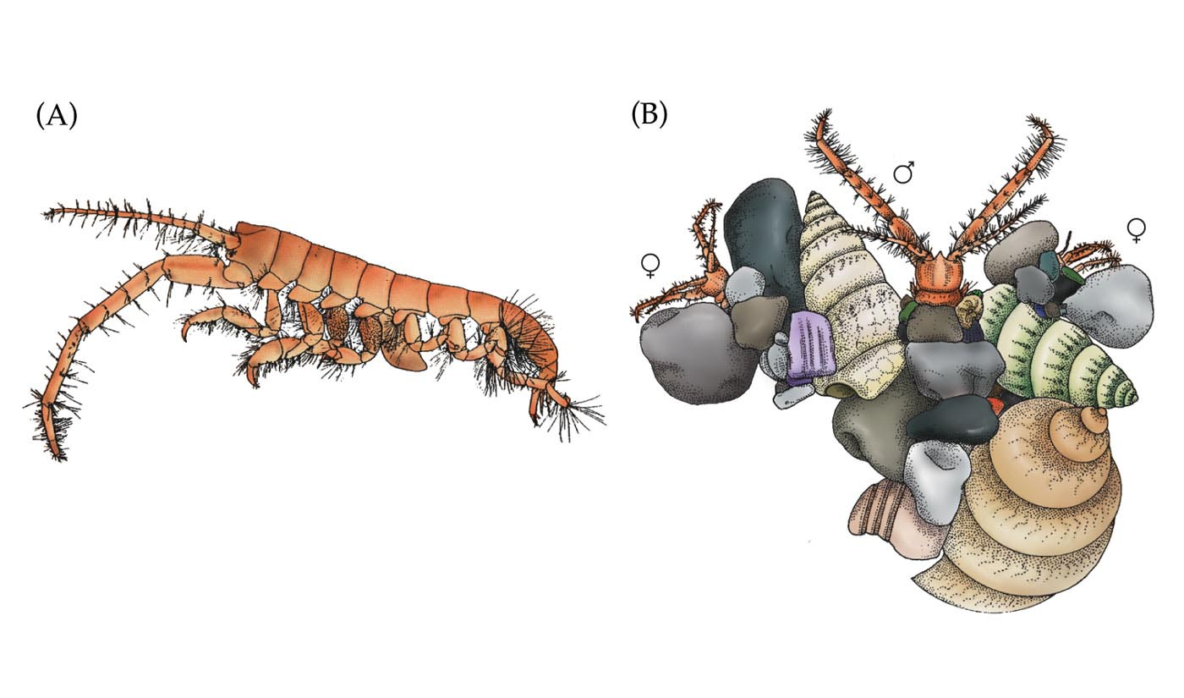
Examples of Mating Systems
Polygyny - Female Defense (Marine amphipod) – “apartment complex” of females

Slide 22
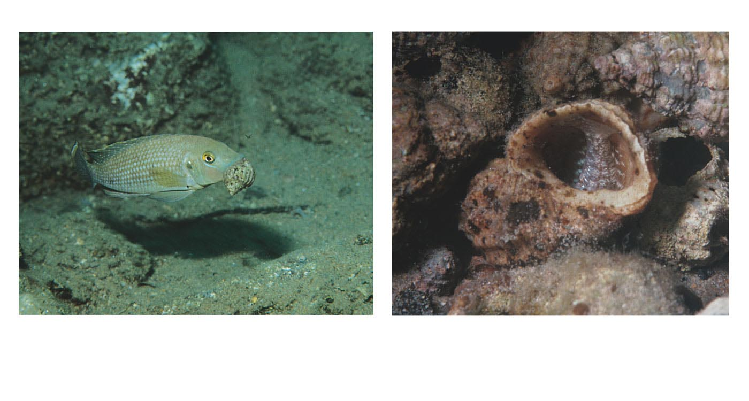
Examples of Mating Systems
Polygyny - Resource Defense (African cichlid)

Slide 23
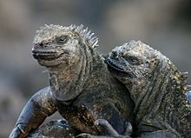
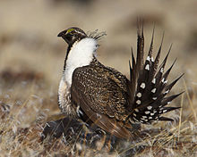
Examples of Mating Systems
Polygyny - Lek (No Resources = Marine Iguana and Sage Grouse)

Slide 24
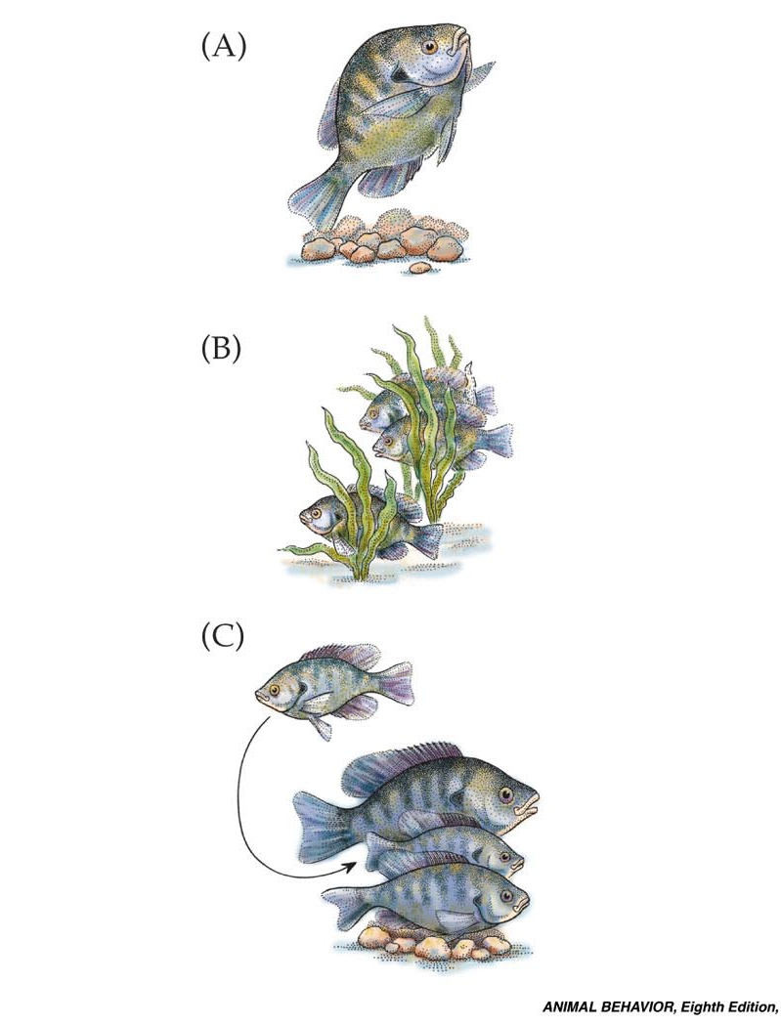
But What if you are not the best…
Sperm Competition…Satelite males and female mimicry
Bluegill sunfish – 3 different egg fertilization behaviors

Slide 25
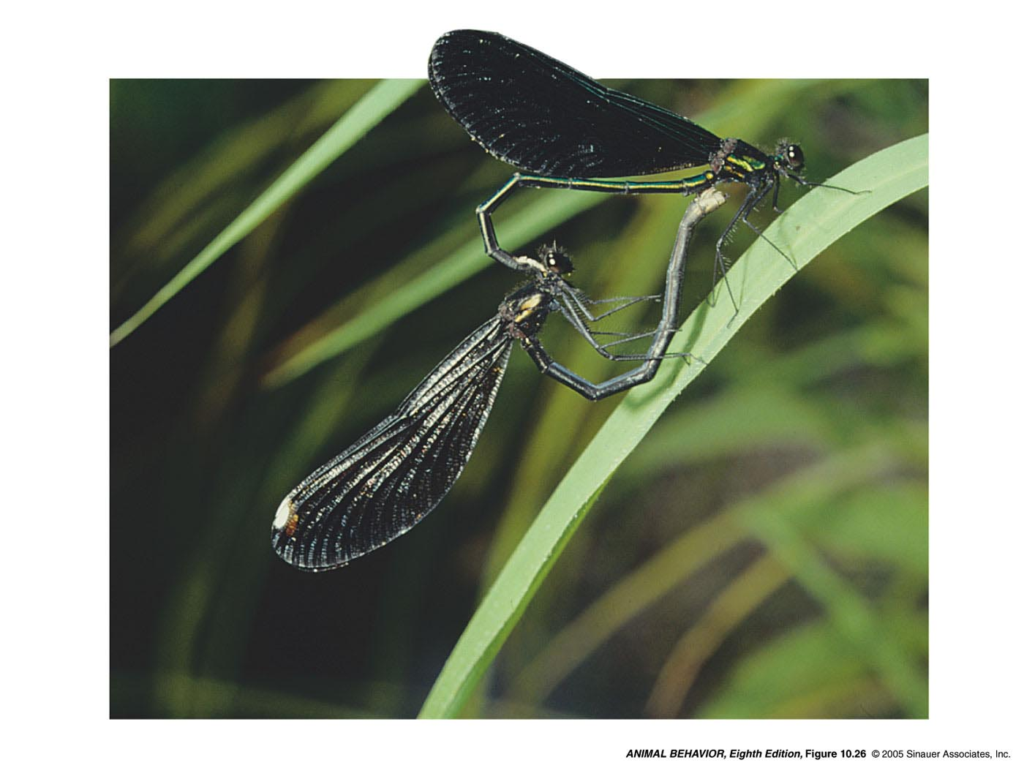
But what if you are not the best…
Sperm Competition…sperm removal
Black-winged damsel fly

Slide 26
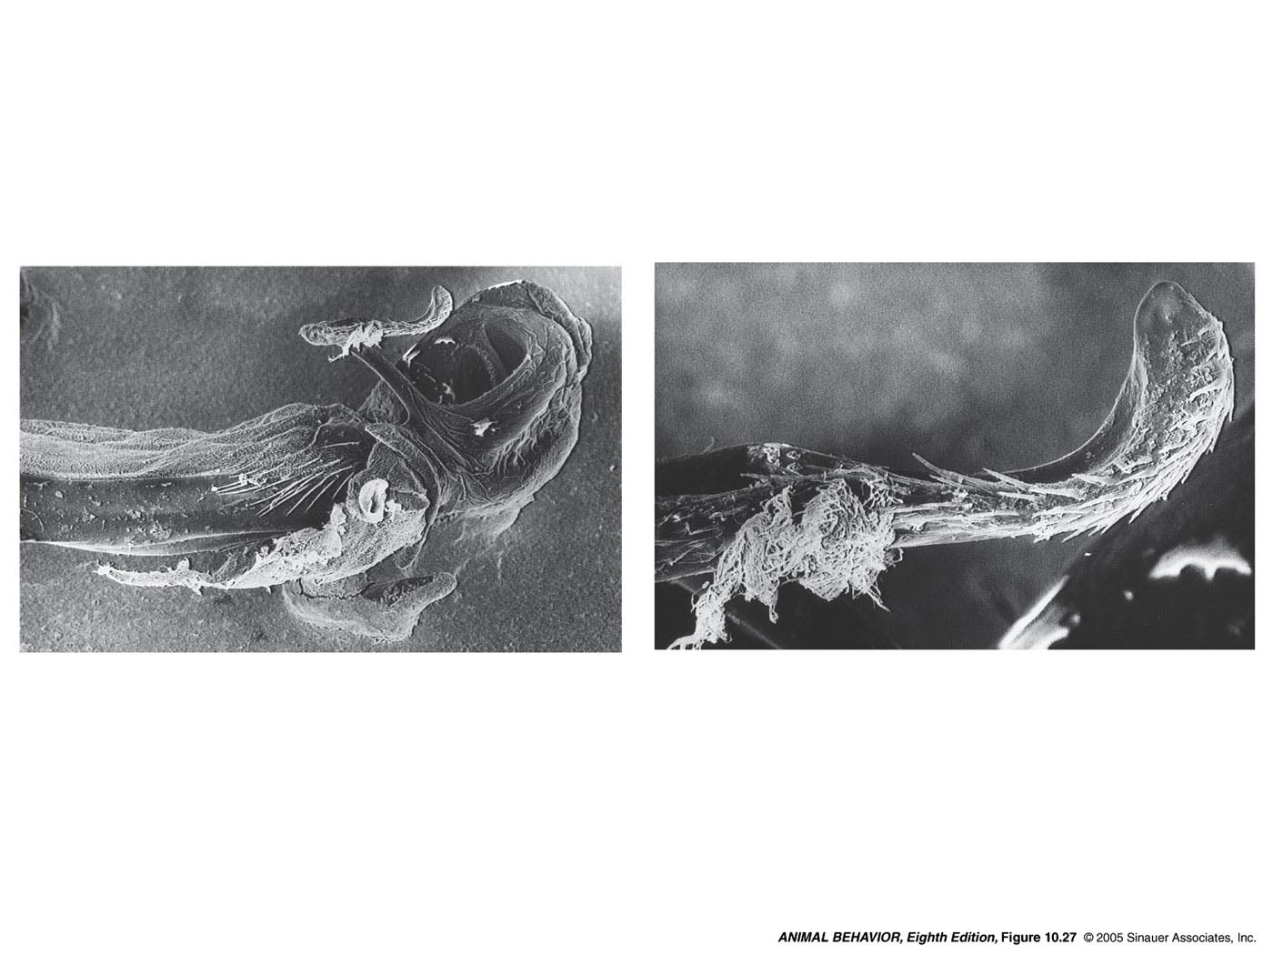
But what if you are not the best…

Slide 27
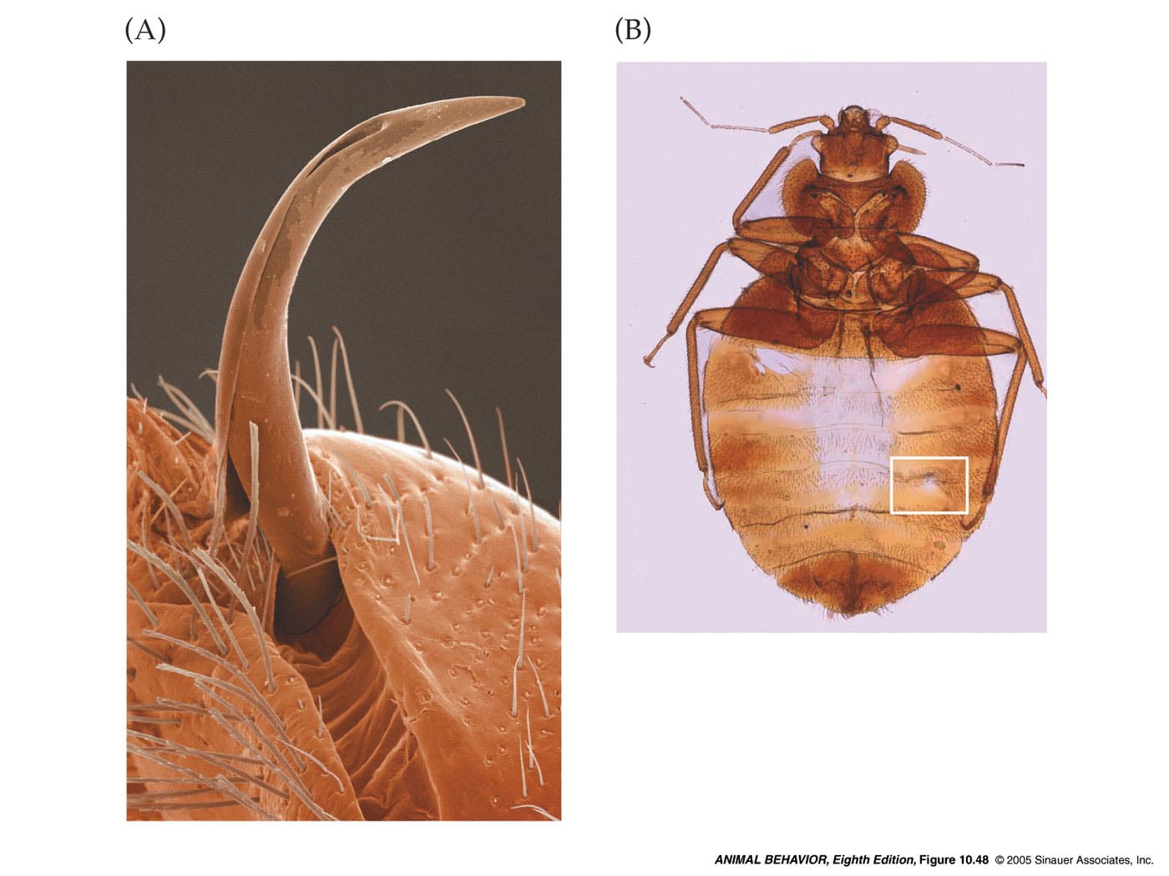
But what if you are not the best…
Sperm Competition…Sperm injection
Bed Bugs

