Slide 1
Bio 2 Plant Families
This Greenhouse is dedicated to the teaching of common plant families.
Twelve families are represented in this collection.
These twelve families represent approximately 151,000 species of plants with similar characteristics.

Slide 2
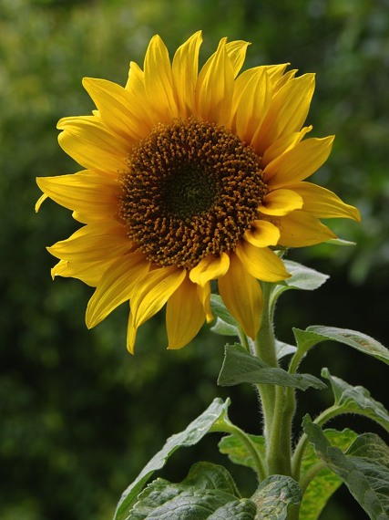
Asteraceae (Composite Family)
Species: 27,700 Rank (based on # of species): #1
Characteristics:
Leaves variable with pinnate venation.
“Flowers” are actually an inflouresence (group) of smaller flowers.
Contains “Ray” Flowers and “Disk Flowers.
Dicots

Slide 3
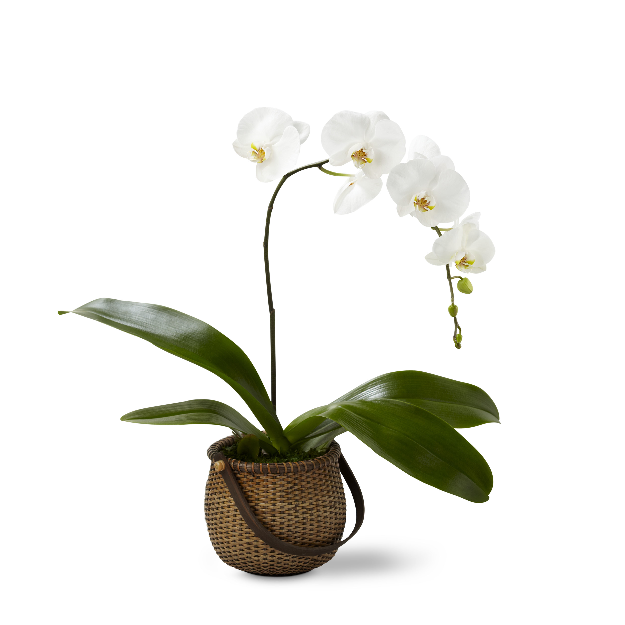
Orchidaceae (Orchid Family)
Species: 27,100 Rank (based on # of species): #2
Characteristics:
Leaves alternate or whorled, often sheathing at based, simple with parallel veination.
Zygomorphic Flowers (Bilaterally Symmetrical)
3 Sepals and 3 Petals
Monocots

Slide 4
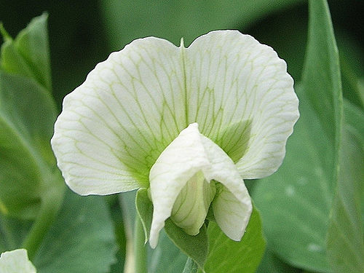
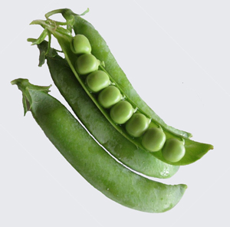
Fabaceae (Pea Family)
Species: 18,800 Rank (based on # of species): #3
Characteristics:
Leaves are usually alternate and compound.
Fruit is in the form of a Legume (pea pod)
Flowers are Zygomorphic with 5 petals and 5 sepals.
Dicots

Slide 5
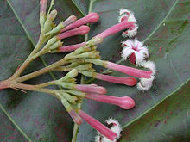
Rubiaceae (Coffee or Madder Family)
Species: 13,000 Rank (based on # of species): #4
Characteristics:
Leaves opposite, simple, with entire margin.
Inflorescences is a cyme (pronounced “saim”).
Corolla is sympetalous with 4-5 lobes (petals are fused to form a “tube”).
Contains the Cinchona plant known for Malaria treatment.
Dicots

Slide 6
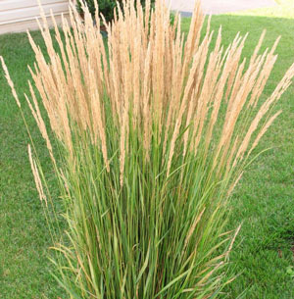
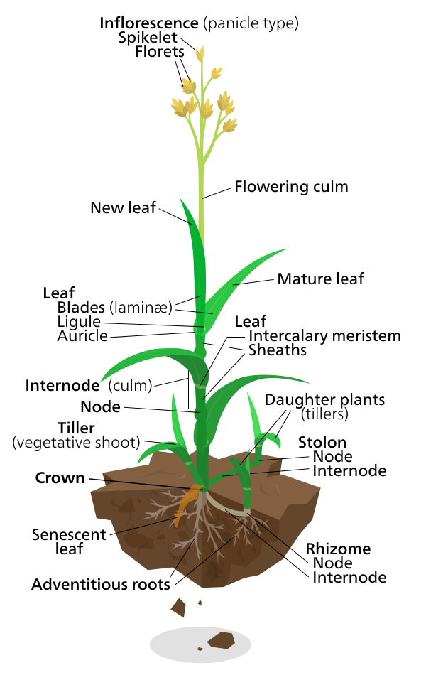
Poaceae (Grass Family)
Species: 10,000 Rank (based on # of species): #5
Characteristics:
Leaves linear with parallel venation.
Hollow stems called culms plugged at intervals plugged by leaf bearing nodes.
Flowers are arranged in spikelets. Each spikelet often has one or more florets.
Monocots

Slide 7
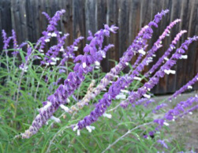
Lamiaceae (Mint Family)
Species: 7,500 Rank (based on # of species): #6
Characteristics:
Leaves are simple & opposite
Flowers are bilaterally symmetrical with 5 united petals and 5 united sepals..
Stems of flowers are square.
Dicots.

Slide 8
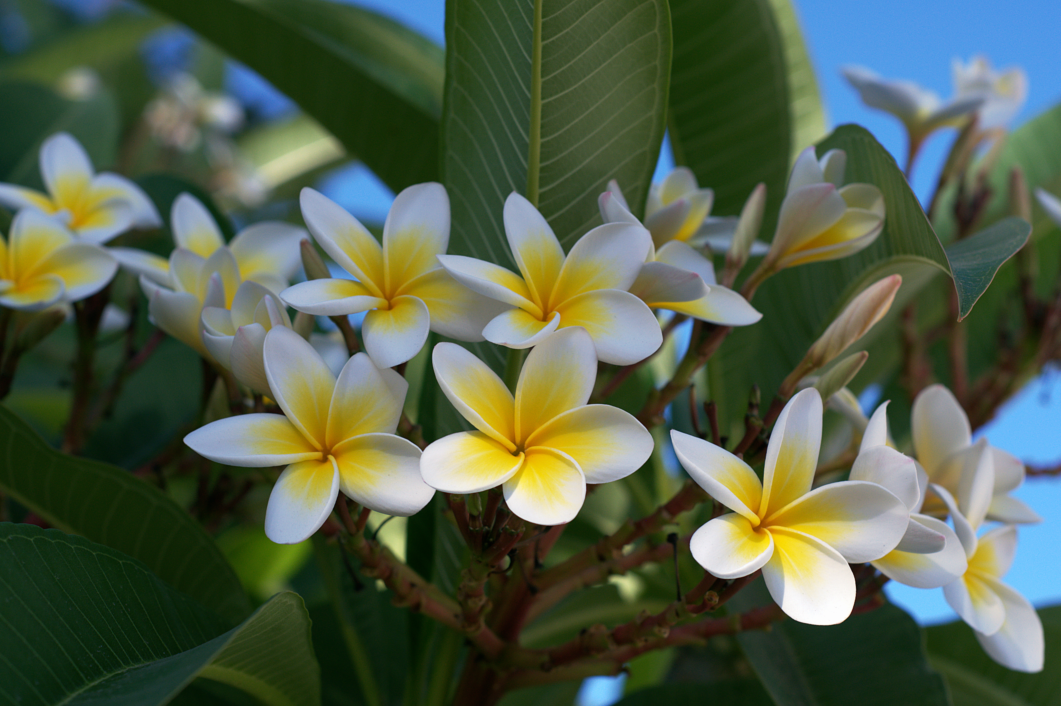
Apocynaceae (Dog Bane Family)
Species: 5,100 Rank (based on # of species: #9
Characteristics:
.Leaves opposite, simple and pinnate venation
5 Sepals, 5 Petals, often “whirled”
Latex (milky sap) in all branches and leaves.
Dicots

Slide 9
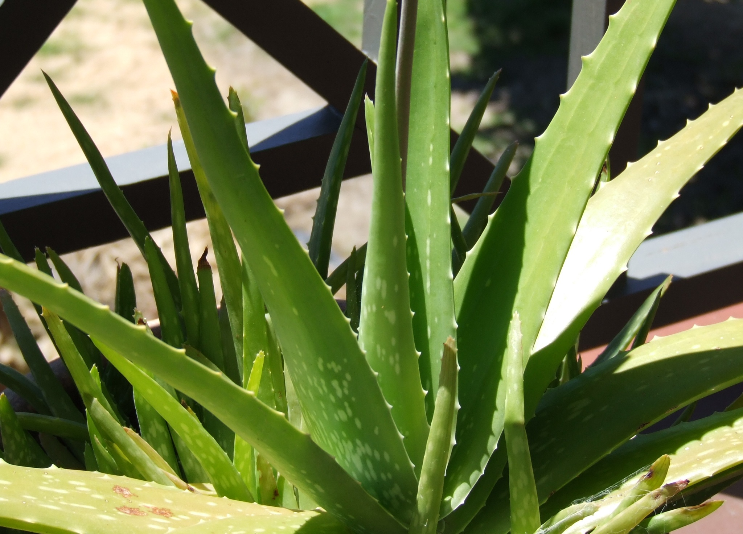
Xanthorrhoeaceae (Aloe Family)
Species: 3,300 Rank (based on # of species: about #20
Characteristics:
.Leaves simple, alternate, parellel-veined, often with a spiny or dentate margin
Inflorescence a raceme or panicle.
Flowers are actinophorphic or zygomorphic
Tepals 3+3, sometimes fused
Monocots

Slide 10
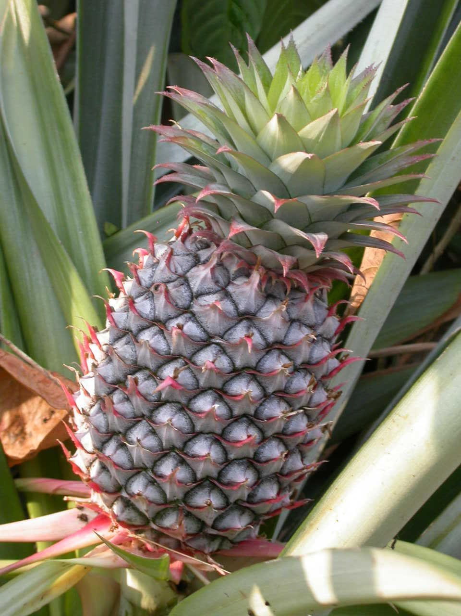
Bromeliaceae (Bromeliad Family)
Species: 3,100 Rank (based on # of species: about #25
Characteristics:
Leaves simple, alternate, and sheathing as base
Inflorescence a raceme or terminal spike
Tepals 6
Monocots

Slide 11
Cactaceae (Cactus Family)
Species: 3,300 Rank (based on # of species: about #19
Characteristics:
Leaves highly reduced or absent
Flowers usually solitary
Tepals many, anthers many, Stigma often multi lobed.
Dicots

Slide 12
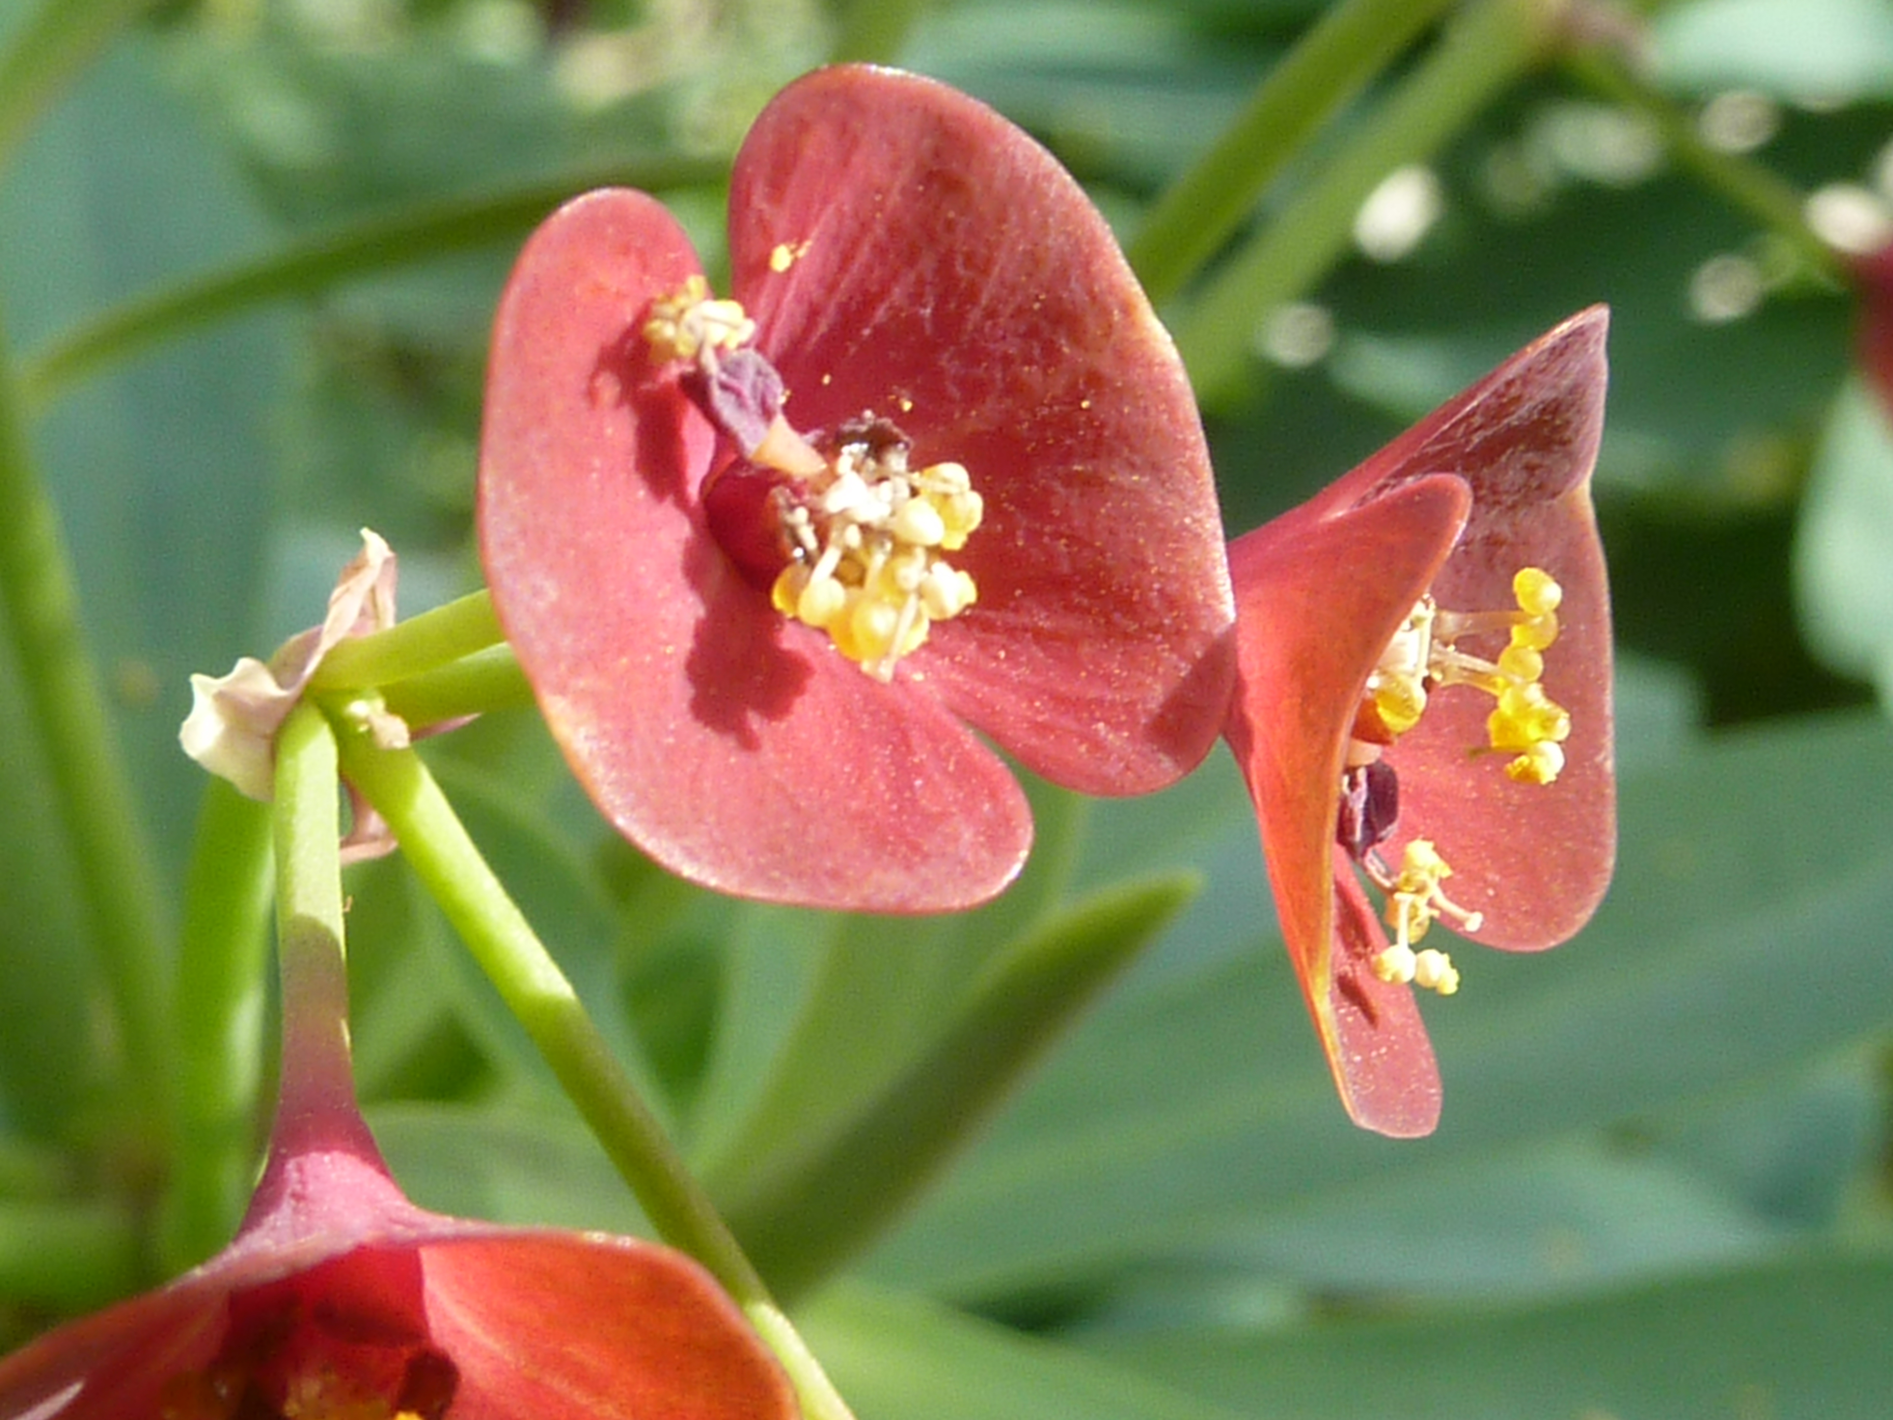
Euphorbiaceae (Spurge Family)
Species: 7,500 Rank (based on # of species: #7
Characteristics:
Leaves simple, two stipules often present
Stems often succulent and fleshy.
Flowers unisexual, inflorescence cyme
Dicots

Slide 13
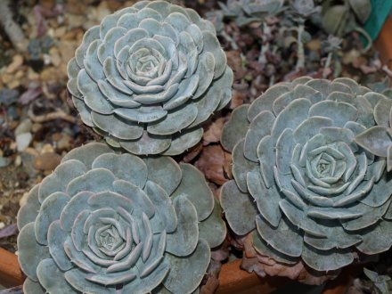
Crassulaceae (Stonecrop Family)
Species: 1,500 Rank (based on # of species: about #30
Characteristics:
Succulent leaves
Flowers often in cymes
Dicots

