Slide 1
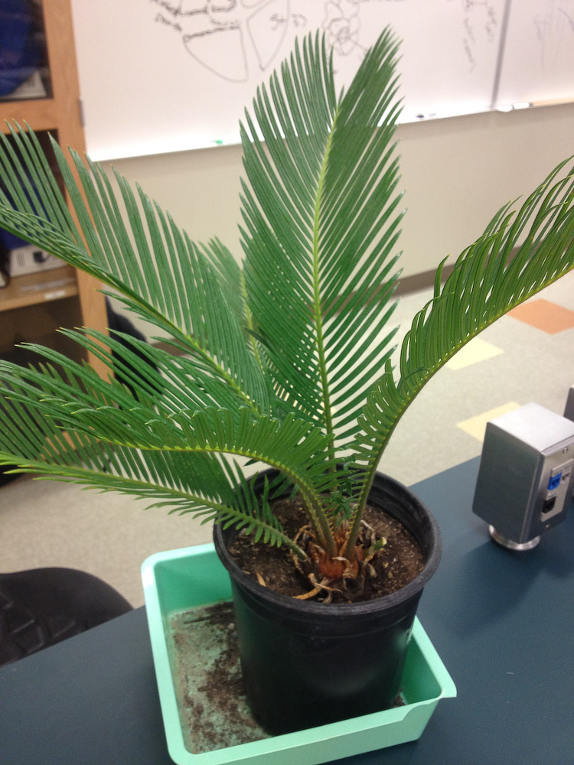
Notes:
Station # 1 Cycadophyta

Slide 2
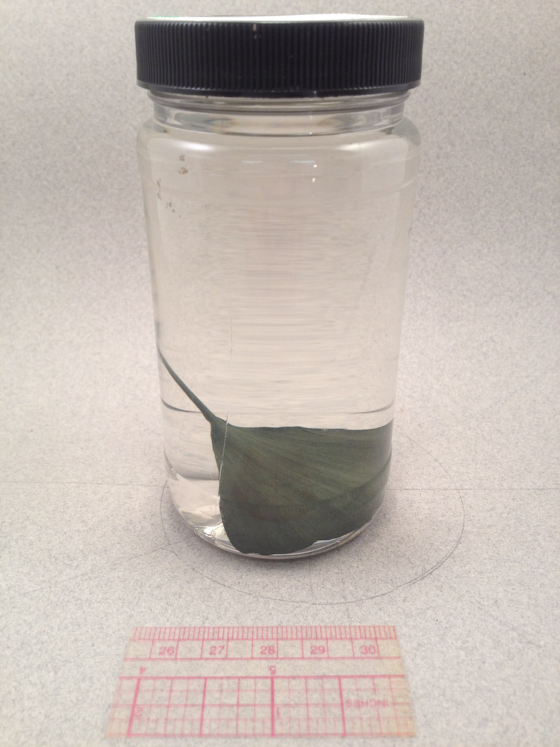
Notes:
Station #2 - Ginkgophyta

Slide 3
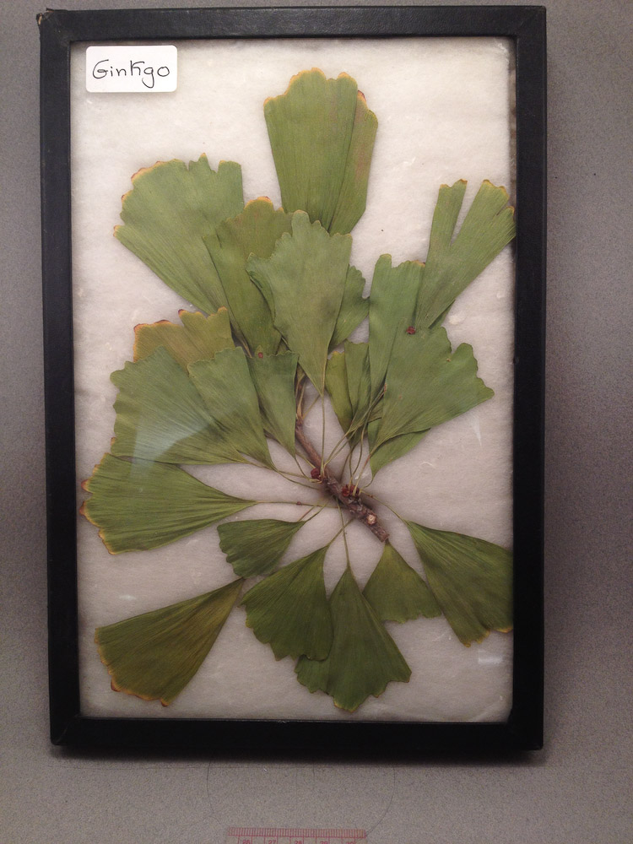
Notes:
Station #2 - Ginkgophyta

Slide 4
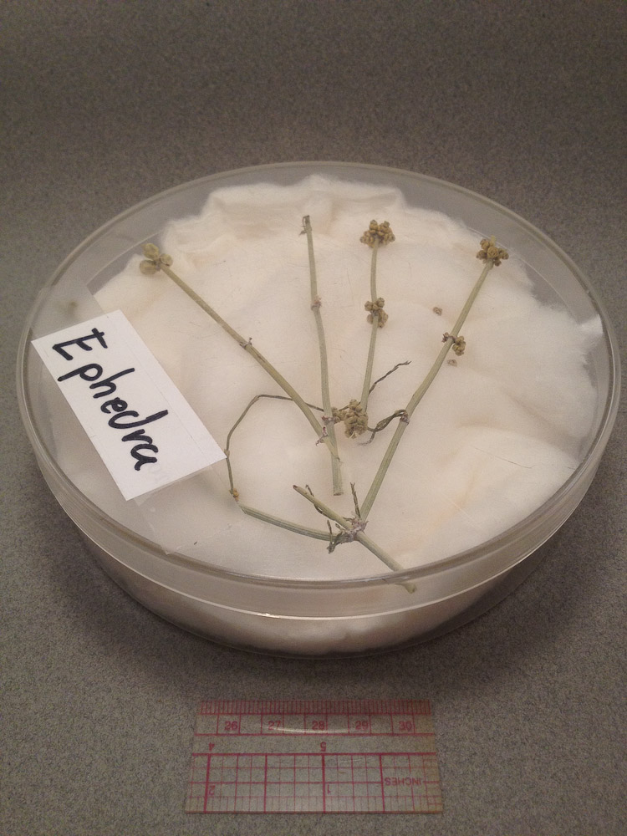
Notes:
Station #3 Gnetophyta

Slide 5
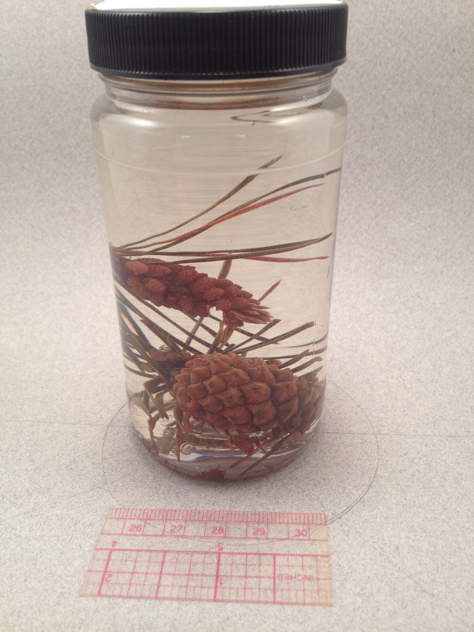
Notes:
Station #4 Coniferophyta

Slide 6
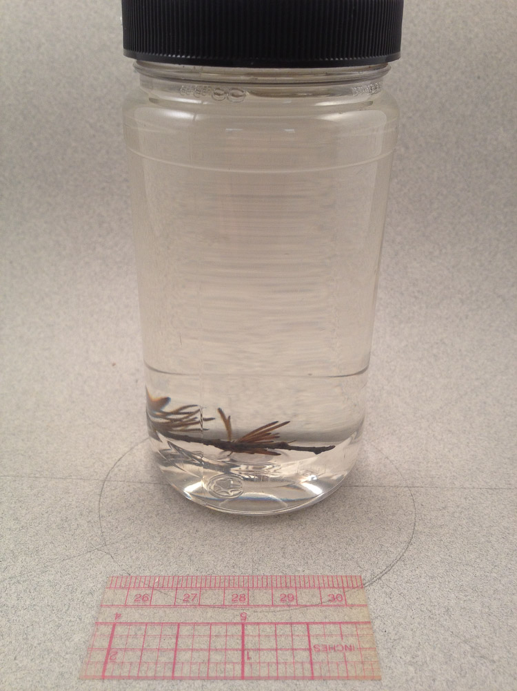
Notes:
Station #4 Coniferophyta

Slide 7
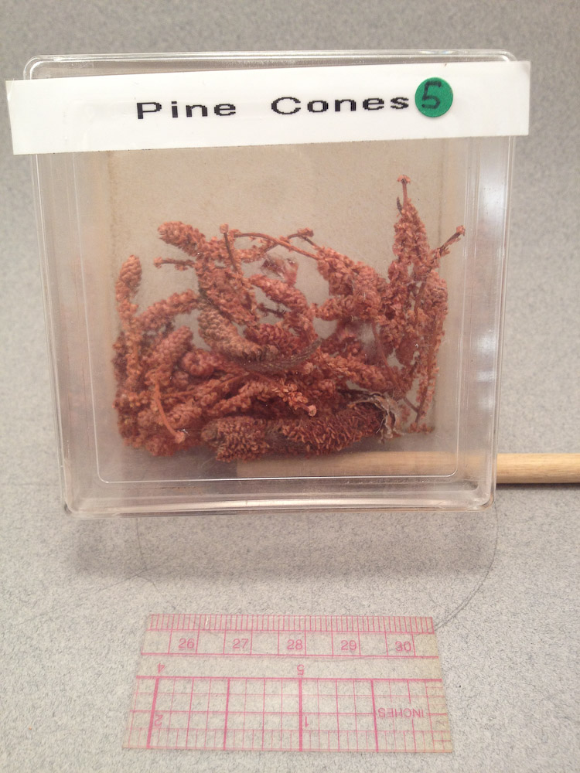
Notes:
Station #5 Male Cones (Staminate Cones)

Slide 8
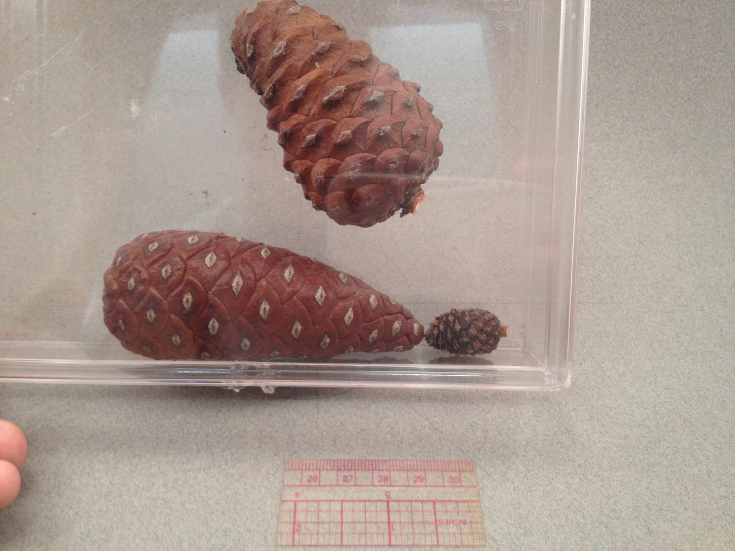
Notes:
Station #5 Female cones (Ovulate Cones)

Slide 9
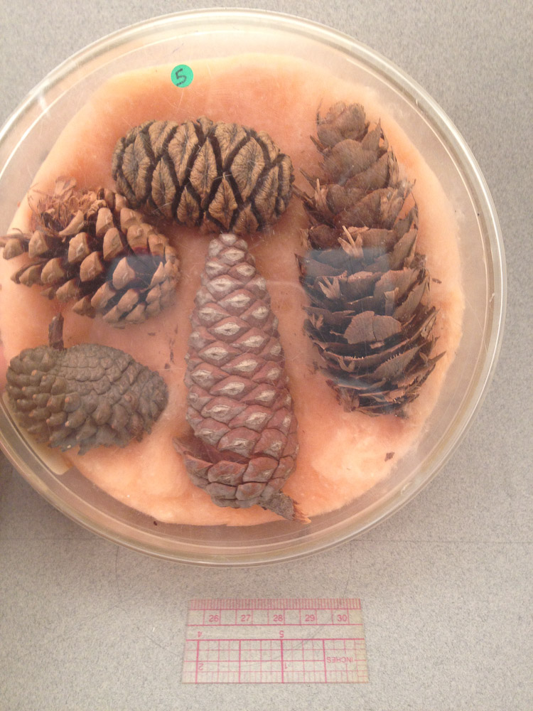
Notes:
Station #5 Female cones (Ovulate Cones)

Slide 10
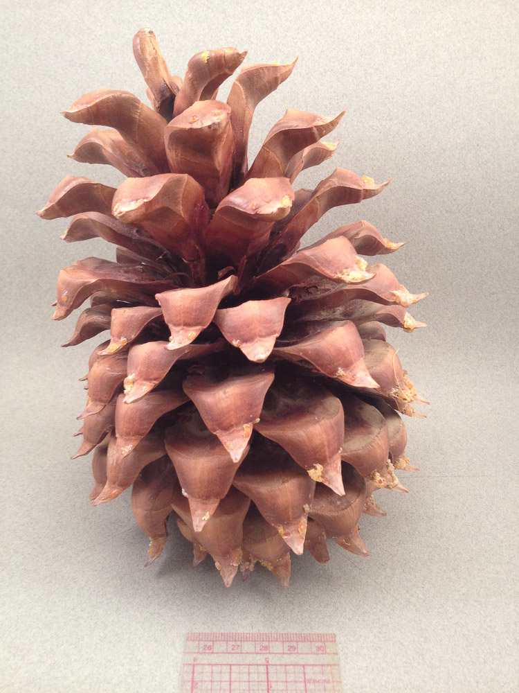
Notes:
Station #5 Female cones (Ovulate Cones)

Slide 11
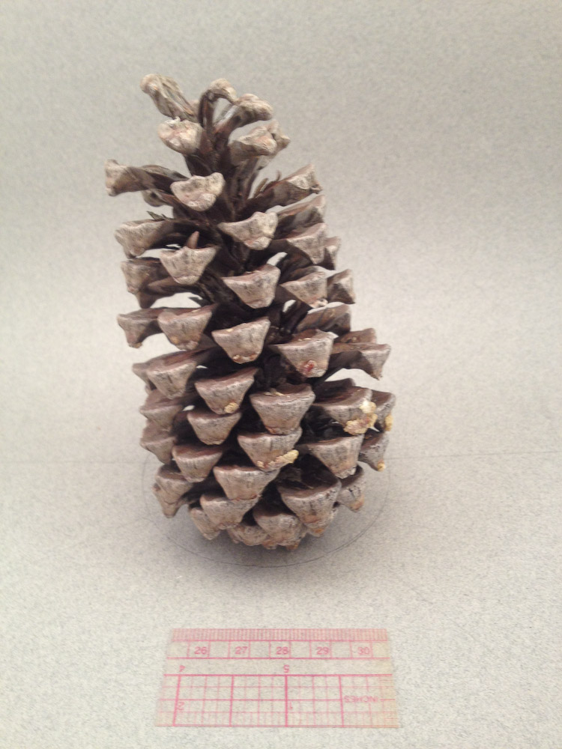
Notes:
Station #5 Female cones (Ovulate Cones)

Slide 12
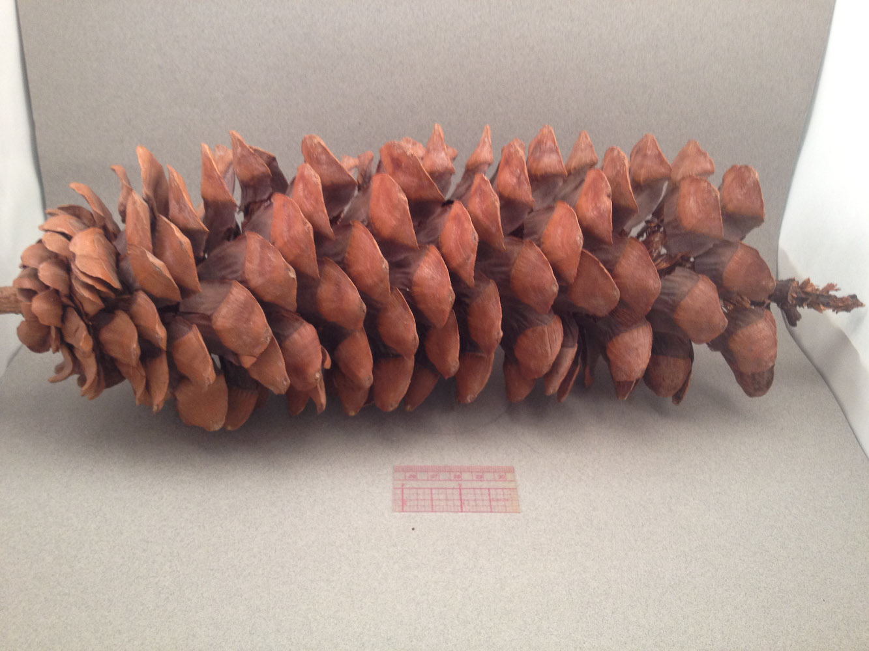
Notes:
Station #5 Female cones (Ovulate Cones)

Slide 13
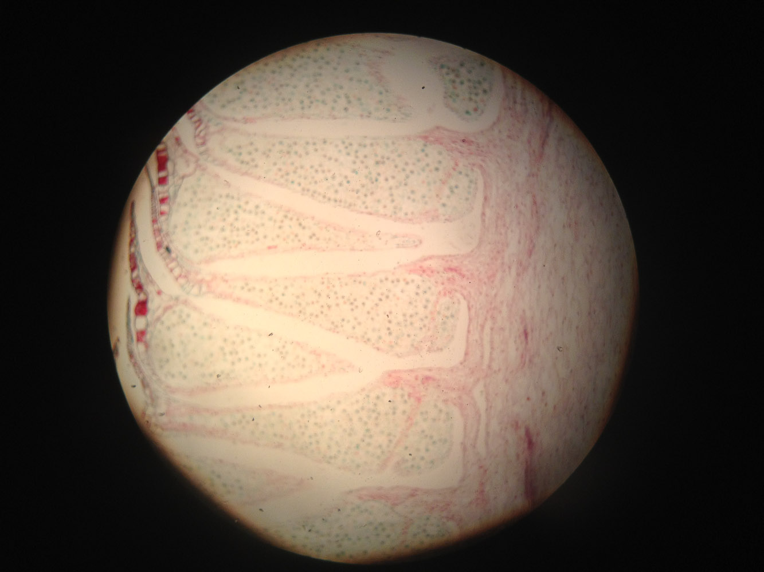
Notes:
Station #6 Male Cone

Slide 14
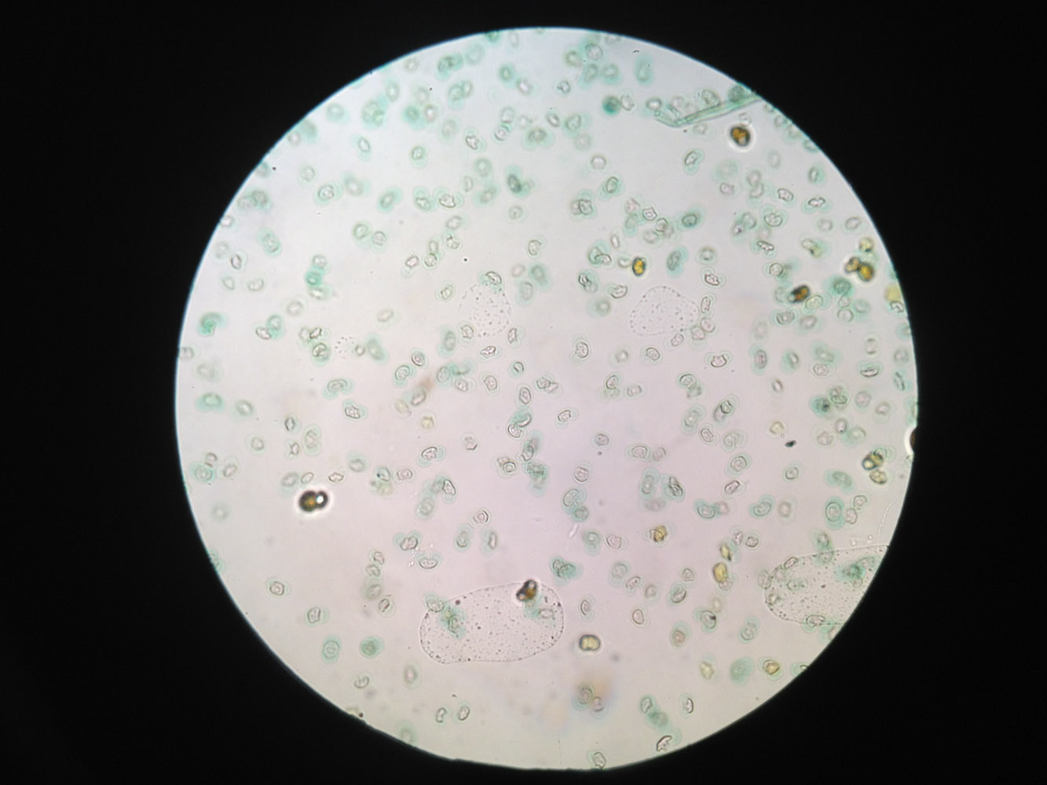
Notes:
Station #7 Pollen Grain

Slide 15
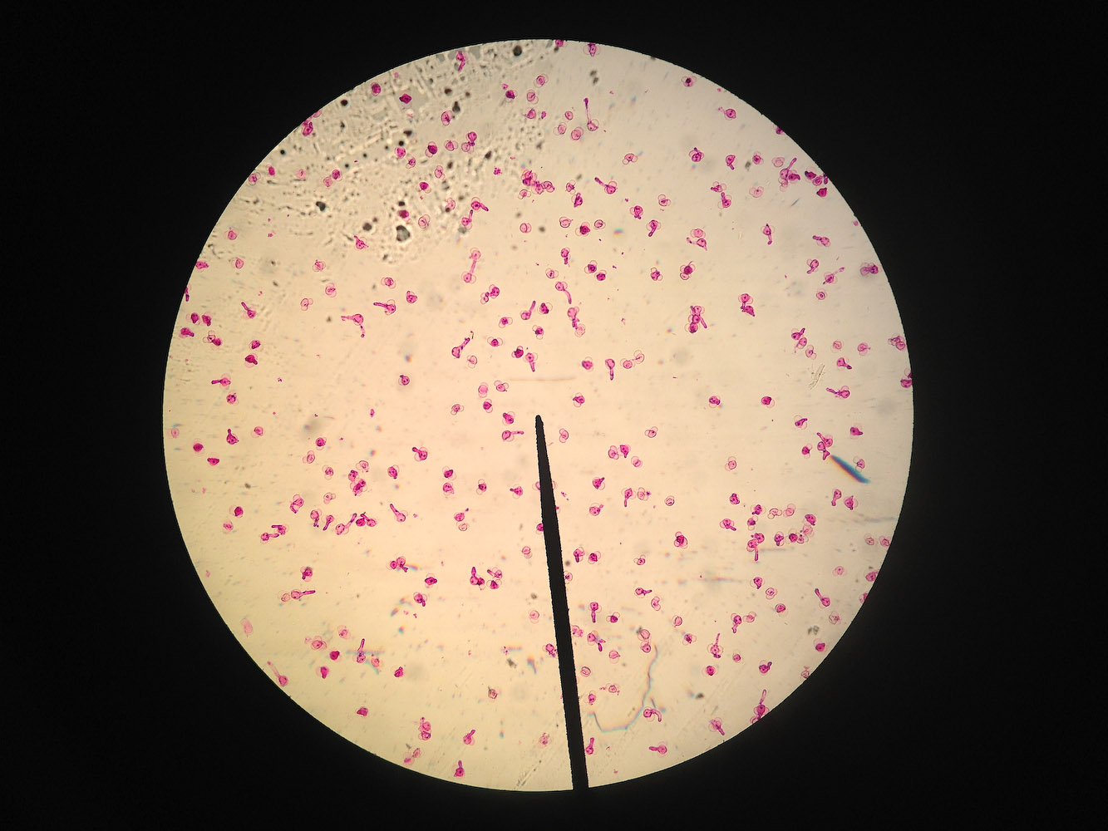
Notes:
Station #8 Pine Tube

Slide 16
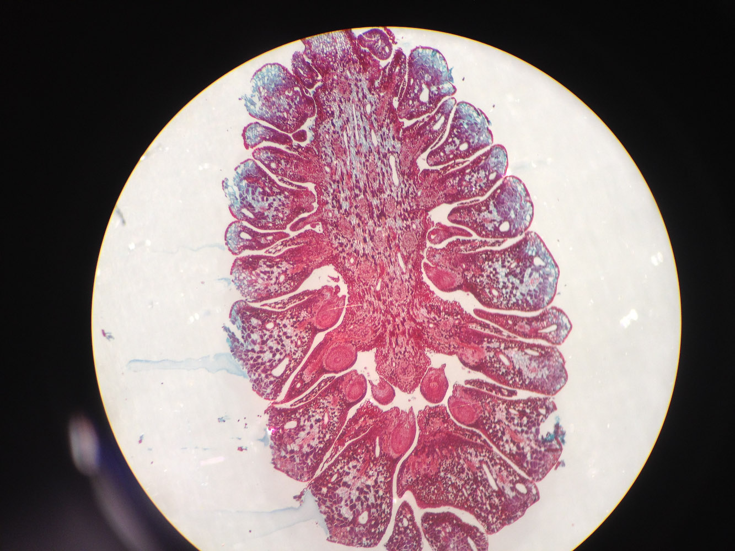
Notes:
Station #9 Female Cone

Slide 17
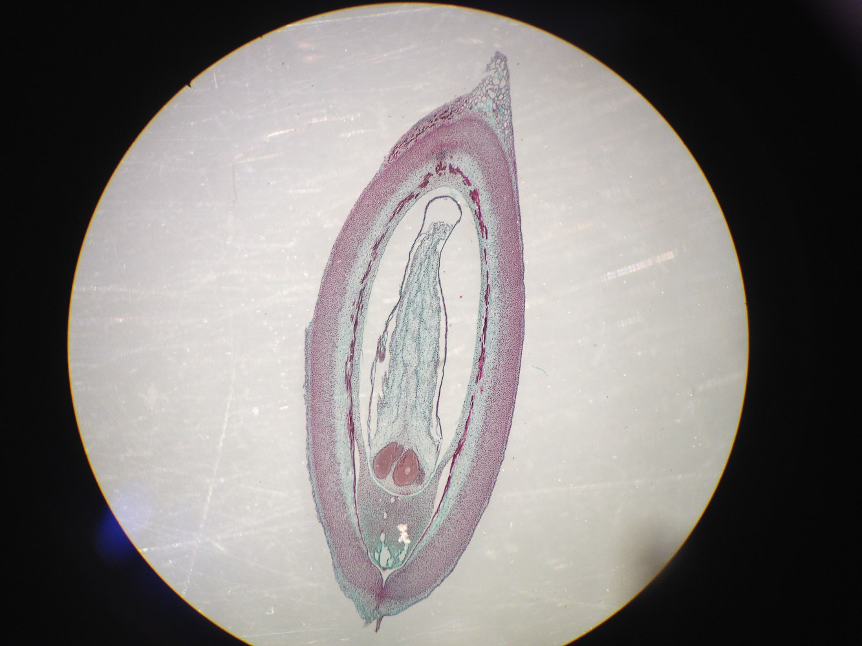
Notes:
Station #10 Pine Ovule within Mature Archegonium

Slide 18
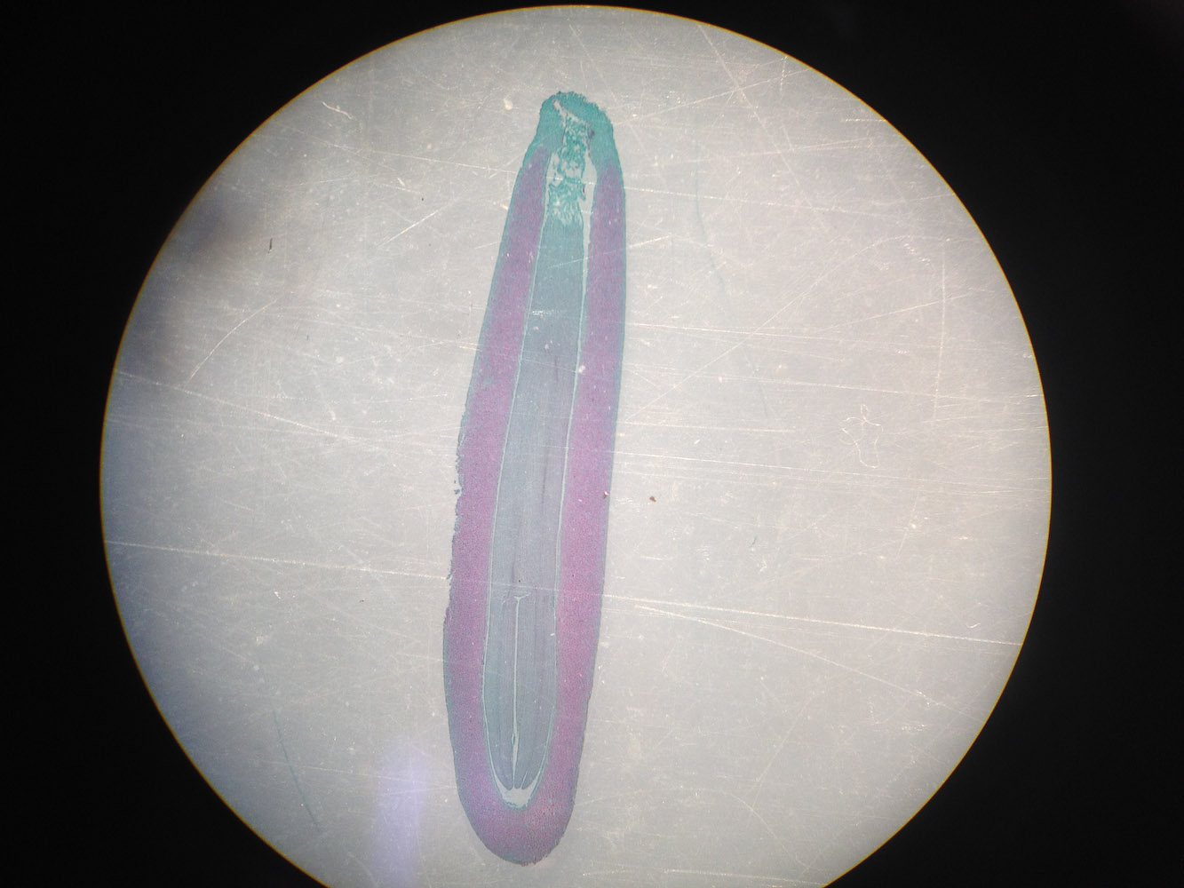
Notes:
Station #11 – Female Cone with Embryo

Slide 19
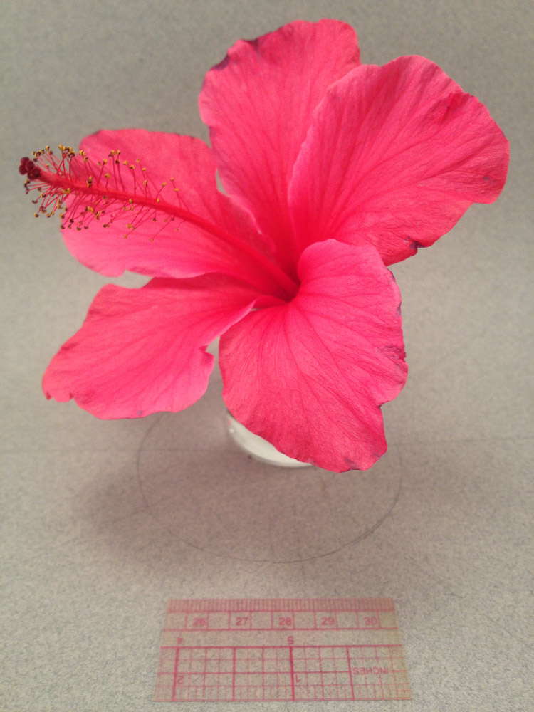
Notes:
Station #12

Slide 20
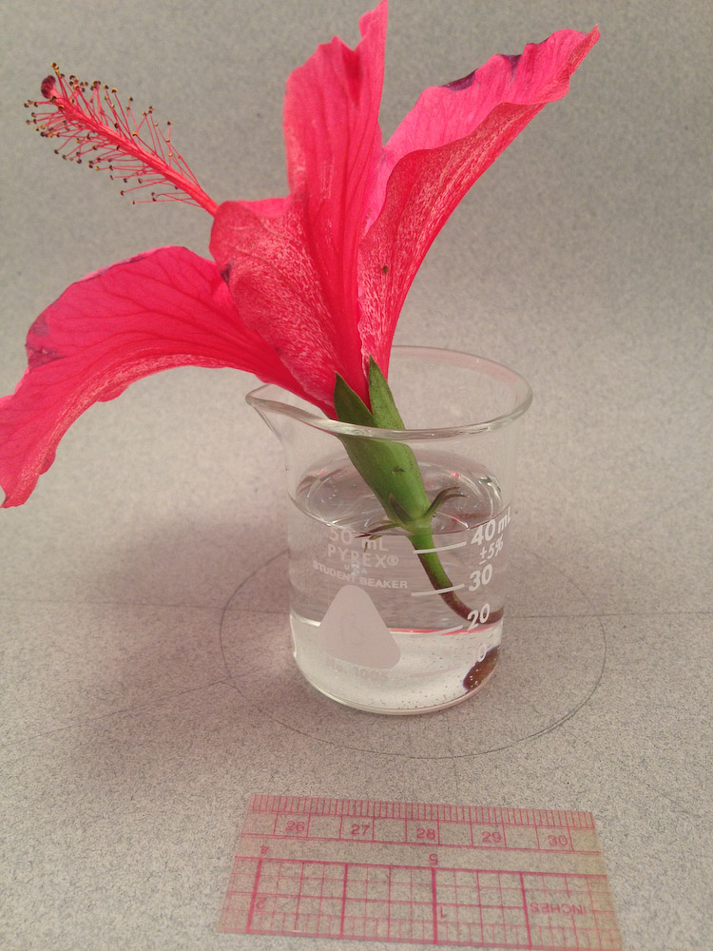
Notes:
Station #12

Slide 21
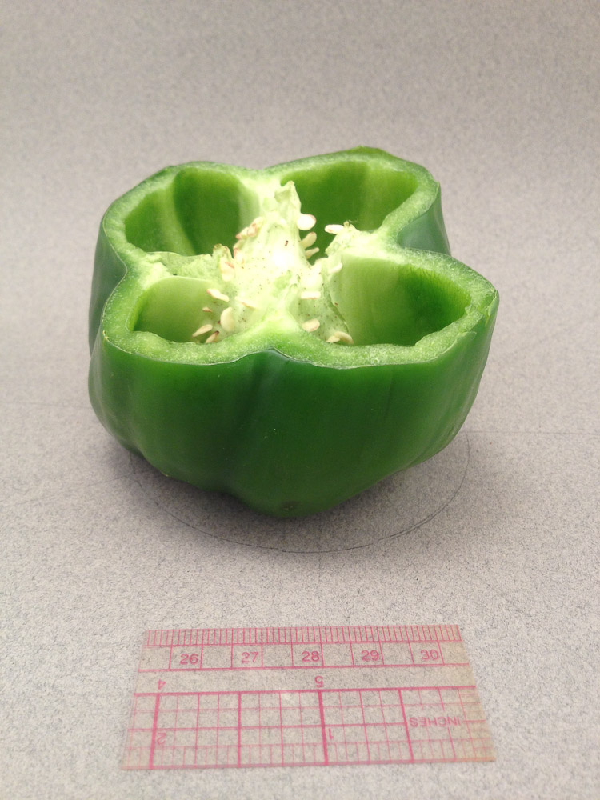
Notes:
Station #14 Placentation

Slide 22
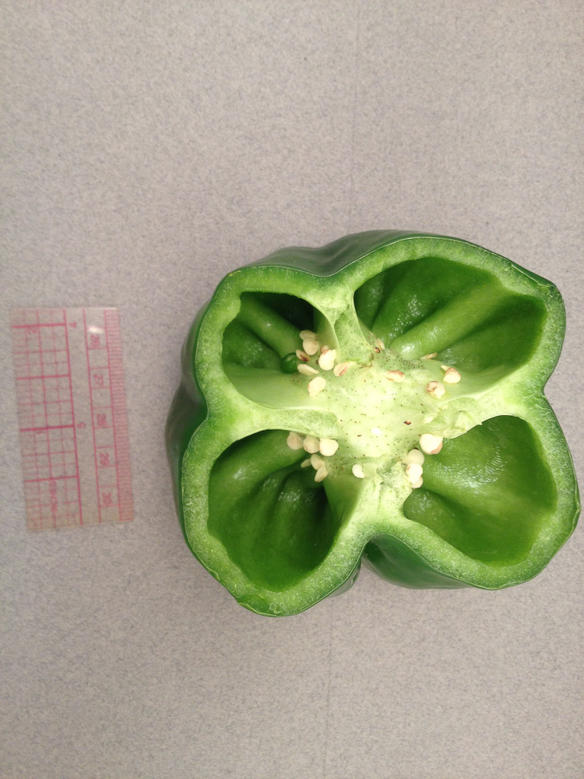
Notes:
Station #14 Placentation

Slide 23
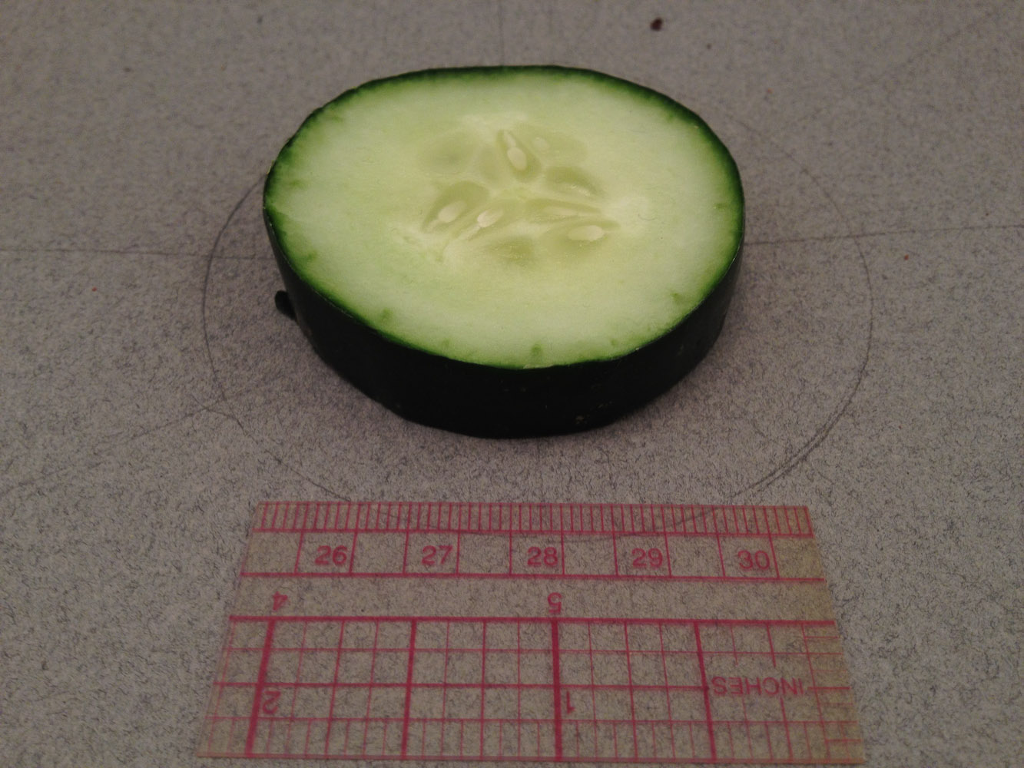
Notes:
Station #14 Placentation

Slide 24
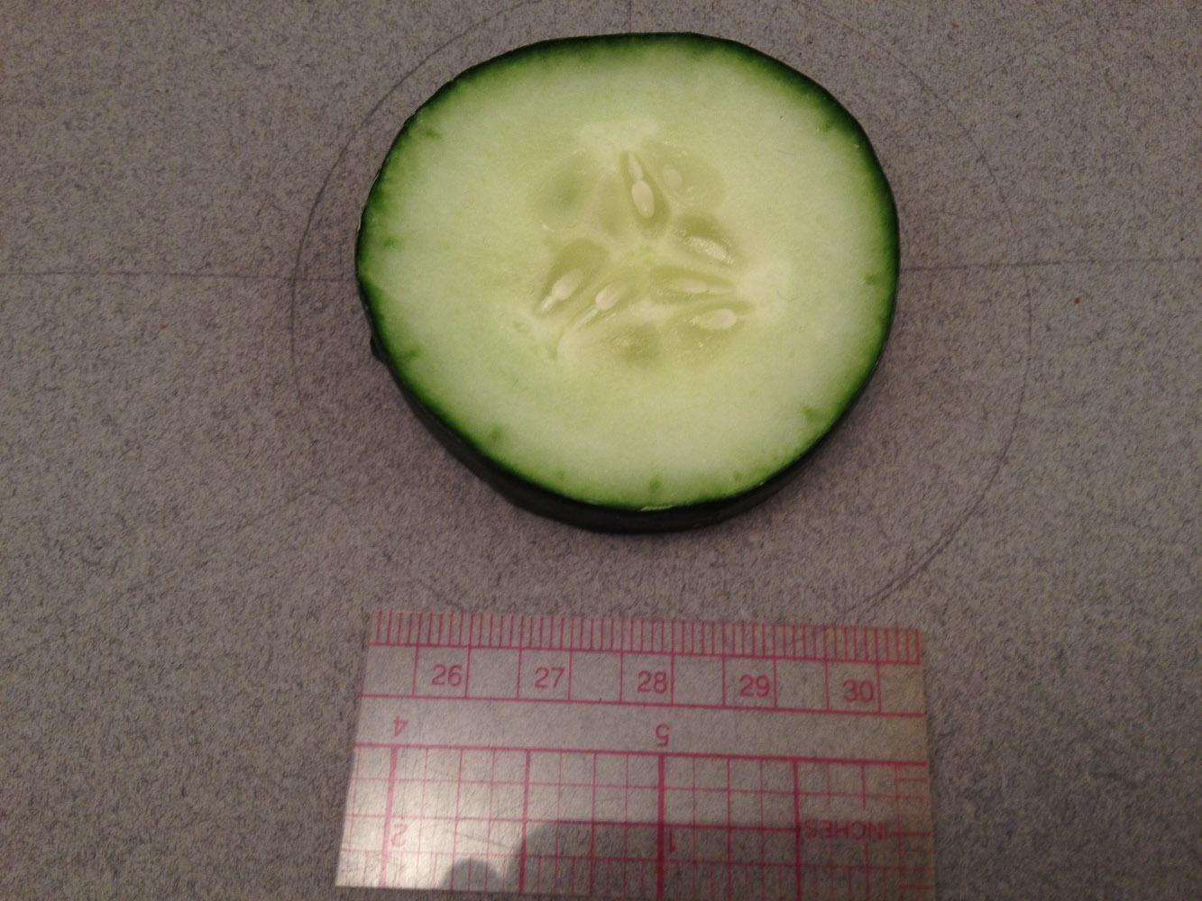
Notes:
Station #14 Placentation

Slide 25
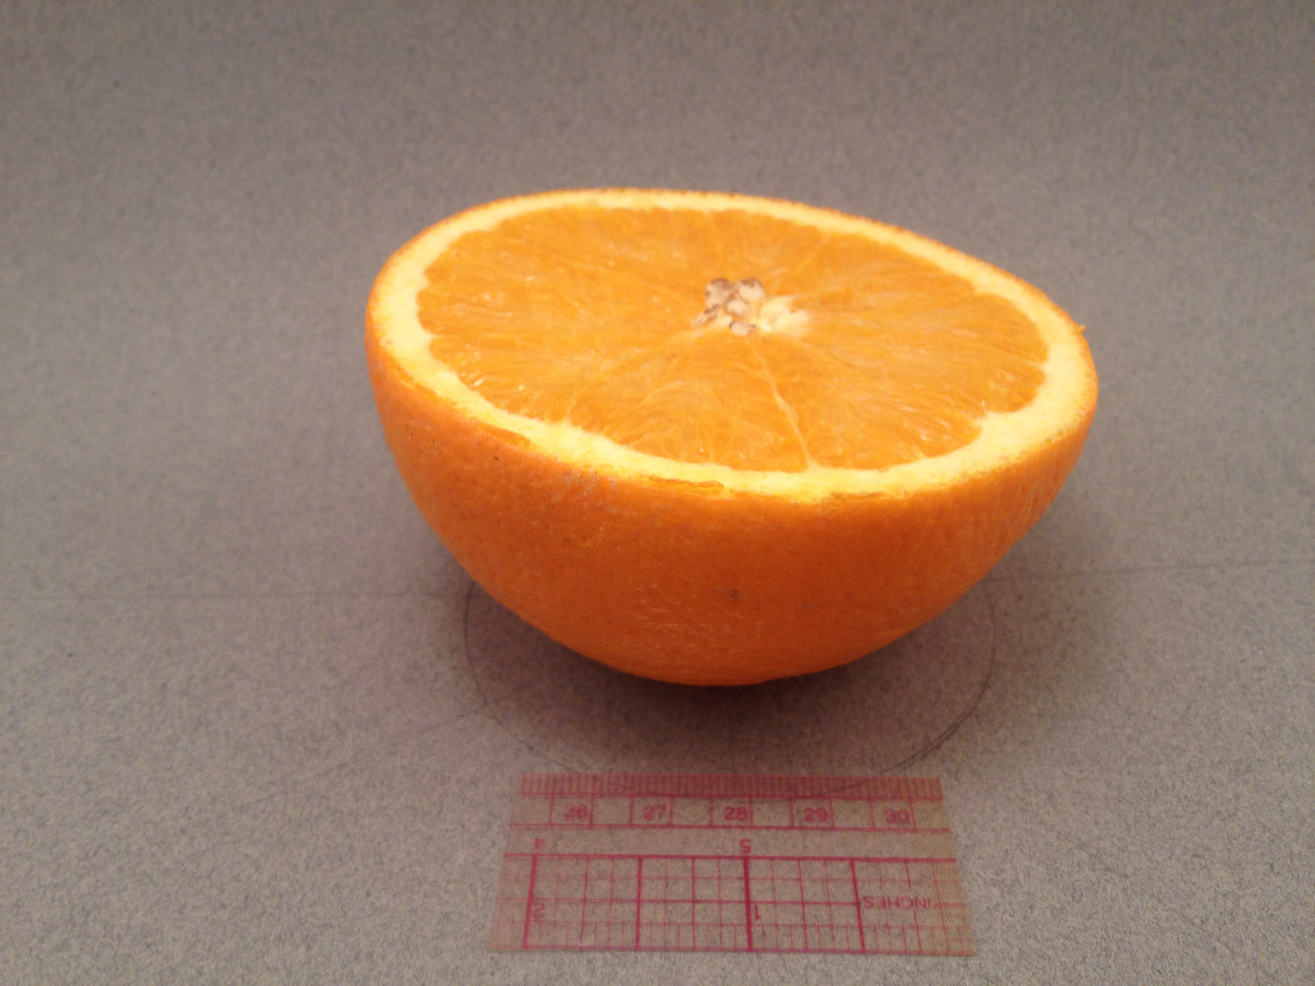
Notes:
Station #14 Placentation

Slide 26
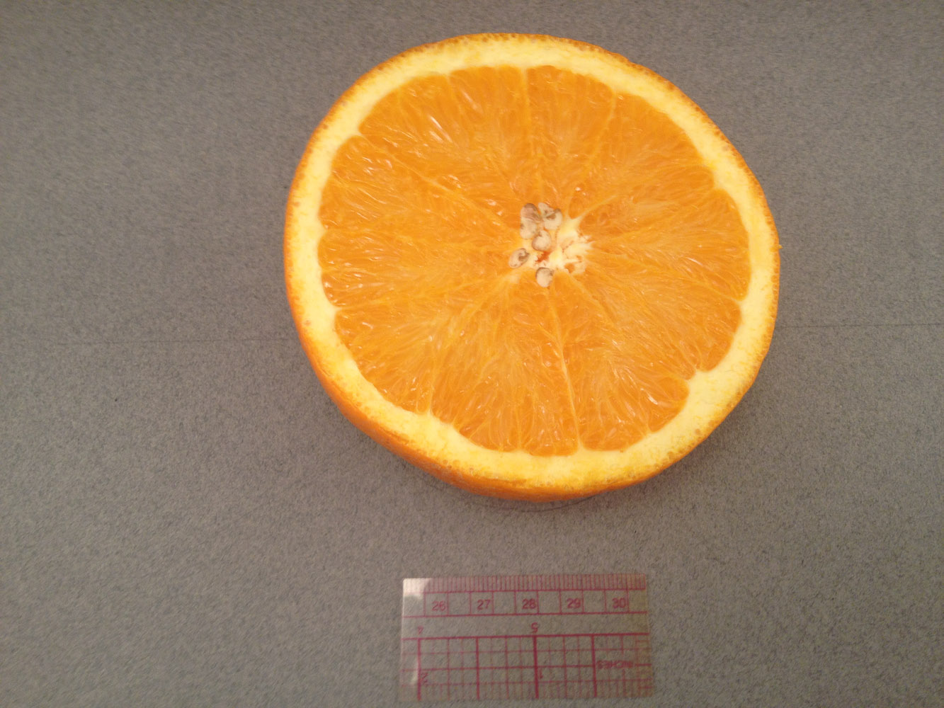
Notes:
Station #14 Placentation

Slide 27
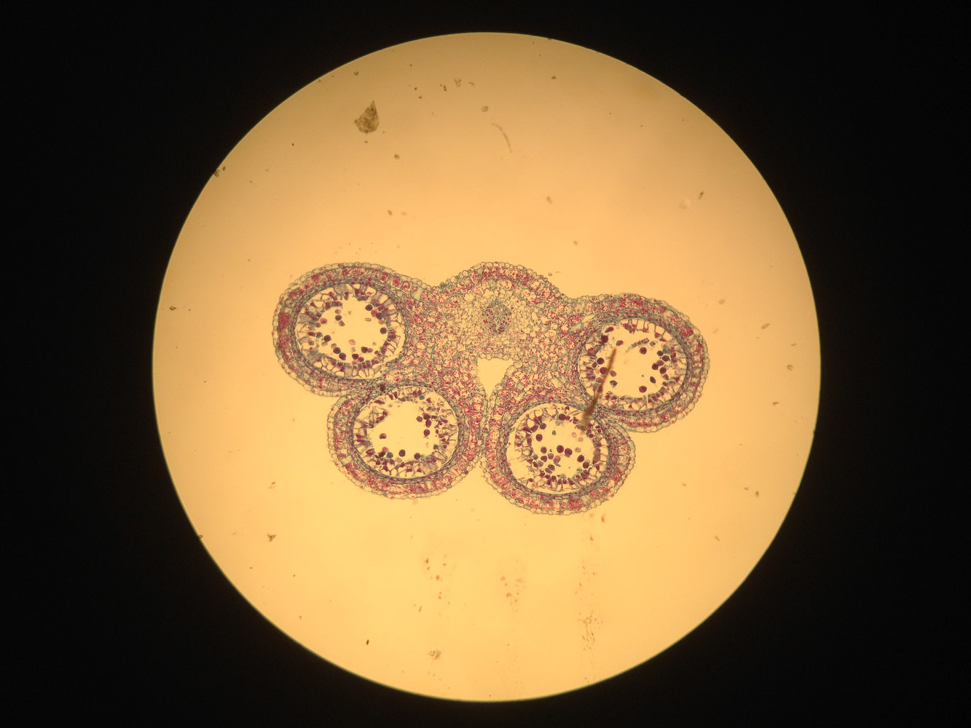
Notes:
Station #15 Male Gametophyte

Slide 28
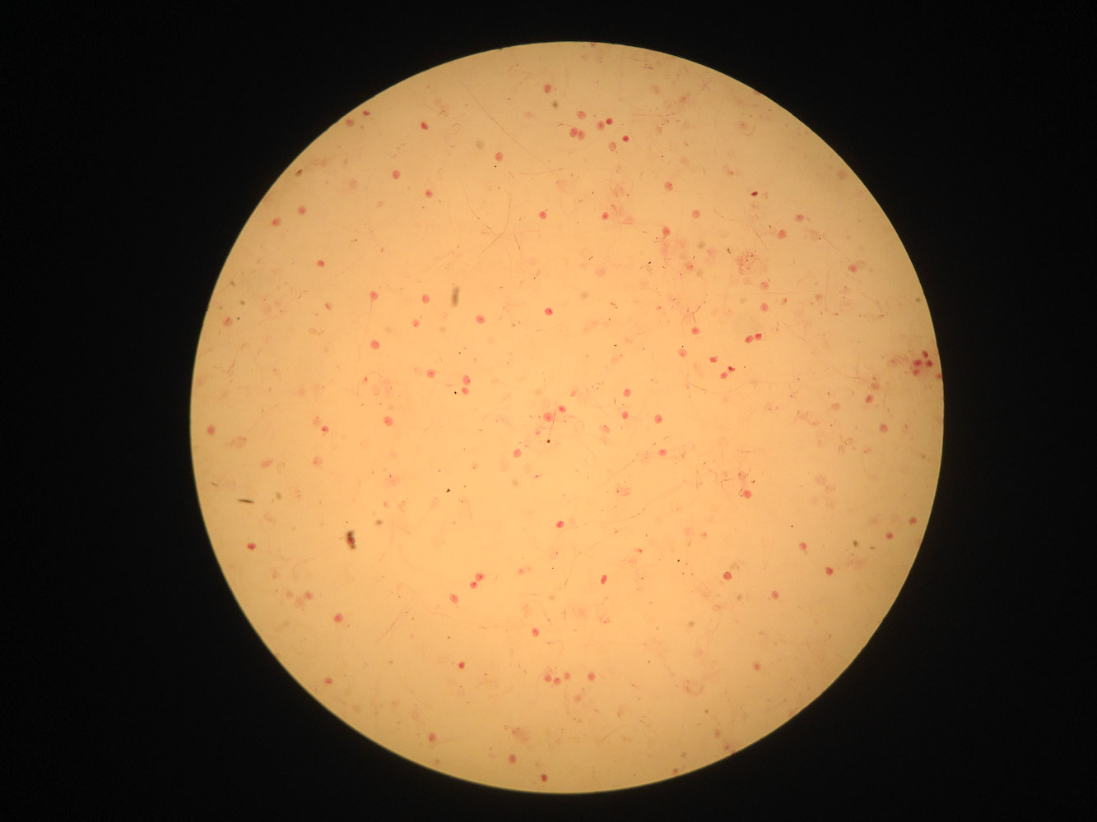
Notes:
Station #17 Germinating Pollen

Slide 29
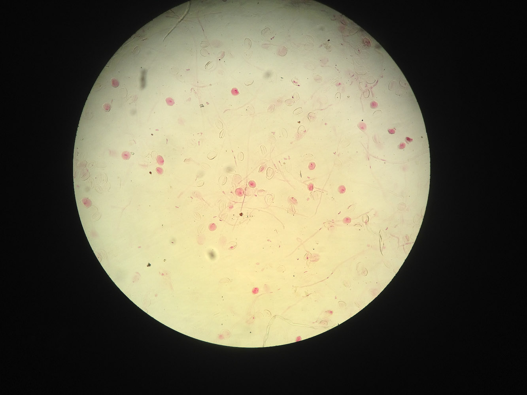
Notes:
Station #17 Germinating Pollen

Slide 30
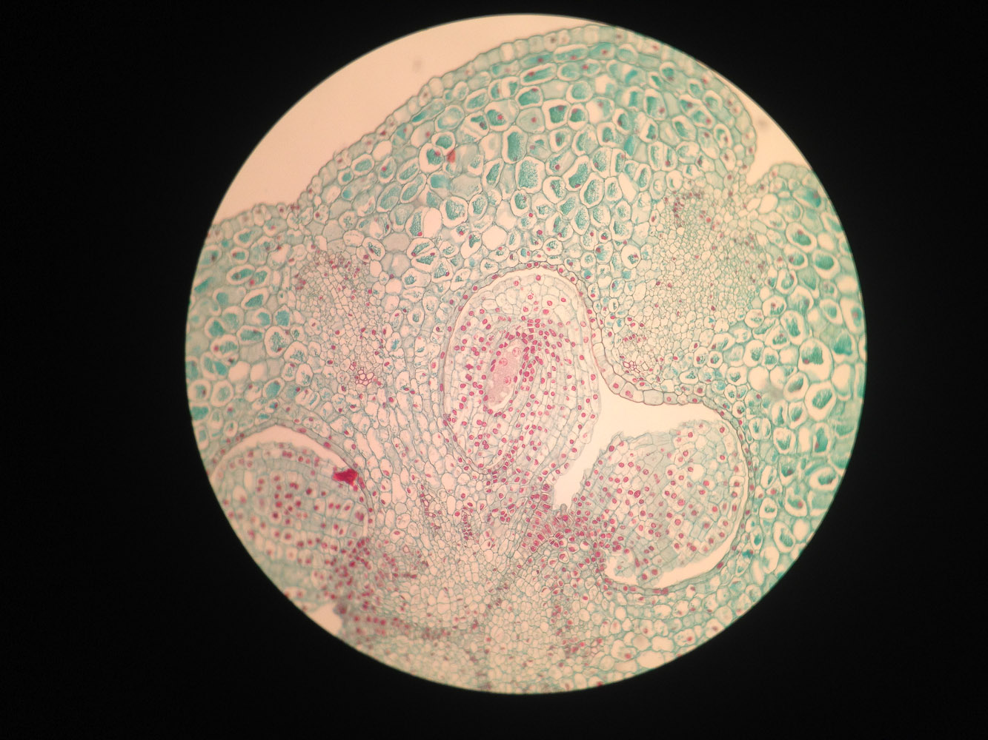
Notes:
Station #18 – Female Gametophyte with 4-nucleate Embryo sac

Slide 31
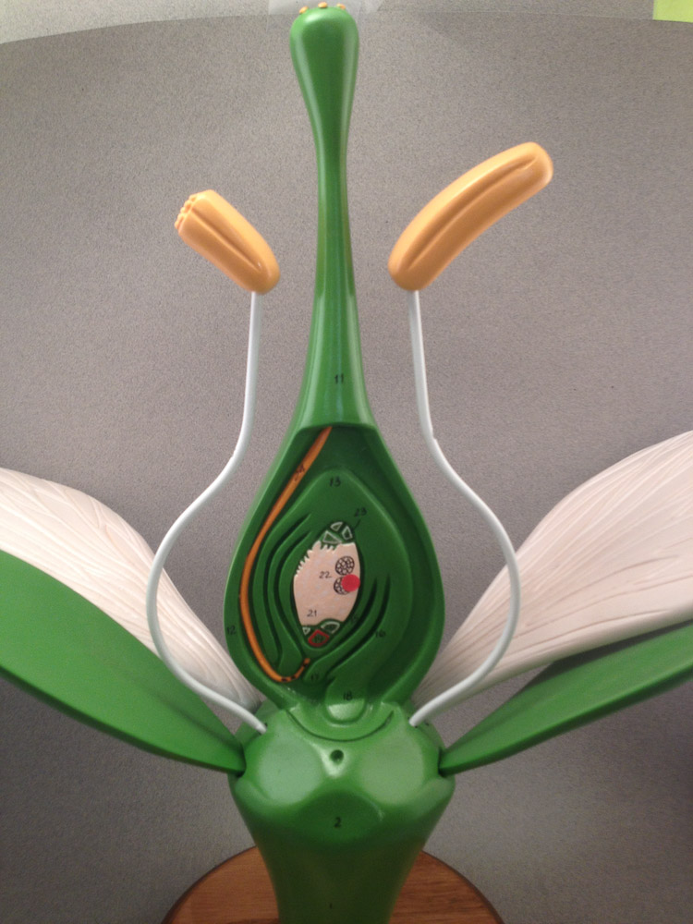
Notes:
Station #19 – Female Gametophyte with 8-nucleate Embryo Sac

Slide 32
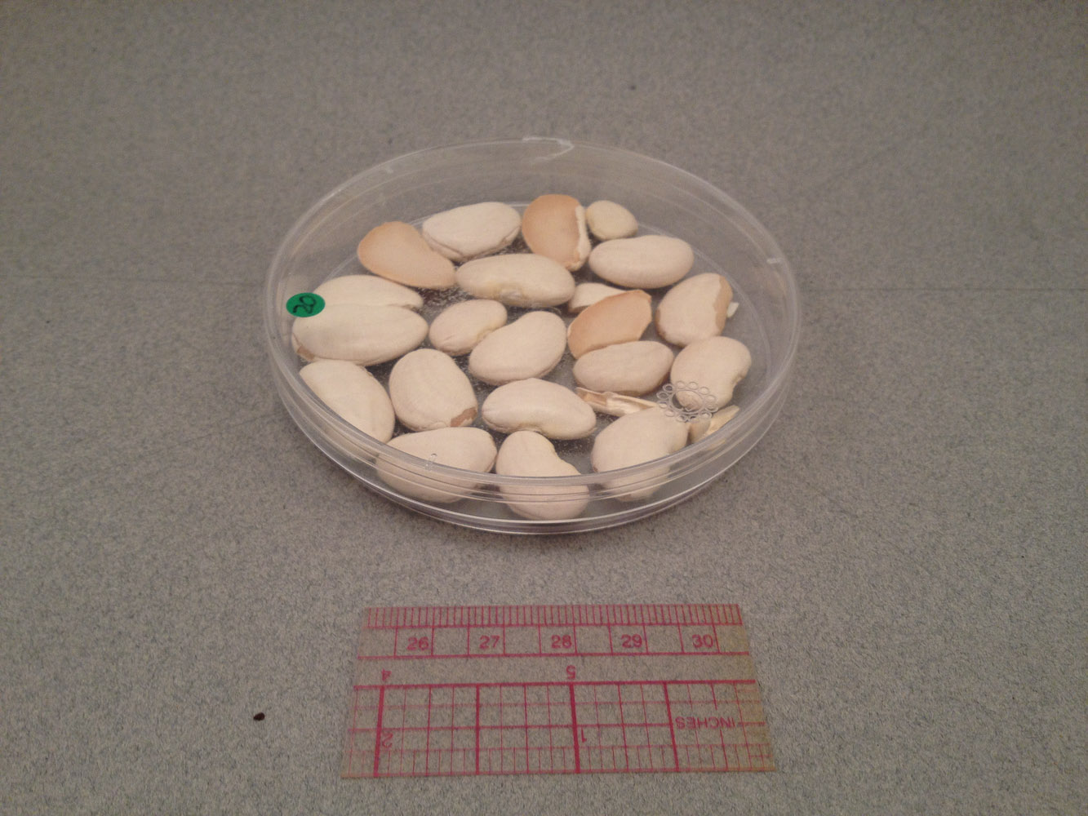
Notes:
Station #20

Slide 33
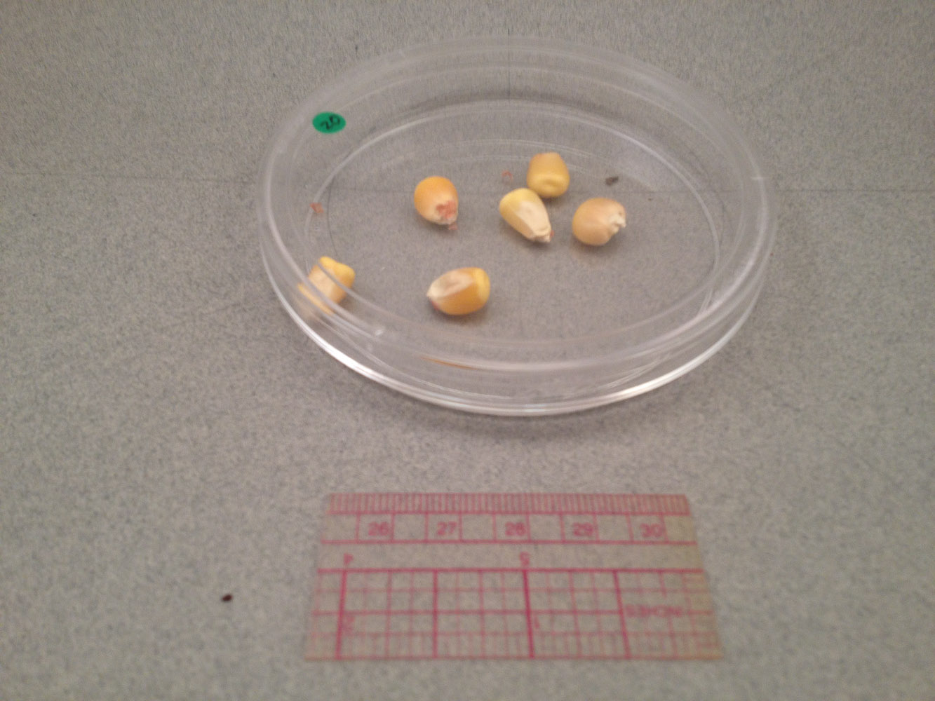
Notes:
Station #20

Slide 34
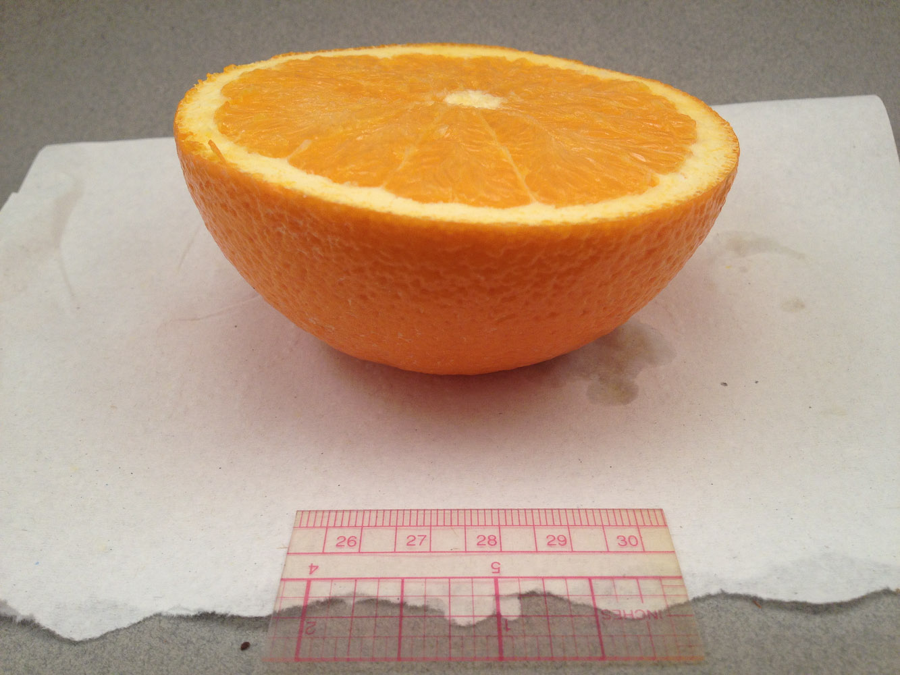
Notes:
Station #22

Slide 35
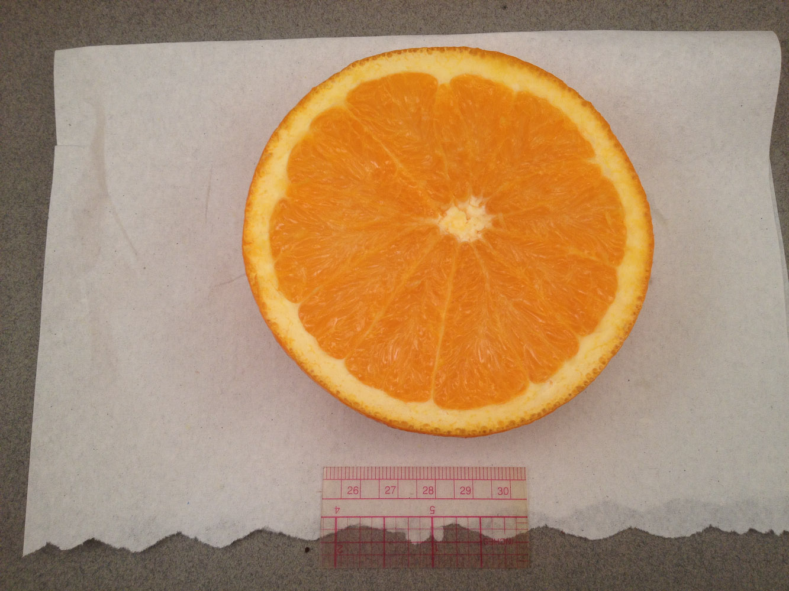
Notes:
Station #22

Slide 36
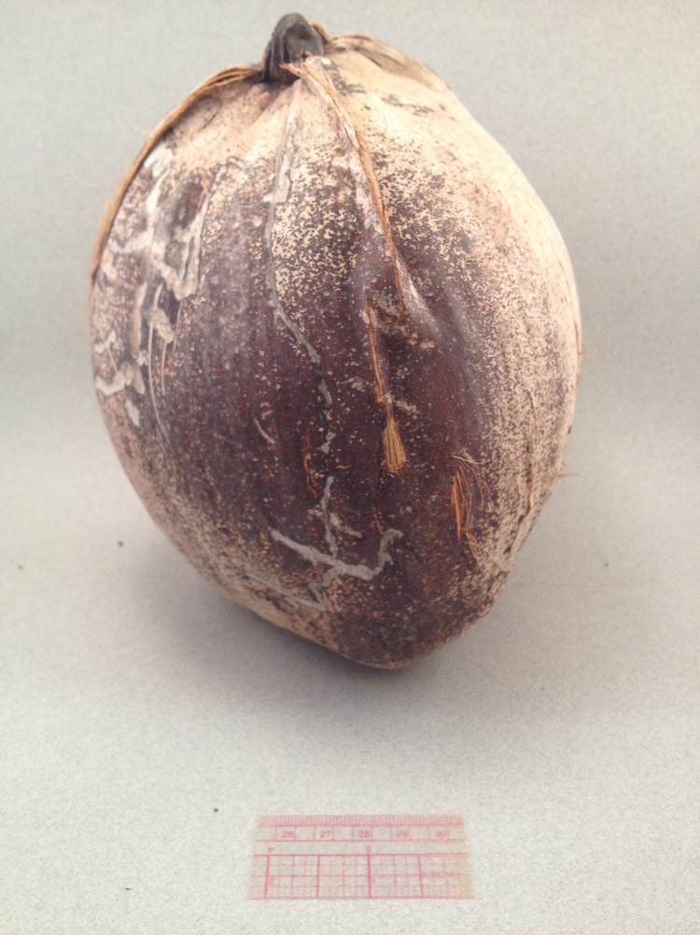
Notes:
Station #23

Slide 37
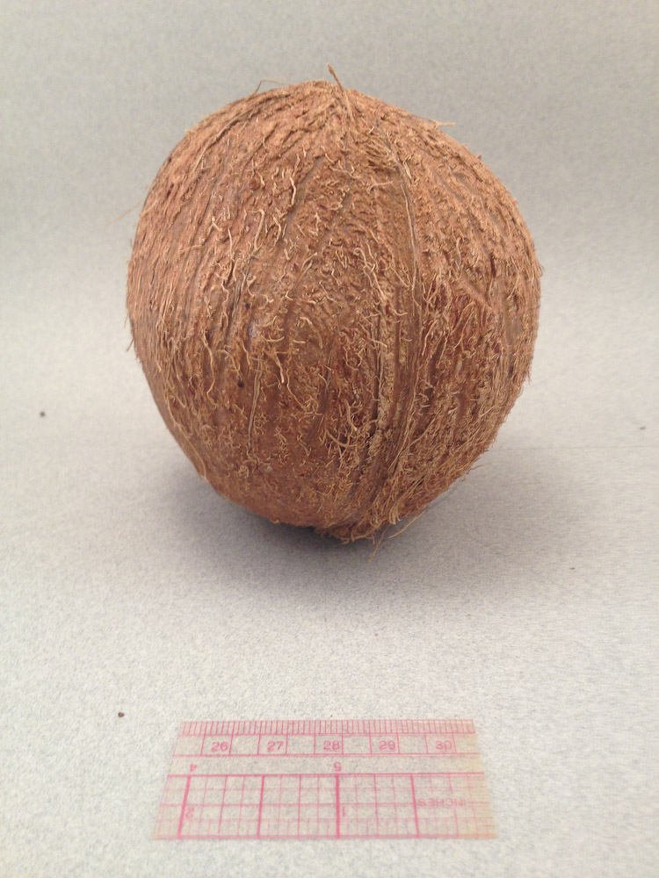
Notes:
Station #23

Slide 38
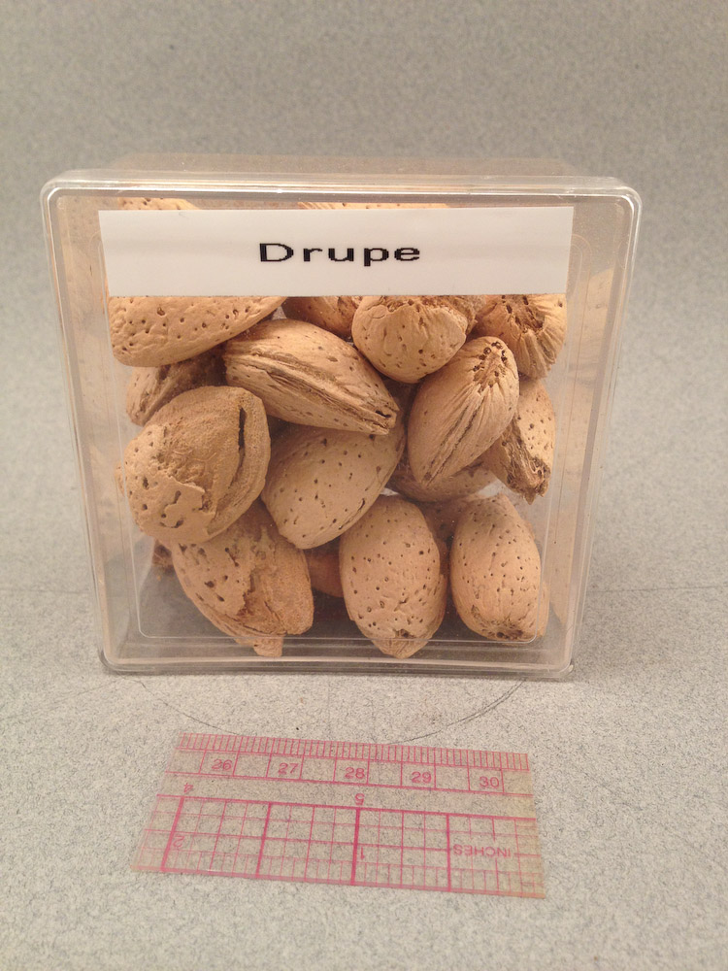
Notes:
Station #23

Slide 39
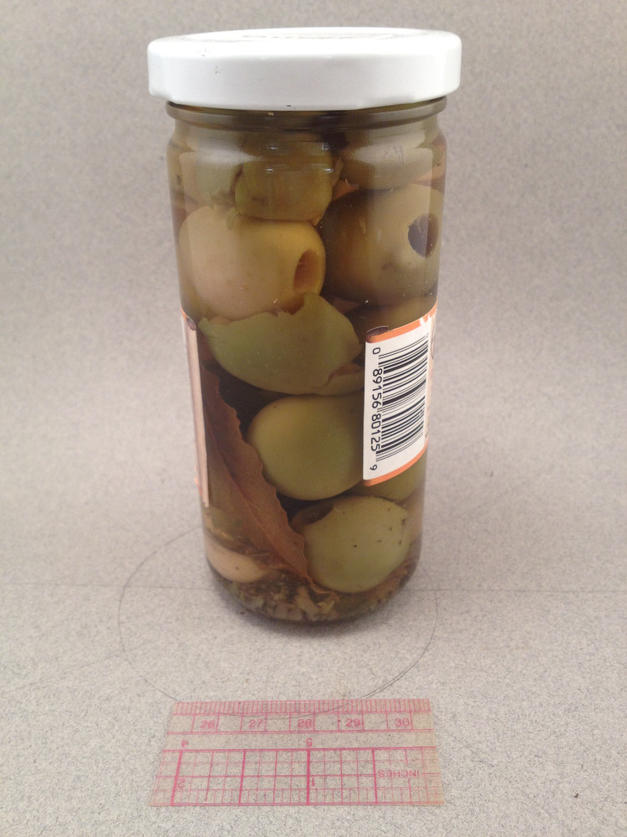
Notes:
Station #23

Slide 40
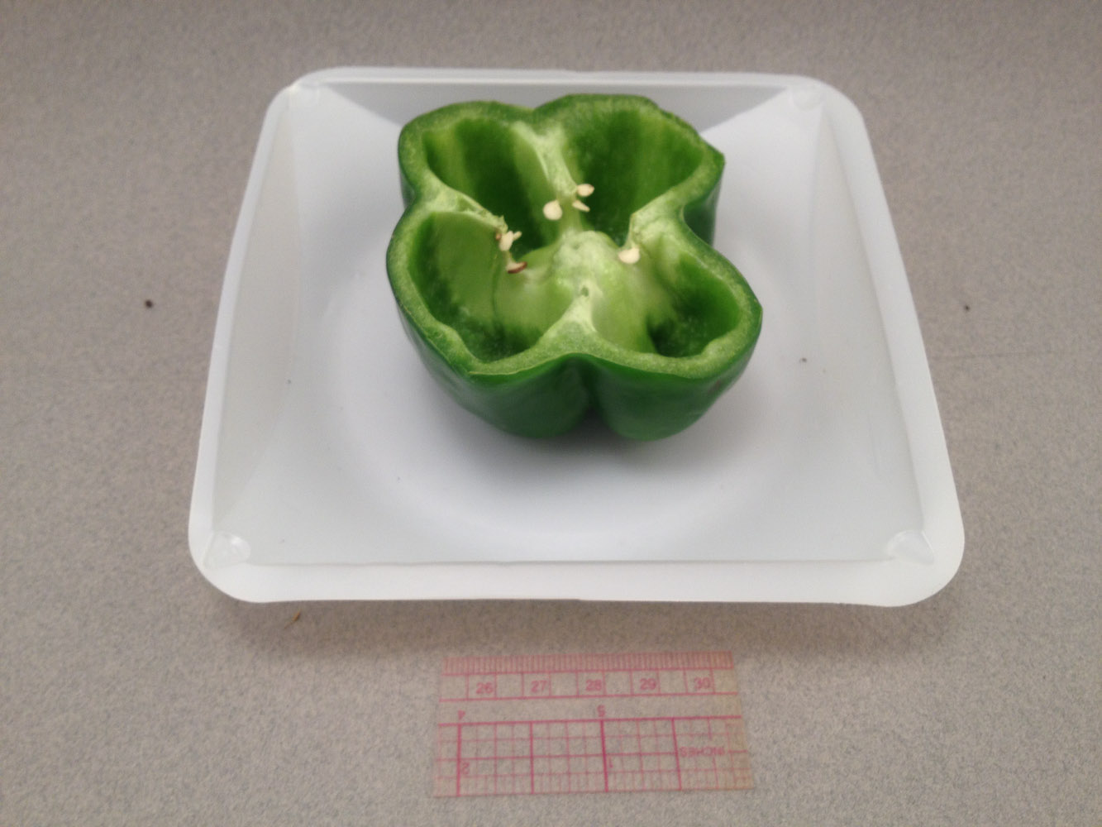
Notes:
Station #23

Slide 41
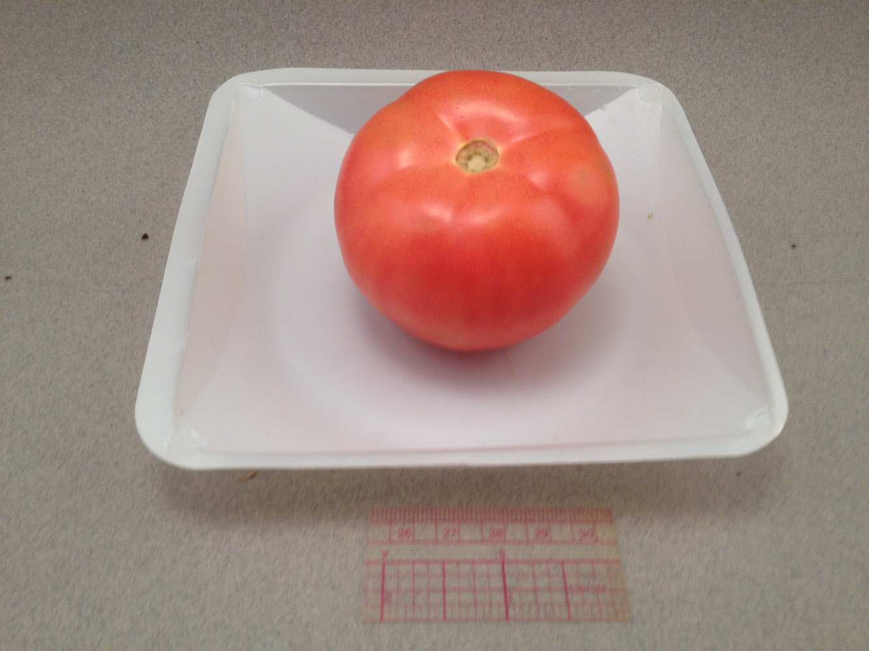
Notes:
Station #23

Slide 42
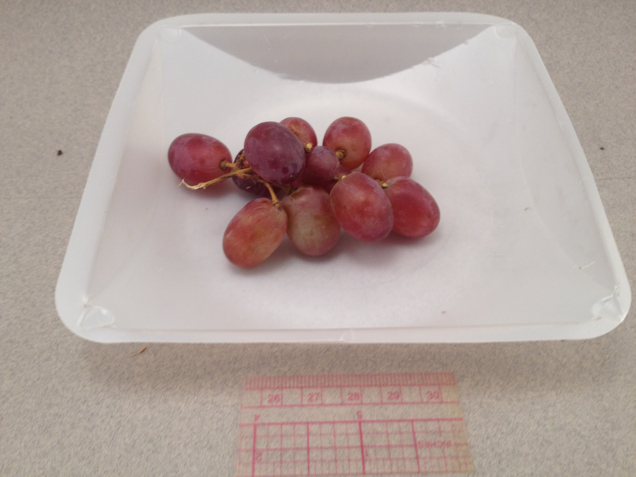
Notes:
Station #23

Slide 43
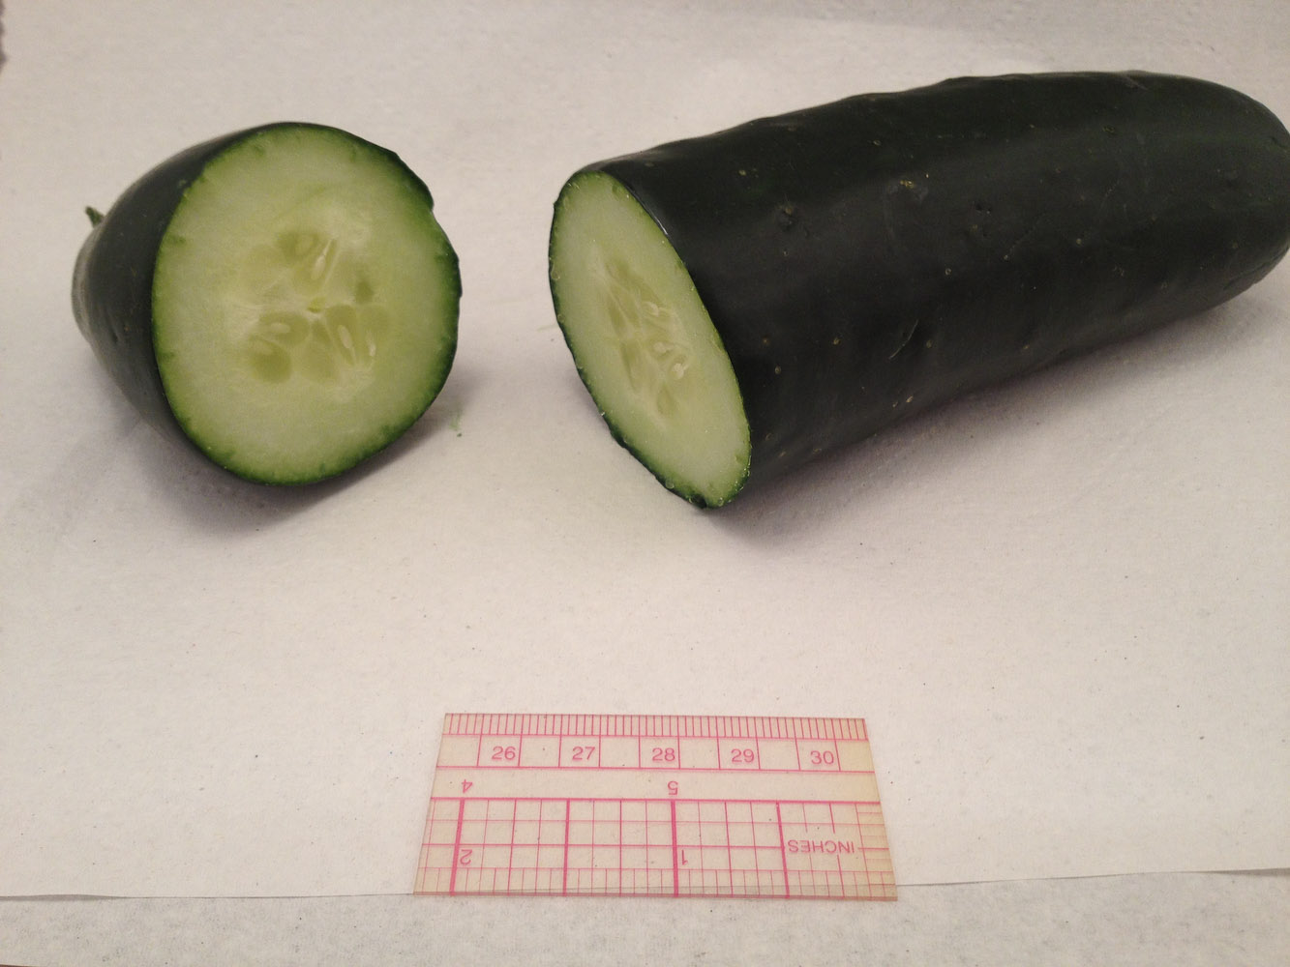
Notes:
Station #23

Slide 44
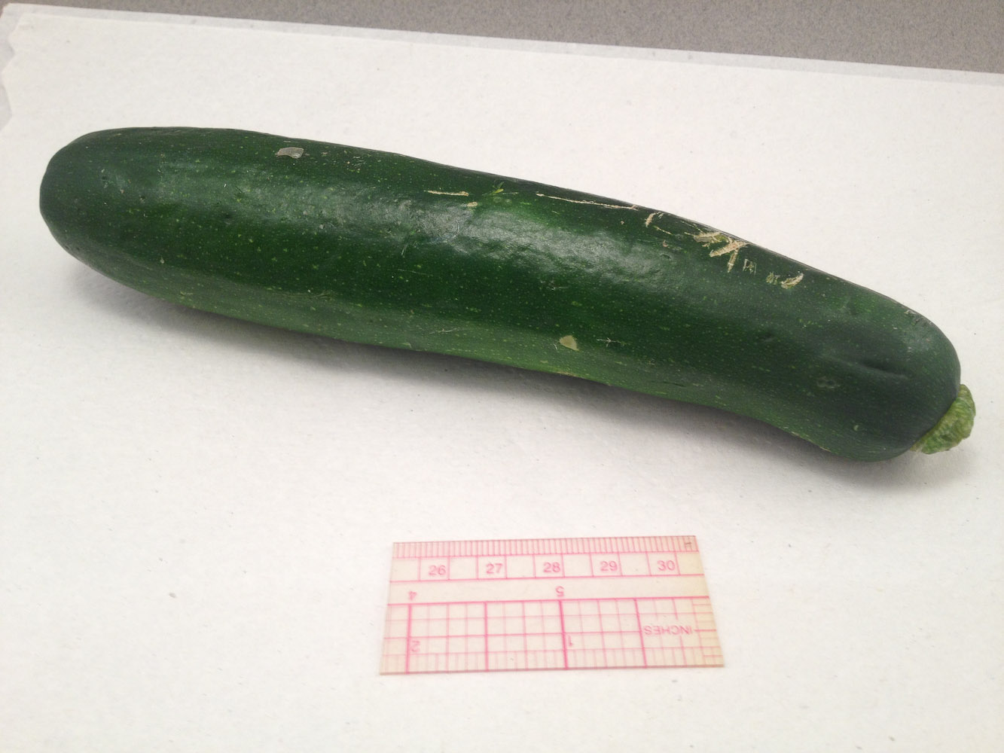
Notes:
Station #23

Slide 45
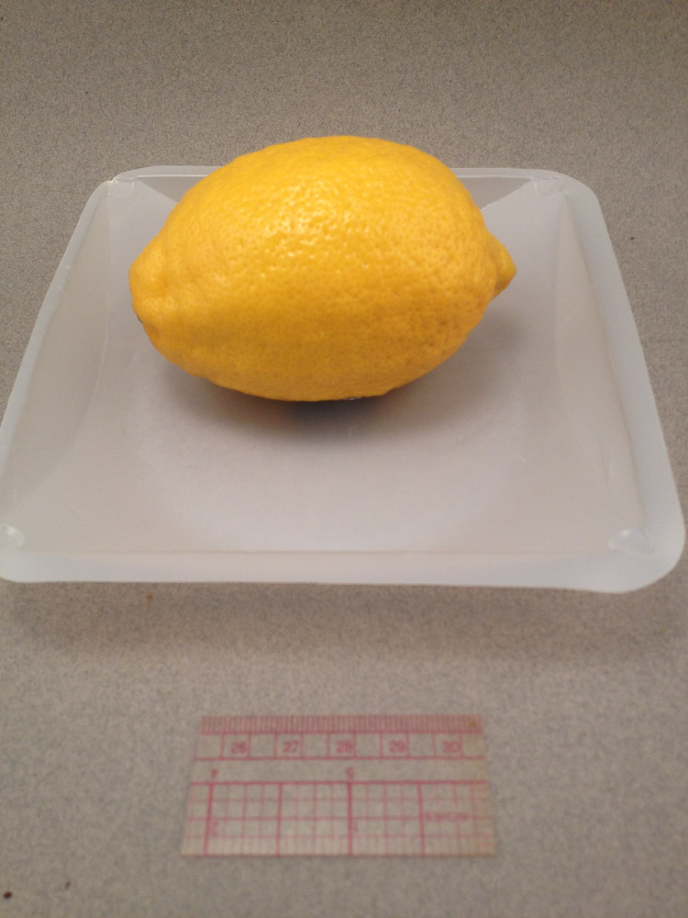
Notes:
Station #23

Slide 46
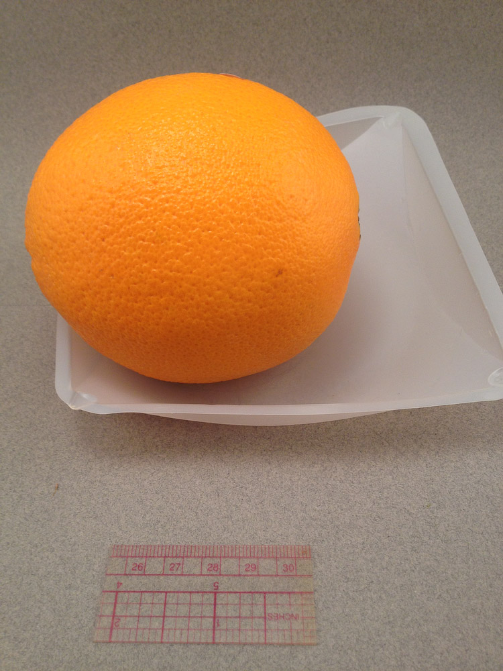
Notes:
Station #23

Slide 47
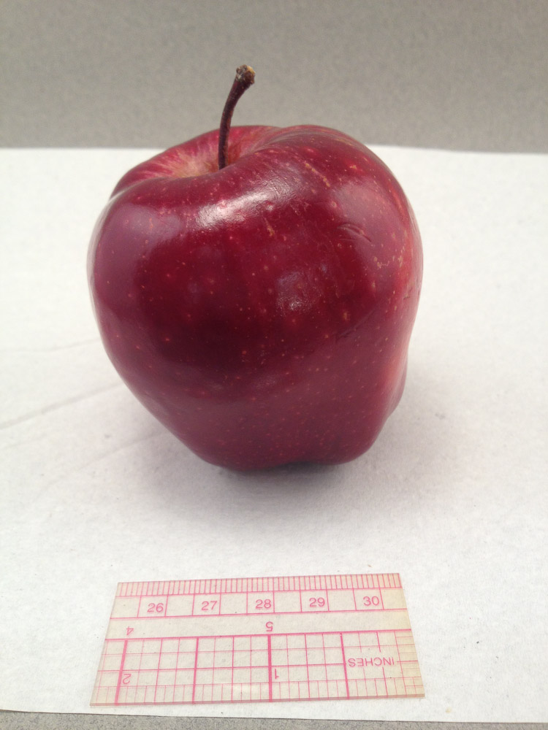
Notes:
Station #23

Slide 48
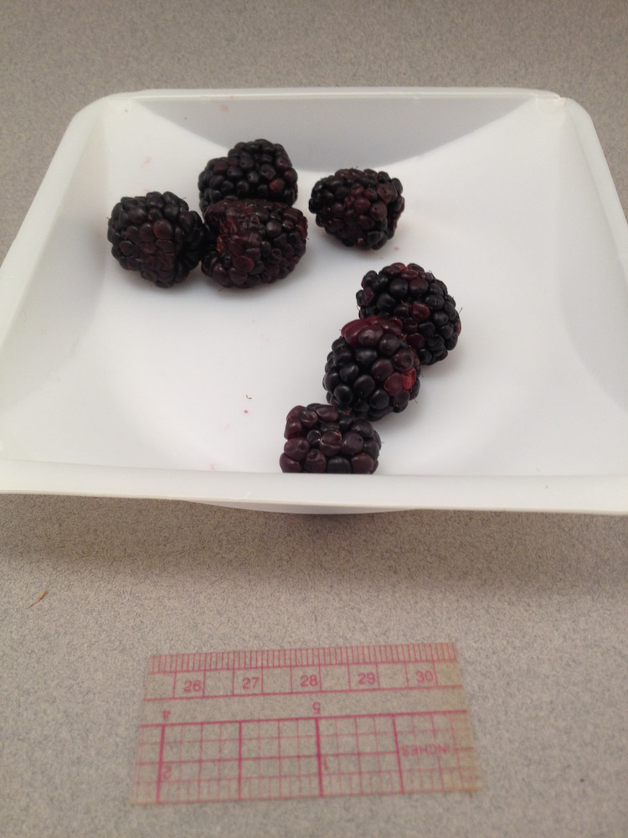
Notes:
Station #23

Slide 49
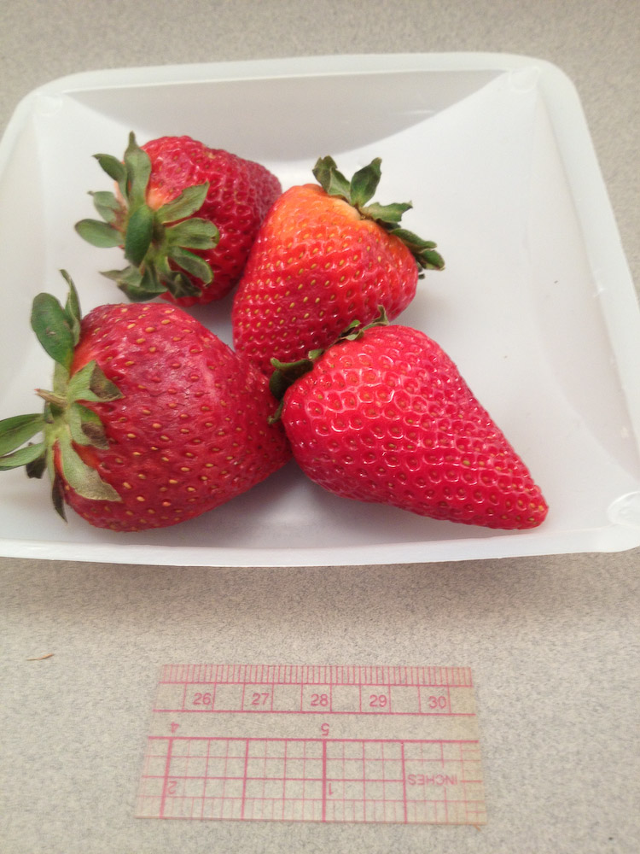
Notes:
Station #23

Slide 50
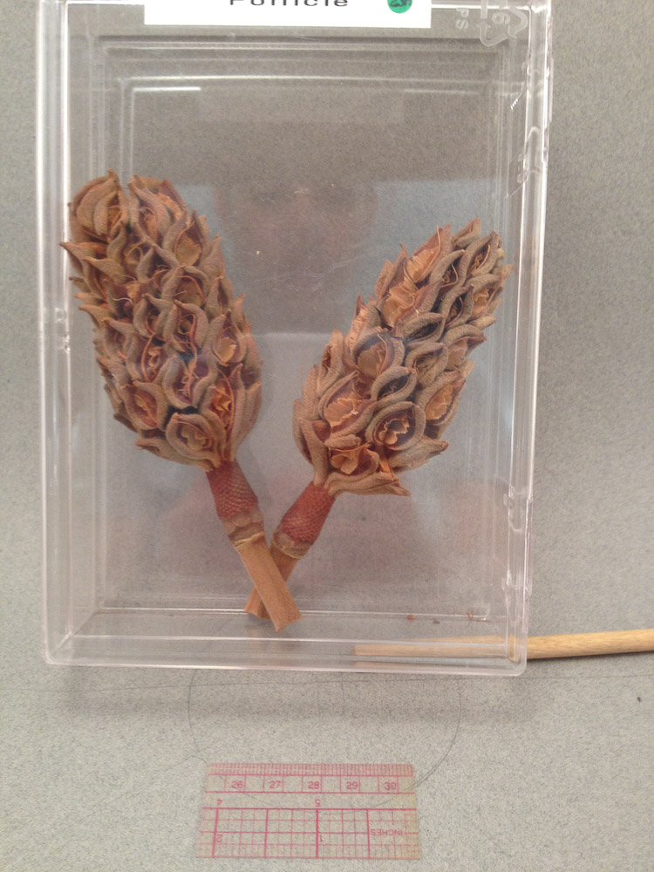
Notes:
Station #23

Slide 51

Notes:
Station #23

Slide 52

Notes:
Station #23

Slide 53

Notes:
Station #23

Slide 54

Notes:
Station #23

Slide 55

Notes:
Station #23

Slide 56

Notes:
Station #23

Slide 57

Notes:
Station #23

Slide 58

Notes:
Station #23

Slide 59

Notes:
Station #23

Slide 60

Notes:
Station #23

Slide 61

Notes:
Station #23

Slide 62

Notes:
Station #23

Slide 63

Notes:
Station #23

Slide 64

Notes:
Station #23

Slide 65

Notes:
Station #23

Slide 66

Notes:
Station #23

Slide 67

Notes:
Station #23

Slide 68

Notes:
Station #23

Slide 69

Notes:
Station #23

Slide 70

Notes:
Station #23

Slide 71

Notes:
Station #23

Slide 72

Notes:
Station #23

Slide 73

Notes:
Station #23

Slide 74

Notes:
Station #23

Slide 75

Notes:
Station #23

Slide 76

Notes:
Station #24 The Root

Slide 77

Notes:
Station #25 – Monocot Root

Slide 78

Notes:
Station 26 – Dicot Root

Slide 79

Notes:
Station 26 – Dicot Root

Slide 80

Notes:
Station #27 Carrot

Slide 81

Notes:
Station #28 Root Hairs

Slide 82

Notes:
Station #30 Dicot Stem (Close up of each vascular bundle would be station #29)

Slide 83

Notes:
Station #31 Monocot Stem

Slide 84

Notes:
Station #31 - Monocot Stem

Slide 85

Notes:
Station #32 Woody Dicot Stem

Slide 86

Notes:
Station #33 – Age of a Woody Dicot

Slide 87

Notes:
Station #33 – Age of a Woody Dicot

Slide 88

Notes:
Station #33 – Age of a Woody Dicot

Slide 89

Notes:
Station #33 – Age of a Woody Dicot

Slide 90

Notes:
Station #34 – Tissue of a Tree Trunk

Slide 91

Notes:
Station #34 – Tissue of a Tree Trunk

Slide 92

Notes:
Station #35 – Spiral Xylem Vessels

Slide 93

Notes:
Station #36 – The Leaf (CS)

Slide 94

Notes:
Station #37 – Lower Epidermis

Slide 95

Notes:
Station #38 – Pine Needle

Slide 96

Notes:
Station #39 – Minerals and Plant Nutrition (label denotes what the plant was given)

Slide 97

Notes:
Station #39 – Minerals and Plant Nutrition (label denotes what the plant was given)

Slide 98

Notes:
Station #39 – Minerals and Plant Nutrition (label denotes what the plant was given)

Slide 99

Notes:
Station #39 – Minerals and Plant Nutrition (label denotes what the plant was given)

Slide 100

Notes:
Station #39 – Minerals and Plant Nutrition (label denotes what the plant was given)

Slide 101

Notes:
Station #40 – Carnivorous Plants

Slide 102

Notes:
Station #40 – Carnivorous Plants

Slide 103

Notes:
Station #40 – Carnivorous Plants

Slide 104

Notes:
Station #40 – Carnivorous Plants

Slide 105

Notes:
Station #41 Gibberellins and Germination

Slide 106

Notes:
Station #41 Gibberellins and Germination

Slide 107

Notes:
Station #41 Gibberellins and Germination

Slide 108

Notes:
Station #42 –Gibberellins and Stem Growth

Slide 109

Notes:
Station #42 –Gibberellins and Stem Growth

Slide 110

Notes:
Station #42 –Gibberellins and Stem Growth

Slide 111

Notes:
Station #43 Phototrophism

Slide 112

Notes:
Station #44 Gravitropism

